Slide 1
Programming Languages Mentoring Workshop
January 23, 2012
POPL

Slide 2
Who you are… (by country of school)
156!!

Slide 3
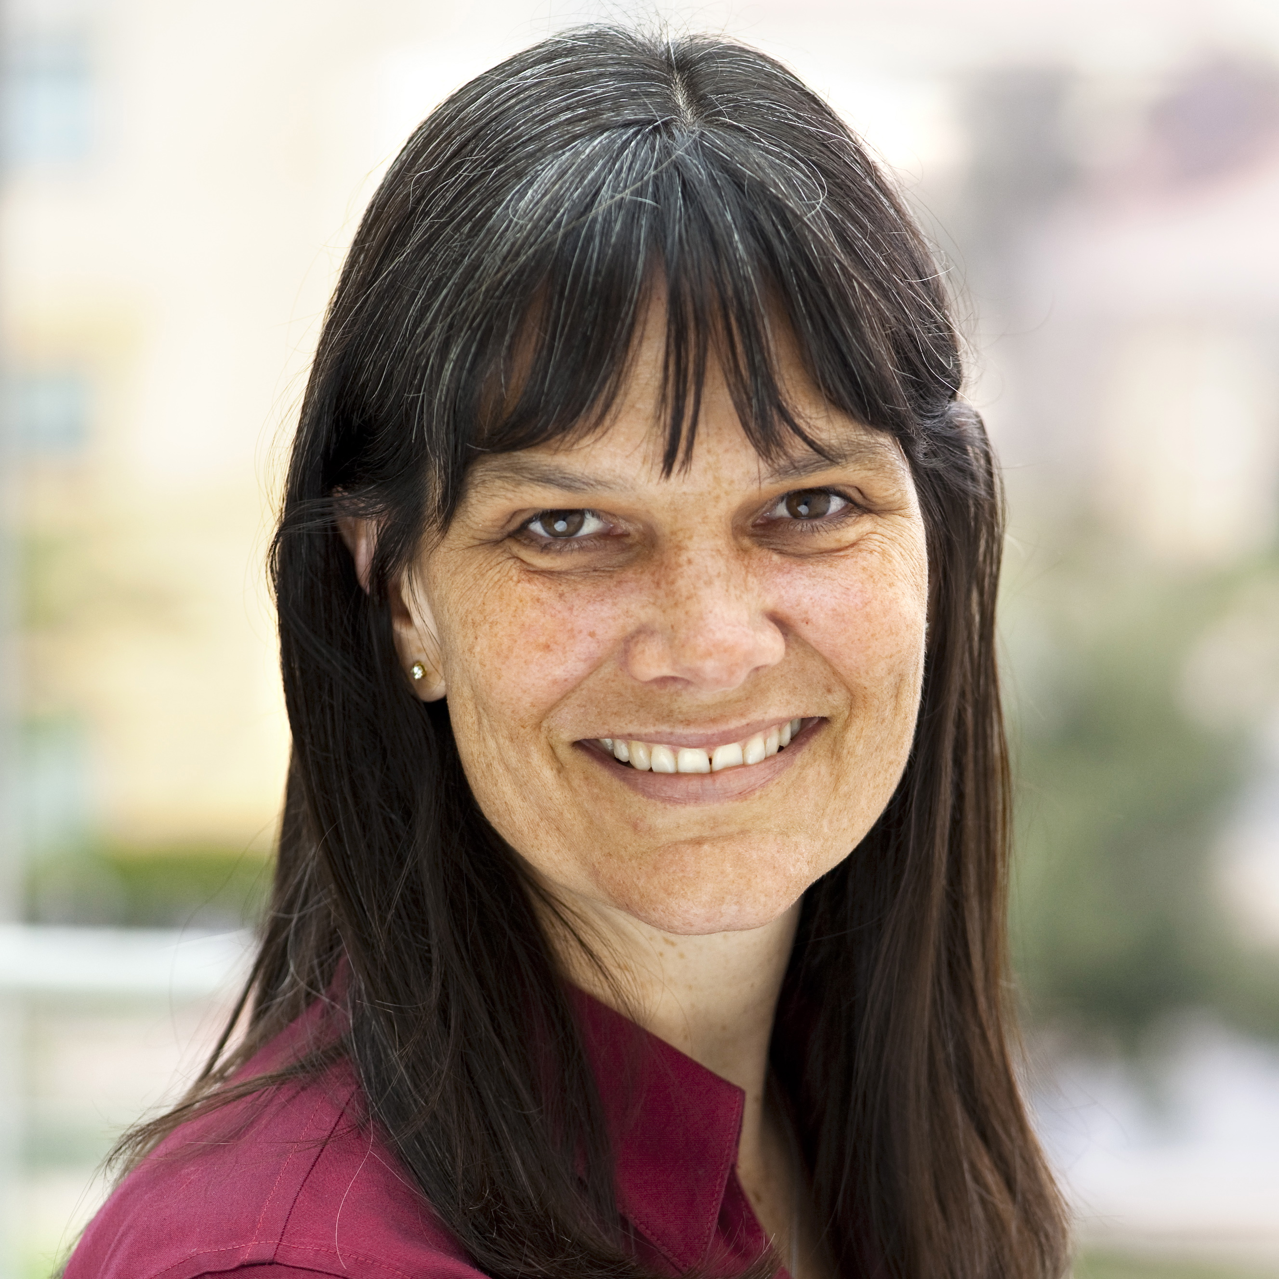
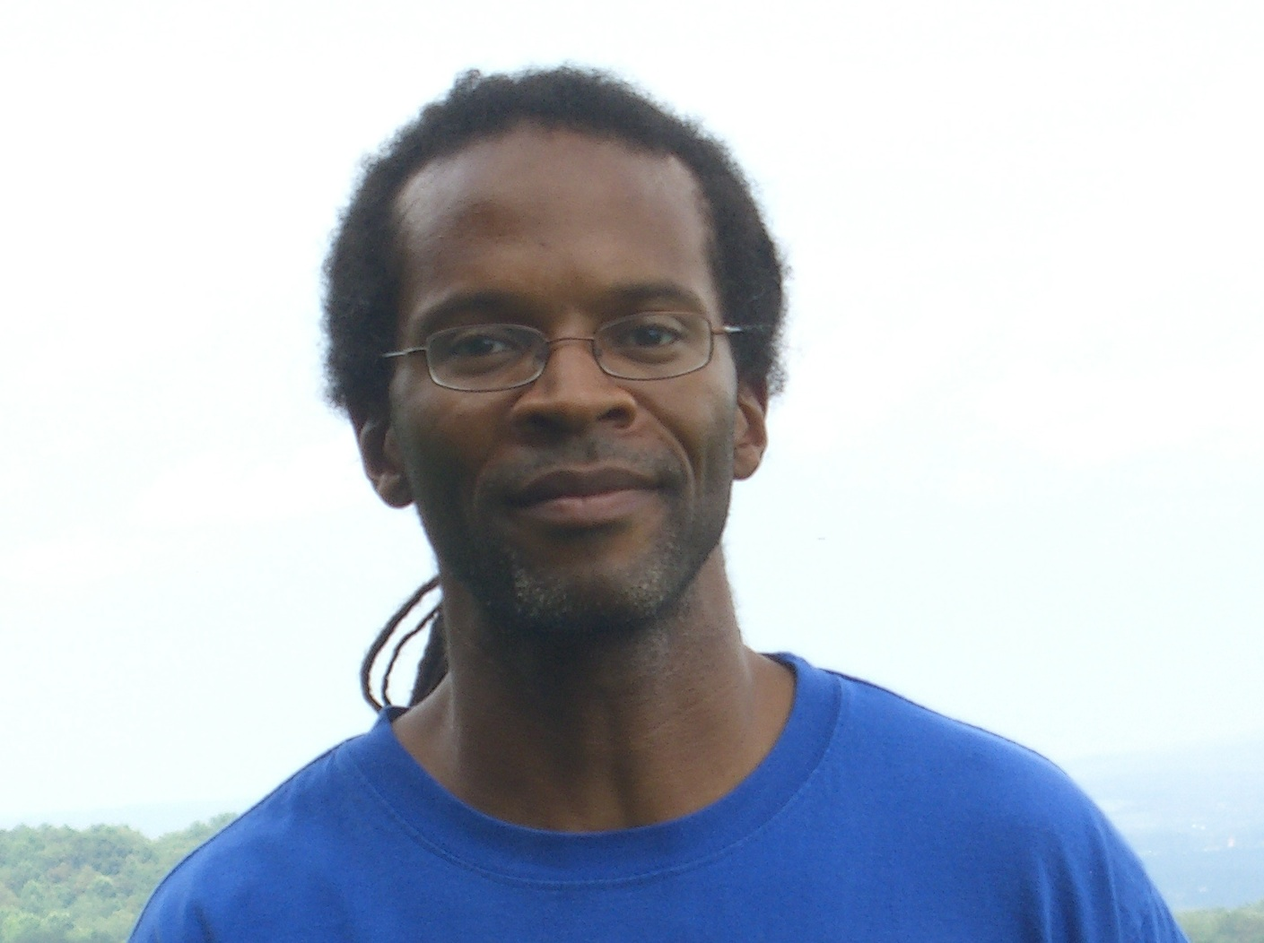
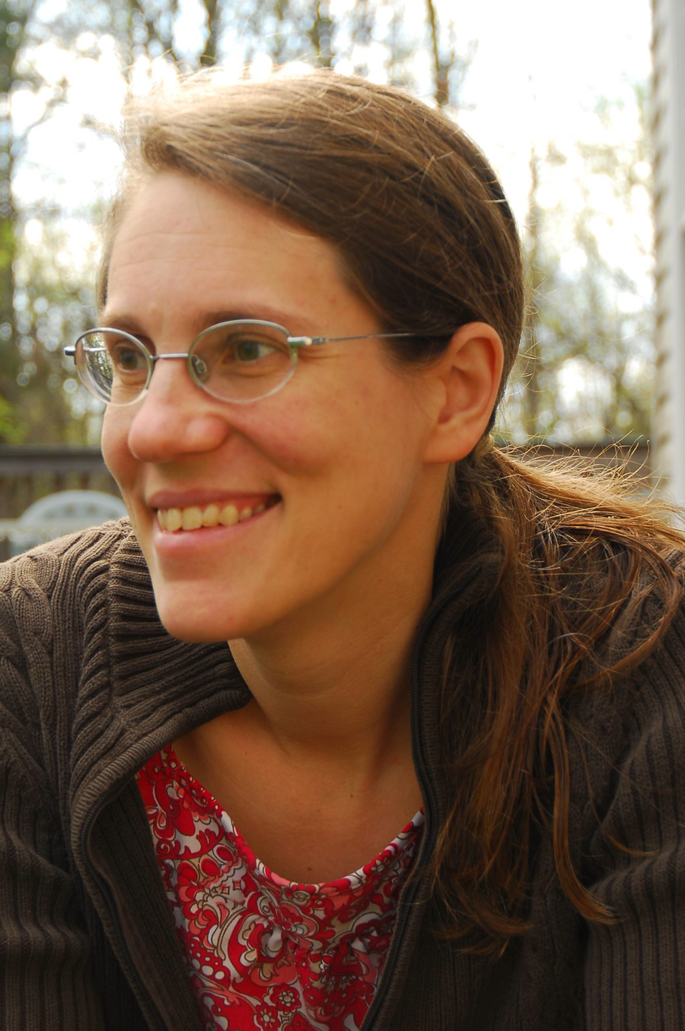
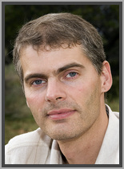
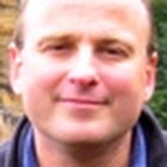
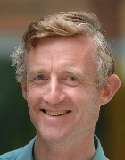
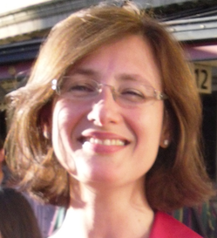

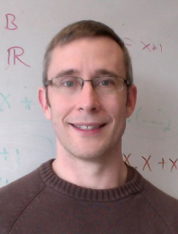
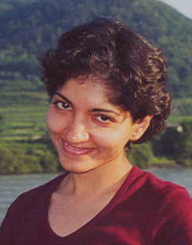

Topic | Speaker | Photos
Introduction | Kathleen Fisher Ron Garcia Stephanie Weirich
Types | Benjamin Pierce
Logic | Bob Harper
Writing Papers | Simon Peyton Jones
Verification | Philippa Gardner
Program Analysis | Tom Ball
Time Management | Steve Zdancewic Amal Ahmed

Slide 4
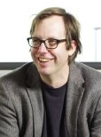
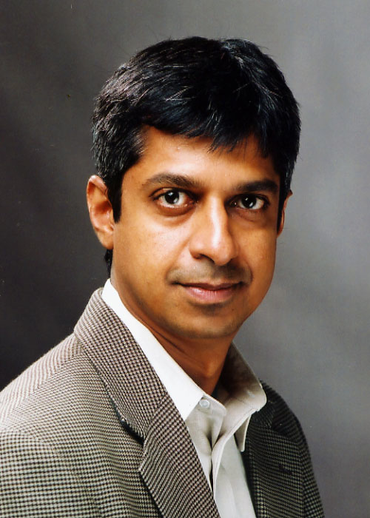
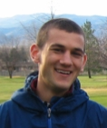
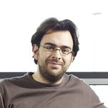
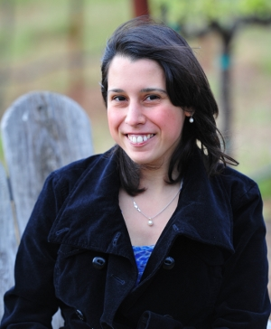

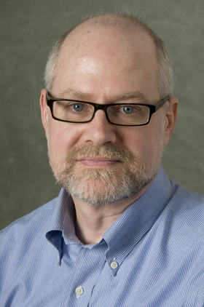
Topic | Speaker | Photos
Termination | Byron Cook
Modeling and Analysis of Embedded Software | Rajeev Alur
Job Search & Life after PhD | Nate Foster Ron Garcia Dimitrios Vytiniotis Isil Dillig
Language Design | Charles Consel
Proposal Writing | John Reppy
Reception

Slide 5





Who to thank…
National Science Foundation
Anonymous private foundation
Please fill out the survey at the end of the workshop!

