Slide 1

Modeling and Verification of Embedded Software
Rajeev Alur
University of Pennsylvania
POPL Mentoring Workshop, Jan 2012

Slide 2
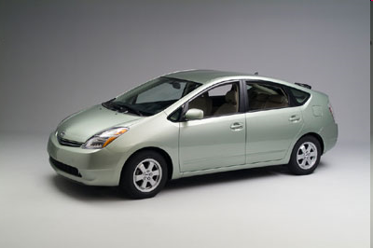

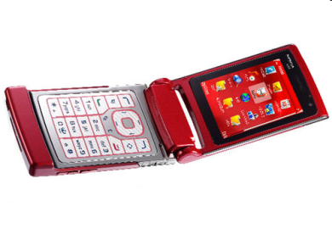
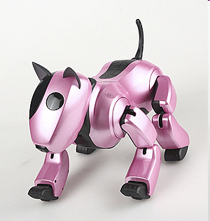
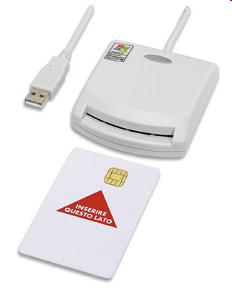
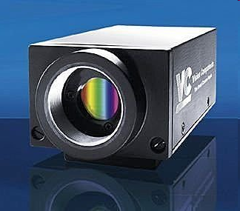
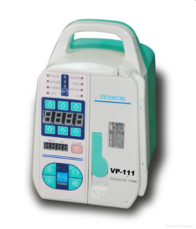
Software: Key to Embedded Revolution
Software Inside!
Software New features, Automation, Customization
Software Bugs, Unpredictability, Recalls
Notes:
2

Slide 3
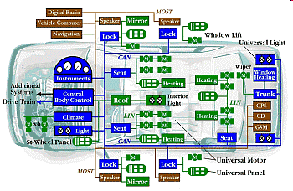
Prius Brake Problems Blamed on Software Glitches
“Toyota officials described the problem as a "disconnect" in the vehicle's complex anti-lock brake system (ABS) that causes less than a one-second lag. With the delay, a vehicle going 60 mph will have traveled nearly another 90 feet before the brakes begin to take hold” (source: CNN Feb 4, 2010)

Slide 4
Verifier
In Search of the Holy Grail…
software/model
yes/proof
correctness
specification
no/bug
Correctness is formalized as a mathematical claim to be proved or falsified rigorously
  always with respect to the given specification
Challenge: Impossibility results for automated verifier
  Yet impressive success for hardware protocols, systems software
  Can we have similar success for embedded control software?

Slide 5
Embedded Computation
Typical embedded program: cruise control
  Loop
  Read the sensors;
  Compute speed;
  Compute pressure for brake pedal / accelerator;
  Transmit the outputs to actuators;
Program has (non-terminating) interaction with the outside world: Reactive computation
Correctness depends on real-time response (does the car brake fast enough?)
Analysis of correctness requires modeling of the dynamics of the car

Slide 6
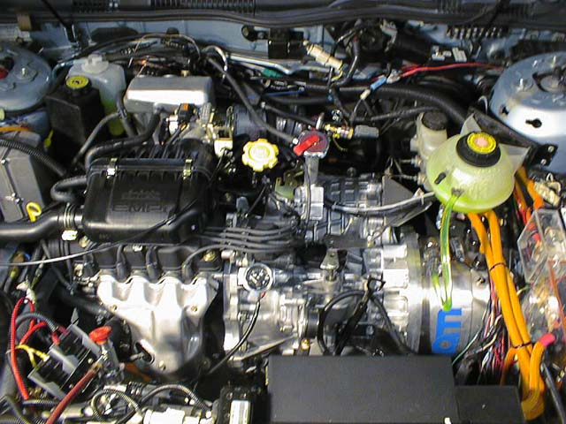
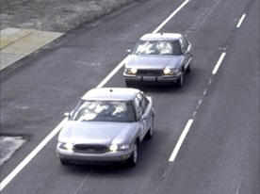
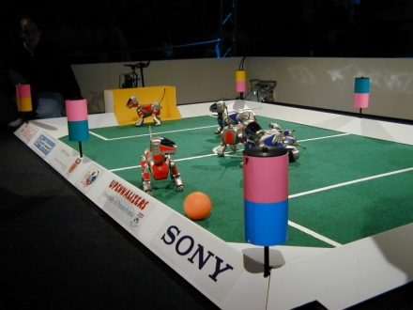
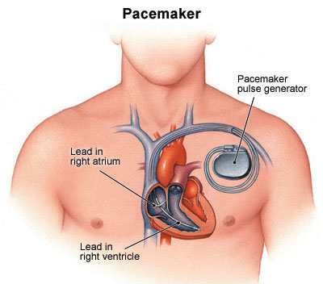
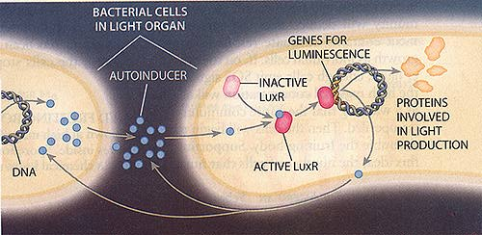
Hybrid Systems
Computer Science
Automata/Logic
Concurrency
Formal verification
+ Control Theory
Optimal control
Stability analysis
Discrete-event system
Software + Environment
State machines
+ Dynamical systems
x>68
on
off
dx/dt = kx
x<70
dx/dt = -k’x
x>60
x<63
Coordination
Protocols
Medical
Devices
Systems
Biology
Automotive
Robotics

Slide 7
Vehicle Platoons
Can we prove correctness of the protocol?
  Build a rigorous model of the controller
  Capture environment assumptions (e.g. bounds on acceleration of the car in the front)
  Requirements: Safe distance, Stability, Absence of deadlocks
  Validation: Simulation, Model checking

Slide 8
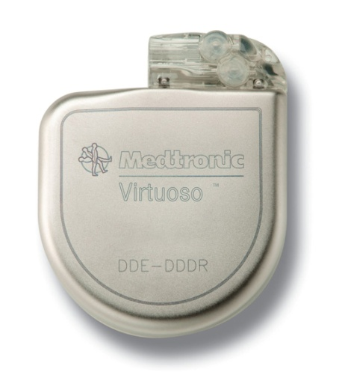
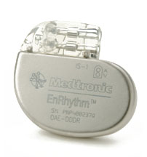

Medical Devices
                From 1985-2005, nearly 30,000 deaths and 600,000 injuries from device failures
                From 1996-2006, the percentage of software-related causes in medical device recalls have grown from 10% to 21% (Complexity↑ → Potential safety violations↑)
                There is currently no well-established standards for development of software for medical devices

Slide 9
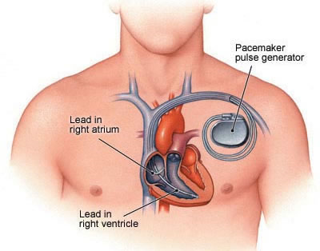
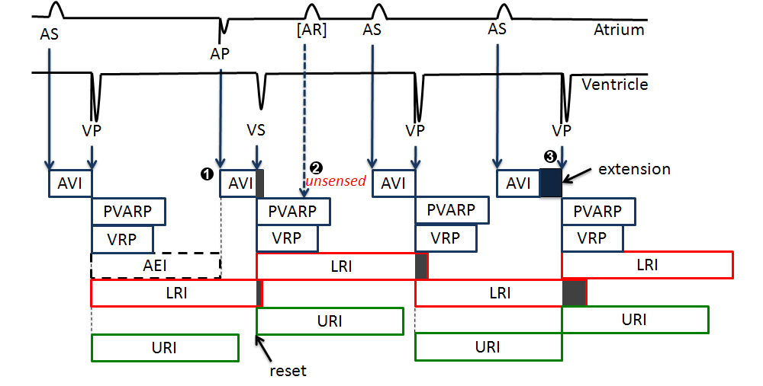
Implantable Pacemaker

Slide 10
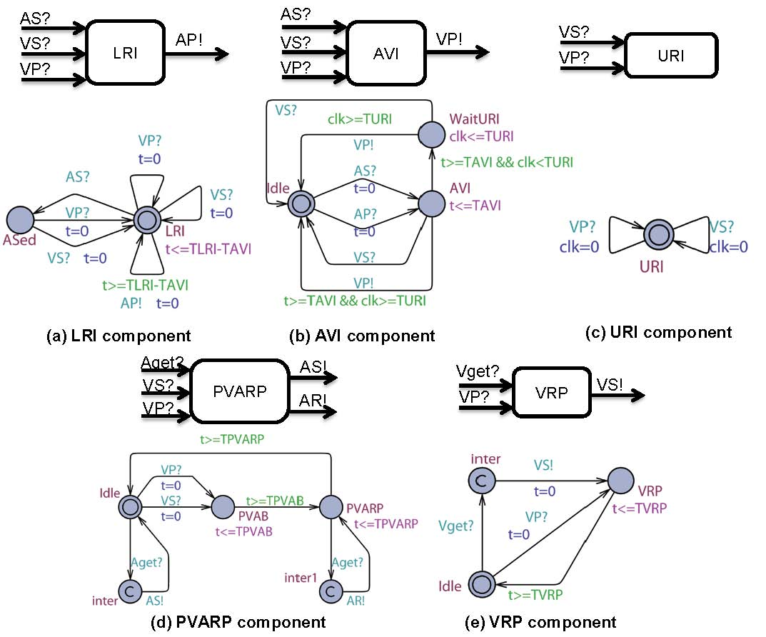
Uppaal Model of Dual Chamber Pacemaker

Slide 11
Talk Outline
Modeling
Symbolic reachability analysis
Conclusions
Notes:
Follow the wall and obstacle avoidance can be sequentially implemented

Slide 12
Hybrid Automata
locations or modes (discrete states)
edge
guard
l’
e : g(X)≥0
X ∈ Inv(l’)
dX ∈ Flow(l’)
l
J(X, X’)
X ∈ Inv(l)
dX ∈ Flow(l)
X ∈ Init(l)
jump transformation
invariant: hybrid automaton may remain in l as long as X ∈ Inv(l)
initial condition
continuous dynamics

Slide 13
Modeling Research
  Hierarchical modeling (Charon)
  Compositionality and refinement (HIOA)
  Heterogeneous modeling (Ptolemy II)
  Model based integration
Notes:
Composition of submodes is called encapsulation.
Sequential composition.
Follow the wall and obstacle avoidance can be sequentially implemented

Slide 14
Charon Language Features: Modularity
Individual components described as agents
  Composition, instantiation, and hiding
Individual behaviors described as modes
  Encapsulation, instantiation, and scoping
Support for concurrency
  Shared variables as well as message passing
Support for discrete and continuous behavior
  Differential as well as algebraic constraints
  Discrete transitions can call Java routines
Compositional semantics with refinement rules
  Components have precise trace-based observational semantics
  Properties of the system can be deduced from components
Notes:
Composition of submodes is called encapsulation.
Sequential composition.
Follow the wall and obstacle avoidance can be sequentially implemented

Slide 15
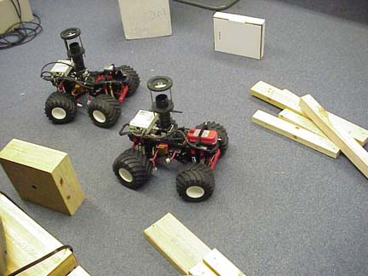
Robot Team Approaching a Target
T

Slide 16
Architectural Hierarchy
write diff analog position pos₁, pos₂
class position { float x; float y;}
Robots
Variables Specifiers
  Range: discrete/analog
  Computation: diff/alg
  Access: read/write/local
pos₁
pos₂
Monitor

Slide 17
Architectural Hierarchy
Robots
r1Est₁
Robots
Robot₁
Robot₂
r1Est₂
pos₁
pos₂
r2Est₁
Monitor
r2Est₂
pos₁
pos₂

Slide 18
Behavioral Hierarchy
pos == target
local diff analog timer
awTarget
dPlan
iAway
atTarget
dStop
iAt
r2Est₁
arrive
Robot₁
dTimer
r2Est₂
.
pos.x = v * cos(phi)
pos.y = v * sin(phi)
r1Est₁
.
r1Est₂
pos
moving
dSteer
aOmega
iFreq
sense
sensing
dStop
iConst
arrive
move

Slide 19
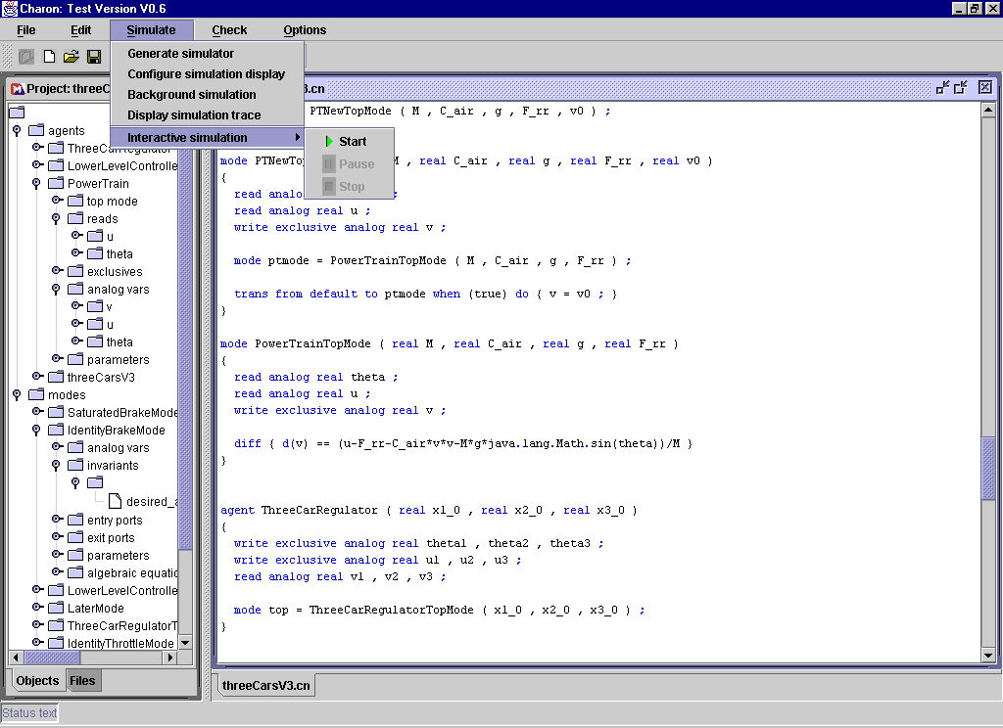
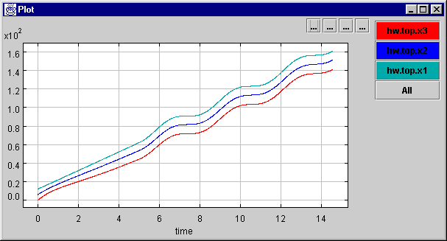
Charon Toolkit

Slide 20
Talk Outline
Modeling
Symbolic reachability analysis
Conclusions
Notes:
Follow the wall and obstacle avoidance can be sequentially implemented

Slide 21
Symbolic Safety Verification
Goal: Given an initial set I, compute the set of reachable states to check if a bad state in F is reachable
Symbolic breadth-first search by applying Post:
Post(R): Set of successors of states in R
F
I

Slide 22
Reachability for Hybrid Systems
What’s a suitable representation of regions?
  Region: subset of R^{k}
  Main problem: handling continuous dynamics
Precise solutions available for restricted continuous dynamics
  Timed automata
  Linear hybrid automata
Even for linear systems, over-approximations of reachable set needed

Slide 23
Polyhedral Flow Pipe Approximations
t₅
t₆
t₇
t₄
t₃
t₈
t₂
t₉
t₁
divide R_{[0,T]}(X₀) into [t_{k},t_{k+1}] segments
enclose each segment with a convex polytope
X₀
R^{M}_{[0,T]}(X₀) = union of polytopes

Slide 24
Challenges for Reachability Analysis
Coping with high dimensionality
Bounding errors due to over-approximations
Handling non-linear dynamics
State-of-the-art toolkit: SpaceEx (spaceex.imag.fr)

Slide 25
Conclusions
Modeling is central to design of embedded software systems
Analysis requires handling of time and dynamics
Many emerging applications: e.g. Pacemaker software
There are no papers at POPL on this topic, but great opportunity for PL researchers to impact industrial practice

