Slide 1
Private resource allocators and their applications
Sebastian Angel Sampath Kannan Zachary Ratliff

Slide 2
When an application consumes resources…
Executes instructions
Downloads a file
Accesses memory

Slide 3
Consumption is observable via side channels
fan speed
power consumption
traffic pattern
completion time

Slide 4
In this work we are concerned with information that leaks when resources are allocated
(any leakage from their consumption is orthogonal)

Slide 5
Attack on anonymous messengers [WPES ‘18]
Dial request
Problem: Adversary (C) learns that B is talking to someone. This opens the door to traffic analysis attacks.
A
C
A
B
Accept request
Dial request
C

Slide 6
Other examples of resource allocation
VM assignment: allocate VM/containers to servers
I/O rate limiting: allocate rate every epoch
(or protocols with a control + data plane)
Cache partitioning: allocate cache lines to processes

Slide 7
The rest of this talk will…
Formalize privacy in this setting
Explain why existing allocators fall short
Outline PRA constructions and their costs
Discussion

Slide 8
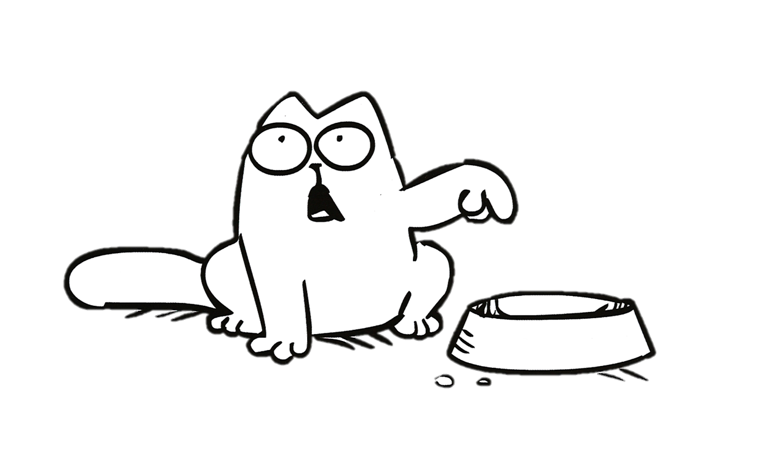
limited resource
(quantity is public)
resource allocator
process 1
process 2
process n

Slide 9
Allocation indistinguishability
Privacy: adversary does not learn if honest processes requested resources by observing its own allocation

Slide 10
Avoiding trivial allocators
Liveness: allocator should sometimes allocate resources to at least one process
An allocator that hoards resources and never allocates anything is private…
But it is also useless

Slide 11
The rest of this talk will…
Formalize privacy in this setting
Explain why existing allocators fall short
Outline PRA constructions and their costs
Discussion

Slide 12
Easy to distinguish FIFO allocator
FIFO
FIFO

Slide 13
Easy to distinguish Random allocator
Allocators cannot be both work conserving and private
Random
Random

Slide 14
Giving up work conservation is not enough
Pr[p_{mal} is allocated a resource | honest + malicious]
≤
Pr[p_{mal} is allocated a resource | malicious]
Random’
Random’

Slide 15
It is impossible for an allocator to be private and live unless the number of processes is bounded a priori
Universe of all processes
Active processes
Active honest processes
Information-theoretic privacy
Computational privacy
Differential privacy

Slide 16
The rest of this talk will…
Formalize privacy in this setting
Explain why existing allocators fall short
Outline PRA constructions and their costs
Discussion

Slide 17
Slot-based allocator (bounded universe)
0
2
4
Private and live, but very wasteful
Pr[p gets a resource] = # resources / bound on universe
0
2
4
1
3
5
1
3
5

Slide 18
Random w/ dummies (bounded active proc.)
Private, live, and less wasteful
Pr[p gets a resource] = # resources / bound on active
Dummy

Slide 19
In many settings it is hard to bound # active processes due to, e.g., sybils
# active processes = # malicious + # honest
Unbounded (or bound is useless, e.g. 2⁶⁴)

Slide 20
Diff. private allocator (bounded active honest)
Pr[p_{mal} is allocated a resource | malicious]
≤
$e^{ε}$ Pr[p_{mal} is allocated a resource | honest + malicious] + $δ$
Dummy
Dummy
Dummy
Dummy
Dummy
Dummy

Slide 21
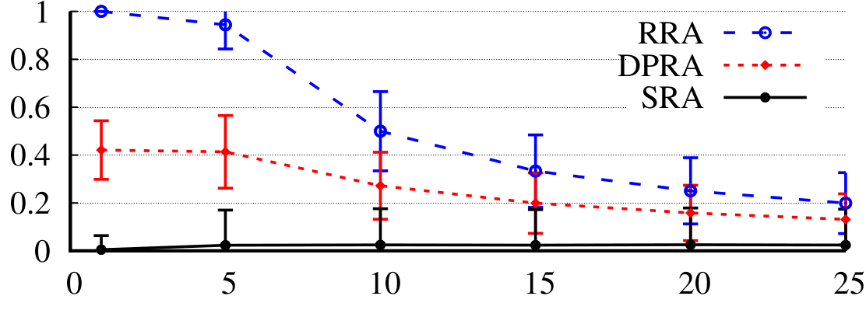
Comparison of PRA efficiency
Utilization
(PRA / non-private allocator)
Weaker assumption (more likely to hold in practice)
Bound on # of active honest processes
Less wasteful
(bound on active processes is 10X, and bound on universe is 2000)

Slide 22
The rest of this talk will…
Formalize privacy in this setting
Explain why existing allocators fall short
Outline PRA constructions and their costs
Discussion

Slide 23
Our paper also describes
How privacy relates to standard properties of allocators
Privacy → population monotonicity
Privacy → group strategy proofness (in some settings)
Resource monotonicity, envy freeness, fairness, etc.
How to allocate multiple units of a resource to processes
How to express priorities among processes
How to integrate PRAs into an anonymous messenger
Code available at: https://github.com/pung-project/pra

Slide 24
PRAs prevent allocation-based side channels
Dial request
A
C
A
B
Accept request
Dial request
C

