Slide 1
What’s a little leakage between friends?
Sebastian Angel
UPenn
David Lazar
MIT CSAIL
Ioanna Tzialla
NYU

Slide 2
Metadata-private messaging (MPM) systems
Allow bidirectional communication without leaking metadata to:
  Network providers
  Servers used to proxy messages
  Users not involved in the communication
Anonymity is not a goal (sender and recipient know each other)
Recent examples:
  Vuvuzela [SOSP ‘15], Pung [OSDI ‘16], Stadium [SOSP ‘17], Atom [SOSP ‘17], MCMix [USENIX Security ‘17], Karaoke [OSDI ‘18]

Slide 3

Straw man MPM system
A
A
A
A
B
B
C
C
Adversary cannot distinguish between these three scenarios
All-to-all communication

Slide 4
Existing MPM systems avoid broadcast
A
Clients send a fixed number of messages per round
(through a proxy server, mix network, etc.)
Clients are in charge of starting/multiplexing conversations
B
C
Point-to-point

Slide 5
MPM systems rely on 4 protocols
Friend discovery: find out if friend is in the system
Friend request: derive a long-term shared secret
Dialing: derive session keys and agree on a round to start talking
Conversation: exchange messages using session keys

Slide 6

No privacy if a friend is compromised
A
C
B
D
If A is talking to B, and B is compromised, B trivially knows about this communication

Slide 7
No privacy if a friend is compromised
A
C
B
D
But what if A is also talking to C?
Is the communication between A and C also observable?
Yes.

Slide 8
Issue: messages sent are a limited resource
A
C
“Hey, let’s chat now!”
B
D
Hmmm…
must be busy
Example: Suppose users can only have 1 conversation per round

Slide 9
Adversary can now distinguish
A
A
A
C
D
Assume A, C, D are all honest (uncompromised) users, but A is being targeted by a compromised friend (B, not depicted)

Slide 10
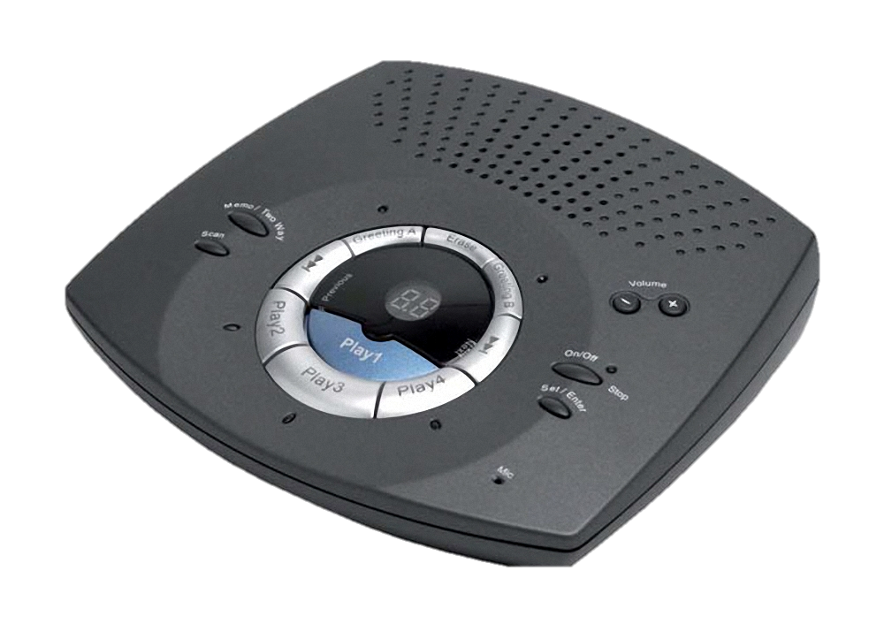
We need a private answering machine
Capacity k (# of concurrent conversation)
Chosen callers (at most k)
Callers C
Privacy: Any subset of callers in C does not learn whether there were other callers
Liveness: Eventually a caller gets through
Efficiency: Capacity is lower than the max number of possible callers

Slide 11
Is there a private, live, and efficient answering machine?
Not possible without some assumptions

Slide 12
Proposal (has many limitations)
Capacity k, max number of friends m
Chosen callers (at most k)
Callers C
(at most m)
Statically map from callers to rounds (mod m)
At most k callers assigned to a given round
If client calls during allocated round, let it through

Slide 13
Drawbacks of our proposal
Requires clients to set a bound on number of friends
  And this bound might leak
Introduces high latency
  Lower capacity or more friends => higher latency
Needs additional mechanisms:
  A might assign to B round 1, but B might assign to A round 3
  Need overlapping rounds (or messages can’t be ephemeral) to communicate

Slide 14
Summary
Existing MPM systems that support dialing are susceptible to compromised friend attacks
  These attacks enable existing disclosure, intersection, hitting set attacks
Can prevent attacks with all-to-all communication
  But this leads to high network costs
Can prevent attack with a private answering machine
  But our proposal has many limitations
  Can we do better?

