Slide 1
Long-run cooperation in the finitely repeated Prisoner’s Dilemma
Duncan Watts

Slide 2
One Shot Prisoner’s Dilemma
 | Defect | Cooperate
Defect | P, P | T, S
Cooperate | S, T | R, R
 | Defect | Cooperate
Defect | 0, 0 | g+1, -l
Cooperate | -l, g+1 | 1, 1
T>R>P>S
T+S < 2R
g = (T-R)/(R-P)
l = (P-S)/(R-P)
Payoff Matrix
Normalized Payoffs

Slide 3

Finitely repeated Prisoner’s Dilemma (in theory)
Defect
Defect
Defect
Defect
Defect
Defect
Defect
Defect
(econs)
Round 1
Round 2
Round 3
Round 4

Slide 4
Finitely repeated Prisoner’s Dilemma (in practice)
Cooperate
Cooperate
Defect
Defect
Cooperate
Cooperate
Cooperate
Defect
(real people)
Round 1
Round 2
Round 3
Round 4
see: Selten and Stoecker [1986]; Andreoni and Miller [1993]; Dal Bo [2005]; Bereby-Meyer and Roth [2006]; Friedman and Oprea [2012], Embrey, Fréchette, and Yuksel [2015]

Slide 5
“Rational Cooperation” Under Incomplete Information
Kreps et al (1982) proposed that disparity between theory and experiment arises from incomplete information:
  Players are rational but believe with some probability p that others are conditionally cooperative (i.e. play Tit-For-Tat)
  Proved that if p is sufficiently high, best response is to cooperate until close to the end of the game
  Endgame effect commences at some number of rounds n prior to end, where n is bounded above by p
“Rational cooperation” explains how cooperation can be pervasive even when no-one is “truly” altruistic
  Leaves open the question of whether or not anyone is truly altruistic

Slide 6
But what about the long run?
Andreoni and Miller (1993) suggest two possibilities
  Rationality hypothesis: If everyone is really rational, over time this should become common knowledge, Nash should prevail
  Altruism hypothesis: if enough players are (conditionally) altruistic, then this becomes common knowledge, cooperation could increase
“Confusion hypothesis” (Andreoni 1995) also makes ambiguous predictions:
  Observed altruism might be consequence of “true” altruism or might instead just represent confusion about game being played
    If former, then altruism should persist
    If latter, then eventually players should learn “real” game and play Nash

Slide 7
Empirical Evidence Inconclusive
Selten and Stoecker (1986) conducted sequence of 25 repeated PD games of 10 rounds each:
  Found that cooperation diminished, and defection began earlier
Andreoni and Miller (1993) conducted sequence of 20 PD games of 10 rounds each:
  Found that cooperation increased, defection occurred later
Andreoni (1988) found no evidence for either direction
Isaac and Walker (1988) found that naïve and experienced players were indistinguishable
Embrey et al. (2018) concluded that unraveling was likely
None of the experiments examined changes over more than one session (few hours)

Slide 8
Would cooperation unravel with experience?
“… we conjecture that convergence to Nash would require in excess of 200 games of 10 rounds each.” [Mason et al. 2014]
“Although … unravelling is at work in all treatments, the process is slow enough that … it is not plausible to observe cooperation rates to decline to negligible levels in an amount of time that is reasonable to spend in a laboratory.” [Embrey et al. 2017]
A experimental study of cooperation over time would:
(maybe) resolve conflict between theory and empirical data
be closer to the real world

Slide 9
Our experiment
(Mao, Dworkin, Suri, Watts, Nature Comms ,2017)
T=7 > R=5 > P=3 > S=1
 | Defect | Cooperate
Defect | 3, 3 | 7, 1
Cooperate | 1, 7 | 5, 5
Normalized form:
g = (T-R)/(R-P) = 1
l = (P-S)/(R-P) = 1
Similar to Selten and Stocker, Andreoni and Miller, “easy” version of Embrey et al

Slide 10
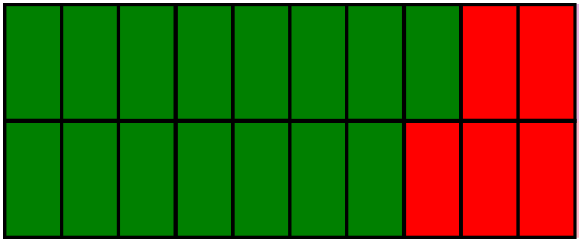

One game of ten rounds
anonymous
partners
Cooperate
Defect
Round 1
Round 10
Game

Slide 11
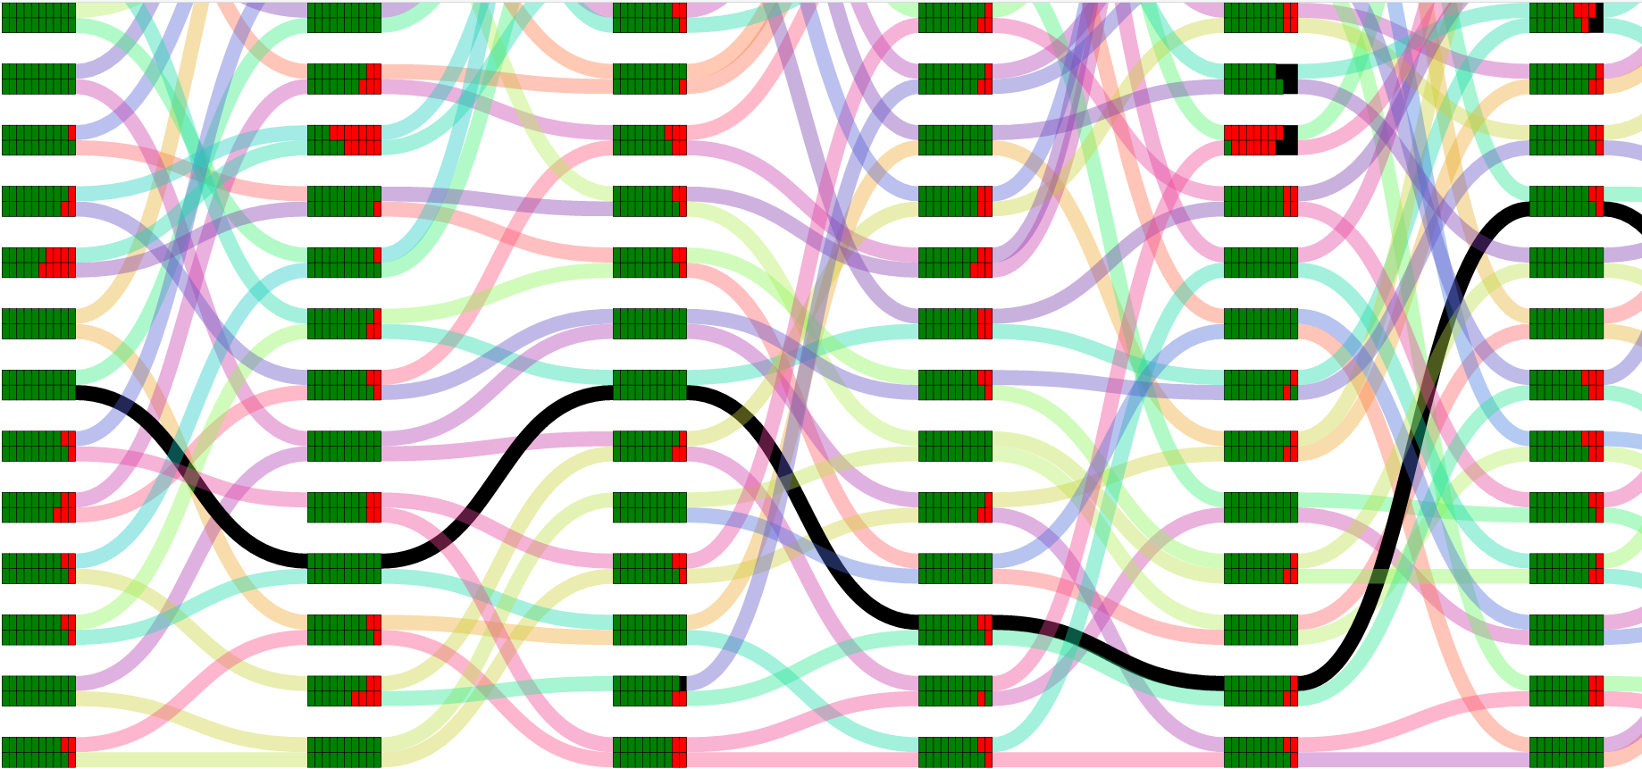
Random rematching across games
Game 1
Game 2
Game 3
Game 4
Game 5
Game 6

Slide 12
Random rematching across games
Game 1
Game 2
Game 3
Game 4
Game 5
Game 6

Slide 13
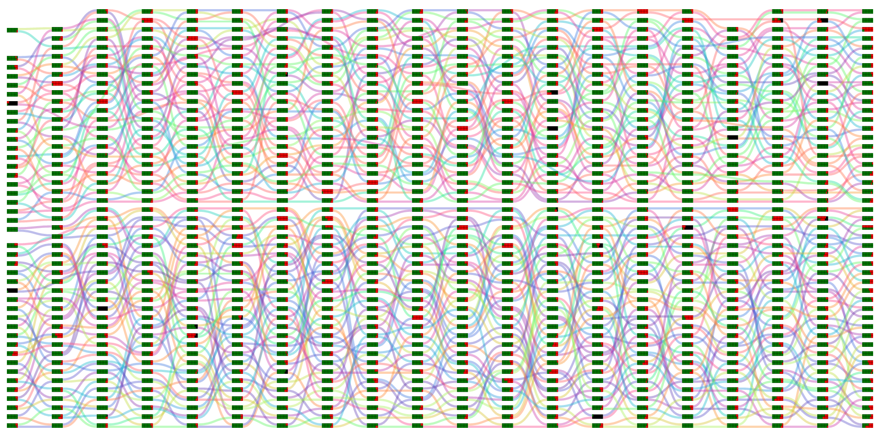
One experiment session – 20 games
50
pairs
Game 1
Game 20

Slide 14
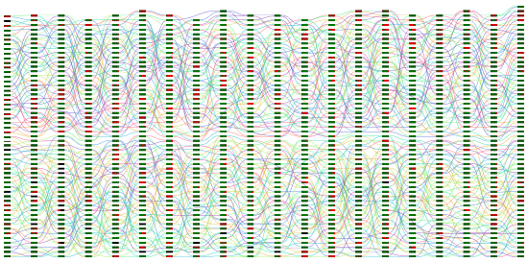
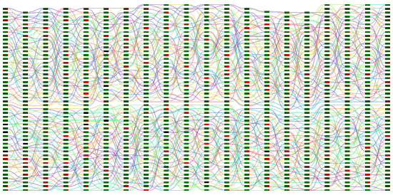
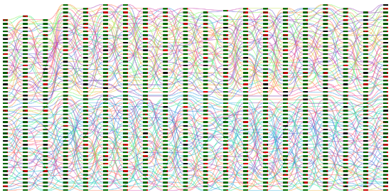
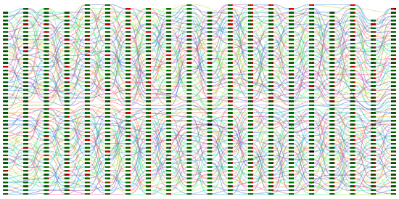
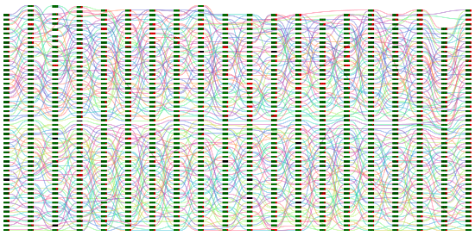
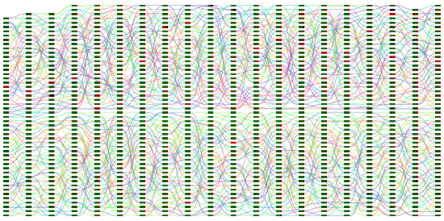
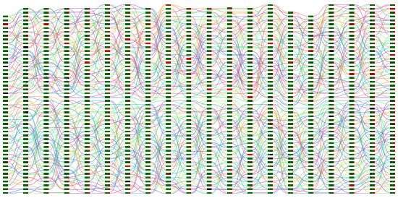
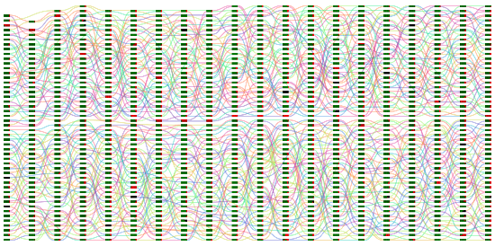
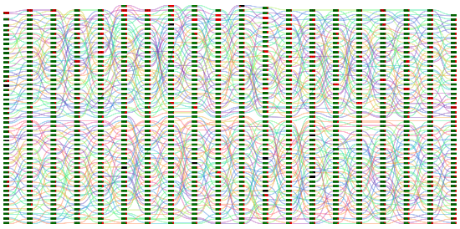
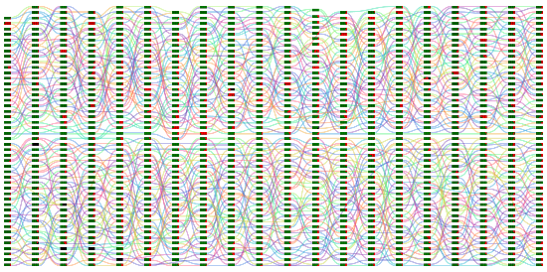
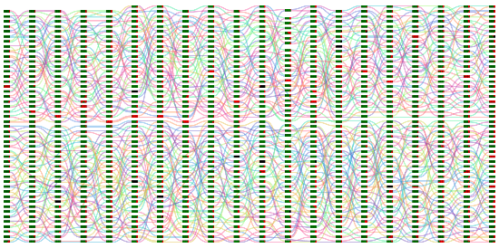
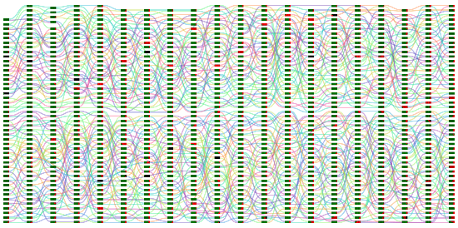
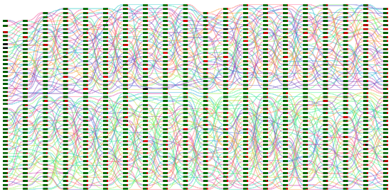
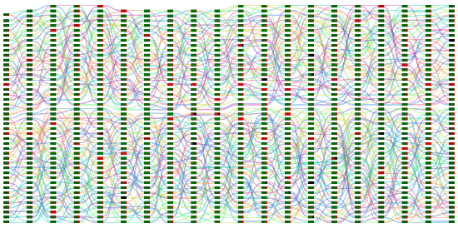
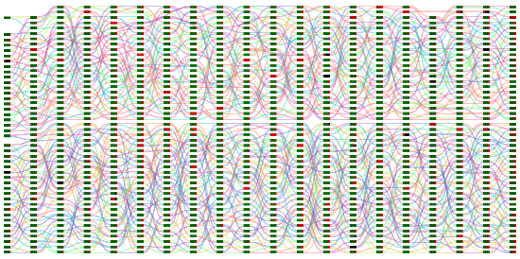
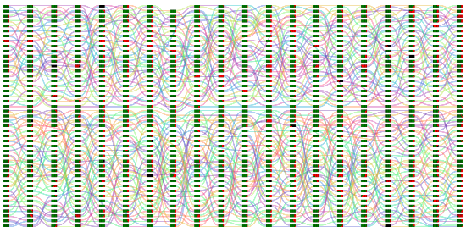
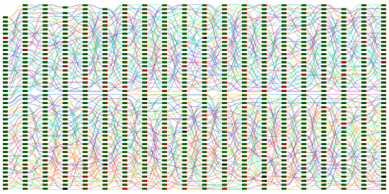
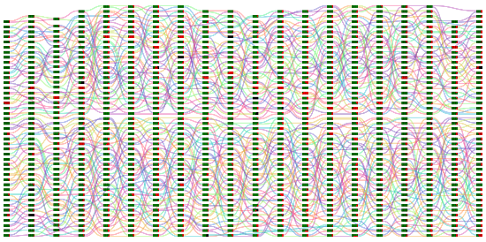
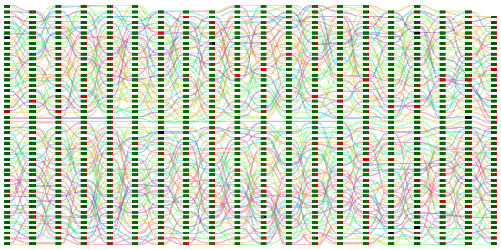
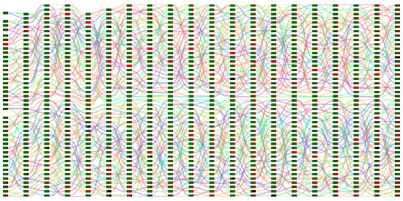
Aug 4, 2015 – Day 1
Aug 31, 2015 – Day 20

Slide 15
Our experiment
20 days
20 games per day
10 rounds per game
113 players to start, 94 completed after attrition
375,000 decisions
Experiment | Number of games
Selten and Stoecker [1985] | 25
Andreoni & Miller [1993] | 20
Dal Bo [2005] | 10
Bereby-Meyer & Roth [2006] | 20
Friedman & Oprea [2012] | 8-10
Embrey et al. [2015] | 20-30
This work | 20 per day, 400 total

Slide 16
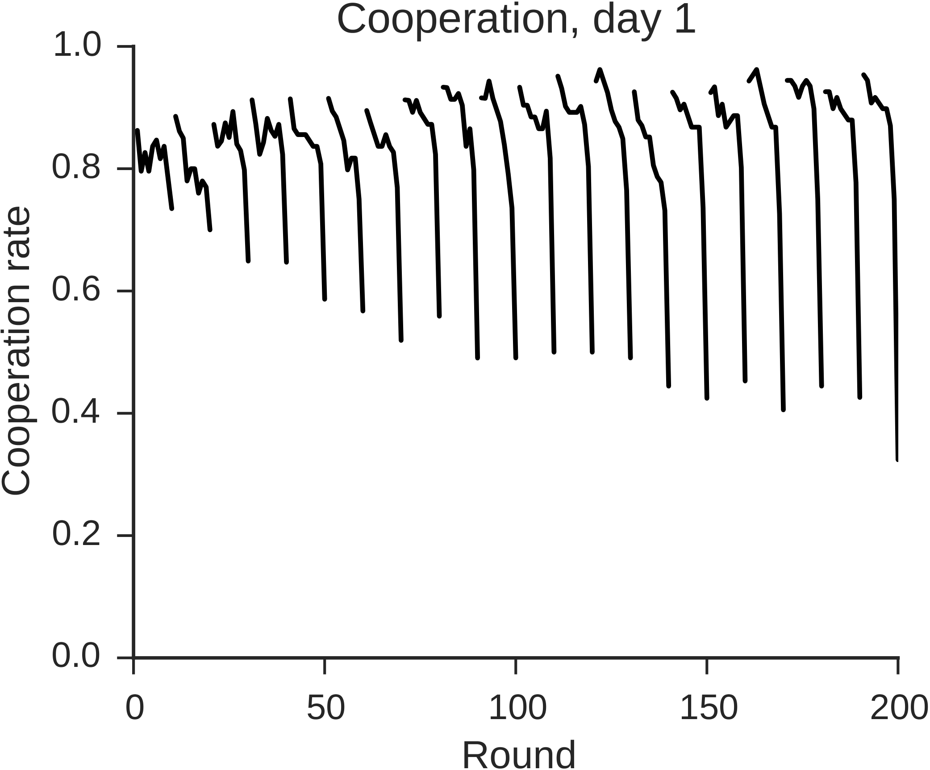
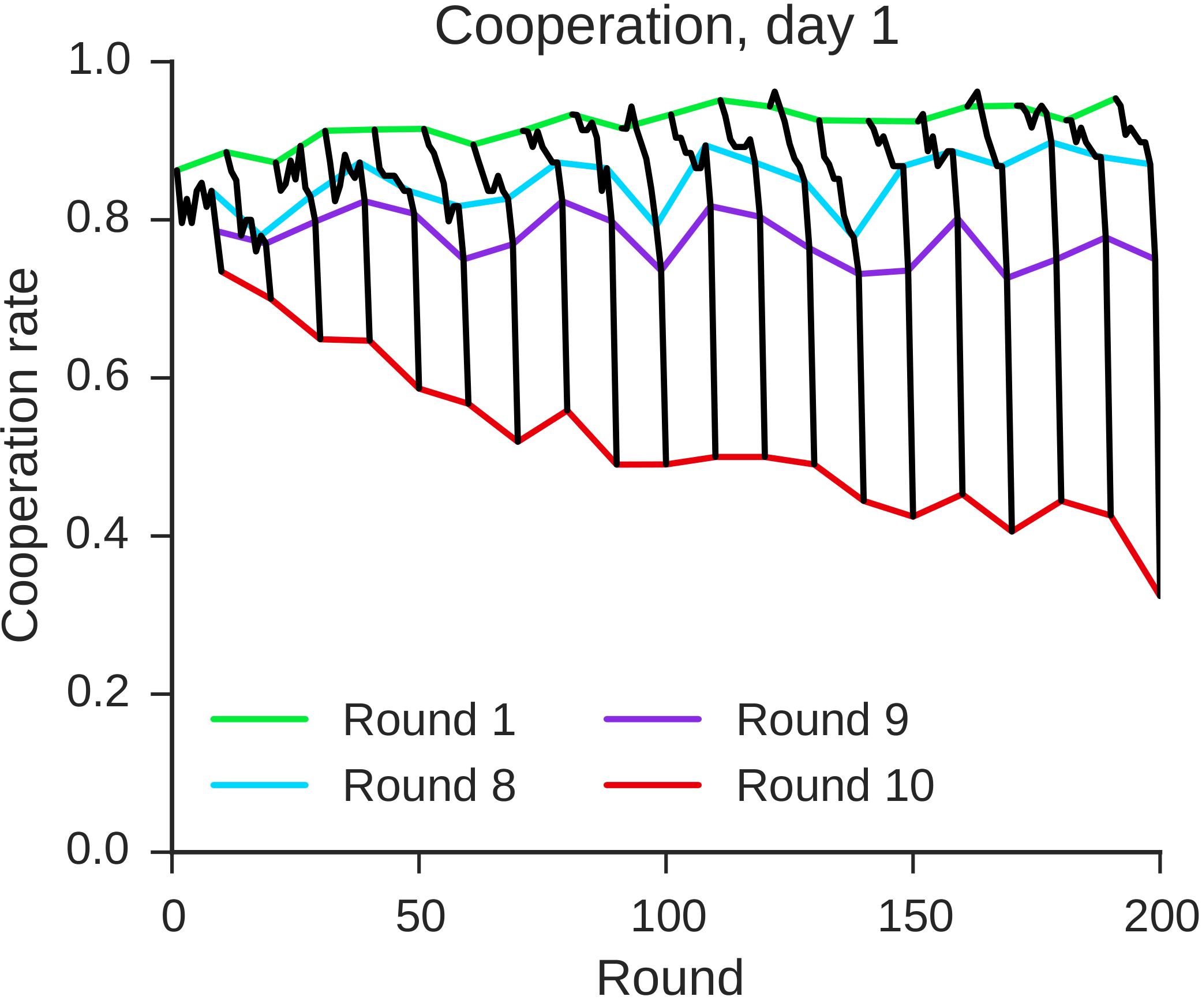

Slide 17
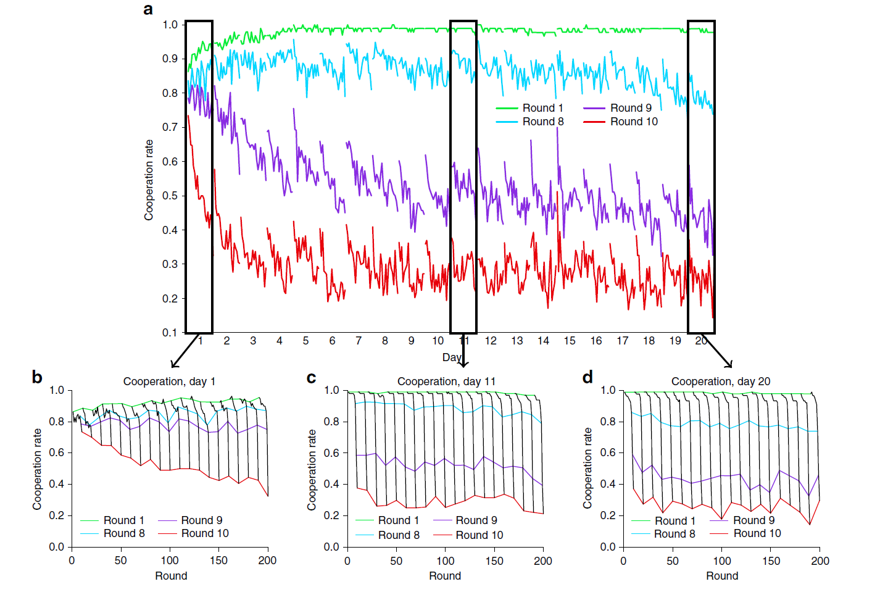
Cooperation over 20 days

Slide 18
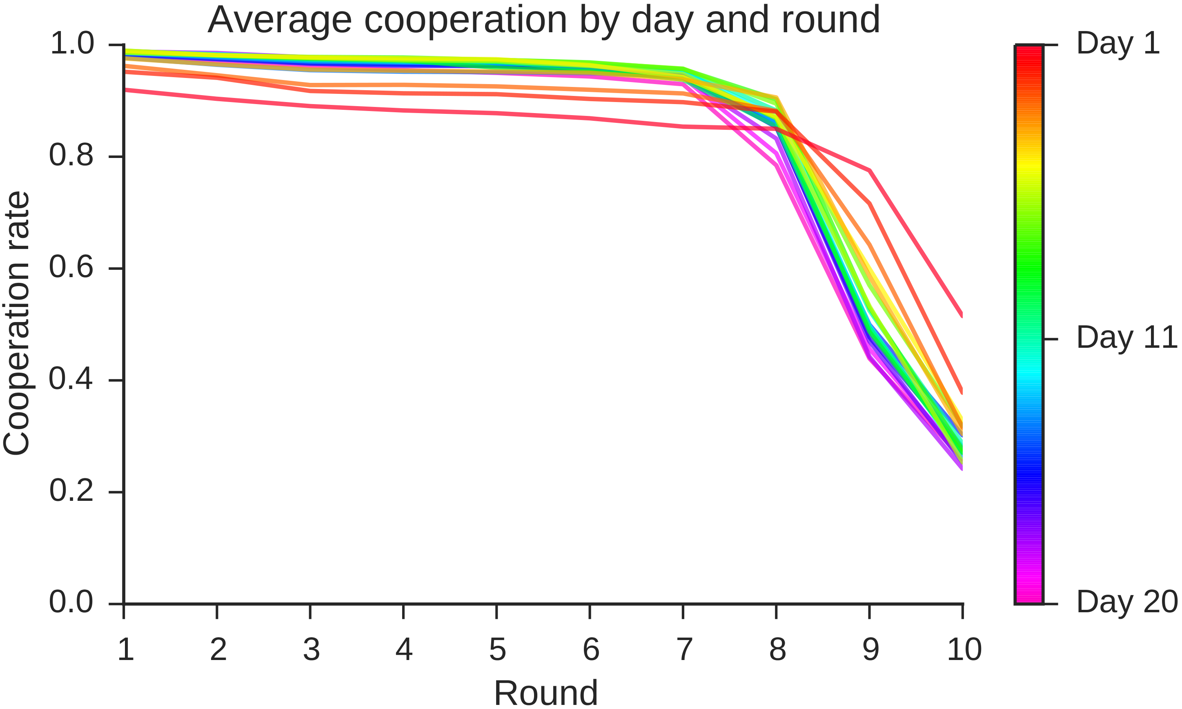
Cooperation over 20 days

Slide 19
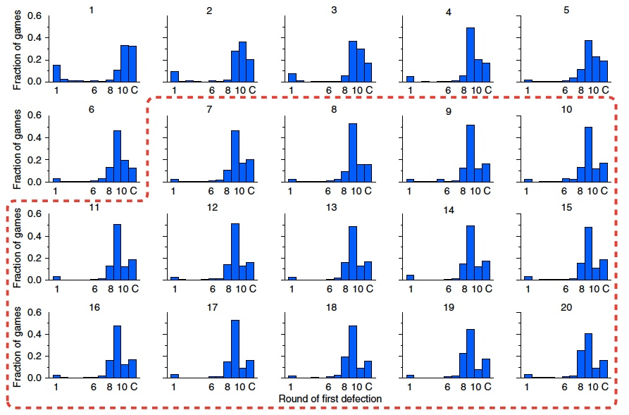
Round of first defection, by day

Slide 20
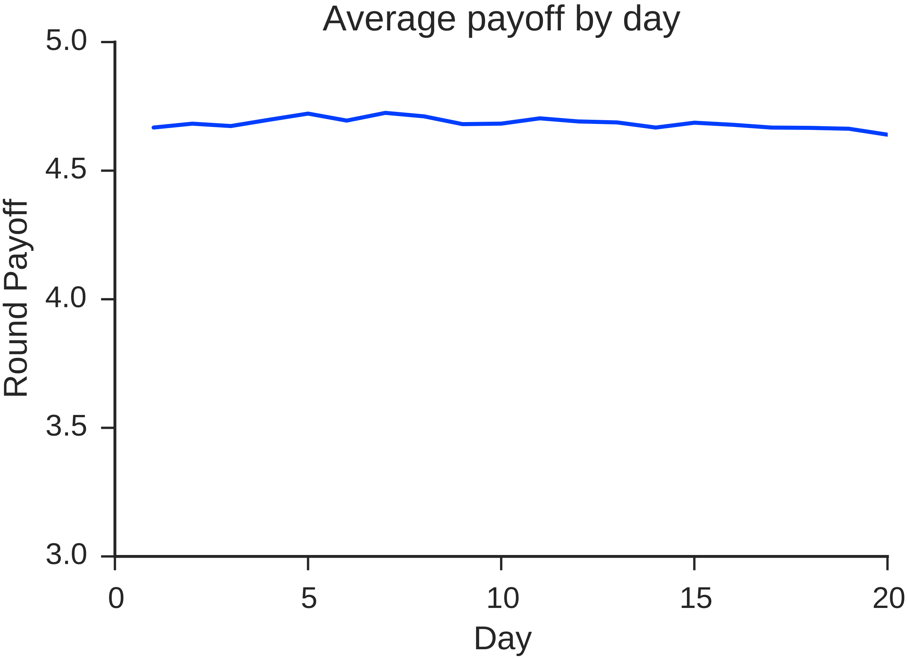
Cooperation is sustained, with high welfare
Payoffs | D | C
D | ₃\³ | ₇\¹
C | ₁\⁷ | ₅\⁵
≈ 84% of maximum social welfare
Despite:
Individual incentives to be selfish (no punishment or reward)
Anonymity of identity (no reputation)
Random rematching (no partner selection)

Slide 21
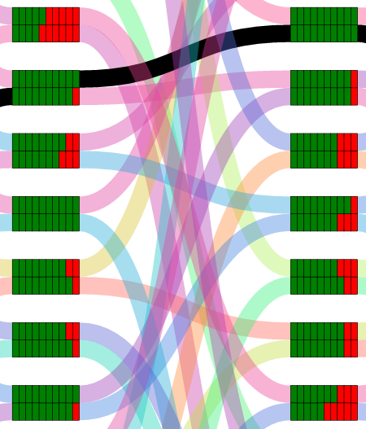
Inferring Player Strategies
Restrict to set of threshold strategies Tn
  Cooperate until round n, defect thereafter
  Defect if opponent defects first
  Special cases:
    T1 = ALLD
    T11 = CC = Grim Trigger
After each game t, for each player i
  Set for each strategy s consistent with play, else
  Update
  Choose
CC
T8
CC
CC
T9
CC
T9
T9
CC
T10

Slide 22
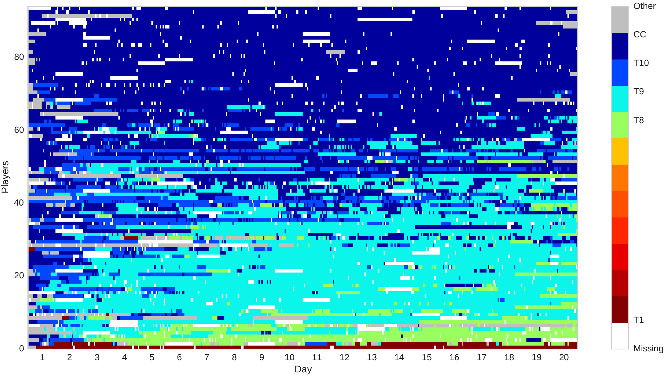
Player strategies over time
~40% are resilient cooperators:
play CC for vast majority of the experiment
CC
Majority (~60%) act like “rational altruists:” start out cooperating then slowly unravel to defect on rounds 8, 9, or 10
T9
T8

Slide 23
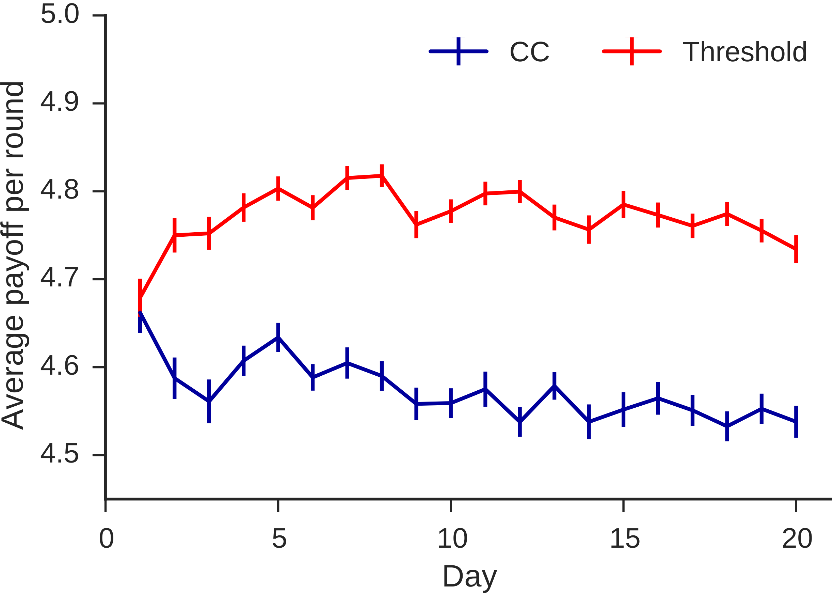
The cost of altruism…
“I started off by trying to cooperate...but as time wore on it became evident that I was only being cheated over and over
again in the final rounds... I started to see my daily bonus go down and inevitably began defecting first on the last round, then in the 9th, and finally in the 8th...”

Slide 24
Agent-based simulation
Some fraction of the population are resilient cooperators
  Play fixed CC strategy
Remaining fraction are rational cooperators.
  For each game, decide among T1, T2, …. T10, CC as follows:
    Estimate distribution of strategies in population (similar to earlier inference procedure)
    Compute expected utility of each strategy against estimated distribution
    Choose stochastic best response with probability
Can now study asymptotic unraveling behavior as function of
  Choose but similar results for

Slide 25
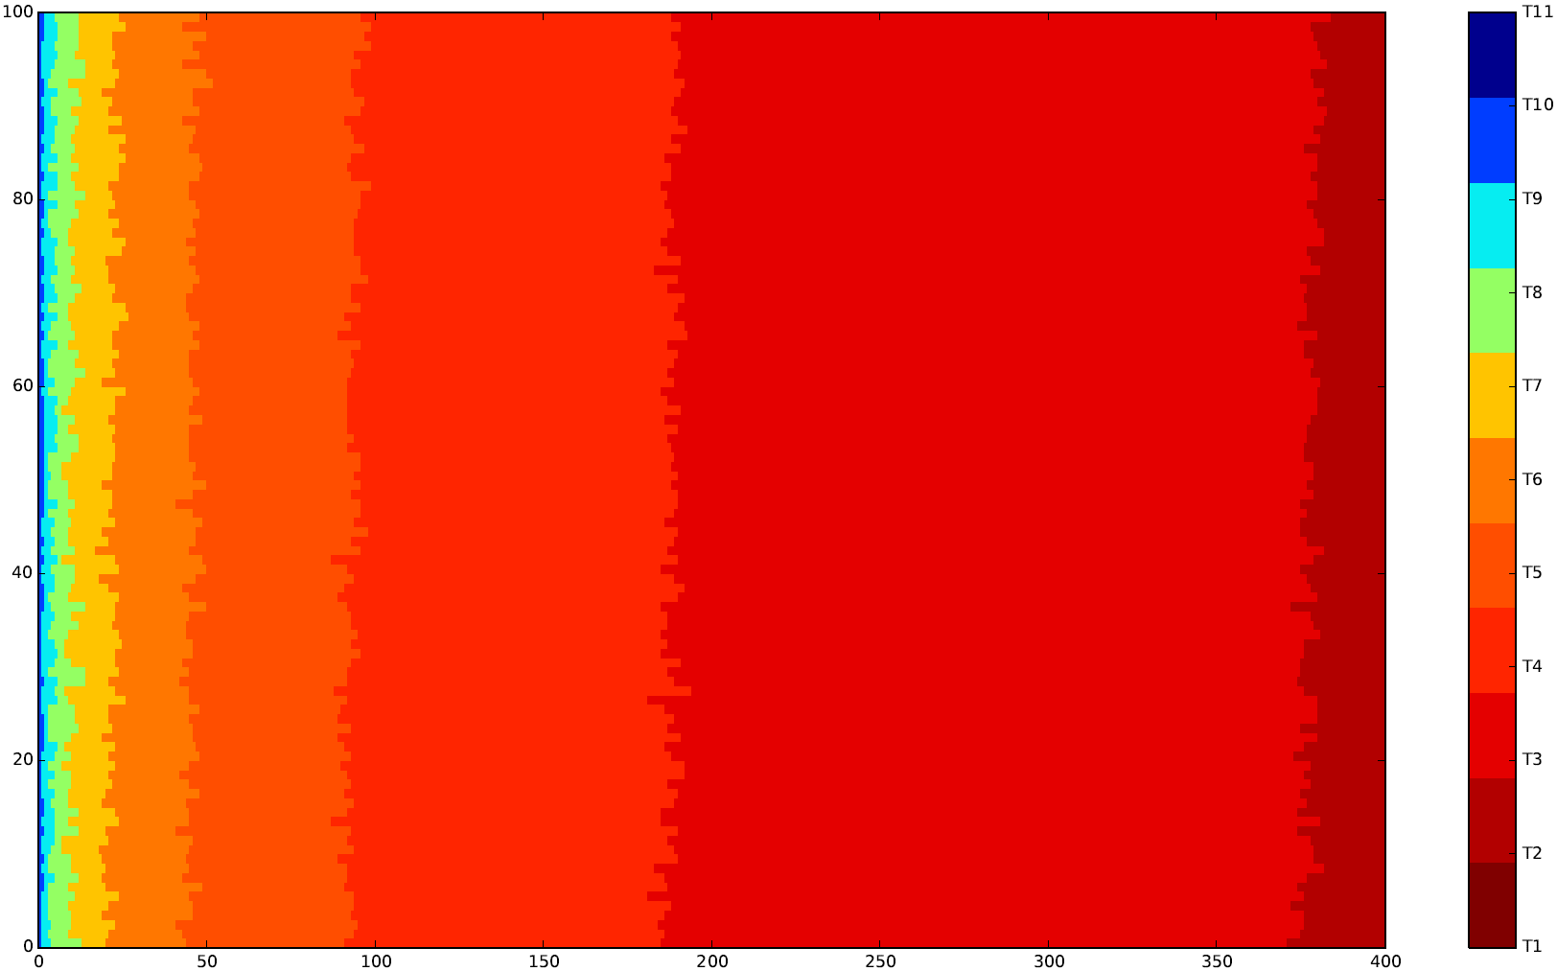
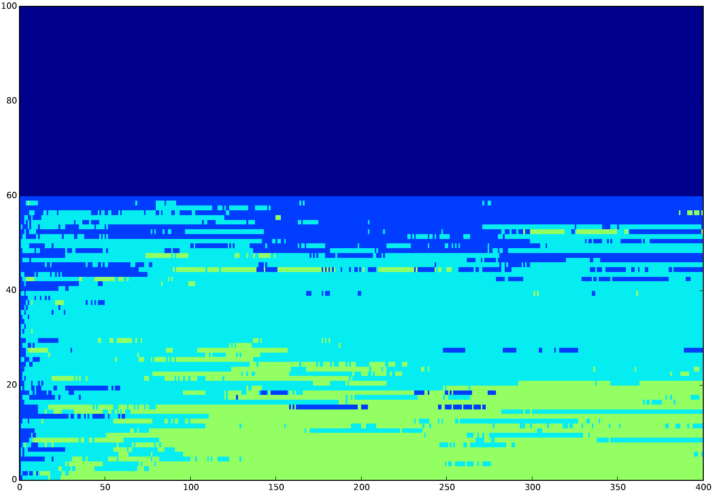
Simulation: with and without resilient players
CC
T10
T9
T6
T5
T4
T3
T8
No resilient players: cooperation breaks down
40% resilient players: cooperation maintained

Slide 26
Empirical data vs. simulation
Empirical strategies
Simulated strategies

Slide 27
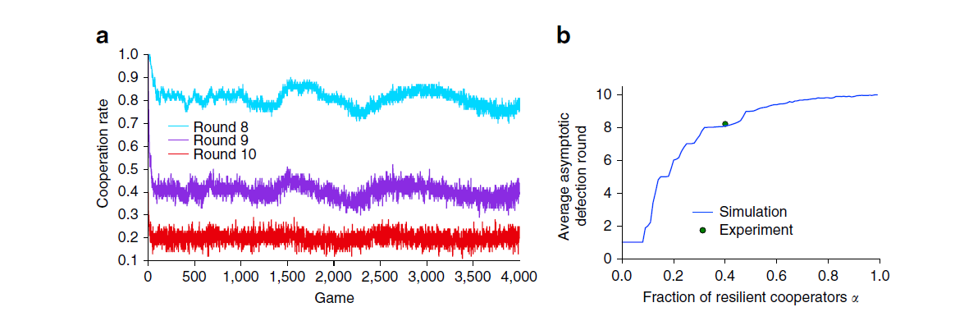
Resilient Cooperators arrest unraveling

Slide 28
Summary
Despite the social dilemma and prior predictions of unraveling, we find that resilient cooperators stabilize cooperation in the population
Resilient cooperators make everyone better off, at a significant cost to themselves
The virtual lab makes it possible to run an experiment, studying collective behavior, over a much longer time than in physical labs
Long-run studies of behavior can yield different results than short lab experiments!

Slide 29

Design Space of Virtual Labs
Realism
More naturalistic tasks
More realistic interactions
Virtual labs: using the Internet as a lab
Duration
Physical labs
Longer periods of time
Fewer constraints on location
Scale
Larger samples
More diverse subjects

Slide 30
Music Lab: N = 28,000
Salganik, Dodds, and Watts (Science, 2006)

Slide 31
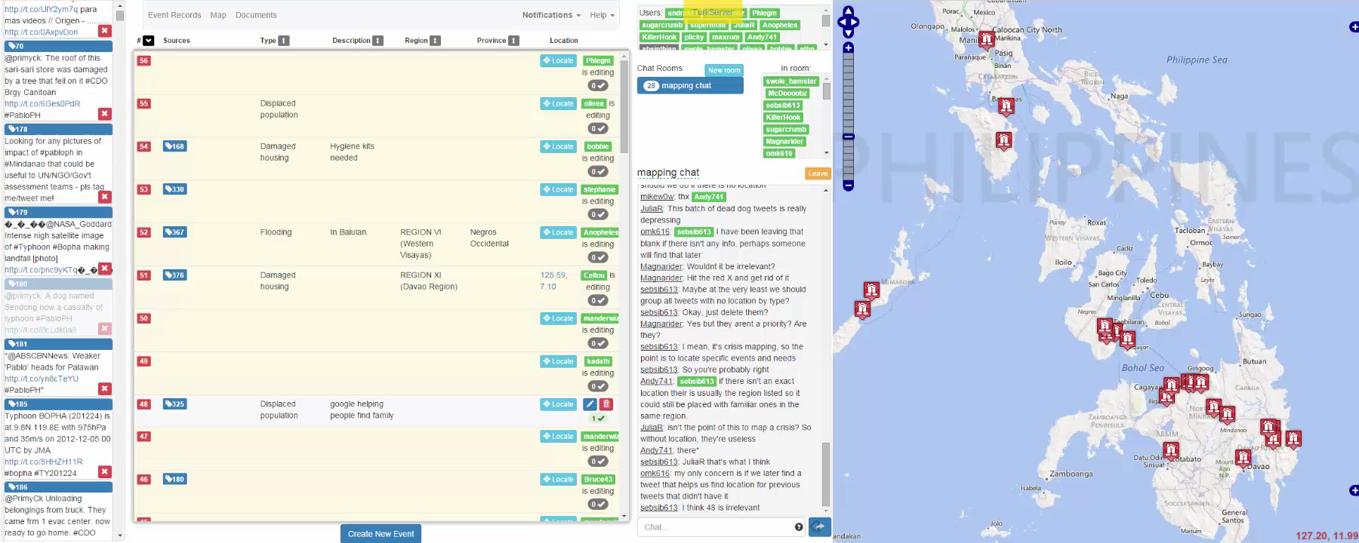
Crisis Mapping in the Lab
Mao, Mason, Suri, Watts (PLoS One, 2016)

Slide 32
The Future
Music Lab studied large N but short duration, simplistic task and interaction
Crisis Mapping studied complex interactions on realistic task but short duration and small N
Long-run PD studied learning dynamics over course of one month but simplistic task and interaction
Real world problems = large N, long duration, complex interactions and tasks
Lots of work still to be done…

Slide 33


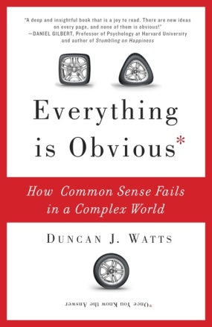
Thank you
Mao, A., Dworkin, L., Suri, S. et al. Resilient cooperators stabilize long-run cooperation in the finitely repeated Prisoner’s Dilemma. Nature Communications 8, 13800 (2017) doi:10.1038/ncomms13800
https://www.nature.com/articles/ncomms13800

