Slide 1
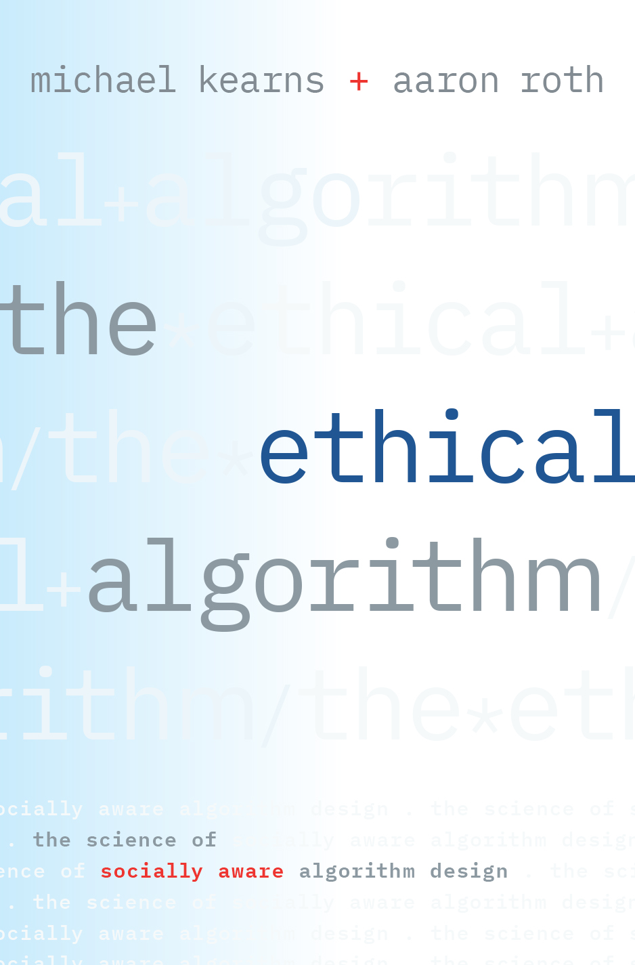
Google Nyc
November 18, 2019

Slide 2
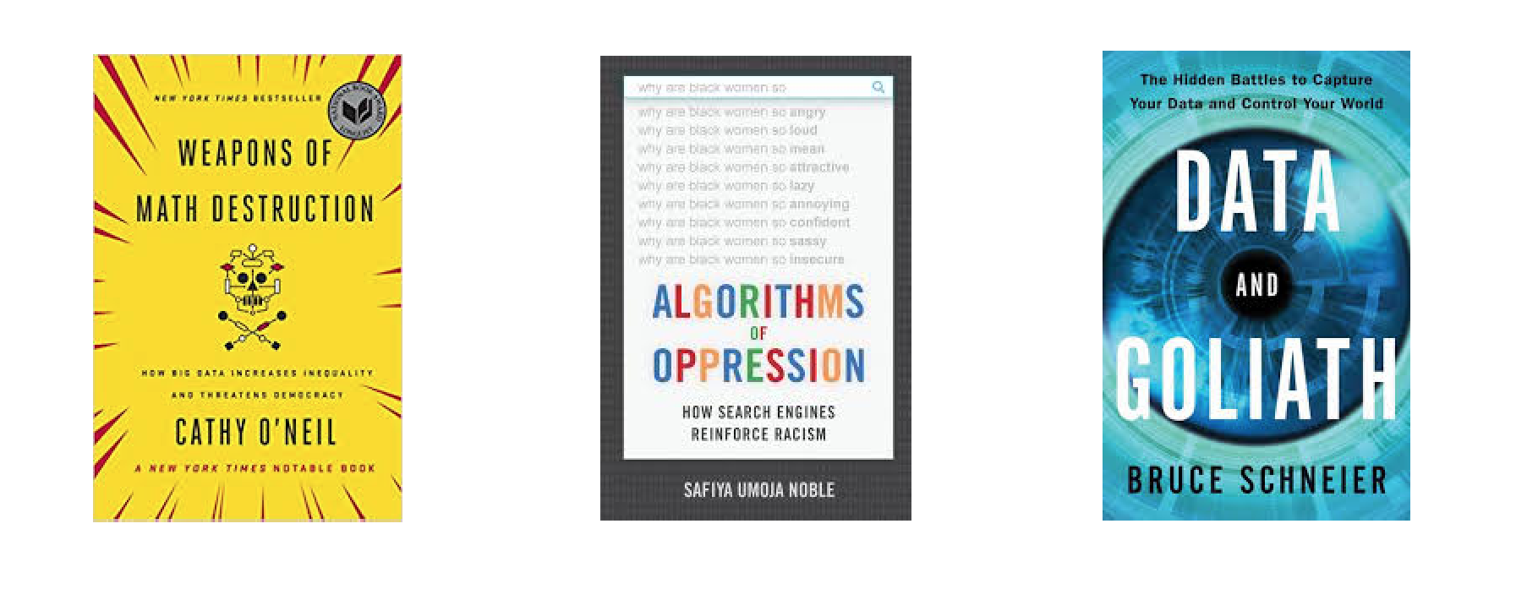

Slide 3
Ethical Algorithms?

Slide 4
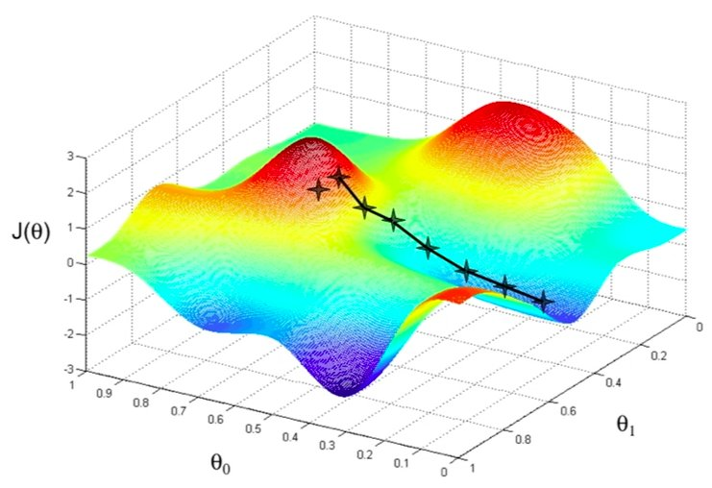
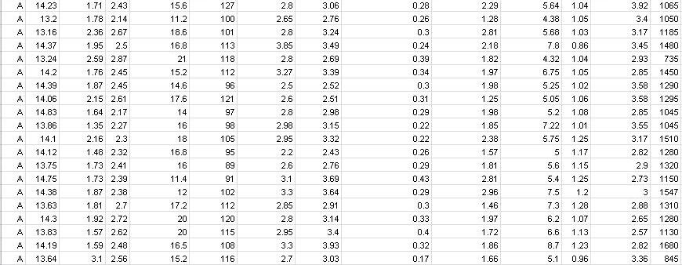
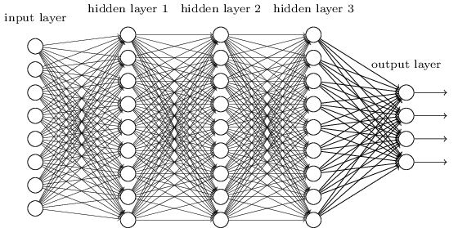
Algorithms:
Hard to Predict Outcomes

Slide 5
Need to Embed Social Values
in Algorithms
Requires being precise about definitions, developing their consequences.
Privacy
Fairness
Accountability
Interpretability
Morality

Slide 6
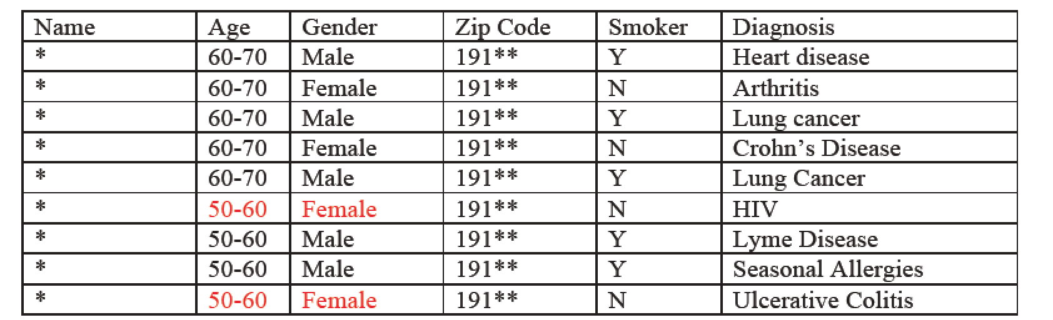
“Anonymized Data Isn’t”

Slide 7
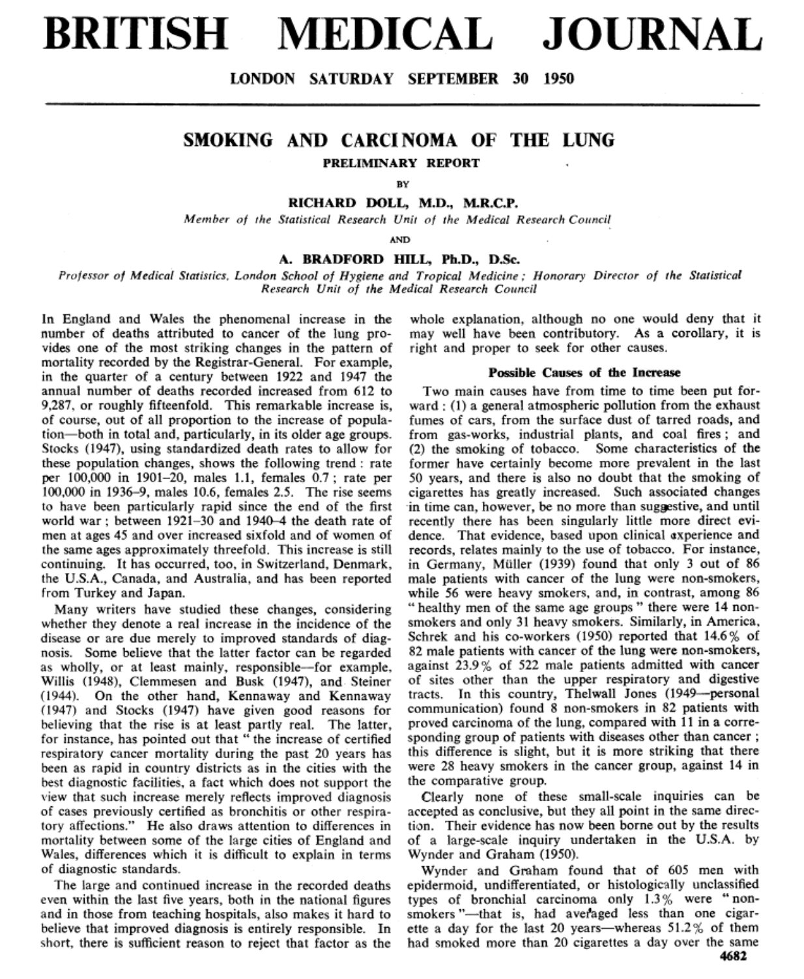

Slide 8
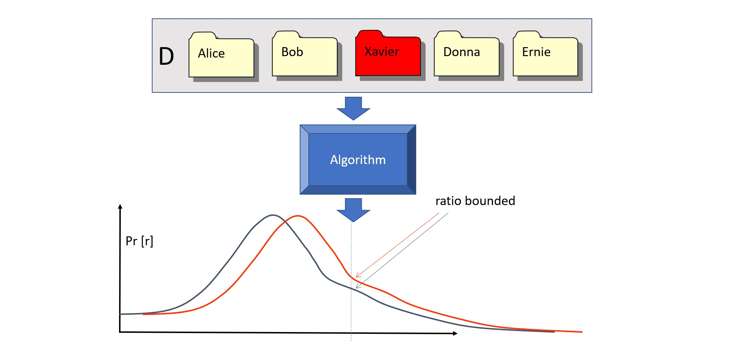
Differential Privacy

Slide 9
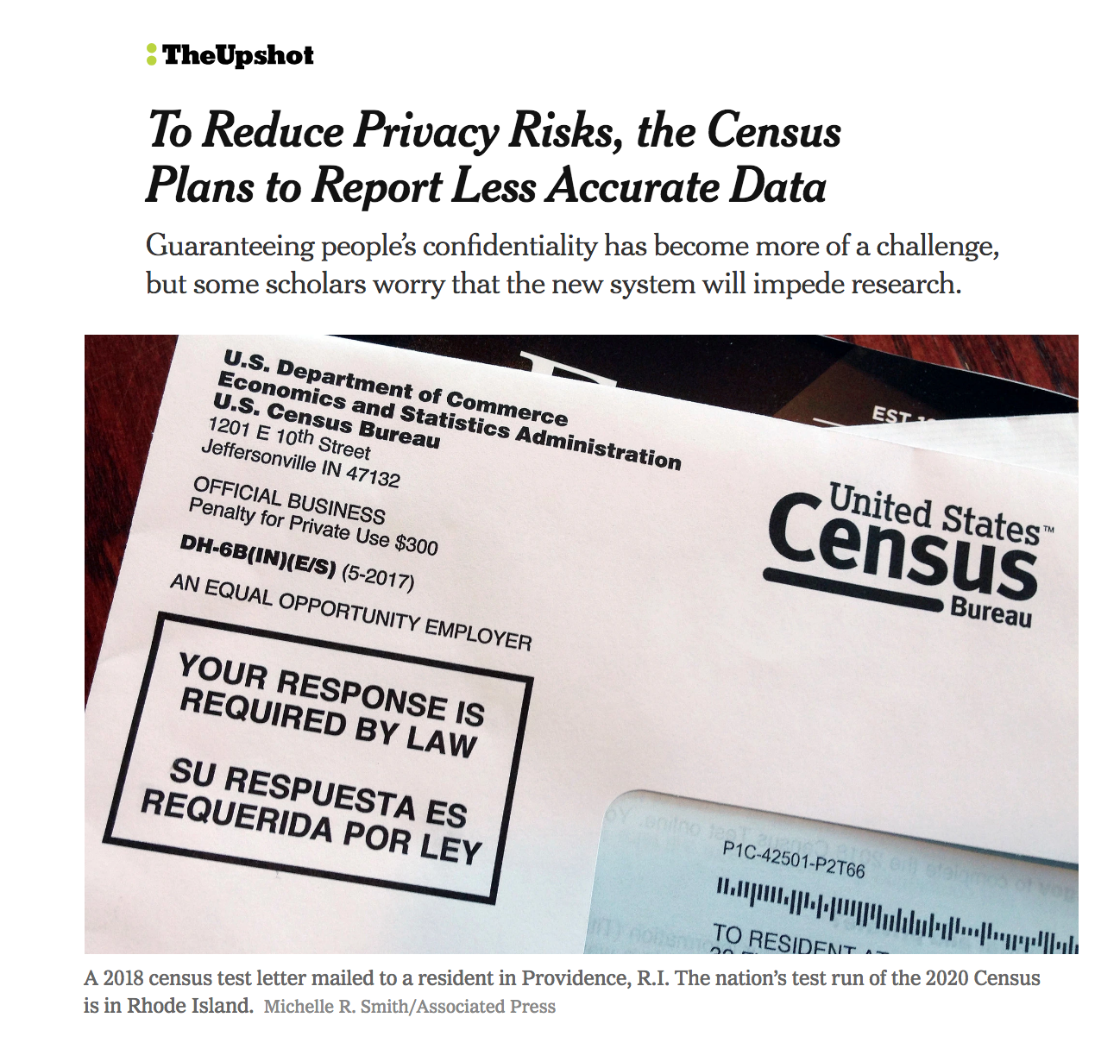

Slide 10
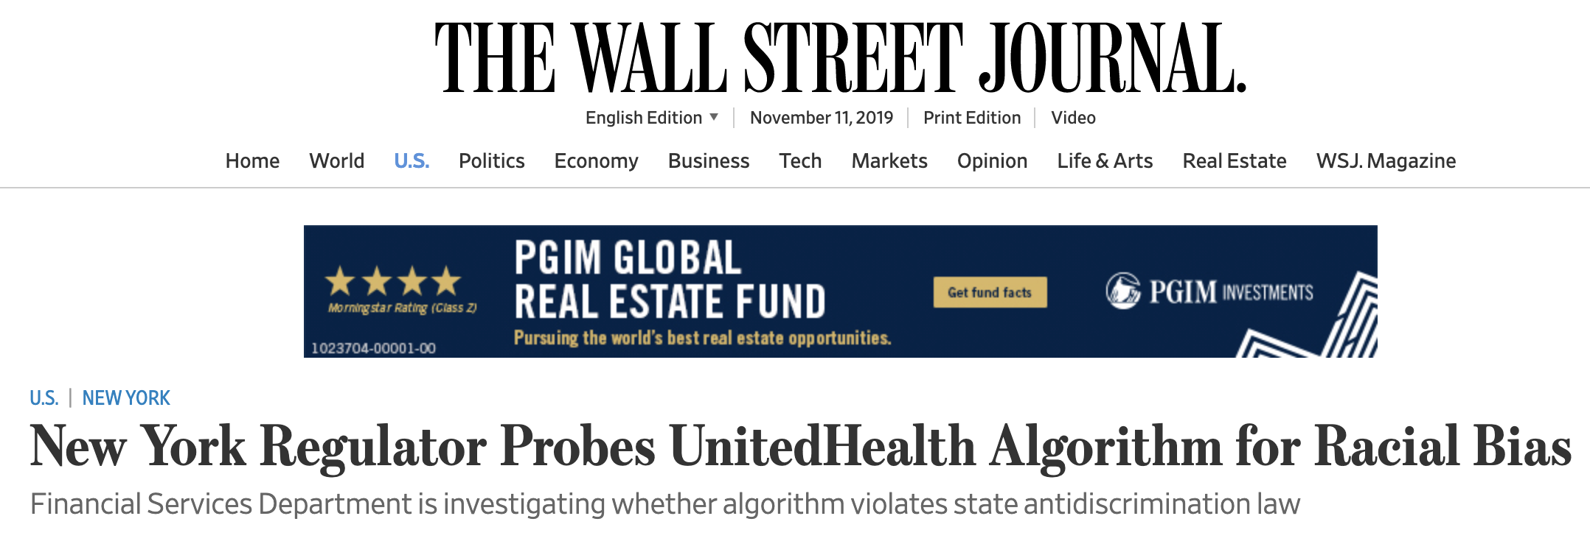
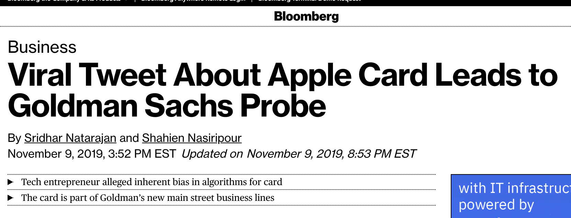
Fairness: A Work in Progress
Don’t agree on the definitions.
Only beginning to understand tradeoffs between different kinds of fairness, and between fairness and accuracy.
Why might machine learning be “unfair”?

Slide 11
SAT Score
GPA
Population 1
Population 2

Slide 12
SAT Score
GPA
Population 1
Population 2

Slide 13
SAT Score
Upshot 1: Optimizing for average error fits the majority population.
Upshot 2: Can obtain Pareto improvements by using group membership.
GPA
Population 1
Population 2

Slide 14
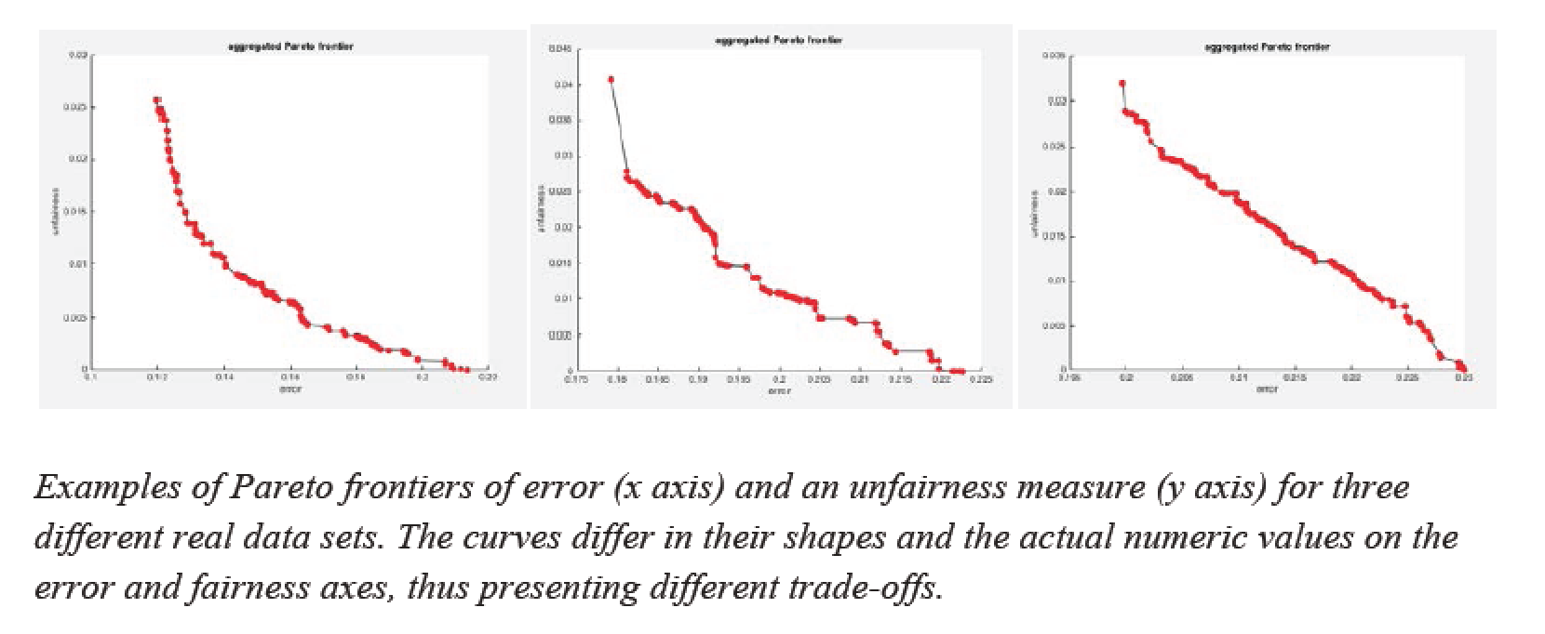
Efficient Frontiers

Slide 15
Other Topics
Games People Play (with Algorithms)
Games Scientists Play (with Data)
Interpretability, Accountability, Morality…. The Singularity

Slide 16
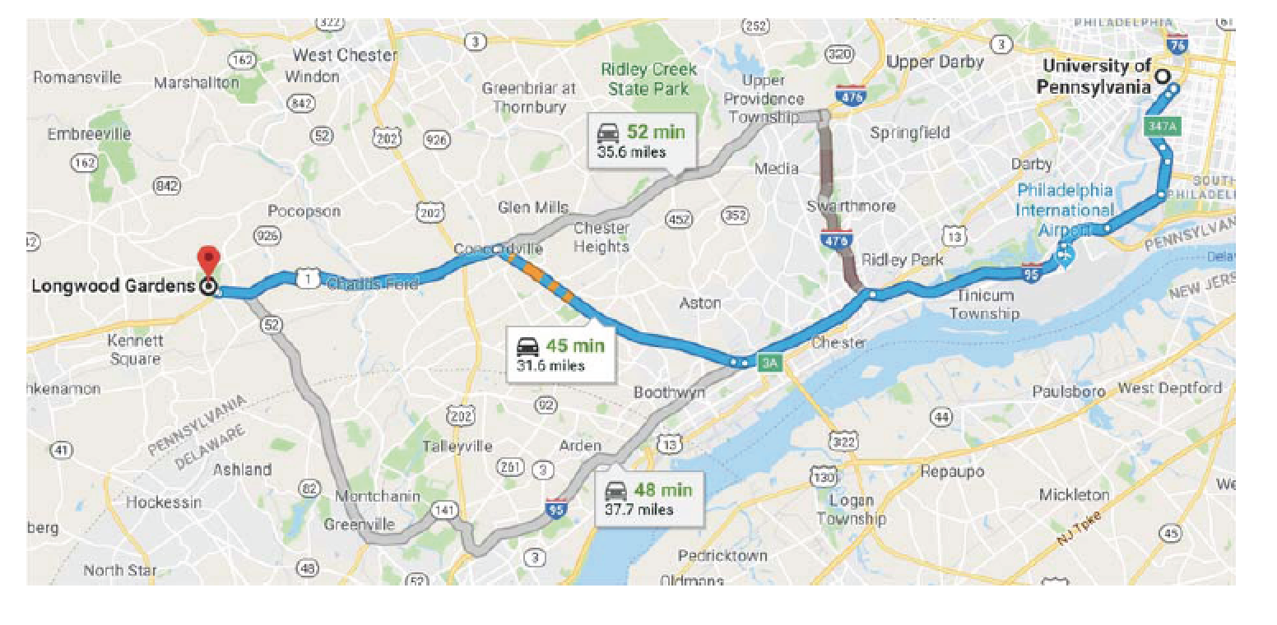
The Commuting Game

Slide 18
Google Nyc
November 18, 2019

