Slide 1
Beyond the Frontier:
Algorithm Design for Fair Machine Learning
Michael Kearns
University of Pennsylvania
Columbia University
March 9, 2022

Slide 2
(The Many) Types of Fairness Definitions
Group Fairness
Equality of error or FP/FN rates across gender, racial groups, etc.
Strong theory and algorithms, practical implementations
But no guarantees to individuals
Conflicts between definitions [Kleinberg Mullainathan Raghavan 2016]
Individual Fairness
Bind at the individual level
Metric fairness (“Fairness Through Awareness”) [Dwork et al. 2011]
Meritocratic fairness [Joseph et al. 2016]
But strong (non-statistical) assumptions have prevented practical implementations
Causal notions, fair representations,…
What about interpolations between group and individual?

Slide 3
Points of Enforcement
Pre-Processing
Debiasing/balancing/reweighting training data
Procuring more/better data
Adding new features
Post-Processing
E.g. “bolt on” randomized classifiers [Hardt Price Srebro 2016]
In-Processing
Retraining
Fairness regularizers
Constrained optimization
To the “left” and “right”

Slide 4
Fairness As Constrained Optimization
Goal: minimize training error subject to fairness constraints
Pass to equivalent two-player, zero-sum game via LP duality
Players are Learner (minimize error) and Regulator (enforce fairness)
Learner’s strategy at Nash equilibrium is optimal solution to constrained optimization
May require mixed strategies over large/infinite action spaces!
But if:
Players play iteratively for T steps
One of the players plays best response and the other plays no-regret
Then Learner’s mixed strategy is T-sparse and 1/$\sqrt{T}$-optimal [Freund Schapire 1996]
(Amazing)
Group fairness settings:
If only a small number of fairness constraints, can make Regulator no-regret
And Learner’s best response is itself a standard classification problem
The “oracle-efficient” approach [Agarwal et al. 2018]
Despite worst-case intractability of ML, results in practical algorithms

Slide 5
An Example
Population subgroups 1,…k
Fairness constraints: for all group pairs i,j |error(f,i) – error(f,j)| <= γ
Learner plays model f in F, Regulator distribution over <i,j> pairs
Payoff to Regulator = -Payoff to Learner = error(f) + E[max(0, |error(f,i) – error(f,j)| - γ)]
Expectation over Regulator’s mixed strategy
Varying γ traces Pareto frontier of error vs. unfairness within F (inherent)
Fairness generalization follows standard theory (subject to group sizes)

Slide 6
Applications
Preventing Fairness Gerrymandering
Subjective Fairness Elicitation
Average Individual Fairness
Minimax Group Fairness
Lexicographic Group Fairness
Multiaccurate Proxies for Downstream Fairness

Slide 7
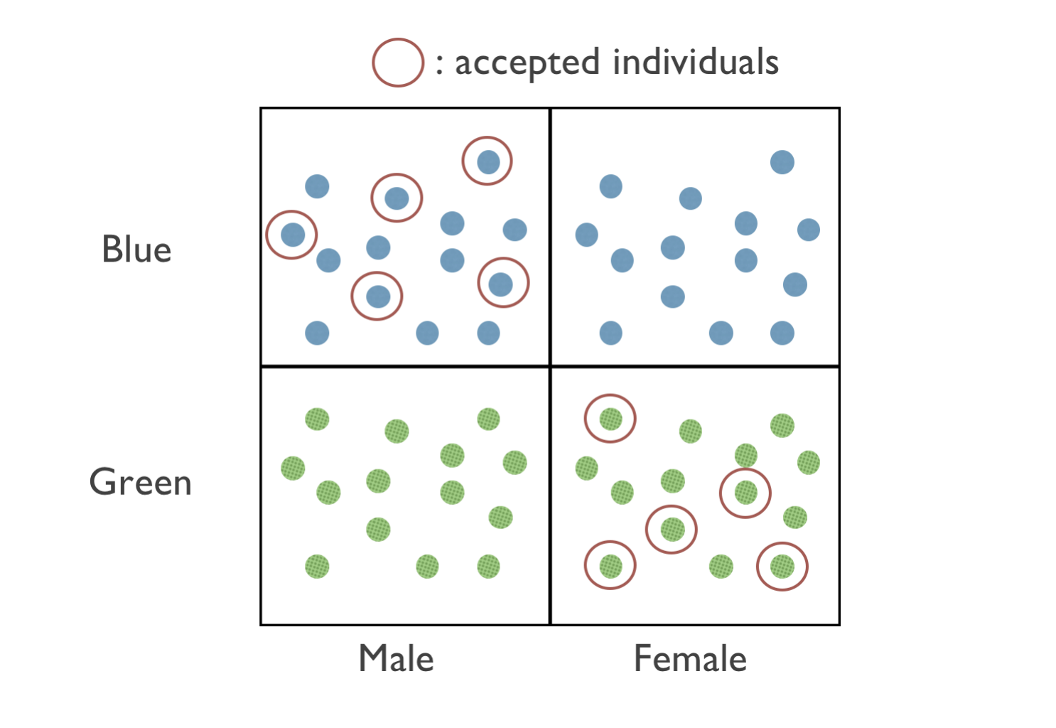
Fairness Gerrymandering

Slide 8
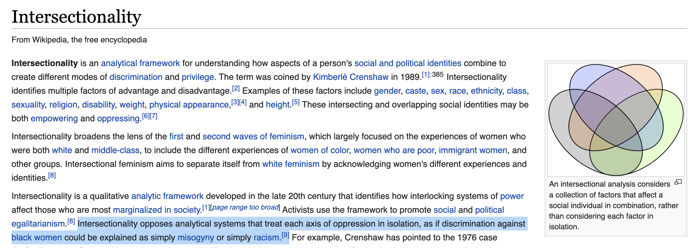

Slide 9
Interpolating Between Groups and Individuals
Problem: achieving group fairness by subgroup discrimination
E.g. disabled Hispanic women over age 55 earning less than $25K
N.B. Facebook hate speech policy
No reason to expect it won’t happen under standard fairness notions
Now both Learner and Regulator have large/infinite action spaces
But can make Learner no-regret, Regulator best response, both reduce to standard ML problems
But cannot generally protect arbitrarily refined/small subgroups (e.g. individuals)
Fairness constraints depend on group size
Or enforce for all sufficiently large groups

Slide 10
Error-Unfairness Dynamics

Slide 11
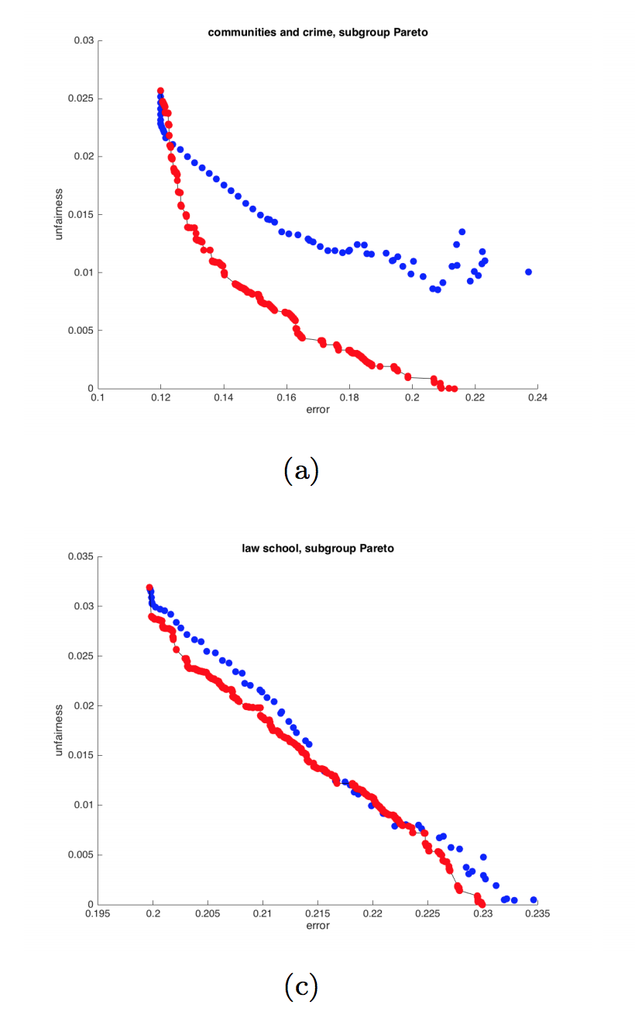
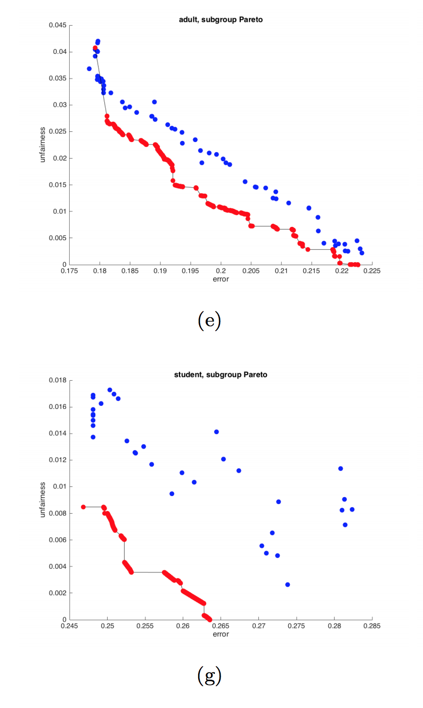
Pareto Frontiers

Slide 12
Subjective Individual Fairness
What if fairness is subjective and complex?
Elicit pairwise fairness constraints from subjects/stakeholders/committee
“A and B should receive same outcome”
“A should receive at least as good an outcome as B”
A distributional form of individual fairness
Elicited pairs form fairness constraint; same algorithmic framework

Slide 13
Fairness Elicitation

Slide 14
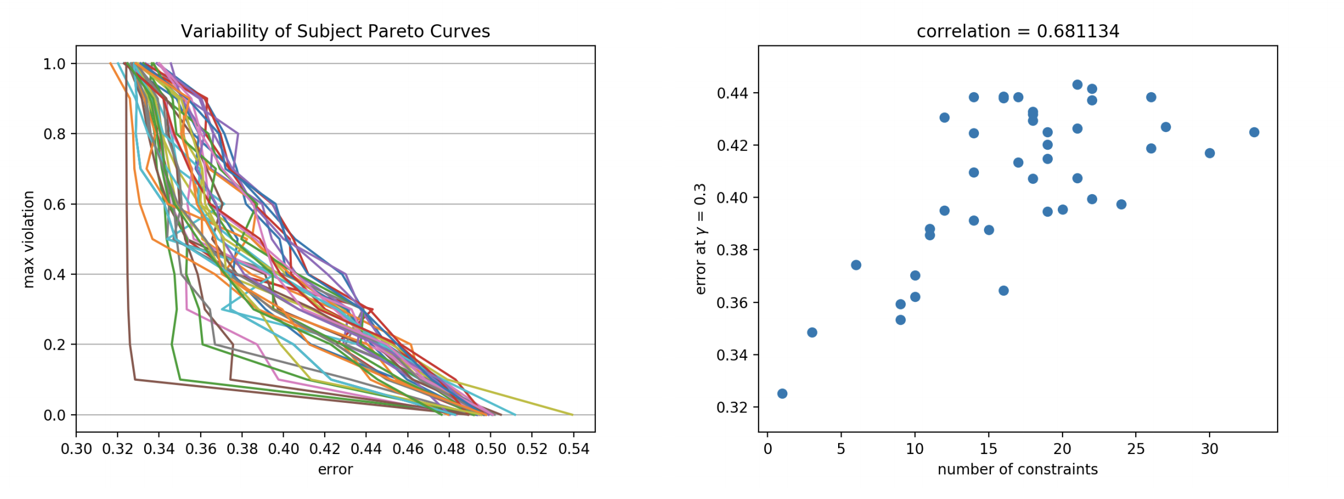
Interpersonal Variability

Slide 15
AI Activism and Bias Bounties
Hard for even vigilant ML orgs to defend everything
Public/commercial APIs enable external audits
e.g. Gender Shades [Buolamwini Gebru 2018]
May identify new subgroup and dataset discriminations
Dynamic is generally adversarial (“gotcha”)
What about making it more productive, as with bug bounties?

Slide 16
The Blurry Pictures Problem
Idea #1: Ask bias hunters to find group g on which current model f underperforms
Problem: What if improvement on g is simply not possible?
Idea #2: Ask hunters to find groups g and classifier h such that error(h,g) < error(f,g)
Find subgroups on which improvement is possible

Slide 17
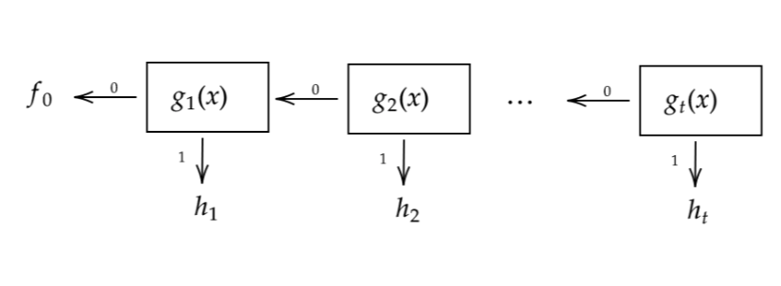
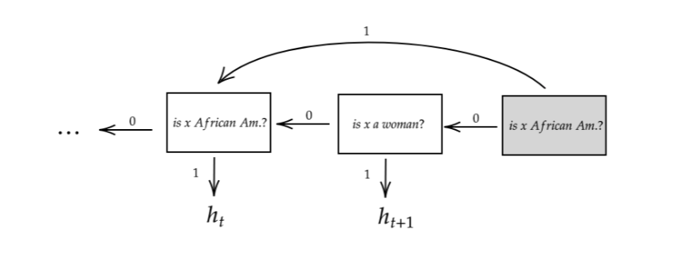
Breaking the Frontier: A Simple Algorithm
New model f’: “If g(x) = 1, use h(x); else use f(x)”
If w = mass/weight of g and d = error(f,g) – error(h,g) > 0 then:
error(f’,g) = error(h,g) < error(f,g)
error(f’) = error(f) - wd
Inductively build a decision list of <g,h> pairs found by hunters
Allow g and h of arbitrary complexity
Control overfitting via techniques from adaptive data analysis/differential privacy:
Only accept improvements with wd >= α → at most 1/α accepts
If <g,h> rejected, provide no further information
By adding back-pointers/”repairs”, monotonic improvement of overall and all subgroup errors
No predetermined model class F → sidestep Pareto!
Ends in one of three ways:
Model with (near) zero error
(Near) Bayes optimal model (minimax group fairness)
Crowd can’t find any improvements
Purely algorithmic versions [Tosh Hsu 2021]
(G,H)-Bayes optimality

Slide 18
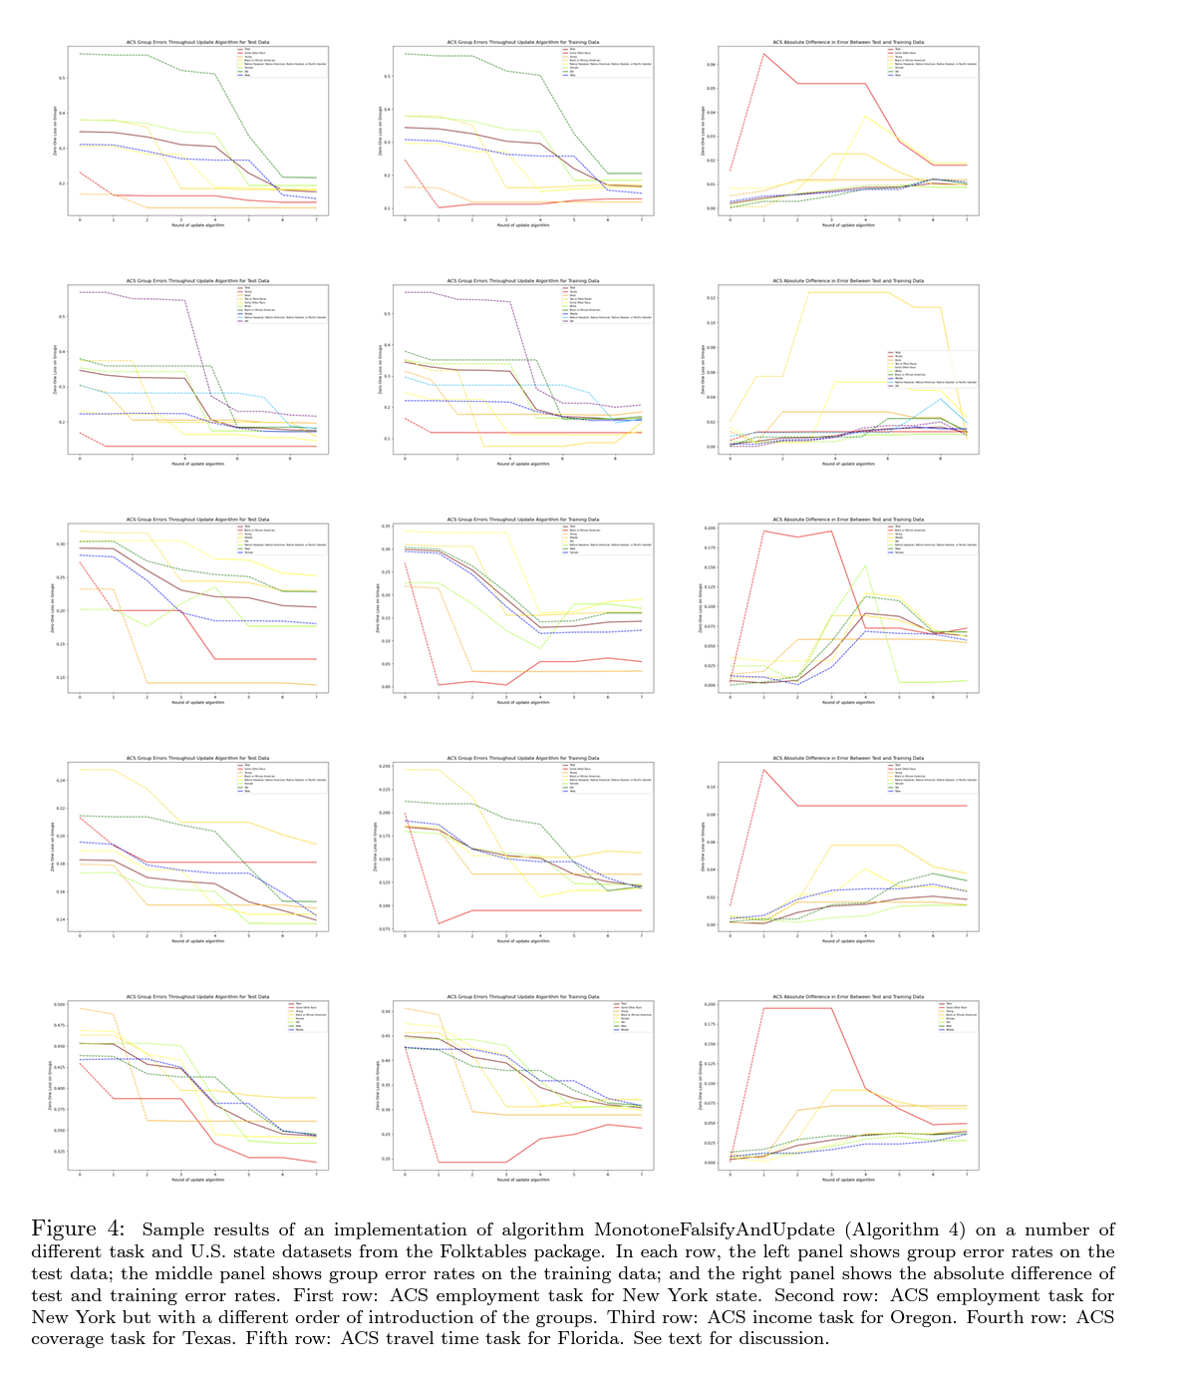

Slide 19
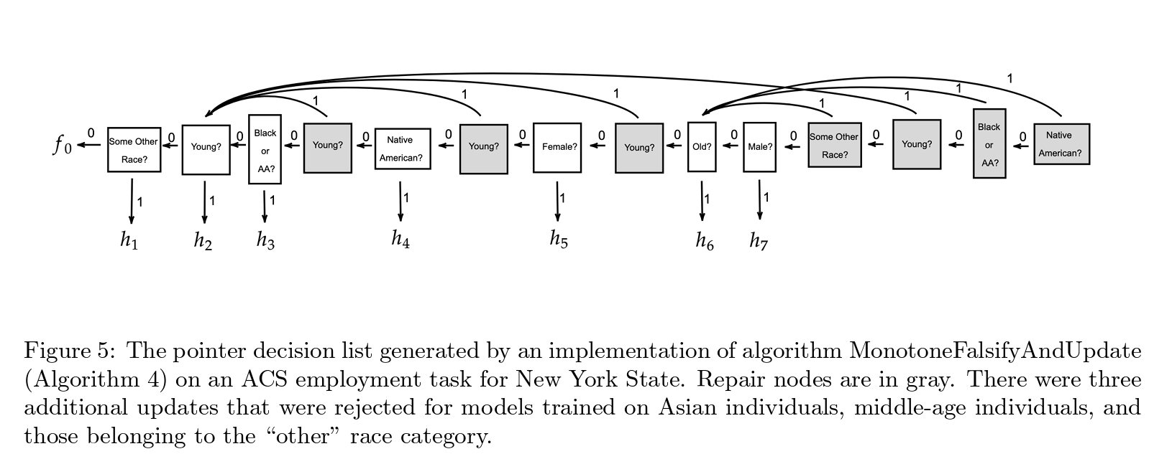

Slide 20
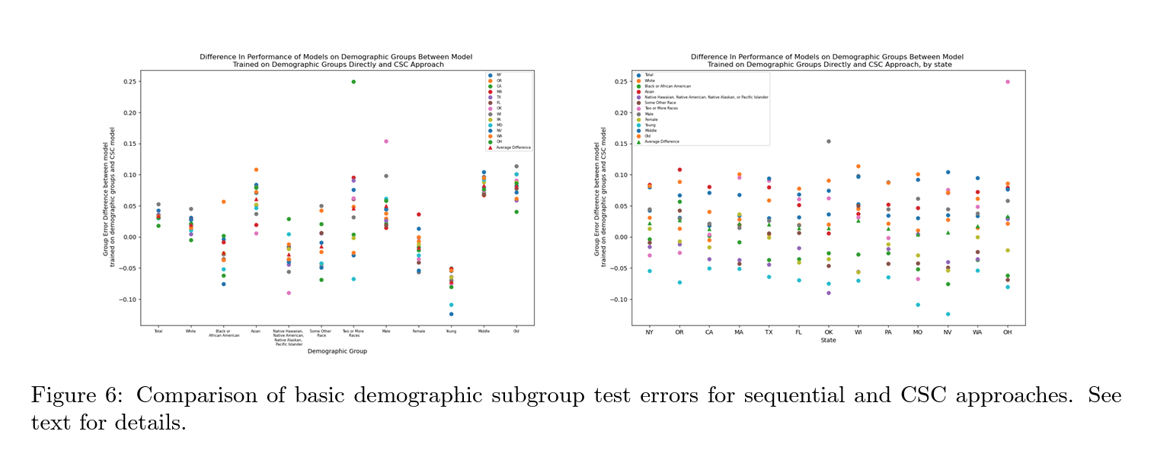
Algorithmically Discovered Pairs

Slide 21
A Communal Experiment
Penn undergraduate class on Ethical Algorithm Design
84 students on 34 teams; divided into two different ACS Folktables datasets/tasks
Working in separate/independent notebooks
Allow any approach to finding improving (g,h)
Post-hoc competition(s):
for every accepted (g,h) in model f1 and every other model f2, try to update f2 with (g,h)
if accepted f1 wins one point; else f2 wins one point
your accepted (g,h) are both your offense and your defense
create communal model f from union of all accepted (g,h)
is it better than all the individual models?
can attribute any correct classification f(x) = y to the (g,h) pair that x reaches

Slide 22
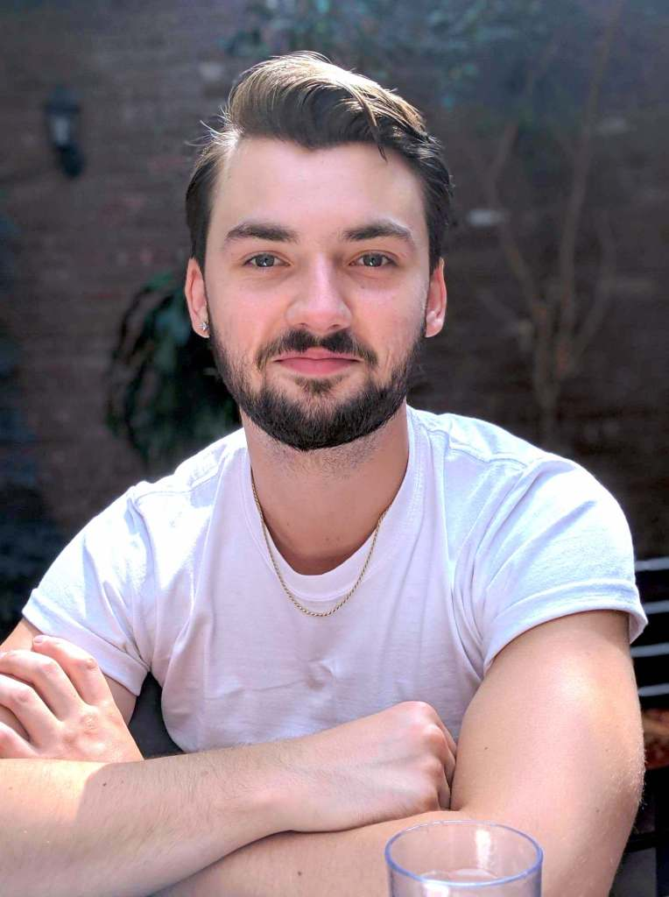
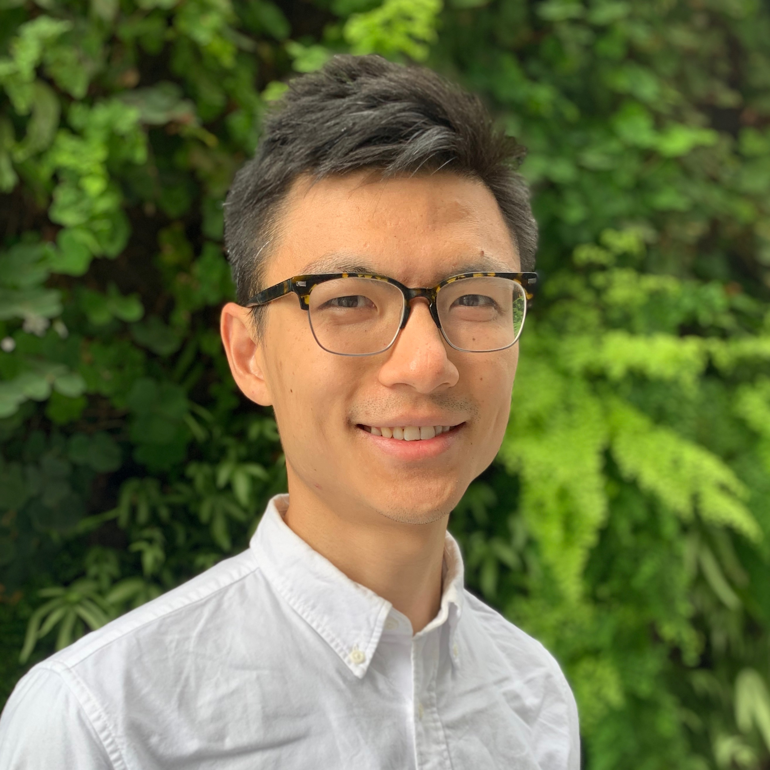
Esteemed Collaborators
Aaron Roth
Ira
Globus-Harris
Chris Jung
Seth
Neel
Logan Stapleton
Steven Wu

Slide 23
Thanks!

