Slide 1

RF-Based 3D Skeletons
Mingmin Zhao
Yonglong Tian Hang Zhao Mohammad Alsheikh Tianhong Li
Rumen Hristov Zachary Kabelac Dina Katabi Antonio Torralba
Notes:
Hello everyone. I am Mingmin.
Today I will be telling you about how we can see human skeletons through wall by just using RF signals.
This is joint work with my colleagues from MIT.

Slide 2
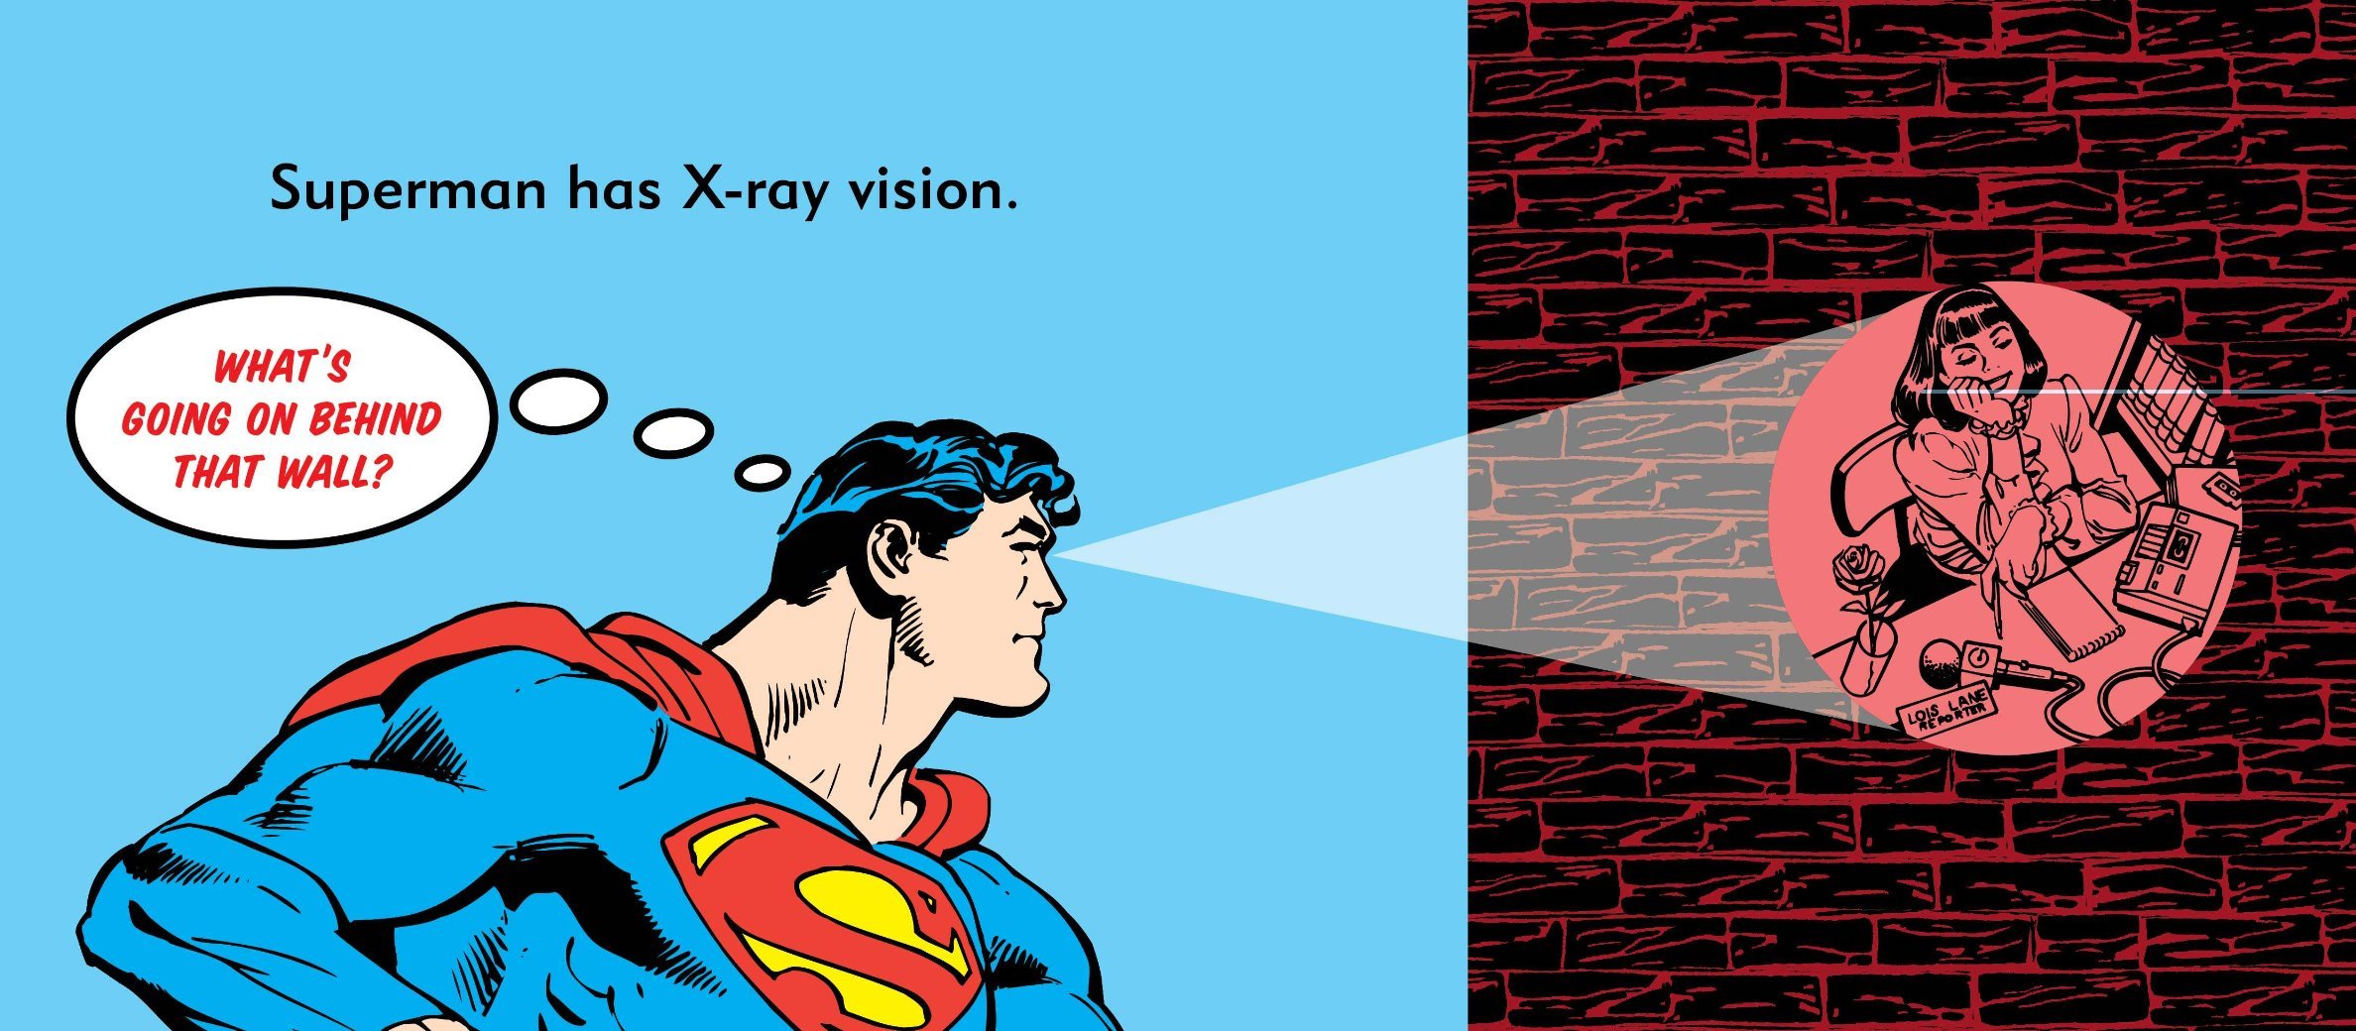
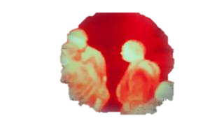
X-Ray Vision
Notes:
I am sure many of you have read about superman when you were kids. And I particularly was so found of superman when I was a kid. There were so many days when I was staring at the wall trying to see if it’s possible to focus on it and start seeing behind it.
Of course I didn’t succeed. But I hope by the end of the talk today, superman would either be proud of me or jealous of me.

Slide 3
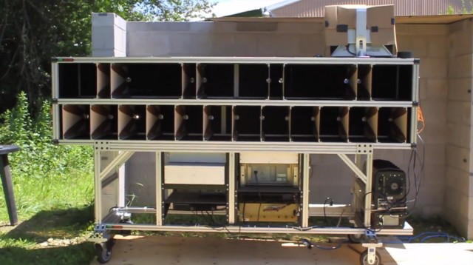
Past Work
DARPA see-through- wall (mid 2000)
MIT Lincoln Lab
(2011)
Notes:
Many scientists have also been looking at x-ray vision and trying to develop a device that can see through walls.
In particular, about 15 years ago, DARPA has funded a project to try to see through walls. The resulting device can sense whether there is a person moving behind the wall.
Then later around 2011, there was another big jump from Lincoln lab and they created a device that can further localize people behind a wall.
However, as you can see, this device is so huge that they have to move it around on a truck.

Slide 4
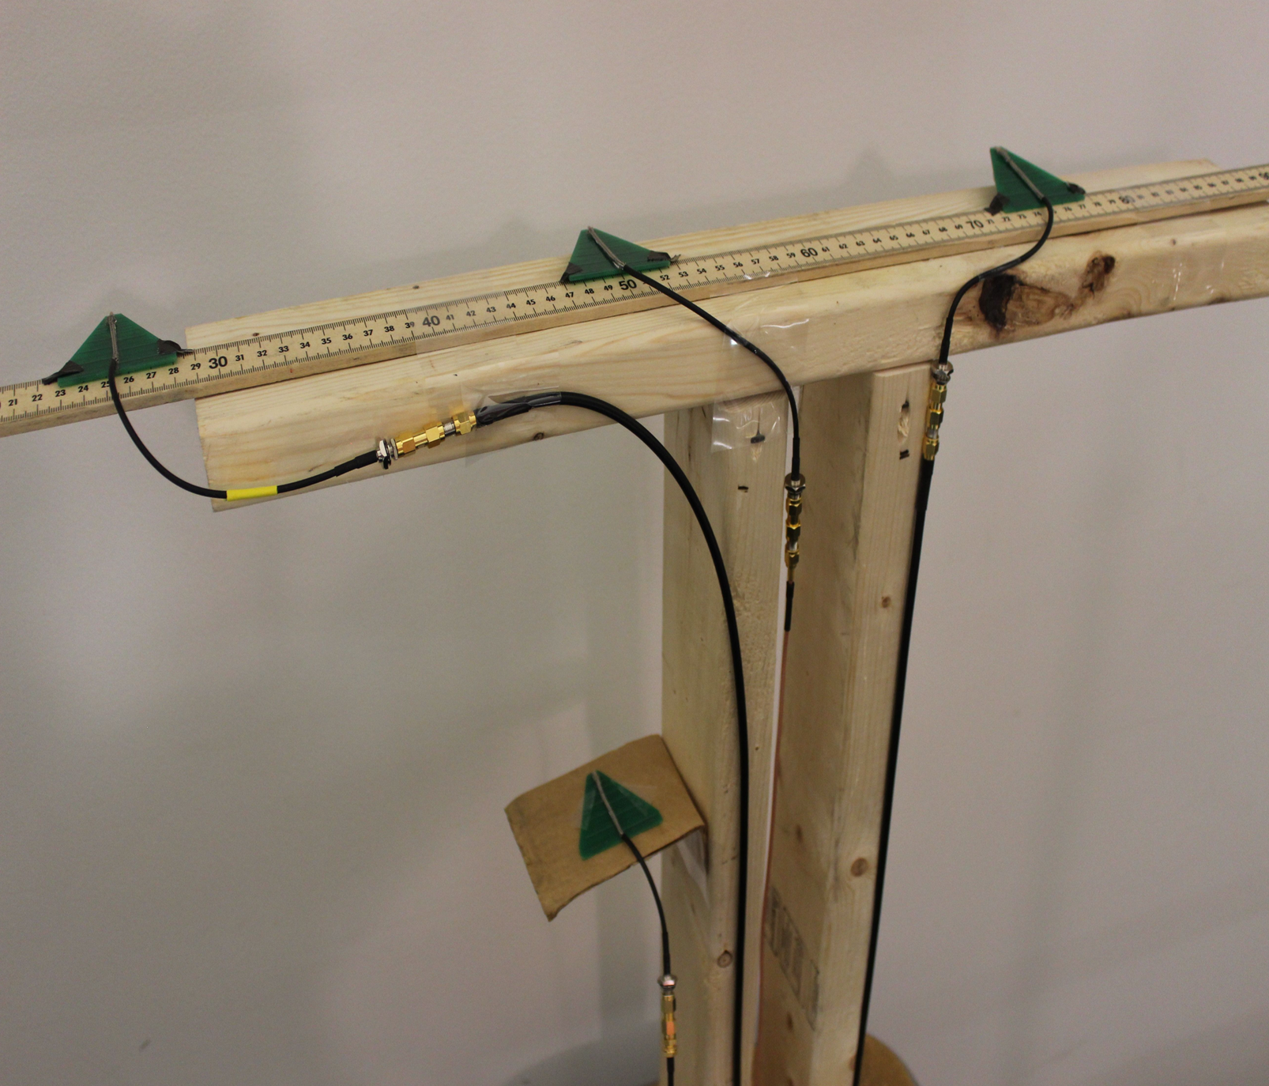
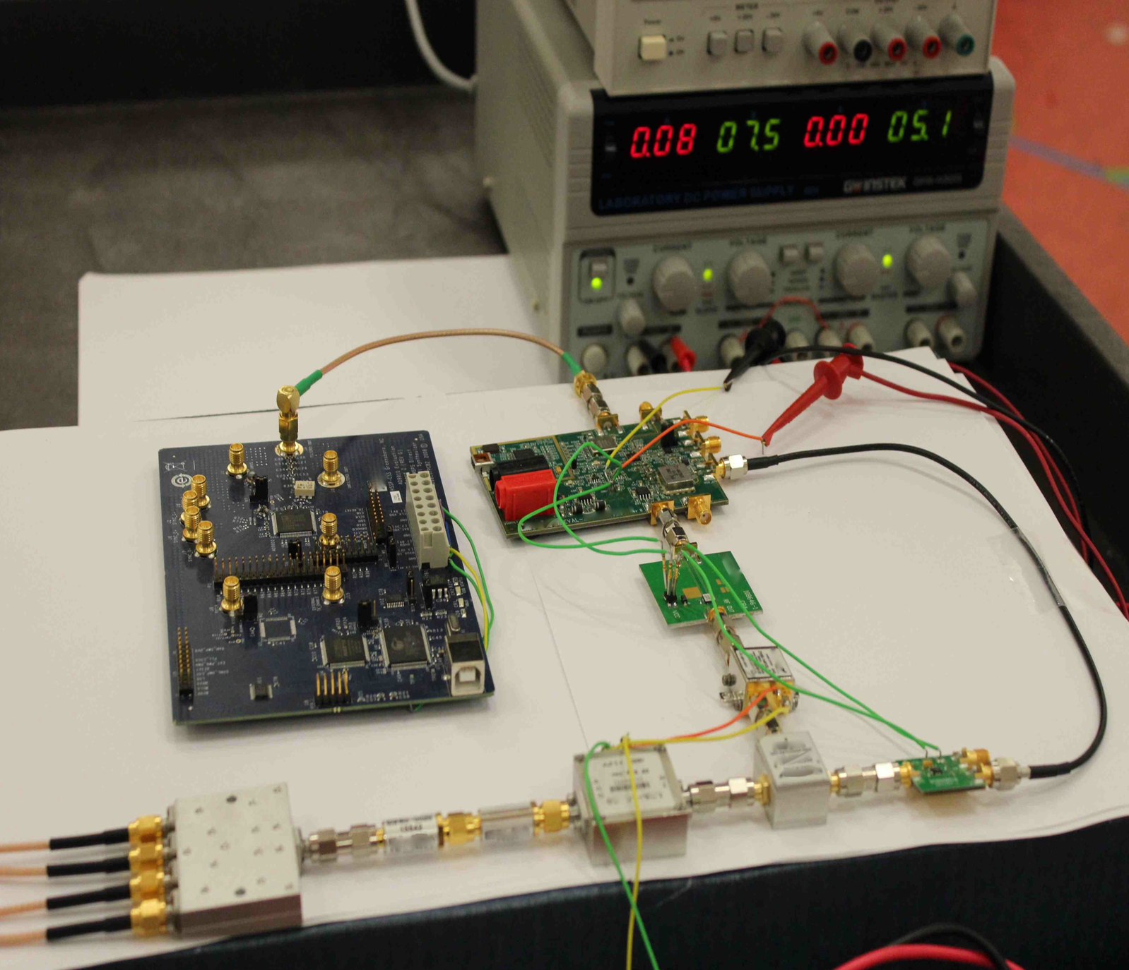
Past Work
Wi-Vi from MIT
(2013)
Notes:
Later in 2013 and actually at SIGCOMM, we saw a paper presented that was able to use very low power consumer devices to be able to track human motion behind walls, and they can do it with much smaller devices.

Slide 5
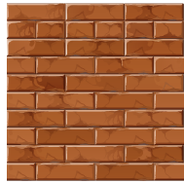

Past Work
?
Notes:
Now let’s just go over how these kind of systems work. The idea at a high level is fairly simple. You have an antenna array x. As we know, wireless signals XXX and they also reflect off XXX. That reflection finally will come back x attenuation.
The job of this device is to use the propagation time of the signal to try to detect the person and track his location. And they give you as the output x. If another.
Of course, this is major advancement in terms of. But this is not really satisfying. Because when I want to x, I want to see the same thing as the super man. I would like also to be able to tell if that person is standing, sitting and how he is moving x. I don’t want to just see a dot.
So the idea that motivated us is can we just go from this dot to an actual human skeleton, a dynamic skeleton that can move with person behind the wall.
I will start by showing you our results and then I will come back and tell you how we get them.

Slide 6
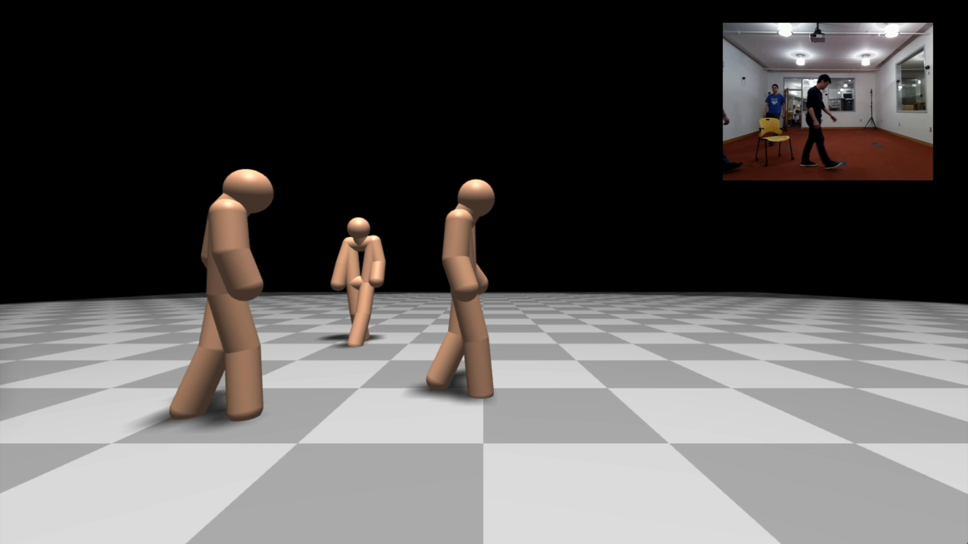
RGB video
(for visualization only)
Notes:
The video I am going to play right now shows the output 3D skeletons from our system. In the corner you will be able to see what is happening in the room from a camera's view.
You can now see how people are moving based on our skeletons and you can tell whether they are sitting or standing. You have an idea of what is going on.

Slide 7
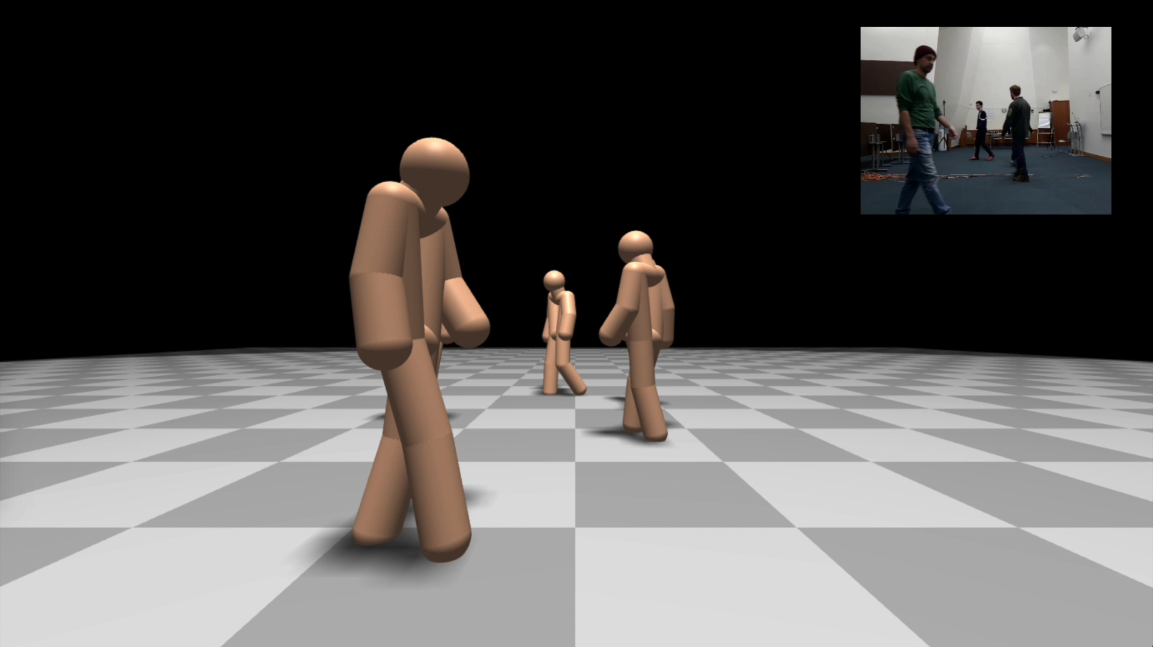
RGB video
(for visualization only)
Notes:
You can have more people and our system still works. You will be able to tell from our skeleton whether they are taking a left step or a right step.
And of course these are all from behind a wall.
NEXT: So now I have showed you our results. But how do we do it? How can we get a dynamic skeleton from RF signals.

Slide 8
How do we do it?
?
Neural Networks!
Notes:
So how do we do it? How can we get a dynamic skeleton from RF signals.
One way to try to solve this problem is to go and model the human body. Model how humans have arms, legs and how those body parts move and how they reflect the RF signals.
I have no idea if that would work. But if you do it that way, it’s gonna be very very
What we did is to use neural networks. NN have recently shown that they are capable of abstracting very complex system and dynamics. Without you telling them exactly the model, they are able to learn the model from examples.
So it’s natural to ask ourselves since we are facing a very complex model, whether a NN could do it.
In the rest of this talk, I am going to tell you the details of our system RF-Pose3D, which as I said is based on NN.

Slide 9
RF-Pose3D
Challenges when using NN to handle RF signals
Design of RF-Pose3D
Evaluation of RF-Pose3D
Notes:
But, you cannot simply use NN with RF signals the same way as you would use them with images or audios. So I am gonna start by telling you the difference and the challenges you face once you start using NN to deal with RF. Then I am gonna tell you how we solve those challenges in order to get our system. Finally I will show you more quantitative evaluation of our system and when it works when it doesn’t.

Slide 10

Problem Statement: Estimate Skeleton from RF
14 body keypoints:
Head
Neck
Shoulders
Elbows
etc.
RF signals
Skeleton
Notes:
Now let’s start. Before getting into the details, it’s very important to make sure that we all understand the problem.
The problem statement is that we are going to take a RF signal and spit out a skeleton.
But does it mean by spitting out a skeleton? It means effectively we are spitting out the exact 3D location of all the keypoints on the human body. A keypoint is something like your head, your neck, you shoulders, your elbows, etc. A skeleton is all of those things as opposed to that single dot you used to have in the old systems.
OK, so now that we understand this problem, why cannot we just throw NNs, which has been very successful in images and audios, to our RF signals?

Slide 11
Specularity of Human Body
Antennas
Notes:
The first challenge is something we call the specularity of the human body wrt RF signal. Let me explain this with a simple example.
Say that you have a antenna array and a simple reflector as you see here. When you transmit RF signals, they are going to shine on the reflector.
The part of the signal that falls along the normal to the surface will reflect back toward the device.
However, if the signal falls onto a different part that is further away from the normal, the reflection will deflect away from the device.
Effectively, this means that antennas array is only getting reflection from a small portion on the surface. It’s not seeing whole reflector but just a small part of it.
So what does that mean for the human body as opposed to this simple reflector?

Slide 12
Challenge 1: A Snapshot Doesn’t Have Skeleton
Antennas
Notes:
Let’s look another example with human body. Again, the signal is shining on the surface of human body but only a mall percent of the that signal reflects toward the device.
In this example, only the signal falls on the left forearm of this person is reflected back toward the device. The rest of the reflection, from the head from the chest for example, is just deflecting away from the device.
So the antenna array is not going to see the whole body but just the forearm.
This is very different from images where a single snapshot of image would capture the whole human body. But here a snapshot of RF captures only a small subset of the body.
NEXT: To solve this challenge, the first idea of the solution is to use human motion across time.

Slide 13

Solution 1: Use Human Motion Across Time
Antennas
Notes:
To solve this challenge, the first idea of the solution is to use human motion across time.
As the human moves, different parts of the body reflect signal back towards the device. In this case for example, his chest is reflecting.
NEXT: Therefore, to be able to capture the whole human skeleton, ...

Slide 14


Solution 1: Use a series of RF snapshots
Time
Time
Neural
Network
Notes:
Therefore, to be able to capture the whole human skeleton, we have to use a series of RF snapshots. Some of them may have arm, some of them may have chest or leg.
But the problem is that those body parts do not below to the same snapshot. Simply stitching them together does not give you a dynamic skeleton that is changing over time.
NEXT: What we want to do is much more complicated than this.

Slide 15
Solution 1: Extracts limbs and fills in missing parts
Time
Time
Neural
Network
Notes:
What we want to do is much more complicated than this.
We want to give multiple snapshots to the NN and teach it not only to generate body parts visible in each particular snapshot, but also to fill up the missing body parts in every snapshot.
With that we can get a full dynamic skeleton.
Are we done? Unfortunately no. Let me tell you the reason. The snapshot I am showing here is actually a simplified version of reality.

Slide 16
4D signals are too large for NN!
RF is a 4D function of space and time
Time
Time
Neural
Network
Notes:
In reality, each RF snapshot is a 3D function of space because typically you are using multiple antennas to capture reflection from different point in the 3D space.
Therefore, when we look at a series of snapshots, we are really looking at a 4D function of both space and time.
The problem is that such 4D RF signal is too large for NN. NN tools nowadays typically deal with 2D images or 3D videos. They don’t naturally scale to 4D inputs. Not to mention all of the time and space complexity you would need to handle during training.
So what should we do?

Slide 17
Solution 1: Neural Network Decomposition
Theorem (informal): An RF-based 4D Neural Networks is equivalent to a combination of two 3D Neural Networks
220x speedup
Notes:
Here is our solution: we decompose the neural network.
Specifically, we model RF signals and systems and prove in the paper that for the RF-based 4D NN we can decompose it to a combination of two 3D NN.
3D NN are similar to what would you use when dealing with videos; they work with standard libraries and run relatively fast.
What this theorem allows us to do is to achieve effectively a 220 times speedup in training our model. A model that would take one year to train now can be trained in less than two days.
NEXT: But for the model to be able to work well, we have to solve the second challenge: which is complexity. Let me explain what I mean by that.

Slide 18






Challenge 2: Complexity
Implications:
Large neural networks
Huge amount of labeled examples
Very hard to train
Extraneous information irrelevant to the skeleton
Different number of people
Notes:
We talked about the RF signals reflecting off human body and this is what we are using to get a skeleton. However, the RF signal not only x, it also reflects off x, the tables, the walls, the chairs, everything. Those reflections would be different from one environment to another. But notice that all these reflections from objects are irrelevant to the problem of interests, which is to discover the human skeleton. So you would want to remove extraneous.
The second thing is that there might be unknown number of people. There are x.
Now you have extraneous information from different environment and you have unknown number of people you need to deal with. If you ask a single NN to do all of these things in addition to learning the skeleton, that’s too much.
That means that NN has to be huge.
And we know that NN already needs a lot of labeled examples to train, but if you ask a single NN to handle all of these things, you just going to need a humongous amount of data.
And the training would be very hard even if you get all these data in the first place. So what would you do?

Slide 19
Solution 2: Task Separation
zooms in on people to remove extraneous information
extracts skeleton
Network2
Network1
Network2
Notes:
Our solution is task separation, instead of asking the NN to do everything at one shot, let’s separate the task and have NNs to do it in two steps.
Let’s first have a NN whose job is simply to zoom in on different people removing everything else. This first NN just need to create boxes center around each person in the space.
Then the second network just need to zoom in on each of these regions and extract a human skeleton.
Interestingly, by zooming in to the regions that have people, our model eliminates all extraneous information in the environment. By presenting the second NN a single region at a time, it just need to extract a single skeleton and doesn’t need to know A and B.
With this task separation, our system becomes much easier to train, to scale, and to generalize.
NEXT: Now I have tell you the design of our NNs. The last thing we need to do is to train the model.

Slide 20


Challenge 3: How to obtain labeled data
annotate skeleton?
annotate skeleton?
Notes:
Now I have tell you the design of our NNs. The last thing we need to do is to train the model.
Usually when you want to train a NN, you need to show it a large amount of labeled examples.
Let’s say you want to extract skeleton from images, how would you train your model?
You can go and show an image to a person and ask him to label skeleton. He can go and say this is the head, this is the neck … It’s annoying but this is possible. In fact, this is how most of the datasets are created.
Now let’s try to do the same thing with RF signal. Imagine I go and ask someone to label skeleton from RF signals, this is not even possible, this person might just go crazy.
So how can we obtain labeled examples for training?

Slide 21
Solution 3: Sync images with RF and annotate images
No Cameras During Testing/Operation
Vision
Model
3D skeletons?
Vision
Model
Multi-view
Geometry
Vision
Model
Notes:
Our idea is to use images to help. We can collect images and RF at the same time and ask people to label images instead of RF signals.
Here is how we gonna do it. We are going to use multiple cameras to capture images from different views. We can then ask human to label skeletons from these images. By solving a geometric optimization problem, we can bring these 2D skeletons from multiple views to the 3D world space. and this gives us a 3D skeleton label for the corresponding RF signals.
What is even better is that we can use start-of-the art vision-based models to replace human. We can uses vision-based NN to extract 2D skeletons from images. Thanks to the recent development in vision, these models work very well, almost as good as human annotators.
So now we don’t even need to annotate a single image at all. This enables us to easily collect a large amount of training data. And of course, those cameras are not needed once our model is trained.

Slide 22
Evaluation
Notes:
Now let me show you the evaluation of our system.

Slide 23
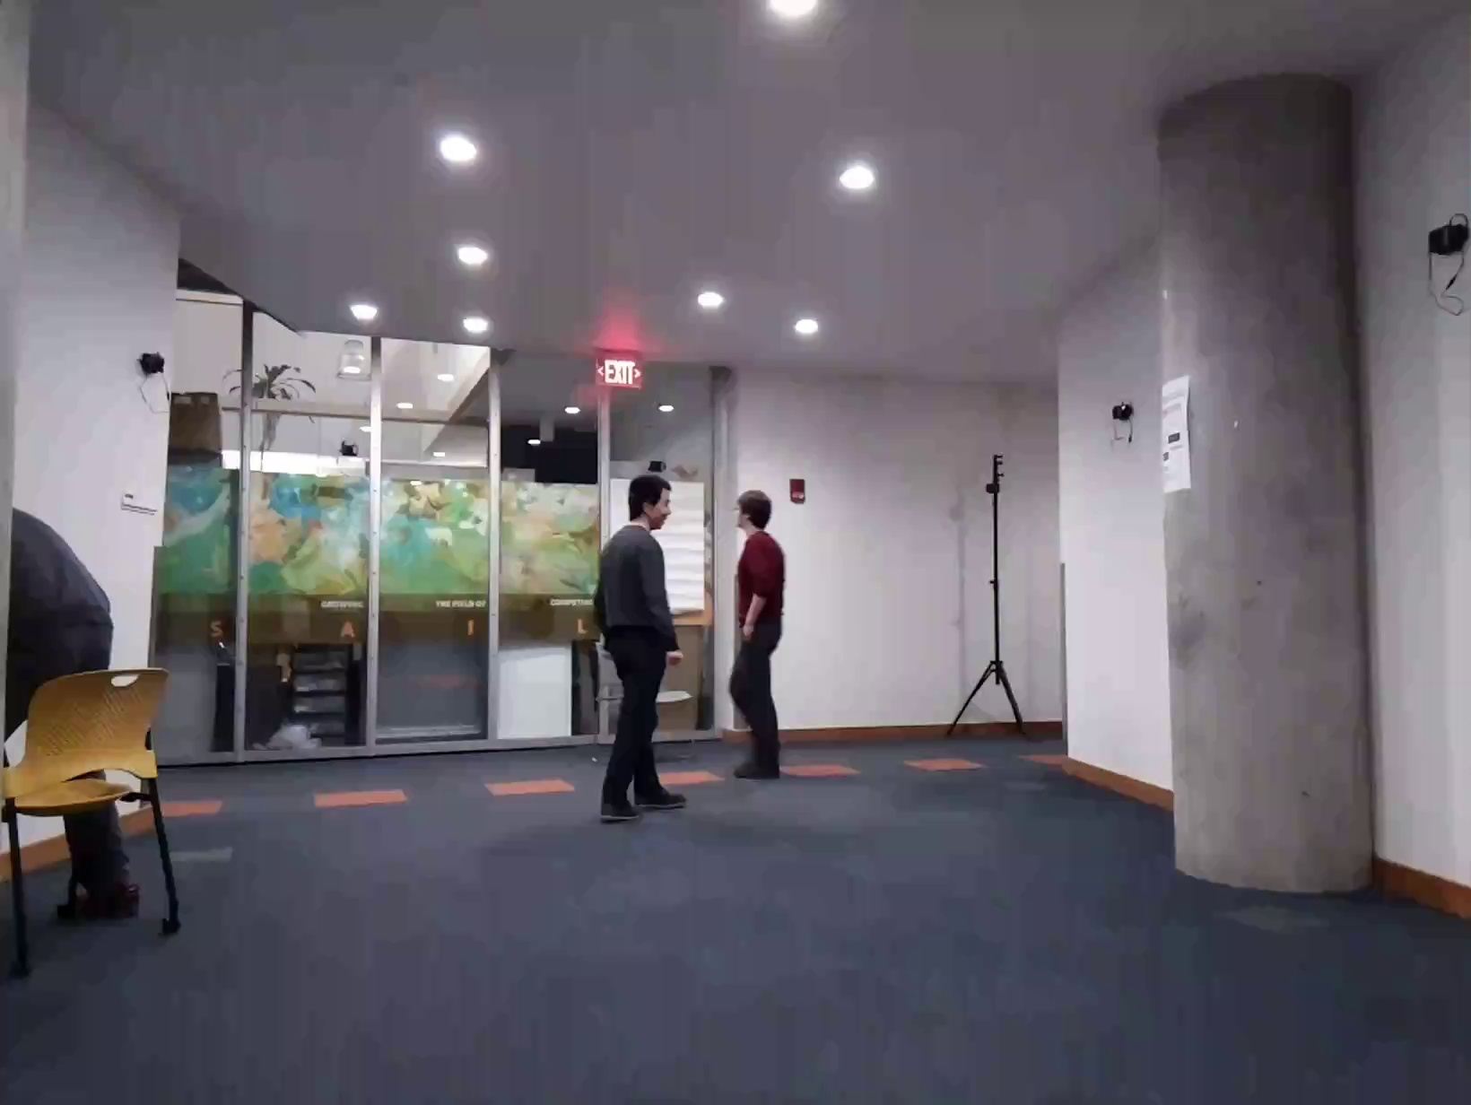
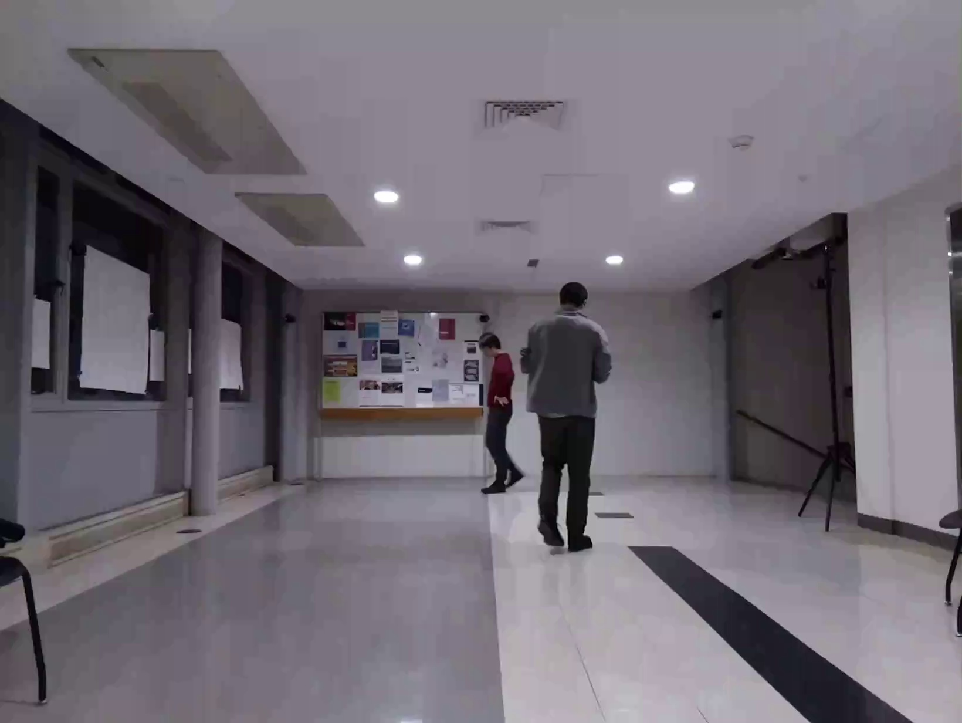
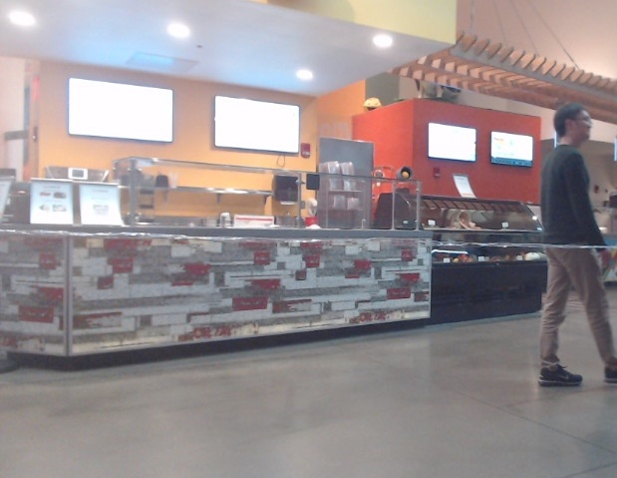
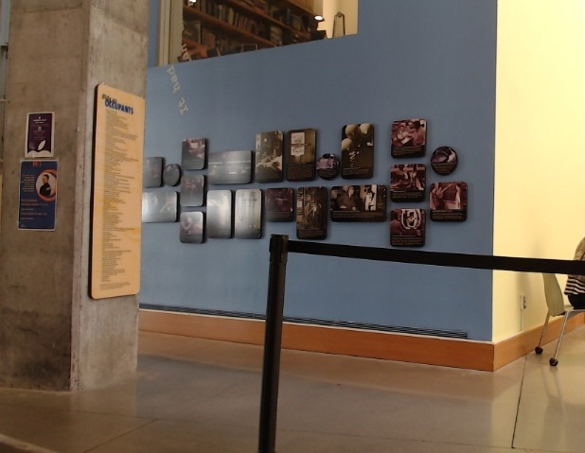
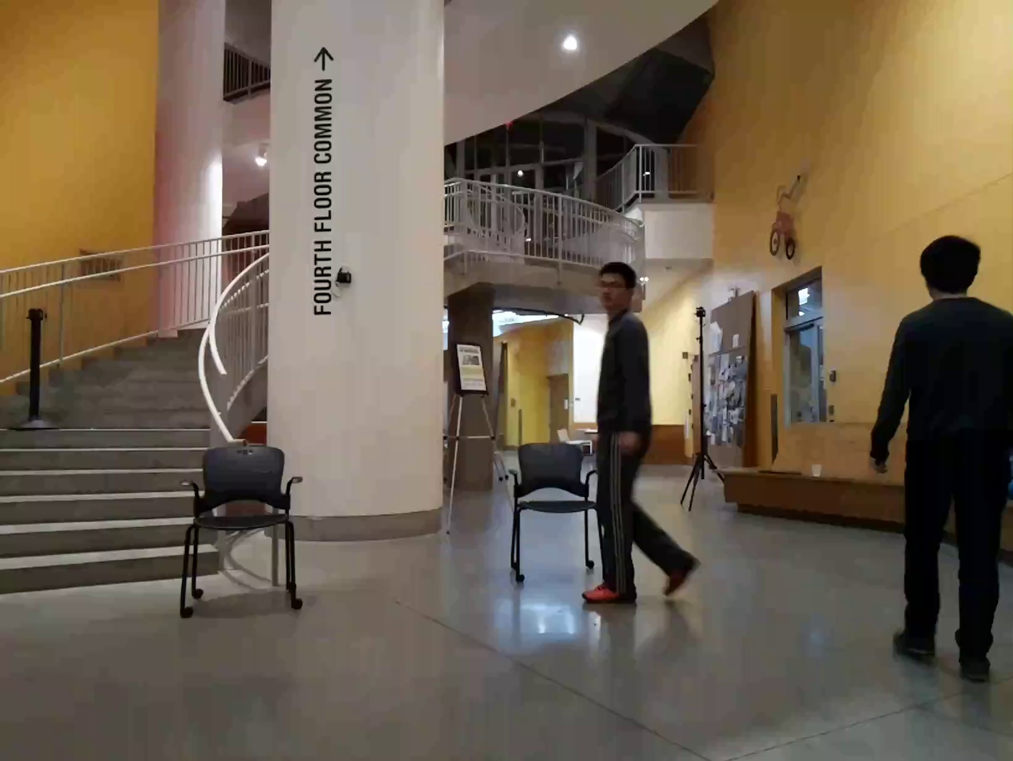
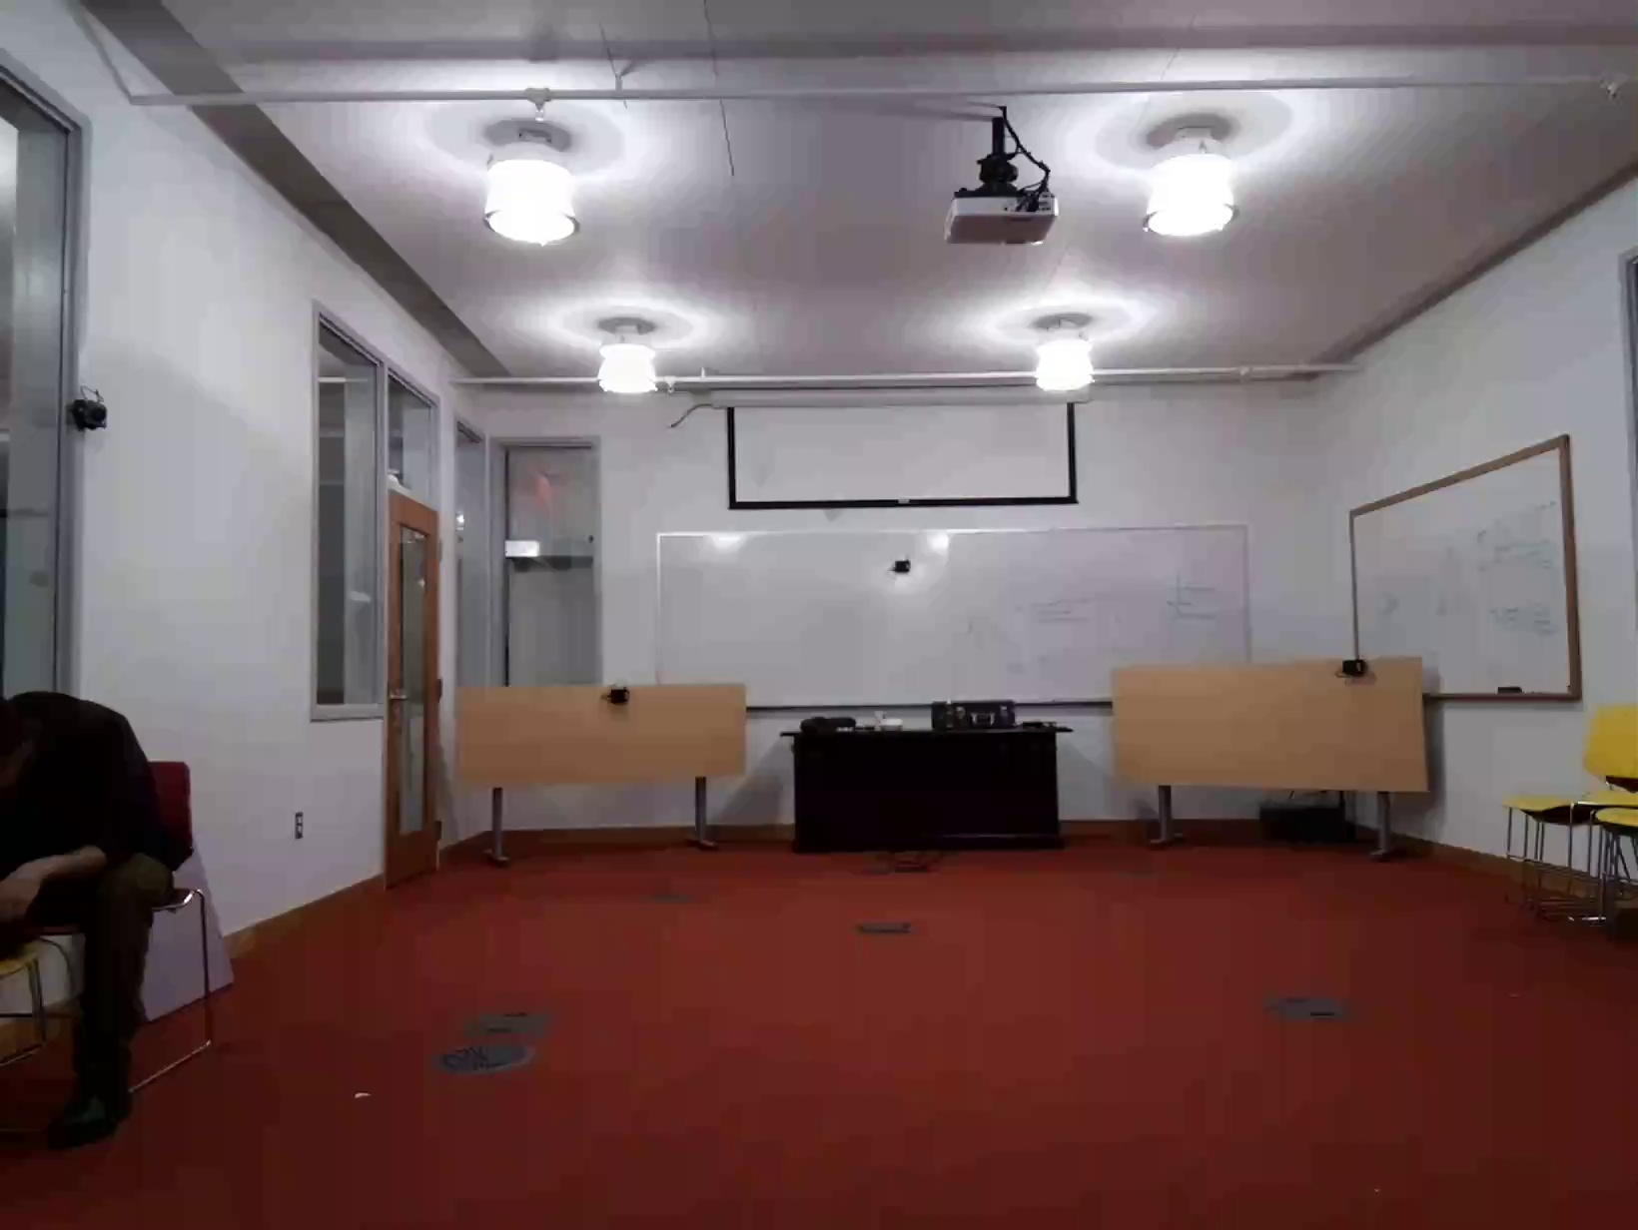
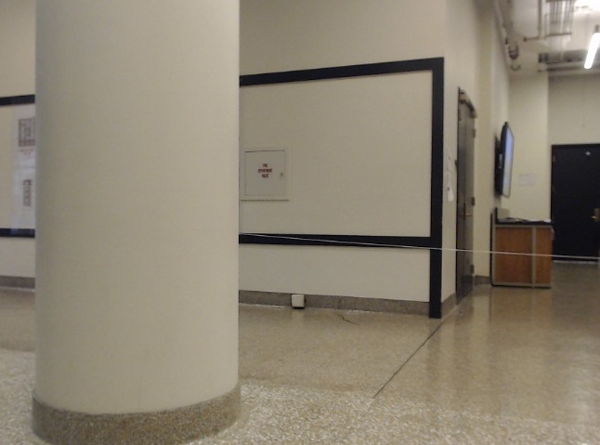
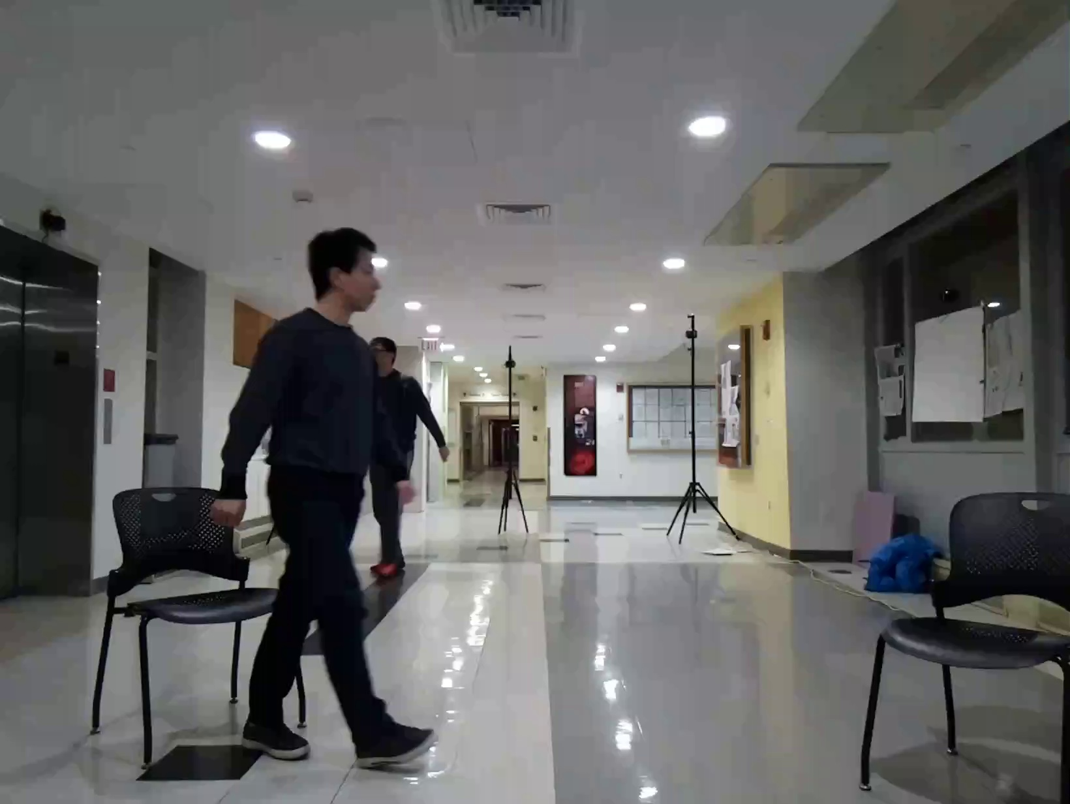
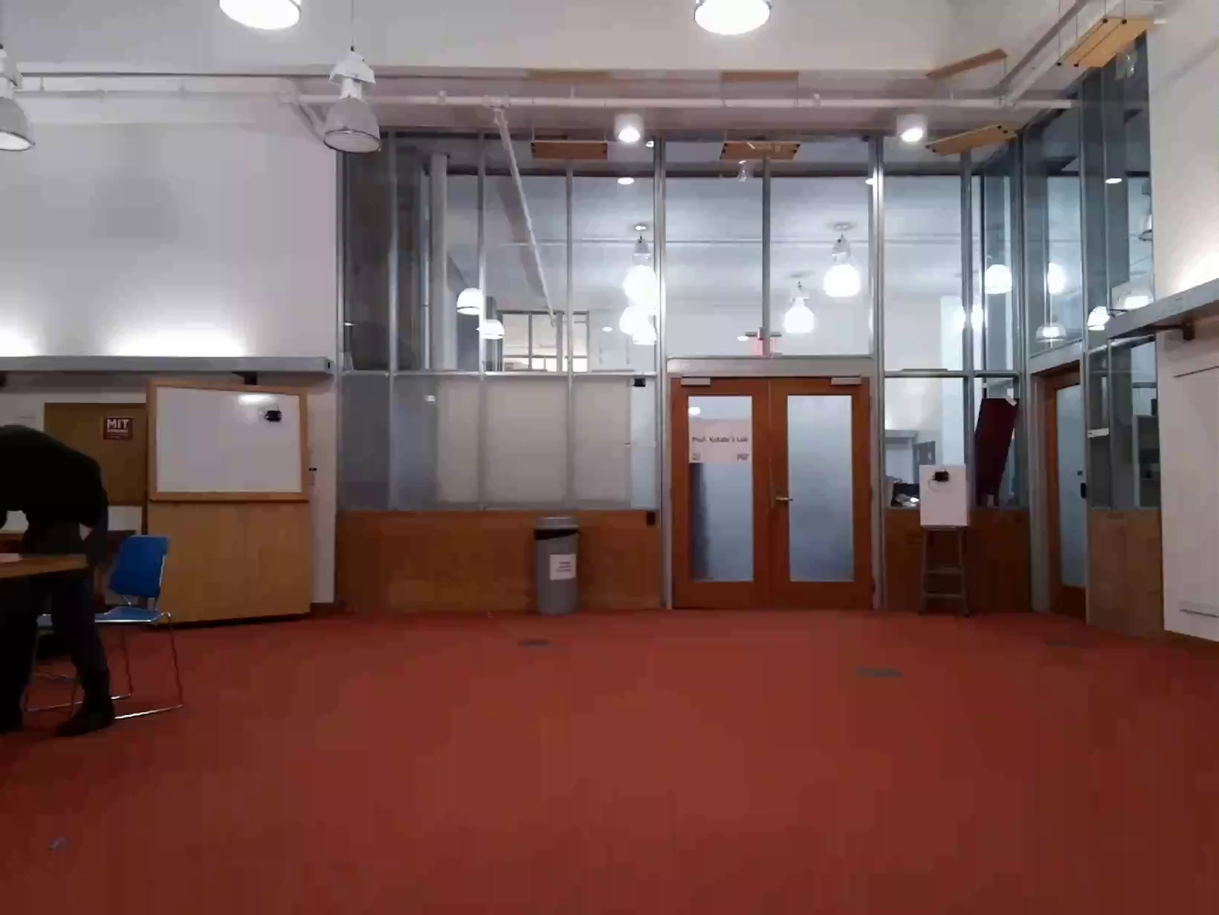
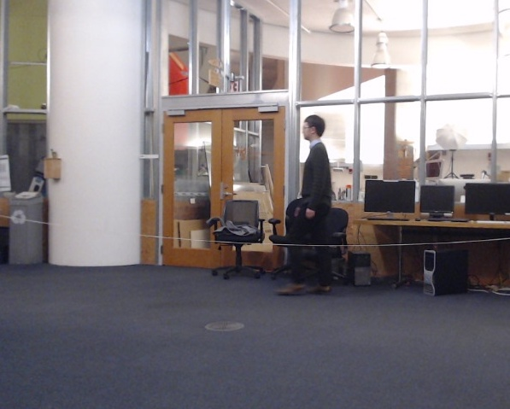
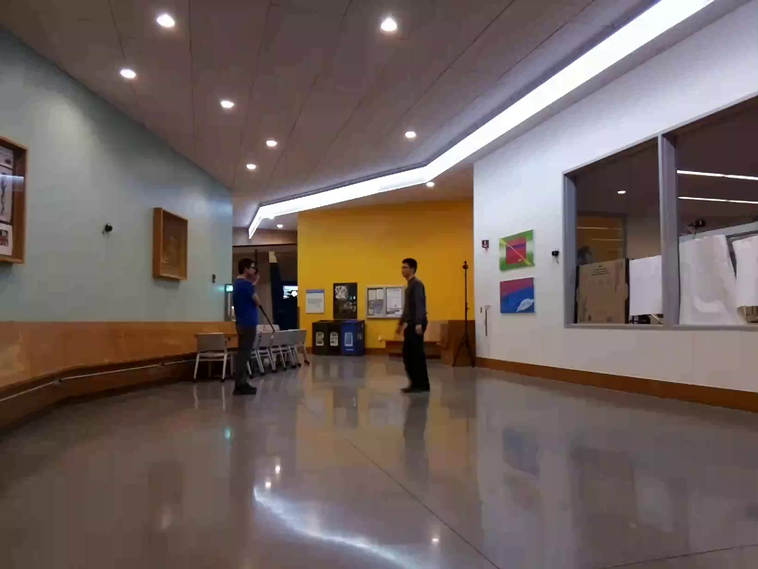
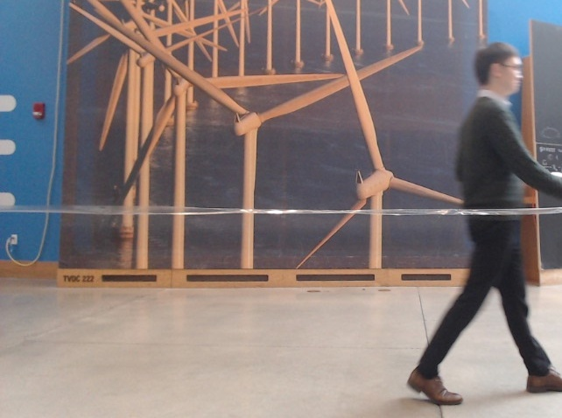
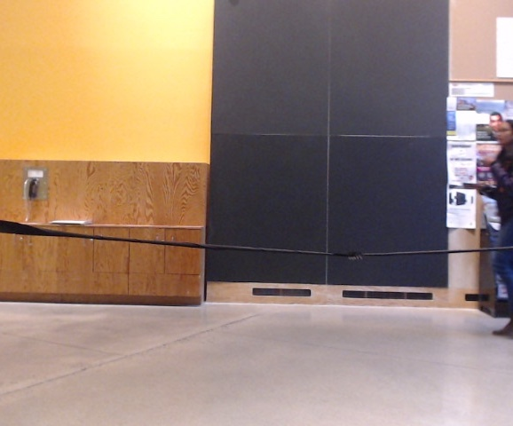
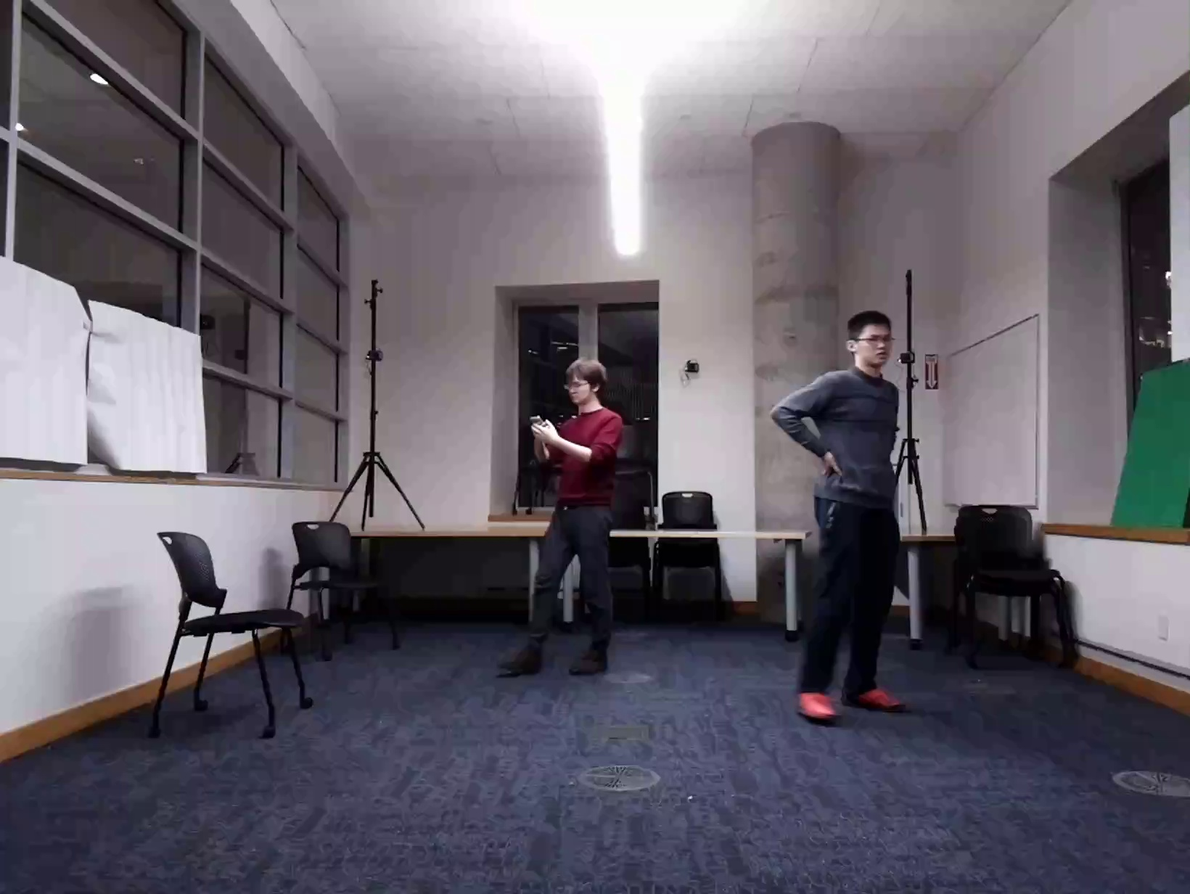
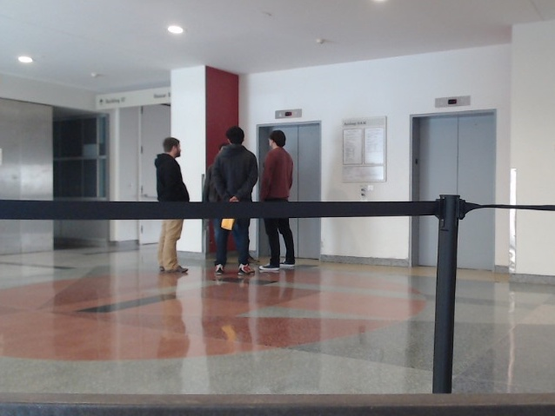
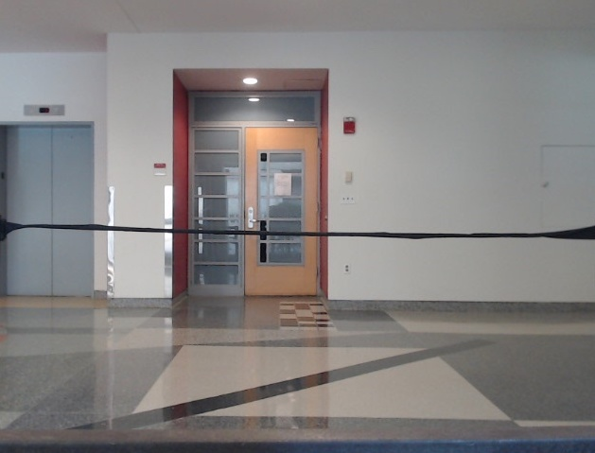
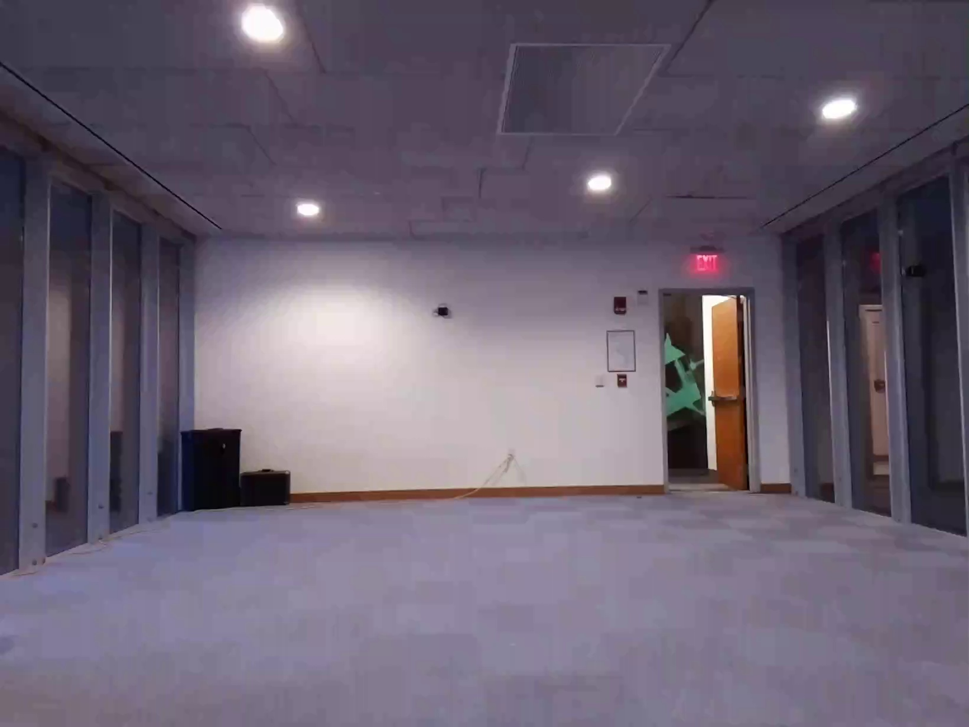
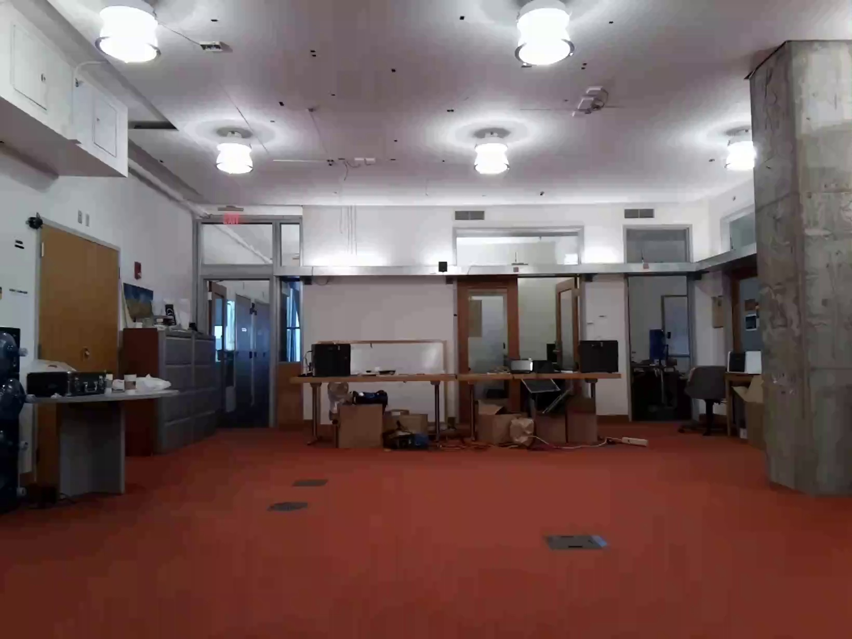
Implementation
HW is similar to past work; uses an FMCW radio with antenna arrays
Model implemented with decomposition in PyTorch.
Collected 16 hours of data at 22 different places on our campus.
Model training takes 2 days with 4 GPUs.
Notes:
Let's first look at how we implement our system.
Our hardware is similar to past work on localization. It uses an FMCW radio with antennas arrays.
We implemented our model with decomposition in PyTorch.
To train the model, we collected 16 hours of data at 22 different locations around our campus. People were going about their own life without much interference from our side. We split the data from 22 different locations and use 16 for training and the other 6 for testing to make sure our model can generalize to new environment.
It takes our model 2 days to train with 4 GPUs.

Slide 24
How Accurate is the Skeleton?
Metric: Keypoint localization error
Predicted Skeleton
Ground Truth Skeleton
Notes:
To evaluate our system, the first question we want to ask is: how accurate is our skeleton?
To evaluate the accuracy of our skeleton, we look at the localization error of each keypoint in the 3D space.
We compare our predicted 3D skeletons with the ground truth, and compute localization error for different keypoints.

Slide 25

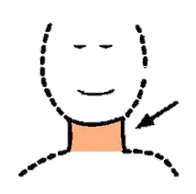
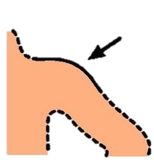

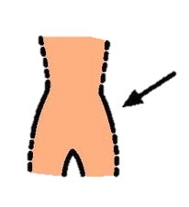
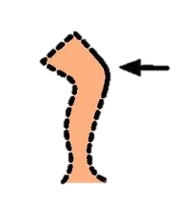
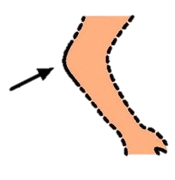
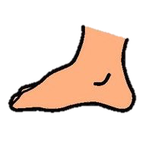
Skeleton Accuracy for Different Keypoints
Notes:
Here is the results.
Our localization error is around 4.3 cm for the head and less than 4 cm for the neck. Our model also works well for the rest of the keypoints and in the worst case, our localization error is less than 6cm.
As you can see, our model is most accurate for the keypoints on the body trunk, for example, the neck and the hip. This is because of the large size of body truck and there are more reflections from them. On the other hand, our model is less accurate for the wrists and the ankles, as there is less reflection from them.
Our average localization error is around 4cm for all different body keypoints. This is much better comparing with the error in previous localization systems. And those systems only give you a single point as opposed to a full skeleton.

Slide 26
Skeleton Accuracy vs. Number of People
Notes:
Let’s now look at the skeleton accuracy with different numbers of people.
The error of course goes up as there are more people in the environment.
But as you can see, the error is still less than 6cm when there are up to 5 people in the environment.

Slide 27
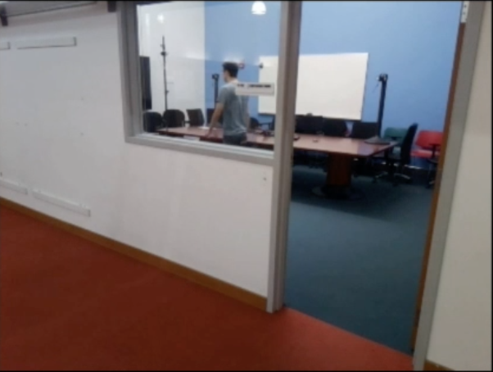
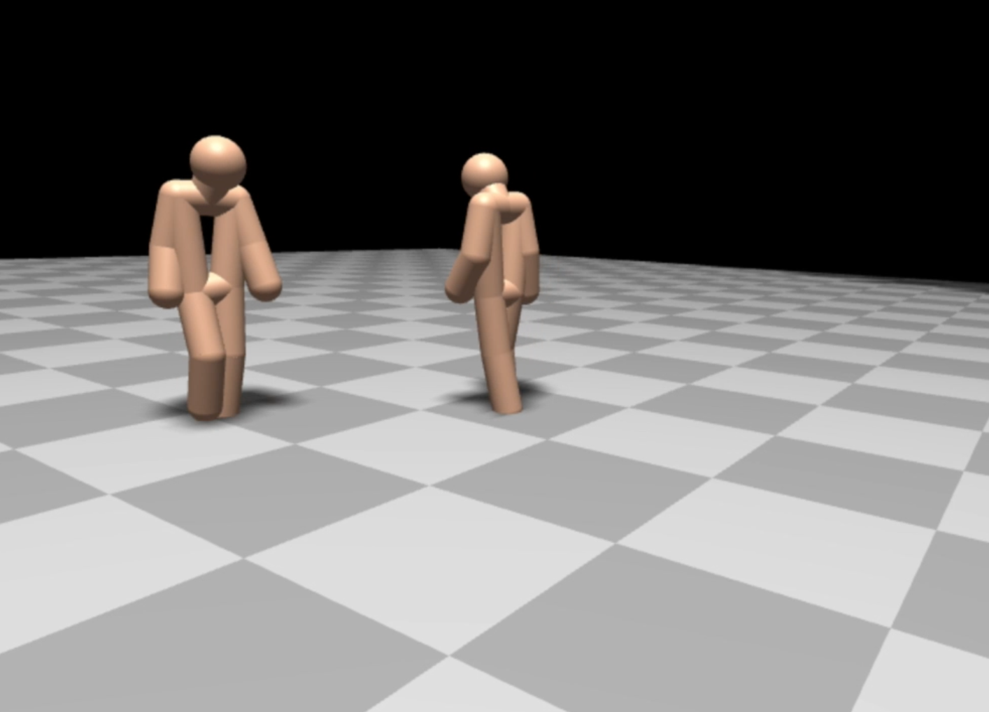
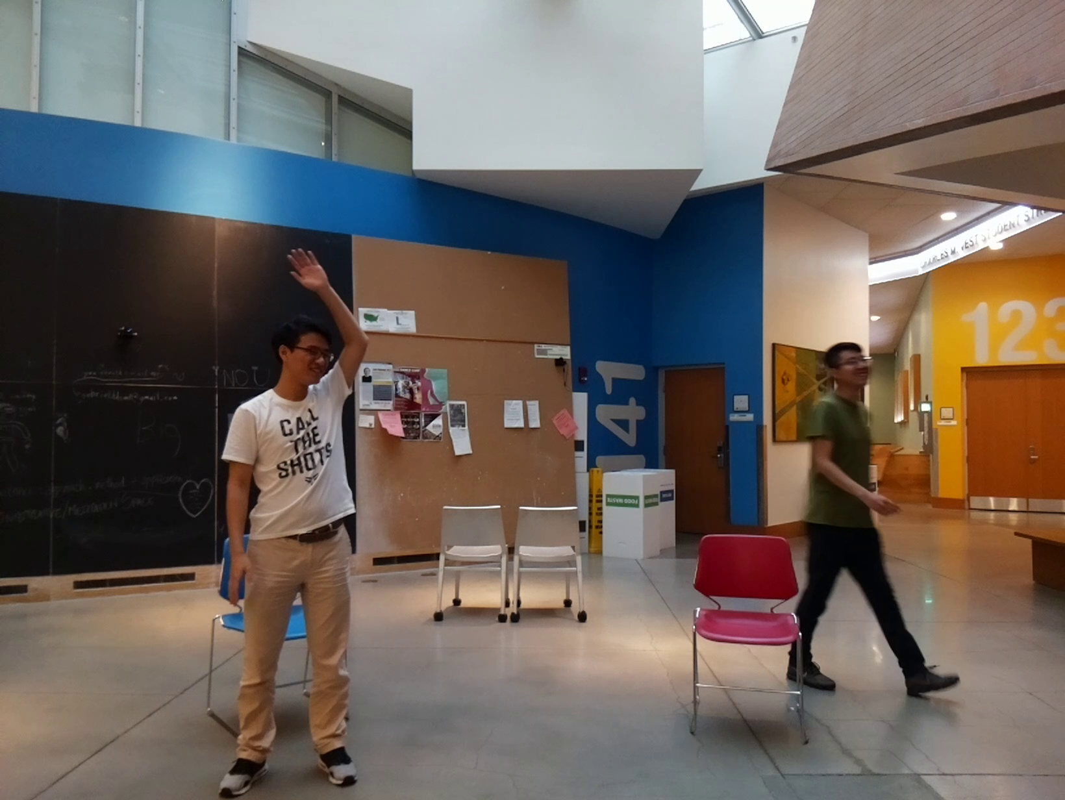
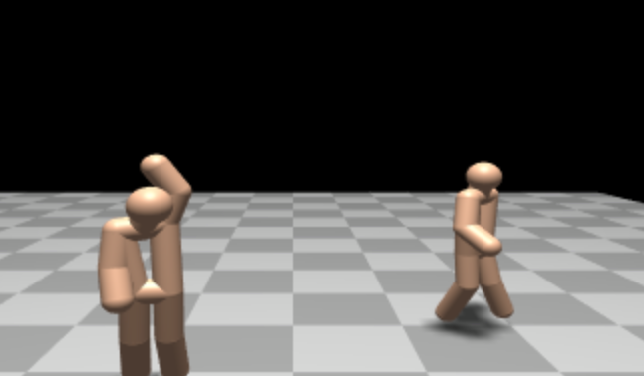
When will RF-Pose3D fail?
It works well with:
Notes:
The next question we want to ask is: when will it fail?
Let’s first summaries the cases when it works well: it works well through walls and occlusions. It also works well with daily activities like walking, sitting, having a discussion or waving hands.

Slide 28
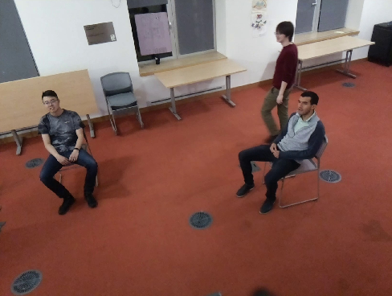
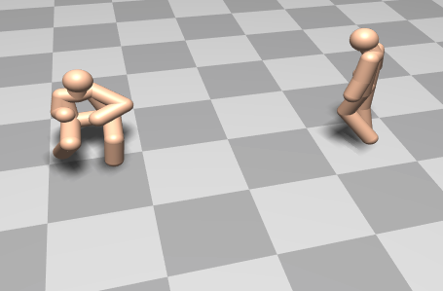
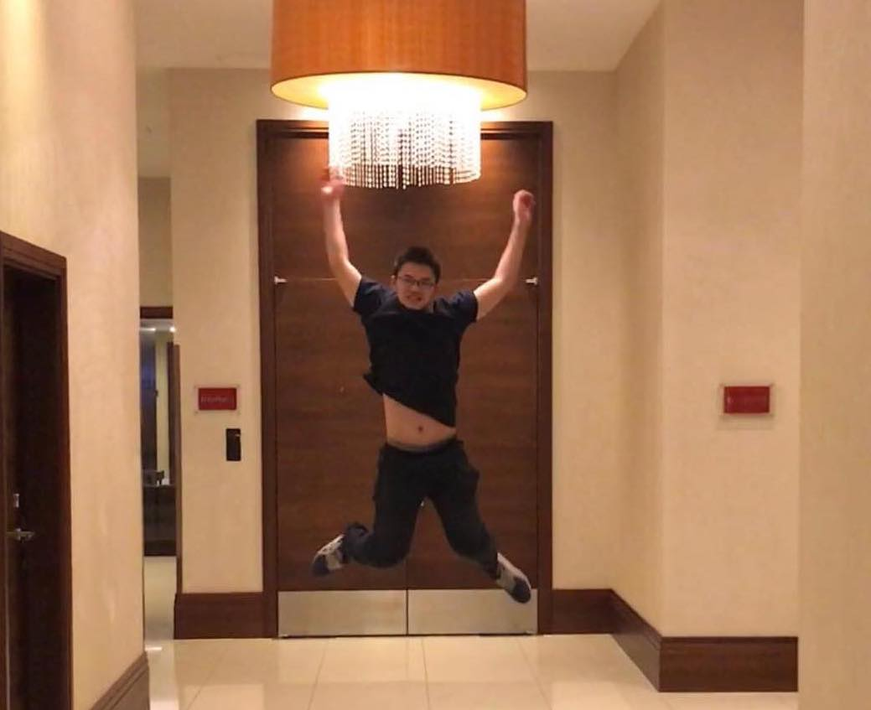
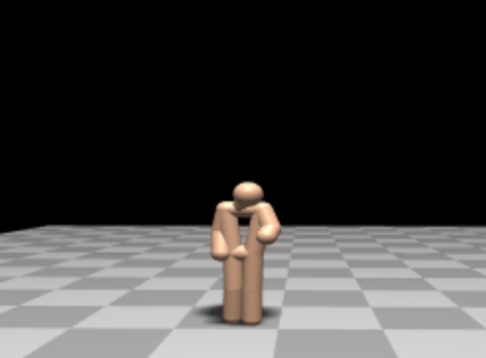
When will RF-Pose3D fail?
It fails when:
Notes:
Now let’s look at cases when our system will fail.
The first failure mode is due to people being static for too long.
In this case for example, there are two people sitting on the chairs but our model is only able to estimate skeleton for one of them.
This is because the second person has been sitting there for so long that our model starts thinking he is just part of the static reflectors in the environment, and therefore decided not to output a skeleton of him.
To solve this problem, it would require the model to take longer history window
The second failure mode is due to the posture we don’t see in the training data. For example, this person is jumping in the air but our system still thinks he is x.
As I said, we collected our data inside our campus building and we don’t even see any jumping examples. Our model would need to see these examples in the training set to be able to deal with them.

Slide 29
Real-time Demo
2 pm to 4 pm @ Northern Hall
Notes:
Finally, our model is able to run in real-time on a laptop. we are going to show a demo of our system this afternoon.
If you are interested to see how it works or try it yourself, please stop by between 2pm and 4pm at the northern hall at the back of the stage.
With that, I am happy to take any questions.

