Slide 1


Through-Wall Human Pose Estimation Using Radio Signals
Mingmin Zhao
Tianhong Li Mohammad Alsheikh Yonglong Tian Hang Zhao
Antonio Torralba Dina Katabi
Notes:
Hello everyone. I am Mingmin from MIT.
Today I will be telling you about through-wall human pose estimation using radio signals.
This is joint work with Tianhong, Mohammad, Yonglong, Hang, Antonio and Dina.

Slide 2
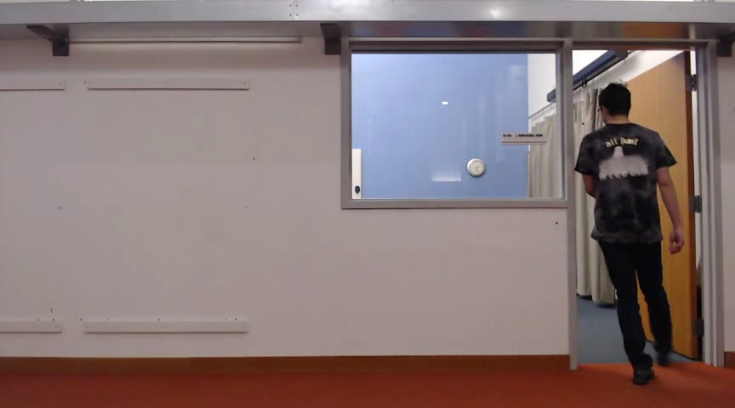
Occlusion is a challenge for pose estimation
Notes:
Occlusion is a fundamental challenge for human pose estimation, as well as many other vision problems.
Existing pose estimation methods cannot work when the person is (partly or fully) occluded.

Slide 3
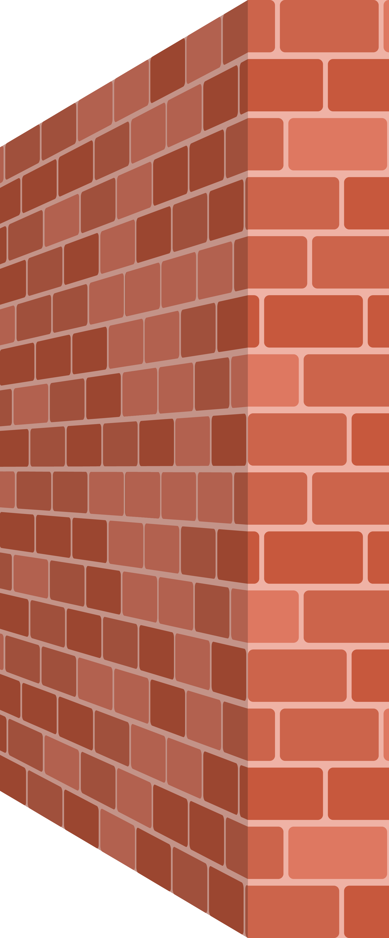


Want to see the pose through walls
Notes:
What we want to do is to see the human pose through walls.
While human eyes or cameras cannot do it,

Slide 4

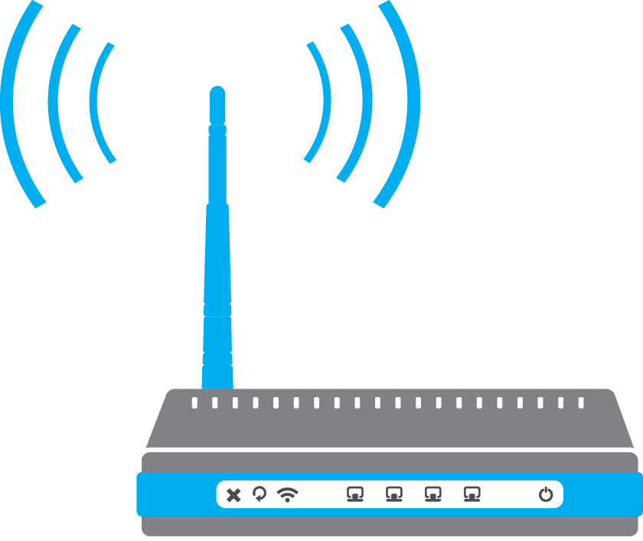
Want to see the pose through walls
Pose？
Notes:
wireless devices we are using everyday actually transmit a signal that traverses through walls.
For example, you can use Wi-Fi even if you are in a different room.
These RF signals not only traverse through wall but also reflect off human body as our body if full of water.
Our idea is to use such wireless signals to estimate human pose through walls.

Slide 5
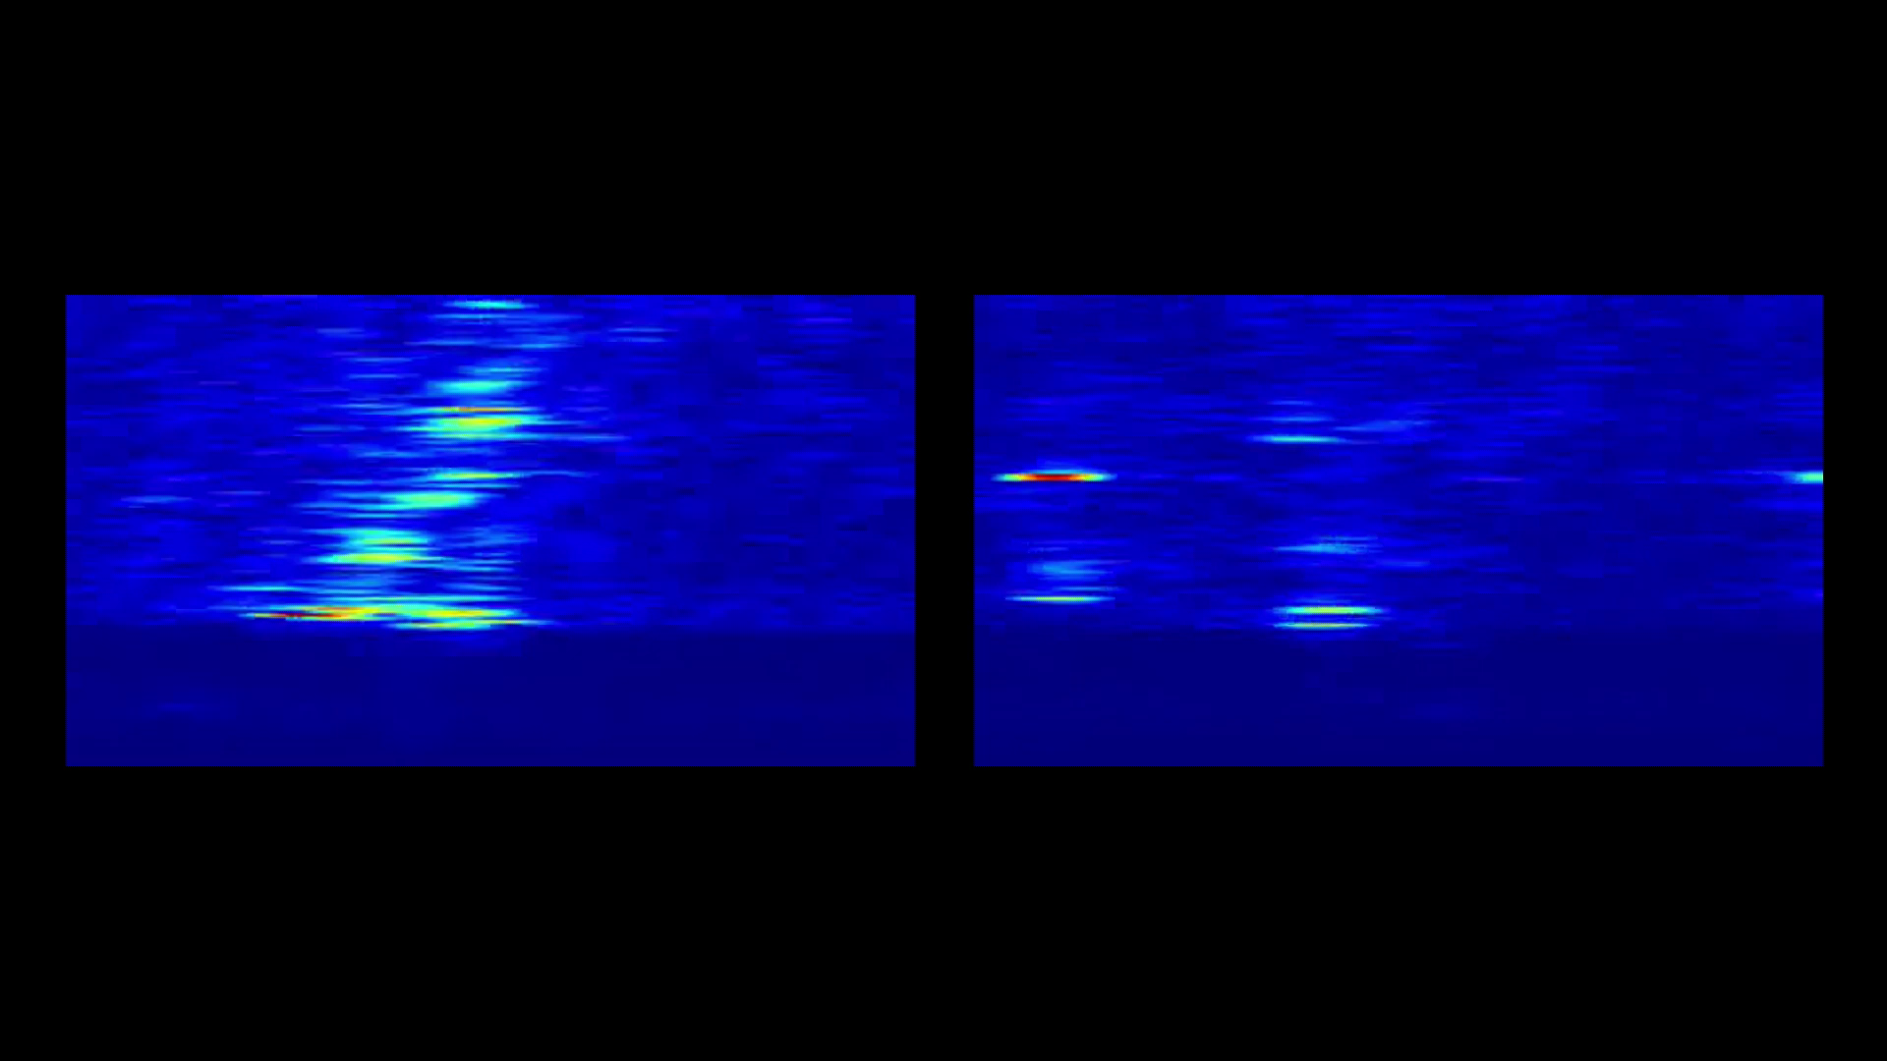
RF Signals
Infeasible to annotate RF with keypoints
How to train a model to estimate pose from RF?
Vertical RF heatmaps
Horizontal RF heatmaps
Notes:
Now let me show you how RF signals look like.
RF signals can be processed into vertical and horizontal heatmaps showing where the reflections are coming from.
What I am showing right now is the RF heatmaps while a person is walking.
As you can see, these peaks on the heatmaps moves with him, even when he is behind the wall.
Before we can go ahead and train a neural network to estimate pose from such RF signals, one question we need to ask is how can we get a labeled dataset.
In fact it’s almost impossible for human to annotate body keypoints from RF signals.
So how can we train a neural network to estimate pose from RF?

Slide 6
Vision provides cross-modal supervision
Teacher Network
(OpenPose)
RGB images
supervisory
signals
Student Network
(RF-Pose)
RF heatmaps
Notes:
Our idea is to use vision to provide cross-modal supervision.
During training, we attach a web camera to our wireless sensor to collect synchronized visual and RF streams.
We use OpenPose as our teacher network to extract confidence maps of each keypoint.
These confidence maps provide supervisory signals to the student network RF-Pose,
that is learning to extract the same confidence maps from the RF signals.

Slide 7
During inference
Teacher Network
(OpenPose)
RGB images
supervisory
signals
post-processing
Student Network
(RF-Pose)
RF heatmaps
Notes:
Once the model is trained, we can use the RF signals only to estimate the confidence maps of body keypoints.
Human pose can be extracted from confidence maps using non-maximal suppression and association.

Slide 8
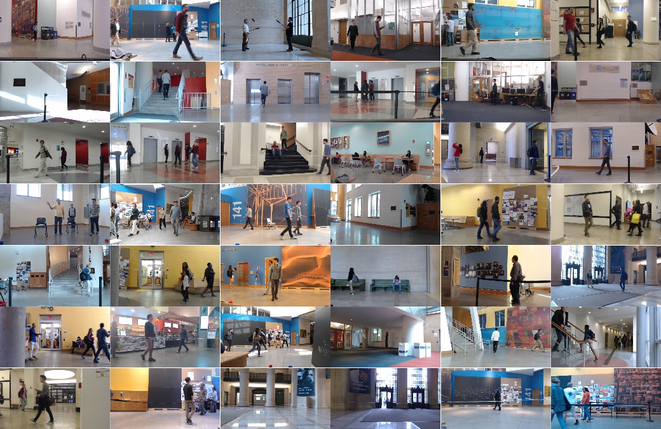
Dataset
50 hours, 50 locations, daily activities
Notes:
To train such a model, we collected 50 hours of data at around 50 different locations around our campus.
People are going about their own life without much interference from our side.

Slide 9
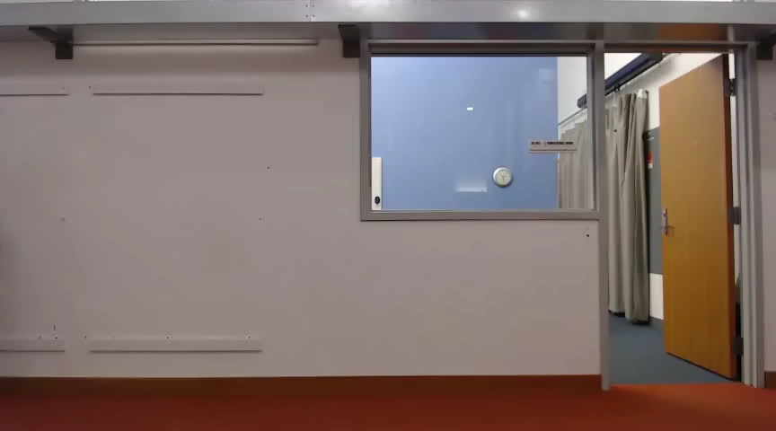

Through-wall poses using only RF
RGB (visualization only)
Skeletons
Confidence Maps
Notes:
Now let me show you the output of our model on the test data.
Interestingly, the student network learns to perform pose estimation even when the person is fully occluded, despite it has never been trained in such scenarios.
The shows an example of student network can outperforming teacher network in certain aspects.

Slide 10
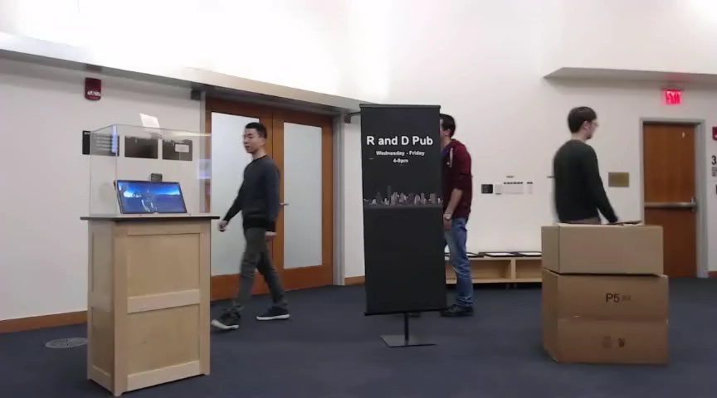
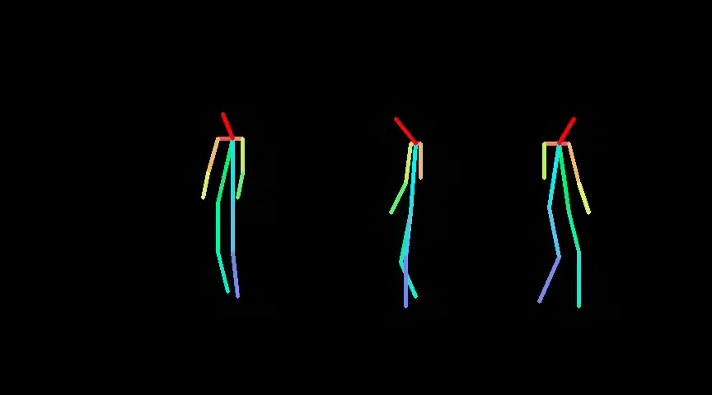
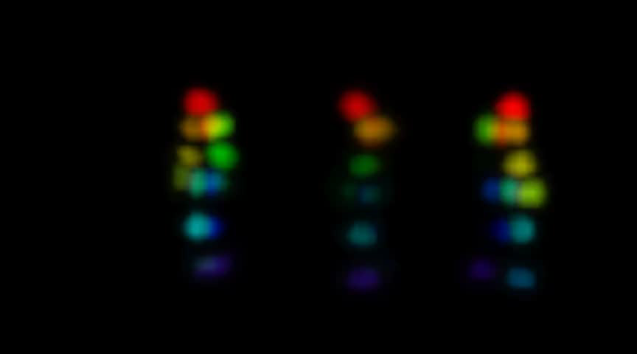
RF-Pose handles various occlusions
RGB (visualization only)
Skeletons
Confidence Maps
Notes:
Our RF-based model also works with multiple people and can handle various types of occlusion, for example, posters, boxes and tables.

Slide 11
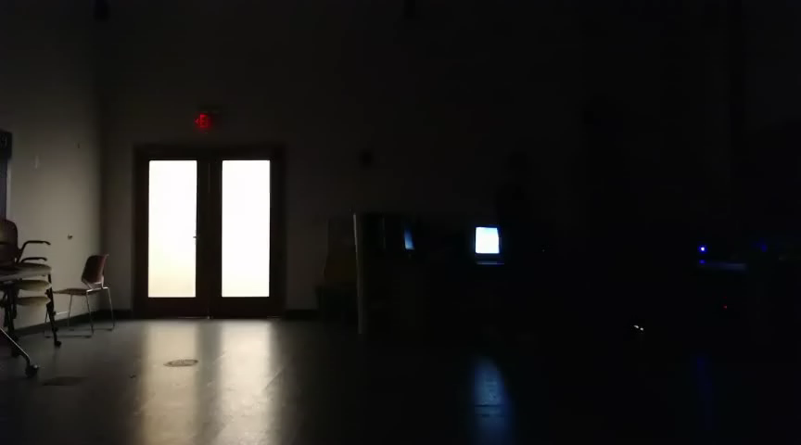
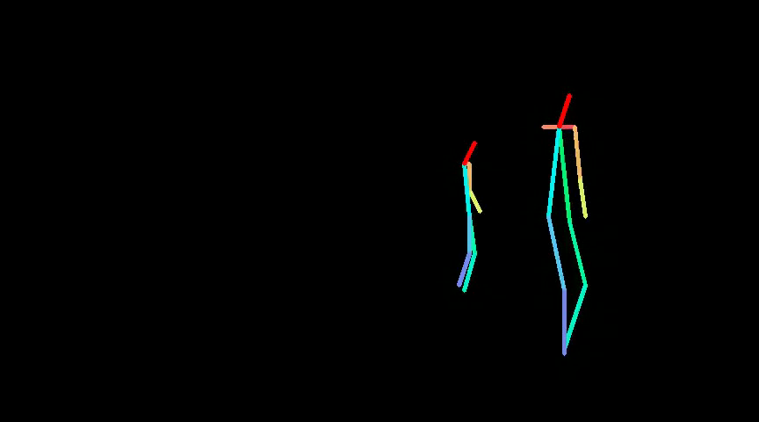

RF-Pose also works in bad lighting
RGB (visualization only)
Skeletons
Confidence Maps
Notes:
It also works in bad lighting conditions, even in the dark, where vision based systems would fail.

Slide 12
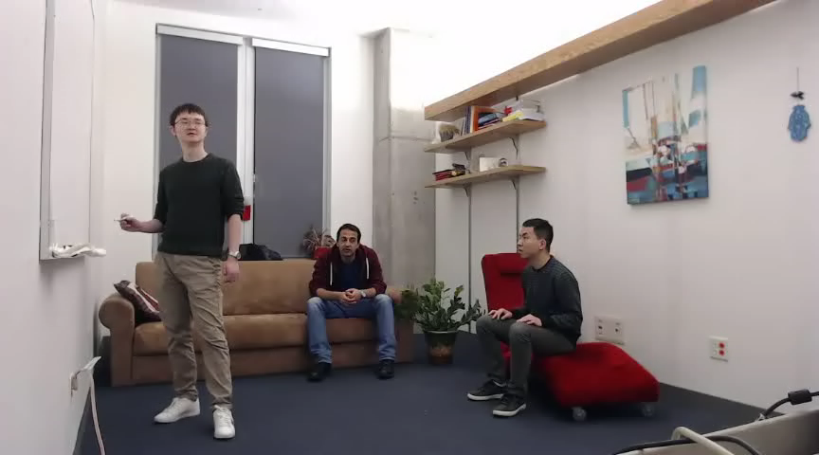
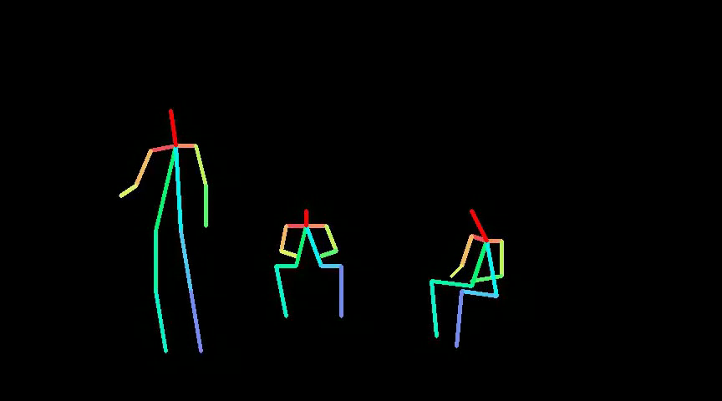
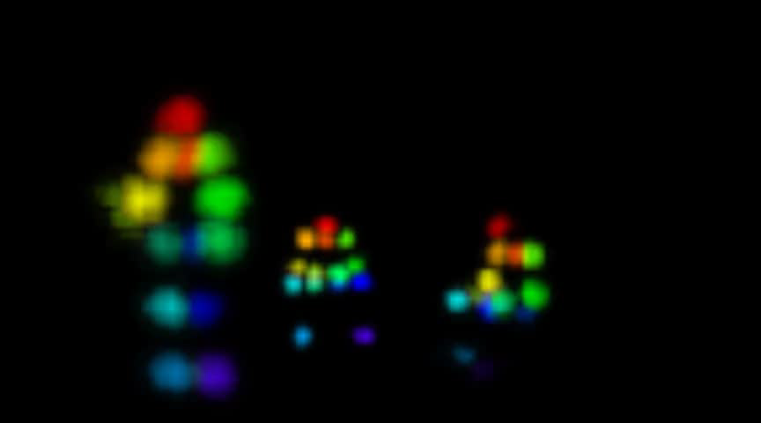
RF-Pose works with different environment and daily activities
RGB (visualization only)
Skeletons
Confidence Maps
Notes:
RF-Pose can work in different environment and can handle different types of daily activities.

Slide 13
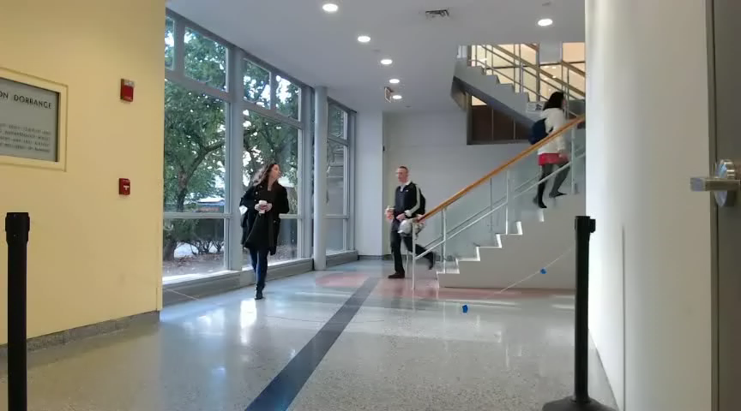
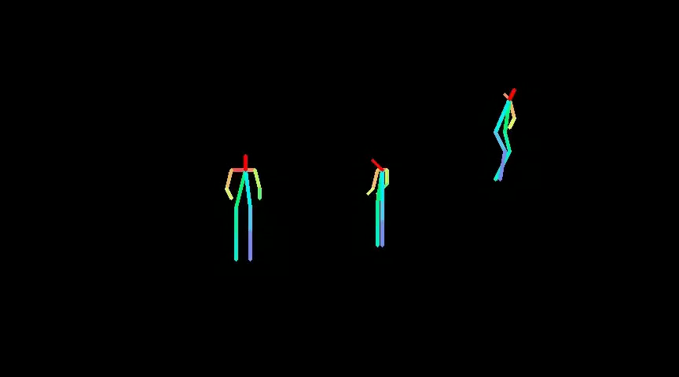
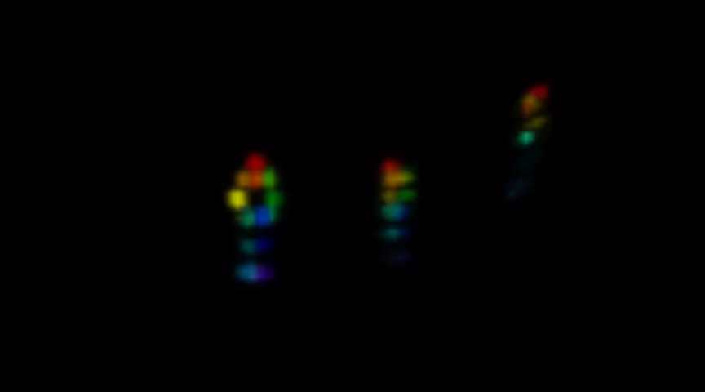
RF-Pose works with different environment and daily activities
RGB (visualization only)
Skeletons
Confidence Maps

Slide 14
Through-Wall Human Pose Estimation Using Radio Signals
For more information, please visit our:
Website: RFPose.csail.mit.edu
Poster: Session P3-1 [C14]
Notes:
For more information, please visit our website or stop by at our poster.

