Slide 1




LASER: Light, Accurate Sharing dEtection and Repair
Liang Luo, Akshitha Sriraman, Brooke Fugate, Shiliang Hu, Chris J Newburn, Gilles Pokam, Joseph Devietti

Slide 2
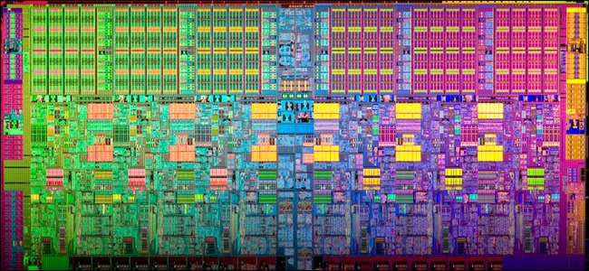
Multicore is Eating the World
+ Performance
+ Energy efficiency
- Performance bugs

Slide 3


Cache Contention Bugs
Contention for a single cash line
Caused significant performance loss (Linux, MySQL, Boost)
Architecture-specific
Hard to find and debug

Slide 4
Background
Cache coherence keeps private caches in sync
All protocols share 3 key states: Modified, Shared, Invalid
X:S
X:M
X:S
L1 $
L1 $
Core
0
Core
1
Write X
Read X

Slide 5
Two Types of Contention
Same Bytes == True Sharing
X:M
Cache Line
X
Core
0
Core
1
Write X
Read X

Slide 6
Two Types of Contention
Different Bytes == False Sharing
X:M
Cache Line
X Y
Core
0
Core
1
Write X
Read Y

Slide 7
Related Work
Sheriff
[Liu and Berger, OOPSLA 2011]
Plastic
[Nanavati et al., EuroSys 2013]
Cheetah
[Liu and Liu, CGO 2016]
Detection & Repair for False Sharing
Offline Analysis
Predicts speedup from FS
vTune Amplifier XE
[Intel]
Detection for generic events

Slide 8
HitM Events
A fundamental part of both types of contention
  A cache hit in a remote core’s cache in M state.
struct
{
uint64_t ip;
uint64_t addr;
…
char csrc;
char cdst;
}
X:M
L1 $
L1 $
Core
0
Core
1
Write X
Read X
MEM_LOAD_UOPS_LLC_XNSP_HITM PEBS Record

Slide 9
HITM Record Accuracy
160 simple programs with read/write and write/write true/false/no sharing
Intel Core i7-4770K 3.4GHz Haswell 4-core processor

Slide 10
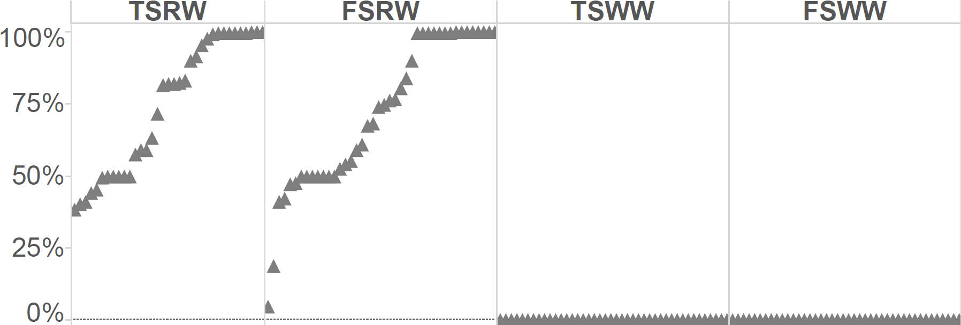
HITM Record Accuracy(1/2)
% correct data addresses
160 simple benchmarks
Counting only exact addresses as being correct

Slide 11
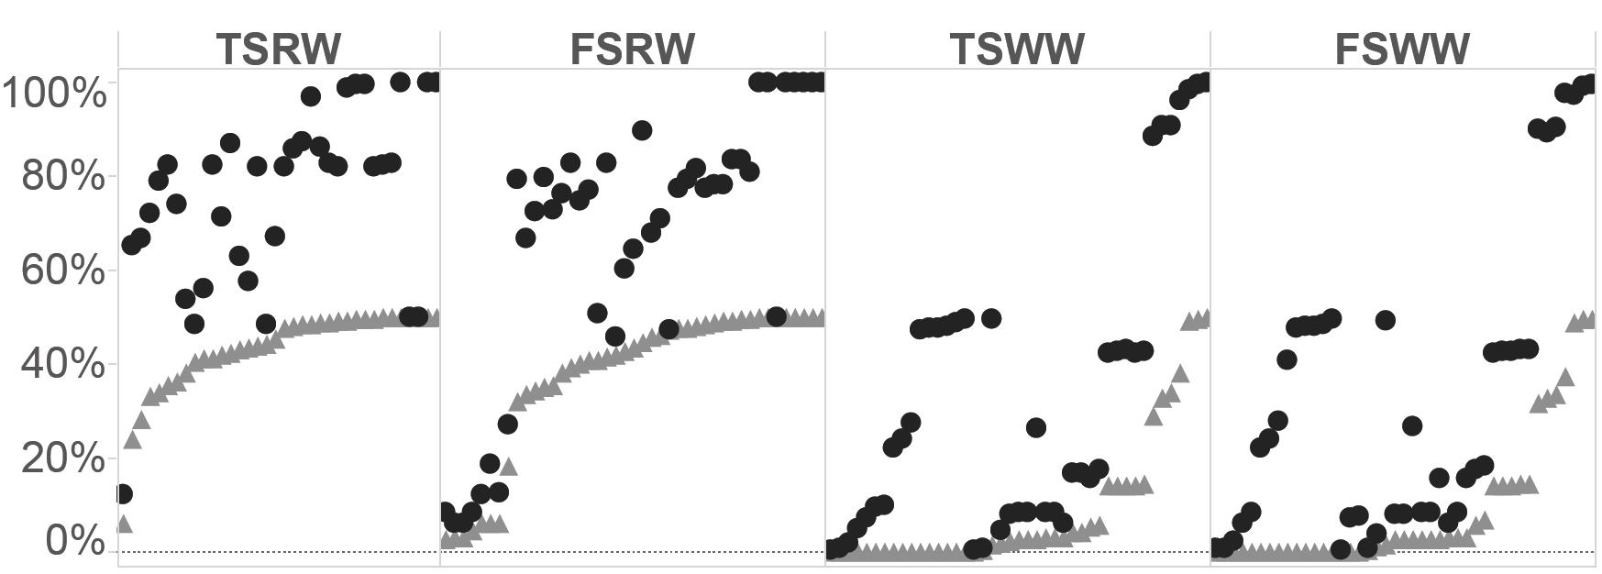
HITM Record Accuracy(2/2)
% correct PC addresses
Counting only exact PC as being correct
160 simple benchmarks
Counting adjacent PCs as being correct

Slide 12
LASER
• Light: leverage Haswell h/w, no s/w or OS changes
• Accurate: low false positives and false negatives
• Sharing: detects both true and false sharing
• dEtection: works as a profiling tool
• Repair: automatically repairs false sharing at runtime

Slide 13
LASER System Overview
Detector
Process
LASER
Repair
User Level App
App
Process
Linux Kernel
Operating System
Driver
Hardware
Haswell or later Processors

Slide 14
Detection Algorithm
Disjoint
Cache Line Model
W
HITM
Store X+8, 4B
HITM
Load X, 2B
FALSE SHARING

Slide 15
Detection Algorithm
Foo.c:23
Sort and Filter
Aggregate by Source Code Line

Slide 16
Evaluating LASER Detection
Intel Core i7-4770K 3.4GHz Haswell 4-core processor
33 workloads from Phoenix 1.0, Parsec 3.0 and Splash2X

Slide 17
LASER Detection Accuracy
Created a database of manually-validated cache contention bugs
  9 bugs total across 33 workloads
  4 new bugs discovered by LASER
 | False Negative | False Positive | Runnable Benchmarks
LASER | 0 | 24 | 33/33
VTUNE | 1 | 64 | 33/33
SHERIFF | 3 | 4 | 12/33

Slide 18
Profiling Performance Comparison
LASER (1.01x) vs VTune Amplifier XE 2015 (1.8x)

Slide 19
Repairing FS with SSB
Needs Online False Sharing elimination!
  Legacy programs – no access to source code.
  Programs that need to be always running.
Challenge is needing to rewrite the program without breaking it as it is running.
Solve the problem of online FS repair with a Software Store Buffer (SSB). LASER repair tool is launched to attempt fix of FS.
  Implemented with Intel Pin

Slide 20
Repairing FS with SSB
Store Buffer 0
Core
0
Cache
Flush
X=1
X=0
Write X,2
Tail
X=2
…
…
Read X
Read X=2
Modified
Shared
Invalid
Store Buffer 1
Core
1
Read X
Cache
Read X=0
Tail
…
…
…
X=0
Flush at synchronization points for TSO compliance and basic block end for performance.

Slide 21
Challenges with Optimizing SSB
The conventional hardware store buffer is not good enough for speedup.
Needs optimizations for better performance
    May cause subtle memory consistency issues.
  For good performance, requires coalescing store buffer. But coalescing violates TSO. E.g. Sheriff does not provide TSO compliance.

Slide 22
LASER’s TSO-Compliant, Coalescing SSB
Instrument regions from Laser’s input by walking through the CFG.
Coalescing, TSO compliant SSB made possible with Intel TSX.
Read X:
Result = SSB[X]
If (Result == null)
Result = *X;
Return Result;
Write X,Val:
If (SSB[X] == null &&
SSB.full())
Flush();
SSB[X] = Val;
Flush:
TSX_Begin_Transaction
Foreach pair in SSB
*pair.memory = pair.value;
TSX_End_Transaction
Redo_TSX_Transaction_If_Fails

Slide 23
LASER FS Repair Performance
Automatic speedups of up to 19%
LASER profiling informs manual fixes of up to 17x

Slide 24
Conclusions
Cache contention bugs undermine the promise of multicore
LASER uses Intel’s Haswell platform for fast, precise contention detection and automatic false sharing repair
Many opportunities to leverage Haswell’s sharing detection capabilities
Researchers Who Read This Paper Also Read
☑
REMIX: Online Detection and Repair of Cache Contention for the JVM
[PLDI 2016]
Add to read list

