Slide 1
CIS 700
Advanced Machine Learning
Structured Machine Learning:
Structured Learning with Latent Variables
Shyam Upadhyay
Department of Computer and Information Science
University of Pennsylvania

Slide 2

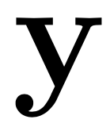
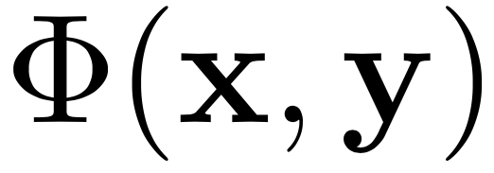
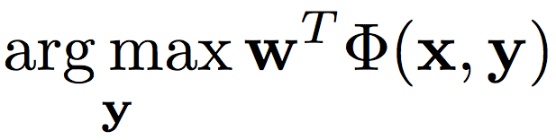
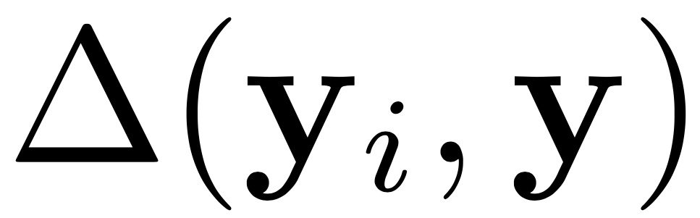
Ingredients of a Structured Prediction Problem
Input
Output
Feature Extractor
Inference
  Inference , also called “Decoding”
  Loss

Slide 3
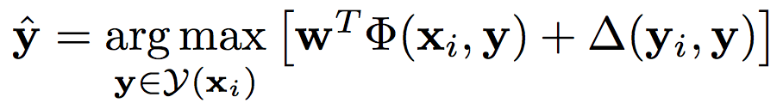
Ingredients of a Structured Prediction Problem (General)
Input
Output
Feature Extractor
Inference
  Inference , also called “Decoding”
  Loss
  Loss-sensitive inference

Slide 4
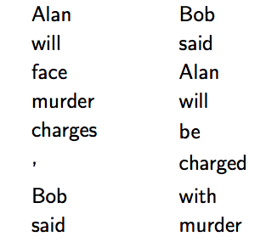
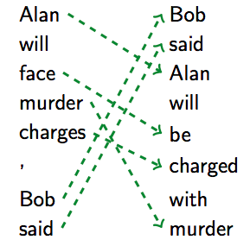
Intuition Behind Latent Modeling
Some tasks have inherent latent structure connecting the input to the output.
  “Latent”- not provided at training time (expensive to annotate).
Predicting a “good” latent structure can improve final prediction
Positing a good latent structure is task-dependent (requires background knowledge)

Slide 5
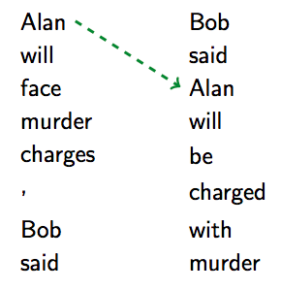
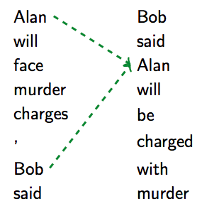
Predicting Latent Structures
Some latent structures are invalid.
Cannot make local decisions, need to predict the structure jointly.
Cannot always enumerate latent structures (trees etc.).
How to predict a good latent structure which helps predict the gold output?

Slide 6
Quick Detour To EM

Slide 7
Soft EM
Soft E Step
  Generate a distribution over latent variables
  Does not commit to a single latent variable.
M Step
Example
  Soft K-Means Clustering, Rabiner’s HMM algorithm …

Slide 8
Example – Soft Clustering
Each point can be “explained” by several clusters.

Slide 9
Hard EM
Hard E Step
  Pick only the best latent variable. (Spike Distribution)
M Step
M Step actually did not change.
Example
  K-Means Clustering
Notes:
Add picture for k-means

Slide 10
Hard Clustering
Each point is “explained” by exactly one cluster.

Slide 11
SSVM and Latent SSVM

Slide 12
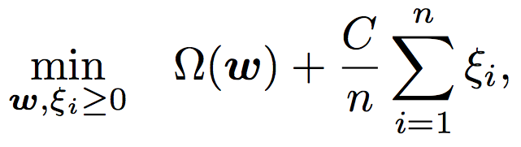

Structured SVM
Notes:
Say what Omega is or use L2 norm

Slide 13
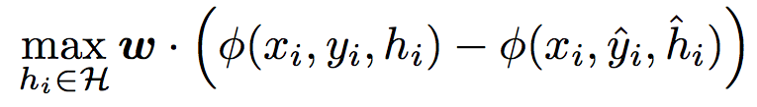



Latent Structured SVM

Slide 14
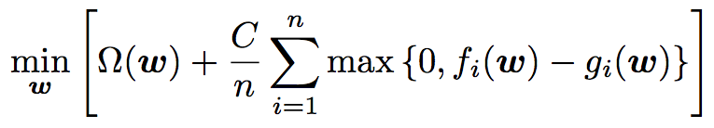

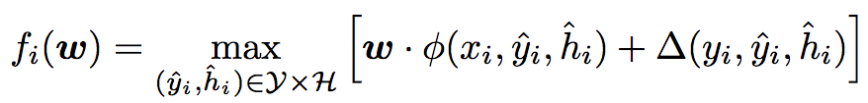

Reformulation
The best explaining hidden variable given the input
This is like Hard EM
We have 2 inference problems!
The best explaining hidden variable given the gold output and input

Slide 15
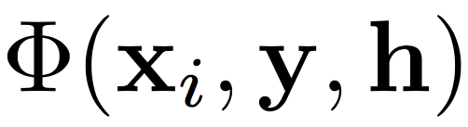

Ingredients of a Structured Prediction Problem with Latent Variables
Input Output Latent structure
Feature Extractor
Inference
  Hidden-Variable Completion
  Joint Inference over output and latent structure (“decoding”)
  Loss
  Generalized to include latent variable, but can ignore it too.

Slide 16


Optimization
Difference of convex functions (or sum of a convex and concave).
CCCP (Concave-Convex Procedure)
Matching points on the convex and concave terms which have the same tangent.

Slide 17
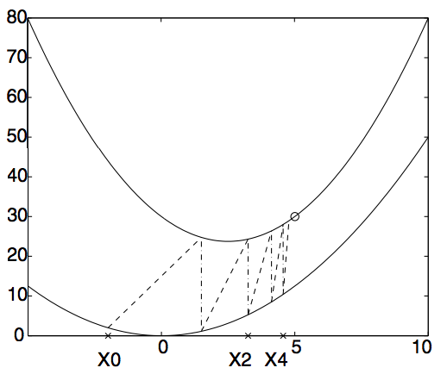
Example of CCCP

Slide 18




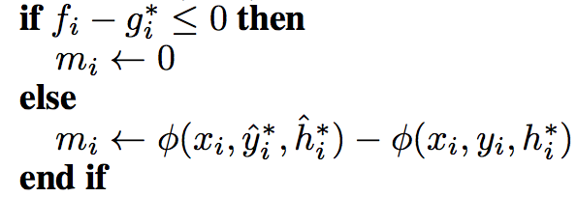

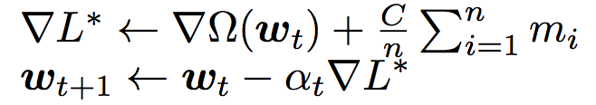
Learning Algorithm
E - Step
Argmax of f
Argmax of g
M - Step
Notes:
MAKE THE INNER LOOP EXPLICITLY THE HARD E STEP
EXPLAIN THAT THE ARGMAX IS ALSO TAKEN.

Slide 19
Interpreting the Updates
What is added to the weight vector
Note similarity to the Structured Perceptron/SVM update.
Note the update also improves the next E step (better latent representation will chosen).
Feature of the latent structure inferred using gold output
Feature of the latent structure inferred jointly

Slide 20
Initialization
The latent SSVM problem is non-convex (convince yourself)
Initialization matters.
How to find a Good Initialization?
How to guide the model better?
  Discriminative Learning over Constrained Latent Representations
    Ming-Wei Chang, Dan Goldwasser, Dan Roth, Vivek Srikumar
  Structured Output Learning with Indirect Supervision
    Ming-Wei Chang, Vivek Srikumar, Dan Goldwasser, Dan Roth

Slide 21
Questions?

