Slide 1
Global Inference for Entity and Identification via a Linear Programming Formulation
By Dan Roth and Wen-tau Yih
PowerPoint by: Reno Kriz
CIS 700-006

Slide 2
Problem Setup
Goal: Want to identify both the named entities in a sentence, as well as the relations between them.
Previous works had attempted to find these locally.
  This leads to global inconsistencies.
This paper discusses formulating the problem as a linear program.
Notes:
Types of named entities: person, location, organization, etc.
Types of relations between named entities: born_in, spouse, works_for, etc.

Slide 3
Example
other | 0.05
per | 0.85
loc | 0.10
other | 0.10
per | 0.60
loc | 0.30
other | 0.05
per | 0.50
loc | 0.45
other | 0.05
per | 0.85
loc | 0.10
other | 0.10
per | 0.60
loc | 0.30
other | 0.05
per | 0.50
loc | 0.45
other | 0.05
per | 0.50
loc | 0.45
  Bernie’s wife, Jane, is a native of Brooklyn
  E1 E2 E3
R₁₂
R₂₃
irrelevant | 0.05
spouse_of | 0.45
born_in | 0.50
irrelevant | 0.05
spouse_of | 0.45
born_in | 0.50
irrelevant | 0.05
spouse_of | 0.45
born_in | 0.50
irrelevant | 0.10
spouse_of | 0.05
born_in | 0.85
irrelevant | 0.10
spouse_of | 0.05
born_in | 0.85
From Dan Roth’s Introductory Lecture
Notes:
In this example, there are three entities: Bernie, Jane, and Brooklyn. This means that there will be six total relations between each pair of entities, but let’s consider two of them for now.

Slide 4
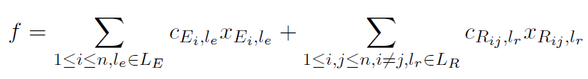
Objective Function
From Yih (2004)

Slide 5
Objective Function
x_{a,k} is a binary variable.
x_{a,k} = 1 when variable a is assigned label k.
Otherwise, x_{a,k} = 0.
From Yih (2004)

Slide 6
Objective Function
c_{a,k} is the confidence score of variable a having label k
From Yih (2004)
Notes:
L_{E} is the set of entity labels, and L_{R} is the set of relation labels.

Slide 7
Constraints
Definition: A constraint is a function that maps a relation label and an entity label to either 0 or 1.
  Can also constrain the labels of two relation variables.
As an example, we can define constraints on the mutual relation spouse_of:
  (spouse_of, spouse_of) = 1
  (spouse_of, l_{r}) = 0, for l_{r} ≠ spouse_of
  (l_{r}, spouse_of) = 0, for l_{r} ≠ spouse_of
Notes:
0 means that the labels contradict the constraint, and 1 means that the labels satisfy the constraint.
Spouse_of is a mutual relation, because if Barack Obama is the spouse of Michelle Obama, then it follows that Michelle Obama is necessarily the spouse of Barack Obama.
This does not always occur; for example, born_in is not a mutual relation.

Slide 8
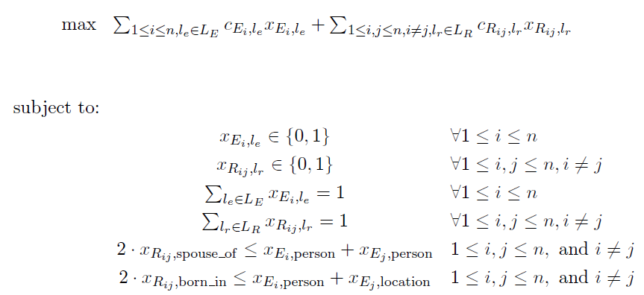
Example Integer Linear Program
From Yih (2004)

Slide 9
Example Integer Linear Program
From Yih (2004)
Notes:
The first two constraints simply forcing the x’s to be binary variables.

Slide 10
Example Integer Linear Program
From Yih (2004)
Notes:
The second two constraints prevent the model from selecting more than one label for each entity and relation.

Slide 11
Example Integer Linear Program
From Yih (2004)
Notes:
The final two constraints impose global consistency.
The first set shows that the only time that spouse_of can occur is when there are two entities labeled as person. The second set shows that the only time that born_in can occur is when there is an entity labeled as person, and another entity labeled as a location.

Slide 12

Overall Cost Function
For the general ILP, the paper converts the problem to minimize the cost.

Slide 13
Overall Cost Function
For the general ILP, the paper converts the problem to minimize the cost.
This is the cost associated with labeling variable u with label f_{u}.
c_{u}(f_{u}) = -log(p), where p is the posterior probability.
Notes:
P is the posterior probability that the model gives for labeling variable u with label f_{u}.
d¹() is the cost function for the first argument, and d²() is the cost function for the second argument.
This cost function is computationally intractable, so we need to first relax into a linear programming formulation of the problem, and then solve the corresponding ILP.

Slide 14
Overall Cost Function
For the general ILP, the paper converts the problem to minimize the cost.
These are the cost functions for the first and second arguments of a relation.
0 if the constraint is obeyed, and ∞ otherwise.

Slide 15
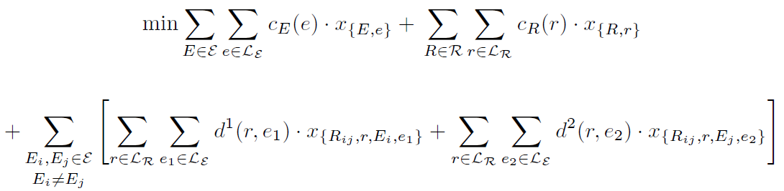
Full Objective
Notes:
This is just the expanded objective function.

Slide 16
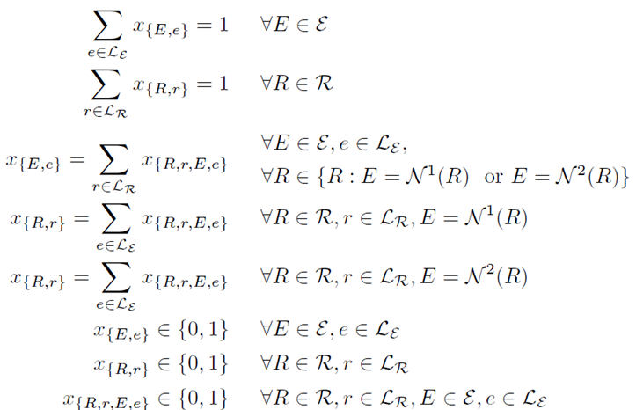
Full Constraints
Notes:
These are all the constraints we have seen in the toy example we looked at, just generalized.

Slide 17
Full Constraints
Notes:
The first two constraints again require that each variable can only be assigned one label.

Slide 18
Full Constraints
Notes:
The next three make sure that the assignment to each variable is consistent with the assignment to its neighboring variables.

Slide 19
Full Constraints
If we have two entities E_{i}, E_{j} with relation R_{ij}, then E_{i} = N¹(R_{ij}) and E₂ = N²(R_{ij})

Slide 20
Full Constraints
Notes:
The last three constraints are constraining each variable to be binary.

Slide 21
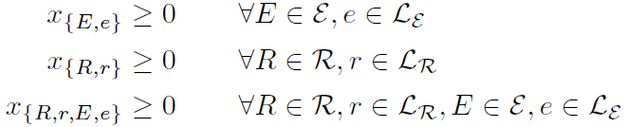
Linear Program Relaxation
To solve the ILP (an NP-hard problem), we can relax the integral constraints as follows:
If a linear program returns an integer solution, than it is the optimal solution to the original problem.

Slide 22
Unimodular
Theorem: If A is an (m,n)-integral matrix with full row rank m, then {x | x ≥ 0, Ax = b} for each integral vector b, iff A is unimodular.
  Definition: A matrix A is unimodular if all entries of A are integers, and the determinant of every square submatrix of A of order m is 0, +1, or -1
Notes:
This is a theorem that will come up in more detail in a paper that we will cover later, but it is also noted here.
In this paper, A was not proven to be unimodular. However, in practice this linear program still always returned integer solutions for every case the paper tested.

Slide 23
Experiments - Data
This paper annotated the named entities and relations in sentences from the TREC documents.
  Chose 1,437 sentences that have at least one active relation.
Overall statistics:
  5,336 entities, 19,048 pairs of entities
Notes:
Active relation: a relation that is not classified as other.
Other relations outnumber all others, because most pairs of entities are not related.

Slide 24
Experiments - Data
Entity Type | Occurrences
person | 1,685
location | 1,968
organization | 978
other | 705
Relation Type | Occurrences
located_in | 406
work_for | 394
orgBased_in | 451
live_in | 521
kill | 268
other | 17,007

Slide 25
Approaches
First approach was to train the entity and relation classifiers separately.
The learning algorithm uses a regularized variation of the Winnow updated rule from SNoW.
  SNoW is a multi-class classifier tailored for large-scale learning tasks.
  This paper uses the raw activation value SNoW outputs to estimate the posterior probabilities.
Notes:
Entity classifier:
Extracted a set of features from words around the target phrase.
Included words, POS tags, and bigrams/trigrams of the mixture of words/tags.
Relation classifier:
Features that are extracted from the two argument entities of the relation (similar to entity classifier).
Also included conjunctions of the features, and patterns extracted from the sentence.
SNoW is a multi-class classifier tailored for large scale learning tasks.

Slide 26
Approaches
Also tested several pipeline models.
  E → R
    First trains the entity classifier.
    Includes the predictions on the two entity arguments of a relation as features for the relation classifier.
  R → E
    Instead trains the relation classifier first.
  R ⇔ E
    Uses the entity classifier in the R → E model and the relation classifier in the E → R model.

Slide 27
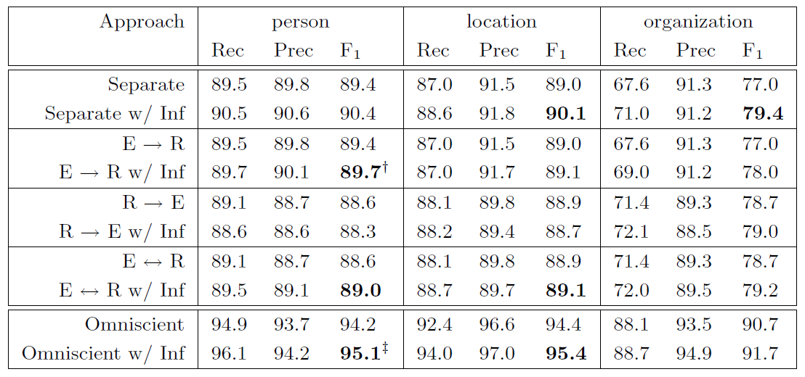
Entity Results
Notes:
This paper tests using 5-fold cross validation.
Omniscient: Trains two classifiers separately.
Assumes that the entity classifier knows the correct relation labels, and the relation classifier knows the correct entity labels.

Slide 28
Entity Results

Slide 29
Entity Results
Notes:
We can see in all of these models that using global inference improves the accuracy.
An interesting thing to note is that even the Omniscient model, which may be able to learn the constraints from the data, still sees improvement from employing inference.

Slide 30
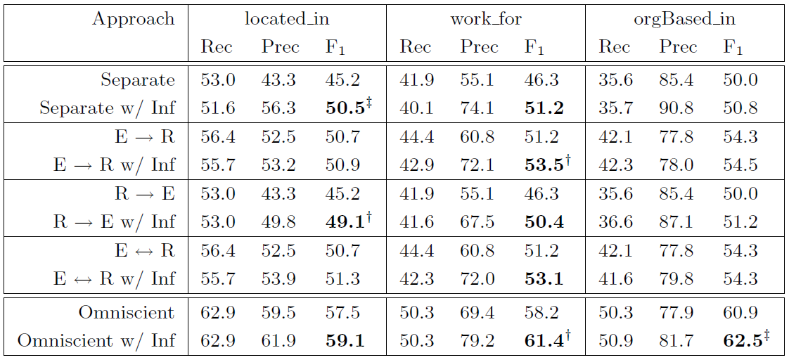
Relation Results

Slide 31
Relation Results

Slide 32
Relation Results

Slide 33
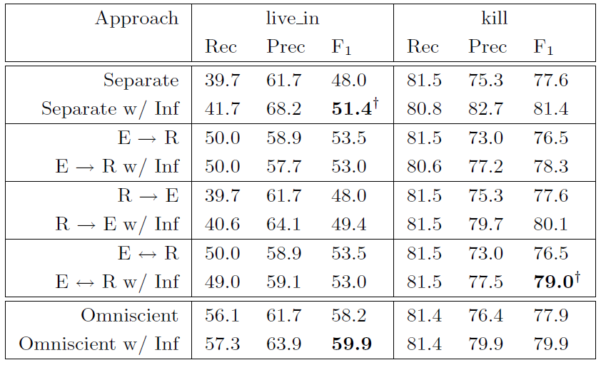
Relation Results

Slide 34
Relation Results

Slide 35

Additional Experiments
Quality of the decisions
  When the inference procedure is not applied, 5-25% of the predictions are incoherent.
  The global inference procedure never generates incoherent predictions.
Forced decision test
  Assumes that the system knows which sentence have the “kill” relation at decision time.
  Includes the constraint:
  Improves the F₁ score of the “kill” relation to 86.2%.
Notes:
A coherent prediction occurs if, for a relation variable and its two corresponding entity variables, the labels of these variables are predicted correctly and the relation is active.
Quality is the number of coherent predictions divided by the sum of coherent and incoherent predictions.
The system does not know which pair of entities have the kill relation.

Slide 36
References
D. Roth and W. Yih, A Linear Programming Formulation for Global Inference in Natural Language Tasks. CoNLL 2004
Wen-tau Yih. Notes on Global Inference as Integer Linear Programming. 2004.

