Slide 1
CIS 700
Advanced Machine Learning for NLP
Multiclass classification: Local and Global Views
Dan Roth
Department of Computer and Information Science
University of Pennsylvania
Augmented and modified by Vivek Srikumar

Slide 2
Administration
Critical Reviews: Some reviews are missing
  Please follow the schedule on the web
Projects:
  NN 17 CCM 7 SVM 6 Perc 6 Exp 5
Groups:
  10 groups, two focused on each technical direction.
  Software:
  Neural Networks: Software – on your own
  Structured SVMs: use Illinois-SL
  Structured Perceptron: use Illinois-SL
  CCMs: use LBJava or Illinois-SL
  Exp: Software – on your own.
  Readers will be given; feel free to use the Illinois NLP Pipeline and/or any other tool.
Content and Requirements:

Slide 3
Outline
A high level view of Structured Prediction
Sequence models
Hidden Markov models
  Inference with HMM
  Learning
Conditional Models and Local Classifiers
Global models
  Conditional Random Fields
  Structured Perceptron for sequences

Slide 4
Structured Prediction: Inference
Placing in context: a crash course in structured prediction
Inference: given input x (a document, a sentence),
predict the best structure y = {y₁,y₂,…,y_{n}} 2 Y (entities & relations)
  Assign values to the y₁,y₂,…,y_{n}, accounting for dependencies among y_{i}s
Inference is expressed as a maximization of a scoring function
y’ = argmax_{y 2 Y} w^{T} Á (x,y)
Inference requires, in principle, touching all y 2 Y at decision time, when we are given x 2 X and attempt to determine the best y 2 Y for it, given w
  For some structures, inference is computationally easy.
  Eg: Using the Viterbi algorithm
  In general, NP-hard (can be formulated as an ILP)
Joint features on inputs and outputs
Set of allowed structures
Feature Weights
(estimated during learning)

Slide 5
Structured Prediction: Learning
Learning: given a set of structured examples {(x,y)}
find a scoring function w that minimizes empirical loss.
Learning is thus driven by the attempt to find a weight vector w such that for each given annotated example (x_{i}, y_{i}):

Slide 6
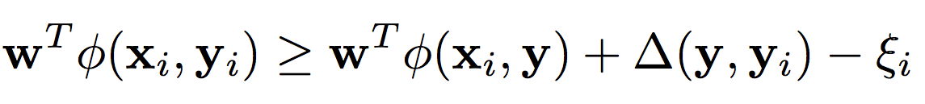
Structured Prediction: Learning
Learning: given a set of structured examples {(x,y)}
find a scoring function w that minimizes empirical loss.
Learning is thus driven by the attempt to find a weight vector w such that for each given annotated example (x_{i}, y_{i}):
We call these conditions the learning constraints.
In most learning algorithms used today, the update of the weight vector w is done in an on-line fashion,
  Think about it as Perceptron; this procedure applies to Structured Perceptron, CRFs, Linear Structured SVM
W.l.o.g. (almost) we can thus write the generic structured learning algorithm as follows:
Score of annotated structure
Score of any other structure
Penalty for predicting other structure
8 y

Slide 7
Structured Prediction: Learning Algorithm
In the structured case, the prediction (inference) step is often intractable and needs to be done many times
For each example (x_{i}, y_{i})
Do: (with the current weight vector w)
  Predict: perform Inference with the current weight vector
    y_{i}’ = argmax_{y 2 Y} w^{T} Á ( x_{i} ,y)
  Check the learning constraints
    Is the score of the current prediction better than of (x_{i}, y_{i})?
  If Yes – a mistaken prediction
    Update w
  Otherwise: no need to update w on this example
EndFor

Slide 8
Structured Prediction: Learning Algorithm
Solution I: decompose the scoring function to EASY and HARD parts
For each example (x_{i}, y_{i})
Do:
  Predict: perform Inference with the current weight vector
    y_{i}’ = argmax_{y 2 Y} w_{EASY}^{T} Á_{EASY} ( x_{i} ,y) + w_{HARD}^{T} Á_{HARD} ( x_{i} ,y)
  Check the learning constraint
    Is the score of the current prediction better than of (x_{i}, y_{i})?
  If Yes – a mistaken prediction
    Update w
  Otherwise: no need to update w on this example
EndDo
EASY: could be feature functions that correspond to an HMM, a linear CRF, or even Á_{EASY} (x,y) = Á(x), omiting dependence on y, corresponding to classifiers.
May not be enough if the HARD part is still part of each inference step.

Slide 9
Structured Prediction: Learning Algorithm
Solution II: Disregard some of the dependencies: assume a simple model.
For each example (x_{i}, y_{i})
Do:
  Predict: perform Inference with the current weight vector
    y_{i}’ = argmax_{y 2 Y} w_{EASY}^{T} Á_{EASY} ( x_{i} ,y) + w_{HARD}^{T} Á_{HARD} ( x_{i} ,y)
  Check the learning constraint
    Is the score of the current prediction better than of (x_{i}, y_{i})?
  If Yes – a mistaken prediction
    Update w
  Otherwise: no need to update w on this example
EndDo

Slide 10
Structured Prediction: Learning Algorithm
Solution III: Disregard some of the dependencies during learning; take into account at decision time
For each example (x_{i}, y_{i})
Do:
  Predict: perform Inference with the current weight vector
    y_{i}’ = argmax_{y 2 Y} w_{EASY}^{T} Á_{EASY} ( x_{i} ,y) + w_{HARD}^{T} Á_{HARD} ( x_{i} ,y)
  Check the learning constraint
    Is the score of the current prediction better than of (x_{i}, y_{i})?
  If Yes – a mistaken prediction
    Update w
  Otherwise: no need to update w on this example
EndDo
    y_{i}’ = argmax_{y 2 Y} w_{EASY}^{T} Á_{EASY} ( x_{i} ,y) + w_{HARD}^{T} Á_{HARD} ( x_{i} ,y)
This is the most commonly used solution in NLP today

Slide 11
Outline
Sequence models
Hidden Markov models
  Inference with HMM
  Learning
Conditional Models and Local Classifiers
Global models
  Conditional Random Fields
  Structured Perceptron for sequences

Slide 12
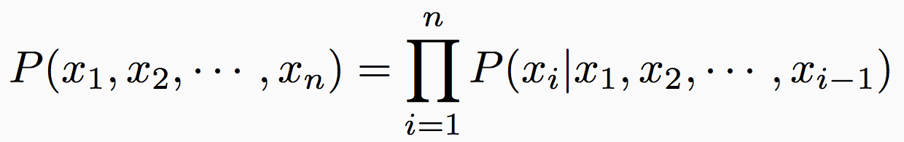
Sequences
Sequences of states
  Text is a sequence of words or even letters
  A video is a sequence of frames
If there are K unique states, the set of unique state sequences is infinite
Our goal (for now): Define probability distributions over sequences
If x₁, x₂, ☹, x_{n} is a sequence that has n tokens, we want to be able to define
  …for all values of n

Slide 13
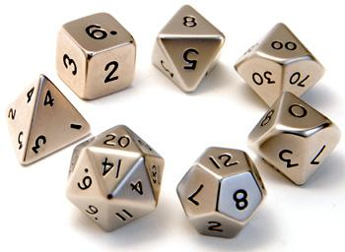
A history-based model
Each token is dependent on all the tokens that came before it
  Simple conditioning
  Each P(x_{i} | …) is a multinomial probability distribution over the tokens

Slide 14
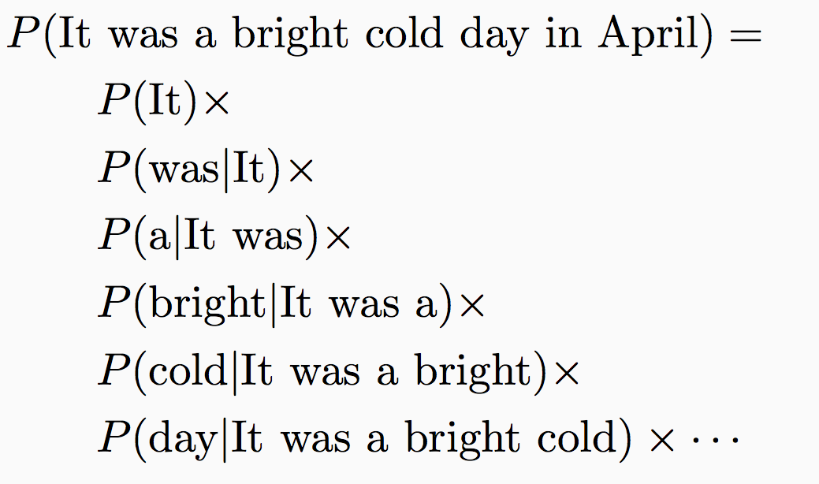
Example: A Language model
It was a bright cold day in April.
Probability of a word starting a sentence
Probability of a word following “It”
Probability of a word following “It was”
Probability of a word following “It was a”

Slide 15
A history-based model
Each token is dependent on all the tokens that came before it
  Simple conditioning
  Each P(x_{i} | …) is a multinomial probability distribution over the tokens
What is the problem here?
  How many parameters do we have?
    Grows with the size of the sequence!

Slide 16
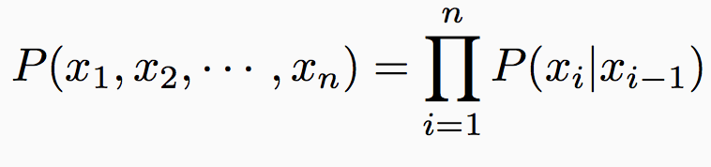
Solution: Lose the history
Discrete Markov Process
A system can be in one of K states at a time
State at time t is x_{t}
First-order Markov assumption
  The state of the system at any time is independent of the full sequence history given the previous state
  Defined by two sets of probabilities:
    Initial state distribution: P(x₁ = S_{j})
    State transition probabilities: P(x_{i} = S_{j} | x_{i-1} = S_{k})

Slide 17
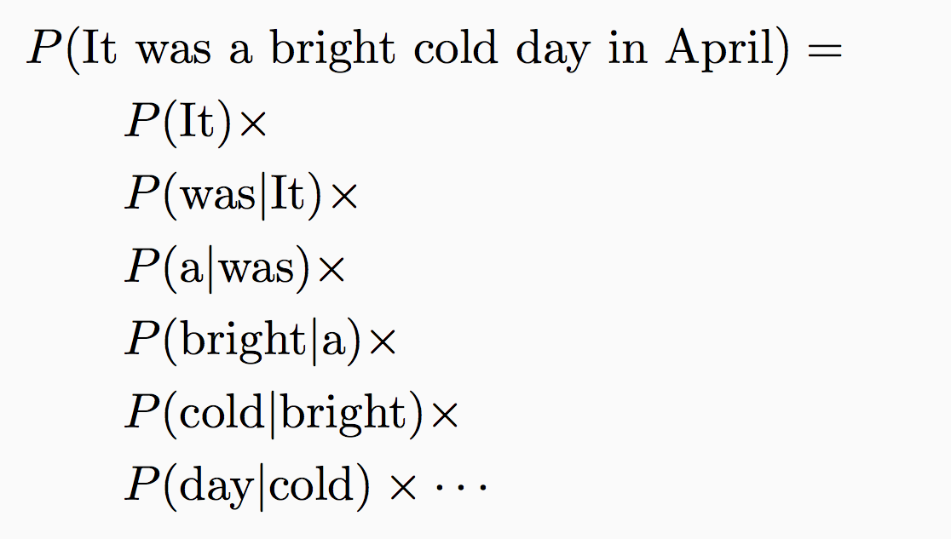
Example: Another language model
It was a bright cold day in April
Probability of a word starting a sentence
Probability of a word following “It”
Probability of a word following “was”
Probability of a word following “a”
If there are K tokens/states, how many parameters do we need?
O(K²)

Slide 18
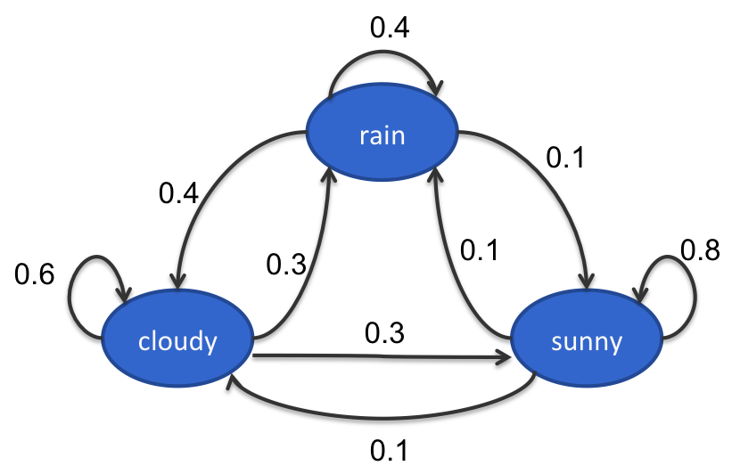
Example: The weather
Three states: rain, cloudy, sunny
Observations are Markov chains:
  Eg: cloudy sunny sunny rain
    Probability of the sequence =
      P(cloudy) P(sunny|cloudy) P(sunny | sunny) P(rain | sunny)
State transitions:
Initial probability
Transition probabilities
These probabilities define the model; can find P(any sequence)

Slide 19
m^{th} order Markov Model
A generalization of the first order Markov Model
  Each state is only dependent on m previous states
  More parameters
  But still less than storing entire history
Questions?

Slide 20
Outline
Sequence models
Hidden Markov models
  Inference with HMM
  Learning
Conditional Models and Local Classifiers
Global models
  Conditional Random Fields
  Structured Perceptron for sequences

Slide 21
Hidden Markov Model
Discrete Markov Model:
  States follow a Markov chain
  Each state is an observation
Hidden Markov Model:
  States follow a Markov chain
  States are not observed
  Each state stochastically emits an observation

Slide 22
Toy part-of-speech example
The Fed raises interest rates
Transitions
Emissions
P(The | Determiner) = 0.5
P(A | Determiner) = 0.3
P(An | Determiner) = 0.1
P(Fed | Determiner) = 0
…
P(Fed| Noun) = 0.001
P(raises| Noun) = 0.04
P(interest| Noun) = 0.07
P(The| Noun) = 0
…
Determiner
Noun
Verb
start
Determiner
Noun
Verb
Noun
Noun
Initial
The
Fed
raises
interest
rates

Slide 23
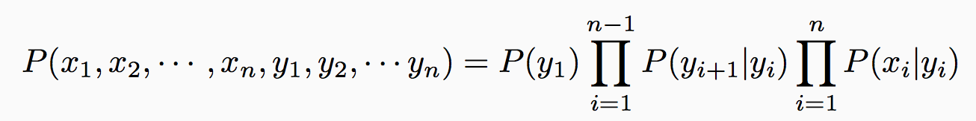
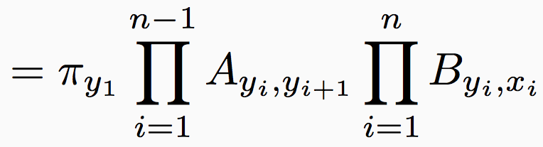
Joint model over states and observations
Notation
  Number of states = K, Number of observations = M
  ¼: Initial probability over states (K dimensional vector)
  A: Transition probabilities (K£K matrix)
  B: Emission probabilities (K£M matrix)
Probability of states and observations
  Denote states by y₁, y₂, ☹ and observations by x₁, x₂, ☹

Slide 24
Example: Named Entity Recognition
Goal: To identify persons, locations and organizations in text
B-org O B-per I-per O O
Facebook CEO Mark Zuckerberg announced new
O O O O O O B-loc I-loc
privacy features in the conference in San Francisco
States
Observations

Slide 25
Other applications
Speech recognition
  Input: Speech signal
  Output: Sequence of words
NLP applications
  Information extraction
  Text chunking
Computational biology
  Aligning protein sequences
  Labeling nucleotides in a sequence as exons, introns, etc.
Questions?

Slide 26
Three questions for HMMs
[Rabiner 1999]
Given an observation sequence, x₁, x₂, ☹ x_{n} and a model (¼, A, B), how to efficiently calculate the probability of the observation?
Given an observation sequence, x₁, x₂, ☹, x_{n} and a model (¼, A, B), how to efficiently calculate the most probable state sequence?
How to calculate (¼, A, B) from observations?

Slide 27
Outline
Sequence models
Hidden Markov models
  Inference with HMM
  Learning
Conditional Models and Local Classifiers
Global models
  Conditional Random Fields
  Structured Perceptron for sequences

Slide 28
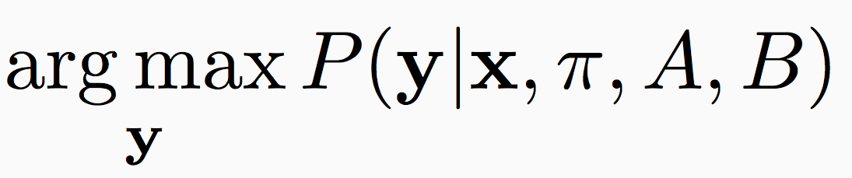
Most likely state sequence
Input:
  A hidden Markov model (¼, A, B)
  An observation sequence x = (x₁, x₂, ☹, x_{n})
Output: A state sequence y = (y₁, y₂, ☹, y_{n}) that corresponds to
  Maximum a posteriori inference (MAP inference)
Computationally: combinatorial optimization
Some slides based on Noah Smith’s slides

Slide 29
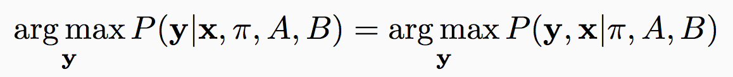
MAP inference
We want
We have defined
But, P(y | x, ¼, A, B) / P(x, y |¼, A, B)
  And we don’t care about P(x) we are maximizing over y
So,

Slide 30
How many possible sequences?
The | Fed | raises | interest | rates
Determiner | Verb | Verb | Verb | Verb
 | Noun | Noun | Noun | Noun
1 | 2 | 2 | 2 | 2
List of allowed tags for each word
In this simple case, 16 sequences (1¢2¢2¢2¢2)

Slide 31
How many possible sequences?
Observations
x₁ | x₂ | … | x_{n}
s₁ | s₁ | … | s₁
s₂ | s₂ |  | s₂
s₃ | s₂ |  | s₃
. | . |  | .
. | . |  | .
s_{K} | s_{K} |  | s_{K}
List of allowed states for each observation
Output: One state per observation y_{i} = s_{j}
K^{n} possible sequences to consider in

Slide 32
Naïve approaches
Try out every sequence
  Score the sequence y as P(y|x, ¼, A, B)
  Return the highest scoring one
  What is the problem?
    Correct, but slow, O(K^{n})
Greedy search
  Construct the output left to right
  For each i, elect the best y_{i} using y_{i-1} and x_{i}
  What is the problem?
    Incorrect but fast, O(n)

Slide 33
Solution: Use the independence assumptions
Recall: The first order Markov assumption
The state at token i is only influenced by the previous state, the next state and the token itself
Given the adjacent labels, the others do not matter
Suggests a recursive algorithm

Slide 34
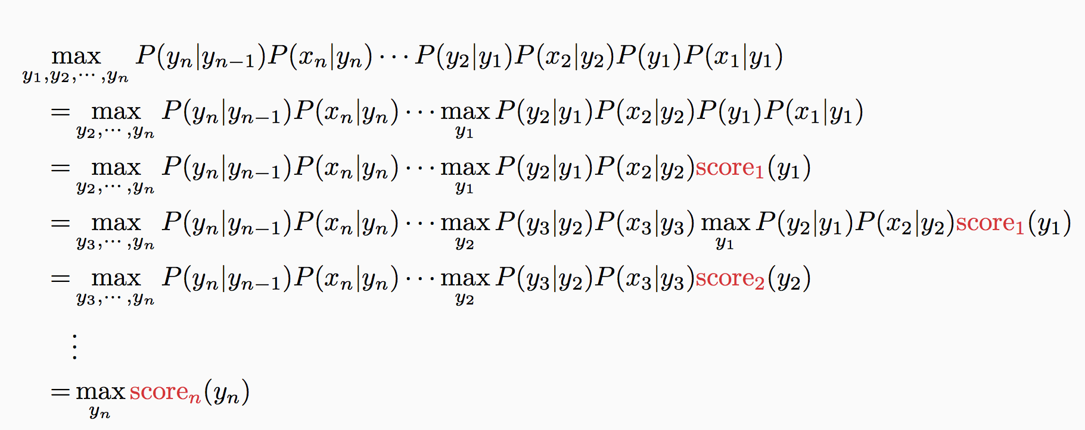
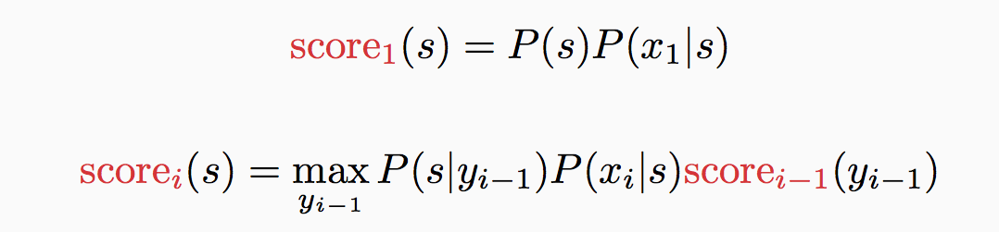
Deriving the recursive algorithm
Transition probabilities
Emission probabilities
Initial probability
y₁
y₂
y₃
…
y_{n}
x₁
x₂
x₃
x_{n}

Slide 35
Deriving the recursive algorithm
The only terms that depend on y₁
y₁
y₂
y₃
…
y_{n}
x₁
x₂
x₃
x_{n}

Slide 36
Deriving the recursive algorithm
Abstract away the score for all decisions till here into score
y₁
y₂
y₃
…
y_{n}
x₁
x₂
x₃
x_{n}

Slide 37
Deriving the recursive algorithm
Only terms that depend on y₂
y₁
y₂
y₃
…
y_{n}
x₁
x₂
x₃
x_{n}

Slide 38
Deriving the recursive algorithm
y₁
y₂
y₃
…
y_{n}
x₁
x₂
x₃
x_{n}
Abstract away the score for all decisions till here into score

Slide 39
Deriving the recursive algorithm
y₁
y₂
y₃
…
y_{n}
x₁
x₂
x₃
x_{n}
Abstract away the score for all decisions till here into score

Slide 40
Deriving the recursive algorithm

Slide 41

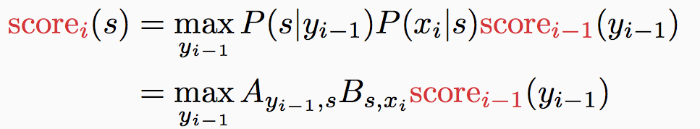

Viterbi algorithm
¼: Initial probabilities
A: Transitions
B: Emissions
Max-product algorithm for first order sequences
Initial: For each state s, calculate
Recurrence: For i = 2 to n, for every state s, calculate
Final state: calculate
This only calculates the max. To get final answer (argmax),
keep track of which state corresponds to the max at each step
build the answer using these back pointers
Questions?

Slide 42
General idea
Dynamic programming
  The best solution for the full problem relies on best solution to sub-problems
  Memoize partial computation
Examples
  Viterbi algorithm
  Dijkstra’s shortest path algorithm
  …

Slide 43
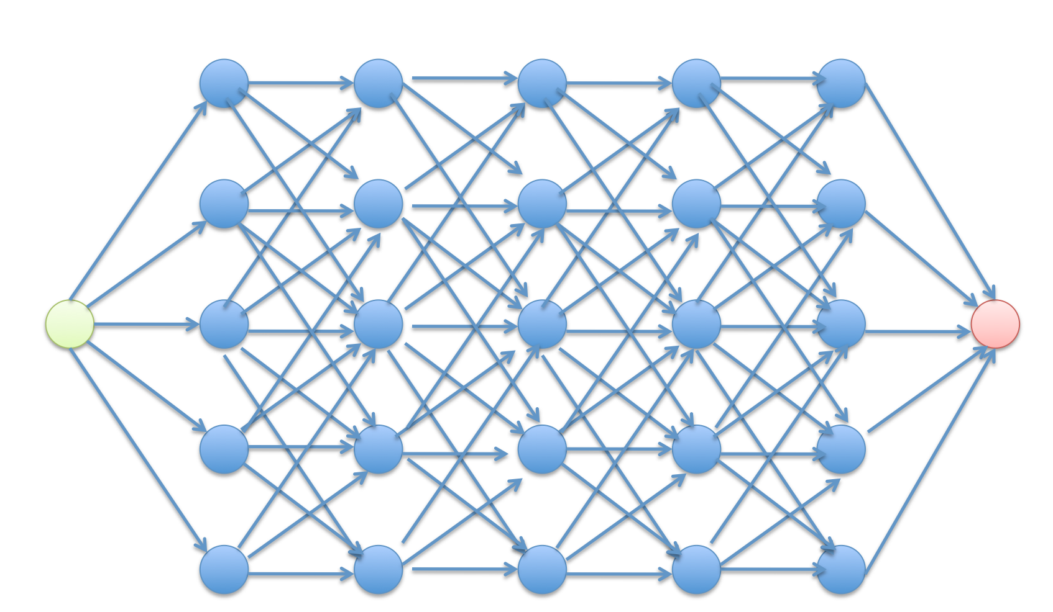
Viterbi algorithm as best path
Goal: To find the highest scoring path in this trellis

Slide 44
Complexity of inference
Complexity parameters
  Input sequence length: n
  Number of states: K
Memory
  Storing the table: nK (scores for all states at each position)
Runtime
  At each step, go over pairs of states
  O(nK²)
Questions?

Slide 45
Outline
Sequence models
Hidden Markov models
  Inference with HMM
  Learning
Conditional Models and Local Classifiers
Global models
  Conditional Random Fields
  Structured Perceptron for sequences

Slide 46
Learning HMM parameters
Assume we know the number of states in the HMM
Two possible scenarios
  We are given a data set D = {<x_{i}, y_{i}>} of sequences labeled with states
    And we have to learn the parameters of the HMM (¼, A, B)
  We are given only a collection of sequences D = {x_{i}}
    And we have to learn the parameters of the HMM (¼, A, B)
    EM algorithm: We will look at this setting in a subsequent lecture
Supervised learning with complete data
Unsupervised learning, with incomplete data

Slide 47
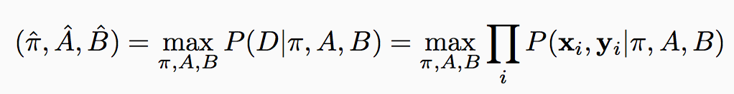
Supervised learning of HMM
We are given a dataset D = {<x_{i}, y_{i}>}
  Each x_{i} is a sequence of observations and y_{i} is a sequence of states that correspond to x_{i}
  Goal: Learn initial, transition, emission distributions (¼, A, B)
How do we learn the parameters of the probability distribution?
  The maximum likelihood principle
Where have we seen this before?
And we know how to write this in terms of the parameters of the HMM

Slide 48
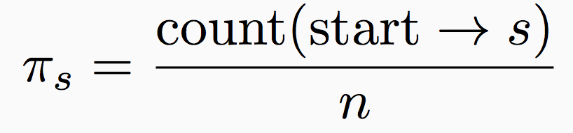
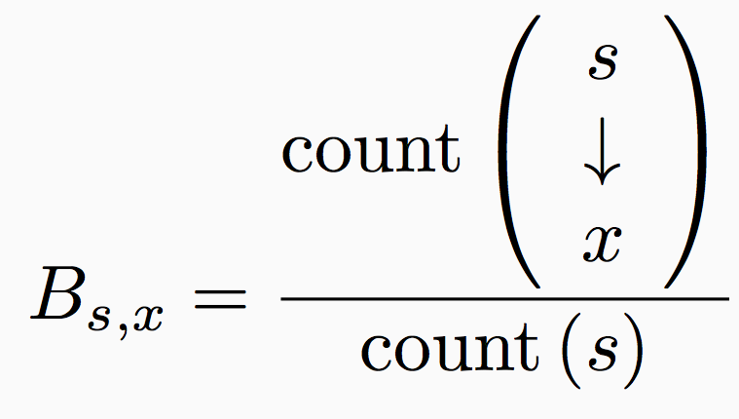
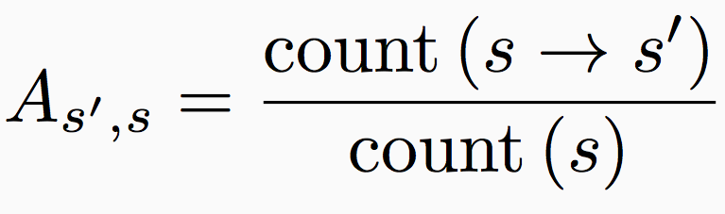
Supervised learning details
¼, A, B can be estimated separately just by counting
  Makes learning simple and fast
[Exercise: Derive the following using derivatives of the log likelihood. Requires Lagrangian multipliers.]
Number of instances where the first state is s
Number of examples
Initial probabilities
Transition probabilities
Emission probabilities

Slide 49
Priors and smoothing
Maximum likelihood estimation works best with lots of annotated data
  Never the case
Priors inject information about the probability distributions
  Dirichlet priors for multinomial distributions
Effectively additive smoothing
  Add small constants to the counts

Slide 50
Hidden Markov Models summary
Predicting sequences
  As many output states as observations
Markov assumption helps decompose the score
Several algorithmic questions
  Most likely state
  Learning parameters
    Supervised, Unsupervised
  Probability of an observation sequence
    Sum over all assignments to states, replace max with sum in Viterbi
  Probability of state for each observation
    Sum over all assignments to all other states
Questions?

Slide 51
HMM redux
Probability of input given the prediction!
The independence assumption
Training via maximum likelihood
We are optimizing joint likelihood of the input and the output for training
At prediction time, we only care about the probability of output given the input. Why not directly optimize this conditional likelihood instead?

Slide 52
Modeling next-state directly
Instead of modeling the joint distribution P(x, y) only focus on P(y|x)
  Which is what we care about eventually anyway
For sequences, different formulations
  Maximum Entropy Markov Model [McCallum, et al 2000]
  Projection-based Markov Model [Punyakanok and Roth, 2001]
  (other names: discriminative/conditional markov model, …)

Slide 53
Generative vs Discriminative models
Generative models
  learn P(x, y)
  Characterize how the data is generated (both inputs and outputs)
  Eg: Naïve Bayes, Hidden Markov Model
Discriminative models
  learn P(y | x)
  Directly characterizes the decision boundary only
  Eg: Logistic Regression, Conditional models (several names)
A generative model tries to characterize the distribution of the inputs, a discriminative model doesn’t care
Questions?

Slide 54

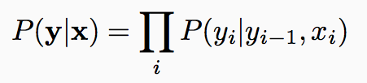
Another independence assumption
This assumption lets us write the conditional probability of the output as
y_{t-1}
y_{t}
y_{t-1}
y_{t}
HMM
Conditional
model
x_{t}
x_{t}
We need to learn this function

Slide 55
Modeling P(y_{i} | y_{i-1}, x_{i})
Different approaches possible
  Train a maximum entropy classifier
  Or, ignore the fact that we are predicting a probability, we only care about maximizing some score. Train any classifier, using say the perceptron algorithm
For both cases:
  Use rich features that depend on input and previous state
  We can increase the dependency to arbitrary neighboring x_{i}’s
    Eg. Neighboring words influence this words POS tag

Slide 56
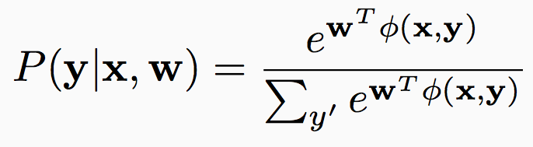
Detour: Log-linear models for multiclass
Consider multiclass classification
  Inputs: x
  Output: y 2 {1, 2, ☹ , K}
  Feature representation: Á(x, y)
    We have seen this before
Define probability of an input x taking a label y as
A generalization of logistic regression to multi-class
Interpretation: Score for label, converted to a well-formed probability distribution by exponentiating + normalizing

Slide 57
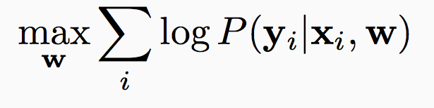
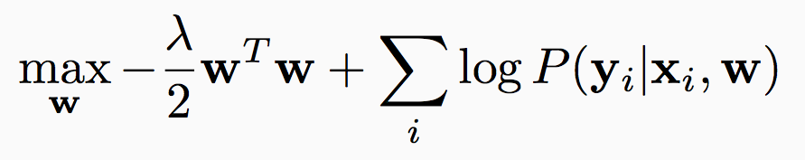
Training a log-linear model
Given a data set D = {<x_{i}, y_{i}>}
  Apply the maximum likelihood principle
  Maybe with a regularizer
Here

Slide 58
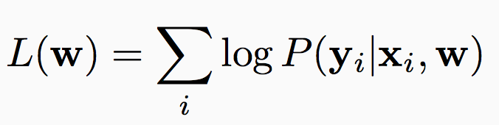
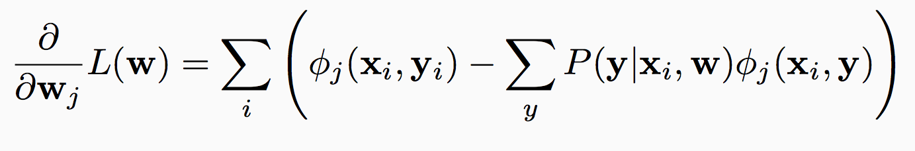
How to maximize?
Gradient based methods
  using gradient of
Simple approach
  Initialize w Ã 0
  For t = 1, 2, …
    Update w Ã w + ®_{t} r L(w)
  Return w
In practice, use more sophisticated methods
  Off the shelf L-BFGS implementations available
A vector, whose j^{th} element is the derivative of L with w_{j}.
Has a neat interpretation
Empirical value of the j^{th} feature
The expected value of this feature according to the current model
Questions?

Slide 59
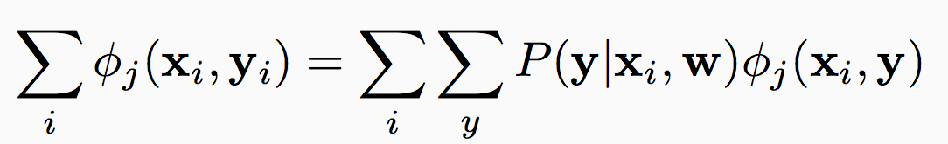
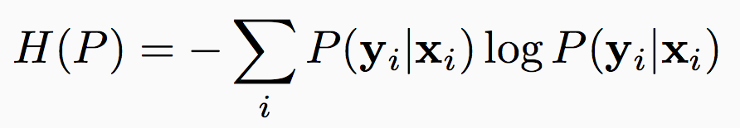
Another training idea: MaxEnt
Consider all distributions P such that the empirical counts of the features matches the expected counts
Recall: Entropy of a distribution P(y|x) is
  A measure of smoothness
  Without any other information, maximized by the uniform distribution
Maximum entropy learning
argmax_{p} H(p) such that it satisfies this constraint

Slide 60
Maximum Entropy distribution = log-linear
Theorem
The maximum entropy distribution among those satisfying the constraint has an exponential form
Among exponential distributions, the maximum entropy distribution is the most likely distribution
Questions?

Slide 61
The next-state model
Back to sequences
This assumption lets us write the conditional probability of the output as
y_{t-1}
y_{t}
y_{t-1}
y_{t}
HMM
Conditional
model
x_{t}
x_{t}
We need to learn this function

Slide 62
Modeling P(y_{i} | y_{i-1}, x_{i})
P(y_{i} | y_{i-1}, x)
Different approaches possible
  Train a maximum entropy classifier
    Basically, multinomial logistic regression
  Ignore the fact that we are predicting a probability, we only care about maximizing some score. Train any classifier, using say the perceptron algorithm
For both cases:
  Use rich features that depend on input and previous state
  We can increase the dependency to arbitrary neighboring x_{i}’s
    Eg. Neighboring words influence this words POS tag

Slide 63
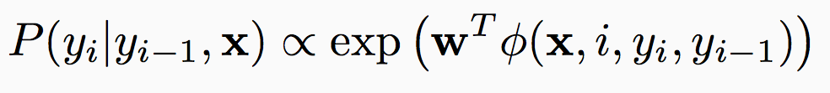
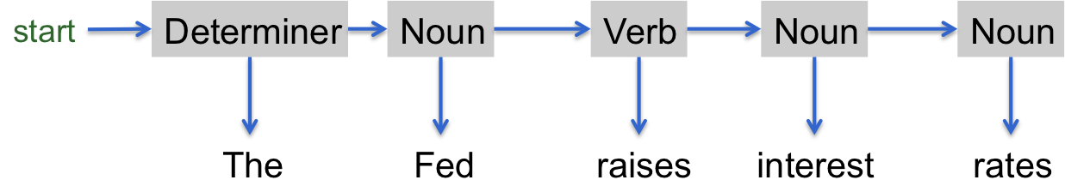
Maximum Entropy Markov Model
Goal: Compute P(y | x)
start
Determiner
Noun
Verb
Noun
Noun
The
Fed
raises
interest
rates
word
The
Fed
raises
interest
rates
Caps
Y
Y
N
N
N
Can get very creative here
-es
N
N
Y
N
N
Previous
start
Determiner
Noun
Verb
Noun
Á(x, 0, start, y₀)
Á(x, 1, y_{0,} y₁)
Á(x, 2, y₁, y₂)
Á(x, 3, y₂, y₃)
Á(x, 4, y₃, y₄)
Compare to HMM: Only depends on the word and the previous tag
Questions?

Slide 64
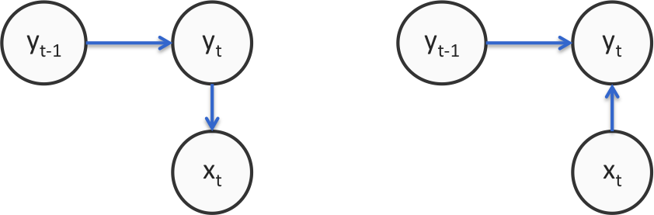
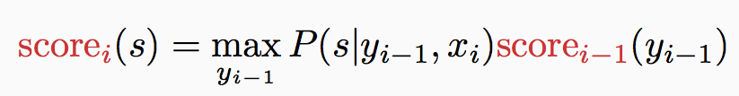
Using MEMM
Training
  Next-state predictor locally as maximum likelihood
    Similar to any maximum entropy classifier
Prediction/decoding
  Modify the Viterbi algorithm for the new independence assumptions
HMM
Conditional Markov model

Slide 65
Generalization: Any multiclass classifier
Viterbi decoding: we only need a score for each decision
  So far, probabilistic classifiers
In general, use any learning algorithm to build get a score for the label y_{i} given y_{i-1} and x
  Multiclass versions of perceptron, SVM
  Just like MEMM, these allow arbitrary features to be defined
Exercise: Viterbi needs to be re-defined to work with sum of scores rather than the product of probabilities

Slide 66
Comparison to HMM
What we gain
  Rich feature representation for inputs
    Helps generalize better by thinking about properties of the input tokens rather than the entire tokens
    Eg: If a word ends with –es, it might be a present tense verb (such as raises). Could be a feature; HMM cannot capture this
  Discriminative predictor
    Model P(y | x) rather than P(y, x)
    Joint vs conditional
Questions?

Slide 67
But…local classifiers ! Label bias problem
Recall: the independence assumption
“Next-state” classifiers are locally normalized
Eg: Part-of-speech tagging the sentence
Option 1: P(D | The) ¢
P(N | D, robot) ¢
P(N | N, wheels) ¢
P(V | N, are) ¢
P(A | V, round)
The
robot
wheels
are
round
1
1
N
V
A
0.8
1
Option 2: P(D | The) ¢
P(N | D, robot) ¢
P(V | N, wheels) ¢
P(N | V, are) ¢
P( R| N, round)
D
N
1
1
0.2
V
N
R
Suppose these are the only state transitions allowed
Example based on [Wallach 2002]

Slide 68
But…local classifiers ! Label bias problem
The
robot
wheels
are
round
Option 1: P(D | The) ¢
P(N | D, robot) ¢
P(N | N, wheels) ¢
P(V | N, are) ¢
P(A | V, round)
1
1
N
V
A
0.8
D
1
N
1
1
0.2
V
N
R
Option 2: P(D | The) ¢
P(N | D, robot) ¢
P(V | N, wheels) ¢
P(N | V, are) ¢
P( R| N, round)
Suppose these are the only state transitions allowed

Slide 69
But…local classifiers ! Label bias problem
The
robot
wheels
are
round
Option 1: P(D | The) ¢
P(N | D, robot) ¢
P(N | N, wheels) ¢
P(V | N, are) ¢
P(A | V, round)
1
1
N
V
A
0.8
P(V | N, Fred) ¢
D
1
N
1
1
0.2
V
N
R
Option 2: P(D | The) ¢
P(N | D, robot) ¢
P(V | N, wheels) ¢
P(N | V, are) ¢
P( R| N, round)
Suppose these are the only state transitions allowed
P(N | V, Fred) ¢
The
robot
wheels
Fred
round
The path scores are the same
Even if the word Fred is never observed as a verb in the data, it will be predicted as one
The input Fred does not influence the output at all

Slide 70
Label Bias
States with a single outgoing transition effectively ignore their input
  States with lower-entropy next states are less influenced by observations
Why?
  Because each the next-state classifiers are locally normalized
  If a state has fewer next states, each of those will get a higher probability mass
    …and hence preferred
Side note: Surprisingly doesn’t affect some tasks
  Eg: POS tagging

Slide 71
Summary: Local models for Sequences
Conditional models
Use rich features in the mode
Possibly suffer from label bias problem

Slide 72
Outline
Sequence models
Hidden Markov models
  Inference with HMM
  Learning
Conditional Models and Local Classifiers
Global models
  Conditional Random Fields
  Structured Perceptron for sequences

Slide 73
Outline
Sequence models
Hidden Markov models
  Inference with HMM
  Learning
Conditional Models and Local Classifiers
Global models
  Conditional Random Fields
  Structured Perceptron for sequences

Slide 74
So far…
Hidden Markov models
  Pros: Decomposition of total probability with tractable
  Cons: Doesn’t allow use of features for representing inputs
    Also, joint model
Local, conditional Markov Models
  Pros: Conditional model, allows features to be used
  Cons: Label bias problem

Slide 75
Global models
Train the predictor globally
  Instead of training local decisions independently
Normalize globally
  Make each edge in the model undirected
  Not associated with a probability, but just a “score”
Recall the difference between local vs. global for multiclass

Slide 76
HMM vs. A local model vs. A global model
P(y_{t} | y_{t-1})
P(y_{t} | y_{t-1}, x_{t})
f^{T}(y_{t}, y_{t-1})
y_{t-1}
y_{t}
y_{t-1}
y_{t}
y_{t-1}
y_{t}
P(x_{t} | y_{t})
f^{E}(y_{t}, x_{t})
HMM
x_{t}
Conditional
model
Global
model
x_{t}
x_{t}
Generative
Discriminative
Local: P is locally normalized to add up to one for each t
Global: The functions f^{T} and f^{E} are scores that are not normalized

Slide 77
Conditional Random Field
y₀
y₁
y₂
y₃
x
w^{T}Á(x, y₀, y₁)
w^{T}Á(x, y₁, y₂)
w^{T}Á(x, y₂, y₃)
Each node is a random variable
We observe some nodes and need to assign the rest
Each clique is associated with a score
Arbitrary features, as with local conditional models

Slide 78
Conditional Random Field: Factor graph
Factors
y₀
y₁
y₂
y₃
x
w^{T}Á(x, y₀, y₁)
w^{T}Á(x, y₁, y₂)
w^{T}Á(x, y₂, y₃)
Each node is a random variable
We observe some nodes and need to assign the rest
Each factor is associated with a score

Slide 79
Conditional Random Field: Factor graph
A different factorization: Recall decomposition of structures into parts. Same idea
y₀
y₁
y₂
y₃
x
w^{T}Á(y₀, y₁)
w^{T}Á(y₀, x)
w^{T}Á( y₁, y₂)
w^{T}Á( y₁, x)
w^{T}Á( y₂, x)
w^{T}Á( y₃, x)
w^{T}Á(x, y₂, y₃)
Each node is a random variable
We observe some nodes and need to assign the rest
Each clique is associated with a score

Slide 80
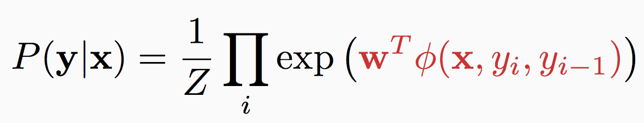
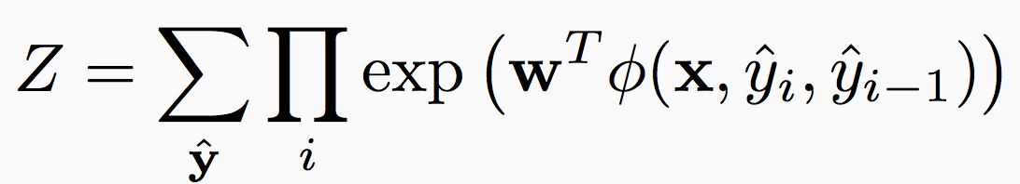
Conditional Random Field for sequences
Z: Normalizing constant, sum over all sequences
y₀
y₁
y₂
y₃
x
w^{T}Á(x, y₀, y₁)
w^{T}Á(x, y₁, y₂)
w^{T}Á(x, y₂, y₃)

Slide 81
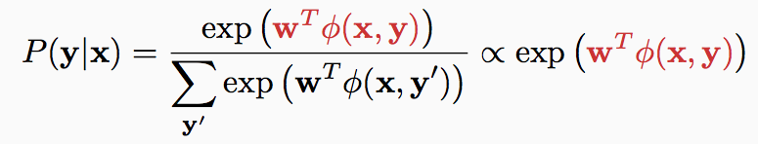
CRF: A different view
Input: x, Output: y, both sequences (for now)
Define a feature vector for the entire input and output sequence: Á(x, y)
Define a giant log-linear model, P(y | x) parameterized by w
  Just like any other log-linear model, except
    Space of y is the set of all possible sequences of the correct length
    Normalization constant sums over all sequences

Slide 82
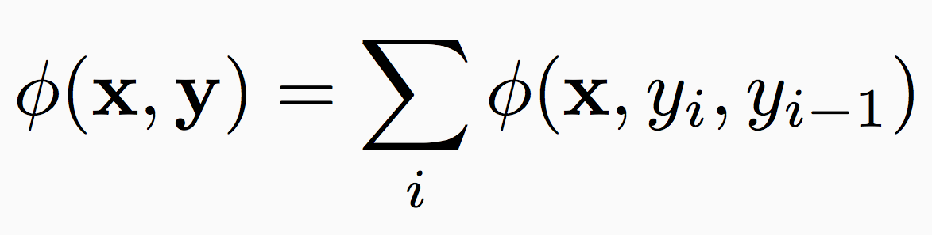
Global features
The feature function decomposes over the sequence
y₀
y₁
y₂
y₃
x
w^{T}Á(x, y₀, y₁)
w^{T}Á(x, y₁, y₂)
w^{T}Á(x, y₂, y₃)

Slide 83
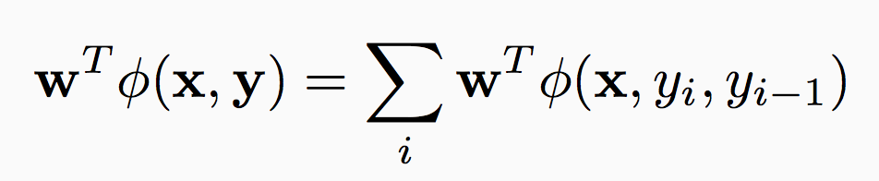
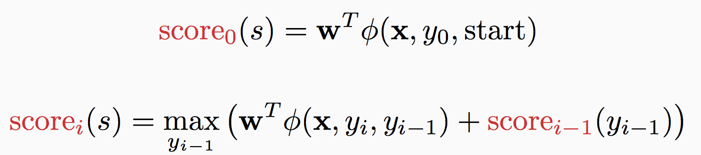
Prediction
Goal: To predict most probable sequence y an input x
But the score decomposes as
Prediction via Viterbi (with sum instead of product)

Slide 84
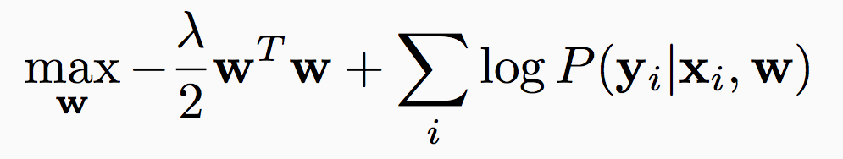
Training a chain CRF
Input:
  Dataset with labeled sequences, D = {<x_{i}, y_{i}>}
  A definition of the feature function
How do we train?
  Maximize the (regularized) log-likelihood
Recall: Empirical loss minimization

Slide 85
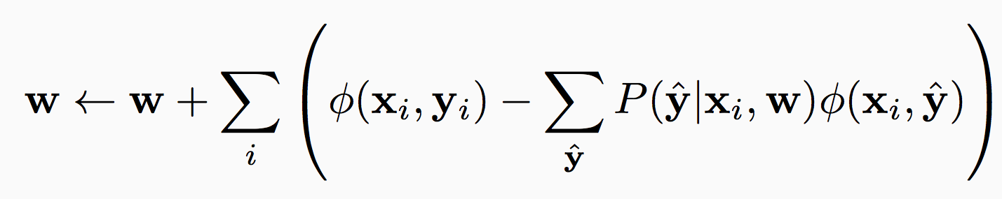
Training with inference
Many methods for training
  Numerical optimization
  Use an implementation of the L-BFGS algorithm in practice
    Stochastic gradient ascent is often competitive
Simple gradient ascent
Training involves inference!
  A different kind than what we have seen so far
  Summing over all sequences is just like Viterbi
    With summation instead of maximization

Slide 86
CRF summary
An undirected graphical model
  Decompose the score over the structure into a collection of factors
  Each factor assigns a score to assignment of the random variables it is connected to
Training and prediction
  Final prediction via argmax w^{T}Á(x, y)
  Train by maximum (regularized) likelihood
Relation to other models
  Effectively a linear classifier
  A generalization of logistic regression to structures
  An instance of Markov Random Field, with some random variables observed
    We will see this soon

Slide 87
Outline
Sequence models
Hidden Markov models
  Inference with HMM
  Learning
Conditional Models and Local Classifiers
Global models
  Conditional Random Fields
  Structured Perceptron for sequences

Slide 88
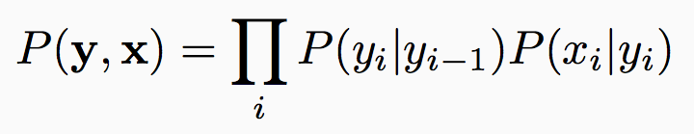
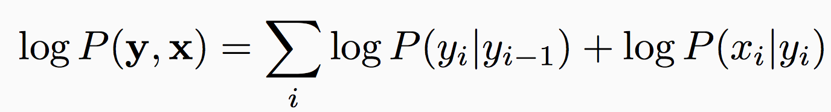
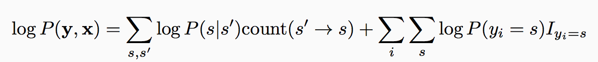
HMM is also a linear classifier
Consider the HMM
Or equivalently
This is a linear function
  log P terms are the weights; counts and indicators are features
  Can be written as w^{T}Á(x, y) and add more features
Indicators: I_{z} = 1 if z is true; else 0

Slide 89
HMM is a linear classifier
Det
Noun
Verb
Det
Noun
The
dog
ate
the
homework
Consider log P(x, y)
log P(x, y) = A linear scoring function = w^{T}Á(x,y)
log P(The | Det) £ 1
log P(Det ! Noun) £ 2
Á(x, y): Properties of this output and the input
+ log P(dog| Noun) £ 1
+ log P(Noun ! Verb) £ 1
+
+ log P(ate| Verb) £ 1
+ log P(Verb ! Det) £ 1
+ log P(the| Det) £ 1
+ log P(homework| Noun) £ 1
w: Parameters of the model

Slide 90
Towards structured Perceptron
HMM is a linear classifier
  Can we treat it as any linear classifier for training?
  If so, we could add additional features that are global properties
    As long as the output can be decomposed for easy inference
The Viterbi algorithm calculates max w^{T}Á(x, y)
    Viterbi only cares about scores to structures (not necessarily normalized)
We could push the learning algorithm to train for un-normalized scores
  If we need normalization, we could always normalize by computing exponentiating and dividing by Z
  That is, the learning algorithm can effectively just focus on the score of y for a particular x
  Train a discriminative model!

Slide 91
Structured Perceptron algorithm
In practice, good to shuffle D before the inner loop
Given a training set D = {(x,y)}
Initialize w = 0 2 <^{n}
For epoch = 1 … T:
  For each training example (x, y) 2 D:
    Predict y’ = argmax_{y’} w^{T}Á(x, y’)
    If y ≠ y’, update w Ã w + learningRate (Á(x, y) - Á(x, y’))
Return w
Prediction: argmax_{y} w^{T}Á(x, y)
T is a hyperparameter to the algorithm
Inference in training loop!
Update only on an error.
Perceptron is an mistake-driven algorithm.
If there is a mistake, promote y and demote y’

Slide 92
Notes on structured perceptron
Mistake bound for separable data, just like perceptron
In practice, use averaging for better generalization
  Initialize a = 0
  After each step, whether there is an update or not, a Ã w + a
    Note, we still check for mistake using w not a
  Return a at the end instead of w
    Exercise: Optimize this for performance – modify a only on errors
Global update
  One weight vector for entire sequence
    Not for each position
  Same algorithm can be derived from constraint classification
    Create a binary classification data set and run perceptron

Slide 93
Structured Perceptron with averaging
Given a training set D = {(x,y)}
Initialize w = 0 2 <^{n}, a = 0 2 <^{n}
For epoch = 1 … T:
  For each training example (x, y) 2 D:
    Predict y’ = argmax_{y’} w^{T}Á(x, y’)
    If y ≠ y’, update w Ã w + learningRate (Á(x, y) - Á(x, y’))
    Set a Ã a + w
Return a

Slide 94
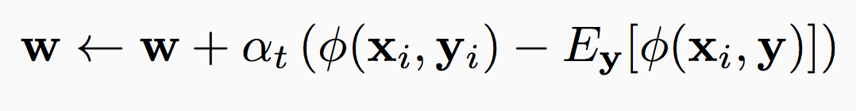
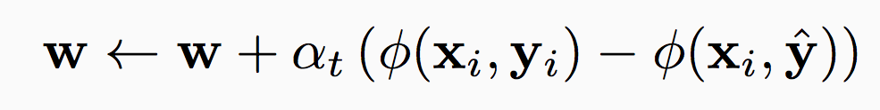
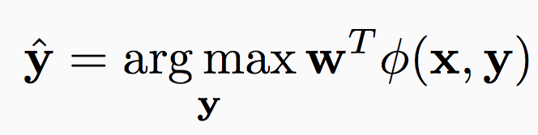
CRF vs. structured perceptron
Consider stochastic gradient descent update for CRF
  For a training example (x_{i}, y_{i})
Structured perceptron
  For a training example (x_{i}, y_{i})
Expectation vs max
Caveat: Adding regularization will change the CRF update, averaging changes the perceptron update

Slide 95
The lay of the land
HMM: A generative model, assigns probabilities to sequences
Two roads diverge
Hidden Markov Models are actually just linear classifiers
Don’t really care whether we are predicting probabilities. We are assigning scores to a full output for a given input (like multiclass)
Generalize algorithms for linear classifiers. Sophisticated models that can use arbitrary features
Structured Perceptron
Structured SVM
Model probabilities via logistic functions. Gives us the log-linear representation
Log-probabilities for sequences for a given input
Learn by maximizing likelihood. Sophisticated models that can use arbitrary features
Conditional Random field
Discriminative/Conditional models
Applicable beyond sequences
Eventually, similar objective minimized with different loss functions
Coming soon…

Slide 96
Sequence models: Summary
Goal: Predict an output sequence given input sequence
Hidden Markov Model
Inference
  Predict via Viterbi algorithm
Conditional models/discriminative models
  Local approaches (no inference during training)
    MEMM, conditional Markov model
  Global approaches (inference during training)
    CRF, structured perceptron
To think
  What are the parts in a sequence model?
  How is each model scoring these parts?
Prediction is not always tractable for general structures
Same dichotomy for more general structures

