Slide 1
CIS 700
Advanced Machine Learning for NLP
Inference
Applications
Dan Roth
Department of Computer and Information Science
University of Pennsylvania

Slide 2
Admin Stuff
On Thursday we will discuss the projects
  Please prepare a 5 minutes PPT presentation
  Send it to me by 4pm on Thursday.
The goal is to show where you are, highlight problems and need for changes
  Try to have some quantitative evaluation already!
  It often allows you to see where you are
Examples are key

Slide 3
Outline
Inference Formulations and Algorithms
  Integer Linear Programs
Applications
  “Difficulty” of modelling
  Dependency Parsing Example

Slide 4
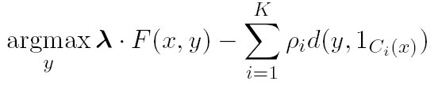
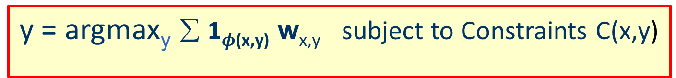
Setting
y = argmax_{y} ∑ 1$φ$_{(x,y)} w_{x,y} subject to Constraints C(x,y)
Modeling NLP problem Variables, Features and constraints | Objective function Constrained Conditional Model
Constrained optimization language How to represent inference? | Integer linear program
Inference How to solve it? | Several inference algorithms: Exact ILP, dual decomposition; search, relaxation; dynamic programming
Learning How to learn the objective function? | Learning λ and ρ. Several learning strategies: L+I, IBT, others.

Slide 5
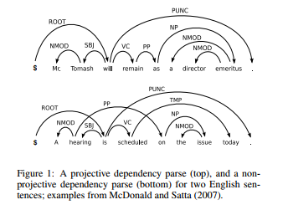
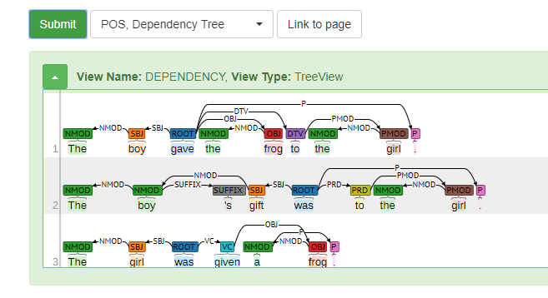
Dependency Parsing
https://github.com/CogComp/cogcomp-nlp

Slide 6
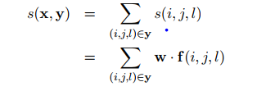
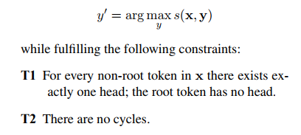
Modeling
Objective
Integer Linear Programming Formulation: Maximum Spanning Tree

Slide 7
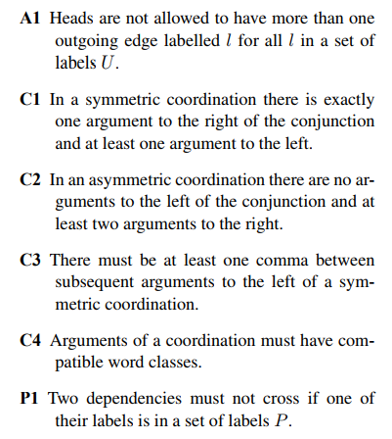
Modeling (2)
Can add a lot more linguistically motivated constraints

Slide 8
Lessons

Slide 9
Issues
Riedel and Clarke (2006):
  An ILP formulation for dependency parsing: MST + linguistically motivated “hard” constraints to forbid some arc configurations.
  Problem: The formulation includes an exponential number of constraints—one for each possible cycle.
  Proposed a cutting plane algorithm, invoking constraints selectively only when they are violated by the current solution.
  Still slow
Martins, Smith, Xing (2009)
  A single commodity flow formulation for the (undirected) minimum spanning tree problem (Magnanti and Wolsey (1994))
  Requires O(n² ) variables and constraints.

Slide 10
Setting
Modeling problems as structured prediction problems
Structure =
  Assumptions on the output; Knowledge about the output
  Augmenting Probabilistic Models with declarative constraints
The prediction (Inference) problem involves assigning values to a set of interdependent discrete variables
  We want to determine the best assignment
If you have a probabilistic model over the variables of interest this problem is often called the MAP problem (Maximum A-Posteriori)

Slide 11
Outline
Modeling problems as structured prediction problems
Hard and soft constraints to represent prior knowledge
  Augmenting Probabilistic Models with declarative constraints.
Inference Algorithms

Slide 12
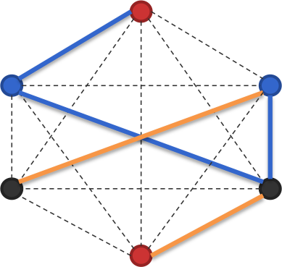
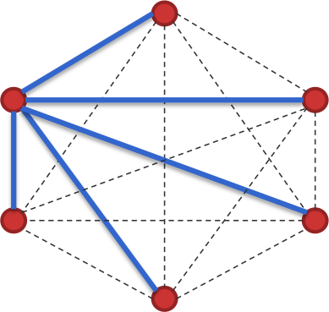
MAP inference is discrete optimization
A combinatorial problem
Computational complexity depends on
  The size of the input
  The factorization of the scores
  More complex factors generally lead to expensive inference
A generally bad strategy in most but the simplest cases: “Enumerate all possible structures and pick the highest scoring one”
,….
-10
54.1

Slide 13
MAP inference is search
We want a collection of decisions that has highest score
  argmax_{y} w^{T}Á(x,y)
No algorithm can find the max without considering every possible structure
  Why?
How can we solve this computational problem?
  Exploit the structure of the search space and the cost function
  That is, exploit decomposition of the scoring function

Slide 14
Approaches for inference
Should the maximization be performed exactly?
  Or is a close-to-highest-scoring structure good enough?
Exact: Search, dynamic programming, integer linear programming
Heuristic (called approximate inference): Gibbs sampling, belief propagation, beam search
Relaxations: linear programming relaxations, Lagrangian delaxation, dual decomposition, AD3

