Slide 1
CIS 700
Advanced Machine Learning for NLP
Comments on Structured Prediction
Dan Roth
Department of Computer and Information Science
University of Pennsylvania

Slide 2
Comments: ILP for Entities & Relations
Formulation
  So far, sequential structure
  What to do when we want to enforce more general structure
  (remember: structure = knowledge; formally – restricting the size of the huge Y space)
History: Metric Labeling
Complexity
  And practice
Expressivity
  Every Boolean condition can be expressed as a set of linear inequalities
Think about: how was did “model” trained?

Slide 3
Admin Stuff
Please send me your draft lectures at least two days before your presentation
Please follow the (changing) schedule on the web
Feedback on projects and reviews – hopefully before the end of this week.
Don’t forget to send us your evaluation of the presentations.

Slide 4
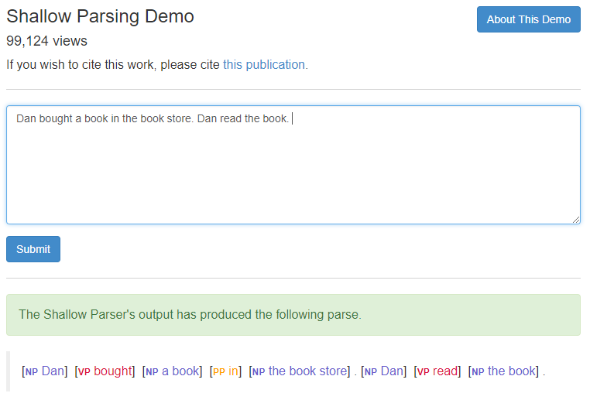
Shallow Parsing Example

Slide 5
Phrase Identification Problem
Did this classifier make a mistake?
(When are you looking at its prediction?)
How to train it?
Use classifiers’ outcomes to identify phrases
Final outcome determined by optimizing classifiers outcome and constrains
Input: o₁ o₂ o₃ o₄ o₅ o₆ o₇ o₈ o₉ o₁₀
Classifier 1:
Classifier 2:
Infer:
[
[
[
[
]
]
]
]
]
]
[
]
[
]
Notes:
The problem of Phrase Identifcation is the problem that utilizes the outcomes of classifiers to identify phrases. Phrases has some structure which will constrain the possible final outcomes. In this work, we emphasize only on the non-overlapping constraint that is all phrases in the final predictions cannot overlap one another.
For example, we have input o₁ to o₁₀. One way to use classifiers is to use two classifiers, one to predict all possible beginning of phrases. Here is the example.
The second classifier will predict the end of phrases, and for instance, these are the outputs from it. Obviously, we cannot just output all of these predictions because they cause some ambiguities and also violate the non-overlapping constraint.
So, we want some inference process to infer the final output, as in this example, which is legitimate.
Formally speaking, we will use some state representation such that we can use to identify those two phrases. One example is this sequence in which purple states represent the phrases.
Before proceeding further, I would like to clarify that, in this talk, when I talk about observations, it is the same as input, and state sequence will be the same as output.

Slide 6
Training regimes
Decomposition of outputs gives two approaches for training
  Decomposed training/Learning without inference
    Learning algorithm does not use the prediction procedure during training
  Global training/Joint training/Inference-based training
    Learning algorithm uses the final prediction procedure during training
Similar to the two strategies we had before with multiclass
Inference complexity often an important consideration in choice of modeling and training
    Especially so if full inference plays a part during training
    Ease of training smaller/less complex models could give intermediate training strategies between fully decomposed and fully joint

Slide 7
Shallow Parsing Example

Slide 8
L+I: Learning plus Inference
Testing: Inference with Constraints
Training w/o Constraints
IBT: Inference-based Training
Learning the components together!
y₂
y₁
y₃
f₁(x)
y₄
X
f₂(x)
y₅
x₃
f₃(x)
Y
x₄
f₄(x)
x₁
x₅
f₅(x)
x₂
x₇
Which one is better? When and Why?
x₆
Notes:
Figure1: Collection of X1,…,Xn and Collection of Y1…Ym with links among X and links among Y and between.
Figure2: Collection of X1,…,Xn and single Y
Description:
Task is to predict a “consistent” output that respects the structural dependencies among Y1…Ym and from X to Y.
One way is to learn a classifier using the structure so that the final classifiers are consistent.
Second way is to learn classifiers that predict each Y separately and then consolidate the predications post learning inference phase.
================
3 basic learning strategies
Local learning only
Local learning + Inference
Inference based Training
Also refer to others’ work
The benefits of each strategy.

Slide 9
Claims
When the local classification problems are “easy”, L+I outperforms IBT.
  In many applications, the components are identifiable and easy to learn (e.g., argument, open-close, PER).
Only when the local problems become difficult to solve in isolation, IBT outperforms L+I, but needs a larger number of training examples.
Will show experimental results and theoretical intuition to support our claims.
L+I: cheaper computationally; modular
IBT should be better in the limit;
In our domains: never happens
Combinations: L+I, and then IBT are possible
Notes:
Take-home messages:
It is a reasonable assumption that local classification is easy, because: (1) we already identify the important components
In many applications, the components are identifiable and easy to learn. Person & Subject

Slide 10
Perceptron-based Global Learning
True Global Labeling
Y
-1
1
-1
-1
1
Local Predictions
Y’
-1
1
1
1
1
Apply Constraints:
Y’
-1
1
-1
1
1
f₁(x)
X
f₂(x)
x₃
f₃(x)
Y
x₄
f₄(x)
x₁
x₅
f₅(x)
x₂
x₇
x₆
For this example, assume that we “know” that y₂ and y₃ have to be different.
Notes:
Figure1: Collection of X1,…,Xn and Collection of Y1…Ym with links among X and links among Y and between.
Figure2: Collection of X1,…,Xn and single Y
Description:
Task is to predict a “consistent” output that respects the structural dependencies among Y1…Ym and from X to Y.
One way is to learn a classifier using the structure so that the final classifiers are consistent.
Second way is to learn classifiers that predict each Y separately and then consolidate the predications post learning inference phase.
================
3 basic learning strategies
Local learning only
Local learning + Inference
Inference based Training
Also refer to others’ work
The benefits of each strategy.

Slide 11
Example 1: Semantic Role Labeling
One important lesson in the following examples is that “consistency” is actually a loaded term. In most interesting cases it would mean “coherency via some knowledge.
Based on the dataset PropBank [Palmer et. al. 05]
  Large human-annotated corpus of verb semantic relations
The task: To predict arguments of verbs
Given a sentence, identifies who does what to whom, where and when.
The bus was heading for Nairobi in Kenya
Predicate
Relation: Head
Mover[A0]: the bus
Destination[A1]: Nairobi in Kenya
Arguments

Slide 12
Predicting verb arguments
The bus was heading for Nairobi in Kenya.
Identify candidate arguments for verb using parse tree
  Filtered using a binary classifier
Classify argument candidates
  Multi-class classifier (one of multiple labels per candidate)
Inference
  Using probability estimates from argument classifier
  Must respect structural and linguistic constraints
    Eg: No overlapping arguments

Slide 13
Inference: verb arguments
The bus was heading for Nairobi in Kenya.
0.1
0.5
0.2
0.1
0.1
0.5
0.2
0.0
0.2
0.1
0.4
0.1
0.1
0.1
0.3
Special label, meaning “Not an argument”
0.1
0.1
0.1
0.1
0.6

Slide 14
Inference: verb arguments
The bus was heading for Nairobi in Kenya.
0.1
0.5
0.2
0.1
0.1
0.5
0.2
0.0
0.2
0.1
0.4
0.1
0.1
0.1
0.3
Special label, meaning “Not an argument”
0.1
0.1
0.1
0.1
0.6
Violates constraint: Overlapping argument!
Total: 2.0
heading (The bus,
for Nairobi,
for Nairobi in Kenya)

Slide 15
Inference: verb arguments
The bus was heading for Nairobi in Kenya.
0.1
0.5
0.2
0.1
0.1
0.5
0.2
0.0
0.2
0.1
0.4
0.1
0.1
0.1
0.3
Special label, meaning “Not an argument”
0.1
0.1
0.1
0.1
0.6
Total: 2.0
Total: 1.9
heading (The bus,
for Nairobi in Kenya)

Slide 16
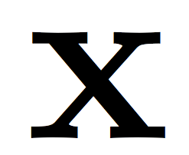
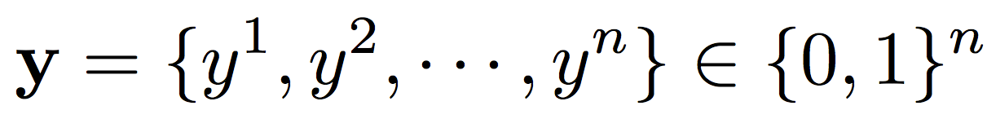
Inference: verb arguments
The bus was heading for Nairobi in Kenya.
0.1
0.5
0.2
0.1
0.1
0.5
0.2
0.0
0.2
0.1
Input Text with pre-processing
Output Five possible decisions for each candidate
Create a binary variable for each decision, only one of which is true for each candidate. Collectively, a “structure”
0.4
0.1
0.1
0.1
0.3
( )
Special label, meaning “Not an argument”
0.1
0.1
0.1
0.1
0.6
Total: 1.9
heading (The bus,
for Nairobi in Kenya)

Slide 17
Structured output is…
A data structure with a pre-defined schema
  Eg: SRL converts raw text into a record in a database
Equivalently, a graph
  Often restricted to be a specific family of graphs: chains, trees, etc
Predicate | A0 | A1 | Location
Head | The bus | Nairobi in Kenya | -
Head
A0
A1
The bus
Nairobi in Kenya
Questions/comments?

Slide 18
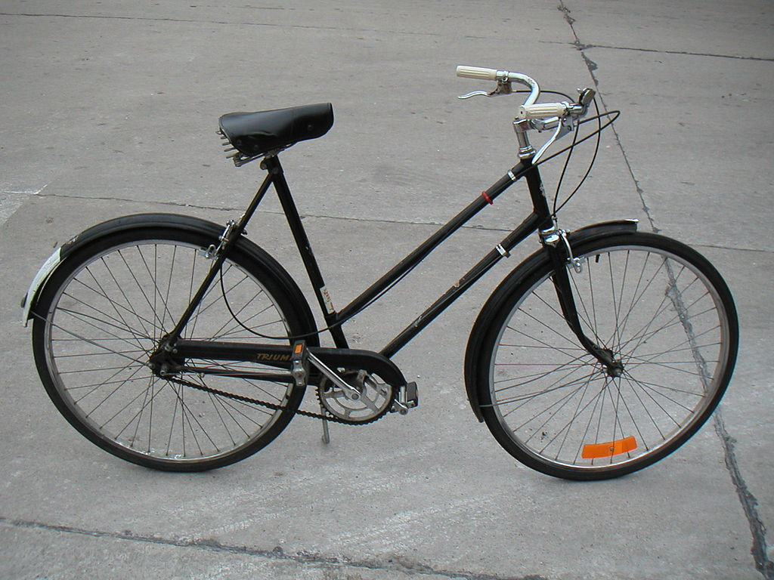
Example 2: Object detection
A good illustration for why one might want decomposition – transfer.
E.g., a wheel classifier might be useful in many other tasks.
How would you design a predictor that labels all the parts using the tools we have seen so far?
saddle/seat
handle bar
Right
facing
bicycle
right wheel
left wheel
Photo by Andrew Dressel - Own work. Licensed under Creative Commons Attribution-Share Alike 3.0

Slide 19
One approach to build this structure
Left wheel detector: Is there a wheel in this box? Binary classifier
1. Left wheel detector
Final output: Combine the predictions of these individual classifiers (local classifiers)
The predictions interact with each other
Eg: The same box can not be both a left wheel and a right wheel, handle bar does not overlap with seat, etc
Need inference to compose the output
2. Right wheel detector
3. Handle bar detector
4. Seat detector
Photo by Andrew Dressel - Own work. Licensed under Creative Commons Attribution-Share Alike 3.0

Slide 20
Structured Prediction: Inference
Placing in context: a crash course in structured prediction (skip)
Inference: given input x (a document, a sentence),
predict the best structure y = {y₁,y₂,…,y_{n}} ε Y (entities & relations)
  Assign values to the y₁,y₂,…,y_{n}, accounting for dependencies among y_{i}s
Inference is expressed as a maximization of a scoring function
y’ = argmax_{y ε Y} w^{T} Φ (x,y)
Inference requires, in principle, touching all y ε Y at decision time, when we are given x ε X and attempt to determine the best y ε Y for it, given w
  For some structures, inference is computationally easy.
  Eg: Using the Viterbi algorithm
  In general, NP-hard (can be formulated as an ILP)
Joint features on inputs and outputs
Set of allowed structures
Feature Weights
(estimated during learning)

Slide 21
Structured Prediction: Learning
Learning: given a set of structured examples {(x,y)}
find a scoring function w that minimizes empirical loss.
Learning is thus driven by the attempt to find a weight vector w such that for each given annotated example (x_{i}, y_{i}):

Slide 22
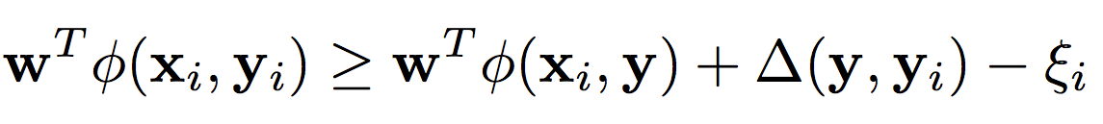
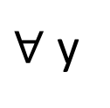
Structured Prediction: Learning
Learning: given a set of structured examples {(x,y)}
find a scoring function w that minimizes empirical loss.
Learning is thus driven by the attempt to find a weight vector w such that for each given annotated example (x_{i}, y_{i}):
We call these conditions the learning constraints.
In most learning algorithms used today, the update of the weight vector w is done in an on-line fashion,
  Think about it as Perceptron; this procedure applies to Structured Perceptron, CRFs, Linear Structured SVM
W.l.o.g. (almost) we can thus write the generic structured learning algorithm as follows:
Score of annotated structure
Score of any other structure
Penalty for predicting other structure
$∀$ y

Slide 23
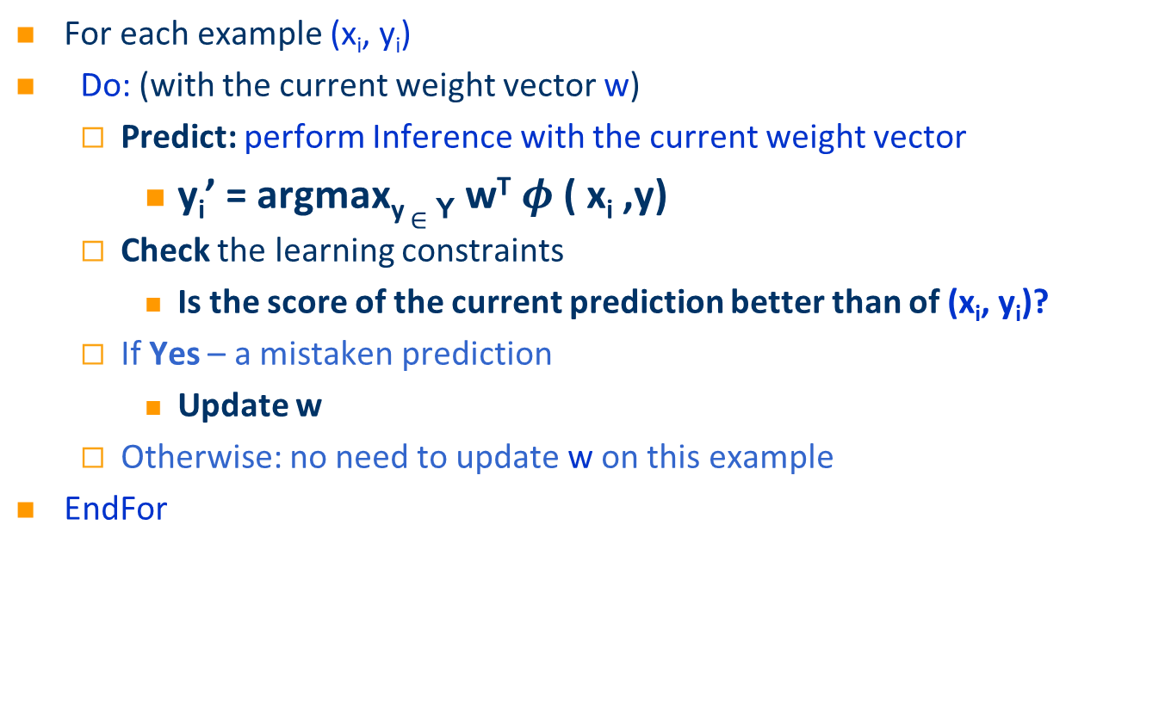
Structured Prediction: Learning Algorithm
In the structured case, prediction (inference) is often intractable but needs to be done many times
For each example (x_{i}, y_{i})
Do: (with the current weight vector w)
  Predict: perform Inference with the current weight vector
    y_{i}’ = argmax_{y} $∈$ _{Y} w^{T} $φ$ ( x_{i} ,y)
  Check the learning constraints
    Is the score of the current prediction better than of (x_{i}, y_{i})?
  If Yes – a mistaken prediction
    Update w
  Otherwise: no need to update w on this example
EndFor

Slide 24
Structured Prediction: Learning Algorithm
Solution I: decompose the scoring function to EASY and HARD parts
For each example (x_{i}, y_{i})
Do:
  Predict: perform Inference with the current weight vector
    y_{i}’ = argmax_{y 2 Y} w_{EASY}^{T} Á_{EASY} ( x_{i} ,y) + w_{HARD}^{T} Á_{HARD} ( x_{i} ,y)
  Check the learning constraint
    Is the score of the current prediction better than of (x_{i}, y_{i})?
  If Yes – a mistaken prediction
    Update w
  Otherwise: no need to update w on this example
EndDo
EASY: could be feature functions that correspond to an HMM, a linear CRF, or even Á_{EASY} (x,y) = Á(x), omiting dependence on y, corresponding to classifiers.
May not be enough if the HARD part is still part of each inference step.

Slide 25
Structured Prediction: Learning Algorithm
Solution II: Disregard some of the dependencies: assume a simple model.
For each example (x_{i}, y_{i})
Do:
  Predict: perform Inference with the current weight vector
    y_{i}’ = argmax_{y 2 Y} w_{EASY}^{T} Á_{EASY} ( x_{i} ,y) + w_{HARD}^{T} Á_{HARD} ( x_{i} ,y)
  Check the learning constraint
    Is the score of the current prediction better than of (x_{i}, y_{i})?
  If Yes – a mistaken prediction
    Update w
  Otherwise: no need to update w on this example
EndDo

Slide 26
Structured Prediction: Learning Algorithm
Solution III: Disregard some of the dependencies during learning; take into account at decision time
For each example (x_{i}, y_{i})
Do:
  Predict: perform Inference with the current weight vector
    y_{i}’ = argmax_{y 2 Y} w_{EASY}^{T} Á_{EASY} ( x_{i} ,y) + w_{HARD}^{T} Á_{HARD} ( x_{i} ,y)
  Check the learning constraint
    Is the score of the current prediction better than of (x_{i}, y_{i})?
  If Yes – a mistaken prediction
    Update w
  Otherwise: no need to update w on this example
EndDo
    y_{i}’ = argmax_{y 2 Y} w_{EASY}^{T} Á_{EASY} ( x_{i} ,y) + w_{HARD}^{T} Á_{HARD} ( x_{i} ,y)
This is the most commonly used solution in NLP today

Slide 27
Constrained Conditional Models
Any MAP problem w.r.t. any probabilistic model, can be formulated as an ILP
[Roth+ 04, Taskar 04]
Penalty for violating
the constraint.
Variables are models
y = argmax_{y} ∑ 1_{Á(x,y)} w_{x,y} subject to Constraints C(x,y)
    y = argmax_{y 2 Y} w^{T}Á(x, y) + u^{T}C(x, y)
Knowledge component:
(Soft) constraints
Weight Vector for “local” models
Features, classifiers; log-linear models (HMM, CRF) or a combination
How far y is from
a “legal/expected” assignment
Training: learning the objective function (w, u)
  Decouple? Decompose? Force u to model hard constraints?
A way to push the learned model to satisfy our output expectations (or expectations from a latent representation)
  [CoDL, Chang et. al (07, 12); Posterior Regularization, Ganchev et. al (10); Unified EM (Samdani et. al (12)]
The benefits of thinking about it as an ILP are conceptual and computational.

Slide 28
Examples: CCM Formulations
  y = argmax_{y 2 Y} w^{T}Á(x, y) + u^{T}C(x, y)
While Á(x, y) and C(x, y) could be the same; we want C(x, y) to express high level declarative knowledge over the statistical models.
  Formulate NLP Problems as ILP problems (inference may be done otherwise)
    1. Sequence tagging (HMM/CRF + Global constraints)
    2. Sentence Compression (Language Model + Global Constraints)
    3. SRL (Independent classifiers + Global Constraints)
Sequential Prediction
HMM/CRF based:
Argmax ∑ ¸_{ij} x_{ij}
Sentence Compression/Summarization:
Language Model based:
Argmax ∑ ¸_{ijk} x_{ijk}
Knowledge/Linguistics Constraints
Cannot have both A states and B states in an output sequence.
Knowledge/Linguistics Constraints
If a modifier chosen, include its head
If verb is chosen, include its arguments
Constrained Conditional Models Allow:
Decouple complexity of the learned model from that of the desired output
Learn a simple model (multiple; pipelines); reason with a complex one.
Accomplished by incorporating constraints to bias/re-rank global decisions to satisfy (minimally violate) expectations.

