Slide 1





Wikification and Beyond:
The Challenges of Entity and Concept Grounding
Dan Roth (UIUC), Heng Ji (RPI)
Ming-Wei Chang (MSR), Taylor Cassidy (ARL&IBM)
http://nlp.cs.rpi.edu/paper/wikificationtutorial.pdf [pptx]
http://L2R.cs.uiuc.edu/Talks/wikificationtutorial.pdf [pptx]
Notes:
Add email, pdf address

Slide 2



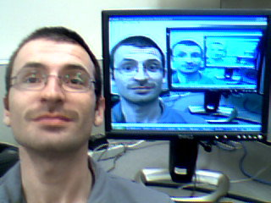
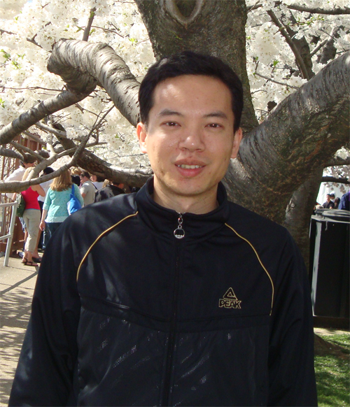

Thank You – Our Brilliant Wikifiers!
Xiaoman Pan
Jin Guang Zheng
Xiao Cheng
Lev Ratinov
Zheng Chen
Hongzhao Huang

Slide 3
Outline
Motivation and Definition)
A Skeletal View of a Wikification System
  High Level Algorithmic Approach
Key Challenges
Coffee Break
Recent Advances
New Tasks, Trends and Applications
What’s Next?
Resources, Shared Tasks and Demos
Notes:
. We expect this idea to inspire a completely new philosophy for fact
extraction which will be essential for the creation of a high-quality StructNet.
Incorporate arbitrary global features and soft constraints;
Features are automatically learned selectively
Save some human knowledge engineering efforts
Capture inter-dependency knowledge on the entire structure
Efficient linear-time beam search by joint learning and decoding
No need to model joint/conditional distribution with a large number of variables
Extract all facts jointly in a unified framework
Local predictions can be mutually improved
Avoid error compounding problem

Slide 4



Information overload
Downside:
We need to deal with a lot of information
Upside:
We may be able to acquire knowledge
This knowledge might support language understanding
  (We may need to understand something in order to do it, though)
Notes:
Impose a “network” on this – idea is that information exists both in the content and in the structure.

Slide 5
Organizing knowledge
It’s a version of Chicago – the standard classic Macintosh menu font, with that distinctive thick diagonal in the ”N”.
Chicago was used by default for Mac menus through MacOS 7.6, and OS 8 was released mid-1997..
Chicago VIII was one of the early 70s-era Chicago albums to catch my
ear, along with Chicago II.

Slide 6
Cross-document co-reference resolution
It’s a version of Chicago – the standard classic Macintosh menu font, with that distinctive thick diagonal in the ”N”.
Chicago was used by default for Mac menus through MacOS 7.6, and OS 8 was released mid-1997..
Chicago VIII was one of the early 70s-era Chicago albums to catch my
ear, along with Chicago II.

Slide 7




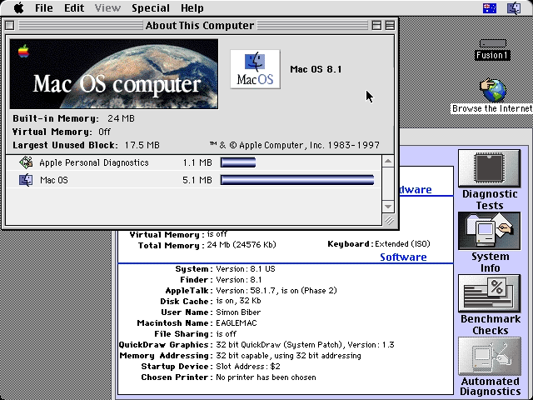
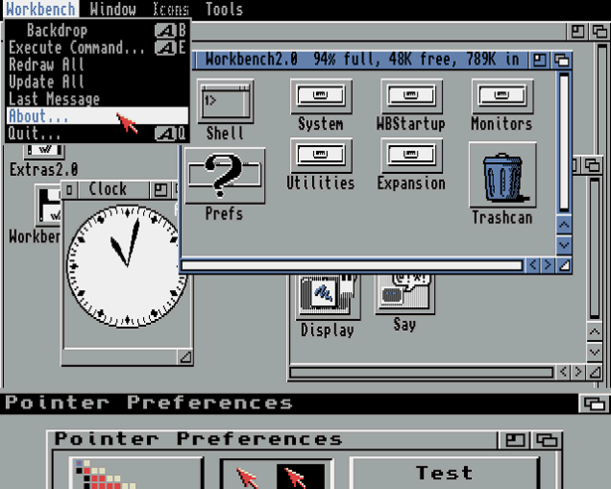
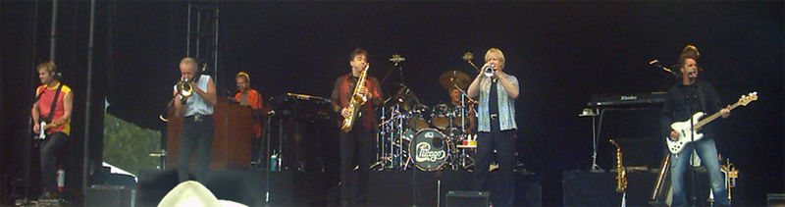
Reference resolution: (disambiguation to Wikipedia)
It’s a version of Chicago – the standard classic Macintosh menu font, with that distinctive thick diagonal in the ”N”.
Chicago was used by default for Mac menus through MacOS 7.6, and OS 8 was released mid-1997..
Chicago VIII was one of the early 70s-era Chicago albums to catch my
ear, along with Chicago II.

Slide 8
The “Reference” Collection has Structure
It’s a version of Chicago – the standard classic Macintosh menu font, with that distinctive thick diagonal in the ”N”.
Chicago was used by default for Mac menus through MacOS 7.6, and OS 8 was released mid-1997..
Chicago VIII was one of the early 70s-era Chicago albums to catch my
ear, along with Chicago II.
Is_a
Is_a
Used_In
Released
Succeeded

Slide 9
Analysis of Information Networks
It’s a version of Chicago – the standard classic Macintosh menu font, with that distinctive thick diagonal in the ”N”.
Chicago was used by default for Mac menus through MacOS 7.6, and OS 8 was released mid-1997..
Chicago VIII was one of the early 70s-era Chicago albums to catch my
ear, along with Chicago II.

Slide 10

Here – Wikipedia as a knowledge resource …. but we can use other resources
Is_a
Is_a
Used_In
Released
Succeeded

Slide 11






Wikification: The Reference Problem
Cycles of Knowledge: Grounding for/using Knowledge
Blumenthal (D) is a candidate for the U.S. Senate seat now held by Christopher Dodd (D), and he has held a commanding lead in the race since he entered it. But the Times report has the potential to fundamentally reshape the contest in the Nutmeg State.
Blumenthal (D) is a candidate for the U.S. Senate seat now held by Christopher Dodd (D), and he has held a commanding lead in the race since he entered it. But the Times report has the potential to fundamentally reshape the contest in the Nutmeg State.
Notes:
Let’s start with what is wikification
Read wiki titles slower

Slide 12
Motivation
Dealing with Ambiguity of Natural Language
  Mentions of entities and concepts could have multiple meanings
Dealing with Variability of Natural Language
  A given concept could be expressed in many ways
Wikification addresses these two issues in a specific way:
The Reference Problem
  What is meant by this concept? (WSD + Grounding)
  More than just co-reference (within and across documents)
Notes:
. We expect this idea to inspire a completely new philosophy for fact
extraction which will be essential for the creation of a high-quality StructNet.
Incorporate arbitrary global features and soft constraints;
Features are automatically learned selectively
Save some human knowledge engineering efforts
Capture inter-dependency knowledge on the entire structure
Efficient linear-time beam search by joint learning and decoding
No need to model joint/conditional distribution with a large number of variables
Extract all facts jointly in a unified framework
Local predictions can be mutually improved
Avoid error compounding problem

Slide 13
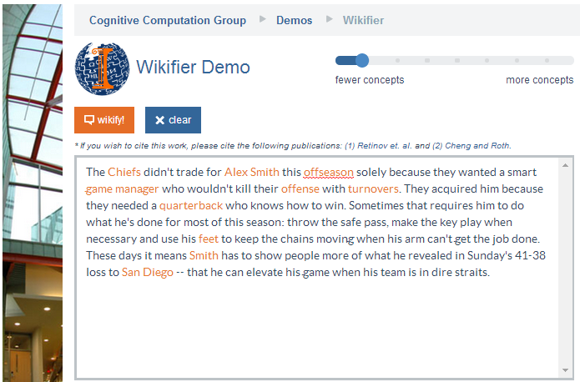
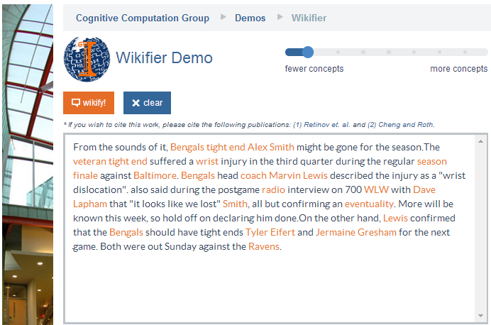
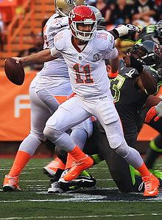
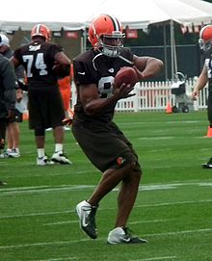
Who is Alex Smith?
Alex Smith
Alex Smith
Smith
Smith
Quarterback of the Kansas City Chief
Tight End of the Cincinnati Bengals
San Diego: The San Diego Chargers (A Football team)
Contextual decision on what is meant by a given entity or concept. WSD with Wikipedia titles as categories.
Ravens: The Baltimore Ravens (A Football team)
Notes:
. We expect this idea to inspire a completely new philosophy for fact
extraction which will be essential for the creation of a high-quality StructNet.
Incorporate arbitrary global features and soft constraints;
Features are automatically learned selectively
Save some human knowledge engineering efforts
Capture inter-dependency knowledge on the entire structure
Efficient linear-time beam search by joint learning and decoding
No need to model joint/conditional distribution with a large number of variables
Extract all facts jointly in a unified framework
Local predictions can be mutually improved
Avoid error compounding problem

Slide 14
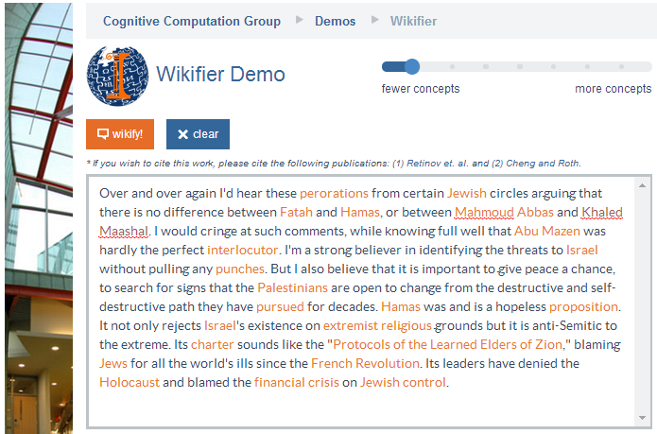
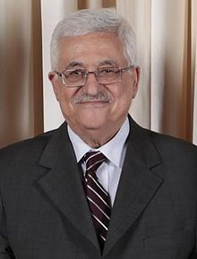
Middle Eastern Politics
Mahmoud Abbas
Abu Mazen
Mahmoud Abbas: http://en.wikipedia.org/wiki/Mahmoud_Abbas
Quarterback of the Kansas City Chief
Tight End of the Cincinnati Bengals
Getting away from surface representations.
Co-reference resolution within and across documents, with grounding
Abu Mazen: http://en.wikipedia.org/wiki/Mahmoud_Abbas
Notes:
. We expect this idea to inspire a completely new philosophy for fact
extraction which will be essential for the creation of a high-quality StructNet.
Incorporate arbitrary global features and soft constraints;
Features are automatically learned selectively
Save some human knowledge engineering efforts
Capture inter-dependency knowledge on the entire structure
Efficient linear-time beam search by joint learning and decoding
No need to model joint/conditional distribution with a large number of variables
Extract all facts jointly in a unified framework
Local predictions can be mutually improved
Avoid error compounding problem

Slide 15
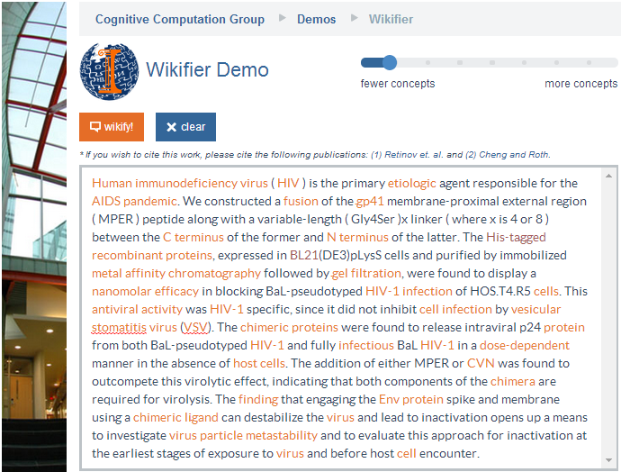
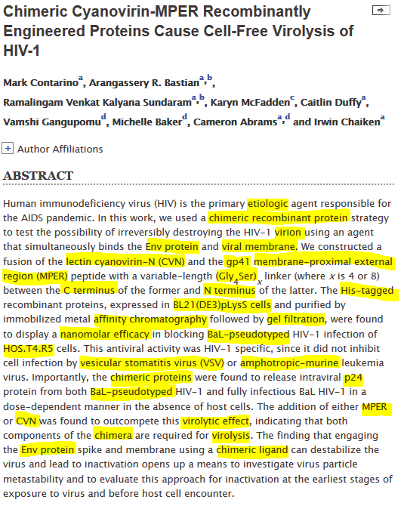
Navigating Unfamiliar Domains
Notes:
. We expect this idea to inspire a completely new philosophy for fact
extraction which will be essential for the creation of a high-quality StructNet.
Incorporate arbitrary global features and soft constraints;
Features are automatically learned selectively
Save some human knowledge engineering efforts
Capture inter-dependency knowledge on the entire structure
Efficient linear-time beam search by joint learning and decoding
No need to model joint/conditional distribution with a large number of variables
Extract all facts jointly in a unified framework
Local predictions can be mutually improved
Avoid error compounding problem

Slide 16
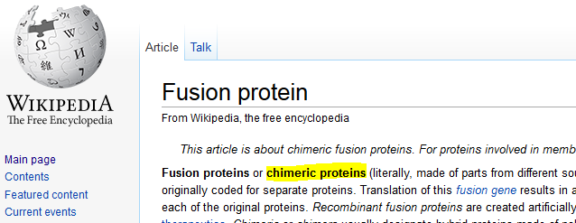
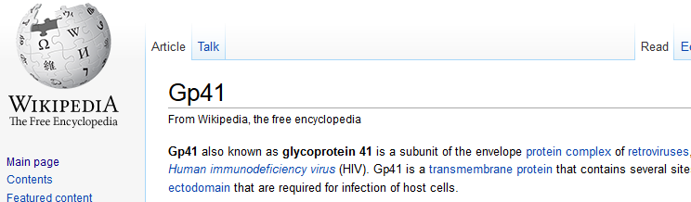
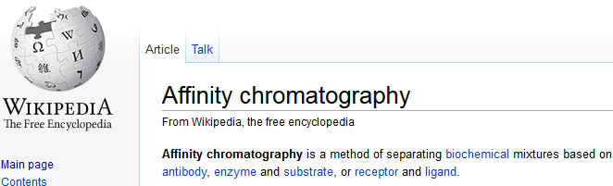
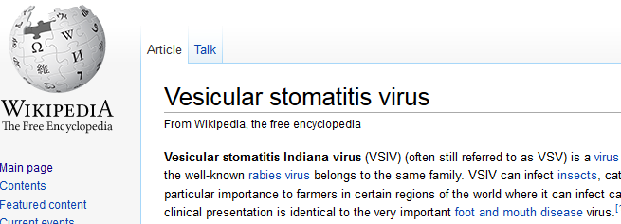
Navigating Unfamiliar Domains
Educational Applications: Unfamiliar domains may contain terms unknown to a reader.
The Wikifier can supply the necessary background knowledge even when the relevant article titles are not identical to what appears in the text, dealing with both ambiguity and variability.
Notes:
. We expect this idea to inspire a completely new philosophy for fact
extraction which will be essential for the creation of a high-quality StructNet.
Incorporate arbitrary global features and soft constraints;
Features are automatically learned selectively
Save some human knowledge engineering efforts
Capture inter-dependency knowledge on the entire structure
Efficient linear-time beam search by joint learning and decoding
No need to model joint/conditional distribution with a large number of variables
Extract all facts jointly in a unified framework
Local predictions can be mutually improved
Avoid error compounding problem

Slide 17
Applications of Wikification
Knowledge Acquisition (via grounding)
  Still remains open: how to organize the knowledge in a useful way?
Co-reference resolution (Ratinov & Roth, 2012)
  “After the vessel suffered a catastrophic torpedo detonation, Kursk sank in the waters of Barents Sea…”
  Knowing Kursk → Russian submarine K-141 Kursk helps system to co-ref “Kursk” and “vessel”
Document classification
  Tweets labeled World, US, Science & Technology, Sports, Business, Health, Entertainment (Vitale et. al., 2012)
  Datalesss classification (ESA-based representations; Song & Roth’ 14)
  Document and concepts are represented via Wikipedia titles
Visualization: Geo- visualization of News (Gao et. al. CHI’14)
Notes:
Some recent in vivo tasks are shown here.
Ratinov and Roth used d2w output to aid coreference resolution.
For example, knowing that kursk can be a vessel helps link kursk to vessel.
WP concepts present in a document help to make document similarity calculation more robust.
Also, WP concepts are rich with information including coarse and fine grained properties that can shed light on,
for example, a users intent during query formulation.

Slide 18
Task Definition
A formal definition of the task consists of:
  A definition of the mentions (concepts, entities) to highlight
  Determining the target encyclopedic resource (KB)
  Defining what to point to in the KB (title)
Notes:
. We expect this idea to inspire a completely new philosophy for fact
extraction which will be essential for the creation of a high-quality StructNet.
Incorporate arbitrary global features and soft constraints;
Features are automatically learned selectively
Save some human knowledge engineering efforts
Capture inter-dependency knowledge on the entire structure
Efficient linear-time beam search by joint learning and decoding
No need to model joint/conditional distribution with a large number of variables
Extract all facts jointly in a unified framework
Local predictions can be mutually improved
Avoid error compounding problem

Slide 19
1. Mentions
A mention: a phrase used to refer to something in the world
  Named entity (person, organization), object, substance, event, philosophy, mental state, rule …
Task definitions vary across the definition of mentions
  All N-grams (up to a certain size); Dictionary-based selection; Data-driven controlled vocabulary (e.g., all Wikipedia titles); only named entities.
Ideally, one would like to have a mention definition that adapts to the application/user
Notes:
. We expect this idea to inspire a completely new philosophy for fact
extraction which will be essential for the creation of a high-quality StructNet.
Incorporate arbitrary global features and soft constraints;
Features are automatically learned selectively
Save some human knowledge engineering efforts
Capture inter-dependency knowledge on the entire structure
Efficient linear-time beam search by joint learning and decoding
No need to model joint/conditional distribution with a large number of variables
Extract all facts jointly in a unified framework
Local predictions can be mutually improved
Avoid error compounding problem

Slide 20
Examples of Mentions (1)
Blumenthal (D) is a candidate for the U.S. Senate seat now held by Christopher Dodd (D), and he has held a commanding lead in the race since he entered it. But the Times report has the potential to fundamentally reshape the contest in the Nutmeg State.
Blumenthal (D) is a candidate for the U.S. Senate seat now held by Christopher Dodd (D), and he has held a commanding lead in the race since he entered it. But the Times report has the potential to fundamentally reshape the contest in the Nutmeg State.
Notes:
Let’s start with what is wikification
Read wiki titles slower

Slide 21
Examples of Mentions (2)
Alex Smith
offseason
turnover
feet
Some task definitions insist on dealing only with mentions that are named entities
How about: Hosni Mubarak’s wife?
Both entities have a Wikipedia page
Notes:
Let’s start with what is wikification
Read wiki titles slower

Slide 22
Examples of Mentions (3)
HIV
gp41
Perhaps the definition of which mentions to highlight should depend on the expertise and interests of the users?
Chimeric proteins
virus
Notes:
Let’s start with what is wikification
Read wiki titles slower

Slide 23




2. Concept Inventory (KB)
Multiple KBs can be used, in principle, as the target KB.
Wikipedia has the advantage of a broad coverage, regularly maintained KB, with significant amount of text associated with each title.
  All type of pages?
    Content pages
    Disambiguation pages
    List pages
What should happened to mentions that do not have entries in the target KB?
Notes:
. We expect this idea to inspire a completely new philosophy for fact
extraction which will be essential for the creation of a high-quality StructNet.
Incorporate arbitrary global features and soft constraints;
Features are automatically learned selectively
Save some human knowledge engineering efforts
Capture inter-dependency knowledge on the entire structure
Efficient linear-time beam search by joint learning and decoding
No need to model joint/conditional distribution with a large number of variables
Extract all facts jointly in a unified framework
Local predictions can be mutually improved
Avoid error compounding problem

Slide 24


3. What to Link to?
Often, there are multiple sensible links.
Baltimore Raven: Should the link be any different? Both?
Baltimore: The city? Baltimore Raven, the Football team? Both?
Atmosphere: The general term? Or the most specific one “Earth Atmosphere?
Notes:
. We expect this idea to inspire a completely new philosophy for fact
extraction which will be essential for the creation of a high-quality StructNet.
Incorporate arbitrary global features and soft constraints;
Features are automatically learned selectively
Save some human knowledge engineering efforts
Capture inter-dependency knowledge on the entire structure
Efficient linear-time beam search by joint learning and decoding
No need to model joint/conditional distribution with a large number of variables
Extract all facts jointly in a unified framework
Local predictions can be mutually improved
Avoid error compounding problem

Slide 25
3. Null Links
Often, there are multiple sensible links.
Dorothy Byrne, a state coordinator for the Florida Green Party,…
How to capture the fact that Dorothy Byrne does not refer to any concept in Wikipedia?
Wikification: Simply map Dorothy Byrne → Null
Entity Linking: If multiple mentions in the given document(s) correspond to the same concept, which is outside KB
  First cluster relevant mentions as representing a single concept
  Map the cluster to Null
Notes:
. We expect this idea to inspire a completely new philosophy for fact
extraction which will be essential for the creation of a high-quality StructNet.
Incorporate arbitrary global features and soft constraints;
Features are automatically learned selectively
Save some human knowledge engineering efforts
Capture inter-dependency knowledge on the entire structure
Efficient linear-time beam search by joint learning and decoding
No need to model joint/conditional distribution with a large number of variables
Extract all facts jointly in a unified framework
Local predictions can be mutually improved
Avoid error compounding problem

Slide 26
Naming Convention
Wikification:
  Map Mentions to KB Titles
  Map Mentions that are not in the KB to NIL
Entity Linking:
  Map Mentions to KB Titles
  If multiple mentions in correspond to the same Title, which is outside KB:
    First cluster relevant mentions as representing a single Title
    Map the cluster to Null
If the set of target mentions only consists of named entities we call the task: Named Entity [Wikification, Linking]
Notes:
. We expect this idea to inspire a completely new philosophy for fact
extraction which will be essential for the creation of a high-quality StructNet.
Incorporate arbitrary global features and soft constraints;
Features are automatically learned selectively
Save some human knowledge engineering efforts
Capture inter-dependency knowledge on the entire structure
Efficient linear-time beam search by joint learning and decoding
No need to model joint/conditional distribution with a large number of variables
Extract all facts jointly in a unified framework
Local predictions can be mutually improved
Avoid error compounding problem

Slide 27
Evaluation
In principle, evaluation on an application is possible, but hasn’t been pursued [with some minor exceptions: NER, Coref]
Factors in Wikification/Entity-Linking Evaluation:
Mention Selection
  Are the mentions chosen for linking correct (R/P)
Linking accuracy
  Evaluate quality of links chosen per-mention
    Ranking
    Accuracy (including NIL)
NIL clustering
  Entity Linking: evaluate out-of-KB clustering (co-reference)
Other (including IR-inspired) metrics
  E.g. MRR, MAP, R-Precision, Recall, accuracy
Notes:
A gold standard annotation may contain
Which mentions should be linked as a task in itself
How the system did on mentions that the gold standard said should be linked
How is system output affected when mentions to be linked aren’t given
How well the system handles out of wp concepts, when relevant,
and system performance in an IR setting, treating documents as queries, and concepts as documents

Slide 28
Outline
Motivation and Definition
A Skeletal View of a Wikification System
  High Level Algorithmic Approach
Key Challenges
Coffee Break
Recent Advances
New Tasks, Trends and Applications
What’s Next?
Resources, Shared Tasks and Demos

Slide 29
Wikification: Subtasks
Wikification and Entity Linking requires addressing several sub-tasks:
  Identifying Target Mentions
    Mentions in the input text that should be Wikified
  Identifying Candidate Titles
    Candidate Wikipedia titles that could correspond to each mention
  Candidate Title Ranking
    Rank the candidate titles for a given mention
  NIL Detection and Clustering
    Identify mentions that do not correspond to a Wikipedia title
    Entity Linking: cluster NIL mentions that represent the same entity.
Notes:
. We expect this idea to inspire a completely new philosophy for fact
extraction which will be essential for the creation of a high-quality StructNet.
Incorporate arbitrary global features and soft constraints;
Features are automatically learned selectively
Save some human knowledge engineering efforts
Capture inter-dependency knowledge on the entire structure
Efficient linear-time beam search by joint learning and decoding
No need to model joint/conditional distribution with a large number of variables
Extract all facts jointly in a unified framework
Local predictions can be mutually improved
Avoid error compounding problem

Slide 30
High-level Algorithmic Approach.
Input: A text document d; Output: a set of pairs (m_{i} ,t_{i})
  m_{i} are mentions in d; t_{j}(m_{i} ) are corresponding Wikipedia titles, or NIL.
(1) Identify mentions m_{i} in d
(2) Local Inference
  For each m_{i} in d:
    Identify a set of relevant titles T(m_{i} )
    Rank titles t_{i} ∈ T(m_{i} )
    [E.g., consider local statistics of edges [(m_{i} ,t_{i}) , (m_{i} ,*), and (*, t_{i} )] occurrences in the Wikipedia graph]
(3) Global Inference
  For each document d:
    Consider all m_{i} ∈ d; and all t_{i} ∈ T(m_{i} )
    Re-rank titles t_{i} ∈ T(m_{i} )
    [E.g., if m, m’ are related by virtue of being in d, their corresponding titles t, t’ may also be related]
Notes:
Don’t focus on “our contribution” only – focus on describing an algorithmic approach (which is impressive and good)

Slide 31
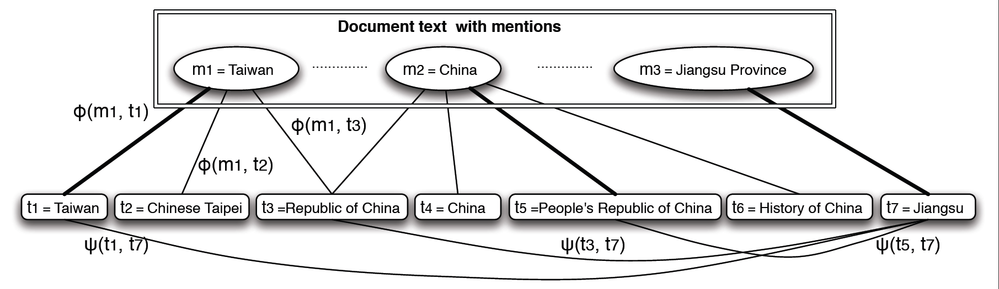
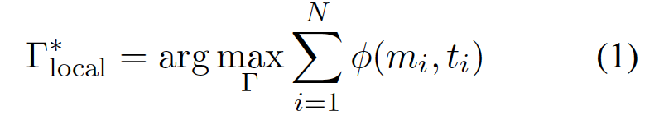
Local approach
A text Document
Identified mentions
Wikipedia Articles
Local score of matching
the mention to the title
(decomposed by m_{i})
Γ is a solution to the problem
  A set of pairs (m,t)
m: a mention in the document
t: the matched Wikipedia Title
Notes:
Changed—change in related slides.

Slide 32
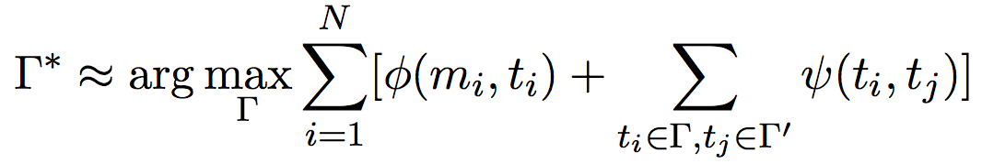
Global Approach: Using Additional Structure
Text Document(s)—News, Blogs,…
Wikipedia Articles
Adding a “global” term to evaluate how good the structure of the solution is.
Use the local solutions Γ’ (each mention considered independently.
Evaluate the structure based on pair-wise coherence scores Ψ(t_{i},t_{j})
Choose those that satisfy document coherence conditions.
Notes:
Add a cartoon of edge cover to justify that the overall problem is hard.

Slide 33
High-level Algorithmic Approach
Input: A text document d; Output: a set of pairs (m_{i} ,t_{i})
  m_{i} are mentions in d; t_{i} are corresponding Wikipedia titles, or NIL.
(1) Identify mentions m_{i} in d
(2) Local Inference
  For each m_{i} in d:
    Identify a set of relevant titles T(m_{i} )
    Rank titles t_{i} ∈ T(m_{i} )
    [E.g., consider local statistics of edges (m_{i} ,t_{i}) , (m_{i} *), and (*, t_{i} ) occurrences of in the Wikipedia graph]
(3) Global Inference
  For each document d:
    Consider all m_{i} ∈ d; and all t_{i} 2 T(m_{i} )
    Re-rank titles t_{i} ∈ T(m_{i} )
    [E.g., if m, m’ are related by virtue of being in d, their corresponding titles t, t’ should also be related]
Notes:
Don’t focus on “our contribution” only – focus on describing an algorithmic approach (which is impressive and good)

Slide 34
Mention Identification
Highest recall: Each n-gram is a potential concept mention
  Intractable for larger documents
Surface form based filtering
  Shallow parsing (especially NP chunks), NP’s augmented with surrounding tokens, capitalized words
  Remove: single characters, “stop words”, punctuation, etc.
Classification and statistics based filtering
  Name tagging (Finkel et al., 2005; Ratinov and Roth, 2009; Li et al., 2012)
  Mention extraction (Florian et al., 2006, Li and Ji, 2014)
  Key phrase extraction, independence tests (Mihalcea and Csomai, 2007), common word removal (Mendes et al., 2012; )
Notes:
We will go over some successful entity mention detection methods (Li and Ji, 2014submission), and highlight some simple yet effective general mention extraction methods based on mining Wikipedia structures and constructing Wikipedia Lexicon (Bunescu, 2006; Cucerzan, 2007; Fernandez et al., 2010; Chang et al., 2010; Chen et al., 2010; Meij et al., 2012; Bysani et al., 2010; Hachey et al., 2013; Huang et al., 2014submission). Due to the noise in informal genres such as web blogs and discussion forums, some systems also performed mis-spelling correction and normalization (Yu et al., 2013; Charton et al., 2013).
XXX to add references
Note that filtering is necessary even if only previous anchor text is used for efficiency! (at least for longer texts or a high-volume data stream)

Slide 35
Mention Identification (Cont’)
Wikipedia Lexicon Construction based on prior link knowledge
  Only n-grams linked in training data (prior anchor text) (Ratinov et al., 2011; Davis et al., 2012; Sil et al., 2012; Demartini et al., 2012; Wang et al., 2012; Han and Sun, 2011; Han et al., 2011; Mihalcea and Csomai, 2007; Cucerzan, 2007; Milne and Witten, 2008; Ferragina and Scaiella, 2010)
    E.g. all n-grams used as anchor text within Wikipedia
  Only terms that exceed link probability threshold (Bunescu, 2006; Cucerzan, 2007; Fernandez et al., 2010; Chang et al., 2010; Chen et al., 2010; Meij et al., 2012; Bysani et al., 2010; Hachey et al., 2013; Huang et al., 2014)
  Dictionary-based chunking
  String matching (n-gram with canonical concept name list)
Mis-spelling correction and normalization (Yu et al., 2013; Charton et al., 2013)
Notes:
.
We will go over some successful entity mention detection methods (Li and Ji, 2014submission), and highlight some simple yet effective general mention extraction methods based on mining Wikipedia structures and constructing Wikipedia Lexicon (Bunescu, 2006; Cucerzan, 2007; Fernandez et al., 2010; Chang et al., 2010; Chen et al., 2010; Meij et al., 2012; Bysani et al., 2010; Hachey et al., 2013; Huang et al., 2014submission). Due to the noise in informal genres such as web blogs and discussion forums, some systems also performed mis-spelling correction and normalization (Yu et al., 2013; Charton et al., 2013).
XXX to add references
Note that filtering is necessary even if only previous anchor text is used for efficiency! (at least for longer texts or a high-volume data stream)

Slide 36
Mention Identification (Cont’)
Multiple input sources are being used
  Some build on the given text only, some use external resources.
Methods used by some popular systems
  Illinois Wikifier (Ratinov et al., 2011; Cheng and Roth, 2013)
    NP chunks and substrings, NER (+nesting), prior anchor text
  TAGME (Ferragina and Scaiella, 2010)
    Prior anchor text
  DBPedia Spotlight (Mendes et al., 2011)
    Dictionary-based chunking with string matching (via DBpedia lexicalization dataset)
  AIDA (Finkel et al., 2005; Hoffart et al., 2011)
    Name Tagging
  RPI Wikifier (Chen and Ji, 2011; Cassidy et al., 2012; Huang et al., 2014)
    Mention Extraction (Li and Ji, 2014)

Slide 37
Mention Identification (Mendes et al., 2012)
L Dictionary-Based chunking (LingPipe) using DBPedia Lexicalization Dataset (Mendes et al., 2011)
Method | P | R | Avg Time per mention
L>3 | 4.89 | 68.20 | .0279
L>10 | 5.05 | 66.53 | .0246
L>75 | 5.06 | 58.00 | .0286
LNP* | 5.52 | 57.04 | .0331
NPL*>3 | 6.12 | 45.40 | 1.1807
NPL*>10 | 6.19 | 44.48 | 1.1408
NPL*>75 | 6.17 | 38.65 | 1.2969
CW | 6.15 | 42.53 | .2516
Kea | 1.90 | 61.53 | .0505
NER | 4.57 | 7.03 | 2.9239
NER ∪ NP | 1.99 | 68.30 | 3.1701
LNP Extends L with simple heuristic to isolate NP’s
NPL_{>k} Same as LNP but with Statistical NP Chunker
CW Extends L by filtering out common words (Daiber, 2011)
Kea Uses supervised key phrase extraction (Frank et al., 1999)
NER Based on OpenNLP 1.5.1
NER∪NP Augments NER with NPL

Slide 38



Need Mention Expansion
“Michael Jordon”
“His Airness”
“Jordanesque”
“Corporate Counsel”
“MJ23”
“Sole practitioner”
“Defense attorney”
“Jordan, Michael”
“Michael J. Jordan”
“Legal counsel”
“Litigator”
Trial lawyer
“Arizona”
“Alitalia”
“Azerbaijan”
“Authority Zero”
“AstraZeneca”
“Assignment Zero”
Notes:
“AZ” may refer to the US state of “Arizona”, the Italian airline “Alitalia”, or the country “Azerbaijan”

Slide 39
Need Mention Expansion
Medical Domain: 33% of abbreviations are ambiguous (Liu et al., 2001), major source of errors in medical NLP (Friedman et al., 2001)
Military Domain
  “GA ADT 1, USDA, USAID, ADP, Turkish PRT, and the DAIL staff met to create the Wardak Agricultural Steering Committee. “
  “DST” = “District Stability Team” or “District Sanitation Technician”?
  “ADP” = “Adrian Peterson” (Person) or “Arab Democratic Party” (Organization) or “American Democracy Project” (Initiative)?
RA | “rheumatoid arthritis”, “tenal artery”, “right atrium”, “right atrial”, “refractory anemia”, “radioactive”, “right arm”, “rheumatic arthritis”, …
PN | “Penicillin”; “Pneumonia”; “Polyarteritis”; “Nodosa”; “Peripheral neuropathy”; “Peripheral nerve”; “Polyneuropathy”; “Pyelonephritis”; “Polyneuritis”; “Parenteral nutrition”; “Positional Nystagmus”; “Periarteritis nodosa”, …
Notes:
For example, a typical meeting report might start with the following sentences: “GA ADT 1, USDA, USAID, Turkish PRT, and the DAIL staff met to create the Wardak Agricultural Steering Committee.”, “Team Leader, CA LNO to US Embassy Assistant CCE and USAID met with Ecole5 Headmaster (Mr. Mohemned Ajmed Mohammed) and FTA President (Mr. Abdurahman Ahmed).” without ever giving the full names for “GA ADT”, “USDA”, “USAID”, “PRT”, “DAIL”, “CA”, “LNO” and “CCE”. In addition, acronyms may change over time. One can assume the existence of a knowledge base which stores the standard full names for many of these acronyms. However, these acronyms are often heavily overloaded (used to represent different entities). For example, “DST” can refer to “District Stability Team” or “District Sanitation Technician” in two documents published by the same DOD organization on the same day; and can be linked to one of 25 possible entries in Wikipedia. “ADP” can refer to “Adrian Peterson” (Person) or “Arab Democratic Party” (Organization) or “American Democracy Project” (Initiative). All of these problems with acronyms are likely to confound CDECR in military domains unless properly addressed.

Slide 40
Mention Expansion
Co-reference resolution
  Each mention in a co-referential cluster should link to the same concept
  Canonical names are often less ambiguous
  Correct types: “Detroit” = “Red Wings”; “Newport” = “Newport-Gwent Dragons”
Known Aliases
  KB link mining (e.g., Wikipedia “re-direct”) (Nemeskey et al., 2010)
  Patterns for Nicknames/ Acronym mining (Zhang et al., 2011; Tamang et al., 2012)
  “full-name” (acronym) or “acronym (full-name)”, “city, state/country”
Statistical models such as weighted finite state transducer (Friburger and Maurel, 2004)
  CCP = “Communist Party of China”; “MINDEF” = “Ministry of Defence”
Ambiguity drops from 46.3% to 11.2% (Chen and Ji, 2011; Tamang et al., 2012).

Slide 41
High-level Algorithmic Approach
Input: A text document d; Output: a set of pairs (m_{i} ,t_{i})
  m_{i} are mentions in d; t_{i} are corresponding Wikipedia titles, or NIL.
(1) Identify mentions m_{i} in d
(2) Local Inference
  For each m_{i} in d:
    Identify a set of relevant titles T(m_{i} )
    Rank titles t_{i} ∈ T(m_{i} )
    [E.g., consider local statistics of edges (m_{i} ,t_{i}) , (m_{i} *), and (*, t_{i} ) occurrences of in the Wikipedia graph]
(3) Global Inference
  For each document d:
    Consider all m_{i} ∈ d; and all t_{i} ∈ T(m_{i} )
    Re-rank titles t_{i} ∈ T(m_{i} )
    [E.g., if m, m’ are related by virtue of being in d, their corresponding titles t, t’ should also be related]
Notes:
Don’t focus on “our contribution” only – focus on describing an algorithmic approach (which is impressive and good)

Slide 42
Generating Candidate Titles
1. Based on canonical names (e.g. Wikipedia page title)
  Titles that are a super or substring of the mention
    Michael Jordan is a candidate for “Jordan”
  Titles that overlap with the mention
    “William Jefferson Clinton” →Bill Clinton;
    “non-alcoholic drink”→Soft Drink
2. Based on previously attested references
  All Titles ever referred to by a given string in training data
    Using, e.g., Wikipedia-internal hyperlink index
    More Comprehensive Cross-lingual resource (Spitkovsky & Chang, 2012)
Notes:
. We expect this idea to inspire a completely new philosophy for fact
extraction which will be essential for the creation of a high-quality StructNet.
Incorporate arbitrary global features and soft constraints;
Features are automatically learned selectively
Save some human knowledge engineering efforts
Capture inter-dependency knowledge on the entire structure
Efficient linear-time beam search by joint learning and decoding
No need to model joint/conditional distribution with a large number of variables
Extract all facts jointly in a unified framework
Local predictions can be mutually improved
Avoid error compounding problem

Slide 43
  Initial Ranking of Candidate Titles
Initially rank titles according to…
  Wikipedia article length
  Incoming Wikipedia Links (from other titles)
  Number of inhabitants or the largest area (for geo-location titles)
More sophisticated measures of prominance
  Prior link probability
  Graph based methods
Notes:
We intend to use various internal metrics such as Kullback-Leibler divergence, distance, dependency, temporal distribution, Meta-path (common neighbors, normalized path count, pairwise random walk and path sim) (Sun et al., 2011b) and global validation features in order to capture the coherence among all entity mentions in any document.
Collective Inference → next

Slide 44
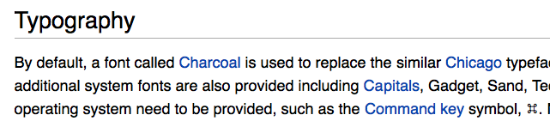
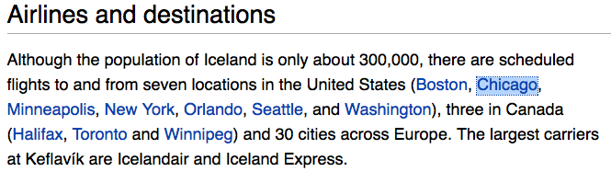
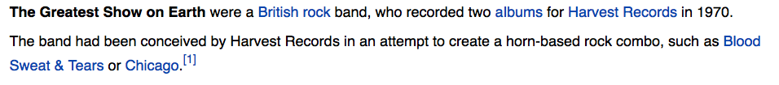
P(t|m): “Commonness”
P(Title|”Chicago”)
Notes:
Change the red font to dark font

Slide 45
P(t|m): “Commonness”
Rank | t | P(t|”Chicago”)
1 | Chicago | .76
2 | Chicago (band) | .041
3 | Chicago (2002_film) | .022
20 | Chicago Maroons Football | .00186
100 | 1985 Chicago Whitesox Season | .00023448
505 | Chicago Cougars | .0000528
999 | Kimbell Art Museum | .00000586
First used by Medelyan et al. (2008)
Most popular method for initial candidate ranking

Slide 46
Note on Domain Dependence
“Commonness” Not robust across domains
Formal Genre
Tweets
Corpus | Recall
ACE | 86.85%
MSNBC | 88.67%
AQUAINT | 97.83%
Wiki | 98.59%
Metric | Score
P1 | 60.21%
R-Prec | 52.71%
Recall | 77.75%
MRR | 70.80%
MAP | 58.53%
Ratinov et al. (2011)
Meij et al. (2012)
Notes:
We can use the commonness distribution as an initial ranking of the candidate concept for a given n-gram.
The percentage of n-grams for which the target concept can be found in the list of candidates gives us the
Best recall we could get, at the n-gram level, if we have a perfect re-ranker.
Note that as our domain differs more and more from Wikipedia, this number decreases, and drastically so for tweets.

Slide 47
  Graph Based Initial Ranking
Centrality (Hachey et al., 2011; Hakimov et al., 2012)
  : the number of all reachable nodes from a
  : the distance between a and b
Importance of the title with respect to Wikipedia - Similar to PageRank (Brin & Page, 1998)
  Hachey et al. (2011) showed tha centrality works slightly better than PageRank
Notes:
We intend to use various internal metrics such as Kullback-Leibler divergence, distance, dependency, temporal distribution, Meta-path (common neighbors, normalized path count, pairwise random walk and path sim) (Sun et al., 2011b) and global validation features in order to capture the coherence among all entity mentions in any document.
Collective Inference → next

Slide 48
Basic Ranking Methods
Local: Mention-Concept Context Similarity
  Use similarity measure to compare the context of the mention with the text associated with a candidate title (the text in the corresponding page)
Global: Document-wide Conceptual Coherence
  Use topical/semantic coherence measures between the set of referent concepts for all mentions in a document

Slide 49
Context Similarity Measures
Determine assignment that maximizes pairwise similarity
Γ
m₁
c₁
Feature vector to capture degree of contextual similarity
m₂
c₂
φ
Mention, Title
…
…
m_{k}
c_{N}
Mapping from mentions to titles
Mention-concept assignment

Slide 50
Context Similarity Measures: Context Source
all document text
all document text
The Chicago Bulls are a profeesional basketball team …
φ
Chicago won six championships…
,

Slide 51
Context Similarity Measures: Context Source
Text document containing mention
all document text
all document text
Compact summary of concept
The Chicago Bulls are a professional basketball team …
φ
Text document associated with concept
Chicago won six championships…
,
mention’s immediate context
Varying notion of distance between mention and context tokens
  Token-level, discourse-level
Varying granularity of concept description
  Synopsis, entire document

Slide 52
Context Similarity Measures: Context Analysis
all document text
all document text
The Chicago Bulls are a profeesional basketball team …
φ
1993
NBA
playoffs
Jordan
Derrick Rose
Chicago won the championship…
NBA
1990’s
,
nsubj
dobj
Context is processed and represented in a variety of ways

Slide 53
Context Similarity Measures: Context Analysis
TF-IDF;
Entropy based representation (Mendes et al., 2011)
Topic model representation
Facts about concept
(e.g. <Jerry Reinsdorf, owner of, Chicago Bulls> in Wikipedia Info box)
all document text
all document text
The Chicago Bulls are a profeesional basketball team …
φ
1993
NBA
playoffs
Jordan
Derrick Rose
Chicago won the championship…
NBA
1990’s
,
nsubj
dobj
Structured text epresentations such as chunks, dependency paths
Automatically extracted Keyphrases, named entities, etc.
Context is processed and represented in a variety of ways

Slide 54
Typical Features for Ranking
Mention/Concept Attribute |  |  | Description
Name | Spelling match |  | Exact string match, acronym match, alias match, string matching…
 | KB link mining |  | Name pairs mined from KB text redirect and disambiguation pages
 | Name Gazetteer |  | Organization and geo-political entity abbreviation gazetteers
Document surface | Lexical |  | Words in KB facts, KB text, mention name, mention text.
 |  |  | Tf.idf of words and ngrams
 | Position |  | Mention name appears early in KB text
 | Genre |  | Genre of the mention text (newswire, blog, …)
 | Local Context |  | Lexical and part-of-speech tags of context words
Entity Context | Type |  | Mention concept type, subtype
 | Relation/Event |  | Concepts co-occurred, attributes/relations/events with mention
 | Coreference |  | Co-reference links between the source document and the KB text
Profiling |  |  | Slot fills of the mention, concept attributes stored in KB infobox
Concept |  |  | Ontology extracted from KB text
Topic |  |  | Topics (identity and lexical similarity) for the mention text and KB text
KB Link Mining |  |  | Attributes extracted from hyperlink graphs of the KB text
Popularity |  | Web | Top KB text ranked by search engine and its length
 |  | Frequency | Frequency in KB texts
(Ji et al., 2011; Zheng et al., 2010; Dredze et al., 2010; Anastacio et al., 2011)
Notes:
Improve font and shade
Response to DR comment: I think this goes here since these are properties of mention, concept candidate, or both, and/or their associated text. But the use of “feature category” is
what is confusing here. Phi is the feature function, but these attributes in the table here could be used as features per se, or could be inputs to a feature function.
So, I changed the column titles to “Mention/Concept Attribute” and “Description” from “feature category” and “feature description”.
I should also make it clear that many systems use features (phi) that are only specified in terms of either the mention or the concept, and not both (e.g. linkability for mentions).
Thus there are cases where the feature function phi is the identity or a simple transformation.
On this note, I renamed the slide to “Typical Attributes for Ranking Features”. Perhaps this is unwieldy.

Slide 55
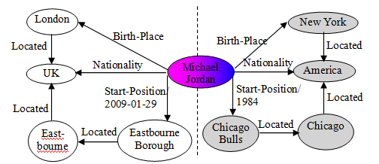

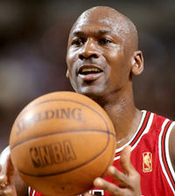
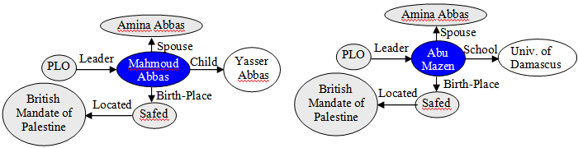

Entity Profiling Feature Examples
Disambiguation
Name Variant Clustering
Deep semantic context exploration and indicative context selection (Gao et al., 2010; Chen et al., 2010; Chen and Ji, 2011; Cassidy et al., 2012)
Exploit name tagging, Wikipedia infoboxes, synonyms, variants and abbreviations, slot filling results and semantic categories
Notes:
This is essentially meant to be a picture of the “profile” attribute type of the previous slide.

Slide 56

Topic Feature Example
Li Na
Li Na
Li Na
player
player
Pakistan
relation
tennis
Russia
vice president
express
final
gain
single
country
Prime minister
half
female
Topical features or topic based document clustering for context expansion (Milne and Witten, 2008; Syed et al., 2008; Srinivasan et al., 2009; Kozareva and Ravi, 2011; Zhang et al., 2011; Anastacio et al., 2011; Cassidy et al., 2011; Pink et al., 2013)
56
Notes:
Hypothesis 2 was tested with the second component of the enhanced system. There may be many people with the same name, but we hope to disambiguate similar query mentions based on whether they occur in topically-related contexts.
For example, there are many famous Li Na’s. We can disambiguate the tennis player from the news reporter based topic membership of the associated document.
**************
Note: there are four Li Na’s in sports. 3 have been in the Olympics. Should we talk about how these topics are similar? But we may have more fine-grained than “sports”. Even though many verbs and nouns in their respective contexts may be the same, hopefully other entities would disambiguate (e.g. Venus Williams will not occur with any of the athlete Li Na’s, except for the tennis player).

Slide 57
Context Similarity Measures: Context Expansion
all document text
all document text
The Chicago Bulls are a profeesional basketball team …
φ
related documents,
e.g. “External Links” in Wikipedia
Chicago won the championship…
Additional info about entity
,
“collaborator” mentions
in other documents
Obtain additional documents related to mention
  Consider mention as information retrieval query
KB may link to additional, more detailed information

Slide 58
Context Similarity Measures: Computation
all document text
all document text
The Chicago Bulls are a profeesional basketball team …
φ
Chicago won the championship…
Additional info about entity
,
Cosine similarity (via TF-IDF)
Other distance metrics (e.g. Jaccard)
2nd order vector composition (Hoffart et al., EMNLP2011)
Mutual Information
Notes:
TODO: add more ways in which

Slide 59
Putting it All Together
Learning to Rank [Ratinov et. al. 2011]
  Consider all pairs of title candidates
    Supervision is provided by Wikipedia
  Train a ranker on the pairs (learn to prefer the correct solution)
  A Collaborative Ranking approach: outperforms many other learning approaches (Chen and Ji, 2011)
 | Score Baseline | Score Context | Score Text
Chicago_city | 0.99 | 0.01 | 0.03
Chicago_font | 0.0001 | 0.2 | 0.01
Chicago_band | 0.001 | 0.001 | 0.02
Notes:
To DR Comment: I do not have the additional data with feature values here, unfortunately.
Double check: “all pairs of title candidates” (is this phrased correctly?)

Slide 60
Ranking Approach Comparison
Unsupervised or weakly-supervised learning (Ferragina and Scaiella, 2010)
  Annotated data is minimally used to tune thresholds and parameters
  The similarity measure is largely based on the unlabeled contexts
Supervised learning (Bunescu and Pasca, 2006; Mihalcea and Csomai, 2007; Milne and Witten, 2008, Lehmann et al., 2010; McNamee, 2010; Chang et al., 2010; Zhang et al., 2010; Pablo-Sanchez et al., 2010, Han and Sun, 2011, Chen and Ji, 2011; Meij et al., 2012)
  Each <mention, title> pair is a classification instance
  Learn from annotated training data based on a variety of features
  ListNet performs the best using the same feature set (Chen and Ji, 2011)
Graph-based ranking (Gonzalez et al., 2012)
  context entities are taken into account in order to reach a global optimized solution together with the query entity
IR approach (Nemeskey et al., 2010)
  the entire source document is considered as a single query to retrieve the most relevant Wikipedia article

Slide 61
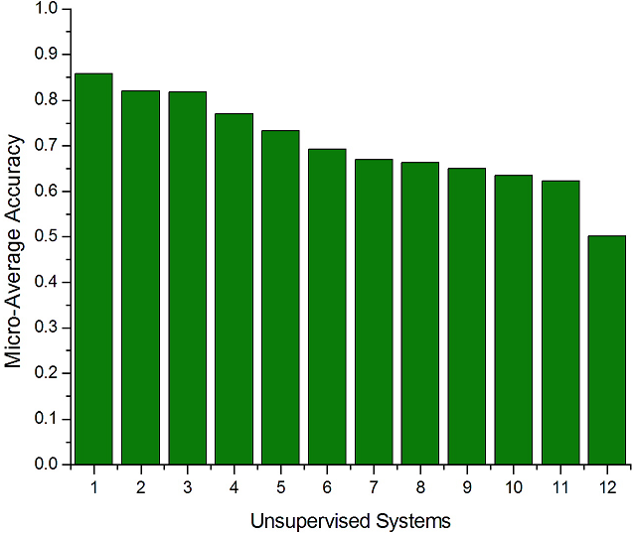
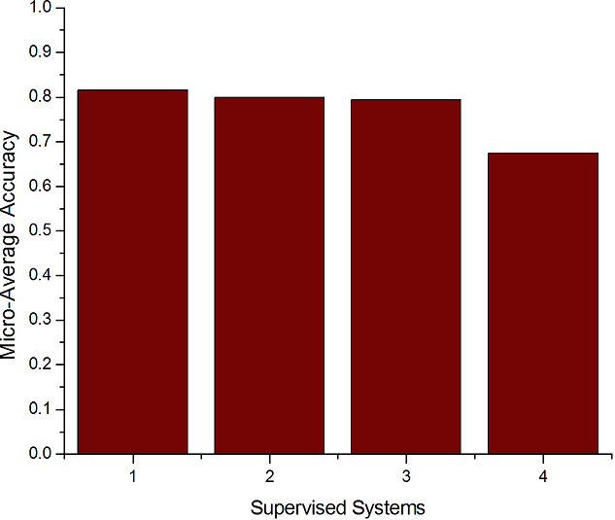
Unsupervised vs. Supervised Ranking
KBP2010 Entity Linking Systems (Ji et al., 2010)
Notes:
Methods in type (2) involve a lot of feature engineering and are therefore much more difficult to duplicate. So the first question we will investigate is how much higher performance can be achieved by using supervised learning? Among the 16 regular entity linking systems, hltcoe, Stanford_UBC, NUSchime and UC3M have explicitly used supervised classification, and they are ranked 4th, 5th, 6th and 10th as shown in Figure 3.

Slide 62
High-level Algorithmic Approach
Input: A text document d; Output: a set of pairs (m_{i} ,t_{i})
  m_{i} are mentions in d; t_{i} are corresponding Wikipedia titles, or NIL.
(1) Identify mentions m_{i} in d
(2) Local Inference
  For each m_{i} in d:
    Identify a set of relevant titles T(m_{i} )
    Rank titles t_{i} ∈ T(m_{i} )
    [E.g., consider local statistics of edges (m_{i} ,t_{i}) , (m_{i} *), and (*, t_{i} ) occurrences of in the Wikipedia graph]
(3) Global Inference
  For each document d:
    Consider all m_{i} ∈ d; and all t_{i} ∈ T(m_{i} )
    Re-rank titles t_{i} ∈ T(m_{i} )
    [E.g., if m, m’ are related by virtue of being in d, their corresponding titles t, t’ should also be related]
Notes:
Don’t focus on “our contribution” only – focus on describing an algorithmic approach (which is impressive and good)

Slide 63
Conceptual Coherence
Recall: The reference collection (might) have structure.
Hypothesis:
  Textual co-occurrence of concepts is reflected in the KB (Wikipedia)
Incite:
  Preferred disambiguation Γ contains structurally coherent concepts
It’s a version of Chicago – the standard classic Macintosh menu font, with that distinctive thick diagonal in the ”N”.
Chicago was used by default for Mac menus through MacOS 7.6, and OS 8 was released mid-1997..
Chicago VIII was one of the early 70s-era Chicago albums to catch my
ear, along with Chicago II.
Is_a
Is_a
Used_In
Released
Succeeded

Slide 64
Co-occurrence (Title 1, Title 2)
The city senses of Boston and Chicago appear together often.

Slide 65
Co-occurrence(Title1, Title2)
Rock music and albums appear together often

Slide 66
Global Ranking
How to approximate the “global semantic context” in the document”?
  It is possible to only use non-ambiguous mentions as a way to approximate it.
How to define relatedness between two titles? (What is Ψ?)

Slide 67
Title Coherence & Relatedness
Let c, d be a pair of titles …
Let C and D be their sets of incoming (or outgoing) links
  Unlabeled, directed link structure
Let C and D ∈{0,1}^{K}, where K is the set of all categories
Introduced by Milne &Witten (2008)
Used by Kulkarni et al. (2009), Ratinov et al (2011), Hoffart et al (2011),
See García et al. (JAIR2014) for variational details
Relatedness Outperforms Pointwise Mutual Information (Ratinov et al., 2011)
Category based similarity introduced by Cucerzan (2007)
Notes:
Reponse to DR comment: I don’t have ablation results as of now but I will look to see if anyone does. For now I can say a bit about who did what.

Slide 68
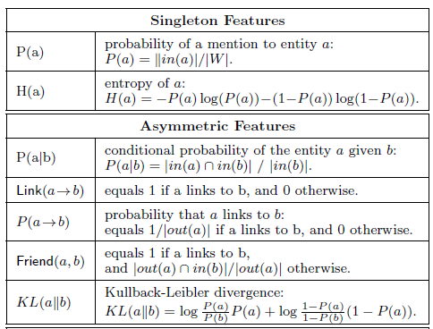
  More Relatedness Measures (Ceccarelli et al., 2013)

Slide 69
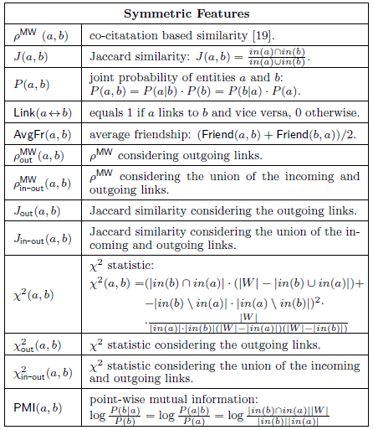
  More Relatedness Measures (Ceccarelli et al., 2013)

Slide 70
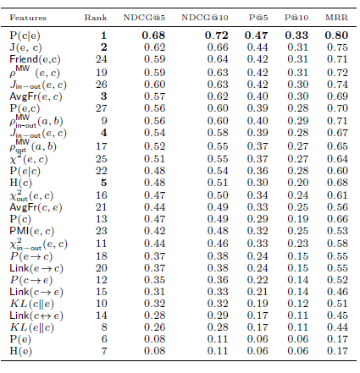
  More Relatedness Measures (Ceccarelli et al., 2013)

Slide 71
Densest Subgraph Heuristic (Moro et al., TACL2014)
Target KB: Babelnet (Navigli & Ponzetto, AI 2012)
  A semantic network of concepts (including named entities), with typed edges for semantic relations, in multiple languages.
Babelfy System
  1. Assign weights to and remove labels from edges using directed triangles
    Inspired by (Watts & Strogatz 1998)
  2. Create semantic signature via Random Walk with Restart (RWR) (Tong et al., 2006) using edge weights for probability
    SemSign_{c} – set of concepts most related to c based on RWR
  3. Graph - V: (m, c) candidates E: based on SemSign
  4. Reduce ambiguity by approximating Densest Subgraph
    Hypothesis: The best concept for a mention comes from the densest portion of the graph

Slide 72
NIL Detection and Clustering
The key difference between Wikification and Entity Linking is the way NIL are treated.
In Wikification:
  Local Processing
  Each mention m_{i} that does not correspond to title t_{i} is mapped to NIL.
In Entity Linking:
  Global Processing
  Cluster all mentions m_{i} that represent the same concept
  If this cluster does not correspond to a title t_{i}, map it to NIL.
Mapping to NIL is challenging in both cases
Notes:
. We expect this idea to inspire a completely new philosophy for fact
extraction which will be essential for the creation of a high-quality StructNet.
Incorporate arbitrary global features and soft constraints;
Features are automatically learned selectively
Save some human knowledge engineering efforts
Capture inter-dependency knowledge on the entire structure
Efficient linear-time beam search by joint learning and decoding
No need to model joint/conditional distribution with a large number of variables
Extract all facts jointly in a unified framework
Local predictions can be mutually improved
Avoid error compounding problem

Slide 73
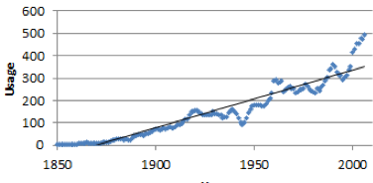
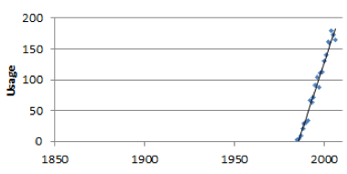
NIL Detection
1. Augment KB with NIL entry and treat it like any other entry
2. Include general NIL-indicating features
Is it in the KB?
W₁
,
W₂
NIL
W_{N}
W_{NIL}
Jordan accepted a basketball scholarship to North Carolina, …
Local man Michael Jordan was appointed county coroner …
In the 1980’s Jordan began developing recurrent neural networks.
KB
Sudden Google Books frequency spike: Entity
1. Binary classification (Within KB vs. NIL)
2. Select NIL cutoff by tuning confidence threshold
Is it an entity?
No spike: Not an entity
Concept Mention Identification (above)
Not all NP’s are linkable
“Prices Quoted”
“Soluble Fiber”
Notes:
. We expect this idea to inspire a completely new philosophy for fact
extraction which will be essential for the creation of a high-quality StructNet.
Incorporate arbitrary global features and soft constraints;
Features are automatically learned selectively
Save some human knowledge engineering efforts
Capture inter-dependency knowledge on the entire structure
Efficient linear-time beam search by joint learning and decoding
No need to model joint/conditional distribution with a large number of variables
Extract all facts jointly in a unified framework
Local predictions can be mutually improved
Avoid error compounding problem

Slide 74
NIL Detection: Main Challenges
Wikipedia’s hyperlinks offer a wealth of disambiguated mentions that can be leveraged to train a Wikification system.
However, relative to mentions from general text, Wikipedia mentions are disproportionately likely to have corresponding Wikipedia pages
Accounting for this bias from statistical models requires more than simply training a Wikification system on a moderate number of examples from non-Wikipedia text
Applying distinct semi-supervised and active learning approaches to the task is a primary area of future work
More advanced selectional preference methods should be applied to solve the cases when the correct referent is ranked very low by statistical models, and combine multi-dimensional clues

Slide 75
NIL Clustering
… Michael Jordan …
… Michael Jordan …
… Michael Jordan …
“All in one”
Simple string matching
… Michael Jordan …
… Michael Jordan …
… Michael Jordan …
“One in one”
Often difficult to beat!
… Michael Jordan …
… Michael Jordan …
… Michael Jordan …
Collaborative Clustering
Most effective when ambiguity is high

Slide 76
NIL Clustering Methods Comparison
(Chen and Ji, 2011; Tamang et al., 2012)
Algorithms |  | B-cubed+ F-Measure | Complexity
Agglomerative clustering | 3 linkage based algorithms (single linkage, complete linkage, average linkage) (Manning et al., 2008) | 85.4%-85.8% | n: the number of mentions
 | 6 algorithms optimizing internal measures cohesion and separation | 85.6%-86.6%
Partitioning Clustering | 6 repeated bisection algorithms optimizing internal measures | 85.4%-86.1% | NNZ: the number of non-zeroes in the input matrix M: dimension of feature vector for each mention k: the number of clusters
 | 6 direct k-way algorithms optimizing internal measures (Zhao and Karypis, 2002) | 85.5%-86.9%
Co-reference methods were also used to address NIL Clustering (E.g., Cheng et. al 2013): L³M Latent Left Linking jointly learn metric and clusters mentions
Notes:
. We expect this idea to inspire a completely new philosophy for fact
extraction which will be essential for the creation of a high-quality StructNet.
Incorporate arbitrary global features and soft constraints;
Features are automatically learned selectively
Save some human knowledge engineering efforts
Capture inter-dependency knowledge on the entire structure
Efficient linear-time beam search by joint learning and decoding
No need to model joint/conditional distribution with a large number of variables
Extract all facts jointly in a unified framework
Local predictions can be mutually improved
Avoid error compounding problem

Slide 77
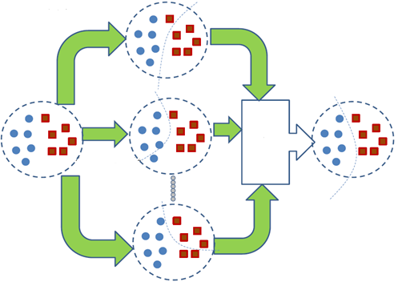
Collaborative Clustering (Chen and Ji, 2011; Tamang et al., 2012)
Consensus functions
  Co-association matrix (Fred and Jain,2002)
  Graph formulations (Strehl and Ghosh, 2002; Fern and Brodley, 2004): instance-based; cluster-based; hybrid bipartite
12% gain over the best individual clustering algorithm
clustering1
final clustering
consensus
function
clusteringN
Notes:
We have applied four similarity functions, including unsupervised learning (cosine and correlation) and supervised learning models (Maximum Entropy and Support Vector Machines). The supervised learning models can be re-trained with any given labeled data and any enriched feature sets. Finally, we developed four consensus functions based on co-association matrix (Fred and Jain, 2002) and graph formulation (Strehl and Ghosh, 2002; Fern and Brodley, 2004). Our preliminary experiments showed that CC can obtain 12% gain over the best individual clustering algorithm (Chen, 2012; Tamang et al., 2012).
. We expect this idea to inspire a completely new philosophy for fact
extraction which will be essential for the creation of a high-quality StructNet.
Incorporate arbitrary global features and soft constraints;
Features are automatically learned selectively
Save some human knowledge engineering efforts
Capture inter-dependency knowledge on the entire structure
Efficient linear-time beam search by joint learning and decoding
No need to model joint/conditional distribution with a large number of variables
Extract all facts jointly in a unified framework
Local predictions can be mutually improved
Avoid error compounding problem

Slide 78
Outline
Motivation and Definition
A Skeletal View of a Wikification System
  High Level Algorithmic Approach
Key Challenges
Coffee Break
Recent Advances
New Tasks, Trends and Applications
What’s Next?
Resources, Shared Tasks and Demos
Notes:
. We expect this idea to inspire a completely new philosophy for fact
extraction which will be essential for the creation of a high-quality StructNet.
Incorporate arbitrary global features and soft constraints;
Features are automatically learned selectively
Save some human knowledge engineering efforts
Capture inter-dependency knowledge on the entire structure
Efficient linear-time beam search by joint learning and decoding
No need to model joint/conditional distribution with a large number of variables
Extract all facts jointly in a unified framework
Local predictions can be mutually improved
Avoid error compounding problem

Slide 79
General Challenges
Blumenthal (D) is a candidate for the U.S. Senate seat now held by Christopher Dodd (D), and he has held a commanding lead in the race since he entered it. But the Times report has the potential to fundamentally reshape the contest in the Nutmeg State.
Ambiguity
Concepts outside of Wikipedia (NIL)
  Blumenthal ?
Variability
Scale
  Millions of labels
The New York Times
The Times
CT
The Nutmeg State
Times
Connecticut
Notes:
This is done with mostly with stats before
What if there is no correct answer for Blumenthal in Wikipedia? How do we link those mentions to NILs even if we know Blumenthal could refer to something we know

Slide 80
General Challenges
A few researchers focused on efficiency of Wikification (e.g. stacking (He et al., 2013) and distributional hierarchical clustering (Bekkerman et al., 2005; Singh et al. 2011)); most others focus on improving quality
State-of-the-art systems (Ratinov et al. 2011) can achieve the above with local and global statistical features
  Reaches bottleneck around 70%~ 85% F1 on non-wiki datasets
  What is missing?
Blumenthal (D) is a candidate for the U.S. Senate seat now held by Christopher Dodd (D), and he has held a commanding lead in the race since he entered it. But the Times report has the potential to fundamentally reshape the contest in the Nutmeg State.
Notes:
Quite impressive, bottleneck: adding more sophisticated contextual features does not help much
We do not want to level off here

Slide 81
Challenges
Dealing with Popularity Bias
Exploiting Semantic Knowledge to Improve Wikification
  Relational Information in the text
Recovering from gaps in background knowledge
  Mostly when dealing with short texts and social media
Exploiting common sense knowledge

Slide 82
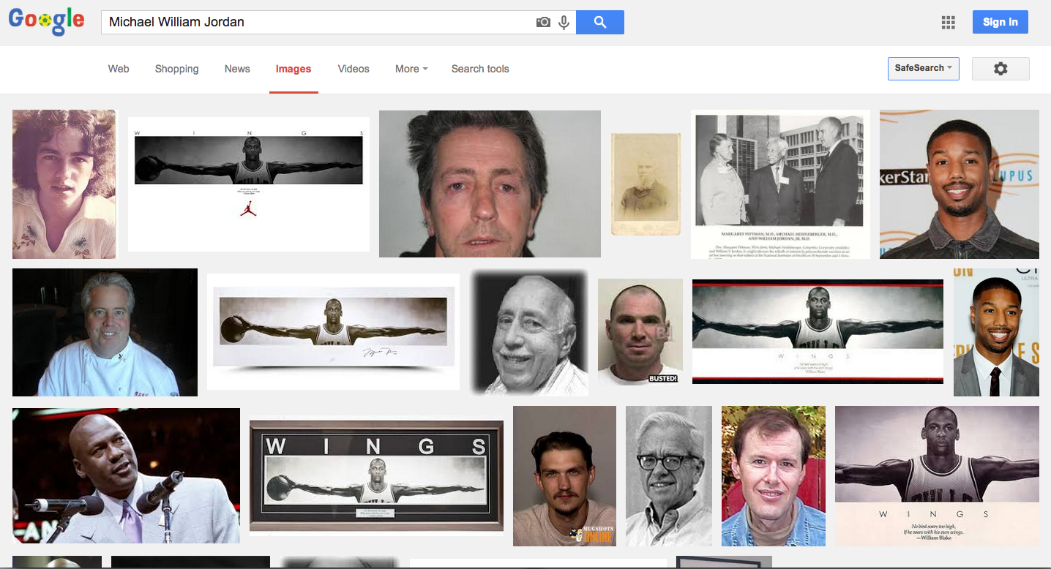
Popularity Bias: If you are called Michael Jordan…
Notes:
Quite impressive, bottleneck: adding more sophisticated contextual features does not help much
We do not want to level off here

Slide 83
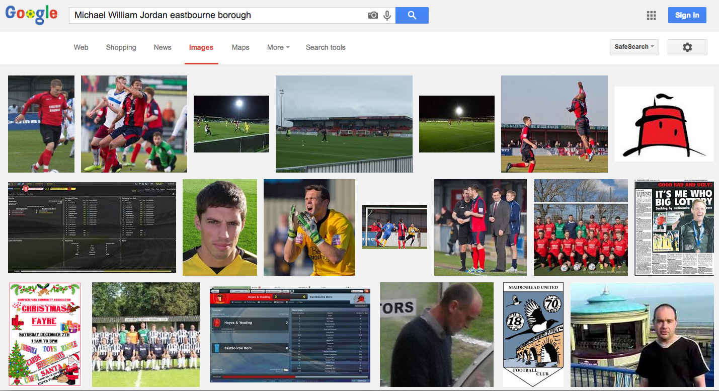
A Little Better…
Notes:
Quite impressive, bottleneck: adding more sophisticated contextual features does not help much
We do not want to level off here

Slide 84


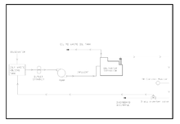
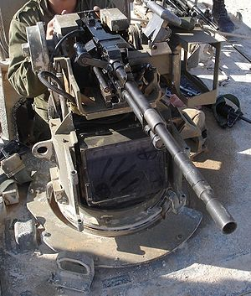
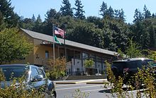
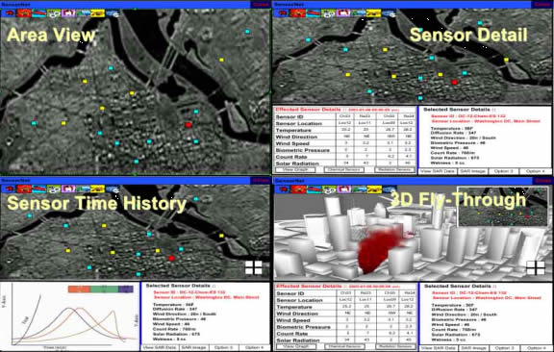
Deep Semantic Knowledge
Local OWS activists were part of this protest.
Order of World Scouts
Occupy Wall Street
Oily Water Separator
Overhead Weapon Station
Open Window School
Open Geospatial Consortium

Slide 85
Deep Semantic Knowledge
Ok, my answer is no one and Obama wins the GE.
I think Romney wins big today and obviously stays in.
Santorum gets enough of a boost to do the Huckabee hangs around.
I think Gingrich's sole win in GA is enough to hang it up and go back to making millions in the private sector.
I think Mitt drops out...
The only one with any reason to will be Newt, but I don't think that he will.
<inventory lemma="win-v">
<sense group="1" n="1" name="beat, prevail or triumph" type="">
<commentary>
NP WIN PP
NP WIN NP [competition,activity,event]
</commentary>
General Electric
United States presidential election, 2012

Slide 86
Deep Semantic Knowledge
An Australian jury found that an Uzbekistan Olympic boxing official was defamed in a book about alleged Olympic corruption in which he was depicted as a major international heroin dealer and racketeer.
Rakhimov was also said to have bribed members of the International Boxing Federation in the vote for the Federation Presidency.
International Boxing Association (amateur), olympic-style
International Boxing Association (professional body), organization that sanctions professional boxing
Notes:
Go beyond sentence level

Slide 87
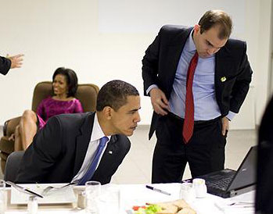
Deep Semantic Knowledge
It was a pool report typo. Here is exact Rhodes quote: ”this is not gonna be a couple of weeks. It will be a period of days.”
At a WH briefing here in Santiago, NSA spox Rhodes came with a litany of pushback on idea WH didn’t consult with Congress.
Rhodes singled out a Senate resolution that passed on March 1st which denounced Khaddafy’s atrocities. WH says UN rez incorporates it
Ben Rhodes
(Speech Writer)
Notes:
Go beyond sentence level

Slide 88

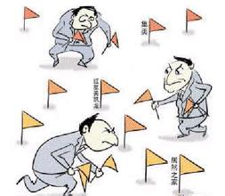

Knowledge Gap between Source and KB
Source: breaking news/new information/rumor | KB: bio, summary, snapshot of life
According to Darwin it is the Males who do the vamping. | Charles Robert Darwin, was an English naturalist and geologist best known for his contributions to evolutionary theory.
I had no idea the victim in the Jackson cases was publicized. | In the summer of 1993, Jackson was accused of child sexual abuse by a 13-year-old boy named Jordan Chandler and his father, Dr. Evan Chandler, a dentist.
I went to youtube and checked out the Gulf oil crisis: all of the posts are one month old, or older… | On April 20, 2010, the Deepwarter Horizon oil platform, located in the Mississippi Canyon about 40 miles (64 km) off the Louisiana coast, suffered a catastrophic explosion; it sank a day-and-a-half later
Notes:
In a document where the concept is not a central topic, the author often assumes that the readers have enough background knowledge (‘anchor’ location from the news release information, world knowledge or related documents) about these entities.

Slide 89


Fill in the Gap with Background Knowledge
Source: breaking news/new information/rumors | KB: bio, summary, snapshot of life
Christies denial of marriage privledges to gays will alienate independents and his “I wanted to have the people vote on it” will ring hollow. | Christie has said that he favoured New Jersey's law allowing same-sex couples to form civil unions, but would veto any bill legalizing same-sex marriage in New Jersey
Translation out of hype-speak: some kook made threatening noises at Brownback and go arrested | Samuel Dale "Sam" Brownback (born September 12, 1956) is an American politician, the 46th and current Governor of Kansas.
Man Accused Of Making Threatening Phone Call To Kansas Gov. Sam Brownback May Face Felony Charge
Connect/Sort
Background Knowledge
Notes:
Long long time ago there was a fight between MT and distillation; Every one complains about MT; but most complaints are from distillation people…because…
We should be ‘guided’ by each other, then we can collaborate and benefit from each other.
…MT …a few names…. Not using ie in approriate way… 50% names are not translated correctly so it affects ie performace.

Slide 90
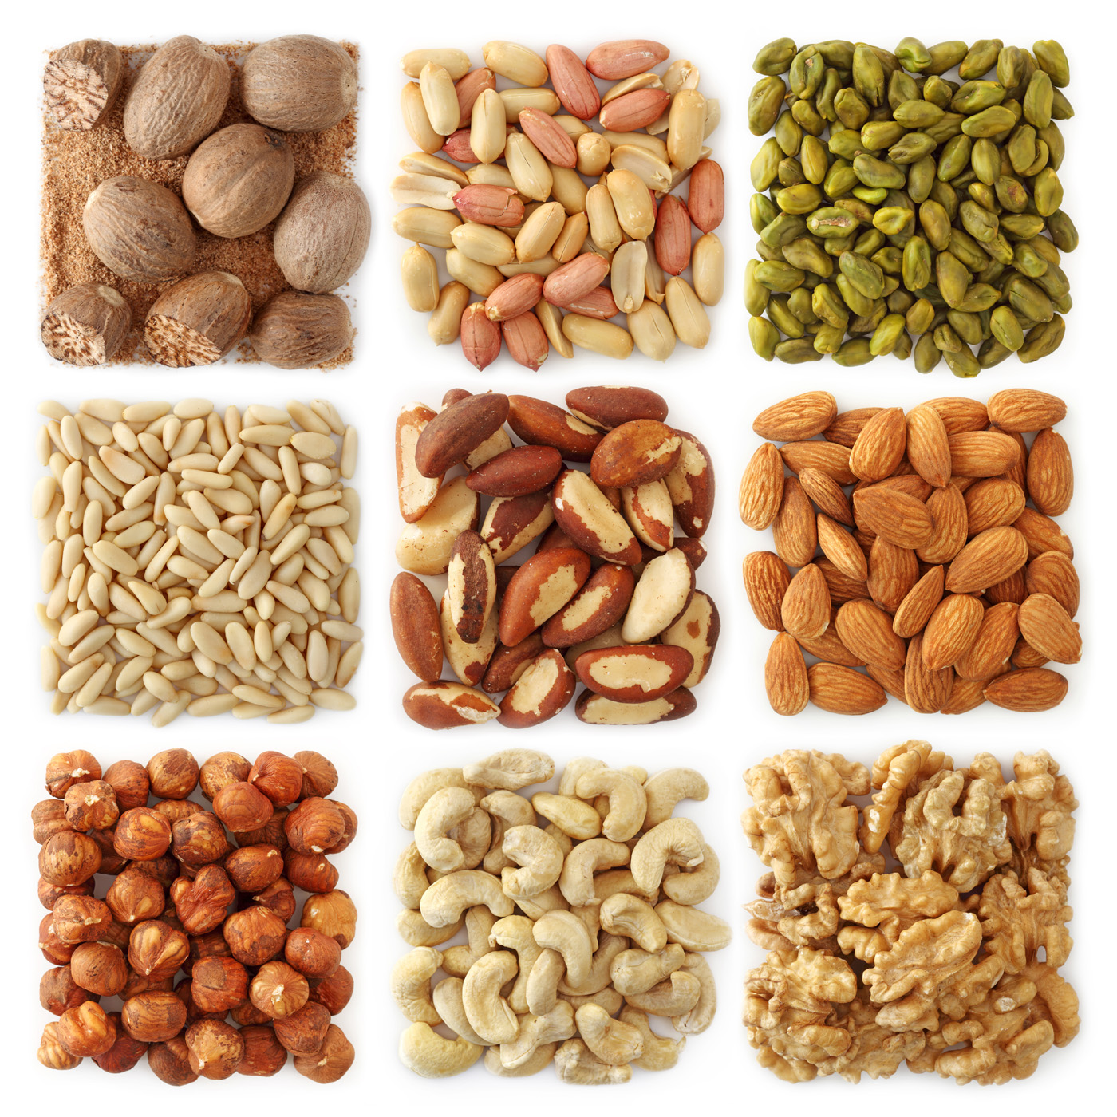
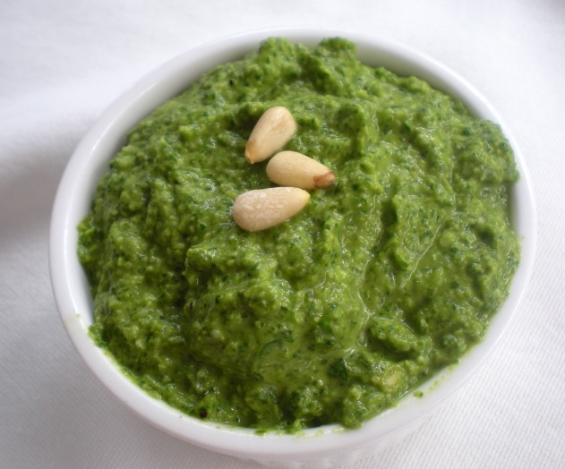
Background Knowledge
Making pesto! I had to soak my nuts for 3 hours

Slide 91
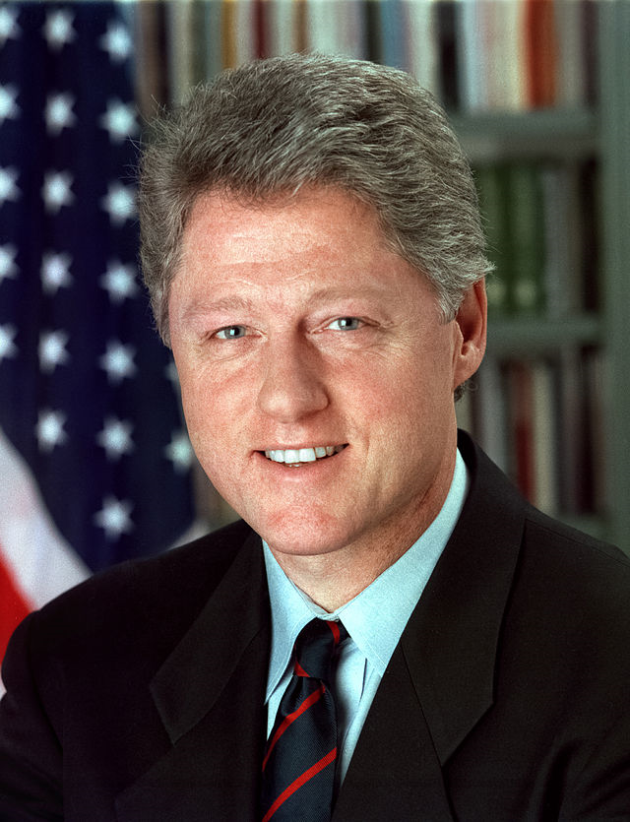
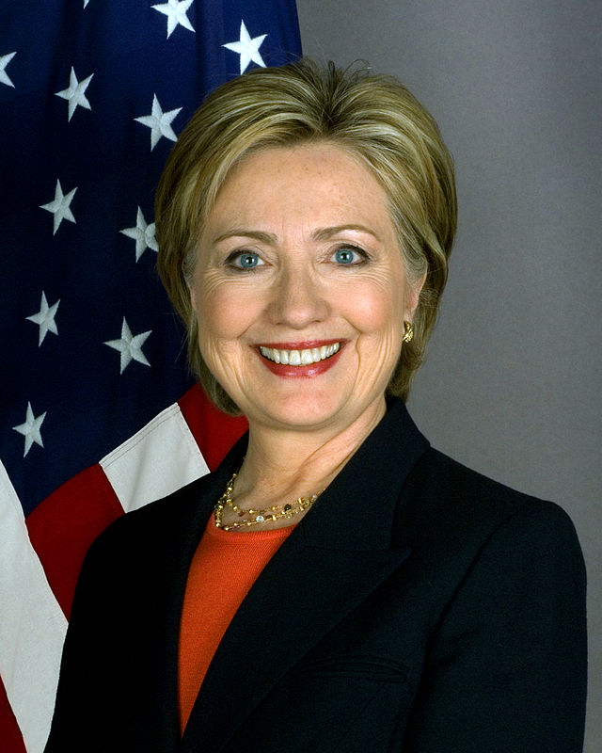
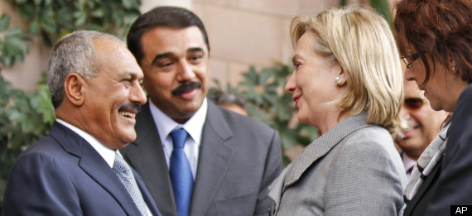
Background Knowledge
Awesome post from wolfblitzercnn: Behind the scenes on Clinton’s Mideast trip - URL - #cnn

Slide 92
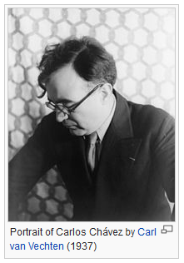
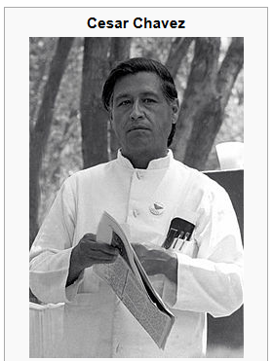
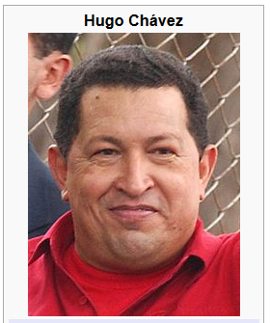
Background Knowledge
Iran and Russia will be the next war along with Chavez if we do not create a successful democracy in Iraq.
Chavez's opposition to Zionism and close relations with Iran, have led to accusations of antisemitism
Soon after this speech, in August Chávez announced that his government would nationalize Venezuela's gold industry,… to banks in Venezuela's political allies like Russia, China and Brazil.
The CD and other opponents of Chávez's Bolivarian government accused it of trying to turn Venezuela from a democracy into a dictatorship by…

Slide 93




Background Knowledge
2005-06-05
Taiwan (TW)
International; weapons
Taiwan successfully fired its first cruise missile.
This will enable Taiwan to hit major military targets in southeast China.
The China Times reported that Taiwan has successfully test fired the Hsiung Feng its first cruise missile enabling Taiwan to hit major military targets in southeast China.
Hsiung Feng IIE

Slide 94
Background Knowledge
1995-12-18
Germany (DE)
International; weapons; war and conflict
There are huge obstacles to achieving peace and cooperation among combatants in the former Yugoslavia.
German Foreign Minister Klaus Kinkel said in opening remarks at the one-day meeting that there can be no peace in the former Yugoslavia if some parties to the conflict remain heavily armed and others try to catch up.
1918-1929: Kingdom of Serbs, Croats and Slovenes
1929-1941: Kingdom of Yugoslavia
1945-1946: Yugoslavia Democratic Union
1946-1963: Federal People's Republic of Yugoslavia
1963-1992: Socialist Federal Republic of Yugoslavia
1992-2003: Federal Republic of Yugoslavia
2003-2006: Serbia and Montenegro
…

Slide 95
Background Knowledge
I-55 will be closed in both directions between Carondelet and the 4500 block
Carondelet is a neighborhood in the extreme southeastern portion of St. Louis, Missouri.
Interstate 55
Interstate 55 in Missouri

Slide 96


Commonsense Knowledge
2008-07-26
During talks in Geneva attended by William J. Burns Iran refused to respond to Solana’s offers.
William_J._Burns (1861-1932)
William_Joseph_Burns (1956- )

Slide 97


Rich Context (Information Networks)
Imam Muhammad Ibn
Saud Islamic University
Saudi Arabia
JFK Airport
Attend-school
Nationality
Employee-of
Nationality
Abdul Aziz Al-Omari
Alomari
Al-Umari
Abdulrahman al-Omari
Abdul Rahman Alomari
Alomari
Al-Umari
City-of-residence
Attend-school
Member-of
Supervisor
City-of-residence
Al-Qaeda
Mohamed Atta
Vero Beach,
Florida
Florida
Flight School
Notes:
97
97
However, when we apply these semantic context features to noisy and informal data, there could be many contextual entities which implicitly provide evidence for disambiguation. For example, as shown in Figure 2, after the September 11 attack occurred, a person whose name is “Abdul Rahman Alomari” was mistakenly identified by the FBI as the attacker because he has a similar name as the real attacker “Abdul Aziz Al-Omari”. They also came from the same nation “Saudi Arabia” and have lived in the same city “Vero Beach, Florida” during a similar time frame. In addition, although “Abdul Rahman Alomari” was not a pilot, he worked at the “JFK airport”. In order to disambiguate these two persons, we need to incorporate deeper semantic context features such as their supervisors (e.g. “Mohamed Atta”), affiliated organizations (e.g. “Al-Qaeda”) and schools attended (e.g. “Imam Muhammad Ibn Saud Islamic University” vs. “Florida Flight School”).

Slide 98
Rich Context
“Supreme Court” (in Japan, China, U.S., Macedonia, etc.)
“LDP (Liberty and Democracy Party)” (in Australia, Japan, etc.)
“Newcastle University” can be located in UK or Australia
Many person entities share the same common names such as “Albert”, “Pasha”, etc.
“Ji county” can be located in “Shanxi” or “Tianjin”
Notes:
For example, for entity with a common name “Shaofen Wan”, if we know its
associated document was from 1992 news, then it’s likely refer to the member of “13th Central Committee of the Communist Party of China”.

Slide 99


Rich Context: Coreferential Mentions
Brazilian government and Abbott Laboratories agree on lower price for AIDS drug Kaletra in response to Brazilian threat to violate the patent.
According to WHO studies the price of the drug was exorbitant and the Brazilian government demanded that Abbot lower the price.
Finding collaborators based cross-document entity clustering (Chen and Ji, 2011)
Notes:
. We expect this idea to inspire a completely new philosophy for fact
extraction which will be essential for the creation of a high-quality StructNet.
Incorporate arbitrary global features and soft constraints;
Features are automatically learned selectively
Save some human knowledge engineering efforts
Capture inter-dependency knowledge on the entire structure
Efficient linear-time beam search by joint learning and decoding
No need to model joint/conditional distribution with a large number of variables
Extract all facts jointly in a unified framework
Local predictions can be mutually improved
Avoid error compounding problem

Slide 100


Rich Context: Related Employer
Hundreds of protesters from various groups converged on the state capitol in Topeka, Kansas today…
Second, I have a really hard time believing that there were any ACTUAL “explosives” since the news story they link to talks about one guy getting arrested for THREATENING Governor Brownback.
Peter Brownback
Sam Brownback

Slide 101


Rich Context: Related Employees
I check the numbers, and am shocked to learn the Sharks have over 10 million in available cap room. Antropov would fit in great with the Sharks, while McCabe would be the big shot (you will remember last year how much they pursued Souray).

Slide 102




Rich Context: Related Colleagues
Where would McCain be without Sarah?
Notes:
McCain = John_McCain
Sarah = Sarah_Palin
Sarah was the nominee for Vice President in the 2008 presidential election alongside John McCain

Slide 103

Rich Context: Related Colleagues
No matter what, he never should have given Michael Jackson that propofol. He seems to think a “proper” court would have let Murray go free.
The trial of Conrad Murray was the American criminal trial of Michael Jackson's personal physician, Conrad Murray.
Notes:
McCain = John_McCain
Sarah = Sarah_Palin
Sarah was the nominee for Vice President in the 2008 presidential election alongside John McCain

Slide 104




Rich Context: Related Family Members
Mubarak, the wife of deposed Egyptian President Hosni Mubarak, …
wife

Slide 105
Outline
Motivation and Definition
A Skeletal View of a Wikification System
  High Level Algorithmic Approach
Key Challenges
Coffee Break
Recent Advances
New Tasks, Trends and Applications
What’s Next?
Resources, Shared Tasks and Demos
Notes:
. We expect this idea to inspire a completely new philosophy for fact
extraction which will be essential for the creation of a high-quality StructNet.
Incorporate arbitrary global features and soft constraints;
Features are automatically learned selectively
Save some human knowledge engineering efforts
Capture inter-dependency knowledge on the entire structure
Efficient linear-time beam search by joint learning and decoding
No need to model joint/conditional distribution with a large number of variables
Extract all facts jointly in a unified framework
Local predictions can be mutually improved
Avoid error compounding problem

Slide 106
Recent Advances
Improving Wikification by
Acquiring Rich Knowledge
  Better Meaning Representation
  Collaborative Title Collection
Global Inference Using the Additional Knowledge
  Joint Mention Extraction and Linking
  Collective Inference
Notes:
. We expect this idea to inspire a completely new philosophy for fact
extraction which will be essential for the creation of a high-quality StructNet.
Incorporate arbitrary global features and soft constraints;
Features are automatically learned selectively
Save some human knowledge engineering efforts
Capture inter-dependency knowledge on the entire structure
Efficient linear-time beam search by joint learning and decoding
No need to model joint/conditional distribution with a large number of variables
Extract all facts jointly in a unified framework
Local predictions can be mutually improved
Avoid error compounding problem

Slide 107
Semantic Relations and Event Extraction
Co-occurrence
  Two pilots had their wedding in Spain on 15th, and so they became the first homosexual couple who got married in Spanish troops. The wedding was held in Sevilla city hall.
  The assistant of Bosnia Premier Taqik said …two Democratic Progressive Party members who held important duties in the central government…
Part-whole Relation
  Verizon coverage in WV is good along the interstates and in the major cities like Charleston, Clarksburg, Fairmont, Morgantown, Huntington, and Parkersburg.-
  Manchester (New Hampshire)
Notes:
. We expect this idea to inspire a completely new philosophy for fact
extraction which will be essential for the creation of a high-quality StructNet.
Incorporate arbitrary global features and soft constraints;
Features are automatically learned selectively
Save some human knowledge engineering efforts
Capture inter-dependency knowledge on the entire structure
Efficient linear-time beam search by joint learning and decoding
No need to model joint/conditional distribution with a large number of variables
Extract all facts jointly in a unified framework
Local predictions can be mutually improved
Avoid error compounding problem

Slide 108
Semantic Relations and Event Extraction (Cont’)
Employer/Title
  Milton, the senior representative of Brazil government
  Milton, the Governor of Pichincha Province, Ecuador
Affiliation
  Bulgarian National Medicines Agency
Located Relation
  Fine Chemical Plant in Wuhu City
Event
  The leader of Chilean Fencing Federation Ertl was elected as the new chairman of this country’s Olympic Committee tonight.
Notes:
. We expect this idea to inspire a completely new philosophy for fact
extraction which will be essential for the creation of a high-quality StructNet.
Incorporate arbitrary global features and soft constraints;
Features are automatically learned selectively
Save some human knowledge engineering efforts
Capture inter-dependency knowledge on the entire structure
Efficient linear-time beam search by joint learning and decoding
No need to model joint/conditional distribution with a large number of variables
Extract all facts jointly in a unified framework
Local predictions can be mutually improved
Avoid error compounding problem

Slide 109
Acquiring Rich Knowledge from KBs
Wikipedia (Han and Zhao, 2009)
  Wikipedia titles and their surface forms
  Associative relation (internal page links), hierarchical relation and equivalence relation between concepts
  Polysemy (disambiguation page) and synonymy (redirect page) between key terms
  Templates (Zheng et al., 2014)
DBPedia (Zheng et al., 2014)
  Rich relational structures and hierarchies, fine-grained types
Notes:
. We expect this idea to inspire a completely new philosophy for fact
extraction which will be essential for the creation of a high-quality StructNet.
Incorporate arbitrary global features and soft constraints;
Features are automatically learned selectively
Save some human knowledge engineering efforts
Capture inter-dependency knowledge on the entire structure
Efficient linear-time beam search by joint learning and decoding
No need to model joint/conditional distribution with a large number of variables
Extract all facts jointly in a unified framework
Local predictions can be mutually improved
Avoid error compounding problem

Slide 110

Collaborative Title Collection on KB
Go beyond Wikipedia: Exploit rich structures in DBPedia, Freebase, YAGO, Ontologies
Google Knowledge base: “people also search for”

Slide 111
Recent Advances
Improving Wikification by
Acquiring Rich Knowledge
  Better Meaning Representation
  Collaborative Concept Collection
Global Inference Using the Additional Knowledge
  Joint Mention Extraction and Linking
  Collective Inference
Notes:
. We expect this idea to inspire a completely new philosophy for fact
extraction which will be essential for the creation of a high-quality StructNet.
Incorporate arbitrary global features and soft constraints;
Features are automatically learned selectively
Save some human knowledge engineering efforts
Capture inter-dependency knowledge on the entire structure
Efficient linear-time beam search by joint learning and decoding
No need to model joint/conditional distribution with a large number of variables
Extract all facts jointly in a unified framework
Local predictions can be mutually improved
Avoid error compounding problem

Slide 112







End-to-end Wikification: Traditional Pipeline Approach
Texts
Entity/
Concept
Mention
Extraction
Coreference
Resolution
Entity
Linking
NIL
Entity
Clustering
Slot
Filling
KB
100％
90％
80％
70％
65％
35％
PERFORMANCE CEILING
Errors are compounded from stage to stage
No interaction between individual predictions
Incapable of dealing with global dependencies
Notes:
Building a Wikification system requires solving two interrelated sub-problems: mention detection and concept disambiguation. A significant portion of recent work considers the two sub-problems separately and focus on the latter by first defining candidate concepts for a deemed mention based on anchor links (Ratinov et al., 2011; Davis et al., 2012; Sil et al., 2012; Demartini et al., 2012; Wang et al., 2012; Han and Sun, 2011; Han et al., 2011; Mihalcea and Csomai, 2007; Cucerzan, 2007; Milne and Witten, 2008; Ferragina and Scaiella, 2010). However, these two sub-problems can mutually enhance each other. Some recent work (Meij et al., 2012; Guo et al., 2013; Fahrni et al., 2013; Huang et al., 2014) jointly identify and disambiguate concept mentions.

Slide 113
Solution: Joint Extraction and Linking
  [Blue Cross]_{ORG} and [Blue Shield of Alabama]_{ORG}
  [Blue Cross and Blue Shield of Alabama]_{ORG} → BCBS of Alabama
Joint Inference
Joint Modeling
Extraction
Linking
…
Clustering
Extraction
Linking
…
Inference
Clustering
Prediction
Prediction
Constrained Conditional Models, ILP [Roth2004,Punyakanok2005,Roth2007, Chang2012, Yang2013]
Re-ranking [Sil2013,Ji2005,McClosky2011]
Dual decomposition [Rush2010]
Probabilistic Graphical Models
[Sutton2004,Wick2012,Wick2013, Singh2013]
Markov logic networks [Poon2007,Poon2010,Kiddon2012]
Linking for extraction [Meij2012,Guo2013,Fahrni2013,Huang2014]
Notes:
(Meij et al., 2012; Guo et al., 2013; Fahrni et al., 2013; Huang et al., 2014)
. Furthermore, these two sub-problems - mention extraction and mention linking - can mutually enhance each other. Some recent work (Meij et al., 2012; Guo et al., 2013; Fahrni et al., 2013; Huang et al., 2014) jointly identify and disambiguate concept mentions.

Slide 114


Joint Extraction and Linking
The Yuri dolgoruky is the first in a series of new nuclear submarines to be commissioned this year but the bulava nuclear-armed missile developed to equip the submarine has failed tests and the deployment prospects are uncertain.

Slide 115

Joint Extraction and Linking

Slide 116
Joint Extraction and Linking
The Yuri dolgoruky is the first in a series of new nuclear submarines to be commissioned this year but the bulava nuclear-armed missile developed to equip the submarine has failed tests and the deployment prospects are uncertain.

Slide 117



Acquiring Rich Knowledge
I had it done three years ago at Johns Hopkins.
Also, because of a lumpectomy I can only use my left arm for B. P. readings.

Slide 118


Global Interaction Feature: Distinct-Links-Per-Mention (Sil and Yates, 2013)
Objective: Penalize over-segmented phrases
  Example:
[Home] [Depot]
[Home Depot]
Indicates
over-segmentation
Indicates
correct
segmentation
Home_Depot
Home_Depot
Home_Depot
#distinct Entities = 1
#mentions = 2
=> Feature Value= 0.5
#distinct Entities = 1
#mentions = 1
=> Feature Value= 1
Notes:
Example1: has 2 separate mentions with the same link
Example2: has 1 mention with 1 link

Slide 119
Global Interaction Feature: Binary Relation Count (Sil and Yates, 2013)
Use Binary Relations between entities in Freebase
Example:
[Home Depot] CEO [Nardelli]
[Home Depot] [CEO Nardelli]
Home_Depot
Robert_Nardelli
Home_Depot
Steve_Nardelli
Relationship in Freebase
Organization Board Member
No relationship!
Indicates: Under-segmentation
Notes:
Objective: Encourage entity tuples b where the entities have a known relationship with one another
Re-ranking lets us ..
Extra slide for notations : green boxes

Slide 120


Global Interaction Feature: Entity Type PMI
(Sil and Yates, 2013)
Find patterns of entities appearing close to each other
Example:
[Home Depot] CEO [Nardelli]
[Home Depot] [CEO Nardelli]
Home_Depot
Type:
Organization
Robert_Nardelli
Type:
Org_Leader
Home_Depot
Type:
Organization
Steve_Nardelli
Type:
Music_Artist

Slide 121
Recent Advances
Improving Wikification by
Acquiring Rich Knowledge
  Better Meaning Representation
  Collaborative Concept Collection
Global Inference Using the Additional Knowledge
  Joint Concept Extraction and Linking
  Collective Inference
Notes:
. We expect this idea to inspire a completely new philosophy for fact
extraction which will be essential for the creation of a high-quality StructNet.
Incorporate arbitrary global features and soft constraints;
Features are automatically learned selectively
Save some human knowledge engineering efforts
Capture inter-dependency knowledge on the entire structure
Efficient linear-time beam search by joint learning and decoding
No need to model joint/conditional distribution with a large number of variables
Extract all facts jointly in a unified framework
Local predictions can be mutually improved
Avoid error compounding problem

Slide 122



From Non-collective to Collective
  Intuition: Promote semantically coherent pairs of titles
  (1) Enrich text with external KB knowledge
      Use graph metrics (as described earlier)
  (2) Enrich text with (some) gold titles
      Use graph propagation algorithms
  (3) Enrich Text with (local) relational information
      Use global inference methods
Collaborative Learning
Collective Animal Behavior
Great Minds Think Alike
Notes:
. We expect this idea to inspire a completely new philosophy for fact
extraction which will be essential for the creation of a high-quality StructNet.
Incorporate arbitrary global features and soft constraints;
Features are automatically learned selectively
Save some human knowledge engineering efforts
Capture inter-dependency knowledge on the entire structure
Efficient linear-time beam search by joint learning and decoding
No need to model joint/conditional distribution with a large number of variables
Extract all facts jointly in a unified framework
Local predictions can be mutually improved
Avoid error compounding problem

Slide 123
  (1) Collective Inference: Basic Idea
Construct a Knowledge Graph from Source
Construct a Knowledge Graph from KBs
Each Knowledge Graph contains a thematically homogeneous coherent story/context
Semantic Matches of Knowledge Graphs using Graph based Measures to Match Three Criteria:
  Ideally we want to align two graphs directly (Yan and Han, 2002), current simplified solutions→
  Similarity: The mention and the concept should have high similarity
  Salience: The concept should be salient and popular in KB
  Coherence: The concept and its collaborators decided by the mention’s collaborators should be strongly connected in KB

Slide 124

  Construct Knowledge Graph of Concept Mentions and their Collaborators

Slide 125

  Construct Corresponding Knowledge Graph of Concept Candidates and their Collaborators

Slide 126

  Put All Graph Measures Together
Information Volume: Strong Connectivity among Important Concept Collaborators (Zheng et al., 2014)
$$Sim\left(m,c\right)=∝×I\left(c\right)+β×\sum_{n∈∩\left(θ_{m},θ_{c}\right), p∈P}{I(n)×I(p)}$$
${IV(G}_{v}$)=$\sum_{c_{i},c_{j}∈V,p∈E}{(Sim\left(m_{i},c_{i}\right)+Sim\left(m_{j},c_{j}\right))}×I\left(p\right)+\sum_{c_{k}∈V}{Sim\left(m_{k},c_{k}\right)}$
Select the concept embedded in the subgraph with the largest information volume
Importance of C
Importance of C’s neighbors
Importance of property P
Notes:
Same measures as before, we can also apply them to richer graphs

Slide 127
  Linking Accuracy on AMR Corpus
Method |  | Acc@1 | Acc@5 | Acc@10
Baseline | Google Search | 85.8% | 90.1% | 90.1%
Knowledge Graph Matching | (1). Knowledge Graph on Merged KBs | 87.8% | 93.1% | 93.5%
 | (1) + Human AMR on Source (Banarescu et al., 2013) | 96.3% | 98.8% | 99.2%
 | (1) + Automatic AMR Edges on Source (Flanigan et al., 2014) | 94.0% | 97.8% | 98.2%
State-of-the-art Supervised Method |  | 94.3% | 97.7% | 97.7%
Notes:
Comparable performance with supervised approaches

Slide 128
  B-cubed+ F-score on KBP Corpus
Method |  | F
Knowledge Graph Matching | (1). Salience + Similarity | 63.6%
 | (2). (1) + Coherence | 70.9% (top 5)
Top 1 Unsupervised System in KBP2013 |  | 63.2%
Top 1 Supervised System in KBP2013 |  | 72.4%
Notes:
Comparable performance with supervised approaches

Slide 129
From Non-collective to Collective
  Intuition: Promote semantically coherent pairs of titles
  (1) Enrich text with external KB knowledge
      Use graph metrics (as described earlier)
  (2) Enrich text with (some) gold titles
      Use graph propagation algorithms
  (3) Enrich Text with (local) relational information
      Use global inference methods
Collaborative Learning
Collective Animal Behavior
Great Minds Think Alike
Notes:
. We expect this idea to inspire a completely new philosophy for fact
extraction which will be essential for the creation of a high-quality StructNet.
Incorporate arbitrary global features and soft constraints;
Features are automatically learned selectively
Save some human knowledge engineering efforts
Capture inter-dependency knowledge on the entire structure
Efficient linear-time beam search by joint learning and decoding
No need to model joint/conditional distribution with a large number of variables
Extract all facts jointly in a unified framework
Local predictions can be mutually improved
Avoid error compounding problem

Slide 130
  Enrichment with (some) Gold Titles:
  Inference with Graph Regularization (Huang et al., 2014)
Relational Graph Construction with semantic relations
  Perform collective inference to identify and link a set of semantically related mentions
  Make use of manifold (cluster) structure and need less training data
Semi-supervised Graph Regularization
  Loss Function: ensure the refined labels is not too far from the initial labels
  Regularizer: smooth the refined labels over the constructed graph
  Both closed and iterative form solutions exist
Loss Function
Regularizer

Slide 131







Collective Inference with Social Relations
Stay up Hawk Fans.
We are going through a slump,
but we have to stay positive. Go Hawks!

Slide 132

Meta Path
A meta-path is a path defined over a network and composed of a sequence of relations between different object types (Sun et al., 2011)
Meta paths between mentions
  M-T-M
  M-T-U-T-M
  M-T-H-T-M
  M-T-U-T-M-T-H-T-M
  M-T-H-T-M-T-U-T-M

Slide 133

Relational Graph
Each pair of mention m and concept c as a node
  m is linkable, and c is the correct concept, <m, c> should be assigned label 1, otherwise 0

Slide 134

Performance Comparison
Semi-Supervised Collective Inference (Huang et al., 2014)
Supervised Model (Meiji et al., 2012)
Labeled Data Size
Semi-supervised collective inference with 30% labeled data achieves
comparable performance with the state-of-the-art supervised model

Slide 135
From Non-collective to Collective
  Intuition: Promote semantically coherent pairs of titles
  (1) Enrich text with external KB knowledge
      Use graph metrics (as described earlier)
  (2) Enrich text with (some) gold titles
      Use graph propagation algorithms
  (3) Enrich Text with (local) relational information
      Use global inference methods
Collaborative Learning
Collective Animal Behavior
Great Minds Think Alike
Notes:
. We expect this idea to inspire a completely new philosophy for fact
extraction which will be essential for the creation of a high-quality StructNet.
Incorporate arbitrary global features and soft constraints;
Features are automatically learned selectively
Save some human knowledge engineering efforts
Capture inter-dependency knowledge on the entire structure
Efficient linear-time beam search by joint learning and decoding
No need to model joint/conditional distribution with a large number of variables
Extract all facts jointly in a unified framework
Local predictions can be mutually improved
Avoid error compounding problem

Slide 136
General Challenges
A few researchers focused on efficiency of Wikification (e.g. stacking (He et al., 2013) and distributional hierarchical clustering (Bekkerman et al., 2005; Singh et al. 2011)); most others focus on improving quality
State-of-the-art systems (Ratinov et al. 2011) can achieve the above with local and global statistical features
  Reaches bottleneck around 70%~ 85% F1 on non-wiki datasets
  What is missing?
Blumenthal (D) is a candidate for the U.S. Senate seat now held by Christopher Dodd (D), and he has held a commanding lead in the race since he entered it. But the Times report has the potential to fundamentally reshape the contest in the Nutmeg State.
Notes:
Quite impressive, bottleneck: adding more sophisticated contextual features does not help much
We do not want to level off here

Slide 137
Relational Inference
Mubarak,
the wife of deposed Egyptian President Hosni Mubarak,…

Slide 138
Relational Inference
Mubarak, the wife of deposed Egyptian President Hosni Mubarak, …
Egyptian President
Hosni Mubarak
, the of deposed , …
Mubarak
wife
What are we missing with Bag of Words (BOW) models?
  Who is Mubarak?
Textual relations provide another dimension of text understanding
Can be used to constrain interactions between concepts
  (Mubarak, wife, Hosni Mubarak)
Has impact on several steps in the Wikification process:
  From candidate selection to ranking and global decision
Notes:
Main contribution here
We will show that by identifying

Slide 139




Knowledge in Relational Inference
apposition
Coreference
possessive
...ousted long time Yugoslav President Slobodan Milošević in October. The Croatian parliament... Mr. Milošević's Socialist Party
What concepts can “Socialist Party” refer to?
  Wikipedia link statistics is uninformative
Notes:
There are quite some relations in this short sentence
Overall it is sparse but important in text understanding, as error propagates in structured inference
We do not actually care about relation types too much, as the relation will be constrained by our knowledge

Slide 140
Candidate Generation
...ousted long time Yugoslav President Slobodan Milošević in October. Mr. Milošević's Socialist Party…
k | e^{k}₃
1 | Slobodan_Milošević
2 | Milošević_(surname)
3 | Boki_Milošević
4 | Alexander_Milošević
…
k | e^{k}₄
1 | Socialist_Party_(France)
2 | Socialist_Party_(Portugal)
3 | Socialist_Party_of_America
4 | Socialist_Party_(Argentina)
…

Slide 141
Candidate Ranking
...ousted long time Yugoslav President Slobodan Milošević in October. Mr. Milošević's Socialist Party…
k | e^{k}₃ | s^{k}₃
1 | Slobodan_Milošević | 0.7
2 | Milošević_(surname) | 0.1
3 | Boki_Milošević | 0.1
4 | Alexander_Milošević | 0.05
…
k | e^{k}₄ | s^{k}₄
1 | Socialist_Party_(France) | 0.23
2 | Socialist_Party_(Portugal) | 0.16
3 | Socialist_Party_of_America | 0.07
4 | Socialist_Party_(Argentina) | 0.06
…
Local and global statistical features
Notes:
Assign score to candidate entities to express the model’s preference based on contextual coherence

Slide 142

Candidate Generation + Relations
...ousted long time Yugoslav President Slobodan Milošević in October. Mr. Milošević's Socialist Party…
k | e^{k}₃ | s^{k}₃
1 | Slobodan_Milošević | 0.7
2 | Milošević_(surname) | 0.1
3 | Boki_Milošević | 0.1
4 | Alexander_Milošević | 0.05
…
k | e^{k}₄ | s^{k}₄
1 | Socialist_Party_(France) | 0.23
2 | Socialist_Party_(Portugal) | 0.16
3 | Socialist_Party_of_America | 0.07
4 | Socialist_Party_(Argentina) | 0.06
…
21 | Socialist_Party_of_Serbia | 0.0
$$r_{34}^{(1,21)}=1$$
More robust candidate generation
  Identified relations are verified against a knowledge base (DBPedia)
  Retrieve relation arguments matching “(Milošević ,?,Socialist Party)” as our new candidates
Notes:
Top-k gives a very strong baseline, single most important feature in Wikification

Slide 143


Candidate Ranking + Relations
...ousted long time Yugoslav President Slobodan Milošević in October. Mr. Milošević's Socialist Party…
k | e^{k}₃ | s^{k}₃
1 | Slobodan_Milošević | 0.7
2 | Milošević_(surname) | 0.1
3 | Boki_Milošević | 0.1
4 | Alexander_Milošević | 0.05
…
k | e^{k}₄ | s^{k}₄
1 | Socialist_Party_(France) | 0.23
2 | Socialist_Party_(Portugal) | 0.16
3 | Socialist_Party_of_America | 0.07
4 | Socialist_Party_(Argentina) | 0.06
…
21 | Socialist_Party_of_Serbia | 0.0
$$r_{34}^{(1,21)}=1$$
Relation query
Retrieved relation tuple
$$w_{34}^{(1,21)}=?$$
$$w=\frac{1}{Z}f\left(q,σ\right)$$
Notes:
Top-k gives a very strong baseline, single most important feature in wikification

Slide 144






Inference Formulation
Having some knowledge, and knowing how to use it to support decisions, facilitates the acquisition of additional knowledge.
  Goal: Promote concepts that are coherent with textual relations
Formulate as an Integer Linear Program (ILP):
If no relation exists, collapses to the non-structured decision
weight to output $e_{i}^{k}$
Whether to output $k$th candidate of the $i$th mention
weight of a relation ${r_{ij}^{}}^{(k,l)}$
Whether a relation exists between $e_{i}^{k}$ and $e_{j}^{l}$
Notes:
Formalize intuition, weights induced from data, small constraints
Objective function collapse to the original output when there is no relation, so our model is negatives-proof
True-negatives and false-negatives will not negatively impact performance of baseline

Slide 145
Wikification Performance Result [Cheng & Roth, EMNLP’13]
Notes:
And we show that by incorporating these relational inference into the disambiguation framework, our system achieves significant improvements over the previous methods

Slide 146



  Other Inference Approaches (mostly, local information)
  Collaborative Ranking and Collaborative Clustering (Chen and Ji, 2011)
    Construct a collaborative network for the target entity based on graph-based clustering
    Rank multiple decisions from collaborative entities (micro) and algorithms (macro)
    7% absolute improvement
  Disambiguate all entities in the contexts with PageRank
    (Fernandez et al., 2010; Pink et al., 2013; Radford et al., 2010; Cucerzan, 2011; Guo et al., 2011; Han and Sun, 2011; Han et al., 2011; Kozareva et al., 2011; Fahrni et al., 2012; Shen et al., 2013; Liu et al., 2013; Dalton and Dietz, 2013)
  Re-formulate mentions using contexts (Gottipati and Jiang, 2010)
    “Cambridge” → “Cambridge, Massachusetts, the United States”
    “Cambridge” → “Cambridge, Ontario, Canada”
  Model contexts using Wikipedia page concepts, and computed linkability scores iteratively (Lehmann et al., 2010, PIoch et al., 2011; Moro et al., 2014)
correct rank :
Notes:
Most methods only focused on the target node and one ranking method
normally through supervised or graph-based reranking models (Cucerzan, 2007; Milne and Witten, 2008; Han and Zhao, 2009; Kulkarni et al., 2009; Pennacchiotti and Pantel, 2009; Ferragina and Scaiella, 2010; Radford et al., 2010; Cucerzan, 2011; Guo et al., 2011; Han and Sun, 2011; Han et al., 2011; Kozareva et al., 2011; Fahrni et al., 2012; Shen et al., 2013; Liu et al., 2013; Dalton and Dietz, 2013).

Slide 147
Outline
Motivation and Definition
A Skeletal View of a Wikification System
  High Level Algorithmic Approach
Key Challenges
Coffee Break
Recent Advances
New Tasks, Trends and Applications
What’s Next?
Resources, Shared Tasks and Demos

Slide 148
New Trends
Wikification Until now: Solving Wikification Problems in
  Standard settings; Long documents
Extending the Wikification task to new settings
  Social media Wikification
  Spatiotemporal Wikification
  Handling emerging entities
  Cross-lingual Entity Linking
  Linking to general KB and ontologies
  Fuzzy matching for candidates

Slide 149
Naming Convention
Wikification:
  Map Mentions to KB Titles
  Map Mentions that are not in the KB to NIL
Entity Linking:
  Map Mentions to KB Titles
  If multiple mentions in correspond to the same Title, which is outside KB:
    First cluster relevant mentions as representing a single Title
    Map the cluster to Null
If the set of target mentions only consists of named entities we call the task: Named Entity [Wikification, Linking]
Notes:
. We expect this idea to inspire a completely new philosophy for fact
extraction which will be essential for the creation of a high-quality StructNet.
Incorporate arbitrary global features and soft constraints;
Features are automatically learned selectively
Save some human knowledge engineering efforts
Capture inter-dependency knowledge on the entire structure
Efficient linear-time beam search by joint learning and decoding
No need to model joint/conditional distribution with a large number of variables
Extract all facts jointly in a unified framework
Local predictions can be mutually improved
Avoid error compounding problem

Slide 150

Motivation: Short and Noisy Text
Microblogs are data gold mines!
  Over 400M short tweets per day
Many applications
  Election results [Tumasjan et al., SSCR 10]
  Disease spreading [Paul and Dredze, ICWSM 11]
  Tracking product feedback and sentiment [Asur and Huberman, WI-IAT 10]
Need more research
  Stanford NER on tweets set achieves 44% F1 [Ritter et. al, EMNLP 2011]

Slide 151


Challenges for Social Media
Messages are short, noisy and informal
  Lack of rich context to compute context similarity and ensure topical coherence
Lack of Labeled Data for Supervised Model
  Lack of Context makes annotation more challenging
  Need to search for more background information
who cares, nobody wanna see the spurs play. Remember they’re boring…

Slide 152


What approach should we use?
Task: Restrict mentions to Named Entities
  Named entity Wikification
Approach 1 (NER + Disambiguation):
  Develop a named entity recognizer for target types
  Link to entities based on the output of the first stage
Approach 2 (End-to-end, Wikification):
  Learn to jointly detect mention and disambiguate entities
  Take advantage of Wikipedia information
Mature Techniques
Limited Types; Adaptation

Slide 153
A Simple End-to-End Wikification System
[Guo, NAACL 13, Chang et. al. #Micropost 14]
Message
Text Normalization
Candidate Generation
Joint Recognition and Disambiguation
Overlap Resolution
Winner of the NEEL challenge;
The best two systems all adopt the end-to-end approach
Wikification Results
Only matching; there is not mention detection stage
Entity Linking Results

Slide 154
Balance the Precision and Recall
In certain applications (such as optimizing F1), we need to tune precision and recall. Much easier to do in a joint model.

Slide 155
How Difficult is Disambiguation?
Data | #Tweets | #Cand | #Entities | P@1
Test 2 | 488 | 7781 | 332 | 89.6%
  Commoness Baseline [Guo et al., NAACL 13]
  Gold mentions match the prior anchor text (e.g. the lexicon)
  P@1 = the accuracy of the most popular entity
The baseline for disambiguating entities is high
  The overall entity linking performance is still low
    Mention detection is challenging for tweets!
  The mention detection problem is even more challenging
    The lexicon is not complete

Slide 156





Morphs in Social Media
=
=
“Conquer West King”
(平西王)
“Bo Xilai”
(薄熙来)
“Baby”
(宝宝)
“Wen Jiabao”
(温家宝)
Chris Christie
the Hutt

Slide 157
Morph Decoding
Goal: automatically determine which term is used as a morph, and resolve it to its true target
Then Wu Sangui helped the army
of Qing dynasty invaded China,
and became Conquer West King.
Conquer West King from
Chongqing fell from power,
still need to sing red songs?

Slide 158
Morph Linking based on Information
Networks Construction (Huang et al., 2013)
Affiliation
Each node is an entity mention
An edge: a semantic relation, event, sentiment, semantic role, dependency relation or co-occurrence, associated with confidence values
Meta-path: a meta-level description of a existing or concatenated path between two object types (Sun et al., 2012)
Justice
Conquer
West King
Earth
Common
Member
Top-employee
Children
Best
Actor
Bo
Guagua
Top_employee
GPE
China
PER
Chongqing
GPE
Located
Top_employee
Bo Xilai
Wen
Jiabao
Children
CCP
Top-employee
Member
PER
Justice
PER
ORG
Affiliation
Notes:
Now we can compute the similarity between the morph and each target candidate. We try to use the meta-path idea, but we extract the labels of the links using all kinds of NLP techniques, such as semantic relations, events, sentimen, semantic role, dependency relation, etc. e.g. the morph peace west king can be connected to its target boxilai by multiple paths.
Semantic Feature: content analysis may provide additional evidence beyond surface feature

Slide 159
New Trends
Wikification Until now: Solving Wikification Problems in
  Standard settings; Long documents
Extending the Wikification task to new settings
  Social media Wikification
  Spatiotemporal Wikification
  Handling emerging entities
  Cross-lingual Entity Linking
  Linking to general KB and ontologies
  Fuzzy matching for candidates

Slide 160
Spatiotemporal Signals
who cares, nobody wanna see the spurs play. Remember they’re boring…
In labeled data: [Fang and Chang, TACL 14]
  In US, San Antonio Spurs accounts for 91% of “spurs”
  In UK, San Antonio Spurs only accounts for 8 % of “spurs”
It is important to use spatiotemporal signals
  How to use? Indirect or direct?
    Direct: associate entities with time and location
    Indirect: assume entities around the same time are similar

Slide 161
Evaluating NE Wikification in Tweets
Information Extraction and Information Retrieval Settings
  IE: Given a collection of tweets, get all of the entities
  IR: Given an entity, get all of the tweets that mentioning it
    Use predefine keywords to get a set of tweets
    Measure the classification performance
IR setting is not easy, because of surface form ambiguity
IR setting is important for market research
 | Query Entity
PER | Hillary Rodham Clinton
ORG | Big Bang (South Korea Band)
LOC | Washington (state)
Bill Clinton
Big Bang Theory
DC, University,…

Slide 162

Spatiotemporal Signals can help
The state of the art baseline
  (At that time)
Using both time and location
  Helps even more
Error analysis:
  Entities are time and location sensitive
 | IE | IR
Base | 57.0 | 58.4
+T | 64.9 | 71.4
+T+L | 68.6 | 79.0

Slide 163

IR: Entity Linking VS Keyword
Entity is better at studying t/s behaviors
Retrieve all tweets for Washington (state)
  Entity Linking can capture the temporal behavior of entities
Keyword is the state of the art
  Naïve keyword: design is simple, but keyword is ambiguous
  Complicate keyword: low recall: Hard to scale

Slide 164

IR: Entity Linking vs Keyword
Entity Linking can recover geo pattern as well
  We can still spot some mistakes by just looking at the results
Future research
  Retweet behavior needs to be reanalysis
  People have done spatiotemporal analysis for language usage
    More research is needed on spatiotemporal analysis for entities

Slide 165
New Trends
Wikification Until now: Solving Wikification Problems in
  Standard settings; Long documents
Extending the Wikification task to new settings
  Social media Wikification
  Spatiotemporal Wikification
  Handling emerging entities
  Cross-lingual Entity Linking
  Linking to general KB and ontologies
  Fuzzy matching for candidates

Slide 166















Hoffart et. al, WWW 2014
“Washington’s Prism program was revealed by the whistleblower Snowden.”

Slide 167
Identifying Emerging Entities
Wikipedia-derived knowledge bases
have lexicon of (name, entity) pairs
Key idea: Profile Emerging Entities from the Web
Assumption: for one name, one emerging entity
 | New Entity | Existing Entity
New Name | assumption | ✖
Existing Name | ✖ | disambiguation
✖

Slide 168
From NED to NED-EE
Knowledge Base
Washington, D.C.
US Government
Washington (state)
US Government
“Washington”
Washington‘s program Prism was revealed by the whistleblower Snowden
“United States”
“Washington_EE”
“White House”, 0.4
Prism (software)
“Obama”, 0.4
Prism (website)
Prism (album)
“US President”, 0.3
“Prism_EE”
Snowden, WA
“Snowden”
Snowden, WA
“Snowden, WA”
Snowden (band)
Dictionary
“Snowden_EE”
Mention
Name
Entity

Slide 169
Harvesting EE Keyphrases
Name Keyphrases
extracted from any
document mentioning
”PRISM”
PRISM
(TV network)
PRISM (website)
PRISM model checker
Entity
Keyphrases
extracted from
annotations of
entities referred to by
”PRISM"
Apollo PRISM

Slide 170
Harvesting EE Keyphrases
Name Keyphrases
extracted from any
document mentioning
”PRISM”
EE Keyphrases
PRISM
(TV network)
PRISM (website)
PRISM model checker
Entity
Keyphrases
extracted from
annotations of
entities referred to by
”PRISM"
Apollo PRISM

Slide 171
Modeling New Entities
...
The PRISM program collects a wide range of data from a number of companies, e.g. Google and Facebook. The leaked National Security Agency (NSA) document obtained by the Guardian claims it operates with the "assistance of communications providers in the US".
...
keyphrases defined by POS pattern filters for
named entities and technical terms

Slide 172
New Trends
Wikification Until now: Solving Wikification Problems in
  Standard settings; Long documents
Extending the Wikification task to new settings
  Social media Wikification
  Spatiotemporal Wikification
  Handling emerging entities
  Cross-lingual Entity Linking
  Linking to general KB and ontologies
  Fuzzy matching for candidates

Slide 173




Cross-lingual Entity Linking (CLEL)
<query id="SF114">
<name>李安</name>
<docid>XIN20030616.0130.0053</docid>
</query>
Parent: Li Sheng
Birth-place: Taiwan Pindong City
Residence: Hua Lian
Attended-School: NYU
  [Cassidy et. al, 2011]

Slide 174
General CLEL System Architecture
Chinese Queries
Chinese
Name
Chinese
Document
Chinese
KB
Name
Translation
Machine
Translation
Chinese Mono-lingual
Entity Linking
English
Name
English
Document
English
KB
Exploit
Cross-lingual
KB Links
English Mono-lingual
Entity Linking
English
Queries
(Cassidy et al., 2012; Miao et al., 2013)
Cross-lingual
NIL Clustering
(Monahan et al., 2011; Fahrni and Strube, 2011; Miao et al., 2013)
Final Answers
Major Challenge: Name Translation (Ji et al., 2011)

Slide 175
New Trends
Wikification Until now: Solving Wikification Problems in
  Standard settings; Long documents
Extending the Wikification task to new settings
  Social media Wikification
  Spatiotemporal Wikification
  Handling emerging entities
  Cross-lingual Entity Linking
  Linking to general KB and ontologies
  Fuzzy matching for candidates

Slide 176
Link to General Database
Many entities are not in Wikipedia
  In “The Great Gatsby” movie
    8 characters listed; only one has a Wikipedia page
  Many movies are missing
Question: How can we link open-ended Databases?
  Challenge: no new labeled data for the new knowledge base
  Similarity-based features are domain independent [Sil, et. al 12]:
  Train on the labeled examples based on a sports database
    Test on the documents with a movie database
  Very simple approach. Outperform the oracle wikifier on the movie domain

Slide 177
Link to Ontologies
Wikification as a “Reading Assistant” for Scientific Literature
KB1 | nuclear factor kappa-light-chain-enhancer of activated B cells
KB2 | nuclear factor of kappa light polypeptide gene enhancer in B-cells inhibitor | KB2-1 | alpha
 |  | KB2-2 | beta
 |  | KB2-3 | eta
 |  | KB2-4 | gamma
KB3 | B-cell lymphoma 3-encoded protein
KB4 | carboxyl-terminus
In resting cells, p50–65 heterodimers [KB1] (referred herein as NF-kB [KB1]) are sequestered in
the cytoplasm by association with members of another family of proteins called IkB [KB2]:
This family of proteins includes IkBa [KB2-1]; IkBb [KB2-2]; IkBe [KB2-3] IkBg [KB2-4] and
Bcl-3 [KB3], but also p105 [NIL1] and p100 [NIL2], due to their C-terminal [KB4]
ankyrin-repeat regions have homologous functions to IkB [KB2].

Slide 178
Link to Biomedical Ontologies
Wikipedia is not enough
  Wikification trained only from news and Wikipedia
  20% end-to-end extraction and linking F-measure
We could learn from Ontologies
  Semantic relations among concepts in the ontologies (e.g. subClassOf) + collective inference technologies ➔ 84.5%
Another approach:
  Wikipedia + Ontologies

Slide 179
New Trends
Wikification Until now: Solving Wikification Problems in
  Standard settings; Long documents
Extending the Wikification task to new settings
  Social media
  Spatiotemporal Wikification
  Handling emerging entities
  Cross-lingual Wikification
  Linking to general KB and ontologies
  Fuzzy matching for candidates

Slide 180
Fuzzy Matching for Candidates
For current Wikification systems all require
  A lexicon that maps a surface form to an entity is needed
Limitations
  Lexicon size is fixed; Computer memory is limited
  Countless surface form variations.
Example 1: Misspellings
  E.g., in queries, OCR and Speech Rec. errors, …
Example 2: How to link hashtags to the entities?
  #TheCloneWar

Slide 181
Link Hashtags
URL/word/Hashtag Breaker [Wang et. al, WWW 11]
  By using the a language model that is trained a very large corpus (Microsft N-gram), we could break hashtags into the words by maximizing the probability of the individual tokens
Building a tire data structure that could get words with similar spellings efficiently [Duan et al. WWW11]
“theCloneWar”
The clone war
q
c

Slide 182
Outline
Motivation and Definition
A Skeletal View of a Wikification System
  High Level Algorithmic Approach
Key Challenges
Coffee Break
Recent Advances
New Tasks, Trends and Applications
What’s Next?
Resources, Shared Tasks and Demos
Notes:
. We expect this idea to inspire a completely new philosophy for fact
extraction which will be essential for the creation of a high-quality StructNet.
Incorporate arbitrary global features and soft constraints;
Features are automatically learned selectively
Save some human knowledge engineering efforts
Capture inter-dependency knowledge on the entire structure
Efficient linear-time beam search by joint learning and decoding
No need to model joint/conditional distribution with a large number of variables
Extract all facts jointly in a unified framework
Local predictions can be mutually improved
Avoid error compounding problem

Slide 183


What’s Next? Now..
Grounding
Knowledge
Text
Wikification & Entity Linking
  Understand the semantic of text by “linking/grounding”
Right now:
  Knowledge = (almost) Wikipedia entities
  Text = Text-based Documents; News Documents
How can we bring text understanding to the next level?
Notes:
. We expect this idea to inspire a completely new philosophy for fact
extraction which will be essential for the creation of a high-quality StructNet.
Incorporate arbitrary global features and soft constraints;
Features are automatically learned selectively
Save some human knowledge engineering efforts
Capture inter-dependency knowledge on the entire structure
Efficient linear-time beam search by joint learning and decoding
No need to model joint/conditional distribution with a large number of variables
Extract all facts jointly in a unified framework
Local predictions can be mutually improved
Avoid error compounding problem

Slide 184
Entity Grounding to Knowledge Grounding
Grounding
Knowledge
Text
Knowledge does not only contain entities
  Relations: Freebase or Dbpedia
Large scale semantic parsing
  Semantic parsing + Entity Linking?
  Which university did Obama go to? [Berant, et. al, ACL 14]
The lexical matching problem in semantic parsing is entity linking
Should we jointly ground entities and relations?

Slide 185
Multiple Knowledge Resources
Grounding
Knowledge
Text
We have: Wikipedia; Freebase; Customized databases; IMDB…
How can we have one unified id for all databases?
  Entity Linking is related to DB Integration
Different Knowledge bases contain different resources
  How to utilized them for better grounding?
How can we use Wikipedia together with another knowledge base?

Slide 186
Handling Various Types of Documents
Grounding
Knowledge
Text
It is not only text
  Webpage, queries, tweets, …. All with meta information
  How can we make use of the meta information?
Noise
  How can we develop robust linking techniques on noisy text?
  Tweet, table + text, broken format, html
Text in different languages

Slide 187
Machine Reading
Grounding
Knowledge
Text
Can we automatically extract large amounts of knowledge by reading text?
Grounding should play an important role
  Grounding ➔ Better understanding of Text ➔ Better Extraction
How to put it back? Trustworthiness [Dong, et. Al 2014]
How to handle probabilistic knowledge bases?

Slide 188
Getting Human in the Loop
Grounding
Knowledge
Text
How can we apply knowledge grounding to better help human?
  To understand text better?
  To query knowledge bases in a better way?
  Personalize assistant? Educational purposes?

Slide 189
Knowledge Grounding
Grounding
Knowledge
Text
Exciting time
  We only touched the surface of an emerging field
  Machines can do a much better job remembering knowledge
    Machines should really be our assistant
  Research + Engineering (Speed, Scale, Accuracy)

Slide 190
Outline
Motivation and Definition
A Skeletal View of a Wikification System
  High Level Algorithmic Approach
Key Challenges
Coffee Break
Recent Advances
New Tasks, Trends and Applications
What’s Next?
Resources, Shared Tasks and Demos
Notes:
. We expect this idea to inspire a completely new philosophy for fact
extraction which will be essential for the creation of a high-quality StructNet.
Incorporate arbitrary global features and soft constraints;
Features are automatically learned selectively
Save some human knowledge engineering efforts
Capture inter-dependency knowledge on the entire structure
Efficient linear-time beam search by joint learning and decoding
No need to model joint/conditional distribution with a large number of variables
Extract all facts jointly in a unified framework
Local predictions can be mutually improved
Avoid error compounding problem

Slide 191
Dataset

Slide 192
Dataset – Long Text
KBP Evaluations (can obtain all data sets after registration)
  http://nlp.cs.rpi.edu/kbp/2014/
CoNLL Dataset
  http://www.mpi-inf.mpg.de/departments/databases-and-information-systems/research/yago-naga/aida/downloads/
Emerging Entity Recognition
  http://www.mpi-inf.mpg.de/departments/databases-and-information-systems/research/yago-naga/aida/downloads/

Slide 193
Dataset - Short Text
Micropost Challenge
    http://www.scc.lancs.ac.uk/microposts2014/challenge/index.html
Dataset for “Adding semantics to microblog posts”
    http://edgar.meij.pro/dataset-adding-semantics-microblog-posts/
Dataset for “Entity Linking on Microblogs with Spatial and Temporal Signals”
    http://research.microsoft.com/en-us/downloads/84ac9d88-c353-4059-97a4-87d129db0464/
Query Entity Linking
    http://edgar.meij.pro/linking-queries-entities/

Slide 194

Dataset Summary Angela Fahrni (2014)

Slide 195
Resources
Reading List
  http://nlp.cs.rpi.edu/kbp/2014/elreading.html
Tool List
  http://nlp.cs.rpi.edu/kbp/2014/tools.html
Shared Tasks
  KBP 2014
    http://nlp.cs.rpi.edu/kbp/2014/
  ERD 2014
    http://web-ngram.research.microsoft.com/erd2014
  #Micropost Challenge (for tweets)
    http://www.scc.lancs.ac.uk/microposts2014/challenge/index.html
  Chinese Entity Linking Task at NLPCC2014
    http://tcci.ccf.org.cn/conference/2014/dldoc/evatask3.pdf
Notes:
. We expect this idea to inspire a completely new philosophy for fact
extraction which will be essential for the creation of a high-quality StructNet.
Incorporate arbitrary global features and soft constraints;
Features are automatically learned selectively
Save some human knowledge engineering efforts
Capture inter-dependency knowledge on the entire structure
Efficient linear-time beam search by joint learning and decoding
No need to model joint/conditional distribution with a large number of variables
Extract all facts jointly in a unified framework
Local predictions can be mutually improved
Avoid error compounding problem

Slide 196
Task and Evaluation

Slide 197
ERD 2014
Given a document, recognize all of the mentions and the entities;
  No target mention is given
An entity snapshot is given
  Intersection of Freebase and Wikipedia
Input: Webpages
Output: Byte-offset based predictions
Webservice-driven; Leaderboard

Slide 198
NIST TAC Knowledge Base Population (KBP)
KBP2009-2010 Entity Linking(Ji et al., 2010)
  Entity mentions are given, Link to KB or NIL, Mono-lingual
KBP2011-2013 (Ji et al., 2011)
  Added NIL clustering and cross-lingual tracks
KBP2014 Entity Discovery and Linking (Evaluation: September)
  http://nlp.cs.rpi.edu/kbp/2014/
  Given a document source collection (from newswire, web documents and discussion forums), an EDL system is required to automatically extract (identify and classify) entity mentions (“queries”), link them to the KB, and cluster NIL mentions
  English Mono-lingual track
  Chinese-to-English Cross-lingual track
  Spanish-to-English Cross-lingual track

Slide 199
Evaluation Metrics
Concept/Entity Extraction
  F-Measure, Clustering
Linking
  Accuracy @ K (K=1, 5, 10…)
End-to-end Concept/Entity Extraction + Linking + NIL Clustering
  B-cubed
  CEAF
  Graph Edit Distance
How should we handle the mention boundary?
  KBP2014 Rules: Extraction for Population
  Fuzzy F1-Measure (ERD 2014)
  Full credit if the predicted boundary overlaps with the gold boundary

Slide 200
Demo

Slide 201
ERD 2014 Evaluation Service
    http://web-ngram.research.microsoft.com/erd2014
    Encourage teams to build webservice
      Easy to share, easy to compare
      Evaluate time as well
      Easy for future teams to collaborate
    We will continue to keep the service
The Governator, as Schwarzenegger came to be known, helped bring about the state's primary election system.
DOC1 0 14 /m/0tc7 The Governator 0.99 0
DOC1 19 33 /m/0tc7 Schwarzenegger 0.97 0

Slide 202
Demos
UIUC Wikification Demo
  http://cogcomp.cs.illinois.edu/demo/wikify/?id=25
RPI Wikification Demo
  http://orion.tw.rpi.edu/~zhengj3/wod/search.php
  http://orion.tw.rpi.edu/~zhengj3/wod/link.php

Slide 203
Thank You – Our Brilliant Wikifiers!

