Slide 1
MAKING SENSE
OF
(AND TRUSTING)
UNSTRUCTURED DATA
Learning and Inference
For
Natural Language Understanding
Dan Roth
Department of Computer Science
University of Illinois at Urbana-Champaign
With thanks to:
Collaborators: Kai-Wei Chang, Ming-Wei Chang, Xiao Chen, Dan Goldwasser,
Gourab Kundu, Lev Ratinov, Yangqiu Song, Vivek Srikumar; …
Funding: NSF; DHS; NIH; DARPA; IARPA, ARL, ONR
DASH Optimization (Xpress-MP); Gurobi.
May 2016
University of Wisconsin

Slide 2
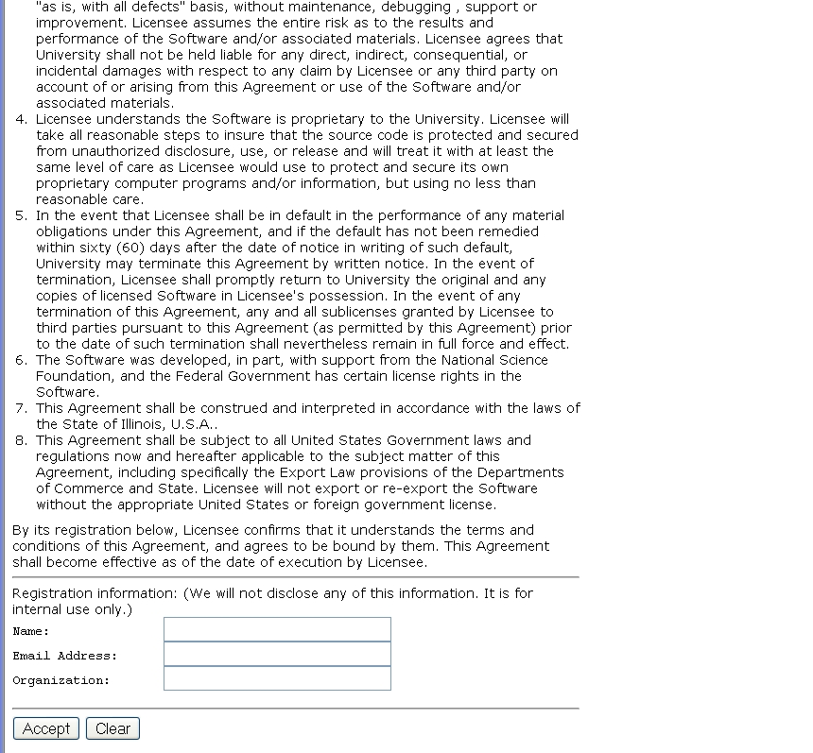
A view on Extracting Meaning from Unstructured Text
A Contract
(and distinguish from other candidates)
Does it say that they will:
Give my email address away?
Log my activity
……
ACCEPT?
Notes:
This is a collection of different problems of ambiguity resolution - from text correction –
Sorry, it was too tempting to use this one…
Word sense disambiguation, part of speech tagging to a decision that involves a decision across sentence
All these are essentially the same classification problem – and with progress in learning theory and NLP
We have pretty reliable solutions to these today.
Here are a few more problems of this kind.

Slide 3
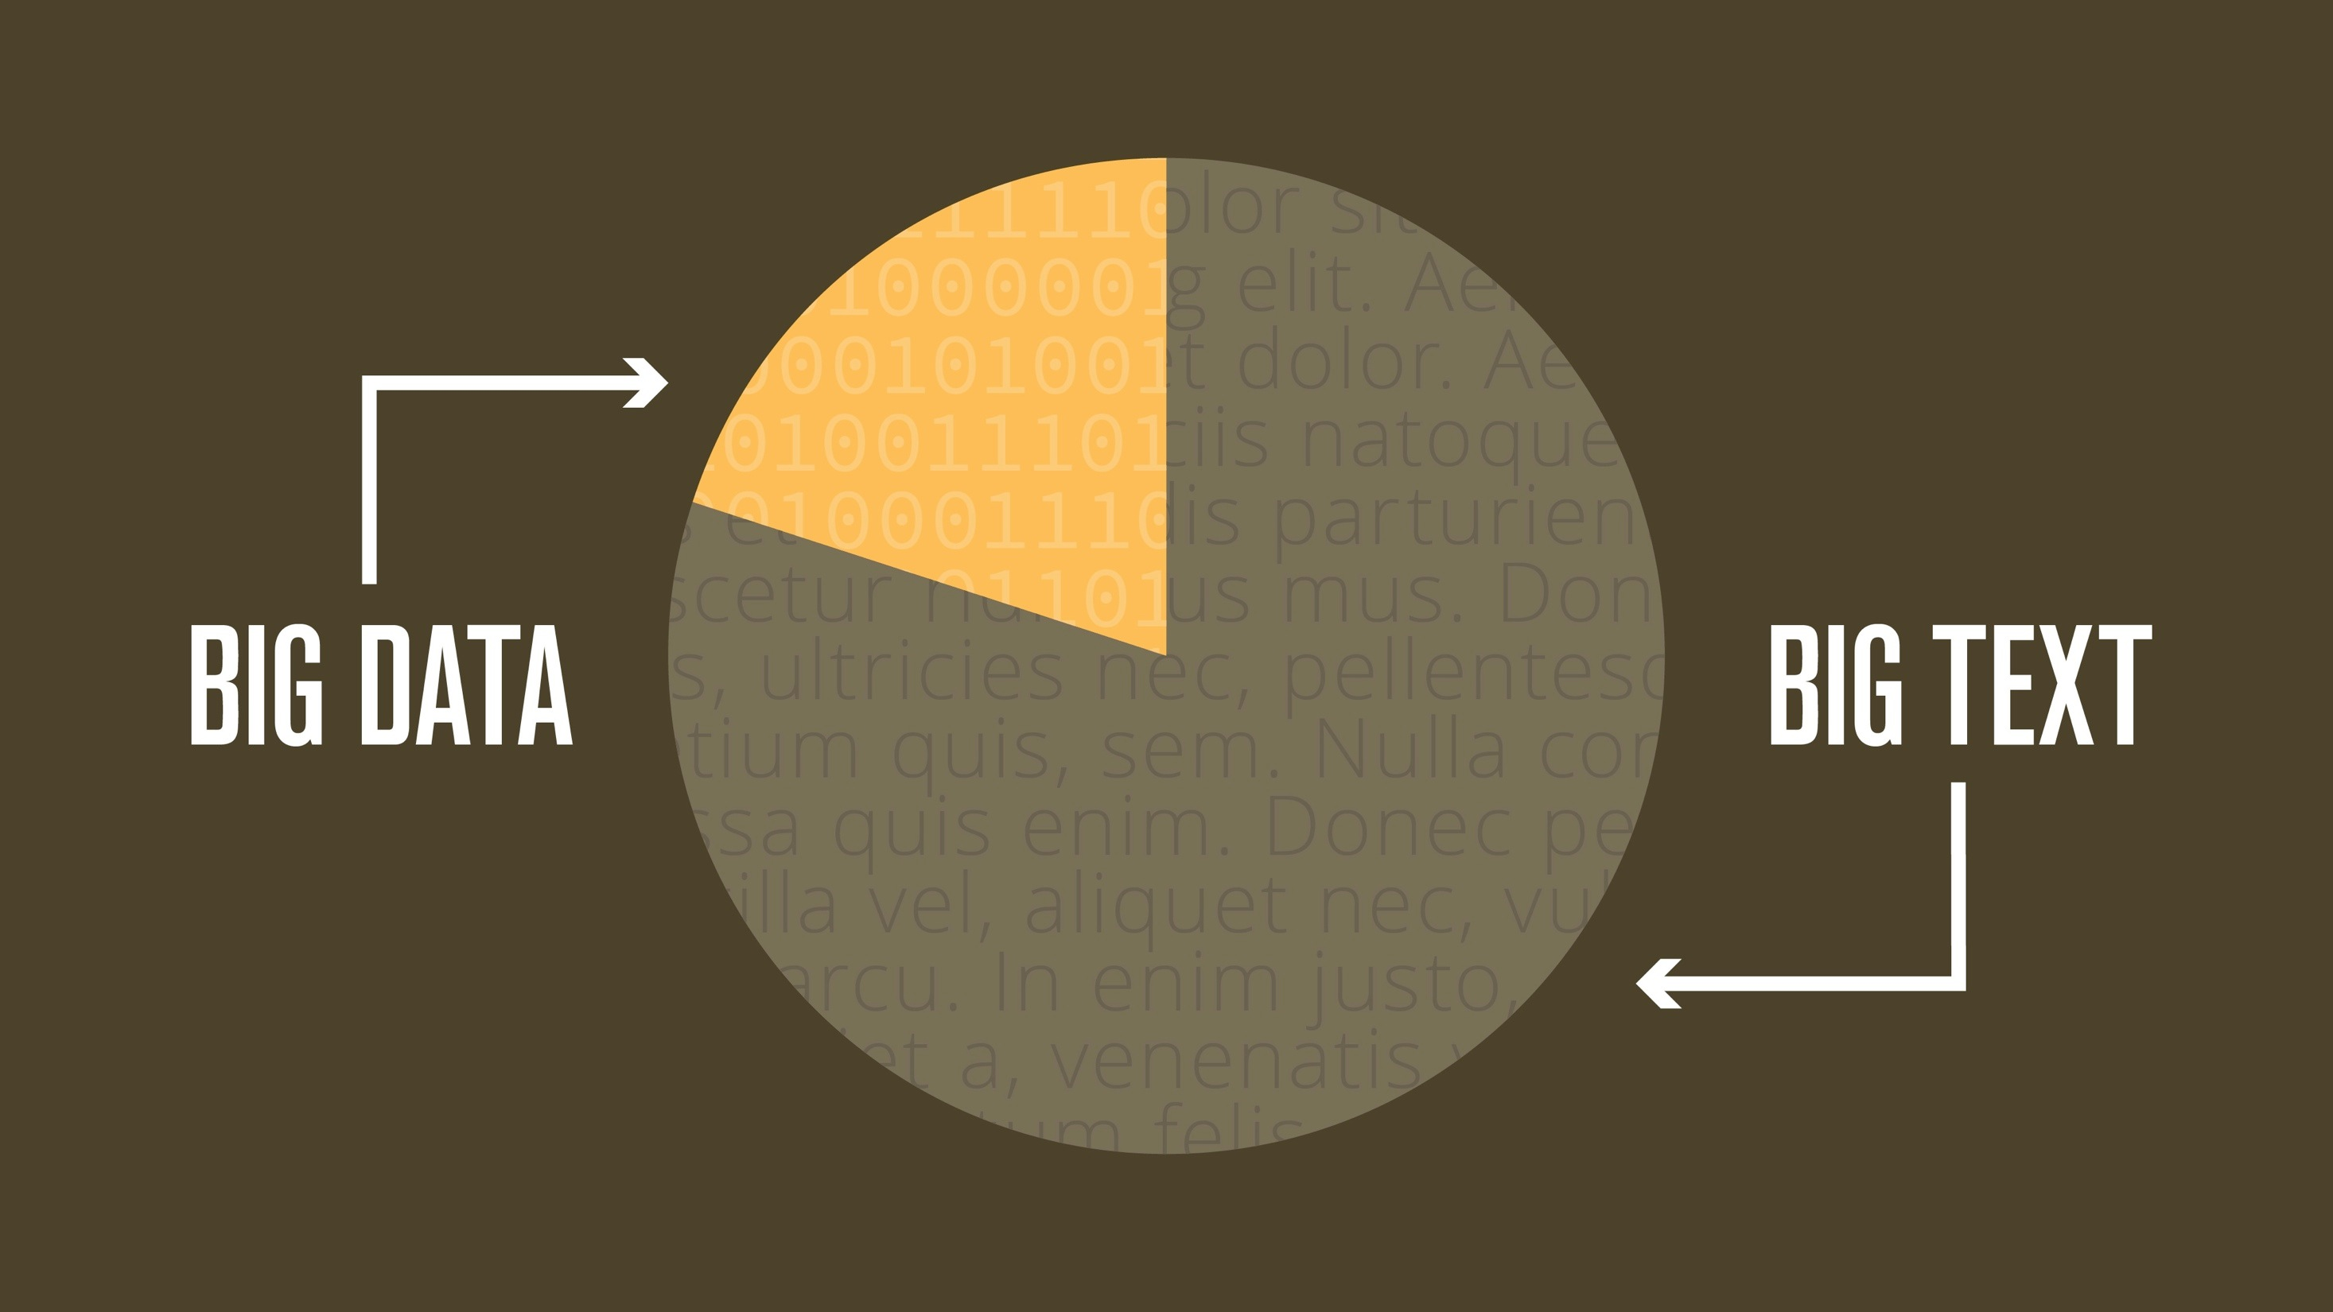
Notes:
How big is this text really? Of all of the information in corporations, 80% is unstructured text.

Slide 4

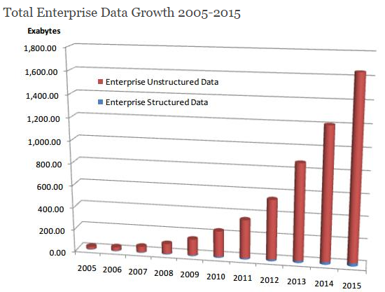
90% of the world’s text has been created in the last 2 years, and there will be a 50-fold increase by 2020.
WORLD TEXT
Large Scale
Data→ Meaning Transformation
Massive & Deep
Scientific Articles
Medical Records
Education
Business
Social Media
2012
2014
2020
http://www.dataversity.net/the-growth-of-unstructured-data-what-are-we-going-to-do-with-all-those-zettabytes/
http://breakthroughanalysis.com/2008/08/01/unstructured-data-and-the-80-percent-rule/
http://www.datasciencecentral.com/profiles/blogs/structured-vs-unstructured-data-the-rise-of-data-anarchy
Notes:
Massive and, more importantly, DEEP (and the last time I’ll use the word DEEP in this talk)
90% [click] of the world’s data has been created in the last 2 years, and there will be a [click] 50-fold increase by 2020.
The compounding effect of regulatory obligations and data is making it impossible for humans to keep up. We need machines to assist.
This is the where the NexLP Story Engine comes in.

Slide 5
Why is it Difficult?
Meaning
Variability
Ambiguity
Language

Slide 6






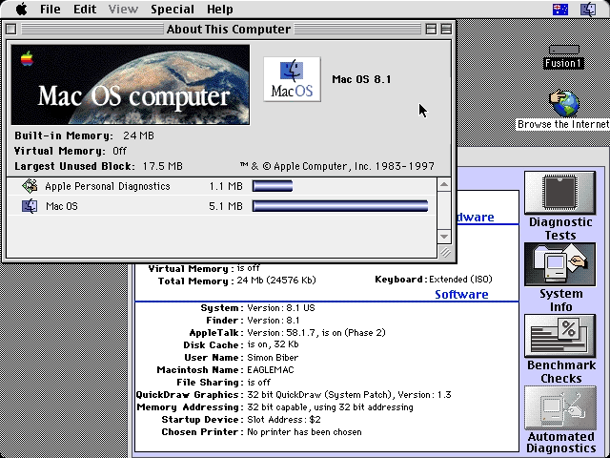
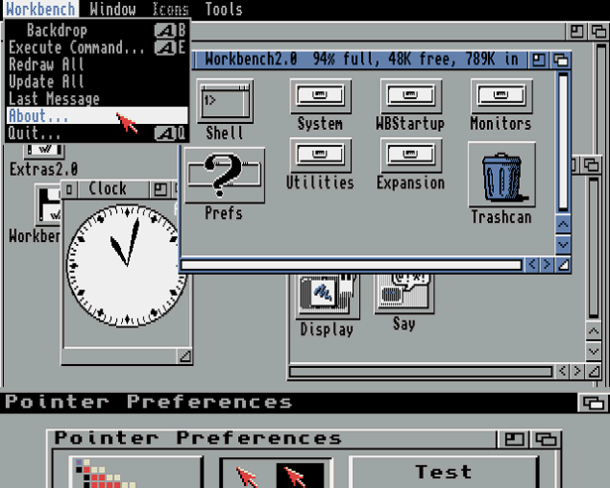
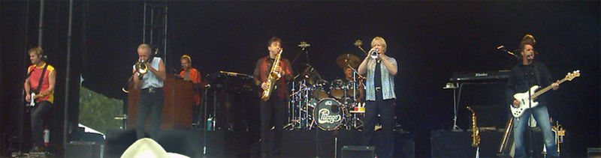
Ambiguity
It’s a version of Chicago – the standard classic Macintosh menu font, with that distinctive thick diagonal in the ”N”.
Chicago was used by default for Mac menus through MacOS 7.6, and OS 8 was released mid-1997..
Chicago VIII was one of the early 70s-era Chicago albums to catch my
ear, along with Chicago II.

Slide 7

Variability in Natural Language Expressions
Determine if Jim Carpenter works for the government
Jim Carpenter works for the U.S. Government.
The American government employed Jim Carpenter.
Jim Carpenter was fired by the US Government.
Jim Carpenter worked in a number of important positions. …. As a press liaison for the IRS, he made contacts in the white house.
Russian interior minister Yevgeny Topolov met yesterday with his US counterpart, Jim Carpenter.
Former US Secretary of Defense Jim Carpenter spoke today…
Standard techniques cannot deal with the variability of expressing meaning
nor with the
ambiguity of interpretation
  Needs:
  Understanding Relations, Entities and Semantic Classes
  Acquiring knowledge from external resources; representing knowledge
  Identifying, disambiguating & tracking entities, events, etc.
  Time, quantities, processes…
Notes:
7

Slide 8



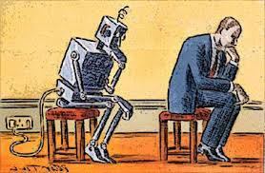
What is Needed?
A computational Framework
Examples:
  Modeling
  Learning
  Inference
Notes:
In a more abstract way : My research span all these aspects & more; but I’ll focus on providing a framework, present some examples, and some recent, exciting results towards the end.
8

Slide 9
Comprehension
(ENGLAND, June, 1989) - Christopher Robin is alive and well. He lives in England. He is the same person that you read about in the book, Winnie the Pooh. As a boy, Chris lived in a pretty home called Cotchfield Farm. When Chris was three years old, his father wrote a poem about him. The poem was printed in a magazine for others to read. Mr. Robin then wrote a book. He made up a fairy tale land where Chris lived. His friends were animals. There was a bear called Winnie the Pooh. There was also an owl and a young pig, called a piglet. All the animals were stuffed toys that Chris owned. Mr. Robin made them come to life with his words. The places in the story were all near Cotchfield Farm. Winnie the Pooh was written in 1925. Children still love to read about Christopher Robin and his animal friends. Most people don't know he is a real person who is grown now. He has written two books of his own. They tell what it is like to be famous.
1. Christopher Robin was born in England. 2. Winnie the Pooh is a title of a book.
3. Christopher Robin’s dad was a magician. 4. Christopher Robin must be at least 65 now.
This is an Inference Problem
Notes:
9
I would like to talk about it in the context of language understanding problems. This is the problem I would like to solve. You are given a short story, a document, a paragraph, which you would like to understand. My working definition for Comprehension here would be “ A process that….”
So, given some statement, I would like to know if they are true in this story or not….
This is a very difficult task…
What do we need to know in order to have a chance to do that? … Many things….
And, there are probably many other stand-alone tasks of this sort that we need to be able to address, if we want to have a chance to COMPREHEND this story, and answer questions with respect to it.
But comprehending this story, being able to determined the truth of these statements is probably a lot more than that – we need to be able to put these things,
(and what is “these” isnt’ so clear) together.
So, how do we address comprehension? Here is a somewhat cartoon-she view of what has happened in this area over the last 30 years or so?
talk about – I wish I could talk about.
Here is a challenge: write a program that responds correctly to these five questions. Many of us would love to be able to do it.
This is a very natural problem; a short paragraph on Christopher Robin that we all
Know and love, and a few questions about it; my six years old can answer these
Almost instantaneously, yes, we cannot write a program that answers more than, say, 2 out of five questions.
What is involved in being able to answer these? Clearly, there are many “small” local decisions that we need to make.
We need to recognize that there are two Chris’s here. A father an a son. We need to resolve co-reference. We need sometimes
To attach prepositions properly;
The key issue, is that it is not sufficient to solve these local problems – we need to figure out how to put them
Together in some coherent way.
And in this talk, I will focus on this. We describe some recent works that we have done in this direction - …..
What do we know – in the last few years there has been a lot of work – and a considerable success on what I call here ---
Here is a more concrete and easy example -----
There is an agreement today that learning/ statistics /information theory (you name it) is of prime importance to making
Progress in these tasks. The key reason, is that rather than working on these high level difficult tasks, we have moved
To work on well defined disambiguation problems that people felt are at the core of many problems.
And, as an outcome of work in NLP and Learning Theory, there is today a pretty good understanding for how to solve
All these problems – which are essentially the same problem.

Slide 10
Natural Language Understanding
Expectation is a knowledge intensive component
Natural language understanding decisions are global decisions that require
  Making (local) predictions driven by different models trained in different ways, at different times/conditions/scenarios
  The ability to put these predictions together coherently
  Knowledge, that guides the decisions so they satisfy our expectations
Natural Language Interpretation is an Inference Process that is best thought of as a knowledge constrained optimization problem, done on top of multiple statistically learned models.
Many forms of Inference; a lot boil down to determining best assignment
Notes:
10

Slide 11
Joint Inference with General Constraint Structure [Roth&Yih’04,07,….]
Recognizing Entities and Relations
Joint inference gives good improvement
other | 0.05
per | 0.85
loc | 0.10
other | 0.05
per | 0.85
loc | 0.10
other | 0.10
per | 0.60
loc | 0.30
other | 0.10
per | 0.60
loc | 0.30
other | 0.05
per | 0.50
loc | 0.45
other | 0.05
per | 0.50
loc | 0.45
other | 0.05
per | 0.50
loc | 0.45
Key Questions:
How to learn the model(s)?
What is the source of the knowledge?
How to guide the global inference?
An Objective function that incorporates learned models with knowledge (output constraints)
A Constrained Conditional Model
  Bernie’s wife, Jane, is a native of Brooklyn
  E1 E2 E3
R₁₂
R₂₃
irrelevant | 0.05
spouse_of | 0.45
born_in | 0.50
irrelevant | 0.05
spouse_of | 0.45
born_in | 0.50
irrelevant | 0.05
spouse_of | 0.45
born_in | 0.50
irrelevant | 0.10
spouse_of | 0.05
born_in | 0.85
irrelevant | 0.10
spouse_of | 0.05
born_in | 0.85
Models could be learned separately/jointly; constraints may come up only at decision time.
Notes:
11
Let’s look at another example in more details.
We want to extract entities (person, location and organization) and relations between them (born in, spouse of).
Given a sentence, suppose the entity classifier and relation classifier have already given us their predictions along with the confidence values. The blue ones are the labels that have the highest confidence individually. However, this global assignment has some obvious mistakes. For example, the second argument of a born_in relation should be location instead of person. Since the classifiers are pretty confident on R23, but not on E3, so we should correct E3 to be location.
Similarly, we should change R12 from “born_in” to “spouse_of”

Slide 12
Structured Prediction: Inference
See AAAI’16 Tutorial on
Structured Prediction
Placing in context: a crash course in structured prediction (skip)
Inference: given input x (a document, a sentence),
predict the best structure y = {y₁,y₂,…,y_{n}} 2 Y (entities & relations)
  Assign values to the y₁,y₂,…,y_{n}, accounting for dependencies among y_{i}s
Inference is expressed as a maximization of a scoring function
y’ = argmax_{y 2 Y} w^{T} Á (x,y)
Inference requires, in principle, touching all y 2 Y at decision time, when we are given x 2 X and attempt to determine the best y 2 Y for it, given w
  For some structures, inference is computationally easy.
  Eg: Using the Viterbi algorithm
  In general, NP-hard (can be formulated as an ILP)
Joint features on inputs and outputs
Set of allowed structures
Feature Weights
(estimated during learning)

Slide 13
Structured Prediction: Learning
Learning: given a set of structured examples {(x,y)}
find a scoring function w that minimizes empirical loss.
Learning is thus driven by the attempt to find a weight vector w such that for each given annotated example (x_{i}, y_{i}):

Slide 14
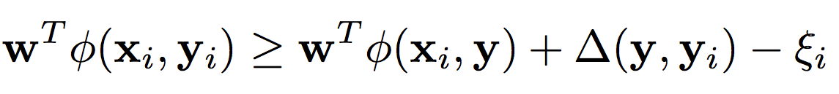
Structured Prediction: Learning
Learning: given a set of structured examples {(x,y)}
find a scoring function w that minimizes empirical loss.
Learning is thus driven by the attempt to find a weight vector w such that for each given annotated example (x_{i}, y_{i}):
We call these conditions the learning constraints.
In most learning algorithms used today, the update of the weight vector w is done in an on-line fashion,
  Think about it as Perceptron; this procedure applies to Structured Perceptron, CRFs, Linear Structured SVM
W.l.o.g. (almost) we can thus write the generic structured learning algorithm as follows:
Score of annotated structure
Score of any other structure
Penalty for predicting other structure
8 y

Slide 15
Structured Prediction: Learning Algorithm
In the structured case, prediction (inference) is often intractable but needs to be done many times
For each example (x_{i}, y_{i})
Do: (with the current weight vector w)
  Predict: perform Inference with the current weight vector
    y_{i}’ = argmax_{y 2 Y} w^{T} Á ( x_{i} ,y)
  Check the learning constraints
    Is the score of the current prediction better than of (x_{i}, y_{i})?
  If Yes – a mistaken prediction
    Update w
  Otherwise: no need to update w on this example
EndFor

Slide 16
Structured Prediction: Learning Algorithm
Solution I: decompose the scoring function to EASY and HARD parts
For each example (x_{i}, y_{i})
Do:
  Predict: perform Inference with the current weight vector
    y_{i}’ = argmax_{y 2 Y} w_{EASY}^{T} Á_{EASY} ( x_{i} ,y) + w_{HARD}^{T} Á_{HARD} ( x_{i} ,y)
  Check the learning constraint
    Is the score of the current prediction better than of (x_{i}, y_{i})?
  If Yes – a mistaken prediction
    Update w
  Otherwise: no need to update w on this example
EndDo
EASY: could be feature functions that correspond to an HMM, a linear CRF, or even Á_{EASY} (x,y) = Á(x), omiting dependence on y, corresponding to classifiers.
May not be enough if the HARD part is still part of each inference step.

Slide 17
Structured Prediction: Learning Algorithm
Solution II: Disregard some of the dependencies: assume a simple model.
For each example (x_{i}, y_{i})
Do:
  Predict: perform Inference with the current weight vector
    y_{i}’ = argmax_{y 2 Y} w_{EASY}^{T} Á_{EASY} ( x_{i} ,y) + w_{HARD}^{T} Á_{HARD} ( x_{i} ,y)
  Check the learning constraint
    Is the score of the current prediction better than of (x_{i}, y_{i})?
  If Yes – a mistaken prediction
    Update w
  Otherwise: no need to update w on this example
EndDo

Slide 18
Structured Prediction: Learning Algorithm
Solution III: Disregard some of the dependencies during learning; take into account at decision time
For each example (x_{i}, y_{i})
Do:
  Predict: perform Inference with the current weight vector
    y_{i}’ = argmax_{y 2 Y} w_{EASY}^{T} Á_{EASY} ( x_{i} ,y) + w_{HARD}^{T} Á_{HARD} ( x_{i} ,y)
  Check the learning constraint
    Is the score of the current prediction better than of (x_{i}, y_{i})?
  If Yes – a mistaken prediction
    Update w
  Otherwise: no need to update w on this example
EndDo
    y_{i}’ = argmax_{y 2 Y} w_{EASY}^{T} Á_{EASY} ( x_{i} ,y) + w_{HARD}^{T} Á_{HARD} ( x_{i} ,y)
This is the most commonly used solution in NLP today

Slide 19
Constrained Conditional Models
Any MAP problem w.r.t. any probabilistic model, can be formulated as an ILP
[Roth+ 04, Taskar 04]
Penalty for violating
the constraint.
Variables are models
y = argmax_{y} ∑ 1_{Á(x,y)} w_{x,y} subject to Constraints C(x,y)
    y = argmax_{y 2 Y} w^{T}Á(x, y) + u^{T}C(x, y)
Knowledge component:
(Soft) constraints
Weight Vector for “local” models
Features, classifiers; log-linear models (HMM, CRF) or a combination
How far y is from
a “legal/expected” assignment
E.g., an entities model; a relations model.
Training: learning the objective function (w, u)
  Decouple? Decompose? Force u to model hard constraints?
A way to push the learned model to satisfy our output expectations (or expectations from a latent representation)
  [CoDL, Chang, Ratinov, Roth (07, 12); Posterior Regularization, Ganchev et. al (10); Unified EM (Samdani & Roth(12)]
The benefits of thinking about it as an ILP are conceptual and computational.

Slide 20
Outline
A Framework for Learning and Inference
  Combining the “soft” with the logical/declarative
    Constrained Conditional Models: A formulation for global inference with knowledge modeled as expressive structural constraints
    Some examples
Learning with Indirect Supervision
  Response Based Learning: learning from the world’s feedback
  Knowledge Acquisition
Scaling Up: Amortized Inference
  Can the k-th inference problem be cheaper than the 1st?

Slide 21
Semantic Role Labeling (SRL)
Archetypical Information Extraction Problem: E.g., Concept Identification and Typing, Event Identification, etc.
I left my pearls to my daughter in my will .
[I]_{A0} left [my pearls]_{A1} [to my daughter]_{A2} [in my will]_{AM-LOC} .
A0 Leaver
A1 Things left
A2 Benefactor
AM-LOC Location
I left my pearls to my daughter in my will .
Notes:
In the context of SRL, the goal is to predict for each possible phrase in a given sentence if it is an argument or not and what type it is.

Slide 22
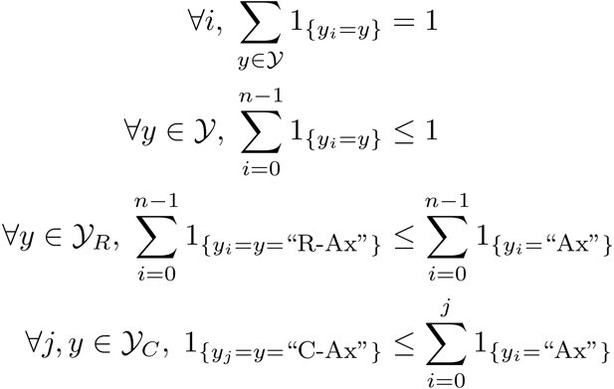
Algorithmic Approach
Learning Based Java: allows a developer to encode constraints in First Order Logic; these are compiled into linear inequalities automatically.
No duplicate argument classes
I left my nice pearls to her
candidate arguments
Identify argument candidates
  Pruning [Xue&Palmer, EMNLP’04]
  Argument Identifier
    Binary classification
Classify argument candidates
  Argument Classifier
    Multi-class classification
Inference
  Use the estimated probability distributions given
  by the argument classifier
  Use structural and linguistic constraints
  Infer the optimal global output
Unique labels
  Variable y^{a,t} indicates whether candidate argument a is assigned a label t.
  c^{a,t} is the corresponding model score
I left my nice pearls to her
I left my nice pearls to her
[ [ [ [ [
] ] ] ] ]
argmax ∑_{a,t} y^{a,t} c^{a,t} = ∑_{a,t} 1_{a=t} c_{a=t}
Subject to:
One label per argument: ∑_{t} y^{a,t} = 1
No overlapping or embedding
Relations between verbs and arguments,….
One inference problem for each verb predicate.
I left my nice pearls to her
Use the pipeline architecture’s simplicity while maintaining uncertainty: keep probability distributions over decisions & use global inference at decision time.
Notes:
We follow a now seemingly standard approach to SRL.
Given a sentence, first we find a set of potential argument candidates by identifying
which words are at the border of an argument.
Then, once we have a set of potential arguments, we use a phrase-level classifier to tell us how likely an argument is to be of each type.
Finally, we use all of the information we have so far to find the assignment of types to argument that gives us the “optimal” global assignment.
Similar approaches (with similar results) use inference procedures tied to their represntation.
Instead, we use a general inference procedure by setting up the problem as a linear programming problem.
This is really where our technique allows us to apply powerful information that similar approaches can not.

Slide 23
Verb SRL is not Sufficient
skip
John, a fast-rising politician, slept on the train to Chicago.
Verb Predicate: sleep
  Sleeper: John, a fast-rising politician
  Location: on the train to Chicago
Who was John?
  Relation: Apposition (comma)
  John, a fast-rising politician
What was John’s destination?
  Relation: Destination (preposition)
  train to Chicago

Slide 24
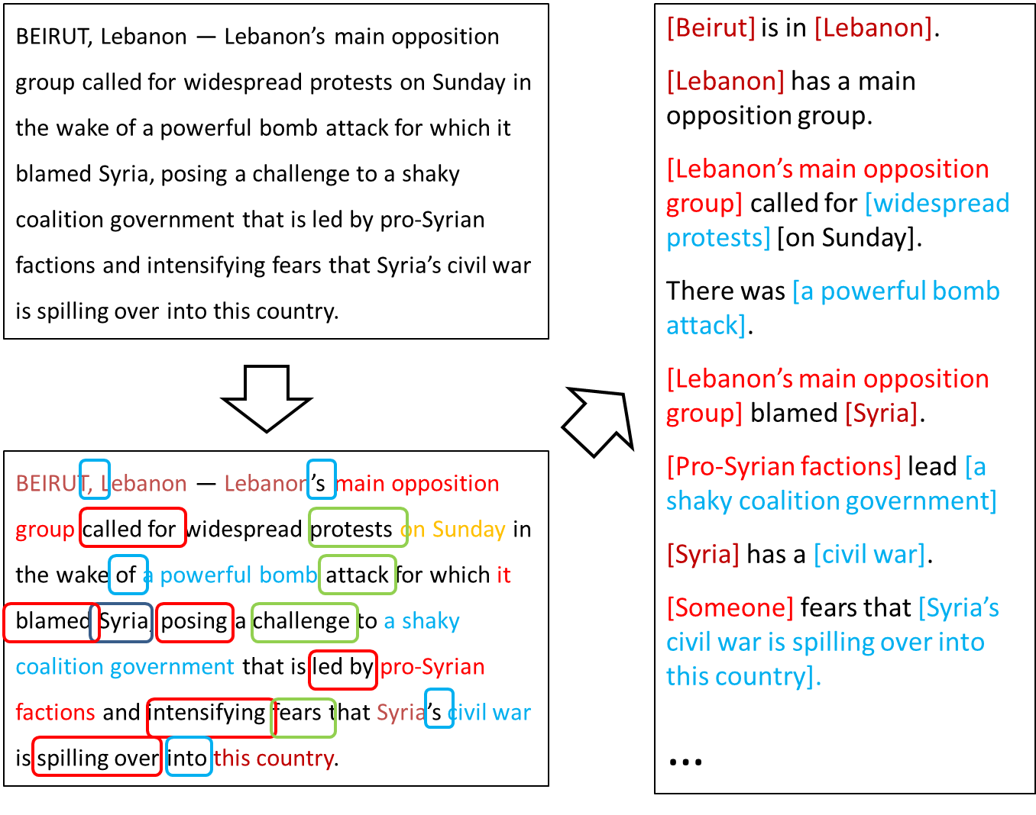
Extended Semantic Role Labeling
Many predicates; many roles; how to deal with more phenomena?
Sentence level analysis may be influenced by other sentences

Slide 25
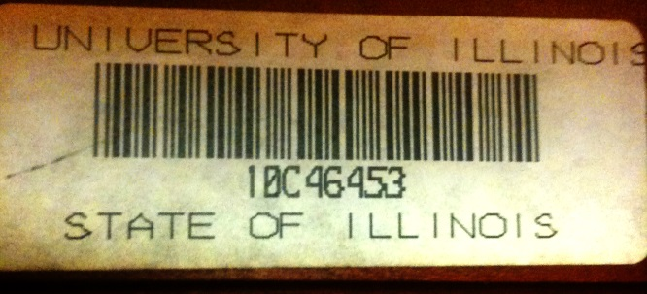
Computational Questions
John, a fast-rising politician, slept on the train to Chicago.
Verb Predicate: sleep
  Sleeper: John, a fast-rising politician
  Location: on the train to Chicago
Who was John?
  Relation: Apposition (comma)
  John, a fast-rising politician
What was John’s destination?
  Relation: Destination (preposition)
  train to Chicago
Identify the relation expressed by the predicate, and its arguments

Slide 26
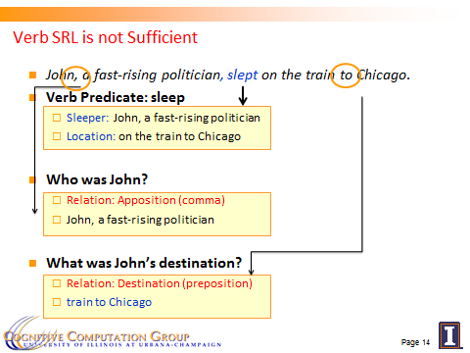
Computational Challenges
Predict the preposition relations
  [EMNLP, ’11]
Identify the relation’s arguments
  [PP: Trans. Of ACL, ’13, Comma: AAAI’16]
Very little supervised data
  per phenomena
Minimal annotation
  only at the predicate level
Learning models in these settings exploits two principles:
  Latent structure can be constrained (via CCMs)
  Coherency among multiple phenomena: learn simple models; infer together
  Skip

Slide 27
Coherency in Semantic Role Labeling
Predicate-arguments generated should be consistent across phenomena
The touchdown scored by Bradford cemented the victory of the Eagles.
Verb | Nominalization | Preposition
Predicate: score A0: Mccoy (scorer) A1: The touchdown (points scored) | Predicate: win A0: the Eagles (winner) | Sense: 11(6) “the object of the preposition is the object of the underlying verb of the nominalization”
Linguistic Constraints:
A0: the Eagles ⇔ Sense(of): 11(6)
A0: Bradford ⇔ Sense(by): 1(1)
Notes:
27

Slide 28
Computational Challenges
Predict the preposition relations
  [EMNLP, ’11]
Identify the relation’s arguments
  [PP: Trans. Of ACL, ’13, Comma: AAAI’16]
Very little supervised data
  per phenomena
Minimal annotation
  only at the predicate level
Learning models in these settings exploits two principles:
  Coherency among multiple phenomena
  Constraining latent structures (relating observed and latent variables)
  Done via global inference via CCM
  Skip
Input & relation
Argument & their types

Slide 29
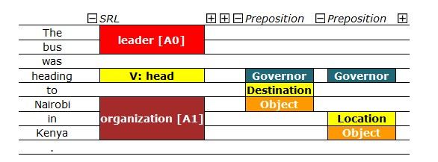
Extended SRL [Demo]
Destination [A1]
Joint inference over phenomena–specific models to enforce consistency
Models trained with latent structure: senses, types, arguments
More to do with other relations, discourse phenomena,…

Slide 30
Constrained Conditional Models—ILP Formulations
Have been shown useful in the context of many NLP problems
[Roth&Yih, 04,07: Entities and Relations; Punyakanok et. al: SRL …]
  Summarization; Co-reference; Information & Relation Extraction; Event Identifications and causality ; Transliteration; Textual Entailment; Knowledge Acquisition; Sentiments; Temporal Reasoning, Parsing,…
Some theoretical work on training paradigms [Punyakanok et. al., 05 more; Constraints Driven Learning, PR, Constrained EM…]
Some work on Inference, mostly approximations, bringing back ideas on Lagrangian relaxation, etc.
Good summary and description of training paradigms:
  [Chang, Ratinov & Roth, Machine Learning Journal 2012]
Summary of work & a bibliography: http://L2R.cs.uiuc.edu/tutorials.html

Slide 31
Outline
A Framework for Learning and Inference
  Combining the “soft” with the logical/declarative
    Constrained Conditional Models: A formulation for global inference with knowledge modeled as expressive structural constraints
    Some examples
Learning with Indirect Supervision
  Response Based Learning: learning from the world’s feedback
  Knowledge Acquisition
Scaling Up: Amortized Inference
  Can the k-th inference problem be cheaper than the 1st?

Slide 32

Data vs. Supervision
Data is abundant
But learning models requires supervision.
We will never have enough annotated data to train good models
Learning is driven by incidental supervision
  Re-thinking of current annotation-heavy approaches to NLP.
  Learning complex models by putting together simpler model
    Via declarative information
  Exploit large amounts of raw data
    That has been augmented with signals that are unrelated to our task
  Exploit incidental cues as sources of supervision

Slide 33

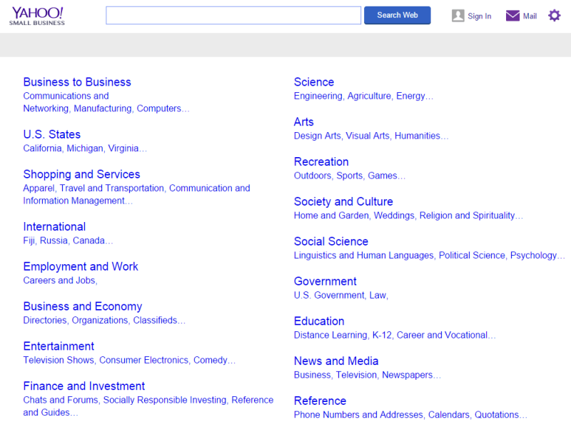
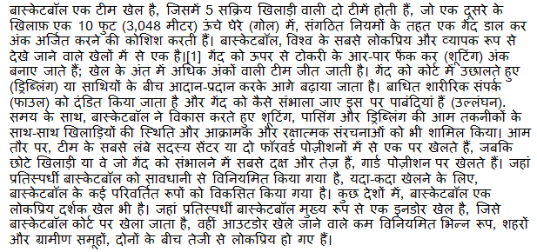
Topical Categorization
How to map a document in language L to an English ontology of semantic categories, without training with task-specific labeled data.
Potentially, given a single document (not a coherent collection)
Economy
-Taxation
Natural Disaster
-Flood

Slide 34
Text Categorization
On Feb. 8, Dong Nguyen announced that he would be removing his hit game Flappy Bird from both the iOS and Android app stores, saying that the success of the game is something he never wanted. Some fans of the game took it personally, replying that they would either kill Nguyen or kill themselves if he followed through with his decision.
Frank Lantz, the director of the New York University Game Center, said that Nguyen's meltdown resembles how some actors or musicians behave. "People like that can go a little bonkers after being exposed to this kind of interest and attention," he told ABC News. "Especially when there's a healthy dose of Internet trolls."
Nguyen did not respond to ABC News' request for comment.
7 February 2014 is going to be a great day in the history of Russia with the upcoming XXII Winter Olympics 2014 in Sochi. As the climate in Russia is subtropical, hence you would love to watch ice capped mountains from the beautiful beaches of Sochi. 2014 Winter Olympics would be an ultimate event for you to share your joys, emotions and the winning moments of your favourite sports champions. If you are really an obsessive fan of Winter Olympics games then you should definitely book your ticket to confirm your presence in winter Olympics 2014 which are going to be held in the provincial town, Sochi. Sochi Organizing committee (SOOC) would be responsible for the organization of this great international multi sport event from 7 to 23 February 2014.
Traditional text categorization requires training a classifier over a set of labeled documents (1,2,….k)
Someone needs to label the data (costly)
All your model knows is to classify into these given labels
It is possible to map a document to an ontology of semantic categories, without training with labeled data?

Slide 35

Text Categorization
On Feb. 8, Dong Nguyen announced that he would be removing his hit game Flappy Bird from both the iOS and Android app stores, saying that the success of the game is something he never wanted. Some fans of the game took it personally, replying that they would either kill Nguyen or kill themselves if he followed through with his decision.
Frank Lantz, the director of the New York University Game Center, said that Nguyen's meltdown resembles how some actors or musicians behave. "People like that can go a little bonkers after being exposed to this kind of interest and attention," he told ABC News. "Especially when there's a healthy dose of Internet trolls."
Nguyen did not respond to ABC News' request for comment.
Sports
Mobile Games
7 February 2014 is going to be a great day in the history of Russia with the upcoming XXII Winter Olympics 2014 in Sochi. As the climate in Russia is subtropical, hence you would love to watch ice capped mountains from the beautiful beaches of Sochi. 2014 Winter Olympics would be an ultimate event for you to share your joys, emotions and the winning moments of your favourite sports champions. If you are really an obsessive fan of Winter Olympics games then you should definitely book your ticket to confirm your presence in winter Olympics 2014 which are going to be held in the provincial town, Sochi. Sochi Organizing committee (SOOC) would be responsible for the organization of this great international multi sport event from 7 to 23 February 2014.
Flappy Bird
Russia
iOS
Olympics
Winter
Android
apps
champions
Sochi
stores
game
mountains
beaches
musicians
sports
Goal: categorize (short) snippets of text into a given (possibly large) ontology, without supervision.

Slide 36
Categorization without Labeled Data [AAAI’08, AAAI’14;IJCAI’16]
This is not an unsupervised learning scenario. Unsupervised learning assumes a coherent collection of data points, and that similar labels are assigned to similar data points. It cannot work on a single document.
Given:
  A single document (or: a collection of documents)
  A taxonomy of categories into which we want to classify the documents
Dataless procedure:
  Let Á(l_{i}) be the semantic representation of the labels
  Let Á(d) be the semantic representation a document:
  Select the most appropriate category:
  l_{i}* = argmin_{i} ||Á(l_{i}) - Á(d)||
  Bootstrap
    Label the most confident documents; use this to train a model.
Key Questions:
  How to Generate a good Semantic Representations?
  How to do it in many languages, with minimal resources?

Slide 37
General Framework
Mobile Game or Sports?
Label
names
Map labels/documents to the same space
Compute document and label similarities
Document(s)
World knowledge
(Cross-lingual)
Choose labels
M. Chang, L. Ratinov, D. Roth, V. Srikumar: Importance of Semantic Representation: Dataless Classification. AAAI‘08.
Y. Song, D. Roth: On dataless hierarchical text classification. AAAI’14.
Y. Song, D. Roth: Unsupervised Sparse Vector Densification for Short Text Similarity. HLT-NAACL’15.
Y. Song, S. Upadhyay, H. Peng, D. Roth: Cross-lingual Dataless Classification for Many Languages. IJCAI’16.

Slide 38
Text Representation
The ideal representation is task specific.
These ideas can be show also in the context of more involved tasks such as Events and Relation Extraction
[Dense] Distributed Representations (Embeddings)
  New powerful implementations of good old ideas
    Learn a representation for a word as a function of words in its context
Brown Clusters
  An HMM based approach
  Found a lot of applications in other NLP tasks
[Sparse] Explicit Semantic Analysis (ESA)
  A Wikipedia driven approach – best for topical classification
    Represent a word as a list of all Wikipedia titles it occurs in
Cross-Lingual ESA:
  Exploits the shared semantic space between two languages.
  This allows us to represent the label space of the English Wikipedia and the text space in language L in the same space.

Slide 39
Wikipedia Pages Cross Languages
Our approach to topical classification of documents in language L relies on our ability to generate a Wikipedia-based representation of words in L: the availability of L-Wikipedia
292 languages have Wikipedia.
We filter the title space to only include long, well linked pages that are linked to the English Wikipedia, yielding 179 languages.
Current works augments these ideas via bridge languages
 | English | Deutsch | Spanish | Hindi
 | English | Deutsch | Español | हिन्दी
# Wikipedia Pages | >15.8M | 3,653,951 | 3,165,178 | 179,131
# Pruned pages: (Len>=100, link>=5) | 3,090,649 | 1,482,675 | 914,927 | 33,298
# Pages linked to English Wikipedia |  | 459,421 | 342,285 | 16,463

Slide 40
Experimenting with Cross-lingual Topic Classification
For 88 languages that have translation, we generate a new data set.
  20 newsgroups.
  Take 100 documents that the English Dataless classifies correctly
  Translate to 88 languages
  This gives us a multi-lingual collection for which we know the labels
  Evaluate the Cross Lingual Dataless
We use two existing multilingual text categorization collections:
  RCV2: 13 languages; 15 labels; 1200 documents/label.
  TED: 13 languages; 4 labels (top level); 10²—10⁴ documents/label.

Slide 41
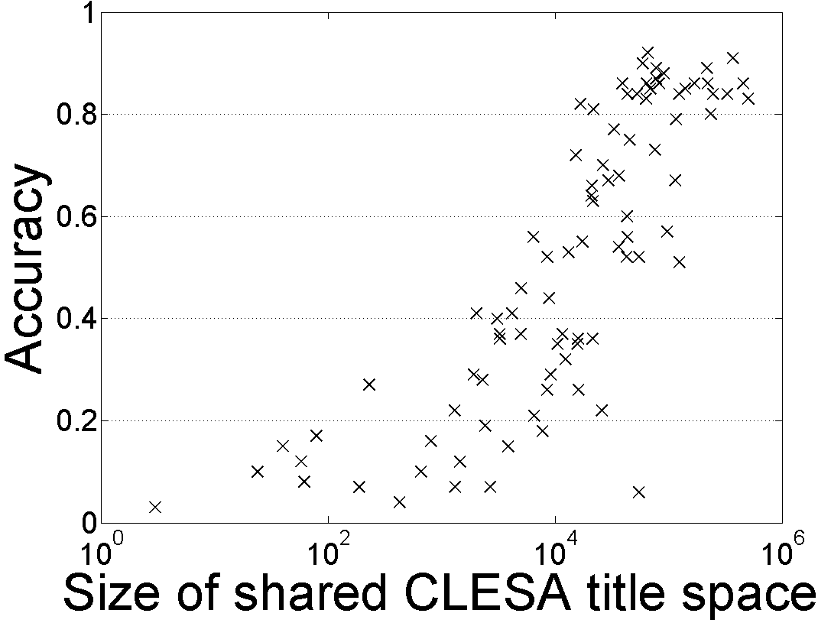
88 20-Newsgroups Topic Classification
Dataless classification for English
Accuracy
Hausa
Hindi
Size of shared English-Language L title space

Slide 42
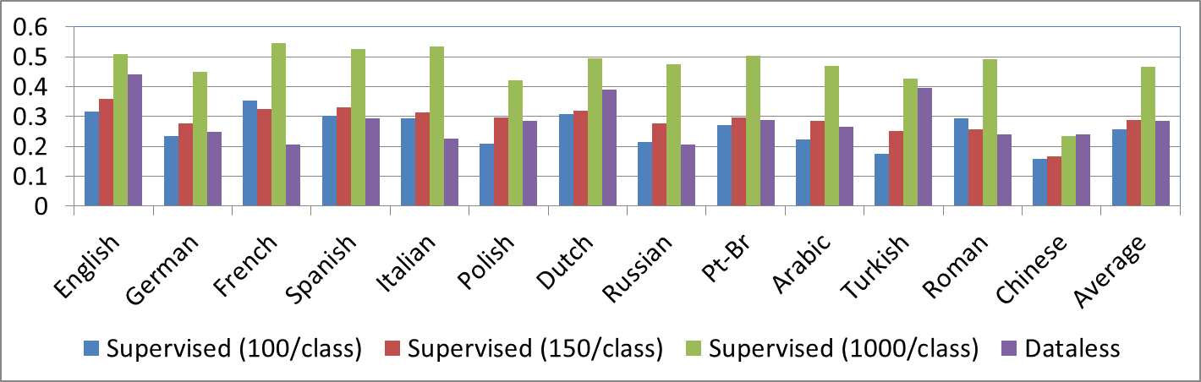
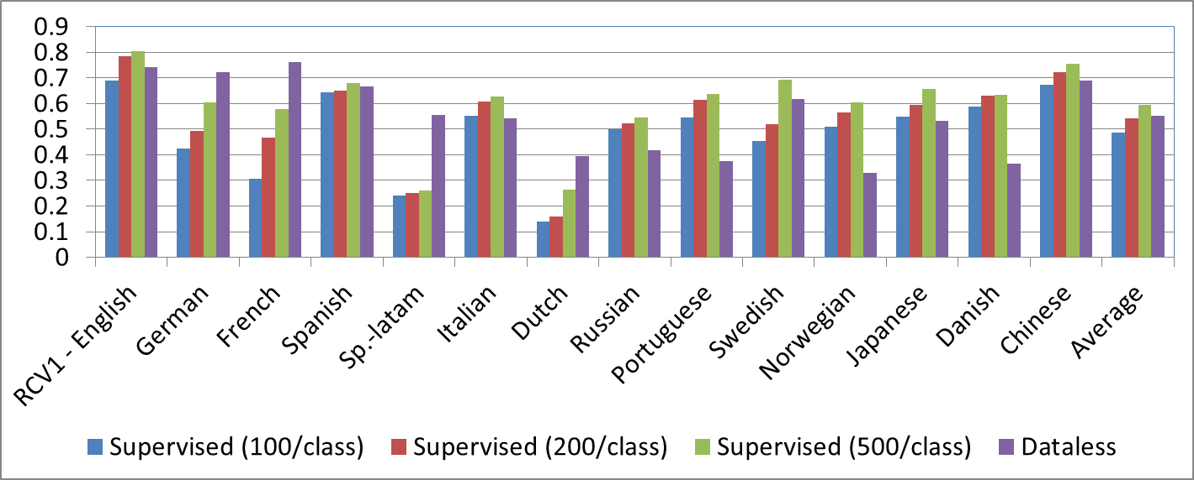
TED DATA
RCV DATA
Better than 200 supervised docs/label
Not as good as 500 docs/label

Slide 43
Summary I: Cross-lingual Topical Classification
Can classify documents in all Wikipedia Languages into any given English Taxonomy
  No additional resources needed
Current performance is better than supervising with 200 documents/label.
  Goal: be better than 500/label
Extending to languages that do not have (enough) Wikipedia data
  We are currently working on extending these methods using bridge languages
  What are good bridges?
  How to map a target language L to its Wikipedia rich bridge language?

Slide 44
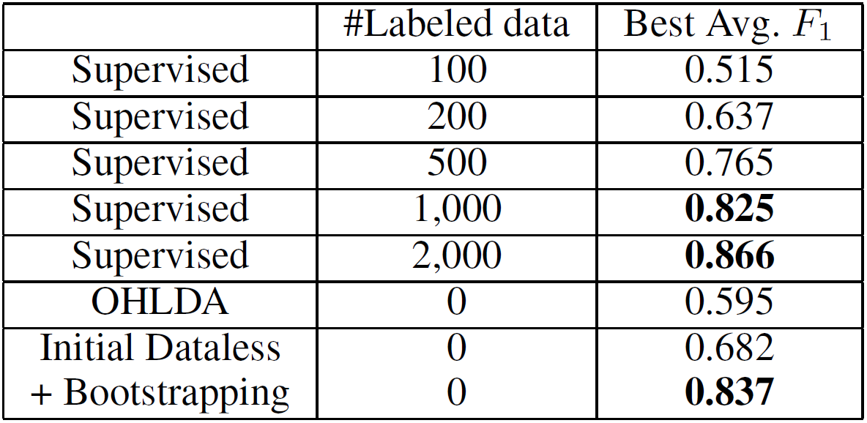
English Dataless Classification Results
Hierarchical Multiclass classification
  Dataless followed by bootstrapping
Moreover, dataless is more flexible in choosing the appropriate category in the taxonomy
No annotated data !!
OHLDA refers to an LDA based unsupervised method proposed in (Ha-Thuc and Renders 2011).

Slide 45

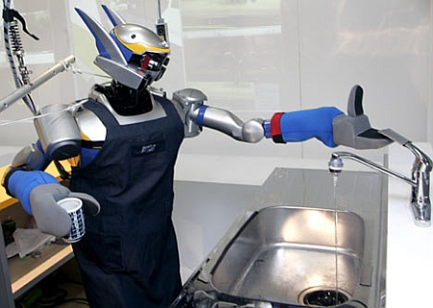

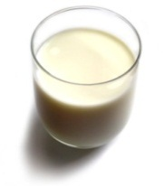
Understanding Language Requires (some) Supervision
Can we rely on this interaction to provide supervision (and eventually, recover meaning) ?
Can I get a coffee with lots of sugar and no milk
Great!
Arggg
Semantic Parser
MAKE(COFFEE,SUGAR=YES,MILK=NO)
How to recover meaning from text?
Standard “example based” ML: annotate text with meaning representation
  Teacher needs deep understanding of the learning agent ; not scalable.
Response Driven Learning: Exploit indirect signals in the interaction between the learner and the teacher/environment
Notes:
NLU: about recovering meaning from text – a lot of work aims directly at that or at some subtasks that might look like this:….

Slide 46
Response Based Learning
We want to learn a model that transforms a natural language sentence to some meaning representation.
Instead of training with (Sentence, Meaning Representation) pairs
Think about some simple derivatives of the models outputs,
  Supervise the derivative [verifier] (easy!) and
  Propagate it to learn the complex, structured, transformation model
English Sentence
Model
Meaning Representation

Slide 47
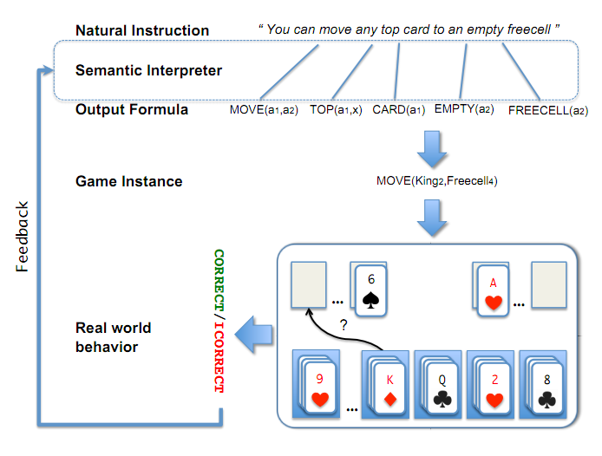
Scenario I: Freecell with Response Based Learning
We want to learn a model to transform a natural language sentence to some meaning representation.
English Sentence
Model
Meaning Representation
A top card can be moved to the tableau if it has a different color than the color of the top tableau card, and the cards have successive values.
Move (a1,a2) top(a1,x1) card(a1) tableau(a2) top(x2,a2) color(a1,x3) color(x2,x4) not-equal(x3,x4) value(a1,x5) value(x2,x6) successor(x5,x6)
Play Freecell (solitaire)
Simple derivatives of the models outputs: game API
  Supervise the derivative and Propagate it to learn the transformation model

Slide 48
Scenario II: Geoquery with Response based Learning
We want to learn a model to transform a natural language sentence to some formal representation.
“Guess” a semantic parse. Is [DB response == Expected response] ?
  Expected: Pennsylvania DB Returns: Pennsylvania→ Positive Response
  Expected: Pennsylvania DB Returns: NYC, or ???? → Negative Response
English Sentence
Model
Meaning Representation
What is the largest state that borders NY?
largest( state( next_to( const(NY))))
Simple derivatives of the models outputs
Query a GeoQuery Database.

Slide 49
Response Based Learning
We want to learn a model that transforms a natural language sentence to some meaning representation.
Instead of training with (Sentence, Meaning Representation) pairs
Think about some simple derivatives of the models outputs,
  Supervise the derivative [verifier] (easy!) and
  Propagate it to learn the complex, structured, transformation model
LEARNING:
Train a structured predictor (semantic parse) with this binary supervision
  Many challenges: e.g., how to make a better use of a negative response?
Learning with a constrained latent representation, making use of a CCM, exploiting knowledge on the structure of the meaning representation.
[Clarke, Goldwasser, Chang, Roth CoNLL’10; Goldwasser, Roth IJCAI’11, MLJ’14]
English Sentence
Model
Meaning Representation

Slide 50
Geoquery: Response based Competitive with Supervised
Clarke, Goldwasser, Chang, Roth CoNLL’10; Goldwasser, Roth IJCAI’11, MLJ’14
Current work addresses significant challenges in terms of the complexity of the natural language and the types of interaction
Algorithm | Training Accuracy | Testing Accuracy | # Training Examples
NOLEARN | 22 | -- | -
Response-based (2010) | 82.4 | 73.2 | 250 answers
Liang et-al 2011 | -- | 78.9 | 250 answers
Response-based (2012,14) | 86.8 | 81.6 | 250 answers
Supervised | -- | 86.07 | 600 structs.
NOLEARN :Initialization point
SUPERVISED : Trained with annotated data
Response based Learning is gathering momentum:
Liang, M.I. Jordan, D. Klein, Learning Dependency-Based Compositional Semantics, ACL’11.
Berant et-al ’ Semantic Parsing on Freebase from Question-Answer Pairs, EMNLP’13, ‘15
Supervised: Y.-W. Wong and R. Mooney. Learning synchronous grammars for semantic parsing with lambda calculus. ACL’07
Notes:
Still a lot of problems. Still, if you think that we can do supervision, let’s think about these problems…

Slide 51






Wikification: The Reference Problem
Knowledge Acquisition
Blumenthal (D) is a candidate for the U.S. Senate seat now held by Christopher Dodd (D), and he has held a commanding lead in the race since he entered it. But the Times report has the potential to fundamentally reshape the contest in the Nutmeg State.
Blumenthal (D) is a candidate for the U.S. Senate seat now held by Christopher Dodd (D), and he has held a commanding lead in the race since he entered it. But the Times report has the potential to fundamentally reshape the contest in the Nutmeg State.
Notes:
Let’s start with what is wikification
Read wiki titles slower

Slide 52
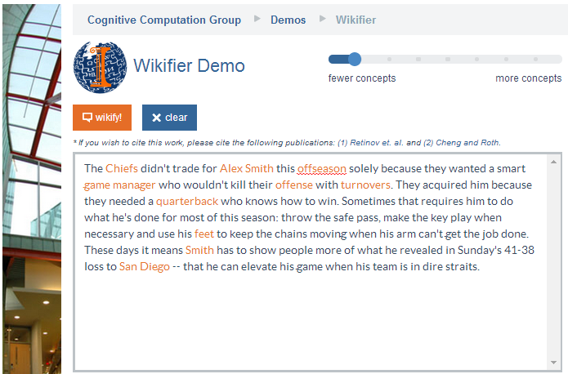
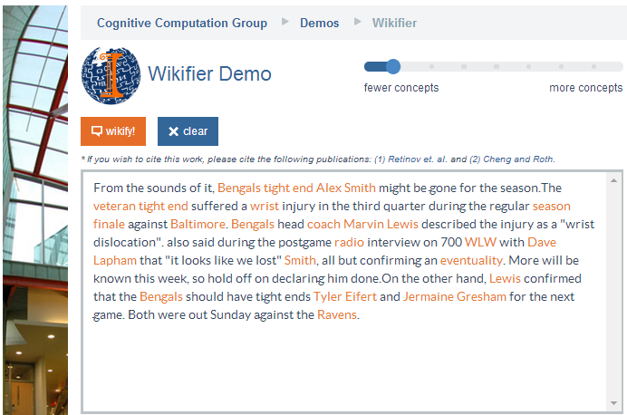
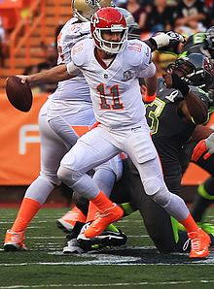
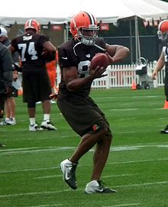
Who is Alex Smith?
Alex Smith
Alex Smith
Smith
Smith
Quarterback of the Kansas City Chief
Tight End of the Cincinnati Bengals
San Diego: The San Diego Chargers (A Football team)
Contextual Disambiguation
Ravens: The Baltimore Ravens (A Football team)

Slide 53
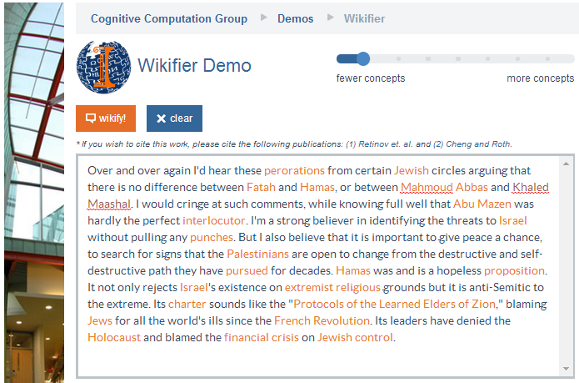
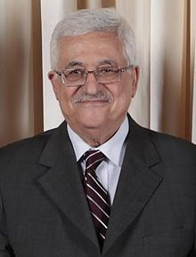
Middle Eastern Politics
Models are learned without annotation – relying on the hyperlink structure of Wikipedia to learn how to rank candidates
Mahmoud Abbas
Abu Mazen
Mahmoud Abbas: http://en.wikipedia.org/wiki/Mahmoud_Abbas
Quarterback of the Kansas City Chief
Tight End of the Cincinnati Bengals
Variability: Getting around multiple surface representations.
Co-reference resolution within & across documents, with grounding
Abu Mazen: http://en.wikipedia.org/wiki/Mahmoud_Abbas

Slide 54
Challenges
Blumenthal (D) is a candidate for the U.S. Senate seat now held by Christopher Dodd (D), and he has held a commanding lead in the race since he entered it. But the Times report has the potential to fundamentally reshape the contest in the Nutmeg State.
Training a global model that identifies concepts in text, disambiguates & grounds them in Wikipedia
Relies on the correctness of the (partial) link structure in Wikipedia, but – requires no human annotation.
State-of-the-art systems (e.g., Ratinov et al. 2011) make use of local and global statistical features
One goal of this effort is knowledge acquisition, in support of better textual inferences, but,
What is missing?
Notes:
Quite impressive, bottleneck: adding more sophisticated contextual features does not help much
We do not want to level off here

Slide 55
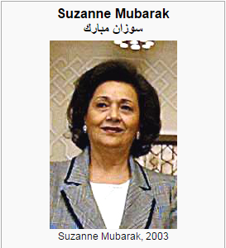
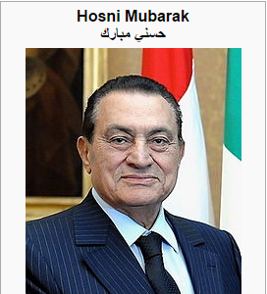
Knowledge Acquisition requires Knowledge (& inference)
Mubarak,
the wife of deposed Egyptian President Hosni Mubarak,…

Slide 56
Relational Inference
Mubarak, the wife of deposed Egyptian President Hosni Mubarak, …
Egyptian President
Hosni Mubarak
, the of deposed , …
Mubarak
wife
What are we missing with Bag of Words (BOW) models?
  Who is Mubarak?
Textual relations provide another dimension of text understanding
Can be used to constrain interactions between concepts
  (Mubarak, wife, Hosni Mubarak)
Has impact in several steps in the Wikification process:
  From candidate selection to ranking and global decision
Notes:
Main contribution here
We will show that by identifying

Slide 57
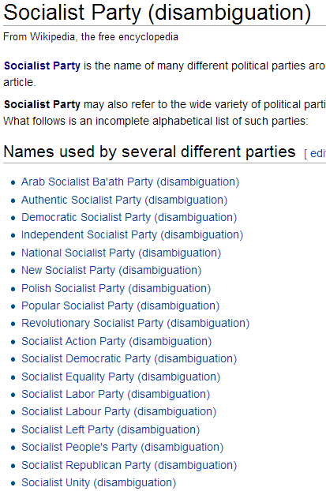

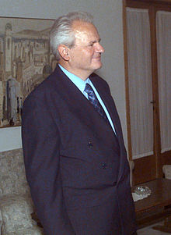
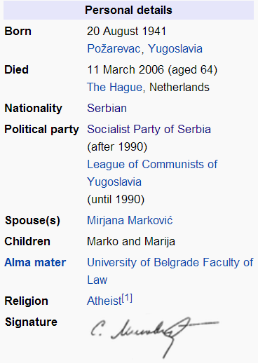
Knowledge in Relational Inference
These relations are part of our E-SRL
apposition
Coreference
possessive
...ousted long time Yugoslav President Slobodan Milošević in October.
... but Mr. Milošević's Socialist Party
What concepts can “Socialist Party” refer to?
  Wikipedia link statistics is uninformative
Notes:
There are quite some relations in this short sentence
Overall it is sparse but important in text understanding, as error propagates in structured inference
We do not actually care about relation types too much, as the relation will be constrained by our knowledge

Slide 58
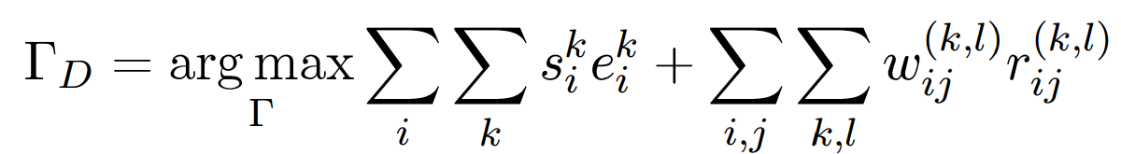
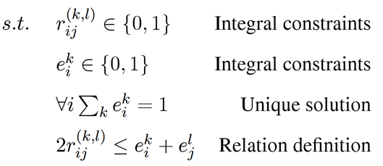
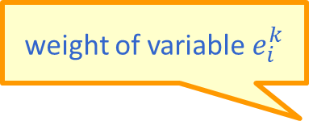
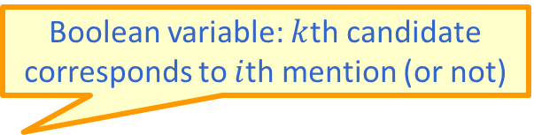
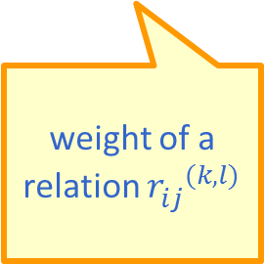
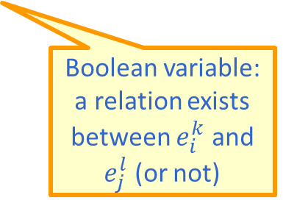
Formulation
Learned models, Knowledge and Ability to use it (Inference) facilitates additional knowledge acquisition
  Goal: Promote concepts that are coherent with textual relations
Formulate as an Integer Linear Program (ILP):
If no relation exists, collapses to the non-structured decision
weight of variable $e_{i}^{k}$
Boolean variable: $k$th candidate corresponds to $i$th mention (or not)
weight of a relation ${r_{ij}^{}}^{(k,l)}$
Boolean variable: a relation exists between $e_{i}^{k}$ and $e_{j}^{l}$ (or not)
Notes:
Formalize intuition, weights induced from data, small constraints
Objective function collapse to the original output when there is no relation, so our model is negatives-proof
True-negatives and false-negatives will not negatively impact performance of baseline

Slide 59
What/How to Learn is Still Open
Knowledge representation called “predicate schemas”
The bee landed on the flower because it had/wanted pollen.
  Lexical knowledge
John Doe robbed Jim Roy. He was arrested by the police.
  Subj of “rob” is more likely than the Obj of “rob” to be the Obj of “arrest”
Need: Learning & Inference approach that can use this knowledge
  (See our work in CoNLL’15 & NAACL’15 for interesting progress on this)
John had 6 books; he wanted to give it to two of his friends. How many will each one get?
  (See our EMNLP’15 & TACL’15 work for progress on Math word problems)
How do we supervise for these kind of problems?
share it with

Slide 60
Outline
A Framework for Learning and Inference
  Combining the “soft” with the logical/declarative
    Constrained Conditional Models: A formulation for global inference with knowledge modeled as expressive structural constraints
    Some examples
Learning with Indirect Supervision
  Response Based Learning: learning from the world’s feedback
  Knowledge Acquisition
Scaling Up: Amortized Inference
  Can the k-th inference problem be cheaper than the 1st?
  Computational advantages of an ILP framework

Slide 61



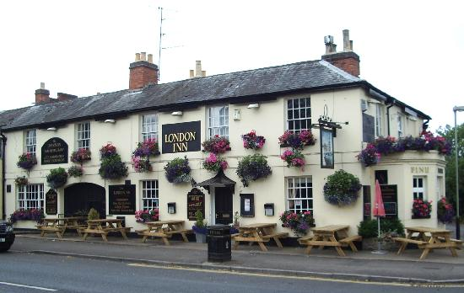


Wisconsin

Slide 62
Amortized ILP based Inference
Imagine that you already solved many structured output inference problems
  Co-reference resolution; Semantic Role Labeling; Parsing citations; Summarization; dependency parsing; image segmentation,…
  Your solution method doesn’t matter either
How can we exploit this fact to save inference cost?
We will show how to do it when your problem is formulated as a 0-1 LP:
Max c ¢ x
Ax ≤ b
x 2 {0,1}
After solving n inference problems, can we make the (n+1)^{th} one faster?
Very general: All discrete MAP problems can be formulated as 0-1 LPs [Roth & Yih’04; Taskar ’04]
We only care about inference formulation, not algorithmic solution

Slide 63
The Hope: POS Tagging on Gigaword
Number of Tokens

Slide 64
The Hope: POS Tagging on Gigaword
Number of examples of a given size
Number of unique POS tag sequences
Number of structures is much smaller than the number of sentences
Number of Tokens

Slide 65
The Hope: Dependency Parsing on Gigaword
Number of examples of a given size
Number of unique Dependency Trees
Number of structures is much smaller than the number of sentences
Number of Tokens

Slide 66
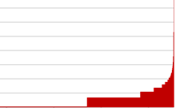
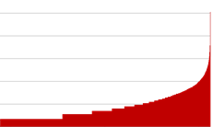
POS Tagging on Gigaword
How skewed is the distribution of the structures?
A small # of structures occur very frequently
Number of Tokens

Slide 67
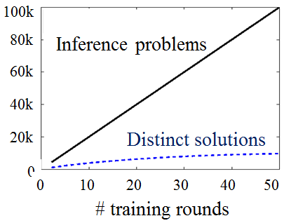
Redundancy in Inference and Learning
This redundancy is important since in all NLP tasks there is a need to solve many inferences, at least one per sentence.
However, it is as important in structured learning, where algorithms cycle between
  performing inference, and
  updating the model.

Slide 68
Amortized ILP Inference
We argue here that the inference formulation provides a new level of abstraction.
These statistics show that many different instances are mapped into identical inference outcomes.
  Pigeon Hole Principle
How can we exploit this fact to save inference cost over the life time of the learning & Inference program?
We give conditions on the objective functions
(for all objectives with the same # or variables and same feasible set),
under which the solution of a new problem Q is the same as the one of P (which we already cached)
If CONDITION (problem cache, new problem)
then (no need to call the solver)
SOLUTION(new problem) = old solution
Else
Call base solver and update cache
End
0.04 ms
2 ms

Slide 69
Theorem I
P
Q
max 2x₁+3x₂+2x₃+x₄
x₁ + x₂ ≤ 1
x₃ + x₄ ≤ 1
max 2x₁+4x₂+2x₃+0.5x₄
x₁ + x₂ ≤ 1
x₃ + x₄ ≤ 1
If
x*_{P}: <0, 1, 1, 0>
c_{P}: <2, 3, 2, 1>
c_{Q}: <2, 4, 2, 0.5>
The objective coefficients of active variables did not decrease from P to Q

Slide 70


Theorem I
Structured Learning: Dual coordinate descent for structured SVM still returns an exact model even if approximate amortized inference is used. [AAAI’15]
Then: The optimal solution of Q is the same as P’s
P
Q
x*_{P}=x*_{Q}
max 2x₁+3x₂+2x₃+x₄
x₁ + x₂ ≤ 1
x₃ + x₄ ≤ 1
max 2x₁+4x₂+2x₃+0.5x₄
x₁ + x₂ ≤ 1
x₃ + x₄ ≤ 1
If
And
x*_{P}: <0, 1, 1, 0>
c_{P}: <2, 3, 2, 1>
c_{Q}: <2, 4, 2, 0.5>
The objective coefficients of active variables did not decrease from P to Q
The objective coefficients of inactive variables did not increase from P to Q
  $${∀i, \left(2y_{p,i}^{∗}−1\right)(c}_{Q,i}−c_{P,i})≥0$$
$${∀i, \left(2y_{p,i}^{∗}−1\right)(c}_{Q,i}−c_{P,i})≥−ε|c_{Q,i}|$$

Slide 71
From Theory to Practice
"A theory is something nobody believes, except the person who made it.
An experiment is something everybody believes, except the person who made it."
—Albert Einstein (remark to Hermann F. Mark)

Slide 72
Amortized Inference Experiments
Setup
  Verb semantic role labeling; Entity and Relations
  Speedup & Accuracy are measured over WSJ test set (Section 23) and Test of E & R
  Baseline: solving ILPs using the Gurobi solver.
For amortization
  Cache 250,000 inference problems (objective, solution) from Gigaword
  For each problem in test set either call the inference engine or re-use a solution from the cache, if our theorems hold.
No training data is needed for this method.
Once you have a model, you can generate a large cache that will be then used to save you time at evaluation time.
Notes:
Only time I show experiments, just since results are so exciting.

Slide 73
Speedup & Accuracy
By decomposing the objective function, building on the fact that “smaller structures” are more redundant, it is possible to get even better results.
The results show that, indeed, the inference formulation provides a new level of abstraction that can be exploited to re-use solutions
Solve only one in six problems!
Speedup
Recent results [AAAI’15] on how to exploit amortized ILP in faster Structured Learning
1.0
Amortization schemes [EMNLP’12, ACL’13]

Slide 74
%Solver Calls (Entity-Relation Extraction)
Recent results [AAAI’15] on how to exploit amortized ILP in faster Structured Learning
Exact
Exact
Better
Ent F1: 87.7
Rel F1: 47.6
% Solver Calls
Ent F1: 87.3
Rel F1: 47.8
Baseline
Amortized
Amortized+Appr.

Slide 75
Before Conclusion
Some recent samples from a research program that attempts to address some of the key scientific and engineering challenges between us and understanding natural language.
Knowledge – Reasoning – Learning Paradigms – Scaling up
Thinking about how to guide learning and inference via a Constrained Optimization framework that supports “best assignment” inference.
This provides a window into some of the current & future directions and collaborations that this line of work facilitates.
Skip
Notes:
75

Slide 76

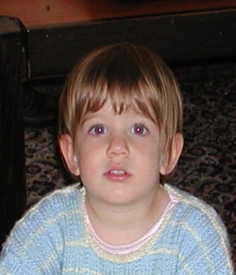
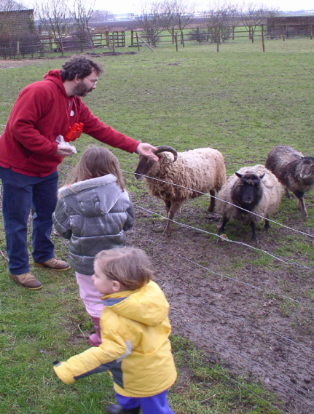
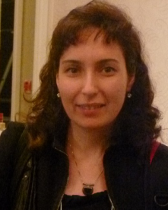
The language-world mapping problem
How do we acquire language?
Psycholinguistics: How to learn the meaning of verbs (and other predicates) from natural, behavior level, feedback? (no “intermediate representation” level feedback).
Education: Developed the best ESL text correction approaches, building on learning algorithms that adapt to the source language of the learner.
“the world”
“the language”
[Topid rivvo den marplox.]
Notes:
So let’s look at the problem facing the child. In learning a language, a child must figure out how to map words and syntactic devices onto the meanings they are meant to convey in the native language.
Viewed in this way, this is a highly unconstrained mapping problem. In principle, anything in the language could be relevant to anything in the world.

Slide 77

Multiple Clinical and Scientific Applications
Scientific Wikification
  Identifying scientific concepts in text, disambiguating them and mapping to existing knowledge bases
Analyzing Electronic Health Records
  Developed some of the best NLP tools for HER and Discharge Reports.
Clinical Decisions
  “Please show me the reports of all patients who have had myocardial infarction (heart attack) more than once.”
Identification of sensitive data (Privacy Reasons)
  HIV Data, Drug Abuse, Family Abuse, Genetic Information
Neuroscience:
  A collaborative program aiming at
  improving Adaptive Reasoning and
  Problem-Solving: Fluid Intelligence

Slide 78
Events: Identification, Analysis, Co-Reference
An “Arrest” Event
Causality
A “Kill” Event
Temporal
Distributional Association Score
The police arrested AAA because he killed BBB two days after Christmas
Discourse Relation Prediction

Slide 79
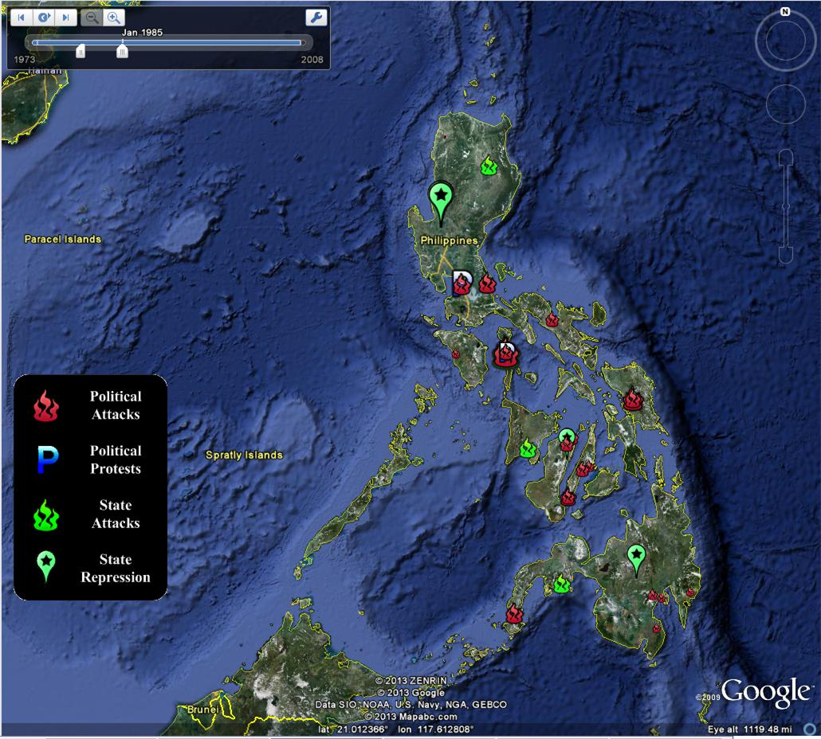
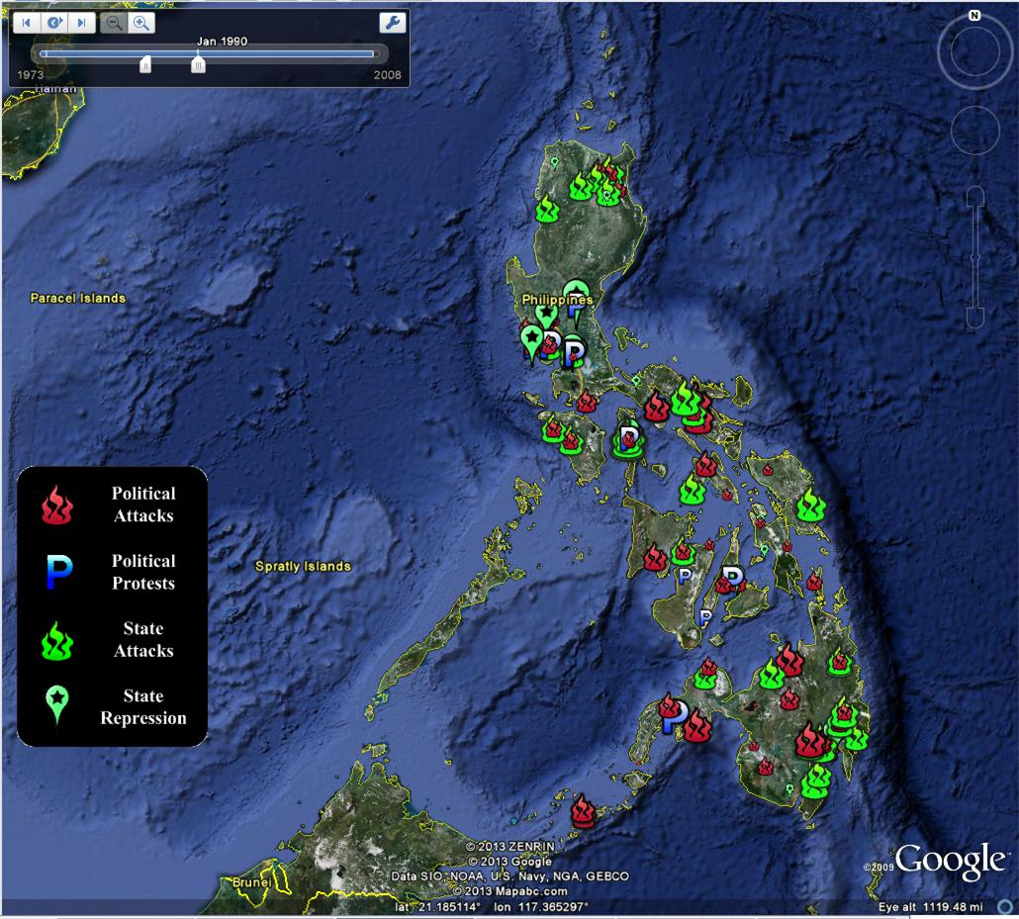
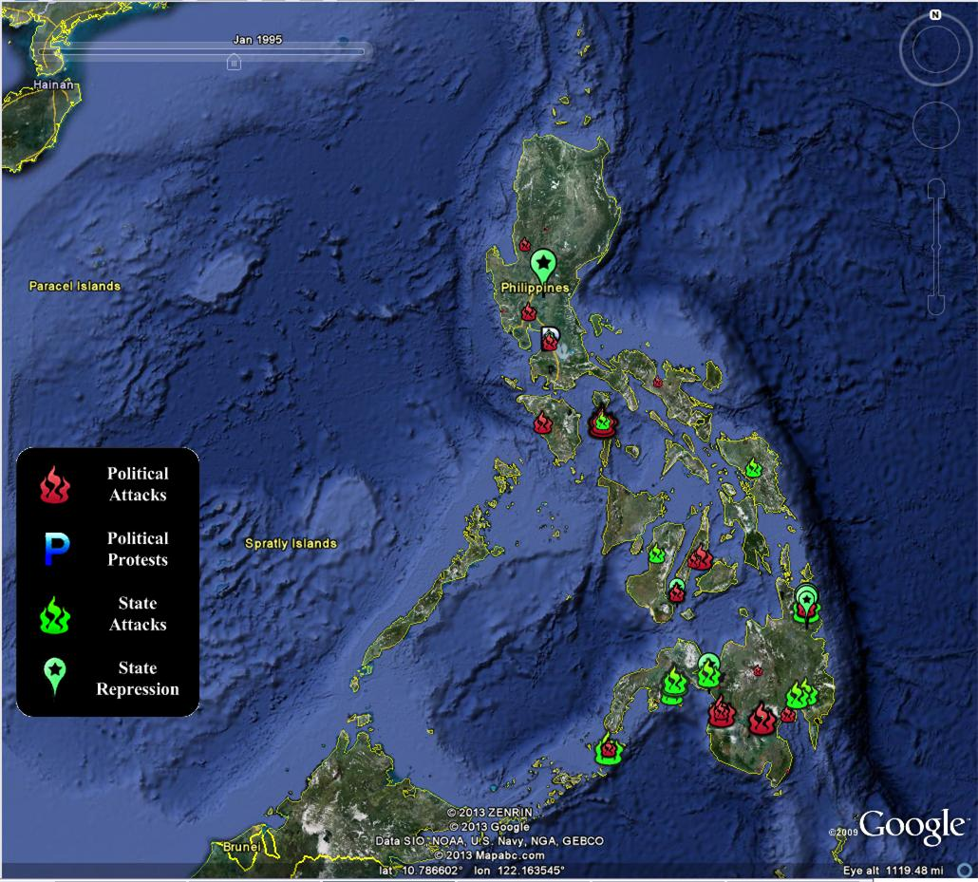
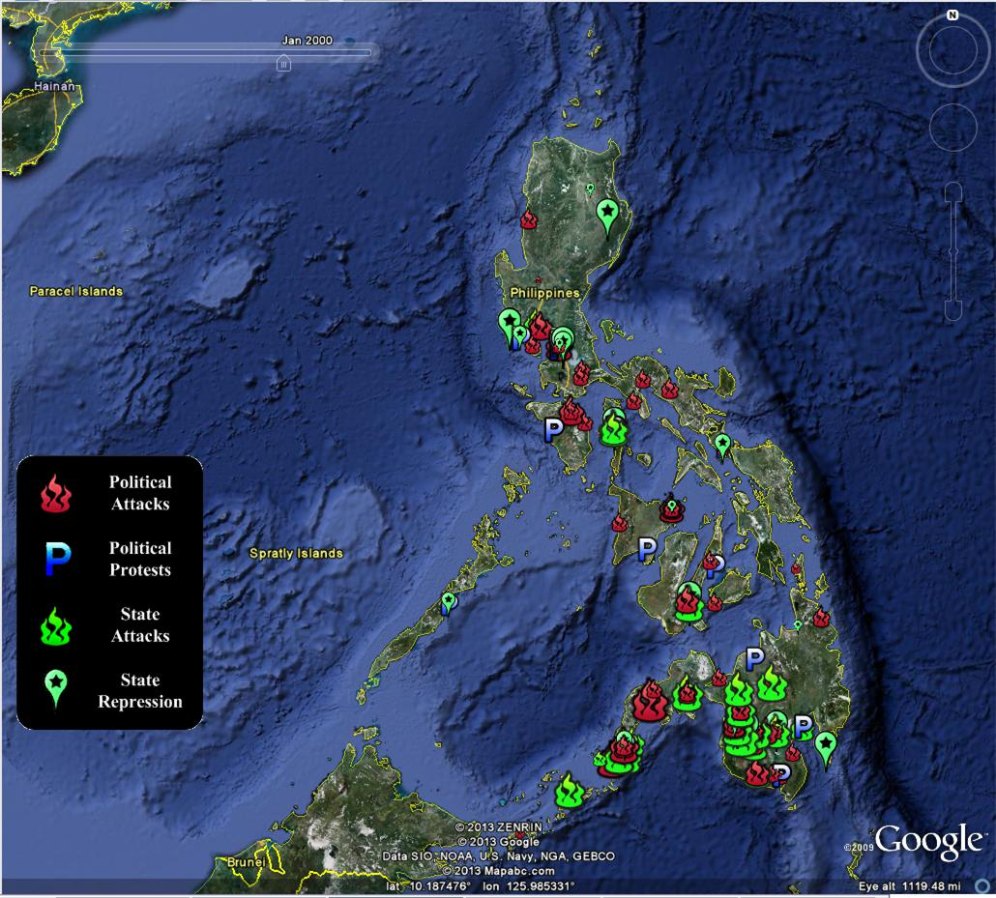


Social, Political and Economic Event Database (SPEED)
Cline Center for Democracy: Quantitative Political Science meets Information extraction
Tracking Societal Stability in the Philippines: Civil strife, Human and property rights, The rule of law, Political regime transitions

Slide 80
Natural Language Understanding
Much research into [data → meaning] attempts to tell us what a document says with some level of certainty
  Why is it difficult to do?
  What our Learning and Inference methods can do today
  Which directions should be pursued?
    How?
  ……
But what should we believe, and who should we trust?

Slide 81

Knowing what to Believe
The advent of the Information Age and the Web
  Overwhelming quantity of information
  But uncertain quality.
    Collaborative media
      Blogs
      Wikis
      Tweets
      Message boards
    Established media are losing market share
      Reduced fact-checking
Notes:
81

Slide 82

Distributed Trust
Sources may provide conflicting
information or mutually
reinforcing information.
  Mistakenly or for a reason
  Not feasible for human to
  read it all
  A computational trust system can be our proxy
  Ideally, assign the trust judgments the user would
  The user may be another system
    A question answering system; A navigation system; A news aggregator
    A warning system
False– only 3 %

Slide 83
Emergency Situations
A distributed data stream needs to be monitored
All data streams have Natural Language Content
  Internet activity
    chat rooms, forums, search activity, twitter and cell phones
  Traffic reports; 911 calls and other emergency reports
  Network activity, power grid reports, networks reports, security systems, banking
  Media coverage
Often, stories appear on tweeter before they break the news
But, a lot of conflicting information, possibly misleading and deceiving
Notes:
83

Slide 84




Medical Domain: Many support groups & medical forums
Hundreds of thousands of people get their medical information from the internet
Best treatment for…..
Side effects of….
But, some users have an agenda,… pharmaceutical companies…
84
Notes:
Users share their experiences in message boards, forums, and blogs.
84

Slide 85
Trustworthiness
Evidence
E(c)
Claims
T(s)
Sources
Sources
Claims
e₁
s₁
B(c)
Given:
  Multiple content sources
  Some target relations (“facts”)
    E.g. [disease, treatments],
    [treatments, side-effects]
  Prior beliefs & background knowledge
Our goal is to:
  Score credibility of sources and trustworthiness of claims based on
    Support across multiple (trusted) sources
    Source characteristics:
      reputation, interest-group (commercial / govt. backed / public interest),
      verifiability of information (cited info)
    Prior Beliefs and Background knowledge
    Understanding content
s₁
e₂
c₁
c₁
s₂
e₃
s₂
c₂
s₃
e₄
c₂
s₃
e₅
c₃
s₄
c₃
s₄
e₆
c₄
s₅
e₇
c₄
s₅
e₈
e₉
e₁₀
Beyond the scientific and engineering challenges, this will have significant societal impact.

Slide 86
Summary: Making Sense of Unstructured Data
Thank you!
Check out our tools, demos, LBJava→Saul, Tutorials,…
Making sense of unstructured data
  Natural Language Understanding is essential to supporting better access, analysis, and synthesis of data.
  Machine Learning and Inference are at the heart of any attempt for scientific and engineering progress in these direction.
  Discussed a unified Learning and Inference approach that has had large impact on our ability to move forward in this direction.
  Very active research area – the problem isn’t solve yet…
  But we have made significant progress, and can already offer interesting insights and practical solutions that reliably address a range a problems.
Trustworthiness of information
  Comes up in the context of social (and “standard” media), but also in the context of using other sensory information.
  Very broad applications, with huge societal impact.

