Slide 1
Natural Language Understanding with
Common Sense Reasoning
Dan Roth
Department of Computer Science
University of Illinois at Urbana-Champaign
With thanks to:
Collaborators: Kai-Wei Chang, Ming-Wei Chang, Xiao Chen, Cindy Fisher,
Daniel Khashabi, Haoruo Peng, Lev Ratinov, Subhro Roy,…
Funding: NSF; DHS; NIH; DARPA; IARPA, ARL, ONR
DASH Optimization (Xpress-MP); Gurobi.
October 2015
University of Utrecht, The Netherlands
Workshop on Computational Reasoning in Natural Language

Slide 2
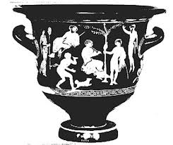







Please…
Identify units
Consider multiple interpretations and representations
  Pictures, text, layout, spelling, phonetics
Put it all together: Determine “best” global interpretation
Satisfy expectations
  Slide; puzzle

Slide 3
Comprehension
(ENGLAND, June, 1989) - Christopher Robin is alive and well. He lives in England. He is the same person that you read about in the book, Winnie the Pooh. As a boy, Chris lived in a pretty home called Cotchfield Farm. When Chris was three years old, his father wrote a poem about him. The poem was printed in a magazine for others to read. Mr. Robin then wrote a book. He made up a fairy tale land where Chris lived. His friends were animals. There was a bear called Winnie the Pooh. There was also an owl and a young pig, called a piglet. All the animals were stuffed toys that Chris owned. Mr. Robin made them come to life with his words. The places in the story were all near Cotchfield Farm. Winnie the Pooh was written in 1925. Children still love to read about Christopher Robin and his animal friends. Most people don't know he is a real person who is grown now. He has written two books of his own. They tell what it is like to be famous.
1. Christopher Robin was born in England. 2. Winnie the Pooh is a title of a book.
3. Christopher Robin’s dad was a magician. 4. Christopher Robin must be at least 65 now.
This is an Inference Problem
Notes:
3
I would like to talk about it in the context of language understanding problems. This is the problem I would like to solve. You are given a short story, a document, a paragraph, which you would like to understand. My working definition for Comprehension here would be “ A process that….”
So, given some statement, I would like to know if they are true in this story or not….
This is a very difficult task…
What do we need to know in order to have a chance to do that? … Many things….
And, there are probably many other stand-alone tasks of this sort that we need to be able to address, if we want to have a chance to COMPREHEND this story, and answer questions with respect to it.
But comprehending this story, being able to determined the truth of these statements is probably a lot more than that – we need to be able to put these things,
(and what is “these” isnt’ so clear) together.
So, how do we address comprehension? Here is a somewhat cartoon-she view of what has happened in this area over the last 30 years or so?
talk about – I wish I could talk about.
Here is a challenge: write a program that responds correctly to these five questions. Many of us would love to be able to do it.
This is a very natural problem; a short paragraph on Christopher Robin that we all
Know and love, and a few questions about it; my six years old can answer these
Almost instantaneously, yes, we cannot write a program that answers more than, say, 2 out of five questions.
What is involved in being able to answer these? Clearly, there are many “small” local decisions that we need to make.
We need to recognize that there are two Chris’s here. A father an a son. We need to resolve co-reference. We need sometimes
To attach prepositions properly;
The key issue, is that it is not sufficient to solve these local problems – we need to figure out how to put them
Together in some coherent way.
And in this talk, I will focus on this. We describe some recent works that we have done in this direction - …..
What do we know – in the last few years there has been a lot of work – and a considerable success on what I call here ---
Here is a more concrete and easy example -----
There is an agreement today that learning/ statistics /information theory (you name it) is of prime importance to making
Progress in these tasks. The key reason, is that rather than working on these high level difficult tasks, we have moved
To work on well defined disambiguation problems that people felt are at the core of many problems.
And, as an outcome of work in NLP and Learning Theory, there is today a pretty good understanding for how to solve
All these problems – which are essentially the same problem.

Slide 4
Comprehension
(ENGLAND, June, 1989) - Christopher Robin is alive and well. He lives in England. He is the same person that you read about in the book, Winnie the Pooh. As a boy, Chris lived in a pretty home called Cotchfield Farm. When Chris was three years old, his father wrote a poem about him. The poem was printed in a magazine for others to read. Mr. Robin then wrote a book. He made up a fairy tale land where Chris lived. His friends were animals. There was a bear called Winnie the Pooh. There was also an owl and a young pig, called a piglet. All the animals were stuffed toys that Chris owned. Mr. Robin made them come to life with his words. The places in the story were all near Cotchfield Farm. Winnie the Pooh was written in 1925. Children still love to read about Christopher Robin and his animal friends. Most people don't know he is a real person who is grown now. He has written two books of his own. They tell what it is like to be famous.
1. Christopher Robin was born in England. 2. Winnie the Pooh is a title of a book.
3. Christopher Robin’s dad was a magician. 4. Christopher Robin must be at least 65 now.
This is an Inference Problem
Notes:
4
I would like to talk about it in the context of language understanding problems. This is the problem I would like to solve. You are given a short story, a document, a paragraph, which you would like to understand. My working definition for Comprehension here would be “ A process that….”
So, given some statement, I would like to know if they are true in this story or not….
This is a very difficult task…
What do we need to know in order to have a chance to do that? … Many things….
And, there are probably many other stand-alone tasks of this sort that we need to be able to address, if we want to have a chance to COMPREHEND this story, and answer questions with respect to it.
But comprehending this story, being able to determined the truth of these statements is probably a lot more than that – we need to be able to put these things,
(and what is “these” isnt’ so clear) together.
So, how do we address comprehension? Here is a somewhat cartoon-she view of what has happened in this area over the last 30 years or so?
talk about – I wish I could talk about.
Here is a challenge: write a program that responds correctly to these five questions. Many of us would love to be able to do it.
This is a very natural problem; a short paragraph on Christopher Robin that we all
Know and love, and a few questions about it; my six years old can answer these
Almost instantaneously, yes, we cannot write a program that answers more than, say, 2 out of five questions.
What is involved in being able to answer these? Clearly, there are many “small” local decisions that we need to make.
We need to recognize that there are two Chris’s here. A father an a son. We need to resolve co-reference. We need sometimes
To attach prepositions properly;
The key issue, is that it is not sufficient to solve these local problems – we need to figure out how to put them
Together in some coherent way.
And in this talk, I will focus on this. We describe some recent works that we have done in this direction - …..
What do we know – in the last few years there has been a lot of work – and a considerable success on what I call here ---
Here is a more concrete and easy example -----
There is an agreement today that learning/ statistics /information theory (you name it) is of prime importance to making
Progress in these tasks. The key reason, is that rather than working on these high level difficult tasks, we have moved
To work on well defined disambiguation problems that people felt are at the core of many problems.
And, as an outcome of work in NLP and Learning Theory, there is today a pretty good understanding for how to solve
All these problems – which are essentially the same problem.

Slide 5
Comprehension
Dan is flying to Philadelphia this weekend. Penn is organizing a workshop on the Penn Discourse Treebank.
  ➔Dan is attending the workshop
  ➔The Workshop is in Philadelphia
Jan is a black Dutch man.
  ➔Jan is a black man.
Interpretation builds on expectations that rely on knowledge.
Jan is a short Dutch man.
  ➔ Jan is a short man.

Slide 6
Natural Language Inferences
visitors
At least 14 people have been killed in southern Sri Lanka, police say. The telecoms minister was among about 35 injured in the blast site at the town of Akuressa, 160km (100 miles) south of the capital, Colombo. Government officials were attending a function at a mosque to celebrate an Islamic holiday at the time. The defense ministry said the suicide attack was carried out by ….
  ➔ 49 people were hit by a suicide bomber in Akuressa.
This is an Inference Problem

Slide 7
Natural Language Understanding
Expectation is a knowledge intensive component
Natural language understanding decisions are global decisions that require
  Making (local) predictions driven by different models trained in different ways, at different times/conditions/scenarios
  The ability to put these predictions together coherently
  Knowledge, that guides the decisions so they satisfy our expectations
Natural Language Interpretation is a Common Sense driven Inference Process that is best thought of as a knowledge constrained optimization problem, done on top of multiple statistically learned models.
Many forms of Inference; a lot boil down to determining best assignment
Notes:
7

Slide 8
A Biased View of Common Sense Reasoning
Hayes&McCarthy
Frame Problem
Brooks
Subsumption
Quillian
Semantic Networks
ConceptNet
Minsky, Filmore
Frames
McCarthy
Formalizing Commonsense
Description Logic
Bobrow
STUDENT
Simon&Newell
General Problem Solver
Lenant
Cyc
Winograd
SHRDLU
2000 1990 1980 1970 1960 1950 1940
Common Sense Reasoning was formulated
traditionally as a “reasoning” process, irrespective of learning and the resulting knowledge representation.
Khardon & Roth
Learning to Reason

Slide 9


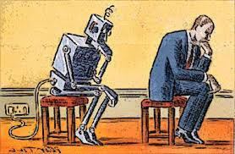
What is Needed?
A computational Framework
Three Examples:
  Pronoun Resolution
  Quantitative Reasoning
  Semantic Parsing
Notes:
Almost all NLP tasks: one example, many decisions
9

Slide 10
Joint Inference with General Constraint Structure [Roth&Yih’04,07,….]
Recognizing Entities and Relations
Joint inference gives good improvement
other | 0.05
per | 0.85
loc | 0.10
other | 0.05
per | 0.85
loc | 0.10
other | 0.10
per | 0.60
loc | 0.30
other | 0.10
per | 0.60
loc | 0.30
other | 0.05
per | 0.50
loc | 0.45
other | 0.05
per | 0.50
loc | 0.45
other | 0.05
per | 0.50
loc | 0.45
Key Questions:
How to guide the global inference?
How to learn the model(s)?
An Objective function that incorporates learned models with knowledge (output constraints)
A Constrained Conditional Model
  Dole ’s wife, Elizabeth , is a native of N.C.
  E1 E2 E3
R₁₂
R₂₃
irrelevant | 0.05
spouse_of | 0.45
born_in | 0.50
irrelevant | 0.05
spouse_of | 0.45
born_in | 0.50
irrelevant | 0.05
spouse_of | 0.45
born_in | 0.50
irrelevant | 0.10
spouse_of | 0.05
born_in | 0.85
irrelevant | 0.10
spouse_of | 0.05
born_in | 0.85
Models could be learned separately/jointly; constraints may come up only at decision time.
Notes:
10
Let’s look at another example in more details.
We want to extract entities (person, location and organization) and relations between them (born in, spouse of).
Given a sentence, suppose the entity classifier and relation classifier have already given us their predictions along with the confidence values. The blue ones are the labels that have the highest confidence individually. However, this global assignment has some obvious mistakes. For example, the second argument of a born_in relation should be location instead of person. Since the classifiers are pretty confident on R23, but not on E3, so we should correct E3 to be location.
Similarly, we should change R12 from “born_in” to “spouse_of”

Slide 11
Constrained Conditional Models
Any MAP problem w.r.t. any probabilistic model, can be formulated as an ILP
[Roth+ 04, Taskar 04]
Penalty for violating
the constraint.
Variables are models
y = argmax_{y} ∑ 1_{Á(x,y)} w_{x,y} subject to Constraints C(x,y)
    y = argmax_{y 2 Y} w^{T}Á(x, y) + u^{T}C(x, y)
Knowledge component:
(Soft) constraints
Weight Vector for “local” models
Features, classifiers; log-linear models (HMM, CRF) or a combination
How far y is from
a “legal/expected” assignment
Training: learning the objective function (w, u)
  Decouple? Decompose? Force u to model hard constraints?
A way to push the learned model to satisfy our output expectations (or expectations from a latent representation)
  [CoDL, Chang et. al (07, 12); Posterior Regularization, Ganchev et. al (10); Unified EM (Samdani et. al (12)]

Slide 12
Examples: CCM Formulations
  y = argmax_{y 2 Y} w^{T}Á(x, y) + u^{T}C(x, y)
While Á(x, y) and C(x, y) could be the same; we want C(x, y) to express high level declarative knowledge over the statistical models.
  Formulate NLP Problems as ILP problems (inference may be done otherwise)
    1. Sequence tagging (HMM/CRF + Global constraints)
    2. Sentence Compression (Language Model + Global Constraints)
    3. SRL (Independent classifiers + Global Constraints)
Sequential Prediction
HMM/CRF based:
Argmax ∑ ¸_{ij} x_{ij}
Sentence Compression/Summarization:
Language Model based:
Argmax ∑ ¸_{ijk} x_{ijk}
Knowledge/Linguistics Constraints
Cannot have both A states and B states in an output sequence.
Knowledge/Linguistics Constraints
If a modifier chosen, include its head
If verb is chosen, include its arguments
Constrained Conditional Models Allow:
Decouple complexity of the learned model from that of the desired output
Learn a simple model (multiple; pipelines); reason with a complex one.
Accomplished by incorporating constraints to bias/re-rank global decisions to satisfy (minimally violate) expectations.

Slide 13
Semantic Role Labeling (SRL)
Archetypical Information Extraction Problem: E.g., Concept Identification and Typing, Event Identification, etc.
I left my pearls to my daughter in my will .
[I]_{A0} left [my pearls]_{A1} [to my daughter]_{A2} [in my will]_{AM-LOC} .
A0 Leaver
A1 Things left
A2 Benefactor
AM-LOC Location
I left my pearls to my daughter in my will .
Notes:
In the context of SRL, the goal is to predict for each possible phrase in a given sentence if it is an argument or not and what type it is.

Slide 14
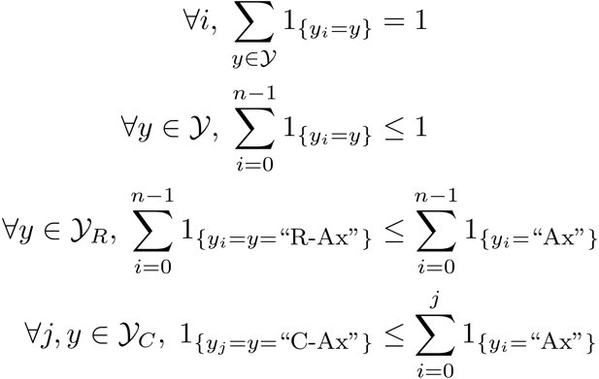
Algorithmic Approach
Learning Based Java: allows a developer to encode constraints in First Order Logic; these are compiled into linear inequalities automatically.
No duplicate argument classes
I left my nice pearls to her
candidate arguments
Unique labels
Identify argument candidates
  Pruning [Xue&Palmer, EMNLP’04]
  Argument Identifier
    Binary classification
Classify argument candidates
  Argument Classifier
    Multi-class classification
Inference
  Use the estimated probability distribution given by the argument classifier
  Use structural and linguistic constraints
  Infer the optimal global output
  Variable y^{a,t} indicates whether candidate argument a is assigned a label t.
  c^{a,t} is the corresponding model score
I left my nice pearls to her
I left my nice pearls to her
[ [ [ [ [
] ] ] ] ]
argmax ∑_{a,t} y^{a,t} c^{a,t} = ∑_{a,t} 1_{a=t} c_{a=t}
Subject to:
One label per argument: ∑_{t} y^{a,t} = 1
No overlapping or embedding
Relations between verbs and arguments,….
One inference problem for each verb predicate.
  Abstract representation of expectations/knowledge
I left my nice pearls to her
Use the pipeline architecture’s simplicity while maintaining uncertainty: keep probability distributions over decisions & use global inference at decision time.
Notes:
We follow a now seemingly standard approach to SRL.
Given a sentence, first we find a set of potential argument candidates by identifying
which words are at the border of an argument.
Then, once we have a set of potential arguments, we use a phrase-level classifier to tell us how likely an argument is to be of each type.
Finally, we use all of the information we have so far to find the assignment of types to argument that gives us the “optimal” global assignment.
Similar approaches (with similar results) use inference procedures tied to their represntation.
Instead, we use a general inference procedure by setting up the problem as a linear programming problem.
This is really where our technique allows us to apply powerful information that similar approaches can not.

Slide 15
More Examples
A lot of our natural language understanding work addresses similar issues and makes use of similar principles
  Semantic Role Labeling for other Predicates
    E.g., Prepositions
    Need to learn a latent representation that captures argument types
  Wikification
    Knowledge constraining the decisions is learned too (e.g., the identification of relations among concepts and entities)
See references for our work on various semantic processing tasks
Skip Details

Slide 16
Extended Semantic Role Labeling
John, a fast-rising politician, slept on the train to Chicago.
Verb Predicate: sleep
  Sleeper: John, a fast-rising politician
  Location: on the train to Chicago
Who was John?
  Relation: Apposition (comma)
  John, a fast-rising politician
What was John’s destination?
  Relation: Destination (preposition)
  train to Chicago
Identify the relation expressed by the predicate, and its arguments

Slide 17
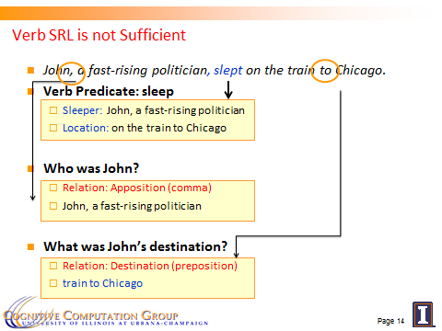
Learning & Inference
Predict the preposition relations
  [EMNLP, ’11]
Identify the relation’s arguments
  [Trans. Of ACL, ‘13]
Very little supervised data
  per phenomena
Minimal annotation
  only at the predicate level
The Learning & Inference paradigm exploits two principles:
  Coherency among multiple phenomena
  Constraining latent structures (relating observed and latent variables)
  Skip
Input & relation
Argument & their types

Slide 18






Wikification: The Reference Problem
Knowledge Acquisition
Blumenthal (D) is a candidate for the U.S. Senate seat now held by Christopher Dodd (D), and he has held a commanding lead in the race since he entered it. But the Times report has the potential to fundamentally reshape the contest in the Nutmeg State.
Blumenthal (D) is a candidate for the U.S. Senate seat now held by Christopher Dodd (D), and he has held a commanding lead in the race since he entered it. But the Times report has the potential to fundamentally reshape the contest in the Nutmeg State.
Notes:
Let’s start with what is wikification
Read wiki titles slower

Slide 19
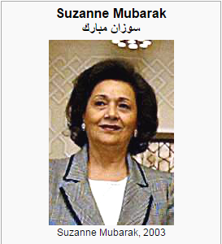
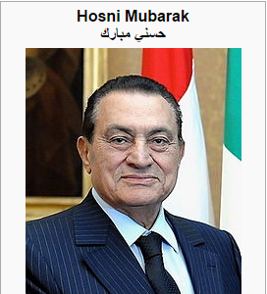
Knowledge Acquisition requires Knowledge (& inference)
Mubarak,
the wife of deposed Egyptian President Hosni Mubarak,…

Slide 20
Relational Inference
Mubarak, the wife of deposed Egyptian President Hosni Mubarak, …
Egyptian President
Hosni Mubarak
, the of deposed , …
Mubarak
wife
What are we missing with Bag of Words (BOW) models?
  Who is Mubarak?
Textual relations provide another dimension of text understanding
Can be used to constrain interactions between concepts
  (Mubarak, wife, Hosni Mubarak)
Has impact in several steps in the Wikification process:
  From candidate selection to ranking and global decision
Notes:
Main contribution here
We will show that by identifying

Slide 21
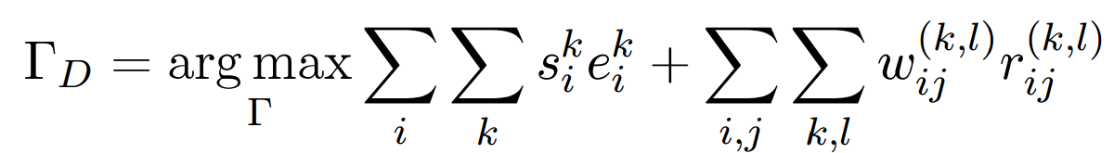
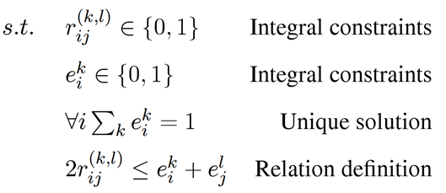
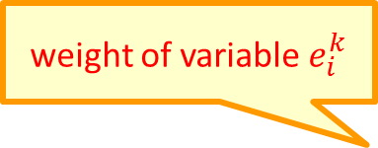
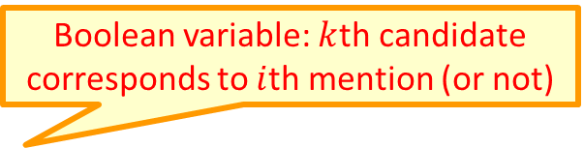
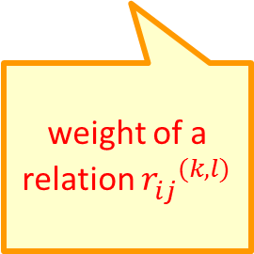
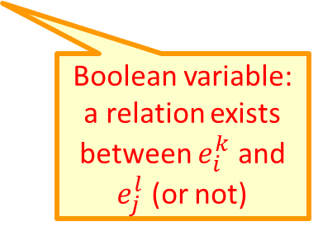
Formulation
Knowledge + Ability to use it (Inference) facilitates additional knowledge acquisition
  Goal: Promote concepts that are coherent with textual relations
Formulate as an Integer Linear Program (ILP):
If no relation exists, collapses to the non-structured decision
weight of variable $e_{i}^{k}$
Boolean variable: $k$th candidate corresponds to $i$th mention (or not)
weight of a relation ${r_{ij}^{}}^{(k,l)}$
Boolean variable: a relation exists between $e_{i}^{k}$ and $e_{j}^{l}$ (or not)
Notes:
Formalize intuition, weights induced from data, small constraints
Objective function collapse to the original output when there is no relation, so our model is negatives-proof
True-negatives and false-negatives will not negatively impact performance of baseline

Slide 22
The Computational Process
Models are induced via some interactive learning process
  Feedback goes back to improve earlier learned models
Relatively abstract knowledge, is used
  “Output expectations”, or “constraints” on what can be represented guide learning and prediction (inference)
Knowledge impacts both models, latent representations and predictions
But the knowledge used and the way it is represented and being used are not good enough…

Slide 23
I. Coreference Resolution
(ENGLAND, June, 1989) - Christopher Robin is alive and well. He lives in England. He is the same person that you read about in the book, Winnie the Pooh. As a boy, Chris lived in a pretty home called Cotchfield Farm. When Chris was three years old, his father wrote a poem about him. The poem was printed in a magazine for others to read. Mr. Robin then wrote a book. He made up a fairy tale land where Chris lived. His friends were animals. There was a bear called Winnie the Pooh. There was also an owl and a young pig, called a piglet. All the animals were stuffed toys that Chris owned. Mr. Robin made them come to life with his words. The places in the story were all near Cotchfield Farm. Winnie the Pooh was written in 1925. Children still love to read about Christopher Robin and his animal friends. Most people don't know he is a real person who is grown now. He has written two books of his own. They tell what it is like to be famous.
(ENGLAND, June, 1989) - Christopher Robin is alive and well. He lives in England. He is the same person that you read about in the book, Winnie the Pooh. As a boy, Chris lived in a pretty home called Cotchfield Farm. When Chris was three years old, his father wrote a poem about him. The poem was printed in a magazine for others to read. Mr. Robin then wrote a book. He made up a fairy tale land where Chris lived. His friends were animals. There was a bear called Winnie the Pooh. There was also an owl and a young pig, called a piglet. All the animals were stuffed toys that Chris owned. Mr. Robin made them come to life with his words. The places in the story were all near Cotchfield Farm. Winnie the Pooh was written in 1925. Children still love to read about Christopher Robin and his animal friends. Most people don't know he is a real person who is grown now. He has written two books of his own. They tell what it is like to be famous.
Big Problem; essential to text understanding; hard.
Requires: good learning and inference models & knowledge
Notes:
23

Slide 24
Recent Advances in Co-reference [Chang, Peng, Samdani, Khashabi]
All together, the outcome is the best end-to-end coreference results on CoNLL data and on ACE [CoNLL’15]
Latent Left-linking Model (L3M) model [ICML 14]
  A latent variable structured prediction model for discriminative supervised clustering. Jointly learns a similarity function and performs inference, assuming a latent left linking forest of mentions.
Joint mention identification & co-reference resolution [CoNLL’15]
  Augment the ILP based Inference formulation with “a legitimate mention” variable, to jointly determine if the mention is legitimate and what to co-ref it with
Hard Co-reference Problems [NAACL’15]

Slide 25
Pronoun Resolution can be Really Hard
When Tina pressed Joan to the floor she was punished.
When Tina pressed Joan to the floor she was hurt.
When Tina pressed charges against Joan she was jailed.
Requires, among other things, thinking about the structure of the sentence – who does what to whom

Slide 26
Hard Co-reference Problems
Knowledge representation called “predicate schemas”
Requires knowledge Acquisition
  The bee landed on the flower because it had/wanted pollen.
    Lexical knowledge
  John Doe robbed Jim Roy. He was arrested by the police.
    The Subj of “rob” is more likely than the Obj of “rob” to be the Obj of “arrest”
Requires an inference framework that can make use of this knowledge

Slide 27

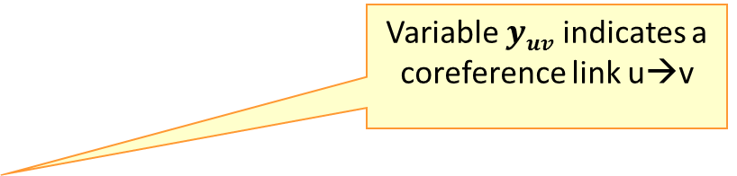


ILP Formulation of Coreference Resolution
Variable $yuv$ indicates a coreference link u→v
$y=arg max_{y} ∑uv wuv$ $⋅yuv$
s.t $∑u<v yuv$ <= 1, ∀v
$yuv$ ε {0,1}
1.5
3.1
3.1
$$u$$
$$v$$
1.2
Best Link Approach: only one of the antecedents u is linked to v
-1.5
0.2

Slide 28
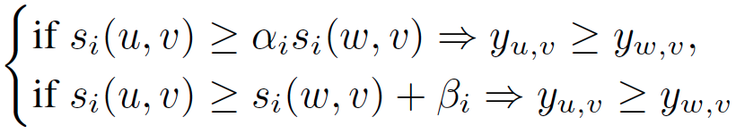

ILP Formulation of Coreference Resolution
Results in a state-of-the-art coreference that at the same time also handles hard instances at close to 90% Precision.
$y=arg max_{y} ∑uv wuv$ $⋅yuv$
s.t $∑u<v yuv$ <= 1, ∀v
$yuv$ ε {0,1}
Acquire knowledge; formulated via “Predicate Schemas”.
  Constraints over predicate schemas are instantiated given a new instance (document) and are incorporated “on-the-fly” into the ILP-based inference formulation to support preferred interpretations.
1.5
3.1
3.1
$$u$$
$$v$$
predicate schemas
predicate schemas
1.2
-1.5
0.2

Slide 29
II. Quantities & Quantitative Reasoning
A crucially important natural language understanding task.
Election results; Stock Market; Casualties,…
The Emmanuel campaign funding totaled three
times that of all his opponents put together.
Understanding implies mapping the text to an arithmetic expression, or an equation: E = 3 ∑_{i} o_{i}
John had 6 books; he wanted to give it to two of his friends. How many will each one get?
~~
share it with

Slide 30
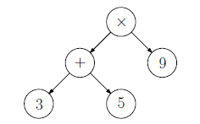
Mapping Natural Language Text to Expressions
Gwen was organizing her book case making sure each of the shelves had exactly 9 books on it. She has 2 types of books – mystery books and picture books. If she had 3 shelves of mystery books and 5 shelves of picture books, how many books did she have total?
[Roy & Roth’15] suggests a solution that involves “parsing” the problem into an expression tree

Slide 31
Inferring the Best Expression Tree
State-of-the-art results on multiple types of arithmetic word problems
Decomposition: Uniqueness properties of the Τ(E) implies that it is determined by the unique Τ−operation between pairs of relevant quantities.
E* = argmax ∑_{q} R(q) 1_{q} + ∑_{(q, q’)} Pair(q, q’, ¯(q, q’)) 1_{q,q’}
Subject to commonsense constraints.
  Legitimacy
  Positive Answer; Integral Answer ; Range,…
Score of q being irrelevant to E
Score of ¯ being the unique operation between (q_{i}, q_{j} )
Abstract Expectations developed given a text snippet

Slide 32
More Examples
A lot of our natural language understanding work addresses similar issues and makes use of similar principles
  Temporal Reasoning (Timelines; causality)
    We have expectations of transitivity, for example
  Discourse Processing
    We have expectations on “coherency” is conveying ideas
  Knowledge Acquisition
    We have expectations dictated by our prior knowledge
See references for our work on various semantic processing tasks

Slide 33
Question Answering (with Inference)
Q: In New York State the shortest day duration occurs during which month?
  (1) December (2) June (3) March (4) September

Slide 34
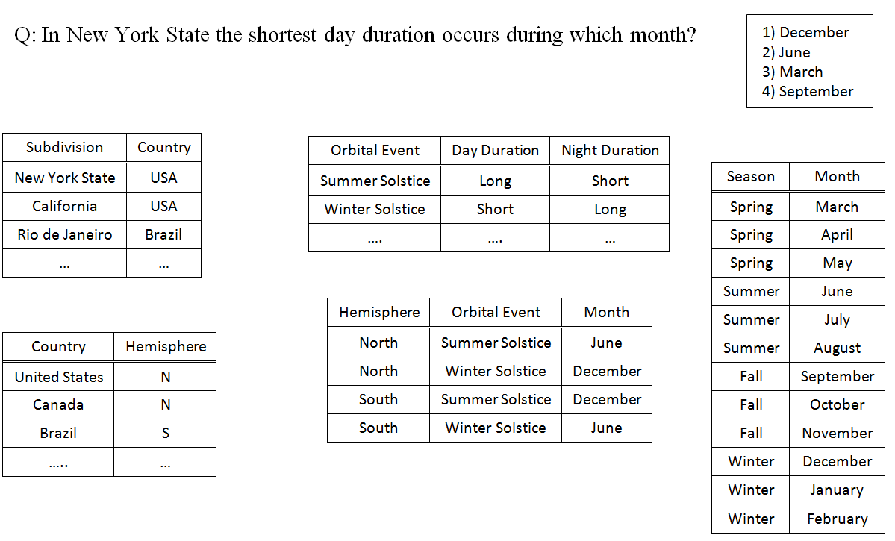
Question Answering (with Inference)

Slide 35
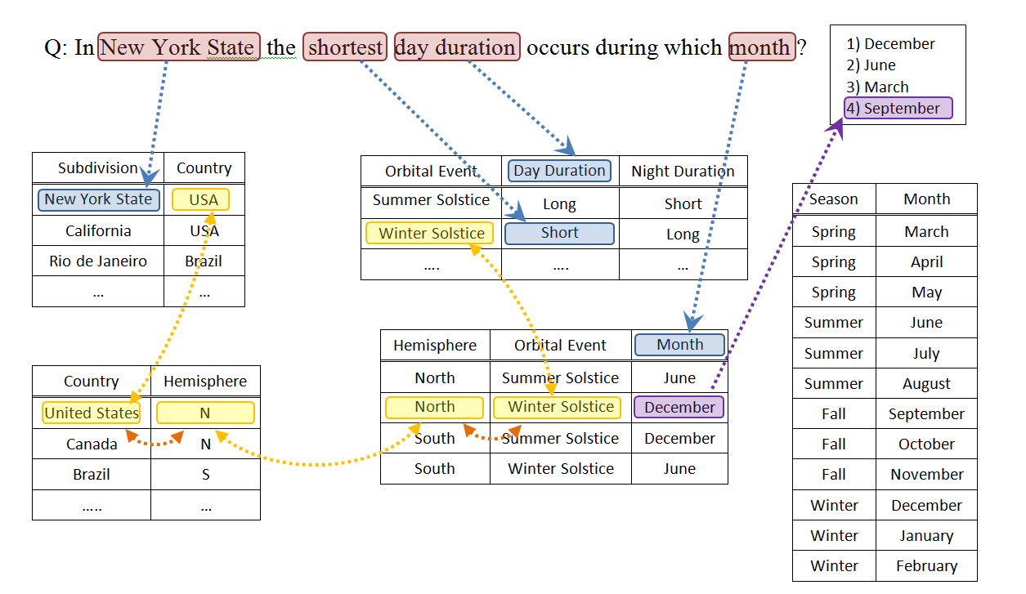
Question Answering (with Inference)

Slide 36



Computational Process
Q: In New York State the shortest period of daylight occurs during which month?
  (1) December (2) June (3) March (4) September
Reasoning Engine
Knowledge Base
A relational representation; tables
Alignment Functions
Knowledge of Entailment, Causality, Semantic Similarity, Equivalence, etc.

Slide 37
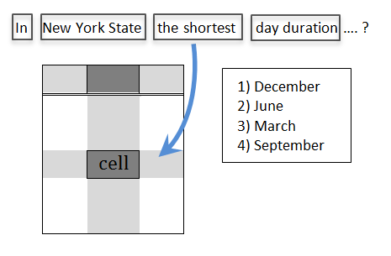
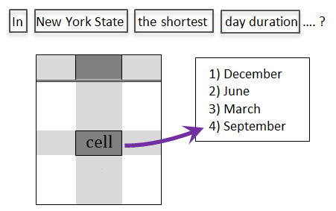
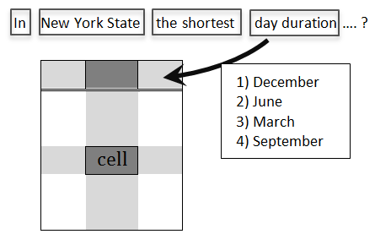
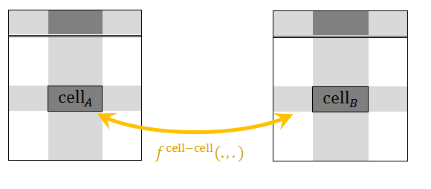
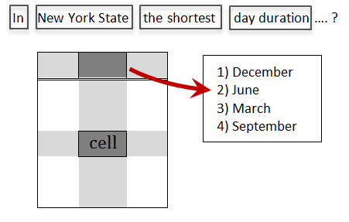





Possible Formulation
variables
$$x^{inter−table}\left({cell}_{A}, {cell}_{B}\right)∈\{0,1\}$$
$$x^{cell−QCons}\left(cell, qCons\right)∈\{0,1\}$$
$$x^{title−QCons}\left(title, qCons\right)∈\{0,1\}$$
$$x^{cell−QOption}\left(cell, qOption\right)∈\{0,1\}$$
$$x^{title−QOption}\left(title, qOption\right)∈\{0,1\}$$
Argmax_{X} {Linear Objective Weighting Alignment-based Scores}
Subject to: Linear constraints characterizing a proper
alignment using variables
Notes:
The industrial solvers like Gurobi

Slide 38
Challenges
We may know of a huge number of relational tables; most are irrelevant to the current problem at hand. What information is important?
What’s important in the question?
Identifying corresponding relational tables and specific fields within them is itself a TE problem.
Scoring variables and scaling.
How to put it together?
  Finding a “chain” could be very difficult
  How do we know what chains to prefer?

Slide 39
Conclusion
Natural Language Understanding is a Common Sense Inference problem.
We would gain by thinking in a unified way about Learning, Knowledge (Representation and Acquisition) and Reasoning.
Provided some recent samples from a research program that addresses
  Learning, Inference and Knowledge via a unified approach
  A constrained optimization framework that guides “best assignment” inference, with (declarative) expectations on the output.

Slide 40
Conclusion
Thank You!
Natural Language Understanding is a Common Sense Inference problem.
We would gain by thinking in a unified way about Learning, Knowledge (Representation and Acquisition) and Reasoning.
Provided some recent samples from a research program that addresses
  Learning, Inference and Knowledge via a unified approach
  A constrained optimization framework that guides “best assignment” inference, with (declarative) expectations on the output.
A lot more needs to be done to address some key issues involving knowledge and reasoning.
Check out our CCM tutorial
tools, demos, LBJava,…

