Slide 1
It’s Time to Reason
Supporting Communication with Computers
Dan Roth
University of Pennsylvania & Amazon AWS AI Labs
Ubiquitous Knowledge Processing Lab
Computer Science
Technical University of Darmstadt
February 2022
Notes:
I used this title not only since I think that it’s time to reason – think more seriously about reasoning as a way to advance AI in general, and NLP, which will be my focus, in particular. Also because I many of my examples – and this talk will mostly be a set of examples -- will be about time, and temporal reasoning. But I hope that you will see that the principles apply more broadly, and beyond NLP.

Slide 2
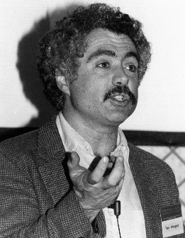
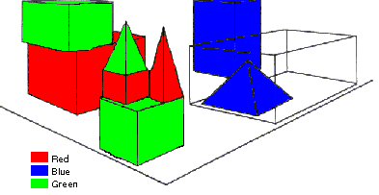
SHRDLU (Terry Winograd, 1968)
Person: Pick up a big red block.
Computer: OK.
Person: Grasp the pyramid.
Computer: I DON'T UNDERSTAND WHICH PYRAMID YOU MEAN.
Person: Find a taller block than the one you are holding and put it into the box.
Computer: BY "IT", I ASSUME YOU MEAN…..
Computer: OK.
Person: What does the box contain?
Computer: THE BLUE PYRAMID AND THE BLUE BLOCK.
Person: What is the pyramid supported by?
Computer: **What do you mean by “supported”?
……….
Person: How many blocks are not in the box?
Computer: FOUR OF THEM.
Understanding, executing and interacting requires language understanding & reasoning
to recognize and understand the domain, the goals, and to advance the task
Notes:
NL is about communication – and NLP, in many respects is supposed to support communication between us, human beings, and computers. There are many reasons to want to communicate – we want better assistants, we want to talk to our cars, our ppt presentations, etc. and we want them to understand what we want, and do it, to simplify our lives.
This is, of course, not a new goal. I am going back here more then 50 years --
SHRDLU, Computer program that has conversation with user, via Natural Language interface
-> About “block world”,
The simulation robot can pick the objects, move them, count them .. Very impressive.
SHRDLU's world was so simple that the entire set of objects and locations could be described by including as few as perhaps 50 words:
This allowed it to support co-reference resolution, make simple deductions on, for example types of blocks that can be stacked and those that cannot, etc.
SHRDLU could therefore understand instructions and answer questions, as you can see in this example.

Slide 3
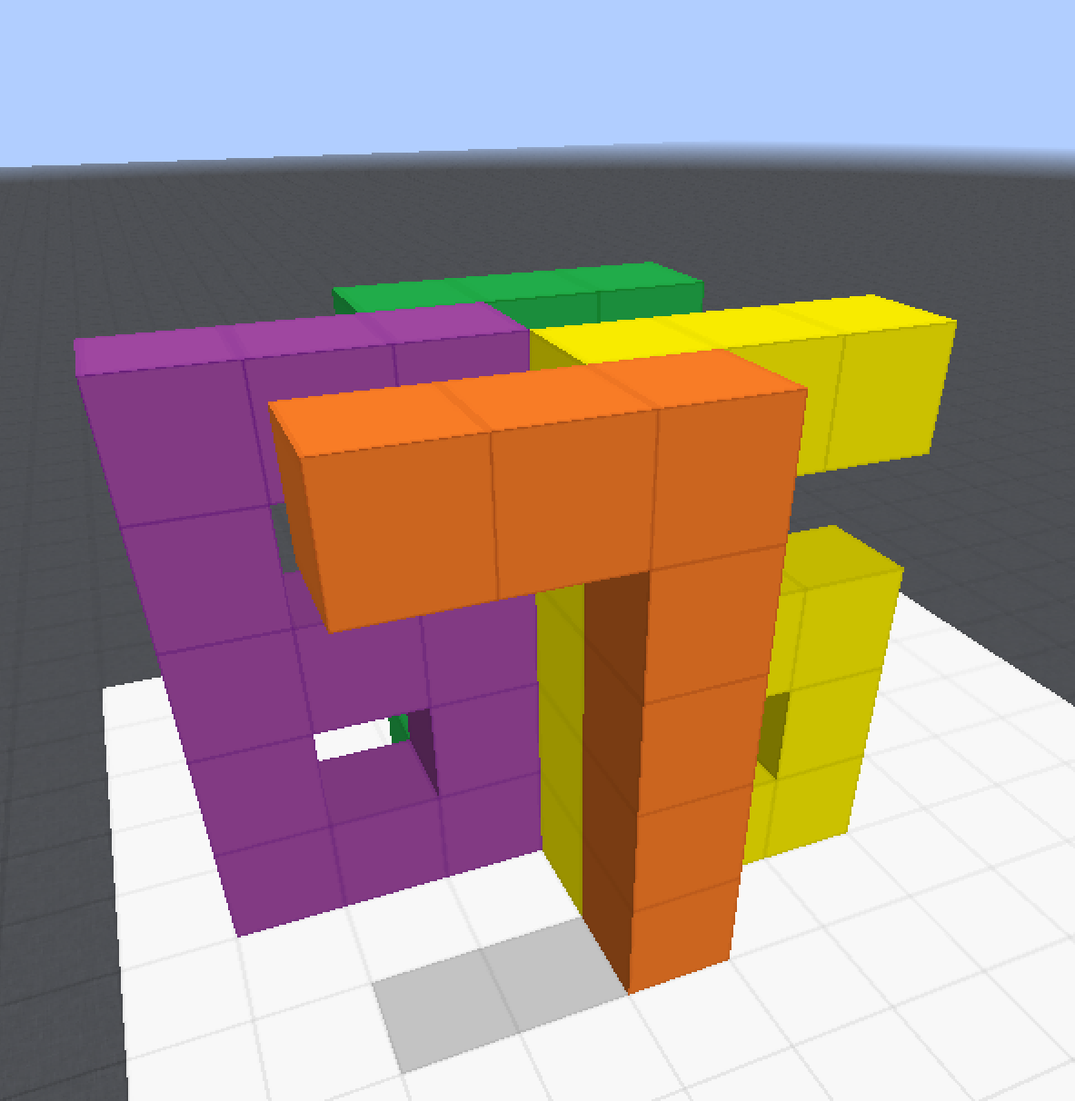
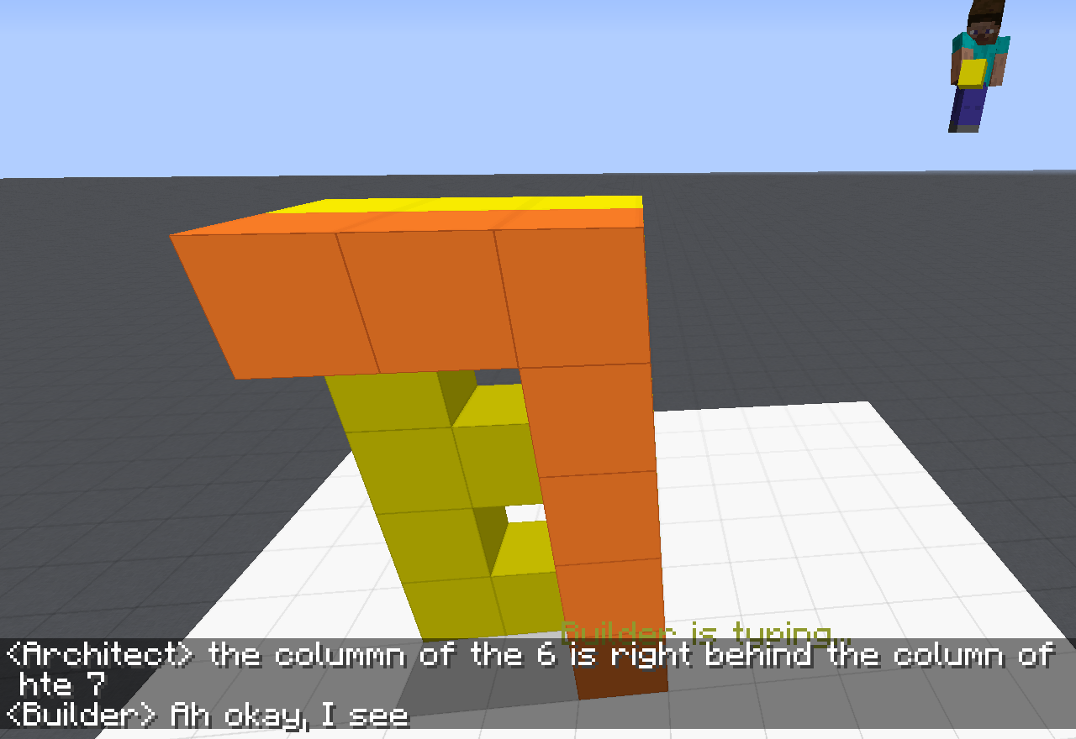
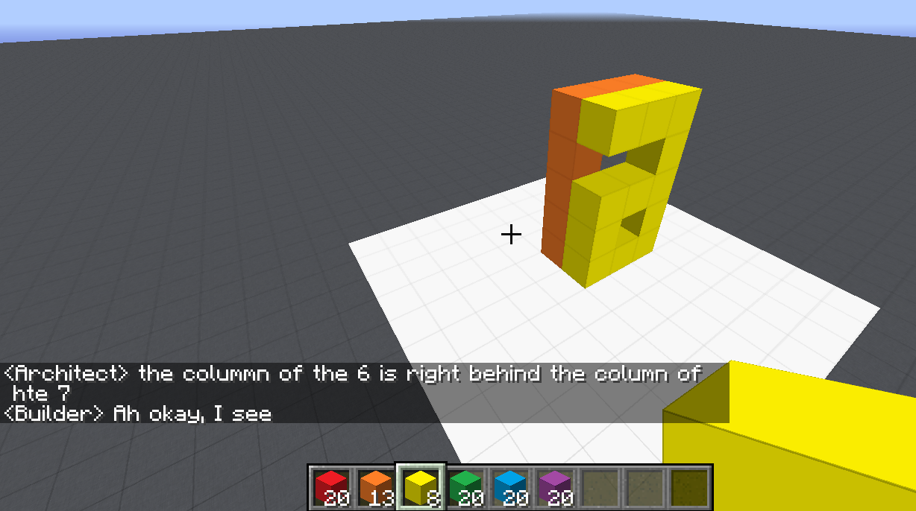
Communication (CwC Project, 2017-2021)
ARCHITECT
CHAT INTERFACE
Architect: | in about the middle build a column five tall
(Builder puts down five orange blocks)
Architect: | then two more to the left of the top to make a 7
(Builder puts down two orange blocks)
Architect: | now a yellow 6
Architect: | the long edge of the 6 aligns with the stem of the 7 and faces right
Builder: | Where does the 6 start?
Architect: | behind the 7 from your perspective
Builder: | Is it directly adjacent?
Architect: | yes directly behind it. touches it
(Builder puts down twelve yellow blocks, in the shape of a 6)
Architect: | too much overlap unfortunately
Architect: | the colummn of the 6 is right behind the column of hte 7
Target Structure
Build Region
BUILDER
[Minecraft example from Julia Hockenmaier]
Notes:
Fast forward 50 years -- we are still trying to solve the same problem --- this time open domain… We can do that, but we are running into similar problems of brittleness that are due, among other things, to our inability to deal well with situations we have never seen before. And this is really the goal of learning!

Slide 4
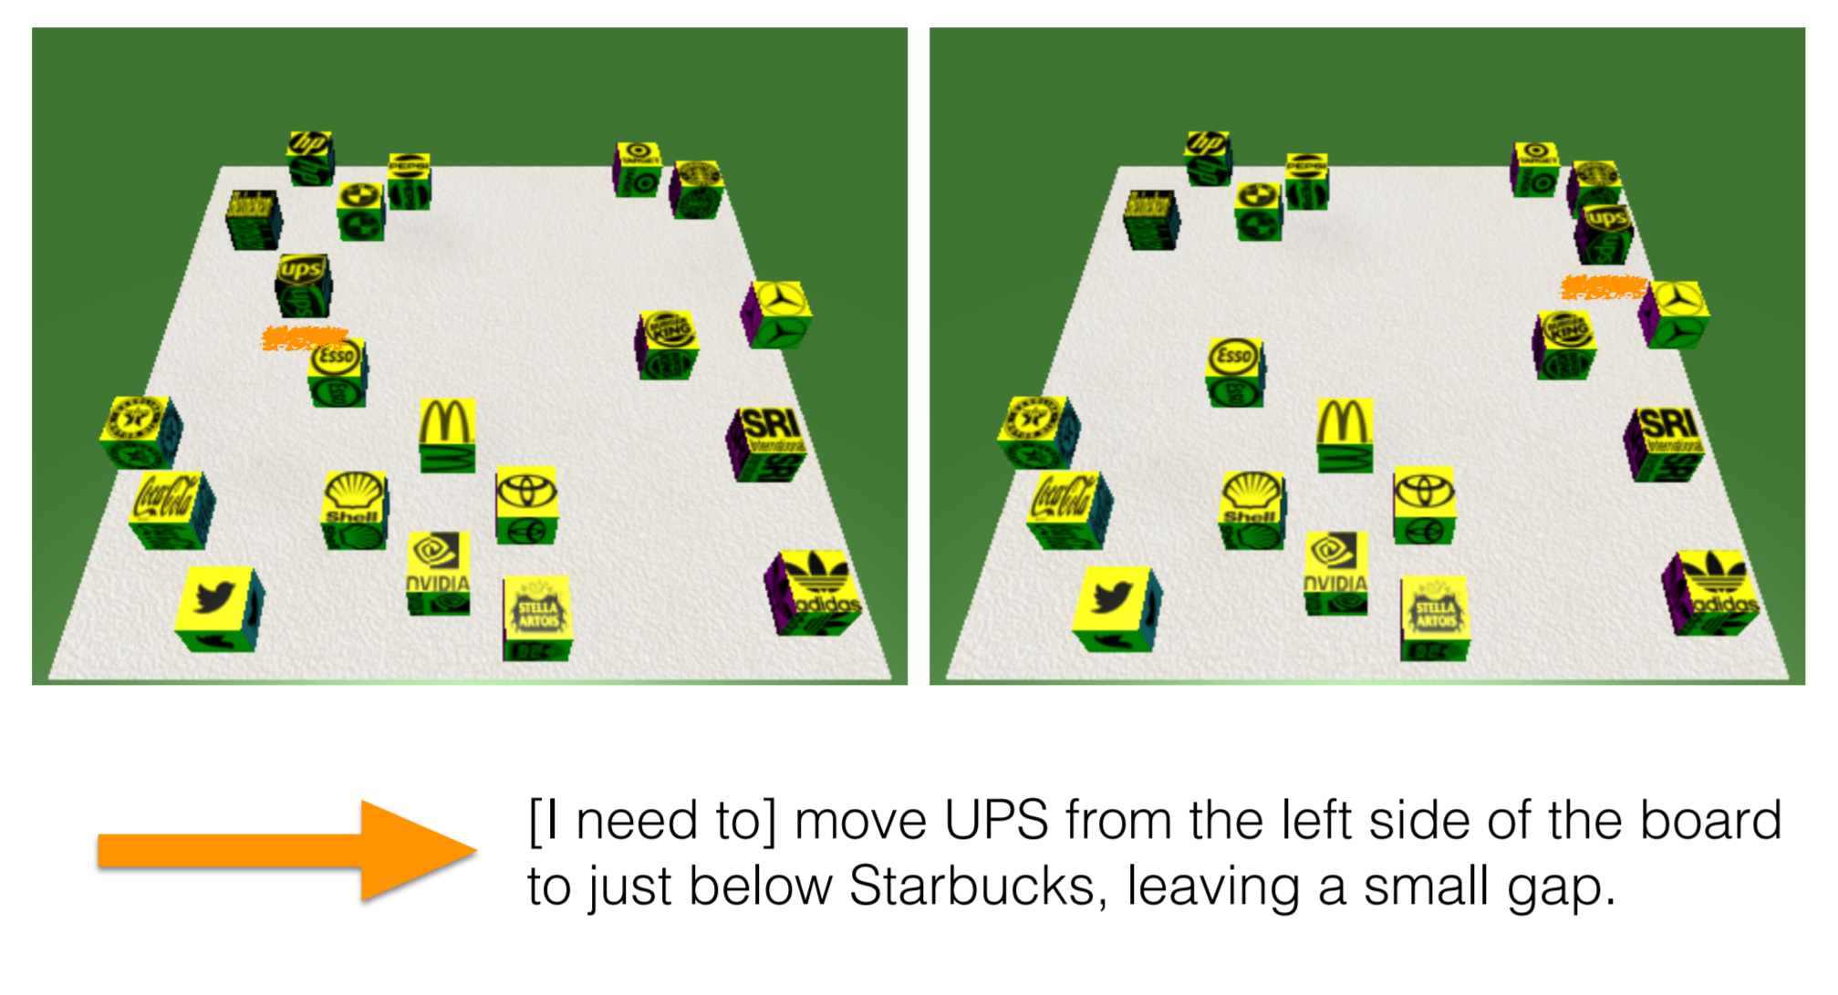
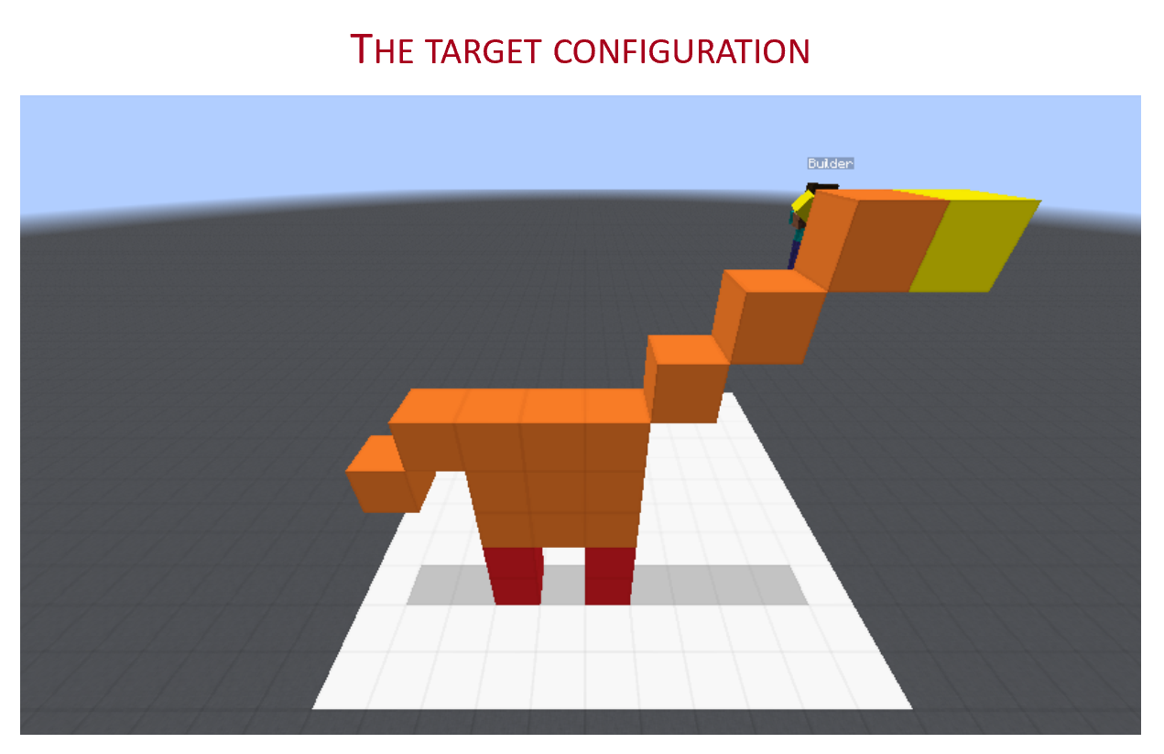
Communication (CwC Project, 2017-2020)
Consider the following explanation:
  [Example from Yonatan Bisk]
  Imagine that this is a chess board
  Place the UPS in H2, and McDonald in G6.
Can you follow these instructions?
  What’s needed for us to be able to induce programs that can do it?
Of course, there are many NLP tasks we are better at today, mostly extraction tasks (including some instruction following tasks)
But, can we do it in a way that allows us to generalize to new, sparse, situations?
  Can we move away from doing well on datasets to doing well on tasks?
This talk is about what we are missing, and how to get there
Without being trained on thousands of chess-understanding examples
Notes:
Why can’t we do it?
Here is one example – a much simpler scenario that we studied on the way to the more realistic Minecraft one.
… Without training specifically on chess programs, since if we do, I can then give you a tennis court analogy….
At the heart of this is the question of “how do we supervise our models?”

Slide 5
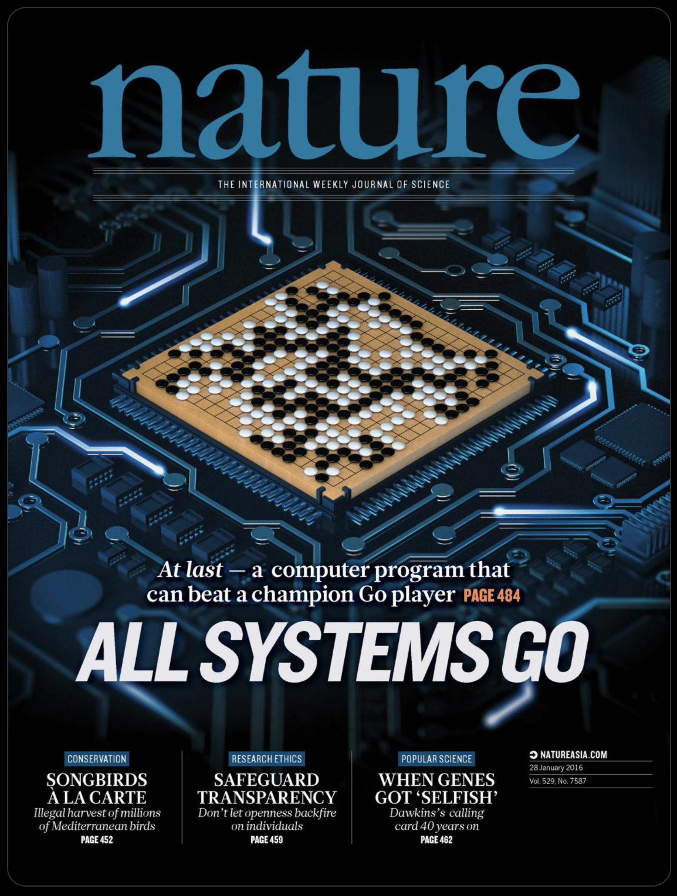

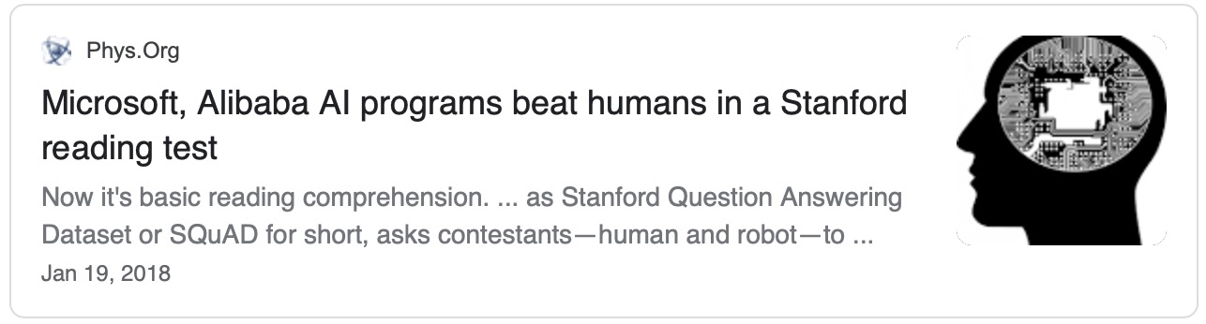



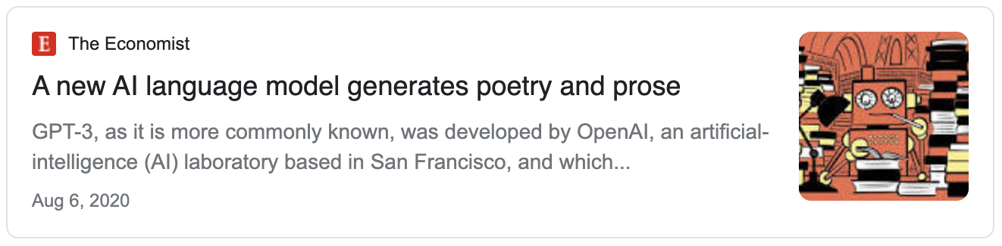
AI is in the News: The Success of Deep Learning

Slide 6
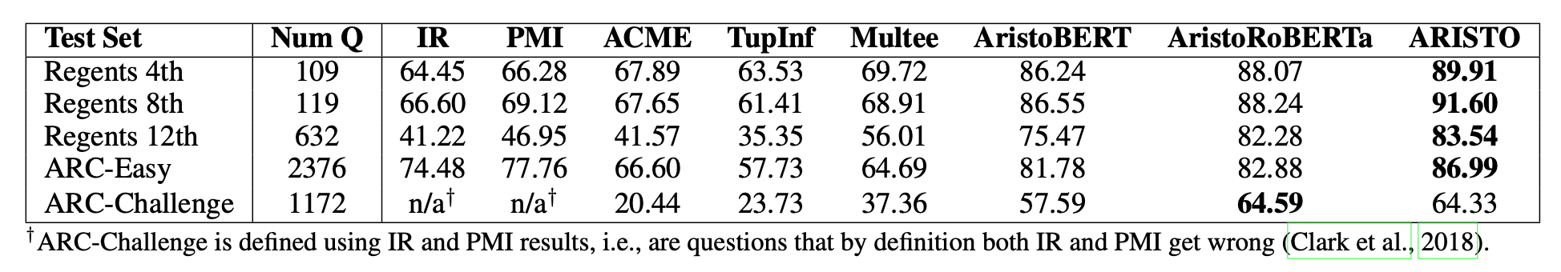
Qualifying our Success
Have we “solved” Question Answering?
Clark et al 2019: On the success of AI2’s ARISTO Project:
  From ‘F’ to ‘A’ on the N.Y. Regents Science Exams: An Overview of the Aristo Project
Very impressive results. But does it do what is says it does?

Slide 7
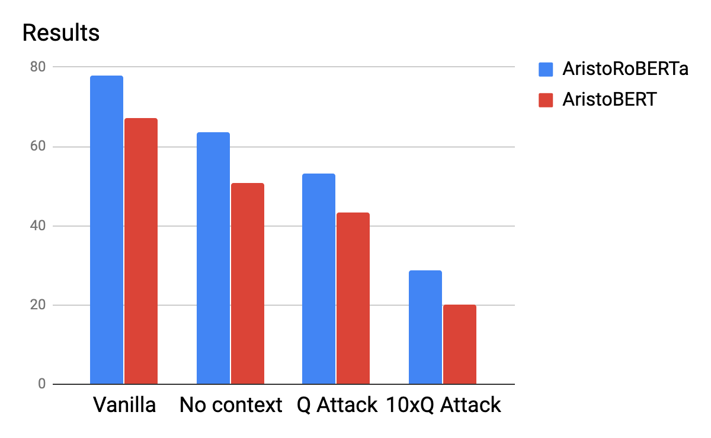
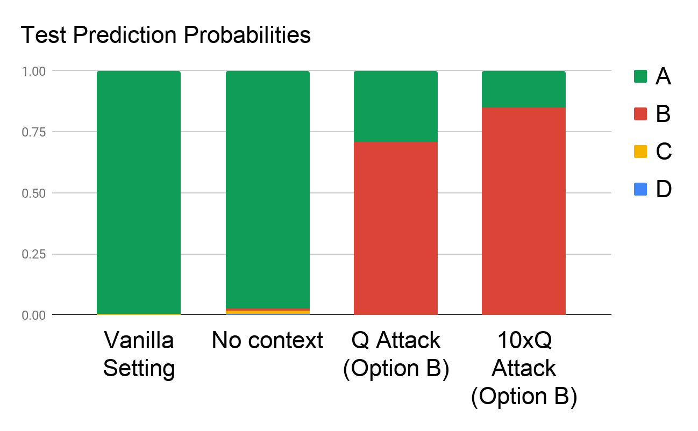
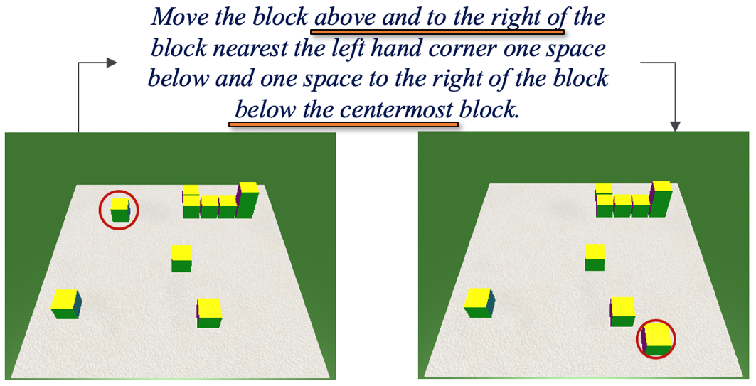
Analyzing Scientific QA [Shah et al. EMNLP Findings 2020]
Question: The rate at which a wave passes through a medium is known as its
Answer Options:
  speed
  amplitude
  acceleration
  wavelength
Supporting Contexts:
  The speed of a wave is the rate at which vibrations propagate through the medium…
  The greater the amplitude of vibrations of the particles of the medium, the greater…
  … hydrophones measure the acceleration of the medium as a seismic wave passes…
  The speed of an electromagnetic wave in a medium depends on its wavelength. As…
Question Question Question Question Question Question Question Question……
Question
Our current systems do not satisfy our “expectations”.
The paper formalizes the notion of “expectations” from a high performing QA model, goes on with more experiments, and suggests alternative ways of training so that the models better satisfy our expectations.
Are we doing Reasoning?
Dan et al. NAACL’21
Notes:
Killing the competition should improve the results – but it reduces it.

Slide 8
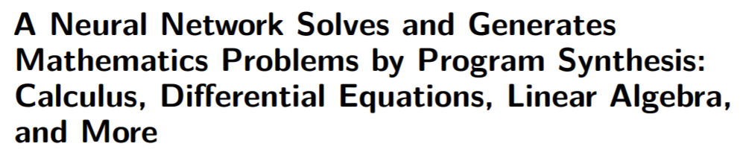
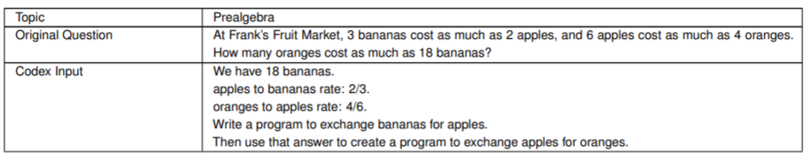
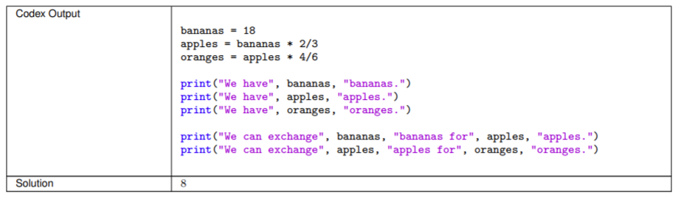
We demonstrate that a neural network pre-trained on text and finetuned on code solves Mathematics problems by program synthesis. We turn questions into programming tasks, automatically generate programs, and then execute them, perfectly solving university-level problems from MIT’s large Mathematics courses…
Drori et al. PNAS 2021
Notes:
We demonstrate that a neural network pre-trained on text and finetuned on code solves Mathematics problems by program synthesis. We turn questions into programming tasks, automatically generate programs, and then execute them, perfectly solving university-level problems from MIT’s large Mathematics courses (Single Variable Calculus 18.01, Multivariable Calculus 18.02, Differential Equations 18.03, Introduction to Probability and Statistics 18.05, Linear Algebra 18.06, and Mathematics for Computer Science 6.042), Columbia University’s COMS3251 Computational Linear Algebra course, as well as questions from a MATH dataset (on Prealgebra, Algebra, Counting and Probability, Number Theory, and Precalculus), the latest benchmark of advanced mathematics problems specifically designed to assess mathematical reasoning. We explore prompt generation methods that enable Transformers to generate question solving programs for these subjects, including solutions with plots. We generate correct answers for a random sample of questions in each topic. We quantify the gap between the original and transformed questions and perform a survey to evaluate the quality and difficulty of generated questions. This is the first work to automatically solve, grade, and generate university-level Mathematics course questions at scale. This represents a milestone for higher education

Slide 9

Is what we are doing sustainable?

Slide 10
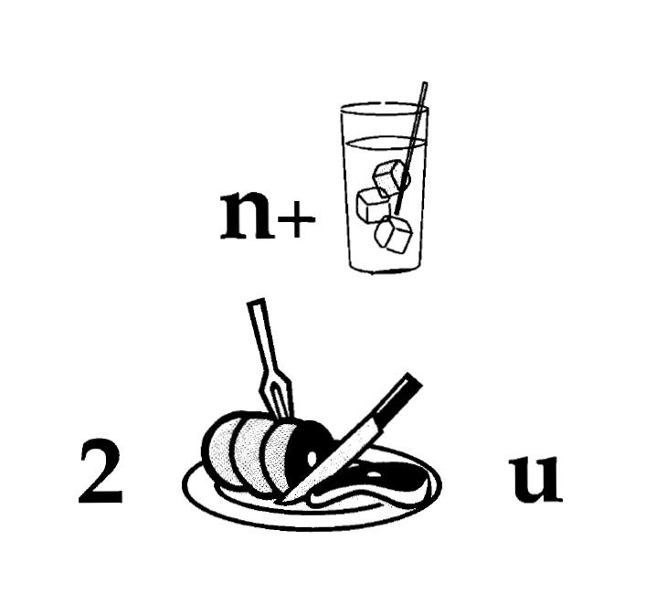
Nice to Meet You
Identify units
Consider multiple
representations & interpretations
  Pictures, text, layout, spelling, phonetics
Put it all together:
  Determine “best” global interpretation
Satisfy expectations
  Slide; puzzle
Computational Problem:
Assigning values to multiple variables, accounting for interdependencies among them
Notes:
As my first example, I’d like you to read this.
People take seconds to read this. But – this is a reasoning process. And, in many respects, I think of natural language understanding this way –
Each component has multiple interpretation on it own, but given the context, and the fact that I put it all on one slide, and you know that it has an interpretation, you quickly find a coherent solution.

Slide 11
Natural Language Understanding
Natural language understanding decisions are global decisions that require
  Making (local) predictions driven by different models trained in different ways, at different times/conditions/scenarios
  The ability to put these predictions together coherently
  Knowledge, that guides the decisions, so they satisfy our expectations
Of course, our programs need a lot more in order to understand and communicate in natural language
  but it exemplifies some important aspects – “discrete reasoning”;
  – “understanding ~~ best interpretation”
And this example brings up another important question:
  How do we train for these kinds of tasks?
Expectation is a knowledge intensive component
Notes:
11
You can think about this as abductive reasoning
Knowledge guides our decisions – and also how we decomposed the problem to components.
Talk about multiple ways of training – decoupling – relate to abstraction
Examples: semantic parsing (do verb + Prep + commas together; lack of jointly annotated data)
Wikification – Relations (but also add geographical coherence; topical coherence; all interrelated signal that are acquired at different times, different contexts, etc.

Slide 12
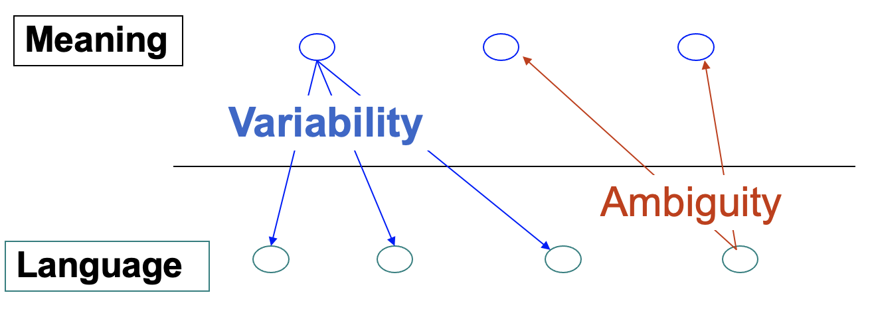



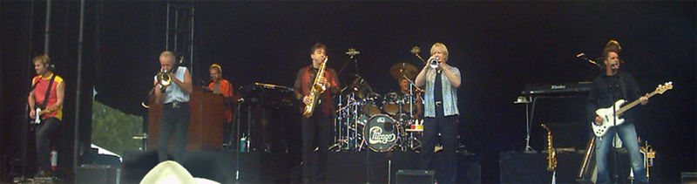
NLU Challenges: Variability and Ambiguity
Determine if Jim Carpenter worked for the government
Jim Carpenter worked for the U.S. Government.
The American government employed Jim Carpenter.
Jim Carpenter was fired by the US Government.
Jim Carpenter worked in many important positions. As a press liaison for the IRS, he made contacts in the white house.
Russian interior minister Yevgeny Topolov met yesterday with his US counterpart, Jim Carpenter.
Former US Secretary of Defense Jim Carpenter spoke today.
It’s a version of Chicago – the standard classic Macintosh menu font, with that distinctive thick diagonal in the ”N”.
Chicago VIII was one of the early 70s-era Chicago albums to catch my ear, along with Chicago III.
In many respects, the progress in ML and NLP over the last decade or two addressed these challenges, more A than V

Slide 13
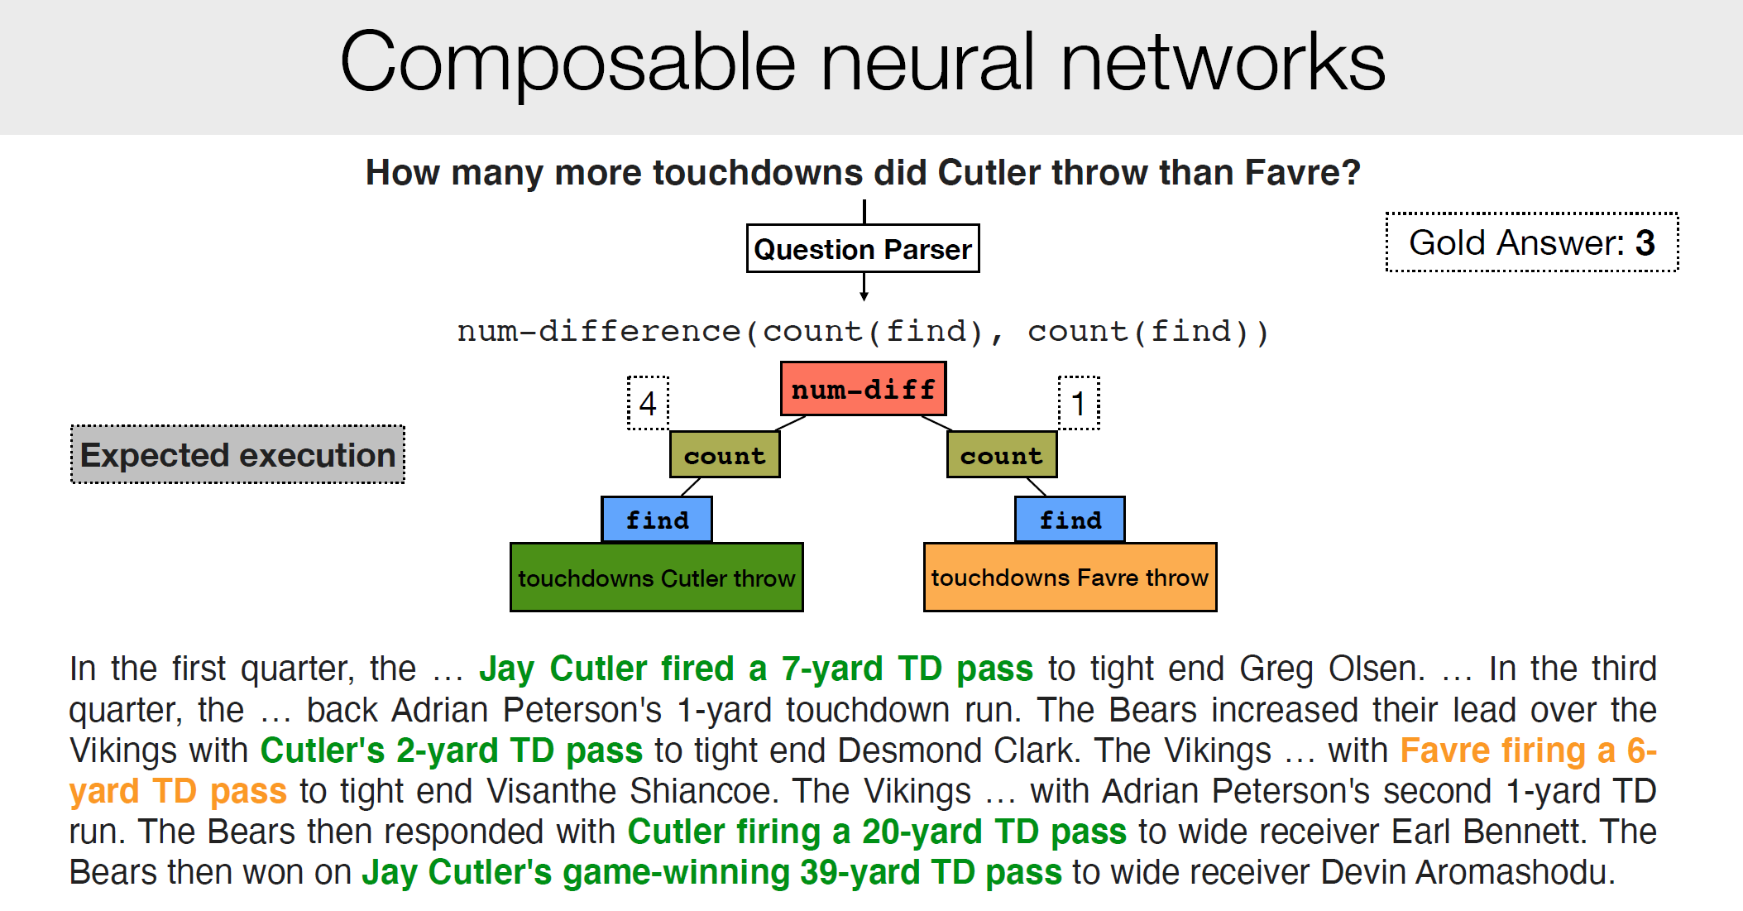
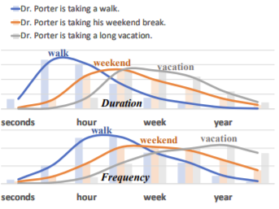
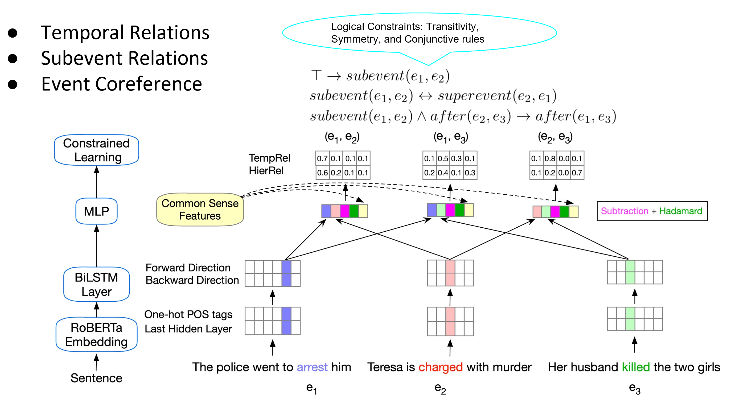
Learning to Reason over Natural Language
Making decisions that depend on natural language understanding requires reasoning abilities
  We need to decompose, compose, and plan
  Symbolic reasoning over learned models
    Reasoning with Declarative knowledge (Constraints)
  Learning with declarative knowledge
Examples:
  Compositionality
  Knowledge
  Putting things together
  Supervision
Understanding Compositional Instructions
Commonsense Reasoning
Training with Logical Constraints
Notes:
The need to do reasoning arises from the realization that a lot of what we face when we communicate in natural language is new. And thus, compositionality is an essential component of NLU. We need to decompose and compose. We cannot expect that all our decisions will be supported by a single function approximation model, nor that we can learn models this way.
I will focus on examples that illustrate challenges.

Slide 14
Principle of Compositionality
The meaning of a complex expression is determined by the meaning of its constituents and the rules used to combine them
“U-Turn is allowed”
“U-Turn is not allowed”
“Swimming is allowed”
“Swimming is not allowed”
*Principle is often credited to Gottlob Frege
Notes:
Thinking seriously about compositionality has essentially disappeared from modern ML – everything is one-shot function approximation, and I’d like to argue that it is essential that we think about it from the Reasoning and the Training perspective

Slide 15


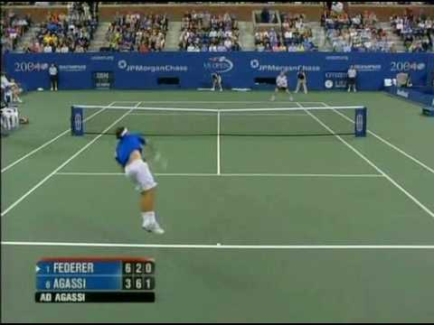
Reasoning in Natural Language
Will we make it to the movie?
  Time now + [time to get to the movie] < start of movie
Will we make it to dinner before the movie?
  Time now + [time to get to dinner] + [duration of dinner] < start of the movie
Will we make it to the movie after the game?
  Start time of the game + [duration of the game] < start of the movie
Will we make it to a movie after the game?
  Start time of the game + [duration of the game] < start of any movie
Reasoning: Is the end time of the game/dinner before the start time of the/any movie?
Identifying compositionality is essential to facilitate training of models
Notes:
So how about when we get to natural language tasks?
Unlike the “standard” extractive QA, where we train models directly to extract a span of text, here we cannot do it. There is a planning/reasoning process here, and it is done on top of multiple components, each of which is learned. And how to learn the “putting together” operator?

Slide 16
Let’s Talk about Dinner
∃ r ∈ [Restaurants] | [Cuisine](r, Mexican)∧ [InCity](PH)
Constraints:
∀ r ∈ [Restaurants] → [Contains](r, m) ∧ [Menus](m)
∀ m ∈ [Menus] → [Contains](d,m) ∧ [Dishes](d)
∃ o ∈ [Dishes] → [Tastes](o, ￢spicy)
∃ r ∈ Restaurants | Cuisine(r, Mexican)∧ InCity(PH)
Constraints:
∀ r ∈ Restaurants → Contains(r, m) ∧ Menus(m)
∀ m ∈ Menus → Contains(d,m) ∧ Dishes(d)
∃ o ∈ Dishes → Tastes(o, ￢spicy)
→ Let’s talk about dinner.
  A: Where do you want to go?
→ I really enjoy Mexican food, but not when it is spicy.
  A: How about a Mexican restaurant with plenty of non-spicy options?
→ Yep, is there one in Philadelphia?
  A: Here are a couple of good options
  …….
Don’t worry, you can still use neural embeddings for predicates and functions that are learned concepts
But this abstraction shows that we need to put some learned components together, along with incorporating declarative constraints…
[Example due to Tania Berdax-Weiss]

Slide 17
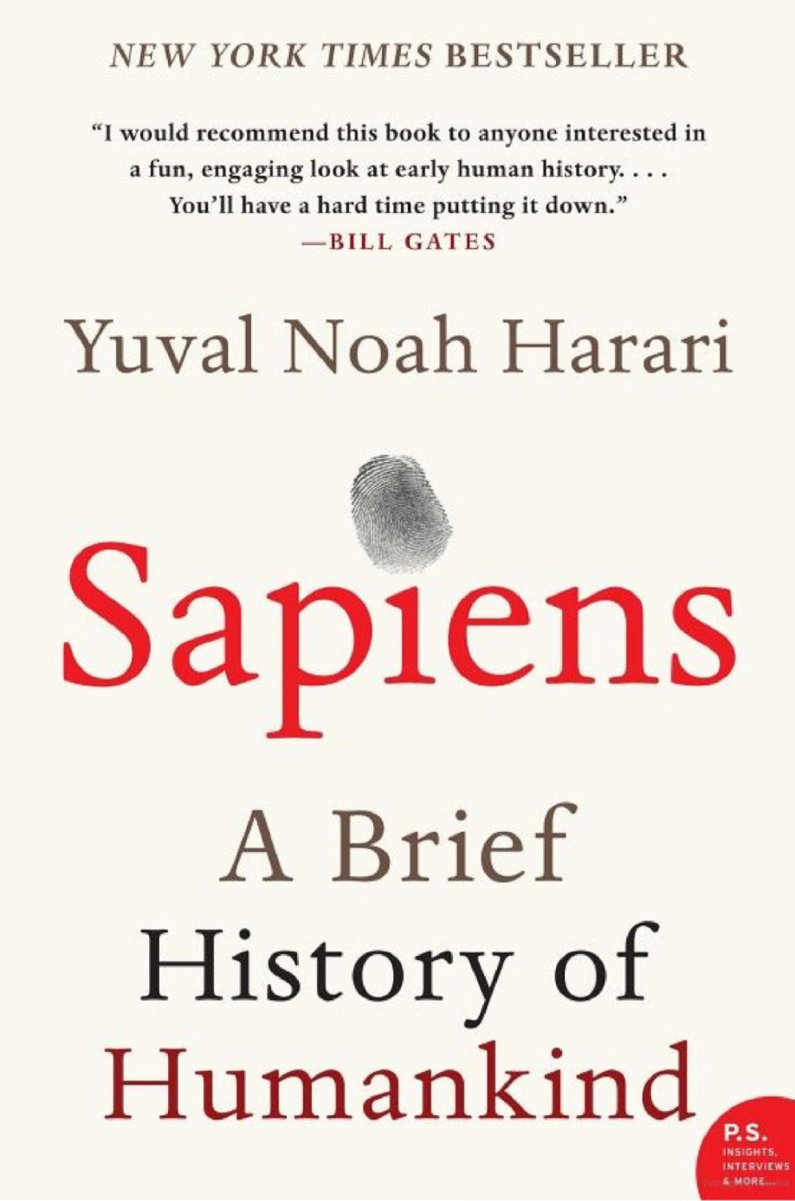
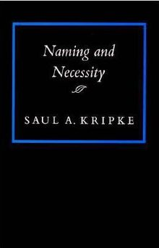

Symbolic Reasoning?
Some people think that symbols are an evil invention of old AI people.
It’s not.
Language is a symbolic system
Even though we communicate via speech, gestures, writing, which are continuous, symbols are the invariants of this communication.
  Harari: Language – the ability to assign symbols to “things” and “reason” about them is key to human cognitive revolution
  Kripke: “Naming” things is key to communication and to cognition
  The Enigma of Reason: “Reasoning is about giving reasons”
Rodgers finished 23-of-36 for 296 yards and two touchdowns. His numbers could've been even better had his receivers not dropped a couple of his passes. One dropped ball was a potential score to Allen Lazard. Despite the drop, Lazard made up for it by leading the Packers in receiving. With Davante Adams tied up with Jalen Ramsey, Lazard was able to snatch four balls for 96 yards and a touchdown. Adams still had a great game despite Ramsey's coverage, hauling in nine of his 10 targets for 66 yards and a touchdown. The score frustrated Ramsey because another defensive back was supposed to pick up Adams, who was in motion.
Mayor Rahm Emanuel now has raised more than $10 million toward his bid for a third term – more than five times the total raised by his 10 challengers combined, campaign finance records show.
Notes:
Table is a collection of things in world.

Slide 18
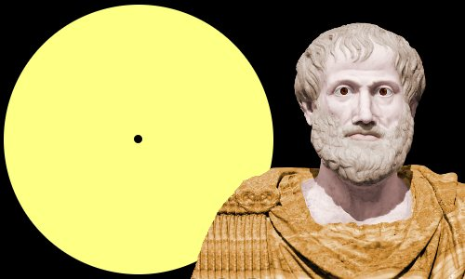

Key Challenges to NLU Researchers
Aristotle founded syllogism, a method by which known information can be used to prove a point.
What are the variables to reason about? Who asks the questions?
  In all of NLP, we have well defined tasks; we collect data & train models
Even in “will we make it to dinner….” the components were given
  And we need to figure out how to estimate them and put it together
  ~~ When did Aristotle die?
  ~~ When was the laptop invented?
  What happened first?
How to do it?
  E.g., how to determine “strategies” on the fly?
How to train for it?
  How can we supervise for these “sparse” events?
So, did Aristotle have a laptop?
In [Geva et al. TACL’21] we develop StrategyQA, a dataset that addresses the question of dynamic, implicit decomposition
[Example due to Les Valiant]

Slide 19


Reasoning
Aristotle: All beliefs come from Syllogism or induction
  Syllogism: reasoning
    We may need to extend Aristotle’s notion of reasoning
There is a lot more to cognitive behavior than induction.
  The notion of generalization is not a mystery any more
    We have mathematical theories for it
    Measure performance relative to the same distribution; computational feasibility & error control;
Reasoning, too, is a major component of cognition.
  It’s essential in order to support larger leaps
  A unified formulation of learning & reasoning will need to
    Account for acquiring and incorporating knowledge
    Figure out ways to put “components” together
    Deal with inconsistencies (by moving to “small worlds”?)
Not a new set of questions [Khardon & Roth, Learning to Reason, JACM’96]
Showed, in a formal way, the advantages of joint learning & reasoning
But, we also need to decouple learning from reasoning, de-compose, and compose
And incorporate knowledge

Slide 20
Knowledge is Key

Slide 21
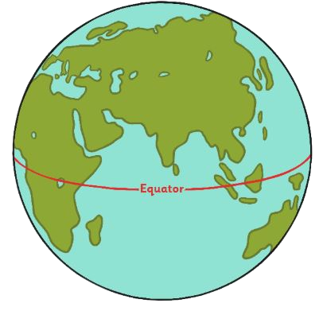
Knowledge is Key
In Yokne’am, at what month of the year is the longest day?
In New York State, at what month of the year is the longest day?
In Boston, at what month of the year is the longest day?
In Malborne, at what month of the year is the longest day?
We don’t have a generalization theory here, since the examples are not “similar”
  But they are
The relevant knowledge is out there.
  We know many things about NY, Boston, etc.; how do we quickly figure out the relevant piece of knowledge?
  We cannot learn directly from these example –
You probably don’t know the answer

Slide 22
Knowledge is Key
Not only to answer questions
  But also, to know how to decompose
  And consequently, what and how to learn
So, did Aristotle have a laptop?
Did Bill Nye vote for FDR?
Did Warren Buffett vote for FDR?
It’s about Time
Not Only about Time
Planning, developing a strategy, is the Reasoning process, and it is knowledge intensive
Did Itzhak Rabin vote for FDR?
Not about Time
In [Geva et al. TACL’21] we develop StrategyQA, a dataset that addresses the question of dynamic, implicit decomposition
Notes:
FDR ran for president in 32, 36, 40, 44.
Buffet was born in 1930 (wasn’t 18)
Bill Nye was born in 1955 (too young)
Rabin was born in 1922, but was never a US citizen

Slide 23

Understanding Indirect Answers [with Annie Louis & Filip Radlinski; EMNLP’20]
How to interpret an utterance in a given situational context?
  A: “Have you eaten”
  B: “I am really hungry”
  B: “I had a really small lunch”
“Probably no”
B didn’t answer, but implied that he/she would like to eat
“Probably yes”
B didn’t answer, but implied that he/she would like to eat
Humans have no difficulty resolving such cases and carrying on the conversation
[Elazar et al. EMNLP’21]: training for commonsense knowledge directly does not generalize
[Done in the context of Winograd Schemas]
The exact answer does not matter if the intention is to invite to dinner
Do you want to have dinner?
I have a deadline tomorrow
I have friends coming over
Notes:
I am giving you food related scenarios, but you can imagine other conversational scenarios with similar properties.
That is, generalization is difficult: if you ask: do you want to have dinner and the answer is “I have a deadline tomorrow” or “I have friends coming over”, you are saying ‘no’, but do we need to train for each situation separately?

Slide 24
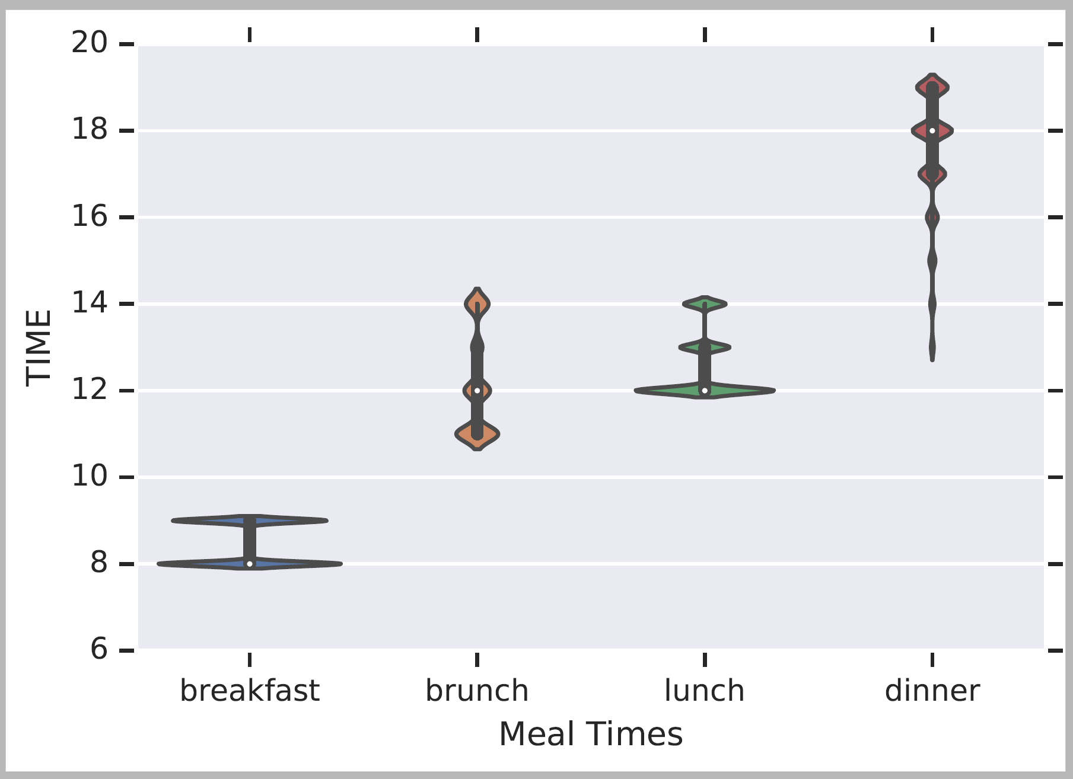
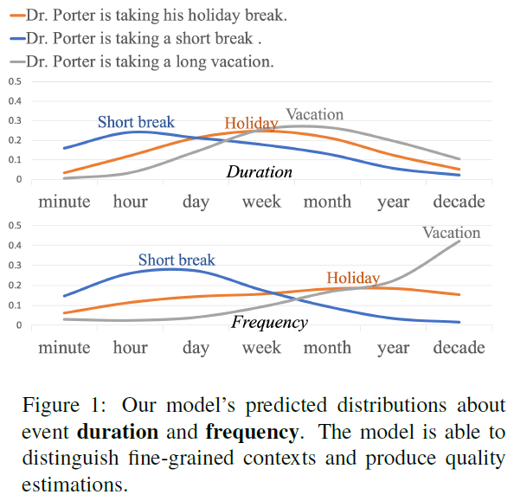
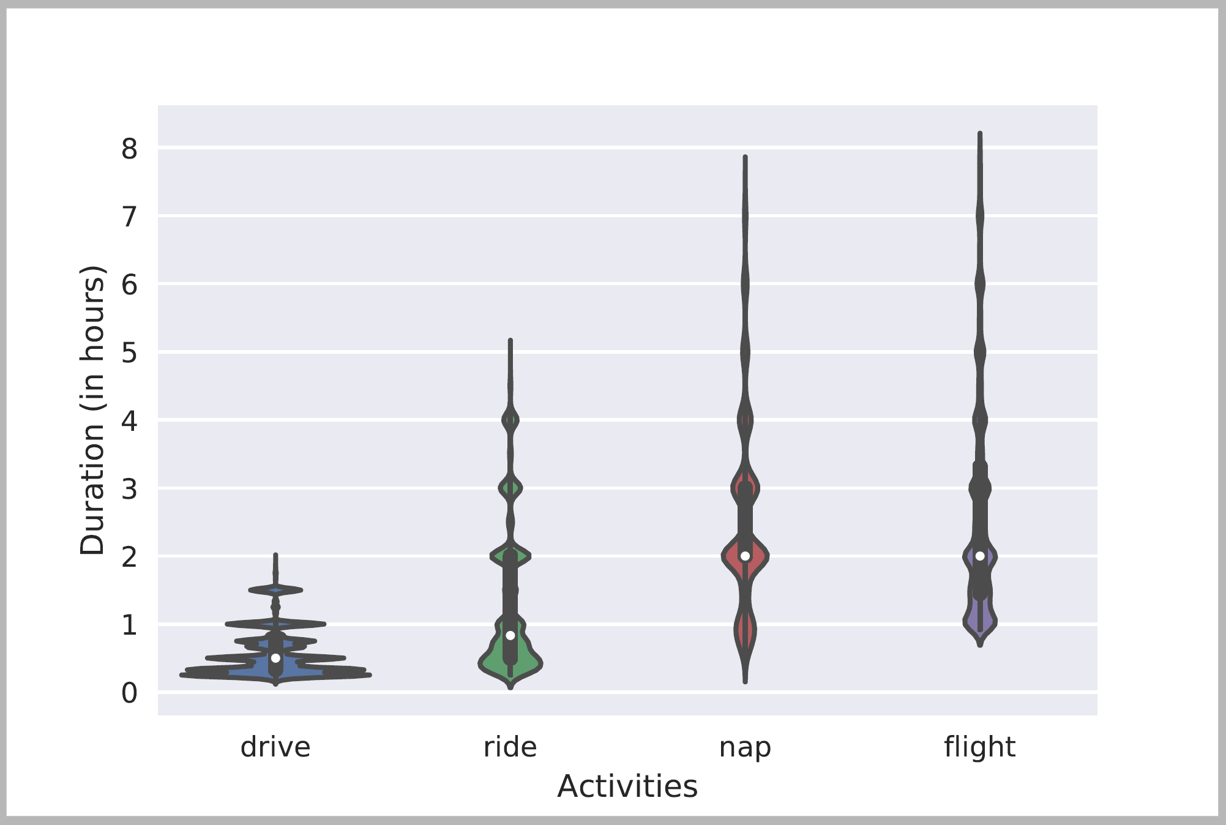
Knowledge About Time
Acquisition + Representation of Quantities, Duration, typical time, frequency.
How to use it – how to put things together?
Will we make it to dinner before the movie?
Typical Time
Typical Temporal Relations
[Zhou et al. ACL’20]
Skip Details
Ning et al. NAACL’18
Duration
[Elazar et al. ACL’19], [Zhang EMNLP-F’20]

Slide 25
Temporal Commonsense [Zhou et al. 18’, 19’,20’]
“will” or “will not”?
Days
Minutes
Dr. Porter is taking a vacation and will not be able to see you soon.
Dr. Porter is taking a walk and will be able to see you soon.
Notes:
When we think about temporal commonsense we think about even more basic things –

Slide 26
The Temporal Commonsense Challenge
My friend Bill went to Duke University in North Carolina. With a degree in CS, he joined Google MTV as a software engineer. As a huge basketball fan, he has attended all 3 NBA finals since then. He also plans to visit Duke regularly as an alumnus to attend their home games.

Slide 27
The Temporal Commonsense Challenge
My friend Bill went to Duke University in North Carolina. With a degree in CS, he joined Google MTV as a software engineer. As a huge basketball fan, he has attended all 3 NBA finals since then. He also plans to visit Duke regularly as an alumnus to attend their home games.
College: about 4 years, starts at the age of 18
Duration
Typical Time
Bill in North Carolina: about 4 years
Duration
Stationarity
Duke in North Carolina: always
Stationarity

Slide 28
The Temporal Commonsense Challenge
My friend Bill went to Duke University in North Carolina. With a degree in CS, he joined Google MTV as a software engineer. As a huge basketball fan, he has attended all 3 NBA finals since then. He also plans to visit Duke regularly as an alumnus to attend their home games.
College: about 4 years, starts at the age of 18
Duration
Typical Time
Bill in North Carolina: about 4 years
Duration
Stationarity
Duke in North Carolina: always (expected)
Stationarity
Join Google: after college graduation
Ordering

Slide 29
The Temporal Commonsense Challenge
My friend Bill went to Duke University in North Carolina. With a degree in CS, he joined Google MTV as a software engineer. As a huge basketball fan, he has attended all 3 NBA finals since then. He also plans to visit Duke regularly as an alumnus to attend their home games.
College: about 4 years, start at the age of 18
Duration
Typical Time
Bill in North Carolina: about 4 years
Duration
Stationarity
Duke in North Carolina: always (expected)
Stationarity
Join Google: after college graduation
Ordering
NBA Finals: every year
Frequency

Slide 30
The Temporal Commonsense Challenge
My friend Bill went to Duke University in North Carolina. With a degree in CS, he joined Google MTV as a software engineer. As a huge basketball fan, he has attended all 3 NBA finals since then. He also plans to visit Duke regularly as an alumnus to attend their home games.
College: about 4 years, start at the age of 18
Duration
Typical Time
Bill in North Carolina: about 4 years
Duration
Stationarity
Duke in North Carolina: always (expected)
Stationarity
Join Google: after college graduation
Ordering
NBA Finals: every year
Frequency
Visit Alma Mater: a few times a year, 1-2 days each time
Frequency
Duration
Attend basketball games: a few hours
Duration

Slide 31
Temporal Common Sense
Two efforts:
  A dataset MC-TACO [Zhou et al. EMNLP’19]
  Acquisition + Representation [Zhou et al. ACL’20, ACL’21]: Duration, typical time, frequency.
Will we make it to dinner before the movie?
Typical Time
Typical Temporal Relations
Ning et al. NAACL’18
[Zhou et al. ACL’20]
Duration
[Elazar et al. ACL’19]

Slide 32
Defining the Temporal Commonsense Challenge
MC-TACO [Zhou et al. EMNLP 2019]
  Multiple Choice TemporAl COmmon-sense
  1,893 questions; 13,225 question-answer pairs
  Querying at least one of the five dimensions:
    Duration
    Frequency
    Typical Occurring Time
    Stationarity
    Ordering
  Exact Match: the percentage of questions of which all candidates are predicted correctly (here: 0.0)
  F1: Gives partial credit (credits “accidental” correct perditions (here: 66.7%)
Gold
Prediction
He went to Duke University.
How long did it take him to graduate?
4 years
✔
10 days
✔
3.5 years
✗
16 hours
✔
Notes:
The type of systems we have today, LM based, get a lot of things right accidentally, so to really know how well we are doing we need to evaluate it carefully. In this case, we can only allow exact match as an answer.

Slide 33
Results: We are Far (from where we want to be)
It’s important to be careful when evaluating LM-based results.
We have multiple plausible answers for each question. You only understand the phenomenon if you tag all the options correctly.
13% difference
40% difference
ESIM: Enhanced LSTM for Natural Language Inference (Chen et al., 2016)
GloVe: Global Vectors for Word Representation (Pennington et al., 2014)
ELMo: Deep contextualized word representations (Peters et al., 2018)
BERT: BERT: Pre-training of Deep Bidirectional Transformers for Language Understanding (Devlin et al., 2019)
RoBERTa: A Robustly Optimized BERT Pretraining Approach (Liu et al., 2019)

Slide 34
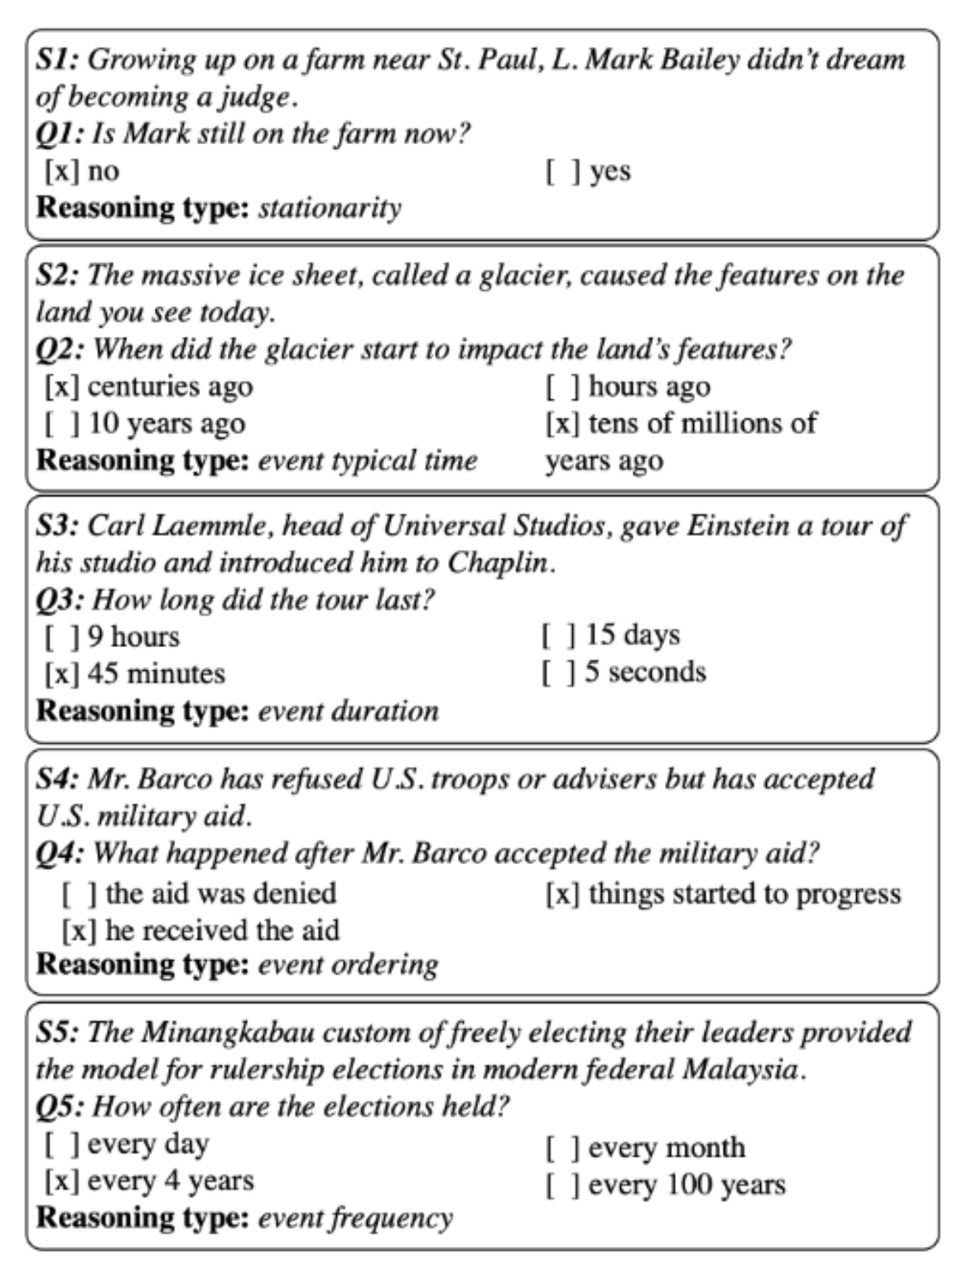
MC-TACO🌮: A Temporal Commonsense Dataset [Zhou et al. EMNLP’19]
The results of a RoBERTa-based models are very low. Not surprising given the need to have commonsense to address these challenges.
Perhaps more importantly, it illustrates the need to decompose, and know how to incorporate knowledge.
Stationarity:
  Paul Simon is in NYC. Let’s go see him.
  The Empire State Building is in NYC.
Stationarity
Typical Time
Duration
Will we make it to dinner before the movie?
Temporal Ordering
Event Frequency
And, we need to account for implicit events [Zhou et al., NAACL’21]
Notes:
The time now, the movie time, but also – how long is our typical dinner?

Slide 35
TemporAl COmmonsense LM
TacoLM – A general LM that is aware of time and temporal common sense
  Minimal Supervision
Used to develop contextual estimation for Duration, Typical Time, and Frequency
  Time is represented as a distribution over time units
confidence
Notes:
In this work, we propose TacoLM, a general language model that is aware of time and temporal common sense, and at the same time built without any annotations. We show that our model is better at solving time-related tasks. For example, in this actual prediction of duration from our model,

Slide 36
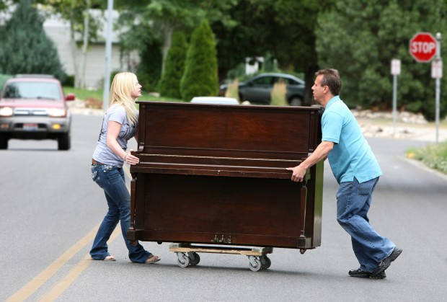

Modeling Temporal Common Sense [Zhou et al. ACL’20]
Context
  How long does “move” take?
    Highly contextual: Move a chair? Move a piano?
    Needs more than direct event arguments
  Achieved using an unsupervised collection of auxiliary signals
  Using patterns from free text
    Extract complete events – predicate and arguments
Joint Modeling
  People do not typically write how long it took them to brush their teeth
    But they’ll say: I brushed my teeth in the morning; I brushed it in the shower.
  Natural constraints:
    duration <= 1/frequency

Slide 37
TacoLM – the Big Picture
Goal: build a general time-aware LM with minimal supervision
  Using high-precision patterns to acquire temporal information
    Unsupervised automatic extraction
  Overcomes reporting biases with a large amount of natural text
  Multiple temporal dimensions
    Duration ~ 1 / Frequency
    Further generalization to combat reporting biases
Step 1: Information Extraction
Step 2: Joint Masked Language Model
“I brush my teeth every morning”
Duration of “brushing teeth” < morning
Output: TacoLM- a time-aware general BERT
Skip Details
Notes:
♦With the goal of building a general time-aware LM with minimal supervision, ♦we start with a focused, unsupervised information extraction step, ♦in which we use a set of high-precision patterns to acquire temporal information. ♦This helps the model to overcome reporting biases as we can automatically extract over a large amount of natural text.
♦We use the temporal information acquired in step 1 in the second step called joint language model pretraining. ♦That is, we pre-train our language model jointly over multiple temporal dimensions, ♦so that it is able to utilize the natural relations such as duration being inversely related to frequency. ♦This is beneficial. For example, we may not see direct mentions of the duration of brushing teeth, however, we know that it is shorter than a morning as the frequency is likely to be every morning. ♦This provides further generalization to combat reporting biases.
♦Finally, we obtain our final model TacoLM, a BERT transformer that is more aware of time.

Slide 38
Information Extraction
Use high-precision patterns based on SRL
  Duration
  Frequency
  Typical Time
  Duration Upper bound
  Hierarchy
Labels
  Units (seconds, … centuries)
  Temporal keywords (Monday, January, …)
Output
  4.3M instances of
  (event, dimension, value) tuple
I played basketball for 2 hours.
Original sentence
SRL Parse
Arg-0
Arg-1
I played basketball for 2 hours.
Verb
Arg-Tmp
Pattern Matching
for 2 hours: matches Duration pattern
Event
Value
I played basketball, Duration, Hours
Formatted Output Instance
Dimension
Notes:
Time units: for duration and frequency
Temporal keyworkd: for typicaly time

Slide 39
Sequence Formatting
Consider [Event] [Dimension] [Value] tuples in each instance
[E1, E2, … M, ET … En, SEP, M, Dim, Val]
  M is a special marker, same across all dimension/value
  Dim is a marker for each dimension, Val is a marker for the value of the dimension
An example:
I played basketball for 2 hours.
Information Extraction
I played basketball, Duration, Hours
Sequence Formatting
I [M] played basketball [SEP] [M] [DUR] [HRS]
Notes:
♦Specifically, for each event, dimension and value tuple, ♦we format it into a sequence of tokens, in which we use special markers to mark the location of the verb, in order to represent the event, and place special tokens that represent the temporal dimension and the value in the same sequence.
♦♦Consider the same example I played basketball for 2 hours. ♦♦We extracted a training instance from the information extraction step, ♦♦and we now further format it into a single sequence containing all the information.

Slide 40
Joint Model with Masked LM
I [M] played basketball [SEP] [M] [DUR] [HRS]
Baseline Model: Pre-trained BERT-base
Main objective: mask some tokens and recover them
How we mask:
  With some probability, mask temporal value while keeping others
  Otherwise, mask a certain portion of E1...En while keeping temporal value unchanged
  Max (P(Event|Dim,Val) + P(Val|Event,Dim)); Preserving original LM capability
Benefits:
  Jointly learns one transformer for all dimensions
  Labels play a role in the transformer
  One event may contain more than one (Dim + Val), so the model learns dimension relationships
I [M] played basketball [SEP] [M] [DUR] [MASK]
I [M] [MASK] [MASK] [SEP] [M] [DUR] [HRS]
Notes:
♦We build our model on top of the pre-trained BERT-base model and ♦employ a simple objective of masking some tokens in our formatted sequence and then recover them. ♦♦♦With the higher probability, we mask the temporal value while keeping the others. ♦♦Otherwise, We will instead mask some event tokens and keep the temporal value token unchanged. ♦In this case, we can maximize the conditional probability of the events and the value at the same time to preserve the original capability of a language model.
♦The benefits of formatting sequences and use the masked LM objective are that we can jointly learn one transformer towards all dimensions, including the original language model capability, ♦and labels play a role in the transformer architecture. ♦As one event may contain more than one (Dim + Val) pair, the model is able to learn inter-dimension relationships.

Slide 41
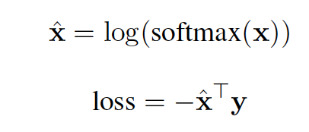
Joint Model with Masked LM
I [M] played basketball [SEP] [M] [DUR] [HRS]
1: Soft cross entropy for recovering Val
  If gold label is “hours”, the label vector y for “minutes, hours, days” will be [0.16, 0.47, 0.25]
2: Label weight adjustment
  Instances with “seconds” have higher loss than those with “years”
3: Full event masking
  Instead of 15% used by BERT, we use 60% when masking E1, … En to reduce biases
I [M] had a cup of [MASK] [SEP] [M] [TYP] [Evening]
-> MASK = coffee, because “cup of”
I [M] had [MASK] [MASK] of [MASK] [SEP] [M] [TYP] [Evening]
Notes:
♦We also use additional techniques including a soft cross entropy loss for temporal value recovery. ♦♦For example, if the gold label is hours, the neighboring values minutes and days will have a non-zero target value. ♦We use label weight adjustments to address the label imbalance in the training data.
♦We also use an additional technique called full event masking to further reduce biases, where instead of the 15% used by BERT, we use 60% when masking the event tokens.
♦This is helpful because a model may attend too much on strong priors, for example, ♦BERT will always predict “coffee” to follow “a cup of”, no matter what the temporal argument is. ♦However, if we mask the phrase “a cup of”, the prediction of the drink will be more conditioned to the temporal value, so that we may see some drink other than coffee to be the most popular choice in evenings.

Slide 42
Putting Things Together

Slide 43
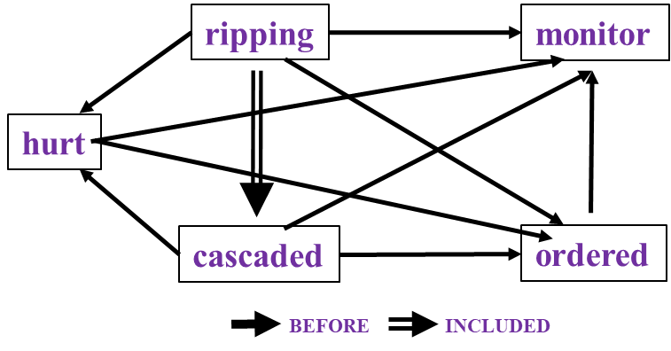
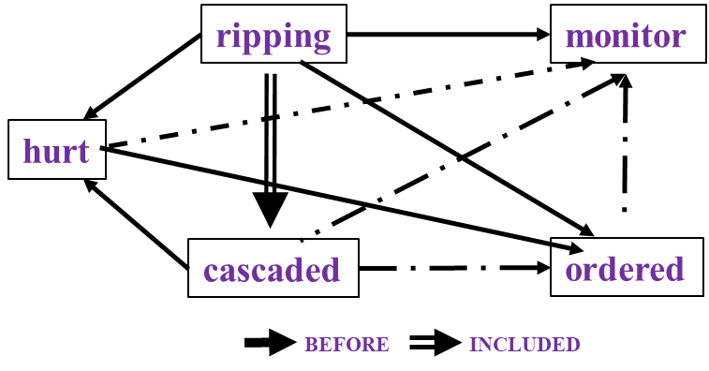

Reasoning about Time and Events
[Ning et al. *SEM’2018; ACL’18, EMNLP’18, EMNLP’19; Wang et al. EMNLP’20]
In Los Angeles that lesson was brought home today when tons of earth cascaded down a hillside, ripping two houses from their foundations. No one was hurt, but firefighters ordered the evacuation of nearby homes and said they'll monitor the shifting ground until March 23rd.
Very difficult task— hinders exhaustive annotation (O(N²) edges)
But, it’s rather easy to get partial annotation (and partial predictions)
And, we have strong expectations from the output
  Transitivity
  Some events tend to precede others, or follow others
Reasoning: How to exploit these [declarative & statistical] “expectations”?
How/why does it impact generalization & supervision?
cascaded
ordered
Time
ripping
Must be before

Slide 44
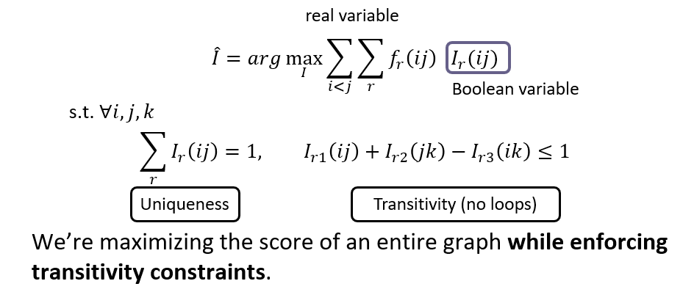
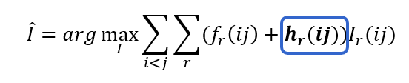
Integer Linear Programming Inference for NLP
Variables are outputs of learned models
Statistical “soft” constrains regularize the objective
Hard constrains
Maximizing the score of the entire graph while enforcing declarative (e.g., transitivity) and statistical constraints.
[Roth & Yih 2004, many others]
Involves reasoning with external knowledge on top of neural models that constitute components (here: temporal relations)
  Declarative knowledge: Transitivity
  Statistical knowledge: Commonsense knowledge
Notes:
This is a final summary for our progress on this task. CAEVO is the previous SOTA, structured learning 2%, common sense 4%, new dataset 11%, LSTM with standard word embeddings 3%, LSTM with BERT embeddings 4% (BERT is the most recent word embedding), and Siamese another 3%.

Slide 45
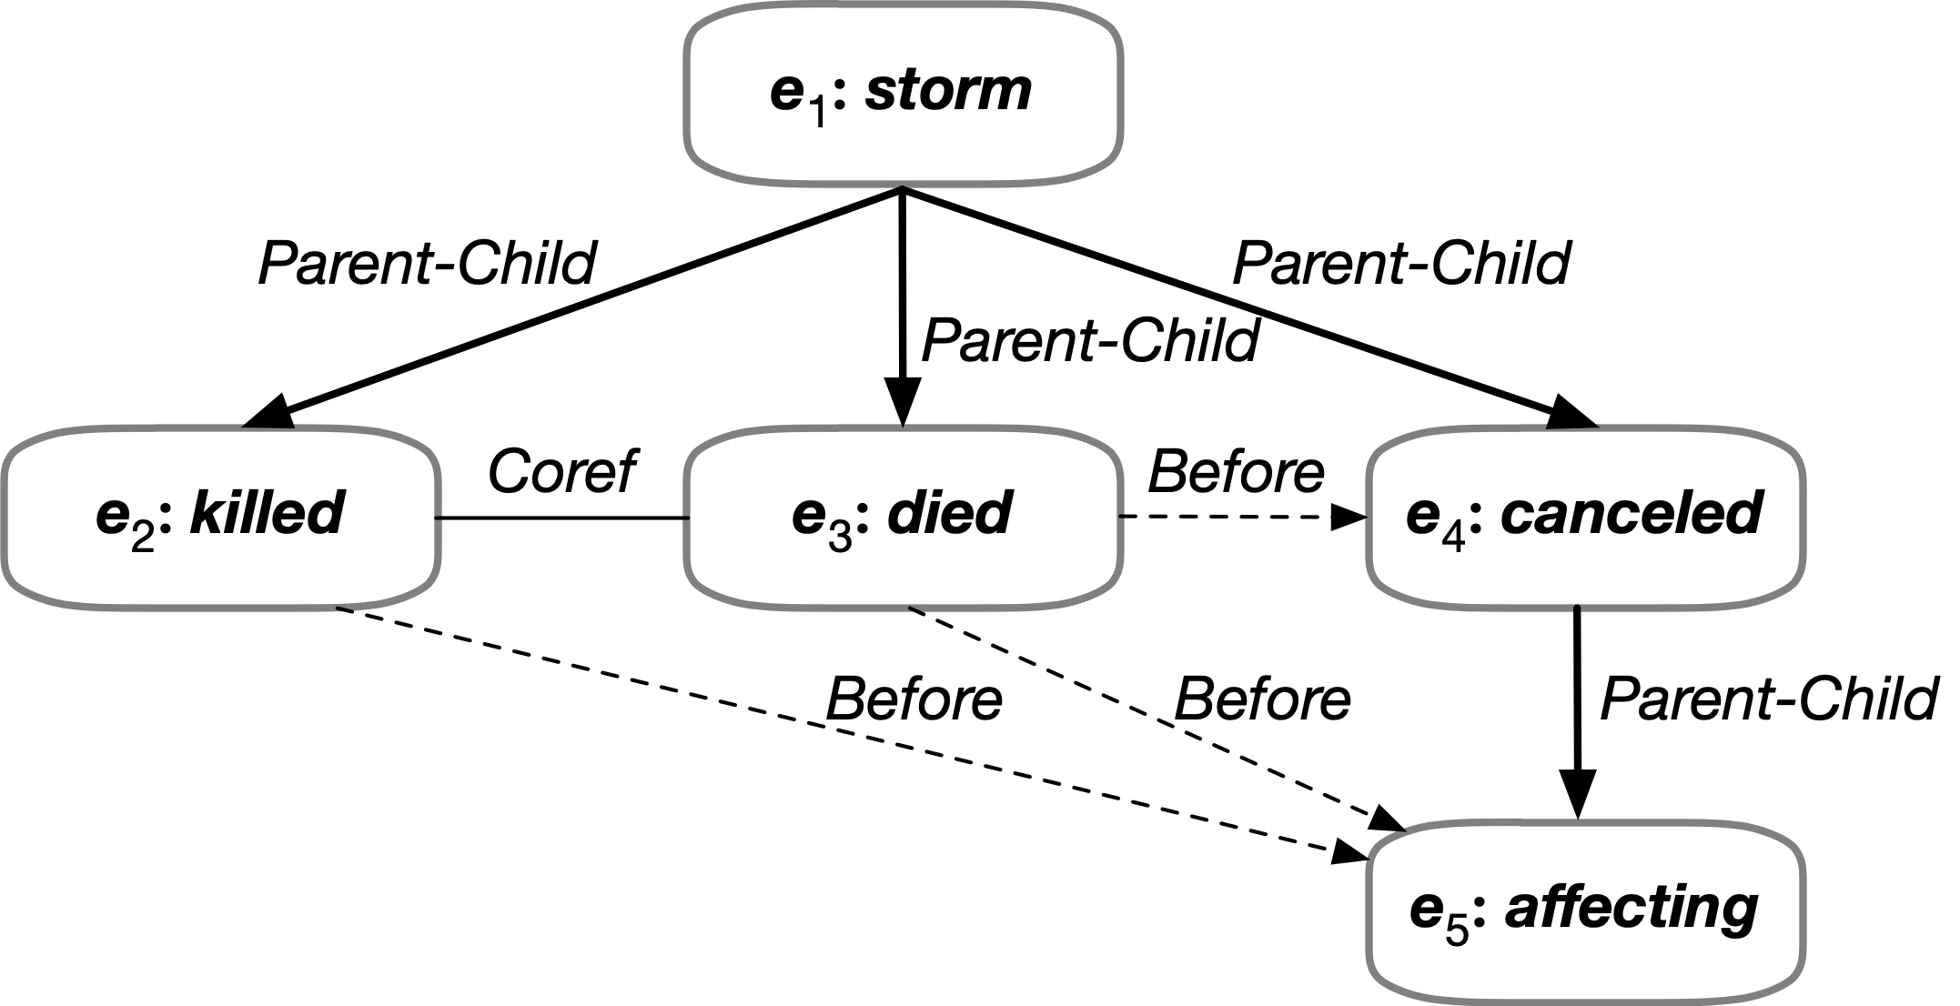

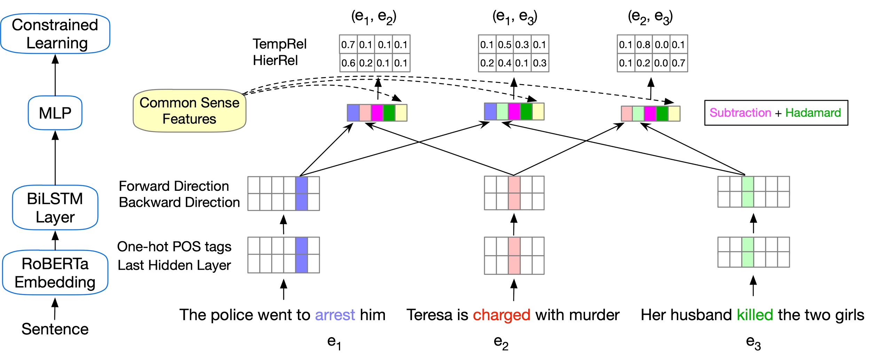
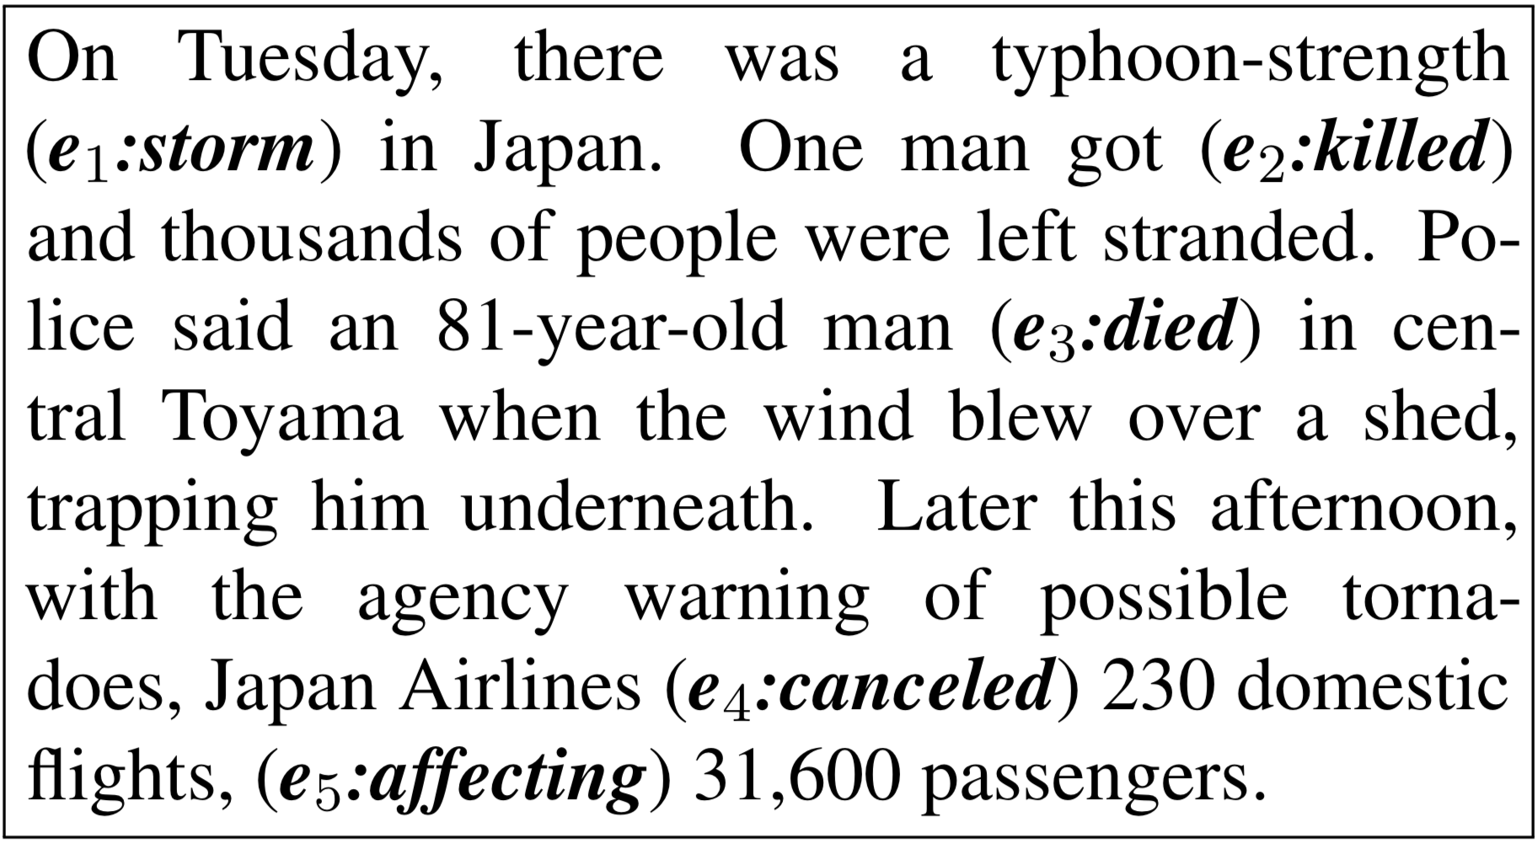
Reasoning about Event Relations [Wang et al. EMNLP’20]
Enforcing logical constraints: Temporal, Symmetry, and Conjunctive by converting declarative constraints into differentiable learning objectives
There are other ways to reason over learned components; quite often these are done via constrained optimization with learned models as variables.
[Zhou et. al NAACL’21]
Temporal Relations
Subevent Relations
Event Coreference
Notes:
This addresses the algorithmic aspect – how can we exploit structure; but is problem specific.
Perhaps even more importantly is the role structure plays in facilitating our learning and reasoning.

Slide 46
Supervision is Key

Slide 47
De-compositions for Reasoning about Text [Gupta et al. ‘18’, ’19, ’20, ’21]
In the first quarter, the Bears Cutler fired a 7-yard TD pass to tight end Greg Olsen. … In the third quarter, the … back Adrian Peterson's 1-yard touchdown run. The Bears increased their lead over the Vikings with Cutler's 2-yard TD pass to tight end Desmond Clark. The gap was reduced when Favre fired a 6-yard TD pass to tight end Visanthe Shiancoe. The Vikings … with Adrian Peterson's second 1-yard TD run. The Bears then responded with Cutler firing a 20-yard TD pass to wide receiver Earl Bennett. The Bears then won on Jay Cutler's game-winning 39-yard TD pass to wide receiver Devin Aromashodu.
Who scored the longest touchdown pass of the game?
Text Comprehension challenges:
  Understand the text
    Identify and contextualize events, entities, quantities (and their scope), relations, etc.
  Understand questions about the text
    Often, requires decomposing the question in a way that depends on the text
  Reason about the text
    Combine and manipulate the identified information to accomplish information needs (e.g., answering questions)
How can we supervise to support this level of understanding?
  Too many (ill-defined) latent decisions
    Annotating text for all is not scalable
  End-task supervision is the only realistic approach
  [Clarke et. al.’10]: Response Driven Semantic Parsing
    But then we insisted on constraining latent layer
  This level of supervision is too loose – how can we learn all the latent decisions from end-task supervision?
She reports worsened seizure frequency, seizures now occurring up to 10/week, in clusters about 2-3 day/week. Previously reported seizures occurring about 2-3 times per month, often around the time of menses,…
What is her seizure frequency?
Mayor Rahm Emanuel has raised more than $10 million toward his bid for a third term – more than five times the total raised by his 10 challengers combined, campaign finance records show.
How much did his challengers raise?
The COVID-19 pandemic in the United States is part of the worldwide pandemic of coronavirus disease 2019 (COVID-19). As of October 2020, there were more than 9,000,000 cases and 230,000 COVID-19-related deaths in the U.S., representing 20% of the world's known COVID-19 deaths, and the most deaths of any country.
Notes:
We are interested in developing a question answering system that given as input a question and a relevant paragraph of context, produces the correct answer
For example, given the question “Who scored the longest touchdown pass of the game?” and a summary of an American Football game, the model should be able to produce the correct answer

Slide 48
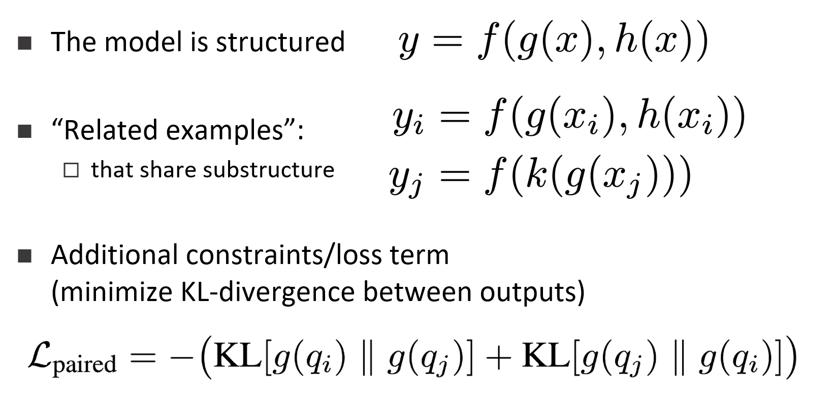
Supervising for Reasoning about Text
Answering complex questions about events requires learning compositional, structured models, that depend on latent decisions
End-task supervision only provides a weak indirect signal to latent decisions
  When do we learn “touchdown”?
  In fact, also: when do we learn “max”?
Directly teaching the intermediate layers does not scale
Indirect supervision: Dream up other examples that make use of the same “components” provides a way to learn what the variables are. [Gupta et al. EMNLP’21]
Who scored the longest touchdown pass of the game?
Who scored the shortest touchdown pass of the game?
In the first quarter, the Bears Cutler fired a 7-yard TD pass to tight end Greg Olsen. … In the third quarter, the … back Adrian Peterson's 1-yard touchdown run. The Bears increased their lead over the Vikings with Cutler's 2-yard TD pass to tight end Desmond Clark. The Vikings … with Favre firing a 6-yard TD pass to tight end Visanthe Shiancoe. The Vikings … with Adrian Peterson's second 1-yard TD run. The Bears then responded with Cutler firing a 20-yard TD pass to wide receiver Earl Bennett. The Bears then won on Jay Cutler's game-winning 39-yard TD pass to wide receiver Devin Aromashodu.
How many touchdowns were scored?
How long was the longest touchdown?
Notes:
We are interested in developing a question answering system that given as input a question and a relevant paragraph of context, produces the correct answer
For example, given the question “Who scored the longest touchdown pass of the game?” and a summary of an American Football game, the model should be able to produce the correct answer

Slide 49
Making decisions that rely on local predictions driven by different models trained in different ways, at different times/conditions/scenarios

Slide 50

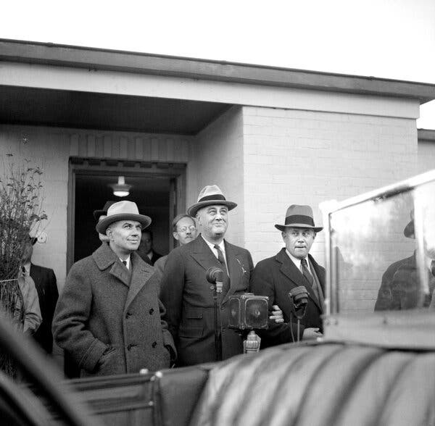
When and Where?
Clip is not the solution
  But could be part of a solution that involves knowledge acquisition on the fly, and reasoning with it.

Slide 51
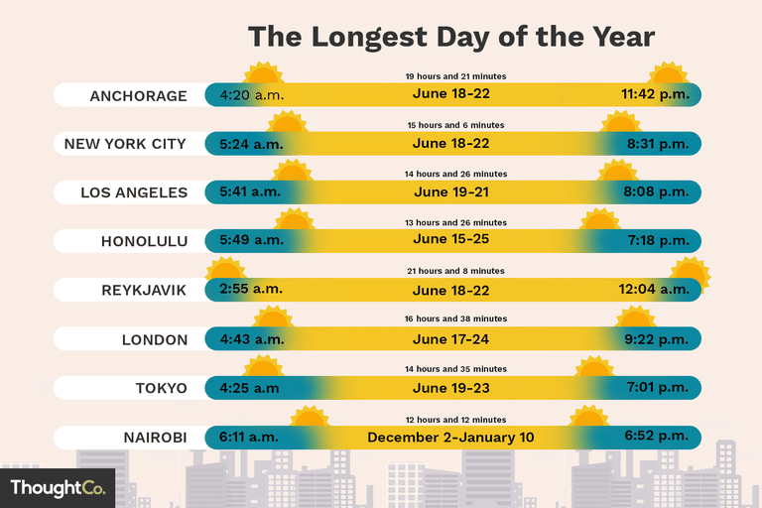
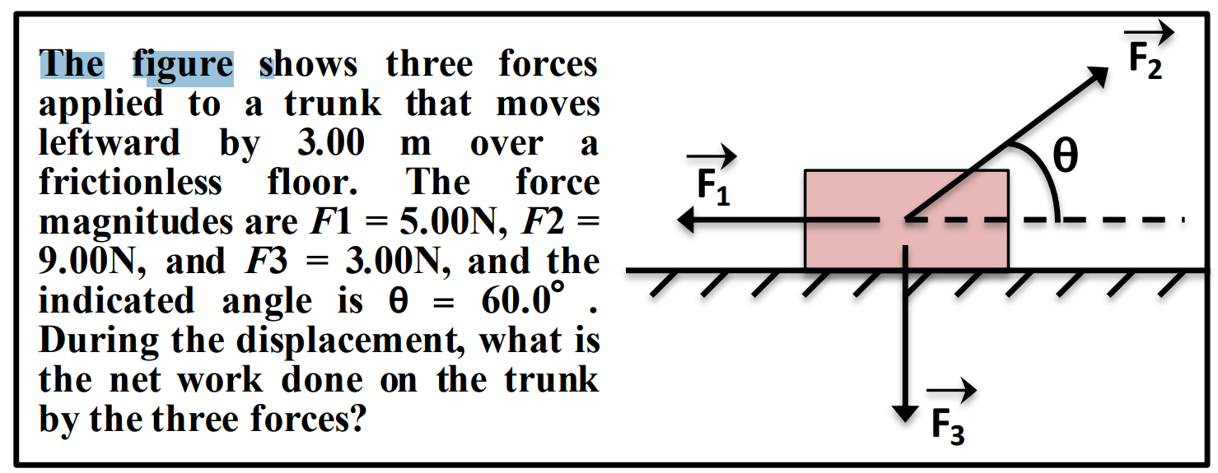

Conclusion
Thank You!
We must think more about reasoning
  To support better communication with computers
Our theories for learning are good for many things
  But aren’t sufficient to deal with the sparse, interesting world
  A theory of Reasoning is needed in order to handle it
Keys include:
  Knowledge
  Compositionality: how to decompose and how to put things together
  How to supervise with incidental supervision signals (those that are unrelated to the task at hand)
These are not the only issues to address in our journey to advance natural language understanding and natural communication skills; but these are core issues that underlie many important topics.

Slide 52
End

