Slide 1
It’s Time to Reason
Dan Roth
Computer and Information Science
University of Pennsylvania
Department of Computer Science
University of California, Santa Barbara
February 2020

Slide 2

Cognitive Computation Group: What We Do
Natural Language Understanding
Learning to Reason
Learning
with Incidental Supervision
Events: Time, Quantities, Space
Semantic Typing
Information Extraction
Linking
Entailment
ESL
Multi-Lingual NLP
Interaction
Common Sense
Navigating
Information Pollution
Representation
Continuous, Symbolic,
Multilingual
Grounding
Psycho-linguistics

Slide 3
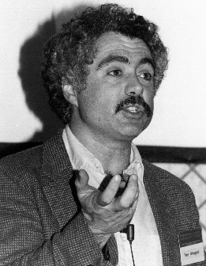
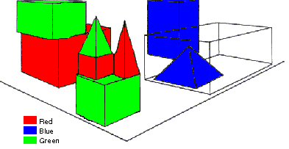
SHRDLU (Terry Winograd, 1968)
Person: Pick up a big red block.
Computer: OK.
Person: Grasp the pyramid.
Computer: I DON'T UNDERSTAND WHICH PYRAMID YOU MEAN.
Person: Find a taller block than the one you are holding and put it into the box.
Computer: BY "IT", I ASSUME YOU MEAN…..
Computer: OK.
Person: What does the box contain?
Computer: THE BLUE PYRAMID AND THE BLUE BLOCK.
Person: What is the pyramid supported by?
Computer: **What do you mean by “supported”?
……….
Person: How many blocks are not in the box?
Computer: FOUR OF THEM.
Understanding, executing and interacting requires language understanding & reasoning
to recognize goals and advance the task
Notes:
SHRDLU, Computer program that has conversation with user, via Natural Language interface
-> About “block world”, virtual box filled with different blocks, different shapes, sizes and colors: e.g. Red block, white box, blue pyramid
The robot can pick the objects, move them, count them ..
Combination of a few principles made the simulation of robot behavior very realistic
SHRDLU's world was so simple that the entire set of objects and locations could be described by including as few as perhaps 50 words:
nouns like "block" and "cone", verbs like "place on" and "move to", and adjectives like "big" and "blue".
The possible combinations of these basic language building blocks were quite simple, and the program was fairly adept at figuring out what the user meant.
SHRDLU also included a basic memory to supply context. One could ask SHRDLU to "put the green cone on the red block" and then "take the cone off"; "the cone" would be taken to mean the green cone one had just talked about. SHRDLU could search back further through the interactions to find the proper context in most cases when additional adjectives were supplied. One could also ask questions about the history, for instance one could ask "did you pick up anything before the cone?“
Deduction rules: Could deduce that blocks could be stacked by looking for examples, but would realize that triangles couldn't be stacked
Learn new names: For instance one could say "a steeple is a small triangle on top of a tall rectangle"; SHRDLU could then answer questions about steeples in the blocks world, and build new ones.

Slide 4
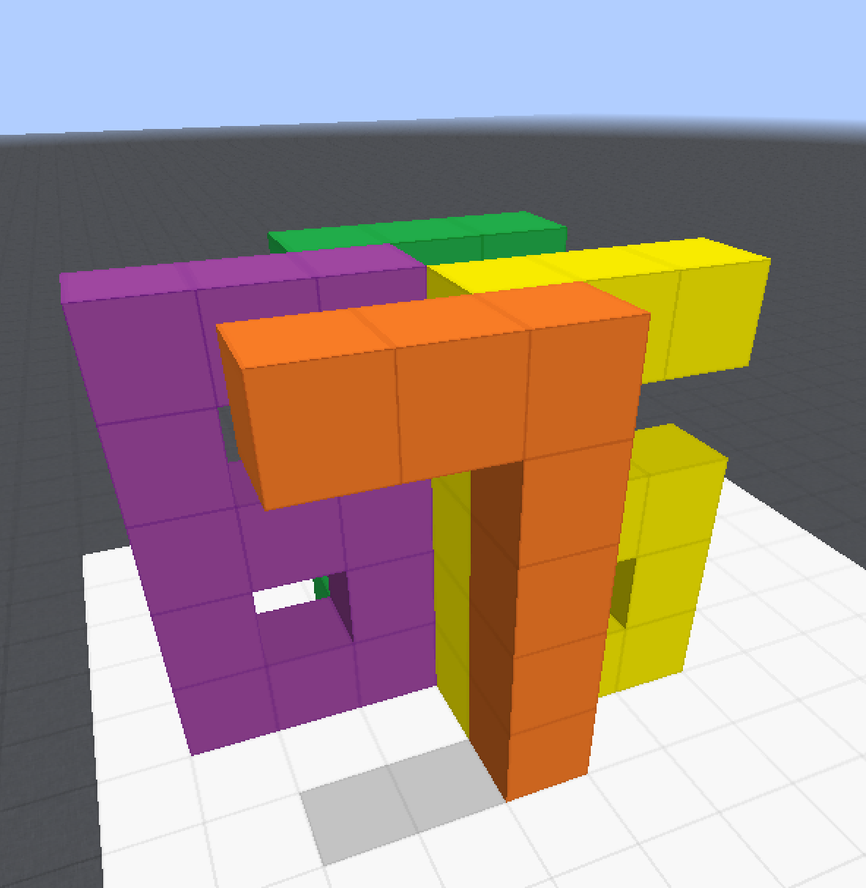
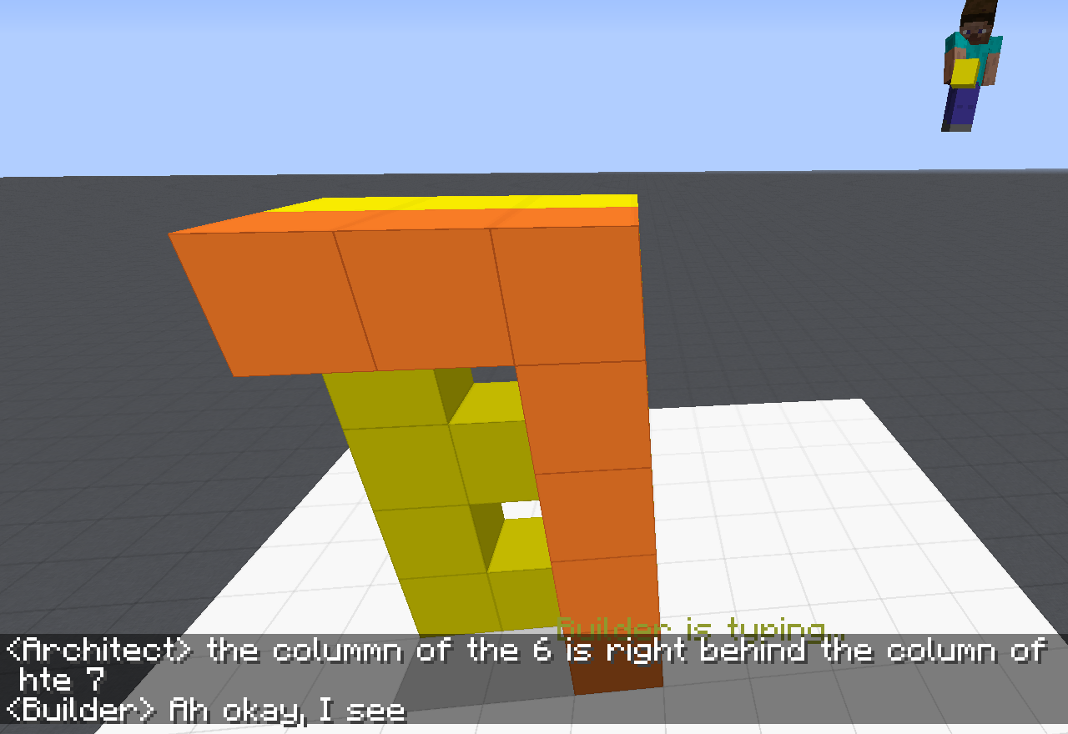
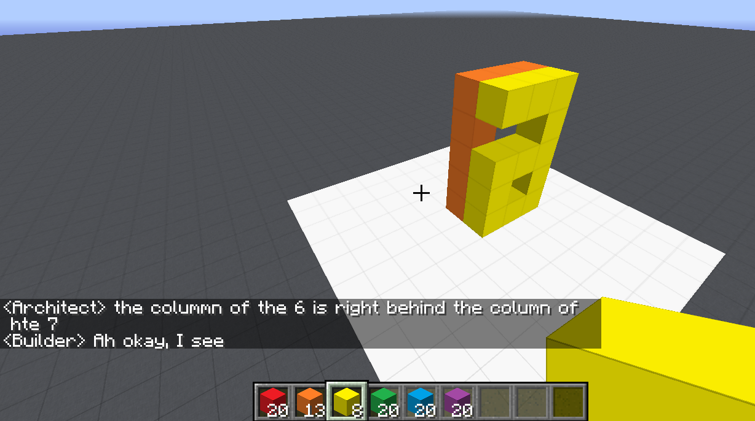
Communication (CwC Project, 2017-2020)
ARCHITECT
CHAT INTERFACE
Architect: | in about the middle build a column five tall
(Builder puts down five orange blocks)
Architect: | then two more to the left of the top to make a 7
(Builder puts down two orange blocks)
Architect: | now a yellow 6
Architect: | the long edge of the 6 aligns with the stem of the 7 and faces right
Builder: | Where does the 6 start?
Architect: | behind the 7 from your perspective
Builder: | Is it directly adjacent?
Architect: | yes directly behind it. touches it
(Builder puts down twelve yellow blocks, in the shape of a 6)
Architect: | too much overlap unfortunately
Architect: | the colummn of the 6 is right behind the column of hte 7
Target Structure
Build Region
BUILDER
[Minecraft example from Julia Hockenmaier]

Slide 5
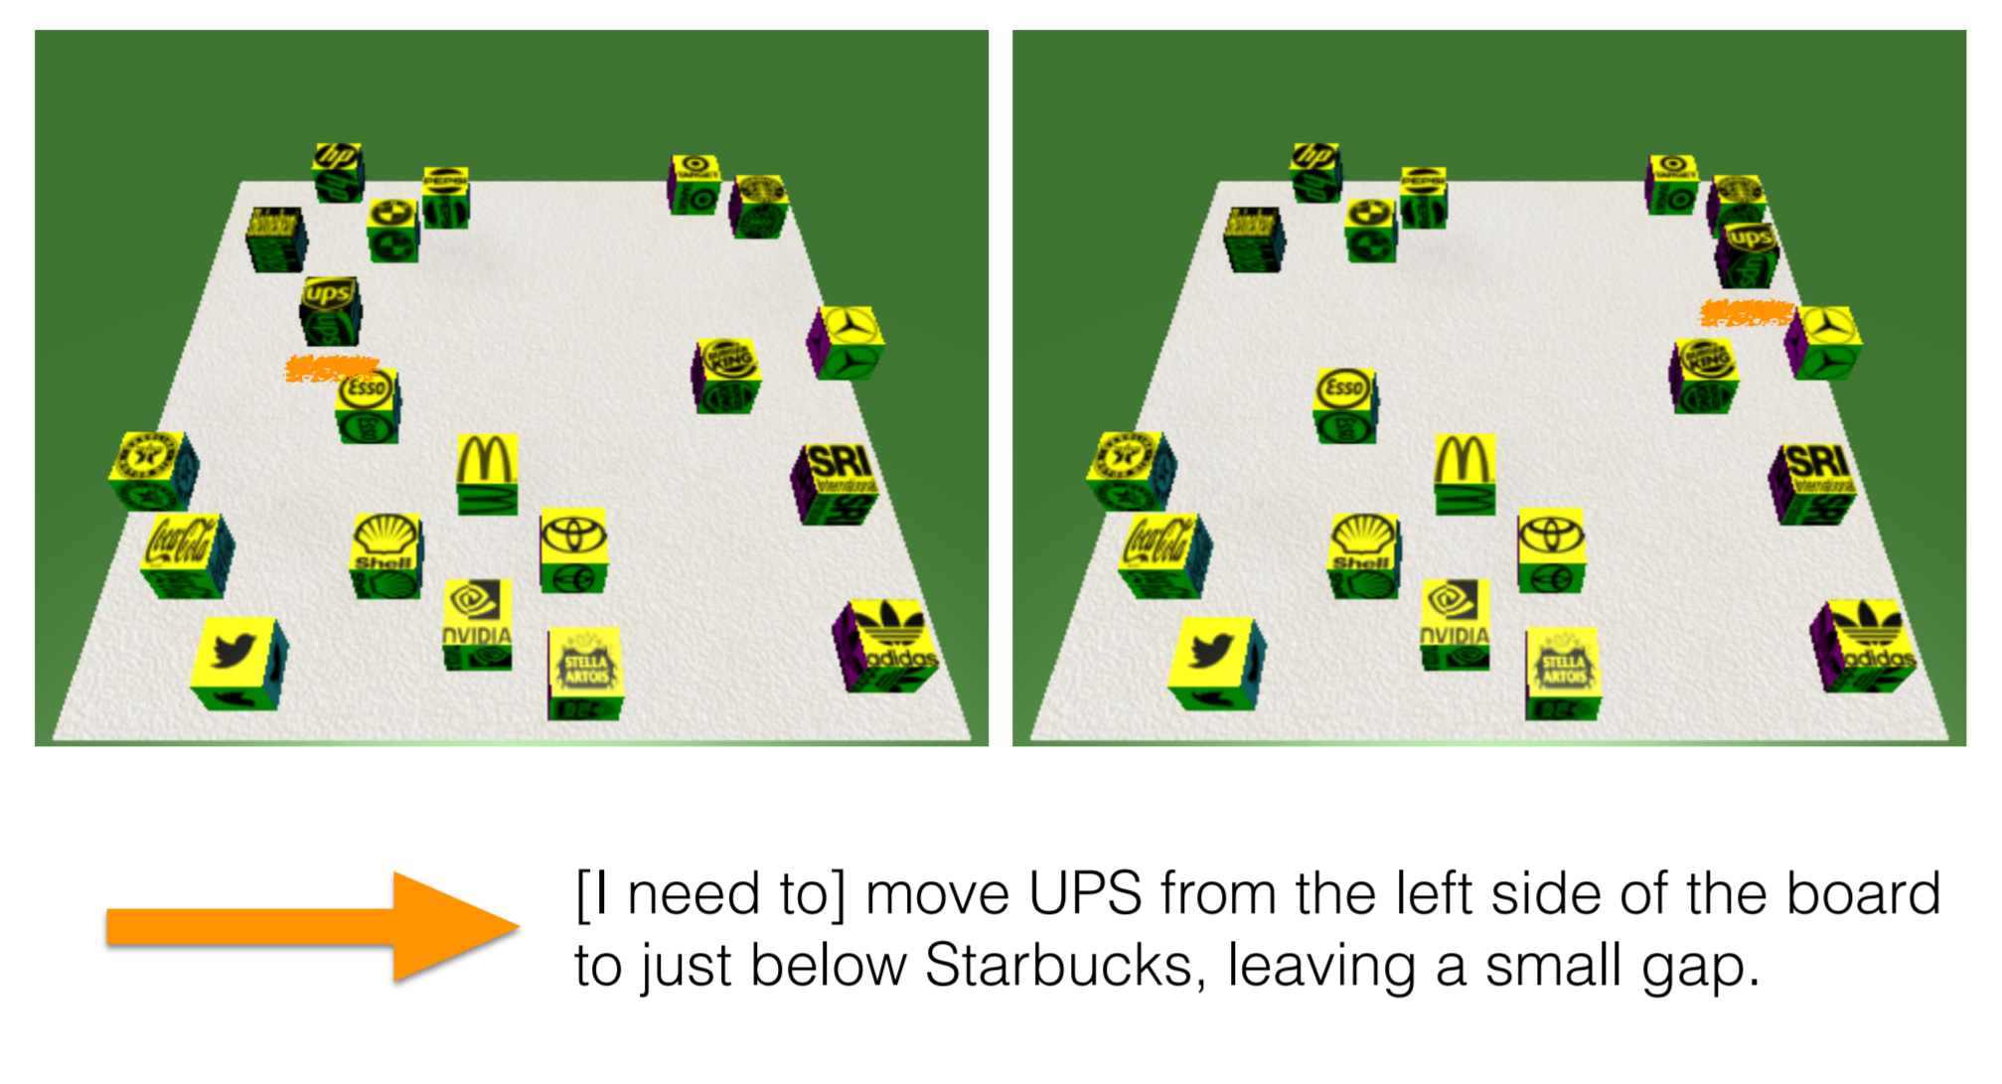
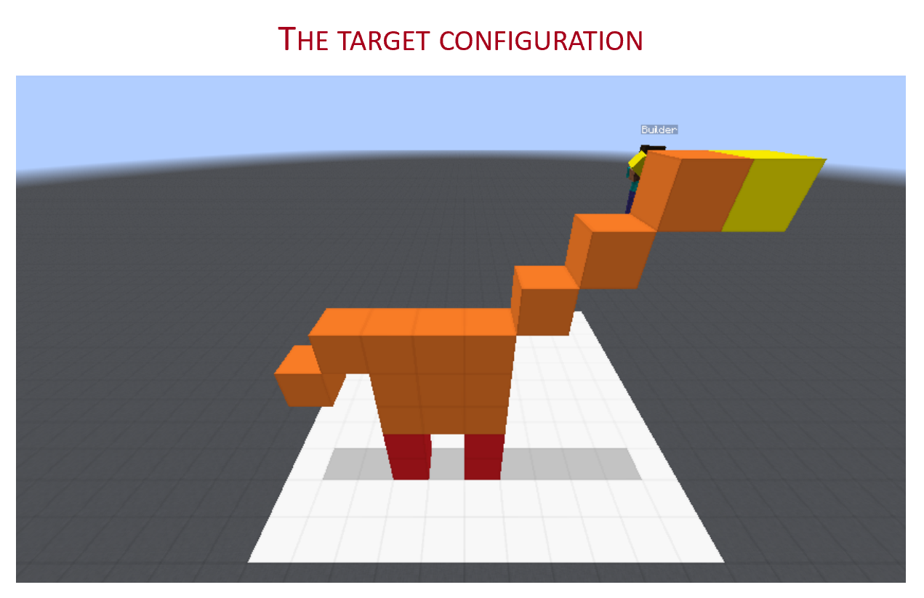
Communication (CwC Project, 2017-2020)
Consider the following explanation:
  [Example from Yonatan Bisk]
  Imagine that this is a chess board
  Place the UPS in H2, and McDonald in G6.
Can you follow these instructions?
  What’s needed for us to be able to write programs that can do it?
Of course, there are many NLP tasks we are better at today, mostly at the sentence level, and mostly extraction tasks.
Today:
Some (optimistic) thoughts and challenges from the perspective of Learning to Reason, in the context of reasoning about time.
  How can we think about learning in the context of doing reasoning?

Slide 6
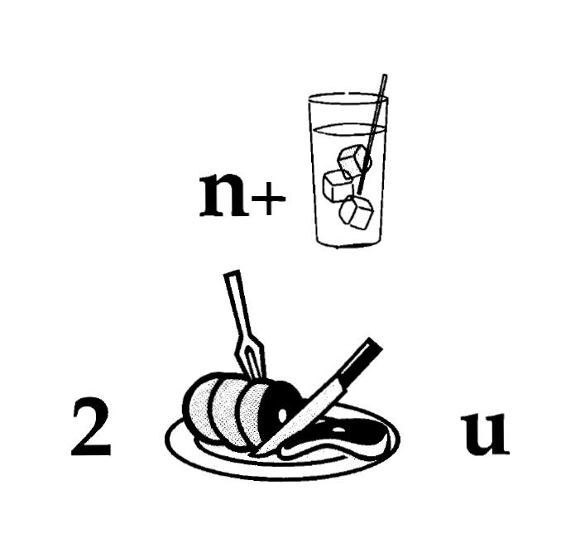
Nice to Meet You
Identify units
Consider multiple
representations & interpretations
  Pictures, text, layout, spelling, phonetics
Put it all together:
  Determine “best” global interpretation
Satisfy expectations
  Slide; puzzle
Computational Problem:
Assigning values to multiple variables, accounting for interdependencies among them

Slide 7
Natural Language Understanding
Natural language understanding decisions are global decisions that require
  Making (local) predictions driven by different models trained in different ways, at different times/conditions/scenarios
  The ability to put these predictions together coherently
  Knowledge, that guides the decisions, so they satisfy our expectations
Of course, our programs need a lot more in order to understand and communicate in natural language
  but it exemplifies some important aspects – “discrete reasoning”;
  – “understanding ~~ best interpretation”
Expectation is a knowledge intensive component
Notes:
7
Give examples for what’s not abductive reasoning
Focus on abductive reasoning
Show the formulation – talk about the boxes
Talk about multiple ways of training – decoupling – relate to abstraction
Examples: semantic parsing (do verb + Prep + commas together; lack of jointly annotated data)
Wikification – Relations (but also add geographical coherence; topical coherence; all interrelated signal that are acquired at different times, different contexts, etc.

Slide 8
Let’s Talk about Dinner
∃ r ∈ Restaurants | Cuisine(r, Mexican)∧ InCity(PH)
Constraints:
∀ r ∈ Restaurants → Contains(r, m) ∧ Menus(m)
∀ m ∈ Menus → Contains(d,m) ∧ Dishes(d)
∃ o ∈ Dishes → Tastes(o, ￢spicy)
→ Let’s talk about dinner.
  A: Where do you want to go?
→ I really enjoy Mexican food, but not when it is spicy.
  A: How about a Mexican restaurant with plenty of non-spicy options?
→ Yep, is there one in Philadelphia?
  A: Here are a couple of good options
  …….
Don’t worry, you can still use neural embeddings for the predicates and functions…
But this abstraction shows that we need to incorporate declarative constraints…
[Example due to Tania Berdax-Weiss]

Slide 9
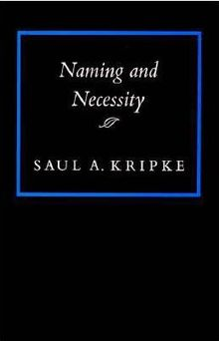

Symbolic Reasoning?
Some people think that symbols are an evil invention of old AI people.
It’s not.
Language is a symbolic system
  Table is a collection of things in world.
Even though we communicate via speech, gestures, writing, which are continuous, symbols are the invariants of this communication.
  Harari: Language – the ability to assign symbols to “things” and “reason” about them is key to human cognitive revolution
  Kripke: “Naming” things is key to communication and to cognition
  The Enigma of Reason: “Reasoning is about giving reasons”

Slide 10
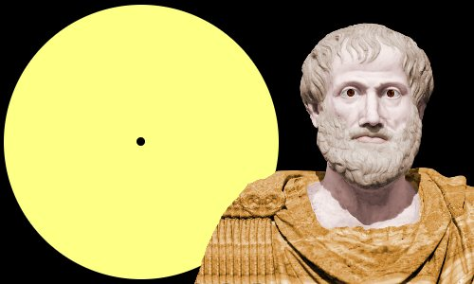
Aristotle’s Logic https://www.famousscientists.org/aristotle/
Aristotle founded the study of formal logic, systematizing logical arguments – he is famous for the syllogism, a method by which known information can be used to prove a point.
Here is a famous example, from Aristotle himself, of a simple syllogism:
  All men are mortal.
  Socrates is a man.
  Therefore, Socrates is mortal.
So, did Aristotle have a laptop?
  [Example due to Les Valiant]
Notes:
Google will say yes!

Slide 11
Key Challenges to NLU Researchers
Today’s NLP addresses well-defined tasks for which we have, or can generate, a lot of training data, but:
Who asks the questions?
  ~~ When did Aristotle die?
  ~~ When was the laptop invented?
  What happened first?
The question isn’t if we need reasoning, but rather:
  How to do it?
    E.g., how to determine “strategies” on the fly?
  How to train for it?
    How can we supervise for these “sparse” events? [A different talk: On Incidental Supervision]
    Should we learn “everything” together? When/how should we decouple/decompose tasks?
Not a new set of questions [Khardon & Roth, Learning to Reason, JACM’1996]
  Showed, in a formal way, the advantages of joint learning & reasoning

Slide 12
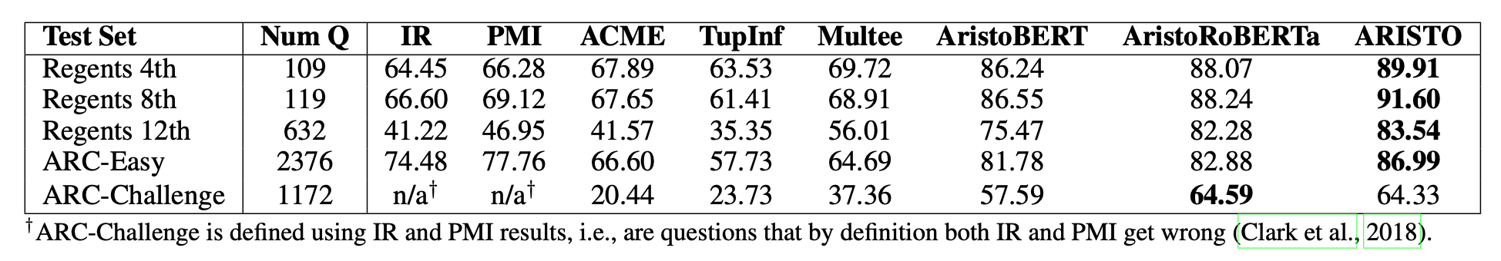
Are We Doing Any Reasoning in NLP Today?
Very little, if at all.
Not only because “we are asking the questions”
Clark et al 2019: On the success of AI2’s ARISTO Project:
  From ‘F’ to ‘A’ on the N.Y. Regents Science Exams: An Overview of the Aristo Project
Very impressive results. But does it do reasoning?

Slide 13
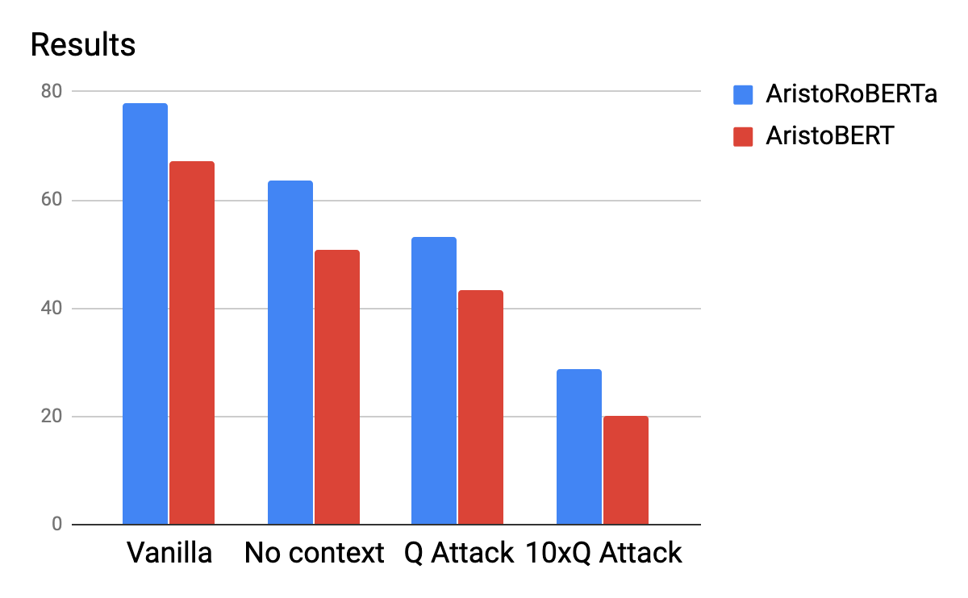
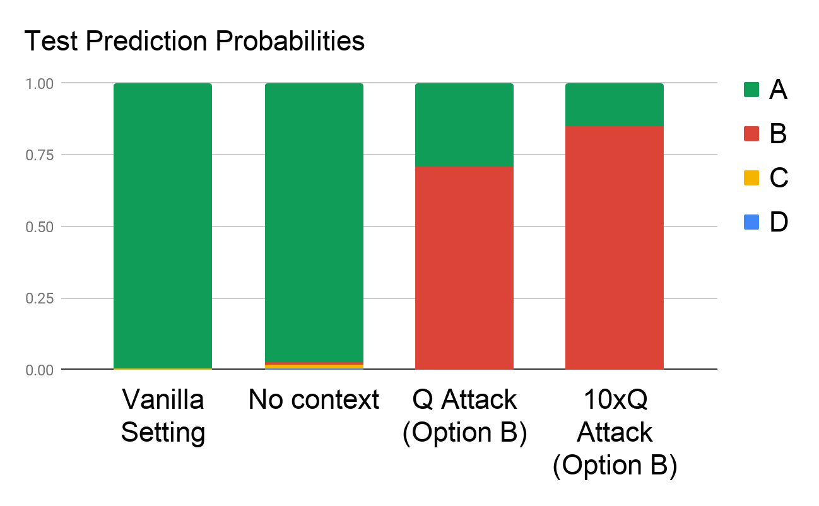
A Scientific QA Example [Shah et al. In Submission]
Question: The rate at which a wave passes through a medium is known as its
Answer Options:
  speed
  amplitude
  acceleration
  wavelength
Supporting Contexts:
  The speed of a wave is the rate at which vibrations propagate through the medium…
  The greater the amplitude of vibrations of the particles of the medium, the greater…
  … hydrophones measure the acceleration of the medium as a seismic wave passes…
  The speed of an electromagnetic wave in a medium depends on its wavelength. As…
Question Question Question Question Question Question Question Question……
Question
Are we doing Reasoning?

Slide 14
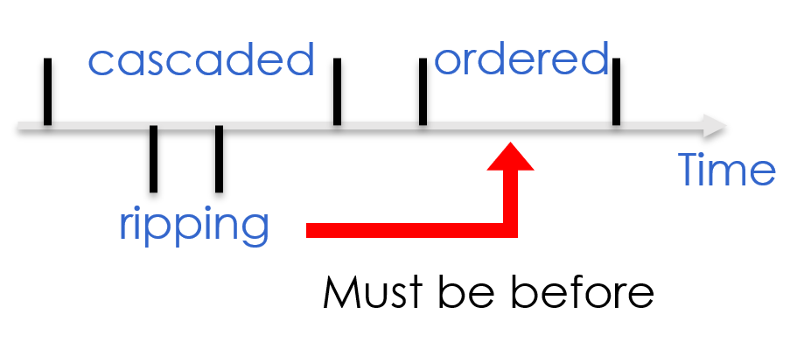
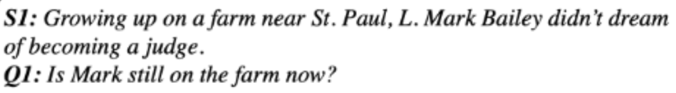
It’s Time to Reason:
Outline
Addressing “sparse” challenges that one cannot train for directly
  Decomposition and Composition (and some more)
Assigning values to multiple interrelated variables
  Given observations and knowledge
  Most likely assignment: Abduction
Computing functions over multiple interrelated inferred variables
  Last; longest, most frequent, etc.
Decisions over a dynamic set of interrelated variables
  The Aristotle example
    Need a strategy to decide what the variables are & a function computed over it
  Temporal Commonsense
(1)
(3)
Who scored the last field goal for the Eagles?
[given a recap of the game]
(2)
Will we make it to dinner before the movie?

Slide 15
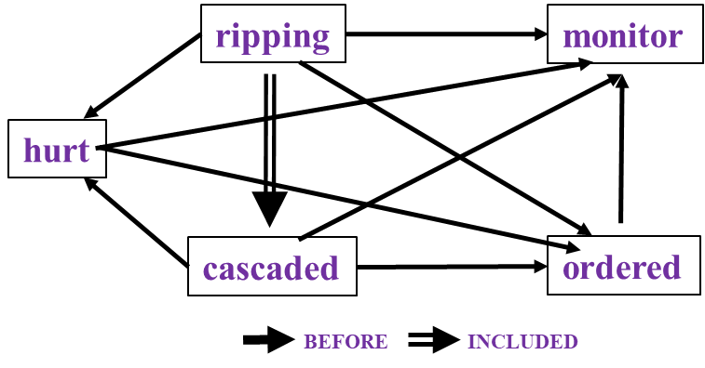
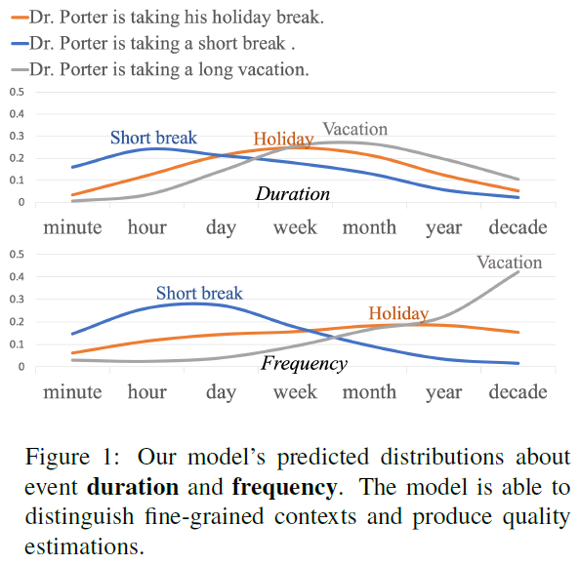
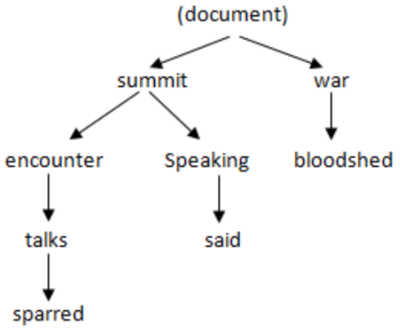
Reasoning about Time and Events
                Temporal relations between events
  Hierarchical relations between events
  Temporal Commonsense
Study them independently and develop approaches to study them as interrelated tasks: Situations
In Los Angeles that lesson was brought home today when tons of earth cascaded down a hillside, ripping two houses from their foundations. No one was hurt, but firefighters ordered the evacuation of nearby homes and said they'll monitor the shifting ground until March 23rd.
U.S. President Barack Obama sparred with Russia’s Vladimir Putin over how to end the war in Syria on Monday during an icy encounter at a G8 summit. Speaking after talks with Obama, Putin said Moscow and Washington agreed the bloodshed must stop…
Reflects an important move in NLU from sentence level to event/situation level.
Addresses issues in combining learning and reasoning, and supervision.

Slide 16
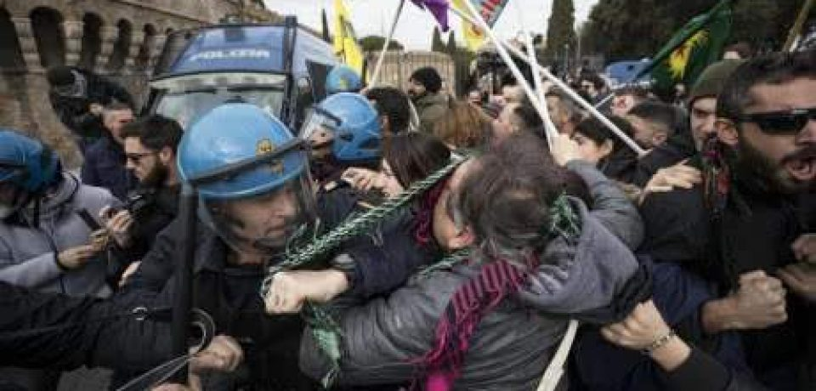

Two Events
People were angry
Police used tear gas
Time
People were angry at something (which ended in violent conflicts with the police)…The police finally used tear gas (to restore order).
Notes:
Now let's try to understand two events: people were angry and police used tear gas. If people were angry happened first, the understanding would be people ended in violent conflicts with the police, and the police used tear gas to restore order.

Slide 17
Two Events
Police used tear gas
People were angry
Time
Police used tear gas…People were angry at the police.
Notes:
If we simply reverse the order of these events, we get a new story, which says that police used tear gas and then people were angry at the police. We can see that time is crucial if we want to understand what’s going on in a situation.

Slide 18
Two Events
Police used tear gas
People were angry
Time
In natural language, we rarely see explicit timestamps, so we have to figure out the temporal order from cues in the text.
Notes:
But in natural language, we never have timestamps like here telling us which one is earlier and which one is later. That leads to “temporal relations”

Slide 19
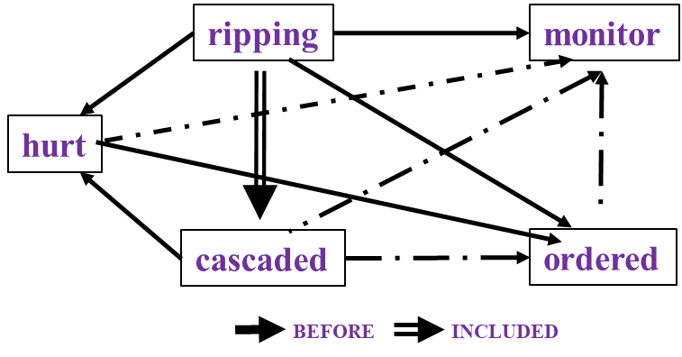

Time and Events [Ning et al. *SEM’2018; ACL’18, EMNLP’18, EMNLP’19]
In Los Angeles that lesson was brought home today when tons of earth cascaded down a hillside, ripping two houses from their foundations. No one was hurt, but firefighters ordered the evacuation of nearby homes and said they'll monitor the shifting ground until March 23rd.
Very difficult task— hinders exhaustive annotation (O(N²) edges)
But, it’s rather easy to get partial annotation – some relations.
And, we have strong expectations from the output
  Transitivity
  Some events tend to precede others, or follow others
How to exploit these “expectations”?
How does it impact supervision?
cascaded
ordered
Time
ripping
Must be before

Slide 20
Constrained Conditional Models [Abductive Reasoning; Chang et al.’12]
Supporting structured, knowledge intensive, NLP decisions
Variables are models
Penalty for violating
the constraints.
Formulation goes back to (Roth & Yih 2004). Also related to PR (Ganchev et al. 2010)
y = argmax_{y} ∑ 1_{∅(x, y)} w_{x,y} subject to Constraints C(x,y)
    y = argmax_{y} $∈$ _{Y} w^{T}$∅$(x, y) + u^{T}C(x, y)
Knowledge component:
(Soft) constraints
A linear function over models – can be used to model any logical function
Features, Models, NN
(non-linearity comes here)
How far are the decisions (y) is from a “legal/expected” assignment
Is it needed/useful in the NN era? Yes [Deutsch et al. CoNLL’19] ; → a neural implementation of CCMs
  But, it’s not sufficient to support all types or reasoning we care about.
It has been used extensively and successfully used in many NLU tasks from IE to discourse to summarization.
A good starting point for thinking about further progress in natural language understanding.
What are the variables? How to represent knowledge?
Is it expressive enough?
  All Boolean functions can be represented as sets of linear constrains.
  Any MAP problem w.r.t. any probabilistic model, can be formulated as an ILP [Roth&Yih 04, Taskar 04]
Training: Learning the objective function (w, u)? Learning all the intermediate functions ∅(x, y)?
  Joint? Decoupled? Learned/provided constraints? Hard/soft?
  There is some understanding for when to do what [IJCAI’05]
Reasoning: A way to push a function over learned models to satisfy output expectations
  (can also think about expectations from a latent representation)

Slide 21
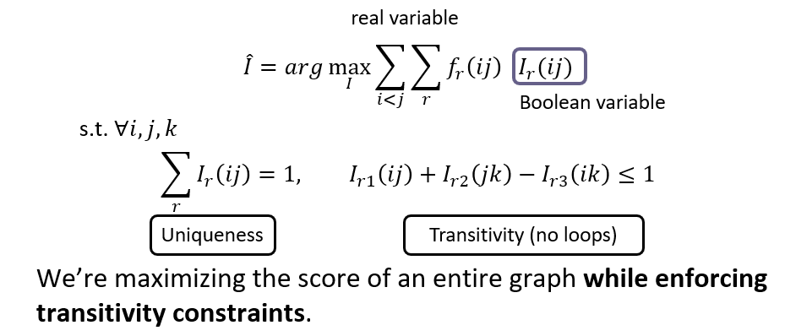
A Revolution in Temporal Reasoning
Generalized common sense
BERT
Neural + ILP
+3%
Axes dataset
+4%
Involves reasoning with external knowledge via a neural implementation of CCMs
Declarative knowledge
  Transitivity
Statistical knowledge
  commonsense knowledge
Common sense
+3%
Structured learning
+11%*
Previous SOTA
+4%
+2%
2015
2017
2019
Thesis work of Qiang Ning (2019)
Notes:
This is a final summary for our progress on this task. CAEVO is the previous SOTA, structured learning 2%, common sense 4%, new dataset 11%, LSTM with standard word embeddings 3%, LSTM with BERT embeddings 4% (BERT is the most recent word embedding), and Siamese another 3%.

Slide 22
Multi-Axis View of Events [ACL’18]
The improvements involves another conceptually important step:
  We suggest that not all events are comparable
  Events reside on multiple axes.
Police tried to eliminate the pro-independence army and restore order. At least 51 people were killed in clashes between police and citizens in the troubled region.
Events could be actual, hypothetical, intentions,..
  Not all events are comparable.
Result: inter-annotator agreements are much higher.
Higher quality training data, with significant improvement in temporal relation identification
Intention axis
restore order
✓
to eliminate army
✓
police tried
51 people killed
Main axis
✓
Notes:
In this particular example, we used intention axis. We also define other axes, such as opinion and hypothesis.

Slide 23
TemProb: Temporal Relation Probabilistic Knowledge Base
Run initial system on New York Times 1987-2007, #Articles~1M
Identify events; identify temporal order
80M temporal relations
Noisy statistics is sufficient to give good priors.
Example pairs |  | Temporal Before (%) | Temporal After (%)
Text Before | Text After
Ask | Help | 86 | 9
Attend | Schedule | 1 | 82
Accept | Propose | 10 | 77
Die | Explode | 14 | 83
Priors on order are often different than order of occurrence in text
Notes:
In NAACL'18, we proposed TemProb, short for ... The intuition is that humans get common sense through lots of life experience. We want to mimic this, so we collected over 1 million articles from new york times. We ran our system on top of it to imitate human's reading experience. To accelerate it, we used 100 AWS instances in parallel and finished it within one day. We find that simply by counting, we could get many interesting statistics. For example, we find ask before help, attend after schedule, accept after propose, and die after explode.
(1min)

Slide 24
Event distributions Support Temporal Relations
Notes:
We also plotted the distribution of events that usually precede or follow specific events, of course, in terms of time. Although we only have the verbs here, we can still get some intuitive answers.

Slide 25
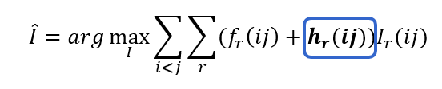
Event distributions from TemProb
Can be implemented within the same framework, and it’s neural counterpart.
We need more types of temporal common sense…
Notes:
This is what I like the most. I have a long list of such examples, and of course, there can be errors in it. But the good thing is, we mined these automatically and no more human annotations were used, so it's pretty nice. Imagine that if we could incorporate the common sense knowledge in TemProb into the temporal relation extraction task, then we can further improve the performance. The only question is how to apply TemProb in our task.
(1 min 20 sec)

Slide 26
A Revolution in Temporal Reasoning
Generalized common sense
BERT
Neural + ILP
+3%
Axes dataset
+4%
Involves reasoning with external knowledge via a neural implementation of CCMs
Declarative knowledge
  Transitivity
Statistical knowledge
  commonsense knowledge
Common sense
+3%
Structured learning
+11%*
Previous SOTA
+4%
+2%
2015
2017
2019
Thesis work of Qiang Ning (2019)
Notes:
This is a final summary for our progress on this task. CAEVO is the previous SOTA, structured learning 2%, common sense 4%, new dataset 11%, LSTM with standard word embeddings 3%, LSTM with BERT embeddings 4% (BERT is the most recent word embedding), and Siamese another 3%.

Slide 27
Putting it all together: A Neural Approach
LSTM
+
Feed-Forward NN (+ ILP Inference)
+
Siamese
Siamese network
Common sense
Long short-term memory network
Structured learning
Feedforward network
Trained on new data
Notes:
Our proposal is to use long short-term memory network (LSTM) to represent structured learning, a feedforward neural net to get supervision from our new dataset, and a Siamese network to represent common sense. Let me quickly go through the high-level ideas behind it.

Slide 28
Putting it all together: A Neural Approach
LSTM takes word embeddings as input
Hidden vectors represent events
FFNN predicts the labels of temporal relations (followed by ILP inference)
Siamese network is a generalized TemProb
Siamese network
(Common sense)
LSTM
Feedforward network
(Trained on new data)
word embeddings
t₀ t₁ t₂ t_{n}
LSTM w/ concatenations of two hidden states
Notes:
Specifically, LSTM takes a sequence of word embeddings as input

Slide 29
Putting it all together: A Neural Approach
LSTM takes word embeddings as input
Hidden vectors represent events
FFNN predicts the labels of temporal relations (followed by ILP inference)
Siamese network is a generalized TemProb
Siamese network
(Common sense)
h_{e1}
LSTM
128
word embeddings
h_{e2}
128
t₀ t₁ t₂ t_{n}
LSTM w/ concatenations of two hidden states
Notes:
And generates hidden vectors to represent those events

Slide 30
Putting it all together: A Neural Approach
  Put all pieces together
: a neural approach
LSTM takes word embeddings as input
Hidden vectors represent events
FFNN predicts the labels of temporal relations (followed by ILP inference)
Siamese network is a generalized TemProb
Siamese network
(Common sense)
h_{e1}
LSTM
128
output
before
after
equal
vague
word embeddings
h_{e2}
64
128
t₀ t₁ t₂ t_{n}
LSTM w/ concatenations of two hidden states
Output confidence scores
Notes:
The event representations are stacked as input to the feedforward neural net, which generates the final temporal relation label

Slide 31
Putting it all together: A Neural Approach
LSTM takes word embeddings as input
Hidden vectors represent events
FFNN predicts the labels of temporal relations (followed by ILP inference)
Siamese network is a generalized TemProb
Siamese network trained on TemProb
v₁
v₂
500
500
150
dropout 0.3
45
dropout 0.3
h_{e1}
LSTM
128
output
before
after
equal
vague
word embeddings
h_{e2}
64
128
t₀ t₁ t₂ t_{n}
LSTM w/ concatenations of two hidden states
Output confidence scores
Notes:
In addition, a separate Siamese network fits the statistics in TemProb

Slide 32
Putting it all together: A Neural Approach
LSTM takes word embeddings as input
Hidden vectors represent events
FFNN predicts the labels of temporal relations (followed by ILP inference)
Siamese network is a generalized TemProb
Siamese network trained on TemProb
v₁
v₂
500
500
150
dropout 0.3
45
dropout 0.3
h_{e1}
LSTM
128
output
before
after
equal
vague
word embeddings
h_{e2}
64
128
t₀ t₁ t₂ t_{n}
LSTM w/ concatenations of two hidden states
Output confidence scores
Notes:
And provides additional embeddings that can be used in the feedforward neural net.

Slide 33
Inducing Semantics
Inducing semantic representations and making decisions that depend on it require learning and, in turn, supervision.
Standard machine learning methodology:
  Given a task
  Collect data for the task and annotate it
  Learn a model [doesn’t matter how]
We will never have enough annotated data to train all the models, for all the tasks we need, this way.
  We don’t even know what are “all the tasks”
  Most of what we learn we don’t learn by “training” on many examples
Current methodology is not scalable and, often, makes no sense
  Annotating for complex tasks is difficult, costly, and sometimes impossible.
    Most decisions we care about are too sparse to be trained for directly
(of course, pre-training is a step in the right direction, a lot more is needed)
It’s ok to do supervised learning.
But what about tasks that cannot be supervised directly?
In most interesting cases, learning should be (and is) driven by incidental supervision signals [Roth AAAI’17]
Incidental supervision: How to understand, acquire and use signals that were not put there to help a specific target task.
Key Examples include the use of external resources such as Wikipedia to support zero-shot semantic typing, text classification, and multilingual NLP
Notes:
Key challenge, to facilitate reasoning, is to induce semantics
Move to the importance of supervision
Examples: Text Classification; Multilingual; Gender classification; Dan gave a talk in an beautiful crowder room at Amazon → SRL annotation.

Slide 34
Incidental Supervision & Reasoning
O’Hare must be in Chicago
O’Hare must be in Chicago
Feb 5 2017 Dozens of passengers heading to Chicago had to undergo additional screenings… It took Hesam Aamyab two tries to make it back to the United States from Iran. He is an Iranian citizen with a US visa who is doing post-doctoral research at UIC. …"Right now, I am in the USA and I'm very happy," Aamyab said. But now, he can't go back to Iran or anywhere else without risk. Other travelers shared the same worry. Asem Aleisawi was at O'Hare on Sunday to meet his wife who was coming in from Jordan.
  Learning/Supervision requires some level of reasoning to infer these weak signals

Slide 35
Events and Time: How to Supervise?
In Los Angeles that lesson was brought home today when tons of earth cascaded down a hillside, ripping two houses from their foundations. No one was hurt, but firefighters ordered the evacuation of nearby homes and said they'll monitor the shifting ground until March 23rd.
Very difficult task— hinders exhaustive annotation (O(N²) edges)
But, it’s rather easy to get partial annotation – some relations.
And, we have strong expectations from the output
  Transitivity
  Some events tend to precede others or follow others [Ning et. al., NAACL’18]
Intuition:
If the structure is tight, there is no need to annotate all the variables.
A partial set of signals can supervise all.

Slide 36
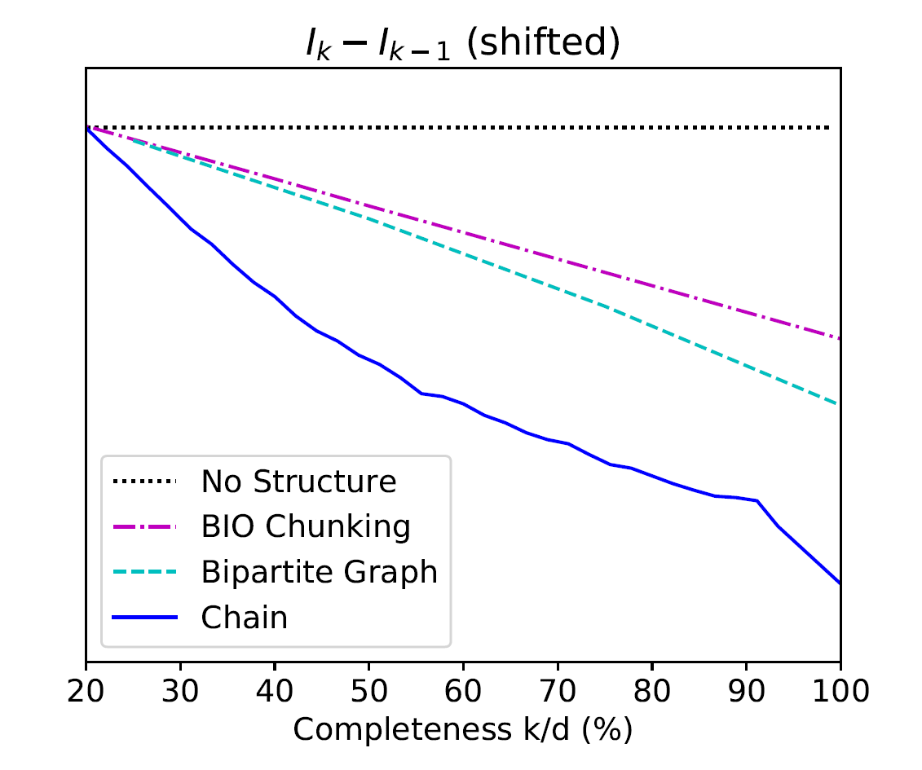
Information Theoretic Measure of New Label’s Benefit
$$Δ_{k}=I_{k}−I_{k−1} \text{: }\text{The} \text{benefit} \text{of} \text{a} \text{new} \text{label}$$
Chain:
Temporal Relation Extraction
Algorithmically:
Results are consistent with tightness of the structure
A version of the Constraint-Driven Learning (CoDL) Algorithm [Chang et al. 2012]
+: p<5%
++: p<1%
++
++
++
++
++
++
++
++
+
Tightness of Structure
Bipartite Graph:
Semantic Role Classification
Seq Tagging
Shallow Parsing
Indeed:
If the structure is tight, there is no need to annotate all the variables.
A partial set of signals can supervise all.
Exploiting knowledge → less supervision needed
++
++
++
++
++
++

Slide 37
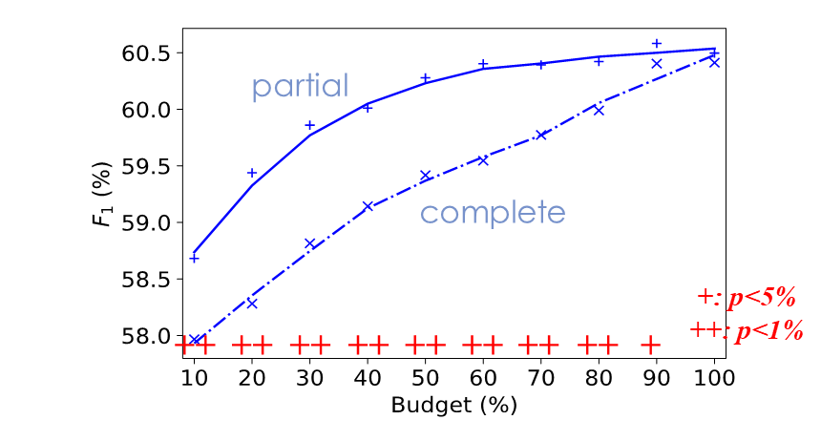
Partial or complete, that’s the question [Ning et a. NAACL’19]
Training Phase
When we have a fixed budget, partial structures indeed lead to better performance.
How should we quantify the quality of “partial”?
(a) Complete
(b) Partial
same budget
same budget
$$𝒯_{test}$$
$$𝒯_{test}$$
Testing Phase

Slide 38
It’s Time to Reason:
Outline
Addressing “sparse” challenges that one cannot train for directly
  Decomposition and Composition (and some more)
Assigning values to multiple interrelated variables
  Given observations and knowledge
  Most likely assignment: Abduction
Computing functions over multiple interrelated inferred variables
  Last; longest, most frequent, etc.
Decisions over a dynamic set of interrelated variables
  The Aristotle example
    Need a strategy to decide what the variables are & a function computed over it
  Temporal Commonsense
(1)
(3)
Who scored the last field goal for the Eagles?
[given a recap of the game]
(2)
Will we make it to dinner before the movie?

Slide 39
Temporal Common Sense [EMNLP’19 + In Submision]
My friend Bill went to Duke University in North Carolina. With a degree in CS, he joined Google MTV as a software engineer. As a huge basketball fan, he has attended all 3 NBA finals since then. He also plans to visit Duke regularly as an alumnus to attend their home games.

Slide 40
Temporal Common Sense
My friend Bill went to Duke University in North Carolina. With a degree in CS, he joined Google MTV as a software engineer. As a huge basketball fan, he has attended all 3 NBA finals since then. He also plans to visit Duke regularly as an alumnus to attend their home games.
College: about 4 years, start at the age of 18
Duration
Typical Time
Bill in North Carolina: about 4 years
Duration
Stationarity
Duke in North Carolina: always
Stationarity

Slide 41
Temporal Common Sense
My friend Bill went to Duke University in North Carolina. With a degree in CS, he joined Google MTV as a software engineer. As a huge basketball fan, he has attended all 3 NBA finals since then. He also plans to visit Duke regularly as an alumnus to attend their home games.
College: about 4 years, start at the age of 18
Duration
Typical Time
Bill in North Carolina: about 4 years
Duration
Stationarity
Duke in North Carolina: always (expected)
Stationarity
Join Google: after college graduation
Ordering

Slide 42
Temporal Common Sense
My friend Bill went to Duke University in North Carolina. With a degree in CS, he joined Google MTV as a software engineer. As a huge basketball fan, he has attended all 3 NBA finals since then. He also plans to visit Duke regularly as an alumnus to attend their home games.
College: about 4 years, start at the age of 18
Duration
Typical Time
Bill in North Carolina: about 4 years
Duration
Stationarity
Duke in North Carolina: always (expected)
Stationarity
Join Google: after college graduation
Ordering
NBA Finals: every year
Frequency

Slide 43
Temporal Common Sense
My friend Bill went to Duke University in North Carolina. With a degree in CS, he joined Google MTV as a software engineer. As a huge basketball fan, he has attended all 3 NBA finals since then. He also plans to visit Duke regularly as an alumnus to attend their home games.
College: about 4 years, start at the age of 18
Duration
Typical Time
Bill in North Carolina: about 4 years
Duration
Stationarity
Duke in North Carolina: always (expected)
Stationarity
Join Google: after college graduation
Ordering
NBA Finals: every year
Frequency
Visit Alma Mater: 0-2 times per year, 0-2 days each time
Frequency
Duration
Attend basketball games: a few hours
Duration

Slide 44
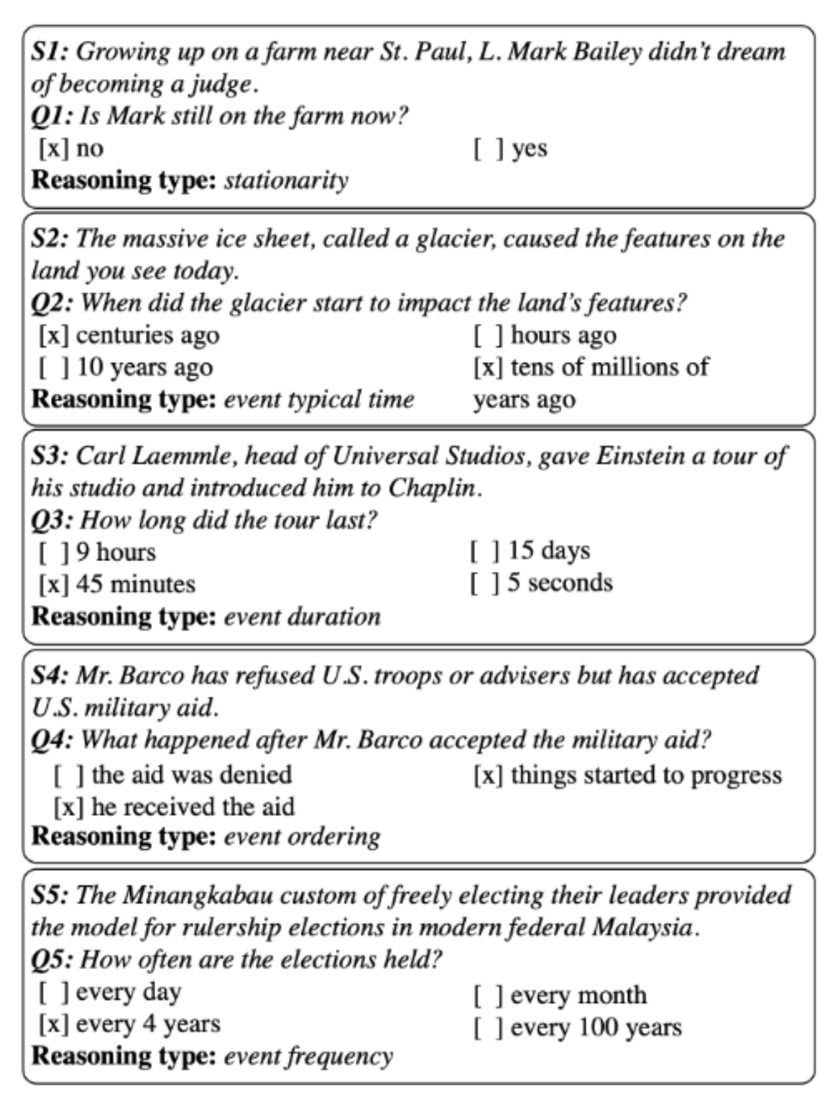
MC-TACO🌮: A Temporal Commonsense Dataset [Zhou et al. EMNLP’19]
A new QA data set that addresses some temporal reasoning tasks. (Along with a baseline approach)
Stationarity:
  Paul Simon is in NYC. Let’s go see him.
  The Empire State Building is in NYC.
Typical Time
Event Frequency
44

Slide 45
Results: We are Far (from where we want to be)
13% difference
It’s important to be careful when evaluating LM-based results.
We have multiple versions of each question, addressing related aspects. We count it as YES only if ALL questions are answered correctly.
40% difference
ESIM: Enhanced LSTM for Natural Language Inference (Chen et al., 2016)
GloVe: Global Vectors for Word Representation (Pennington et al., 2014)
ELMo: Deep contextualized word representations (Peters et al., 2018)
BERT: BERT: Pre-training of Deep Bidirectional Transformers for Language Understanding (Devlin et al., 2019)
RoBERTa: A Robustly Optimized BERT Pretraining Approach (Liu et al., 2019)

Slide 46
MC-TACO🌮: A Temporal Commonsense Dataset [Zhou et al. EMNLP’19]
A new QA data set that addresses some temporal reasoning tasks. (Along with a baseline approach)
Stationarity:
  Paul Simon is in NYC. Let’s go see him.
  The Empire State Building is in NYC.
The results of BERT-based models are very low. Not surprising given the need to have commonsense to address these challenges.
Perhaps more importantly, it illustrates the need to decompose, and know how to incorporate knowledge.
Typical Time
Will we make it to dinner before the movie?
Event Frequency
46

Slide 47
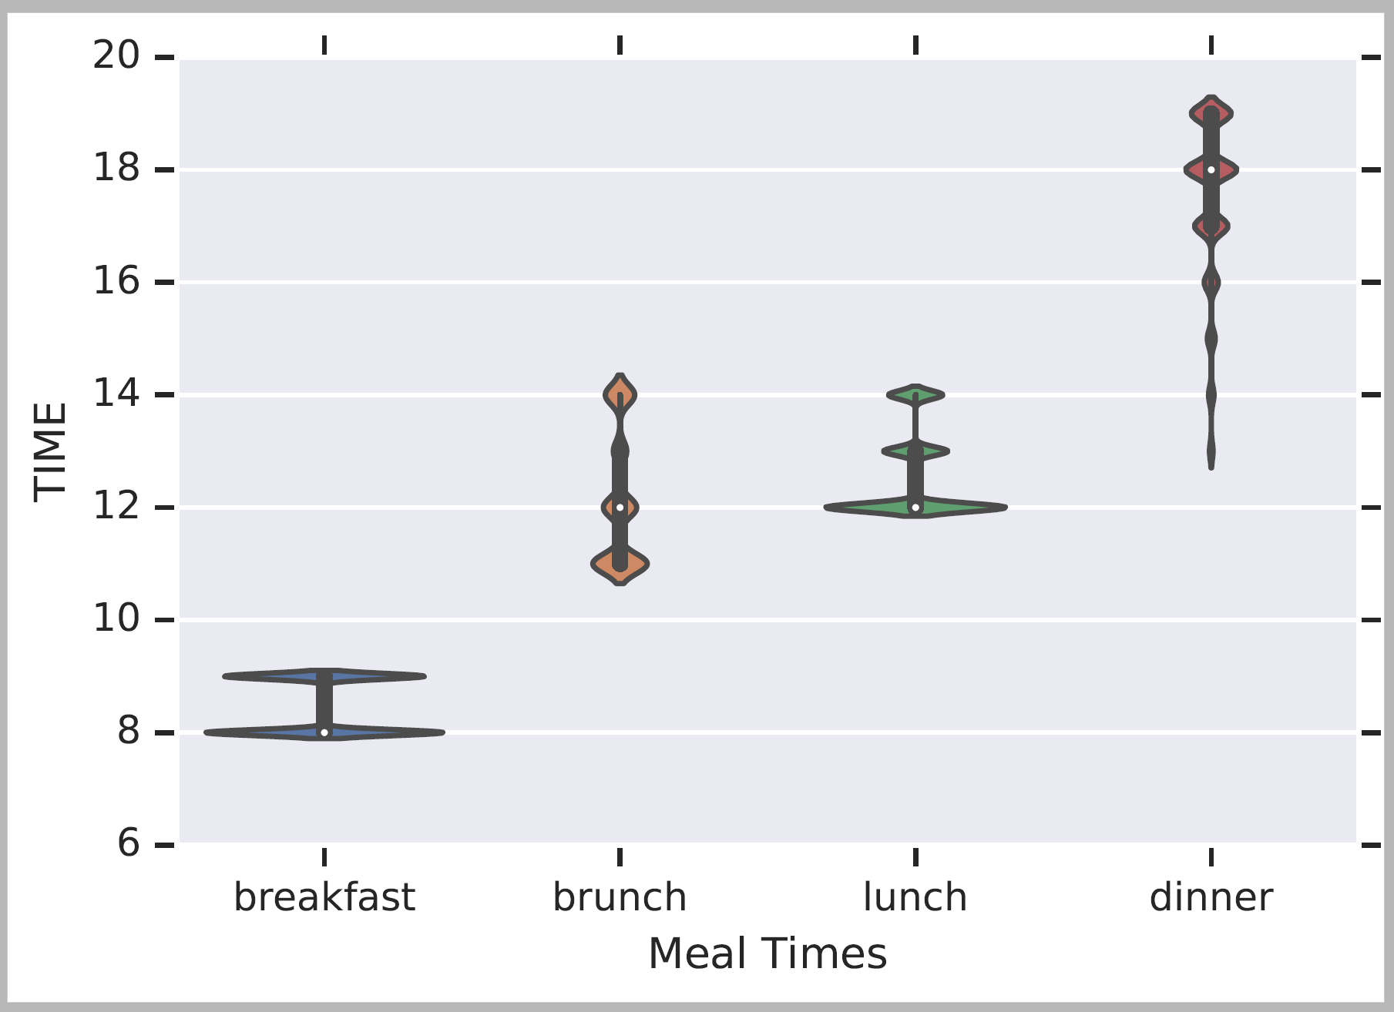
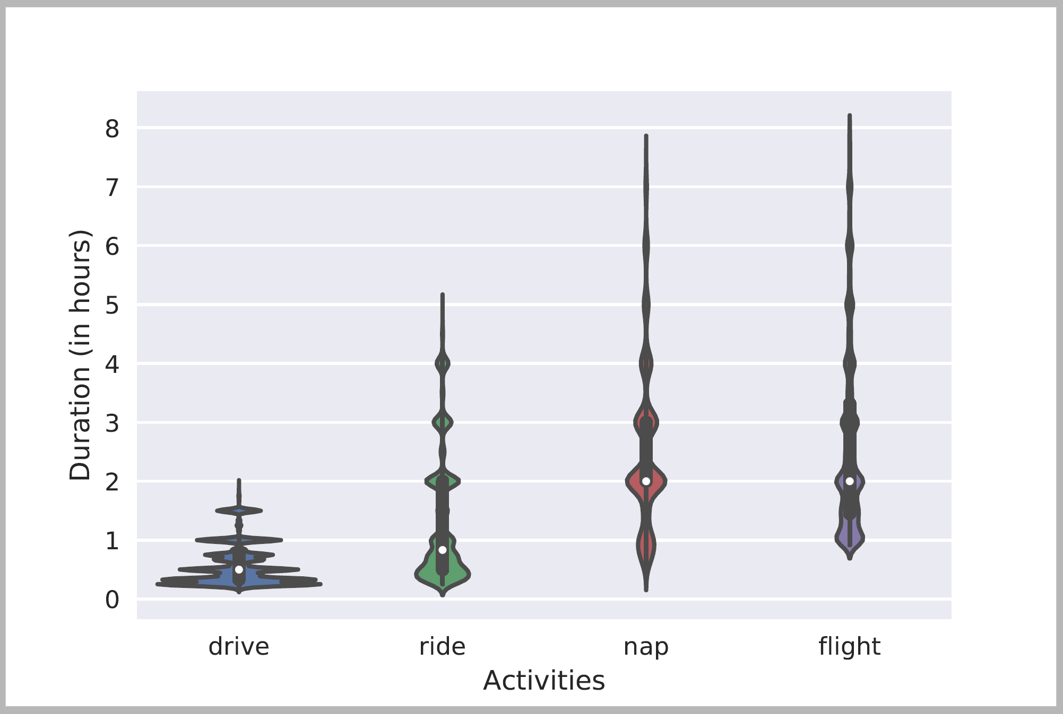
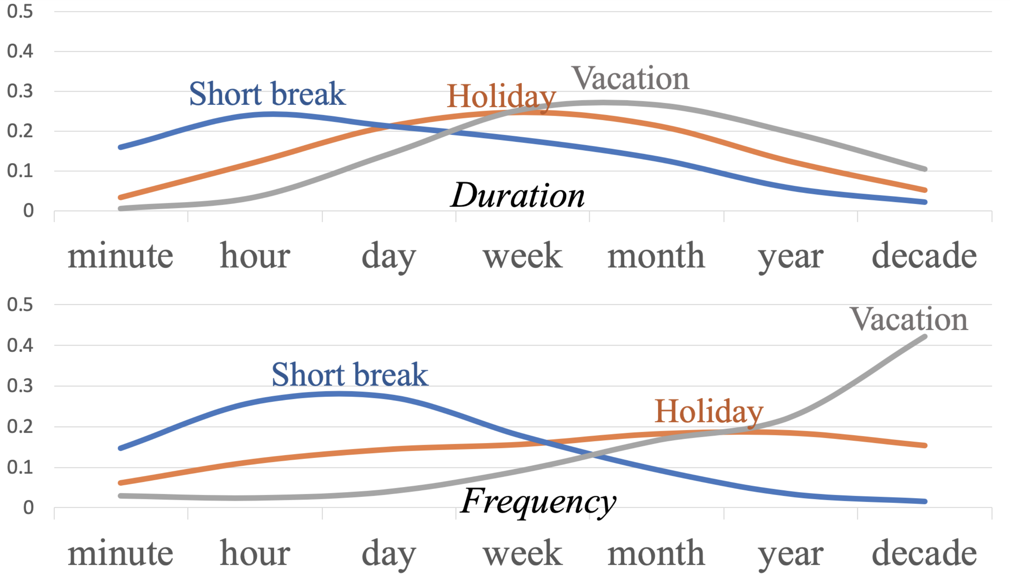
Acquiring Temporal Commonsense
Temporal order of events:
  [Ning et al. NAACL’2018]
Distributions over quantities:
    [Elazar et al, ACL’19]
Jointly modeling multiple temporal aspects
Contextual modeling
[In submission]
Typical Time
Duration

Slide 48
(1) Contextual Modeling
Modelling distributions of temporal properties of events
  In fine-grained contexts
How long does “move” take?
  People do not actually say “I moved my chair for [X] minutes”.
  How long does “I moved to a different city” take?
Events are highly contextual: The event must be specific enough to be meaningful

Slide 49
(2) Joint Modeling
Events are interrelated, and their temporal aspects are inter-related
  People rarely say explicitly how long it takes to brush their teeth
  But, we can get it from “brush teeth in the morning” or “brush teeth every day” or “brush teeth during shower”
The are also some natural constraints: duration <= 1/frequency
We extract explicit and implicit temporal mentions from a large corpus.
  I opened the window in three seconds.
  I opened the window five minutes ago.
Used as weak supervision
Used in a sequential language modeling approach.
[Event, dim, value] are used in a full event masked LM.
Exploiting these signals jointly and contextually.
Soft Cross-Entropy Objective for Ordinal Classification

Slide 50
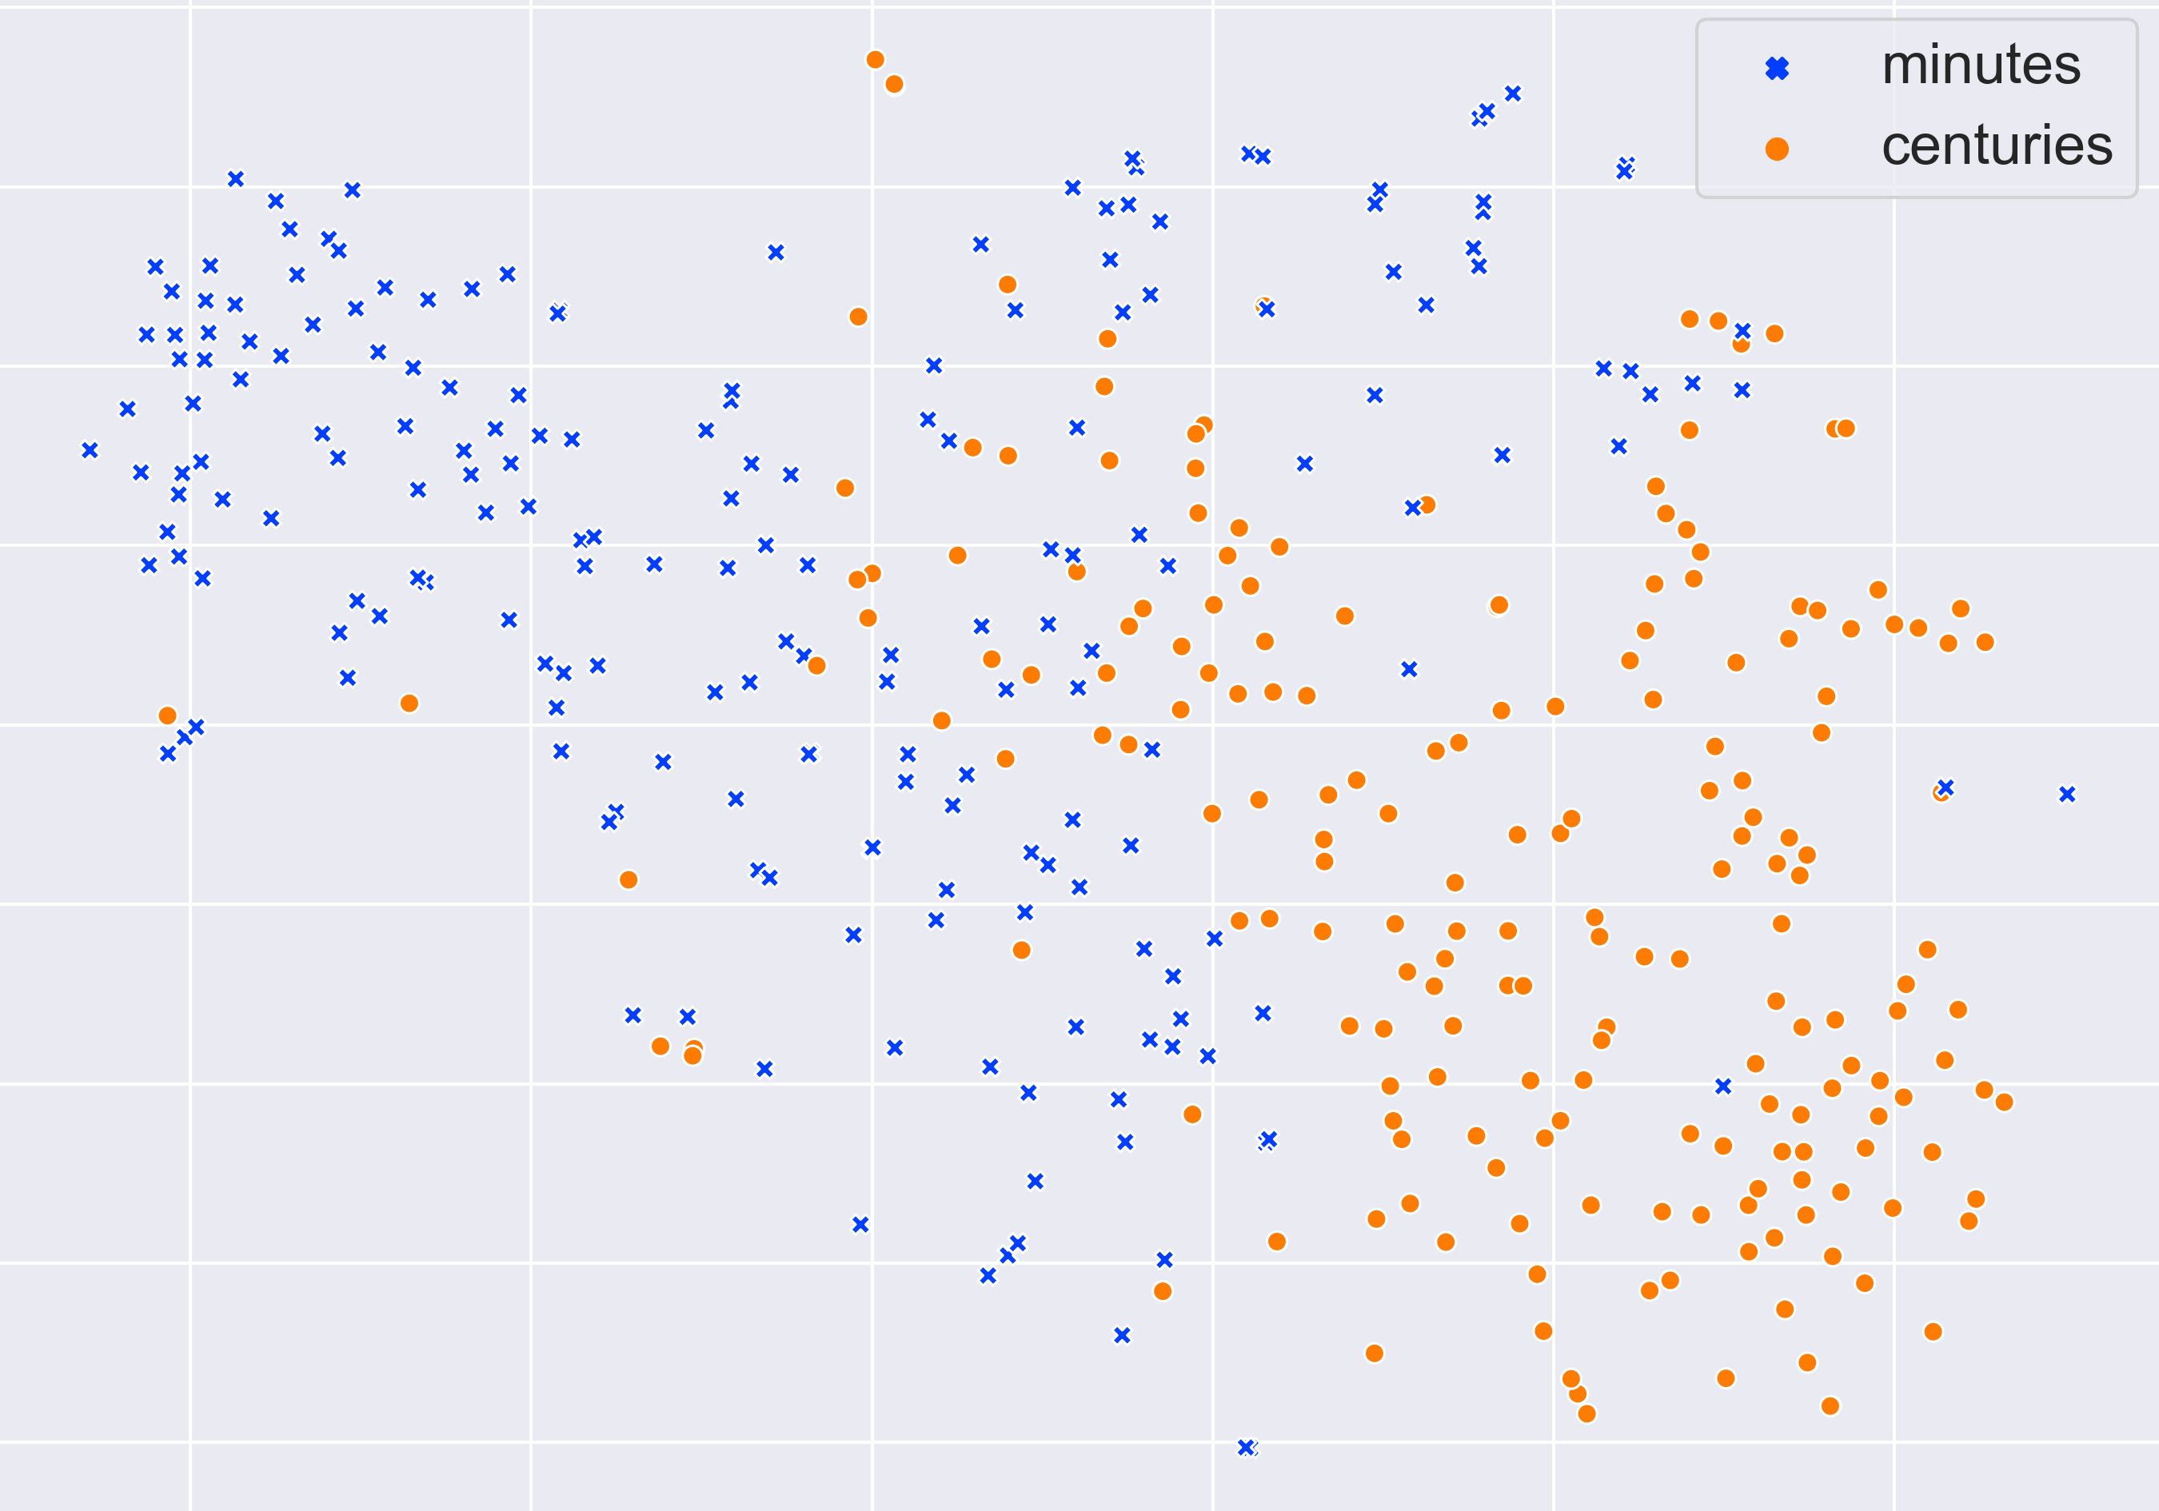
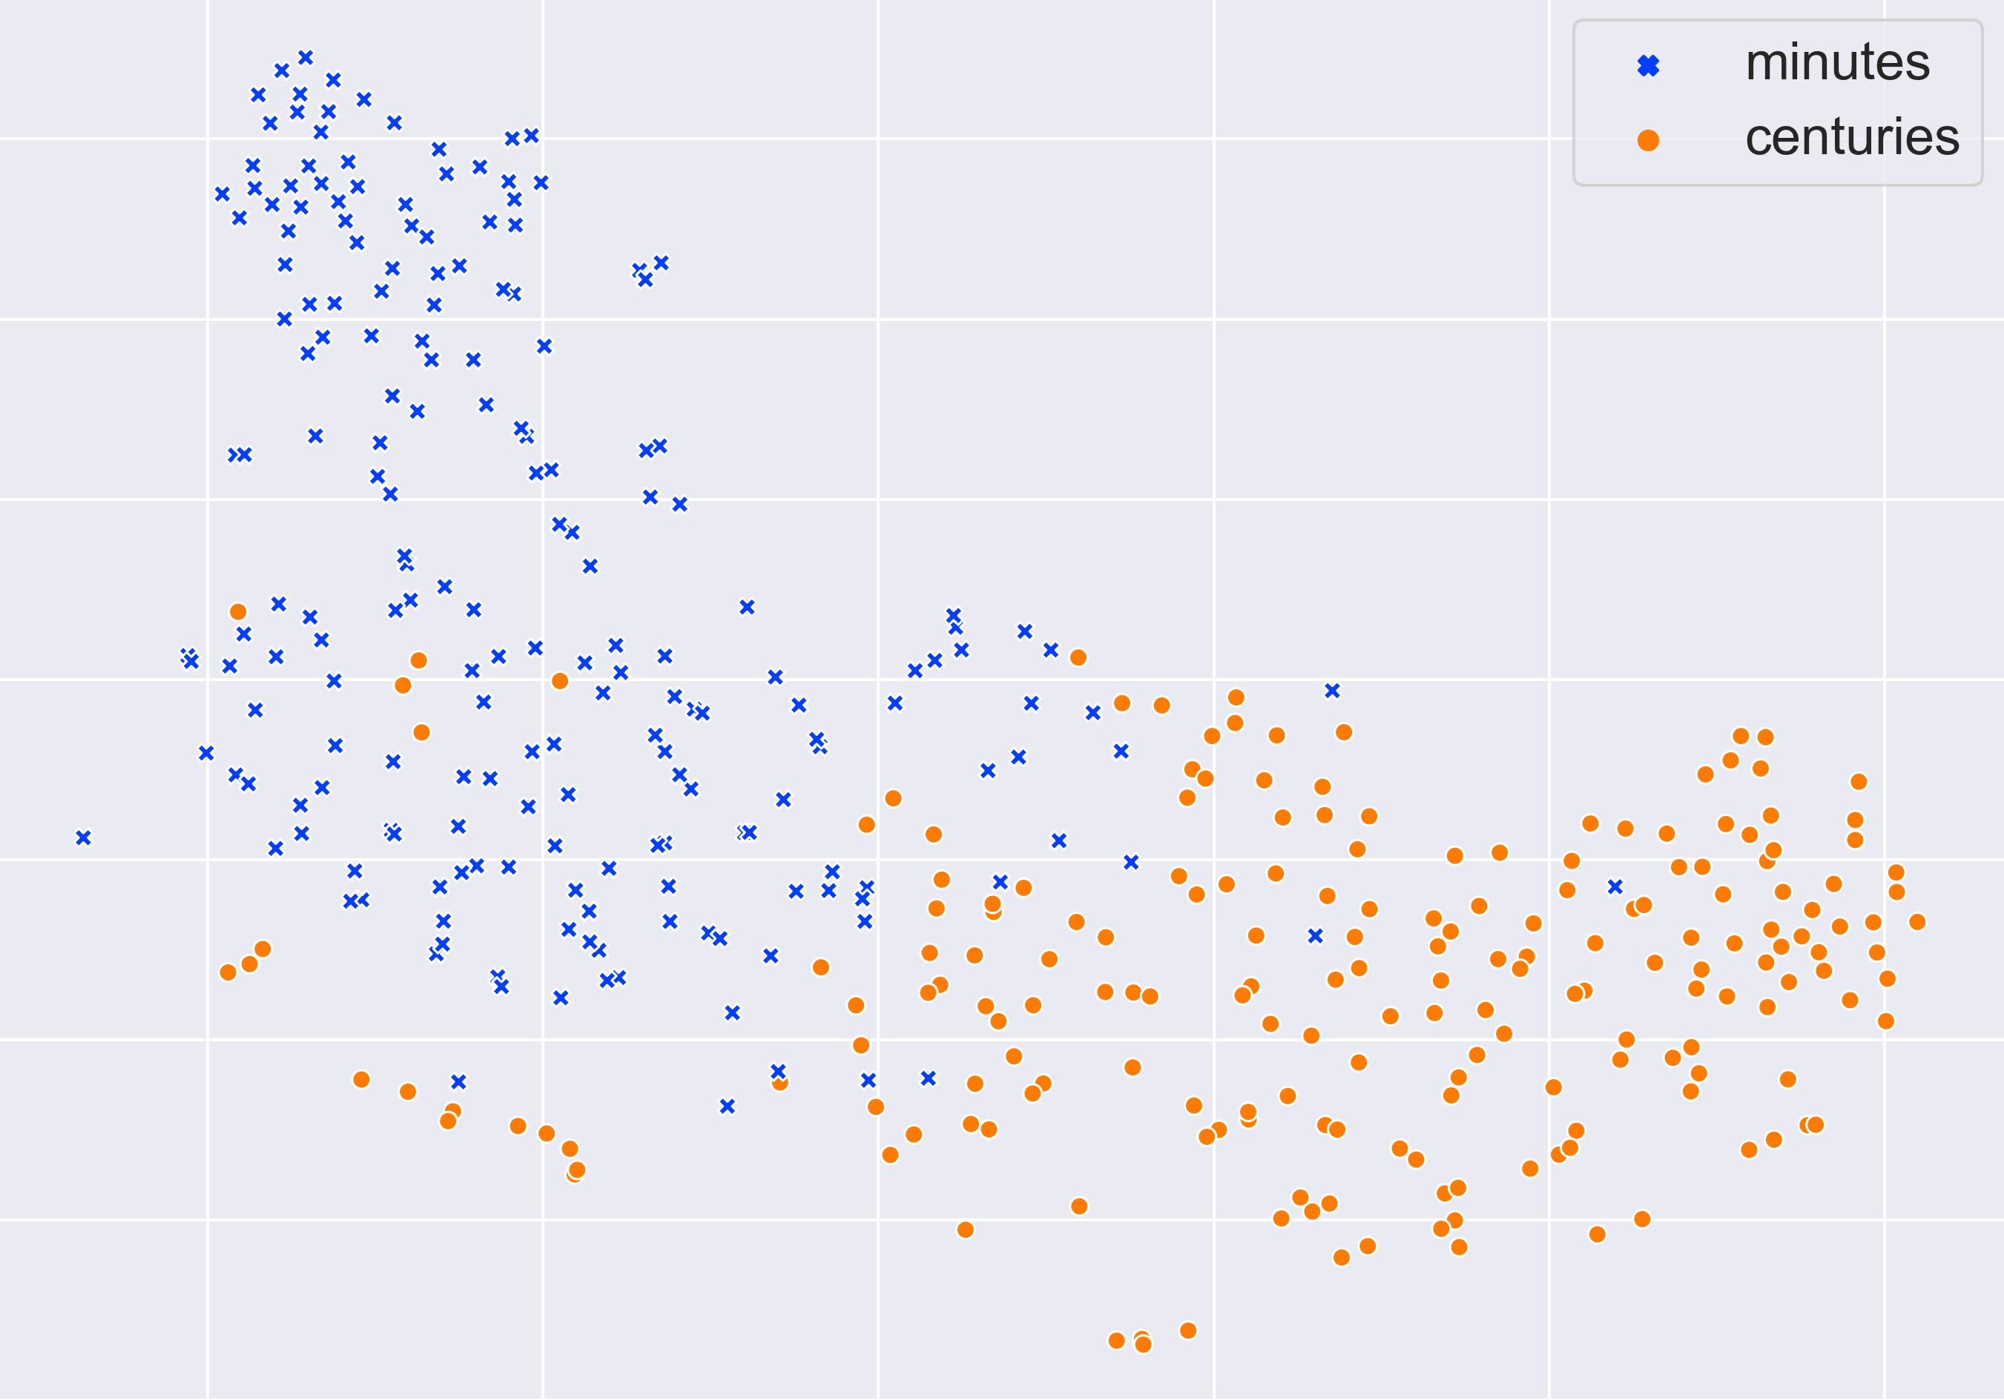
Evaluation: Embedding space
A collection of events with duration of “minutes” or “centuries” (two extremes)
BERT (left), Ours (right) representation on the event’s trigger
  PCA + t-SNE to 2D visualization
Our model separates the events much better (➔ our model is aware of time)
BERT
Our Model

Slide 51
What Do We Know?
We can estimate some temporal aspects well
But we don’t know if Aristotle had a laptop
  Not even if “we can make it to dinner before the movie”.
Decompose or not decompose?
  The strategy: What do we need to know in order to answer
  What functions are to be computed over components?
How/What to learn?
But, we have made significant progress in reasoning about time, and a few additional reasoning tasks in NLP
Duration
Typical Time
Did Aristotle have a laptop?

Slide 52
It’s Time to Reason:
Outline
Addressing “sparse” challenges that one cannot train for directly
  Decomposition and Composition (and some more)
Assigning values to multiple interrelated variables
  Given observations and knowledge
  Most likely assignment: Abduction
Computing functions over multiple interrelated inferred variables
  Last; longest, most frequent, etc.
Decisions over a dynamic set of interrelated variables
  The Aristotle example
    Need a strategy to decide what the variables are & a function computed over it
  Temporal Commonsense
(1)
(3)
Who scored the last field goal for the Eagles?
[given a recap of the game]
(2)
Will we make it to dinner before the movie?

Slide 53
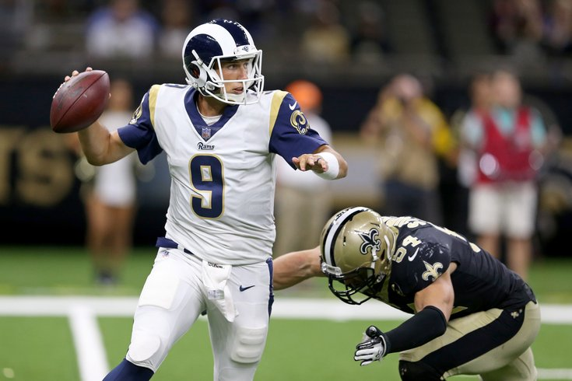
Some questions to my Sports’ Assistant
Modified version of a question from AI2’s DROP dataset
Coming off a road win over the Cowboys, the Redskins traveled to Lincoln Financial Field for a Week 5 NFC East duel with the Philadelphia Eagles. In the first quarter, the Redskins trailed early as RB Brian Westbrook scored on a 9-yard TD run and the Eagles DeSean Jackson returned a punt 68 yards for a touchdown. Washington still trailed at half time 14:9, with field goals from Shaun Suisham. In the third quarter, the Redskins took the lead on a trick play as WR Antwaan Randle El threw an 18-yard TD pass to TE Chris Cooley. In the fourth quarter, the Redskins increased their lead when Clinton Portis scored on a 4-yard TD run. The Eagles managed one more score in the final quarter for a final score of 17:23.
How many touchdowns did the Eagles score in the first quarter?
Answer: 2
How do you know?
How many field goals did Washington score?
Answer: 3
→ Need a resource – the rules of the game.
How many field goals did the Eagles score?
Answer: 1
The answer isn’t available in any KB, but can be gleaned from the recap.
Semantic parsing is harder: it involves executing programs on the text
  Count(scoring team=Eagles (identify TD, scoring team))
[Nitish Gupta et al. ICLR’20]
Football Scoring Rule Book:
TD could be 6, 7, or 8 points.
  Kick….
Field goal is worth 3 points
…..
General rules that are to be instantiated….
What computational tasks should we think about?
“Discrete” Reasoning is essential here. And, how/what should we train?

Slide 54
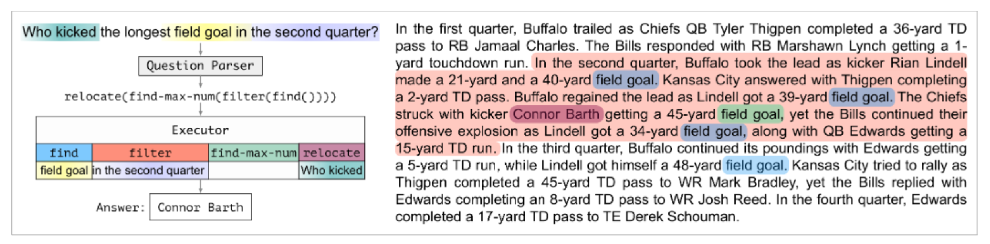
Decomposition for Reasoning about Text[Gupta et al. ICLR’20]
We need to induce a program, with some executable modules at the leaves
  “This phrase” indicates a field goal
  “This player” scored it; “this is the team” that scored it
  “This is the length” of the field goal
Reason symbolically over it.
  Imagine more expressive functions
Differentiable modules: to support end-to-end training.
End-to-end training: realistic supervision, only at the answer level
But, when have we learned “max” and “field goal”?
Colors represent levels of attention over phrases

Slide 55
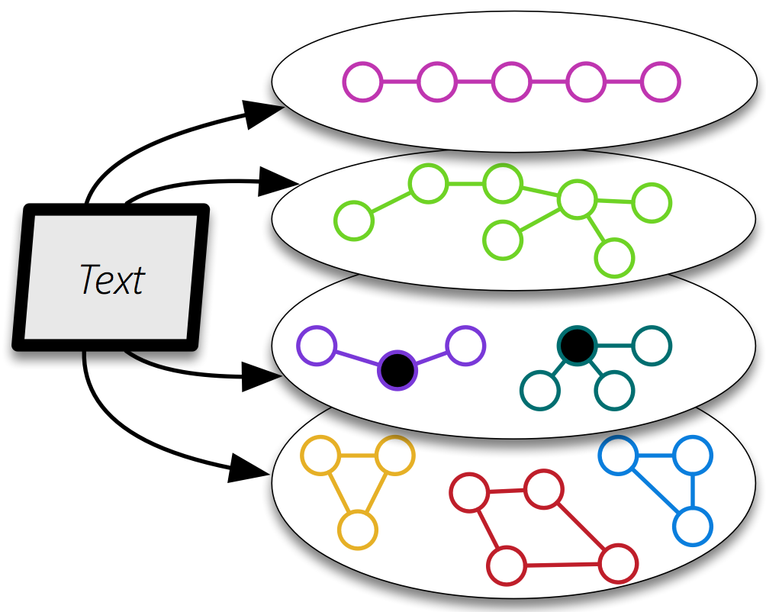
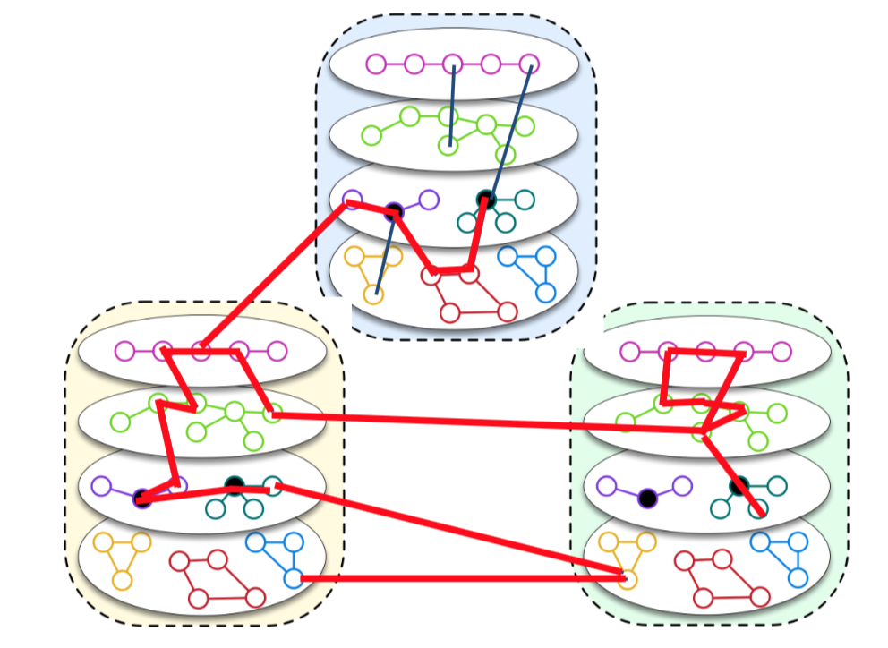
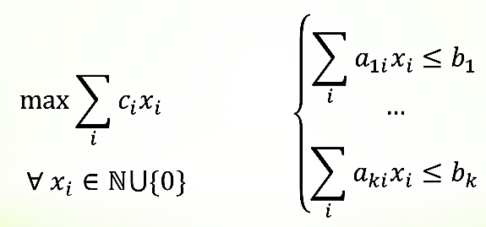
QA via Inference over Semantic Graphs [Khashabi et. al AAAI’18]
(An optimization method that recovered from the differentiability virus)
Addressing “sparse” QA challenges that one cannot train for directly
Create a unified representation of families of graphs (symbolic + continuous).
Use constrained optimization for inference over it.
Allows us to think about abductive inference – the best explanation given observations and knowledge
Not a QA specific representation
  Used also to address Algebra word problems, Physics 101 , etc.
Components can be as neural as you want
Robust, due to a stronger notion of modularity
Easier to bring in:
  Previously trained models
  Knowledge: declarative and statistical
Notes:
To show you the big picture, we form an abstraction of text, as a collection of semantic graphs.
- Each instantiation of the graphs, can contain a different phenomena over text, with nodes being mentions within your text.
- Nodes could contain embeddings/representations that will be used during the reasoning time to create alignments.
I’d like to emphasize that such representations has nothing to do with the QA task. It is purely generic, and it reflects an understanding of the language.
consequently, we expect these representations to be useful for a range of tasks;
============
also, they are to be learned from/as part of/ a range of tasks.

Slide 56

CliffsNotes
Multiple natural language documents
  Small units of text or large units of texts
  Reading news about an event/situation over time and/or from multiple sources
  Reading a book
  The novel features the character David Copperfield, his journey of change and growth from infancy to maturity, as many people enter and leave his life and he passes through the stages of his development. (Fiction, and you know it)
  London and England in the 19-th century; socio-economic state, child exploitation; schools, prisons, emigration to Australia (true historical facts)
What are the computational tasks that we should think about?

Slide 57
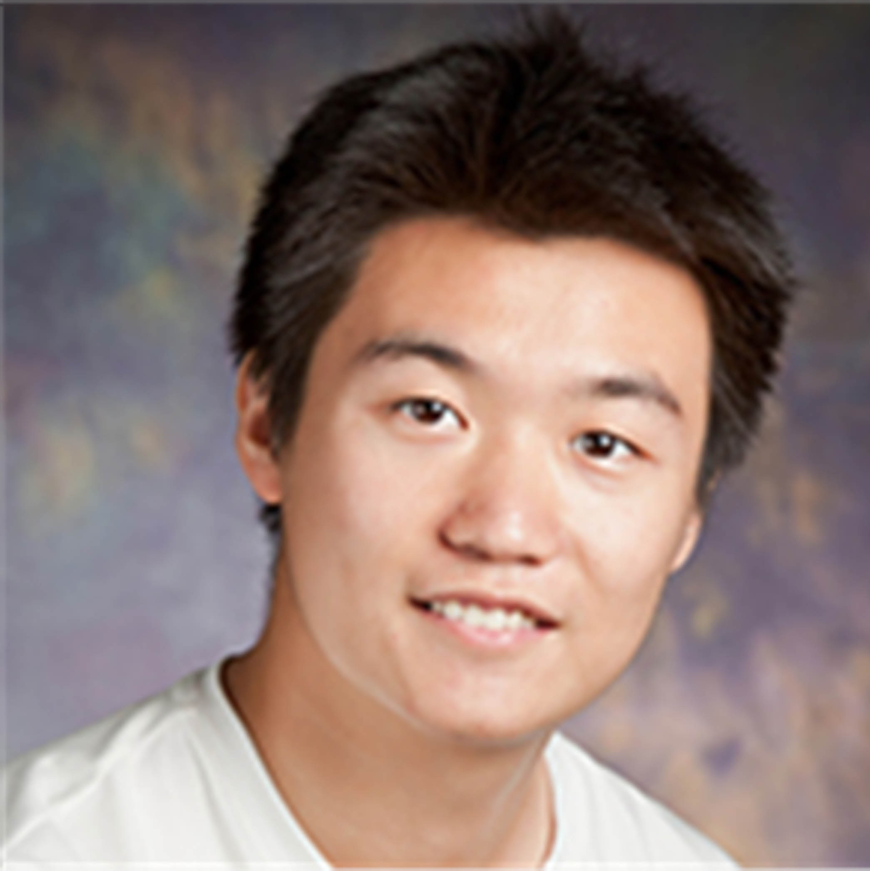

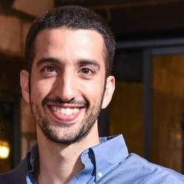

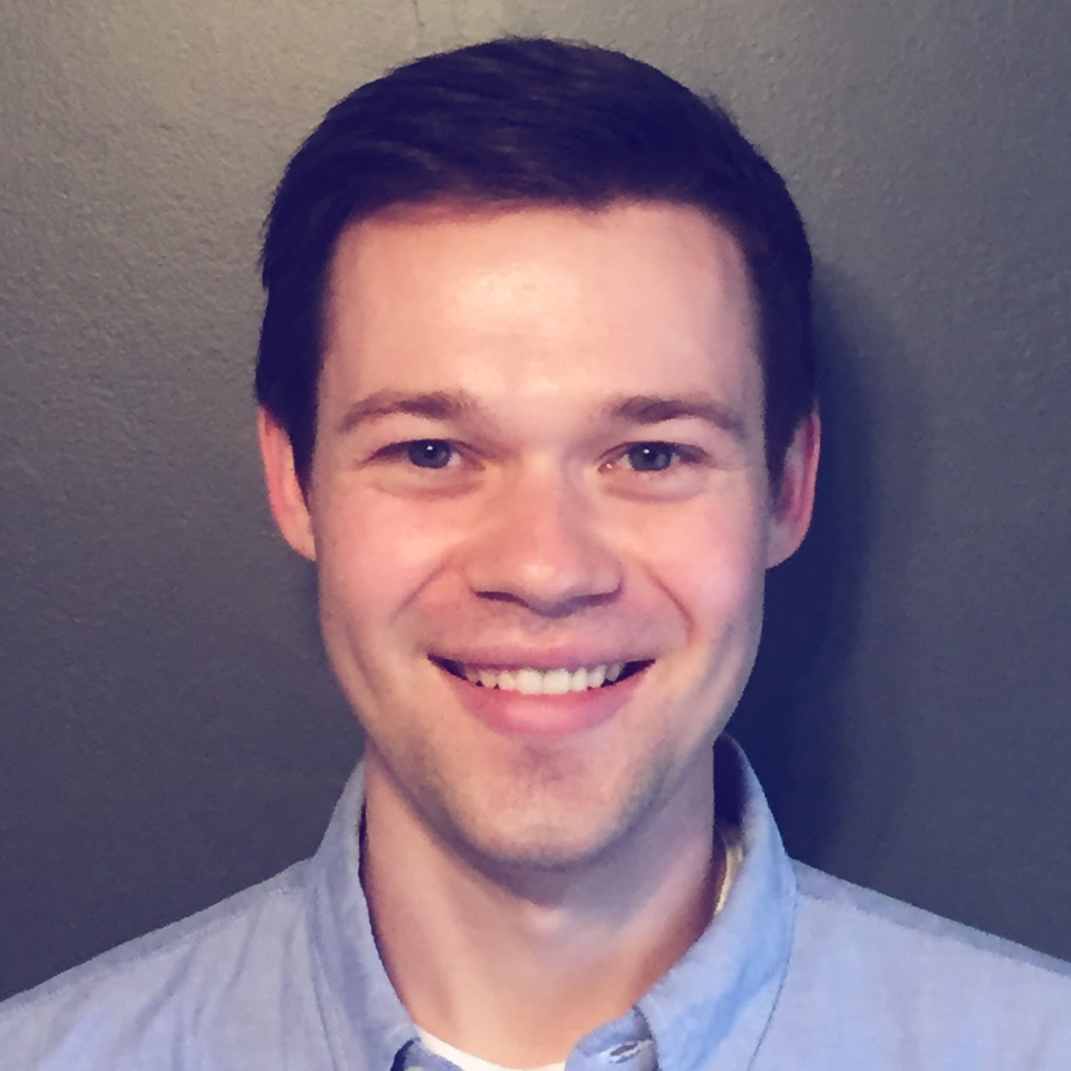

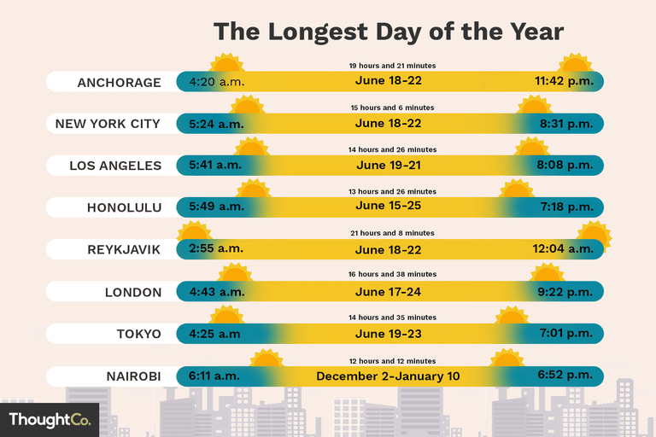
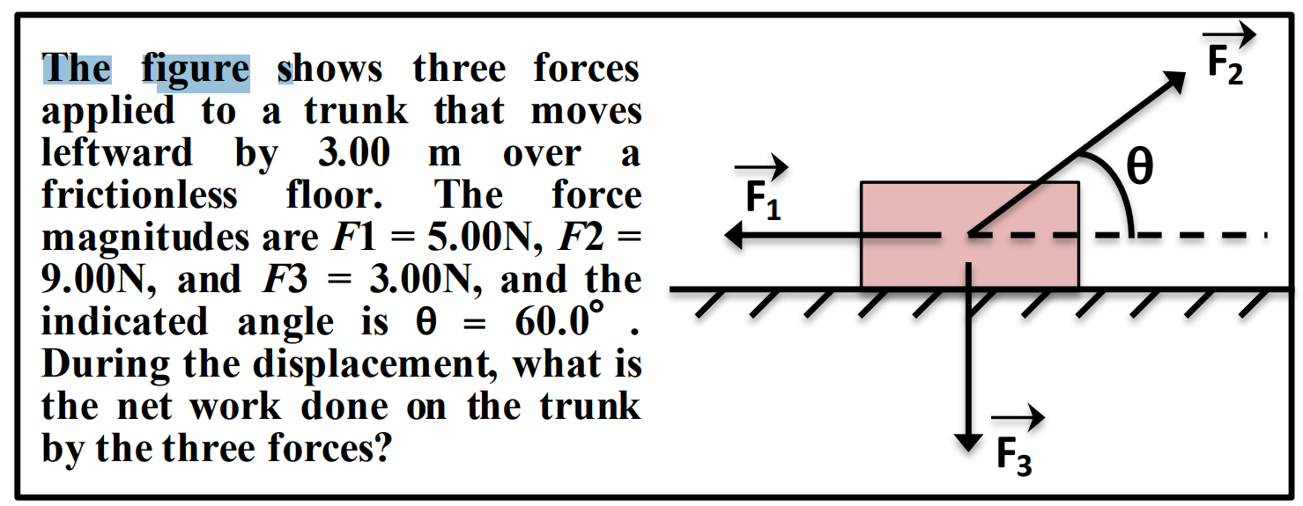
Conclusion
Thank You!
A small sample from a research program that attempts to address some of the key scientific and engineering challenges between us and understanding natural language
In the context of temporal reasoning tasks
  Reasoning: To decouple or not to decouple?
  (Temporal) Common Sense
  Supervision: how to think about it when we actually want to do reasoning?

Slide 58
End

Slide 59
Incidental Supervision & Reasoning
O’Hare must be in Chicago
O’Hare must be in Chicago
Feb 5 2017 Dozens of passengers heading to Chicago had to undergo additional screenings… It took Hesam Aamyab two tries to make it back to the United States from Iran. He is an Iranian citizen with a US visa who is doing post-doctoral research at UIC. …"Right now, I am in the USA and I'm very happy," Aamyab said. But now, he can't go back to Iran or anywhere else without risk. Other travelers shared the same worry. Asem Aleisawi was at O'Hare on Sunday to meet his wife who was coming in from Jordan.
  Learning/Supervision requires some level of reasoning to infer these weak signals

Slide 60
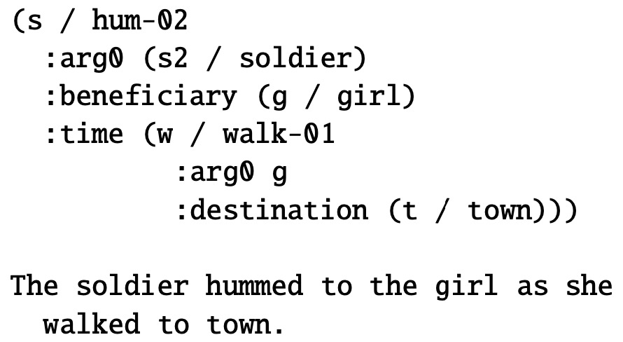
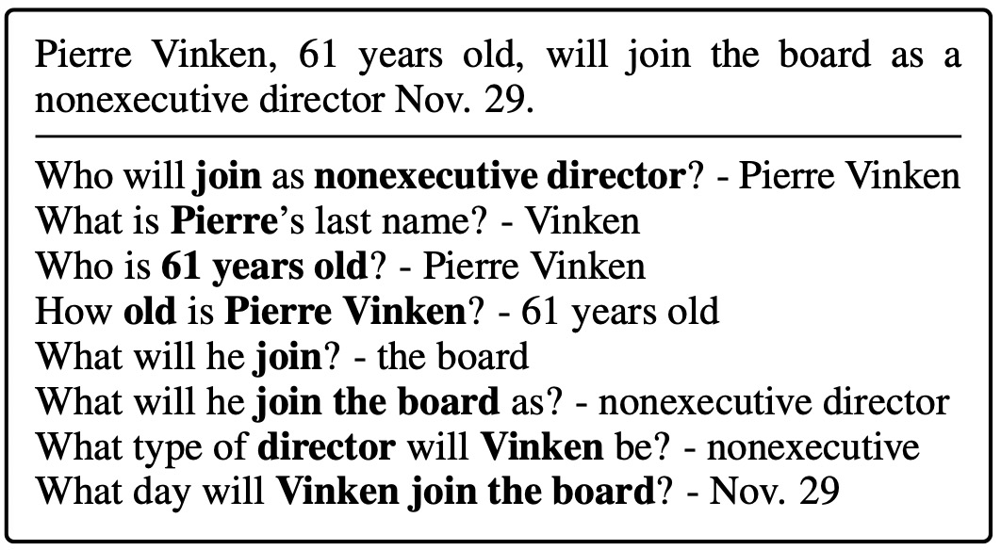
Motivation
An example in the AMR paper.
An example in the QAMR paper.
Take-away: AMR annotations are expensive and not scalable, while QAMR annotations are non-expert and flexible.
Question: Can we use low-cost signals such as QA data to help related tasks? For example, can we use QAMR to improve NER?

Slide 61
Partial or complete, that’s the question [NAACL’19]
Training Phase
When we have a fixed budget, partial structures indeed lead to better performance.
How should we quantify the quality of “partial”?
(a) Complete
(b) Partial
same budget
same budget
$$𝒯_{test}$$
$$𝒯_{test}$$
Testing Phase

Slide 62
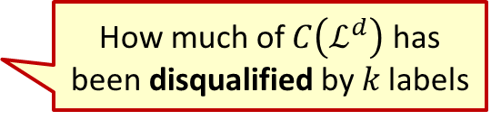
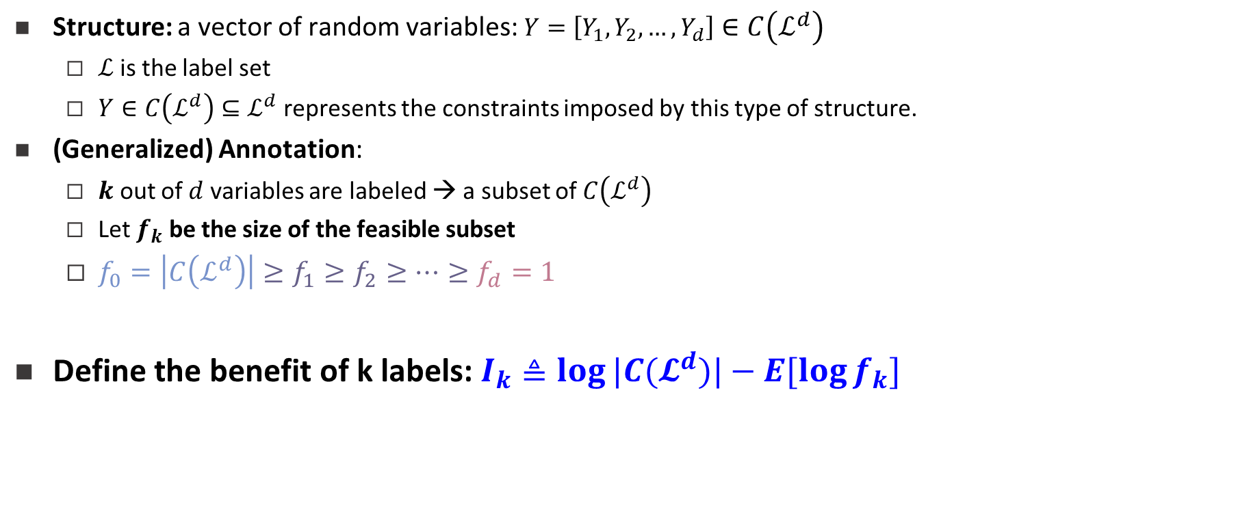

Structure
Structure: a vector of random variables: $Y=\left[Y_{1},Y_{2},…,Y_{d}\right]∈C\left(ℒ^{d}\right)$
  $ℒ$is the label set
  $Y∈C\left(ℒ^{d}\right)⊆ℒ^{d}$represents the constraints imposed by this type of structure.
(Generalized) Annotation:
  $k$ out of $d$ variables are labeled → a subset of $C\left(ℒ^{d}\right)$
  Let $f_{k}$ be the size of the feasible subset
  $f_{0}=\left|C\left(ℒ^{d}\right)\right|≥f_{1}≥f_{2}≥⋯≥f_{d}=1$
Define the benefit of k labels: $I_{k}≜\log{|C(𝓛^{d})|}−E[\log{f_{k}}]$
Constrained output; not all assignments are possible.
Intuition:
If the structure is tight, there is no need to annotate all the variables.
A partial set of signals can supervise all.
No annotation
Complete annotation
How much of $C\left(ℒ^{d}\right)$ has been disqualified by 𝑘 labels
1
1→2→3→4
Or
1→3→2→4
2
3
$$f_{k}=2$$
Partial order
4

Slide 63
Diminishing Return of New Labels
$$I_{k}:\text{The} \text{benefit} \text{of} \text{k} \text{labels} \text{is} \text{concave}$$
$$Δ_{k}=I_{k}−I_{k−1} \text{: }\text{The} \text{benefit} \text{of} \text{a} \text{new} \text{label} \text{is} \text{diminishing}$$

Slide 64
Improvement Consistent With Tightness Analysis By $I_{k}$
$$Δ_{k}=I_{k}−I_{k−1} \text{: }\text{The} \text{benefit} \text{of} \text{a} \text{new} \text{label}$$
Chain:
Temporal Relation Extraction
Algorithmically:
Results are consistent with tightness of the structure
A version of the Constraint-Driven Learning (CoDL) Algorithm [Chang et al. 2012]
+: p<5%
++: p<1%
++
++
++
++
++
++
++
++
+
more concave
Bipartite Graph:
Semantic Role Classification
Seq Tagging
Shallow Parsing
Indeed:
If the structure is tight, there is no need to annotate all the variables.
A partial set of signals can supervise all.
++
++
++
++
++
++

Slide 65

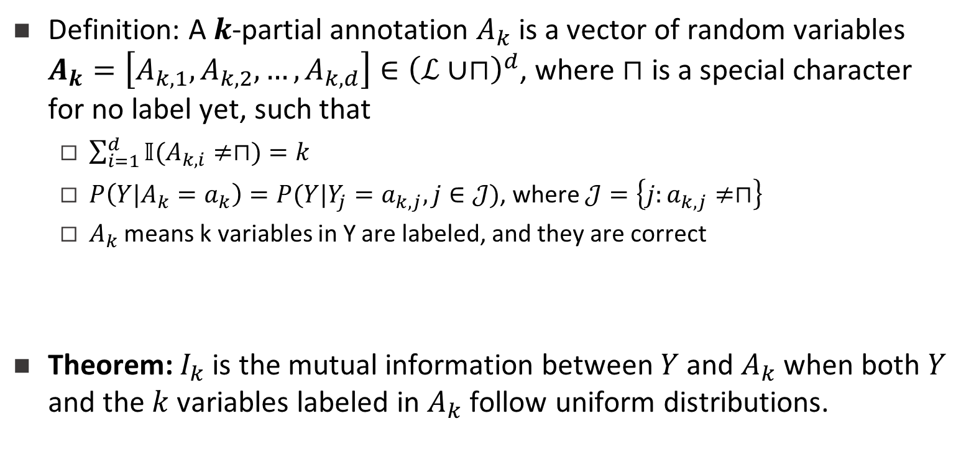
What is $I_{k}$ Actually?
Definition: A $k$-partial annotation $A_{k}$ is a vector of random variables $A_{k}=\left[A_{k,1},A_{k,2},…,A_{k,d}\right]∈{\left(ℒ∪⊓\right)}^{d}$, where $⊓$ is a special character for no label yet, such that
  $\sum_{i=1}^{d}{𝕀(A_{k,i}≠⊓)}=k$
  $P\left(Y|A_{k}=a_{k}\right)=P(Y|Y_{j}=a_{k,j},j∈𝒥)$, where $𝒥=\left\{j:a_{k,j}≠⊓\right\}$
  $A_{k}$ means k variables in Y are labeled, and they are correct
Theorem: $I_{k}$ is the mutual information between $Y$ and $A_{k}$ when both $Y$ and the $k$ variables labeled in $A_{k}$ follow uniform distributions.
Notes:
If we define k-partial annotation as a vector of random variables A_k. You don’t need to read the formulations below. The translation is: A_k means k variables are labeled in Y. Then actually we can prove, that I_k is the mutual information between structure Y and the k-partial annotation A_k, when they follow certain uniform distributions. This is a very interesting finding.
(30 sec)

