Slide 1
Constrained Conditional Models
Integer Linear Programming Formulations for
Natural Language Understanding
Dan Roth
Department of Computer Science
University of Illinois at Urbana-Champaign
With thanks to:
Collaborators: Ming-Wei Chang, Gourab Kundu, Lev Ratinov, Rajhans Samdani,
Vivek Srikumar, Many others
Funding: NSF; DHS; NIH; DARPA.
DASH Optimization (Xpress-MP)
August 2012
Statistical Relational AI @ UAI 2012

Slide 2
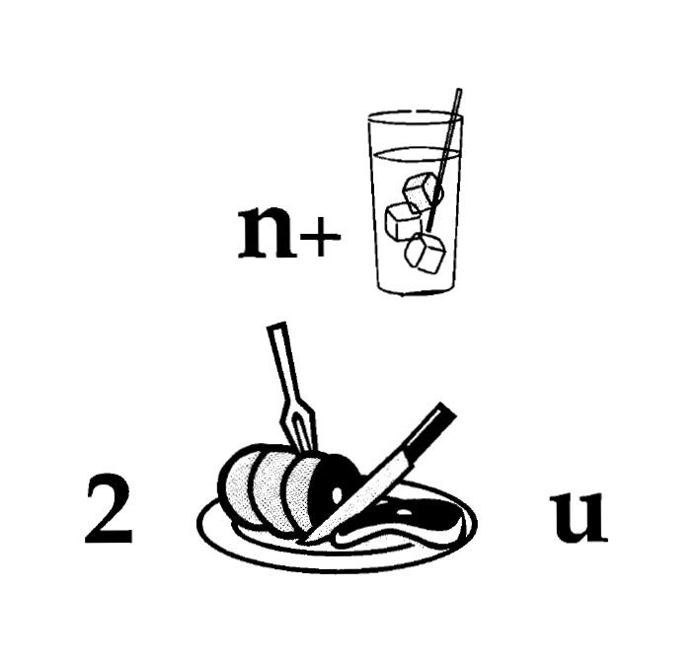
Nice to Meet You
Notes:
2
This is how we think about decisions in NLP

Slide 3
Learning and Inference in NLP
Natural Language Decisions are Structured
  Global decisions in which several local decisions play a role but there are mutual dependencies on their outcome.
It is essential to make coherent decisions in a way that takes the interdependencies into account. Joint, Global Inference.
TODAY:
  How to support real, high level, natural language decisions
  How to learn models that are used, eventually, to make global decisions
  A framework that allows one to exploit interdependencies among decision variables both in inference (decision making) and in learning.
  Inference: A formulation for inference with expressive declarative knowledge.
  Learning: Ability to learn simple models; amplify its power by exploiting interdependencies.

Slide 4
Comprehension
(ENGLAND, June, 1989) - Christopher Robin is alive and well. He lives in England. He is the same person that you read about in the book, Winnie the Pooh. As a boy, Chris lived in a pretty home called Cotchfield Farm. When Chris was three years old, his father wrote a poem about him. The poem was printed in a magazine for others to read. Mr. Robin then wrote a book. He made up a fairy tale land where Chris lived. His friends were animals. There was a bear called Winnie the Pooh. There was also an owl and a young pig, called a piglet. All the animals were stuffed toys that Chris owned. Mr. Robin made them come to life with his words. The places in the story were all near Cotchfield Farm. Winnie the Pooh was written in 1925. Children still love to read about Christopher Robin and his animal friends. Most people don't know he is a real person who is grown now. He has written two books of his own. They tell what it is like to be famous.
1. Christopher Robin was born in England. 2. Winnie the Pooh is a title of a book.
3. Christopher Robin’s dad was a magician. 4. Christopher Robin must be at least 65 now.
This is an Inference Problem
Notes:
4
I would like to talk about it in the context of language understanding problems. This is the problem I would like to solve. You are given a short story, a document, a paragraph, which you would like to understand. My working definition for Comprehension here would be “ A process that….”
So, given some statement, I would like to know if they are true in this story or not….
This is a very difficult task…
What do we need to know in order to have a chance to do that? … Many things….
And, there are probably many other stand-alone tasks of this sort that we need to be able to address, if we want to have a chance to COMPREHEND this story, and answer questions with respect to it.
But comprehending this story, being able to determined the truth of these statements is probably a lot more than that – we need to be able to put these things,
(and what is “these” isnt’ so clear) together.
So, how do we address comprehension? Here is a somewhat cartoon-she view of what has happened in this area over the last 30 years or so?
talk about – I wish I could talk about.
Here is a challenge: write a program that responds correctly to these five questions. Many of us would love to be able to do it.
This is a very natural problem; a short paragraph on Christopher Robin that we all
Know and love, and a few questions about it; my six years old can answer these
Almost instantaneously, yes, we cannot write a program that answers more than, say, 2 out of five questions.
What is involved in being able to answer these? Clearly, there are many “small” local decisions that we need to make.
We need to recognize that there are two Chris’s here. A father an a son. We need to resolve co-reference. We need sometimes
To attach prepositions properly;
The key issue, is that it is not sufficient to solve these local problems – we need to figure out how to put them
Together in some coherent way.
And in this talk, I will focus on this. We describe some recent works that we have done in this direction - …..
What do we know – in the last few years there has been a lot of work – and a considerable success on what I call here ---
Here is a more concrete and easy example -----
There is an agreement today that learning/ statistics /information theory (you name it) is of prime importance to making
Progress in these tasks. The key reason, is that rather than working on these high level difficult tasks, we have moved
To work on well defined disambiguation problems that people felt are at the core of many problems.
And, as an outcome of work in NLP and Learning Theory, there is today a pretty good understanding for how to solve
All these problems – which are essentially the same problem.

Slide 5
Learning and Inference
Global decisions in which several local decisions play a role but there are mutual dependencies on their outcome.
  In current NLP we often think about simpler structured problems: Parsing, Information Extraction, SRL, etc.
  As we move up the problem hierarchy (Textual Entailment, QA,….) not all component models can be learned simultaneously
  We need to think about (learned) models for different sub-problems
  Knowledge relating sub-problems (constraints) may appear only at evaluation time
Goal: Incorporate models’ information, along with prior knowledge (constraints) in making coherent decisions
  Decisions that respect the local models as well as domain & context specific knowledge/constraints.
Notes:
5

Slide 6
Outline
Background: NL Structure with Constrained Conditional Models
  Global Inference with expressive structural constraints in NLP
Constraints Driven Learning
  Training Paradigms for latent structure
  Constraints Driven Learning (CoDL)
  Unified (Constrained) Expectation Maximization
Amortized ILP Inference
  Exploiting Previous Inference Results

Slide 7
Three Ideas Underlying Constrained Conditional Models
Modeling
Idea 1:
Separate modeling and problem formulation from algorithms
  Similar to the philosophy of probabilistic modeling
Idea 2:
Keep model simple, make expressive decisions (via constraints)
  Unlike probabilistic modeling, where models become more expressive
Idea 3:
Expressive structured decisions can be supported by simply
learned models
  Global Inference can be used to amplify the simple models (and even minimal supervision).
Inference
Learning

Slide 8
Pipeline
Motivation I
Raw Data
Most problems are not single classification problems
POS Tagging
Phrases
Semantic Entities
Relations
Parsing
WSD
Semantic Role Labeling
Conceptually, Pipelining is a crude approximation
  Interactions occur across levels and down stream decisions often interact with previous decisions.
  Leads to propagation of errors
  Occasionally, later stages could be used to correct earlier errors.
But, there are good reasons to use pipelines
  Putting everything in one basket may not be right
  How about choosing some stages and think about them jointly?

Slide 9
Inference with General Constraint Structure [Roth&Yih’04,07]
Recognizing Entities and Relations
Improvement over no inference: 2-5%
other | 0.05
per | 0.85
loc | 0.10
other | 0.05
per | 0.85
loc | 0.10
other | 0.10
per | 0.60
loc | 0.30
other | 0.10
per | 0.60
loc | 0.30
other | 0.05
per | 0.50
loc | 0.45
other | 0.05
per | 0.50
loc | 0.45
other | 0.05
per | 0.50
loc | 0.45
Y = argmax ∑_{y} score(y=v) [[y=v]] =
= argmax score(E₁ = PER)¢ [[E₁ = PER]] + score(E₁ = LOC)¢ [[E₁ = LOC]] +…
score(R₁ = S-of)¢ [[R₁ = S-of]] +…..
Subject to Constraints
An Objective function that incorporates learned models with knowledge (constraints)
A constrained Conditional Model
  Dole ’s wife, Elizabeth , is a native of N.C.
  E1 E2 E3
Key Questions:
How to guide the global
inference?
- Why not learn Jointly?
R₁₂
R₂₃
irrelevant | 0.05
spouse_of | 0.45
born_in | 0.50
Note:
Non Sequential Model
irrelevant | 0.05
spouse_of | 0.45
born_in | 0.50
irrelevant | 0.05
spouse_of | 0.45
born_in | 0.50
irrelevant | 0.10
spouse_of | 0.05
born_in | 0.85
irrelevant | 0.10
spouse_of | 0.05
born_in | 0.85
Models could be learned separately; constraints may come up only at decision time.
Notes:
9
Let’s look at another example in more details.
We want to extract entities (person, location and organization) and relations between them (born in, spouse of).
Given a sentence, suppose the entity classifier and relation classifier have already given us their predictions along with the confidence values. The blue ones are the labels that have the highest confidence individually. However, this global assignment has some obvious mistakes. For example, the second argument of a born_in relation should be location instead of person. Since the classifiers are pretty confident on R23, but not on E3, so we should correct E3 to be location.
Similarly, we should change R12 from “born_in” to “spouse_of”

Slide 10
Problem Setting
C(y₂,y₃,y₆,y₇,y₈)
Random Variables Y:
Conditional Distributions P (learned by models/classifiers)
Constraints C– any Boolean function
defined over partial assignments (possibly: + weights W )
Goal: Find the “best” assignment
  The assignment that achieves the highest global performance.
This is an Integer Programming Problem
y₁
C(y₁,y₄)
y₂
y₃
y₄
y₅
y₆
y₇
y₈
observations
Y*=argmax_{Y} P•Y subject to constraints C
(+ W•C)
Notes:
10
A constraint C is simply defined as a 3-tuple (R, E1, and E2). If a class label of a relation is R, the legitimate class labels of its two entity arguments are E1 and E2.
For example, the first argument of the born_in relation must be a person, and the second argument is a location.

Slide 11
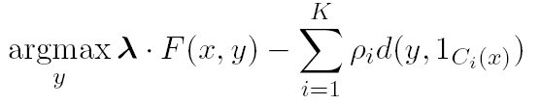
Constrained Conditional Models
Penalty for violating
the constraint.
(Soft) constraints component
Weight Vector for “local” models
Features, classifiers; log-linear models (HMM, CRF) or a combination
How far y is from
a “legal” assignment
How to solve?
This is an Integer Linear Program
Solving using ILP packages gives an exact solution.
Cutting Planes, Dual Decomposition & other search techniques are possible
How to train?
Training is learning the objective function
Decouple? Decompose?
How to exploit the structure to minimize supervision?

Slide 12
Examples: CCM Formulations
CCMs can be viewed as a general interface to easily combine declarative domain knowledge with data driven statistical models
  Formulate NLP Problems as ILP problems (inference may be done otherwise)
    1. Sequence tagging (HMM/CRF + Global constraints)
    2. Sentence Compression (Language Model + Global Constraints)
    3. SRL (Independent classifiers + Global Constraints)
Sequential Prediction
HMM/CRF based:
Argmax ∑ ¸_{ij} x_{ij}
Sentence Compression/Summarization:
Language Model based:
Argmax ∑ ¸_{ijk} x_{ijk}
Linguistics Constraints
Cannot have both A states and B states in an output sequence.
Linguistics Constraints
If a modifier chosen, include its head
If verb is chosen, include its arguments

Slide 13
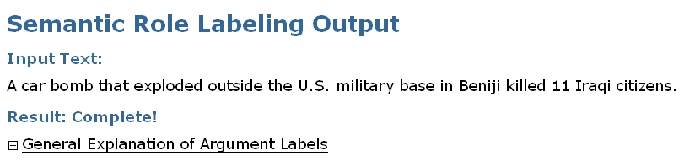
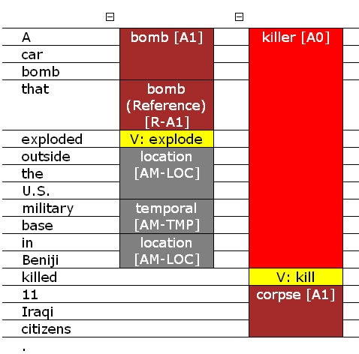
Semantic Role Labeling
Who did what to whom, when, where, why,…
Demo: http://cogcomp.cs.illinois.edu/
Top ranked system in CoNLL’05 shared task
Key difference is the Inference

Slide 14
A simple sentence
I left my pearls to my daughter in my will .
[I]_{A0} left [my pearls]_{A1} [to my daughter]_{A2} [in my will]_{AM-LOC} .
A0 Leaver
A1 Things left
A2 Benefactor
AM-LOC Location
I left my pearls to my daughter in my will .
Notes:
In the context of SRL, the goal is to predict for each possible phrase in a given sentence if it is an argument or not and what type it is.

Slide 15
Algorithmic Approach
I left my nice pearls to her
candidate arguments
Identify argument candidates
  Pruning [Xue&Palmer, EMNLP’04]
  Argument Identifier
    Binary classification
Classify argument candidates
  Argument Classifier
    Multi-class classification
Inference
  Use the estimated probability distribution given by the argument classifier
  Use structural and linguistic constraints
  Infer the optimal global output
I left my nice pearls to her
I left my nice pearls to her
[ [ [ [ [
] ] ] ] ]
I left my nice pearls to her
Notes:
We follow a now seemingly standard approach to SRL.
Given a sentence, first we find a set of potential argument candidates by identifying
which words are at the border of an argument.
Then, once we have a set of potential arguments, we use a phrase-level classifier to tell us how likely an argument is to be of each type.
Finally, we use all of the information we have so far to find the assignment of types to argument that gives us the “optimal” global assignment.
Similar approaches (with similar results) use inference procedures tied to their represntation.
Instead, we use a general inference procedure by setting up the problem as a linear programming problem.
This is really where our technique allows us to apply powerful information that similar approaches can not.

Slide 16
Semantic Role Labeling (SRL)
0.5
0.15
0.15
0.1
0.1
0.05
0.1
0.2
0.6
0.05
0.15
0.6
0.05
0.05
0.05
0.05
0.05
0.7
0.05
0.15
0.3
0.2
0.2
0.1
0.2
I left my pearls to my daughter in my will .
Notes:
16
Here is how we use it to solve our problem. Assume each line and color here represent all possible arguments and argument types with the grey color means null or not actually an argument. Associated with each line is the score obtained from the argument classifier.

Slide 17
Semantic Role Labeling (SRL)
0.5
0.15
0.15
0.1
0.1
0.05
0.1
0.2
0.6
0.05
0.15
0.6
0.05
0.05
0.05
0.05
0.05
0.7
0.05
0.15
0.3
0.2
0.2
0.1
0.2
I left my pearls to my daughter in my will .
Notes:
17
If we were to let the argument classifier to make the final prediction, we would have this output which violates the non-overlapping constarints.

Slide 18
Semantic Role Labeling (SRL)
0.5
0.15
0.15
0.1
0.1
0.05
0.1
0.2
0.6
0.05
0.15
0.6
0.05
0.05
0.05
0.05
0.05
0.7
0.05
0.15
0.3
0.2
0.2
0.1
0.2
One inference problem for each verb predicate.
I left my pearls to my daughter in my will .
Notes:
18
Instead, when we use the ILP inference, it will eliminate bottom argument which is now the assignment that maximizes the linear summation of the scores that also satisfy the non-overlapping constraints.

Slide 19



Constraints
Any Boolean rule can be encoded as a set of linear inequalities.
No duplicate argument classes
Reference-Ax
Continuation-Ax
Many other possible constraints:
    Unique labels
    No overlapping or embedding
    Relations between number of arguments; order constraints
    If verb is of type A, no argument of type B
If there is an Reference-Ax phrase, there is an Ax
If there is an Continuation-x phrase, there is an Ax before it
Universally quantified rules
Learning Based Java: allows a developer to encode constraints in First Order Logic; these are compiled into linear inequalities automatically.
Notes:
19
Animation to show the following 3 constraints step by step
Binary constraints
Summation = 1 assures that it’s assigned only one label
Non-overlapping constraints
Remember to put a small bar picture

Slide 20
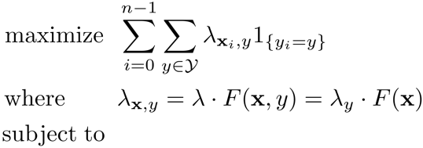
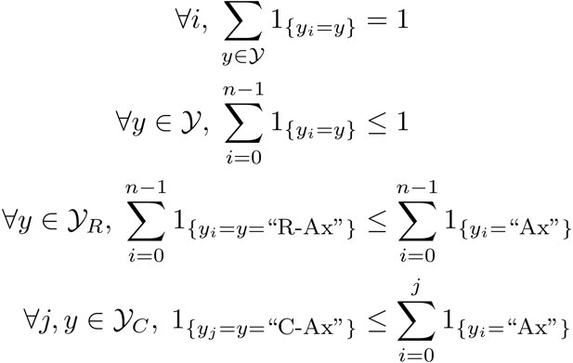
SRL: Posing the Problem

Slide 21
Context: There are Many Formalisms
Our goal is to assign values to multiple interdependent discrete variables
These problems can be formulated and solved with multiple approaches
  Markov Random Fields (MRFs) provide a general framework for it. But:
The decision problem for MRFs can be written as an ILP too
  [Roth & Yih 04,07, Taskar 04]
Key difference: In MRF approaches the model is learned globally.
  Not easy to systematically incorporate problem understanding and knowledge
  CCMs, on the other hand, are designed to address also cases in which some of the component models are learned in other contexts and at other times, or incorporated as background knowledge.
  That is, some components of the global decision need not, or cannot, be trained in the context of the decision problem.
  Markov Logic Networks (MLNs) attempt to compile knowledge into an MRF, thus provide one example of a global training approach.
Caveat: Everything can be done with everything, but there are key conceptual differences that impact what is easy to do

Slide 22
Constrained Conditional Models: Probabilistic Justification
Assume that you have learned a probability distribution P(x,y).
And, a set of constraints C_{i}
The closest distribution to P(x,y) that “satisfies the constraints” has the form: [Ganchev et. al. JMLR, 2010]
The resulting objective function is has a CCM form:
CCM is the “right” objective function if you want to learn a model and “push” it to satisfy a set of given constraints.
$$P\left(x,y\right)\exp^{−\sum{ρ_{i}d(y, 1_{C_{i}}\left(x\right))}}$$

Slide 23
Context: Constrained Conditional Models
Conditional Markov Random Field
Constraints Network
y₁
y₂
y₃
y₁
y₂
y₃
y₄
y₅
y₆
y₇
y₈
y₄
y₅
y₆
y₇
y₈
y* = argmax_{y} ∑ w_{i} Á(x; y)
Linear objective functions
Often Á(x,y) will be local functions, or Á(x,y) = Á(x)
− ∑_{i} ½_{i} d_{C}(x,y)
Expressive constraints over output variables
Soft, weighted constraints
Specified declaratively as FOL formulae
Clearly, there is a joint probability distribution that represents this mixed model.
We would like to:
  Learn a simple model or several simple models
  Make decisions with respect to a complex model
Key difference from MLNs which provide a concise definition of a model, but the whole joint one.

Slide 24
Constrained Conditional Models—Before a Summary
Constrained Conditional Models – ILP formulations – have been shown useful in the context of many NLP problems
[Roth&Yih, 04,07: Entities and Relations; Punyakanok et. al: SRL …]
  Summarization; Co-reference; Information & Relation Extraction; Event Identifications; Transliteration; Textual Entailment; Knowledge Acquisition; Sentiments; Temporal Reasoning, Dependency Parsing,…
Some theoretical work on training paradigms [Punyakanok et. al., 05 more; Constraints Driven Learning, PR, Constrained EM…]
Some work on Inference, mostly approximations, bringing back ideas on Lagrangian relaxation, etc.
We will present some recent work on learning and inference in this context.
Summary of work & a bibliography: http://L2R.cs.uiuc.edu/tutorials.html

Slide 25
Outline
Background: NL Structure with Constrained Conditional Models
  Global Inference with expressive structural constraints in NLP
Constraints Driven Learning
  Training Paradigms for latent structure
  Constraints Driven Learning (CoDL)
  Unified (Constrained) Expectation Maximization
Amortized ILP Inference
  Exploiting Previous Inference Results

Slide 26
Constrained Conditional Models (aka ILP Inference)
Penalty for violating
the constraint.
(Soft) constraints component
Weight Vector for “local” models
Features, classifiers; log-linear models (HMM, CRF) or a combination
How far y is from
a “legal” assignment
How to solve?
This is an Integer Linear Program
Solving using ILP packages gives an exact solution.
Cutting Planes, Dual Decomposition & other search techniques are possible
How to train?
Training is learning the objective function
Decouple? Decompose?
How to exploit the structure to minimize supervision?

Slide 27
Training Constrained Conditional Models
Decompose Model
Decompose Model from constraints
Training:
  Independently of the constraints (L+I)
  Jointly, in the presence of the constraints (IBT)
  Decomposed to simpler models
There has been a lot of work, theoretical and experimental, on these issues, starting with [Punyakanok et. al IJCAI’05]
Not surprisingly, decomposition is good.
  See a summary in [Chang et. al. Machine Learning Journal 2012]
There has been a lot of work on exploiting CCMs in learning structures with indirect supervision [Chang et. al, NAACL’10, ICML’10]
Some recent work: [Samdani et. al ICML’12]

Slide 28
Information extraction without Prior Knowledge
Lars Ole Andersen . Program analysis and specialization for the C Programming language. PhD thesis. DIKU , University of Copenhagen, May 1994 .
Prediction result of a trained HMM
Lars Ole Andersen . Program analysis and
specialization for the
C
Programming language
. PhD thesis .
DIKU , University of Copenhagen , May
1994 .
[AUTHOR]
[TITLE]
[EDITOR]
[BOOKTITLE]
[TECH-REPORT]
[INSTITUTION]
[DATE]
Violates lots of natural constraints!
Notes:
28
28

Slide 29
Strategies for Improving the Results
Increasing the model complexity
Increase difficulty of Learning
Can we keep the learned model simple and still make expressive decisions?
(Pure) Machine Learning Approaches
  Higher Order HMM/CRF?
  Increasing the window size?
  Adding a lot of new features
    Requires a lot of labeled examples
  What if we only have a few labeled examples?
Other options?
  Constrain the output to make sense
  Push the (simple) model in a direction that makes sense
Notes:
29

Slide 30
Examples of Constraints
Each field must be a consecutive list of words and can appear at most once in a citation.
State transitions must occur on punctuation marks.
The citation can only start with AUTHOR or EDITOR.
The words pp., pages correspond to PAGE.
Four digits starting with 20xx and 19xx are DATE.
Quotations can appear only in TITLE
…….
Easy to express pieces of “knowledge”
Non Propositional; May use Quantifiers

Slide 31
Information Extraction with Constraints
Adding constraints, we get correct results!
  Without changing the model
[AUTHOR] Lars Ole Andersen .
[TITLE] Program analysis and specialization for the
C Programming language .
[TECH-REPORT] PhD thesis .
[INSTITUTION] DIKU , University of Copenhagen ,
[DATE] May, 1994 .
Constrained Conditional Models Allow:
Learning a simple model
Make decisions with a more complex model
Accomplished by directly incorporating constraints to bias/re-rank decisions made by the simpler model
Notes:
31

Slide 32
Guiding (Semi-Supervised) Learning with Constraints
In traditional Semi-Supervised learning the model can drift away from the correct one.
Constraints can be used to generate better training data
  At training to improve labeling of un-labeled data (and thus improve the model)
  At decision time, to bias the objective function towards favoring constraint satisfaction.
Seed examples
Model
Constraints
Better Predictions
Better model-based labeled data
Un-labeled Data
Decision Time
Constraints

Slide 33
Constraints Driven Learning (CoDL)
[Chang, Ratinov, Roth, ACL’07;ICML’08,MLJ’12]
(w₀,½₀)=learn(L)‏
For N iterations do
T=φ
For each x in unlabeled dataset
h Ã argmax_{y} w^{T} Á(x,y) - ∑ ½_{k} d_{C}(x,y)
T=T ∪ {(x, h)}
(w,½) = γ (w₀,½₀) + (1- γ) learn(T)
Supervised learning algorithm parameterized by
(w,½). Learning can be justified as an optimization
procedure for an objective function
Inference with constraints:
augment the training set
Learn from new training data
Weigh supervised &
unsupervised models.
Excellent Experimental Results showing the advantages of using constraints, especially with small amounts on labeled data [Chang et. al, Others]
Notes:
33
33

Slide 34

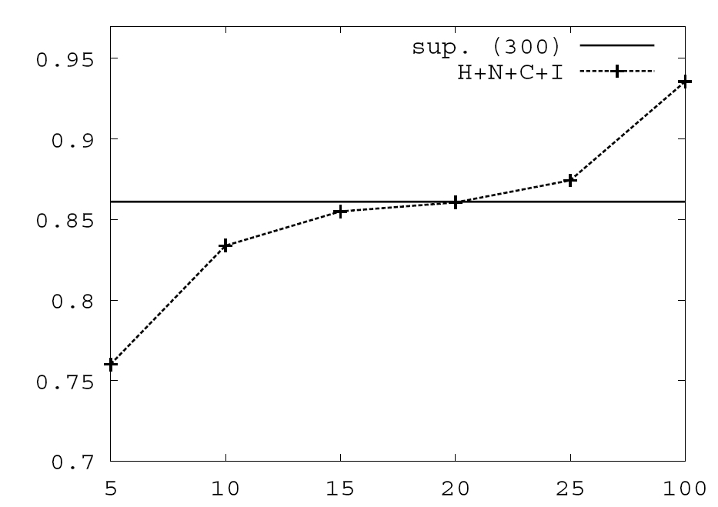
Value of Constraints in Semi-Supervised Learning
Objective function:
Learning w/o Constraints: 300 examples.
Constraints are used to Bootstrap a semi-supervised learner
Poor model + constraints used to annotate unlabeled data, which in turn is used to keep training the model.
Learning w 10 Constraints
# of available labeled examples

Slide 35
CoDL as Constrained Hard EM
Hard EM is a popular variant of EM
While EM estimates a distribution over all y variables in the E-step,
… Hard EM predicts the best output in the E-step
y*= argmax_{y} P(y|x,w)
Alternatively, hard EM predicts a peaked distribution
q(y) = ±_{y=y*}
Constrained-Driven Learning (CODL) – can be viewed as a constrained version of hard EM:
y*= argmax_{y:Uy· b} P_{w}(y|x)
Constraining the feasible set

Slide 36
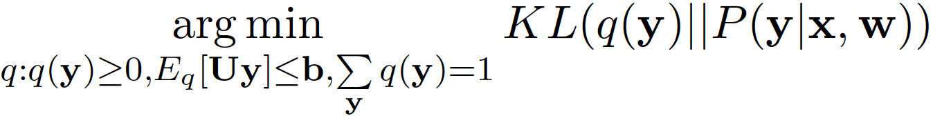
Constrained EM: Two Versions
While Constrained-Driven Learning [CODL; Chang et al, 07] is a constrained version of hard EM:
y*= argmax_{y:Uy· b} P_{w}(y|x)
… It is possible to derive a constrained version of EM:
To do that, constraints are relaxed into expectation constraints on the posterior probability q:
E_{q}[Uy] · b
The E-step now becomes:
q’ =
This is the Posterior Regularization model [PR; Ganchev et al, 10]
Constraining the feasible set

Slide 37
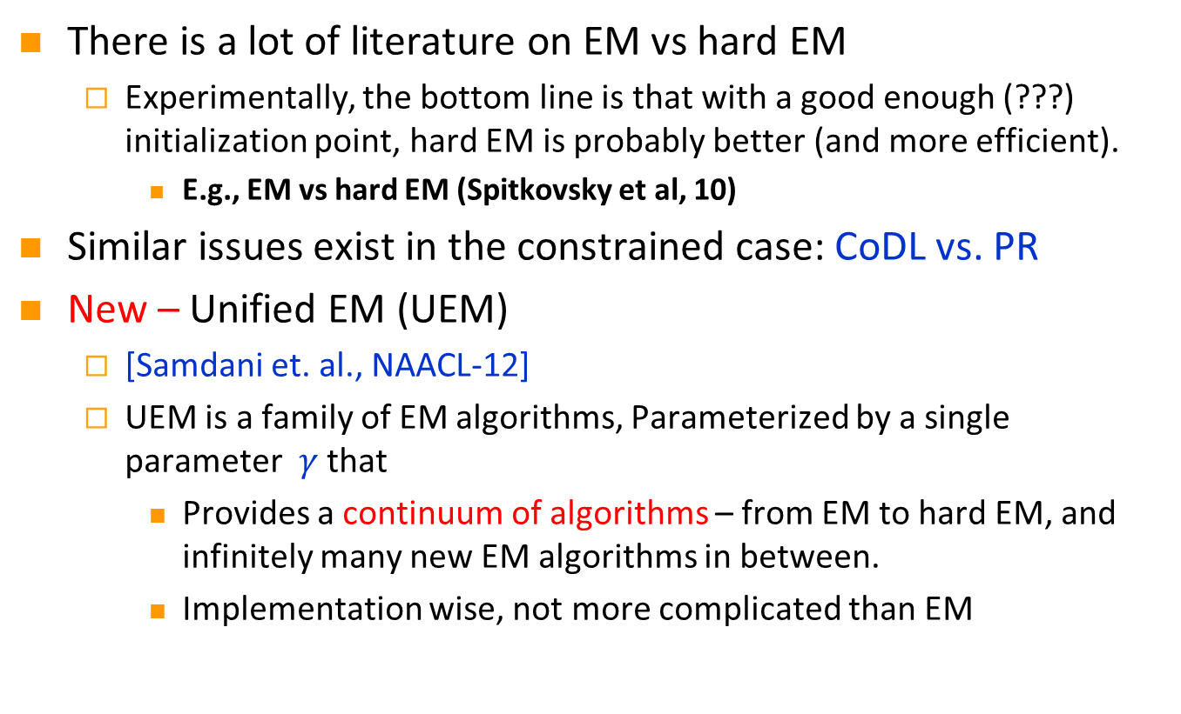
Which (Constrained) EM to use?
There is a lot of literature on EM vs hard EM
  Experimentally, the bottom line is that with a good enough (???) initialization point, hard EM is probably better (and more efficient).
    E.g., EM vs hard EM (Spitkovsky et al, 10)
Similar issues exist in the constrained case: CoDL vs. PR
New – Unified EM (UEM)
  [Samdani et. al., NAACL-12]
  UEM is a family of EM algorithms, Parameterized by a single parameter $γ$that
    Provides a continuum of algorithms – from EM to hard EM, and infinitely many new EM algorithms in between.
    Implementation wise, not more complicated than EM

Slide 38
Unified EM (UEM)
EM (PR) minimizes the KL-Divergence KL(q , P (y|x;w)) KL(q , p) = ∑_{y} q(y) log q(y) – q(y) log p(y)
UEM changes the E-step of standard EM and minimizes a modified KL divergence KL(q , P (y|x;w); °) where
KL(q , p; °) = ∑_{y} ° q(y) log q(y) – q(y) log p(y)
Provably: Different ° values ! different EM algorithms
Neal & Hinton 99
Changes the entropy of the posterior
Notes:
In order to see the details of UEM, let’s have a look at how em WORKS.

Slide 39
Unsupervised POS tagging: Different EM instantiations
Measure percentage accuracy relative to EM
Initialization with 40-80 examples
Initialization with 20 examples
Performance relative to EM
Initialization with 10 examples
Initialization with 5 examples
Uniform Initialization
EM
Gamma
Hard EM

Slide 40
Summary: Constraints as Supervision
Introducing domain knowledge-based constraints can help guiding semi-supervised learning
  E.g. “the sentence must have at least one verb”, “a field y appears once in a citation”
Constrained Driven Learning (CoDL) : Constrained hard EM
PR: Constrained soft EM
UEM : Beyond “hard” and “soft”
Related literature:
  Constraint-driven Learning (Chang et al, 07; MLJ-12),
  Posterior Regularization (Ganchev et al, 10),
  Generalized Expectation Criterion (Mann & McCallum, 08),
  Learning from Measurements (Liang et al, 09)
  Unified EM (Samdani et al 2012: NAACL-12)

Slide 41
Outline
Background: NL Structure with Constrained Conditional Models
  Global Inference with expressive structural constraints in NLP
Constraints Driven Learning
  Training Paradigms for latent structure
  Constraints Driven Learning (CoDL)
  Unified (Constrained) Expectation Maximization
Amortized ILP Inference
  Exploiting Previous Inference Results

Slide 42
Constrained Conditional Models (aka ILP Inference)
Penalty for violating
the constraint.
(Soft) constraints component
Weight Vector for “local” models
Features, classifiers; log-linear models (HMM, CRF) or a combination
How far y is from
a “legal” assignment
How to solve?
This is an Integer Linear Program
Solving using ILP packages gives an exact solution.
Cutting Planes, Dual Decomposition & other search techniques are possible
How to train?
Training is learning the objective function
Decouple? Decompose?
How to exploit the structure to minimize supervision?

Slide 43

Inference in NLP
In NLP, we typically don’t solve a single inference problem.
We solve one or more inference per sentence.
Beyond improving the inference algorithm, what can be done?
S1
He
is
reading
a
book
S2
I
am
watching
a
movie
POS
PRP
VBZ
VBG
DT
NN
S1 & S2 look very different but their output structures are the same
The inference outcomes
are the same
After inferring the POS structure for S1,
Can we speed up inference for S2 ?

Slide 44
Amortized ILP Inference [Kundu, Srikumar & Roth, EMNLP-12]
We formulate the problem of amortized inference: reducing inference time over the lifetime of an NLP tool
We develop conditions under which the solution of a new problem can be exactly inferred from earlier solutions without invoking the solver.
  ➔ A family of exact inference schemes
  ➔ A family of approximate solution schemes
Our methods are invariant to the underlying solver; we simply reduce the number of calls to the solver
Significant improvements both in terms of solver calls and wall clock time in a state-of-the-art Semantic Role Labeling

Slide 45
The Hope: POS Tagging on Gigaword
Number of structures is much smaller than the number of sentences
Number of Tokens

Slide 46
The Hope: Dep. Parsing on Gigaword
Number of structures is much smaller than the number of sentences
Number of Tokens

Slide 47
The Hope: Semantic Role Labeling on Gigaword
Number of structures is much smaller than the number of sentences
Number of Tokens

Slide 48
POS Tagging on Gigaword
How skewed is the distribution of the structures?
Number of Tokens

Slide 49
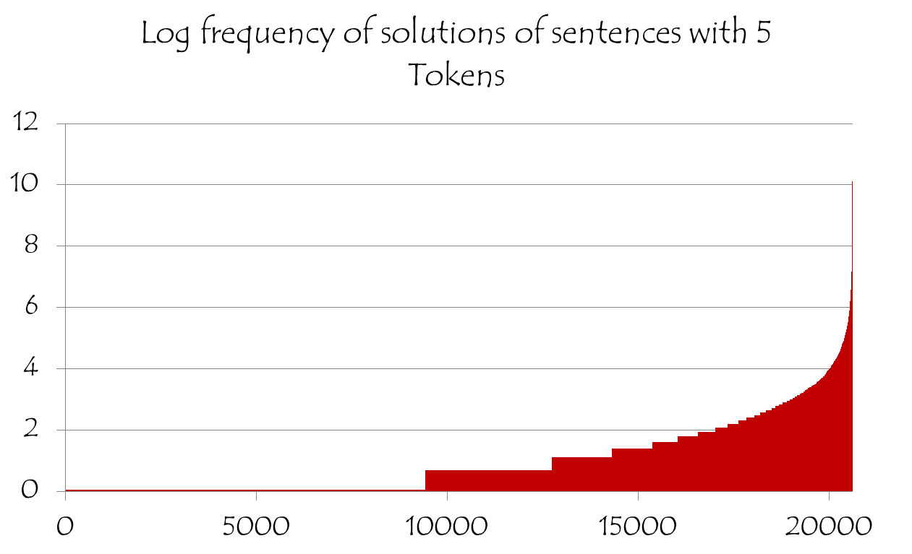
Frequency Distribution – POS Tagging (5 tokens)
Some structures occur very frequently
log
frequency
Solution Id

Slide 50
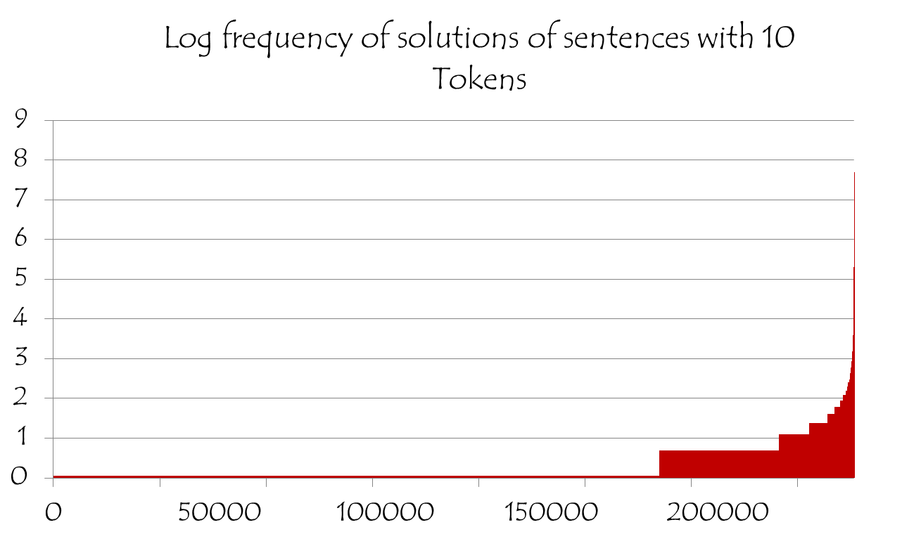
Frequency Distribution – POS Tagging (10 tokens)
Some structures occur very frequently
log
frequency
Solution Id

Slide 51
Amortized ILP Inference
These statistics show that for many different instances the inference outcomes are identical
The question is: how to exploit this fact and save inference cost.
We do this in the context of 0-1 LP, which is the most commonly used formulation in NLP.
ILP can be expressed as
max cx
Ax ≤ b
x 2 {0,1}

Slide 52
Example I
We define an equivalence class as the set of ILPs that have:
  the same number of inference variables
  the same feasible set
  (same constraints modulo renaming)
P
Q
max 2x₁+3x₂+2x₃+x₄
x₁ + x₂ ≤ 1
x₃ + x₄ ≤ 1
max 2x₁+4x₂+2x₃+0.5x₄
x₁ + x₂ ≤ 1
x₃ + x₄ ≤ 1
Same equivalence
class
x*_{P}: <0, 1, 1, 0>
c_{P}: <2, 3, 2, 1>
c_{Q}: <2, 4, 2, 0.5>
Optimal Solution
Objective coefficients of problems P, Q

Slide 53
Example I
P
Q
max 2x₁+3x₂+2x₃+x₄
x₁ + x₂ ≤ 1
x₃ + x₄ ≤ 1
max 2x₁+4x₂+2x₃+0.5x₄
x₁ + x₂ ≤ 1
x₃ + x₄ ≤ 1
x*_{P}: <0, 1, 1, 0>
c_{P}: <2, 3, 2, 1>
c_{Q}: <2, 4, 2, 0.5>
Objective coefficients of active variables did not decrease from P to Q

Slide 54
Example I
Conclusion: The optimal solution of Q is that same is P’s
P
Q
x*_{P}=x*_{Q}
max 2x₁+3x₂+2x₃+x₄
x₁ + x₂ ≤ 1
x₃ + x₄ ≤ 1
max 2x₁+4x₂+2x₃+0.5x₄
x₁ + x₂ ≤ 1
x₃ + x₄ ≤ 1
x*_{P}: <0, 1, 1, 0>
c_{P}: <2, 3, 2, 1>
c_{Q}: <2, 4, 2, 0.5>
Objective coefficients of inactive variables did not increase from P to Q

Slide 55
Exact Theorem I
x*_{P,i} = 0
c_{Q,i} ≤ c_{P,i}
x*_{P,i} = 1
c_{Q,i} ≥ c_{P,i}
Denote: δc = c_{Q} - c_{P}
Theorem:
Let x*_{P} be the optimal solution of an ILP P We are and assume that an ILP Q
  Is in the same equivalence class as P
  And, For each i ϵ {1, …, n_{p} } (2x*_{P,i} – 1)δc_{i} ≥ 0, where δc = c_{Q} - c_{P}
Then, without solving Q, we can guarantee that the optimal solution of Q is x*_{Q}= x*_{P}

Slide 56
Example II
Conclusion: The optimal solution of Q is the same as the P’s
x*_{P1}= x*_{P2} = x*_{Q}
P1
x*_{P1=p2}: <0, 1, 1, 0>
c_{P1}: <2, 3, 2, 1>
c_{P2}: <2, 4, 2, 0.5>
max 2x₁+3x₂+2x₃+x₄
x₁ + x₂ ≤ 1
x₃ + x₄ ≤ 1
P2
c_{Q}: <10, 18, 10, 3.5>
c_{Q} = 2c_{P1} + 3c_{P2}
max 2x₁+4x₂+2x₃+0.5x₄
x₁ + x₂ ≤ 1
x₃ + x₄ ≤ 1
Q
max 10x₁+18x₂+10x₃+3.5x₄
x₁ + x₂ ≤ 1
x₃ + x₄ ≤ 1

Slide 57
Exact Theorem II
Theorem:
Assume we have seen m ILP problems {P₁, P₂, …, P_{m}} s.t.
  All are in the same equivalence class
  All have the same optimal solution
Let ILP Q be a new problem s.t.
  Q is in the same equivalence class as P₁, P₂, …, P_{m}
  There exists an z ≥ 0 such that c_{Q} = ∑ z_{i} c_{Pi}
Then, without solving Q, we can guarantee that the optimal solution of Q is x*_{Q}= x*_{Pi}

Slide 58
Exact Theorem II (Geometric Interpretation)
Solution x*
c_{P2}
c_{P1}
All ILPs in the cone will share the maximizer
ILPs corresponding to all these objective vectors will share the same maximizer for this feasible region
Feasible region

Slide 59
Example III
P1
c_{Q} = 2c_{P1} + 3c_{P2}
x*_{P1}= x*_{P2} = x*_{Q}
max 2x₁+3x₂+2x₃+x₄
x₁ + x₂ ≤ 1
x₃ + x₄ ≤ 1
P2
max 2x₁+4x₂+2x₃+0.5x₄
x₁ + x₂ ≤ 1
x₃ + x₄ ≤ 1
Q
max 10x₁+18x₂+10x₃+3.5x₄
x₁ + x₂ ≤ 1
x₃ + x₄ ≤ 1

Slide 60
Example III
Conclusion: The optimal solution of Q’ is the same as that of Q
x*_{Q’} = x*_{Q} = x*_{P1}= x*_{P2}
P1
max 2x₁+3x₂+2x₃+x₄
x₁ + x₂ ≤ 1
x₃ + x₄ ≤ 1
c_{Q} = 2c_{P1} + 3c_{P2}
x*_{P1}= x*_{P2} = x*_{Q}
P2
c_{Q’}= < 9, 19, 12, 2.5>
c_{Q} = < 10, 18, 10, 3.5>
x*_{Q} = < 0, 1, 1, 0>
max 2x₁+4x₂+2x₃+0.5x₄
x₁ + x₂ ≤ 1
x₃ + x₄ ≤ 1
Q
Q’
max 10x₁+18x₂+10x₃+3.5x₄
x₁ + x₂ ≤ 1
x₃ + x₄ ≤ 1
max 9x₁+19x₂+12x₃+2.5x₄
x₁ + x₂ ≤ 1
x₃ + x₄ ≤ 1

Slide 61
Exact Theorem III (Combining I and II)
Theorem:
Assume we have seen m ILP problems {P₁, P₂, …, P_{m}} s.t.
  All are in the same equivalence class
  All have the same optimal solution
Let ILP Q be a new problem s.t.
  Q is in the same equivalence class as P₁, P₂, …, P_{m}
  There exists an z ≥ 0 such that δc = c_{Q} - ∑ z_{i} c_{Pi} and (2x*_{P,i} – 1) δc_{i} ≥ 0
Then, without solving Q, we can guarantee that the optimal solution of Q is x*_{Q}= x*_{Pi}

Slide 62
Approximation Methods
Will the conditions of the exact theorem hold in practice?
The statistics we showed
before almost guarantees
they will. There are very
few structures relative to
the number of instances.
To guarantee that the conditions on the objective coefficients be satisfied we can relax them, and move to approximation methods.
Approximate methods have potential for more speedup than exact theorems. It turns out that indeed:
  Higher Speedup is higher without a drop in accuracy.

Slide 63
Simple Approximation Method (I, II)
Most Frequent Solution:
  Find the set of ILPs C solved previously that fall in the same equivalence class as Q
  Find the Solution S that occurs most frequently in C
  If the frequency of S is above a threshold (support) in C, return S otherwise call the ILP solver
Top K Approximation:
  Find the set of ILPs C from cache that fall in the same equivalence class as Q
  Find the K Solutions that occur most frequently in C
  Evaluate each of the K solutions on the objective function of Q and select the one with the highest objective value

Slide 64
Theory based Approximation Methods (III, IV)
Approximation of Theorem I:
  Find the set of ILPs C previously solved that fall in the same equivalence class as Q
  If there is an ILP P in C that satisfies Theorem I within an error margin of ϵ, (for each i ϵ {1, …, n_{p} } (2x*_{P,i} – 1)δc_{i} + ϵ ≥ 0, where δc = c_{Q} - c_{P} ), return x*_{P}
Approximation of Theorem III:
  Find the set of ILPs C from cache that fall in the same equivalence class as Q
  If there is an ILP P in C that satisfies Theorem III within an error margin of ϵ, (There exists an z ≥ 0 such that δc = c_{Q} - ∑ z_{i} c_{Pi} and (2x*_{P,i} – 1) δc_{i} + ϵ ≥ 0 ), return x*_{P}

Slide 65
Semantic Role Labeling Task
Who did what to whom, when, where, why,…
I left my pearls to my daughter in my will .
[I]_{A0} left [my pearls]_{A1} [to my daughter]_{A2} [in my will]_{AM-LOC} .
A0 Leaver
A1 Things left
A2 Benefactor
AM-LOC Location
I left my pearls to my daughter in my will .
Overlapping arguments
Notes:
Here is the problem of learning the representation –
Notice that these constraints are represented in terms of the arguments – so I need to generate the vocabulary, which I will do using learning, to be able to talk about it and say that I don’t like A2, unless I have an AI.
The other problem is semantic role labeling problem. This is the problem that we will focus on in this talk.
In this problem, given a sentence, we want to identify for each verb, all the participants or arguments of that verb.
We can view the process also as trying to identifying different arguments represented by different lines and colors here. What makes the problem hard is that not only there are quadratic number of possible arguments but if we look at all possible assignments for the whole structure there will be exponential number of them. And making prediction for each of these arguments independently is not possible because some of the assignments are illegal due to the constraint that the output arguments may not overlap.
The rest of the talk will focus on how we tackle this problem, and also discuss some of the related issues by using this problem in experiment. We have a demo of the system that we have developed which is currently the state-of-the-art system. The URL is http://l2r.cs.uiuc.edu/~cogcomp/srl-demo.php. At any point in this talk if you get tired, you can start playing with this demo. There are also demos of the other systems developed in our group.

Slide 66
Experiments: Semantic Role Labeling
SRL: Based on the state-of-the-art Illinois SRL
  Top performing system in CoNLL 2005
  [V. Punyakanok and D. Roth and W. Yih, The Importance of Syntactic Parsing and Inference in Semantic Role Labeling, Computational Linguistics – 2008]
  In SRL, we solve an ILP problem for each verb predicate in each sentence
Amortization Experiments:
  Speedup & Accuracy are measured over WSJ test set (Section 23)
  Baseline is solving ILP using Gurobi 4.6
For amortization:
  We collect 250,000 SRL inference problems from Gigaword and store in a database
  For each ILP in test set, we invoke one of the theorems (exact / approx.)
  If found, we return it, otherwise we call the baseline ILP solver

Slide 67
Speedup & Accuracy
Speedup
F1
Exact
Approximate

Slide 68
Speedup in terms of clock time
Exact
Approximate

Slide 69
Summary: Amortized ILP Inference
Inference can be amortized over the lifetime of an NLP tool
Yields significant speed up, due to reducing the number of calls to the inference engine, independently of the solver.
Future work:
  Decomposed Amortized Inference
  Approximation augmented with warm start
  Relations to Lifted Inference

Slide 70
Conclusion
Thank You!
Presented Constrained Conditional Models: A Computational Framework for global inference and a vehicle for incorporating knowledge in structured tasks – via Integer Linear Programming Formulations
A powerful learning and inference paradigm for high level tasks, where multiple interdependent components are learned and need to support coherent decisions, often modulo declarative constraints.
Learning issues:
  Constraints driven learning, constrained EM
  Many other issues have been and should be studied
Inference:
  Presented a first step in amortized inference
  How to use previous inference outcomes to reduce inference cost
Check out our tools & demos
Notes:
70

Slide 71
Features Versus Constraints in CCMs
Indeed, used differently
F_{i} : X £ Y ! {0,1} or R; C_{i} : X £ Y ! {0,1};
  In principle, constraints and features can encode the same properties
In practice, they are very different
Features
  Local , short distance properties – to allow tractable inference
  Propositional (grounded):
  E.g. True if: “the” followed by a Noun occurs in the sentence”
Constraints
  Global properties
  Quantified, first order logic expressions
  E.g.True if: “all y_{i}s in the sequence y are assigned different values.”
Notes:
71

Slide 72
Role of Constraints: Encoding Prior Knowledge
Consider encoding the knowledge that:
  Entities of type A and B cannot occur simultaneously in a sentence
The “Feature” Way
  Many new (possible) features: propsitionalizing;
  Only a “suggestion” to the learning algorithm; need to learn weights
  Wastes parameters to learn indirectly knowledge we have.
  Results in higher order models; may require tailored models
The Constraints Way
  Tell the model what it should attend to
  Keep the model simple; add expressive constraints directly
  A small set of constraints
  Allows for decision time incorporation of constraints
A form of supervision
Details depend on whether (1) learned model use Á(x,y) or Á (x)
(2) hard or soft constraints
Notes:
72

