Slide 1
Navigating Information Pollution
Dan Roth
Computer and Information Science
University of Pennsylvania
Chinese National Conference of Social Media Processing (SMP) Forum on Argumentation Mining
September 2020

Slide 2
Information Pollution
Information Technology started with much optimism
  Democratizing access to the world’s information would have significant impact on education, medical care, science, public policies,…
Few foresaw the huge radical impact of the information revolution
  Information pollution
“The contamination of the information supply with irrelevant, redundant, unsolicited, incorrect, and otherwise low-value information.”
[Levent Orman'15]
Notes:
When information technology was about to embark a few decades ago, it started with much "hope" and positivity.
- The hope of democratizing information.
- Giving access to information to people who wouldn't have had otherwise.
What happened in practice was very different from what was expected: we ended up with massive amounts of polluted information.
Which resulted in radicalizing our societies and endangering our most-basic societal institutions.
- You have seen it in US elections, Brexit and many other places as we speak.

Slide 3
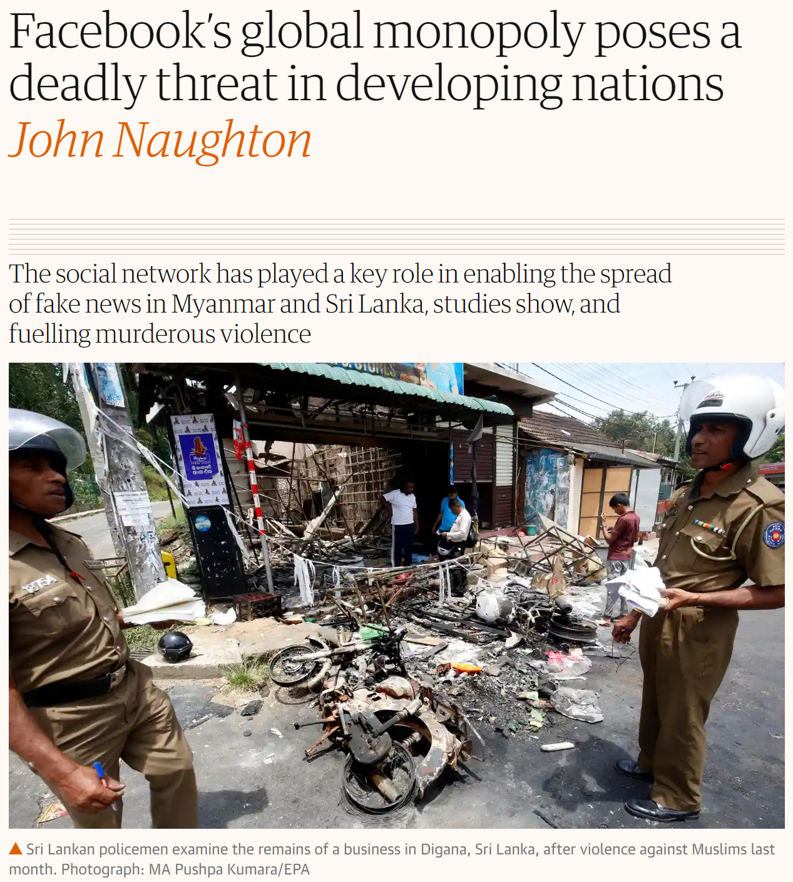
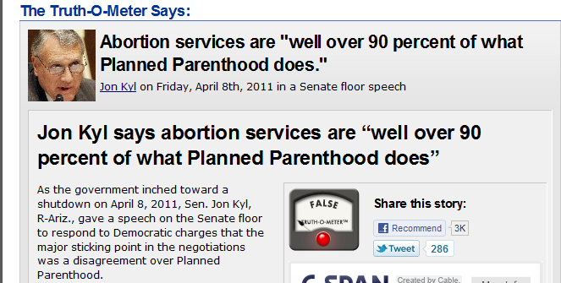
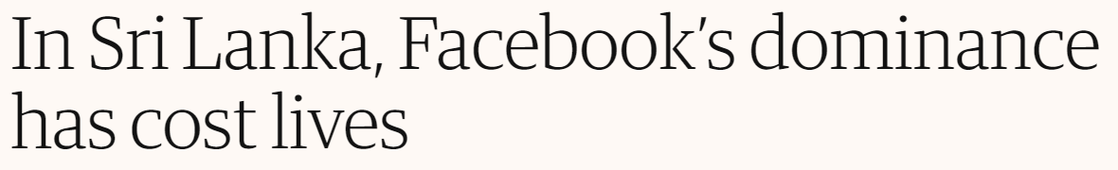
Expressions of the Information Pollution
False: only 3 %
Sources may provide conflicting information
or mutually reinforcing information.
  Mistakenly or for a reason
Redundancy could be highly influential and biased
And, ease of incitment can be deadly
We are right to be concerned.
But factual information (or lack of)
  The fake news problem
is not really the core of the problem.
And not where information pollution hurts the most
Notes:
You have seen and suffered from information pollution. It typically involves….
Facts is not the only issue a solution should address

Slide 4
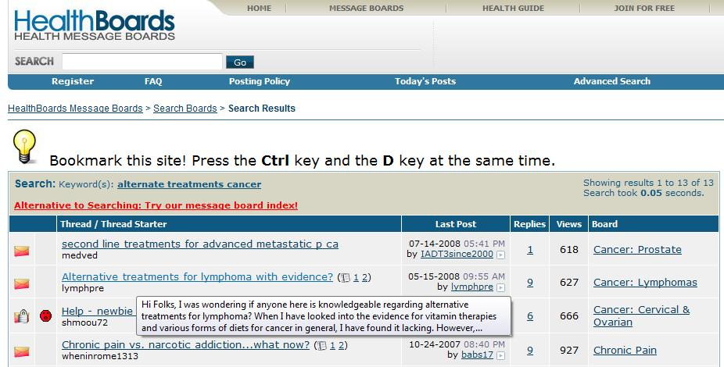

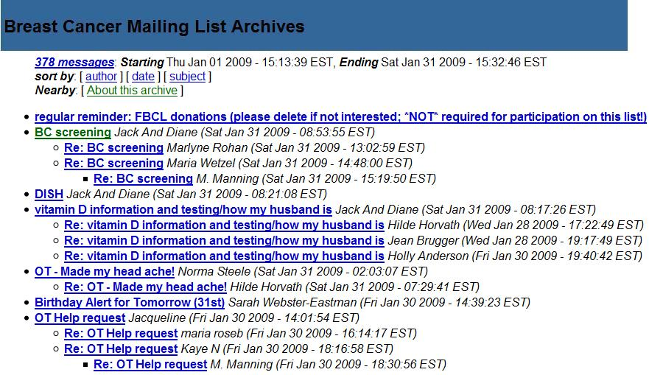
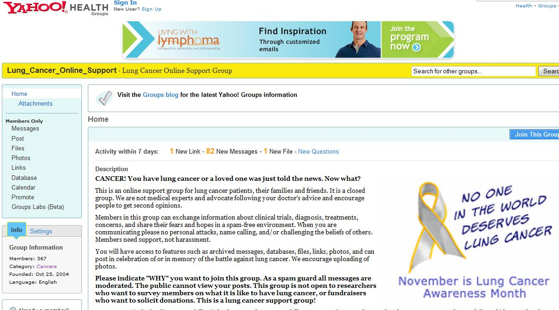
Information Pollution: Not Just Politics
Medical Domain, Education, Public Policy, etc.
  “Best treatment for X;” “Side effects of X .”
Are they consistent?
Are they trustworthy?
Are they written by someone with an agenda?
Notes:
The reach of this phenomena is way beyond politics.
- Every single days thousands of (of not 10s of thousands) of people, go to the we and search queries like ...
- But as micro-consumers of information, we have no ideas whether: ...

Slide 5
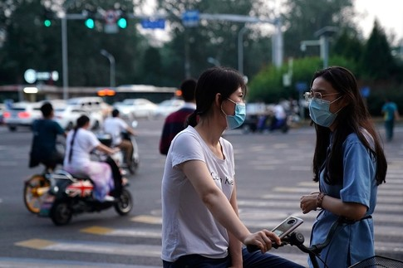

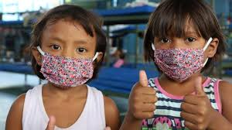
Should we Mandate Wearing Masks for COVID-19?
The answer has changed dramatically in the past few month months
  The reasons are multi-faceted
  No objective truth; things are conditional, contextual and could change with time
  Fact checking alone does not solve this problem
Masks and face coverings can prevent the wearer from transmitting the COVID-19 virus to others and may provide some protection to the wearer.
Which type of face mask is most effective against COVID-19?
Masks should NOT be worn by children under the age of 2 or anyone who has trouble breathing, is unconscious, incapacitated, or otherwise unable to remove the mask without assistance.
Notes:
The reach of this phenomena is way beyond politics.
- Every single days thousands of (of not 10s of thousands) of people, go to the we and search queries like ...
- But as micro-consumers of information, we have no ideas whether: ...

Slide 6
Information Pollution: Not Just Fact-Checking
Many issues do not have a single “answer.”
  “Should we allow experiments with animals?”
    Possible answers are subject to context, world views or background.
    Moral, utilitarian, libertarian, philosophy, etc.
Factual information (or lack of) is not really the core of the problem.
Notes:
Another factor that makes this challenging is that ...
And both of these view could be reasonable under certain world-view.
In other words, calling this problem "fake news" challenge is a grave over-simplification.

Slide 7
Goal
A computational model that will help us navigate the polluted information world.
Reason, over time, about
  Sources, their expertise and trustworthiness
  The content they generate
  The content’s compatibility, or lack of, with our perspectives, and with other sources’ content.
This computational mechanism will serve as our proxy and help us judiciously handle the information pollution.
  It should provide a diverse set of Perspectives
  Supported by evidence
  From trustworthy sources
  Avoid redundancy, that biases views

Slide 8
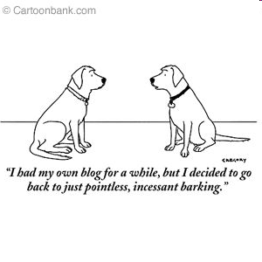
Keys to Progress
Research in Natural Language Understanding attempts to tell us what a document says with some level of certainty. We should focus it in two directions:
Outline
Perspectives
Computational Trustworthiness
Claim Provenance
Redundancy & Bias
Understanding Sources
What should we believe, and who should we trust?
Sources may
  Have their own, often hidden, motivations
  Make different or even contradictory claims
Understanding the evidence
Sources may present different, but legitimate, perspectives
Most interesting issues/questions have multiple “right” answers
  Perspectives must be supported by evidence
Mis/dis-information can come in multiple ways
Factual Contradictions; Biased Coverage; Even vocabulary selection
Notes:
Connecting this to natural processing, there two axes along which I think we use NLP to address such problems:
1. Understanding of sources
2. Understanding of evidences
➔ 1. What should we believe; who should we trust; understanding of agendas and motivations.
→ 2. Are the evidences to a claim make different or contradictory claims? Or maybe there are multiple perspectives to an issue?
These are not only are applications to NLP, they also derive the research.
And tying it back to the story I started with, it's unlikely that you can learn this creating massive annotated data:
There are nuances to claims and perspectives that you can't exhaustively cover all of them.
================
Think about two two newspapers that describe hurricane; one can describe it as what happened, and the other one can describe it in relation to climate change.
These two actually describe two different views of the world, and by their world selection, they deliver different messages.

Slide 9
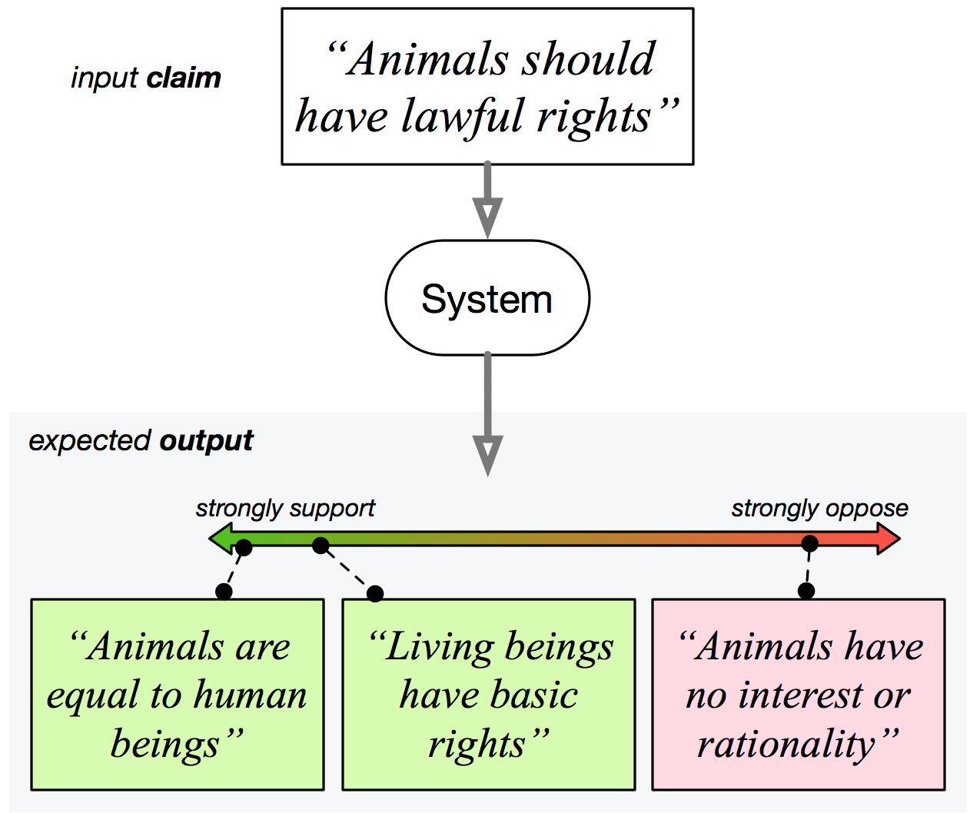
Discovering Diverse “Perspectives”
Chen et al. NAACL’19: provide users with the understanding that each “story” has more than one “perspective.”
Goal:
  Perspectives could give a fuller understanding of an issue.
  Make us more open-minded, less afraid & more likely to consider other views.
  [Eventually, perspectives will be accommodated by information about sources (expertise & trustworthiness) and provenance.]
  Video
[Chen, et al. NAACL’19]
  Give a fuller understanding of an issue; make us more open mined, less afraid & more likely to consider other views V.G. Vydiswaran, C. Zhai, D. Roth, P. Pirolli, Overcoming bias to learn about controversial topics. JASIST’14
Notes:
In our recent work in this direction, we view the world as “perspectives.
The goal is to give the readers the understanding that each story, really has more than one perspective. It’s not black and white.
We want, as I show it here, given a claim, a system to go to pools of perspectives (in principle, all of the web) and give me all the perspectives addressing this claim, some supporting it and some against it.

Slide 10
Goals and Challenges
Perspectrum

Slide 11
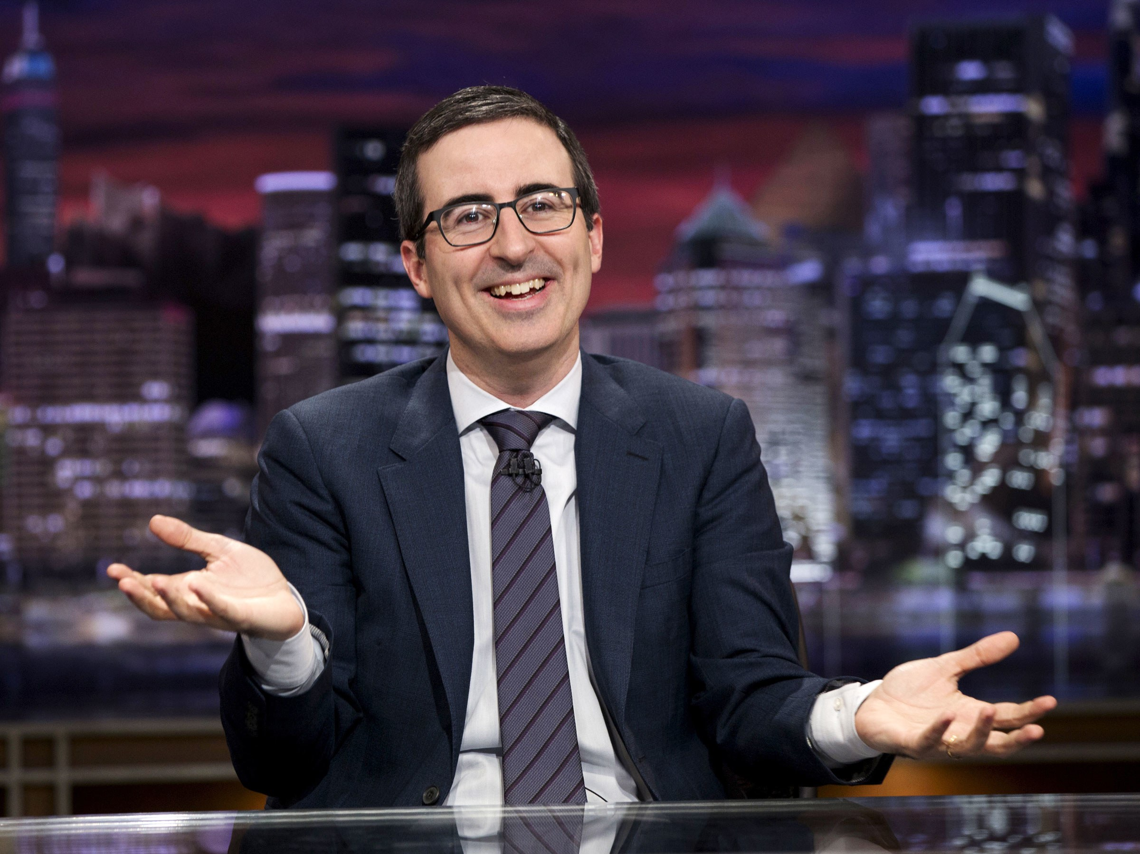
Should abortion be legal???

Slide 12
I don’t know them until I see them !!!
Q: Should abortion be legal???
Arguments for
Arguments against
Women have a right to choose
Abortion is murder
There can be medical reasons for terminating pregnancy
Legalizing abortions leads to irresponsible sexual behavior

Slide 13
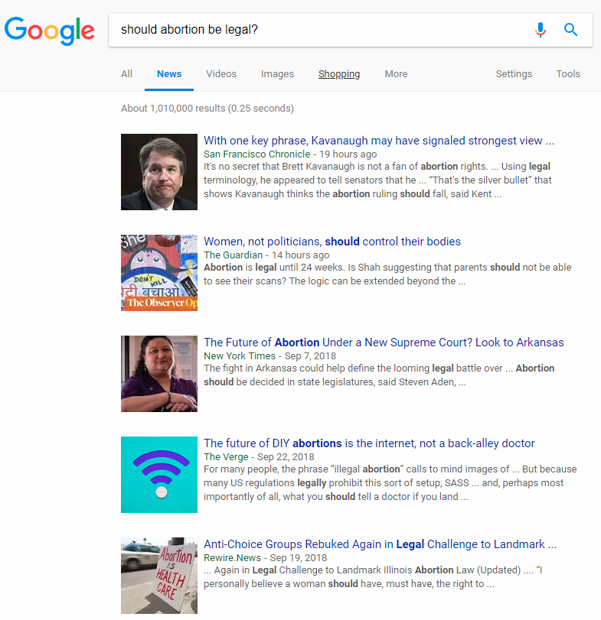
Information Access today
“Diversify” in terms of including different sources, not opinions
Poor organization
Rank based on “content relevance/similarity”, and polularity

Slide 14
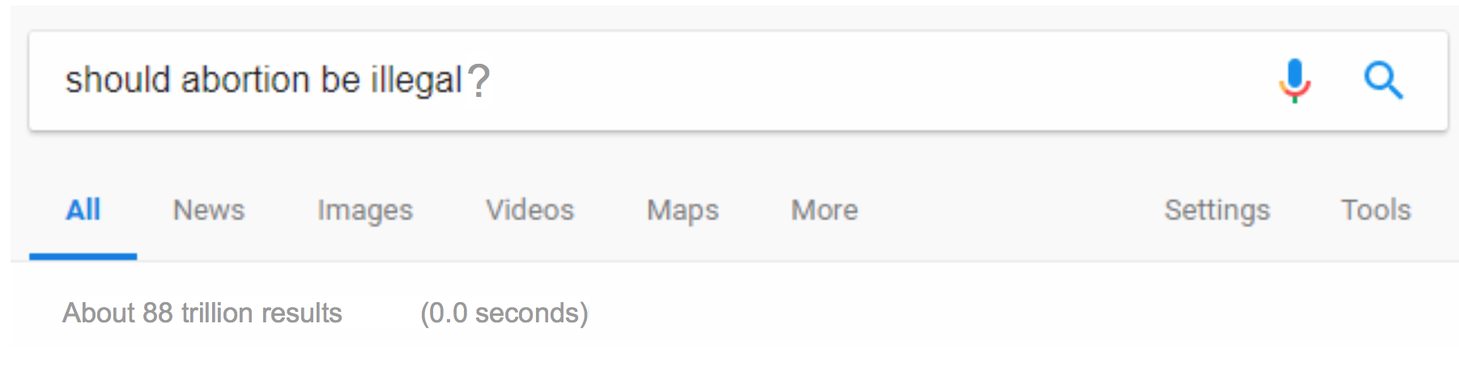


Future
Perspectives for
Perspectives against
…more
Women have a right to choose
A fetus is a life from conception, therefore abortion is murder
Avoid Redundancy by understanding relations between relevant articles
- Evidence
- Trustworthiness
- Expertise
- Evidence
- Trustworthiness
- Expertise
…
…
Rape victims should have the right to terminate the pregnancy
Legalizing abortions leads to irresponsible sexual behavior
- Evidence
- Trustworthiness
- Expertise
- Evidence
- Trustworthiness
- Expertise
…
…
…
There can be medical reasons for terminating a pregnancy
Most abortions are performed out of convenience
- Evidence
- Trustworthiness
- Expertise
- Evidence
- Trustworthiness
- Expertise
…
…
Notes:
Ofen the answer to these question is not a simple yes or not.
The question is multi-faceted and involves many tricky nuances.
Read this!
http://cogcomp.org/papers/VZRP14.pdf

Slide 15
Schema
Query
Perspective 1
Perspective 2
Perspective 3
Perspective 4
...
Evidence ...
Evidence ...
Evidence ...
Evidence ...

Slide 16
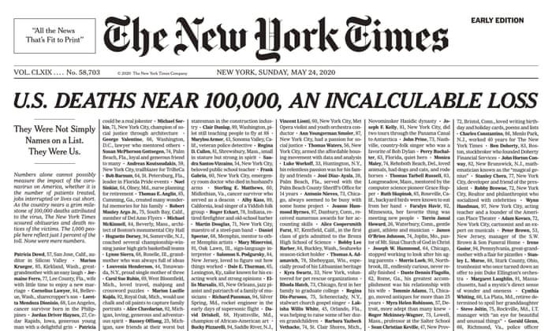
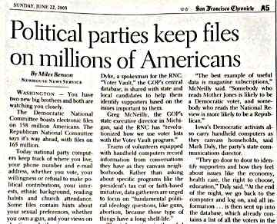
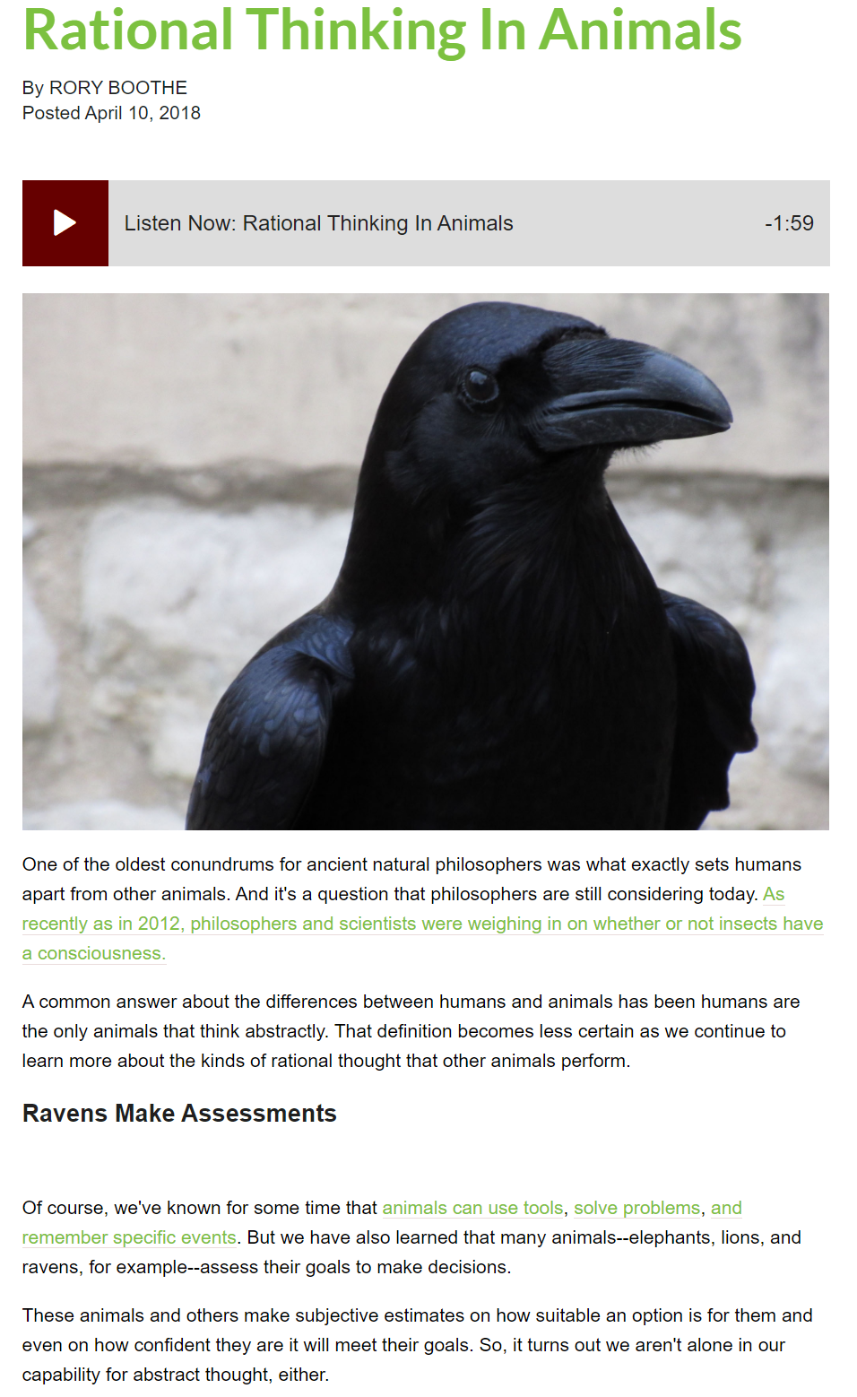
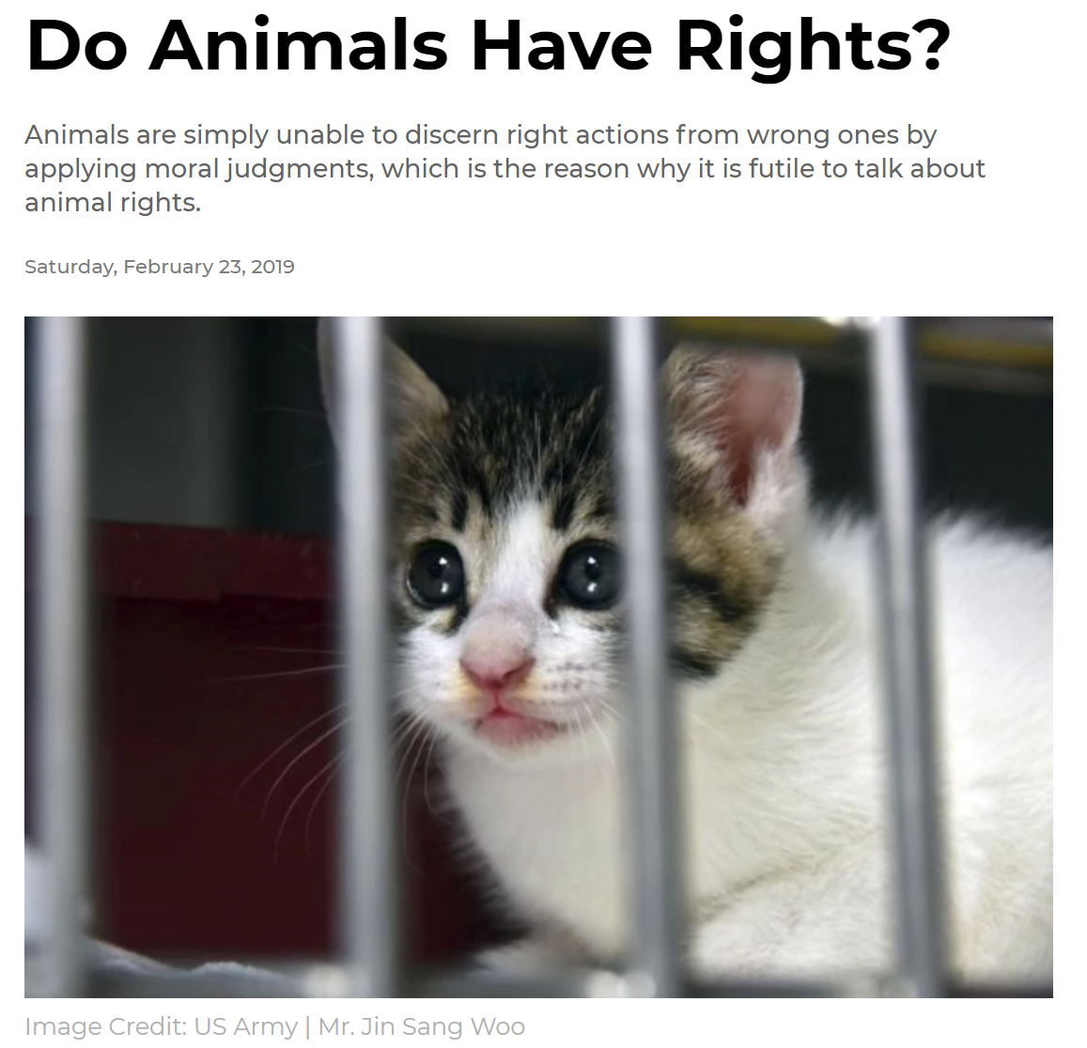
Schema
Claim: animals have rights
Persp 1: Animalsl are equal to human beings
Persp 2: Animals have no interest or rationality
Evidence: Abstract
It is true that animals and human beings are different. It is also true that men are different from women and children from adults. Equality does not require beings to be identical
Evidence: Abstract
Some philosophers argue that only beings that are able to make rational choices can have moral rights because the function of rights is to protect choice. Animals are not able to make rational choices because they can only follow instinct, …..

Slide 17
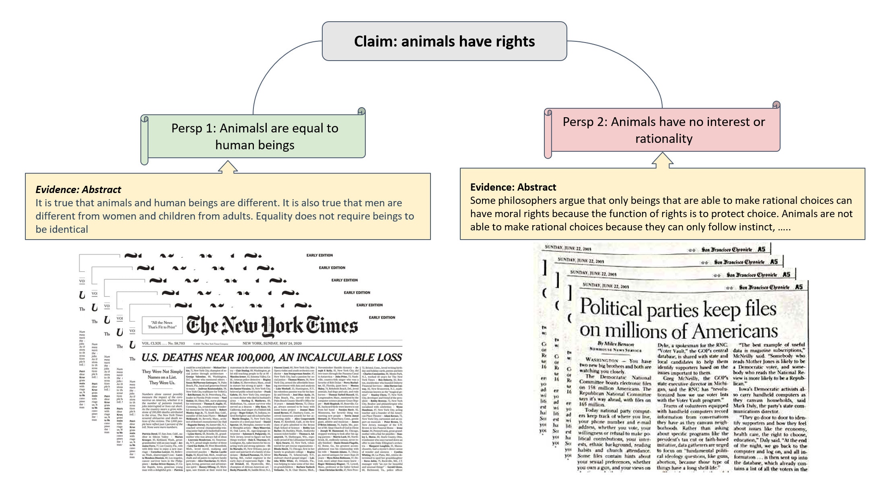
Challenges
Identify relevant articles
  “standard” search
Identify perspectives expressed in the articles
  Relevant to the query
Generate concise perspectives
Summarize the evidence provided for each perspective
  Identify supporting/opposing evidence for each perspective
Identify relations between articles
  Add values? Redundant? Agrees? Disagrees?
Challenges to classification, variations of textual entailment, generation and summarization. All depend on rather deep text understanding.

Slide 18
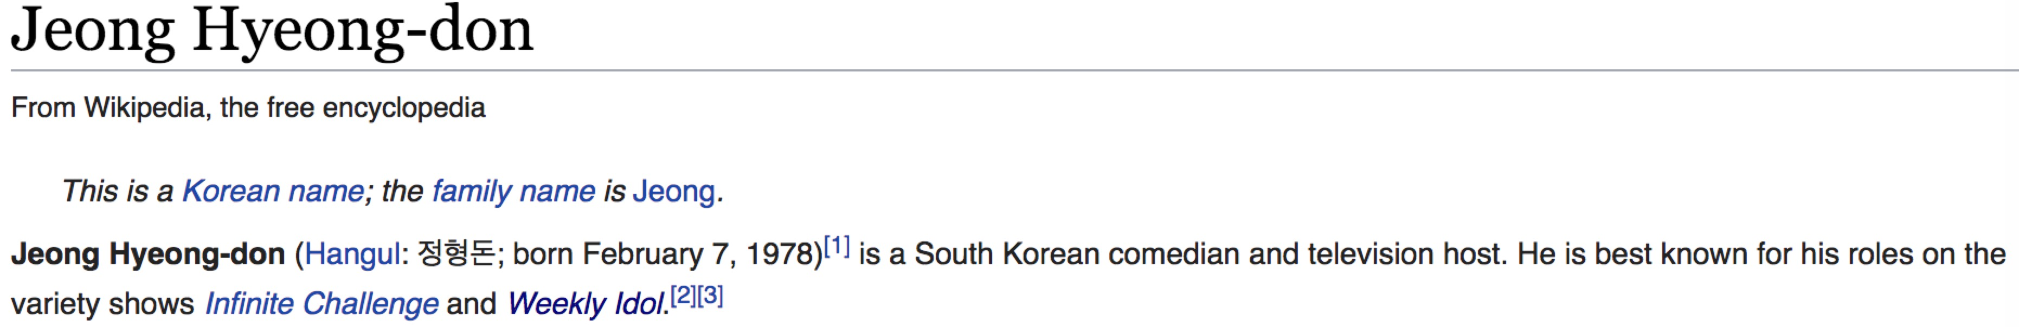
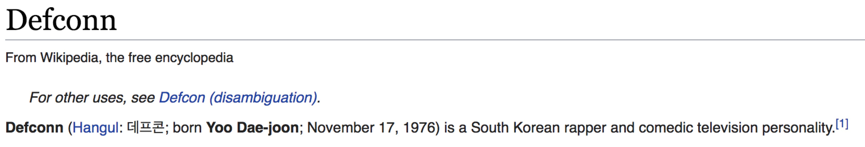
Example: Supporting/Refuting a Claim [Yin&Roth EMNLP’18]
False
Claim: Both hosts of Weekly Idol were born in 1983.
Sometimes evidence has to be aggregated from multiple sentences or even multiple articles
Different number of evidence pieces might be needed to support different claims
“Similarity” to the claim does not make the text snippet good evidence
Both hosts of Weekly Idol killed in a car accident

Slide 19
Computational Approach [Yin & Roth 19]
Evidential claim verification = EntailModel(identified evidence, claim)
Evidence identification
Depends on
Claim entailment
Study done in the context of the FEVER data set
(Thorne et al. 2018)
Joint
Currently developing a new dataset that is along this view:
Coupled Representations: Representations of the evidence and the claim need to be aware of all coupled system components
Notes:
Evidence identification should depend on the truth value of the claim entailment
Representing the evidence should depend on the claim
Representing the claim should depend on the evidence.

Slide 20
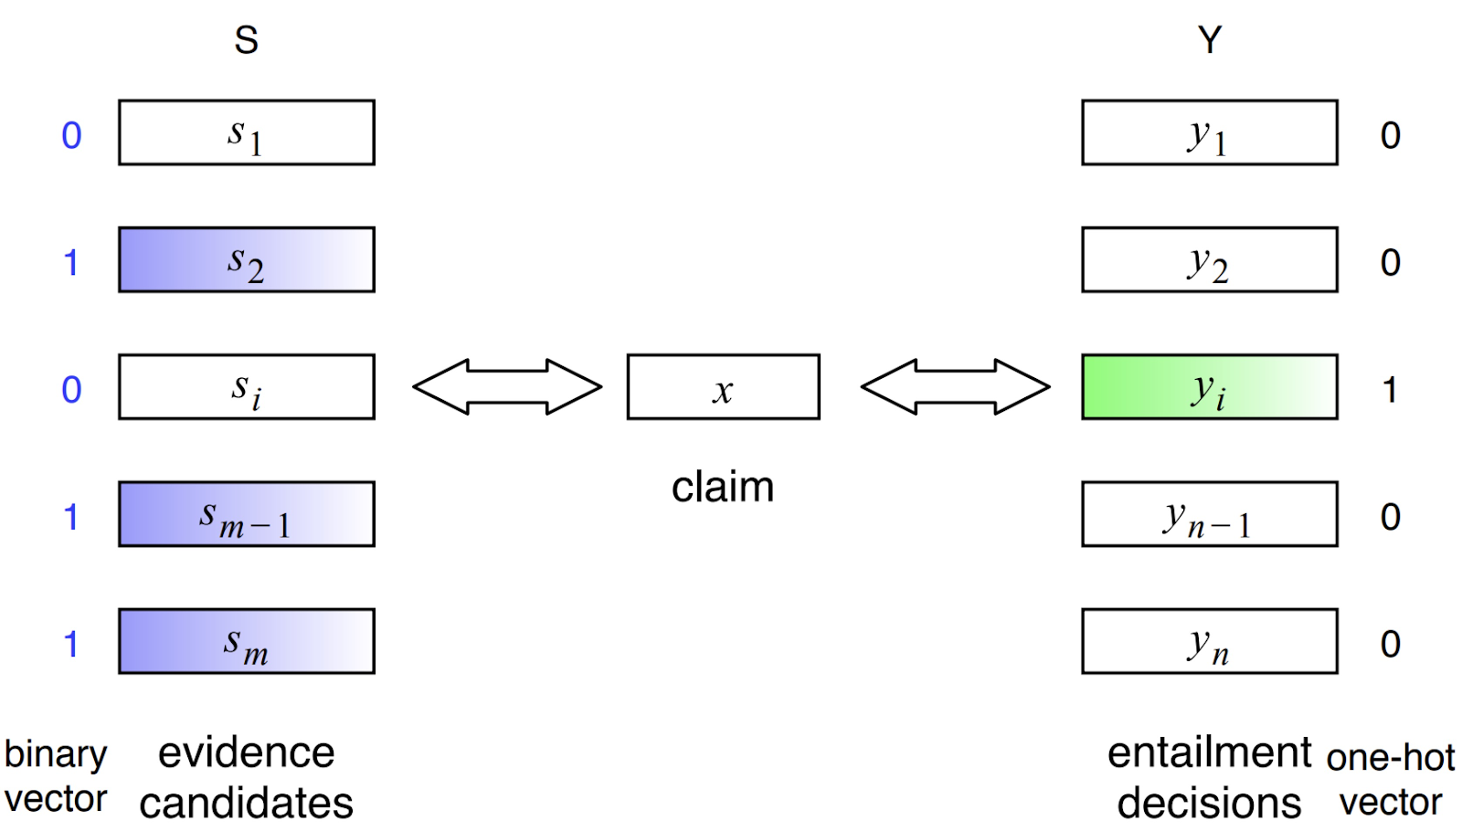
A Joint Approach: A TwoWingOptimization Strategy
Evidence
identification
Claim entailment
Binary vector enables multiple textual snippets to be identified as evidence
A generic architecture, assuming only one correct label among multiple options
TwoWingOS – a two-wing optimization strategy

Slide 21
System architecture of evidence identification
System architecture of
claim entailment
All sentences in top-5 retrieved articles
Claim

Slide 22
Computational Trustworthiness
There is a need to assume some basic beliefs
  Earth is round
  Trustworthiness will be determined based on some level of agreement with these basic beliefs
Given:
  Multiple content sources
  Multiple “claims”
  Prior beliefs & background knowledge
The goal is to induce:
  A distribution over the credibility of sources and the trustworthiness of claims they make, accounting for
    Sources characteristics, history, interdependence, expertise
    Claims agreement, compatibility
    Prior Beliefs and Background knowledge
  [Pasternack & Roth 10-14; Vydiswaran et. al ‘11-15; Zhang & Roth 2019]
Evidence
Sources
Sources
e₁
Claims
Claims
s₁
s₁
c₁
e₂
c₁
s₂
e₃
s₂
c₂
s₃
e₄
c₂
s₃
e₅
c₃
s₄
c₃
s₄
e₆
c₄
s₅
e₇
c₄
s₅
e₈
e₉
e₁₀
Understanding the evidence
Extracting claims

Slide 23
Provenance for Natural Language Claims [Zhang et al. ACL’20]
Who said it, and why?
This is an age that people can generate and publish content very easily.
Often, local information alone cannot determine the truth value of a claim – need to find evidence and influences.
Goal: a longer-term, holistic, and systematic approach to navigate information influence and pollution.
We need (a new notion of) provenance!

Slide 24
Use Case: Claim Verification
Query Claims
Facebook soon plans to charge fees to users of the social network.

Slide 25
Use Case: Claim Verification
Query Claims
Facebook soon plans to charge fees to users of the social network.
What is the evidence? How do we know if it is true?

Slide 26

Use Case: Claim Verification
A typical claim verification pipeline:
  Search for evidence
  Do textual entailment
Query Claims
…
was concerned about the interests of its users. Facebook could charge a monthly fee. Now, that pretense is gone. Facebook no longer even claims the service will always be free
…
Facebook soon plans to charge fees to users of the social network.

Slide 27
Use Case: Claim Verification
What else would we like to have?
Query Claims
…
was concerned about the interests of its users. Facebook could charge a monthly fee. Now, that pretense is gone. Facebook no longer even claims the service will always be free
…
Facebook soon plans to charge fees to users of the social network.

Slide 28
Use Case: Claim Verification
What else would we like to have?
  Who authored the evidence claim?
?
Query Claims
…
was concerned about the interests of its users. Facebook could charge a monthly fee. Now, that pretense is gone. Facebook no longer even claims the service will always be free
…
Facebook soon plans to charge fees to users of the social network.

Slide 29

Use Case: Claim Verification
What else would we like to have?
  Was the author influenced by another source when writing his/her claim?
Query Claims
…
But now that has changed. Business Insider first reported on Tuesday that on August 7th,
…
was concerned about the interests of its users. Facebook could charge a monthly fee. Now, that pretense is gone. Facebook no longer …
…
Facebook quietly ditched the 'It’s free and always will be' slogan from its homepage
…
Facebook soon plans to charge fees to users of the social network.

Slide 30

Use Case: Claim Verification
What else would we like to have?
  Was the author influenced by multiple sources?
…
Facebook quietly ditched the 'It’s free and always will be' slogan from its homepage
…
Query Claims
…
But now that has changed. Business Insider first reported on Tuesday that on August 7th,
…
was concerned about the interests of its users. Facebook could charge a monthly fee. Now, that pretense is gone. Facebook no longer …
Facebook soon plans to charge fees to users of the social network.
…
The best way for Facebook to do that is to offer services for free, which ads enable us to do.
…

Slide 31
Use Case: Claim Verification
What else would we like to have?
  How did those sources influence the author to write the claim?
…
Facebook quietly ditched the 'It’s free and always will be' slogan from its homepage
…
entailed
Query Claims
…
But now that has changed. Business Insider first reported on Tuesday that on August 7th,
…
was concerned about the interests of its users. Facebook could charge a monthly fee. Now, that pretense is gone. Facebook no longer …
Facebook soon plans to charge fees to users of the social network.
triggered
…
The best way for Facebook to do that is to offer services for free, which ads enable us to do.
…
contradicted

Slide 32
Provenance Addresses Our Needs
Provenance encodes claims and:
  Relationship between the claim and its source
  Reference relations between sources and relations between their corresponding claims
  Composition of claims
Important for (beyond claim verification):
  Describing the context and history of the claim
  Understanding the relationship between claim-making documents
  Studying “who” influences an author
  Understanding the evolution of claims

Slide 33
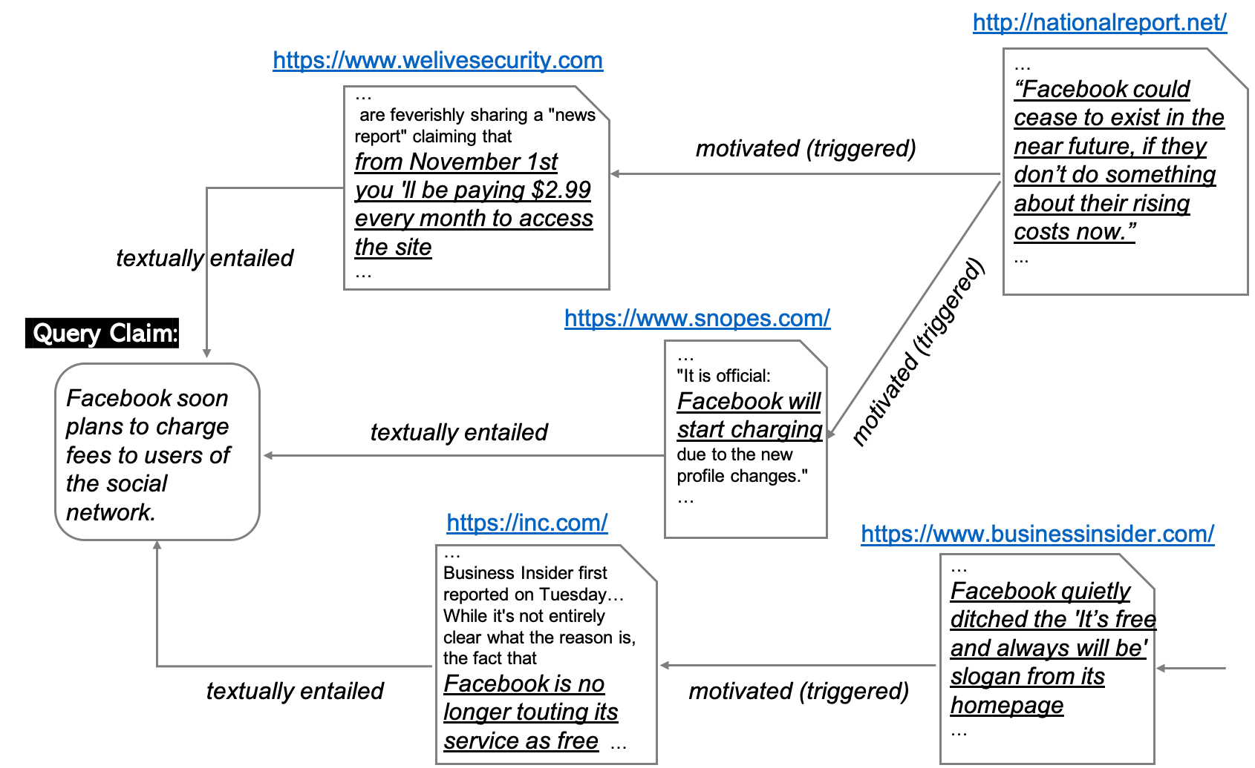
Formalizing Claim Provenance
A labeled directed acyclic graph

Slide 34
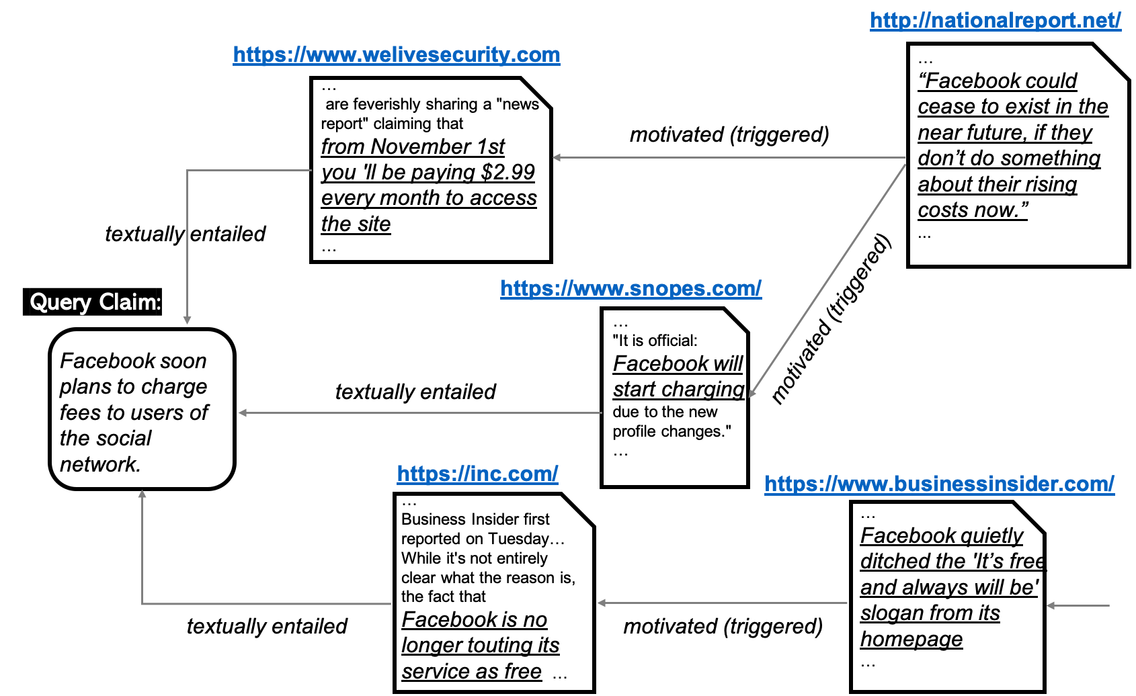
Formalizing Claim Provenance
A labeled directed acyclic graph
Nodes:
  Sources and claims they make.
  The claims include:
    Query claim
    Previous versions of the query claim
    Claims that influence the query claim

Slide 35
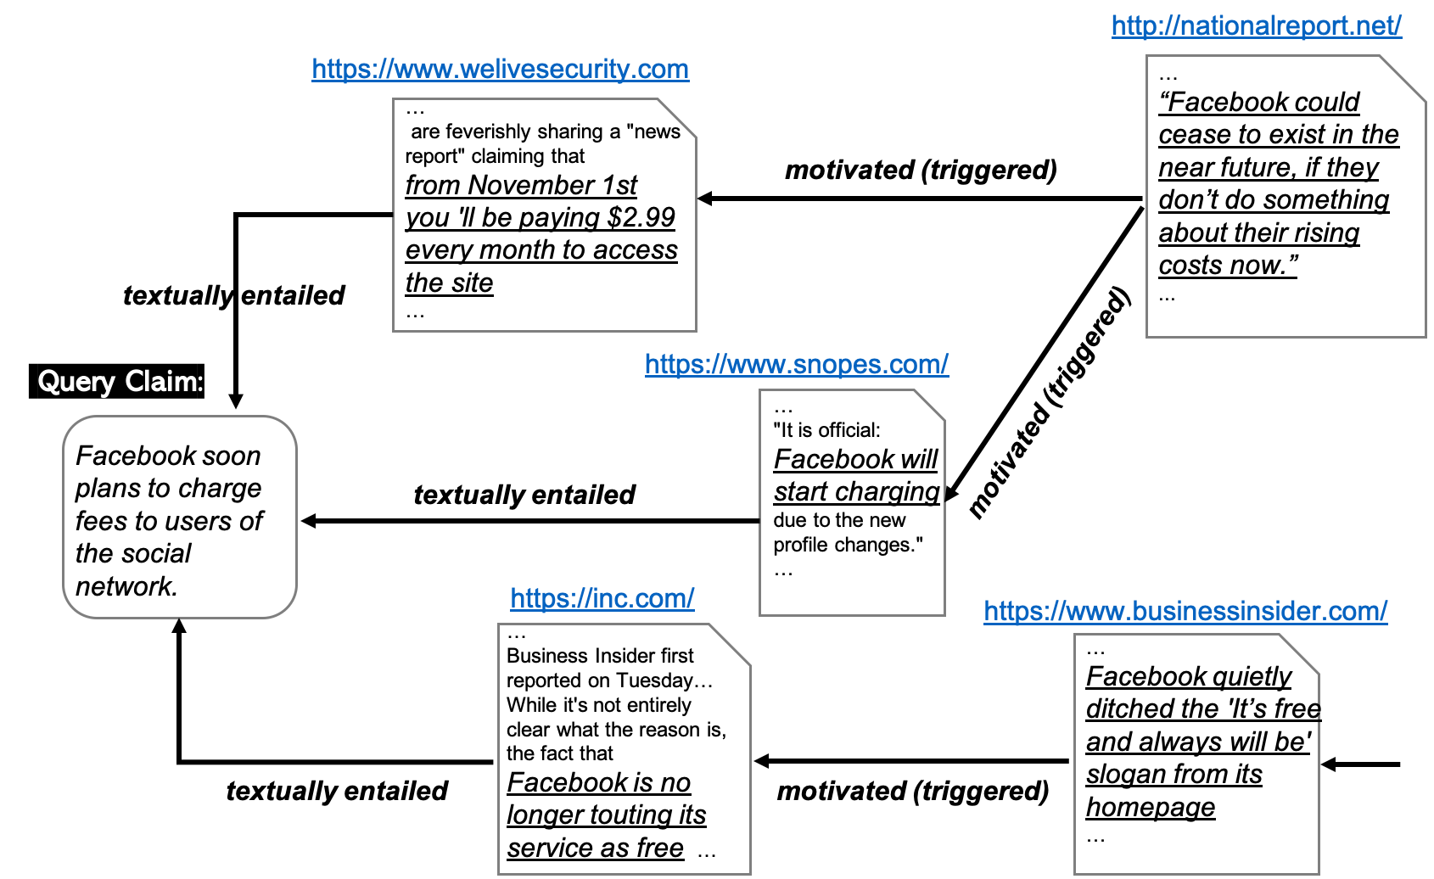
Formalizing Claim Provenance
A labeled directed acyclic graph
Nodes:
  Sources and claims they make.
  The claims include:
    Query claim
    Previous versions of the query claim
    Claims that influence the query claim
Edges:
  The reference relationship between claims
  The label represents how a claim may be derived by another one:
    Identical, paraphrased, textually entailed, motivated (triggered, contradicted, falsely derived)

Slide 36
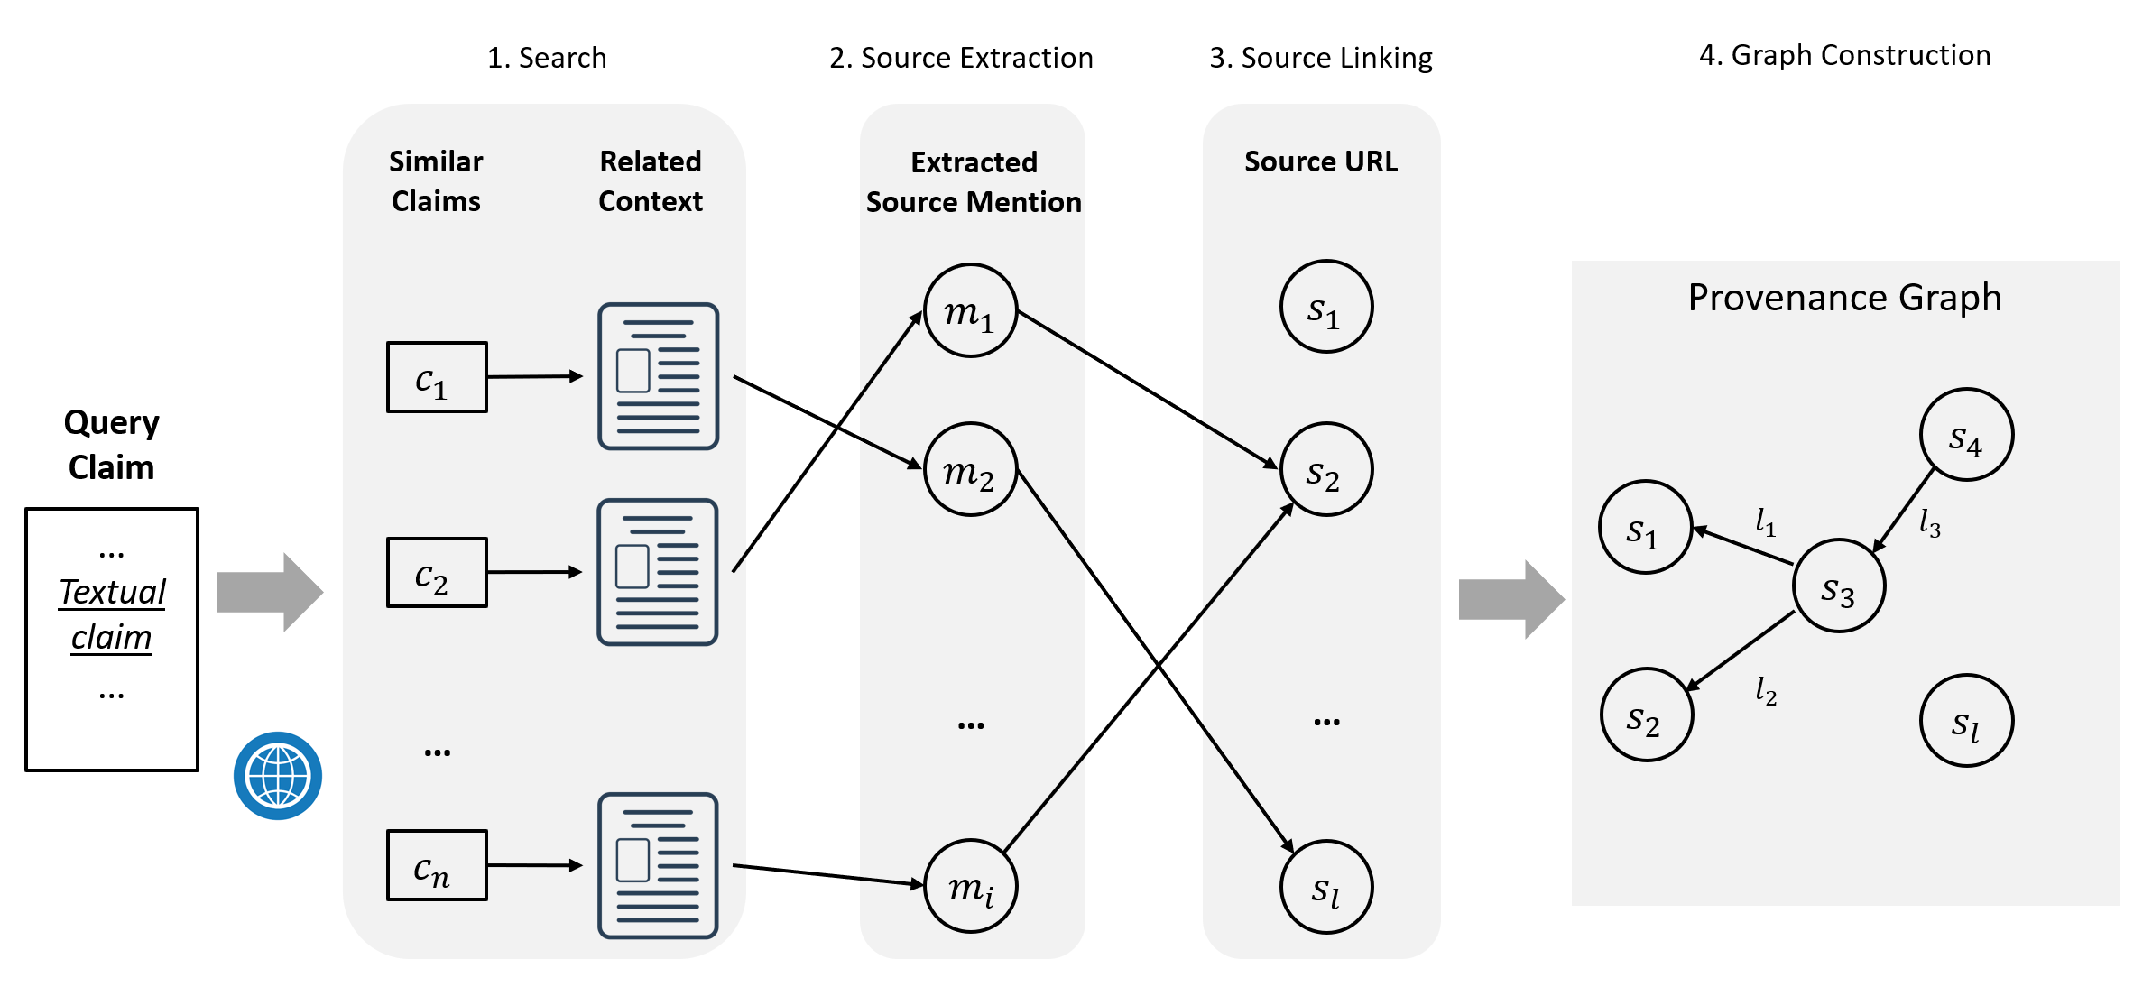
(Initial) Solution Overview [Zhang et al. ACL’20]
The solution involves
  Extracting information for the graph,
  Constructing the graphs (Textual Entailment)
The Effectiveness of the solution
  Evaluated in the context of claim verification

Slide 37



Conclusion
Thank You!
Our project on Information Pollution in the context of Covid-19: Video
We are right to be concerned.
  Information Pollution is a by-product of systems that were intended to produce a collective benefit.
  The ease of incitement, amplification of the most odious beliefs, devaluing critical thinking, resulting in
    Increased anxiety and fear, polarization, fragmentation,
    Loss of trust in key institutions of our society
  And factual information (or lack of) is not really the core of the problem.
    Inability of our current information delivery systems to understand perspectives and evidence, expertise and trustworthiness
A small sample from a research program that focuses on the NLP challenges, and attempts to address some of the key scientific and engineering challenges in Navigating Information Pollution
  Perspective; Trustworthiness; Claim Provenance
Sihao Chen
Daniel Khashabi
Xander Uyttendaele
Yi Zhang

Slide 38
References
"Who said it, and Why?" Provenance for Natural Language Claims
Yi Zhang and Zachary G. Ives and Dan Roth
ACL - 2020
Evidence-based Trustworthiness
Yi Zhang and Zachary G. Ives and Dan Roth
ACL - 2019
PerspectroScope: A Window to the World of Diverse Perspectives
Sihao Chen and Daniel Khashabi and Chris Callison-Burch and Dan Roth
ACL Demonstrations - 2019
Seeing Things from a Different Angle: Discovering Diverse Perspectives about Claims
Sihao Chen and Daniel Khashabi and Wenpeng Yin and Chris Callison-Burch and Dan Roth
NAACL – 2019
Back

