Slide 1
Navigating Information Pollution
A Perspective from AI & Natural Language Processing
Dan Roth
Computer and Information Science
University of Pennsylvania
&
Amazon AWS AI
Patients
SEAS/PSOM Workshop on Clinician-centric Trustworthy AI
Workshop
on
Clinician-centric AI: Will clinicians ever trust AI recommendations?
April 2022

Slide 2



Information Pollution
Mis/Dis-information is not a new phenomenon
But the “information revolution” has made it much easier to radically impact more people and more areas of our life.
This technology, with all its benefits, has already had a detrimental effect on our life.
It imposes risks on the major institutions of our society by facilitating
  Massive disinformation campaigns
  Ease of large-scale incitement
  Information bubbles.

Slide 3
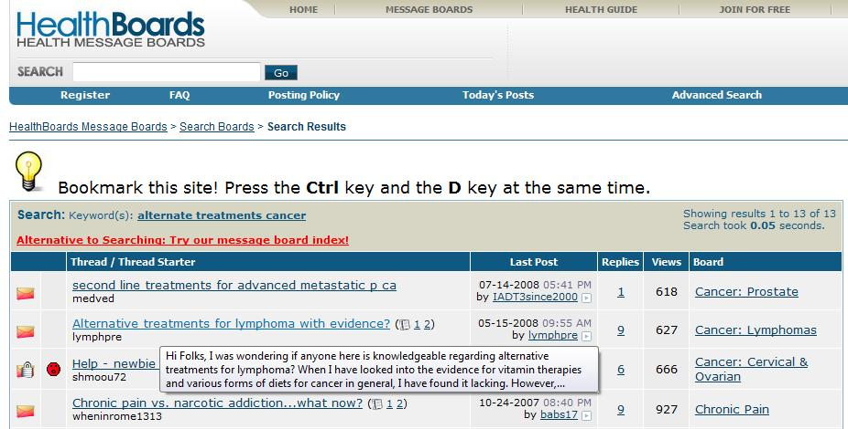
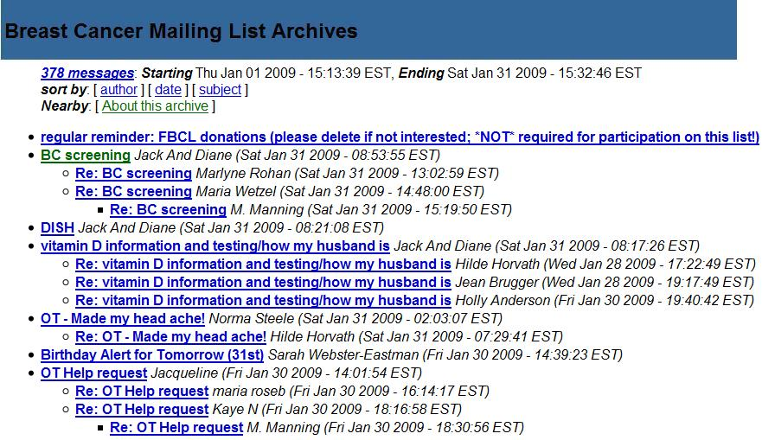
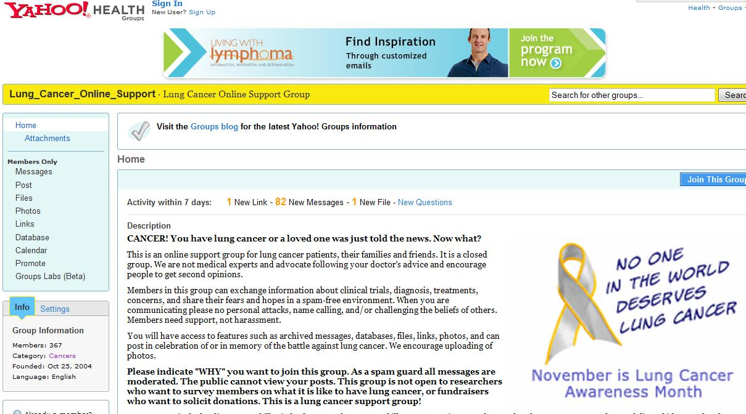
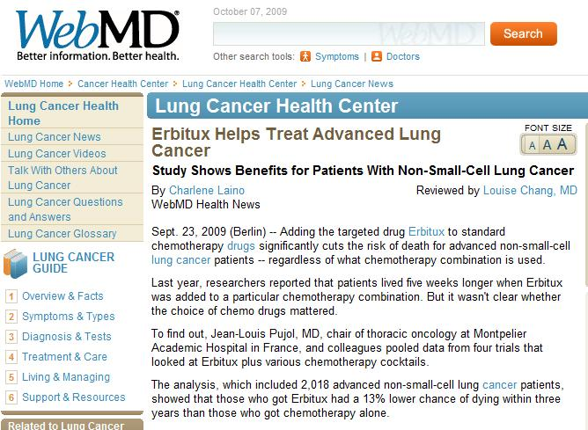

Information Pollution: Flood of Information
The large amount of information available makes it difficult to identify information that is relevant to the situation
“Best treatment for X”; “Side effects of X .”
  Is it consistent?
  Is it trustworthy?
  Is it applicable to me?
Notes:
The vast amount of information available does not allow us to understand it – what’s right, wrong, consistent with our beliefs, makes sense, compatible with other views,…
The reach of this phenomena is way beyond politics.
- Every single days thousands of (of not 10s of thousands) of people, go to the we and search queries like ...
- But as micro-consumers of information, we have no ideas whether: ...

Slide 4
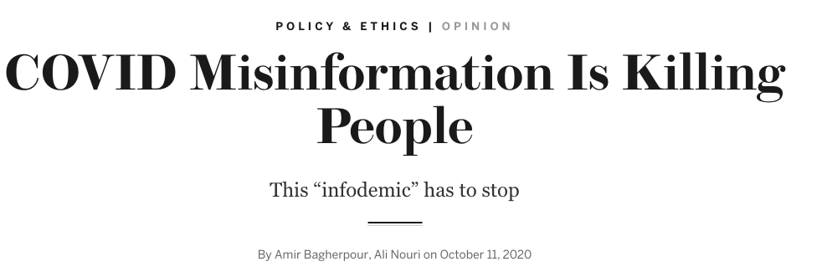
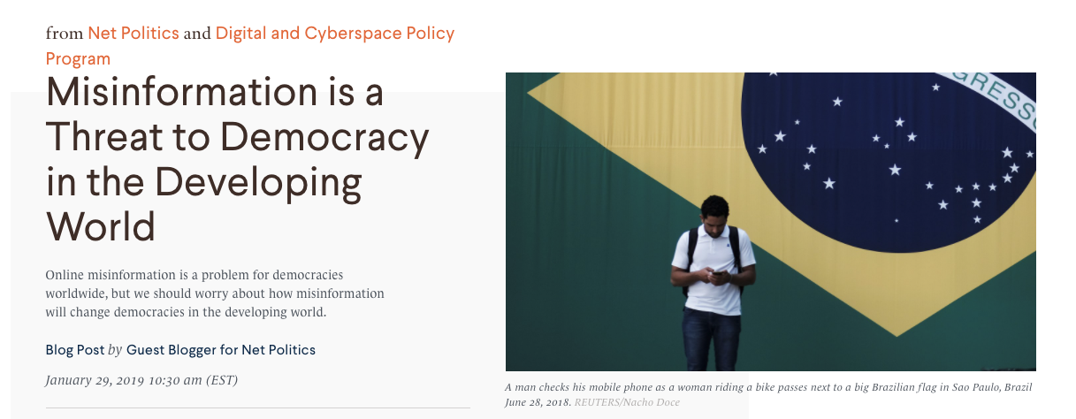
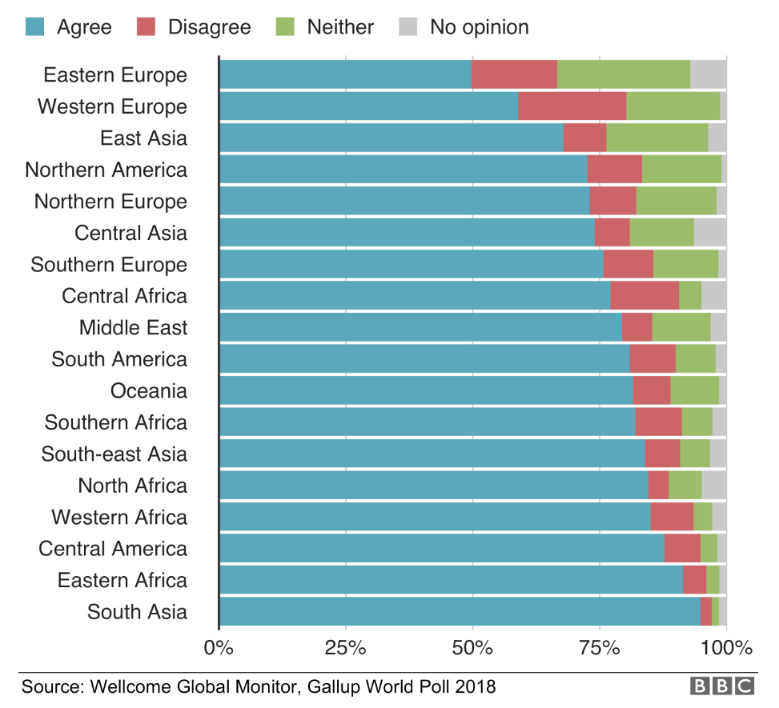
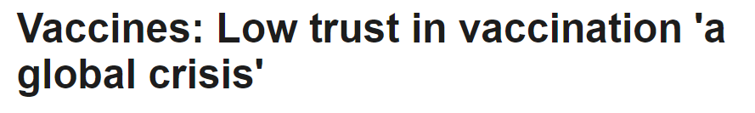

Information Pollution: An Agenda
A lot of the information available on-line is produced by sources with an agenda
[Study covering 140k people worldwide: BBC June’19]
E.g., in France one in three disagreed that vaccines were safe
Where was trust high?
  South Asia (95%) Eastern Africa (92%),
  Bangladesh, and Rwanda (~100%)
Notes:
The vast amount of information available does not allow us to understand it – what’s right, wrong, consistent with our beliefs, makes sense, compatible with other views,…
The reach of this phenomena is way beyond politics.
- Every single days thousands of (of not 10s of thousands) of people, go to the we and search queries like ...
- But as micro-consumers of information, we have no ideas whether: ...

Slide 5
Information Pollution: Not Just Fact-Checking
Factual information (or lack of) is not really the core of the problem.
Information Pollution comes in two interrelated flavors:
A lot of information, providing “answers” to questions people have
  Disregarding the fact that there is no one answer that fits all.
  Many issues don’t have a single “answer.”
    “Should X be legalized?”
    Possible answers are subject to context, world views or background.
    Science, Morality, philosophy, etc.
Misleading, malicious, mis/disinformation
  Serving an agenda that is often hidden from the audience
  Or, more generally, attempts to cause chaos
Notes:
How do we make progress towards a solution? First, we need to realize that factual information isn’t the core

Slide 6
Navigating Information Pollution
Readers and analysts need an investigative journalist as a proxy
Our Goal:
  A computational model that supports navigating the polluted information world.
Provide readers with the ability to understand:
  Perspectives
  Information Provenance
  Sources’ expertise and trustworthiness
Notes:
How do we make progress towards a solution? First, we need to realize that factual information isn’t the core

Slide 7
  Perspectives

Slide 8
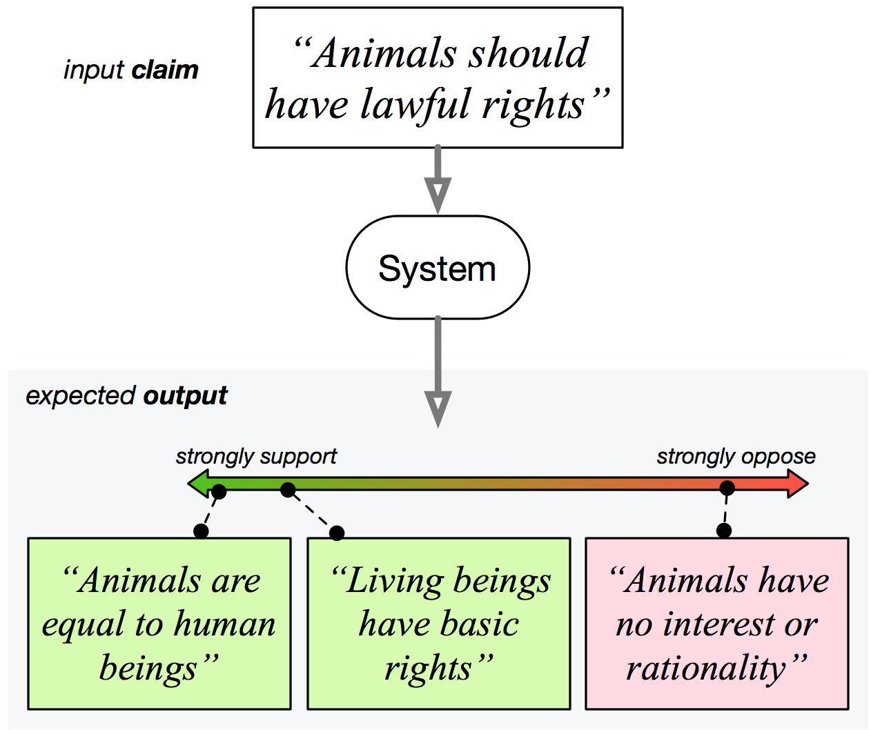
Discovering Diverse “Perspectives”
Most information needs do not have a single correct answer.
Rather than providing a “list” of “relevant” articles
  Driven by key-word match and previous searches
Our system should be aware that there are many ways to respond to queries/claims
  understand our information needs,
  understand all the relevant information available,
  present us with multiple perspectives, and with evidence for them.
Hope:
  Perspectives could give a fuller understanding of an issue.
  Support open-mindedness, consideration of other views.
  And, perspectives will be accommodated by information about sources (expertise & trustworthiness) and about provenance.
  Video
We need a system that understands text, understands our information needs, and can digest the huge amounts of information out there on our behalf.
Notes:
In our recent work in this direction, we view the world as “perspectives.
The goal is to give the readers the understanding that each story, really has more than one perspective. It’s not black and white.
We want, as I show it here, given a claim, a system to go to pools of perspectives (in principle, all of the web) and give me all the perspectives addressing this claim, some supporting it and some against it.

Slide 9
How to Present Information?
Multiple Machine-Learning-driven language understanding tasks
Design Challenges for a Multi-Perspective Search Engine
Sihao Chen, Siyi Liu, Xander Uyttendaele, Yi Zhang, William W. Bruno, Dan Roth,
NAACL’22, Findings Track
Query
Is it time to end to lockdown?
Yes
No
Identify Perspectives
The lockdown should stop
It’s too dangerous to end it
Support
Support
Oppose
Maintaining the current lockdown in the US would only make things worse, asserts John Lee of The Spectator ...
The current lockdown should stay in place until the COVID-19 situation gets better, argues Brian Resnick of Vox. ...
Summarize: Abstract
Summarize
Summarize
Writing in this magazine a month ago, I applauded the British government’s stated aim of trying to follow the science in dealing with COVID ...
.
This month, Missouri allowed concerts to resume for the first time since the state’s stay-at-home order started at the beginning of April. Yes, concerts, where people usually pack together, breathing the same air.
Writing in this magazine a month ago, I applauded the British government’s stated aim of trying to follow the science in dealing with COVID ...
.
This month, Missouri allowed concerts to resume for the first time since the state’s stay-at-home order started at the beginning of April. Yes, concerts, where people usually pack together, breathing the same air.
Relevant Articles
This month, Missouri allowed concerts to resume for the first time since the state’s stay-at-home order started at the beginning of April. Yes, concerts, where people usually pack together, breathing the same air.
Writing in this magazine a month ago, I applauded the British government’s stated aim of trying to follow the science in dealing with COVID ...
.
Notes:
To alleviate such problem, we present MultiOpEd, an open-domain English news editorial corpus that supports various tasks pertaining to the argumentation structure in news editorials. The structure of our dataset is formatted as below. Given a query, which is a question about a commonly debated topic, Click., we present two pieces of news editorials, that support the opposite sides of the story relevant to the query. And for each news article, Click., there is an expert-written abstract that summarizes the article, Click. and a one-sentence, concise perspective summary of the abstract. For example, on the right side of this figure. Click. We have a news article that discusses the pandemic and the lockdown. However, it’s hard to directly study the arguments within the article, and figure out what is its opinion on the topic since the arguments are expressed implicitly. Click. Luckily, we have an expert-written abstract of the article that summarizes the arguments made, Click and an even more concise perspective sentence that summarizes the key perspective and stance of the news article. This abstraction over the the news editorials can help us better identify and analyze the argumentation structures of news articles.
Click. Another advantage of our dataset is that it always presents news editorials in pairs of opposite perspectives on a same controversial topic. We hope that this unique structure can provide opportunities to study the cross-documents argumentation structures in news editorials.

Slide 10
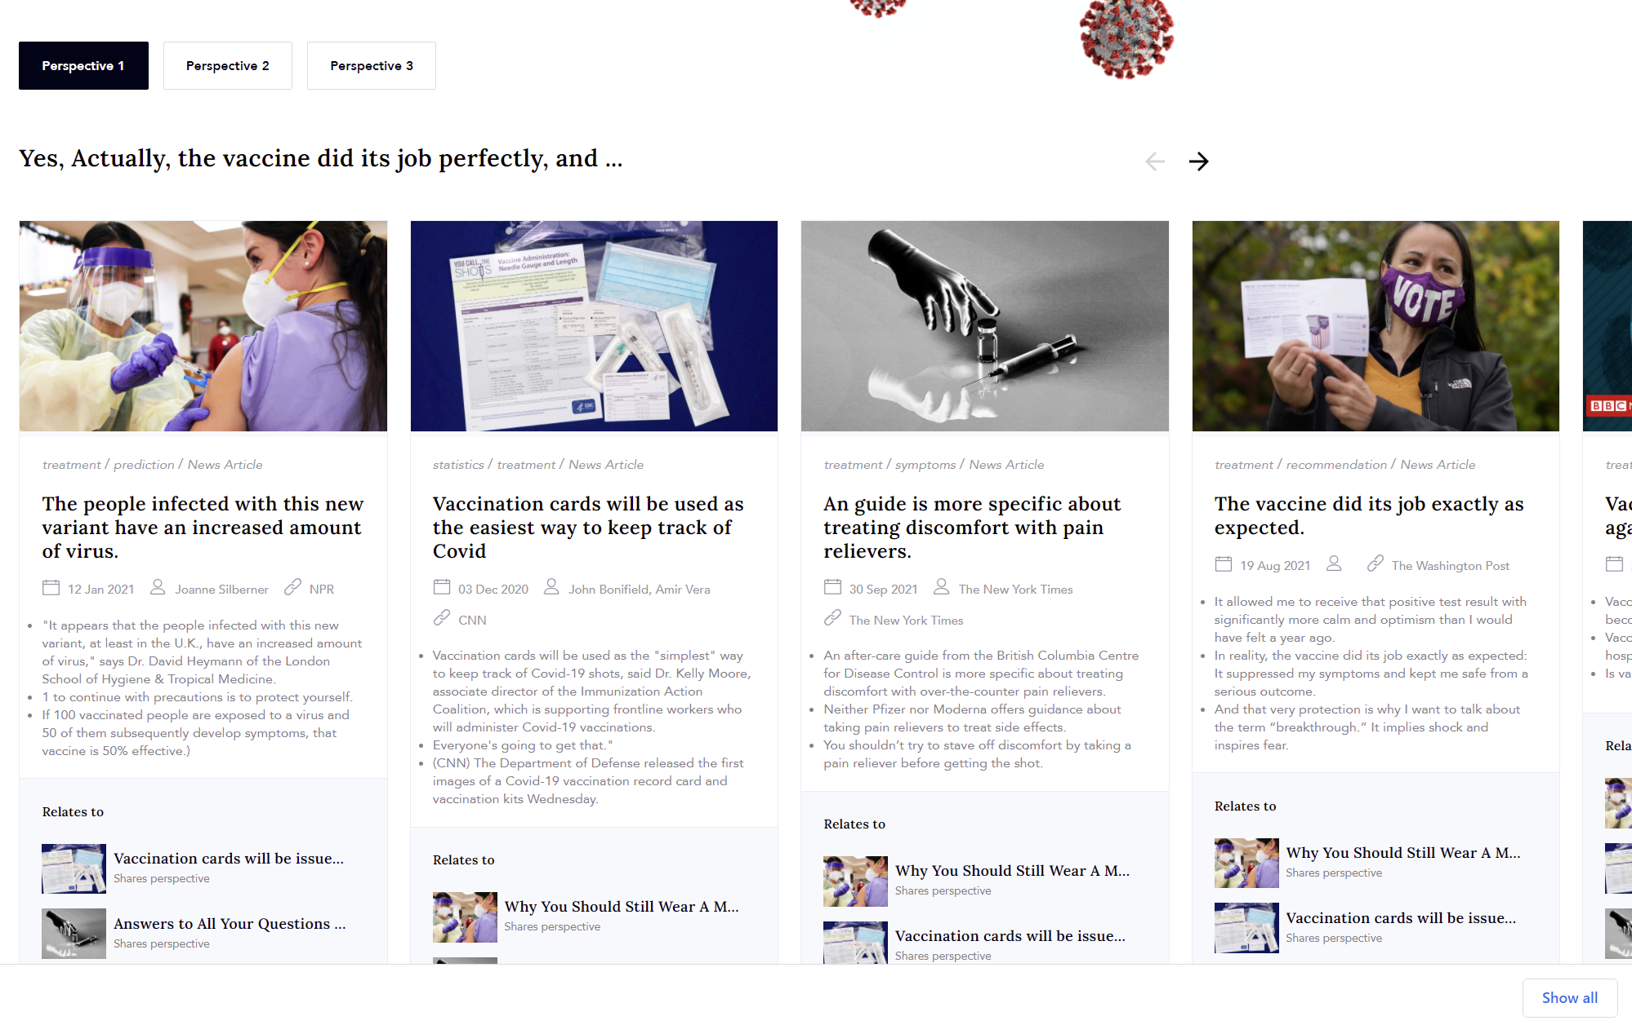
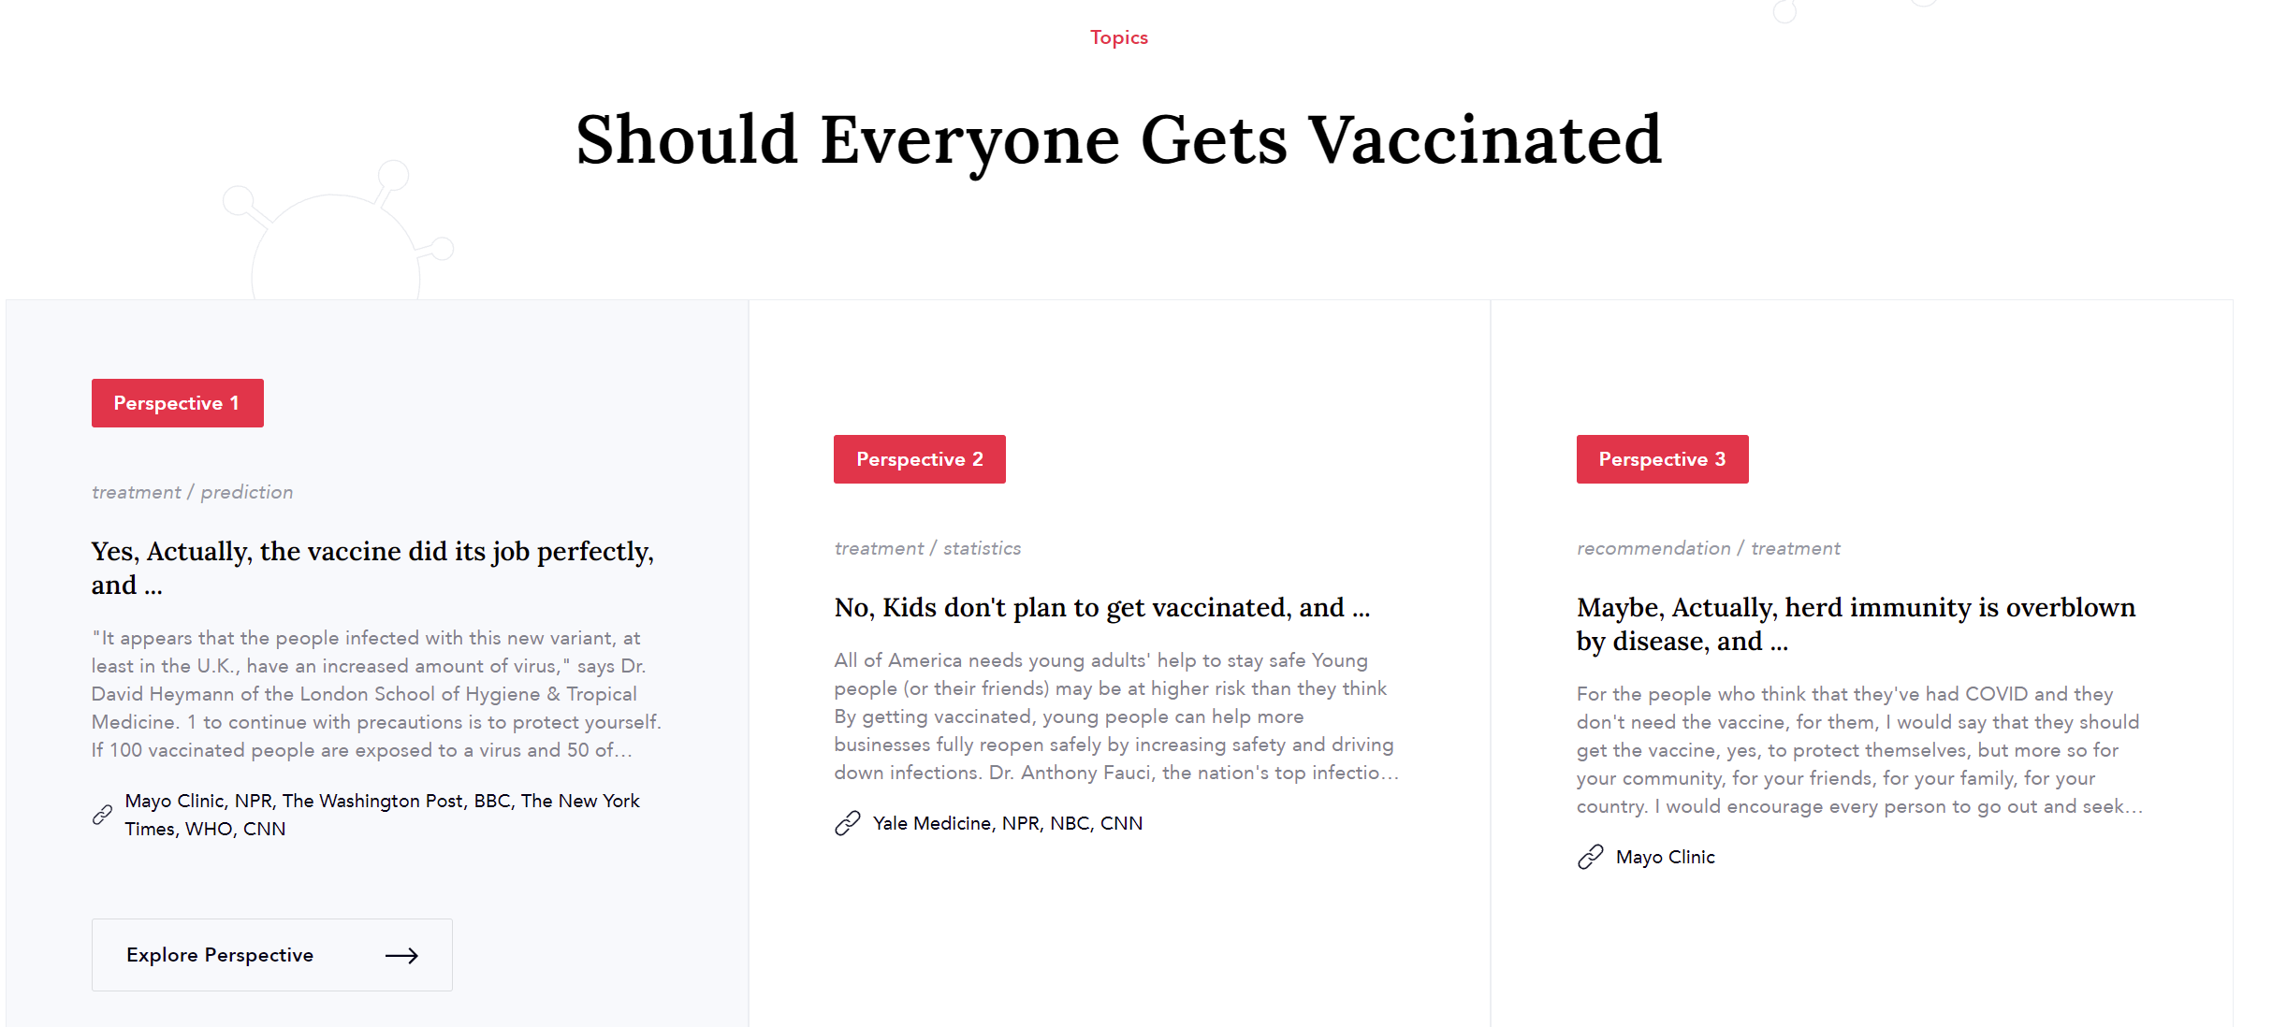
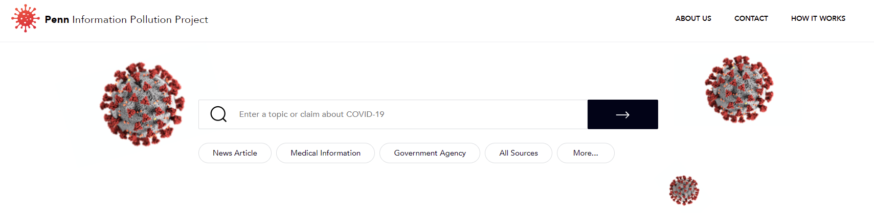
A Experimental Web Site
http://dickens.seas.upenn.edu:4011/

Slide 11
  Claim Provenance

Slide 12
Example: Fact-Checking
How do we know if it is true?
Query Claims:
Facebook soon plans to charge fees to users of the social network.

Slide 13

Examples: Fact-Checking
A typical claim verification pipeline:
  Search for evidence
  Do Textual Entailment: (Premise → Hypothesis)
Query Claims:
…
While it’s not entirely clear what the reason is, the fact that Facebook is no longer touting its services as free could mean one of several things ...
…
Facebook soon plans to charge fees to users of the social network.

Slide 14
Examples: Not Just Fact-Checking
What else would we like to have?
Query Claims:
…
While it’s not entirely clear what the reason is, the fact that Facebook is no longer touting its services as free could mean one of several things ...
…
Facebook soon plans to charge fees to users of the social network.

Slide 15
Examples: Not Just Fact-Checking
What else would we like to have?
  Who authored the evidence claim?
?
Query Claims:
…
While it’s not entirely clear what the reason is, the fact that Facebook is no longer touting its services as free could mean one of several things ...
…
Facebook soon plans to charge fees to users of the social network.

Slide 16

Examples: Not Just Fact-Checking
What else would we like to have?
  Who authored the evidence claim?
  Was the author influenced by another source when writing his/her claim?
…
But now that has changed. Business Insider first reported on Tuesday that on August 7th,
…
was concerned about the interests of its users. Facebook could charge a monthly fee. Now, that pretense is gone. Facebook no longer …
Query Claims:
Facebook soon plans to charge fees to users of the social network.
…
Facebook quietly ditched the 'It’s free and always will be' slogan from its homepage
…

Slide 17

Examples: Not Just Fact-Checking
What else would we like to have?
  Who authored the evidence claim?
  Was the author influenced by another source when writing his/her claim?
  Was the author influenced by interacting claims from multiple sources?
…
Facebook quietly ditched the 'It’s free and always will be' slogan from its homepage
…
…
But now that has changed. Business Insider first reported on Tuesday that on August 7th,
…
was concerned about the interests of its users. Facebook could charge a monthly fee. Now, that pretense is gone. Facebook no longer …
Query Claims:
Facebook soon plans to charge fees to users of the social network.
…
The best way for Facebook to do that is to offer services for free, which ads enable us to do.
…

Slide 18
Examples: Not Just Fact-Checking
What else would we like to have?
  Who authored the evidence claim?
  Was the author influenced by another source when writing his/her claim?
  Was the author influenced by interacting claims from multiple sources?
  How did those sources influence the author to write the claim?
entailed
…
Facebook quietly ditched the 'It’s free and always will be' slogan from its homepage
…
…
But now that has changed. Business Insider first reported on Tuesday that on August 7th,
…
was concerned about the interests of its users. Facebook could charge a monthly fee. Now, that pretense is gone. Facebook no longer …
Query Claims:
Facebook soon plans to charge fees to users of the social network.
triggered
…
The best way for Facebook to do that is to offer services for free, which ads enable us to do.
…
contradicted

Slide 19

Claim Provenance
Provenance supports understanding:
  Relationship between a claim and its source
  Relations between sources and the evolution of claims they make
  Composition of claims
Important for (beyond fact-checking):
  Describing the context and history of a claim
  Studying “who” influences the claim/author
  Understanding the relations between documents that make claims
Addressing these challenges requires progress on multiple Machine-Learning-driven language understanding tasks

Slide 20



Conclusion
Thank You!
Will Patients ever trust AI recommendations?
Navigating information pollution requires Natural Language Understanding
  Key Challenges to today’s Natural Language Technologies
We are working on computational approaches that address:
Perspectives
  Different but legitimate perspectives
  Supported by evidence
  Have involved relations:
    compatible, contradictory, complementary,…
Claim Provenance
  The origin and evolution of claims
Understanding Sources
  Their level of expertise and trustworthiness
Sihao Chen, Siyi Liu, Xander Uyttendaele, Yi Zhang, William W. Bruno, Dan Roth, Design Challenges for a Multi-Perspective Search Engine, NAACL’22, Findings Track
Yi Zhang and Zachary G. Ives and Dan Roth, What is Your Article Based On? Inferring Fine-Grained Provenance ACL’21
Siyi Liu and Sihao Chen and Xander Uyttendaele and Dan Roth
"MultiOpEd: A Corpus of Multi-Perspective News Editorials“ NAACL’21
Yi Zhang and Zachary G. Ives and Dan Roth
""Who said it, and Why?" Provenance for Natural Language Claims“ ACL’20
Yi Zhang and Zachary G. Ives and Dan Roth
"Evidence-based Trustworthiness“ ACL’19
Sihao Chen and Daniel Khashabi and Chris Callison-Burch and Dan Roth
"PerspectroScope: A Window to the World of Diverse Perspectives“ ACL-Demo’19

