Slide 1
Learning from
Natural Instructions
Dan Roth
Department of Computer Science
University of Illinois at Urbana-Champaign
With thanks to:
Collaborators: Ming-Wei Chang, James Clarke, Michael Connor, Dan Goldwasser,
Lev Ratinov, Vivek Srikumar, Many others
Funding: NSF; DHS; NIH; DARPA.
DASH Optimization (Xpress-MP)
December 2011
Technion, Israel

Slide 2
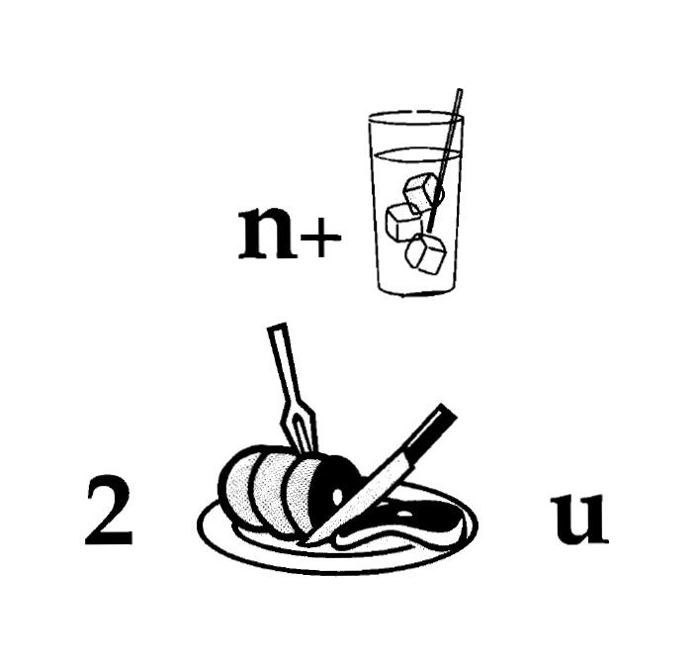
Nice to Meet You

Slide 3

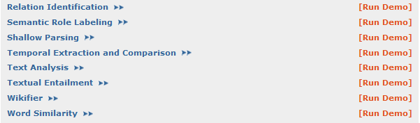
Comprehension
A process that maintains and updates a collection of propositions about the state of affairs.
(ENGLAND, June, 1989) - Christopher Robin is alive and well. He lives in England. He is the same person that you read about in the book, Winnie the Pooh. As a boy, Chris lived in a pretty home called Cotchfield Farm. When Chris was three years old, his father wrote a poem about him. The poem was printed in a magazine for others to read. Mr. Robin then wrote a book. He made up a fairy tale land where Chris lived. His friends were animals. There was a bear called Winnie the Pooh. There was also an owl and a young pig, called a piglet. All the animals were stuffed toys that Chris owned. Mr. Robin made them come to life with his words. The places in the story were all near Cotchfield Farm. Winnie the Pooh was written in 1925. Children still love to read about Christopher Robin and his animal friends. Most people don't know he is a real person who is grown now. He has written two books of his own. They tell what it is like to be famous.
1. Christopher Robin was born in England. 2. Winnie the Pooh is a title of a book.
3. Christopher Robin’s dad was a magician. 4. Christopher Robin must be at least 65 now.
This is an Inference Problem
Notes:
I would like to talk about it in the context of language understanding problems. This is the problem I would like to solve. You are given a short story, a document, a paragraph, which you would like to understand. My working definition for Comprehension here would be “ A process that….”
So, given some statement, I would like to know if they are true in this story or not….
This is a very difficult task…
What do we need to know in order to have a chance to do that? … Many things….
And, there are probably many other stand-alone tasks of this sort that we need to be able to address, if we want to have a chance to COMPREHEND this story, and answer questions with respect to it.
But comprehending this story, being able to determined the truth of these statements is probably a lot more than that – we need to be able to put these things,
(and what is “these” isnt’ so clear) together.
So, how do we address comprehension? Here is a somewhat cartoon-she view of what has happened in this area over the last 30 years or so?
talk about – I wish I could talk about.
Here is a challenge: write a program that responds correctly to these five questions. Many of us would love to be able to do it.
This is a very natural problem; a short paragraph on Christopher Robin that we all
Know and love, and a few questions about it; my six years old can answer these
Almost instantaneously, yes, we cannot write a program that answers more than, say, 2 out of five questions.
What is involved in being able to answer these? Clearly, there are many “small” local decisions that we need to make.
We need to recognize that there are two Chris’s here. A father an a son. We need to resolve co-reference. We need sometimes
To attach prepositions properly;
The key issue, is that it is not sufficient to solve these local problems – we need to figure out how to put them
Together in some coherent way.
And in this talk, I will focus on this. We describe some recent works that we have done in this direction - …..
What do we know – in the last few years there has been a lot of work – and a considerable success on what I call here ---
Here is a more concrete and easy example -----
There is an agreement today that learning/ statistics /information theory (you name it) is of prime importance to making
Progress in these tasks. The key reason, is that rather than working on these high level difficult tasks, we have moved
To work on well defined disambiguation problems that people felt are at the core of many problems.
And, as an outcome of work in NLP and Learning Theory, there is today a pretty good understanding for how to solve
All these problems – which are essentially the same problem.

Slide 4

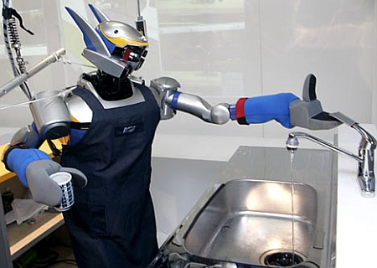


Connecting Language to the World
Can we rely on this interaction to provide supervision (and, eventually, recover meaning) ?
Connecting Language to the World
Can I get a coffee with sugar and no milk
Great!
Arggg
Semantic Parser
MAKE(COFFEE,SUGAR=YES,MILK=NO)
How to recover meaning from text?
Annotate with meaning representation; use (standard) “example based” ML
  Teacher needs deep understanding of the learning agent
  Annotation burden; not scalable.
Instructable computing
  Natural communication between teacher/agent
Notes:
NLP: about recovering meaning from text – a lot of work aims directly at that or at some subtasks that…

Slide 5
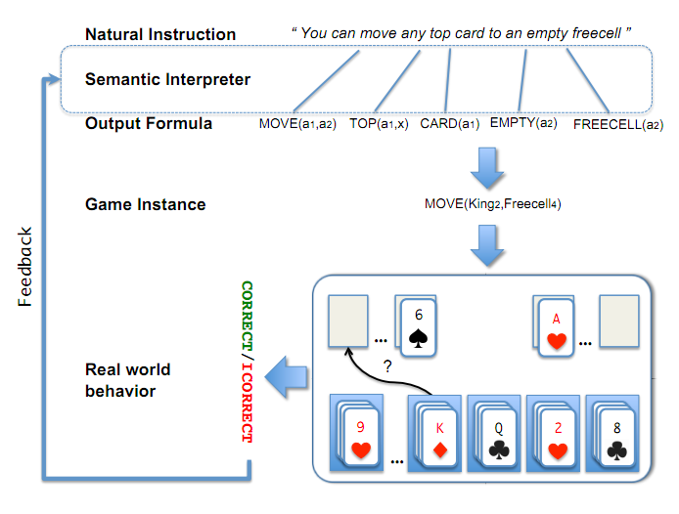
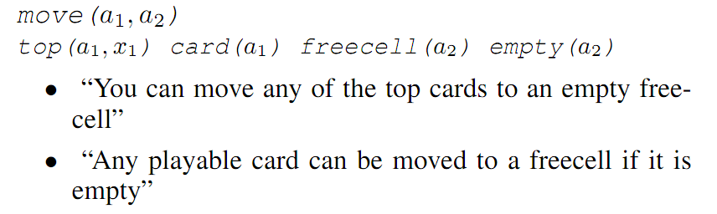
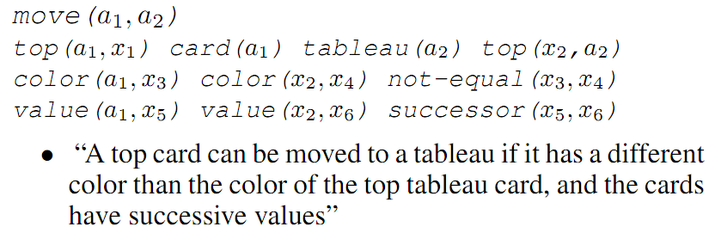
Scenarios I: Understanding Instructions [IJCAI’11]
Understanding Games’ Instructions
Allow a human teacher to interact with an automated learner using natural instructions
  Agonstic of agent's internal representations
  Contrasts with traditional 'example-based' ML
A top card can be moved to the tableau if it has a different color than the color of the top tableau card, and the cards have successive values.

Slide 6
What to Learn from Natural Instructions?
Two conceptual ways to think about learning from instructions
(i) Learn directly to play the game [EMNLP’09; Barziley et. al 10,11]
  Consults the natural language instructions
  Use them as a way to improve your feature based representation
(ii) Learn to interpret a natural language lesson [IJCAI’11]
  (And jointly) how to use this interpretation to do well on the final task.
  Will this help generalizing to other games?
Semantic Parsing into some logical representation is a necessary intermediate step
  Learn how to semantically parse from task level feedback
  Evaluate at the task, rather than the representation level

Slide 7
Scenario I’: Semantic Parsing [CoNLL’10,ACL’11…]
X :“What is the largest state that borders New York and Maryland ?"
Successful interpretation involves multiple decisions
  What entities appear in the interpretation?
  “New York” refers to a state or a city?
  How to compose fragments together?
    state(next_to()) >< next_to(state())
Question: How to learn to semantically parse from “task level” feedback.
Y: largest( state( next_to( state(NY)) AND next_to (state(MD))))
Notes:
Almost all NLP tasks: one example, many decisions
7

Slide 8
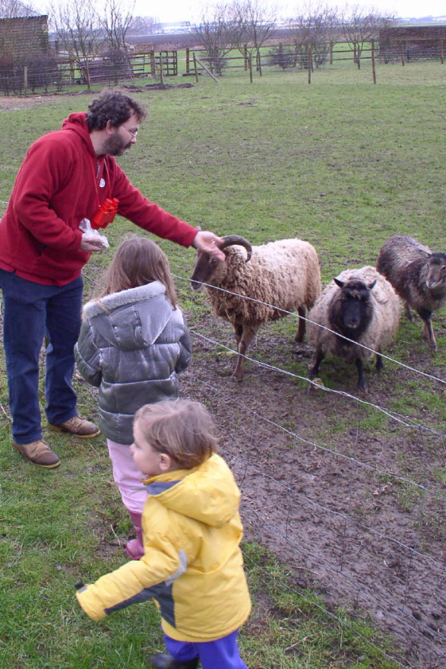
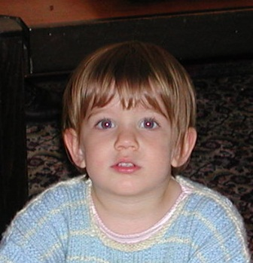
Scenario II. The language-world mapping problem [IJCAI’11, ACL’10,…]
“the world”
How do we acquire language?
Is it possible to learn the meaning of verbs from natural, behavior level, feedback? (no “intermediate representation” level feedback)
“the language”
[Topid rivvo den marplox.]
Notes:
So let’s look at the problem facing the child. In learning a language, a child must figure out how to map words and syntactic devices onto the meanings they are meant to convey in the native language.
Viewed in this way, this is a highly unconstrained mapping problem. In principle, anything in the language could be relevant to anything in the world.

Slide 9
Outline
Background: NL Structure with Integer Linear Programming
  Global Inference with expressive structural constraints in NLP
Constraints Driven Learning with Indirect Supervision
  Training Paradigms for latent structure
  Indirect Supervision Training with latent structure (NAACL’10)
  Training Structure Predictors by Inventing binary labels (ICML’10)
Response based Learning
  Driving supervision signal from World’s Response (CoNLL’10,IJCAI’11)
  Semantic Parsing ; Playing Freecell; Language Acquisition

Slide 10
Interpret Language Into An Executable Representation
X :“What is the largest state that borders New York and Maryland ?"
Successful interpretation involves multiple decisions
  What entities appear in the interpretation?
  “New York” refers to a state or a city?
  How to compose fragments together?
    state(next_to()) >< next_to(state())
Question: How to learn to semantically parse from “task level” feedback.
Y: largest( state( next_to( state(NY) AND next_to (state(MD))))
Notes:
Almost all NLP tasks: one example, many decisions
10

Slide 11
Learning and Inference in NLP
Natural Language Decisions are Structured
  Global decisions in which several local decisions play a role but there are mutual dependencies on their outcome.
It is essential to make coherent decisions in a way that takes the interdependencies into account. Joint, Global Inference.
But: Learning structured models requires annotating structures.
Interdependencies among decision variables should be exploited in Decision Making (Inference) and in Learning.
  Goal: learn from minimal, indirect supervision
  Amplify it using interdependencies among variables

Slide 12
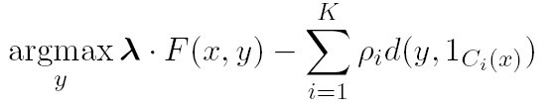
Constrained Conditional Models (aka ILP Inference)
Penalty for violating
the constraint.
(Soft) constraints component
Weight Vector for “local” models
Features, classifiers; log-linear models (HMM, CRF) or a combination
How far y is from
a “legal” assignment
How to solve?
This is an Integer Linear Program
Solving using ILP packages gives an exact solution.
Cutting Planes, Dual Decomposition & other search techniques are possible
How to train?
Training is learning the objective function
Decouple? Decompose?
How to exploit the structure to minimize supervision?

Slide 13
Three Ideas
Modeling
Idea 1:
Separate modeling and problem formulation from algorithms
  Similar to the philosophy of probabilistic modeling
Idea 2:
Keep model simple, make expressive decisions (via constraints)
  Unlike probabilistic modeling, where models become more expressive
Idea 3:
Expressive structured decisions can be supervised indirectly via
related simple binary decisions
  Global Inference can be used to amplify the minimal supervision.
Inference
Learning

Slide 14
Examples: CCM Formulations (aka ILP for NLP)
CCMs can be viewed as a general interface to easily combine declarative domain knowledge with data driven statistical models
  Formulate NLP Problems as ILP problems (inference may be done otherwise)
    1. Sequence tagging (HMM/CRF + Global constraints)
    2. Sentence Compression (Language Model + Global Constraints)
    3. SRL (Independent classifiers + Global Constraints)
Sequential Prediction
HMM/CRF based:
Argmax ∑ ¸_{ij} x_{ij}
Sentence Compression/Summarization:
Language Model based:
Argmax ∑ ¸_{ijk} x_{ijk}
Linguistics Constraints
Cannot have both A states and B states in an output sequence.
Linguistics Constraints
If a modifier chosen, include its head
If verb is chosen, include its arguments

Slide 15
Example: Sequence Tagging
Any Boolean rule can be encoded as a (collection of) linear constraints.
LBJ: allows a developer to encode constraints in FOL, to be compiled into linear inequalities automatically.
HMM / CRF:
Example:
the
man
saw
the
dog
D
D
D
D
D
N
N
N
N
N
A
A
A
A
A
As an ILP:
V
V
V
V
V
Discrete predictions
output consistency
Other constraints

Slide 16
Information extraction without Prior Knowledge
Lars Ole Andersen . Program analysis and specialization for the C Programming language. PhD thesis. DIKU , University of Copenhagen, May 1994 .
Prediction result of a trained HMM
Lars Ole Andersen . Program analysis and
specialization for the
C
Programming language
. PhD thesis .
DIKU , University of Copenhagen , May
1994 .
[AUTHOR]
[TITLE]
[EDITOR]
[BOOKTITLE]
[TECH-REPORT]
[INSTITUTION]
[DATE]
Violates lots of natural constraints!
Notes:
16
16

Slide 17
Strategies for Improving the Results
Increasing the model complexity
Increase difficulty of Learning
Can we keep the learned model simple and still make expressive decisions?
(Pure) Machine Learning Approaches
  Higher Order HMM/CRF?
  Increasing the window size?
  Adding a lot of new features
    Requires a lot of labeled examples
  What if we only have a few labeled examples?
Other options?
  Constrain the output to make sense
  Push the (simple) model in a direction that makes sense
Notes:
17

Slide 18
Examples of Constraints
Each field must be a consecutive list of words and can appear at most once in a citation.
State transitions must occur on punctuation marks.
The citation can only start with AUTHOR or EDITOR.
The words pp., pages correspond to PAGE.
Four digits starting with 20xx and 19xx are DATE.
Quotations can appear only in TITLE
…….
Easy to express pieces of “knowledge”
Non Propositional; May use Quantifiers

Slide 19
Information Extraction with Constraints
Adding constraints, we get correct results!
  Without changing the model
[AUTHOR] Lars Ole Andersen .
[TITLE] Program analysis and specialization for the
C Programming language .
[TECH-REPORT] PhD thesis .
[INSTITUTION] DIKU , University of Copenhagen ,
[DATE] May, 1994 .
Constrained Conditional Models Allow:
Learning a simple model
Make decisions with a more complex model
Accomplished by directly incorporating constraints to bias/re-rank decisions made by the simpler model
Notes:
19

Slide 20
Guiding (Semi-Supervised) Learning with Constraints
In traditional Semi-Supervised learning the model can drift away from the correct one.
Constraints can be used to generate better training data
  At training to improve labeling of un-labeled data (and thus improve the model)
  At decision time, to bias the objective function towards favoring constraint satisfaction.
Model
Constraints
Un-labeled Data
Decision Time
Constraints

Slide 21
Constraints Driven Learning (CoDL)
Several Training Paradigms
[Chang, Ratinov, Roth, ACL’07;ICML’08,ML, to appear]
Generalized by Ganchev et. al [PR work]
(w₀,½₀)=learn(L)‏
For N iterations do
T=φ
For each x in unlabeled dataset
h Ã argmax_{y} w^{T} Á(x,y) - ∑ ½_{k} d_{C}(x,y)
T=T ∪ {(x, h)}
(w,½) = γ (w₀,½₀) + (1- γ) learn(T)
Supervised learning algorithm parameterized by
(w,½). Learning can be justified as an optimization
procedure for an objective function
Inference with constraints:
augment the training set
Learn from new training data
Weigh supervised &
unsupervised models.
Excellent Experimental Results showing the advantages of using constraints, especially with small amounts on labeled data [Chang et. al, Others]
Page 21
Notes:
21
21

Slide 22

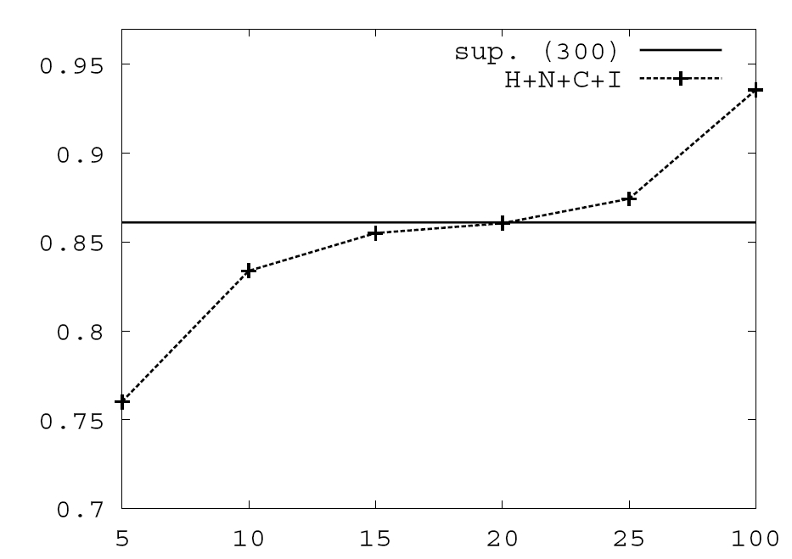
Constraints Driven Learning (CODL)
[Chang, Ratinov, Roth, ACL’07;ICML’08,MLJ, to appear]
Generalized by Ganchev et. al [PR work]
Semi-Supervised Learning Paradigm that makes use of constraints to bootstrap from a small number of examples
Objective function:
Learning w 10 Constraints
Learning w/o Constraints: 300 examples.
Poor model + constraints
Constraints are used to:
Bootstrap a semi-supervised
learner
Correct weak models
predictions on unlabeled
data, which in turn are used
to keep training the model.
# of available labeled examples

Slide 23
Constrained Conditional Models [AAAI’08, MLJ’12]
Constrained Conditional Models – ILP formulations – have been shown useful in the context of many NLP problems, [Roth&Yih, 04,07; Chang et. al. 07,08,…]
  SRL, Summarization; Co-reference; Information & Relation Extraction; Event Identifications; Transliteration; Textual Entailment; Knowledge Acquisition
Some theoretical work on training paradigms [Punyakanok et. al., 05 more]
See a NAACL’10 tutorial on my web page & an NAACL’09 ILPNLP workshop
Summary of work & a bibliography: http://L2R.cs.uiuc.edu/tutorials.html
But: Learning structured models requires annotating structures.

Slide 24
Outline
Background: NL Structure with Integer Linear Programming
  Global Inference with expressive structural constraints in NLP
Constraints Driven Learning with Indirect Supervision
  Training Paradigms for latent structure
  Indirect Supervision Training with latent structure (NAACL’10)
  Training Structure Predictors by Inventing binary labels (ICML’10)
Response based Learning
  Driving supervision signal from World’s Response (CoNLL’10,IJCAI’11)
  Semantic Parsing ; playing Freecell; Language Acquisition

Slide 25
Semantic Parsing as Structured Prediction
X :“What is the largest state that borders New York and Maryland ?"
Successful interpretation involves multiple decisions
  What entities appear in the interpretation?
  “New York” refers to a state or a city?
  How to compose fragments together?
    state(next_to()) >< next_to(state())
Question: How to learn to semantically parse from “task level” feedback.
Y: largest( state( next_to( state(NY) AND next_to (state(MD))))
Notes:
Almost all NLP tasks: one example, many decisions
25

Slide 26
I. Paraphrase Identification
Given an input x 2 X
Learn a model f : X ! {-1, 1}
Consider the following sentences:
S1: Druce will face murder charges, Conte said.
S2: Conte said Druce will be charged with murder .
Are S1 and S2 a paraphrase of each other?
There is a need for an intermediate representation to justify this decision
H
X
Y
We need latent variables that explain
  why this is a positive example.
Given an input x 2 X
Learn a model f : X ! H ! {-1, 1}
Notes:
As an intermediate step, think about the problem of paraphrasing; you don’t to *generate* a structure, just to determine if there is one.

Slide 27
Algorithms: Two Conceptual Approaches
Two stage approach (a pipeline; typically used for TE, paraphrase id, others)
  Learn hidden variables; fix it
    Need supervision for the hidden layer (or heuristics)
  For each example, extract features over x and (the fixed) h.
  Learn a binary classier for the target task
Proposed Approach: Joint Learning
  Drive the learning of h from the binary labels
  Find the best h(x)
  An intermediate structure representation is good to the extent is supports better final prediction.
  Algorithm? How to drive learning a good H?
H
X
Y

Slide 28
Learning with Constrained Latent Representation (LCLR): Intuition
If x is positive
  There must exist a good explanation (intermediate representation)
  9 h, w^{T} Á(x,h) ¸ 0
  or, max_{h} w^{T} Á(x,h) ¸ 0
If x is negative
  No explanation is good enough to support the answer
  8 h, w^{T} Á(x,h) · 0
  or, max_{h} w^{T} Á(x,h) · 0
Altogether, this can be combined into an objective function:
Min_{w} ¸/2 ||w||² + C∑_{i} L(1-z_{i}max_{h 2 C} w^{T} ∑_{{s}} h_{s} Á_{s} (x_{i}))
Why does inference help?
  Constrains intermediate representations supporting good predictions
New feature vector for the final decision. Chosen h selects a representation.
Inference: best h subject to constraints C

Slide 29
Optimization
Non Convex, due to the maximization term inside the global minimization problem
In each iteration:
  Find the best feature representation h* for all positive examples (off-the shelf ILP solver)
  Having fixed the representation for the positive examples, update w solving the convex optimization problem:
  Not the standard SVM/LR: need inference
Asymmetry: Only positive examples require a good intermediate representation that justifies the positive label.
  Consequently, the objective function decreases monotonically

Slide 30


Iterative Objective Function Learning
ILP inference discussed earlier; restrict possible hidden structures considered.
Generate features
  Formalized as Structured SVM + Constrained Hidden Structure
  LCRL: Learning Constrained Latent Representation
Inference
best h subj. to C
Prediction
with inferred h
Initial Objective Function
Update weight vector
Feedback relative to binary problem
Training
w/r to binary decision label
Notes:
Over training iterations the model’s weights change-
➔ Better feature representations➔ Better classification results ➔ used for self training ➔ Better feature representations …

Slide 31
Learning with Constrained Latent Representation (LCLR): Framework
LCLR provides a general inference formulation that allows the use of expressive constraints to determine the hidden level
  Flexibly adapted for many tasks that require latent representations.
Paraphrasing: Model input as graphs, V(G_{1,2}), E(G_{1,2})
  Four (types of) Hidden variables:
    h_{v1,v2} – possible vertex mappings; h_{e1,e2} – possible edge mappings
  Constraints:
    Each vertex in G₁ can be mapped to a single vertex in G₂ or to null
    Each edge in G₁ can be mapped to a single edge in G₂ or to null
    Edge mapping active iff the corresponding node mappings are active
H
LCLR Model
H: Problem Specific
Declarative Constraints
X
Y

Slide 32
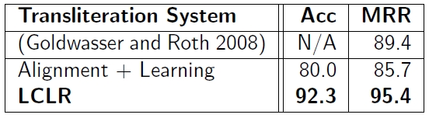
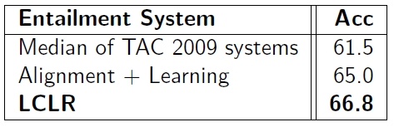

Experimental Results
Transliteration:
Recognizing Textual Entailment:
Paraphrase Identification:*

Slide 33
Outline
Background: NL Structure with Integer Linear Programming
  Global Inference with expressive structural constraints in NLP
Constraints Driven Learning with Indirect Supervision
  Training Paradigms for latent structure
  Indirect Supervision Training with latent structure (NAACL’10)
  Training Structure Predictors by Inventing binary labels (ICML’10)
Response based Learning
  Driving supervision signal from World’s Response (CoNLL’10,IJCAI’11)
  Semantic Parsing ; playing Freecell; Language Acquisition

Slide 34
II: Structured Prediction
Before, the structure was in the intermediate level
  We cared about the structured representation only to the extent it helped the final binary decision
  The binary decision variable was given as supervision
What if we care about the structure?
  Information & Relation Extraction; POS tagging, Semantic Parsing
Invent a companion binary decision problem!

Slide 35
Information extraction
Lars Ole Andersen . Program analysis and specialization for the C Programming language. PhD thesis. DIKU , University of Copenhagen, May 1994 .
Prediction result of a trained HMM
Lars Ole Andersen . Program analysis and
specialization for the
C
Programming language
. PhD thesis .
DIKU , University of Copenhagen , May
1994 .
[AUTHOR]
[TITLE]
[EDITOR]
[BOOKTITLE]
[TECH-REPORT]
[INSTITUTION]
[DATE]
Notes:
35
35

Slide 36
Structured Prediction
H
X
Y
Before, the structure was in the intermediate level
  We cared about the structured representation only to the extent it helped the final binary decision
  The binary decision variable was given as supervision
What if we care about the structure?
  Information Extraction; Relation Extraction; POS tagging, many others.
Invent a companion binary decision problem!
  Parse Citations: Lars Ole Andersen . Program analysis and specialization for the C Programming language. PhD thesis. DIKU , University of Copenhagen, May 1994 .
  Companion: Given a citation; does it have a legitimate citation parse?
  POS Tagging
  Companion: Given a word sequence, does it have a legitimate POS tagging sequence?
Binary Supervision is almost free

Slide 37
Companion Task Binary Label as Indirect Supervision
The two tasks are related just like the binary and structured tasks discussed earlier
All positive examples must have a good structure
Negative examples cannot have a good structure
We are in the same setting as before
  Binary labeled examples are easier to obtain
  We can take advantage of this to help learning a structured model
Algorithm: combine binary learning and structured learning
H
X
Y

Slide 38
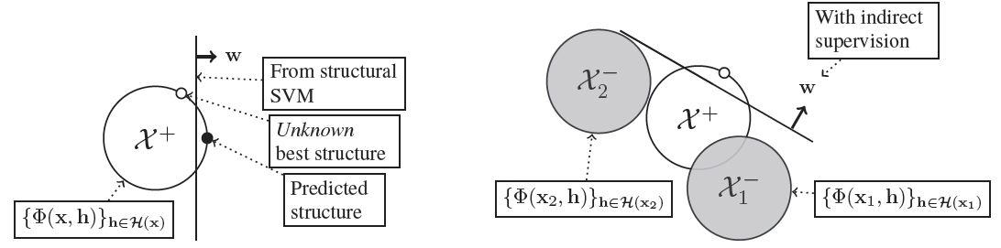
Learning Structure with Indirect Supervision
In this case we care about the predicted structure
Use both Structural learning and Binary learning
Predicted
Correct
Negative examples cannot have a good structure
The feasible structures of an example
Negative examples restrict the space of hyperplanes supporting the decisions for x

Slide 39
Joint Learning Framework
Joint learning : If available, make use of both supervision types
Target Task
Companion Task
I
t
a
l
y
I l l i n o i s
Yes/No
ט
י
ל
א
י
ה
ל
י
י
א
נ
ו
י
Loss function – same as described earlier.
Key: the same parameter w for both components
Loss on Target Task
Loss on Companion Task

Slide 40
Experimental Result
Very little direct (structured) supervision.

Slide 41
Experimental Result
Very little direct (structured) supervision.
(Almost free) Large amount binary indirect supervision

Slide 42
Outline
Background: NL Structure with Integer Linear Programming
  Global Inference with expressive structural constraints in NLP
Constraints Driven Learning with Indirect Supervision
  Training Paradigms for latent structure
  Indirect Supervision Training with latent structure (NAACL’10)
  Training Structure Predictors by Inventing binary labels (ICML’10)
Response based Learning
  Driving supervision signal from World’s Response (CoNLL’10,IJCAI’11)
  Semantic Parsing ; playing Freecell; Language Acquisition

Slide 43
Connecting Language to the World [CoNLL’10,ACL’11,IJCAI’11]
Can I get a coffee with no sugar and just a bit of milk
Great!
Arggg
Semantic Parser
MAKE(COFFEE,SUGAR=NO,MILK=LITTLE)
Can we rely on this interaction to provide supervision?

Slide 44

Real World Feedback
Supervision = Expected Response
Check if Predicted response == Expected response
x
NL
Query
“What is the largest state that borders NY?"
Traditional approach:
learn from logical forms and gold alignments
EXPENSIVE!
Our approach: use only the responses
Logical
Query
r
Query
Response:
y
largest( state( next_to( const(NY))))
Pennsylvania
r
Query
Response:
Interactive Computer System
Pennsylvania
Binary Supervision
Semantic parsing is a structured prediction problem:
identify mappings from text to a meaning representation
Expected : Pennsylvania
Predicted : Pennsylvania
Positive Response
Expected : Pennsylvania
Predicted : NYC
Negative Response
Train a structured predictor with this binary supervision !

Slide 45
Response Based Learning
Repeat
for all input sentences do
Find best structured output
Query feedback function
end for
Learn new W using feedback
Until Convergence
X: What is the largest state that borders NY?
Y: largest( state( next_to( const(NY))))
Use the expected response as supervision
  Feedback(y,r) = 1 if execute(query(y) = r) and 0 o/w
Structure Learning with Binary feedback
  DIRECT protocol: Convert the learning problem into binary prediction
  AGGRESSIVE protocol: Convert the feedback into structured supervision
Learning approach – iteratively identify more correct structures
  Learning terminates when no new structures are added

Slide 46
Constraints Drive Inference
Repeat
for all input sentences do
Find best structured output
Query feedback function
end for
Learn new W using feedback
Until Convergence
X: What is the largest state that borders NY?
Y: largest( state( next_to( const(NY))))
Decompose into two types of decisions:
  First order: Map lexical items to logical symbols
    {“largest”→ largest(), “borders”→next_to(),.., “NY”→const(NY)}
  Second order: Compose meaning from logical fragments
    largest(state(next_to(const(NY))))
Domain’s semantics is used to constrain interpretations
  declarative constraints: Lexical resources (wordnet); type consistency: distance in sentence, in dependency tree,…
And now…
So Far

Slide 47
Empirical Evaluation [CoNLL’10,ACL’11]
Key Question: Can we learn from this type of supervision?
Algorithm | # training structures | Test set accuracy
No Learning: Initial Objective Fn Binary signal: Protocol I | 0 0 | 22.2% 69.2 %
Binary signal: Protocol II | 0 | 73.2 %
WM*2007 (fully supervised – uses gold structures) | 310 | 75 %
*[WM] Y.-W. Wong and R. Mooney. 2007. Learning synchronous grammars for semantic parsing with lambda calculus. ACL.
Current emphasis: Learning to understand natural language instructions for games via response based learning

Slide 48
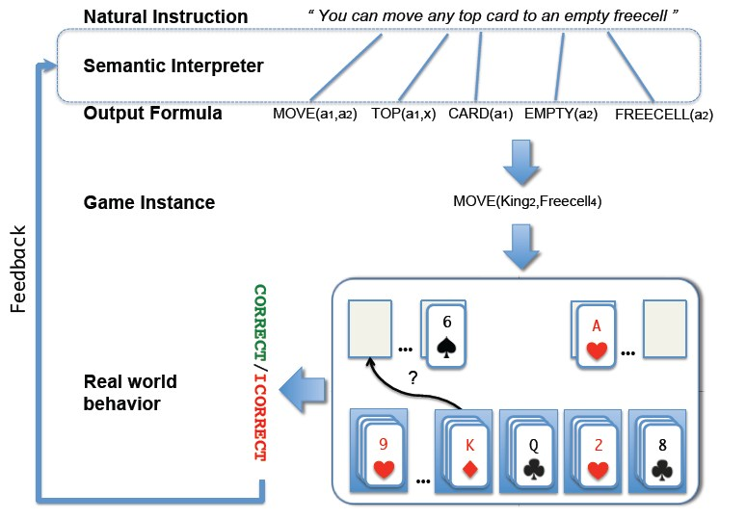
Learning from Natural Instructions
A human teacher interacts with an automated learner using natural instructions
Learner is given:
  A lesson describing the target concept directly
  A few instances exemplifying it
Challenges:
how to interpret the lesson and
(2) how to use this interpretation to do well on the final task.

Slide 49
Lesson Interpretation as an inference problem
X: You can move any top card to an empty freecell
Y: Move(a1,a2) Top(a1, x) Card (a1) Empty(a2) Freecell(a2)
Semantic interpretation is framed as an Integer Linear Program with three types of constraints:
  Lexical Mappings: (1st order constraints)
    At most one predicate mapped to each word
  Argument Sharing Constraints (2nd order constraints)
    Type consistency; decision consistency
  Global Structure Constraints
    Connected structure enforced via flow constraints

Slide 50
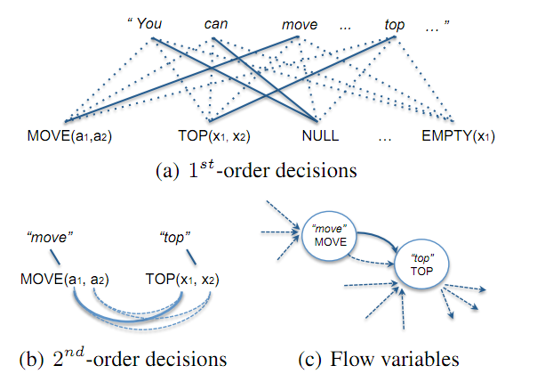
Lesson Interpretation as an inference problem
X: You can move any top card to an empty freecell
Y: Move(a1,a2) Top(a1, x) Card (a1) Empty(a2) Freecell(a2)
Semantic interpretation is framed as an Integer Linear Program with three types of constraints:
  Lexical Mappings: (1st order constraints)
    At most one predicate mapped to each word
  Argument Sharing Constraints (2nd order constraints)
    Type consistency; decision consistency
  Global Structure Constraints
    Connected structure enforced via flow constraints

Slide 51
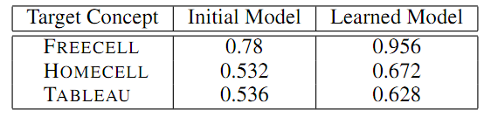
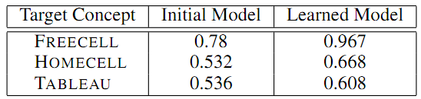
Empirical Evaluation [IJCAI’11]
Can the induced game-hypothesis generalize to new game instances?
  Accuracy was evaluated over previously unseen game moves
Can the learned reader generalize to new inputs?
  Accuracy was evaluated over previously unseen game moves using classification rules generated from previously unseen instructions.

Slide 52
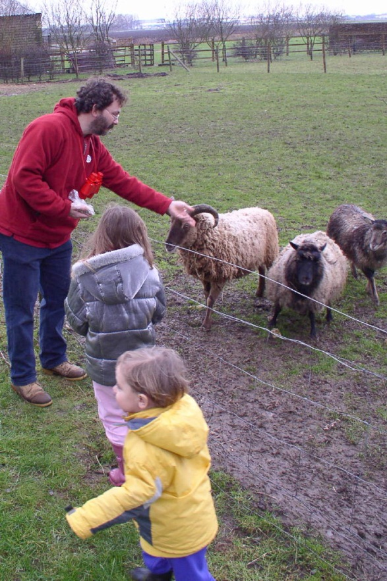
The language-world mapping problem
Skip
How do we acquire language?
“the world”
“the language”
[Topid rivvo den marplox.]
Notes:
So let’s look at the problem facing the child. In learning a language, a child must figure out how to map words and syntactic devices onto the meanings they are meant to convey in the native language.
Viewed in this way, this is a highly unconstrained mapping problem. In principle, anything in the language could be relevant to anything in the world.

Slide 53

BabySRL: Learning Semantic Roles From Scratch
A joint line of research with Cindy Fisher’s group.
Driven by Structure-mapping: a starting point for syntactic bootstrapping
Children can learn the meanings of some nouns via cross-situational observations alone [Fisher 1996, Gillette, Gleitman, Gleitman, & Lederer, 1999;more]
But how do they learn the meaning of verbs?
  Sentences comprehension is grounded by the acquisition of an initial set of concrete nouns
  These nouns yields a skeletal sentence structure — candidate arguments; cues to its semantic predicate—argument structure.
  Represent sentence in an abstract form that permits generalization to new verbs
[Johanna rivvo den sheep.]
Nouns identified
Notes:
To explore this possibility, my colleagues and I have been thinking about how very simple aspects of sentence structures might be intrinsically meaningful to children -- even before they’ve learned much about the syntax of the native language.
One possibility is that the set of nouns in the sentence might provide an initial cue to the structure of the semantic predicate conveyed by the verb.
The set of nouns is useful because it provides a probabilistic estimate of the verb’s number of semantic arguments.

Slide 54
BabySRL [Connor et. al, CoNLL’08, ’09,ACL’10, IJCAI’11]
Realistic Computational model developed to experiment with theories of early language acquisition
  SRL as minimal level language understanding: who does what to whom.
  Verbs meanings are learned via their syntactic argument-taking roles
  Semantic feedback to improve syntactic & meaning representation
Inputs and knowledge sources
  Only those we can defend children have access to
Key Components:
  Representation: Theoretically motivated representation of the input
  Learning: Guided by knowledge kids have
Exciting results – generalization to new verbs, reproducing and recovering from mistakes made by young children.

Slide 55
Minimally Supervised BabySRL [IJCAI’11]
Goal: Unsupervised “parsing” – identifying arguments & their roles
Provide little prior knowledge & only high level semantic feedback
  Defensible from psycholinguistic evidence
Learning with
Indirect Supervision
Input + Distributional Similarity
Structured
Intermediate Representation
(no supervision)
Binary weak supervision for the final decision
Unsupervised parsing
  Identifying part-of-speech states
Argument Identification
  Identify Argument States
  Identify Predicate States
Argument Role Classification
  Labeled Training using predicted arguments
Learning is done from CHILDES corpora
IJCAI’11: indirect supervision driven from scene feedback

Slide 56
Conclusion
Thank You!
Study a new type of machine learning, based on natural language interpretation and feedback
The motivation is to reduce annotation cost and focus the learning process on human-level task expertise rather than on machine learning and technical expertise
Technical approach is based on
  (1) Learning structure with indirect supervision
  (2) Constraining intermediate structure representation declaratively
These were introduced via Constrained Conditional Models: Computational Framework for global inference and a vehicle for incorporating knowledge in structured tasks
  Integer Linear Programming Formulation – a lot of recent work (see tutorial)
Game playing domain, Psycholinguistics, Semantic Parsing, ESL,…other structured tasks.
Check out our tools & demos
Notes:
56

Slide 57
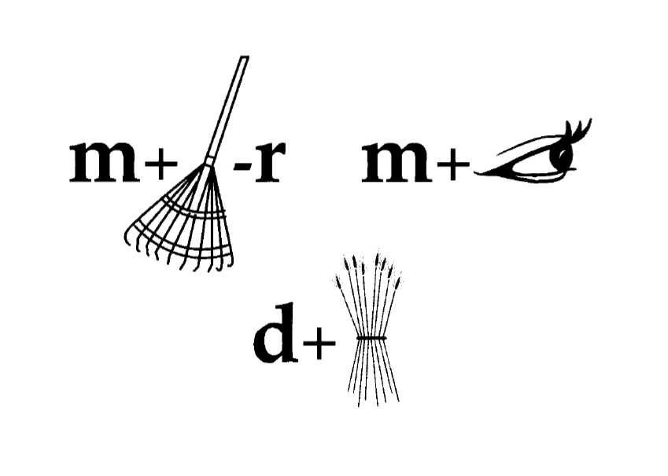
Questions?
Thank you
Notes:
In the rest of my talk, I’ll introduce this general framework by looking at two case studies. The first one, resolving non-overlapping constraints, is a simple case that is usually done using dynamic programming.

