Slide 1
Learning and Inference for
Natural Language Understanding
Dan Roth
Department of Computer Science
University of Illinois at Urbana-Champaign
With thanks to:
Collaborators: Kai-Wei Chang, Xiao Chen, Dan Goldwasser, Daniel Khashabi,
Gourab Kundu, Haoruo Peng, Lev Ratinov, Vivek Srikumar; others
Funding: NSF; DHS; NIH; DARPA; IARPA, ARL, ONR, Google, AI2
DASH Optimization (Xpress-MP); Gurobi.
October 2015
NLPCC 2015
Nanchang, China

Slide 2
Comprehension
(ENGLAND, June, 1989) - Christopher Robin is alive and well. He lives in England. He is the same person that you read about in the book, Winnie the Pooh. As a boy, Chris lived in a pretty home called Cotchfield Farm. When Chris was three years old, his father wrote a poem about him. The poem was printed in a magazine for others to read. Mr. Robin then wrote a book. He made up a fairy tale land where Chris lived. His friends were animals. There was a bear called Winnie the Pooh. There was also an owl and a young pig, called a piglet. All the animals were stuffed toys that Chris owned. Mr. Robin made them come to life with his words. The places in the story were all near Cotchfield Farm. Winnie the Pooh was written in 1925. Children still love to read about Christopher Robin and his animal friends. Most people don't know he is a real person who is grown now. He has written two books of his own. They tell what it is like to be famous.
1. Christopher Robin was born in England. 2. Winnie the Pooh is a title of a book.
3. Christopher Robin’s dad was a magician. 4. Christopher Robin must be at least 65 now.
This is an Inference Problem
Notes:
2
I would like to talk about it in the context of language understanding problems. This is the problem I would like to solve. You are given a short story, a document, a paragraph, which you would like to understand. My working definition for Comprehension here would be “ A process that….”
So, given some statement, I would like to know if they are true in this story or not….
This is a very difficult task…
What do we need to know in order to have a chance to do that? … Many things….
And, there are probably many other stand-alone tasks of this sort that we need to be able to address, if we want to have a chance to COMPREHEND this story, and answer questions with respect to it.
But comprehending this story, being able to determined the truth of these statements is probably a lot more than that – we need to be able to put these things,
(and what is “these” isnt’ so clear) together.
So, how do we address comprehension? Here is a somewhat cartoon-she view of what has happened in this area over the last 30 years or so?
talk about – I wish I could talk about.
Here is a challenge: write a program that responds correctly to these five questions. Many of us would love to be able to do it.
This is a very natural problem; a short paragraph on Christopher Robin that we all
Know and love, and a few questions about it; my six years old can answer these
Almost instantaneously, yes, we cannot write a program that answers more than, say, 2 out of five questions.
What is involved in being able to answer these? Clearly, there are many “small” local decisions that we need to make.
We need to recognize that there are two Chris’s here. A father an a son. We need to resolve co-reference. We need sometimes
To attach prepositions properly;
The key issue, is that it is not sufficient to solve these local problems – we need to figure out how to put them
Together in some coherent way.
And in this talk, I will focus on this. We describe some recent works that we have done in this direction - …..
What do we know – in the last few years there has been a lot of work – and a considerable success on what I call here ---
Here is a more concrete and easy example -----
There is an agreement today that learning/ statistics /information theory (you name it) is of prime importance to making
Progress in these tasks. The key reason, is that rather than working on these high level difficult tasks, we have moved
To work on well defined disambiguation problems that people felt are at the core of many problems.
And, as an outcome of work in NLP and Learning Theory, there is today a pretty good understanding for how to solve
All these problems – which are essentially the same problem.

Slide 3
Why is it Difficult?
Meaning
Variability
Ambiguity
Language

Slide 4






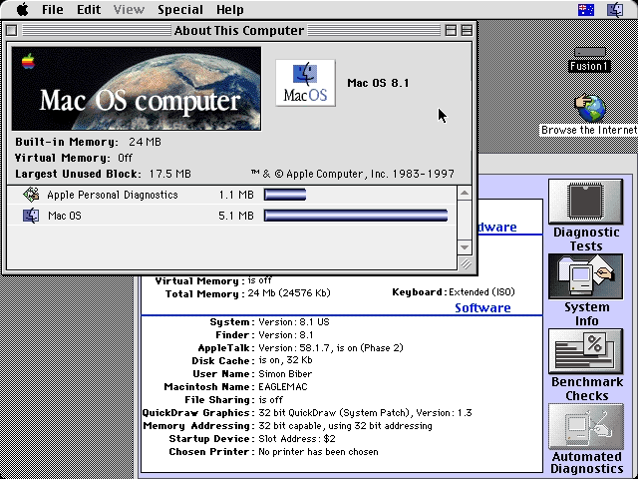
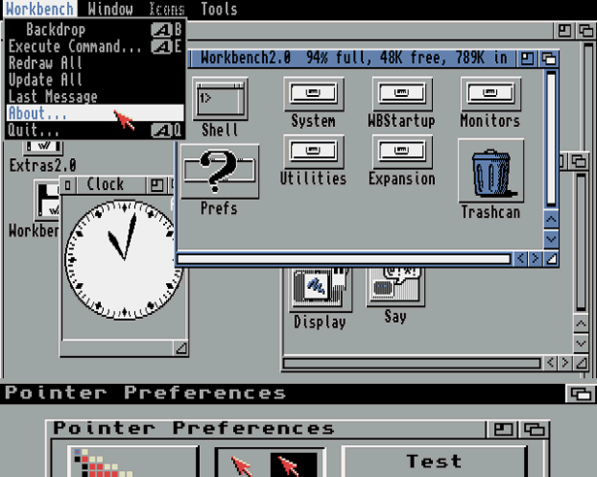
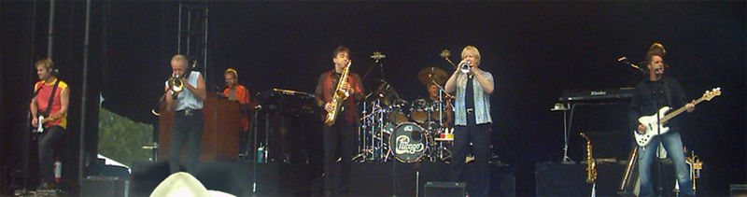
Ambiguity
It’s a version of Chicago – the standard classic Macintosh menu font, with that distinctive thick diagonal in the ”N”.
Chicago was used by default for Mac menus through MacOS 7.6, and OS 8 was released mid-1997..
Chicago VIII was one of the early 70s-era Chicago albums to catch my
ear, along with Chicago II.

Slide 5

Variability in Natural Language Expressions
Determine if Jim Carpenter works for the government
Jim Carpenter works for the U.S. Government.
The American government employed Jim Carpenter.
Jim Carpenter was fired by the US Government.
Jim Carpenter worked in a number of important positions. …. As a press liaison for the IRS, he made contacts in the white house.
Russian interior minister Yevgeny Topolov met yesterday with his US counterpart, Jim Carpenter.
Former US Secretary of Defense Jim Carpenter spoke today…
Standard techniques cannot deal with the variability of expressing meaning
nor with the
ambiguity of interpretation
  Needs:
  Understanding Relations, Entities and Semantic Classes
  Acquiring knowledge from external resources; representing knowledge
  Identifying, disambiguating & tracking entities, events, etc.
  Time, quantities, processes…
Notes:
5

Slide 6
What does it take?
Understanding natural language
  Lexical inference
  Semantic Parsing
  Discourse phenomena
  …..
Understanding a lot of domains
  Events
  Temporal Reasoning
  Spatial Reasoning
  Quantitative Reasoning
  …….
Knowledge
  Acquisition
  Representation
  ….
How to use knowledge to support textual inference?

Slide 7



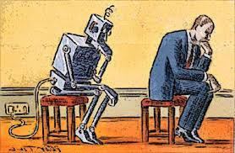
What is Needed?
A computational Framework
Examples:
  Modeling
  Learning
  Inference
Notes:
Almost all NLP tasks: one example, many decisions
7

Slide 8
Comprehension
(ENGLAND, June, 1989) - Christopher Robin is alive and well. He lives in England. He is the same person that you read about in the book, Winnie the Pooh. As a boy, Chris lived in a pretty home called Cotchfield Farm. When Chris was three years old, his father wrote a poem about him. The poem was printed in a magazine for others to read. Mr. Robin then wrote a book. He made up a fairy tale land where Chris lived. His friends were animals. There was a bear called Winnie the Pooh. There was also an owl and a young pig, called a piglet. All the animals were stuffed toys that Chris owned. Mr. Robin made them come to life with his words. The places in the story were all near Cotchfield Farm. Winnie the Pooh was written in 1925. Children still love to read about Christopher Robin and his animal friends. Most people don't know he is a real person who is grown now. He has written two books of his own. They tell what it is like to be famous.
1. Christopher Robin was born in England. 2. Winnie the Pooh is a title of a book.
3. Christopher Robin’s dad was a magician. 4. Christopher Robin must be at least 65 now.
This is an Inference Problem
Notes:
8
I would like to talk about it in the context of language understanding problems. This is the problem I would like to solve. You are given a short story, a document, a paragraph, which you would like to understand. My working definition for Comprehension here would be “ A process that….”
So, given some statement, I would like to know if they are true in this story or not….
This is a very difficult task…
What do we need to know in order to have a chance to do that? … Many things….
And, there are probably many other stand-alone tasks of this sort that we need to be able to address, if we want to have a chance to COMPREHEND this story, and answer questions with respect to it.
But comprehending this story, being able to determined the truth of these statements is probably a lot more than that – we need to be able to put these things,
(and what is “these” isnt’ so clear) together.
So, how do we address comprehension? Here is a somewhat cartoon-she view of what has happened in this area over the last 30 years or so?
talk about – I wish I could talk about.
Here is a challenge: write a program that responds correctly to these five questions. Many of us would love to be able to do it.
This is a very natural problem; a short paragraph on Christopher Robin that we all
Know and love, and a few questions about it; my six years old can answer these
Almost instantaneously, yes, we cannot write a program that answers more than, say, 2 out of five questions.
What is involved in being able to answer these? Clearly, there are many “small” local decisions that we need to make.
We need to recognize that there are two Chris’s here. A father an a son. We need to resolve co-reference. We need sometimes
To attach prepositions properly;
The key issue, is that it is not sufficient to solve these local problems – we need to figure out how to put them
Together in some coherent way.
And in this talk, I will focus on this. We describe some recent works that we have done in this direction - …..
What do we know – in the last few years there has been a lot of work – and a considerable success on what I call here ---
Here is a more concrete and easy example -----
There is an agreement today that learning/ statistics /information theory (you name it) is of prime importance to making
Progress in these tasks. The key reason, is that rather than working on these high level difficult tasks, we have moved
To work on well defined disambiguation problems that people felt are at the core of many problems.
And, as an outcome of work in NLP and Learning Theory, there is today a pretty good understanding for how to solve
All these problems – which are essentially the same problem.

Slide 9
Natural Language Understanding
Expectation is a knowledge intensive component
Natural language understanding decisions are global decisions that require
  Making (local) predictions driven by different models trained in different ways, at different times/conditions/scenarios
  The ability to put these predictions together coherently
  Knowledge, that guides the decisions so they satisfy our expectations
  How can we get there?
Natural Language Interpretation is a Common Sense driven Inference Process that is best thought of as a knowledge constrained optimization problem, done on top of multiple statistically learned models.
Many forms of Inference; a lot boil down to determining best assignment
Notes:
9

Slide 10
Joint Inference with General Constraint Structure [Roth&Yih’04,07,….]
Recognizing Entities and Relations
Joint inference gives good improvement
other | 0.05
per | 0.85
loc | 0.10
other | 0.05
per | 0.85
loc | 0.10
other | 0.10
per | 0.60
loc | 0.30
other | 0.10
per | 0.60
loc | 0.30
other | 0.05
per | 0.50
loc | 0.45
other | 0.05
per | 0.50
loc | 0.45
other | 0.05
per | 0.50
loc | 0.45
Key Questions:
How to guide the global inference?
How to learn the model(s)?
An Objective function that incorporates learned models with knowledge (output constraints)
A Constrained Conditional Model
  Dole ’s wife, Elizabeth , is a native of N.C.
  E1 E2 E3
R₁₂
R₂₃
irrelevant | 0.05
spouse_of | 0.45
born_in | 0.50
irrelevant | 0.05
spouse_of | 0.45
born_in | 0.50
irrelevant | 0.05
spouse_of | 0.45
born_in | 0.50
irrelevant | 0.10
spouse_of | 0.05
born_in | 0.85
irrelevant | 0.10
spouse_of | 0.05
born_in | 0.85
Models could be learned separately/jointly; constraints may come up only at decision time.
Notes:
10
Let’s look at another example in more details.
We want to extract entities (person, location and organization) and relations between them (born in, spouse of).
Given a sentence, suppose the entity classifier and relation classifier have already given us their predictions along with the confidence values. The blue ones are the labels that have the highest confidence individually. However, this global assignment has some obvious mistakes. For example, the second argument of a born_in relation should be location instead of person. Since the classifiers are pretty confident on R23, but not on E3, so we should correct E3 to be location.
Similarly, we should change R12 from “born_in” to “spouse_of”

Slide 11
Constrained Conditional Models
Any MAP problem w.r.t. any probabilistic model, can be formulated as an ILP
[Roth+ 04, Taskar 04]
Penalty for violating
the constraint.
Variables are models
y = argmax_{y} ∑ 1_{Á(x,y)} w_{x,y} subject to Constraints C(x,y)
    y = argmax_{y 2 Y} w^{T}Á(x, y) + u^{T}C(x, y)
Knowledge component:
(Soft) constraints
Weight Vector for “local” models
Features, classifiers; log-linear models (HMM, CRF) or a combination
How far y is from
a “legal/expected” assignment
Training: learning the objective function (w, u)
  Decouple? Decompose? Force u to model hard constraints?
A way to push the learned model to satisfy our output expectations (or, sometimes, expectations from a latent representation)
  [CoDL, Chang et. al (07, 12); Posterior Regularization, Ganchev et. al (10); Unified EM (Samdani et. al (12)]
The benefits of thinking about it as an ILP are conceptual and computational.

Slide 12
Examples: CCM Formulations
  y = argmax_{y 2 Y} w^{T}Á(x, y) + u^{T}C(x, y)
While Á(x, y) and C(x, y) could be the same; we want C(x, y) to express high level declarative knowledge over the statistical models.
  Formulate NLP Problems as ILP problems (inference may be done otherwise)
    1. Sequence tagging (HMM/CRF + Global constraints)
    2. Sentence Compression (Language Model + Global Constraints)
    3. SRL (Independent classifiers + Global Constraints)
Sequential Prediction
HMM/CRF based:
Argmax ∑ ¸_{ij} x_{ij}
Sentence Compression/Summarization:
Language Model based:
Argmax ∑ ¸_{ijk} x_{ijk}
Knowledge/Linguistics Constraints
Cannot have both A states and B states in an output sequence.
Knowledge/Linguistics Constraints
If a modifier chosen, include its head
If verb is chosen, include its arguments
Constrained Conditional Models Allow:
Decouple complexity of the learned model from that of the desired output
Learn a simple model (multiple; pipelines); reason with a complex one.
Accomplished by incorporating constraints to bias/re-rank global decisions to satisfy (minimally violate) expectations.

Slide 13
Outline
Knowledge and Inference
  Combining the soft with the logical/declarative nature of Natural Language
    Constrained Conditional Models: A formulation for global inference with knowledge modeled as expressive structural constraints
    Some examples
Cycles of Knowledge
  Grounding/Acquisition – knowledge – inference
Learning with Indirect Supervision
  Response Based Learning: learning from the world’s feedback
Scaling Up: Amortized Inference
  Can the k-th inference problem be cheaper than the 1st?

Slide 14
Semantic Role Labeling (SRL)
Archetypical Information Extraction Problem: E.g., Concept Identification and Typing, Event Identification, etc.
I left my pearls to my daughter in my will .
[I]_{A0} left [my pearls]_{A1} [to my daughter]_{A2} [in my will]_{AM-LOC} .
A0 Leaver
A1 Things left
A2 Benefactor
AM-LOC Location
I left my pearls to my daughter in my will .
Notes:
In the context of SRL, the goal is to predict for each possible phrase in a given sentence if it is an argument or not and what type it is.

Slide 15
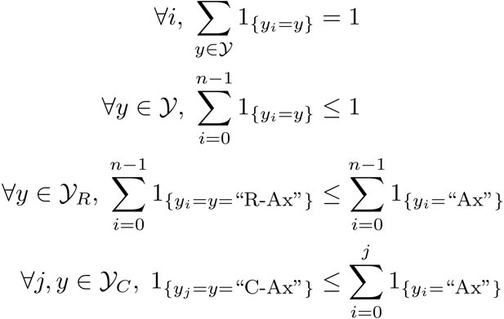
Algorithmic Approach
Learning Based Java: allows a developer to encode constraints in First Order Logic; these are compiled into linear inequalities automatically.
No duplicate argument classes
I left my nice pearls to her
candidate arguments
Unique labels
Identify argument candidates
  Pruning [Xue&Palmer, EMNLP’04]
  Argument Identifier
    Binary classification
Classify argument candidates
  Argument Classifier
    Multi-class classification
Inference
  Use the estimated probability distribution given by the argument classifier
  Use structural and linguistic constraints
  Infer the optimal global output
  Variable y^{a,t} indicates whether candidate argument a is assigned a label t.
  c^{a,t} is the corresponding model score
I left my nice pearls to her
I left my nice pearls to her
[ [ [ [ [
] ] ] ] ]
argmax ∑_{a,t} y^{a,t} c^{a,t} = ∑_{a,t} 1_{a=t} c_{a=t}
Subject to:
One label per argument: ∑_{t} y^{a,t} = 1
No overlapping or embedding
Relations between verbs and arguments,….
One inference problem for each verb predicate.
I left my nice pearls to her
Use the pipeline architecture’s simplicity while maintaining uncertainty: keep probability distributions over decisions & use global inference at decision time.
Notes:
We follow a now seemingly standard approach to SRL.
Given a sentence, first we find a set of potential argument candidates by identifying
which words are at the border of an argument.
Then, once we have a set of potential arguments, we use a phrase-level classifier to tell us how likely an argument is to be of each type.
Finally, we use all of the information we have so far to find the assignment of types to argument that gives us the “optimal” global assignment.
Similar approaches (with similar results) use inference procedures tied to their represntation.
Instead, we use a general inference procedure by setting up the problem as a linear programming problem.
This is really where our technique allows us to apply powerful information that similar approaches can not.

Slide 16
Verb SRL is not Sufficient
John, a fast-rising politician, slept on the train to Chicago.
Verb Predicate: sleep
  Sleeper: John, a fast-rising politician
  Location: on the train to Chicago
Who was John?
  Relation: Apposition (comma)
  John, a fast-rising politician
What was John’s destination?
  Relation: Destination (preposition)
  train to Chicago

Slide 17
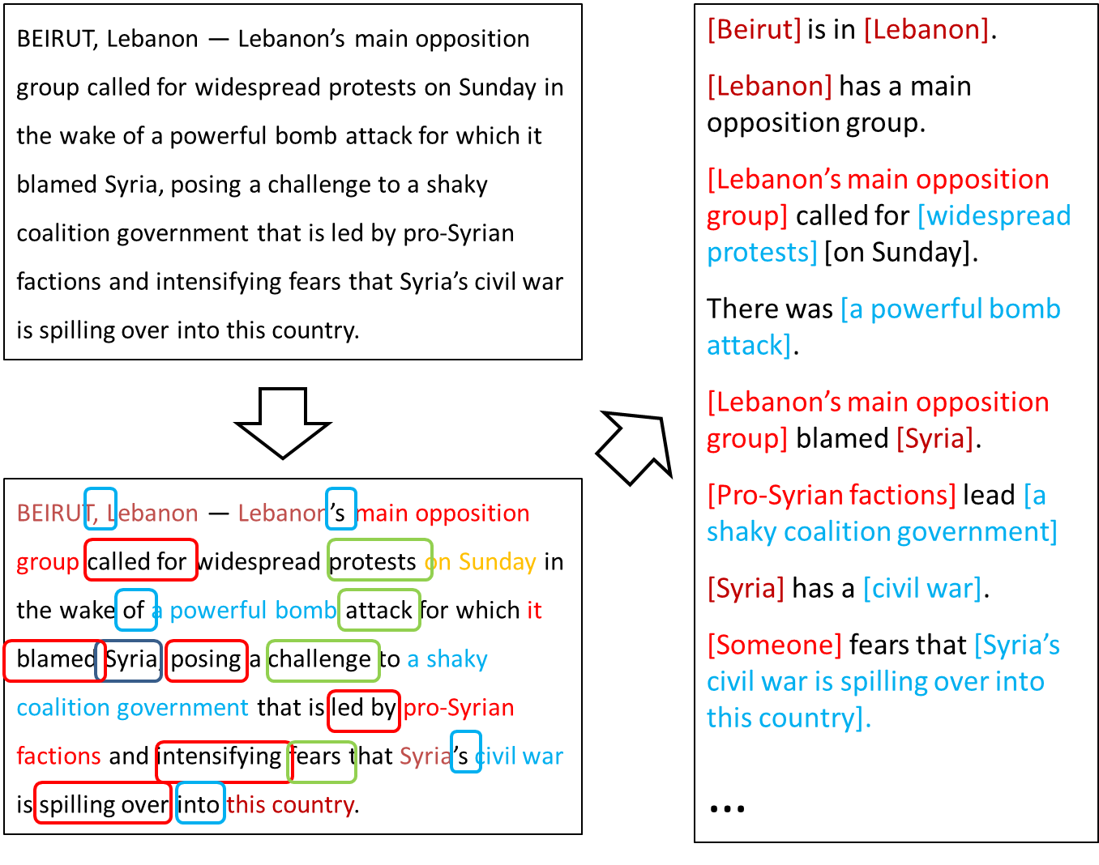
Extended Semantic Role Labeling
Improved sentence level analysis; dealing with more phenomena
Sentence level analysis may be influenced by other sentences

Slide 18
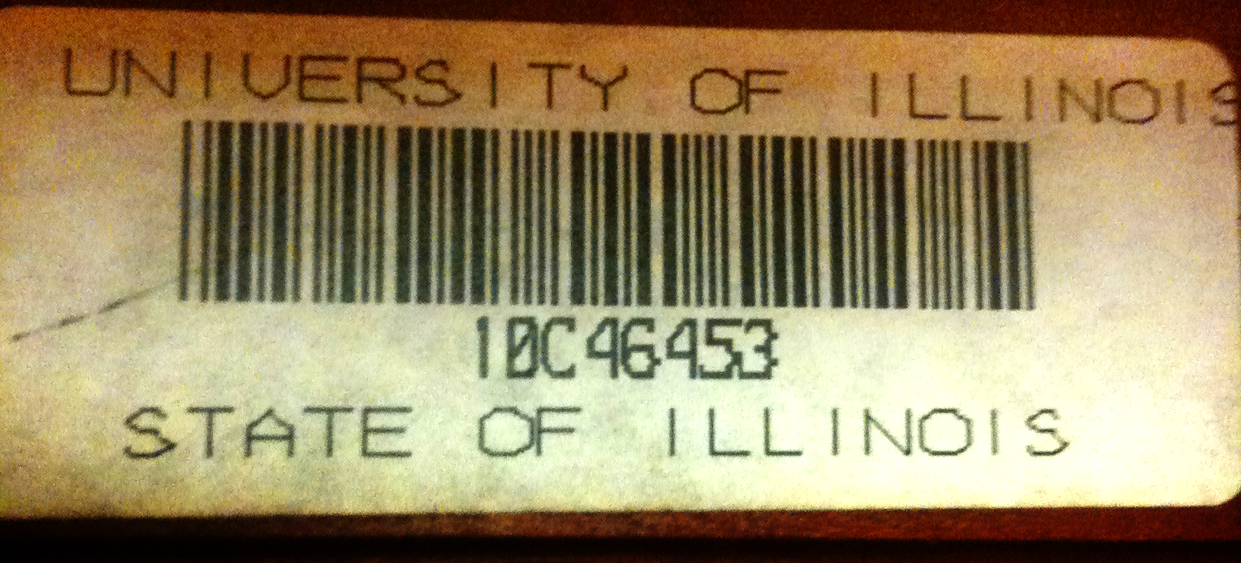
Examples of Preposition Relations
Queen of England
City of Chicago
Notes:
The university that serves Illinois vs. A state named Illinois

Slide 19
Predicates Expressed by Prepositions
Ambiguity & Variability
live at Conway House
at:1
Index of definition on Oxford English Dictionary
Location
stopped at 9 PM
at:2
drive at 50 mph
at:5
Temporal
look at the watch
at:9
Numeric
cooler in the evening
in:3
the camp on the island
on:7
ObjectOfVerb
arrive on the 9th
on:17

Slide 20
Computational Questions
John, a fast-rising politician, slept on the train to Chicago.
Verb Predicate: sleep
  Sleeper: John, a fast-rising politician
  Location: on the train to Chicago
Who was John?
  Relation: Apposition (comma)
  John, a fast-rising politician
What was John’s destination?
  Relation: Destination (preposition)
  train to Chicago
Identify the relation expressed by the predicate, and its arguments

Slide 21
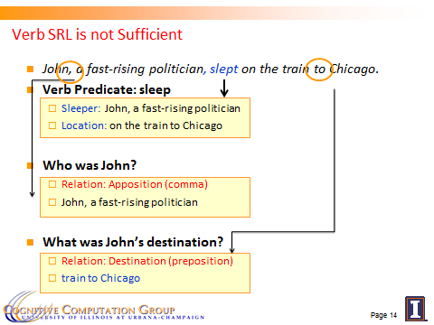
Computational Challenges
Predict the preposition relations
  [EMNLP, ’11]
Identify the relation’s arguments
  [Trans. Of ACL, ‘13]
Very little supervised data
  per phenomena
Minimal annotation
  only at the predicate level
The Learning & Inference paradigm exploits two principles:
  Coherency among multiple phenomena
  Constraining latent structures (relating observed and latent variables)
  Skip
Input & relation
Argument & their types

Slide 22
Prepositional Relations: Coherence of predictions
Predicate arguments from different triggers should be consistent
The bus was heading for Nairobi in Kenya.
Joint constraints linking the two tasks.
Destination ⇔ A1
Location
Destination
Predicate: head.02
A0 (mover): The bus
A1 (destination): for Nairobi in Kenya

Slide 23
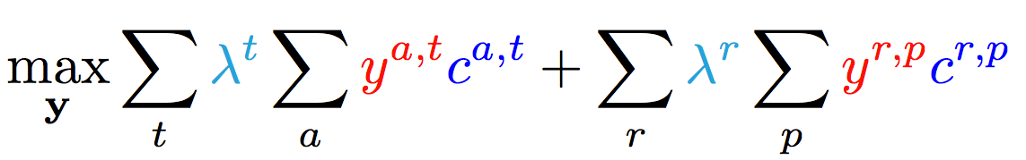
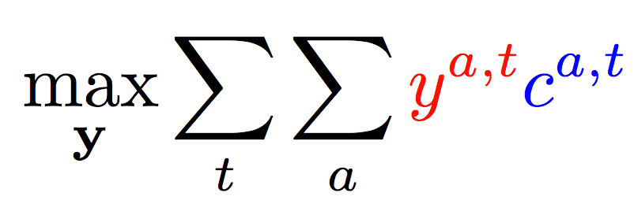
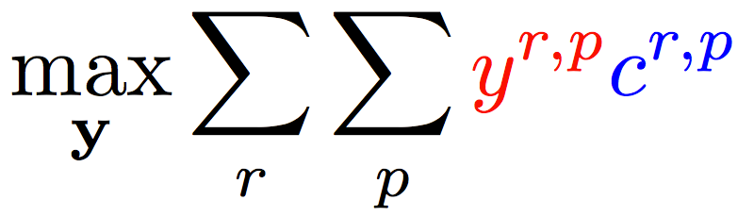
Joint inference (CCMs)
  Variable y^{a,t} indicates whether candidate argument a is assigned a label t.
  c^{a,t} is the corresponding model score
Verb arguments
Preposition relations
+ ….
Argument candidates
Re-scaling parameters (one per label)
Preposition relation
label
Constraints:
Preposition
Each argument label
Verb SRL constraints
Preposition SRL Constraints
+ Joint constraints between tasks; easy with ILP formulations
Joint Inference – no (or minimal) joint learning

Slide 24
Predicate-Argument Structure of Prepositions
…………….her to suffer from infection.
Supervision
Prediction y
Poor care led to her death from flu.
Latent Structure
r(y)
Relation
Cause
Governor
death
flu
Object
h(y)
Governor type
“Experience”
“disease”
Object type
“Knowledge” of the hidden structure (abstractions captured via wordnet classes and distributional clustering) supports better relation prediction. (Similarly: hidden word senses)
Inference relating latent and observed variables is a CCM

Slide 25
Latent Inference
Inference takes into account constrains among parts of the structure (r and h), formulated as a CCM
Learning with Latent inference: Given an example annotated with r(y*) , predict with:
argmax_{y} w^{T} Á(x,[r(y),h(y)])
s.t r(y*) = r(y)
While satisfying constraints between r(y) and h(y)
That is: “complete the hidden structure” in the best possible way, to support correct prediction of the supervised variable
      During training, the loss is defined over the entire structure, where we scale the loss of elements in h(y).
Generalization of Latent Structure SVM [Yu & Joachims ’09] &
Learning with Indirect Supervision [Chang et. al. ’10]

Slide 26
Performance
Learned to predict predicates, arguments, types and senses.
Using types helps. Joint inference with word sense helps too
More components constrain inference results and improve performance

Slide 27
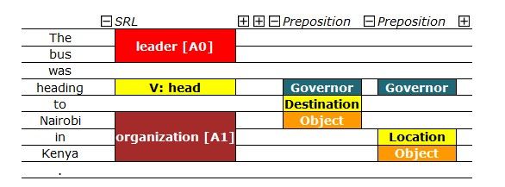
Extended SRL [Demo]
Destination [A1]
Joint inference over phenomena specific models to enforce consistency
Models trained with latent structure: senses, types, arguments
More to do with other relations, discourse phenomena,…

Slide 28
Constrained Conditional Models—ILP Formulations
Have been shown useful in the context of many NLP problems
[Roth&Yih, 04,07: Entities and Relations; Punyakanok et. al: SRL …]
  Summarization; Co-reference; Information & Relation Extraction; Event Identifications and causality ; Transliteration; Textual Entailment; Knowledge Acquisition; Sentiments; Temporal Reasoning, Parsing,…
Some theoretical work on training paradigms [Punyakanok et. al., 05 more; Constraints Driven Learning, PR, Constrained EM…]
Some work on Inference, mostly approximations, bringing back ideas on Lagrangian relaxation, etc.
Good summary and description of training paradigms: [Chang, Ratinov & Roth, Machine Learning Journal 2012]
Summary of work & a bibliography: http://L2R.cs.uiuc.edu/tutorials.html

Slide 29
Outline
Knowledge and Inference
  Combining the soft with the logical/declarative nature of Natural Language
    Constrained Conditional Models: A formulation for global inference with knowledge modeled as expressive structural constraints
    Some examples
Cycles of Knowledge
  Grounding/Acquisition – knowledge – inference
Learning with Indirect Supervision
  Response Based Learning: learning from the world’s feedback
Scaling Up: Amortized Inference
  Can the k-th inference problem be cheaper than the 1st?

Slide 30






Wikification: The Reference Problem
Knowledge Acquisition
Blumenthal (D) is a candidate for the U.S. Senate seat now held by Christopher Dodd (D), and he has held a commanding lead in the race since he entered it. But the Times report has the potential to fundamentally reshape the contest in the Nutmeg State.
Blumenthal (D) is a candidate for the U.S. Senate seat now held by Christopher Dodd (D), and he has held a commanding lead in the race since he entered it. But the Times report has the potential to fundamentally reshape the contest in the Nutmeg State.
Notes:
Let’s start with what is wikification
Read wiki titles slower

Slide 31
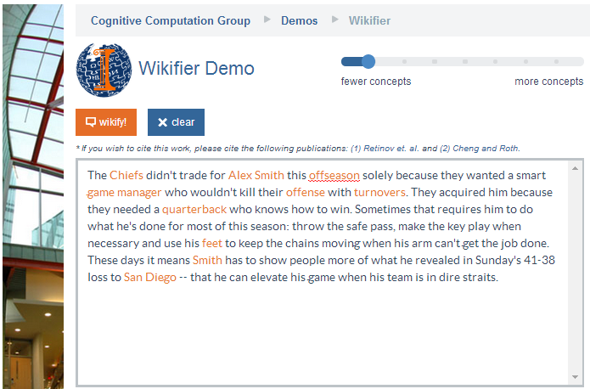
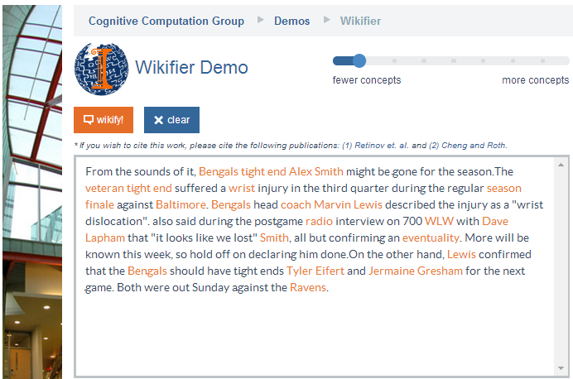
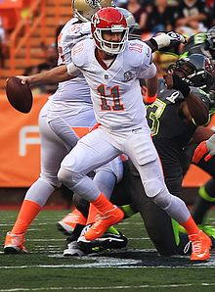
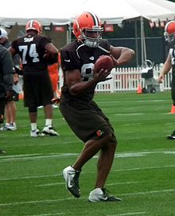
Who is Alex Smith?
Alex Smith
Alex Smith
Smith
Smith
Quarterback of the Kansas City Chief
Tight End of the Cincinnati Bengals
San Diego: The San Diego Chargers (A Football team)
Contextual Disambiguation
Ravens: The Baltimore Ravens (A Football team)

Slide 32
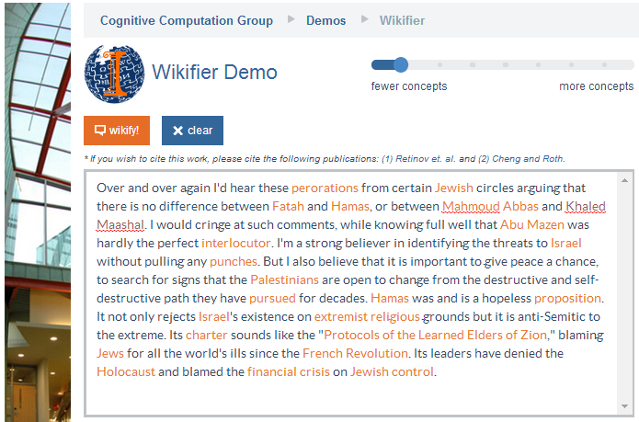
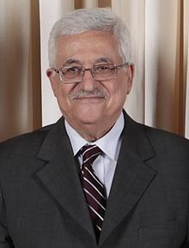
Middle Eastern Politics
Mahmoud Abbas
Abu Mazen
Mahmoud Abbas: http://en.wikipedia.org/wiki/Mahmoud_Abbas
Quarterback of the Kansas City Chief
Tight End of the Cincinnati Bengals
Variability: Getting around multiple surface representations.
Co-reference resolution within & across documents, with grounding
Abu Mazen: http://en.wikipedia.org/wiki/Mahmoud_Abbas

Slide 33
Challenges
Blumenthal (D) is a candidate for the U.S. Senate seat now held by Christopher Dodd (D), and he has held a commanding lead in the race since he entered it. But the Times report has the potential to fundamentally reshape the contest in the Nutmeg State.
Training a global model that identifies concepts in text, disambiguates & grounds them in Wikipedia
Relies on the correctness of the (partial) link structure in Wikipedia, but – requires no human annotation.
State-of-the-art systems (e.g., Ratinov et al. 2011) make use of local and global statistical features
One goal of this effort is knowledge acquisition, in support of better textual inferences, but,
What is missing?
Notes:
Quite impressive, bottleneck: adding more sophisticated contextual features does not help much
We do not want to level off here

Slide 34
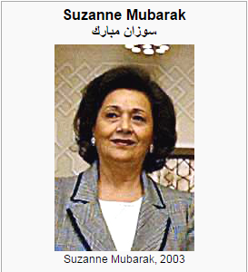
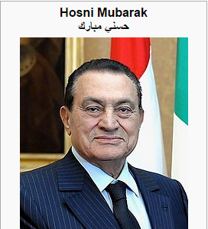
Knowledge Acquisition requires Knowledge (& inference)
Mubarak,
the wife of deposed Egyptian President Hosni Mubarak,…

Slide 35
Relational Inference
Mubarak, the wife of deposed Egyptian President Hosni Mubarak, …
Egyptian President
Hosni Mubarak
, the of deposed , …
Mubarak
wife
What are we missing with Bag of Words (BOW) models?
  Who is Mubarak?
Textual relations provide another dimension of text understanding
Can be used to constrain interactions between concepts
  (Mubarak, wife, Hosni Mubarak)
Has impact in several steps in the Wikification process:
  From candidate selection to ranking and global decision
Notes:
Main contribution here
We will show that by identifying

Slide 36
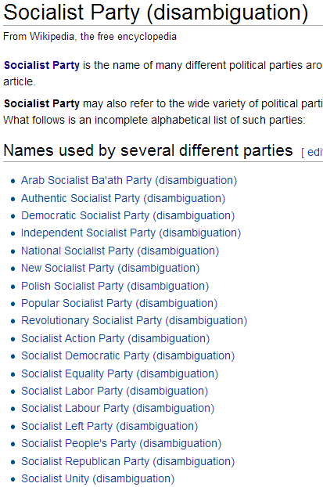

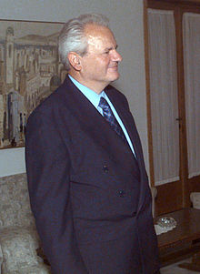
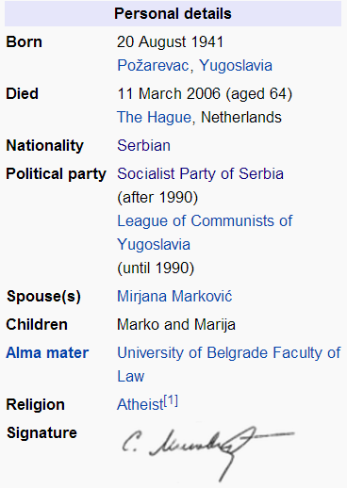
Knowledge in Relational Inference
These relations are part of our E-SRL
apposition
Coreference
possessive
...ousted long time Yugoslav President Slobodan Milošević in October.
... but Mr. Milošević's Socialist Party
What concepts can “Socialist Party” refer to?
  Wikipedia link statistics is uninformative
Notes:
There are quite some relations in this short sentence
Overall it is sparse but important in text understanding, as error propagates in structured inference
We do not actually care about relation types too much, as the relation will be constrained by our knowledge

Slide 37
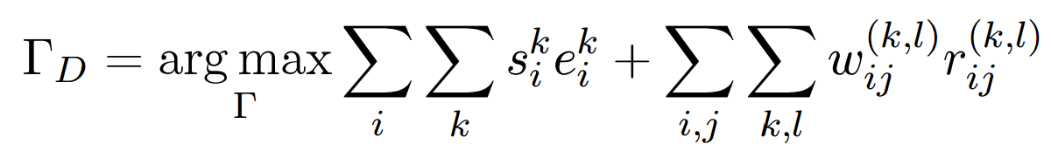
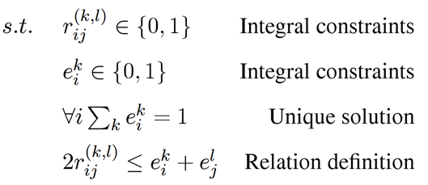
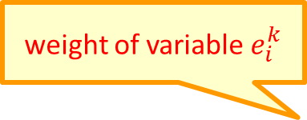
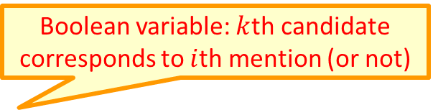
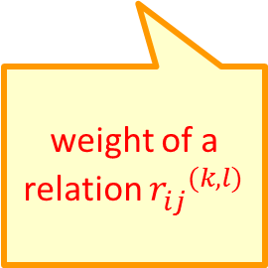
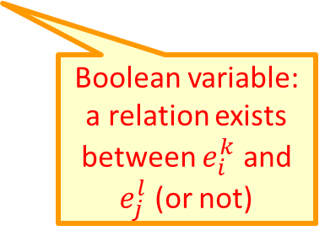
Formulation
Knowledge + Ability to use it (Inference) facilitates additional knowledge acquisition
  Goal: Promote concepts that are coherent with textual relations
Formulate as an Integer Linear Program (ILP):
If no relation exists, collapses to the non-structured decision
weight of variable $e_{i}^{k}$
Boolean variable: $k$th candidate corresponds to $i$th mention (or not)
weight of a relation ${r_{ij}^{}}^{(k,l)}$
Boolean variable: a relation exists between $e_{i}^{k}$ and $e_{j}^{l}$ (or not)
Notes:
Formalize intuition, weights induced from data, small constraints
Objective function collapse to the original output when there is no relation, so our model is negatives-proof
True-negatives and false-negatives will not negatively impact performance of baseline

Slide 38
Outline
Knowledge and Inference
  Combining the soft with the logical/declarative nature of Natural Language
    Constrained Conditional Models: A formulation for global inference with knowledge modeled as expressive structural constraints
    Some examples
Cycles of Knowledge
  Grounding/Acquisition – knowledge – inference
Learning with Indirect Supervision
  Response Based Learning: learning from the world’s feedback
Scaling Up: Amortized Inference
  Can the k-th inference problem be cheaper than the 1st?

Slide 39

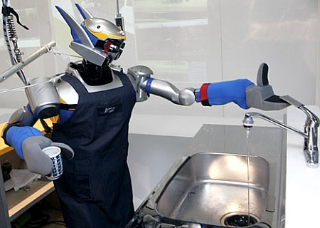

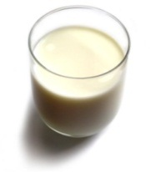
Understanding Language Requires Supervision
Can we rely on this interaction to provide supervision (and eventually, recover meaning) ?
Can I get a coffee with lots of sugar and no milk
Great!
Arggg
Semantic Parser
MAKE(COFFEE,SUGAR=YES,MILK=NO)
How to recover meaning from text?
Standard “example based” ML: annotate text with meaning representation
  Teacher needs deep understanding of the learning agent ; not scalable.
Response Driven Learning: Exploit indirect signals in the interaction between the learner and the teacher/environment
Notes:
NLU: about recovering meaning from text – a lot of work aims directly at that or at some subtasks that might look like this:….

Slide 40
Response Based Learning
We want to learn a model that transforms a natural language sentence to some meaning representation.
Instead of training with (Sentence, Meaning Representation) pairs
Think about some simple derivatives of the models outputs,
  Supervise the derivative [verifier] (easy!) and
  Propagate it to learn the complex, structured, transformation model
English Sentence
Model
Meaning Representation

Slide 41
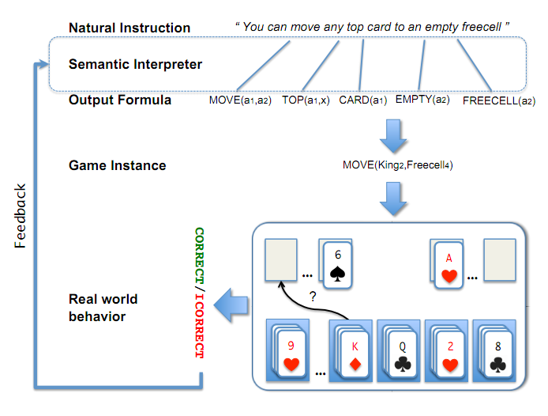
Scenario I: Freecell with Response Based Learning
We want to learn a model to transform a natural language sentence to some meaning representation.
English Sentence
Model
Meaning Representation
A top card can be moved to the tableau if it has a different color than the color of the top tableau card, and the cards have successive values.
Move (a1,a2) top(a1,x1) card(a1) tableau(a2) top(x2,a2) color(a1,x3) color(x2,x4) not-equal(x3,x4) value(a1,x5) value(x2,x6) successor(x5,x6)
Play Freecell (solitaire)
Simple derivatives of the models outputs: game API
  Supervise the derivative and
  Propagate it to learn the transformation model

Slide 42
Scenario II: Geoquery with Response based Learning
We want to learn a model to transform a natural language sentence to some formal representation.
“Guess” a semantic parse. Is [DB response == Expected response] ?
  Expected: Pennsylvania DB Returns: Pennsylvania→ Positive Response
  Expected: Pennsylvania DB Returns: NYC, or ???? → Negative Response
English Sentence
Model
Meaning Representation
What is the largest state that borders NY?
largest( state( next_to( const(NY))))
Simple derivatives of the models outputs
Query a GeoQuery Database.

Slide 43
Response Based Learning: Using a Simple Feedback
We want to learn a model to transform a natural language sentence to some formal representation.
Instead of training with (Sentence, Meaning Representation) pairs
Think about some simple derivatives of the models outputs,
  Supervise the derivative (easy!) and
  Propagate it to learn the complex, structured, transformation model
LEARNING:
Train a structured predictor (semantic parse) with this binary supervision
  Many challenges: e.g., how to make a better use of a negative response?
Learning with a constrained latent representation, making used of CCM inference, exploiting knowledge on the structure of the meaning representation.
English Sentence
Model
Meaning Representation

Slide 44
Geoquery: Response based Competitive with Supervised
Clarke, Goldwasser, Chang, Roth CoNLL’10; Goldwasser, Roth IJCAI’11, MLJ’14
Algorithm | Training Accuracy | Testing Accuracy | # Training Examples
NOLEARN | 22 | -- | -
Response-based (2010) | 82.4 | 73.2 | 250 answers
Liang et-al 2011 | -- | 78.9 | 250 answers
Response-based (2012) | 86.8 | 81.6 | 250 answers
Supervised | -- | 86.07 | 600 structs.
NOLEARN :Initialization point
SUPERVISED : Trained with annotated data
Response based Learning is gathering momentum:
Liang, M.I. Jordan, D. Klein, Learning Dependency-Based Compositional Semantics, ACL’11.
Berant et-al ’ Semantic Parsing on Freebase from Question-Answer Pairs, EMNLP’13
Supervised: Y.-W. Wong and R. Mooney. Learning synchronous grammars for semantic parsing with lambda calculus. ACL’07
Notes:
Add number of examples

Slide 45
Outline
Knowledge and Inference
  Combining the soft with the logical/declarative nature of Natural Language
    Constrained Conditional Models: A formulation for global inference with knowledge modeled as expressive structural constraints
    Some examples
Cycles of Knowledge
  Grounding/Acquisition – knowledge – inference
Learning with Indirect Supervision
  Response Based Learning: learning from the world’s feedback
Scaling Up: Amortized Inference
  Can the k-th inference problem be cheaper than the 1st?
  Computational significance of ILP formulations

Slide 46

Inference for BIG TEXT
In NLP, we typically don’t solve a single inference problem.
We solve one or more per sentence.
Beyond improving the inference algorithm, what can be done?
S1
He
is
reading
a
book
S2
She
is
watching
a
movie
POS
PRP
VBZ
VBG
DT
NN
S1 & S2 look very different but their output structures are the same
The inference outcomes
are the same
After inferring the POS structure for S1,
Can we speed up inference for S2 ?

Slide 47
Amortized ILP based Inference
Imagine that you already solved many structured output inference problems
  Co-reference resolution; Semantic Role Labeling; Parsing citations; Summarization; dependency parsing; image segmentation,…
  Your solution method doesn’t matter either
How can we exploit this fact to save inference cost?
We will show how to do it when your problem is formulated as a 0-1 LP, Max cx
Ax ≤ b
x 2 {0,1}
After solving n inference problems, can we make the (n+1)^{th} one faster?
Very general: All discrete MAP problems can be formulated as 0-1 LPs
We only care about inference formulation, not algorithmic solution

Slide 48
The Hope: POS Tagging on Gigaword
Number of Tokens

Slide 49
The Hope: POS Tagging on Gigaword
Number of examples of a given size
Number of unique POS tag sequences
Number of structures is much smaller than the number of sentences
Number of Tokens

Slide 50
The Hope: Dependency Parsing on Gigaword
Number of examples of a given size
Number of unique Dependency Trees
Number of structures is much smaller than the number of sentences
Number of Tokens

Slide 51
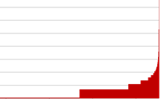
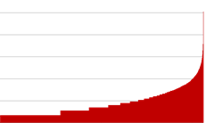
POS Tagging on Gigaword
How skewed is the distribution of the structures?
A small # of structures occur very frequently
Number of Tokens

Slide 52
Amortized ILP Inference
We argue here that the inference formulation provides a new level of abstraction.
These statistics show that many different instances are mapped into identical inference outcomes.
  Pigeon Hole Principle
How can we exploit this fact to save inference cost over the life time of the agent? ?
We give conditions on the objective functions
(for all objectives with the same # or variables and same feasible set),
under which the solution of a new problem Q is the same as the one of P (which we already cached)

Slide 53
Theorem II (Geometric Interpretation)
Solution x*
max 2x₁+3x₂+2x₃+1x₄
x₁ + x₂ ≤ 1
x₃ + x₄ ≤ 1
c_{P2}
c_{P1}
All ILPs in the cone will share the maximizer
ILPs corresponding to all these objective vectors will share the same maximizer for this feasible region
Feasible region
max 2x₁+4x₂+2x₃+0.5x₄
x₁ + x₂ ≤ 1
x₃ + x₄ ≤ 1

Slide 54
Amortized Inference Experiments
Setup
  Verb semantic role labeling; Entity and Relations
  Speedup & Accuracy are measured over WSJ test set (Section 23) and Test of E & R
  Baseline: solving ILPs using the Gurobi solver.
For amortization
  Cache 250,000 inference problems (objective, solution) from Gigaword
  For each problem in test set either call the inference engine or re-use a solution from the cache, if our theorems hold.
No training data is needed for this method.
Once you have a model, you can generate a large cache that will be then used to save you time at evaluation time.

Slide 55
Speedup & Accuracy
Solve only one in three problems!
Amortized inference gives a speedup without losing accuracy
Speedup
1.0
Amortization schemes [EMNLP’12, ACL’13]

Slide 56
Speedup & Accuracy
By decomposing the objective function, building on the fact that “smaller structures” are more redundant, it is possible to get even better results.
The results show that, indeed, the inference formulation provides a new level of abstraction that can be exploited to re-use solutions
Solve only one in six problems!
Speedup
Recent results [AAAI’15] on how to exploit amortized ILP in faster Structured Learning
1.0
More Thms
Wall Clock
Amortization schemes [EMNLP’12, ACL’13]

Slide 57
Before Concluding
Why is automating natural language understanding difficult?
  When Tina pressed Joan to the floor she was hurt.
  When Tina pressed Joan to the floor she was punished.
  When Tina pressed charges against Joan she was jailed.
Requires, among other things, thinking about the structure of the sentence – who does what to whom
  (See our work in CoNLL’15 and NAACL’15 for interesting progress on this)
John had 6 books; he wanted to give it to two of his friends. How many will each one get?
  (See our EMNLP’15 work for interesting progress on Math word problems)
share it with

Slide 58
Conclusion
Thank You!
NL interpretation is an inference problem best modelled as a knowledge constrained optimization problem over multiple statistically learned models.
A lot more work is needed; there is a lot more that we try to do…
Some recent samples from a research program that attempts to address some of the key scientific and engineering challenges between us and understanding natural language
Knowledge – Reasoning – Learning Paradigms – Scaling up
  Thinking about Learning, Inference and knowledge via a Constrained Optimization framework that supports “best assignment” Inference.
Check out our tools, demos, LBJava, CCM tutorial,…

