Slide 1








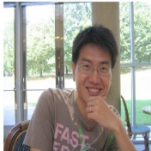










Incidental Supervision for
Natural Language Understanding
Illinois
Dan Roth
Computer and Information Science
University of Pennsylvania
NAACL 18
Workshop on New Forms of Generalization
in Deep Learning and Natural Language Processing
June 2018
Notes:
Title

Slide 2
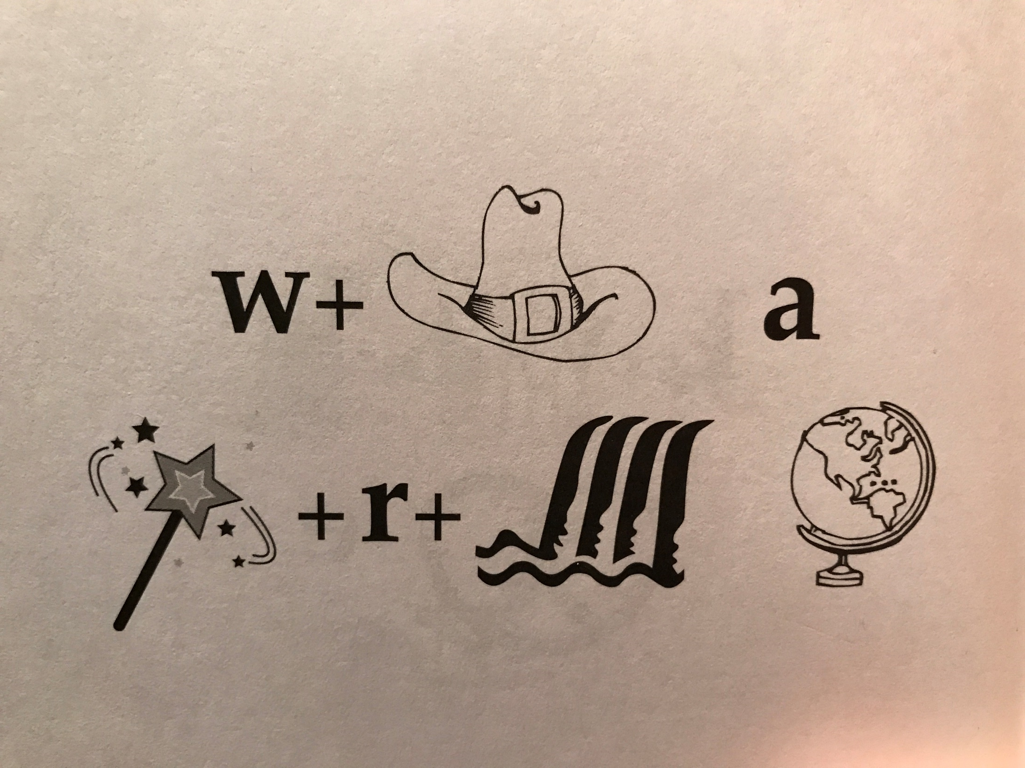
What a Wonderful (Wond-r-Fall) World
Identify units
Consider multiple
representations & interpretations
  Pictures, text, layout, spelling, phonetics
Put it all together:
  Determine “best” global interpretation
Satisfy expectations
  Slide; puzzle
How can we do it?
1.5
Notes:
How do you do it?
I think of NLU this way – there are a lot of components; each you acquired at different times, different ways; in each case you have a distribution over possible interpretations, each one is valid in some context; but here, given the expectation that I laid out by putting all these symbols together on one slide, indicating to you that they mean something, you were able to find a coherent explanation quite quickly – and all of you basically reached the same conclusion, hence, we, as human being, can communicate.
If you buy into this interpretation, you can't directly learn to make all the decisions you need to make; you need to represent models, and knowledge, in such a way that, when you need to make a decision, you can figure out quickly what’s relevant, and combine it in the right way.
That has implications on what’s important (1) Knowledge and how to use it (2) Learning and, especially, how to supervise models so that they behave well in NEW situations and, (3) Scaling up – how to make decisions quickly, given that we need to draw on a huge number of possibly pieces of knowledge, most of which are irrelevant to the current decision.
One of the issues that is underlying Knowledge and Learning is that of representation. issues But today I’ll talk only about learning and specifically --

Slide 3
Natural Language Understanding
Expectation is a knowledge intensive component
Natural language understanding decisions are global decisions that require
  Making (local) predictions driven by different models trained in different ways, at different times/conditions/scenarios
  The ability to put these predictions together coherently
  Knowledge, that guides the decisions so they satisfy our expectations
Natural Language Interpretation is an Inference Process that is best thought of as a knowledge-constrained optimization problem, done on top of multiple statistically learned models.
Notes:
3
Give examples for what’s not abductive reasoning
Focus on abductive reasoning
Show the formulation – talk about the boxes
Talk about multiple ways of training – decoupling – relate to abstraction
Examples: semantic parsing (do verb + Prep + commas together; lack of jointly annotated data)
Wikification – Relations (but also add geographical coherence; topical coherence; all interrelated signal that are acquired at different times, different contexts, etc.

Slide 4

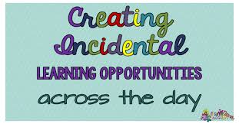

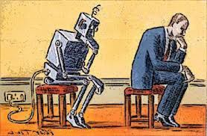
What’s Important?
Learning and Reasoning in the Presence of Knowledge.
  Combining the “soft” with the logical/declarative
Scaling Up
Computational & #(phenomena)
Knowledge is essential for effective Machine Learning
Training Models
  With Incidental Supervision
Notes:
In a more abstract way : My research span all these aspects & more; but I’ll focus on providing a framework, present some examples, and some recent, exciting results towards the end.
4

Slide 5
Inducing Semantics
Inducing semantic representations and making decisions that depend on it require learning and, in turn, supervision.
Standard machine learning methodology:
  Given a task
  Collect data for the task and annotate it
  Learn a model [doesn’t matter how]
We will never have enough annotated data to train all the models, for all the tasks we need, this way.
  We don’t even know what are “all the tasks”
This methodology is not scalable and, often, makes no sense
  Annotating for complex tasks is difficult, costly, and sometimes impossible.
    When an intermediate representation is ill-defined, but the outcome is
    E.g., think about events
In most interesting cases, learning should be (and is) driven by incidental supervision [Roth AAAI’17]
Notes:
Key challenge, to facilitate reasoning, is to induce semantics

Slide 6
Incidental Supervision
Data provides hints
  These are often sufficient to infer supervision signals for a range of tasks.
  Data exists independent of the task(s) at hand.
Utilizing these hints
  Can be substantially less costly than producing explicit annotation
  More realistic – provides signals for tasks we haven’t defined
  Weak signals can be aggregated/amplified to produce higher quality signals
Notes:
Key challenge, to facilitate reasoning, is to induce semantics

Slide 7
Incidental Supervision & Reasoning
O’Hare must be in Chicago
O’Hare must be in Chicago
Feb 5 2017 Dozens of passengers heading to Chicago had to undergo additional screenings… It took Hesam Aamyab two tries to make it back to the United States from Iran. He is an Iranian citizen with a US visa who is doing post-doctoral research at UIC. …"Right now, I am in the USA and I'm very happy," Aamyab said. But now, he can't go back to Iran or anywhere else without risk. Other travelers shared the same worry. Asem Aleisawi was at O'Hare on Sunday to meet his wife who was coming in from Jordan.
  Learning/Supervision requires some level of reasoning to infer these weak signals

Slide 8
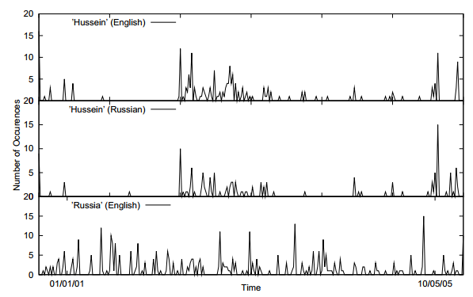
Incidental Supervision Signals
Searching for supervision signals could be challenging.
Supervision could be incidental, in the sense that it provides some signals that might be co-related to the target task.
Temporal histograms
Assume a comparable, weakly temporally aligned news feeds.
Hussein (English)
Transliteration: How to write “Hussein” in Russian?
Hussein (Russian)
Weak synchronicity provides a cue about the relatedness of (some) NEs across the languages, and can be exploited to associate them
[Klementiev & Roth, 06,08]
Germany (English)
Notes:
If I want to solve this transliteration task, I need examples; but I don’t need anyone to label many for me.
But I did not learn it this way – I learned from a few examples, that were not annotated, but for various reasons, I was pretty sure were pretty good….
I could make the observation, that if one looks at comparable news articles from about the same time, the key entities they cover are the same, and they occur with about the same temporal frequency.
Start with labeling
Then transliteration
Then psychology
Then semantic parsing
(Emphasize that this requires reasoning)
End with the example of reasoning in learning (Chicago)

Slide 9
Incidental Supervision Signals
Need an inference mechanism that supports combining signals/models
By itself, this temporal signal may not be sufficient to support learning robust models.
Along with weak phonetic signals, context, topics, etc. it can be used to get robust models.
Temporal histograms
Assume a comparable, weakly temporally aligned news feeds.
Hussein (English)
Hussein (Russian)
Weak synchronicity provides a cue about the relatedness of (some) NEs across the languages, and can be exploited to associate them
[Klementiev & Roth, 06,08]
Russia (English)

Slide 10
Incidental Supervision
Data provides hints
  These are often sufficient to infer supervision signals for a range of tasks.
  Data exists independent of the task(s) at hand.
(1) Representations
  Often, making prediction is all about representing knowledge
(2) Signals
  Exploiting weak signals an putting them together Examples:
(3) Behavioral Level Feedback
  It’s End-to-End, but with behavioral level feedback
Notes:
Key challenge, to facilitate reasoning, is to induce semantics

Slide 11
Text Categorization
Is it possible to map a document to an entry in a taxonomy of semantic categories, without training with labeled data?
The route for a return to No. 1 in the Emirates ATP Rankings is paved for Rafael Nadal and Roger Federer at next week’s Western & Southern Open. Andy Murray will relinquish top spot to one of the two in Cincinnati and if it is the Swiss who goes on to win the Coupe Rogers this week in Montreal, he would clinch World No. 1 with an equal or better finish than the Spaniard next week.
It’s about Sport
It’s about Tennis
Traditional text categorization requires training a classifier over a set of labeled documents (1,2,….k)
Someone needs to label the data (costly)
All your model knows is to classify into these given labels
Total costs for on-the-job health care benefits are expected to rise an average of 5% in 2018, surpassing $14,000 a year per employee, according to a National Business Group on Health survey of large employers. Specialty drugs continue to be the top driver of increasing costs. Companies will pick up nearly 70% of the tab, but employees must still bear about 30%, or roughly $4,400, on average.
It’s about Money
It’s about Health Care
You can do it, since you have an “understanding” of the labels

Slide 12
Categorization without Labeled Data [AAAI’08, AAAI’14, IJCAI’16]
This is not an unsupervised learning scenario. Unsupervised learning assumes a coherent collection of data points, where similar data points are assigned similar labels. It does not work on a single document. Related (but not identical) to 0/1-shot learning.
Given:
  A single document (or: a collection of documents)
  A taxonomy of categories into which we want to classify the documents
Dataless/Zero-Shot procedure:
  Let f(l_{i}) be the semantic representation of the labels (label descriptions)
  Let f(d) be the semantic representation of a document
  Select the most appropriate category:
  l_{i}* = argmin_{i} dist (f(l_{i}) - f(d))
  Bootstrap
    Label the most confident documents; use this to train a model.
Key Question:
  How to generate good Semantic Representations?

Slide 13
Text Representation
[Dense] Distributed Representations (Embeddings)
  Learn a representation for a word as a function of words in its context
Brown Clusters
  An HMM based approach
  Found a lot of applications in other NLP tasks
[Sparse] Explicit Semantic Analysis (ESA)
  A Wikipedia driven approach – best for topical classification
    Represent a word as a (weighted) list of all Wikipedia titles it occurs in
  Gabrilovich & Markovitch 2009
  [See new *SEM’18 paper on sparse representations]
No task specific supervision. Wikipedia is there.
Yields excellent results

Slide 14
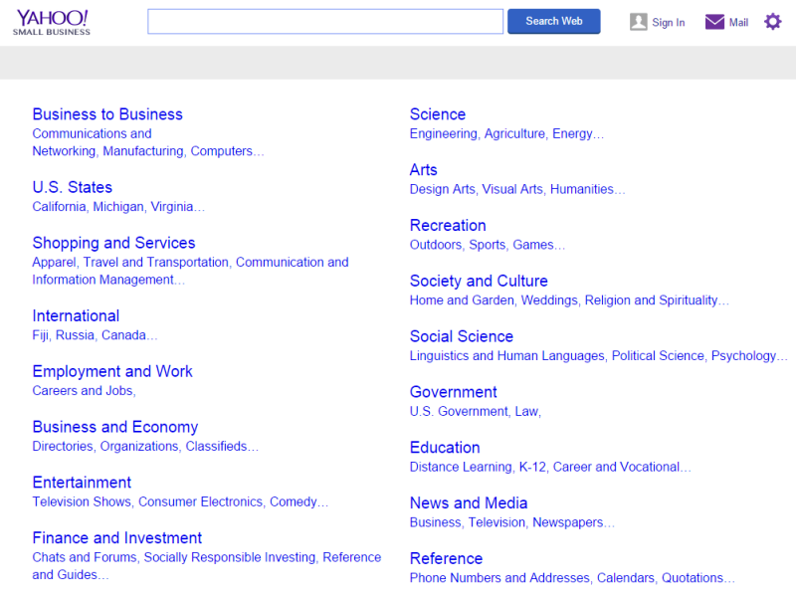
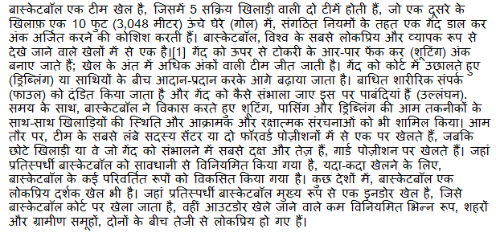
Cross-lingual Document Categorization
Map a document in language L to an English ontology of semantic categories, without training with task-specific labeled data.
No task specific supervision: count on existing cross-lingual links
Sports
-Basketball

Slide 15
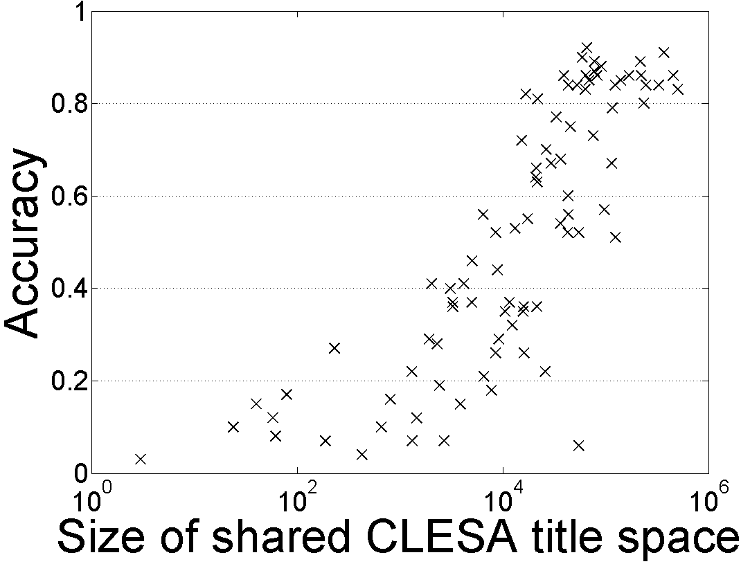
Single Document Classification (88 Language) [Song et. al. IJCAI’16]
Can be done to all 293 languages represented in Wikipedia
Performance depends on the Wikipedia size (Cross-language links)
Dataless classification for English
Accuracy
Hausa
Hindi
Size of shared English-Language L title space

Slide 16
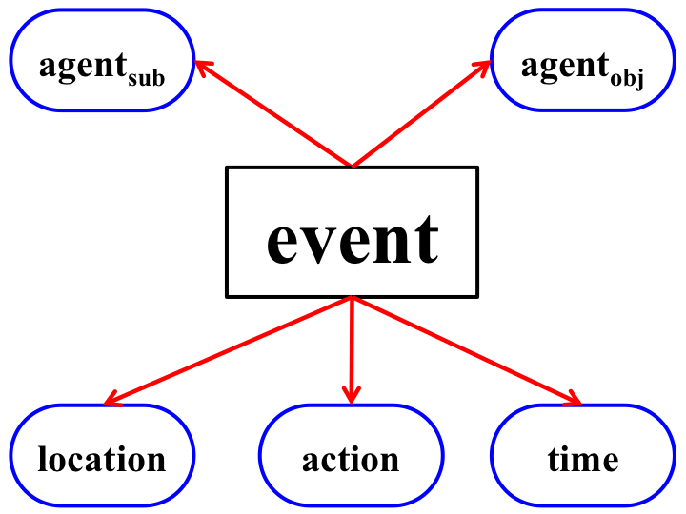
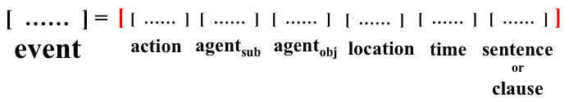
Minimally Supervised Event Pipeline [Peng et al. EMNLP’16]
Multiclass classification into a small taxonomy.
Lack of data
Over 300 police officers were fanning out to track down the assailants who attacked Moscow tourists in the Russian city of Nizhny Novgorod, RIA Novosti news agency reported Sunday.
Event representations are structured
  We use Semantic Role Labeling (SRL) to guide this aspect.
  Type classification: zero-shot: via definitions or proto-types
Represent via concatenation of event components
  Explicit Semantic Analysis, Brown Cluster, Word2Vec, etc.
Type: Conflict.Attack

Slide 17
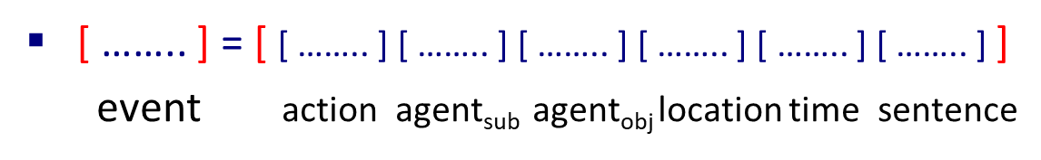
Event Co-reference [Peng et al. EMNLP’16]
Best 1st co-reference algorithm
  Consider each mention from left to right
  cos(v(e_{i}), v(e_{j})) as the similarity between events
  Choose the antecedent with highest similarity or start a new cluster
Domain Transfer Results
Performance across domain is significantly better than supervised methods
  Metric: CoNLL scores
Dataset: TAC-KBP-15
Within domain
Across domain
MSEP Supervised

Slide 18
Representation: Learning from Task Independent Resource
This learning protocol relies on the ability to induce good semantic representations.
Semantic representations should be learned using existing signals, independently of the task at hand.
  (Multilingual) Text Categorization
  Event Detection and Co-reference
    Requires more involved representations
  Entity Typing (coarse and fine)
    Represent context – identify “known” entities with type-compatible contexts
    Using ELMo + ESA
  Relation identification
    Represent definitions of concepts and relations between them
    [*SEM’18: First steps for Hypernymy Relations]
In all cases – key benefits are shown in adaptation
Wikification/Entity Linking is another good example where representations are learned from existing resources, put there independent of the task. SKIP

Slide 19
Incidental Supervision
Data provides hints
  These are often sufficient to infer supervision signals for a range of tasks.
  Data exists independent of the task(s) at hand.
(1) Representations
  Often, making prediction is all about representing knowledge
(2) Signals
  Exploiting weak signals an putting them together
(3) Behavioral Level Feedback
  It’s End-to-End, but with behavioral level feedback
Notes:
Key challenge, to facilitate reasoning, is to induce semantics

Slide 20
Signals
In many problems it’s easy to get some good signals
  High Precision annotation
But difficult to get exhaustive annotation
  Low recall

Slide 21
NER in Low Resource Languages: Partial Annotation
Easy to get some lists and even help from non-native speakers.
ebisi’ra giliyyaana phinnddale aaja pyaalestaaina adhiinastha
gaajaa theke aaja raate ekhabara jaaniyyechhena .
  ABC’s Gillian Findale has reported from Gaza under Palestine today.
But, we have strong expectations from the output!
  Immediate neighbors of an entity are non-entities.
  Punctuations, numbers are non-entities
  Names have low frequency
  Ratio of entities to non-entities is quite stable across languages
    b = |E|/(|N| + |E|) ~~ 10% +/- 5% [Augenstein et al, 2017]
Expectations from the output allows one to bootstrap from weak signals quite reliably.
Notes:
Romanized Bengalli

Slide 22
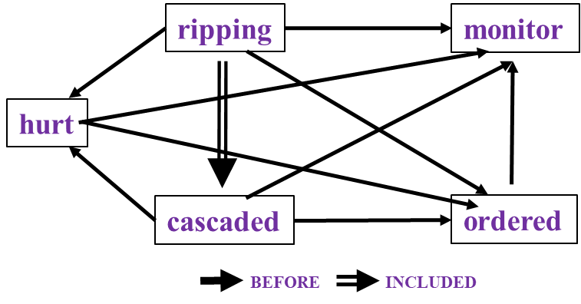
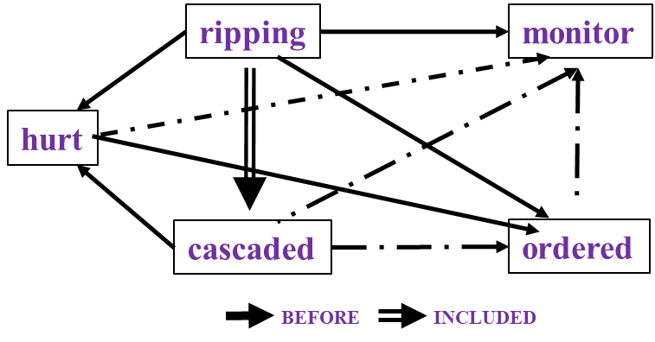
Temporal Relation Extraction [Qiang et al. *SEM’2018]
In Los Angeles that lesson was brought home today when tons of earth cascaded down a hillside, ripping two houses from their foundations. No one was hurt, but firefighters ordered the evacuation of nearby homes and said they'll monitor the shifting ground until March 23rd.
Very difficult task— hinders exhaustive annotation (O(N²) edges)
But, it’s rather easy to get partial annotation – some relations.
And, we have strong expectations from the output – Transitivity.

Slide 23
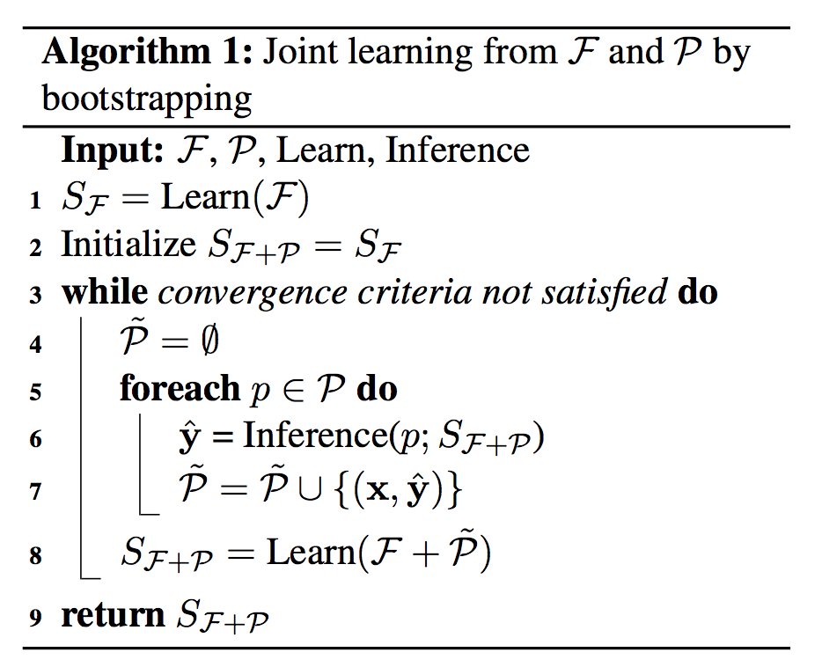
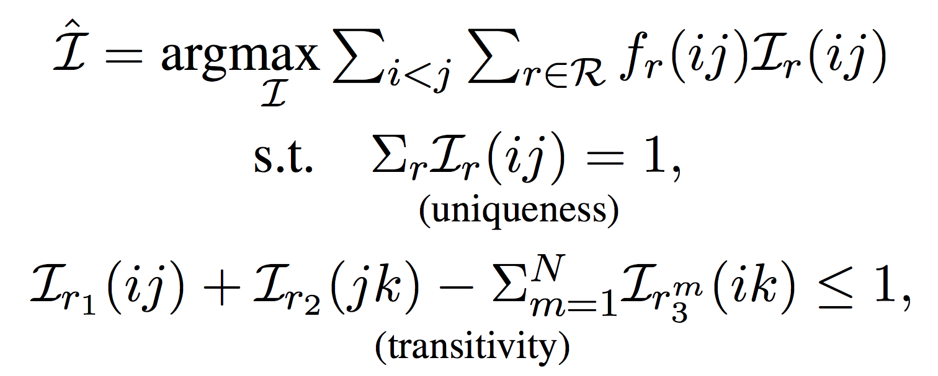
Constraint-Driven Learning
Constrained EM algorithms
  CoDL [Chang et al. 2007, 2012]; Posterior Regularization [Ganchev et al. 2010]
Knowledge >> Annotation
Bootstrapping with Constraints
Temporal: Transitivity Constraints
Modeled via an ILP formulation
 | F1
Bootstrapping | 45.6
+ Constraints (CoDL) | 49.0

Slide 24
Signals
In many problems it’s easy to get some good signals
  High Precision annotation
But difficult to get exhaustive annotation
  Low recall
Examples
  Transliteration
  Named Entities (Low Resource Languages)
  Temporal Relations
In these cases (and many others)
  It’s easy to get partial annotations
  Strong expectations from the output satisfy can amplify it

Slide 25
Incidental Supervision
Data provides hints
  These are often sufficient to infer supervision signals for a range of tasks.
  Data exists independent of the task(s) at hand.
Representation
  Often, making prediction is all about representing knowledge
Signals
  Exploiting weak signals an putting them together Examples:
Behavioral Level Feedback
  It’s End-to-End, but with behavioral level feedback
Notes:
Key challenge, to facilitate reasoning, is to induce semantics

Slide 26
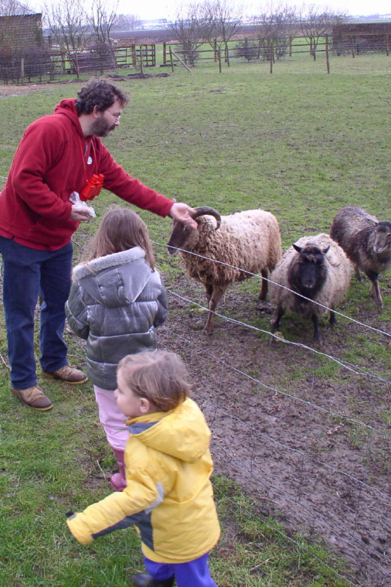
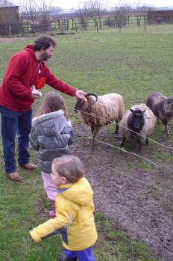


The language-world mapping problem [BabySRL: Connor, Fisher & Roth, 2012]
Behavioral feedback is needed!
Take inspiration from language acquisition?
  Clearly, a lot of incidental supervision
  Harder problems (understanding verbs) bootstrap from easier
“the world”
Scene 1
Smur! Rivvo della frowler.
“the language”
Chase?
Flee?
Topid rivvo den marplox.
Nouns identified
Blert dor marplox, arno.
Scene 3
[Topid rivvo den marplox.]
Cross-situational observations
Scene n
Marplox dorinda blicket.
Representation + Expectations
Notes:
When thinking about incidental supervision, I think that we can draw inspiration from language acquisition – kids need to solve the language-wolrd mapping problem, and all they have to work with are incidental supervision signals
So let’s look at the problem facing the child. In learning a language, a child must figure out how to map words and syntactic devices onto the meanings they are meant to convey in the native language.
Viewed in this way, this is a highly unconstrained mapping problem. In principle, anything in the language could be relevant to anything in the world.

Slide 27
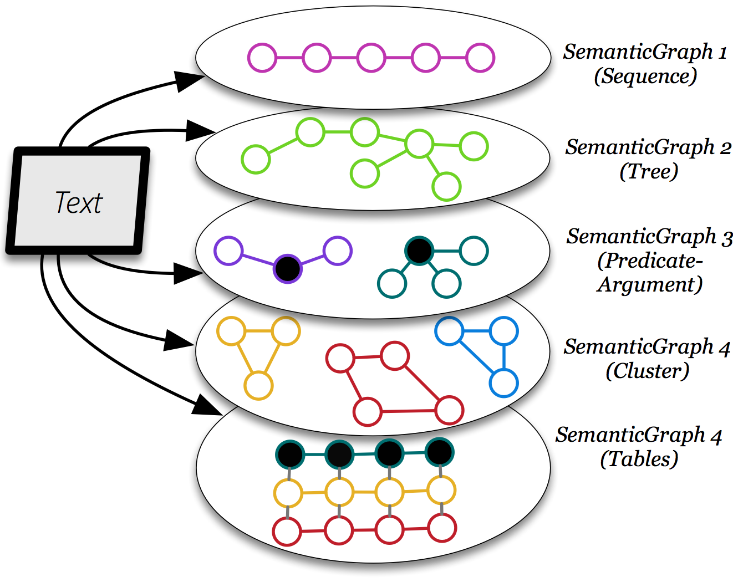
Behavioral Feedback
It’s end-to-end; but the end is not the annotated goal task.
  We care about a collection of models and representations that, via reasoning, can support many behaviors. And learning is driven by these.
Reasoning & Learning
Behaviors
Behaviors
Behaviors
Behaviors
Behaviors
Reasoning & Learning
(Many) Representations and Models we care about.
Reflect an understanding of the language
Notes:
With this in mind, we form abstraction of a text, as a collection of graphs. Chain graphs, Trees, Predicate-Argument graphs, cluster graphs and even tables.
I’d like to emphasize that such representations has nothing to do with the QA task. It is purely genertic, and it reflects our understanding of the language.

Slide 28

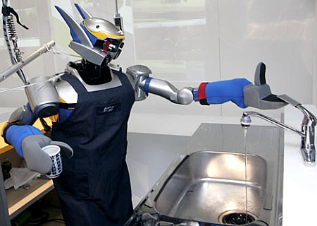

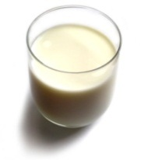
Understanding Language Requires (some) Feedback
Can we rely on this interaction to provide supervision (and eventually, recover meaning) ?
Can I get a coffee with lots of sugar and no milk
Great!
The Goal
Arggg
Meaning Representation:
MAKE(COFFEE,SUGAR=YES,MILK=NO)
How to recover meaning from text?
Standard “example based” ML: annotate text with meaning representation
  The teacher needs deep understanding of the learning agent ; not scalable.
Response Driven Learning (a recent name: learning from denotation): Exploit indirect signals in the interaction between the learner and the teacher/environment
Notes:
NLU: about recovering meaning from text – a lot of work aims directly at that or at some subtasks that might look like this:….

Slide 29
Response Based Learning
We want to learn a model that transforms a natural language sentence to some meaning representation.
Instead of training with (Sentence, Meaning Representation) pairs
Think about behavioral derivatives of the models outputs
  Supervise the derivatives (easy!) and
  Propagate it to learn the complex, structured, transformation model
English Sentence
Model
Meaning Representation

Slide 30
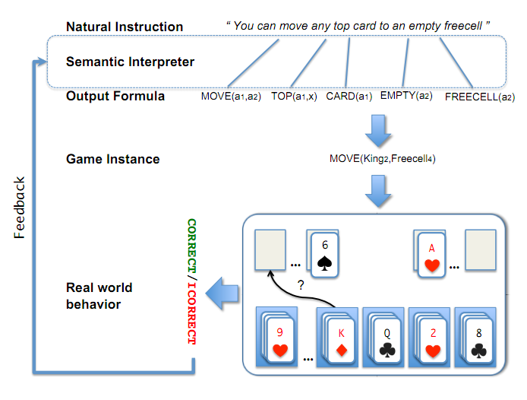
A Response based Learning Scenario
We want to learn a model to transform a natural language sentence to some meaning representation.
English Sentence
Model
Meaning Representation
A top card can be moved to the tableau if it has a different color than the color of the top tableau card, and the cards have successive values.
Move (a1,a2) top(a1,x1) card(a1) tableau(a2) top(x2,a2) color(a1,x3) color(x2,x4) not-equal(x3,x4) value(a1,x5) value(x2,x6) successor(x5,x6)
Play Freecell (solitaire)
Simple derivatives of the models outputs: game API
  Supervise the derivative and Propagate it to learn the transformation model

Slide 31
Response Based Learning
We want to learn a model that transforms a natural language sentence to some meaning representation.
Instead of training with (Sentence, Meaning Representation) pairs
Think about some simple derivatives of the models outputs,
  Supervise the derivative (easy!) and
  Propagate it to learn the complex, structured, transformation model
LEARNING:
Train a structured predictor (semantic parse) with this binary supervision
  Many challenges: e.g., how to make a better use of a negative response?
Learning with a constrained latent representation, use inference to expectations to exploit knowledge (e.g., on the structure of the meaning representation).
[Clarke, Goldwasser, Chang, Roth CoNLL’10; Goldwasser, Roth IJCAI’11, MLJ’14]
English Sentence
Model
Meaning Representation
As for other problems, people are excited today about NN models, but this does not get around the need to supervise models in a realistic way.

Slide 32
Incidental Supervision and Reasoning
Co-ref
  The bee landed on the flower because it had/wanted pollen.
    Lexical knowledge
  John Doe robbed Jim Roy. He was arrested by the police.
    The Subj of “rob” is more likely than the Obj of “rob” to be the Obj of “arrest”
[But see Peng et al. ACL’16, CoNLL’17, NAACL’15 for progress on this]
John had 6 books; he wanted to give it to two of his friends. How many will each one get?
share it with
How do we supervise for these problems?

Slide 33
Conclusion
Thank You!
Some recent samples from a research program that attempts to address some of the key scientific and engineering challenges between us and understanding natural language
Incidental Supervision: Utilizing hints in the data to infer/amplify supervision signals for a range of tasks.
  Representations
  Signals
  Behavioral feedback
Importance and effectiveness of using knowledge in learning

Slide 34
A Story
(ENGLAND, June, 1989) - Christopher Robin is alive and well. He lives in England. He is the same person that you read about in the book, Winnie the Pooh. As a boy, Chris lived in a pretty home called Cotchfield Farm. When Chris was three years old, his father wrote a poem about him. The poem was printed in a magazine for others to read. Mr. Robin then wrote a book. He made up a fairy tale land where Chris lived. His friends were animals. There was a bear called Winnie the Pooh. There was also an owl and a young pig, called a piglet. All the animals were stuffed toys that Chris owned. Mr. Robin made them come to life with his words. The places in the story were all near Cotchfield Farm. Winnie the Pooh was written in 1925. Children still love to read about Christopher Robin and his animal friends. Most people don't know he is a real person who is grown now. He has written two books of his own. They tell what it is like to be famous.
1. Christopher Robin was born in England. 2. Winnie the Pooh is a title of a book.
3. Christopher Robin’s dad was a magician. 4. Christopher Robin must be at least 65 now.
This is an Inference Problem
Notes:
34
I would like to talk about it in the context of language understanding problems. This is the problem I would like to solve. You are given a short story, a document, a paragraph, which you would like to understand. My working definition for Comprehension here would be “ A process that….”
So, given some statement, I would like to know if they are true in this story or not….
This is a very difficult task…
What do we need to know in order to have a chance to do that? … Many things….;
If I would ask you “Where does Chris live?” you will not be satisfied with an answer – “Chris Lived in a Pretty home”
And, there are probably many other stand-alone tasks of this sort that we need to be able to address, if we want to have a chance to COMPREHEND this story, and answer questions with respect to it.
But comprehending this story, being able to determined the truth of these statements is probably a lot more than that – we need to be able to put these things,
(and what is “these” isnt’ so clear) together.
So, how do we address comprehension? Here is a somewhat cartoon-she view of what has happened in this area over the last 30 years or so?
talk about – I wish I could talk about.
Here is a challenge: write a program that responds correctly to these five questions. Many of us would love to be able to do it.
This is a very natural problem; a short paragraph on Christopher Robin that we all
Know and love, and a few questions about it; my six years old can answer these
Almost instantaneously, yes, we cannot write a program that answers more than, say, 2 out of five questions.
What is involved in being able to answer these? Clearly, there are many “small” local decisions that we need to make.
We need to recognize that there are two Chris’s here. A father an a son. We need to resolve co-reference. We need sometimes
To attach prepositions properly;
The key issue, is that it is not sufficient to solve these local problems – we need to figure out how to put them
Together in some coherent way.
And in this talk, I will focus on this. We describe some recent works that we have done in this direction - …..
What do we know – in the last few years there has been a lot of work – and a considerable success on what I call here ---
Here is a more concrete and easy example -----
There is an agreement today that learning/ statistics /information theory (you name it) is of prime importance to making
Progress in these tasks. The key reason, is that rather than working on these high level difficult tasks, we have moved
To work on well defined disambiguation problems that people felt are at the core of many problems.
And, as an outcome of work in NLP and Learning Theory, there is today a pretty good understanding for how to solve
All these problems – which are essentially the same problem.

Slide 35
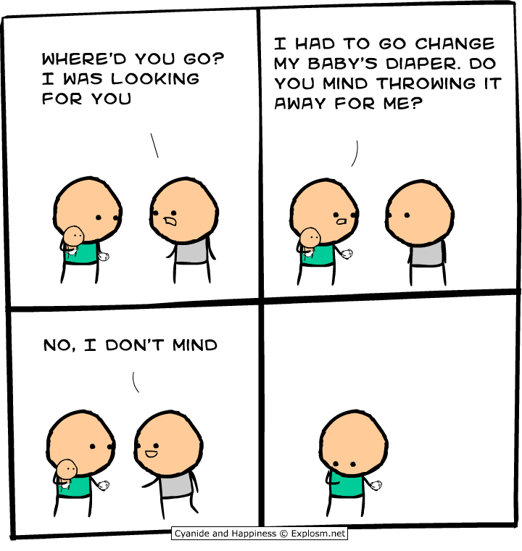
Another Challenge for Incidental Supervision

