Slide 1
Making sense of and
Trusting
Unstructured Data
Dan Roth
Department of Computer Science
University of Illinois at Urbana-Champaign
With thanks to:
Collaborators: Ming-Wei Chang, Prateek Jindal, Jeff Pasternak, Lev Ratinov
Rajhans Samdani, Vivek Srikumar, Vinod Vydiswaran; Many others
Funding: NSF; DHS; NIH; DARPA; IARPA.
DASH Optimization (Xpress-MP)
February 2013
IBM Research – UIUC Alums Symposium

Slide 2
Data Science: Making Sense of (Unstructured) Data
Most of the data today is unstructured, mostly text
  books, newspaper articles, journal publications, reports, internet activity, social network activity
Deal with the huge amount of unstructured data as if it was organized in a database with a known schema.
  how to locate, organize, access, analyze and synthesize unstructured data.
Handle Content & Network (who connects to whom, who authors what,…)
Develop the theories, algorithms, and tools to enable transforming raw data into useful and understandable information & integrating it with existing resources
Today’s message:
    Much research into [data → meaning] attempts to tell us
    what a document says with some level of certainty
    But what should we believe, and who should we trust?
1st Part
2nd Part

Slide 3
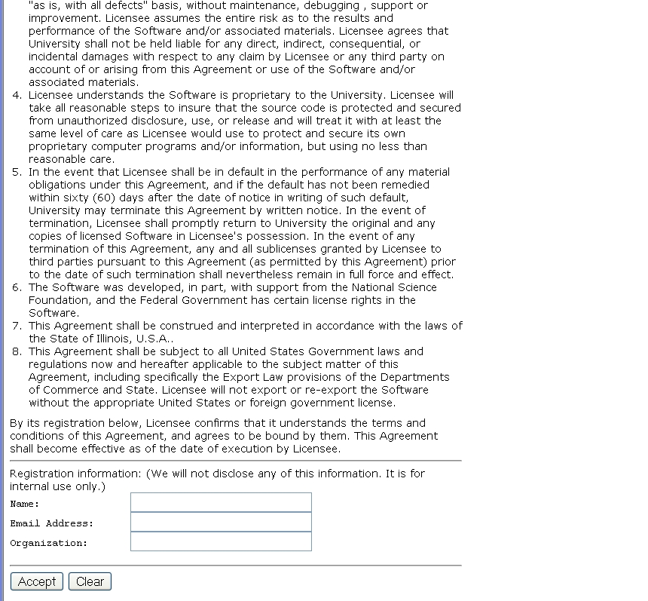
A view on Extracting Meaning from Unstructured Text
Large Scale Understanding: Massive & Deep
Given:
A long contract that you need to ACCEPT
Determine:
Does it satisfy the 3 conditions that you really
care about?
(and distinguish from other candidates)
Does it say that they’ll give
my email address away?
ACCEPT?
Notes:
This is a collection of different problems of ambiguity resolution - from text correction –
Sorry, it was too tempting to use this one…
Word sense disambiguation, part of speech tagging to a decision that involves a decision across sentence
All these are essentially the same classification problem – and with progress in learning theory and NLP
We have pretty reliable solutions to these today.
Here are a few more problems of this kind.

Slide 4
Why is it difficult?
Meaning
Variability
Ambiguity
Language

Slide 5

Variability in Natural Language Expressions
Determine if Jim Carpenter works for the government
Jim Carpenter works for the U.S. Government.
The American government employed Jim Carpenter.
Jim Carpenter was fired by the US Government.
Jim Carpenter worked in a number of important positions. …. As a press liaison for the IRS, he made contacts in the white house.
Russian interior minister Yevgeny Topolov met yesterday with his US counterpart, Jim Carpenter.
Former US Secretary of Defense Jim Carpenter spoke today…
Standard techniques cannot deal with the variability of expressing meaning
nor with the
ambiguity of interpretation
  Needs:
  Relations, Entities and Semantic Classes, NOT keywords
  Bring knowledge from external resources
  Integrate over large collections of text and DBs
  Identify and track entities, events, etc.
Notes:
5
If you only want to know if the relation holds, and you have a lot of data, maybe you will find it expressed somewhere in a simple way; but if you are given a single document and want to know if it holds, the problem is much harder.

Slide 6
What can this give us?
Moving towards natural language understanding…
A political scientist studies Climate Change and its effect on Societal instability. He wants to identify all events related to demonstrations, protests, parades, analyze them (who, when, where, why) and generate a timeline and a causality chain.
An electronic health record (EHR) is a personal health record in digital format. Includes information relating to:
  Current and historical health, medical conditions and medical tests; referrals, treatments, medications, demographic information etc.: A write only document
  Use it in medical advice systems; medication selection and tracking (Vioxx…); disease outbreak and control; science – correlating response to drugs with other conditions
Notes:
Almost all NLP tasks: one example, many decisions
6

Slide 7
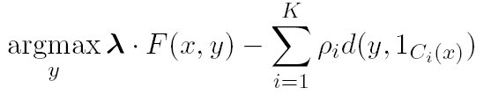
Machine Learning + Inference based NLP
It’s difficult to program predicates of interest due to
  Ambiguity (everything has multiple meanings)
  Variability (everything you want to say you can say in many ways)
Models are based on Statistical Machine Learning & Inference
Modeling and learning algorithms for different phenomena
  Classification models
  Structured models
  Learning protocols that exploit Indirect Supervision
Inference as a way to introduce domain & task specific constraints
  Constrained Conditional Models: formulating inference as ILP
Well understood; easy to build black box categorizers
Learn models; Acquire knowledge/constraints; Make decisions.
Notes:
Take-home messages:
It is a reasonable assumption that local classification is easy, because: (1) we already identify the important components
In many applications, the components are identifiable and easy to learn. Person & Subject

Slide 8
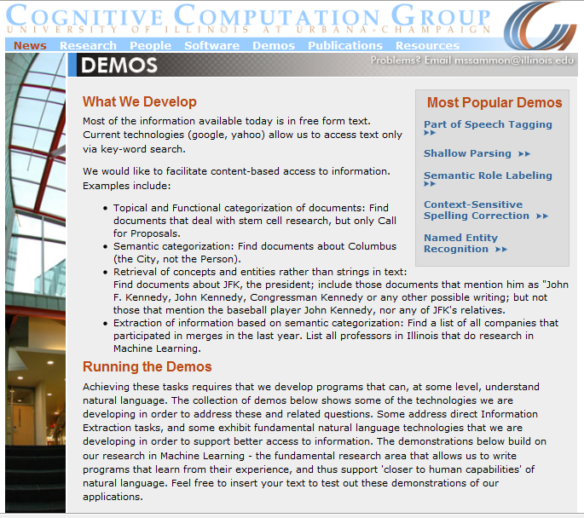
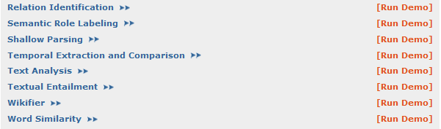
Extended Semantic Role Labeling (+Nom+Prep)
Temporal extraction, Shallow Reasoning, & Timelines
Significant Progress in NLP and Information Extraction
Improved Wikifier
New Co-Reference
Notes:
I would like to talk about it in the context of language understanding problems. This is the problem I would like to solve. You are given a short story, a document, a paragraph, which you would like to understand. My working definition for Comprehension here would be “ A process that….”
So, given some statement, I would like to know if they are true in this story or not….
This is a very difficult task…
What do we need to know in order to have a chance to do that? … Many things….
And, there are probably many other stand-alone tasks of this sort that we need to be able to address, if we want to have a chance to COMPREHEND this story, and answer questions with respect to it.
But comprehending this story, being able to determined the truth of these statements is probably a lot more than that – we need to be able to put these things,
(and what is “these” isnt’ so clear) together.
So, how do we address comprehension? Here is a somewhat cartoon-she view of what has happened in this area over the last 30 years or so?
talk about – I wish I could talk about.
Here is a challenge: write a program that responds correctly to these five questions. Many of us would love to be able to do it.
This is a very natural problem; a short paragraph on Christopher Robin that we all
Know and love, and a few questions about it; my six years old can answer these
Almost instantaneously, yes, we cannot write a program that answers more than, say, 2 out of five questions.
What is involved in being able to answer these? Clearly, there are many “small” local decisions that we need to make.
We need to recognize that there are two Chris’s here. A father an a son. We need to resolve co-reference. We need sometimes
To attach prepositions properly;
The key issue, is that it is not sufficient to solve these local problems – we need to figure out how to put them
Together in some coherent way.
And in this talk, I will focus on this. We describe some recent works that we have done in this direction - …..
What do we know – in the last few years there has been a lot of work – and a considerable success on what I call here ---
Here is a more concrete and easy example -----
There is an agreement today that learning/ statistics /information theory (you name it) is of prime importance to making
Progress in these tasks. The key reason, is that rather than working on these high level difficult tasks, we have moved
To work on well defined disambiguation problems that people felt are at the core of many problems.
And, as an outcome of work in NLP and Learning Theory, there is today a pretty good understanding for how to solve
All these problems – which are essentially the same problem.

Slide 9
Semantic Role Labeling
Who does what to whom, when and where

Slide 10
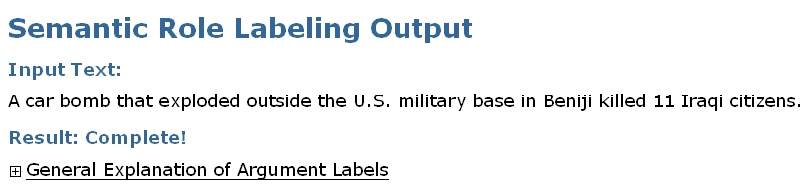
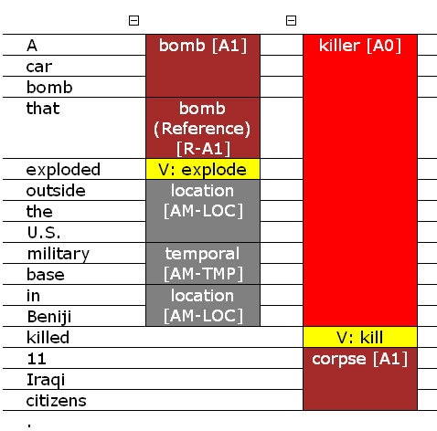
Extracting Relations via Semantic Analysis
Screen shot from a CCG demo
http://cogcomp.cs.illinois.edu/page/demos
  Semantic parsing reveals several relations in the sentence along with their arguments.
Top system in the CoNLL Shared Task Competition 2005

Slide 11
Extended Semantic Role labeling
Verb Predicates, Noun predicates, prepositions, each dictates some relations, which have to cohere.
Ambiguity and Variability of Prepositional Relations
Cause
Location
His first patient died of pneumonia. Another, who arrived from NY yesterday suffered from flu. Most others already recovered from flu
Difficulty: no single source with annotation for all phenomena
cause
Start-state
Learn models; Acquire knowledge/constraints; Make decisions.

Slide 12
Events
An “Arrest” Event
Causality
A “Kill” Event
Temporal
Distributional Association Score
The police arrested AAA because he killed BBB two days after Christmas
Discourse Relation Prediction

Slide 13
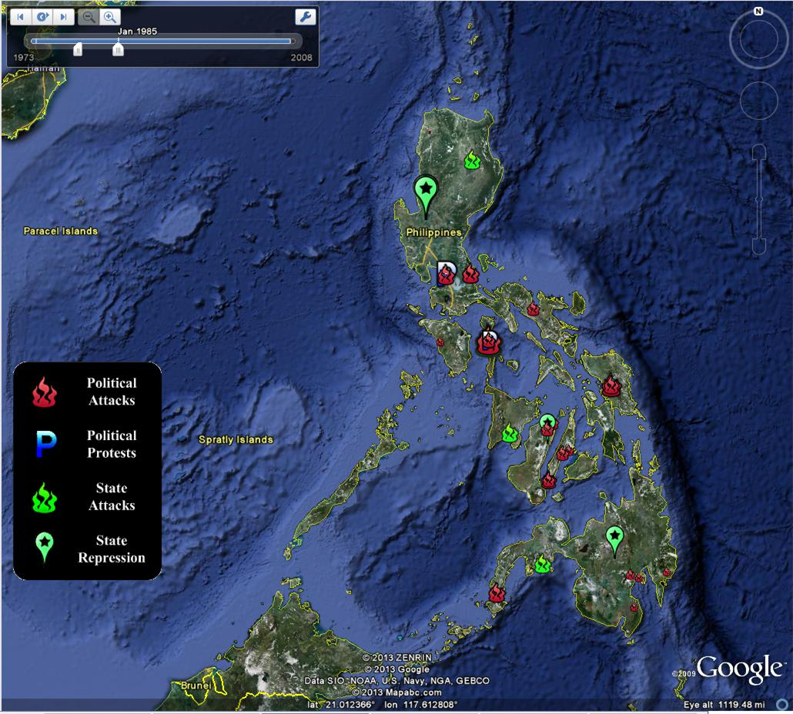
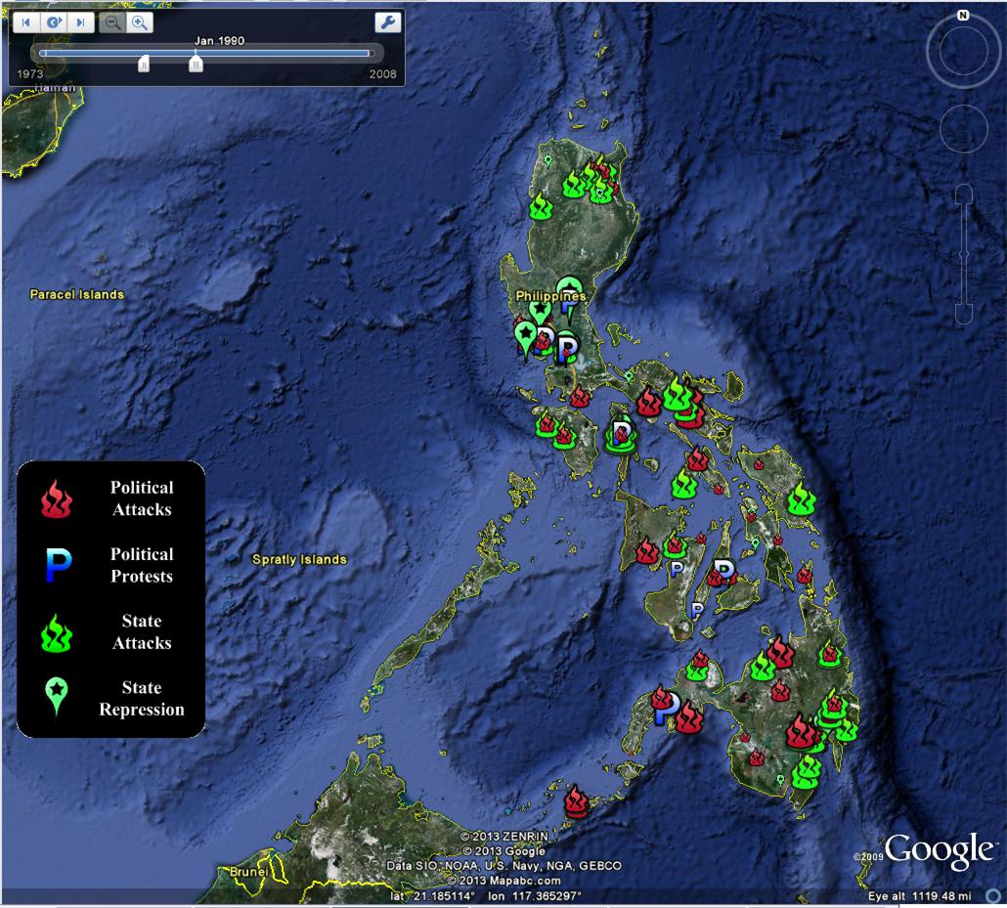
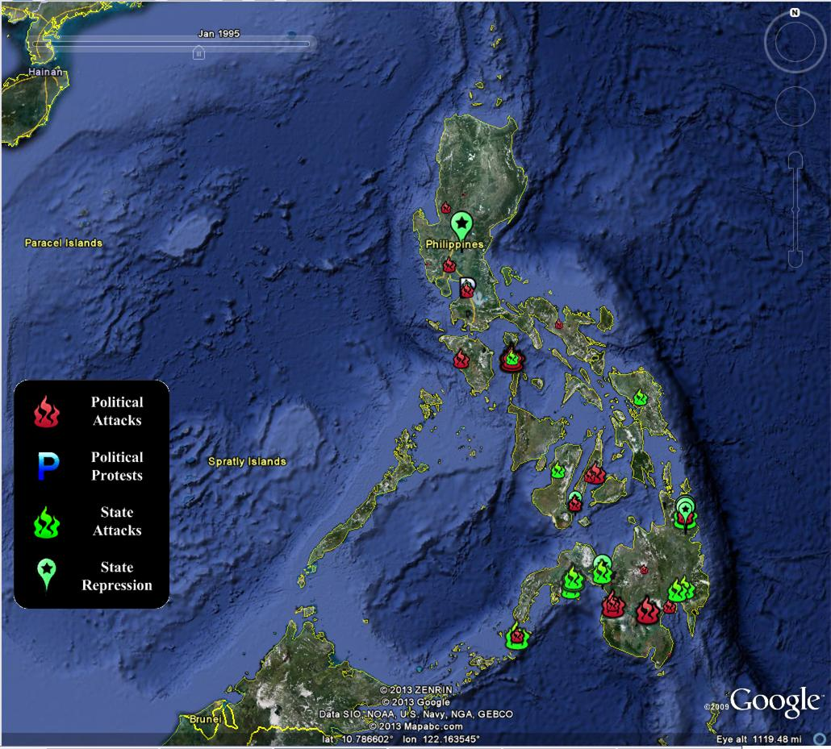
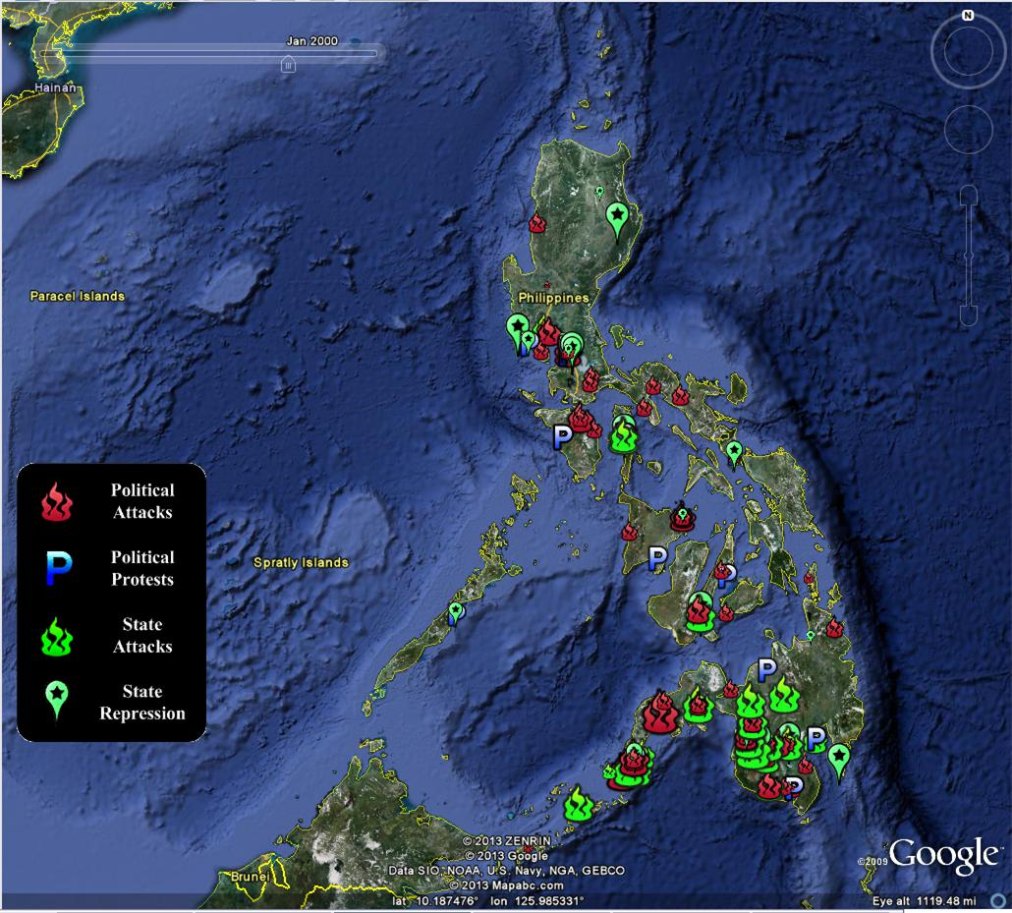
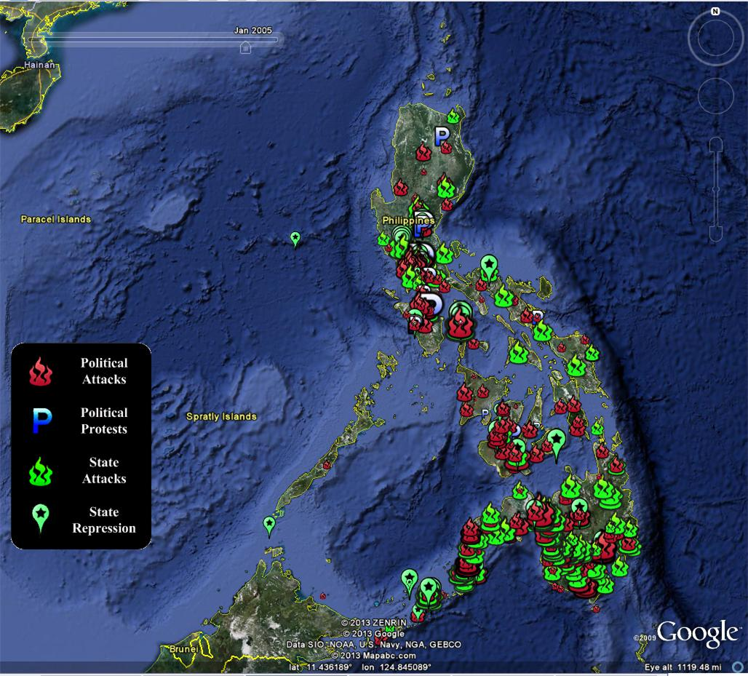
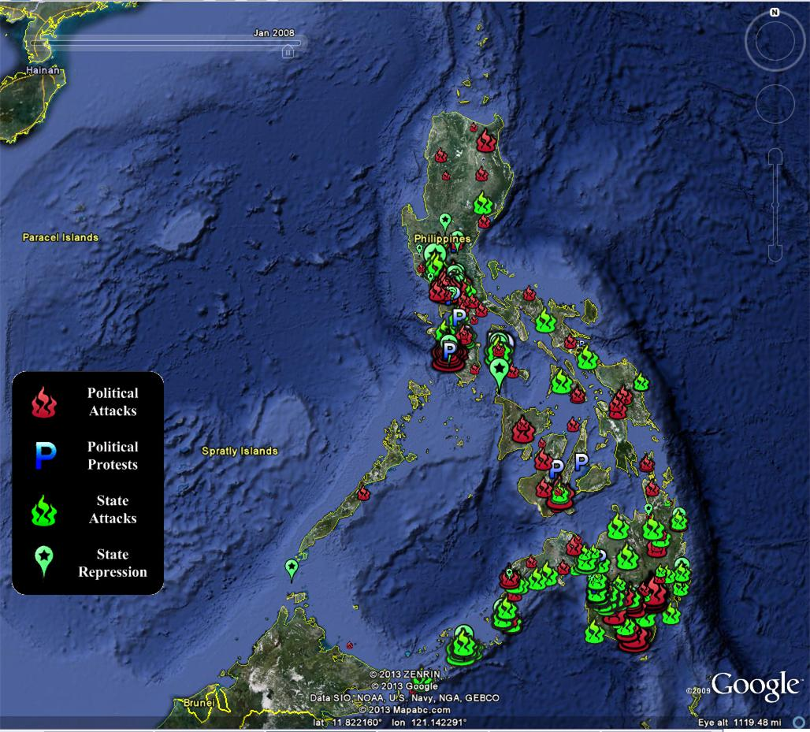
Social, Political and Economic Event Database (SPEED)
Cline Center for Democracy: Quantitative Political Science meets Information extraction
Tracking Societal Stability in the Philippines: Civil strife, Human and property rights, The rule of law, Political regime transitions

Slide 14
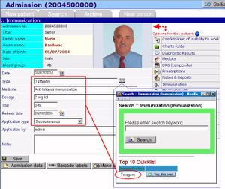
Medical Informatics
Technological Challenges
Privacy Challenges
An electronic health record (EHR) is a personal health record in digital format.
Patient-centric information that should aid clinical decision-making.
  Includes information relating to the current and historical health, medical conditions and medical tests of its subject.
  Data about medical referrals, treatments, medications, demographic information and other non-clinical administrative information.
A narrative with embedded database elements
Potential Benefits
Health
  Utilize in medical advice systems
  Medication selection and tracking (Vioxx…)
  Disease outbreak and control
Science
  Correlating response to drugs with other conditions
Needs
Enable information extraction & information integration across various projections of the data and across systems

Slide 15
Analyzing Electronic Health Records
Identify Important Mentions
The patient is a 65 year old female with post thoracotomy syndrome that occurred on the site of her thoracotomy incision .
She had a thoracic aortic aneurysm repaired in the past and subsequently developed neuropathic pain at the incision site .
She is currently on Vicodin , one to two tablets every four hours p.r.n. , Fentanyl patch 25 mcg an hour , change of patch every 72 hours , Elavil 50 mgq .h.s. , Neurontin 600 mg p.o. t.i.d. with still what she reports as stabbing left-sided chest pain that can be as severe as a 7/10.
She has failed conservative therapy and is admitted for a spinal cord stimulator trial .
[The patient] is a 65 year old female with [post thoracotomy syndrome] [that] occurred on the site of [[her] thoracotomy incision] .
[She] had [a thoracic aortic aneurysm] repaired in the past and subsequently developed [neuropathic pain] at [the incision site] .
[She] is currently on [Vicodin] , one to two tablets every four hours p.r.n. , [Fentanyl patch] 25 mcg an hour , change of patch every 72 hours , [Elavil] 50 mgq .h.s. , [Neurontin] 600 mg p.o. t.i.d. with still what [she] reports as [stabbing left-sided chest pain] [that] can be as severe as a 7/10.
[She] has failed [conservative therapy] and is admitted for [a spinal cord stimulator trial] .

Slide 16
Analyzing Electronic Health Records
Red : Problems
Green : Treatments
Purple : Tests
Blue : People
Identify Concept Types
[The patient] is a 65 year old female with [post thoracotomy syndrome] [that] occurred on the site of [[her] thoracotomy incision] .
[She] had [a thoracic aortic aneurysm] repaired in the past and subsequently developed [neuropathic pain] at [the incision site] .
[She] is currently on [Vicodin] , one to two tablets every four hours p.r.n. , [Fentanyl patch] 25 mcg an hour , change of patch every 72 hours , [Elavil] 50 mgq .h.s. , [Neurontin] 600 mg p.o. t.i.d. with still what [she] reports as [stabbing left-sided chest pain] [that] can be as severe as a 7/10.
[She] has failed [conservative therapy] and is admitted for [a spinal cord stimulator trial] .

Slide 17
Analyzing Electronic Health Records
Other needs: temporal recognition & reasoning, relations, quantities, etc.
Coreference Resolution
[The patient] is a 65 year old female with [post thoracotomy syndrome] [that] occurred on the site of [[her] thoracotomy incision] .
[She] had [a thoracic aortic aneurysm] repaired in the past and subsequently developed [neuropathic pain] at [the incision site] .
[She] is currently on [Vicodin] , one to two tablets every four hours p.r.n. , [Fentanyl patch] 25 mcg an hour , change of patch every 72 hours , [Elavil] 50 mgq .h.s. , [Neurontin] 600 mg p.o. t.i.d. with still what [she] reports as [stabbing left-sided chest pain] [that] can be as severe as a 7/10.
[She] has failed [conservative therapy] and is admitted for [a spinal cord stimulator trial] .

Slide 18
Multiple Applications
Clinical Decisions:
  “Please show me the reports of all patients who had headache that was not cured by Aspirin.”
    Concept Recognition; Relation Identification (Problem, Treatment)
  “Please show me the reports of all patients who have had myocardial infarction (heart attack) more than once.”
    Coreference Resolution
Identification of sensitive data (Privacy Reasons)
  HIV Data, Drug Abuse, Family Abuse, Genetic Information
    Concept Recognition, Relations Recognition (drug, drug abuse), coreference resolution (multiple incidents, same people)
Generating summaries for patients
Creating automatic reminders of medications

Slide 19
Information Extraction in the Medical Domain
Models learned on newswire data do not adapt well to the medical domain.
Different vocabulary, sentence and document structure.
More importantly, the medical domain offers a chance to do better than the general newswire domain.
Background Knowledge: Narrow domain; a lot of manually curated KB resources that can be used to help identification & disambiguation.
  UMLS: A large biomedical KB, with semantic types and relationships between concepts.
  Mesh: A large thesaurus of medical vocabulary.
  SNOMED CT: A comprehensive clinical terminology.
Structure: Medical Text has more structure that can be exploited.
  Discourse structure: Concepts in the section “Principal Diagnosis” are more likely to be “medical problems”.
  EHRs have some internal structure: Doctors, One Patient, Family Members.
Notes:
Take-home messages:
It is a reasonable assumption that local classification is easy, because: (1) we already identify the important components
In many applications, the components are identifiable and easy to learn. Person & Subject

Slide 20
Current Status
State-of-the-art Coreference Resolution System for Clinical Narratives (JAMIA’12, COLING’12, in submission)
State-of-the-art Concept and Relation Extraction (I2B2 workshop’12)
Current work:
  Continuing work on concept identification and Relations
  End-2-End Coreference Resolution System
  Sensitive Concepts
Notes:
Take-home messages:
It is a reasonable assumption that local classification is easy, because: (1) we already identify the important components
In many applications, the components are identifiable and easy to learn. Person & Subject

Slide 21
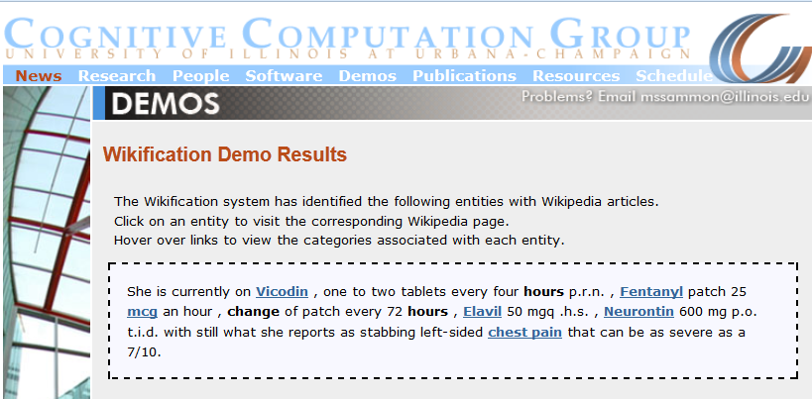
Mapping to Encyclopedic Resources (Demo)
Beyond supporting better Natural Language Processing, Wikification could allow people to read and understand these documents and access them in an easier way.
http://en.wikipedia.org/wiki/Amitriptyline
Hydrocodone/paracetamol
http://http://en.wikipedia.org/wiki/Vicodin

Slide 22
Outline
Making Sense of Unstructured Data
  Political Science application
  The Medical Domain
Trustworthiness of Information: Can you believe what you read?
  Key questions in credibility of information
  A constraints driven approach to determining trustworthiness

Slide 23
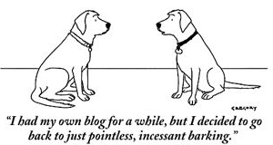


Knowing what to Believe
The advent of the Information Age and the Web
  Overwhelming quantity of information
  But uncertain quality.
    Collaborative media
      Blogs
      Wikis
      Tweets
      Message boards
    Established media are losing market share
      Reduced fact-checking
Notes:
23

Slide 24
Emergency Situations
A distributed data stream needs to be monitored
All Data streams have Natural Language Content
  Internet activity
    chat rooms, forums, search activity, twitter and cell phones
  Traffic reports; 911 calls and other emergency reports
  Network activity, power grid reports, networks reports, security systems, banking
  Media coverage
Often, stories appear on tweeter before they break the news
But, a lot of conflicting information, possibly misleading and deceiving
Notes:
24

Slide 25
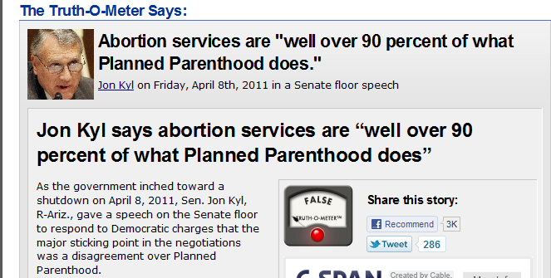
Distributed Trust
Integration of data from multiple heterogeneous sources is essential.
Different sources may provide
conflicting information or mutually
reinforcing information.
  Mistakenly or for a reason
  But there is a need to estimate
  source reliability and (in)dependence.
  Not feasible for human to read it all
  A computational trust system
  can be our proxy
  Ideally, assign the trust judgments the user would
  The user may be another system
    A question answering system; A navigation system; A news aggregator
    A warning system
False– only 3 %

Slide 26
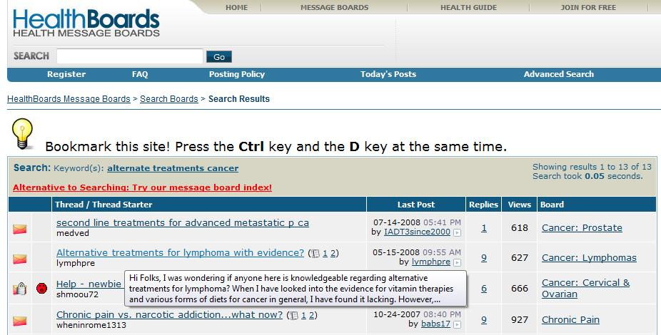
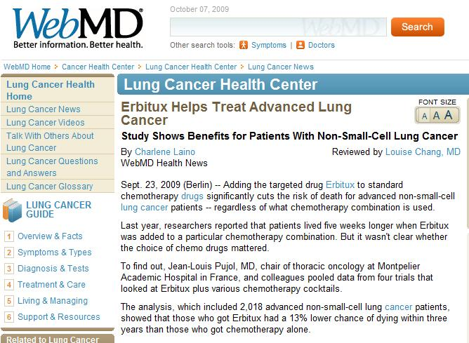
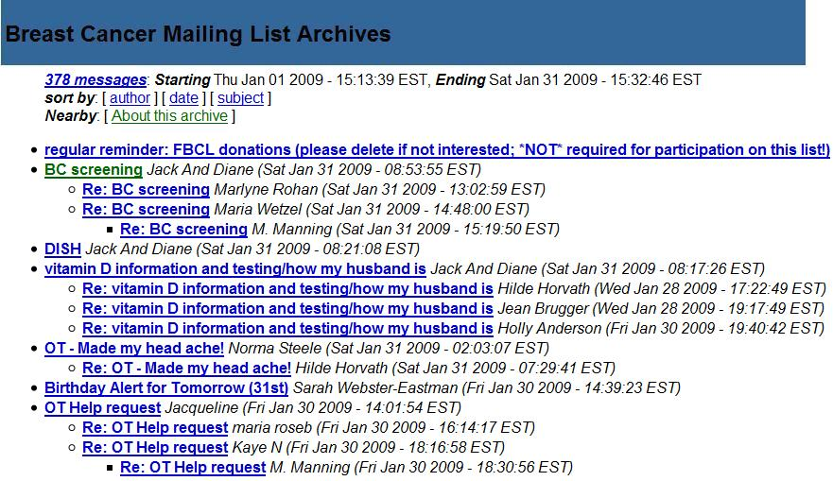
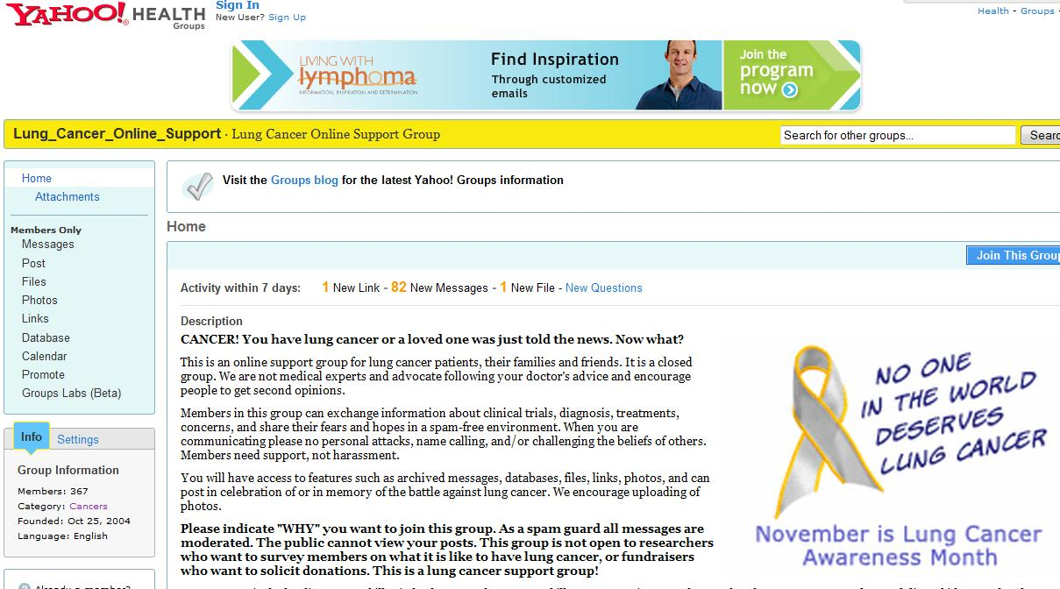
Medical Domain: Many support groups and medical forums
Hundreds of Thousands of people get their medical information from the internet
Best treatment for…..
Side effects of….
But, some users have an agenda,… pharmaceutical companies…
26
Notes:
Users share their experiences in message boards, forums, and blogs.
26

Slide 27
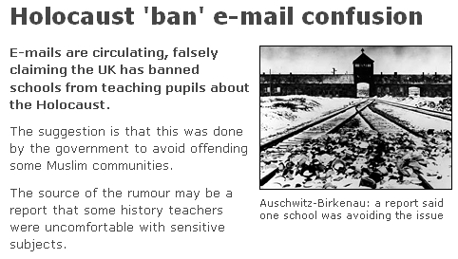
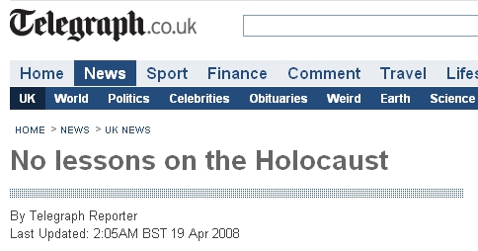
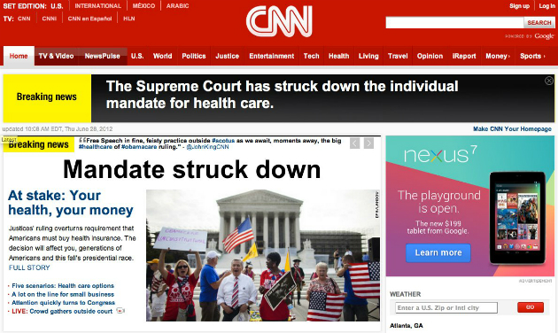
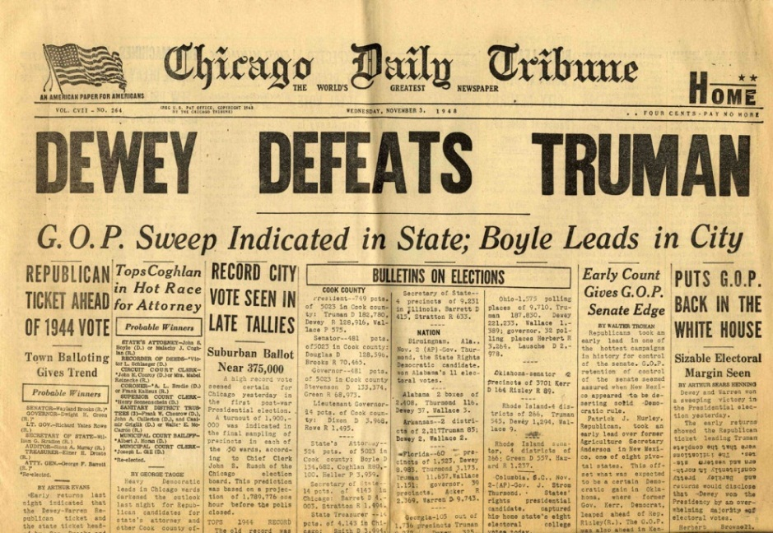
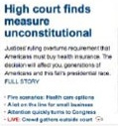
Not so Easy
Integration of data from multiple heterogeneous sources is essential.
Different sources may provide either conflicting information or mutually reinforcing information.
Interpreting a distributed stream of conflicting pieces of information is not easy even for experts.

Slide 28
Trustworthiness [Pasternack & Roth COLING’10, WWW’11, IJCAI’11; Vydiswaran, Zhai, Roth, KDD’11]
Given:
  Multiple content sources: websites, blogs, forums, mailing lists
  Some target relations (“facts”)
    E.g. [disease, treatments], [treatments, side-effects]
  Prior beliefs and background knowledge
Our goal is to:
  Score trustworthiness of claims and sources based on
    support across multiple (trusted) sources
    source characteristics:
      reputation, interest-group (commercial / govt. backed / public interest),
      verifiability of information (cited info)
    Prior Beliefs and Background knowledge
    Understanding content

Slide 29


Research Questions [Pasternack&Roth COLING’10,[WWW,IJCAI]’11; Vydiswaran, Zhai, Roth, KDD’11]
1. Trust Metrics
  (a) Trustworthy messages have some typical characteristics.
  (b) Accuracy is misleading. A lot of (trivial) truths do not make a message trustworthy.
2. Algorithmic Framework: Constrained Trustworthiness Models
  Just voting isn’t good enough
  Need to incorporate prior beliefs & background knowledge
3. Incorporating Evidence for Claims
  Not sufficient to deal with claims and sources
  Need to find (diverse) evidence – natural language difficulties
4. Building a Claim-Verification system
  Automate Claim Verification—find supporting & opposing evidence
  Natural Language; user biases; information credibility

Slide 30
1. Comprehensive Trust Metrics [Pasternak & Roth’10]
A single, accuracy-derived metric is inadequate
We proposed three measures of trustworthiness:
  Truthfulness: Importance-weighted accuracy
  Completeness: How thorough a collection of claims is
  Bias: Results from supporting a favored position with:
    Untruthful statements
    Targeted incompleteness (“lies of omission”)
Calculated relative to the user’s beliefs and information requirements
These apply to collections of claims and Information sources
Found that our metrics align well with user perception overall and are preferred over accuracy-based metrics
Notes:
30

Slide 31
2. Constrained Trustworthiness Models [Pasternak & Roth’10,11,12]
Veracity of claims
Trustworthiness of sources
T(s)
Sources
B(C)
Hub-Authority style
s₁
Claims
c₁
B^{(n+1)}(c)=∑_{s} w(s,c) T^{n}(s)
s₂
c₂
T^{(n+1)}(s)=∑_{c} w(s,c) B^{n+1}(c)
s₃
Encode additional information into a generalized fact-finding graph
Rewrite the algorithm to use this information
(Un)certainty of the information extractor; Similarity between claims; Attributes , group memberships & source dependence;
Often readily available in real-world domains
c₃
1
s₄
c₄
s₅
Incorporate Prior knowledge
Common-sense: Cities generally grow over time; A person has 2 biological parents
Specific knowledge: The population of Los Angeles is greater than that of Phoenix
2
Solved via Iterative constrained optimization (constrained EM), via generalized constrained models
Represented declaratively (FOL like) and converted automatically into linear inequalities
Notes:
Callout for tau and sigma

Slide 32
Constrained Fact-Finding
Oftentimes we have prior knowledge in a domain:
  “Obama is younger than both Bush and Clinton”
  “All presidents are at least 35”
Main idea: if we use declarative prior knowledge to help us, we can make much better trust decisions
Prior knowledge comes in two flavors
  Common-sense
    Cities generally grow over time; a person has two biological parents
    Hotels without Western-style toilets are bad
  Specific knowledge
    John was born in 1970 or 1971; The Hilton is better than the Motel 6
    population(Los Angeles)> Population(Phoenix)
As before, this knowledge is encoded as linear constraints

Slide 33
The Enforcement Mechanism
This Objective function will be the distance between:
    The beliefs B^{i}(C)’ produced by the fact-finder
    A new set of beliefs B^{i}(C) that satisfies the linear constraints
T(s)
Sources
B(C)
s₁
Claims
Calculate T^{i}(S) given B^{i-1}(C)
Calculate B^{i}(C)’ given T^{i}(S)
“Correct” B^{i}(C)’ ! B^{i}(C)
c₁
s₂
c₂
s₃
c₃
s₄
c₄
s₅
Inference: Correct assignment to fit constraints
Notes:
33

Slide 34
Experimental Overview: City population
Sources are wikipedia authors
44,761 claims by 4,107 authors (Truth: US Census)
Goal: determine true population of each city in each year
Notes:
34

Slide 35
Experimental Overview
City population (Wikipedia infobox data)
Basic biographies (Wikipedia infobox data)
American vs. British Spelling (articles)
  British National Corpus, Reuters, Washington Post
  “Color” vs. “colour”: 694 such pairs
  An author claims a particular spelling by using it in an article
  Goal: find the “true” British spellings
    British viewpoint
    American spellings predominate by far
    No single objective “ground truth”
  Without prior knowledge the fact-finders do very poorly
    Predict American spellings instead
Notes:
35

Slide 36
3. Incorporating Evidence for Claims [Vydiswaran, Zhai & Roth’10,11,12]
Evidence
Sources
E(c)
Claims
T(s)
e₁
s₁
B(c)
s₂
e₄
e₂
c₁
T(s_{i})
E(c_{i})
s₂
e₃
c₃
s₃
T(s_{i})
e₅
e₄
c₂
E(c_{i})
s₃
B(c)
e₅
s₄
e₆
c₃
T(s_{i})
E(c_{i})
s₄
e₆
e₇
c₄
The truth value of a claim depends on its source as well as on evidence.
  Evidence documents influence each other and have different relevance to claims.
Global analysis of this data, taking into account the relations between stories, their relevance, and their sources, allows us to determine trustworthiness values over sources and claims.
s₅
e₈
1
e₉
e₁₀
The NLP of Evidence Search
Does this text snippet provide evidence to this claim? Textual Entailment
What kind of evidence?
For, Against: Opinion Sentiments
2
Notes:
Callout for tau and sigma

Slide 37
4. Building ClaimVerifier
Algorithmic Questions
Users
Language Understanding Questions
Retrieve text snippets as evidence that supports or opposes a claim
Textual Entailment driven search and Opinion/Sentiment analysis
Source
Claim
Presenting evidence for or against claims
HCI Questions [Vydiswasaran et. al’12]
What do subjects prefer – information from credible sources or information that closely aligns with their bias?
What is the impact of user bias?
Does the judgment change if credibility/ bias information is visible to the user?
Evidence
Data

Slide 38
Summary
Thank You!
Presented some progress on several efforts in the direction of Making Sense of Unstructured Data
  Applications with societal importance
Trustworthiness of information comes up in the context of social media, but also in the context of the “standard” media
Trustworthiness comes with huge Societal Implications
Addressed some of the Key Scientific & Technological obstacles
  Algorithmic Issues
  Human-Computer Interaction Issues
A lot can (and should) be done.
Notes:
If you read some text online, can you believe it? We pose these questions and as a first step, try to approach it based on other users’ shared experience on something similar.
38

