Slide 1
Learning from Incidental Supervision Signals for
Natural Language Understanding
Dan Roth
University of Pennsylvania & NexLP, Inc.
Knowledge Discovery from Unstructured Data in Financial Services
AAAI-20 Workshop
February 2020

Slide 2
Challenges (1)
Analyze Suspicious Transaction Reports (STRs) that banks submit to government agencies.
  Extract relationships and transaction details.
ALERTED ACTIVITY
  On 01/01/2011 the 01/01/2011 wire was stopped by ABC DE’s filter:
  JJ sent a $4,950.00 wire from account 123567 at GH Bank DE, through ABC DE, to account 123456 at Peoples’ Bank of Malibu head office, Malibu, to be remitted to People’s Bank of Malibu, XYZ Branch, for the benefit of BB for “Prayer Religious Items.”
Determine: who did what to whom, where and when?
  What are the transactions; from whom, to whom?
  People involved, roles and affiliations
  Organizations and their roles
  Timelines of events

Slide 3
Challenges (2)
Inter-banking rate issues
  A client investigates if bankers were fixing the inter-banking rate.
  "Mate, can you raise the main one by 0.2 till Wednesday? I owe you a drink.“
Messages here are typically very short; the language is colloquial and ungrammatical. Messages include many quantities (rates), how much to adjust, etc.
A “simple” classification problem – but what is the label?
  And, where is the training data?

Slide 4
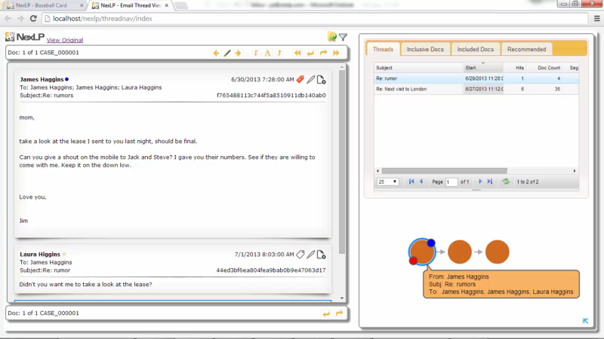
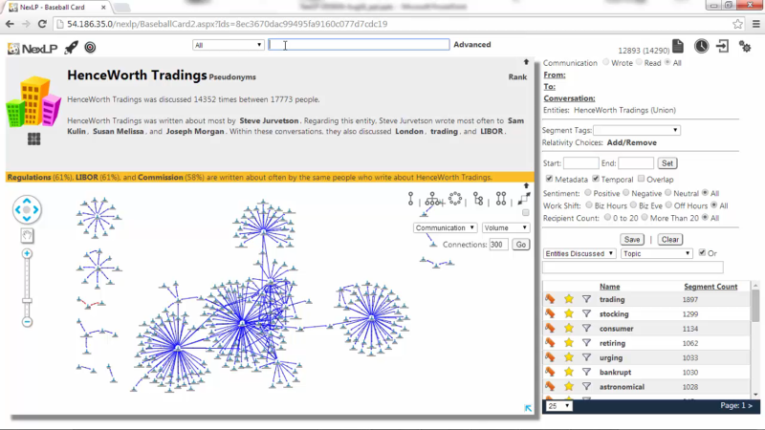
Challenges (3)
Hedge fund investigated a former employee.
A sales manager that was fired and was suspected to have taken with him clients.
A team of lawyers took 3 weeks to go over a few hundred thousands emails and found nothing.
The NexLP engine processed the data –
  Communications among entities: who communicates to whom, when, about what?
  Identified anomalies in communication (temporal and other irregular communications)
Guided an investigator to the suspect email to him mom about clients shortly before leaving.

Slide 5

Date: Thu, 11 May 2000 07:32:00 -0700 (PDT)
From: david.delainey@enron.com
To: mike.jakubik@enron.com
Subject: Re: Raptor
That may work - I don't want to end up with an equity position I just worked hard to eliminate. Further, raptor may be a good accounting hedge but if we took back JEDI's share at existing marks we would be destroying significant real value. Will the buy back price of the equity/debt we get back from JEDI incorporate the write downs we think should occur?
Regards,
Delainey

Slide 6
Sent
Year/Month: May 2000
Month: May
Year: 2000
Work Shift: Business Evening
Concept ai
Equity
equity interest
equity markets
equity stakes
Hedge
hedge fund
hedging strategy
statistical hedging
Destroying
destroying competition
Destroying value
Raptor
Raptor structure
Raptor vehicles
Raptor transaction
Date: Thu, 11 May 2000 07:32:00 -0700 (PDT)
From: david.delainey@enron.com
To: mike.jakubik@enron.com
Subject: Re: Raptor
That may work - I don't want to end up with an equity position I just worked hard to eliminate. Further, raptor may be a good accounting hedge but if we took back JEDI's share at existing marks we would be destroying significant real value. Will the buy back price of the equity/debt we get back from JEDI incorporate the write downs we think should occur?
Regards,
Delainey
Communicators
david delainey
david delainey
delainey david w
dave delainey
david delaney
dave delaney
david delaine
Mike Jakubik
organizations
JEDI
JEDI II
Joint Energy Development Investments
CLUSTER
056_electricity/issues/
capacity
Domains involved
Enron.com
Emotional intelligence
Sentiment: -5.50
Pressure: 10.50
Opportunity: 7.50
Intent: 4.50
Rationalization: 4.50
Notes:
BUILD UP DATA EXTRACTED** make it more complex in the level of things we “learn” and model optimization based on what’s the best thing…

Slide 7
Date: Thu, 11 May 2000 07:32:00 -0700 (PDT)
From: david.delainey@enron.com
To: mike.jakubik@enron.com
Subject: Re: Raptor
That may work - I don't want to end up with an equity position I just worked hard to eliminate. Further, raptor may be a good accounting hedge but if we took back JEDI's share at existing marks we would be destroying significant real value. Will the buy back price of the equity/debt we get back from JEDI incorporate the write downs we think should occur?
Regards,
Delainey

Slide 8
Inducing Semantics
Inducing semantic representations and making decisions that depend on it require learning and, in turn, supervision.
Standard machine learning methodology:
  Given a task
  Collect data for the task and annotate it
  Learn a model [doesn’t matter how]
We will never have enough annotated data to train all the models, for all the tasks we need, this way.
  We don’t even know what are “all the tasks”
  Most of what we learn we don’t learn by “training” on many examples
Current methodology is not scalable and, often, makes no sense
  Annotating for complex tasks is difficult, costly, and sometimes impossible.
    Most decisions we care about are too sparse to be trained for directly
It’s ok to do supervised learning.
But what about tasks that cannot be supervised directly?
In most interesting cases, learning should be (and is) driven by incidental supervision signals [Roth AAAI’17]
Incidental supervision: How to understand, acquire and use signals that were not put there to help a specific target task.
Notes:
Key challenge, to facilitate reasoning, is to induce semantics
Move to the importance of supervision

Slide 9
Incidental Supervision
Data exists independent of the task(s) at hand.
  Data provides hints
  These are often sufficient to infer supervision signals (even for tasks we haven’t defined)
Notes:
Key challenge, to facilitate reasoning, is to induce semantics

Slide 10
Incidental Supervision & Reasoning
O’Hare must be in Chicago
O’Hare must be in Chicago
Feb 5 2017 Dozens of passengers heading to Chicago had to undergo additional screenings… It took Hesam Aamyab two tries to make it back to the United States from Iran. He is an Iranian citizen with a US visa who is doing post-doctoral research at UIC. …"Right now, I am in the USA and I'm very happy," Aamyab said. But now, he can't go back to Iran or anywhere else without risk. Other travelers shared the same worry. Asem Aleisawi was at O'Hare on Sunday to meet his wife who was coming in from Jordan.
  Learning/Supervision requires some level of reasoning to infer these weak signals

Slide 11
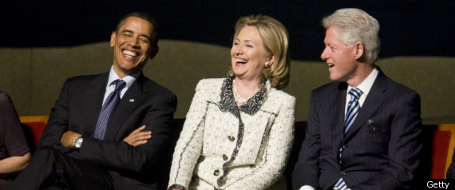
Many Simple Ideas
A gender classifier
  Or maybe just a list of names classified by gender
    Name → Male/Female
  Option one: annotate
  Option two: Use all People’s Wikipedia page
    Count gender pronouns in the first paragraph; decide gender by majority
Images
  Difficult to label objects
  Easy to learn same/different
    Two objects in the same image are different
    Two consecutive video frames are likely to contain the same object.
Recent work showing the importance of pre-training [ELMo, BERT]
  Good, related, but more is needed.
Notes:
Give the gender example;
Give a vision example?
Key challenge, to facilitate reasoning, is to induce semantics

Slide 12
Incidental Supervision
Data exists independent of the task(s) at hand.
  Data provides hints
  These are often sufficient to infer supervision signals (even for tasks we haven’t defined)
Utilizing these hints
  Can be substantially less costly than producing explicit annotation
  More realistic – provides signals for tasks we haven’t defined
    Is often used only at decision time
  Can be used for transfer across languages and domains
  Expectations from the output can be used to amplify week signals to high quality signals
Notes:
Key challenge, to facilitate reasoning, is to induce semantics

Slide 13
Incidental Supervision: Outline
Data provides hints
  These are often sufficient to infer supervision signals for a range of tasks.
  Data exists independent of the task(s) at hand.
Tasks:
Text Classification
(Fine) Semantic Typing
  A former Democrat, Bloomberg, switched
  his party registration in 2001.
Temporal Relations (Timelines)
Shallow Semantic Parsing
Methods:
Using data that is out there
  Wikipedia
Label Aware Classification
  “Understanding” the task & label
Transfer from other tasks
Exploiting declarative & statistical knowledge
Notes:
Give the gender example;
Give a vision example?
Key challenge, to facilitate reasoning, is to induce semantics

Slide 14
Text Classification
A lot of the work in NLP can still be viewed as text classification
  Categorization into topics
  Identify intention of text
  Identify abusing text
  Identifying collusion
  Classify fact/opinion
  ……
While you understand the labels, models are not given information about the labels
We simply view these tasks as multi-class classification
The only thing that has changed since the 70-ies is slightly better learning algorithms, and slightly better word representations
The research community uses data embeddings broadly!
And, heavy reliance on task specific supervision
But there is almost no use of task/label understanding.
Promote Label-Aware Models as a form of Incidental Supervision

Slide 15
Text Categorization
Is it possible to map a document to an entry in a taxonomy of semantic categories, without training with labeled data?
Second seed Rafael Nadal continues his quest for an unprecedented 12th title at this event against Grigor Dimitrov of Bulgaria. The Spaniard leads their FedEx ATP Head2Head 11-1 and has won their past four matches, in addition to all four of their previous battles on clay. Their most recent meeting took place in the 2018 Monte-Carlo semi-finals, which saw Nadal drop just five games in his victory.
It’s about Sport
It’s about Tennis
Traditional text categorization requires training a classifier over a set of labeled documents (1,2,….k)
Someone needs to label the data (costly)
All your model knows is to classify into these given labels
Total costs for on-the-job health care benefits are expected to rise an average of 5% in 2018, surpassing $14,000 a year per employee, according to a National Business Group on Health survey of large employers. Specialty drugs continue to be the top driver of increasing costs. Companies will pick up nearly 70% of the tab, but employees must still bear about 30%, or roughly $4,400, on average.
It’s about Money
It’s about Health Care
You can classify these documents without task specific annotation, since you have an “understanding” of the labels

Slide 16
Categorization without Labeled Data [AAAI’08, AAAI’14, IJCAI’16]
This is not an unsupervised learning scenario. Unsupervised learning assumes a coherent collection of data points, where similar data points are assigned similar labels. It does not work on a single document. Related (but not identical) to 0-shot learning.
Given:
  A single document (or: a collection of documents)
  A taxonomy of categories into which we want to classify the documents
Dataless/Zero-Shot procedure:
  Let f(l_{i}) be the semantic representation of the labels (label descriptions)
  Let f(d) be the semantic representation of a document
  Select the most appropriate category:
  l_{i}* = argmin_{i} dist (f(l_{i}) - f(d))
  Bootstrap
    Label the most confident documents; use this to train a model.
Key Question:
  How to generate good Semantic Representations?
Originally:
  Task Independent Representations: best results with Wikipedia-based (ESA) [Gabrilovich & Markovitch AAAI’06]
  Sparse representation: a TF/IDF weighted list of URL a concept appears in
Hard to beat

Slide 17
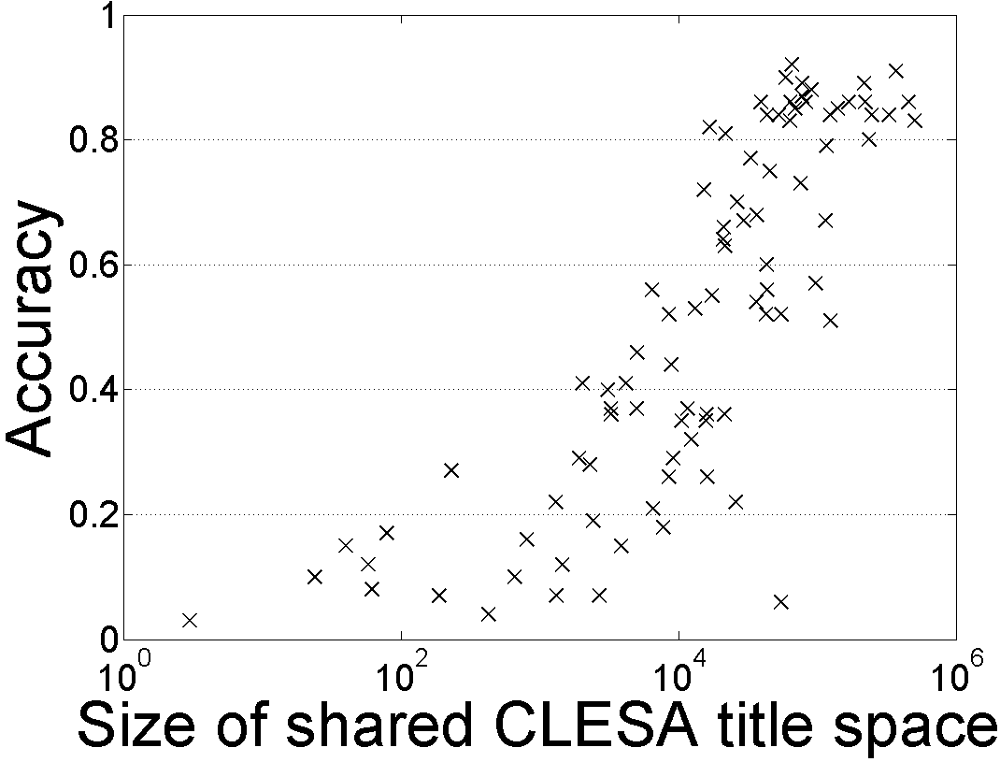
Single Document Classification (88 Languages)
[Song et. al. IJCAI’16; AIJ’19]
Can be done to all 293 languages represented in Wikipedia
Performance depends on the Wikipedia size (Cross-language links)
Dataless classification for English
Accuracy
Hausa
Hindi
Size of shared English-Language L title space

Slide 18
Incidental Supervision: Outline
Data provides hints
  These are often sufficient to infer supervision signals for a range of tasks.
  Data exists independent of the task(s) at hand.
Tasks:
Text Classification
(Fine) Semantic Typing
  A former Democrat, Bloomberg, switched
  his party registration in 2001.
Temporal Relations (Timelines)
Shallow Semantic Parsing
Methods:
Using data that is out there
  Wikipedia
Label Aware Classification
  “Understanding” the task & label
Transfer from other tasks
Exploiting declarative & statistical knowledge
Notes:
Give the gender example;
Give a vision example?
Key challenge, to facilitate reasoning, is to induce semantics

Slide 19
Representation: Learning from Task Independent Resources
This learning protocol relies on the ability to induce good semantic representations.
Semantic representations could be learned using existing signals, independently of the task at hand.
Many examples:
  (Multilingual) Text Categorization
  Event Detection and Co-reference
    Requires more involved representations
  Transliteration
  Wikification/Entity Linking
  Relation identification
    Using definitions of concepts and relations between them [*SEM’18]
In all cases – key benefits are shown in adaptation/transfer learning
Tasks can be defined otherwise – Open Domain Zero-Shot (fine) Entity Typing
The research community uses data embeddings broadly!
And, heavy reliance on task specific supervision
But there is almost no use of task/label understanding.
Promote Label-Aware Models as a form of Incidental Supervision
[AAAI’08, AAAI’14, IJCAI’16, AAAI’17]
skip

Slide 20
Semantic Entity Typing
Label mentions with their semantic types
Penn State:
/organization
/organization/education_institution
Department of Chemistry:
/organization
/education
/education/department
A handful of professors in the Department of Chemistry at Penn State are being recognized for their efforts and contributions to the scientific community.
Notes:
Why do you need "semantic entity typing"?

Slide 21
Entity Typing Today
Semantic Typing is essential for many tasks; and is hard.
Many datasets, each with distinct semantic types.
domain
Many datasets for other domains.
Law
Medical
No transfer, nor ability to add Types flexibly.
Annotate and train.
Re-annotate and re-train…
Biology
PER, LOC, ORG, ….
Various Professions, ORG, ….
[Ratinov & Roth 09]
[Hovy,06]
[Weischedel&Brunstein,05]
[Ling&Weld,12]
News
(typical text)
CoNLL
4 types
OntoNotes
18 types
BBN
57 types
FIGER
112 types
granularity
Coarse Typing
Fine Typing
Notes:
Over the years, the field has adopted various definitions for entity-typing.

Slide 22
A Common Approach: Supervised Learning
Input: sentence, mention.
Output: a set of types.
A former Democrat, Bloomberg, switched his party registration in 2001.
person
politician
The Label Taxonomy is defined during training, via the annotation.
Notes:
Such as taxonomies defined this way are not easily changeable.

Slide 23
Zero-Shot Open Entity Typing
Input: sentence, mention
Output: a set of types
, target taxonomy.
(according to the target type taxonomy).
ZOE
(Zero-shot Open Entity Typing)
A former Democrat, Bloomberg, switched his party registration in 2001.
person
Classifies into an input taxonomy
Target Taxonomy
person
location
organization

Slide 24
Zero-Shot Open Entity Typing
Instead, this can be done in a label aware way
Input: sentence, mention, target taxonomy.
Output: a set of types (according to the target type taxonomy).
ZOE
(Zero-shot Open Entity Typing)
A former Democrat, Bloomberg, switched his party registration in 2001.
person
politician
Open: Classifies into a taxonomy given with the input
Zero-shot: no taxonomy-specific supervision
Target Taxonomy
person
org
politician
doctor
hospital
hotel

Slide 25
ZOE: Type-Compatible Grounding
label aware models
Key question: how do we “understand” the taxonomy?
“Type” as a conceptual container binding entities together.
  Defined extensionally as a set of members of the type
  (Not examples annotated in context; Wikipedia pages, say)
politician
Richard Nixon
Bill Clinton
Elizabeth Warren
Boris Johnson
company
Computational Approach: Determine the type of an input mention by finding entities in the type-defining-set that share a similar context
Of course, each entity will be in multiple such buckets
Lehman Brothers
Reuters
CNN
Google
Notes:
Types are conceptual containers that bind entities together to form a coherent group.
I know what a politician is since I know many politicians

Slide 26
ZOE: Type-Compatible Grounding
“Type” as conceptual container binding entities together.
A former Democrat, Bloomberg, switched his party registration in 2001.
politician
Richard Nixon
Bill Clinton
ELMo [Peters et al. 18]
Context-consistent
Elizabeth Warren
Boris Johnson
Different contexts where “Elizabeth Warren” is mentioned
Warren is a member of the Democratic Party, after switching party affiliation from the Republican Party in 1996.
company
Lehman Brothers
Reuters
CNN
Google
WikiLinks [Singh et al. 12]
Notes:
Types are conceptual containers that bind entities together to form a coherent group.
I know what a politician is since I know many politicians

Slide 27
ZOE: Type-Compatible Grounding
“Type” as conceptual container binding entities together.
Since its founding, Bloomberg has made several acquisitions.
politician
Richard Nixon
Bill Clinton
Context-consistent
Elizabeth Warren
Boris Johnson
Different contexts where “Berkshire Hathaway” is mentioned
Berkshire Hathaway Berkshire Hathaway Inc has acquired a 25 billion rupees ($356 million) stake in the parent of digital payments company Paytm.
company
Lehman Brothers
Reuters
Berkshire Hathaway
Enron
Context consistency allows us to determine good candidates for type compatibility.
Notes:
Types are conceptual containers that bind entities together to form a coherent group.
I know what a politician is since I know many politicians

Slide 28
Zero-Shot Open Typing: Big Picture
A former Democrat, Bloomberg switched his party registration in 2001.
A mention &
its context
High-level Algorithm:
Map the mention to context-consistent Wikipedia concepts (noting the each belong to multiple types)
  Simple Entity Linking
Rank candidate titles by context-consistency and infer the types according to the type taxonomy.
Mapping type-compatible Wikipedia entities
Richard Nixon
Bill de Blasio
Elizabeth Warren
person
mayor
person
politician
politician
politician
president
person
scholar
Inference: aggregate and rank the consistency scores.
Experimental results are very good: both flexible taxonomy and transfer across domains [EMNLP’18]
person
politician
official

Slide 29
Empirical Results: Fine-Typing [EMNLP’18]
Outperforms supervised system in cross-domain.
Comparable results with supervised systems.
Summary: A label-aware approach leads to the ability to transfer across domains & taxonomies.
System | Trained on | Evaluated on
 |  | FIGER | BBN | Ontonotes
AFET [Ren et al. 16] | FIGER | 66 | ? | ?
NFETC [Xu&Barbosa 18] | FIGER | 79 | ? | ?
AFET [Ren et al. 16] | BBN | ? | 75 | ?
AAA [Abishek et al. 17] | BBN | ? | 79 | ?
AFET [Ren et al. 16] | Ontonotes | ? | ? | 65
NFETC [Xu&Barbosa 18] | Ontonotes | ? | ? | 70
ZOE (this work) | - | 71 | 75 | 61
politician
Richard Nixon
Elizabeth Warren

Slide 30
Incidental Supervision: Outline
Data provides hints
  These are often sufficient to infer supervision signals for a range of tasks.
  Data exists independent of the task(s) at hand.
Tasks:
Text Classification
(Fine) Semantic Typing
  A former Democrat, Bloomberg, switched
  his party registration in 2001.
Temporal Relations (Timelines)
Shallow Semantic Parsing
Methods:
Using data that is out there
  Wikipedia
Label Aware Classification
  “Understanding” the task & label
Transfer from other tasks
Exploiting declarative & statistical knowledge
Notes:
Give the gender example;
Give a vision example?
Key challenge, to facilitate reasoning, is to induce semantics

Slide 31
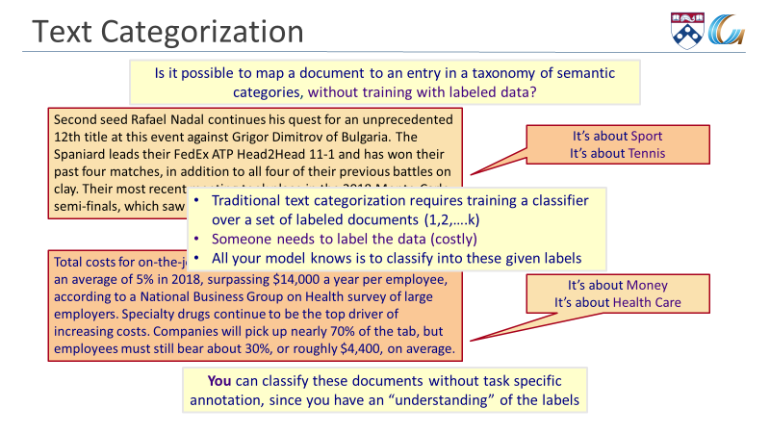
Categorization without Labeled Data [AAAI’08, AAAI’14, IJCAI’16]
Given:
  A single document (or: a collection of documents)
  A taxonomy of categories into which we want to classify the documents
Dataless/Zero-Shot procedure:
  Let f(l_{i}) be the semantic representation of the labels (label descriptions)
  Let f(d) be the semantic representation of a document
  Select the most appropriate category:
  l_{i}* = argmin_{i} dist (f(l_{i}) - f(d))
Key Question:
  How to generate good Semantic Representations?
Originally:
  Wikipedia-based (ESA) sparse representations
    Other representations possible.
Works great for Topic categorization.
  Competitive with supervised approaches (w/o too much data)

Slide 32
Types of Text Classification
But there is more to Text classification than topic categorization
Type (1): The document is about [Tennis; Religion; Banking….]
  Vocabulary will be related to Tennis,….
Type (2): The document is [happy; harassing; abusive]
  Vocabulary will not mention harassment….
This distinction goes unnoticed when we simply train a multiclass classifier
  If you give it enough examples, it will get it.
  But that means, that you need to give it a lot of examples….
Can we do better?

Slide 33
Toward General Zero-Shot Text Classification
Label-Aware classification
  Our models need to “understand” the labels.
  While the community spends a lot of time representing input data, so far, we have not spent time representing the task.
  As shown earlier, easy for Topics; challenging for other types of text classifications.
We propose to study text classification as a textual entailment task
  Generic capability; no task/label-specific training
  Allows transfer from already existing textual entailment datasets
  Deals with multiple Text Classification tasks uniformly.
Textual Entailment: [Dagan, Roth, Sammons, Zanzoto’13]
Text Hypothesis
⊆
Eyeing the huge market potential, currently led by Google, Yahoo took over search company Overture Services Inc last year
⊆
Yahoo acquired
Overture

Slide 34

Textual Entailment for Zero-Shot-TC
This document is about Tennis
Text Classification is inherently a Textual Entailment problem.
Given a document or a text snippet:
  Classifying it is equivalent to determining the truth value of a hypothesis
A program that “knows” how to determine textual entailment can thus classify with respect to any label (hypothesis).
It expresses joy
It constitutes harassment
Assuming, of course, that it “understands” the meaning of the hypothesis.
A model that “knows” the trick of determining textual entailment – independent of the task at hand
A model that “understands” the label – part of the input.

Slide 35

How?
(1) Teach it Textual Entailment
Entailment model learning
  Tune BERT
  Data:
    MNLI (Williams et al., 2018)
    RTE (GLUE version, Wang et al., 2019)
    FEVER (Thorne et al., 2018)
  Many details omitted
(2) Map Labels to Hypotheses
Manually write hypotheses that represent the labels
(3) Hope that Textual Entailment Models Transfer….
Very promising experimental results [EMNLP’19]
Still: Topics categories are easier than Situations and Emotions.
Improvements in Textual Entailment will seamlessly support classification into new categories, without any label-specific annotation!

Slide 36
Incidental Supervision: Outline
Data provides hints
  These are often sufficient to infer supervision signals for a range of tasks.
  Data exists independent of the task(s) at hand.
Tasks:
Text Classification
(Fine) Semantic Typing
  A former Democrat, Bloomberg, switched
  his party registration in 2001.
Temporal Relations (Timelines)
Shallow Semantic Parsing
Methods:
Using data that is out there
  Wikipedia
Label Aware Classification
  “Understanding” the task & label
Transfer from other tasks
Exploiting declarative & statistical knowledge
Notes:
Give the gender example;
Give a vision example?
Key challenge, to facilitate reasoning, is to induce semantics

Slide 37
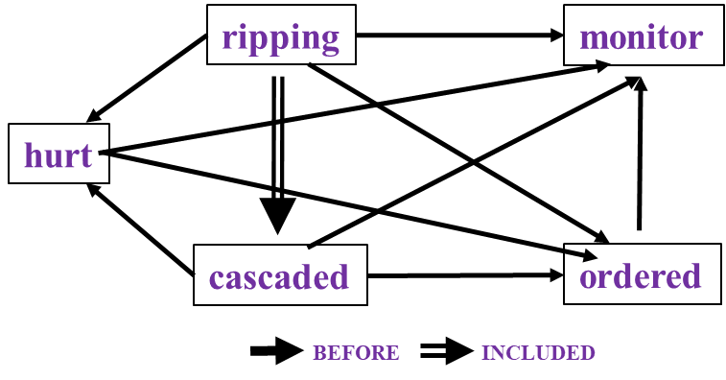
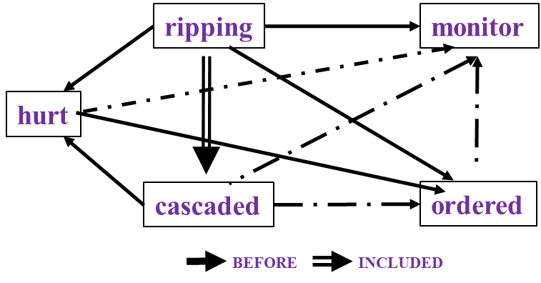
Events and Time [Ning et al. *SEM’2018; ACL’18, EMNLP’18, EMNLP’19]
In Los Angeles that lesson was brought home today when tons of earth cascaded down a hillside, ripping two houses from their foundations. No one was hurt, but firefighters ordered the evacuation of nearby homes and said they'll monitor the shifting ground until March 23rd.
Very difficult task— hinders exhaustive annotation (O(N²) edges)
But, it’s rather easy to get partial annotation – some relations.
And, we have strong expectations from the output
  Transitivity
  Some events tend to precede others or follow others [Ning et. al., NAACL’18]
Intuition:
If the structure is tight, there is no need to annotate all the variables.
A partial set of signals can supervise all.

Slide 38
A Revolution in Temporal Reasoning
Generalized common sense
BERT
Neural + ILP
+3%
Axes dataset
+4%
Common sense
+3%
Structured learning
+11%*
Previous SOTA
+4%
+2%
2015
2017
2019
Thesis work of Qiang Ning (2019)
Notes:
This is a final summary for our progress on this task. CAEVO is the previous SOTA, structured learning 2%, common sense 4%, new dataset 11%, LSTM with standard word embeddings 3%, LSTM with BERT embeddings 4% (BERT is the most recent word embedding), and Siamese another 3%.

Slide 39
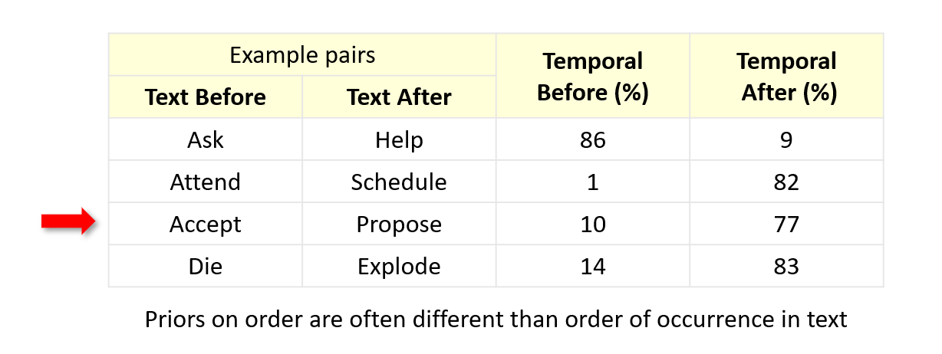
Inducing Event distributions (no supervision)
Notes:
We also plotted the distribution of events that usually precede or follow specific events, of course, in terms of time. Although we only have the verbs here, we can still get some intuitive answers.

Slide 40
TemProb: Temporal Relation Probabilistic Knowledge Base
Run initial system on New York Times 1987-2007, #Articles~1M
Identify events; identify temporal order
80M temporal relations
Noisy statistics is sufficient to give good priors.
Example pairs |  | Temporal Before (%) | Temporal After (%)
Text Before | Text After
Ask | Help | 86 | 9
Attend | Schedule | 1 | 82
Accept | Propose | 10 | 77
Die | Explode | 14 | 83
Priors on order are often different than order of occurrence in text
Notes:
In NAACL'18, we proposed TemProb, short for ... The intuition is that humans get common sense through lots of life experience. We want to mimic this, so we collected over 1 million articles from new york times. We ran our system on top of it to imitate human's reading experience. To accelerate it, we used 100 AWS instances in parallel and finished it within one day. We find that simply by counting, we could get many interesting statistics. For example, we find ask before help, attend after schedule, accept after propose, and die after explode.
(1min)

Slide 41
Event distributions from TemProb
Notes:
For example, before bomb, there is fire; after bomb, there are kill, destroy, and people get wound.

Slide 42
Event distributions from TemProb

Slide 43
Event distributions from TemProb
Notes:
This is what I like the most. I have a long list of such examples, and of course, there can be errors in it. But the good thing is, we mined these automatically and no more human annotations were used, so it's pretty nice. Imagine that if we could incorporate the common sense knowledge in TemProb into the temporal relation extraction task, then we can further improve the performance. The only question is how to apply TemProb in our task.
(1 min 20 sec)

Slide 44
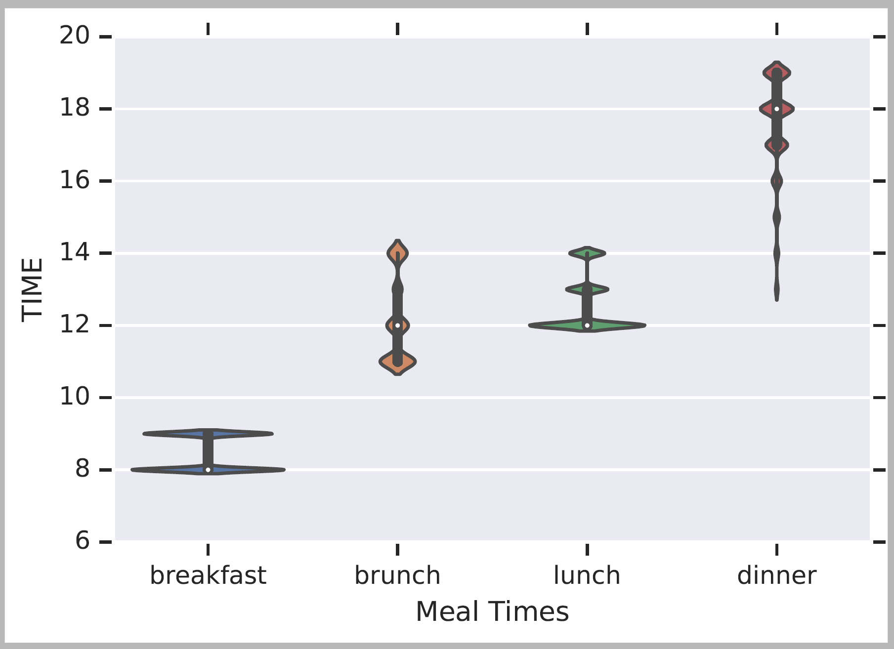
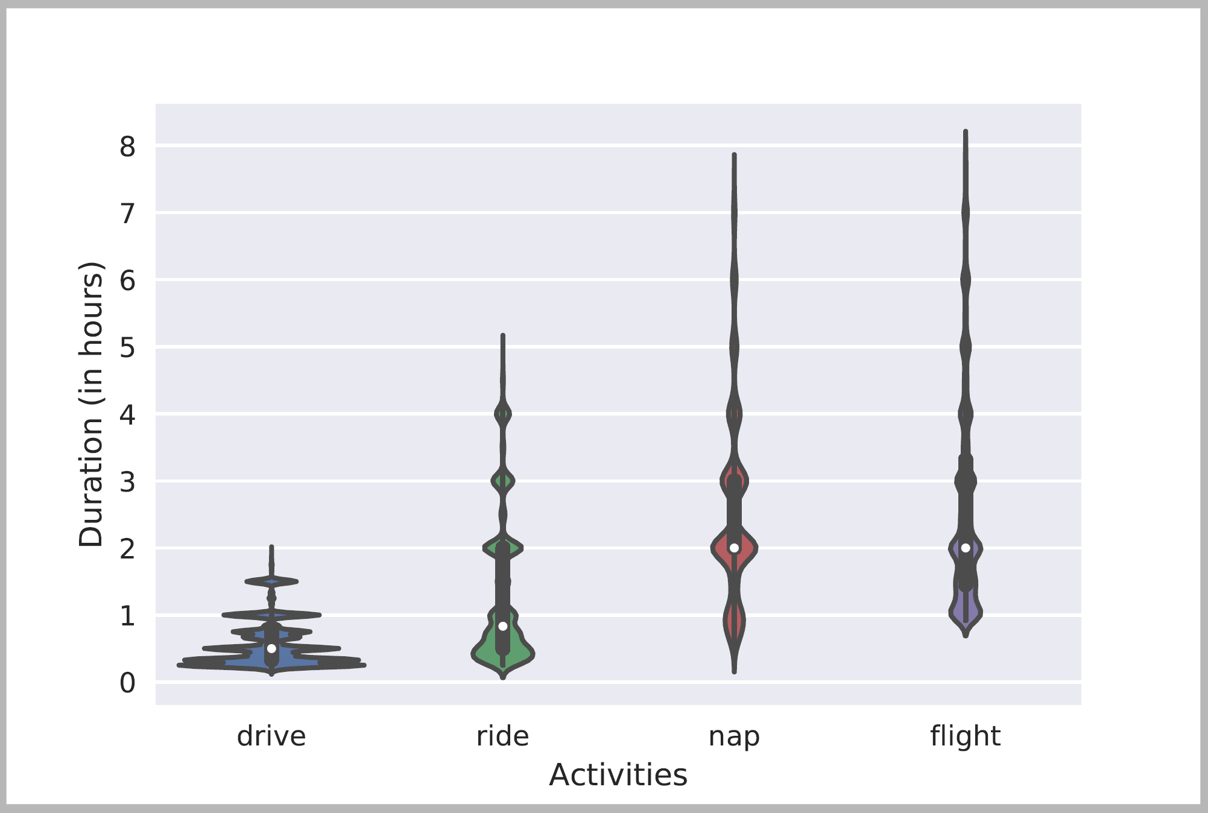
Many Forms of Temporal Common Sense
Understanding temporals constraints, if used right, can significantly help determining temporal relations between events, and timelines
All done with indirect supervision signals
Typical Time
Duration

Slide 45
Is This Art?
So far, we provided a few examples where signals that are co-related with the task at hand, can be used to replace supervision.
Is this an art? Can we develop a theory that supports it?
There is a beginning of a theory [Ning et al. 2019]
  And systematic algorithms that exploit the current understanding

Slide 46
Conclusion
Thank You!
The standard, annotation heavy, machine learning we use today is not sufficient.
  It’s unrealistic, cannot scale, and very limited.
Machine Learning efforts within corporations hit these barriers everyday
Some recent samples from a research program that attempts to address some of these challenges ito better extract information and understand natural language
Incidental supervision: How to understand, acquire and use signals that were not put there to help a specific target task.
  Multiple tasks; a range of methods.
A lot more is needed – but these ideas are already effective and being used

Slide 47
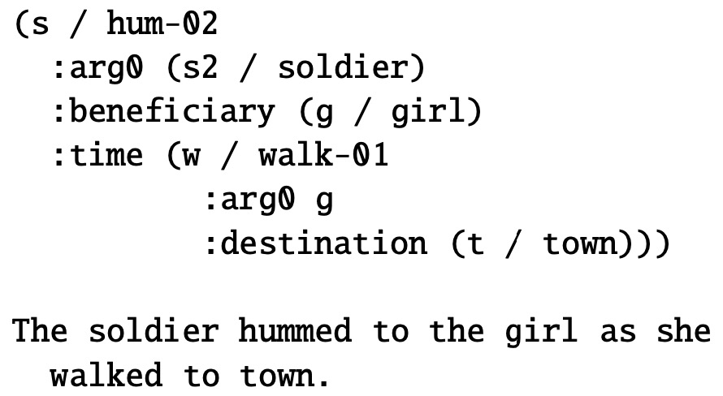
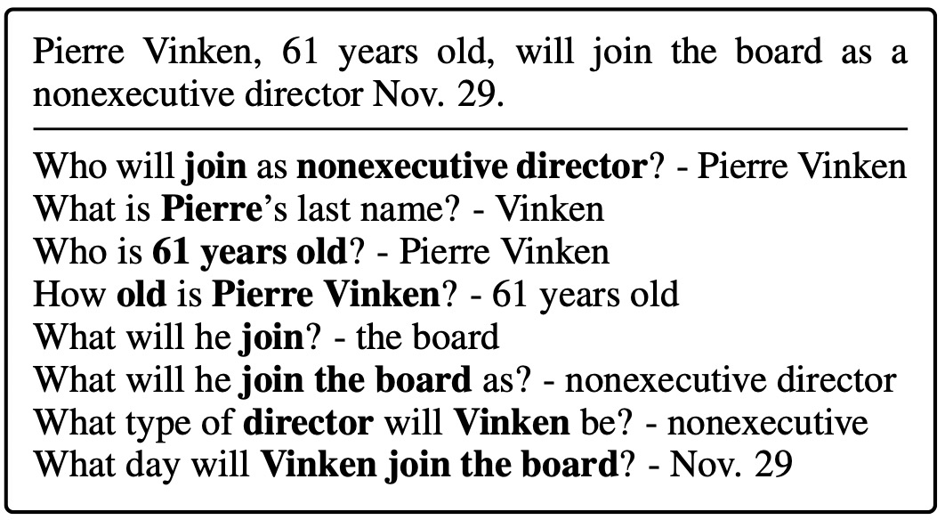
Motivation
An example in the AMR paper.
An example in the QAMR paper.
Take-away: AMR annotations are expensive and not scalable, while QAMR annotations are non-expert and flexible.
Question: Can we use low-cost signals such as QA data to help related tasks? For example, can we use QAMR to improve NER?

