Slide 1
Inducing Semantics with Minimal (or No) Supervision
Learning and Inference
For
Natural Language Understanding
Dan Roth
Department of Computer Science
University of Illinois at Urbana-Champaign
With thanks to:
Collaborators: Kai-Wei Chang, Ming-Wei Chang, Xiao Chen, Dan Goldwasser,
Gourab Kundu, Lev Ratinov, Vivek Srikumar; Chen-Tse Tsai,…
Funding: NSF; DHS; NIH; DARPA; IARPA, ARL, ONR
DASH Optimization (Xpress-MP); Gurobi.
December 2016
AI*IA 2016, Genoa, Italy

Slide 2
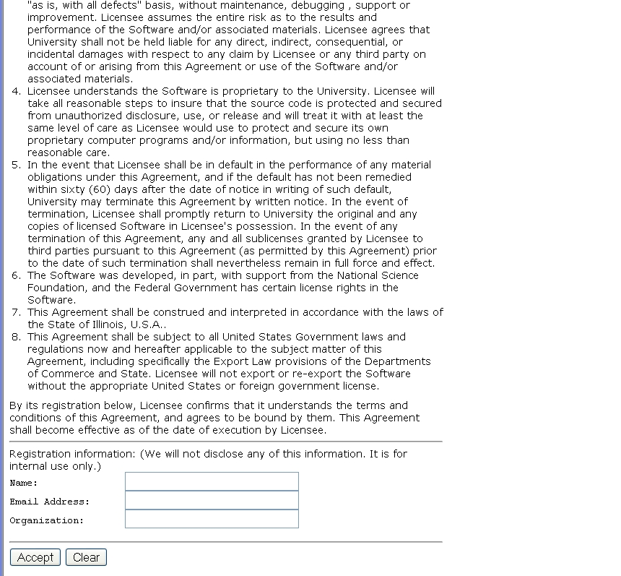
A view on Extracting Meaning from Unstructured Text
A Contract
(and distinguish from other candidates)
Does it say that they will:
Give my email address away?
Log my activity
……
ACCEPT?

Slide 3
Why is it Difficult?
Meaning
Variability
Ambiguity
Language

Slide 4






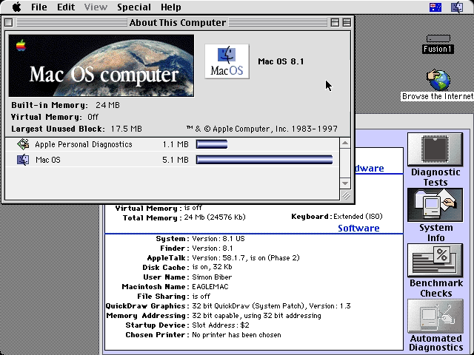
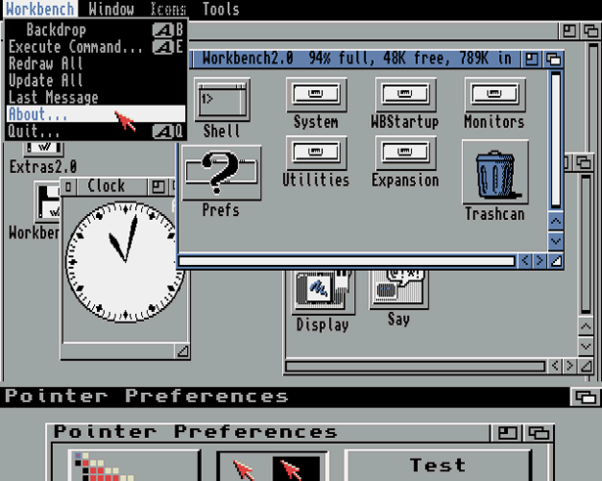
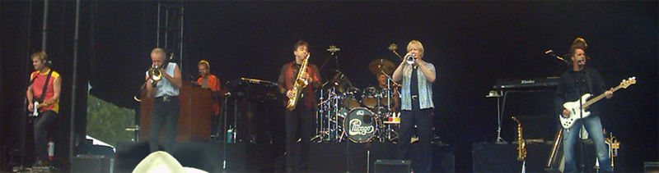
Ambiguity
It’s a version of Chicago – the standard classic Macintosh menu font, with that distinctive thick diagonal in the ”N”.
Chicago was used by default for Mac menus through MacOS 7.6, and OS 8 was released mid-1997..
Chicago VIII was one of the early 70s-era Chicago albums to catch my
ear, along with Chicago II.

Slide 5

Variability in Natural Language Expressions
Determine if Jim Carpenter works for the government
Jim Carpenter works for the U.S. Government.
The American government employed Jim Carpenter.
Jim Carpenter was fired by the US Government.
Jim Carpenter worked in a number of important positions. …. As a press liaison for the IRS, he made contacts in the white house.
Russian interior minister Yevgeny Topolov met yesterday with his US counterpart, Jim Carpenter.
Former US Secretary of Defense Jim Carpenter spoke today…
Standard techniques cannot deal with the variability of expressing meaning
nor with the
ambiguity of interpretation
  Needs:
  Understanding Relations, Entities and Semantic Classes
  Acquiring knowledge from external resources; representing knowledge
  Identifying, disambiguating & tracking entities, events, etc.
  Time, quantities, processes…
Notes:
5

Slide 6



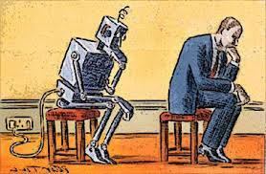
What is Needed?
Notes:
In a more abstract way : My research span all these aspects & more; but I’ll focus on providing a framework, present some examples, and some recent, exciting results towards the end.
6

Slide 7
Comprehension
(ENGLAND, June, 1989) - Christopher Robin is alive and well. He lives in England. He is the same person that you read about in the book, Winnie the Pooh. As a boy, Chris lived in a pretty home called Cotchfield Farm. When Chris was three years old, his father wrote a poem about him. The poem was printed in a magazine for others to read. Mr. Robin then wrote a book. He made up a fairy tale land where Chris lived. His friends were animals. There was a bear called Winnie the Pooh. There was also an owl and a young pig, called a piglet. All the animals were stuffed toys that Chris owned. Mr. Robin made them come to life with his words. The places in the story were all near Cotchfield Farm. Winnie the Pooh was written in 1925. Children still love to read about Christopher Robin and his animal friends. Most people don't know he is a real person who is grown now. He has written two books of his own. They tell what it is like to be famous.
1. Christopher Robin was born in England. 2. Winnie the Pooh is a title of a book.
3. Christopher Robin’s dad was a magician. 4. Christopher Robin must be at least 65 now.
This is an Inference Problem
Notes:
7
I would like to talk about it in the context of language understanding problems. This is the problem I would like to solve. You are given a short story, a document, a paragraph, which you would like to understand. My working definition for Comprehension here would be “ A process that….”
So, given some statement, I would like to know if they are true in this story or not….
This is a very difficult task…
What do we need to know in order to have a chance to do that? … Many things….
And, there are probably many other stand-alone tasks of this sort that we need to be able to address, if we want to have a chance to COMPREHEND this story, and answer questions with respect to it.
But comprehending this story, being able to determined the truth of these statements is probably a lot more than that – we need to be able to put these things,
(and what is “these” isnt’ so clear) together.
So, how do we address comprehension? Here is a somewhat cartoon-she view of what has happened in this area over the last 30 years or so?
talk about – I wish I could talk about.
Here is a challenge: write a program that responds correctly to these five questions. Many of us would love to be able to do it.
This is a very natural problem; a short paragraph on Christopher Robin that we all
Know and love, and a few questions about it; my six years old can answer these
Almost instantaneously, yes, we cannot write a program that answers more than, say, 2 out of five questions.
What is involved in being able to answer these? Clearly, there are many “small” local decisions that we need to make.
We need to recognize that there are two Chris’s here. A father an a son. We need to resolve co-reference. We need sometimes
To attach prepositions properly;
The key issue, is that it is not sufficient to solve these local problems – we need to figure out how to put them
Together in some coherent way.
And in this talk, I will focus on this. We describe some recent works that we have done in this direction - …..
What do we know – in the last few years there has been a lot of work – and a considerable success on what I call here ---
Here is a more concrete and easy example -----
There is an agreement today that learning/ statistics /information theory (you name it) is of prime importance to making
Progress in these tasks. The key reason, is that rather than working on these high level difficult tasks, we have moved
To work on well defined disambiguation problems that people felt are at the core of many problems.
And, as an outcome of work in NLP and Learning Theory, there is today a pretty good understanding for how to solve
All these problems – which are essentially the same problem.

Slide 8
Natural Language Understanding
Expectation is a knowledge intensive component
Natural language understanding decisions are global decisions that require
  Making (local) predictions driven by different models trained in different ways, at different times/conditions/scenarios
  The ability to put these predictions together coherently
  Knowledge, that guides the decisions so they satisfy our expectations
Natural Language Interpretation is an Inference Process that is best thought of as a knowledge constrained optimization problem, done on top of multiple statistically learned models.
Many forms of Inference; a lot boil down to determining best assignment
Notes:
8

Slide 9
Joint Inference with General Constraint Structure [Roth&Yih’04,07,….]
Recognizing Entities and Relations
Joint inference gives good improvement
other | 0.05
per | 0.85
loc | 0.10
other | 0.05
per | 0.85
loc | 0.10
other | 0.10
per | 0.60
loc | 0.30
other | 0.10
per | 0.60
loc | 0.30
other | 0.05
per | 0.50
loc | 0.45
other | 0.05
per | 0.50
loc | 0.45
other | 0.05
per | 0.50
loc | 0.45
Key Questions:
How to learn the model(s)?
What is the source of the knowledge?
How to guide the global inference?
An Objective function that incorporates learned models with knowledge (output constraints)
A Constrained Conditional Model
  Bernie’s wife, Jane, is a native of Brooklyn
  E1 E2 E3
R₁₂
R₂₃
irrelevant | 0.05
spouse_of | 0.45
born_in | 0.50
irrelevant | 0.05
spouse_of | 0.45
born_in | 0.50
irrelevant | 0.05
spouse_of | 0.45
born_in | 0.50
irrelevant | 0.10
spouse_of | 0.05
born_in | 0.85
irrelevant | 0.10
spouse_of | 0.05
born_in | 0.85
Models could be learned separately/jointly; constraints may come up only at decision time.
Notes:
9
Let’s look at another example in more details.
We want to extract entities (person, location and organization) and relations between them (born in, spouse of).
Given a sentence, suppose the entity classifier and relation classifier have already given us their predictions along with the confidence values. The blue ones are the labels that have the highest confidence individually. However, this global assignment has some obvious mistakes. For example, the second argument of a born_in relation should be location instead of person. Since the classifiers are pretty confident on R23, but not on E3, so we should correct E3 to be location.
Similarly, we should change R12 from “born_in” to “spouse_of”

Slide 10
Structured Prediction: Inference
See AAAI’16 Tutorial on
Structured Prediction
Placing in context: a crash course in structured prediction (skip)
Inference: given input x (a document, a sentence),
predict the best structure y = {y₁,y₂,…,y_{n}} 2 Y (entities & relations)
  Assign values to the y₁,y₂,…,y_{n}, accounting for dependencies among y_{i}s
Inference is expressed as a maximization of a scoring function
y’ = argmax_{y 2 Y} w^{T} Á (x,y)
Inference requires, in principle, touching all y 2 Y at decision time, when we are given x 2 X and attempt to determine the best y 2 Y for it, given w
  For some structures, inference is computationally easy.
  Eg: Using the Viterbi algorithm
  In general, NP-hard (can be formulated as an ILP)
Joint features on inputs and outputs
Set of allowed structures
Feature Weights
(estimated during learning)

Slide 11
Constrained Conditional Models
Any MAP problem w.r.t. any probabilistic model, can be formulated as an ILP
[Roth+ 04, Taskar 04]
Penalty for violating
the constraint.
Variables are models
y = argmax_{y} ∑ 1_{Á(x,y)} w_{x,y} subject to Constraints C(x,y)
    y = argmax_{y 2 Y} w^{T}Á(x, y) + u^{T}C(x, y)
Knowledge component:
(Soft) constraints
Weight Vector for “local” models
Features, classifiers; log-linear models (HMM, CRF) or a combination
How far y is from
a “legal/expected” assignment
E.g., an entities model; a relations model.
Training: learning the objective function (w, u)
  Decouple? Decompose? Force u to model hard constraints?
Inference: A way to push the learned model to satisfy our output expectations (or expectations from a latent representation)
  [CoDL, Chang, Ratinov, Roth (07, 12); Posterior Regularization, Ganchev et. al (10); Unified EM (Samdani & Roth(12), dozens of applications in NLP]
The benefits of thinking about it as an ILP are conceptual and computational.

Slide 12
Comprehension
(ENGLAND, June, 1989) - Christopher Robin is alive and well. He lives in England. He is the same person that you read about in the book, Winnie the Pooh. As a boy, Chris lived in a pretty home called Cotchfield Farm. When Chris was three years old, his father wrote a poem about him. The poem was printed in a magazine for others to read. Mr. Robin then wrote a book. He made up a fairy tale land where Chris lived. His friends were animals. There was a bear called Winnie the Pooh. There was also an owl and a young pig, called a piglet. All the animals were stuffed toys that Chris owned. Mr. Robin made them come to life with his words. The places in the story were all near Cotchfield Farm. Winnie the Pooh was written in 1925. Children still love to read about Christopher Robin and his animal friends. Most people don't know he is a real person who is grown now. He has written two books of his own. They tell what it is like to be famous.
1. Christopher Robin was born in England. 2. Winnie the Pooh is a title of a book.
3. Christopher Robin’s dad was a magician. 4. Christopher Robin must be at least 65 now.
This is an Inference Problem
Notes:
12
I would like to talk about it in the context of language understanding problems. This is the problem I would like to solve. You are given a short story, a document, a paragraph, which you would like to understand. My working definition for Comprehension here would be “ A process that….”
So, given some statement, I would like to know if they are true in this story or not….
This is a very difficult task…
What do we need to know in order to have a chance to do that? … Many things….
And, there are probably many other stand-alone tasks of this sort that we need to be able to address, if we want to have a chance to COMPREHEND this story, and answer questions with respect to it.
But comprehending this story, being able to determined the truth of these statements is probably a lot more than that – we need to be able to put these things,
(and what is “these” isnt’ so clear) together.
So, how do we address comprehension? Here is a somewhat cartoon-she view of what has happened in this area over the last 30 years or so?
talk about – I wish I could talk about.
Here is a challenge: write a program that responds correctly to these five questions. Many of us would love to be able to do it.
This is a very natural problem; a short paragraph on Christopher Robin that we all
Know and love, and a few questions about it; my six years old can answer these
Almost instantaneously, yes, we cannot write a program that answers more than, say, 2 out of five questions.
What is involved in being able to answer these? Clearly, there are many “small” local decisions that we need to make.
We need to recognize that there are two Chris’s here. A father an a son. We need to resolve co-reference. We need sometimes
To attach prepositions properly;
The key issue, is that it is not sufficient to solve these local problems – we need to figure out how to put them
Together in some coherent way.
And in this talk, I will focus on this. We describe some recent works that we have done in this direction - …..
What do we know – in the last few years there has been a lot of work – and a considerable success on what I call here ---
Here is a more concrete and easy example -----
There is an agreement today that learning/ statistics /information theory (you name it) is of prime importance to making
Progress in these tasks. The key reason, is that rather than working on these high level difficult tasks, we have moved
To work on well defined disambiguation problems that people felt are at the core of many problems.
And, as an outcome of work in NLP and Learning Theory, there is today a pretty good understanding for how to solve
All these problems – which are essentially the same problem.

Slide 13
Inducing Semantics
Inducing semantic representations and making decisions that depend on it require learning and, in turn, supervision.
Standard machine learning methodology:
  Given a task
  Collect data for the task and annotate it
  Learn a model
We will never have enough annotated data to train all the models, for all the tasks we need this way.
This methodology is not scalable and, often, makes no sense
  Annotating for complex tasks is difficult, costly, and sometimes impossible.
    When an intermediate representation is ill-defined, but the outcome is
    E.g., think about events

Slide 14
Learning with Indirect Supervision
In most interesting cases, learning should be (and is) driven by incidental supervision
  Re-thinking the current annotation-heavy approaches to NLP.
  Dimension I: Types of tasks: “Lexical” vs. “Structural”
  Dimension II: Types of indirect supervision:
    Exploiting incidental cues in the data, unrelated to the task, as sources of supervision
    Learning complex models by putting together simpler models + some (declarative) knowledge
    Supervising indirectly, via feedback on the model behaviour
Mostly examples; not a lot of formulas.

Slide 15
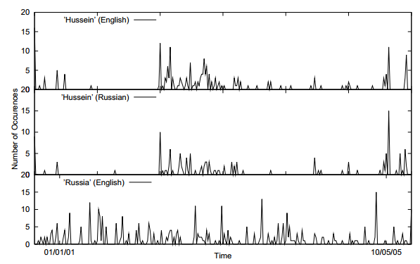
Incidental Supervision Signals [Klementiev & Roth’06]
Supervision need not be only in the form of labeled data
It could be incidental, in the sense that it provides some signals that might be co-related to the target task.
Temporal histograms
Assume a comparable, weakly temporally aligned news feeds.
Hussein (English)
Transliteration: How to write Hussein in Russian?
Hussein (Russian)
Weak synchronicity provides a cue about the relatedness of (some) NEs across the languages, and can be exploited to associate them
[Klementiev & Roth, 06,08]
Russia (English)

Slide 16
Incidental Supervision Signals [Klementiev & Roth’06]
Need an inference mechanism that supports combining signals/models
By itself, such temporal signal is not sufficient to support training robust models.
Along with weak phonetic signals, context, topics, etc. it can be used to get robust models.
Temporal histograms
Assume a comparable, weakly temporally aligned news feeds.
Hussein (English
Hussein (Russian)
Weak synchronicity provides a cue about the relatedness of (some) NEs across the languages, and can be exploited to associate them
[Klementiev & Roth, 06,08]
Russia (English)

Slide 17

Outline
Introduction
  Natural Language Understanding
  Inference
  The idea of Incidental Supervision
Lexical Incidental Supervision
  Exploiting existing information as supervision
    Dataless Classification
    Wikification and Entity Linking (KBs, Multilingual)
Learning only simple models
  Put it together via knowledge
Response Driven Learning
  Learning from the world’s feedback
Conclusion

Slide 18

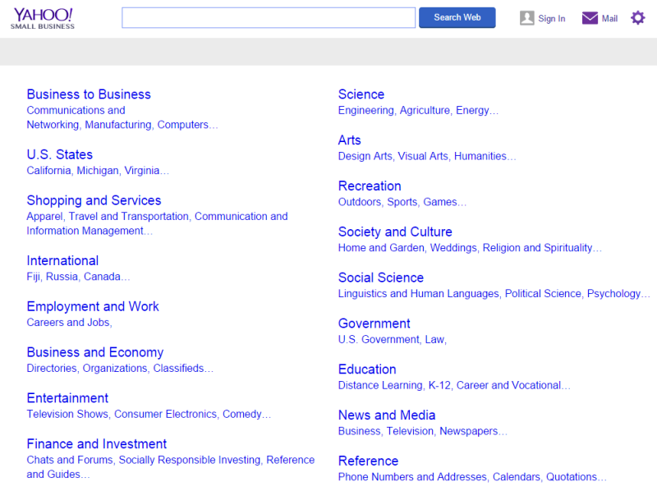
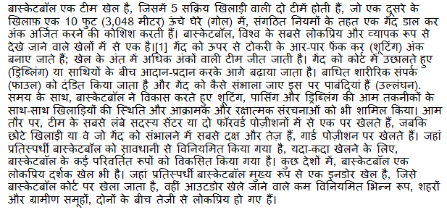
Cross-lingual Document Categorization
Map a document in language L to an English ontology of semantic categories, without training with task-specific labeled data.
Potentially, given a single document (not a coherent collection)
Economy
-Taxation
Sports
-Basketball

Slide 19
Text Categorization
On Feb. 8, Dong Nguyen announced that he would be removing his hit game Flappy Bird from both the iOS and Android app stores, saying that the success of the game is something he never wanted. Some fans of the game took it personally, replying that they would either kill Nguyen or kill themselves if he followed through with his decision.
Frank Lantz, the director of the New York University Game Center, said that Nguyen's meltdown resembles how some actors or musicians behave. "People like that can go a little bonkers after being exposed to this kind of interest and attention," he told ABC News. "Especially when there's a healthy dose of Internet trolls."
Nguyen did not respond to ABC News' request for comment.
7 February 2014 is going to be a great day in the history of Russia with the upcoming XXII Winter Olympics 2014 in Sochi. As the climate in Russia is subtropical, hence you would love to watch ice capped mountains from the beautiful beaches of Sochi. 2014 Winter Olympics would be an ultimate event for you to share your joys, emotions and the winning moments of your favourite sports champions. If you are really an obsessive fan of Winter Olympics games then you should definitely book your ticket to confirm your presence in winter Olympics 2014 which are going to be held in the provincial town, Sochi. Sochi Organizing committee (SOOC) would be responsible for the organization of this great international multi sport event from 7 to 23 February 2014.
Traditional text categorization requires training a classifier over a set of labeled documents (1,2,….k)
Someone needs to label the data (costly)
All your model knows is to classify into these given labels
Is it possible to map a document to an ontology of semantic categories, without training with labeled data?

Slide 20

Text Categorization
On Feb. 8, Dong Nguyen announced that he would be removing his hit game Flappy Bird from both the iOS and Android app stores, saying that the success of the game is something he never wanted. Some fans of the game took it personally, replying that they would either kill Nguyen or kill themselves if he followed through with his decision.
Frank Lantz, the director of the New York University Game Center, said that Nguyen's meltdown resembles how some actors or musicians behave. "People like that can go a little bonkers after being exposed to this kind of interest and attention," he told ABC News. "Especially when there's a healthy dose of Internet trolls."
Nguyen did not respond to ABC News' request for comment.
Sports
Mobile Games
7 February 2014 is going to be a great day in the history of Russia with the upcoming XXII Winter Olympics 2014 in Sochi. As the climate in Russia is subtropical, hence you would love to watch ice capped mountains from the beautiful beaches of Sochi. 2014 Winter Olympics would be an ultimate event for you to share your joys, emotions and the winning moments of your favourite sports champions. If you are really an obsessive fan of Winter Olympics games then you should definitely book your ticket to confirm your presence in winter Olympics 2014 which are going to be held in the provincial town, Sochi. Sochi Organizing committee (SOOC) would be responsible for the organization of this great international multi sport event from 7 to 23 February 2014.
Flappy Bird
Russia
iOS
Olympics
Winter
Android
apps
champions
Sochi
stores
game
mountains
beaches
musicians
sports
Goal: categorize (short) snippets of text into a given (possibly large) ontology, without supervision.

Slide 21
Categorization without Labeled Data [AAAI’08, AAAI’14, IJCAI’16]
This is not an unsupervised learning scenario. Unsupervised learning assumes a coherent collection of data points, and that similar labels are assigned to similar data points. It cannot work on a single document.
Given:
  A single document (or: a collection of documents)
  A taxonomy of categories into which we want to classify the documents
Dataless procedure:
  Let f(l_{i}) be the semantic representation of the labels (label descriptions)
  Let f(d) be the semantic representation of a document
  Select the most appropriate category:
  l_{i}* = argmin_{i} || f(l_{i}) - f(d)||
  Bootstrap
    Label the most confident documents; use this to train a model.
Key Questions:
  How to generate good Semantic Representations?
  How to do it in many languages, with minimal resources?

Slide 22
General Framework
Mobile Game or Sports?
Label
Definitions
Map labels/documents to the same space
Compute document and label similarities
Document(s)
World knowledge
(Cross-lingual)
Choose labels
M. Chang, L. Ratinov, D. Roth, V. Srikumar: Importance of Semantic Representation: Dataless Classification. AAAI‘08.
Y. Song, D. Roth: On dataless hierarchical text classification. AAAI’14.
Y. Song, D. Roth: Unsupervised Sparse Vector Densification for Short Text Similarity. HLT-NAACL’15.
Y. Song, S. Upadhyay, H. Peng, D. Roth: Cross-lingual Dataless Classification for Many Languages. IJCAI’16.

Slide 23
Text Representation
[Dense] Distributed Representations (Embeddings)
  New powerful implementations of good old ideas
    Learn a representation for a word as a function of words in its context
Brown Clusters
  An HMM based approach
  Found a lot of applications in other NLP tasks
[Sparse] Explicit Semantic Analysis (ESA)
  A Wikipedia driven approach – best for topical classification
    Represent a word as a (weighted) list of all Wikipedia titles it occurs in
  Gabrilovich & Markovitch 2009
Cross-lingual ESA:
  Exploits the shared semantic space between two languages
The ideal representation is task specific. ESA++ was effective also in the context of more involved tasks such as Events [see Peng & Roth EMNLP’16]
No task specific supervision. Wikipedia is there.
No task specific supervision. Cross-Lingual links exist.

Slide 24
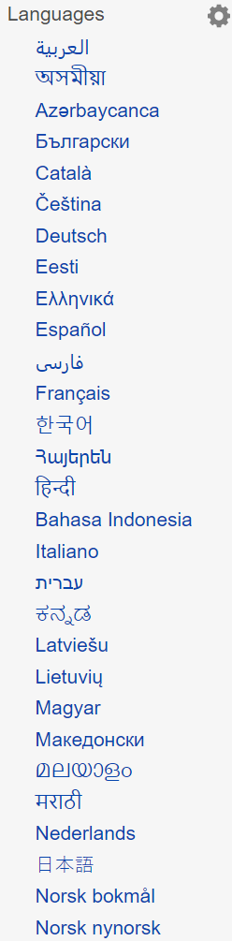
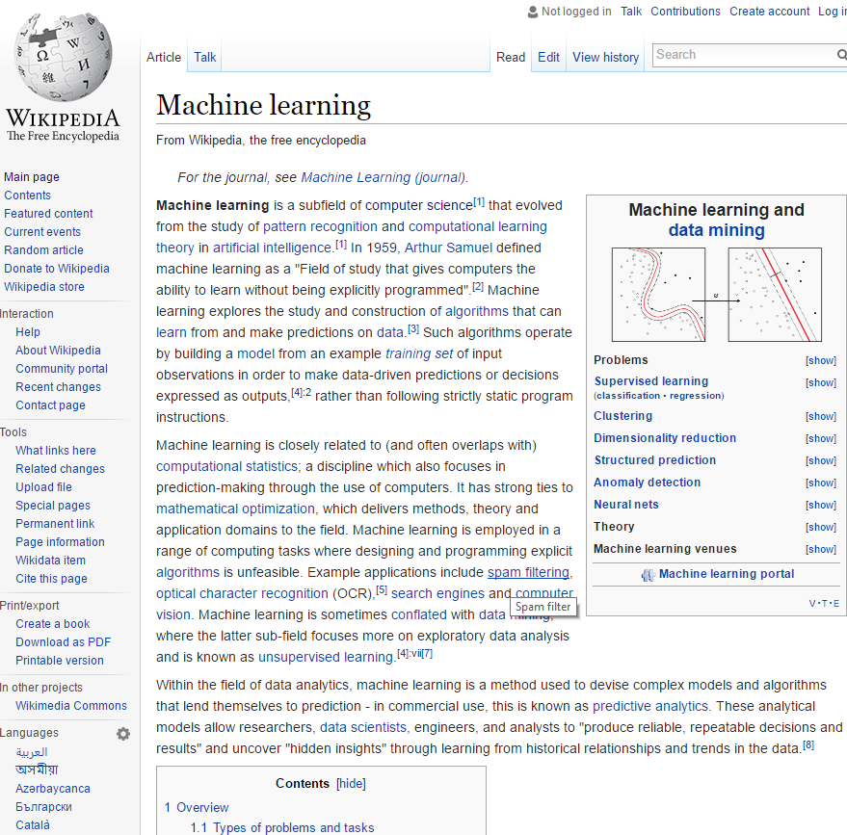
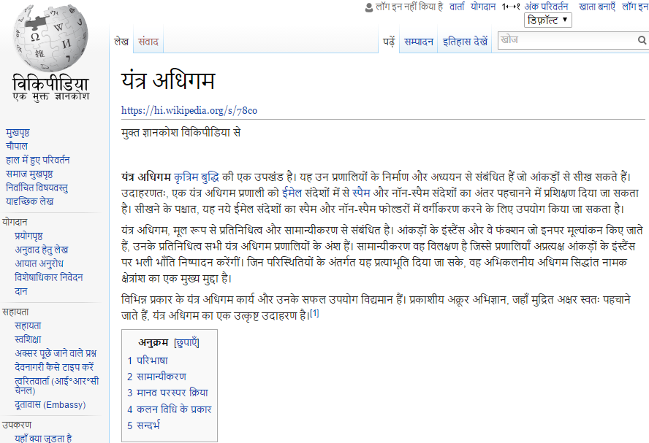
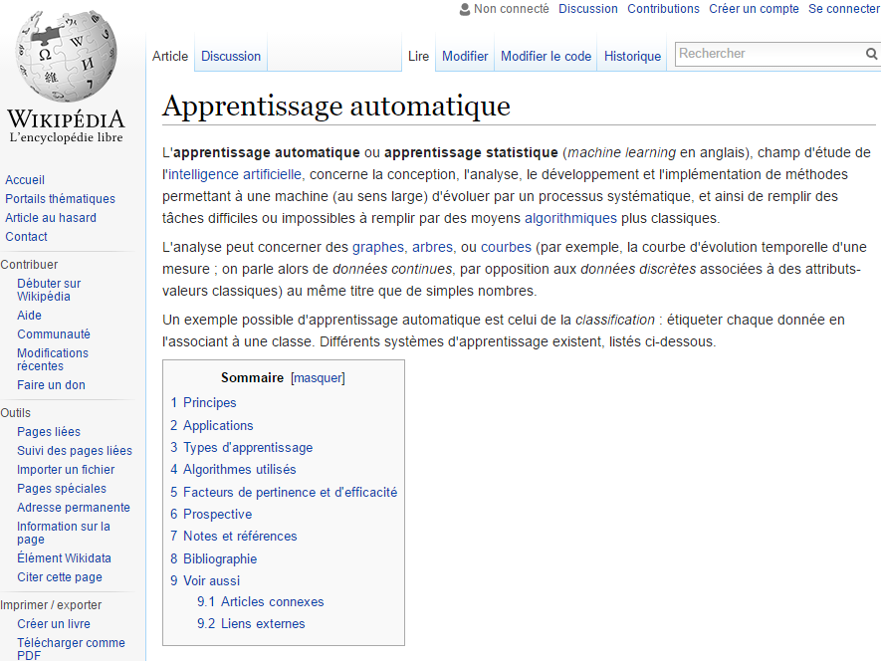
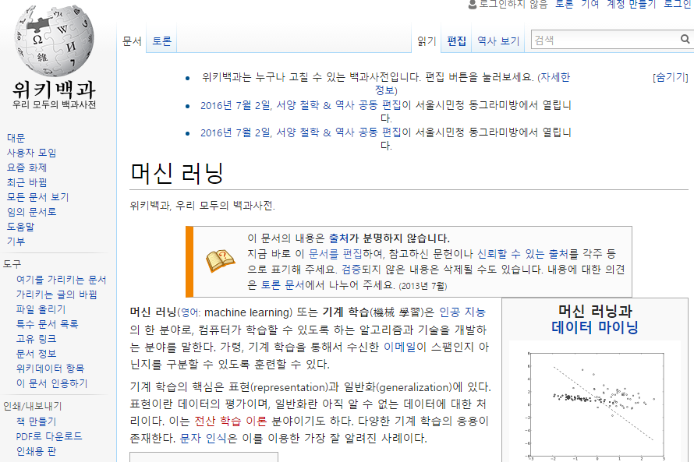
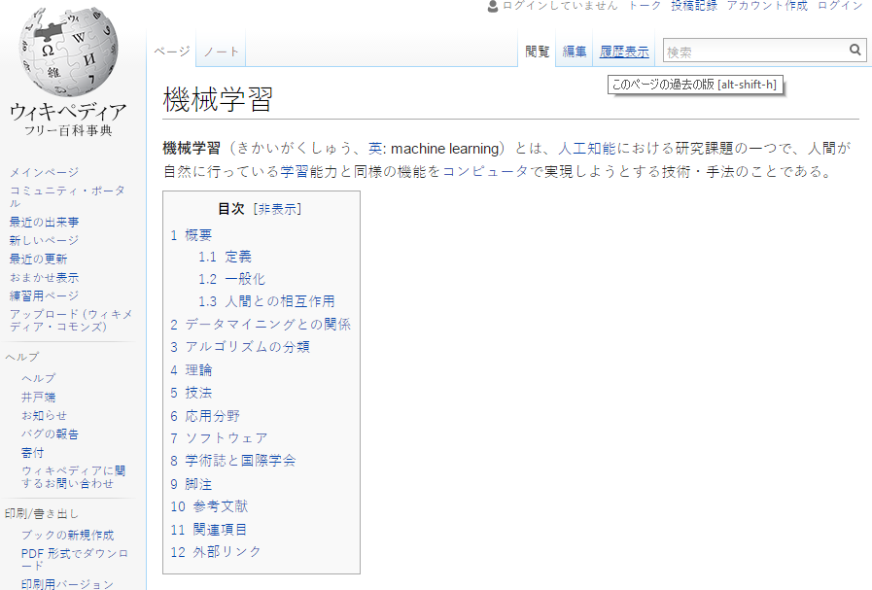
Language Links

Slide 25
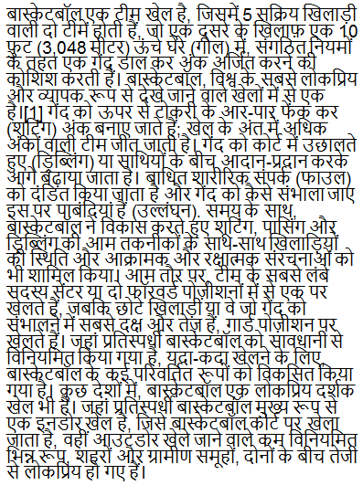
Cross-lingual Semantic Similarity (One Document)
Cross-lingual Explicit Semantic Analysis (CLESA)
  Represent L Document and English Labels in the corresponding ESA Space
  Map representation via cross links.
  Compute similarity based on the intersected Wikipedia titles
Hindi Document
Wikipedia Articles
English Wikipedia
Hindi Wikipedia
English Labels
Label:
Sports +
definition
Cosine Similarity
cos[e(l_{i}), c(h(d))]
Martin Potthast, Benno Stein, and Maik Anderka. A wikipedia-based multilingual retrieval model. In ECIR’08.
Philipp Sorg and Philipp Cimiano. Exploiting wikipedia for cross-lingual and multilingual information retrieval. Data and Knowledge Engineering, 74:26–45, 2012.
Notes:
To be more formal. A five step algorithm.

Slide 26
Wikipedia Pages Across Languages
Topical classification of documents in language L relies on:
  The ability to generate a Wikipedia-based representation of words in L: the availability of L-Wikipedia
  The existence of a title space mapping between L and English
292 languages have Wikipedia.
We filter the title space to only include long, well linked pages that are linked to the English Wikipedia, yielding 179 languages.
Current work augments these ideas via bridge languages
 | English | Deutsch | Spanish | Hindi
 | English | Deutsch | Español | हिन्दी
# Wikipedia Pages | >15.8M | 3,653,951 | 3,165,178 | 179,131
# Pruned pages: (Len>=100, link>=5) | 3,090,649 | 1,482,675 | 914,927 | 33,298
# Pages linked to English Wikipedia |  | 459,421 | 342,285 | 16,463

Slide 27
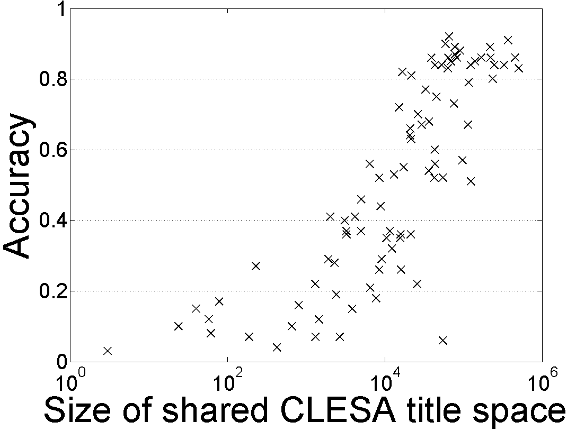
Single Document Classification (88 Language) [Song et. al. IJCAI’16]
Can be done to all 292 languages represented in Wikipedia
Results in English are equivalent to having 1000-2000 labels per category.
In cross-lingual classification, equivalent to having > 200 labels per category.
Dataless classification for English
Accuracy
Hausa
Hindi
Size of shared English-Language L title space

Slide 28
Outline
Introduction
  Natural Language Understanding
  Inference
  The idea of Incidental Supervision
Lexical Incidental Supervision
  Exploiting existing information as supervision
    Dataless Classification
    Wikification and Entity Linking (KBs, Multilingual)
Learning only simple models
  Put it together via knowledge
Response Driven Learning
  Learning from the world’s feedback
Conclusion

Slide 29






Wikification: The Reference Problem
Blumenthal (D) is a candidate for the U.S. Senate seat now held by Christopher Dodd (D), and he has held a commanding lead in the race since he entered it. But the Times report has the potential to fundamentally reshape the contest in the Nutmeg State.
Blumenthal (D) is a candidate for the U.S. Senate seat now held by Christopher Dodd (D), and he has held a commanding lead in the race since he entered it. But the Times report has the potential to fundamentally reshape the contest in the Nutmeg State.
Notes:
Let’s start with what is wikification
Read wiki titles slower

Slide 30
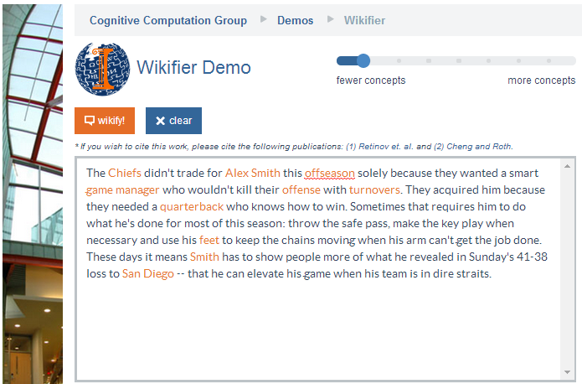
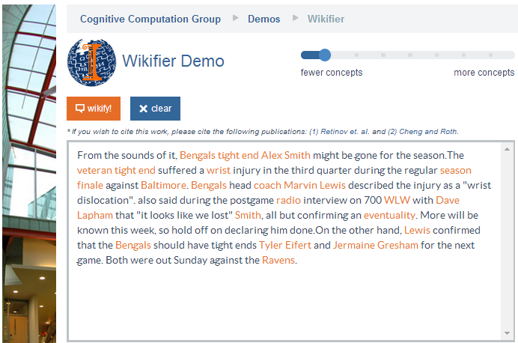
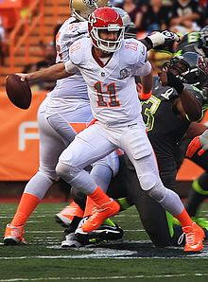
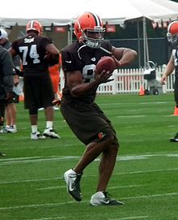
Who is Alex Smith?
Alex Smith
Alex Smith
Smith
Smith
Quarterback of the Kansas City Chief
Tight End of the Cincinnati Bengals
San Diego: The San Diego Chargers (A Football team)
Contextual Disambiguation
Ravens: The Baltimore Ravens (A Football team)

Slide 31
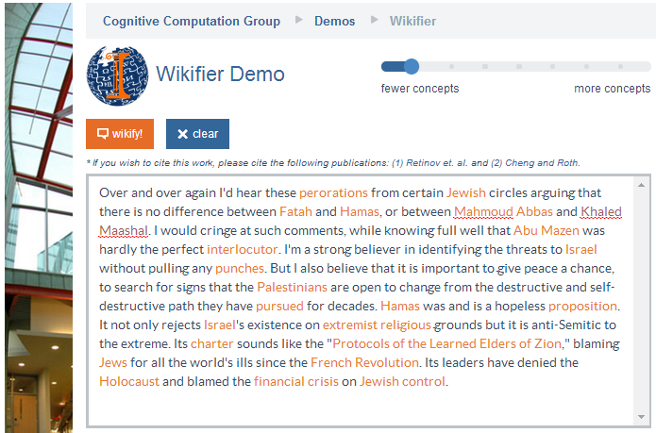
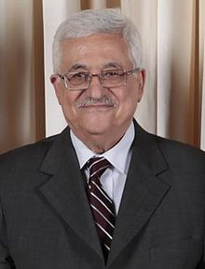
Middle Eastern Politics
Models are learned without annotation – relying on the hyperlink structure of Wikipedia to learn how to rank candidates
Mahmoud Abbas
Abu Mazen
Mahmoud Abbas: http://en.wikipedia.org/wiki/Mahmoud_Abbas
Quarterback of the Kansas City Chief
Tight End of the Cincinnati Bengals
Variability: Getting around multiple surface representations.
Co-reference resolution within & across documents, with grounding
Abu Mazen: http://en.wikipedia.org/wiki/Mahmoud_Abbas

Slide 32
Wikification Challenges
Blumenthal (D) is a candidate for the U.S. Senate seat now held by Christopher Dodd (D), and he has held a commanding lead in the race since he entered it. But the Times report has the potential to fundamentally reshape the contest in the Nutmeg State.
    Training a global model that [Ratinov et. al., ‘09; Chen & Roth’13]
  Identifies concepts in text
  Identifies candidate Wikipedia titles for these
  Ranks the corresponding titles
    Accounting for local context and global page/title space considerations
Relies on the correctness of the (partial) link structure in Wikipedia, but – requires no task specific human annotation.
“Standard” Wikification already makes use of incidental supervision to train the key model – ranking the candidate titles for a given mention.
Notes:
Quite impressive, bottleneck: adding more sophisticated contextual features does not help much
We do not want to level off here

Slide 33
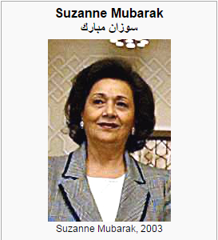
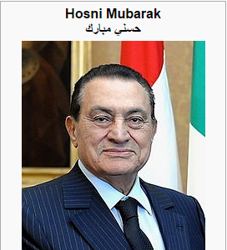
Knowledge Acquisition requires Knowledge (& inference)
Mubarak,
the wife of deposed Egyptian President Hosni Mubarak,…

Slide 34
Relational Inference
Mubarak, the wife of deposed Egyptian President Hosni Mubarak, …
Egyptian President
Hosni Mubarak
, the of deposed , …
Mubarak
wife
What are we missing with Bag of Words (BOW) models?
  Who is Mubarak?
Textual relations provide another dimension of text understanding
Can be used to constrain interactions between concepts
  (Mubarak, wife, Hosni Mubarak)
Has impact in several steps in the Wikification process:
  From candidate selection to ranking and global decision
Notes:
Main contribution here
We will show that by identifying

Slide 35
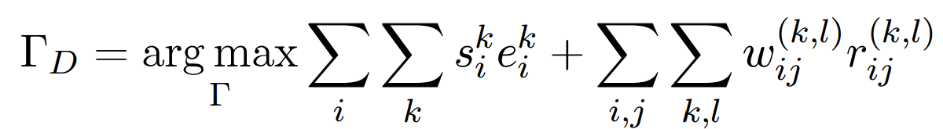
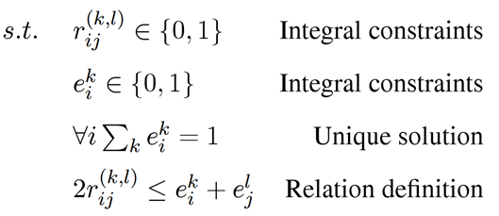
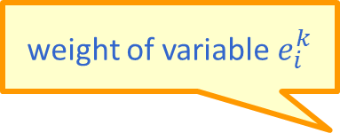
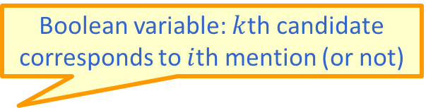
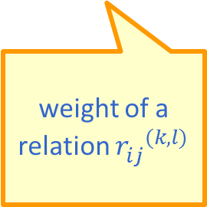
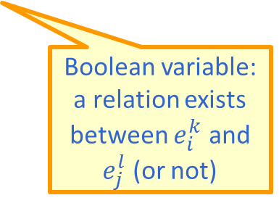
Formulation
Multiple weak signals, some are completely free, and some are knowledge-driven, are combined to support better global decisions.
  Goal: Promote concepts that are coherent with textual relations
Formulate as an Integer Linear Program (ILP):
If no relation exists, collapses to the non-structured decision
weight of variable $e_{i}^{k}$
Boolean variable: $k$th candidate corresponds to $i$th mention (or not)
weight of a relation ${r_{ij}^{}}^{(k,l)}$
Boolean variable: a relation exists between $e_{i}^{k}$ and $e_{j}^{l}$ (or not)
Notes:
Formalize intuition, weights induced from data, small constraints
Objective function collapse to the original output when there is no relation, so our model is negatives-proof
True-negatives and false-negatives will not negatively impact performance of baseline

Slide 36
Wikification: The Reference Problem
Current work on Wikification focuses on:
Linking text to general Knowledge Bases, including those that do not have the rich hyperlink structure of Wikipedia, medical KBs
Multilingual Wikification: wikifying text in other languages into the English Wikipedia [Tsai & Roth COLING’16: Wikifying in 298 languages]
Blumenthal (D) is a candidate for the U.S. Senate seat now held by Christopher Dodd (D), and he has held a commanding lead in the race since he entered it. But the Times report has the potential to fundamentally reshape the contest in the Nutmeg State.
Blumenthal (D) is a candidate for the U.S. Senate seat now held by Christopher Dodd (D), and he has held a commanding lead in the race since he entered it. But the Times report has the potential to fundamentally reshape the contest in the Nutmeg State.
Notes:
Let’s start with what is wikification
Read wiki titles slower

Slide 37
(I) Grounding into Resources w/o a Hyperlink Structure
Training Wikification and Entity Linking builds on the hyperlink structure in Wikipedia
  And the large amount of text describing each entry
In many cases, Knowledge Bases are available, and grounding into them could be useful, but
  No hyperlinks
  Small amount of text for each entry
The BioMedical domain is a key example

Slide 38
Biomedical Wikification
Text
Mentions
BRCA2 and homologous recombination.
Multiple reference KBs & Medical taxonomies
Concept ID
Concept ID
PR:000004804, EG:675
GO:0006310
Protein Ontology
Entrez Gene
id: PR:000004804
name: breast cancer type 2
susceptibility protein
def: A protein that is a translation
product of the human BRCA2
gene or a 1:1 ortholog thereof
synonyms: BRCA2, FACD,…
is_a: PR:000000001
id: EG:675
symbol: BRCA2
description:
protein-coding BRCA2
breast cancer 2, early
onset
synonyms: BRCC2,
BROVCA2, …
Notes:
I’ll describe the task by an example. Given a piece of text, it can be a sentence, a paragraph, or a document. Here it is a title of a journal paper.
There are actually two sub tasks. The first one is mention detection. We want to extract substrings which are concepts. In this example, mentions are the two underlined words.
This task is already very challenging and I’m currently working on it.
In this work, we take the mentions as given and focus on the second step, grounding the mentions to multiple KBs.
Here, BRCA2 is grounded to two concepts in two different ontologies. We can see that the concepts in KBs can overlap and we want to find all concepts the mention refers to.
And here are examples of an entry in the ontology. A concept usually contains an id, name, a short definition, some synonyms, and few relations with other concepts.
This succinct information is quite different from what wikipedia has, which makes this task harder.

Slide 39
KB Wikification Challenges
Ambiguity
  A term in text can be used to express many different concepts
  E.g., BRCA2 is used by 177 concepts
Variability
  A concept may be expressed in text using many surface forms
  E.g., EG:675 has synonyms BRCC2, FACD, FAD, FANCD, …
No Supervision
  Wikipedia has nice hyperlink structure which does not exist here
  It is difficult to obtain human annotations
  Minimal descriptive text in the KBs/Ontologies
Exploiting indirect supervision: [Tsai & Roth TACL‘16]
  An algorithmic approach that trains a ranking model by building on [a small percentage of] concepts that are mentioned in multiple KBs.
  Outperforming existing unsupervised methods.
Notes:
This task is very challenging, the main challenges are coming from the general WSD problem, the ambiguity and variability.
Ambiguity means a term can be ….
Variability means. …
Another challenge of not using wikipedia is the supervision.
A good wikification system usually trains a ranking model to score concepts using supervised learning. And wikipedia’s hyperlink structure kind of provides free supervision
Which the ontologies we use don’t have. Also, it is reletively difficult to
One of the key contributions in this work is we

Slide 40
Key Idea: Indirect Supervision
Mentions in Text
Candidate Generation
Candidate Ranking
KB₁
KB₂
…
KB_{l}
Indirect Supervision
We explore the redundancy and relationship between KBs to construct training examples for ranking
1. Discovering positive examples
  Cross reference
    Use one as “mention” which is annotated by another
  Has participant relationship
2. Use “incidental” context: neighbors in the KB
  Adaptation issue, since at evaluation, the context is from the given text
Evaluation is done on the Colorado Richly Annotated Full-Text corpus [Bada et al., 2012]: 67 full text of biomedical journal articles, 7 ontologies
GO:0005649
SO:0000340
xref
xref
Wikipdeia:Chromosome
GO:0005649
SO:0000340
fructose metabolic process
GO:0006000
has_participant
fructose
GO:0006000

Slide 41
Wikipedia Dataset
For many mentions in Wikipedia, the baseline of simply choosing the title that maximizes Pr(title|mention) is very good
Language | Method | Hard | Easy | Total
Spanish | EsWikifier | 40.11 | 99.28 | 79.56
 | MonoEmb | 38.46 | 96.12 | 76.90
 | WordAlign | 48.75 | 95.78 | 80.10
 | WikiME | 54.46 | 94.83 | 81.37
Chinese | MonoEmb | 43.73 | 97.85 | 79.81
 | WikiME | 57.61 | 98.03 | 84.55
Turkish | MonoEmb | 40.47 | 98.15 | 78.93
 | WikiME | 60.18 | 97.55 | 85.10
Tamil | MonoEmb | 34.51 | 98.65 | 77.30
 | WikiME | 54.13 | 99.13 | 84.15
Tagalog | MonoEmb | 35.47 | 99.44 | 78.12
 | WikiME | 56.70 | 98.46 | 84.54
Top TAC’15 Entity Linking System; used to produce a state-of-the-art multilingual NER.

Slide 42
Outline
Introduction
  Natural Language Understanding
  Inference
  The idea of Incidental Supervision
Lexical Incidental Supervision
  Exploiting existing information as supervision
    Dataless Classification
    Wikification and Entity Linking (KBs, Multilingual)
Learning only simple models
  Put it together via knowledge
Response Driven Learning
  Learning from the world’s feedback
Conclusion

Slide 43
Semantic Role Labeling (SRL)
Archetypical Information Extraction Problem: E.g., Concept Identification and Typing, Event Identification, etc.
I left my pearls to my daughter in my will .
[I]_{A0} left [my pearls]_{A1} [to my daughter]_{A2} [in my will]_{AM-LOC} .
A0 Leaver
A1 Things left
A2 Benefactor
AM-LOC Location
I left my pearls to my daughter in my will .
Notes:
In the context of SRL, the goal is to predict for each possible phrase in a given sentence if it is an argument or not and what type it is.

Slide 44
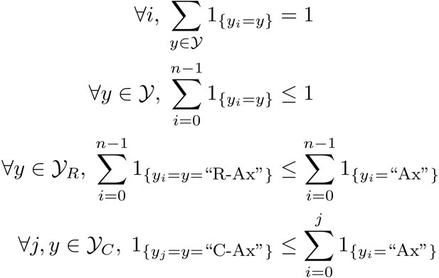
Algorithmic Approach
Learning Based Java: allows a developer to encode constraints in First Order Logic; these are compiled into linear inequalities automatically.
No duplicate argument classes
I left my nice pearls to her
candidate arguments
Identify argument candidates
  Pruning [Xue&Palmer, EMNLP’04]
  Argument Identifier
    Binary classification
Classify argument candidates
  Argument Classifier
    Multi-class classification
Inference
  Use the estimated probability distributions given
  by the argument classifier
  Use structural and linguistic constraints
  Infer the optimal global output
Unique labels
  Variable y^{a,t} indicates whether candidate argument a is assigned a label t.
  c^{a,t} is the corresponding model score
I left my nice pearls to her
I left my nice pearls to her
[ [ [ [ [
] ] ] ] ]
argmax ∑_{a,t} y^{a,t} c^{a,t} = ∑_{a,t} 1_{a=t} c_{a=t}
Subject to:
One label per argument: ∑_{t} y^{a,t} = 1
No overlapping or embedding
Relations between verbs and arguments,….
One inference problem for each verb predicate.
I left my nice pearls to her
Use the pipeline architecture’s simplicity while maintaining uncertainty: keep probability distributions over decisions & use global inference at decision time.
Notes:
We follow a now seemingly standard approach to SRL.
Given a sentence, first we find a set of potential argument candidates by identifying
which words are at the border of an argument.
Then, once we have a set of potential arguments, we use a phrase-level classifier to tell us how likely an argument is to be of each type.
Finally, we use all of the information we have so far to find the assignment of types to argument that gives us the “optimal” global assignment.
Similar approaches (with similar results) use inference procedures tied to their represntation.
Instead, we use a general inference procedure by setting up the problem as a linear programming problem.
This is really where our technique allows us to apply powerful information that similar approaches can not.

Slide 45
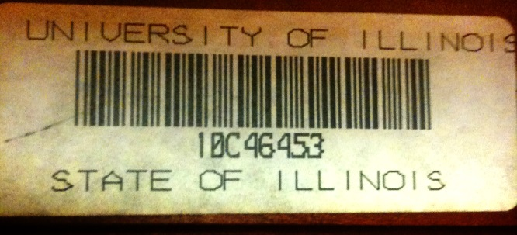
Verb SRL is not Sufficient
skip
John, a fast-rising politician, slept on the train to Chicago.
Verb Predicate: sleep
  Sleeper: John, a fast-rising politician
  Location: on the train to Chicago
Who was John?
  Relation: Apposition (comma)
  John, a fast-rising politician
What was John’s destination?
  Relation: Destination (preposition)
  train to Chicago

Slide 46
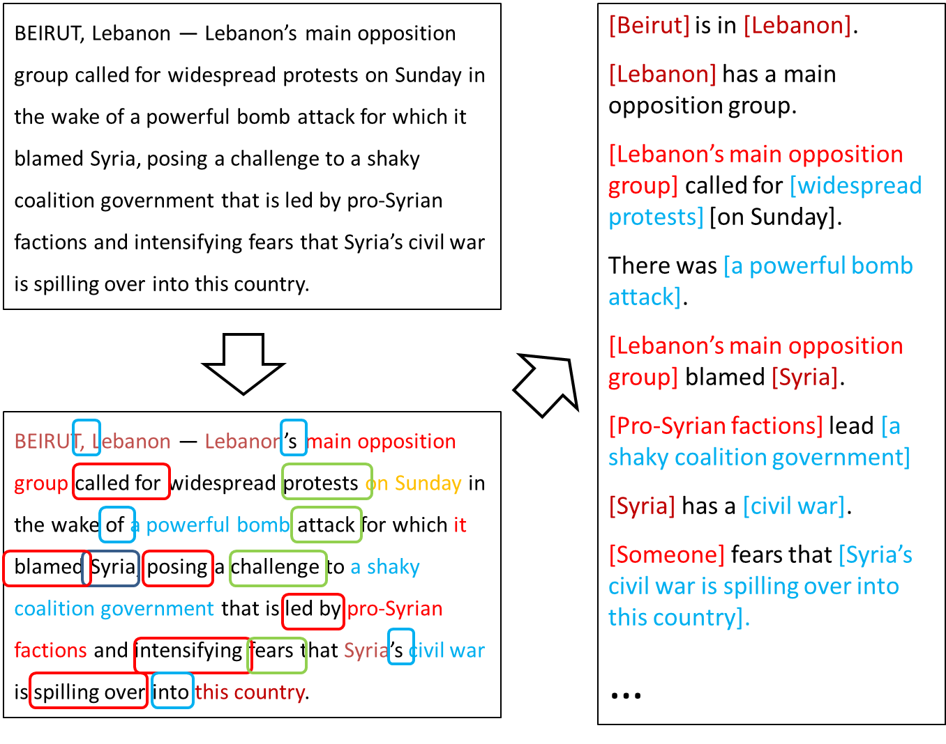
Extended Semantic Role Labeling
Many predicates; many roles; how to deal with more phenomena?
Sentence level analysis may be influenced by other sentences

Slide 47
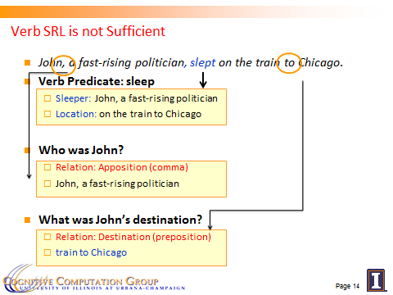
Computational Challenges
Predict the [preposition] relations
  [EMNLP, ’11]
Identify the relation’s arguments
  [PP: Trans. Of ACL, ’13, Comma: AAAI’16]
Very little supervised data
  per phenomena
Minimal annotation
  only at the predicate level
Learning models in these settings exploits two principles:
  Latent structure can be constrained (via CCMs)
  Coherency among multiple phenomena: learn simple models; infer together

Slide 48
Coherency in Semantic Role Labeling
Predicate-arguments generated should be consistent across phenomena
The touchdown scored by Brady cemented the victory of the Patriots.
Verb | Nominalization | Preposition
Predicate: score A0: Brady (scorer) A1: The touchdown (points scored) | Predicate: win A0: the Patriots (winner) | Sense: 11(6) “the object of the preposition is the object of the underlying verb of the nominalization”
Linguistic Constraints:
A0: the Patriots ⇔ Sense(of): 11(6)
A0: Brady ⇔ Sense(by): 1(1)
Notes:
48

Slide 49
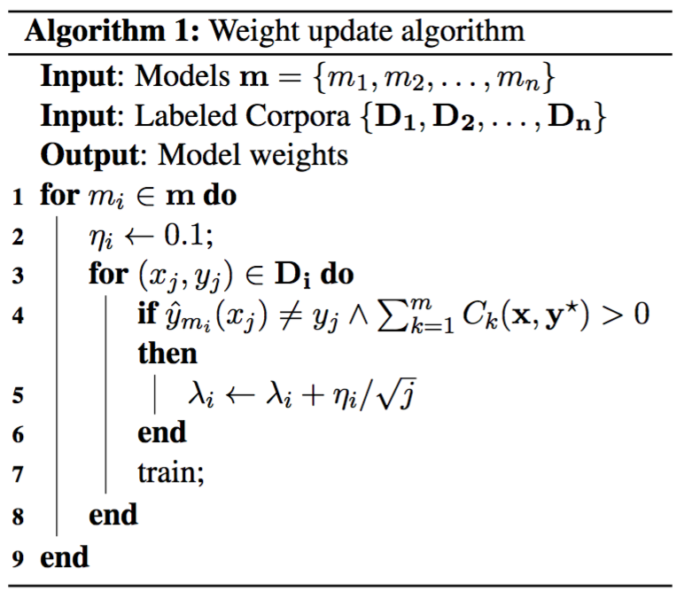
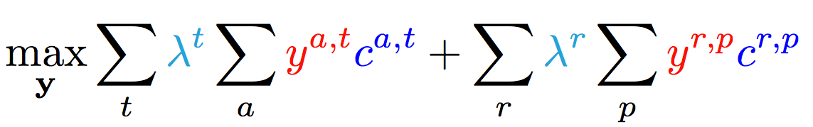
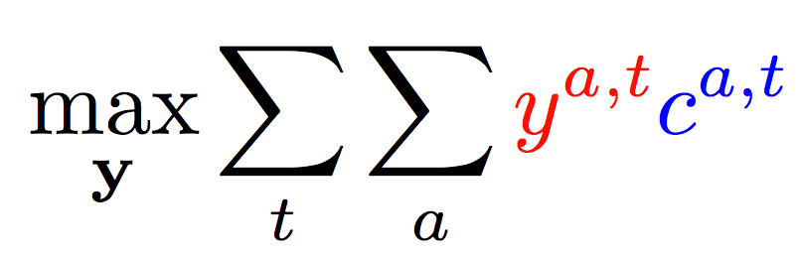
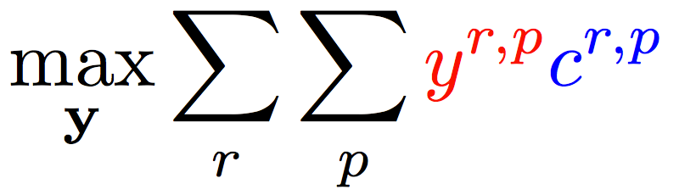
Enforce Coherence via Joint inference (CCMs)
  Variable y^{a,t} indicates whether candidate argument a is assigned a label t.
  c^{a,t} is the corresponding model score
Verb arguments
Preposition relations
+ ….
Argument candidates
Re-scaling parameters (one per label)
Preposition relation
label
Constraints:
Preposition
Each argument label
Verb SRL constraints
Preposition SRL Constraints
+ Joint constraints between tasks
How to learn the coefficients of different components?
It’s possible to learn scaling coefficients without jointly annotated data

Slide 50
Training Complex Models without Joint Supervision
Verbs
Nouns
Commas
Prepositions
Compounds
Possessives
Adjective-Noun
Light verbs
Phrasal verbs
NER
Wikification
Events
Implicit relations
  Missing Arguments
  Missing Predicates
Conjunctions
Quantifiers
Negations
Quantities (comparators)
Temporal
There is a need to understand multiple phenomena in natural language text
  We will never have enough jointly annotated data
Joint inference via declarative constraints
  Is essential both to provide coherent structured prediction, and
  At a way to get around lack of joint annotation

Slide 51
Outline
Introduction
  Natural Language Understanding
  Inference
  The idea of Incidental Supervision
Lexical Incidental Supervision
  Exploiting existing information as supervision
    Dataless Classification
    Wikification and Entity Linking (KBs, Multilingual)
Learning only simple models
  Put it together via knowledge
Response Driven Learning
  Learning from the world’s feedback
Conclusion

Slide 52

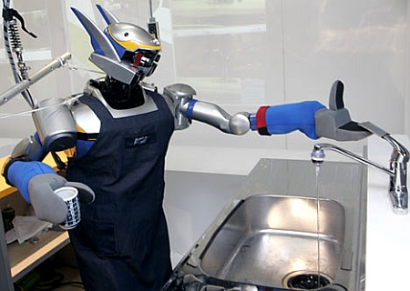

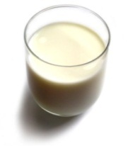
Understanding Language Requires (some) Supervision
Can we rely on this interaction to provide supervision (and eventually, recover meaning) ?
Can I get a coffee with lots of sugar and no milk
Great!
Arggg
Semantic Parser
MAKE(COFFEE,SUGAR=YES,MILK=NO)
How to recover meaning from text?
Standard “example based” ML: annotate text with meaning representation
  Teacher needs deep understanding of the learning agent ; not scalable.
Response Driven Learning: Exploit indirect signals in the interaction between the learner and the teacher/environment
Notes:
NLU: about recovering meaning from text – a lot of work aims directly at that or at some subtasks that might look like this:….

Slide 53
Response Based Learning
We want to learn a model that transforms a natural language sentence to some meaning representation.
Instead of training with (Sentence, Meaning Representation) pairs
Think about some simple derivatives of the models outputs,
  Supervise the derivative [verifier] (easy!) and
  Propagate it to learn the complex, structured, transformation model
English Sentence
Model
Meaning Representation

Slide 54
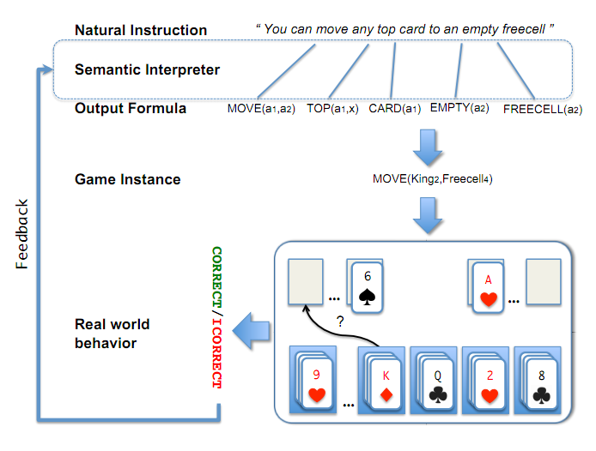
Scenario I: Freecell with Response Based Learning
We want to learn a model to transform a natural language sentence to some meaning representation.
English Sentence
Model
Meaning Representation
A top card can be moved to the tableau if it has a different color than the color of the top tableau card, and the cards have successive values.
Move (a1,a2) top(a1,x1) card(a1) tableau(a2) top(x2,a2) color(a1,x3) color(x2,x4) not-equal(x3,x4) value(a1,x5) value(x2,x6) successor(x5,x6)
Play Freecell (solitaire)
Simple derivatives of the models outputs: game API
  Supervise the derivative and Propagate it to learn the transformation model

Slide 55
Scenario II: Geoquery with Response based Learning
We want to learn a model to transform a natural language sentence to some formal representation.
“Guess” a semantic parse. Is [DB response == Expected response] ?
  Expected: Pennsylvania DB Returns: Pennsylvania→ Positive Response
  Expected: Pennsylvania DB Returns: NYC, or ???? → Negative Response
English Sentence
Model
Meaning Representation
What is the largest state that borders NY?
largest( state( next_to( const(NY))))
Simple derivatives of the models outputs
Query a GeoQuery Database.

Slide 56
Response Based Learning
We want to learn a model that transforms a natural language sentence to some meaning representation.
Instead of training with (Sentence, Meaning Representation) pairs
Think about some simple derivatives of the models outputs,
  Supervise the derivative [verifier] (easy!) and
  Propagate it to learn the complex, structured, transformation model
LEARNING:
Train a structured predictor (semantic parse) with this binary supervision
  Many challenges: e.g., how to make a better use of a negative response?
Learning with a constrained latent representation, making use of a CCM, exploiting knowledge on the structure of the meaning representation.
[Clarke, Goldwasser, Chang, Roth CoNLL’10; Goldwasser, Roth IJCAI’11, MLJ’14]
English Sentence
Model
Meaning Representation
As for other problems, people are excited today about NN models, but this does not get around the need to supervise model in a realistic way.

Slide 57
Geoquery: Response based Competitive with Supervised
Clarke, Goldwasser, Chang, Roth CoNLL’10; Goldwasser, Roth IJCAI’11, MLJ’14
Current work addresses significant challenges in terms of the complexity of the natural language and the types of interaction
Algorithm | Training Accuracy | Testing Accuracy | # Training Examples
NOLEARN | 22 | -- | -
Response-based (2010) | 82.4 | 73.2 | 250 answers
Liang et-al 2011 | -- | 78.9 | 250 answers
Response-based (2012,14) | 86.8 | 81.6 | 250 answers
Supervised | -- | 86.07 | 600 structs.
NOLEARN :Initialization point
SUPERVISED : Trained with annotated data
Response based Learning is gathering momentum:
Liang, M.I. Jordan, D. Klein, Learning Dependency-Based Compositional Semantics, ACL’11.
Berant et-al ’ Semantic Parsing on Freebase from Question-Answer Pairs, EMNLP’13, ‘15
Supervised: Y.-W. Wong and R. Mooney. Learning synchronous grammars for semantic parsing with lambda calculus. ACL’07
Notes:
Still a lot of problems. Still, if you think that we can do supervision, let’s think about these problems…

Slide 58
Before Conclusion
Knowledge representation called “predicate schemas”
The bee landed on the flower because it had/wanted pollen.
  Lexical knowledge
John Doe robbed Jim Roy. He was arrested by the police.
  Subj of “rob” is more likely than the Obj of “rob” to be the Obj of “arrest”
  Need: Learning & Inference approach that acquires the knowledge and uses it appropriately.
  (See our work in NAACL’15, ACL’16 for interesting progress on this)
John had 6 books; he wanted to give it to two of his friends. How many will each one get?
  (See our EMNLP’16 & TACL’15 work for progress on Math word problems)
share it with
How do we supervise for these problems?

Slide 59
Summary
Thank you!
We need to re-think the annotation-heavy approach in NLP
  And other Cognitive Computations
Learning should be (and is) driven by incidental signals.
  Weak signals that exist in the data and the environment
  Independently of the task at hand
We need to develop ways to identify and exploit these signals
  Along with developing the necessary inference support
Proposed some evidence in a range of problems and supervision scenarios
  It will also force us to re-think evaluation – we should move systematically extrinsic evaluations
Check out our tools, demos, LBJava→Saul, Tutorials,…
Notes:
59

