Slide 1
Reasoning for Communicating with Agents
Dan Roth
Computer and Information Science
University of Pennsylvania
&
Amazon AWS AI
ACL-IJCNLP 2021
Workshop on
Interactive Learning for Natural Language Processing
August 2021

Slide 2
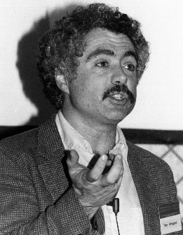
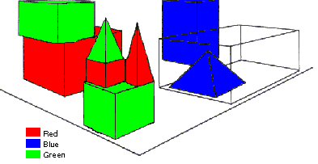
SHRDLU (Terry Winograd, 1968)
Person: Pick up a big red block.
Computer: OK.
Person: Grasp the pyramid.
Computer: I DON'T UNDERSTAND WHICH PYRAMID YOU MEAN.
Person: Find a taller block than the one you are holding and put it into the box.
Computer: BY "IT", I ASSUME YOU MEAN…..
Computer: OK.
Person: What does the box contain?
Computer: THE BLUE PYRAMID AND THE BLUE BLOCK.
Person: What is the pyramid supported by?
Computer: **What do you mean by “supported”?
……….
Person: How many blocks are not in the box?
Computer: FOUR OF THEM.
Understanding, executing and interacting requires language understanding & reasoning
to recognize and understand the domain, the goals, and to advance the task
Notes:
SHRDLU, Computer program that has conversation with user, via Natural Language interface
-> About “block world”,
The simulation robot can pick the objects, move them, count them .. Very impressive.
SHRDLU's world was so simple that the entire set of objects and locations could be described by including as few as perhaps 50 words:
This allowed it to support co-reference resolution, make simple deductions on, for example types of blocks that can be stacked and those that cannot, etc.
SHRDLU could therefore understand instructions and answer questions, as you can see in this example.

Slide 3
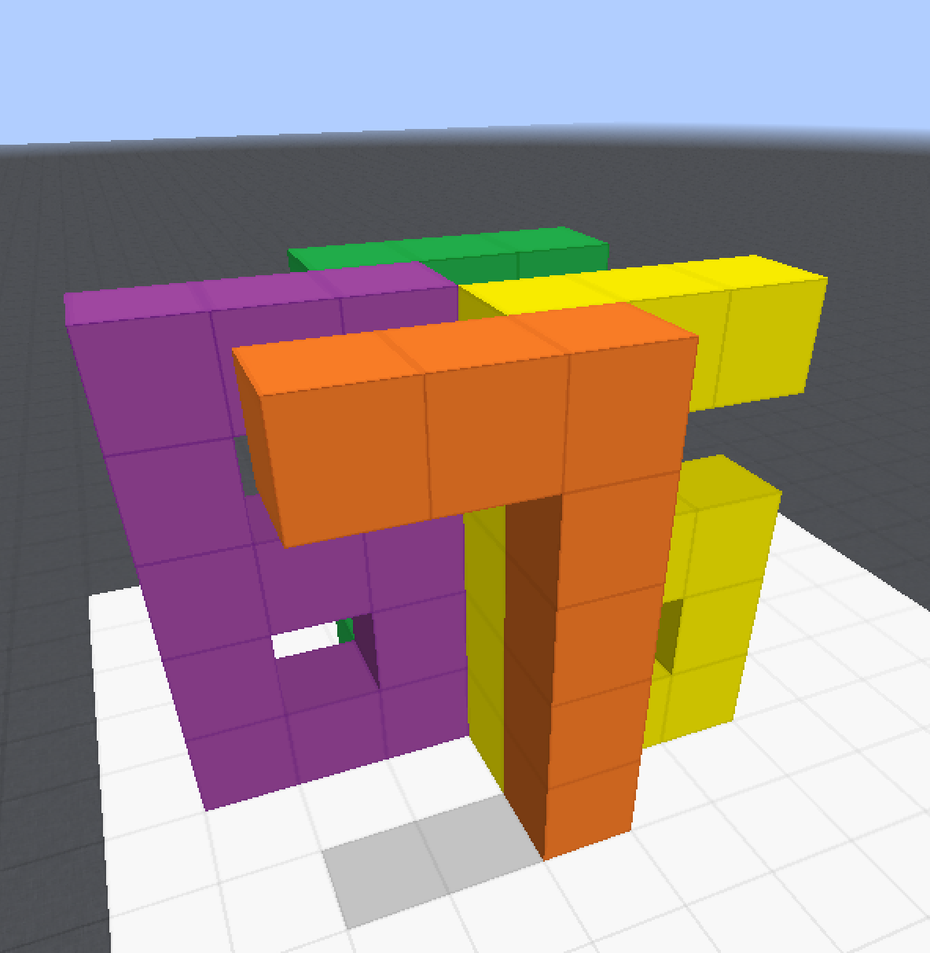
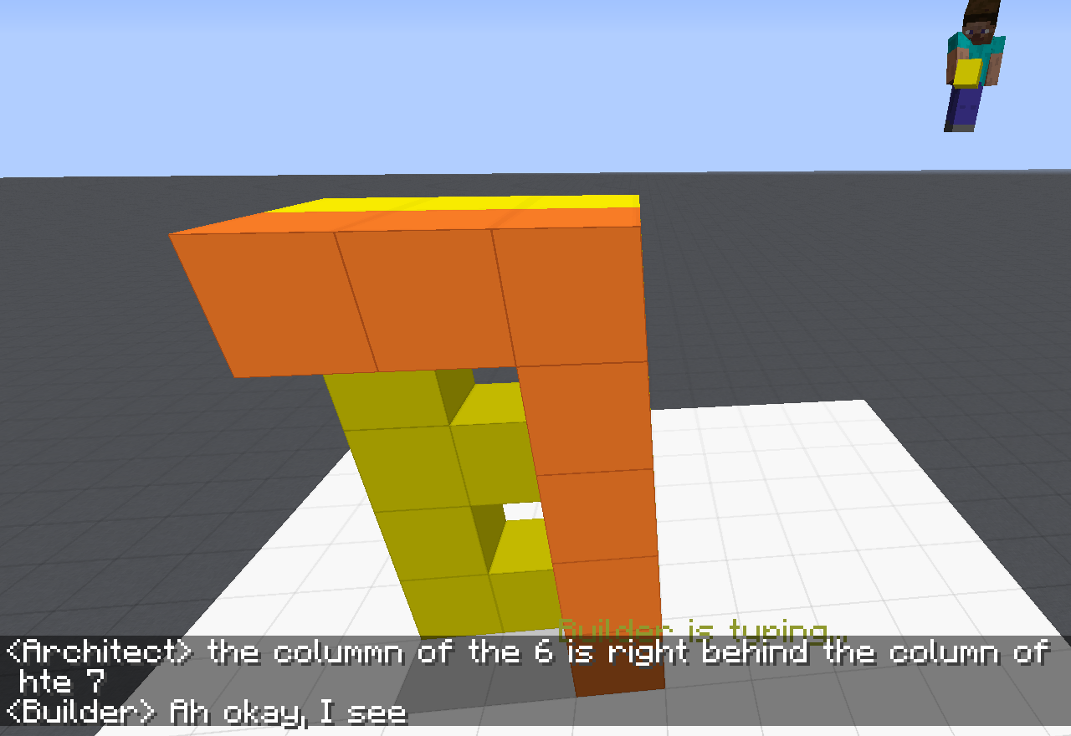
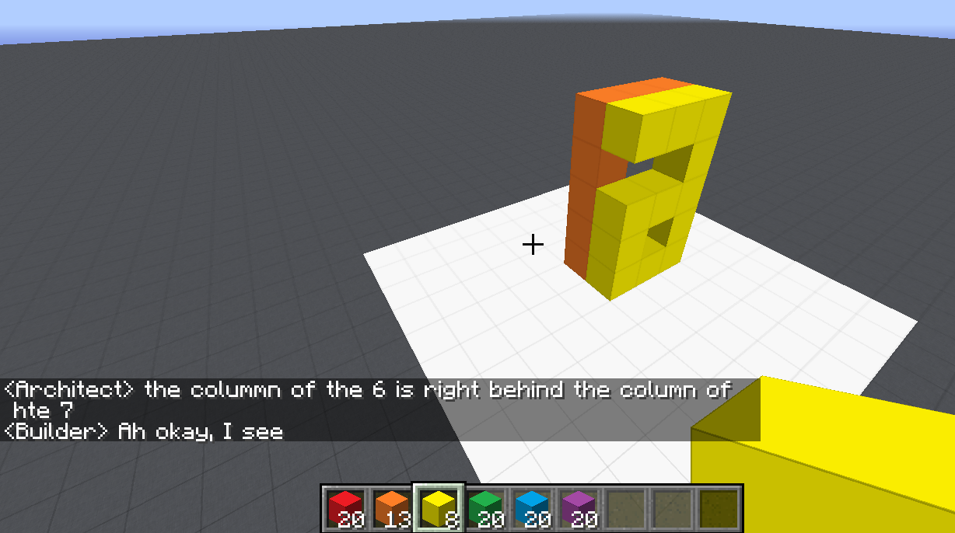
Communication (CwC Project, 2017-2020)
ARCHITECT
CHAT INTERFACE
Architect: | in about the middle build a column five tall
(Builder puts down five orange blocks)
Architect: | then two more to the left of the top to make a 7
(Builder puts down two orange blocks)
Architect: | now a yellow 6
Architect: | the long edge of the 6 aligns with the stem of the 7 and faces right
Builder: | Where does the 6 start?
Architect: | behind the 7 from your perspective
Builder: | Is it directly adjacent?
Architect: | yes directly behind it. touches it
(Builder puts down twelve yellow blocks, in the shape of a 6)
Architect: | too much overlap unfortunately
Architect: | the colummn of the 6 is right behind the column of hte 7
Target Structure
Build Region
BUILDER
[Minecraft example from Julia Hockenmaier]
Notes:
Fast forward 50 years -- we are still trying to solve the same problem --- this time open domain… We can do that, but we are running into similar problems of brittleness that are due, among other things, to our inability to deal well with situations we have never seen before. And this is really the goal of learning!

Slide 4
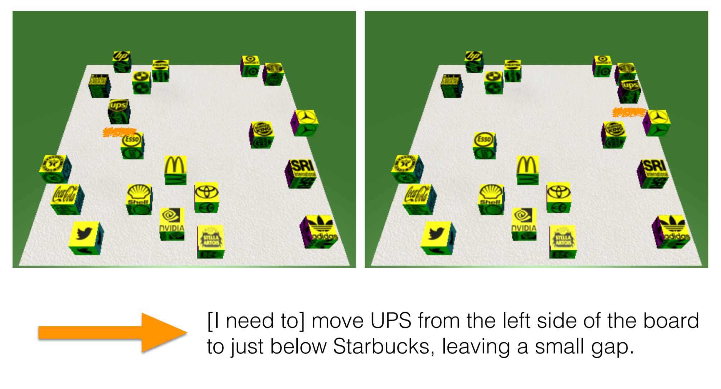
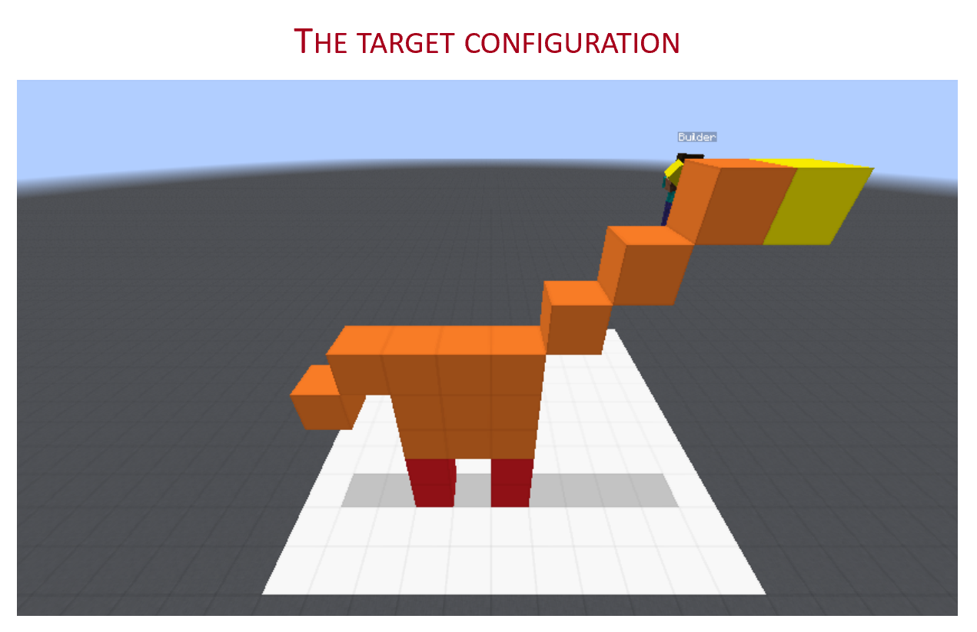
Communication (CwC Project, 2017-2020)
Consider the following explanation:
  [Example from Yonatan Bisk]
  Imagine that this is a chess board
  Place the UPS in H2, and McDonald in G6.
Can you follow these instructions?
  What’s needed for us to be able to induce programs that can do it?
Of course, there are many NLP tasks we are better at today, mostly extraction tasks.
But, can we do it in a way that allows us to generalize to new situations?
  Can we move away from doing well on datasets to doing well on tasks?
Without being trained on thousands of chess-understanding examples
Notes:
Why can’t we do it?
Here is one example – a much simpler scenario that we studied on the way to the more realistic Minecraft one.
… Without training specifically on chess programs, since if we do, I can then give you a tennis court analogy….
At the heart of this is the question of “how do we supervise our models?”

Slide 5
Challenges We Need to Address
Many challenges on our way to facilitate communication
  Key issues here have to do with how we supervise models to deal with sparse situations
  Reasoning: making decisions in situations that we cannot directly train for
Communication, from Hard to Easy
  Understanding Instructions
    Robustness
  Answering Questions
    Decomposition, Composition, and Commonsense (temporal domain)
  Interpretating Answers
    Indirect Answers

Slide 6
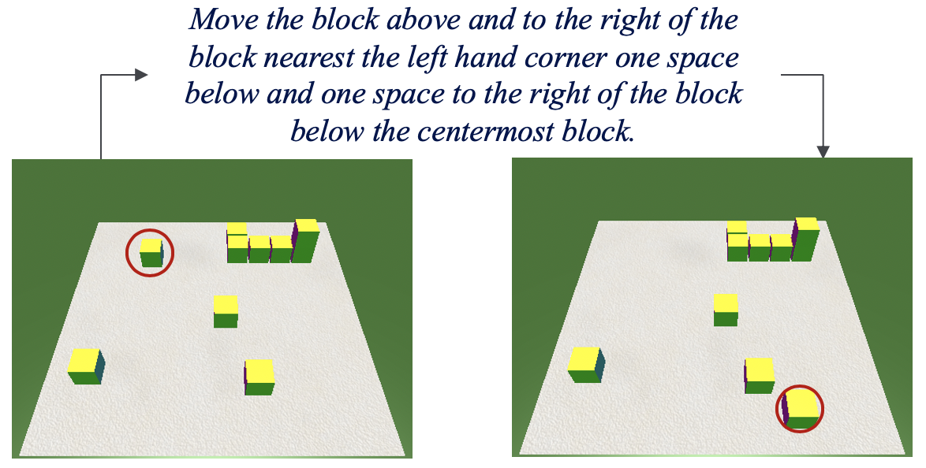
Instructions in a Spatial Domain
Given a current world state and a natural language instruction, we want to generate the new world state by moving a single block.
This involves two sub-tasks :
  identifying the source block
  identifying the target location

Slide 7
Challenges
Ambiguity
Compositional Instructions
  Move the block that is [ to the left of [ the block closest to [ the right side of the table ]]] so that it is on top of the block that is [at the top of the [ group of blocks [ closest to the [ left side of the table ]]]].
Entity Grounding
  third block
Understanding Spatial Relations
Plan Recognition
  slide the top-right corner block 2 blocks straight up . Then slide it 6 block spaces to the left .
Concept Learning
How do we train?
  End to End
Clarke et al. 2010 Driving Semantic Parsing from the World's Response
  1st to propose training this way
  But – suggested constraining latent layers in meaningful ways
Notes:
Today, we are not doing it; we have models that are so powerful so we think that we can try our luck, but it’s not going to work with a simple minded end-to-end training

Slide 8
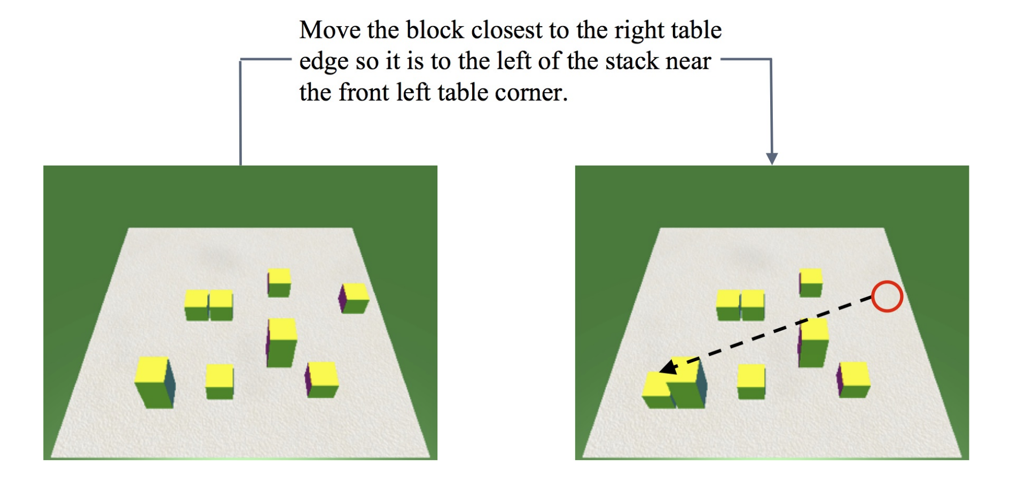
Expectations from a Model (1) [Dan et al. NAACL’21]
Perturbations on the world state:
  Adding/ removing semantically irrelevant blocks.
  Slight perturbations in block locations --- uniform translations or instance dependent.
Move the block closest to the right table edge so that it is to the left of the stack near the front left table corner.
Notes:
Today, we are not doing it; we have models that are so powerful so we think that we can try our luck, but it’s not going to work with a simple minded end-to-end training

Slide 9
Expectations from a Model (2) [Dan et al. NAACL’21]
Perturbations to the language:
  Word substitutions or syntactic alterations that are consistent with the world state.
Move the rightmost block to the left of the leftmost stack.
Move the block closest to the right table edge so that it is to the left of the stack near the front left table corner.

Slide 10
Expectations from a Model (3) [Dan et al. NAACL’21]
“Symmetric” Perturbations:
  Given an instruction, world pair (I,W) we generate a corresponding (I’,W’) where W’ is a horizontal, vertical or diagonal translation of W and the corresponding semantic units in I are flipped too.
Move the block closest to the left table edge so that it is to the right of the stack near the front right table corner.

Slide 11
Generalization in Instruction Following Systems
In [Dan et al. NAACL’21] we show that current SOTA models are highly susceptible to such perturbations.
We then augment the training data to make the resulting model robust.
  The resulting model does better on perturb data and, in most cases, also on the original data
Not surprising
  Data augmentation can, to a limited extent, address these issues
A solution?
  More than a solution, it shows that we need to think harder about training paradigms that support these forms of communication.

Slide 12
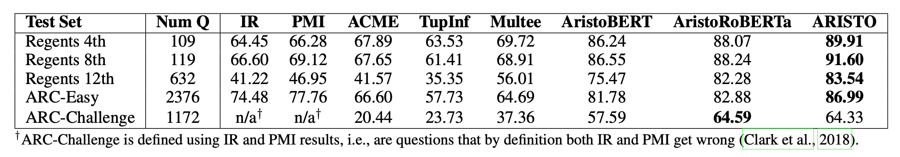
A Simpler Case
Clark et al 2019: On the success of AI2’s ARISTO Project:
  From ‘F’ to ‘A’ on the N.Y. Regents Science Exams: An Overview of the Aristo Project
Very impressive results. But, does the model perform as we expect it to?

Slide 13
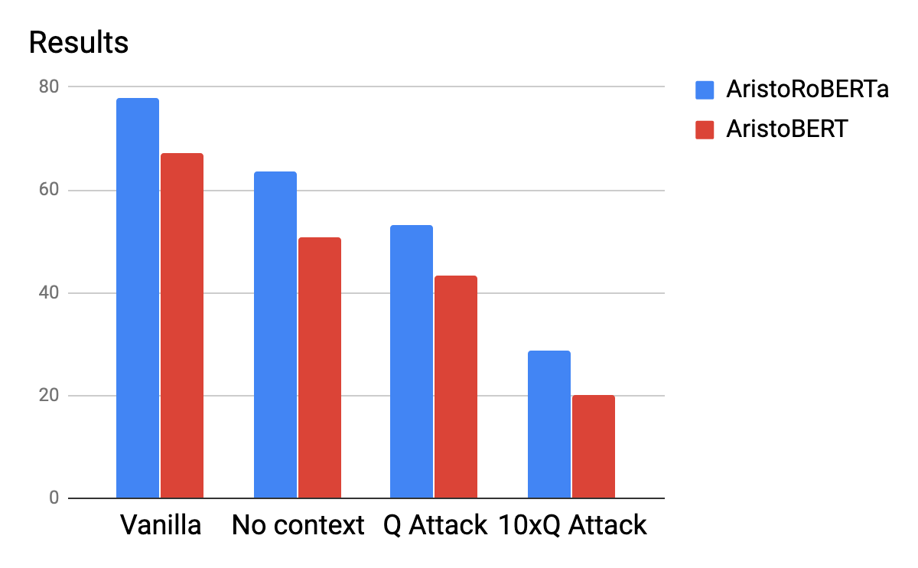
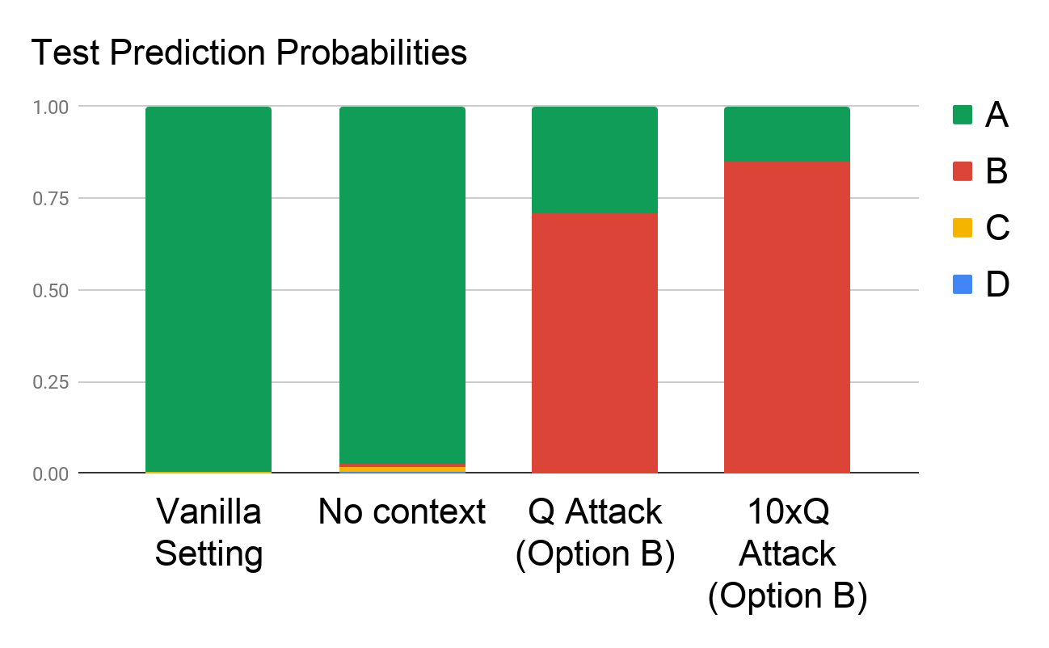
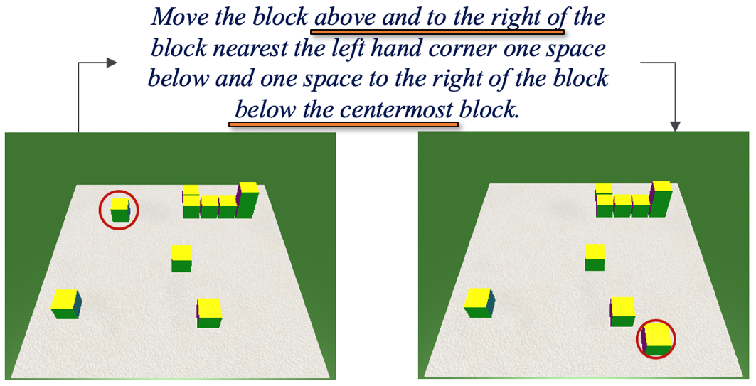
A Scientific QA Example [Shah et al. EMNLP Findings 2020]
Question: The rate at which a wave passes through a medium is known as its
Answer Options:
  speed
  amplitude
  acceleration
  wavelength
Supporting Contexts:
  The speed of a wave is the rate at which vibrations propagate through the medium…
  The greater the amplitude of vibrations of the particles of the medium, the greater…
  … hydrophones measure the acceleration of the medium as a seismic wave passes…
  The speed of an electromagnetic wave in a medium depends on its wavelength. As…
Question Question Question Question Question Question Question Question……
Question
The paper formalizes the notion of “expectations” from a high performing QA model, goes on with more experiments, and suggests alternative ways of training so that the models better satisfy our expectations.
Are we doing Reasoning?
Dan et al. NAACL’21
Notes:
Killing the competition should improve the results – but it reduces it.

Slide 14
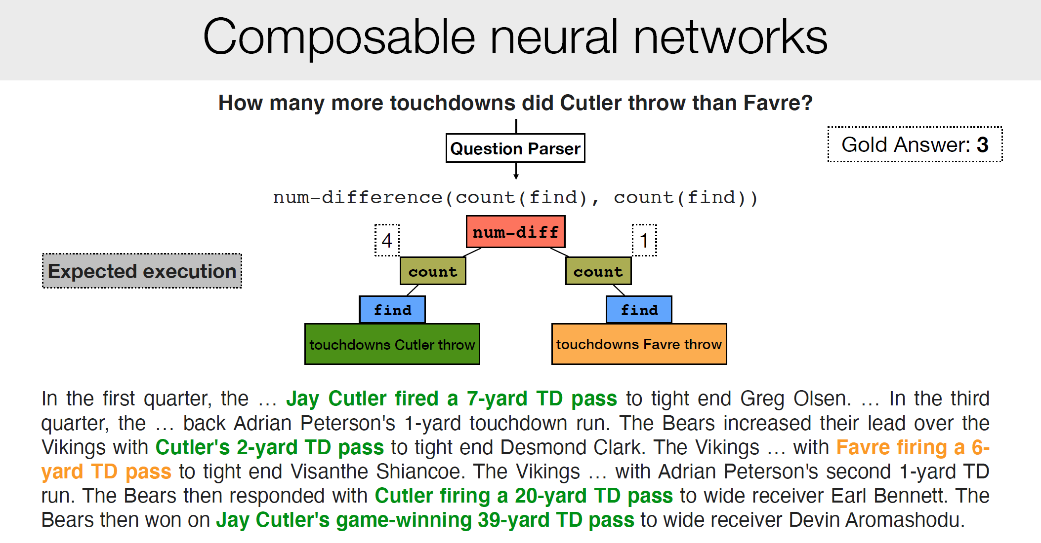
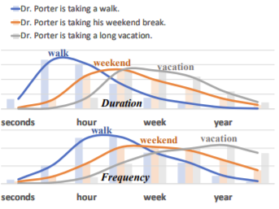
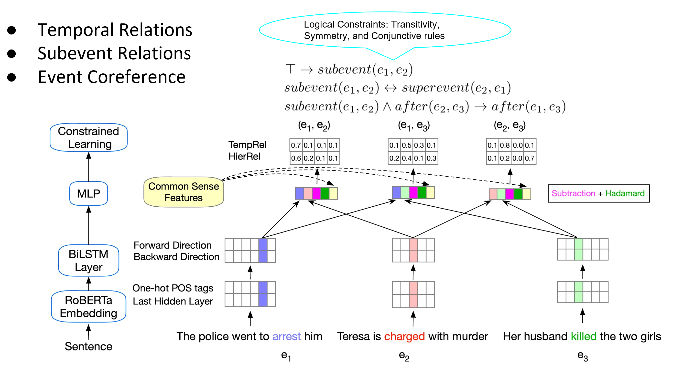
Learning to Reason over Natural Language
Making decisions that depend on natural language understanding requires reasoning abilities
  We need to decompose and compose
  Symbolic reasoning over models
    Reasoning with Declarative Constraints
  Learning with declarative knowledge
Case Studies:
  Complex Question Answering
  Natural Language instructions
  Reasoning about Events and Time
Understanding Compositional Instructions
Commonsense Reasoning
Training with Logical Constraints
Notes:
The need to do reasoning arises from the realization the compositionality is an essential component of NLU. We need to compose and decompose. We cannot expect that all our decisions will be supported by independent function approximation.

Slide 15
Principle of Compositionality
The meaning of a complex expression is determined by the meaning of its constituents and the rules used to combine them
“U-Turn is allowed”
“U-Turn is not allowed”
“Swimming is allowed”
“Swimming is not allowed”
*Principle is often credited to Gottlob Frege
Notes:
Thinking seriously about compositionality has essentially disappeared from modern ML – everything is one-shot function approximation, and I’d like to argue that it is essential that we think about it from the Reasoning and the Training perspective

Slide 16


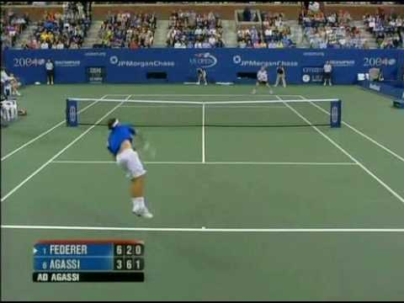
Some Questions to my Agent
Will we make it to the movie?
  Time now + [time to get to the movie] < start of movie
Will we make it to dinner before the movie?
  Time now + [time to get to dinner] + [duration of dinner] < start of the movie
  (there is a lot more going on here)
Will we make it to the movie after the game?
  Start time of the game + [duration of the game] < start of the movie
Will we make it to a movie after the game?
  Start time of the game + [duration of the game] < start of any movie
Reasoning: Is the end time of the game/dinner before the start time of the/any movie?
Identifying compositionality is essential to facilitate training of models

Slide 17
Let’s Talk about Dinner
∃ r ∈ Restaurants | Cuisine(r, Mexican)∧ InCity(PH)
Constraints:
∀ r ∈ Restaurants → Contains(r, m) ∧ Menus(m)
∀ m ∈ Menus → Contains(d,m) ∧ Dishes(d)
∃ o ∈ Dishes → Tastes(o, ￢spicy)
→ Let’s talk about dinner.
  A: Where do you want to go?
→ I really enjoy Mexican food, but not when it is spicy.
  A: How about a Mexican restaurant with plenty of non-spicy options?
→ Yep, is there one in Philadelphia?
  A: Here are a couple of good options
  …….
Don’t worry, you can still use neural embeddings for the predicates and functions…
But this abstraction shows that supporting interesting decisions requires that we put some components together, along with incorporating declarative constraints…
[Example due to Tania Berdax-Weiss]

Slide 18
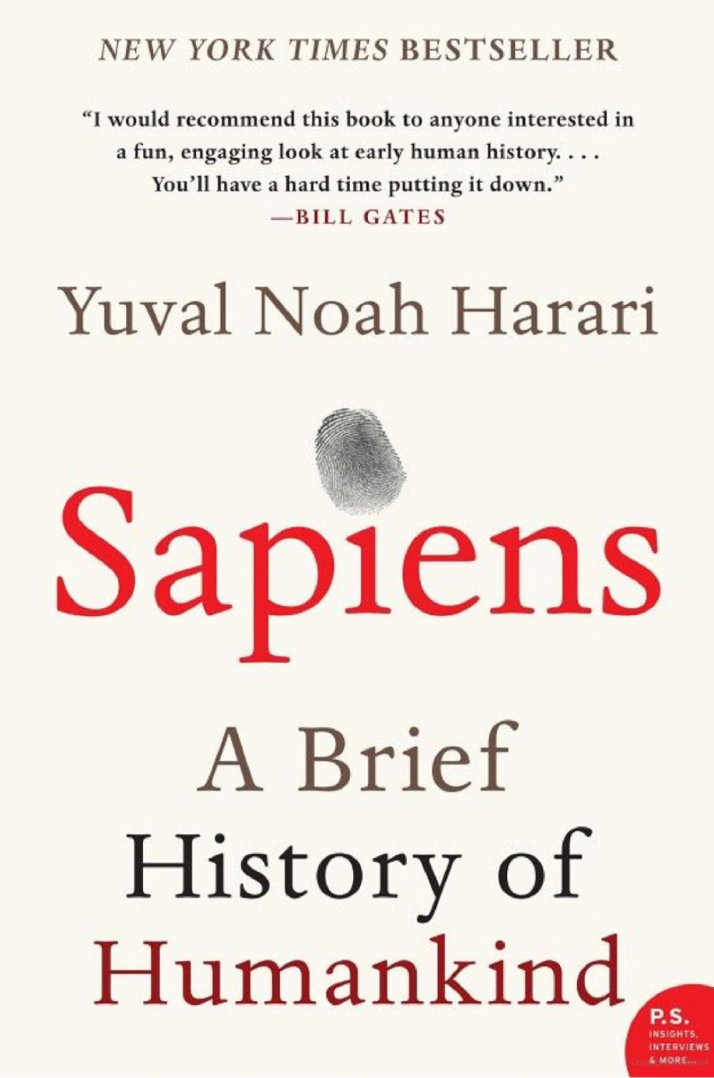
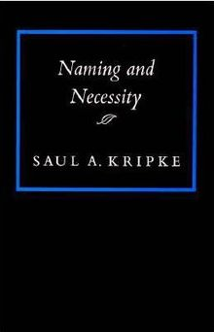

Symbolic Reasoning?
Some people think that symbols are an evil invention of old AI people.
It’s not.
Language is a symbolic system
Even though we communicate via speech, gestures, writing, which are continuous, symbols are the invariants of this communication.
  Harari: Language – the ability to assign symbols to “things” and “reason” about them is key to human cognitive revolution
  Kripke: “Naming” things is key to communication and to cognition
  The Enigma of Reason: “Reasoning is about giving reasons”
Rodgers finished 23-of-36 for 296 yards and two touchdowns. His numbers could've been even better had his receivers not dropped a couple of his passes. One dropped ball was a potential score to Allen Lazard. Despite the drop, Lazard made up for it by leading the Packers in receiving. With Davante Adams tied up with Jalen Ramsey, Lazard was able to snatch four balls for 96 yards and a touchdown. Adams still had a great game despite Ramsey's coverage, hauling in nine of his 10 targets for 66 yards and a touchdown. The score frustrated Ramsey because another defensive back was supposed to pick up Adams, who was in motion.
Mayor Rahm Emanuel now has raised more than $10 million toward his bid for a third term – more than five times the total raised by his 10 challengers combined, campaign finance records show.
Notes:
Table is a collection of things in world.

Slide 19
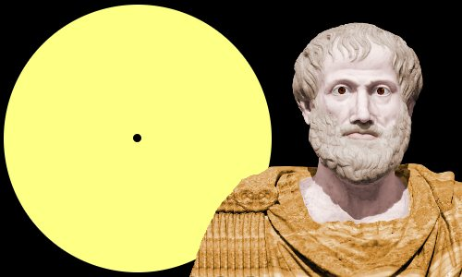

Symbolic Reasoning
Language is a symbolic system
Regardless of implementation, symbols are the invariants of our communication.
In “will we make it to dinner….” the components were given
  And we need to figure out how to estimate them and put it together
Here, the components are not given
  How do we know, given this question, to think about:
    ~~ When did Aristotle die?
    ~~ When was the laptop invented?
    What happened first?
How do we determine “strategies” on the fly?
  And how do we train for it?
In [Geva et al. TACL’21] we develop StrategyQA, a dataset that addresses the question of dynamic, implicit decomposition
So, did Aristotle have a laptop?
[Example due to Les Valiant]
Notes:
Some current researchers think that symbols are an evil invention of old AI people
Google will say yes!

Slide 20


Challenges We Need to Address
Many challenges on our way to facilitate communication
  Key issues here have to do with how we supervise models to deal with sparse situations
  Reasoning: making decisions in situations that we cannot directly train for
Communication, from Hard to Easy
  Understanding Instructions
    Robustness
  Answering Questions
    Decomposition, Composition, and Commonsense
  Interpretating Answers
    Indirect Answers
Will we make it to dinner before the movie?
  Reasoning about temporal order of events
    Ning et al. 2018-2021
  Commonsense (typical duration of dinner)
  Implicit Events (time to park)
  Putting things together

Slide 21
Temporal Commonsense [Zhou et al. 18’, 19’,20’]
“will” or “will not”?
Days
Minutes
Dr. Porter is taking a vacation and will not be able to see you soon.
Dr. Porter is taking a walk and will be able to see you soon.
Notes:
When we think about temporal commonsense we think about even more basic things –

Slide 22
The Temporal Commonsense Challenge
My friend Bill went to Duke University in North Carolina. With a degree in CS, he joined Google MTV as a software engineer. As a huge basketball fan, he has attended all 3 NBA finals since then. He also plans to visit Duke regularly as an alumnus to attend their home games.

Slide 23
The Temporal Commonsense Challenge
My friend Bill went to Duke University in North Carolina. With a degree in CS, he joined Google MTV as a software engineer. As a huge basketball fan, he has attended all 3 NBA finals since then. He also plans to visit Duke regularly as an alumnus to attend their home games.
College: about 4 years, starts at the age of 18
Duration
Typical Time
Bill in North Carolina: about 4 years
Duration
Stationarity
Duke in North Carolina: always
Stationarity

Slide 24
The Temporal Commonsense Challenge
My friend Bill went to Duke University in North Carolina. With a degree in CS, he joined Google MTV as a software engineer. As a huge basketball fan, he has attended all 3 NBA finals since then. He also plans to visit Duke regularly as an alumnus to attend their home games.
College: about 4 years, starts at the age of 18
Duration
Typical Time
Bill in North Carolina: about 4 years
Duration
Stationarity
Duke in North Carolina: always (expected)
Stationarity
Join Google: after college graduation
Ordering

Slide 25
The Temporal Commonsense Challenge
My friend Bill went to Duke University in North Carolina. With a degree in CS, he joined Google MTV as a software engineer. As a huge basketball fan, he has attended all 3 NBA finals since then. He also plans to visit Duke regularly as an alumnus to attend their home games.
College: about 4 years, start at the age of 18
Duration
Typical Time
Bill in North Carolina: about 4 years
Duration
Stationarity
Duke in North Carolina: always (expected)
Stationarity
Join Google: after college graduation
Ordering
NBA Finals: every year
Frequency

Slide 26
The Temporal Commonsense Challenge
My friend Bill went to Duke University in North Carolina. With a degree in CS, he joined Google MTV as a software engineer. As a huge basketball fan, he has attended all 3 NBA finals since then. He also plans to visit Duke regularly as an alumnus to attend their home games.
College: about 4 years, start at the age of 18
Duration
Typical Time
Bill in North Carolina: about 4 years
Duration
Stationarity
Duke in North Carolina: always (expected)
Stationarity
Join Google: after college graduation
Ordering
NBA Finals: every year
Frequency
Visit Alma Mater: a few times a year, 1-2 days each time
Frequency
Duration
Attend basketball games: a few hours
Duration

Slide 27
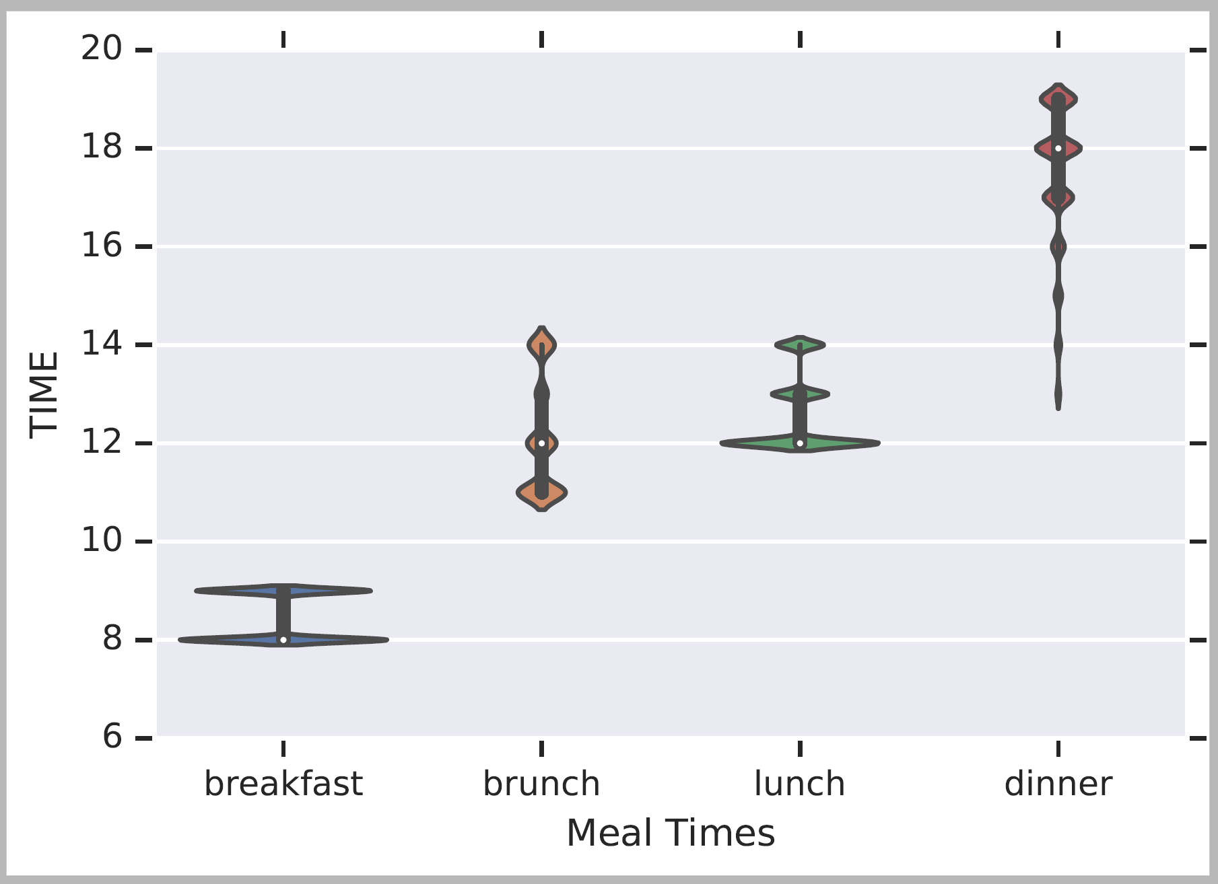
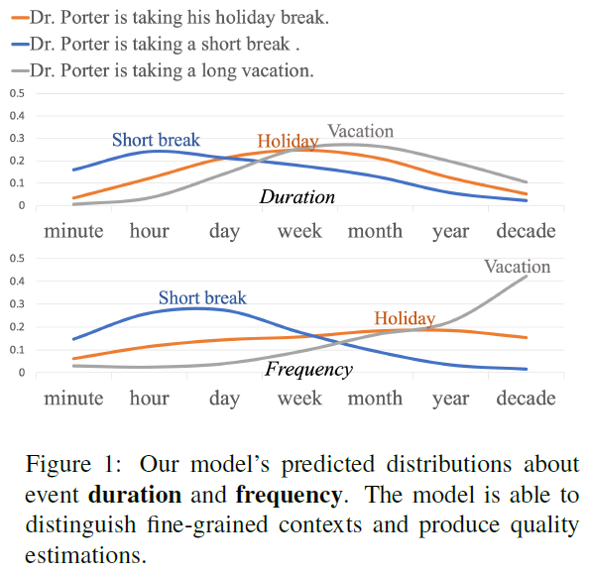
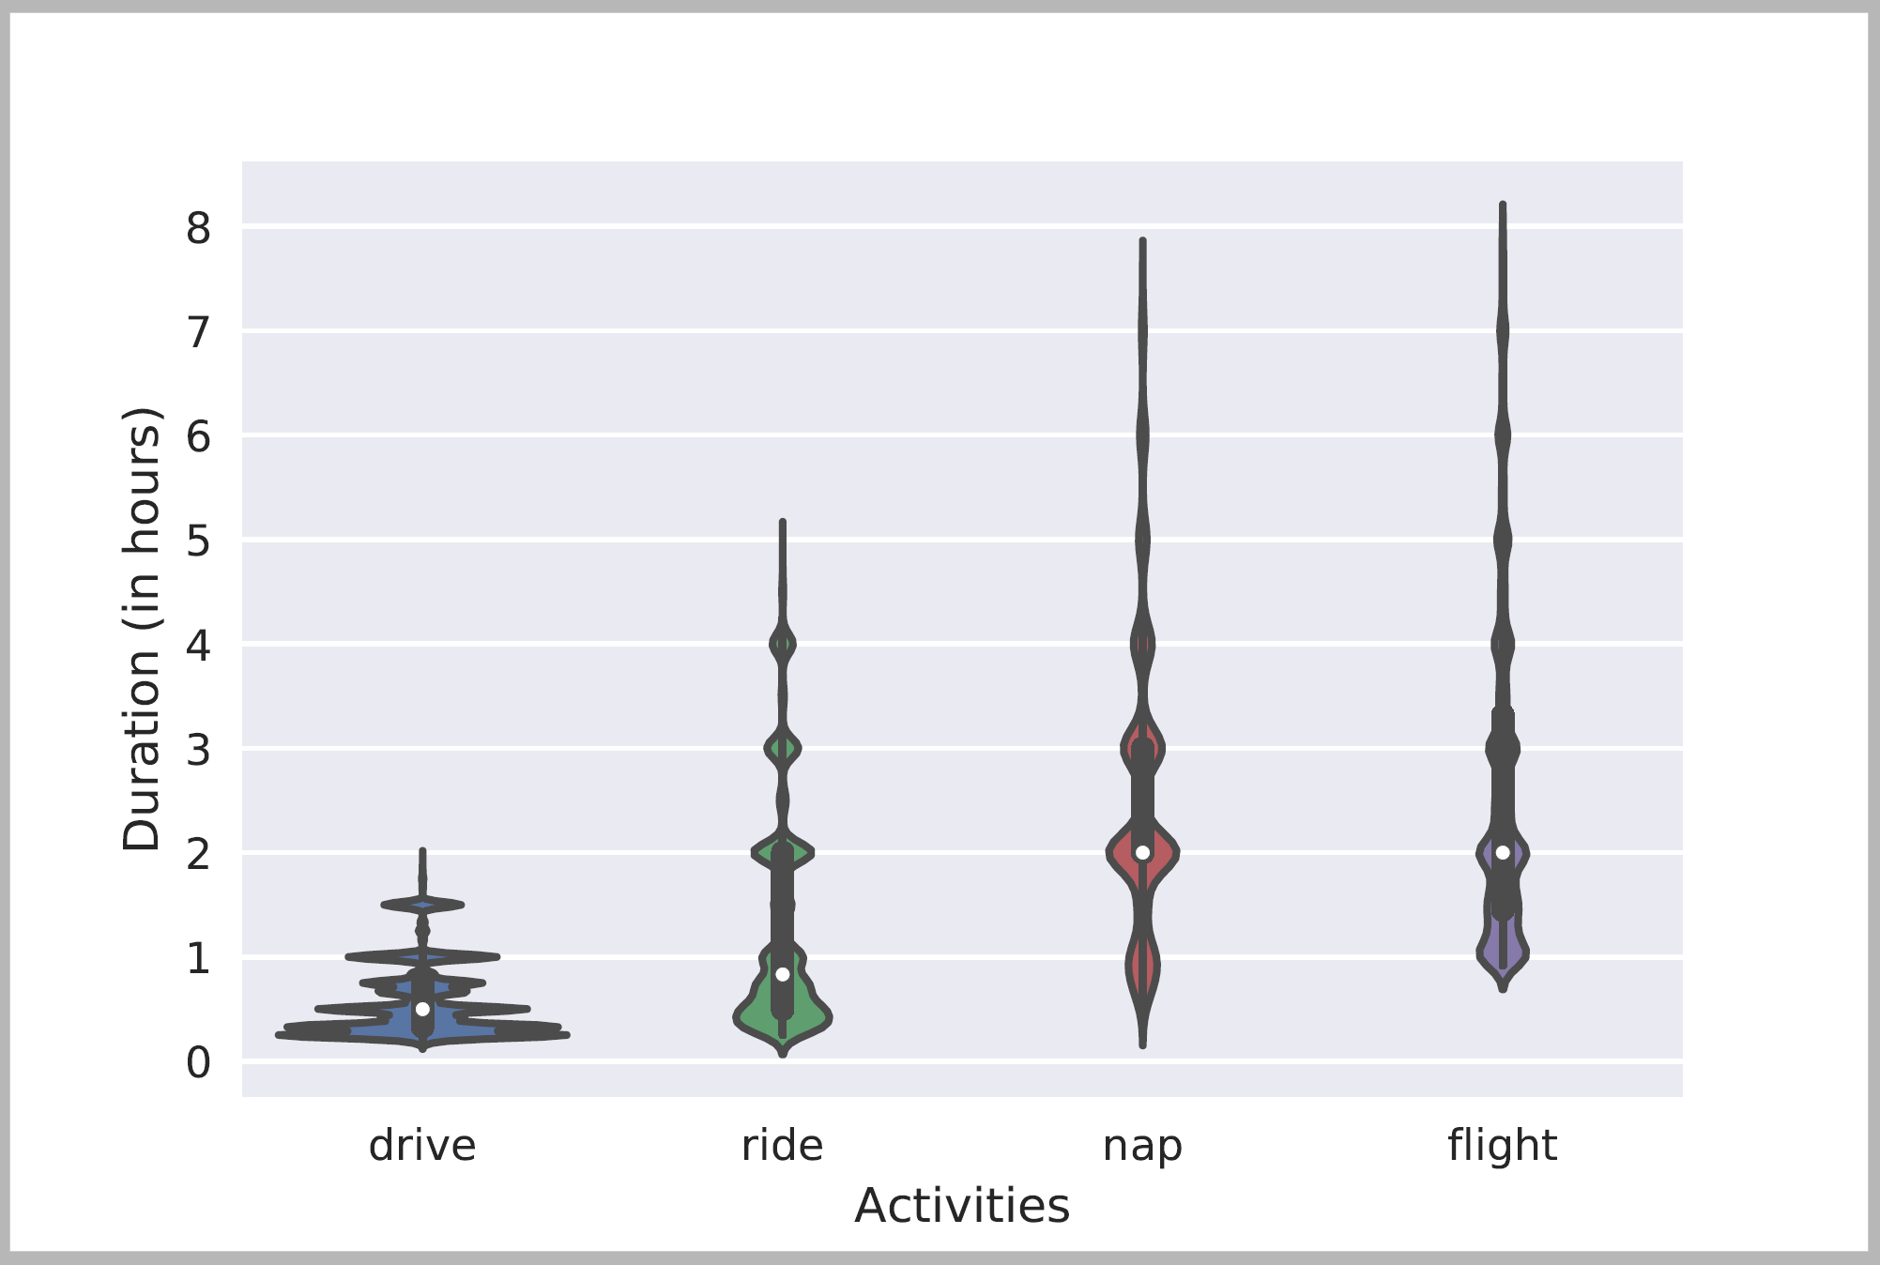
Temporal Common Sense
Two efforts:
  A dataset MC-TACO (multiple choice temporal commonsense) [Zhou et al. EMNLP’19]
  Acquisition + Representation [Zhou et al. ACL’20]: Duration, typical time, frequency.
Will we make it to dinner before the movie?
Typical Time
Typical Temporal Relations
Ning et al. NAACL’18
[Zhou et al. ACL’20]
Duration
[Elazar et al. ACL’19]

Slide 28
Defining the Temporal Commonsense Challenge
MC-TACO [Zhou et al. EMNLP 2019]
  Multiple Choice TemporAl COmmon-sense
  1,893 questions; 13,225 question-answer pairs
  Querying at least one of the five dimensions:
    Duration
    Frequency
    Typical Occurring Time
    Stationarity
    Ordering
  Exact Match: the percentage of questions of which all candidates are predicted correctly (here: 0.0)
  F1: Gives partial credit (credits “accidental” correct perditions (here: 66.7%)
Gold
Prediction
He went to Duke University.
How long did it take him to graduate?
4 years
✔
10 days
✔
3.5 years
✗
16 hours
✔
Notes:
The type of systems we have today, LM based, get a lot of things right accidentally, so to really know how well we are doing we need to evaluate it carefully. In this case, we can only allow exact match as an answer.

Slide 29
Results: We are Far (from where we want to be)
It’s important to be careful when evaluating LM-based results.
We have multiple plausible answers for each question. You only understand the phenomenon if you tag all the options correctly.
13% difference
40% difference
ESIM: Enhanced LSTM for Natural Language Inference (Chen et al., 2016)
GloVe: Global Vectors for Word Representation (Pennington et al., 2014)
ELMo: Deep contextualized word representations (Peters et al., 2018)
BERT: BERT: Pre-training of Deep Bidirectional Transformers for Language Understanding (Devlin et al., 2019)
RoBERTa: A Robustly Optimized BERT Pretraining Approach (Liu et al., 2019)

Slide 30
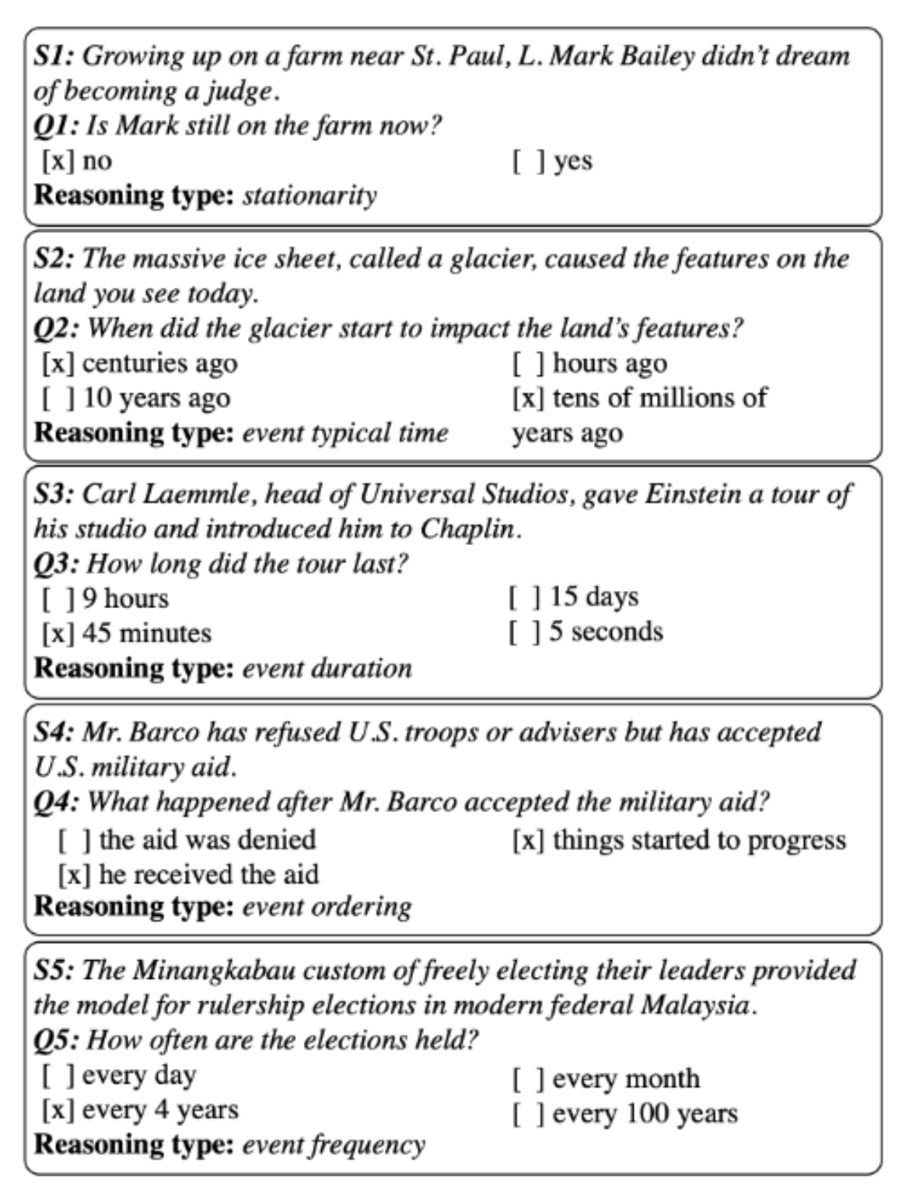
MC-TACO🌮: A Temporal Commonsense Dataset [Zhou et al. EMNLP’19]
The results of a RoBERTa-based models are very low. Not surprising given the need to have commonsense to address these challenges.
Perhaps more importantly, it illustrates the need to decompose, and know how to incorporate knowledge.
Stationarity:
  Paul Simon is in NYC. Let’s go see him.
  The Empire State Building is in NYC.
Stationarity
Typical Time
Duration
Will we make it to dinner before the movie?
Temporal Ordering
Event Frequency
And, we need to account for implicit events [Zhou et al., NAACL’21]
Notes:
The time now, the movie time, but also – how long is our typical dinner?

Slide 31
TemporAl COmmonsense LM
TacoLM – A general LM that is aware of time and temporal common sense
  Minimal Supervision
Used to develop contextual estimation for Duration, Typical Time, and Frequency
  Time is represented as a distribution over time units
confidence
Notes:
In this work, we propose TacoLM, a general language model that is aware of time and temporal common sense, and at the same time built without any annotations. We show that our model is better at solving time-related tasks. For example, in this actual prediction of duration from our model,

Slide 32
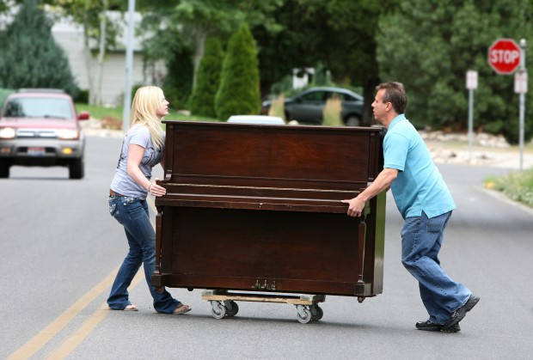

Modeling Temporal Common Sense [Zhou et al. ACL’20]
Context
  How long does “move” take?
    Highly contextual: Move a chair? Move a piano?
    Needs more than direct event arguments
  Achieved using an unsupervised collection of auxiliary signals
  Using patterns from free text
    Extract complete events – predicate and arguments
Joint Modeling
  People do not typically write how long it took them to brush their teeth
    But they’ll say: I brushed my teeth in the morning; I brushed it in the shower.
  Natural constraints:
    duration <= 1/frequency

Slide 33
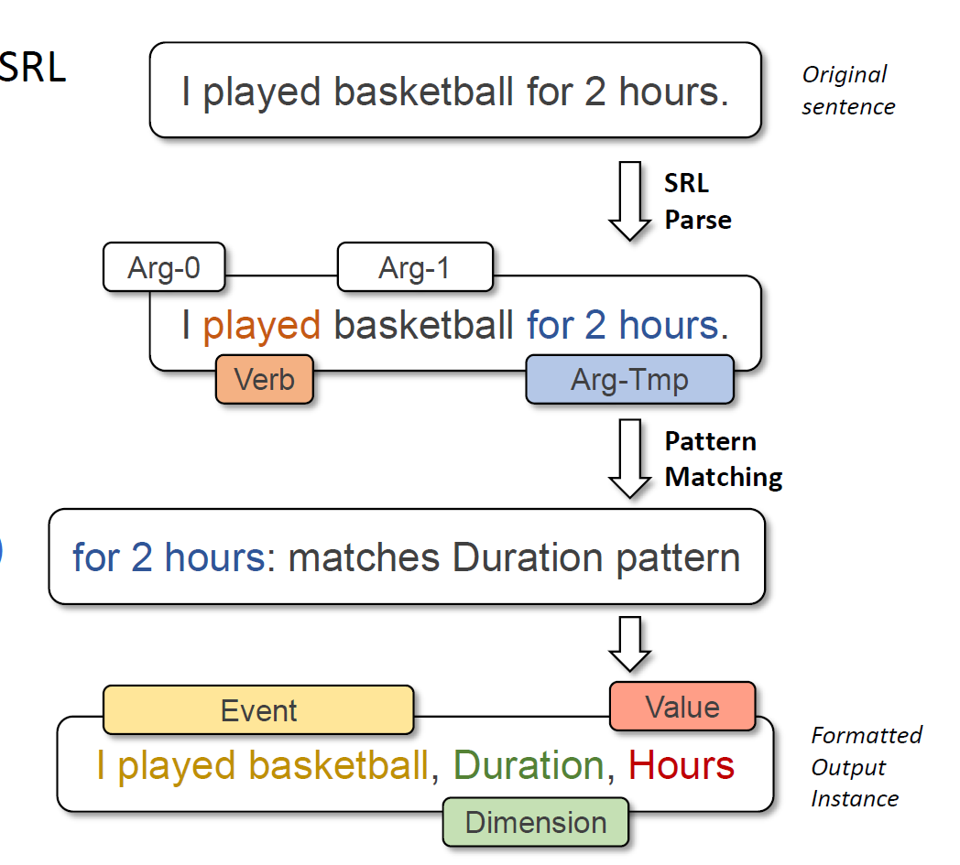
TacoLM – the Big Picture
Goal: build a general time-aware LM with minimal supervision
  Using high-precision patterns to acquire temporal information
    Unsupervised automatic extraction
  Overcomes reporting biases with a large amount of natural text
  Multiple temporal dimensions
    Duration ~ 1 / Frequency
    Further generalization to combat reporting biases
Step 1: Information Extraction
Step 2: Joint Masked Language Model
“I brush my teeth every morning”
Duration of “brushing teeth” < morning
Supports full event masking
Output: TacoLM- a time-aware general BERT
Skip Details
Notes:
♦With the goal of building a general time-aware LM with minimal supervision, ♦we start with a focused, unsupervised information extraction step, ♦in which we use a set of high-precision patterns to acquire temporal information. ♦This helps the model to overcome reporting biases as we can automatically extract over a large amount of natural text.
♦We use the temporal information acquired in step 1 in the second step called joint language model pretraining. ♦That is, we pre-train our language model jointly over multiple temporal dimensions, ♦so that it is able to utilize the natural relations such as duration being inversely related to frequency. ♦This is beneficial. For example, we may not see direct mentions of the duration of brushing teeth, however, we know that it is shorter than a morning as the frequency is likely to be every morning. ♦This provides further generalization to combat reporting biases.
♦Finally, we obtain our final model TacoLM, a BERT transformer that is more aware of time.

Slide 34
Information Extraction
Use high-precision patterns based on SRL
  Duration
  Frequency
  Typical Time
  Duration Upper bound
  Hierarchy
Labels
  Units (seconds, … centuries)
  Temporal keywords (Monday, January, …)
Output
  4.3M instances of
  (event, dimension, value) tuples
I played basketball for 2 hours.
Original sentence
SRL Parse
Arg-0
Arg-1
I played basketball for 2 hours.
Verb
Arg-Tmp
Pattern Matching
for 2 hours: matches Duration pattern
Event
Value
I played basketball, Duration, Hours
Formatted Output Instance
Dimension
Notes:
Time units: for duration and frequency
Temporal keyworkd: for typicaly time

Slide 35
Sequence Formatting
Consider [Event] [Dimension] [Value] tuples in each instance
[E1, E2, … M, ET … En, SEP, M, Dim, Val]
  M is a special marker, same across all dimension/value
  Dim is a marker for each dimension, Val is a marker for the value of the dimension
An example:
I played basketball for 2 hours.
Information Extraction
I played basketball, Duration, Hours
Sequence Formatting
I [M] played basketball [SEP] [M] [DUR] [HRS]
Notes:
♦Specifically, for each event, dimension and value tuple, ♦we format it into a sequence of tokens, in which we use special markers to mark the location of the verb, in order to represent the event, and place special tokens that represent the temporal dimension and the value in the same sequence.
♦♦Consider the same example I played basketball for 2 hours. ♦♦We extracted a training instance from the information extraction step, ♦♦and we now further format it into a single sequence containing all the information.

Slide 36
Joint Model with Masked LM
I [M] played basketball [SEP] [M] [DUR] [HRS]
Baseline Model: Pre-trained BERT-base
Main objective: mask some tokens and recover them
How we mask:
  With some probability, mask temporal value while keeping others
  Otherwise, mask a certain portion of E1...En while keeping temporal value unchanged
  Max (P(Event|Dim,Val) + P(Val|Event,Dim)); Preserving original LM capability
Benefits:
  Jointly learns one transformer for all dimensions
  Labels play a role in the transformer
  One event may contain more than one (Dim + Val), so the model learns dimension relationships
I [M] played basketball [SEP] [M] [DUR] [MASK]
I [M] [MASK] [MASK] [SEP] [M] [DUR] [HRS]
Notes:
♦We build our model on top of the pre-trained BERT-base model and ♦employ a simple objective of masking some tokens in our formatted sequence and then recover them. ♦♦♦With the higher probability, we mask the temporal value while keeping the others. ♦♦Otherwise, We will instead mask some event tokens and keep the temporal value token unchanged. ♦In this case, we can maximize the conditional probability of the events and the value at the same time to preserve the original capability of a language model.
♦The benefits of formatting sequences and use the masked LM objective are that we can jointly learn one transformer towards all dimensions, including the original language model capability, ♦and labels play a role in the transformer architecture. ♦As one event may contain more than one (Dim + Val) pair, the model is able to learn inter-dimension relationships.

Slide 37
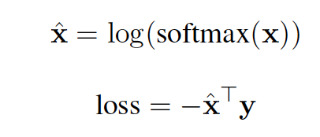
Joint Model with Masked LM
I [M] played basketball [SEP] [M] [DUR] [HRS]
1: Soft cross entropy for recovering Val
  If gold label is “hours”, the label vector y for “minutes, hours, days” will be [0.16, 0.47, 0.25]
2: Label weight adjustment
  Instances with “seconds” have higher loss than those with “years”
3: Full event masking
  Instead of 15% used by BERT, we use 60% when masking E1, … En to reduce biases
I [M] had a cup of [MASK] [SEP] [M] [TYP] [Evening]
-> MASK = coffee, because “cup of”
I [M] had [MASK] [MASK] of [MASK] [SEP] [M] [TYP] [Evening]
Notes:
♦We also use additional techniques including a soft cross entropy loss for temporal value recovery. ♦♦For example, if the gold label is hours, the neighboring values minutes and days will have a non-zero target value. ♦We use label weight adjustments to address the label imbalance in the training data.
♦We also use an additional technique called full event masking to further reduce biases, where instead of the 15% used by BERT, we use 60% when masking the event tokens.
♦This is helpful because a model may attend too much on strong priors, for example, ♦BERT will always predict “coffee” to follow “a cup of”, no matter what the temporal argument is. ♦However, if we mask the phrase “a cup of”, the prediction of the drink will be more conditioned to the temporal value, so that we may see some drink other than coffee to be the most popular choice in evenings.

Slide 38
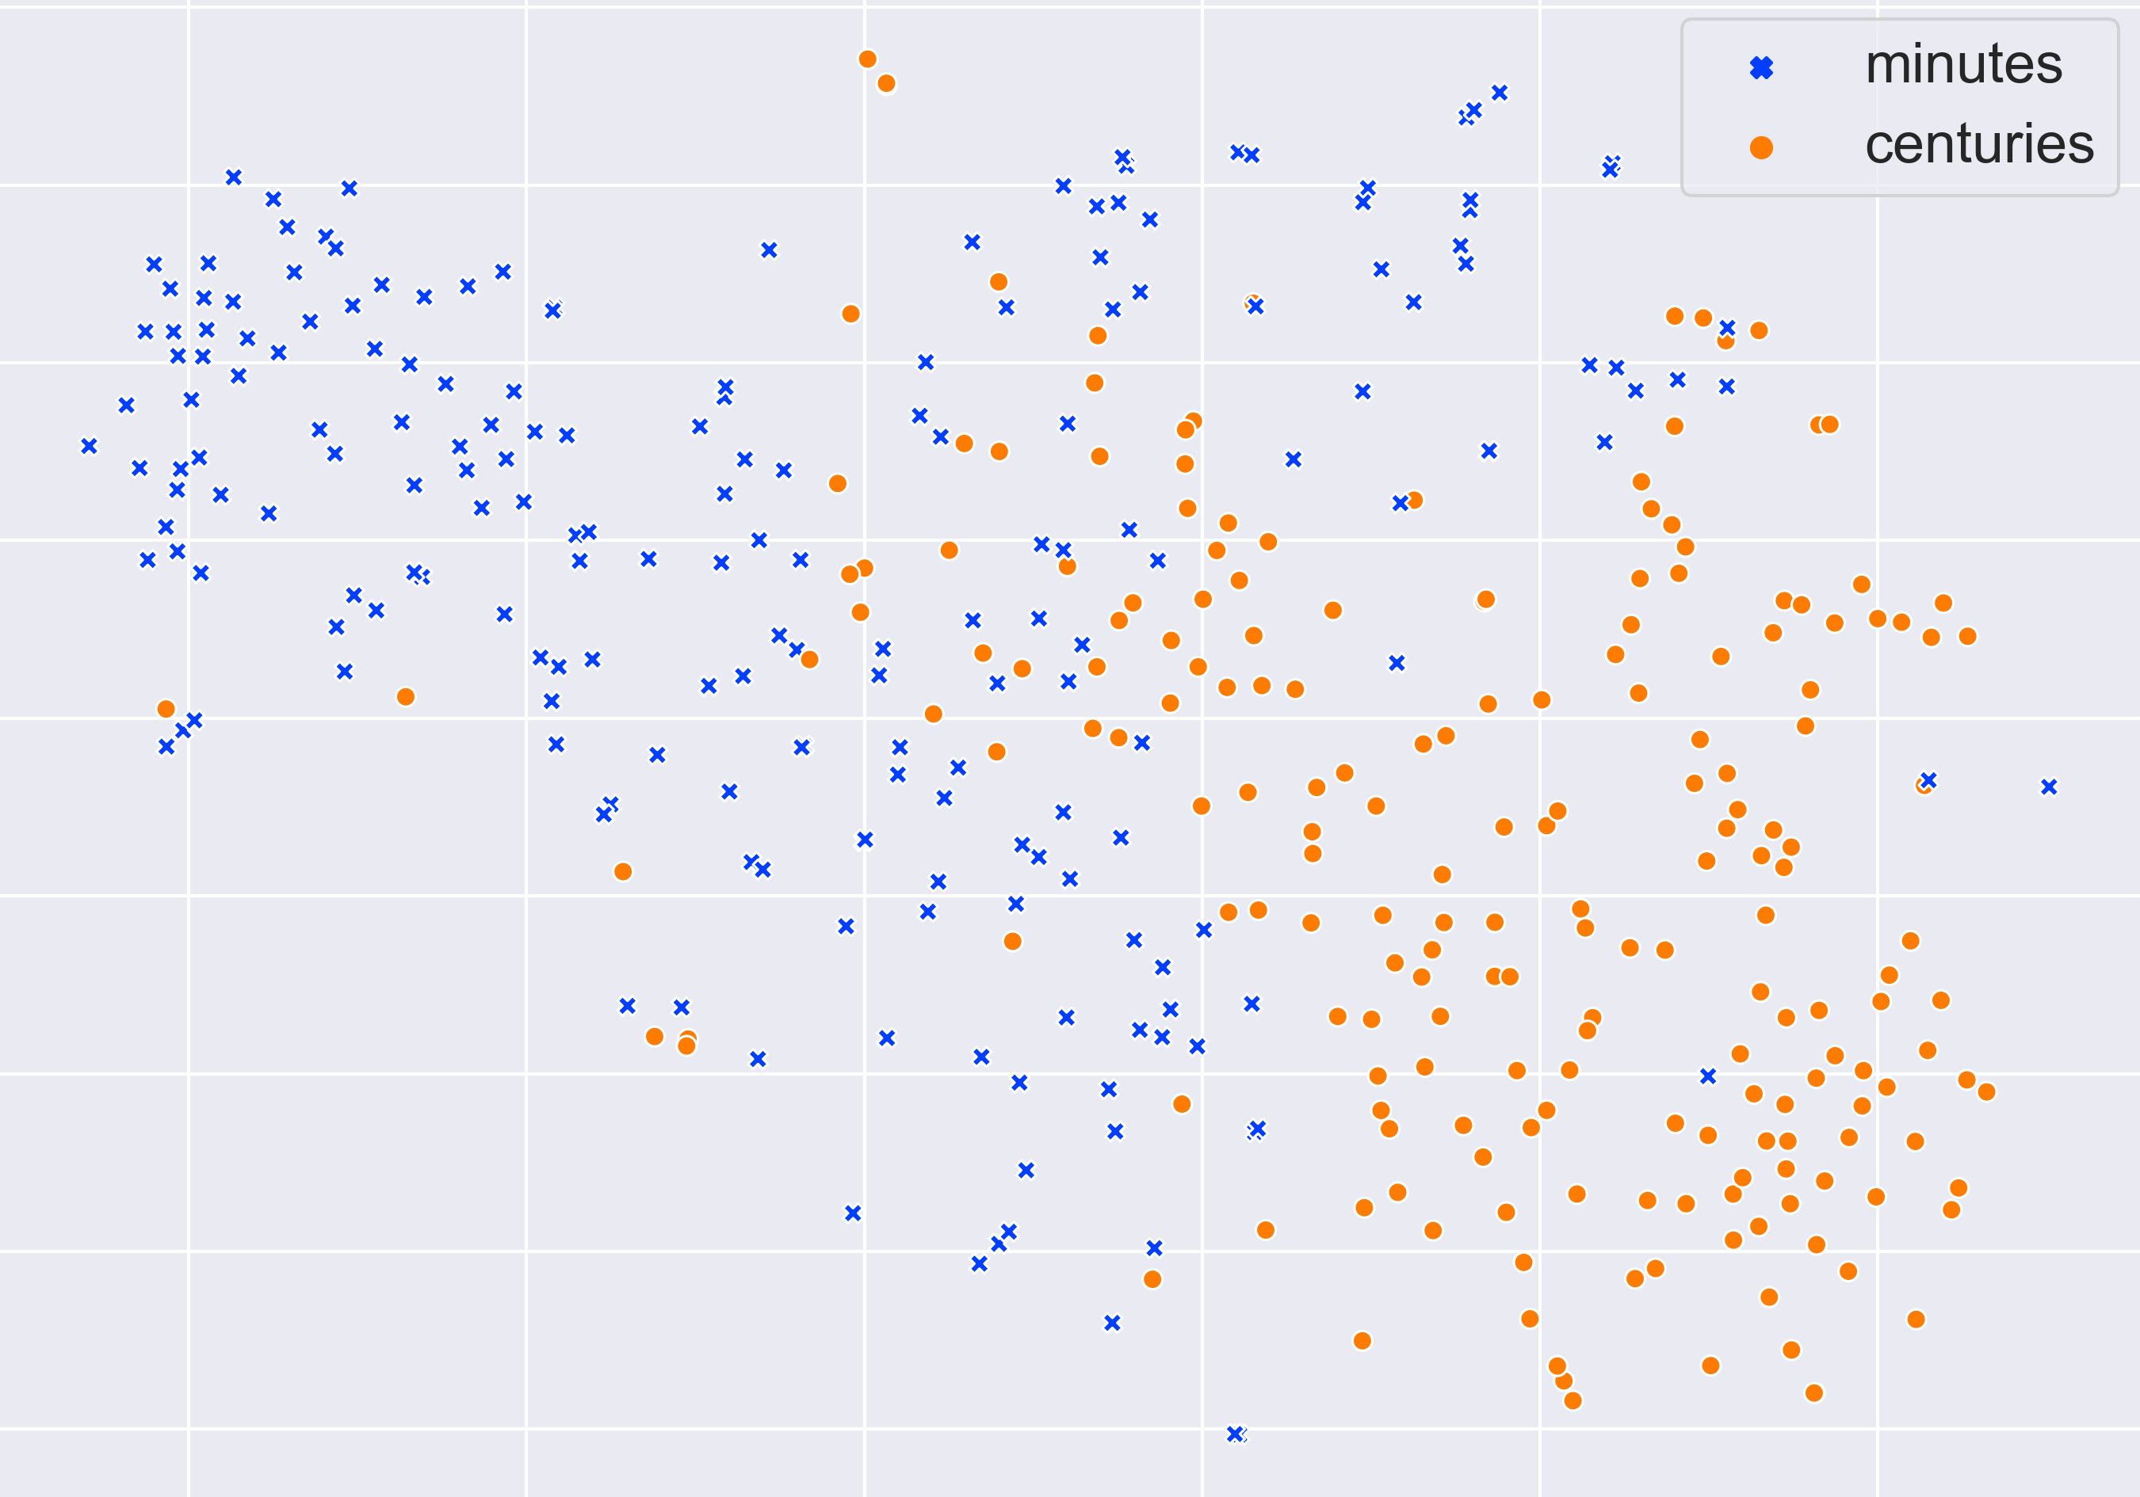
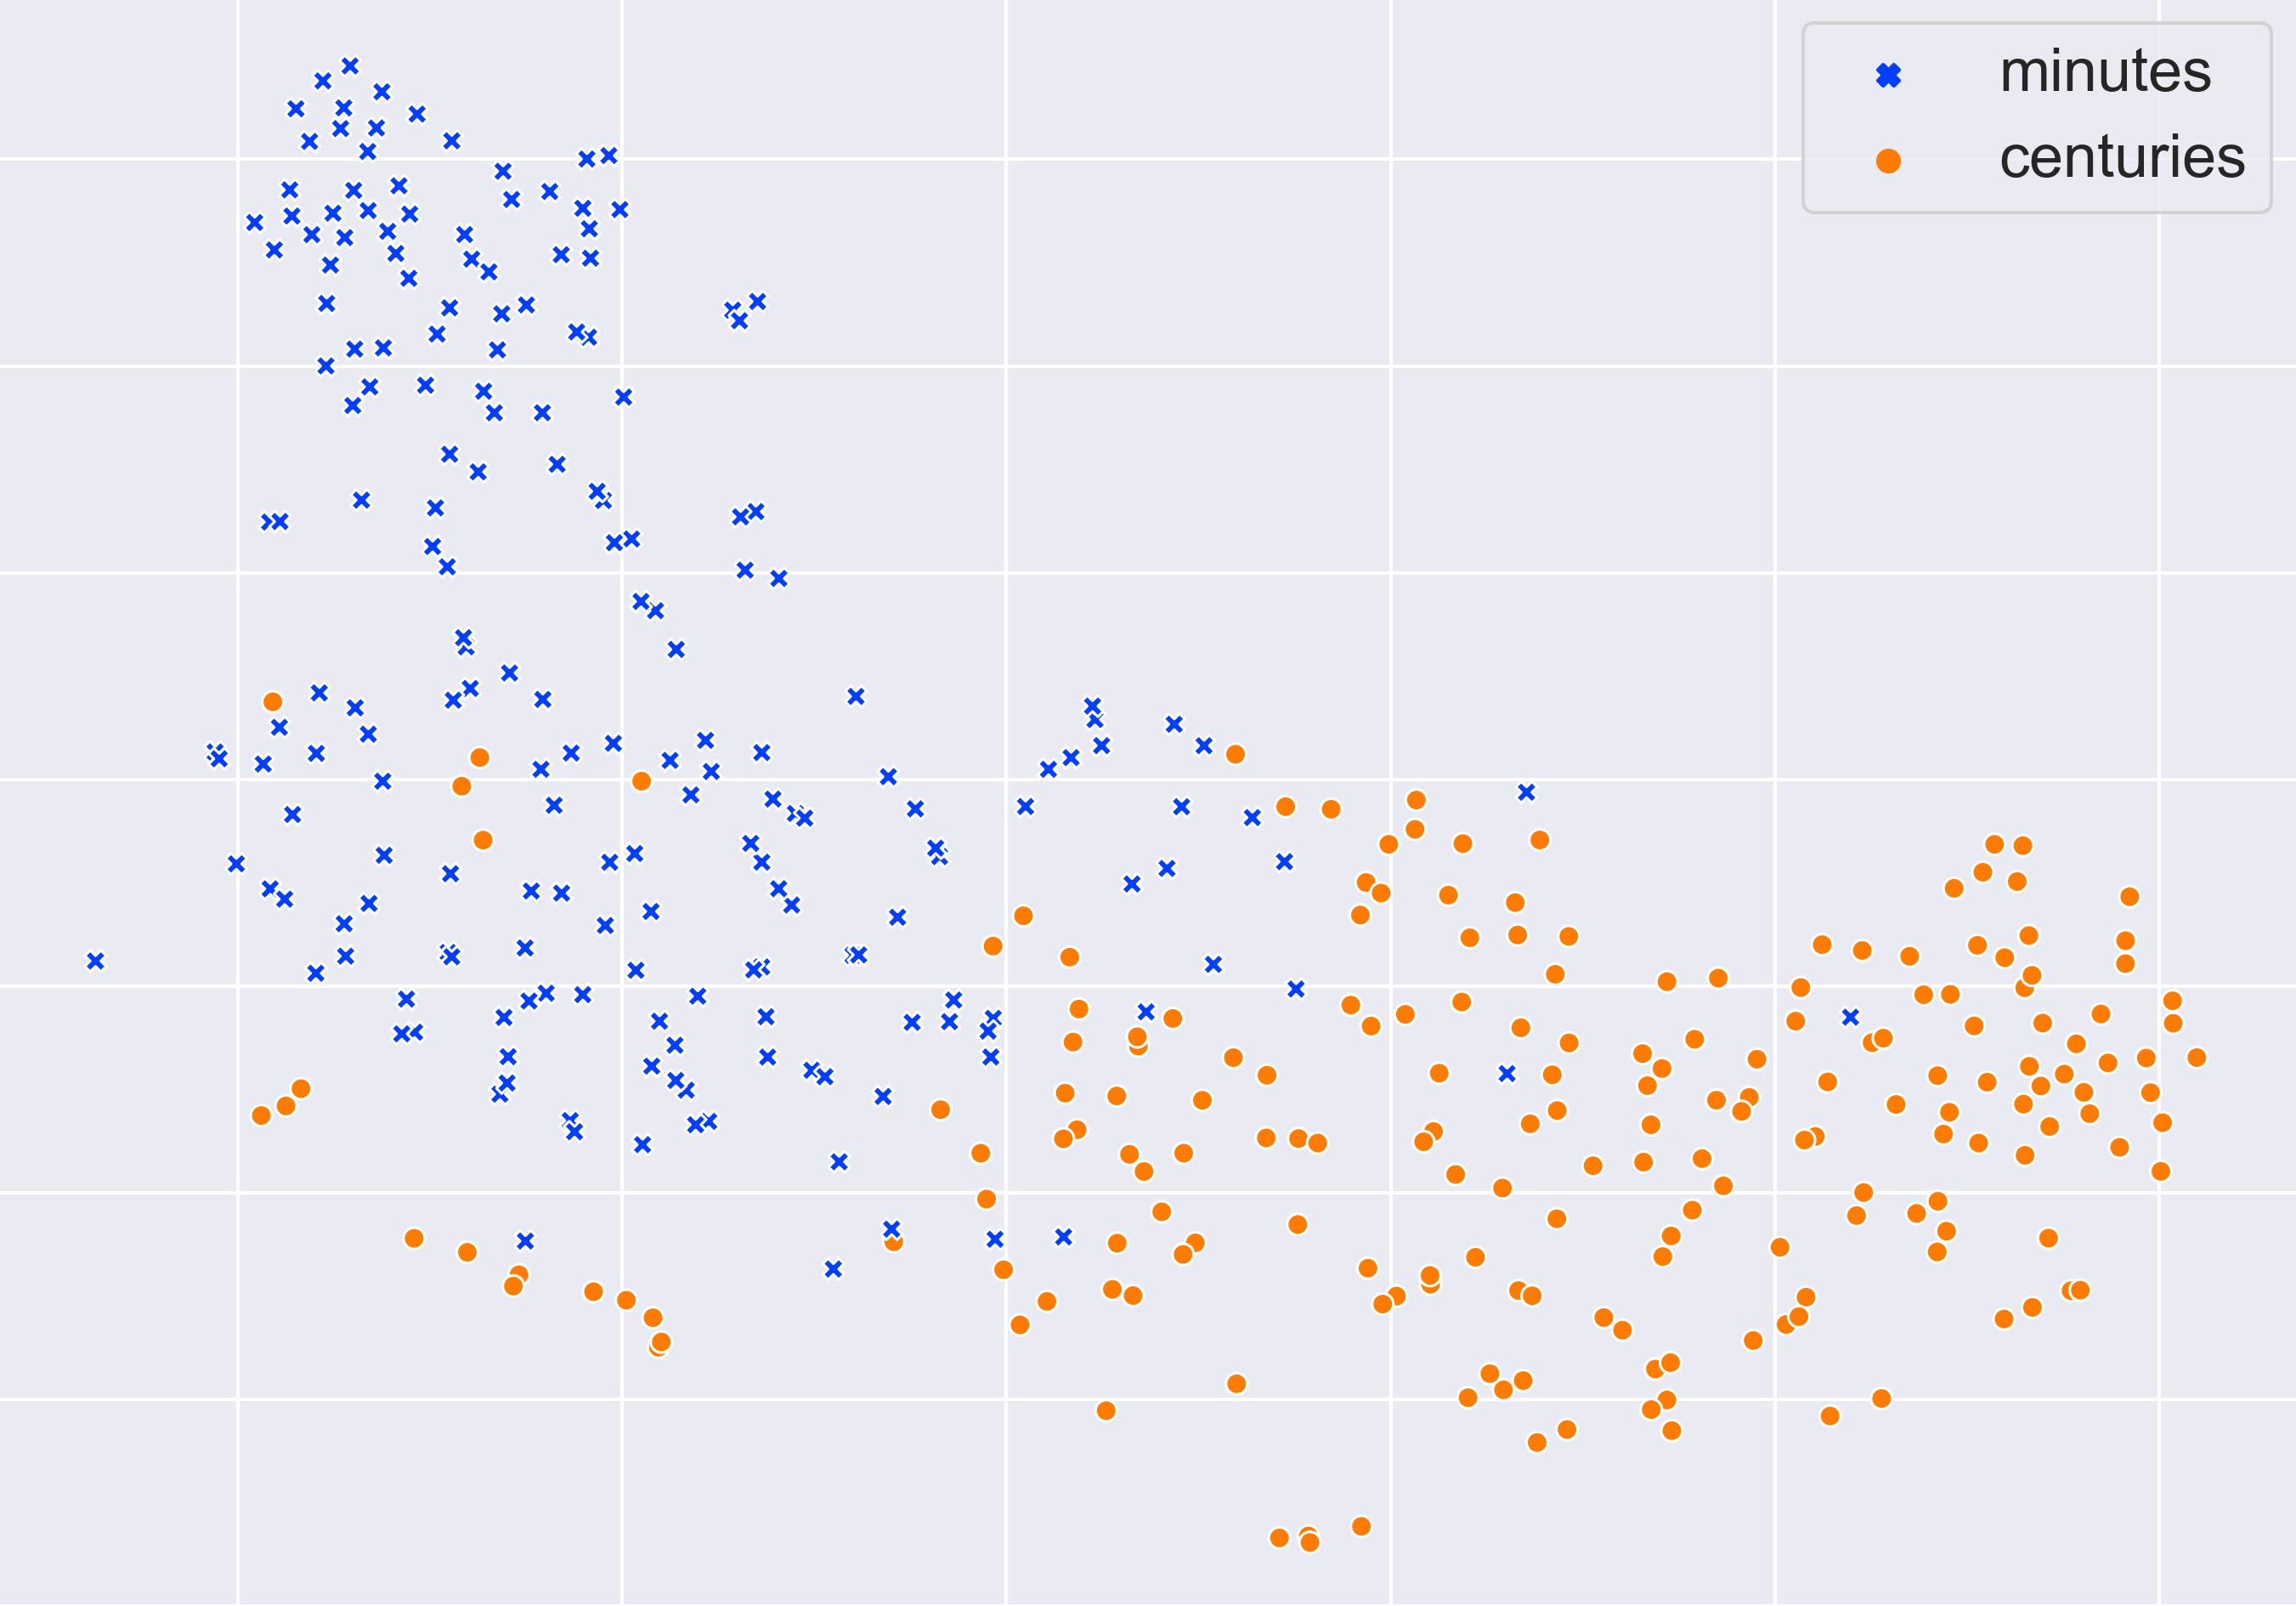
Evaluation: Embedding space
A collection of events with duration of “minutes” or “centuries” (two extremes)
  BERT & TACOLM representations of events’ triggers
  PCA + t-SNE to 2D visualization
Our model separates the events much better (➔ our model is aware of time)
  Extrinsic Evaluations show the advantage of TACOLM over “generic” LMs
BERT
TACOLM

Slide 39
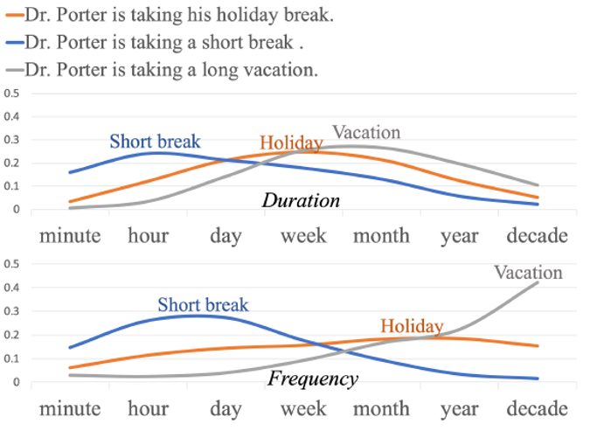


Temporal Commonsense, So Far…
A range of natural language understanding tasks require that we “understand” time
  And many of these require that we have commonsense
  In particular, since natural language rarely provides explicit temporal information
    How long does it take to open a window?
    What “things” change with time (and what do not)?
  In most cases – temporal knowledge is distributional
MC-TACO data set
  A challenge QA dataset for temporal commonsense
TACO-LM
  A time-aware Contextual Language Model
  Duration, typical time, frequency
  Produced distributions over time units;
    19% improvements over “standard” LMs
There is a lot more to do!
Will we make it to dinner before the movie?
Notes:
In conclusion, ♦we build a time-aware language model, and we are able to do this without annotations thanks to the ♦unsupervised information extraction step based on patterns. ♦We propose a joint learning scheme ♦that is able to utilize the inter-dimension relations. ♦The final model is able to directly predict events’ duration, frequency and typical time, ♦with an average 19% improvement over BERT. ♦It also produces bell-shaped distributions over continuous labels, ♦♦ and it differentiates fine grained contexts.
♦It also works as a general language mode, achieving 8% improvement on child-parent event relation extraction tasks. ♦Please refer to this link for our model and data, thank you!
Among the challenges – a key difference is that in Aristotle, the decomposition is implicit; in the dinner question it is explicit, so we can deal with it in a better way.
And, there are implicit events – how long would it take you find parking?

Slide 40



Temporal Reasoning on Implicit Events [Zhou et al. NAACL’21]
I got a free plane ticket to Chicago last week and had some local deep-dish pizza.
get tickets → fly to Chicago → deep dish pizza
A new Temporal Closure Inference dataset (TRACIE)
  A textual entailment dataset
  Premise: the Story [ROC stories]
  Hypotheses:
    Fly starts before had pizza starts
    Fly ends after had pizza starts
Develop a pattern-based pre-trained temporal model
Supports Symbolic Temporal Reasoning
  End time is rarely mentioned in text, and is very difficult to annotate
  But: End Time = Start Time + Duration
  Use a differentiable end-to-end design over existing modules
Generic reasoning module, without task-specific instances
Our Pre-trained Temporal model does well on Temporal data sets in a zero-shot way.
End time is important
Implicit event | comparator | query | explicit event
[randomly selected]

Slide 41



Reasoning via Symbolic Module Combination
A general way to “educate” sub-modules followed by dataset-specific finetuning
Expert 1 (Distance): Given two events, determine which start time is earlier and how early
Expert 2 (Duration): Given an event phrase, estimate how long it lasts
  Training is done via unsupervised pattern IE, as in TACO-LM
Task-specific pretraining
Dataset-specific fine-tuning with combined modules
(More) General Reasoning about Time
Pattern based IE from unlabeled text
Pre-trained LM
(fairly good on many things)
Expert Modules
(very good at one thing)

Slide 42
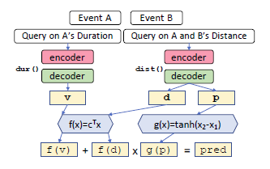
Reasoning via Symbolic Module Combination
Textual Entailment: Context → Fly starts/ends before/after Eat Pizza
If the comparator is “start” (compare e₁’s start time with e₂’s start time)
  If distance(e₁,e₂) > 0 then before; else after
If the comparator is “end” (compare e₁’s end time with e₂’s start time)
  If distance (e₁,e₂) - duration(e₁) > 0 then before; else after
Easy
Symbolic Reasoning
Estimation of e₁,e₂ in the form of probabilities across units
Probabilities of pos/neg
End time prediction
p = [P_{bef}, P_{aft}]
d = dist over temporal units
Dot product the probability vector with a constant vector to get a median estimation of the probabilities
Very strong results:
Outperforms “standard” pre-trained models that are fined tuned on TRACIE, even without seeing TRACIE
Differentiable end-to-end fine-tuning

Slide 43
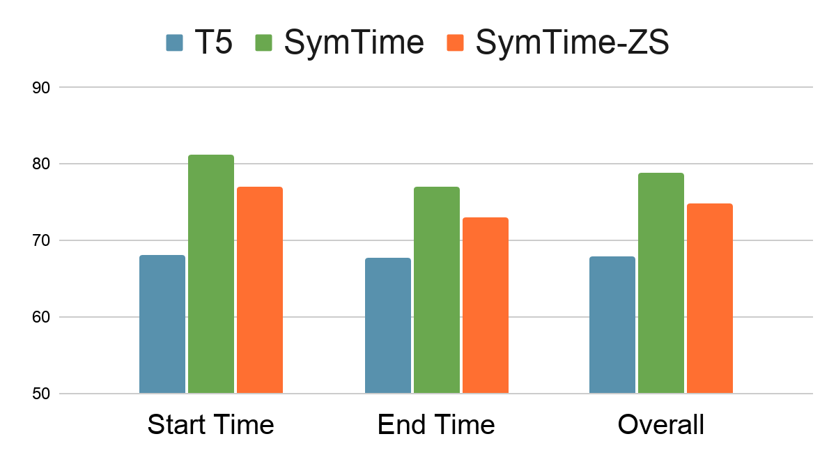
Experiments: Symbolic Differentiable Reasoning
SymTime: Symbolic Temporal Reasoning; our proposed model
SymTime-ZS: Our proposed model without TRACIE finetuning
T5: T5-Large fine-tuned on a dataset annotated for Time (MATRES)
SymTime: Our PTNTIME based model, fine-tuned on TRACIE
SymTime-ZS: Our PTNTIME based model, without fine-tunning on TRACIE
Zero-shot model significantly outperforms supervised baselines
Will we make it to dinner before the movie?
Symbolic (differentiable) Reasoning over temporal distributions
Notes:
Our zero-shot model also outperforms all supervised baselines without any fine-tuning on TRACIE, encouraging future works of event understanding from distant supervision.

Slide 44
Challenges We Need to Address
Many challenges on our way to facilitate communication
  Key issues here have to do with how we supervise models to deal with sparse situations
  Reasoning: making decisions in situations that we cannot directly train for
Communication, from Hard to Easy
  Understanding Instructions
    Robustness
  Answering Questions
    Decomposition, Composition, and Commonsense
  Interpretating Answers
    Indirect Answers
There is a lot more to say about Answering questions
  Some of the most interesting are about supervision
Skip Details

Slide 45
Talk with My Agent About….[Gupta et al. ‘18’, ’19, ’20, ’21]
In the first quarter, the Bears Cutler fired a 7-yard TD pass to tight end Greg Olsen. … In the third quarter, the … back Adrian Peterson's 1-yard touchdown run. The Bears increased their lead over the Vikings with Cutler's 2-yard TD pass to tight end Desmond Clark. The gap was reduced when Favre fired a 6-yard TD pass to tight end Visanthe Shiancoe. The Vikings … with Adrian Peterson's second 1-yard TD run. The Bears then responded with Cutler firing a 20-yard TD pass to wide receiver Earl Bennett. The Bears then won on Jay Cutler's game-winning 39-yard TD pass to wide receiver Devin Aromashodu.
Who scored the longest touchdown pass of the game?
Text Comprehension challenges:
  Understand the text
    Identify and contextualize events, entities, quantities (and their scope), relations, etc.
  Understand questions about the text
    Often, requires decomposing the question in a way that depends on the text
  Reason about the text
    Combine and manipulate the identified information to accomplish information needs (e.g., answering questions)
How can we supervise to support this level of understanding?
  Too many (ill-defined) latent decisions
    Annotating text for all is not scalable
  End-task supervision is the only realistic approach
  [Clarke et. al.’10]: Response Driven Semantic Parsing
  This level of supervision is too loose – how can we learn all the latent decisions from end-to-end supervision?
She reports worsened seizure frequency, seizures now occurring up to 10/week, in clusters about 2-3 day/week. Previously reported seizures occurring about 2-3 times per month, often around the time of menses,…
What is her seizure frequency?
Mayor Rahm Emanuel has raised more than $10 million toward his bid for a third term – more than five times the total raised by his 10 challengers combined, campaign finance records show.
How much did his challengers raise?
The COVID-19 pandemic in the United States is part of the worldwide pandemic of coronavirus disease 2019 (COVID-19). As of October 2020, there were more than 9,000,000 cases and 230,000 COVID-19-related deaths in the U.S., representing 20% of the world's known COVID-19 deaths, and the most deaths of any country.
Notes:
We are interested in developing a question answering system that given as input a question and a relevant paragraph of context, produces the correct answer
For example, given the question “Who scored the longest touchdown pass of the game?” and a summary of an American Football game, the model should be able to produce the correct answer

Slide 46
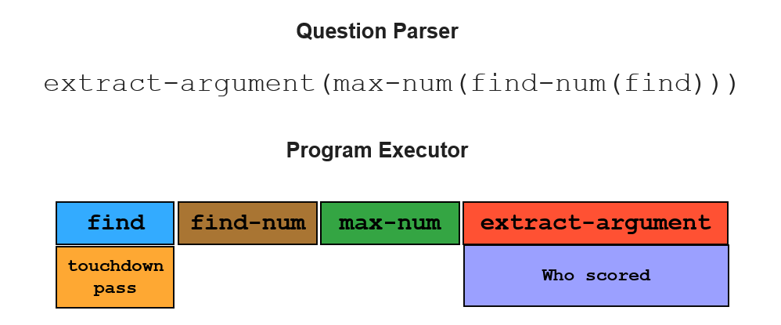
Supervising for Reasoning about Text
Who scored the longest touchdown pass of the game?
Answering complex questions about events requires reasoning, done over learned compositional, structured models, that depend on latent decisions
We need to induce a program, with some executable modules at the leaves
  “This phrase” indicates a field goal/touchdown
  “This player” scored it; “this is the length”, etc.
Reason symbolically over it.
  Possibly, over probabilistic representations of the latent variables.
One key to supervision: indirect signals
Who scored the shortest touchdown pass of the game?
In the first quarter, the Bears Cutler fired a 7-yard TD pass to tight end Greg Olsen. … In the third quarter, the … back Adrian Peterson's 1-yard touchdown run. The Bears increased their lead over the Vikings with Cutler's 2-yard TD pass to tight end Desmond Clark. The Vikings … with Favre firing a 6-yard TD pass to tight end Visanthe Shiancoe. The Vikings … with Adrian Peterson's second 1-yard TD run. The Bears then responded with Cutler firing a 20-yard TD pass to wide receiver Earl Bennett. The Bears then won on Jay Cutler's game-winning 39-yard TD pass to wide receiver Devin Aromashodu.
How many touchdowns were scored?
How long was the longest touchdown?
Jay Cutler
Notes:
We are interested in developing a question answering system that given as input a question and a relevant paragraph of context, produces the correct answer
For example, given the question “Who scored the longest touchdown pass of the game?” and a summary of an American Football game, the model should be able to produce the correct answer

Slide 47
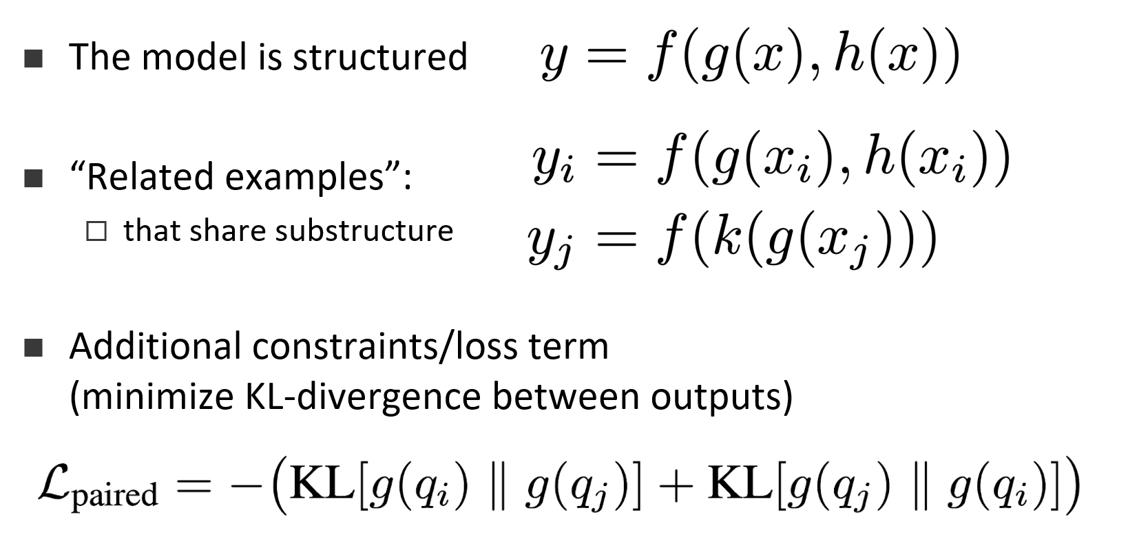
Supervising for Reasoning about Text
Who scored the longest touchdown pass of the game?
Answering complex questions about events requires learning compositional, structured models, that depend on latent decisions
End-task supervision only provides a weak indirect signal to latent decisions
  When do we learn “touchdown”?
  In fact, also: when do we learn “max”?
We introduce a way to generate and leverage indirect supervision signals via paired examples
  Stronger cues for learning latent decisions.
Who scored the shortest touchdown pass of the game?
In the first quarter, the Bears Cutler fired a 7-yard TD pass to tight end Greg Olsen. … In the third quarter, the … back Adrian Peterson's 1-yard touchdown run. The Bears increased their lead over the Vikings with Cutler's 2-yard TD pass to tight end Desmond Clark. The Vikings … with Favre firing a 6-yard TD pass to tight end Visanthe Shiancoe. The Vikings … with Adrian Peterson's second 1-yard TD run. The Bears then responded with Cutler firing a 20-yard TD pass to wide receiver Earl Bennett. The Bears then won on Jay Cutler's game-winning 39-yard TD pass to wide receiver Devin Aromashodu.
How many touchdowns were scored?
How long was the longest touchdown?
Jay Cutler
Latent Decision Model
Notes:
We are interested in developing a question answering system that given as input a question and a relevant paragraph of context, produces the correct answer
For example, given the question “Who scored the longest touchdown pass of the game?” and a summary of an American Football game, the model should be able to produce the correct answer

Slide 48
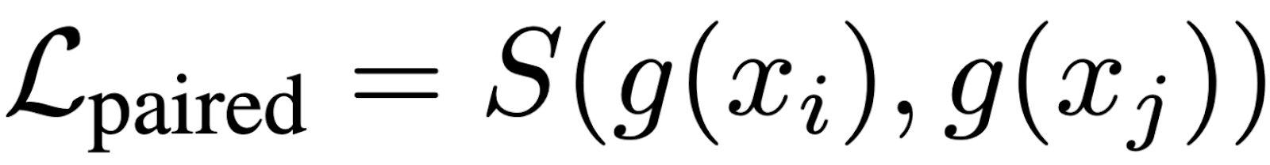
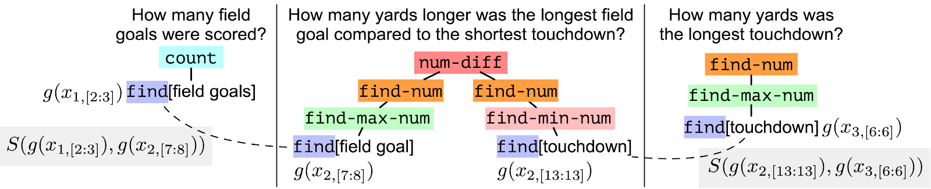
Paired Objective
Enforce consistency between outputs of shared-substructures
encourage similarity between outputs
This approach to supervision can be shown to provide better compositional generalization

Slide 49
Challenges We Need to Address
Many challenges on our way to facilitate communication
  Key issues here have to do with how we supervise models to deal with sparse situations
  Reasoning: making decisions in situations that we cannot directly train for
Communication, from Hard to Easy
  Understanding Instructions
    Robustness
  Answering Questions
    Decomposition, Composition, and Commonsense
  Interpretating Answers
    Indirect Answers
Agents need to understand and reason about implicit events
  But also about implicit information in responses they receive

Slide 50

Understanding Indirect Answers [with Annie Louis & Filip Radlinski; EMNLP’20]
How to interpret an utterance in a given situational context?
Yes/No questions can be answered directly
  A: “Do you have kids”
  B: “Yes”
Or indirectly
  A: “Do you have kids”
  B: “I have two daughters”
A meets his/her new neighbor
And A can infer more than just Yes/No
Yes, has kids.
Two daughters
Has only two kids.

Slide 51

It’s not always Yes/No
How to interpret an utterance in a given situational context?
  A: “Have you eaten”
  B: “I am really hungry”
“Probably no”
B didn’t answer, but implied that he/she would like to eat
The exact answer does not matter if the intention is to invite to dinner
Humans have no difficulty resolving such cases and carrying on the conversation

Slide 52
It could be Contextual
It could be quite clear regardless of the question:
  A1: “I would like that”
  A2: “I wish”
But,
Humans have no difficulty resolving such cases and carrying on the conversation
“Want to get Dinner?”
“Want to get lunch?”
“Dinner would be lovely”

Slide 53
Understanding Indirect Answers [with Annie Louis & Filip Radlinski; EMNLP’20]
Study this question computationally
Develop a dataset
Develop models that show that this problem is tractable
Open: how to continue the conversation?
A meets his/her new neighbor

Slide 54
A Lot of Related Work
Why people provide indirect answers?
    (Stenstrom, 1984, Brown and Levinson, 1978, Hirschberg, 1985)
  Being more polite, provide explanation, anticipate follow-up questions.
Some computational work
    Green and Carberry, 1999 , Potts 2008, de Marneffe et al, 2009-11,2016
But no large-scale corpus and data-driven solutions
  Recent work on Yes/No questions (e.g., BOOLQ, Clark et. al 2019)
    Focuses on factual Yes/No answers from a passage.

Slide 55
‘Circa’ dataset
Circa ~ approximately
First large-scale dataset with 34,268 single turn dialogs
  Question + indirect answer
High quality and crowd-annotated in 4 steps
  With several pilots
Your friend’s preferences about food
Your friend’s preferences about books
Your friend’s preferences about music
Your friend’s preferred weekend activities
Meeting your new neighbor
Meeting your childhood neighbor at a cafe
Your friend is at the door leaving work on a Friday
Your friend visits you from out of town
Your friend is considering changing his job
Your friend is considering buying a flat in NY
Define Situational Context:
  Not easy: which questions elicit indirect answers?
Sample 350 questions from each situation, 10 answers for each question
350 x 10 x 10 = 35,000 questions.

Slide 56
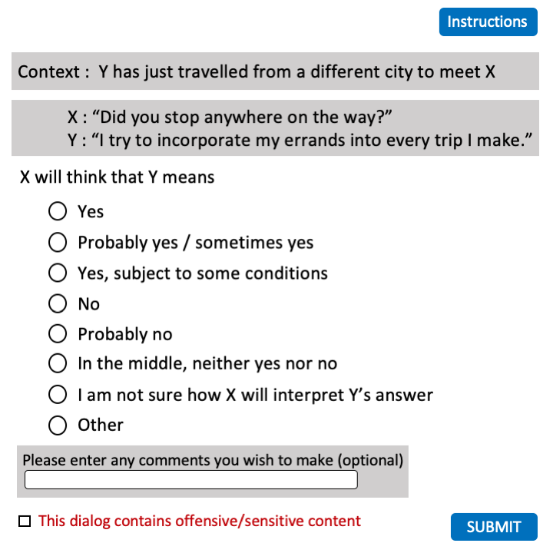
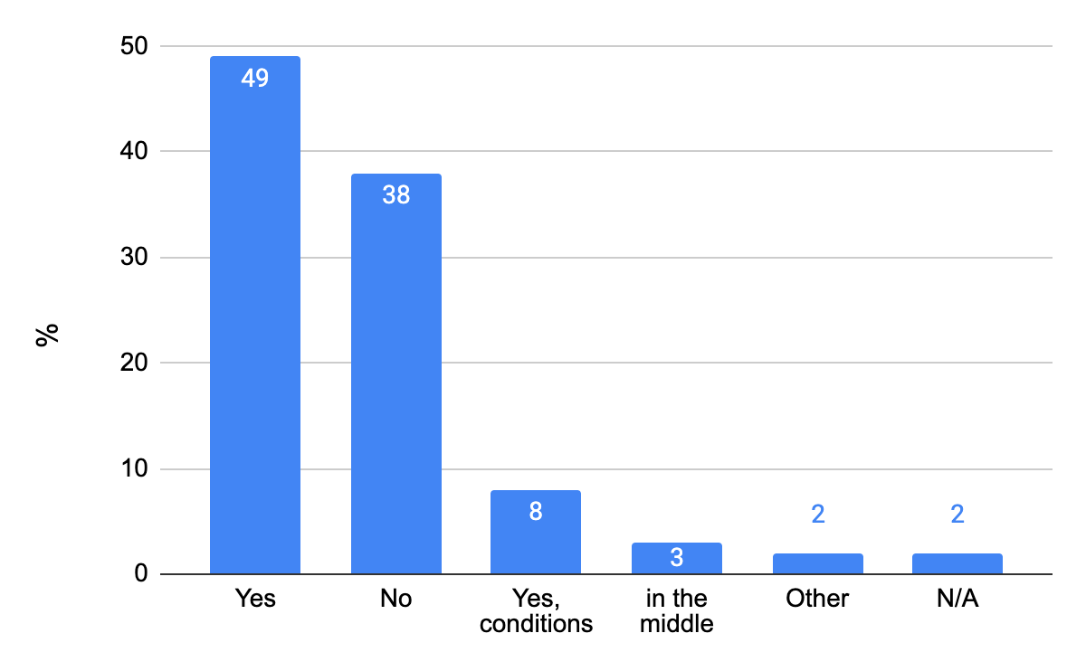
Answer Interpretation
5 annotators per QA: how do you understand the answer
35,000 * 5 = 175,000 judgements
Relaxed Labels: Map to definite labels
  Probably yes → Yes
  Probably no → No
  I am not sure → In the middle
Good Agreement (0.76 Fleiss Kappa on Relaxed)

Slide 57
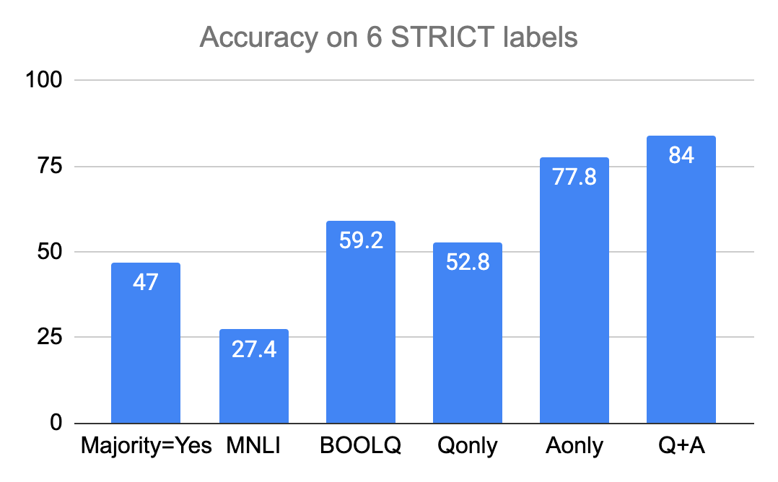
Automatically Predicting Meaning
Multiclass classification
Approach:
  BERT fine-tuned on our dataset
BERT fine-tuned on Questions only
  Q: “Is it good to see me?”
BERT fine-tuned on Answers only
  A: “I would love to.”
BERT fine-tuned on Question + Answer
  Q: “Are you coming to the party?”
  A: “I am really tired today.”
Also, leveraging transfer learning
  MNLI, BOOLQ, Discourse Connective Predictor
Good Agreement (0.76 Fleiss Kappa on Relaxed)
Answer contains important signals
Best performance comes from Q + A

Slide 58
Understanding Indirect Answers [with Annie Louis & Filip Radlinski; EMNLP’20]
A challenging inference problem
  Good accuracies but much scope for improvements
Out-of-scenario prediction not yet robust
  Data publicly released at http://goo.gle/circa
Multilingual and cultural differences still to be explored
Follow up questions?
A: “Do you have kids”
B: “I have two daughters”
There are many coherent follow-ups
A meets his/her new neighbor
Wonderful!
Do you have any pets?
If A’s intention was to provide some neighbourhood information
There are some great schools nearby!
With lots of parks, it is very family friendly around here

Slide 59


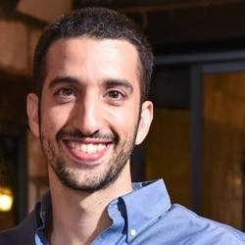
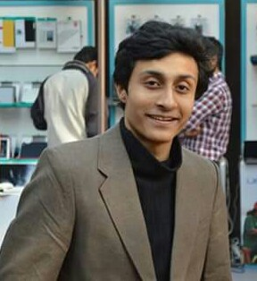




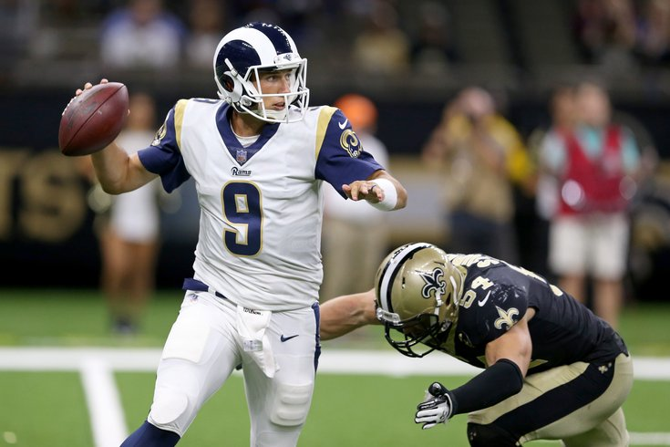
Conclusion
Thank You!
A small sample from a research program that attempts to address some of the key scientific and engineering challenges between us and understanding natural language
In the context of reasoning in order to communicate better
  Understanding Instructions
  Answering Questions that require reasoning about time (& Common Sense)
  Interpreting Indirect Answers

Slide 60
End

Slide 61
CliffsNotes
Multiple natural language documents
  Small units of text or large units of texts
  Reading news about an event/situation over time and/or from multiple sources
  Reading a book
  The novel features the character David Copperfield, his journey of change and growth from infancy to maturity, as many people enter and leave his life and he passes through the stages of his development. (Fiction, and you know it)
  London and England in the 19-th century; socio-economic state, child exploitation; schools, prisons, emigration to Australia (true historical facts)
What are the computational tasks that we should think about?

Slide 62
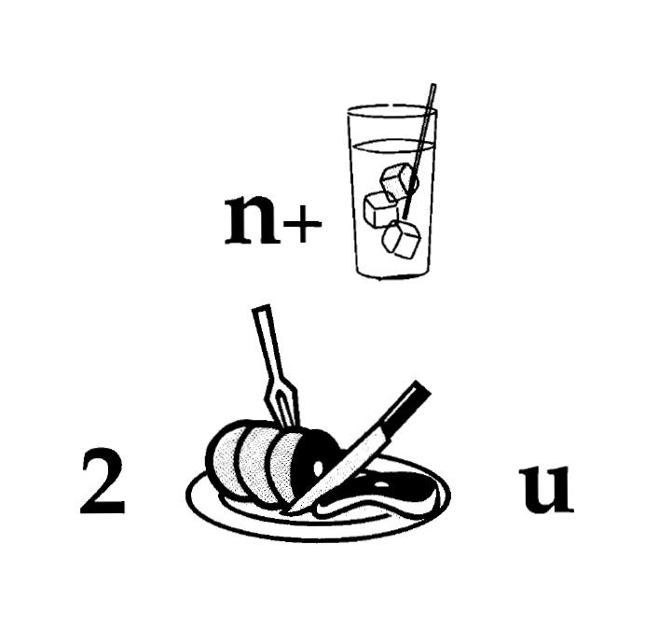
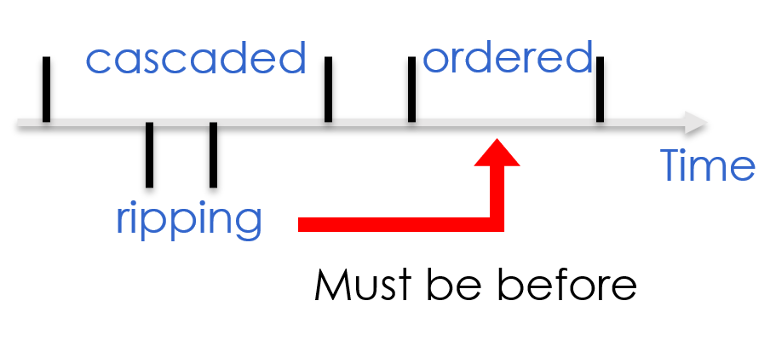
It’s Time to Reason:
Outline
Addressing “sparse” challenges
  Decomposition and Composition (and some more)
Assigning values to multiple interrelated variables
  Given observations and knowledge
  Most likely assignment: Abduction
Decisions over a dynamic set of interrelated variables
  The Aristotle example
    Need a strategy to decide what the variables are & a function computed over it
  Temporal Commonsense
Computing functions over multiple interrelated inferred variables
  Last; longest, frequency, etc.
Will we make it to dinner before the movie?
Who scored the last field goal for the Eagles?
[given a recap of the game]
She reports worsened seizure frequency, seizures now occurring up to 10/week, in clusters about 2-3 day/week. Previously reported seizures occurring about 2-3 times per month, often around the time of menses,…
[Example courtesy of Brian Litt’s Lab]

