Slide 1
It’s Time for Reasoning or
Learning to Reason (Chp. II)
Dan Roth
Computer and Information Science
University of Pennsylvania
Department of Computer Science
Indiana University, IN
September 2019

Slide 2
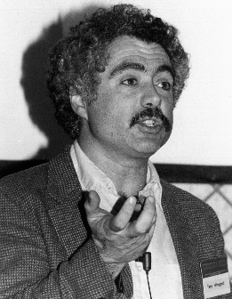
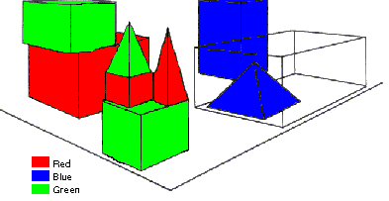
SHRDLU (Terry Winograd, 1968)
Person: Pick up a big red block.
Computer: OK.
Person: Grasp the pyramid.
Computer: I DON'T UNDERSTAND WHICH PYRAMID YOU MEAN.
Person: Find a taller block than the one you are holding and put it into the box.
Computer: BY "IT", I ASSUME YOU MEAN…..
Computer: OK.
Person: What does the box contain?
Computer: THE BLUE PYRAMID AND THE BLUE BLOCK.
Person: What is the pyramid supported by?
Computer: **What do you mean by “supported”?
……….
Person: How many blocks are not in the box?
Computer: FOUR OF THEM.
Understanding, executing and interacting requires language understanding & reasoning
to recognize goals and advance the task
Notes:
SHRDLU, Computer program that has conversation with user, via Natural Language interface
-> About “block world”, virtual box filled with different blocks, different shapes, sizes and colors: e.g. Red block, white box, blue pyramid
The robot can pick the objects, move them, count them ..
Combination of a few principles made the simulation of robot behavior very realistic
SHRDLU's world was so simple that the entire set of objects and locations could be described by including as few as perhaps 50 words:
nouns like "block" and "cone", verbs like "place on" and "move to", and adjectives like "big" and "blue".
The possible combinations of these basic language building blocks were quite simple, and the program was fairly adept at figuring out what the user meant.
SHRDLU also included a basic memory to supply context. One could ask SHRDLU to "put the green cone on the red block" and then "take the cone off"; "the cone" would be taken to mean the green cone one had just talked about. SHRDLU could search back further through the interactions to find the proper context in most cases when additional adjectives were supplied. One could also ask questions about the history, for instance one could ask "did you pick up anything before the cone?“
Deduction rules: Could deduce that blocks could be stacked by looking for examples, but would realize that triangles couldn't be stacked
Learn new names: For instance one could say "a steeple is a small triangle on top of a tall rectangle"; SHRDLU could then answer questions about steeples in the blocks world, and build new ones.

Slide 3
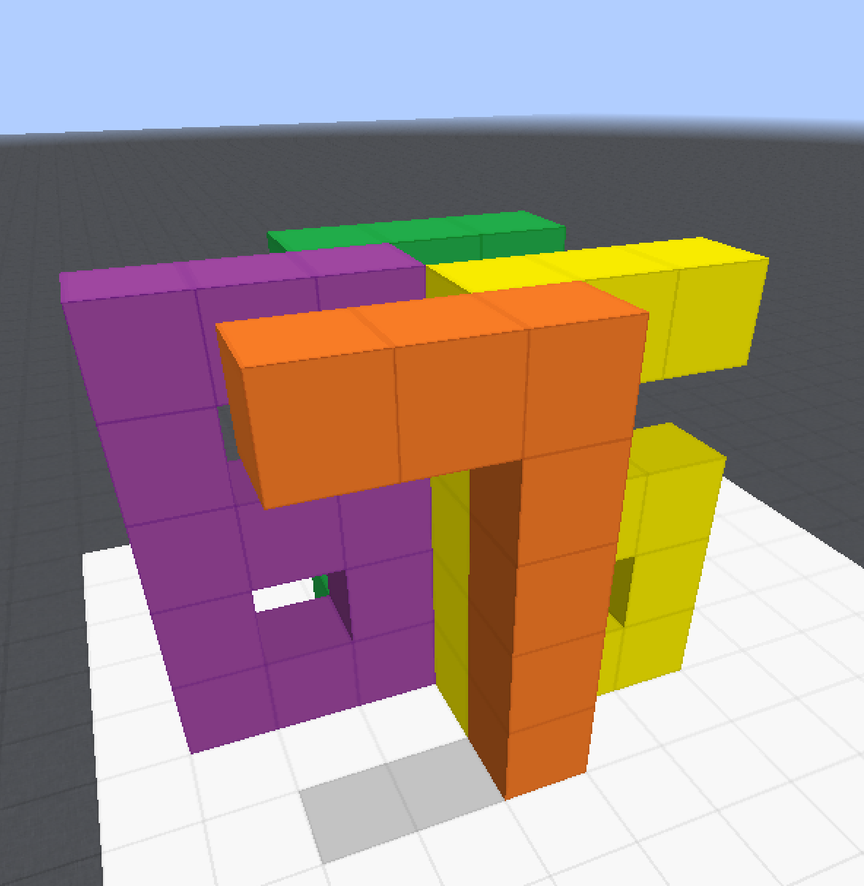
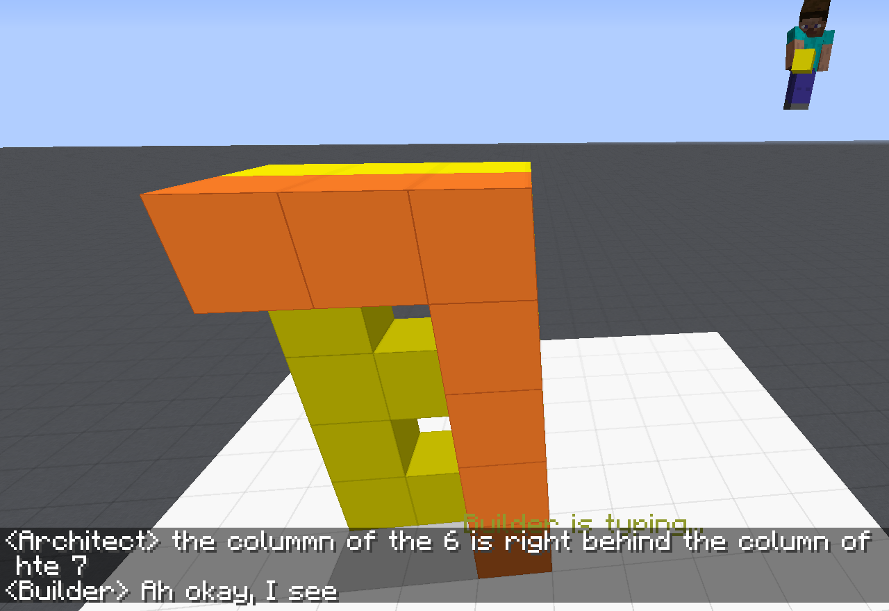
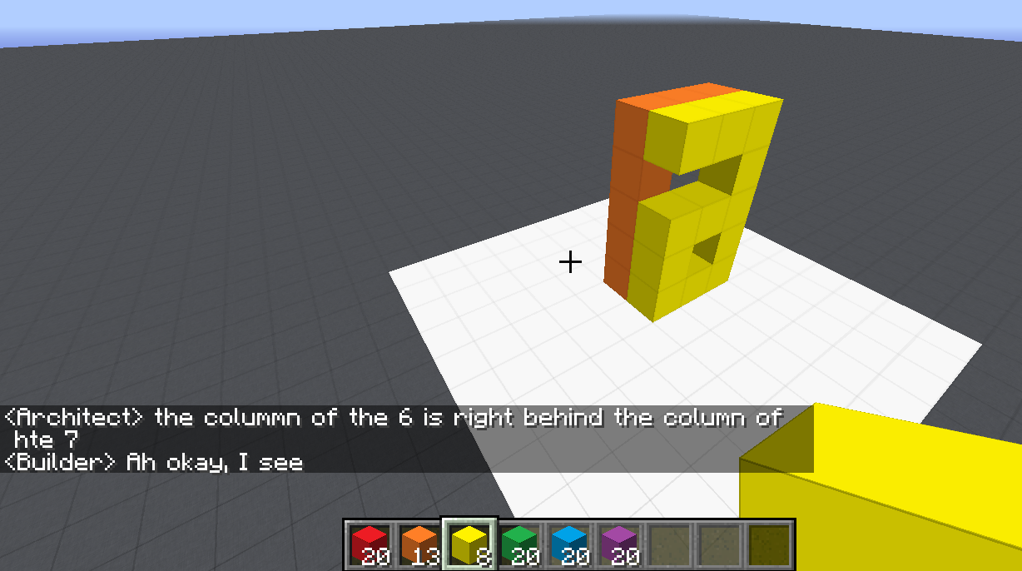
Communication (CwC Project, 2017-2019)
ARCHITECT
CHAT INTERFACE
Architect: | in about the middle build a column five tall
(Builder puts down five orange blocks)
Architect: | then two more to the left of the top to make a 7
(Builder puts down two orange blocks)
Architect: | now a yellow 6
Architect: | the long edge of the 6 aligns with the stem of the 7 and faces right
Builder: | Where does the 6 start?
Architect: | behind the 7 from your perspective
Builder: | Is it directly adjacent?
Architect: | yes directly behind it. touches it
(Builder puts down twelve yellow blocks, in the shape of a 6)
Architect: | too much overlap unfortunately
Architect: | the colummn of the 6 is right behind the column of hte 7
Target Structure
Build Region
BUILDER
[Minecraft example from Julia Hockenmaier]

Slide 4
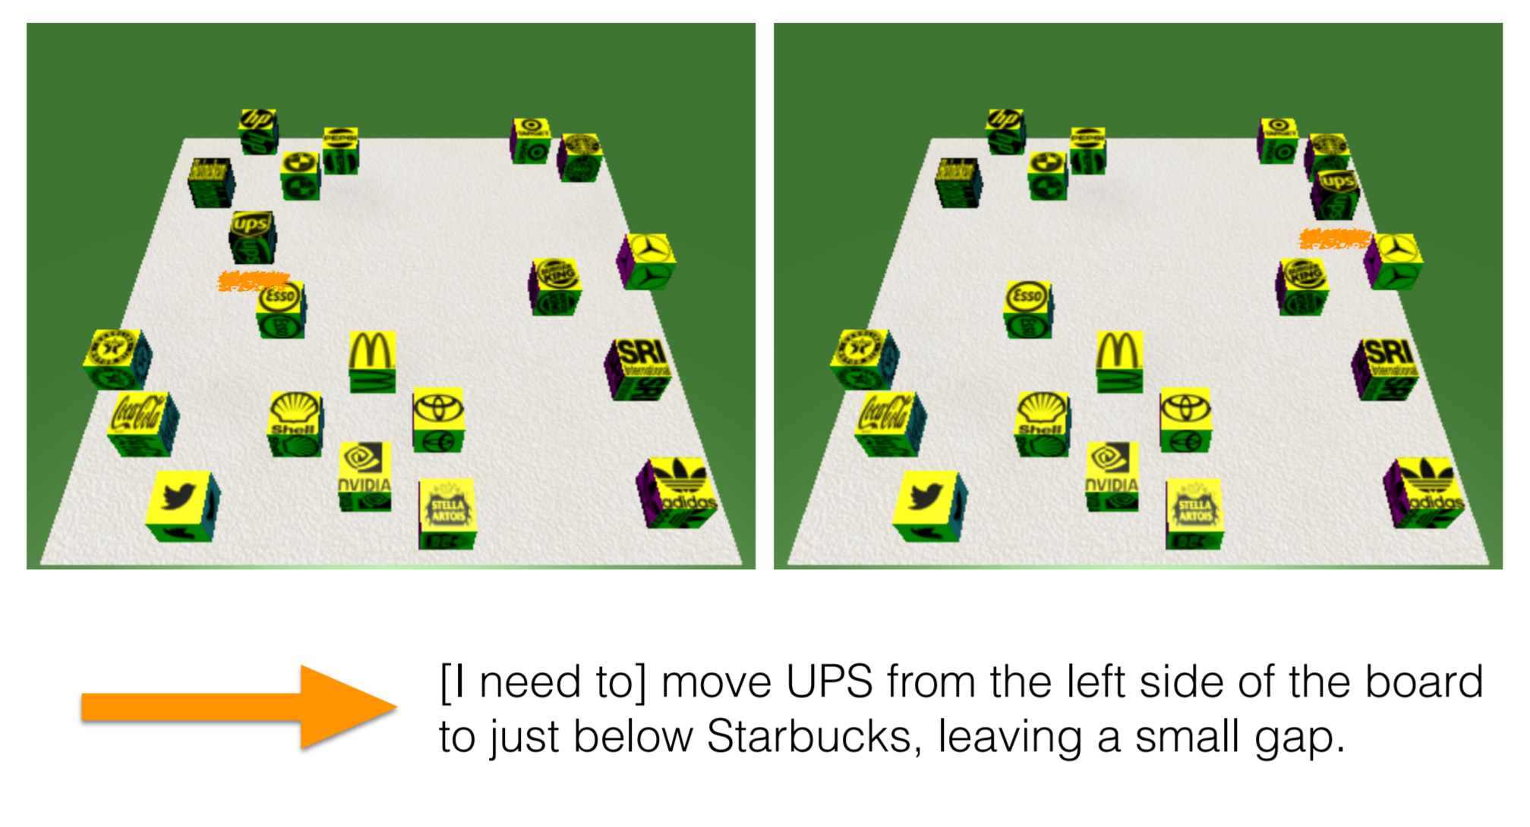
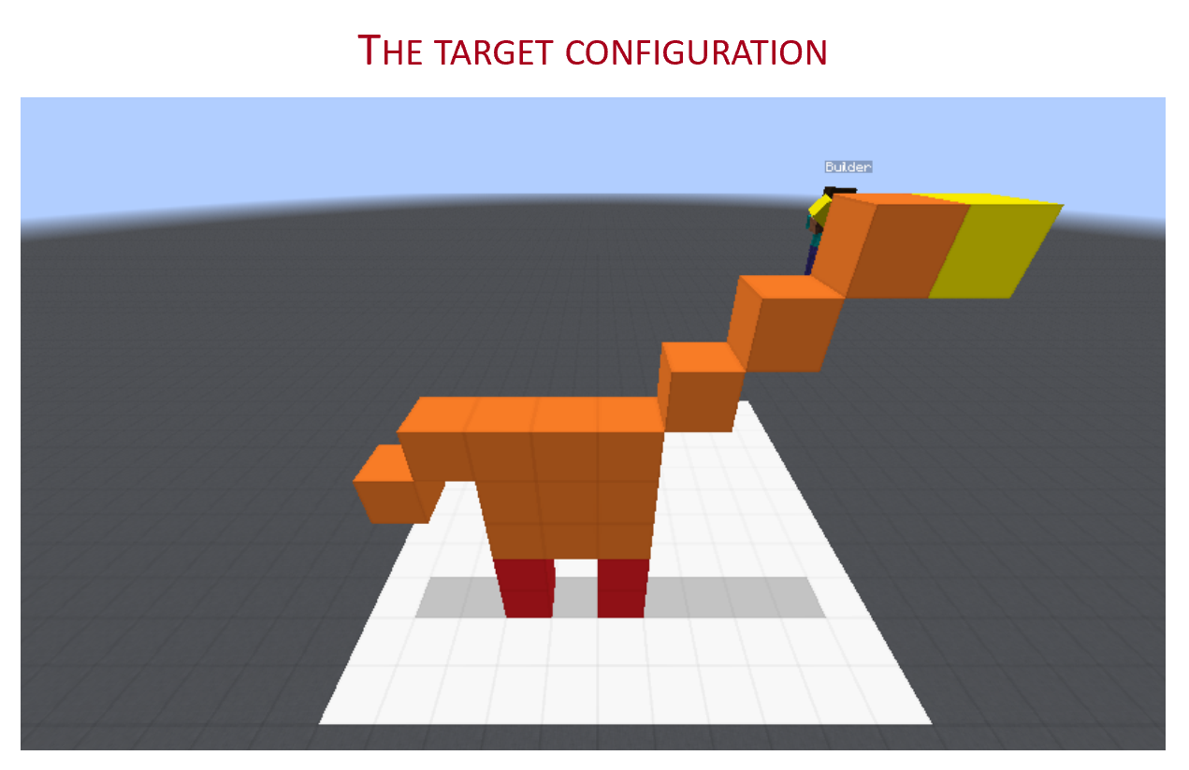
Communication (CwC Project, 2017-2019)
Consider the following explanation:
  [Example from Yonatan Bisk]
  Imagine that this is a chess board
  Place the UPS in H2, and McDonald in G6.
Can you follow these instructions?
  What’s needed for us to be able to write programs that can do it?
Of course, there are many NLP tasks we are better at today, mostly at the sentence level, and mostly extraction tasks.
Today:
Some (optimistic) thoughts and challenges from the perspective of Learning to Reason
  How should we think about learning in the context of doing reasoning

Slide 5
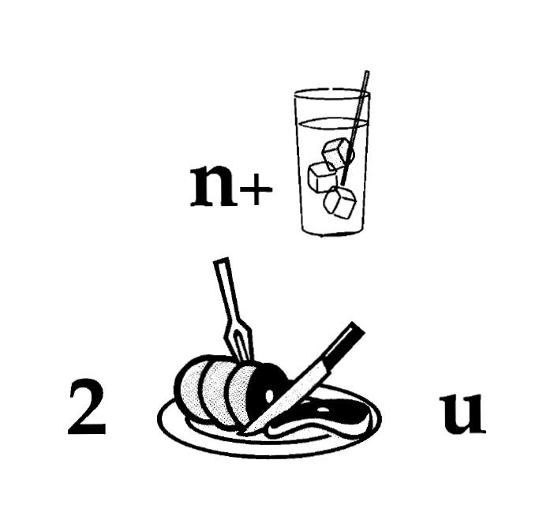
Nice to Meet You
Identify units
Consider multiple
representations & interpretations
  Pictures, text, layout, spelling, phonetics
Put it all together:
  Determine “best” global interpretation
Satisfy expectations
  Slide; puzzle
Computational Problem:
Assigning values to multiple variables, accounting for interdependencies among them

Slide 6
Natural Language Understanding
Natural language understanding decisions are global decisions that require
  Making (local) predictions driven by different models trained in different ways, at different times/conditions/scenarios
  The ability to put these predictions together coherently
  Knowledge, that guides the decisions so they satisfy our expectations
Expectation is a knowledge intensive component
Natural Language Interpretation is an Inference Process that is best thought of as a knowledge-constrained optimization problem, done on top of multiple statistically learned models.
Notes:
6
Give examples for what’s not abductive reasoning
Focus on abductive reasoning
Show the formulation – talk about the boxes
Talk about multiple ways of training – decoupling – relate to abstraction
Examples: semantic parsing (do verb + Prep + commas together; lack of jointly annotated data)
Wikification – Relations (but also add geographical coherence; topical coherence; all interrelated signal that are acquired at different times, different contexts, etc.

Slide 7
Why is it Difficult?
Meaning
Variability
Ambiguity
Language

Slide 8






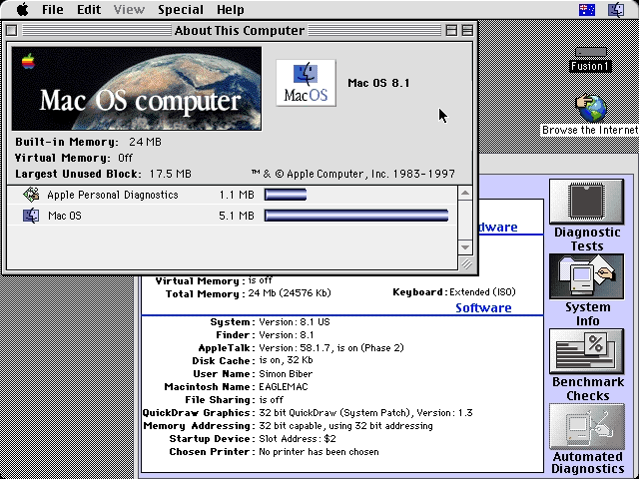
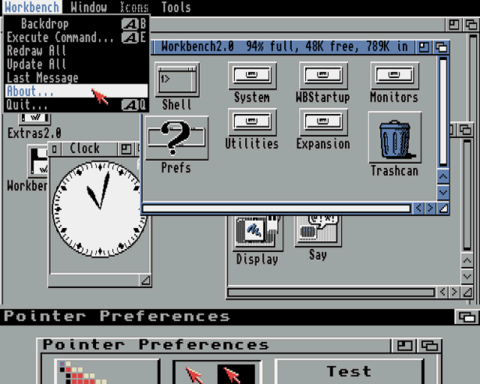
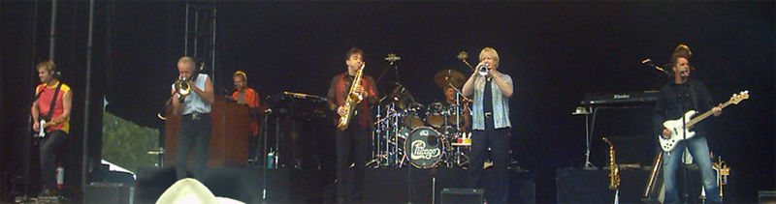
Ambiguity
It’s a version of Chicago – the standard classic Macintosh menu font, with that distinctive thick diagonal in the ”N”.
Chicago was used by default for Mac menus through MacOS 7.6, and OS 8 was released mid-1997..
Chicago VIII was one of the early 70s-era Chicago albums to catch my
ear, along with Chicago II.

Slide 9

Variability in Natural Language Expressions
Determine if Jim Carpenter works for the government
Jim Carpenter works for the U.S. Government.
The American government employed Jim Carpenter.
Jim Carpenter was fired by the US Government.
Jim Carpenter worked in a number of important positions. …. As a press liaison for the IRS, he made contacts in the white house.
Russian interior minister Yevgeny Topolov met yesterday with his US counterpart, Jim Carpenter.
Former US Secretary of Defense Jim Carpenter spoke today…
Standard techniques cannot deal with the variability of expressing meaning
nor with the
ambiguity of interpretation
Machine Learning is needed to support abstraction over the raw text, and deal with:
  Understanding Relations, Entities and Semantic Classes
  Acquiring knowledge from external resources; representing knowledge
  Identifying, disambiguating & tracking entities, events, etc.
  Time, quantities, processes…
We have made a lot of progress on some aspects of dealing with ambiguity and variability, but
Notes:
9

Slide 10
Communication (CwC Project, 2017-2019)
Consider the following explanation:
  [Example from Yonatan Bisk]
  Imagine that this is a chess board
  Place the UPS in H2, and McDonald in G6.
Can you follow these instructions?
  What’s needed for us to be able to write programs that can do it?
Of course, there are many NLP tasks we are better at today, mostly at the sentence level, and mostly extraction tasks.
Today:
Some (optimistic) thoughts and challenges from the perspective of Learning to Reason
  How should we think about learning in the context of doing reasoning

Slide 11
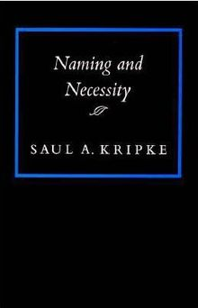
Symbolic Reasoning?
Some people think that symbols is an evil invention of old AI people.
It’s not.
Language is a symbolic system
  Table is a collection of things in world.
Even though we communicate via speech, gestures, writing, which are continuous, symbols are the invariants of this communication.
  Harari: Language – the ability to assign symbols to “things” and “reason” about them is key to human cognitive revolution
  Kripke: “Naming” things is key to communication and to cognition

Slide 12
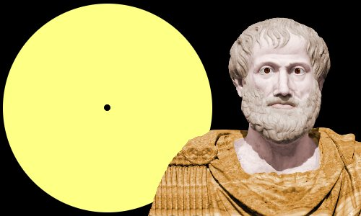
Aristotle’s Logic https://www.famousscientists.org/aristotle/
Aristotle founded the study of formal logic, systematizing logical arguments – he is famous for the syllogism, a method by which known information can be used to prove a point.
Here is a famous example, from Aristotle himself, of a simple syllogism:
  All men are mortal.
  Socrates is a man.
  Therefore, Socrates is mortal.
So, did Aristotle have a laptop?
  [Example due to Les Valiant]

Slide 13
Key Challenges to NLU Researchers
Today’s NLP addresses well-defined tasks for which we have a lot of training data, but:
Who asks the questions?
  When did Aristotle die?
  When was the laptop invented?
  What happened first?
The question isn’t if we need reasoning, but rather:
  How to do it?
    E.g., how to determine “strategies” on the fly?
  How to train for it?
    How can we supervise for these “sparse” events? [A different talk: On Incidental Supervision]
    Should we learn “everything” together? When/how should we decouple/decompose tasks?
Of course, AI has thought about Reasoning a lot…
  In most cases, in a way that decuples reasoning from learning
    And often, commits to a representation that is independent of the task

Slide 14
Learning to Reason I[Khardon & Roth JACM’96; 1994—2000]
Proposed in reaction to the standard of complete decoupling of Learning and Reasoning
A unifying computational theory of Learning and Reasoning.
  Reasoning should be studied together with Learning and the representation it produces.
Formally showing the benefits in jointly studying Learning and Reasoning
  Some hard reasoning tasks become tractable if done on top of learning into an appropriate knowledge representation.
  [Khardon & Roth JACM’96; 1994—2000]
This is now called End-to-End….
But, understanding when to decompose learning and when to decouple it from reasoning is also very important.
  At the heart of supporting transfer, compositionality, and reasoning.
No better domain to think about this than Natural Language

Slide 15
Constrained Conditional Models [Abductive Reasoning; Chang et al.’12]
Supporting structured knowledge intensive, NLP decisions
Variables are models
Penalty for violating
the constraints.
Formulation goes back to (Roth & Yih 2004). Also related to PR (Ganchev et al. 2010)
y = argmax_{y} ∑ 1_{∅(x, y)} w_{x,y} subject to Constraints C(x,y)
    y = argmax_{y} $∈$ _{Y} w^{T}$∅$(x, y) + u^{T}C(x, y)
Knowledge component:
(Soft) constraints
A linear function over models – can be used to model any logical function
Features, Models, NN
(non-linearity comes here)
How far y is from a “legal/expected” assignment
Not enough.
But, has been used extensively and successfully in many NLU tasks from IE to parsing to discourse tasks to summarization.
A good framework to serve as a starting point for thinking about further progress in natural language understanding.
What are the variables? How to represent knowledge?
Is it expressive enough?
  All Boolean functions can be represented as sets of linear constrains.
  Any MAP problem w.r.t. any probabilistic model, can be formulated as an ILP [Roth&Yih 04, Taskar 04]
Training: Learning the objective function (w, u)? Learning all the intermediate functions ∅(x, y)?
  Joint? Decoupled? Learned/provided constraints? Hard/soft?
  There is some understanding for when to do what [IJCAI’05]
Reasoning: A way to push a function over learned models to satisfy output expectations
  (can also think about expectations from a latent representation)

Slide 16
It’s Time for Reasoning: Outline
Did Aristotle have a laptop?
Reasoning about time in natural language
  Temporal ordering of events
  Learning & Inference paradigms to support reasoning
  Acquisition of temporal common sense
  Supervision paradigms
  This is far from being exhaustive, but:
    Reflects an important move in NLU from sentence level to situation level
    Highlights several important issues from the perspective of supervision, and combining learning with reasoning
Bonus Coverage: Navigating the Information Polluted World
  NLU Inference with societal impact

Slide 17
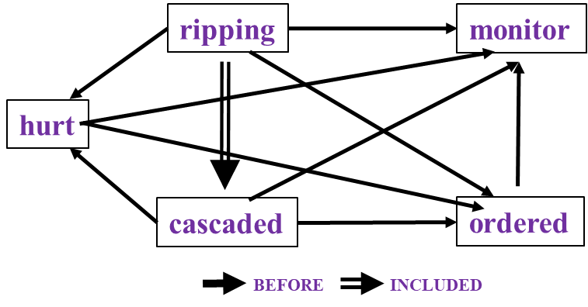
Time and Events [Ning et al. *SEM’2018; ACL’18, EMNLP’18, EMNLP’19]
In Los Angeles that lesson was brought home today when tons of earth cascaded down a hillside, ripping two houses from their foundations. No one was hurt, but firefighters ordered the evacuation of nearby homes and said they'll monitor the shifting ground until March 23rd.
Very difficult task— hinders exhaustive annotation (O(N²) edges)
But, it’s rather easy to get partial annotation – some relations.
And, we have strong expectations from the output
  Transitivity
  Some events tend to precede others, or follow others [Ning et. al., NAACL’18]

Slide 18
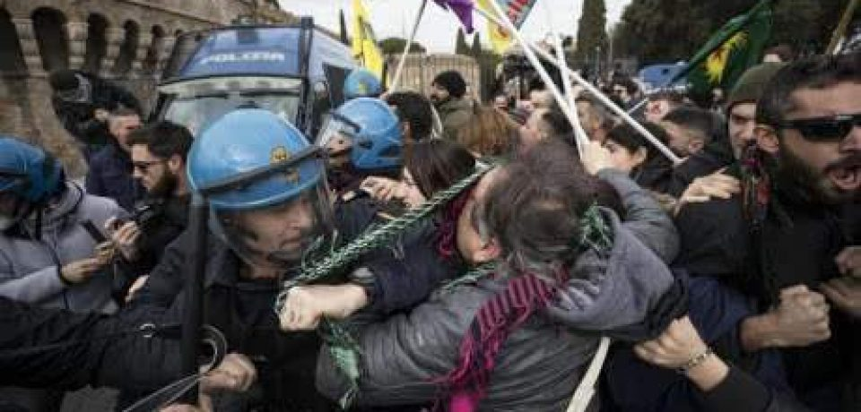

Two Events
People were angry
Police used tear gas
Time
People were angry at something (which ended in violent conflicts with the police)…The police finally used tear gas (to restore order).
Notes:
Now let's try to understand two events: people were angry and police used tear gas. If people were angry happened first, the understanding would be people ended in violent conflicts with the police, and the police used tear gas to restore order.

Slide 19
Two Events
Police used tear gas
People were angry
Time
Police used tear gas…People were angry at the police.
Notes:
If we simply reverse the order of these events, we get a new story, which says that police used tear gas and then people were angry at the police. We can see that time is crucial if we want to understand what’s going on in a situation.

Slide 20
Two Events
Police used tear gas
People were angry
Time
In natural language, we rarely see explicit timestamps, so we have to figure out the temporal order from cues in the text.
Notes:
But in natural language, we never have timestamps like here telling us which one is earlier and which one is later. That leads to “temporal relations”

Slide 21
Temporal Relations
Event: An action or state headed by a verb
BE_INCLUDED
Tons of earth cascaded down a hillside, ripping two houses. Firefighters will monitor the shifting ground.
BEFORE
In the context of this talk we assume that events have been identified, and we only study relations among them.
Notes:
This leads to the so called temporal relations. Here in this example, we have two events: met and leaving, and a time point Thursday. We have met before leaving, and leaving included in Thursday. My system will first extract those events, and then label the temprels among them, but my talk today will mainly focus on temprel extraction, assuming those events are already extracted.

Slide 22
Multiple Events Form a Situation
The task is to label the edges of the temporal graphs.
In Los Angeles that lesson was brought home Friday when tons of earth cascaded down a hillside, ripping two houses from their foundations. No one was hurt, but firefighters ordered the evacuation of nearby homes and said they'll monitor the shifting ground until March 23rd.
ripping
monitor
This task is difficult:
Temporal relation extraction | Literature F1 (%)
w/ gold events | low 50’s
w/o gold events | low 30’s
hurt
cascaded
ordered
BEFORE
BE_INCLUDED
Notes:
When we have multiple events, they form a situation.(read snippet) If we draw all the temprels in this situation, it would form a graph, which we call a temporal graph. In other words, we want to label those edges in a consistent way. This task is difficult and the literature F1's with or without gold events are both very low, which also reflects the difficulty of understanding a situation.

Slide 23
Temporal graphs are structured
Due to transitivity, TempRels are not independent
First step: global inference
ripping
monitor
ripping
monitor
ripping
ripping
monitor
monitor
monitor
cascaded
ordered
?
hurt
hurt
hurt
Time
ripping
ordered
ordered
cascaded
ordered
cascaded
cascaded
cascaded
cascaded
Must be before
BEFORE
INCLUDED
Notes:
The motivation is that temporal graphs are structured, or in other words, temporal relations are not independent. In the previous graph, assume that we are looking at ripping, cascaded, and ordered. Then because ripping is inside cascaded and cascaded is before ordered, the relation between ripping and ordered must be before. Existing methods are all local learning plus global inference. That is
(40 sec)

Slide 24
I. Global inference (a toy example)
monitor
0.6
0.7
0.4
0.3
cascaded
0.8
ordered
0.2
Resulting temporal graph is not feasible
Notes:
Here's a toy example of how we solve for the final graph. The naive way is to select the best score for each edge. And we get a loop! However, time cannot be a loop. How should we avoid this situation?

Slide 25
Global inference (a toy example)
Option 1
Option 2
Option 3
monitor
monitor
monitor
0.6
0.7
0.4
0.7
0.6
0.3
cascaded
ordered
cascaded
ordered
cascaded
ordered
0.2
0.8
0.8
0.6+0.2+0.7=1.5
0.4+0.8+0.7=1.9
0.6+0.3+0.8=1.7
We should not only select the assignment with the best score, but also one that does not violate our constraints (here: transitivity). Formulated as an ILP (Roth & Yih 2004)
Notes:
To do that, we actually have three options, as shown here.

Slide 26
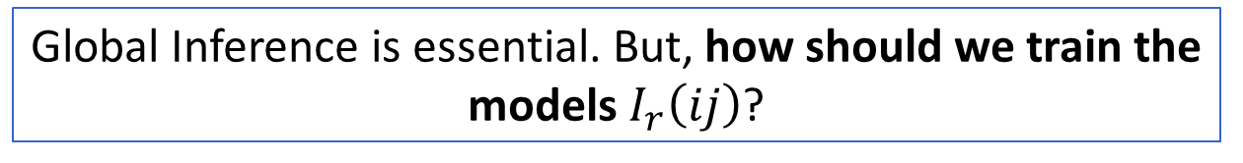
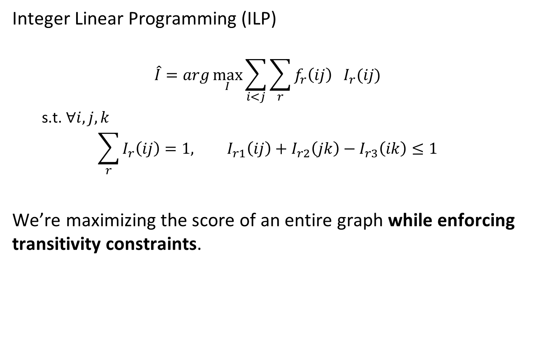




Global inference via ILP
$$I_{→}\left(ij\right)=1$$
$$f_{→}\left(ij\right)=0.6$$
Integer Linear Programming (ILP)
  $$\hat{I}=arg\max_{I}{\sum_{i<j}{\sum_{r}{f_{r}\left(ij\right){ I}_{r}(ij)}}}$$
  s.t. $∀i,j,k$
  $$\sum_{r}{I_{r}\left(ij\right)}=1, I_{r1}\left(ij\right)+I_{r2}\left(jk\right)−I_{r3}\left(ik\right)≤1$$
We’re maximizing the score of an entire graph while enforcing transitivity constraints.
j
Event i
real variable
$$f_{←}\left(ij\right)=0.4$$
$$I_{←}\left(ij\right)=1$$
Boolean variable
Uniqueness
Transitivity (no loops)
Global Inference is essential. But, how should we train the models $I_{r}\left(ij\right)$?
Notes:
ILP stands for...We have two types of variables. Boolean variable I, indicating the relation between event i and event j. And real variable f, representing the confidence scores for each relation. We sum them up, enforce the no-loop constraint, and that's our mathematical formulation for this problem.
(30 sec)

Slide 27
II. Local learning is not sufficient
tons of earth cascaded down a hillside,
…ripping two houses…firefighters ordered the evacuation of nearby homes…
Q: (ripping, ordered)=? (difficult even for humans)
Annotation says “before”, but training this way without accounting for the relation to “cascaded” misleads the model and leads to overfitting
Jointly training the relations is essential
  Structured Learning
cascaded
ordered
Time
ripping
Must be before
Notes:
But our argument is: local learning is not sufficient. In the previous example, imagine a learning algorithm is looking at this pair: ripping and ordered. Even for humans, when we only look at the local context, we don't know the relation between ripping and ordered. But annotation says the label is "before", so the algorithm will simply update the local model to fit it, which leads to overfitting. If we bring in a third event, "cascaded", and since we know (ripping,cascaded)=included and (cascaded,ordered)=before, we immediately know (ripping,ordered)=before, and we don't rely on the local model itself to overfit this decision. That's why global information is specifically needed in this task. Again, the question is, how should we formulate it?
(1min)

Slide 28
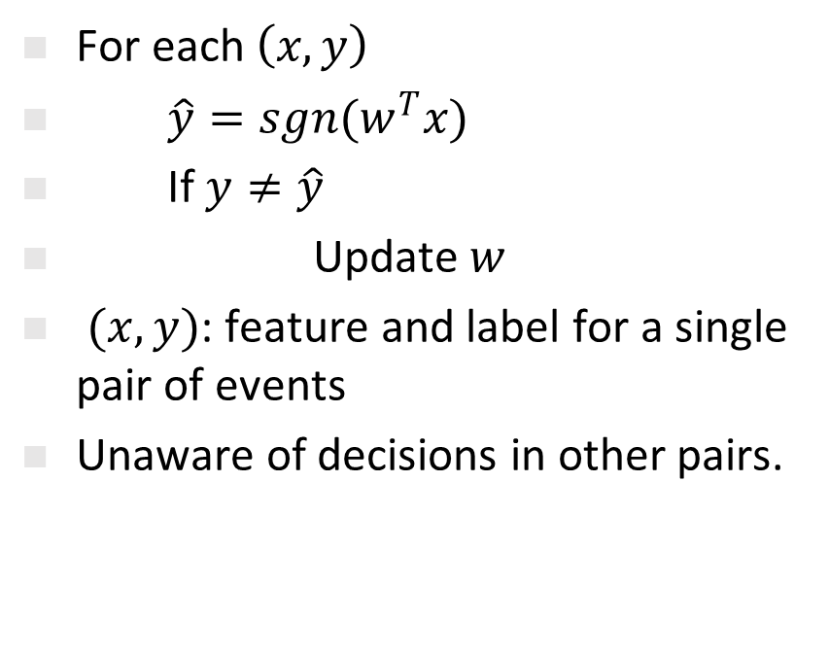
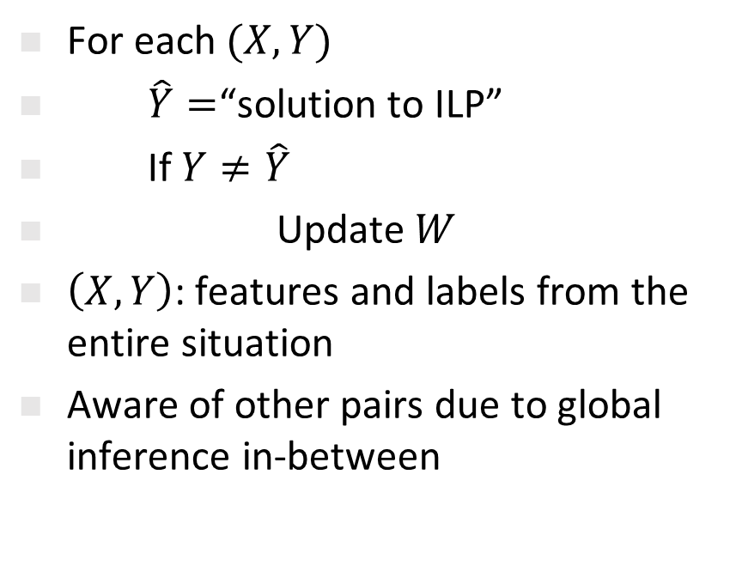
Structured (global) Learning
[Collins, 2002]
Local Learning
Structured Learning
For each $\left(x,y\right)$
$\hat{y}=sgn(w^{T}x)$
If $y≠\hat{y}$
Update $w$
$(x,y)$: feature and label for a single pair of events
Unaware of decisions in other pairs.
For each $(X,Y)$
$\hat{Y}=$“solution to ILP”
If $Y≠\hat{Y}$
Update $W$
$\left(X,Y\right)$: features and labels from the entire situation
Aware of other pairs due to global inference in-between
  Part I: Structured learning
Notes:
This is a standard structured learning problem. If you're not familiar with it, let's use perceptron as an example to do a side-by-side comparison. Left is the standard perceptron and right is structured perceptron. In local learning, an instance is a single pair of events, while in global learning, an instance is the entire situation, usually a paragraph, a document, or even multiple documents. Local learning is unaware of decisions in other pairs; global learning is using a global inference in-between so it's aware of the entire situation.
(40 secs)

Slide 29
III. Temporal Common Sense
More than 10 people have (event1: died), police said. A car (event2: exploded) on Friday in a group of men.
Which event came first, event1 or event2?
This turns out to be difficult.
What about now?
  Context is important, but not sufficient
  Humans have good priors about which event “usually” happens before another.
We would like to acquire it, and use it to enhance our temporal relation identification
Notes:
This means, when the event content is missing, the problem is very difficult even for humans.

Slide 30
TemProb: Temporal Relation Probabilistic Knowledge Base
Run initial system on New York Times 1987-2007, #Articles~1M
Identify events; identify temporal order
80M temporal relations
Simply by counting, we get
Example pairs |  | Time Before (%) | Time After (%)
Text Before | Text After
Ask | Help | 86 | 9
Attend | Schedule | 1 | 82
Accept | Propose | 10 | 77
Die | Explode | 14 | 83
Notes:
In NAACL'18, we proposed TemProb, short for ... The intuition is that humans get common sense through lots of life experience. We want to mimic this, so we collected over 1 million articles from new york times. We ran our system on top of it to imitate human's reading experience. To accelerate it, we used 100 AWS instances in parallel and finished it within one day. We find that simply by counting, we could get many interesting statistics. For example, we find ask before help, attend after schedule, accept after propose, and die after explode.
(1min)

Slide 31
Event distributions from TemProb
Notes:
We also plotted the distribution of events that usually precede or follow specific events, of course, in terms of time. Although we only have the verbs here, we can still get some intuitive answers.

Slide 32
Event distributions from TemProb
Notes:
For example, before bomb, there is fire; after bomb, there are kill, destroy, and people get wound.

Slide 33
Event distributions from TemProb

Slide 34
Event distributions from TemProb
Notes:
This is what I like the most. I have a long list of such examples, and of course, there can be errors in it. But the good thing is, we mined these automatically and no more human annotations were used, so it's pretty nice. Imagine that if we could incorporate the common sense knowledge in TemProb into the temporal relation extraction task, then we can further improve the performance. The only question is how to apply TemProb in our task.
(1 min 20 sec)

Slide 35
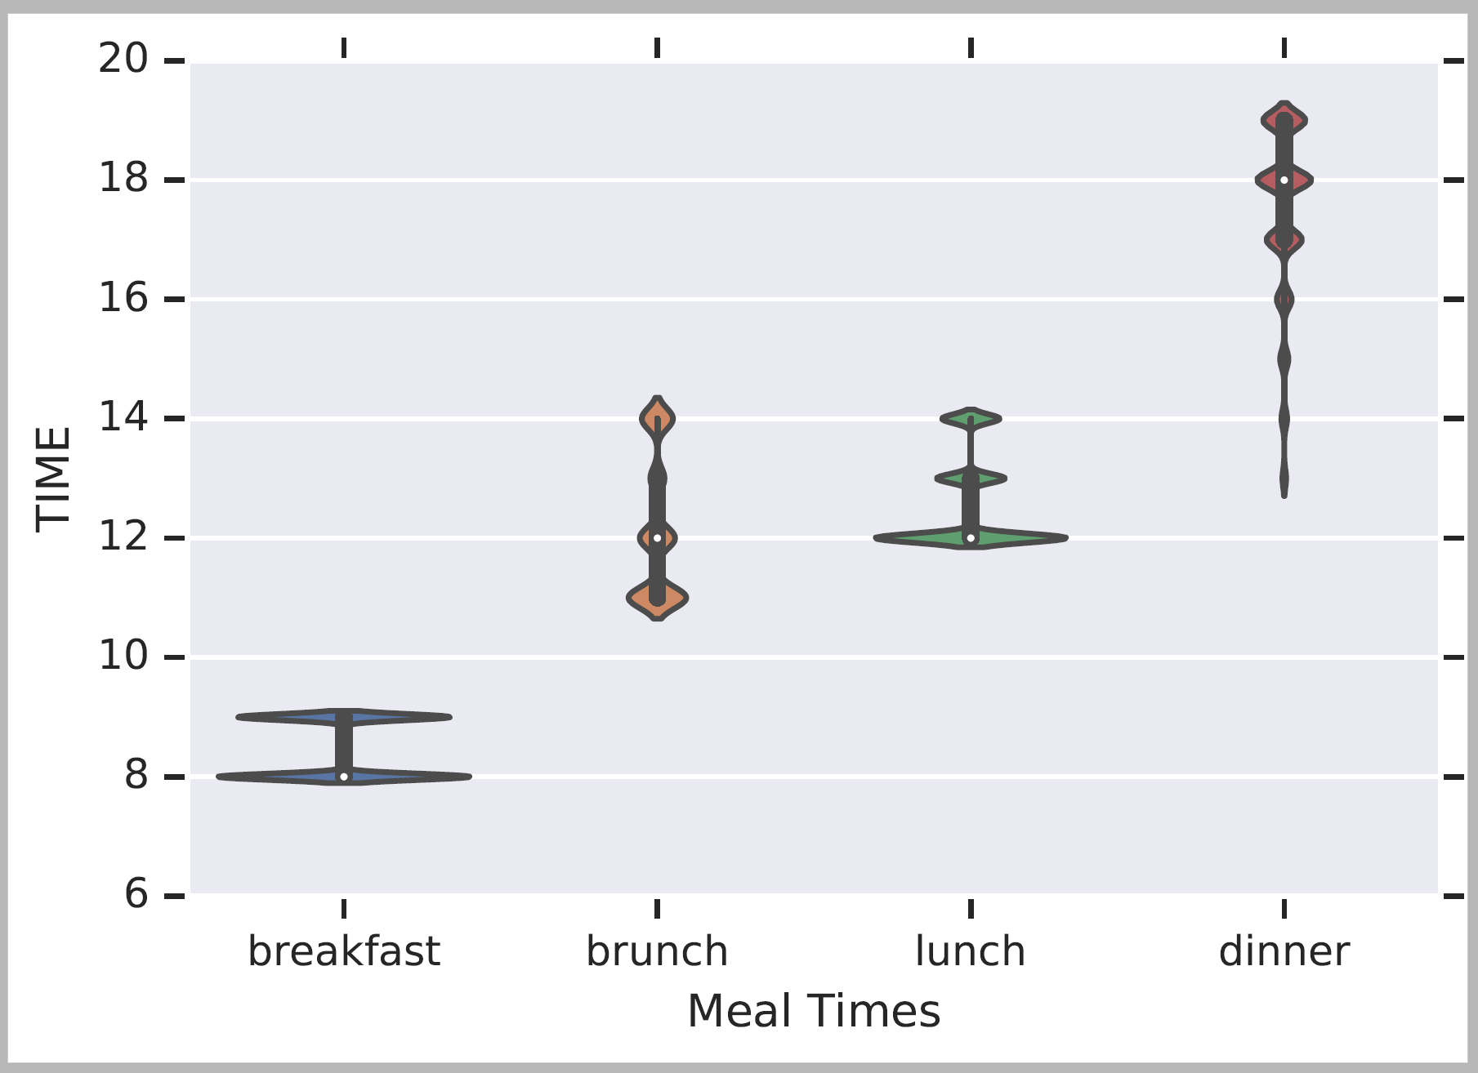
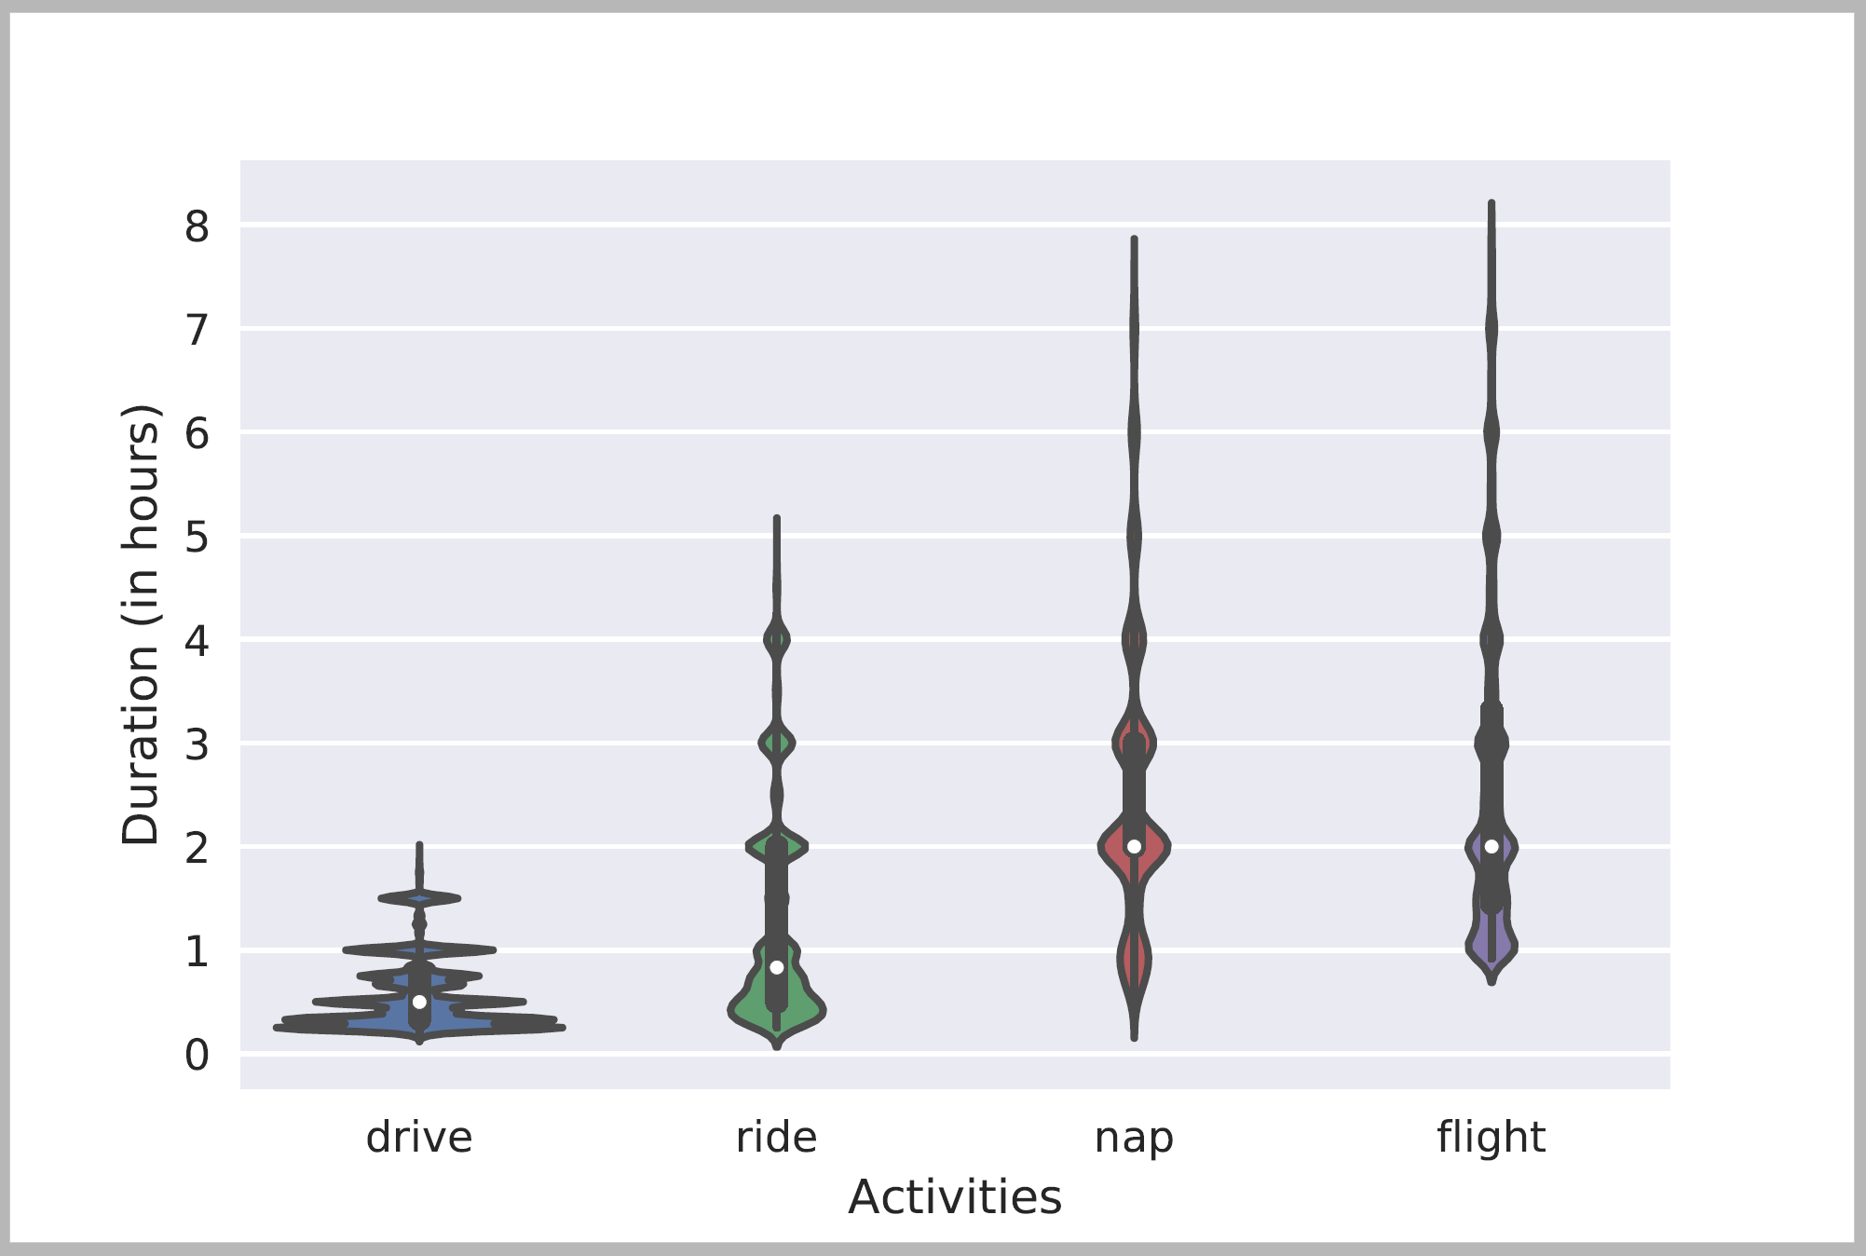
Many Forms of Temporal Common Sense
Frequency, Periodicity [ACL’19]
Not being used in this talk
Typical Time
Duration

Slide 36
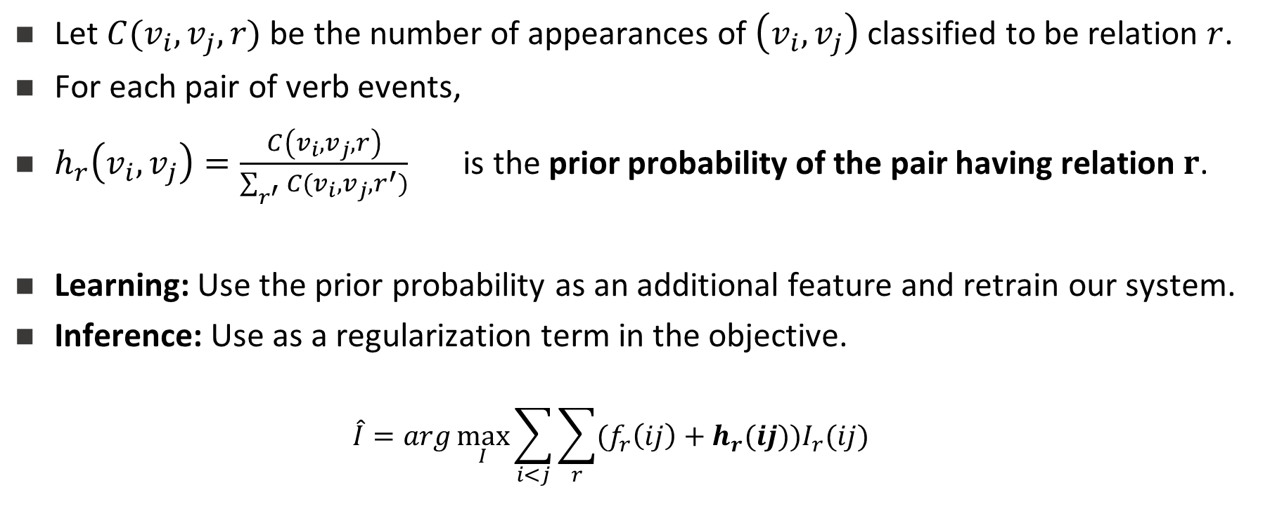
III. Making use of TemProb
Let $C(v_{i},v_{j},r)$ be the number of appearances of $\left(v_{i},v_{j}\right)$ classified to be relation $r$.
For each pair of verb events,
$h_{r}\left(v_{i},v_{j}\right)=\frac{C\left(v_{i},v_{j},r\right)}{\sum_{r^{′}}{C(v_{i},v_{j},r^{′})}}$ is the prior probability of the pair having relation $r$.
Learning: Use the prior probability as an additional feature and retrain our system.
Inference: Use as a regularization term in the objective.
  $$\hat{I}=arg\max_{I}{\sum_{i<j}{\sum_{r}{(f_{r}\left(ij\right)+h_{r}(ij))I_{r}(ij)}}}$$
Notes:
Again, I tried to use TemProb in both learning and inference. During learning, we can add the prior obtained in TemProb as an addition feature, so that we should simply retrain the system.
During inference, we can further add the prior as regularization terms, to drive the prediction to favor our common sense. Here the grey part was the ILP formulation we used earlier, and the red part is the newly added common sense regularizations.
These are pretty convenient modifications to our old system. My research philosophy is, if one is doing it right, the solution should not be complicated in most cases.
(40 sec)

Slide 37
It’s Time for Reasoning: Outline
Did Aristotle have a laptop?
Reasoning about time in natural language
  Temporal ordering of events
  Learning & Inference paradigms to support reasoning
  Acquisition of temporal common sense
  Supervision paradigms
  This is far from being exhaustive, but:
    Reflects an important move in NLU from sentence level to situation level
    Highlights several important issues from the perspective of supervision, and combining learning with reasoning
Bonus Coverage: Navigating the Information Polluted World
  NLU Inference with societal impact

Slide 38
Putting it all together: A Neural Approach
LSTM
+
Feed-Forward NN
+
Siamese
Siamese network
Common sense
Long short-term memory network
Structured learning
Feedforward network
Trained on new data
Notes:
Our proposal is to use long short-term memory network (LSTM) to represent structured learning, a feedforward neural net to get supervision from our new dataset, and a Siamese network to represent common sense. Let me quickly go through the high-level ideas behind it.

Slide 39
Putting it all together: A Neural Approach
LSTM takes word embeddings as input
Hidden vectors represent events
FFNN predicts the labels of temporal relations (followed by ILP inference)
Siamese network is a generalized TemProb
Siamese network
(Common sense)
LSTM
Feedforward network
(Trained on new data)
word embeddings
t₀ t₁ t₂ t_{n}
LSTM w/ concatenations of two hidden states
Notes:
Specifically, LSTM takes a sequence of word embeddings as input

Slide 40
Putting it all together: A Neural Approach
LSTM takes word embeddings as input
Hidden vectors represent events
FFNN predicts the labels of temporal relations (followed by ILP inference)
Siamese network is a generalized TemProb
Siamese network
(Common sense)
h_{e1}
LSTM
128
word embeddings
h_{e2}
128
t₀ t₁ t₂ t_{n}
LSTM w/ concatenations of two hidden states
Notes:
And generates hidden vectors to represent those events

Slide 41
Putting it all together: A Neural Approach
  Put all pieces together
: a neural approach
LSTM takes word embeddings as input
Hidden vectors represent events
FFNN predicts the labels of temporal relations (followed by ILP inference)
Siamese network is a generalized TemProb
Siamese network
(Common sense)
h_{e1}
LSTM
128
output
before
after
equal
vague
word embeddings
h_{e2}
64
128
t₀ t₁ t₂ t_{n}
LSTM w/ concatenations of two hidden states
Output confidence scores
Notes:
The event representations are stacked as input to the feedforward neural net, which generates the final temporal relation label

Slide 42
Putting it all together: A Neural Approach
LSTM takes word embeddings as input
Hidden vectors represent events
FFNN predicts the labels of temporal relations (followed by ILP inference)
Siamese network is a generalized TemProb
Siamese network trained on TemProb
v₁
v₂
500
500
150
dropout 0.3
45
dropout 0.3
h_{e1}
LSTM
128
output
before
after
equal
vague
word embeddings
h_{e2}
64
128
t₀ t₁ t₂ t_{n}
LSTM w/ concatenations of two hidden states
Output confidence scores
Notes:
In addition, a separate Siamese network fits the statistics in TemProb

Slide 43
Putting it all together: A Neural Approach
LSTM takes word embeddings as input
Hidden vectors represent events
FFNN predicts the labels of temporal relations (followed by ILP inference)
Siamese network is a generalized TemProb
Siamese network trained on TemProb
v₁
v₂
500
500
150
dropout 0.3
45
dropout 0.3
h_{e1}
LSTM
128
output
before
after
equal
vague
word embeddings
h_{e2}
64
128
t₀ t₁ t₂ t_{n}
LSTM w/ concatenations of two hidden states
Output confidence scores
Notes:
And provides additional embeddings that can be used in the feedforward neural net.

Slide 44
A Revolution in Temporal Reasoning
Generalized common sense
BERT
Neural + ILP
+3%
Axes dataset
+4%
Common sense
+3%
Structured learning
+11%*
Previous SOTA
+4%
+2%
2015
2017
2019
Thesis work of Qiang Ning (2019)
Notes:
This is a final summary for our progress on this task. CAEVO is the previous SOTA, structured learning 2%, common sense 4%, new dataset 11%, LSTM with standard word embeddings 3%, LSTM with BERT embeddings 4% (BERT is the most recent word embedding), and Siamese another 3%.

Slide 45
Multi-Axis View of Events [ACL’18]
The improvements involves another conceptually important step:
  We suggest that not all events are comparable
  Events reside on multiple axes.
Police tried to eliminate the pro-independence army and restore order. At least 51 people were killed in clashes between police and citizens in the troubled region.
Events could be actual, hypothetical, intentions,..
  Not all events are comparable.
Result: inter-annotator agreements are much higher.
Higher quality training data, with significant improvement in temporal relation identification
Intention axis
restore order
✓
to eliminate army
✓
police tried
51 people killed
Main axis
✓
Notes:
In this particular example, we used intention axis. We also define other axes, such as opinion and hypothesis.

Slide 46
Proposed solution: multi-axis
We complete a set of definitions for axes
Event Type | Axis Type | %
intention, opinion | orthogonal axis | ~20
hypothesis, generic | parallel axis | ~10
negation | not on any axis
static, recurrent | not considered now
main | main axis | ~70
  Part III: Data annotation
Notes:
In this particular example, we used intention axis. We also define other axes, such as opinion and hypothesis.

Slide 47
It’s Time for Reasoning: Outline
Did Aristotle have a laptop?
So far: Reasoning about time in natural language
Showed the importance of:
  Global Inference
  Global Training
  Incorporating knowledge into learning and inference
Significant improvements over the last 3-4 years, 50 F1 → 80 F1
What kinds of supervision signals can we get?

Slide 48
Inducing Semantics
Inducing semantic representations and making decisions that depend on it require learning and, in turn, supervision.
Standard machine learning methodology:
  Given a task
  Collect data for the task and annotate it
  Learn a model [doesn’t matter how]
We will never have enough annotated data to train all the models, for all the tasks we need, this way.
  We don’t even know what are “all the tasks”
  Most of what we learn we don’t learn by “training” on many examples
Current methodology is not scalable and, often, makes no sense
  Annotating for complex tasks is difficult, costly, and sometimes impossible.
    Most decisions we care about are too sparse to be trained for directly
It’s ok to do supervised learning.
But what about tasks that cannot be supervised directly?
In most interesting cases, learning should be (and is) driven by incidental supervision [Roth AAAI’17]
Temporal Relations provide a way to think about one aspect of incidental supervision signals.
Notes:
Key challenge, to facilitate reasoning, is to induce semantics

Slide 49
Incidental Supervision
Data exists independent of the task(s) at hand.
  Data provides hints
  These are often sufficient to infer supervision signals (even for tasks we haven’t defined)
    E.g., current work on QA-AMR (ask me later)
Utilizing these hints
  Can be substantially less costly than producing explicit annotation
  More realistic – provides signals for tasks we haven’t defined
    Is often used only at decision time
  Can be used for transfer across languages and domains
  Expectations from the output can be used to amplify week signals to high quality signals
  Yes, pre-training is a step in the right direction
Notes:
Key challenge, to facilitate reasoning, is to induce semantics

Slide 50
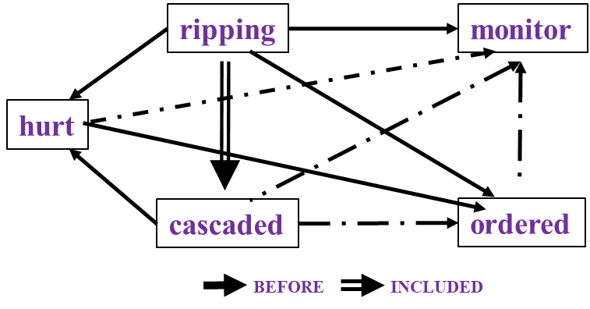
Temporal Relations [Ning et al. *SEM’2018; ACL’18, EMNLP’18]
Two key questions: (i) What level of supervision is really needed?
(ii) Algorithmic Approach: how to gain from it?
In Los Angeles that lesson was brought home today when tons of earth cascaded down a hillside, ripping two houses from their foundations. No one was hurt, but firefighters ordered the evacuation of nearby homes and said they'll monitor the shifting ground until March 23rd.
Very difficult task— hinders exhaustive annotation (O(N²) edges)
But, it’s rather easy to get partial annotation – some relations.
And, we have strong expectations from the output
  Transitivity
  Some events tend to precede others, or follow others [Ning et. al., NAACL’18]
Intuition:
If the structure is tight, there is no need to annotate all the variables.
A partial set of signals can supervise all.

Slide 51
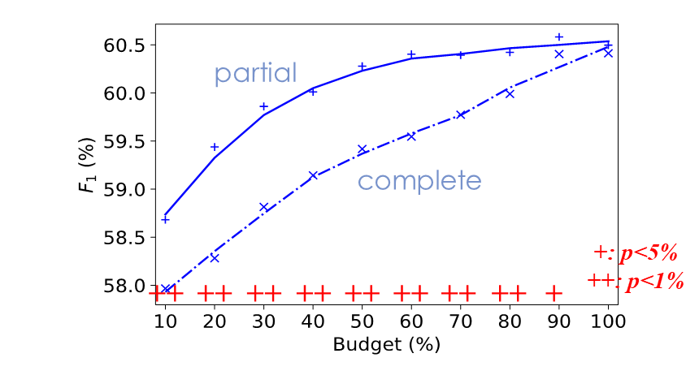
Partial or complete, that’s the question [NAACL’19]
Training Phase
When we have a fixed budget, partial structures indeed lead to better performance.
How should we quantify the quality of “partial”?
(a) Complete
(b) Partial
same budget
same budget
$$𝒯_{test}$$
$$𝒯_{test}$$
Testing Phase

Slide 52
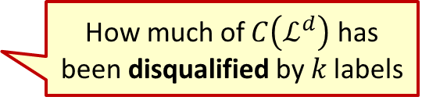
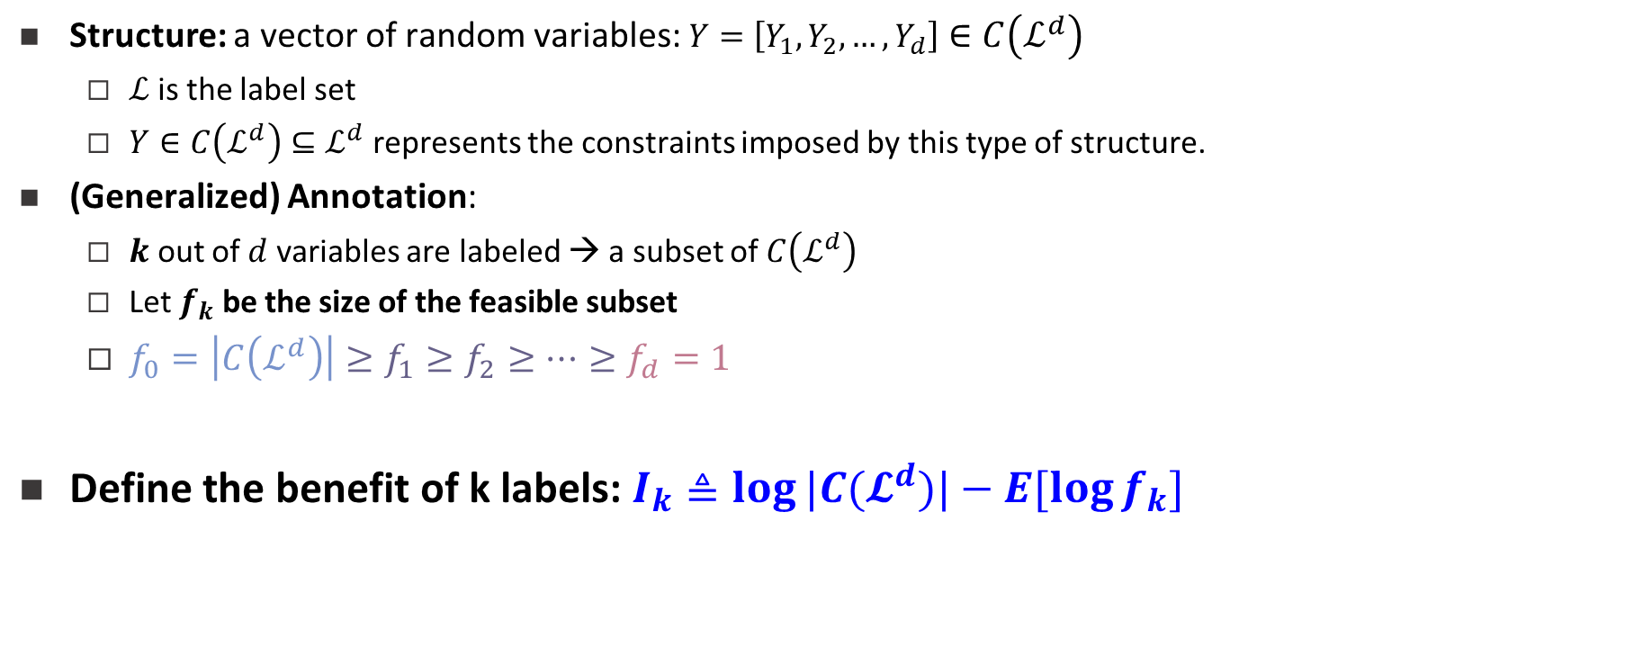

Structure
Structure: a vector of random variables: $Y=\left[Y_{1},Y_{2},…,Y_{d}\right]∈C\left(ℒ^{d}\right)$
  $ℒ$is the label set
  $Y∈C\left(ℒ^{d}\right)⊆ℒ^{d}$represents the constraints imposed by this type of structure.
(Generalized) Annotation:
  $k$ out of $d$ variables are labeled → a subset of $C\left(ℒ^{d}\right)$
  Let $f_{k}$ be the size of the feasible subset
  $f_{0}=\left|C\left(ℒ^{d}\right)\right|≥f_{1}≥f_{2}≥⋯≥f_{d}=1$
Define the benefit of k labels: $I_{k}≜\log{|C(𝓛^{d})|}−E[\log{f_{k}}]$
Constrained output; not all assignments are possible.
Intuition:
If the structure is tight, there is no need to annotate all the variables.
A partial set of signals can supervise all.
No annotation
Complete annotation
How much of $C\left(ℒ^{d}\right)$ has been disqualified by 𝑘 labels
1
1→2→3→4
Or
1→3→2→4
2
3
$$f_{k}=2$$
Partial order
4

Slide 53
Diminishing return of new labels
$$I_{k}:\text{The} \text{benefit} \text{of} \text{k} \text{labels} \text{is} \text{concave}$$
$$Δ_{k}=I_{k}−I_{k−1} \text{: }\text{The} \text{benefit} \text{of} \text{a} \text{new} \text{label} \text{is} \text{diminishing}$$

Slide 54
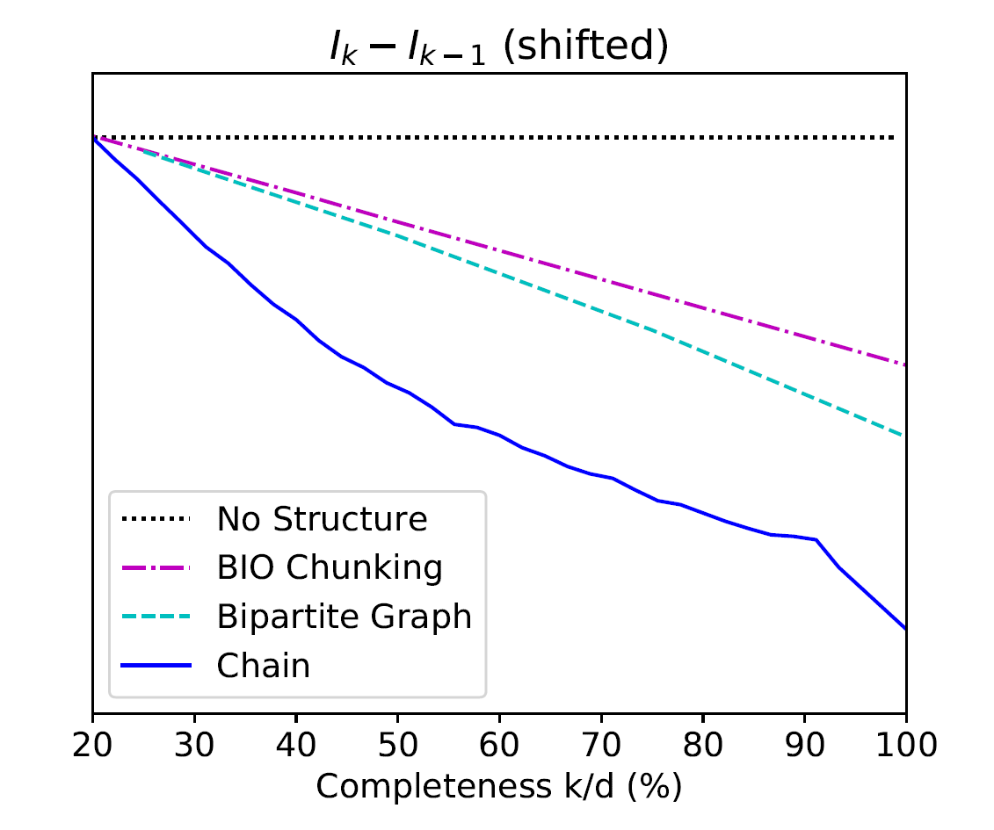
Improvement Consistent With Tightness Analysis By $I_{k}$
$$Δ_{k}=I_{k}−I_{k−1} \text{: }\text{The} \text{benefit} \text{of} \text{a} \text{new} \text{label}$$
Chain:
Temporal Relation Extraction
Algorithmically:
Results are consistent with tightness of the structure
A version of the Constraint-Driven Learning (CoDL) Algorithm [Chang et al. 2012]
+: p<5%
++: p<1%
++
++
++
++
++
++
++
++
+
more concave
Bipartite Graph:
Semantic Role Classification
Seq Tagging
Shallow Parsing
Indeed:
If the structure is tight, there is no need to annotate all the variables.
A partial set of signals can supervise all.
++
++
++
++
++
++

Slide 55

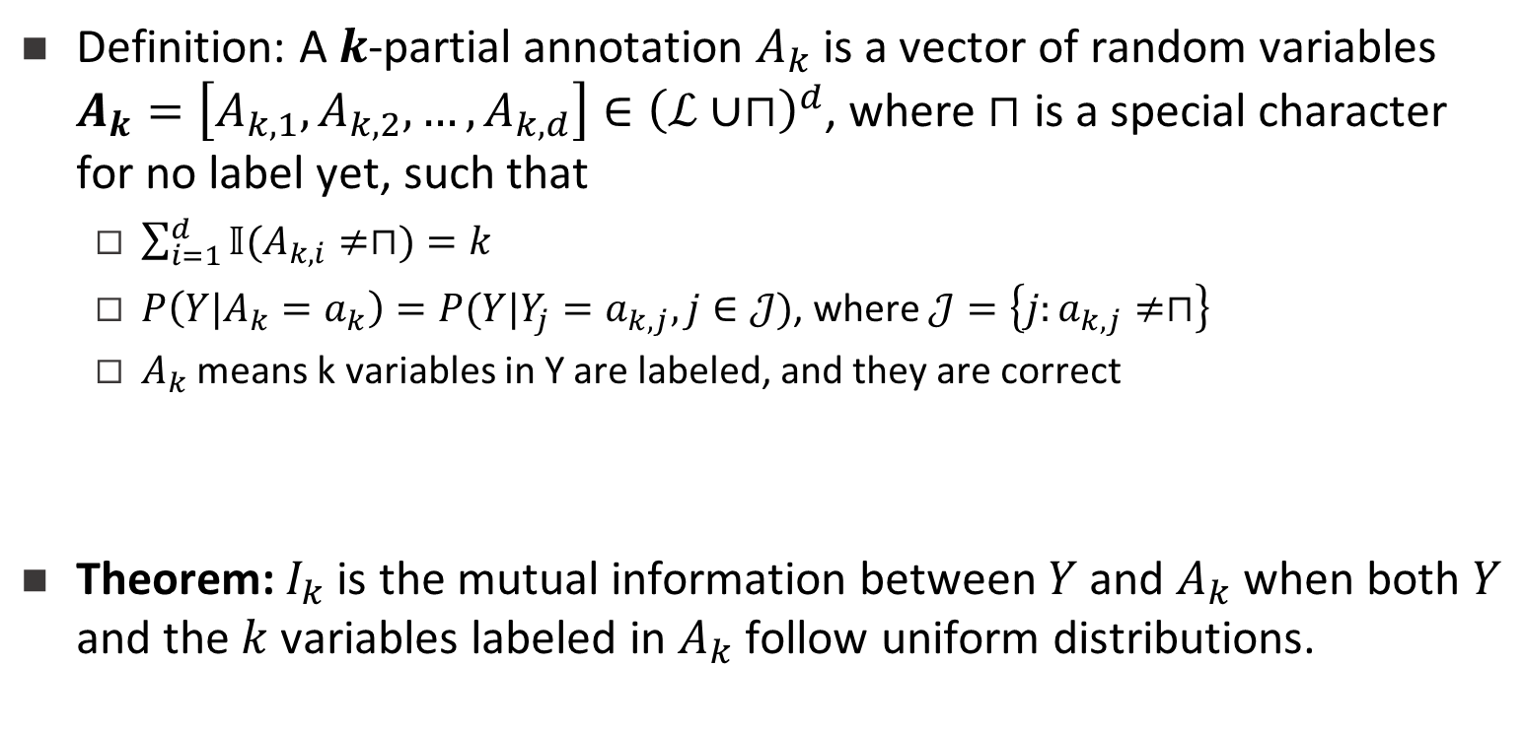
What is $I_{k}$ actually?
Definition: A $k$-partial annotation $A_{k}$ is a vector of random variables $A_{k}=\left[A_{k,1},A_{k,2},…,A_{k,d}\right]∈{\left(ℒ∪⊓\right)}^{d}$, where $⊓$ is a special character for no label yet, such that
  $\sum_{i=1}^{d}{𝕀(A_{k,i}≠⊓)}=k$
  $P\left(Y|A_{k}=a_{k}\right)=P(Y|Y_{j}=a_{k,j},j∈𝒥)$, where $𝒥=\left\{j:a_{k,j}≠⊓\right\}$
  $A_{k}$ means k variables in Y are labeled, and they are correct
Theorem: $I_{k}$ is the mutual information between $Y$ and $A_{k}$ when both $Y$ and the $k$ variables labeled in $A_{k}$ follow uniform distributions.
Notes:
If we define k-partial annotation as a vector of random variables A_k. You don’t need to read the formulations below. The translation is: A_k means k variables are labeled in Y. Then actually we can prove, that I_k is the mutual information between structure Y and the k-partial annotation A_k, when they follow certain uniform distributions. This is a very interesting finding.
(30 sec)

Slide 56
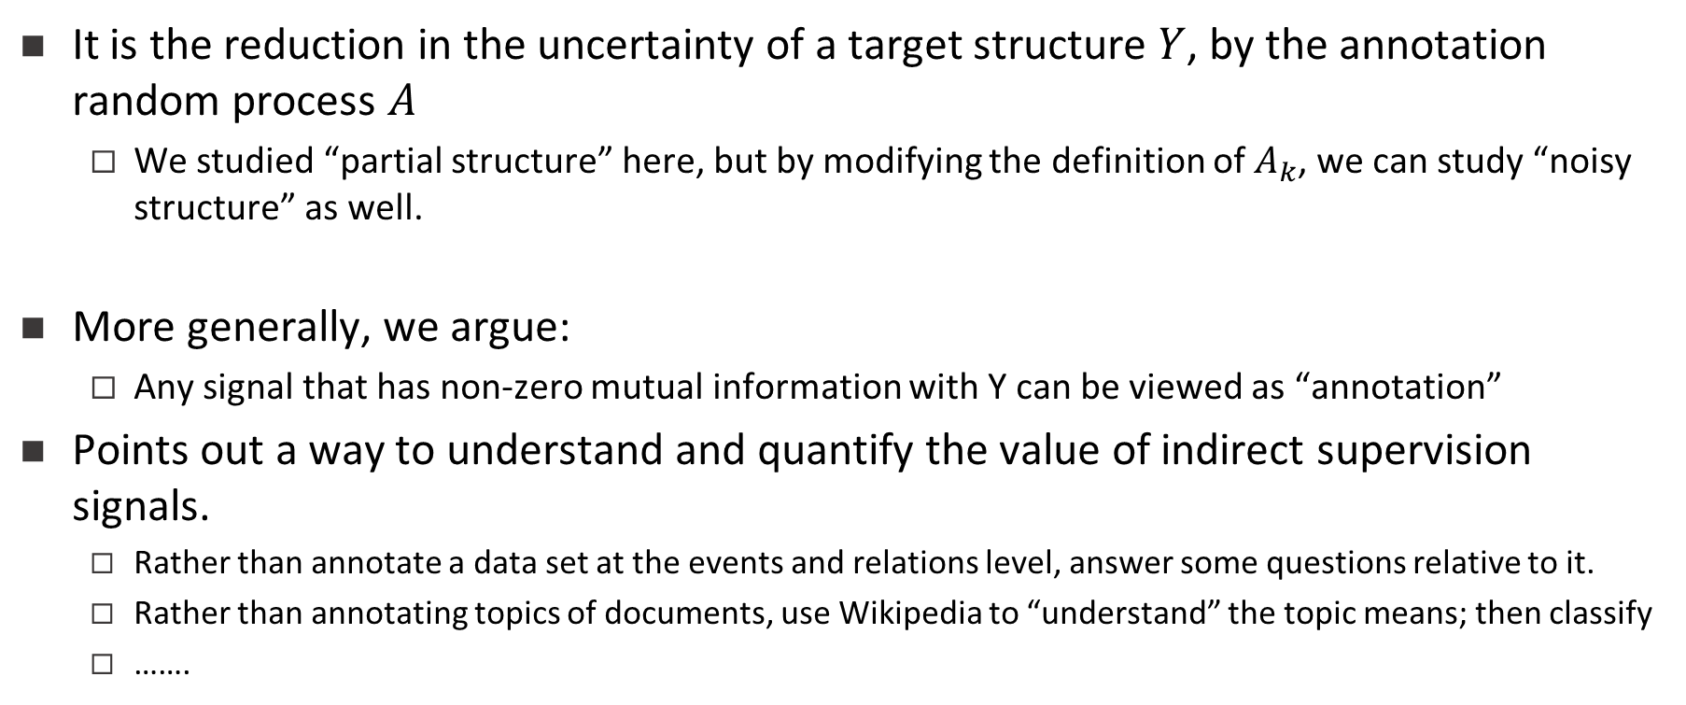
A View of Structured Annotation
It is the reduction in the uncertainty of a target structure $Y$, by the annotation random process $A$
  We studied “partial structure” here, but by modifying the definition of $A_{k}$, we can study “noisy structure” as well.
More generally, we argue:
  Any signal that has non-zero mutual information with Y can be viewed as “annotation”
Points out a way to understand and quantify the value of indirect supervision signals.
  Rather than annotate a data set at the events and relations level, answer some questions relative to it.
  Rather than annotating topics of documents, use Wikipedia to “understand” the topic means; then classify
  …….
Incidental Supervision
Notes:
(partial 5 min)

Slide 57
It’s Time for Reasoning: Outline
Did Aristotle have a laptop?
We cannot answer this question yet.
But, we have made significant progress in reasoning about time, and a few additional reasoning tasks in NLP

Slide 58
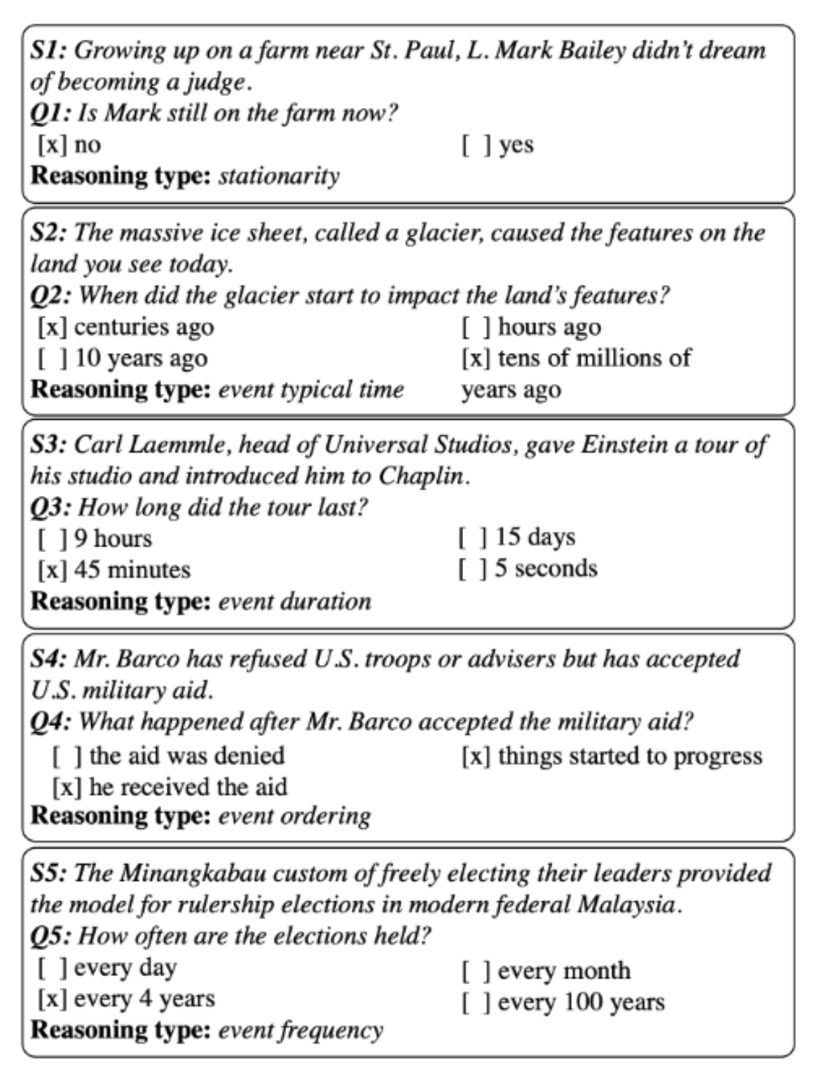
More Temporal Reasoning [EMNLP’19]
A new QA data set that addresses some temporal reasoning tasks. (Along with a baseline approach)
Paul Simon is in NYC. Let’s go see him.
The Empire State Building is in NYC.
Typical Time
Event Frequency

Slide 59

CliffsNotes
Multiple natural language documents
  Small units of text or large units of texts
  Reading news about an event/situation over time and/or from multiple sources
  Reading a book
  The novel features the character David Copperfield, his journey of change and growth from infancy to maturity, as many people enter and leave his life and he passes through the stages of his development. (Fiction, and you know it)
  London and England in the 19-th century; socio-economic state, child exploitation; schools, prisons, emigration to Australia (true historical facts)
What are the computational tasks that we should think about?

Slide 60
Recap
Modified version of a question for AI2’s DROP dataset
Coming off a road win over the Cowboys, the Redskins traveled to Lincoln Financial Field for a Week 5 NFC East duel with the Philadelphia Eagles. In the first quarter, the Redskins trailed early as RB Brian Westbrook scored on a 9-yard TD run and the Eagles DeSean Jackson returned a punt 68 yards for a touchdown. Washington still trailed at half time 14:9, with field goals from Shaun Suisham. In the third quarter, the Redskins took the lead on a trick play as WR Antwaan Randle El threw an 18-yard TD pass to TE Chris Cooley. In the fourth quarter, the Redskins increased their lead when Clinton Portis scored on a 4-yard TD run. The Eagles managed one more score in the final quarter for a final score of 17:23.
What are the computational tasks that we should think about?
How many touchdowns did the Eagles score in the first quarter?
Answer: 2
How many field goals did Washington score?
Answer: 3
→ Need a resource – the rules of the game.
How many field goals did the Eagles score?
Answer: 1

Slide 61
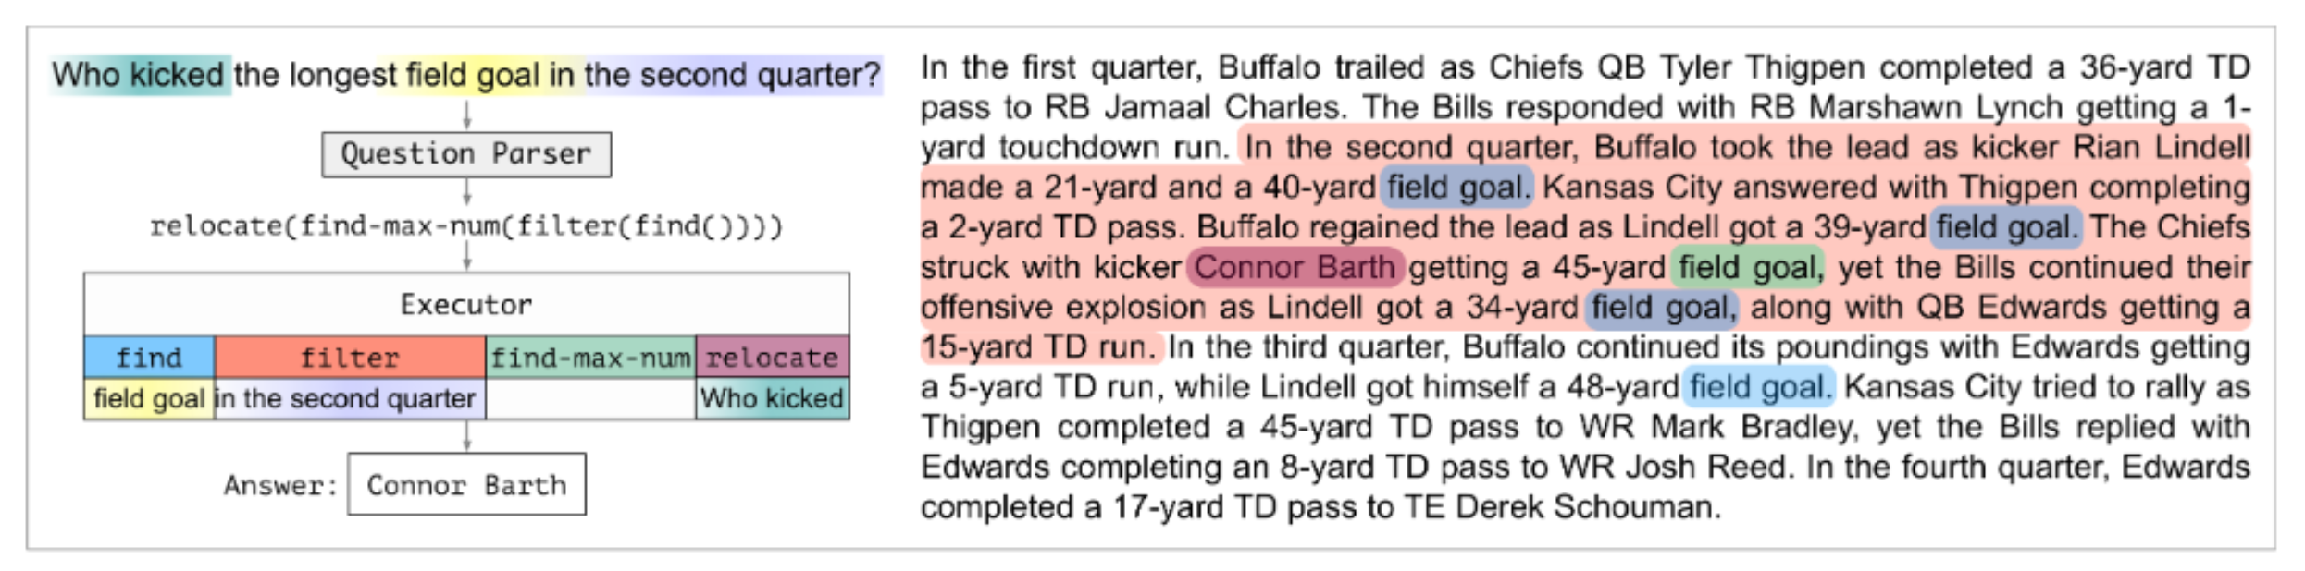
Question Decomposition [In Submission]
We need to induce a program, with some executable modules at the leaves
  This phrase indicates a field goal
  This player scored it; this is the team that scored it
  This is the length of the field goal
Reason symbolically over it.
  Imagine more expressive functions
Colors represent levels of attention over phrases

Slide 62
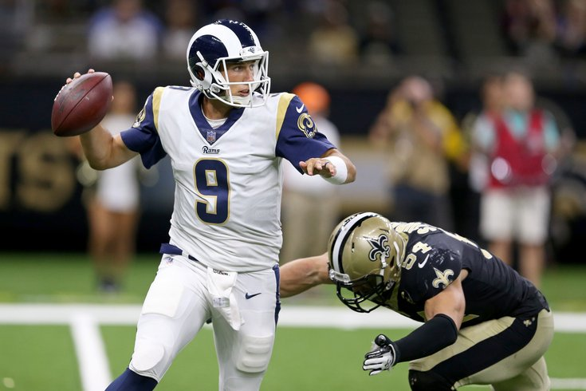
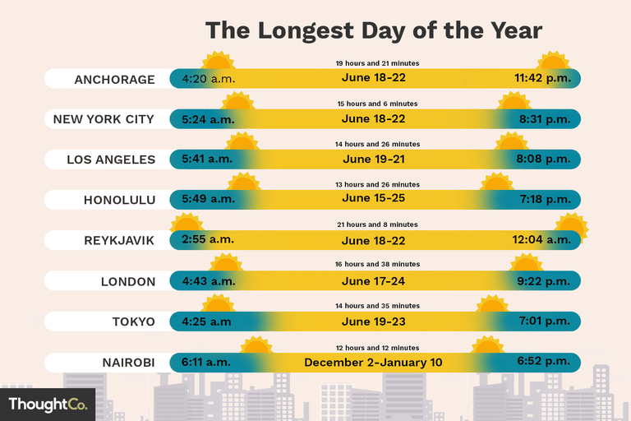
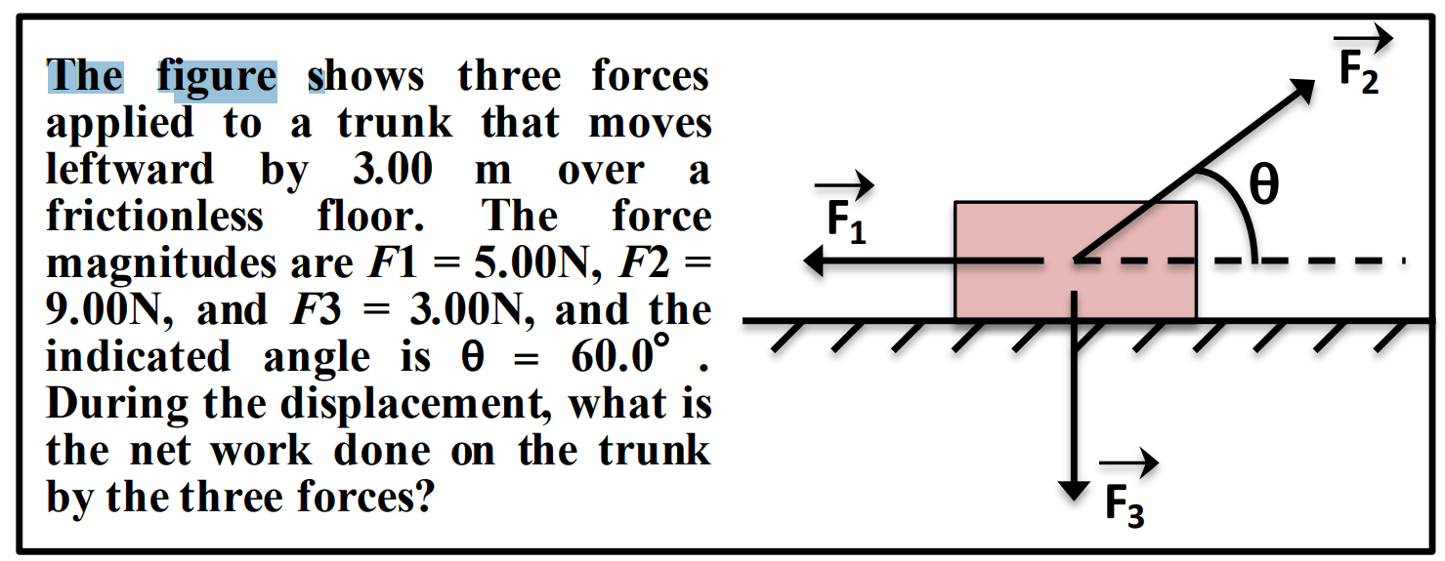
Conclusion
Thank You!
A small sample from a research program that attempts to address some of the key scientific and engineering challenges between us and understanding natural language
Reasoning: To decouple or not to decouple?
Supervision: how to think about it when we actually want to do reasoning?
  In the context of temporal reasoning tasks

