Slide 1

Natural Language Understanding with
Incidental Supervision
Dan Roth
Computer and Information Science
University of Pennsylvania
February 2018
CMU Language Technologies Institute Colloquium
Notes:
Title

Slide 2
Natural Language Understanding: Theses
Automating natural language understanding requires learning (many) models and reasoning with respect to them.
In order to do machine learning effectively one needs to know how to represent and combine knowledge effectively
  During learning and decision making
Inducing the many statistical models needed requires reasoning, to identify incidental supervision signals that exist in the data.
Automating natural language understanding requires learning (many) models and reasoning with respect to them.
In order to do machine learning effectively one needs to know how to represent and combine knowledge effectively
  During learning and decision making
Inducing the many statistical models needed requires reasoning, to identify incidental supervision signals that exist in the data.
Notes:
Start with a few claims that frame my work --

Slide 3


Natural Language Understanding
visitors
killed
No connective
This is an Inference Problem
At least 14 people have been killed in southern Sri Lanka, police say. The telecoms minister was among about 35 injured in the blast site at the town of Akuressa, 160km (100 miles) south of the capital, Colombo. Government officials were attending a function at a mosque to celebrate an Islamic holiday at the time. The minister said later that the suicide attack was carried out by ….
  ➔ 49 people were hit by a suicide bomber in Akuressa.
Requires dealing with a large number of phenomena
  lexical, quantitative, co-reference, semantic types, discourse conventions, knowledge…
Understanding is telling ourselves a story about the story
  It’s probably this; it could be that; what if… – multiple forms of reasoning
Notes:
I read this story; but a small part of it got wet by a drop of ink; so you will help me figure out if what I heard on National Public Radio is correct given this story, and also, what’s behind this black ink.
Where? …..How do you know?
Cannot be pumpkins -- the minister cannot be a pumpkin; and I cannot add it to people (semantic type);
but can be killed from the semantic types perspective (even though “killed” is a verb), but you probably infer that the argument is missing and can go on.
Killed does not make sense since we think that the seconds sentence elaborates on the first sentence rather than contradicts it – this is part of a convention that we buy into when we read a story – we have some expectations.
It would not fit into our equation – 35 + 14 = 49;
And, this is the telecom minister, and the minister here might be the same one….
Visitors – makes sense since he talked about it later – but doesn’t fit the math.
Injured is good;
But he probably wasn’t injured too seriously, since he was talking about it later.
There is a lot of “what if” when we read a story like that – even at the very low level …..
More than anything else, understanding is telling ourselves a story about the story….

Slide 4
Natural Language Understanding
Satisfying expectations is a knowledge intensive reasoning process
Natural language understanding decisions are global decisions that require
  Making (local) predictions driven by different models trained in different ways, at different times/conditions/scenarios
  The ability to put these predictions together coherently
  Knowledge, that guides the decisions so they satisfy our expectations
  But today, I’ll focus on the underlying learning processes and argue that they, too, necessitate some reasoning.
Notes:
4
Give examples for what’s not abductive reasoning
Focus on abductive reasoning
Show the formulation – talk about the boxes
Talk about multiple ways of training – decoupling – relate to abstraction
Examples: semantic parsing (do verb + Prep + commas together; lack of jointly annotated data)
Wikification – Relations (but also add geographical coherence; topical coherence; all interrelated signal that are acquired at different times, different contexts, etc.

Slide 5
Why is it Difficult?
Reasoning has been studied a lot in AI…
The majority of these studies decouple the nature of the underlying representation, how it is acquired, … [Learning to Reason, Khardon & Roth JACM’97]
Meaning
Variability
Ambiguity
Language

Slide 6


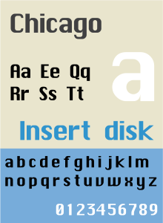



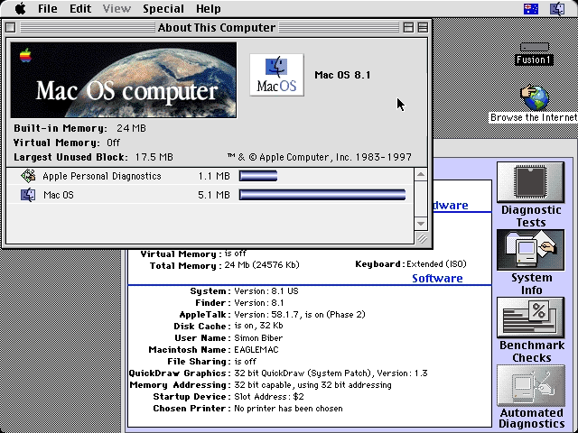
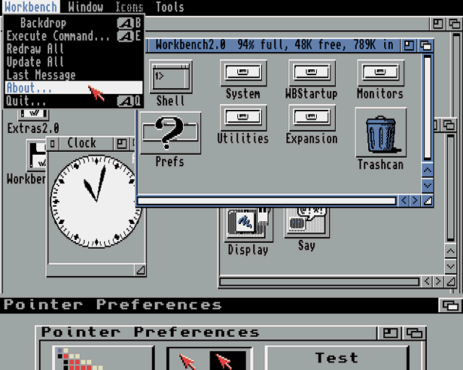
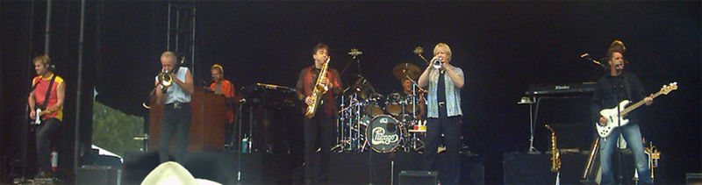
Ambiguity
It’s a version of Chicago – the standard classic Macintosh menu font, with that distinctive thick diagonal in the ”N”.
Chicago was used by default for Mac menus through MacOS 7.6, and OS 8 was released mid-1997..
Chicago VIII was one of the early 70s-era Chicago albums to catch my
ear, along with Chicago II.

Slide 7

Variability in Natural Language Expressions
Determine if Jim Carpenter works for the government
Jim Carpenter works for the U.S. Government.
The American government employed Jim Carpenter.
Jim Carpenter was fired by the US Government.
Jim Carpenter worked in a number of important positions. …. As a press liaison for the IRS, he made contacts in the white house.
Russian interior minister Yevgeny Topolov met yesterday with his US counterpart, Jim Carpenter.
Former US Secretary of Defense Jim Carpenter spoke today…
Conventional programming techniques cannot deal with the variability of expressing meaning nor with the
ambiguity of interpretation
  Machine Learning is needed to support abstraction over the raw text, and deal with:
  Identifying/Understanding Relations, Entities and Semantic Classes
  Acquiring knowledge from external resources; representing knowledge
  Identifying, disambiguating & tracking entities, events, etc.
  Time, quantities, processes…
Notes:
7

Slide 8
Inducing Semantics
Inducing semantic representations and making decisions that depend on it require learning and, in turn, supervision.
Standard machine learning methodology:
  Given a task
  Collect data for the task and annotate it
  Learn a model [doesn’t matter how]
We will never have enough annotated data to train all the models, for all the tasks we need this way.
  We don’t even know what are “all the tasks”
This methodology is not scalable and, often, makes no sense
  Annotating for complex tasks is difficult, costly, and sometimes impossible.
    When an intermediate representation is ill-defined, but the outcome is
    E.g., think about events
We should think about annotating data to evaluate performance, not to train. We already know that given large amounts of data we have ways to mimic this input-output mapping.
This is not where the challenge is!
In most interesting cases, learning should be (and is) driven by incidental supervision [Roth AAAI’17]
Notes:
Key challenge, to facilitate reasoning, is to induce semantics

Slide 9
Incidental Supervision
Data provides hints
  that are often sufficient to infer supervision signals for a range of tasks
  Data exists independent of the task(s) at hand.
Utilizing these hints
  Can be substantially less costly than producing explicit annotation
  More realistic – provides signals for tasks we haven’t defined
  Weak signals can be aggregated to produce higher quality signals
Examples:
  Information Extraction tasks
  Low Resource Languages
  SRL and Semantic Parsing
  Temporal and quantities
  …..
X Some protocols
Notes:
Key challenge, to facilitate reasoning, is to induce semantics

Slide 10
Gender Project
For a project in which we study gender coverage in the news
  Coverage
  Contribution
  ….
How to identify the gender of a given name?
  First idea: Pronouns.
    Not always easy in the news, but provides extremely high accuracy using the first paragraph of a person’s Wikipedia page.
  Generalization: First name matters
  Local signals can help improving
Notes:
Key challenge, to facilitate reasoning, is to induce semantics

Slide 11
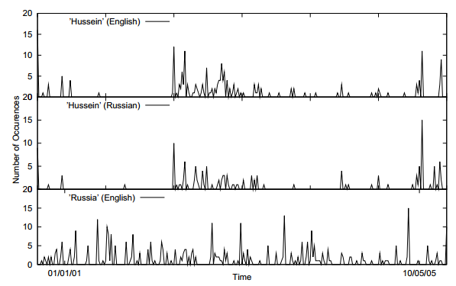
Incidental Supervision Signals
Searching for supervision signals could be challenging.
Supervision could be incidental, in the sense that it provides some signals that might be co-related to the target task.
Temporal histograms
Assume a comparable, weakly temporally aligned news feeds.
Hussein (English)
Transliteration: How to write “Hussein” in Russian?
Hussein (Russian)
Weak synchronicity provides a cue about the relatedness of (some) NEs across the languages, and can be exploited to associate them
[Klementiev & Roth, 06,08]
Russia (English)
Notes:
If I want to solve this transliteration task, I need examples; but I don’t need anyone to label many for me.
I could make the observation, that if one looks at comparable news articles from about the same time, the key entities they cover are the same, and they occur with about the same temporal frequency.
Start with labeling
Then transliteration
Then psychology
Then semantic parsing
(Emphasize that this requires reasoning)
End with the example of reasoning in learning (Chicago)

Slide 12
Incidental Supervision Signals
Need an inference mechanism that supports combining signals/models
By itself, this temporal signal may not be sufficient to support learning robust models.
Along with weak phonetic signals, context, topics, etc. it can be used to get robust models.
Incidental supervision in not distant supervision; but distant supervision is one instance of it.
Temporal histograms
Assume a comparable, weakly temporally aligned news feeds.
Hussein (English)
Hussein (Russian)
Weak synchronicity provides a cue about the relatedness of (some) NEs across the languages, and can be exploited to associate them
[Klementiev & Roth, 06,08]
Russia (English)

Slide 13
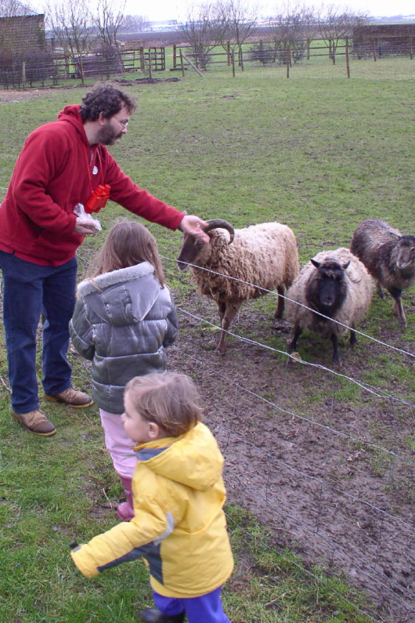
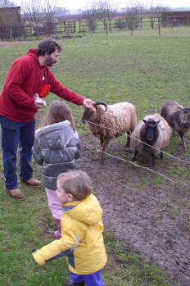


The language-world mapping problem [BabySRL: Connor, Fisher & Roth, 2012]
Take inspiration from language acquisition?
  Clearly, a lot of incidental supervision
  Harder problems (understanding verbs) bootstrap from easier
“the world”
Scene 1
Smur! Rivvo della frowler.
“the language”
Chase?
Flee?
Topid rivvo den marplox.
Nouns identified
Blert dor marplox, arno.
Scene 3
[Topid rivvo den marplox.]
Cross-situational observations
Scene n
Marplox dorinda blicket.
Notes:
When thinking about incidental supervision, I think that we can draw inspiration from language acquisition – kids need to solve the language-wolrd mapping problem, and all they have to work with are incidental supervision signals
So let’s look at the problem facing the child. In learning a language, a child must figure out how to map words and syntactic devices onto the meanings they are meant to convey in the native language.
Viewed in this way, this is a highly unconstrained mapping problem. In principle, anything in the language could be relevant to anything in the world.

Slide 14
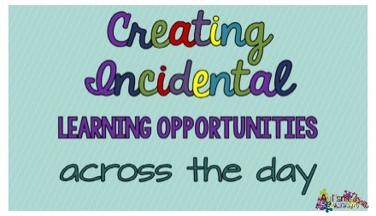
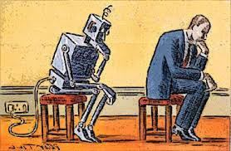

Outline
Introduction
  Natural Language Understanding
  The idea of Incidental Supervision
Exploiting existing information as supervision
  Information that is there independently of that task at hand
    Dataless Classification
    Wikification and Entity Linking (KBs, Multilingual)
Learning only simple models
  Structured examples
    Put it together via Inference & Knowledge
Response Driven Learning
  Learning from the world’s feedback
Conclusion

Slide 15
Text Categorization
Is it possible to map a document to an entry in a taxonomy of semantic categories, without training with labeled data?
The route for a return to No. 1 in the Emirates ATP Rankings is paved for Rafael Nadal and Roger Federer at next week’s Western & Southern Open. Andy Murray will relinquish top spot to one of the two in Cincinnati and if it is the Swiss who goes on to win the Coupe Rogers this week in Montreal, he would clinch World No. 1 with an equal or better finish than the Spaniard next week.
It’s about Sport
It’s about Tennis
Traditional text categorization requires training a classifier over a set of labeled documents (1,2,….k)
Someone needs to label the data (costly)
All your model knows is to classify into these given labels
Total costs for on-the-job health care benefits are expected to rise an average of 5% in 2018, surpassing $14,000 a year per employee, according to a National Business Group on Health survey of large employers. Specialty drugs continue to be the top driver of increasing costs. Companies will pick up nearly 70% of the tab, but employees must still bear about 30%, or roughly $4,400, on average.
It’s about Money
It’s about Health Care
You can do it, since you have an “understanding” of the labels

Slide 16
Categorization without Labeled Data [AAAI’08, AAAI’14, IJCAI’16]
This is not an unsupervised learning scenario. Unsupervised learning assumes a coherent collection of data points, where similar data points are assigned similar labels. It does not work on a single document. Related (but not identical) to 0/1-shot learning.
Given:
  A single document (or: a collection of documents)
  A taxonomy of categories into which we want to classify the documents
Dataless procedure:
  Let f(l_{i}) be the semantic representation of the labels (label descriptions)
  Let f(d) be the semantic representation of a document
  Select the most appropriate category:
  l_{i}* = argmin_{i} dist (f(l_{i}) - f(d))
  Bootstrap
    Label the most confident documents; use this to train a model.
Key Question:
  How to generate good Semantic Representations?

Slide 17
Text Representation
[Dense] Distributed Representations (Embeddings)
  New powerful implementations of good old ideas
    Learn a representation for a word as a function of words in its context
Brown Clusters
  An HMM based approach
  Found a lot of applications in other NLP tasks
[Sparse] Explicit Semantic Analysis (ESA)
  A Wikipedia driven approach – best for topical classification
    Represent a word as a (weighted) list of all Wikipedia titles it occurs in
  Gabrilovich & Markovitch 2009
No task specific supervision. Wikipedia is there.
Yields excellent results

Slide 18
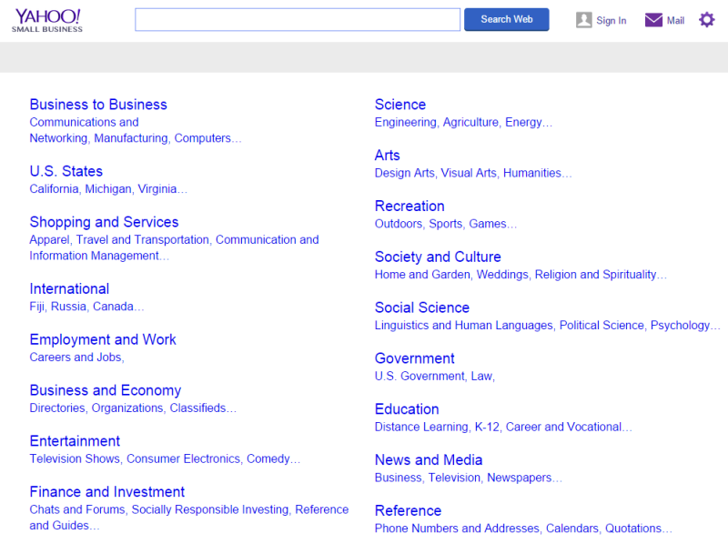
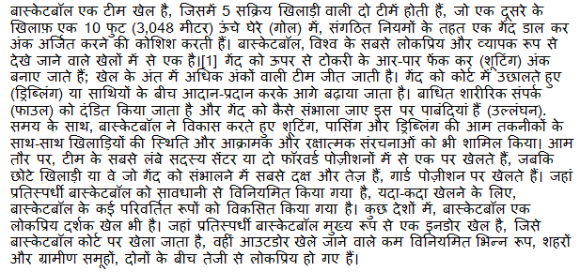
Cross-lingual Document Categorization
Map a document in language L to an English ontology of semantic categories, without training with task-specific labeled data.
Potentially, given a single document (not a coherent collection)
No task specific supervision: count on existing cross-lingual links
Sports
-Basketball

Slide 19
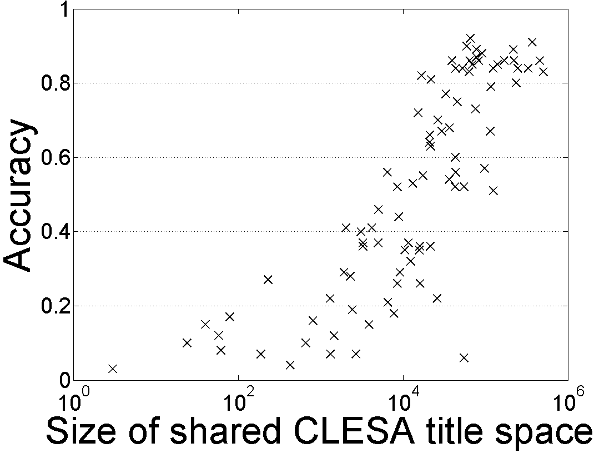
Single Document Classification (88 Language) [Song et. al. IJCAI’16]
Can be done to all 292 languages represented in Wikipedia
Performance depends on the Wikipedia size
Dataless classification for English
Accuracy
Hausa
Hindi
Size of shared English-Language L title space

Slide 20
Supervision-less Learning
This learning protocol relies on the ability to induce good semantic representations.
Relevant semantic representations should be learned using existing signals, independently of the task at hand.
Success Stories:
  Text Categorization
  Event Detection and Co-reference
    Requires more involved representations
No real understanding for how to do this in general
  Named Entity Recognition: New entity types…
  Relation Extraction: New relation types…

Slide 21






Wikification: The Reference Problem
Knowledge Acquisition
Blumenthal (D) is a candidate for the U.S. Senate seat now held by Christopher Dodd (D), and he has held a commanding lead in the race since he entered it. But the Times report has the potential to fundamentally reshape the contest in the Nutmeg State.
Blumenthal (D) is a candidate for the U.S. Senate seat now held by Christopher Dodd (D), and he has held a commanding lead in the race since he entered it. But the Times report has the potential to fundamentally reshape the contest in the Nutmeg State.
Ambiguity
Variability
Notes:
Let’s start with what is wikification
Read wiki titles slower

Slide 22
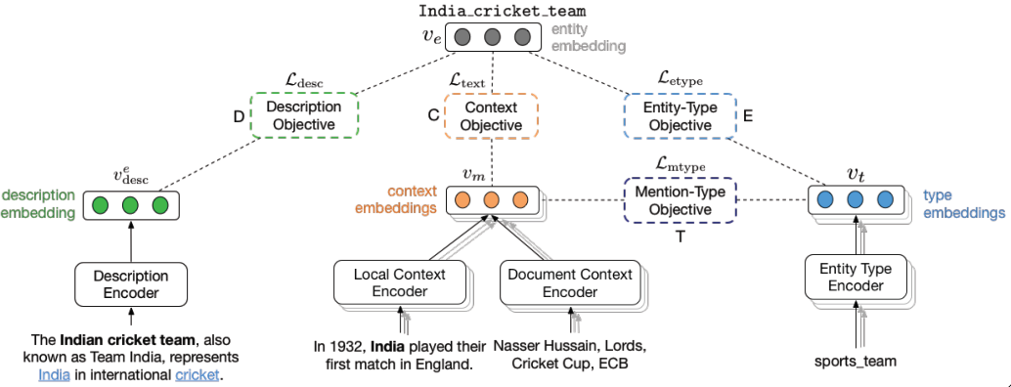
Wikification Challenges
Blumenthal (D) is a candidate for the U.S. Senate seat now held by Christopher Dodd (D), and he has held a commanding lead in the race since he entered it. But the Times report has the potential to fundamentally reshape the contest in the Nutmeg State.
Identify concepts in text
Identifies candidate Wikipedia titles for these
Ranks the corresponding titles: local context & global mention/title space
    Distance Based Models
  Simple entity representation
  A complex similarity metric
  Ratinov et. al’11; Chen&Roth’13
    Representation Based Models
  Learned entity representation
  Simple similarity metric
  Tsai et al ‘16; Gupta et al. ‘17
In Both cases: rely on the correctness of the (partial) link structure in Wikipedia with no task specific annotation
Notes:
Quite impressive, bottleneck: adding more sophisticated contextual features does not help much
We do not want to level off here

Slide 23
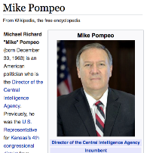
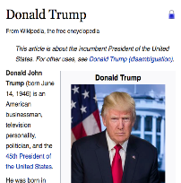
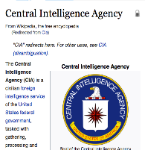
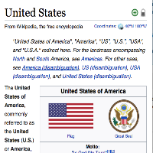
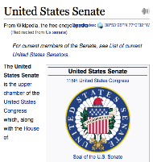
Cross-Lingual Wikification (EDL)
Given a non-English document, extract named entities and disambiguate into the English Wikipedia
    சிஐஏ இயக்குநர் மைக் பாம்பேயோ நியமனத்துக்கு அமெரிக்க செனட் சபை ஒப்புதல். ஆனால், சிஐஏ முகமை மற்றும் அமெரிக்க அதிபர் டிரம்ப் இடையே ஒரு பயனுள்ள அலுவல் ரீதியான உறவினை உருவாக்குவதே மைக் பாம்பேயோவின் உடனடி பணியாக இருக்கும்.
    சிஐஏ இயக்குநர் மைக் பாம்பேயோ நியமனத்துக்கு அமெரிக்க செனட் சபை ஒப்புதல். ஆனால், சிஐஏ முகமை மற்றும் அமெரிக்க அதிபர் டிரம்ப் இடையே ஒரு பயனுள்ள அலுவல் ரீதியான உறவினை உருவாக்குவதே மைக் பாம்பேயோவின் உடனடி பணியாக இருக்கும்.

Slide 24
Challenges: Multilingual [Tsai et al. ‘16, ‘17 ‘18]
    சிஐஏ இயக்குநர் மைக் பாம்பேயோ நியமனத்துக்கு அமெரிக்க செனட் சபை ஒப்புதல். ஆனால், சிஐஏ முகமை மற்றும் அமெரிக்க அதிபர் டிரம்ப் இடையே ஒரு பயனுள்ள அலுவல் ரீதியான உறவினை உருவாக்குவதே மைக் பாம்பேயோவின் உடனடி பணியாக இருக்கும்.
    சிஐஏ இயக்குநர் மைக் பாம்பேயோ நியமனத்துக்கு அமெரிக்க செனட் சபை ஒப்புதல். ஆனால், சிஐஏ முகமை மற்றும் அமெரிக்க அதிபர் டிரம்ப் இடையே ஒரு பயனுள்ள அலுவல் ரீதியான உறவினை உருவாக்குவதே மைக் பாம்பேயோவின் உடனடி பணியாக இருக்கும்.
Identifying name mentions in many languages
Identifying candidate English Wikipedia/KB titles
Computing similarity between mention context
and Wikipedia page across languages
Can address these challenges in all 293 Wikipedia languages in Wikipedia, without task specific annotation.
One key issue is representational: make use of existing cross-lingual Wikipedia links to learn cross-lingual embeddings
But it’s not only representational
Donald_Trump
Trump,_Colorado
Trumps_(Tarot_cards)
Trumpf
0.5
0.1
0.1
0.3

Slide 25
Biomedical Wikification
Text
Wikification into Knowledge Bases
Mentions
BRCA2 and homologous recombination.
Multiple reference KBs & Medical taxonomies
Concept ID
Concept ID
PR:000004804, EG:675
GO:0006310
Protein Ontology
Entrez Gene
id: PR:000004804
name: breast cancer type 2
susceptibility protein
def: A protein that is a translation
product of the human BRCA2
gene or a 1:1 ortholog thereof
synonyms: BRCA2, FACD,…
is_a: PR:000000001
id: EG:675
symbol: BRCA2
description:
protein-coding BRCA2
breast cancer 2, early
onset
synonyms: BRCC2,
BROVCA2, …
Notes:
I’ll describe the task by an example. Given a piece of text, it can be a sentence, a paragraph, or a document. Here it is a title of a journal paper.
There are actually two sub tasks. The first one is mention detection. We want to extract substrings which are concepts. In this example, mentions are the two underlined words.
This task is already very challenging and I’m currently working on it.
In this work, we take the mentions as given and focus on the second step, grounding the mentions to multiple KBs.
Here, BRCA2 is grounded to two concepts in two different ontologies. We can see that the concepts in KBs can overlap and we want to find all concepts the mention refers to.
And here are examples of an entry in the ontology. A concept usually contains an id, name, a short definition, some synonyms, and few relations with other concepts.
This succinct information is quite different from what wikipedia has, which makes this task harder.

Slide 26
KB Wikification Challenges
Ambiguity
  A term in text can be used to express many different concepts
  E.g., BRCA2 is used by 177 concepts
Variability
  A concept may be expressed in text using many surface forms
  E.g., EG:675 has synonyms BRCC2, FACD, FAD, FANCD, …
No Annotation
  Wikipedia has nice hyperlink structure which does not exist here
  It is difficult to obtain human annotations
  Minimal descriptive text in the KBs/Ontologies
Incidental supervision: [Tsai & Roth TACL‘16]
  An algorithmic approach that trains a model by building on [a small percentage of] concepts that are mentioned in multiple KBs.
Notes:
This task is very challenging, the main challenges are coming from the general WSD problem, the ambiguity and variability.
Ambiguity means a term can be ….
Variability means. …
Another challenge of not using wikipedia is the supervision.
A good wikification system usually trains a ranking model to score concepts using supervised learning. And wikipedia’s hyperlink structure kind of provides free supervision
Which the ontologies we use don’t have. Also, it is reletively difficult to
One of the key contributions in this work is we

Slide 27
Outline
Introduction
  Natural Language Understanding
  The idea of Incidental Supervision
Exploiting existing information as supervision
  Information that is there independently of that task at hand
    Dataless Classification
    Wikification and Entity Linking (KBs, Multilingual)
Learning only simple models
  Structured examples
    Put it together via Inference & Knowledge
Response Driven Learning
  Learning from the world’s feedback
Conclusion

Slide 28
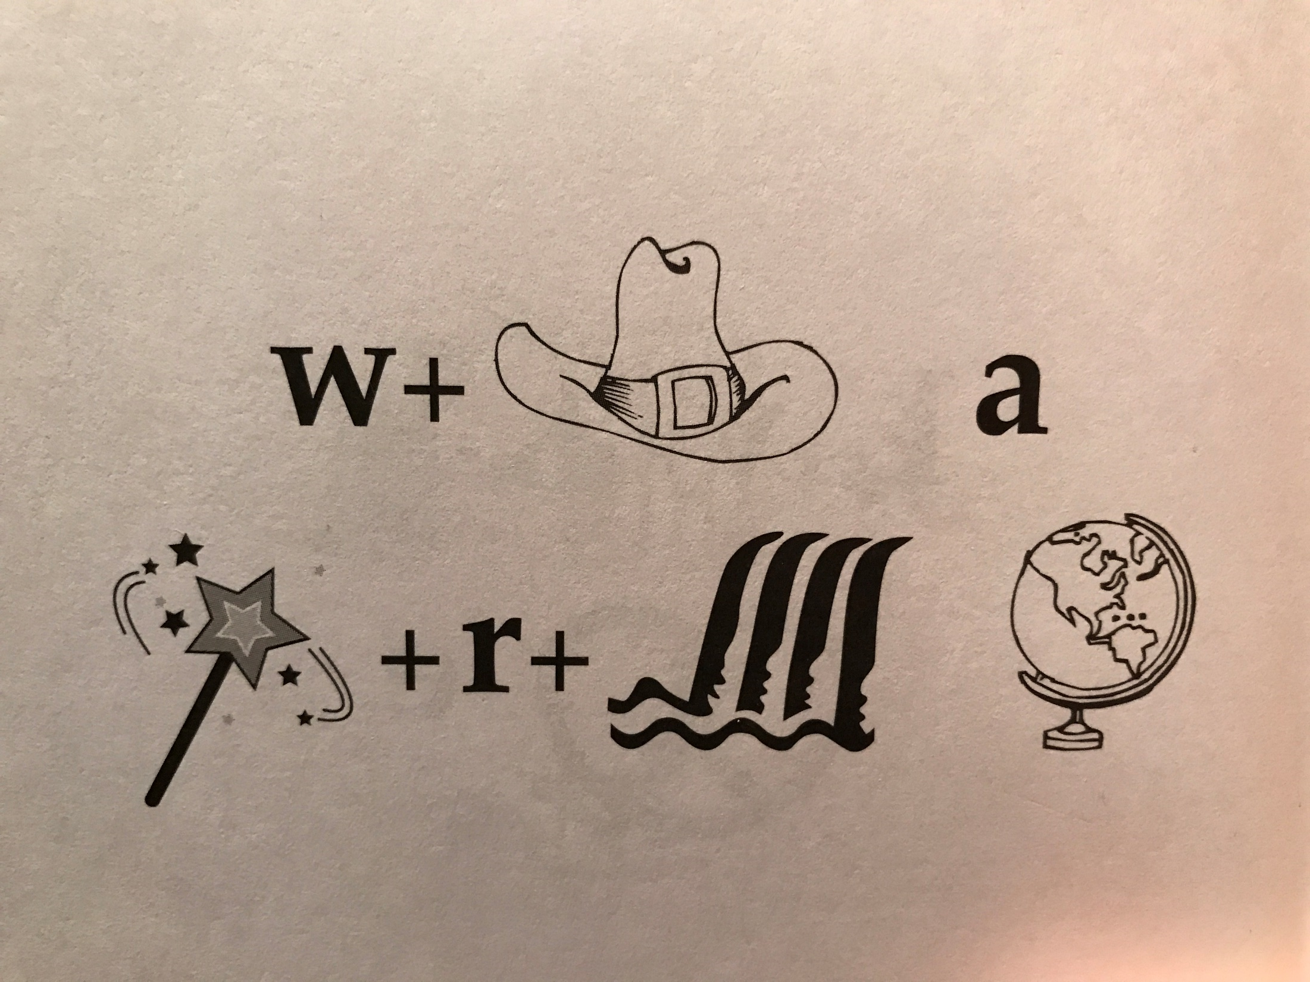
What a Wonderful (Wond-r-Fall) World
Identify units
Consider multiple
representations & interpretations
  Pictures, text, layout, spelling, phonetics
Put it all together:
  Determine “best” global interpretation
Satisfy expectations
  Slide; puzzle
How can we do it?
1.5
Notes:
How do you do it?
I think of NLU this way – there are a lot of components; each you acquired at different times, different ways; in each case you have a distribution over possible interpretation, each one is valid in some context; but here, given the expectation that I laid out by putting all these symbols together on one slide, indicating to you that they mean something, you were able to find a coherent explanation quite quickly – and all of you basically reached the same conclusion, hence, we, as human being, can communicate.

Slide 29
A Story
(ENGLAND, June, 1989) - Christopher Robin is alive and well. He lives in England. He is the same person that you read about in the book, Winnie the Pooh. As a boy, Chris lived in a pretty home called Cotchfield Farm. When Chris was three years old, his father wrote a poem about him. The poem was printed in a magazine for others to read. Mr. Robin then wrote a book. He made up a fairy tale land where Chris lived. His friends were animals. There was a bear called Winnie the Pooh. There was also an owl and a young pig, called a piglet. All the animals were stuffed toys that Chris owned. Mr. Robin made them come to life with his words. The places in the story were all near Cotchfield Farm. Winnie the Pooh was written in 1925. Children still love to read about Christopher Robin and his animal friends. Most people don't know he is a real person who is grown now. He has written two books of his own. They tell what it is like to be famous.
1. Christopher Robin was born in England. 2. Winnie the Pooh is a title of a book.
3. Christopher Robin’s dad was a magician. 4. Christopher Robin must be at least 65 now.
This is an Inference Problem
Notes:
29
I would like to talk about it in the context of language understanding problems. This is the problem I would like to solve. You are given a short story, a document, a paragraph, which you would like to understand. My working definition for Comprehension here would be “ A process that….”
So, given some statement, I would like to know if they are true in this story or not….
This is a very difficult task…
What do we need to know in order to have a chance to do that? … Many things….;
If I would ask you “Where does Chris live?” you will not be satisfied with an answer – “Chris Lived in a Pretty home”
And, there are probably many other stand-alone tasks of this sort that we need to be able to address, if we want to have a chance to COMPREHEND this story, and answer questions with respect to it.
But comprehending this story, being able to determined the truth of these statements is probably a lot more than that – we need to be able to put these things,
(and what is “these” isnt’ so clear) together.
So, how do we address comprehension? Here is a somewhat cartoon-she view of what has happened in this area over the last 30 years or so?
talk about – I wish I could talk about.
Here is a challenge: write a program that responds correctly to these five questions. Many of us would love to be able to do it.
This is a very natural problem; a short paragraph on Christopher Robin that we all
Know and love, and a few questions about it; my six years old can answer these
Almost instantaneously, yes, we cannot write a program that answers more than, say, 2 out of five questions.
What is involved in being able to answer these? Clearly, there are many “small” local decisions that we need to make.
We need to recognize that there are two Chris’s here. A father an a son. We need to resolve co-reference. We need sometimes
To attach prepositions properly;
The key issue, is that it is not sufficient to solve these local problems – we need to figure out how to put them
Together in some coherent way.
And in this talk, I will focus on this. We describe some recent works that we have done in this direction - …..
What do we know – in the last few years there has been a lot of work – and a considerable success on what I call here ---
Here is a more concrete and easy example -----
There is an agreement today that learning/ statistics /information theory (you name it) is of prime importance to making
Progress in these tasks. The key reason, is that rather than working on these high level difficult tasks, we have moved
To work on well defined disambiguation problems that people felt are at the core of many problems.
And, as an outcome of work in NLP and Learning Theory, there is today a pretty good understanding for how to solve
All these problems – which are essentially the same problem.

Slide 30
Natural Language Understanding
Expectation is a knowledge intensive component
Natural language understanding decisions are global decisions that require
  Making (local) predictions driven by different models trained in different ways, at different times/conditions/scenarios
  The ability to put these predictions together coherently
  Knowledge, that guides the decisions so they satisfy our expectations
Natural Language Interpretation is an Inference Process that is best thought of as a knowledge constrained optimization problem, done on top of multiple statistically learned models.
[ILP Formulations; Constraints Driven Learning (CoDL)]
[Roth & Yih’04,….Chang et al. 2007, Chang et. al 2012,……..]
Notes:
30
Give examples for what’s not abductive reasoning
Focus on abductive reasoning
Show the formulation – talk about the boxes
Talk about multiple ways of training – decoupling – relate to abstraction
Examples: semantic parsing (do verb + Prep + commas together; lack of jointly annotated data)
Wikification – Relations (but also add geographical coherence; topical coherence; all interrelated signal that are acquired at different times, different contexts, etc.

Slide 31
Semantic Role Labeling (SRL) [Extended SRL]
I left my pearls to my daughter in my will .
[I]_{A0} left [my pearls]_{A1} [to my daughter]_{A2} [in my will]_{AM-LOC} .
A0 Leaver
A1 Things left
A2 Benefactor
AM-LOC Location
I left my pearls to my daughter in my will .
Algorithmic approach:
  Learn multiple models, identifying different argument types;
  Account for interdependencies via ILP inference.
  argmax ∑_{a,t} y^{a,t} c^{a,t} = ∑_{a,t} 1_{a=t} c_{a=t}
  Subject to:
    One label per argument: ∑_{t} y^{a,t} = 1
    Relations between verbs and arguments,….
Notes:
In the context of SRL, the goal is to predict for each possible phrase in a given sentence if it is an argument or not and what type it is.

Slide 32
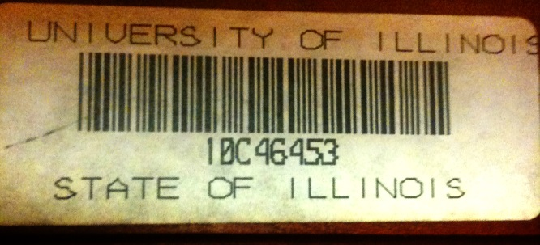
Verb SRL is not Enough
John, a fast-rising politician, slept on the train to Chicago.
Verb Predicate: sleep
  Sleeper: John, a fast-rising politician
  Location: on the train to Chicago
Who was John?
  Relation: Apposition (comma)
  John, a fast-rising politician
What was John’s destination?
  Relation: Destination (preposition)
  train to Chicago
  Variable y^{a,t} indicates whether candidate argument a is assigned a label t.
  c^{a,t} is the corresponding model score
argmax ∑_{a,t} y^{a,t} c^{a,t} = ∑_{a,t} 1_{a=t} c_{a=t}
Subject to:
One label per argument: ∑_{t} y^{a,t} = 1
No overlapping or embedding
Relations between verbs and arguments,…

Slide 33
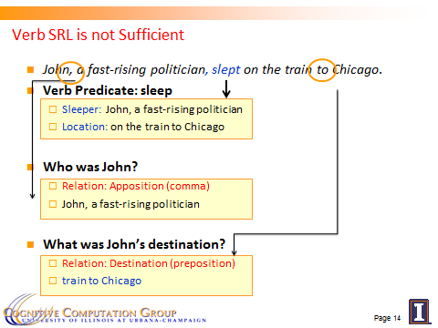
Computational Challenges
Very little supervised data
  per phenomenon
Partial Annotation
  Only at the predicate level
  Without identifying arguments
Typically, no jointly labeled data
  But, there is data per phenomenon
Solution
  Learn (simpler) models, one for each phenomenon
  Rely on knowledge-based constraints to make sure the outcomes cohere
    Coherency among multiple phenomena
    Latent structure can be constrained (via CCMs)
  This will also improve the performance of each model

Slide 34
Coherency in Semantic Role Labeling
Predicate-arguments generated should be consistent across phenomena
The touchdown scored by Foles cemented the victory of the Eagles.
Verb | Nominalization | Preposition
Predicate: score A0: Foles (scorer) A1: The touchdown (points scored) | Predicate: win A0: the Eagles (winner) | Sense: 11(6) “the object of the preposition is the object of the underlying verb of the nominalization”
Linguistic Constraints:
A0: the Eagles ⇔ Sense(of): 11(6)
A0: Foles ⇔ Sense(by): 1(1)
Notes:
34

Slide 35
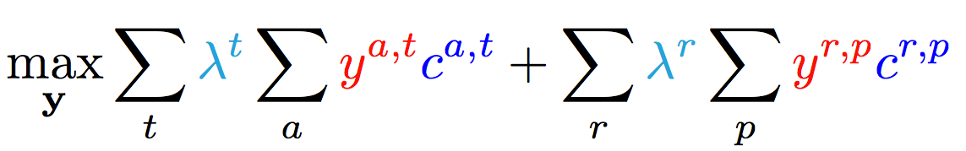
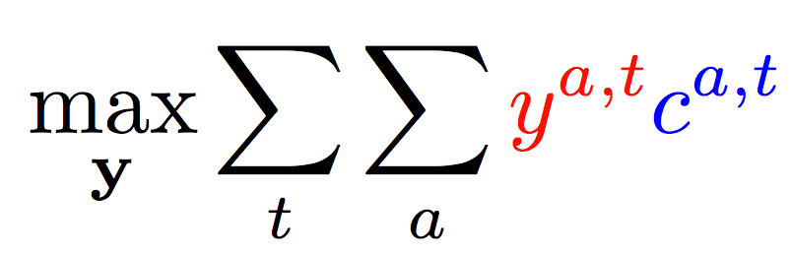
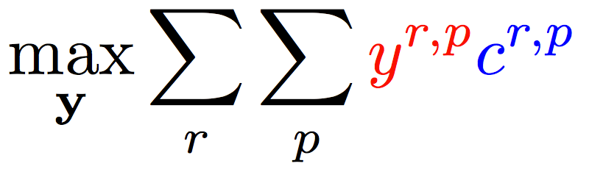
Enforce Coherence via Joint inference (CCMs)
  Variable y^{a,t} indicates whether candidate argument a is assigned a label t.
  c^{a,t} is the corresponding model score
Verb arguments
Preposition relations
+ ….
Argument candidates
Re-scaling parameters (one per label)
Preposition relation
label
Constraints:
Preposition
Each argument label
Verb SRL constraints
Preposition SRL Constraints
+ Joint coherency constraints between tasks

Slide 36
Reasoning for Using Complex Models without Joint Supervision
Verbs
Nouns
Commas
Prepositions
Compounds
Possessives
Adjective-Noun
Light verbs
Phrasal verbs
NER
Wikification
Events
Implicit relations
  Missing Arguments
  Missing Predicates
Conjunctions
Quantifiers
Negations
Quantities (comparators)
Temporal
There is a need to understand multiple phenomena in natural language text
  We will never have enough jointly annotated data
Joint inference via declarative constraints
  Is essential both to provide coherent global prediction, and
  At a way to get around lack of joint annotation
Joint Inference can also be used to improve individual models.

Slide 37
Outline
Introduction
  Natural Language Understanding
  The idea of Incidental Supervision
Exploiting existing information as supervision
  Information that is there independently of that task at hand
    Dataless Classification
    Wikification and Entity Linking (KBs, Multilingual)
Learning only simple models
  Structured examples
    Put it together via Inference & Knowledge
Response Driven Learning
  Learning from the world’s feedback
Conclusion

Slide 38
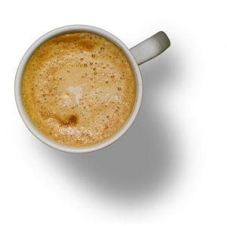
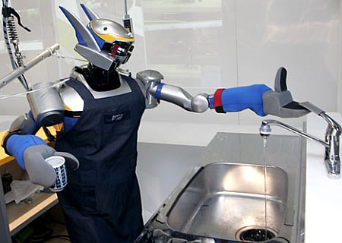

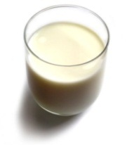
Understanding Language Requires (some) Supervision
Can we rely on this interaction to provide supervision (and eventually, recover meaning) ?
Can I get a coffee with lots of sugar and no milk
Great!
Arggg
Meaning Representation:
MAKE(COFFEE,SUGAR=YES,MILK=NO)
How to recover meaning from text?
Standard “example based” ML: annotate text with meaning representation
  The teacher needs deep understanding of the learning agent ; not scalable.
Response Driven Learning: Exploit indirect signals in the interaction between the learner and the teacher/environment
Notes:
NLU: about recovering meaning from text – a lot of work aims directly at that or at some subtasks that might look like this:….

Slide 39
Response Based Learning
We want to learn a model that transforms a natural language sentence to some meaning representation.
Instead of training with (Sentence, Meaning Representation) pairs
Think about simple behavioral derivatives of the models outputs
  Supervise the derivatives (easy!) and
  Propagate it to learn the complex, structured, transformation model
English Sentence
Model
Meaning Representation

Slide 40
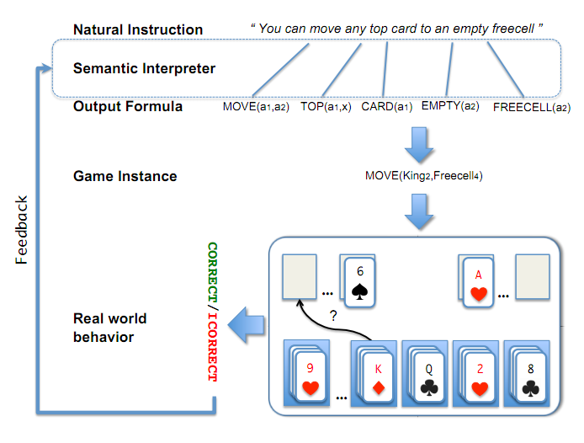
A Response based Learning Scenario
We want to learn a model to transform a natural language sentence to some meaning representation.
English Sentence
Model
Meaning Representation
A top card can be moved to the tableau if it has a different color than the color of the top tableau card, and the cards have successive values.
Move (a1,a2) top(a1,x1) card(a1) tableau(a2) top(x2,a2) color(a1,x3) color(x2,x4) not-equal(x3,x4) value(a1,x5) value(x2,x6) successor(x5,x6)
Play Freecell (solitaire)
Simple derivatives of the models outputs: game API
  Supervise the derivative and Propagate it to learn the transformation model

Slide 41
Scenario II: Geoquery with Response based Learning
We want to learn a model to transform a natural language sentence to some formal representation.
“Guess” a semantic parse. Is [DB response == Expected response] ?
  Expected: Pennsylvania DB Returns: Pennsylvania→ Positive Response
  Expected: Pennsylvania DB Returns: NYC, or ???? → Negative Response
English Sentence
Model
Meaning Representation
What is the largest state that borders NY?
largest( state( next_to( const(NY))))
Simple derivatives of the models outputs
Query a GeoQuery Database.
A fifth grader can play with it and supervise it – no need to know SQL

Slide 42
Response Based Learning
We want to learn a model that transforms a natural language sentence to some meaning representation.
Instead of training with (Sentence, Meaning Representation) pairs
Think about some simple derivatives of the models outputs,
  Supervise the derivative (easy!) and
  Propagate it to learn the complex, structured, transformation model
LEARNING:
Train a structured predictor (semantic parse) with this binary supervision
  Many challenges: e.g., how to make a better use of a negative response?
Learning with a constrained latent representation, use inference to exploit knowledge (e.g., on the structure of the meaning representation).
[Clarke, Goldwasser, Chang, Roth CoNLL’10; Goldwasser, Roth IJCAI’11, MLJ’14]
English Sentence
Model
Meaning Representation
As for other problems, people are excited today about NN models, but this does not get around the need to supervise models in a realistic way.

Slide 43
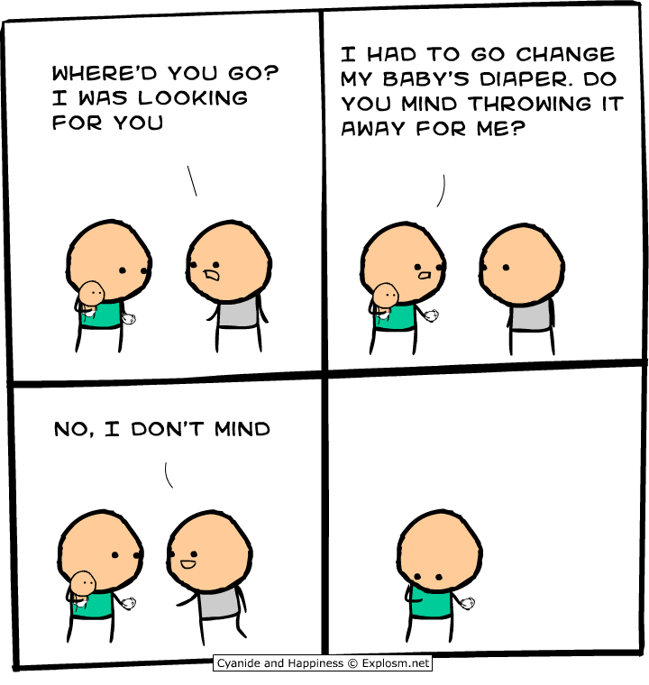
Another Challenge for Incidental Supervision

Slide 44
Incidental Supervision and Reasoning
Co-ref
  The bee landed on the flower because it had/wanted pollen.
    Lexical knowledge
  John Doe robbed Jim Roy. He was arrested by the police.
    The Subj of “rob” is more likely than the Obj of “rob” to be the Obj of “arrest”
[But see Peng et al. ACL’16, CoNLL’17, NAACL’15 for progress on this]

Slide 45
Incidental Supervision & Reasoning
O’Hare must be in Chicago
O’Hare must be in Chicago
Feb 5 2017 Dozens of passengers heading to Chicago had to undergo additional screenings… It took Hesam Aamyab two tries to make it back to the United States from Iran. He is an Iranian citizen with a US visa who is doing post-doctoral research at UIC. …"Right now, I am in the USA and I'm very happy," Aamyab said. But now, he can't go back to Iran or anywhere else without risk. Other travelers shared the same worry. Asem Aleisawi was at O'Hare on Sunday to meet his wife who was coming in from Jordan.
  Learning/Supervision requires some level of reasoning to infer these weak signals
John had 6 books; he wanted to give it to two of his friends. How many will each one get?
  You must have learned something from this thought experiment…
share it with
How do we supervise for these problems?

Slide 46
Summary
Thank you!
We need to re-think the annotation-heavy approach to NLP
  And other Cognitive Computations
Learning should be (and is) driven by incidental signals.
  Weak signals that exist in the data and the environment
  Independent of the task at hand
We need to develop ways to identify and exploit these signals
  Along with developing the necessary inference support
Proposed some evidence in a range of problems and supervision scenarios
  It will also force us to re-think evaluation – we should move to systematically extrinsic evaluations
Notes:
46

