Slide 1

The Necessity of Learning and Reasoning
A Natural Language Understanding Perspective
Dan Roth
Computer and Information Science
University of Pennsylvania
IJCAI John McCarthy Award Lecture
IJCAI 2017
Melbourne, Australia
Notes:
Title

Slide 2
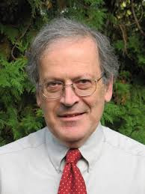

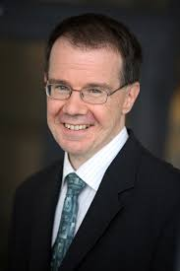
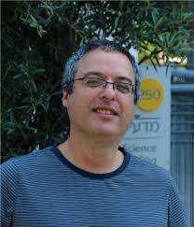

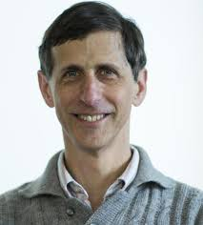
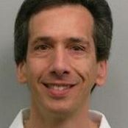
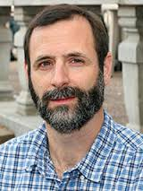
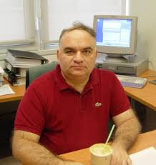


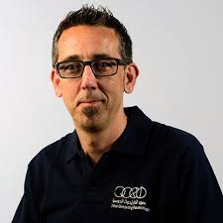

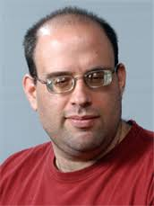
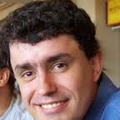


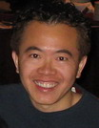
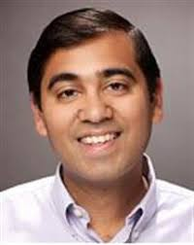

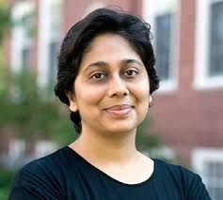


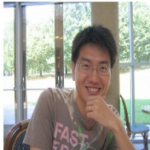

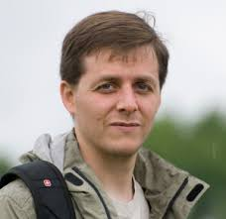
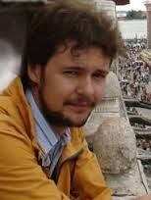

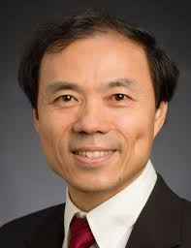





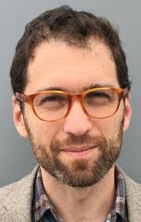







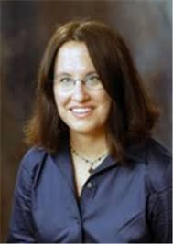
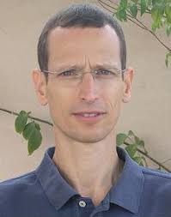













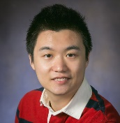














Thanks
Illinois
Since 1997
Notes:
Thanks a lot Michael for your kind words.
It’s exciting and humbling to receive such an award recognizing the significance of the work that I, together with many collaborators have done over the last 20 years.
I have spent the last 20 twenty years at the University of Illinois at Urbana/Chamapign, where in 1997 I started the Cognitive Computation Group (even before it was popular to call what we do Cognitive Computing).
I have worked with many people – and I will not manage to mention all of them today – some I will mention later in the talk.
But all, especially my students, have taught me a great deal, made this twenty years long ride feel like a few weeks.
And I’d like to share with you in the next hour or so, some of what we have done, thought about , and some of the ideas we pursued and pushed forward as part of a unified research program leading to natural language understanding.
Given this great experience, I’d like to start with the following statement that you can read for yourself.

Slide 3
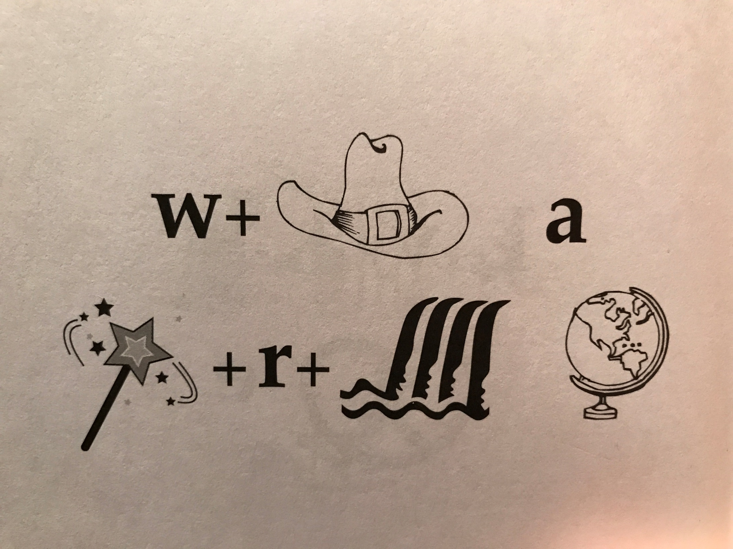
What a Wonderful (Wond-r-Fall) World
Identify units
Consider multiple
representations & interpretations
  Pictures, text, layout, spelling, phonetics
Put it all together:
  Determine “best” global interpretation
Satisfy expectations
  Slide; puzzle
How can we do it?
1.5
Notes:
How do you do it?
I think of NLU this way – there are a lot of components; each you acquired at different times, different ways; in each case you have a distribution over possible interpretation, each one is valid in some context; but here, given the expectation that I laid out by putting all these symbols together on one slide, indicating to you that they mean something, you were able to find a coherent explanation quite quickly – and all of you basically reached the same conclusion, hence, we, as human being, can communicate.

Slide 4

What’s Important
How to make progress towards natural language understanding
  Think about stories
  Learning and Reasoning
Dispel with some of the currently hot trends
  If we want to reach the moon…
A tribute to John McCarthy
  His thoughts about stories
A brief, example-based, tour of some of my work in these directions
Notes:
This is my model for natural language comprehension – and I’d like to talk about some of the key issues we need to think about if we want to make progress in NLU
In doing it, I’ll dispel with some of the currently hot trends – they can help up clime trees, but we want to reach the moon.
I will use it to pay tribute to John McCarthy – many of you, I hope, know that he thought a lot about representations and Reasoning, I will discuss some of his thoughts about natural language stories
And I’ll use it to give you a brief tour of some of the relevant, hopefully important, ideas came from my work in these directions, and were we should go.

Slide 5


Natural Language Understanding
visitors
killed
No connective
This is an Inference Problem
At least 14 people have been killed in southern Sri Lanka, police say. The telecoms minister was among about 35 injured in the blast site at the town of Akuressa, 160km (100 miles) south of the capital, Colombo. Government officials were attending a function at a mosque to celebrate an Islamic holiday at the time. The minister said later that the suicide attack was carried out by ….
  ➔ 49 people were hit by a suicide bomber in Akuressa.
Requires dealing with a large number of phenomena
  lexical, quantitative, co-reference, semantic types, discourse convention, knowledge…
Understanding is telling ourselves a story about the story
Notes:
I read this story; but a small part of it got wet; so you will help me figure out if what I heard on National Public Radio is correct given this story, and also, what’s behind this black ink.
Where? …..How do you know?
Cannot be pumpkins -- the minister cannot be a pumpkin; and I cannot add it to people (semantic type);
but can be killed from the semantic types perspective (even though “killed” is a verb), but you probably infer that the argument is missing and can go on.
Killed does not make sense since we think that the seconds sentence elaborates on the first sentence rather than contradicts it – this is part of a convention that we buy into when we read a story – we have some expectations.
It would not fit into our equation – 35 + 14 = 49;
And, this is the telecom minister, and the minister here might be the same one….
Visitors – makes sense since he talked about it later – but doesn’t fit the math.
Injured is good;
But he probably wasn’t injured too seriously, since he was talking about it later.
There is a lot of “what if” when we read a story like that – even at the very low level …..
More than anything else, understanding is telling ourselves a story about the story….

Slide 6
No Magic Box
At least 14 people have been killed in southern Sri Lanka, police say. The telecoms minister was among about 35 injured in the blast site at the town of Akuressa, 160km (100 miles) south of the capital, Colombo. Government officials were attending a function at a mosque to celebrate an Islamic holiday at the time. The minister said later that the suicide attack was carried out by
Magic Box

Slide 7
No Magic Box
At least 14 people have been killed in southern Sri Lanka, police say. The telecoms minister was among about 35 injured in the blast site at the town of Akuressa, 160km (100 miles) south of the capital, Colombo. Government officials were attending a function at a mosque to celebrate an Islamic holiday at the time. The minister said later that the suicide attack was carried out by
Magic Box
All Inferences
How, Why, What if

Slide 8
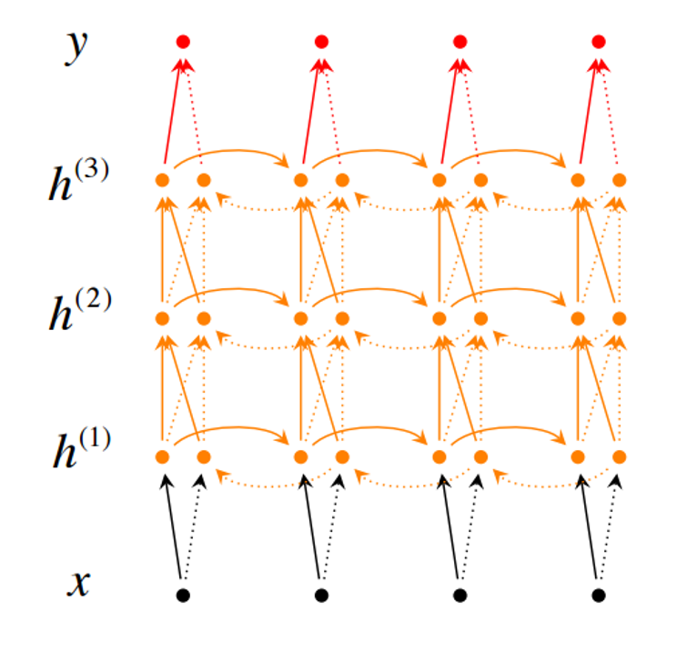
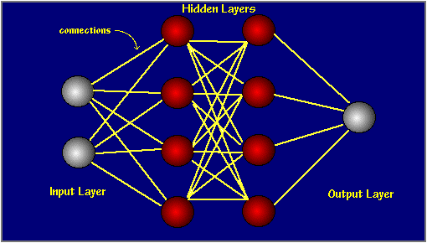
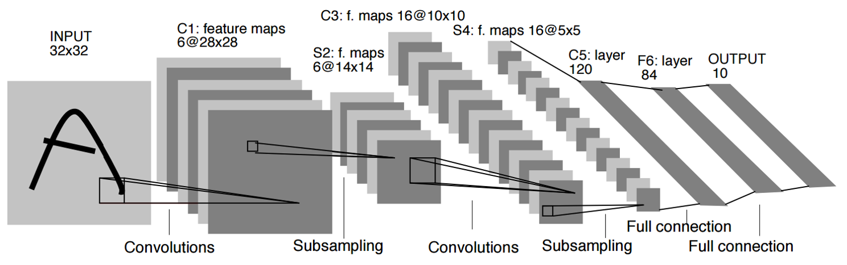
No Magic Box
At least 14 people have been killed in southern Sri Lanka, police say. The telecoms minister was among about 35 injured in the blast site at the town of Akuressa, 160km (100 miles) south of the capital, Colombo. Government officials were attending a function at a mosque to celebrate an Islamic holiday at the time. The minister said later that the suicide attack was carried out by
All Inferences
How, Why, What if

Slide 9
No Magic Box
At least 14 people have been killed in southern Sri Lanka, police say. The telecoms minister was among about 35 injured in the blast site at the town of Akuressa, 160km (100 miles) south of the capital, Colombo. Government officials were attending a function at a mosque to celebrate an Islamic holiday at the time. The minister said later that the suicide attack was carried out by
A lot of “magic boxes” are needed to address NLU.
  Induced different ways, at different times, using different resources
  Some via learning from examples, some by being told decleartively, by being read, or inferred.
Not everything is an input-output problem
  And there is a need to reason over the “boxes”

Slide 10
A Story
(ENGLAND, June, 1989) - Christopher Robin is alive and well. He lives in England. He is the same person that you read about in the book, Winnie the Pooh. As a boy, Chris lived in a pretty home called Cotchfield Farm. When Chris was three years old, his father wrote a poem about him. The poem was printed in a magazine for others to read. Mr. Robin then wrote a book. He made up a fairy tale land where Chris lived. His friends were animals. There was a bear called Winnie the Pooh. There was also an owl and a young pig, called a piglet. All the animals were stuffed toys that Chris owned. Mr. Robin made them come to life with his words. The places in the story were all near Cotchfield Farm. Winnie the Pooh was written in 1925. Children still love to read about Christopher Robin and his animal friends. Most people don't know he is a real person who is grown now. He has written two books of his own. They tell what it is like to be famous.
1. Christopher Robin was born in England. 2. Winnie the Pooh is a title of a book.
3. Christopher Robin’s dad was a magician. 4. Christopher Robin must be at least 65 now.
This is an Inference Problem
Notes:
10
I would like to talk about it in the context of language understanding problems. This is the problem I would like to solve. You are given a short story, a document, a paragraph, which you would like to understand. My working definition for Comprehension here would be “ A process that….”
So, given some statement, I would like to know if they are true in this story or not….
This is a very difficult task…
What do we need to know in order to have a chance to do that? … Many things….;
If I would ask you “Where does Chris live?” you will not be satisfied with an answer – “Chris Lived in a Pretty home”
And, there are probably many other stand-alone tasks of this sort that we need to be able to address, if we want to have a chance to COMPREHEND this story, and answer questions with respect to it.
But comprehending this story, being able to determined the truth of these statements is probably a lot more than that – we need to be able to put these things,
(and what is “these” isnt’ so clear) together.
So, how do we address comprehension? Here is a somewhat cartoon-she view of what has happened in this area over the last 30 years or so?
talk about – I wish I could talk about.
Here is a challenge: write a program that responds correctly to these five questions. Many of us would love to be able to do it.
This is a very natural problem; a short paragraph on Christopher Robin that we all
Know and love, and a few questions about it; my six years old can answer these
Almost instantaneously, yes, we cannot write a program that answers more than, say, 2 out of five questions.
What is involved in being able to answer these? Clearly, there are many “small” local decisions that we need to make.
We need to recognize that there are two Chris’s here. A father an a son. We need to resolve co-reference. We need sometimes
To attach prepositions properly;
The key issue, is that it is not sufficient to solve these local problems – we need to figure out how to put them
Together in some coherent way.
And in this talk, I will focus on this. We describe some recent works that we have done in this direction - …..
What do we know – in the last few years there has been a lot of work – and a considerable success on what I call here ---
Here is a more concrete and easy example -----
There is an agreement today that learning/ statistics /information theory (you name it) is of prime importance to making
Progress in these tasks. The key reason, is that rather than working on these high level difficult tasks, we have moved
To work on well defined disambiguation problems that people felt are at the core of many problems.
And, as an outcome of work in NLP and Learning Theory, there is today a pretty good understanding for how to solve
All these problems – which are essentially the same problem.

Slide 11
Natural Language Understanding
Expectation is a knowledge intensive component
Natural language understanding decisions are global decisions that require
  Making (local) predictions driven by different models trained in different ways, at different times/conditions/scenarios
  The ability to put these predictions together coherently
  Knowledge, that guides the decisions so they satisfy our expectations
Natural Language Interpretation is an Inference Process that is best thought of as a knowledge constrained optimization problem, done on top of multiple statistically learned models.
Notes:
11
Give examples for what’s not abductive reasoning
Focus on abductive reasoning
Show the formulation – talk about the boxes
Talk about multiple ways of training – decoupling – relate to abstraction
Examples: semantic parsing (do verb + Prep + commas together; lack of jointly annotated data)
Wikification – Relations (but also add geographical coherence; topical coherence; all interrelated signal that are acquired at different times, different contexts, etc.

Slide 12
A Biased View of Common Sense Reasoning
Hayes&McCarthy
Frame Problem
Brooks
Subsumption
Quillian
Semantic Networks
ConceptNet
Minsky, Filmore
Frames
McCarthy
Formalizing Commonsense
Description Logic
Bobrow
STUDENT
Simon&Newell
General Problem Solver
Lenant
Cyc
Winograd
SHRDLU
2000 1990 1980 1970 1960 1950 1940
Common Sense Reasoning was formulated
traditionally as a “reasoning” process, irrespective of learning and the resulting knowledge representation.
Khardon & Roth
Learning to Reason

Slide 13
Learning to Reason
A unifying computational theory of Learning and Reasoning.
  Reasoning should be studied together with Learning and the knowledge representation it produces.
Formally showing the benefits in jointly studying Learning and Reasoning
  Some hard reasoning tasks become easy if done on top of learning into an appropriate knowledge representation.
  [Khardon & Roth JACM’96; 1994—2000]
In some sense, these ideas are now main stream.
  But, understanding when to decompose learning and when to decouple it from reasoning is also very important.
  At the heart of supporting abstraction and transfer
No better domain to think about this than Natural Langauge

Slide 14
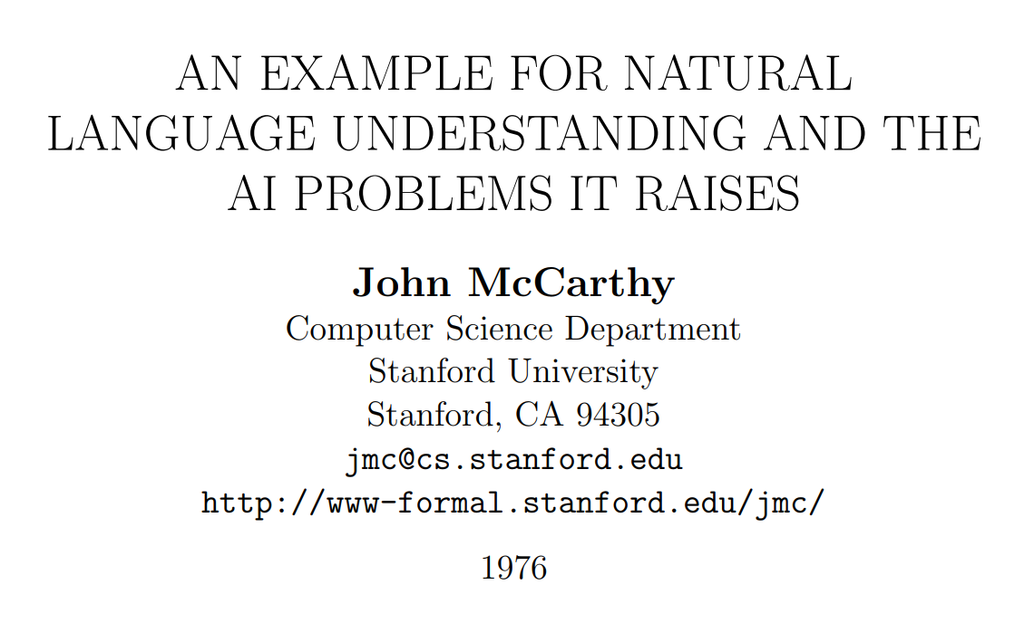
John McCarthy on Natural Language Understanding

Slide 15
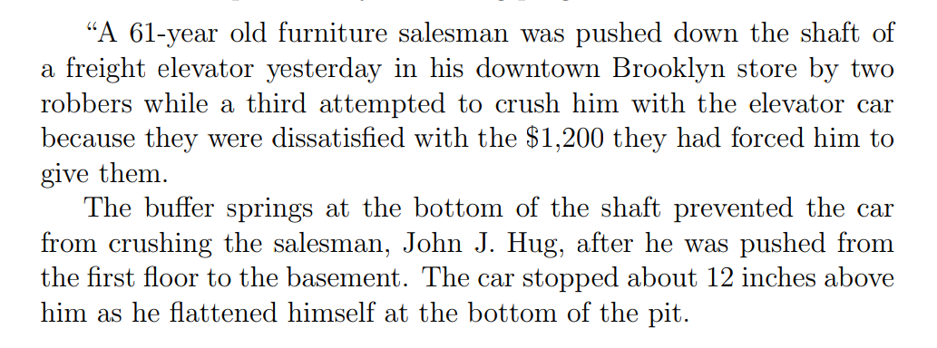
A New York Times Story

Slide 16
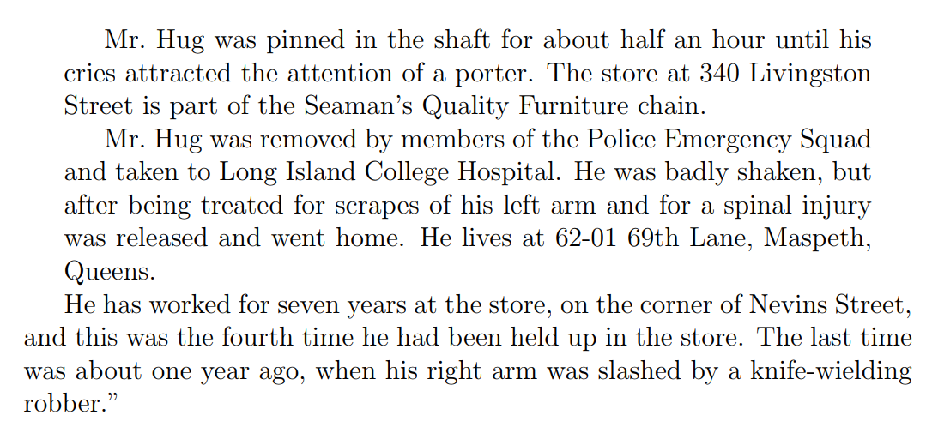
A New York Times Story (Cont.)

Slide 17
New York Times Story: Questions
An intelligent person or program should be able to answer the following questions based on the information in the story:
  The article proceeds with 22 questions:
1. Who was in the store when the events began?
  Probably Mr. Hug alone, although the robbers might have been waiting for him, but if so, this would have been stated.
2. What did the porter say to the robbers?
  Nothing, because the robbers left before he came.
20. Why did Mr. Hug yell from the bottom of the elevator shaft?
  So as to attract the attention of someone who would rescue him.
“The above list of questions is rather random. I doubt it covers all facets of understanding the story.”

Slide 18
McCarthy’s Challenges
The QA module is not being trained Once the program knows English, and has the relevant background knowledge, it should answer the questions
A formalism capable of expressing the assertion of the sentences free from dependence on the grammar of the English language. (“Artificial Natural Language”, ANL)
  Semantic Parser
An “understander” that constructs the “facts” from the text.
  Information Extraction: Entities, Relations, Temporal, Quantities,…
Expression of the “general information” about the world that could allow getting the answers to the questions from the “facts” and the “general information”
  Background Knowledge
A “problem solver” that could answer the above questions on the basis of the “facts”.
  Question Answering Engine

Slide 19
A Biased View of Common Sense Reasoning
One cannot simply map natural language to a representation that gives rise to reasoning
Hayes&McCarthy
Frame Problem
Brooks
Subsumption
Quillian
Semantic Networks
ConceptNet
Minsky, Filmore
Frames
McCarthy
Formalizing Commonsense
Description Logic
Bobrow
STUDENT
Simon&Newell
General Problem Solver
Lenant
Cyc
Winograd
SHRDLU
2000 1990 1980 1970 1960 1950 1940
Common Sense Reasoning was formulated
traditionally as a “reasoning” process, irrespective of learning and the resulting knowledge representation.
Khardon & Roth
Learning to Reason

Slide 20
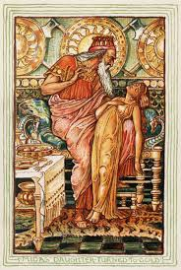
Why is it Difficult?
Midas: I hope that everything I touch becomes gold.
One cannot simply map natural language to a representation that gives rise to reasoning
Meaning
Variability
Ambiguity
Language

Slide 21






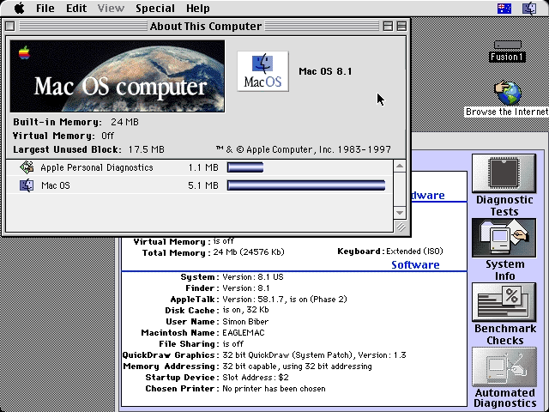
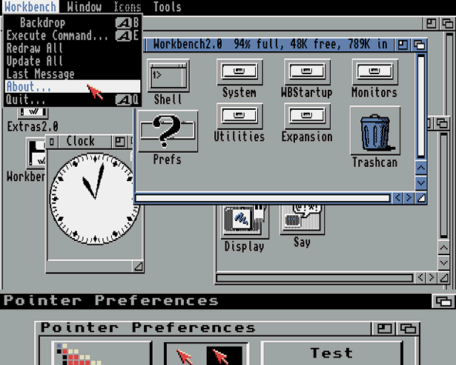
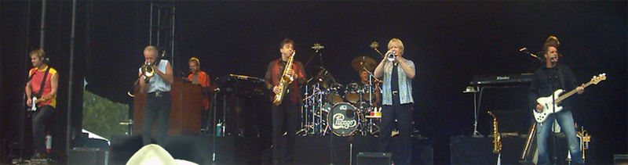
Ambiguity
It’s a version of Chicago – the standard classic Macintosh menu font, with that distinctive thick diagonal in the ”N”.
Chicago was used by default for Mac menus through MacOS 7.6, and OS 8 was released mid-1997..
Chicago VIII was one of the early 70s-era Chicago albums to catch my
ear, along with Chicago II.

Slide 22

Variability in Natural Language Expressions
Determine if Jim Carpenter works for the government
Jim Carpenter works for the U.S. Government.
The American government employed Jim Carpenter.
Jim Carpenter was fired by the US Government.
Jim Carpenter worked in a number of important positions. …. As a press liaison for the IRS, he made contacts in the white house.
Russian interior minister Yevgeny Topolov met yesterday with his US counterpart, Jim Carpenter.
Former US Secretary of Defense Jim Carpenter spoke today…
Conventional programming techniques cannot deal with the variability of expressing meaning nor with the
ambiguity of interpretation
  Machine Learning is needed to support abstraction over the raw text, and deal with:
  Identifying/Understanding Relations, Entities and Semantic Classes
  Acquiring knowledge from external resources; representing knowledge
  Identifying, disambiguating & tracking entities, events, etc.
  Time, quantities, processes…
Notes:
22

Slide 23



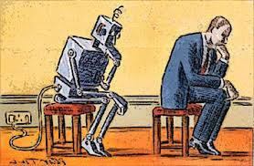
What’s Important?
Learning and Reasoning in the Presence of Knowledge.
  Combining the “soft” with the logical/declarative
Scaling Up
  Computational Issues
Training Models
  With Incidental Supervision
Notes:
In a more abstract way : My research span all these aspects & more; but I’ll focus on providing a framework, present some examples, and some recent, exciting results towards the end.
23

Slide 24
Natural Language Understanding
Expectation is a knowledge intensive component
Natural language understanding decisions are global decisions that require
  Making (local) predictions driven by different models trained in different ways, at different times/conditions/scenarios
  The ability to put these predictions together coherently
  Knowledge, that guides the decisions so they satisfy our expectations
  Multiple forms of Inference; many boil down to determining best assignment to a collection of variables of interest
  But not all…
Natural Language Interpretation is an Inference Process that is best thought of as a knowledge constrained optimization problem, done on top of multiple statistically learned models.
Notes:
24
Give examples for what’s not abductive reasoning
Focus on abductive reasoning
Show the formulation – talk about the boxes
Talk about multiple ways of training – decoupling – relate to abstraction
Examples: semantic parsing (do verb + Prep + commas together; lack of jointly annotated data)
Wikification – Relations (but also add geographical coherence; topical coherence; all interrelated signal that are acquired at different times, different contexts, etc.

Slide 25
Joint Inference with General Constraint StructureEntities and Relations
Joint inference gives good improvement
other | 0.05
per | 0.85
loc | 0.10
other | 0.10
per | 0.60
loc | 0.30
other | 0.05
per | 0.50
loc | 0.45
other | 0.05
per | 0.85
loc | 0.10
other | 0.10
per | 0.60
loc | 0.30
other | 0.05
per | 0.50
loc | 0.45
other | 0.05
per | 0.50
loc | 0.45
Key Questions:
How to learn the model(s)?
What is the source of the knowledge?
How to guide the global inference?
An Objective function that incorporates learned models with knowledge (expectation constraints)
A Constrained Conditional Model
  Bernie’s wife, Jane, is a native of Brooklyn
  E1 E2 E3
R₁₂
R₂₃
irrelevant | 0.05
spouse_of | 0.45
born_in | 0.50
irrelevant | 0.05
spouse_of | 0.45
born_in | 0.50
irrelevant | 0.05
spouse_of | 0.45
born_in | 0.50
irrelevant | 0.10
spouse_of | 0.05
born_in | 0.85
irrelevant | 0.10
spouse_of | 0.05
born_in | 0.85
Not all learning is from examples; communication-driven learning is essential.
Models could be learned separately/jointly; constraints may come up only at decision time.

Slide 26
Constrained Conditional Models
Any MAP problem w.r.t. any probabilistic model, can be formulated as an ILP
[Roth+ 04, Taskar 04]
Penalty for violating
the constraint.
Variables are models
    y = argmax_{y} $∈$ _{Y} w^{T}$∅$(x, y) + u^{T}C(x, y)
Knowledge component:
(Soft) constraints
y = argmax_{y} ∑ 1_{∅(x, y)} w_{x,y} subject to Constraints C(x,y)
Weight Vector for “local” models
Magic Box(es)
Features, classifiers; NN; log-linear models; a combination (non-linearity comes here)
How far y is from
a “legal/expected” assignment
E.g., an entities model; a relations model.
Training: learning the objective function (w, u)
  Decouple? Decompose? Force u to model hard constraints?
  There is some understanding for when to do what
Inference: A way to push the learned model to satisfy our output expectations (or expectations from a latent representation)
  [CoDL, Chang, Ratinov, Roth (07, 12); Posterior Regularization, Ganchev et. al (10); Unified EM (Samdani & Roth(12), dozens of applications in NLP]
The benefits of thinking about it as an ILP are conceptual and computational.
Decomposition is key for abstraction and transfer

Slide 27
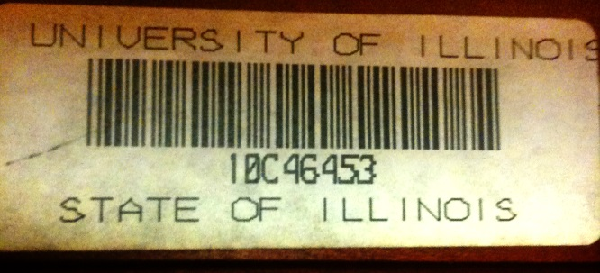
Shallow Semantic Parsing (Extended Semantic Role Labeling)
John, a fast-rising politician, slept on the train to Chicago.
Verb Predicate: sleep
  Sleeper: John, a fast-rising politician
  Location: on the train to Chicago
Who was John?
  Relation: Apposition (comma)
  John, a fast-rising politician
What was John’s destination?
  Relation: Destination (preposition)
  train to Chicago
  Variable y^{a,t} indicates whether candidate argument a is assigned a label t.
  c^{a,t} is the corresponding model score
argmax ∑_{a,t} y^{a,t} c^{a,t} = ∑_{a,t} 1_{a=t} c_{a=t}
Subject to:
One label per argument: ∑_{t} y^{a,t} = 1
No overlapping or embedding
Relations between verbs and arguments,…

Slide 28
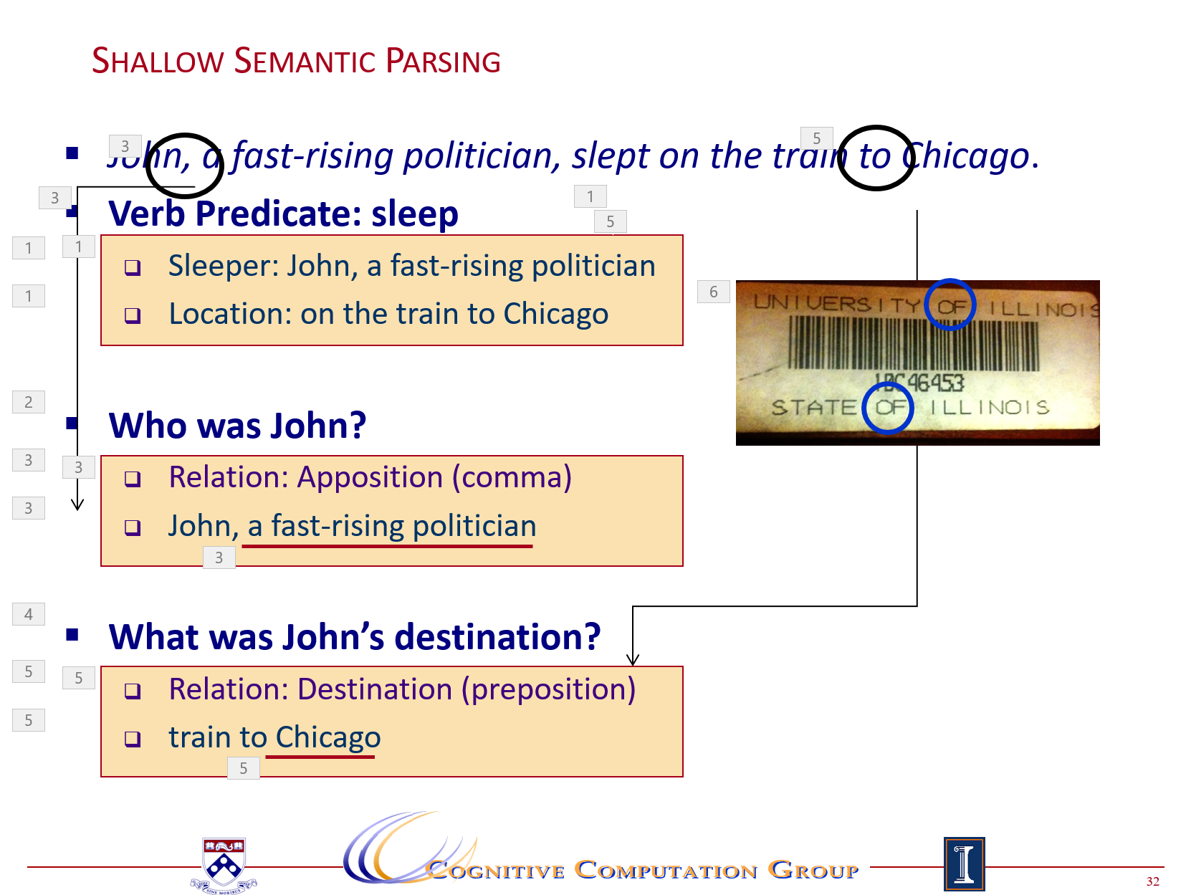
Computational Challenges
Identify and type relations
  expressed by each predicate
Identify the relation’s arguments
Very little supervised data
  per phenomena
Incomplete annotation
  only at the predicate level
Learning models in these settings exploits two principles:
  Coherency among multiple phenomena
    learn simple models; infer together
  Latent structure can be constrained (via CCMs)

Slide 29
Coherency in Semantic Role Labeling
Predicate-arguments generated should be consistent across phenomena
The touchdown scored by Brady cemented the victory of the Patriots.
Verb | Nominalization | Preposition
Predicate: score A0: Brady (scorer) A1: The touchdown (points scored) | Predicate: win A0: the Patriots (winner) | Sense: 11(6) “the object of the preposition is the object of the underlying verb of the nominalization”
Linguistic Constraints:
A0: the Patriots ⇔ Sense(of): 11(6)
A0: Brady ⇔ Sense(by): 1(1)
Notes:
29

Slide 30
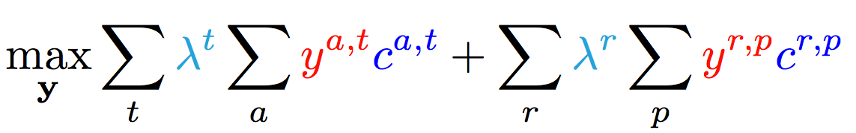
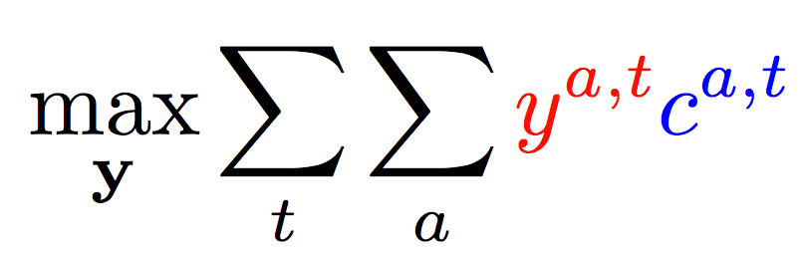
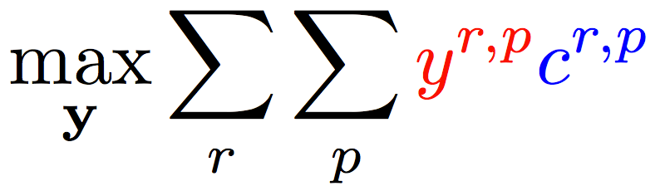
Enforce Coherence via Joint inference (CCMs)
  Variable y^{a,t} indicates whether candidate argument a is assigned a label t.
  c^{a,t} is the corresponding model score
Verb arguments
Preposition relations
+ ….
Argument candidates
Re-scaling parameters (one per label)
Preposition relation
label
Constraints:
Preposition
Each argument label
Verb SRL constraints
Preposition SRL Constraints
+ Joint coherency constraints between tasks

Slide 31
Reasoning for Using Complex Models without Joint Supervision
Verbs
Nouns
Commas
Prepositions
Compounds
Possessives
Adjective-Noun
Light verbs
Phrasal verbs
NER
Wikification
Events
Implicit relations
  Missing Arguments
  Missing Predicates
Conjunctions
Quantifiers
Negations
Quantities (comparators)
Temporal
There is a need to understand multiple phenomena in natural language text
  We will never have enough jointly annotated data
Joint inference via declarative constraints
  Is essential both to provide coherent global prediction, and
  At a way to get around lack of joint annotation
Joint Inference can also be used to improve individual models.

Slide 32






Wikification: The Reference Problem
Knowledge Acquisition
Blumenthal (D) is a candidate for the U.S. Senate seat now held by Christopher Dodd (D), and he has held a commanding lead in the race since he entered it. But the Times report has the potential to fundamentally reshape the contest in the Nutmeg State.
Blumenthal (D) is a candidate for the U.S. Senate seat now held by Christopher Dodd (D), and he has held a commanding lead in the race since he entered it. But the Times report has the potential to fundamentally reshape the contest in the Nutmeg State.
Notes:
Let’s start with what is wikification
Read wiki titles slower

Slide 33
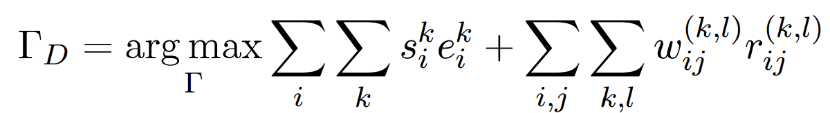
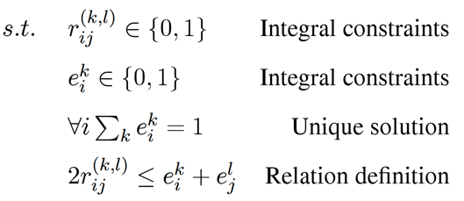
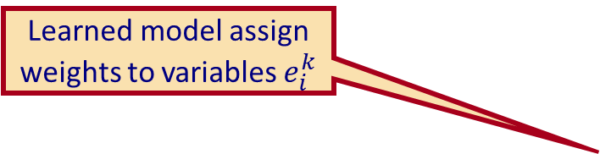
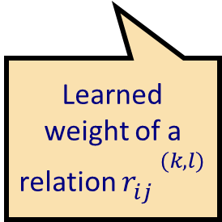
Learning and Inference Formulation
Goal: Promote titles that are coherent with textual relations
In the presence of multiple decisions & pieces of knowledge, inference helps to maintain global coherence
It also supports supervising the weaker components
Learned model assign weights to variables $e_{i}^{k}$
Boolean variables represent assignments of mentions to titles
Learned weight of a relation ${r_{ij}^{}}^{(k,l)}$
Boolean variables represent relations among mentions or candidate titles
Notes:
Formalize intuition, weights induced from data, small constraints
Objective function collapse to the original output when there is no relation, so our model is negatives-proof
True-negatives and false-negatives will not negatively impact performance of baseline

Slide 34
What’s Important?
Learning and Reasoning in the Presence of Knowledge.
  Combining the “soft” with the logical/declarative
Scaling Up
  Computational Issues
Training Models
  With Incidental Supervision
Notes:
In a more abstract way : My research span all these aspects & more; but I’ll focus on providing a framework, present some examples, and some recent, exciting results towards the end.
34

Slide 35
Inducing Semantics
Inducing semantic representations and making decisions that depend on it require learning and, in turn, supervision.
Standard machine learning methodology:
  Given a task
  Collect data for the task and annotate it
  Learn a model
We will never have enough annotated data to train all the models, for all the tasks we need this way.
  We don’t even know what are “all the tasks”
This methodology is not scalable and, often, makes no sense
  Annotating for complex tasks is difficult, costly, and sometimes impossible.
    When an intermediate representation is ill-defined, but the outcome is
    E.g., think about events
We should think about annotating data to evaluate performance, not to train. We already know that given large amounts of data we have ways to mimic this input-output mapping.
This is not where the challenge is!
In most interesting cases, learning should be (and is) driven by incidental supervision [Roth AAAI’17]

Slide 36
Text Categorization
Is it possible to map a document to an ontology of semantic categories, without training with labeled data?
The route for a return to No. 1 in the Emirates ATP Rankings is paved for Rafael Nadal and Roger Federer at next week’s Western & Southern Open. Andy Murray will relinquish top spot to one of the two in Cincinnati and if it is the Swiss who goes on to win the Coupe Rogers this week in Montreal, he would clinch World No. 1 with an equal or better finish than the Spaniard next week.
It’s about Sport
It’s about Tennis
Traditional text categorization requires training a classifier over a set of labeled documents (1,2,….k)
Someone needs to label the data (costly)
All your model knows is to classify into these given labels
Total costs for on-the-job health care benefits are expected to rise an average of 5% in 2018, surpassing $14,000 a year per employee, according to a National Business Group on Health survey of large employers. Specialty drugs continue to be the top driver of increasing costs.Companies will pick up nearly 70% of the tab, but employees must still bear about 30%, or roughly $4,400, on average.
It’s about Money
It’s about Health Care
You can do it, since you have an understanding of the labels

Slide 37
Categorization without Labeled Data [AAAI’08, AAAI’14, IJCAI’16]
This is not an unsupervised learning scenario. Unsupervised learning assumes a coherent collection of data points, where similar data points are assigned similar labels. It does not work on a single document. Related (but not identical) to 0/1-shot learning.
Given:
  A single document (or: a collection of documents)
  A taxonomy of categories into which we want to classify the documents
Dataless procedure:
  Let f(l_{i}) be the semantic representation of the labels (label descriptions)
  Let f(d) be the semantic representation of a document
  Select the most appropriate category:
  l_{i}* = argmin_{i} dist (f(l_{i}) - f(d))
  Bootstrap
    Label the most confident documents; use this to train a model.
Key Question:
  How to generate good Semantic Representations?

Slide 38
Text Representation
[Dense] Distributed Representations (Embeddings)
  New powerful implementations of good old ideas
    Learn a representation for a word as a function of words in its context
Brown Clusters
  An HMM based approach
  Found a lot of applications in other NLP tasks
[Sparse] Explicit Semantic Analysis (ESA)
  A Wikipedia driven approach – best for topical classification
    Represent a word as a (weighted) list of all Wikipedia titles it occurs in
  Gabrilovich & Markovitch 2009
No task specific supervision. Wikipedia is there.
Yields excellent results

Slide 39
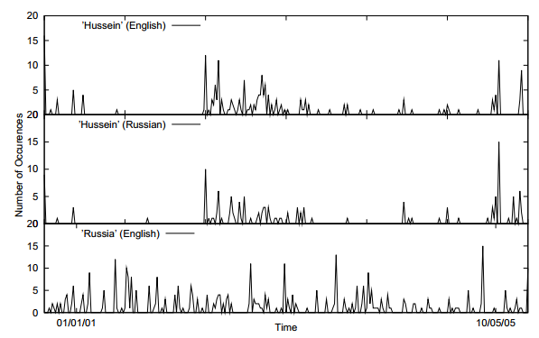
Incidental Supervision Signals
Searching for supervision signals could be challenging.
Supervision could be incidental, in the sense that it provides some signals that might be co-related to the target task.
Temporal histograms
Assume a comparable, weakly temporally aligned news feeds.
Hussein (English)
Transliteration: How to write “Hussein” in Russian?
Hussein (Russian)
Weak synchronicity provides a cue about the relatedness of (some) NEs across the languages, and can be exploited to associate them
[Klementiev & Roth, 06,08]
Russia (English)
Notes:
If I want to solve this transliteration task, I need examples; but I don’t need anyone to label many for me.
I could make the observation, that if one looks at comparable news articles from about the same time, the key entities they cover are the same, and they occur with about the same temporal frequency.
Start with labeling
Then transliteration
Then psychology
Then semantic parsing
(Emphasize that this requires reasoning)
End with the example of reasoning in learning (Chicago)

Slide 40
Incidental Supervision Signals
Need an inference mechanism that supports combining signals/models
By itself, this temporal signal may not be sufficient to support learning robust models.
Along with weak phonetic signals, context, topics, etc. it can be used to get robust models.
Incidental supervision in not distant supervision; but distant supervision is one instance of it.
Temporal histograms
Assume a comparable, weakly temporally aligned news feeds.
Hussein (English)
Hussein (Russian)
Weak synchronicity provides a cue about the relatedness of (some) NEs across the languages, and can be exploited to associate them
[Klementiev & Roth, 06,08]
Russia (English)

Slide 41
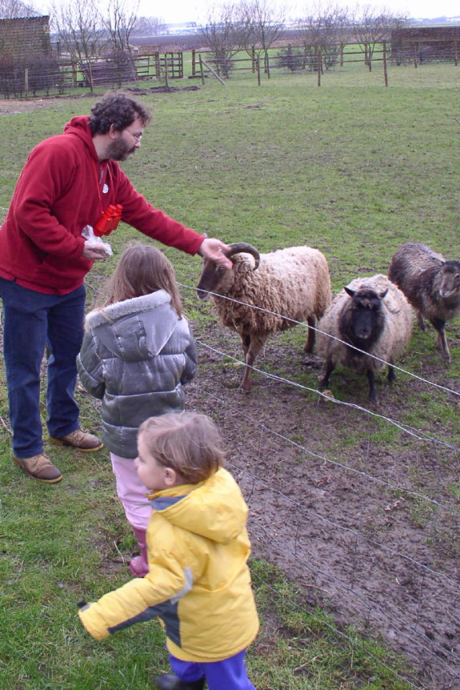
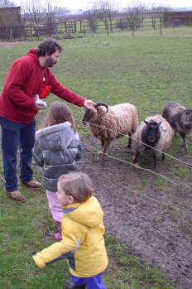


The language-world mapping problem [BabySRL: Connor, Fisher & Roth, 2012]
Take inspiration from language acquisition?
  Clearly, a lot of incidental supervision
  Harder problems (understanding verbs) bootstrap from easier
“the world”
Scene 1
Smur! Rivvo della frowler.
“the language”
Chase?
Flee?
Topid rivvo den marplox.
Nouns identified
Blert dor marplox, arno.
Scene 3
[Topid rivvo den marplox.]
Cross-situational observations
Scene n
Marplox dorinda blicket.
Notes:
When thinking about incidental supervision, I think that we can draw inspiration from language acquisition – kids need to solve the language-wolrd mapping problem, and all they have to work with are incidental supervision signals
So let’s look at the problem facing the child. In learning a language, a child must figure out how to map words and syntactic devices onto the meanings they are meant to convey in the native language.
Viewed in this way, this is a highly unconstrained mapping problem. In principle, anything in the language could be relevant to anything in the world.

Slide 42

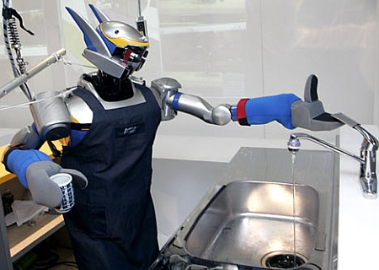

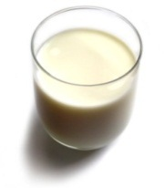
Understanding Language Requires (some) Supervision
Can we rely on this interaction to provide supervision (and eventually, recover meaning) ?
Can I get a coffee with lots of sugar and no milk
Great!
Arggg
Semantic Parser
MAKE(COFFEE,SUGAR=YES,MILK=NO)
How to recover meaning from text?
Standard “example based” ML: annotate text with meaning representation
  The teacher needs deep understanding of the learning agent ; not scalable.
Response Driven Learning: Exploit indirect signals in the interaction between the learner and the teacher/environment
Notes:
NLU: about recovering meaning from text – a lot of work aims directly at that or at some subtasks that might look like this:….

Slide 43
Response Based Learning
We want to learn a model that transforms a natural language sentence to some meaning representation.
Instead of training with (Sentence, Meaning Representation) pairs
Think about simple behavioral derivatives of the models outputs
  Supervise the derivatives (easy!) and
  Propagate it to learn the complex, structured, transformation model
English Sentence
Model
Meaning Representation

Slide 44
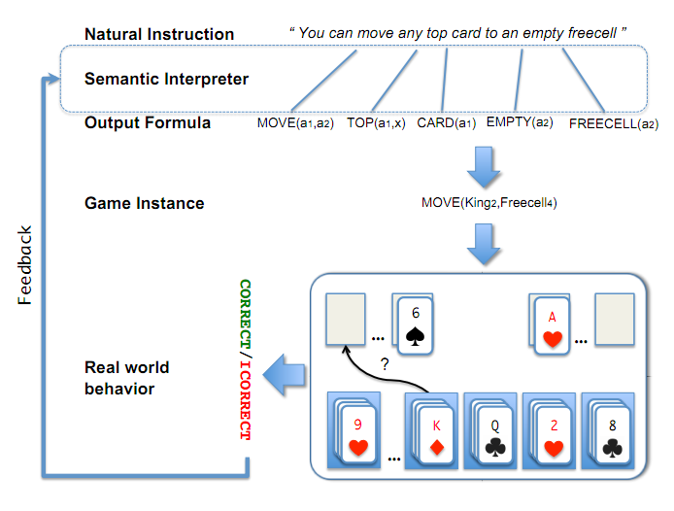
A Response based Learning Scenario
We want to learn a model to transform a natural language sentence to some meaning representation.
English Sentence
Model
Meaning Representation
A top card can be moved to the tableau if it has a different color than the color of the top tableau card, and the cards have successive values.
Move (a1,a2) top(a1,x1) card(a1) tableau(a2) top(x2,a2) color(a1,x3) color(x2,x4) not-equal(x3,x4) value(a1,x5) value(x2,x6) successor(x5,x6)
Play Freecell (solitaire)
Simple derivatives of the models outputs: game API
  Supervise the derivative and Propagate it to learn the transformation model

Slide 45
Incidental Supervision & Reasoning
O’Hare must be in Chicago
O’Hare must be in Chicago
Feb 5 2017 Dozens of passengers heading to Chicago had to undergo additional screenings… It took Hesam Aamyab two tries to make it back to the United States from Iran. He is an Iranian citizen with a US visa who is doing post-doctoral research at UIC. …"Right now, I am in the USA and I'm very happy," Aamyab said. But now, he can't go back to Iran or anywhere else without risk. Other travelers shared the same worry. Asem Aleisawi was at O'Hare on Sunday to meet his wife who was coming in from Jordan.
  Learning/Supervision requires some level of reasoning to infer these weak signals
John had 6 books; he wanted to give it to two of his friends. How many will each one get?
  You must have learned something from this thought experiment…
share it with
How do we supervise for these problems?

Slide 46
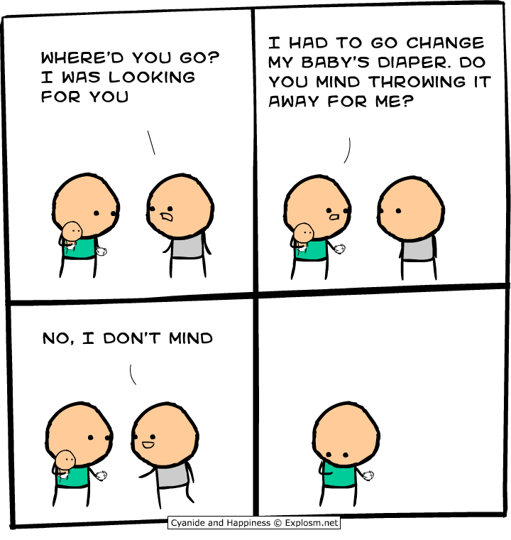
Another Challenge for Incidental Supervision

Slide 47
What’s Important?
Learning and Reasoning in the Presence of Knowledge.
  Combining the “soft” with the logical/declarative
Scaling Up
  Computational Issues
Training Models
  With Incidental Supervision
Notes:
In a more abstract way : My research span all these aspects & more; but I’ll focus on providing a framework, present some examples, and some recent, exciting results towards the end.
47

Slide 48
Computational Issues
Intelligence is a large scale phenomenon
  In terms of data, phenomena, and computation
A lot of the work we have done is on limitations
  E.g., Computational Complexity of Probabilistic Reasoning [Roth’93, 96]
But it’s important to ask the question:
  How to efficiently perform computations that are seemingly hard?
  Lifted Inference
    An effort to support probabilistic inference at an abstract rather than propositional level [Poole; Braz, Amir & Roth’95-97; many others…]
  Alternative Representations of Distributions
    Arithmetic Circuits [Darwich’03….]
    Learning Multilinear Representations [Samdani & Roth 09]

Slide 49
Amortized Inference [Srikumar, Kundu, Chang, Upadhyay & Roth’12, ‘13 ’15]
Constrained Optimization – ILP – as a way to combine learned models and declarative knowledge.
Not only the problem is NP-Hard; as you constrain it more, it becomes harder…
And we have to do it many times…
The solution is in amortization
y = argmax_{y} ∑ 1_{Á(x,y)} w_{x,y} subject to Constraints C(x,y)
Max c ¢ x
Ax ≤ b x 2 {0,1}
Very general: All discrete MAP problems can be formulated as 0-1 LPs [Roth & Yih’04; Taskar ’04]
Important: we care here about the formulation; not about the algorithmic solution chosen.

Slide 50
Amortized ILP based Inference
Imagine that you already solved many inference problems
  Your algorithmic solution method doesn’t matter
How can we exploit this fact to save inference cost?
  After solving n inference problems, can we make the (n+1)^{th} one faster?
We give conditions on the objective functions
  Under which the solution of a new problem Q is the same as the one of P (which we already cached)
If CONDITION (problem cache, new problem)
then (no need to call the solver)
SOLUTION(new problem) = old solution
Else
Call base solver and update cache
End
0.04 ms
2 ms

Slide 51
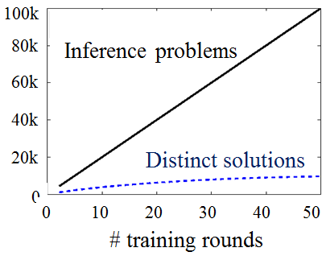
The Theorem Must Fire a Lot
We argue here that the inference formulation provides a new level of abstraction.
#
Modulo renaming
  Dan gave a talk
  Vinod ate a pizza
  Heng read a book
have the same POS tagging structure, Parse Tree, Semantic Parse
Holds for many problems
  # of observed POS sequences
  # of observed Parse Trees
  # of Coreference Chains Configurations
  # of observed semantic parses
  …….
# Problems
Pigeon Hole Principle
  Many different instances have to be mapped into identical inference outcomes
  Often, saves 85% of the computation.
# Distinct Solutions
Problem size
skip

Slide 52

An Important Application: Information Trustworthiness
Research in Natural Language Understanding attempts to tell us what a document says with some level of certainty
But what should we believe, and who should we trust?
The advent of the Information Age and the Web
  Overwhelming quantity of information
  But uncertain quality.
    Collaborative media
      Blogs
      Wikis
      Tweets
      Message boards
    Established media are losing market share
      Reduced fact-checking

Slide 53

Distributed Trust
False– only 3 %
Sources may provide conflicting
information or mutually
reinforcing information.
  Mistakenly or for a reason
  Not feasible for human to
  read it all
  A computational trust system can be our proxy
  Ideally, assign the trust judgments the user would
  The user may be another system
    A question answering system; A navigation system; A news aggregator
    A warning system

Slide 54




Medical Domain: Many support groups & medical forums
Hundreds of thousands of people get their medical information from the internet
Best treatment for…..
Side effects of….
But, some users have an agenda,… pharmaceutical companies…
54
Notes:
Users share their experiences in message boards, forums, and blogs.
54

Slide 55
Trustworthiness [Pasternack & Roth 10-14; Vydiswaran et. al ‘11-15]
Evidence
E(c)
Claims
T(s)
Sources
Sources
e₁
Claims
Given:
  Multiple content sources
  Some target relations (“facts”)
    E.g. [disease, treatments],
    [treatments, side-effects]
  Prior beliefs & background knowledge
Our goal is to:
  Score credibility of sources and trustworthiness of claims based on
    Support across multiple (trusted) sources
    Source characteristics:
      reputation, interest-group (commercial / govt. backed / public interest),
      verifiability of information (cited info)
    Prior Beliefs and Background knowledge
    Understanding content
s₁
s₁
B(c)
e₂
c₁
c₁
s₂
e₃
s₂
c₂
s₃
e₄
c₂
s₃
e₅
c₃
s₄
c₃
s₄
e₆
c₄
s₅
e₇
c₄
s₅
e₈
e₉
e₁₀
Beyond the scientific and engineering challenges, this will have significant societal impact.

Slide 56

Summary
Thank you!
Learning and reasoning have been long recognized as fundamental phenomena of intelligence.
We provided some examples from a research program that contributed to the development of a unifying computational theory for the two phenomena.
These insights led to significant progress in a range of natural language understanding problems.
There is a lot more to do
  We are far from facilitating natural communication with machines via natural language.
  Try to reach the moon.
Notes:
56

