Slide 1
Natural Language Understanding with
Incidental Supervision
Dan Roth
University of Pennsylvania
Workshop on Weakly Supervised Learning @ ICLR2021
May 2021

Slide 2
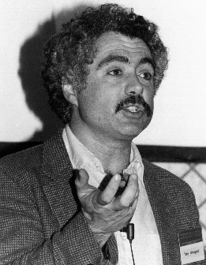
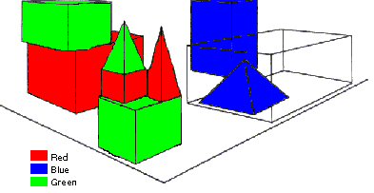
SHRDLU (Terry Winograd, 1968)
Person: Pick up a big red block.
Computer: OK.
Person: Grasp the pyramid.
Computer: I DON'T UNDERSTAND WHICH PYRAMID YOU MEAN.
Person: Find a taller block than the one you are holding and put it into the box.
Computer: BY "IT", I ASSUME YOU MEAN…..
Computer: OK.
Person: What does the box contain?
Computer: THE BLUE PYRAMID AND THE BLUE BLOCK.
Person: What is the pyramid supported by?
Computer: **What do you mean by “supported”?
……….
Person: How many blocks are not in the box?
Computer: FOUR OF THEM.
Understanding, executing and interacting requires language understanding & reasoning
to recognize and understand the domain, the goals, and to advance the task
Notes:
SHRDLU, Computer program that has conversation with user, via Natural Language interface
-> About “block world”,
The simulation robot can pick the objects, move them, count them .. Very impressive.
SHRDLU's world was so simple that the entire set of objects and locations could be described by including as few as perhaps 50 words:
This allowed it to support co-reference resolution, make simple deductions on, for example types of blocks that can be stacked and those that cannot, etc.
SHRDLU could therefore understand instructions and answer questions, as you can see in this example.

Slide 3
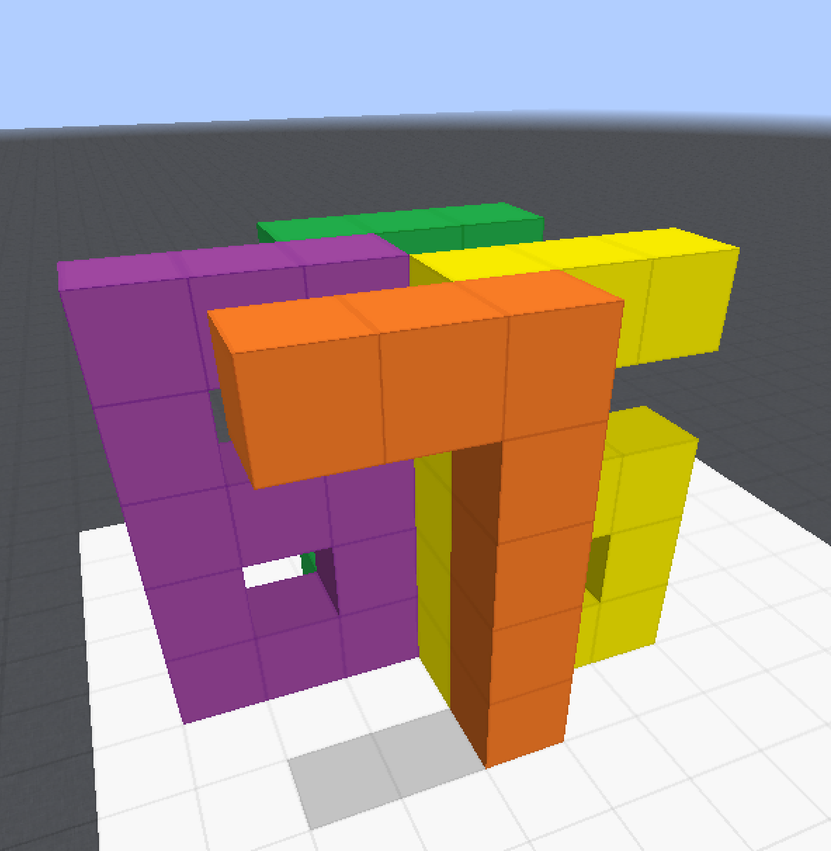
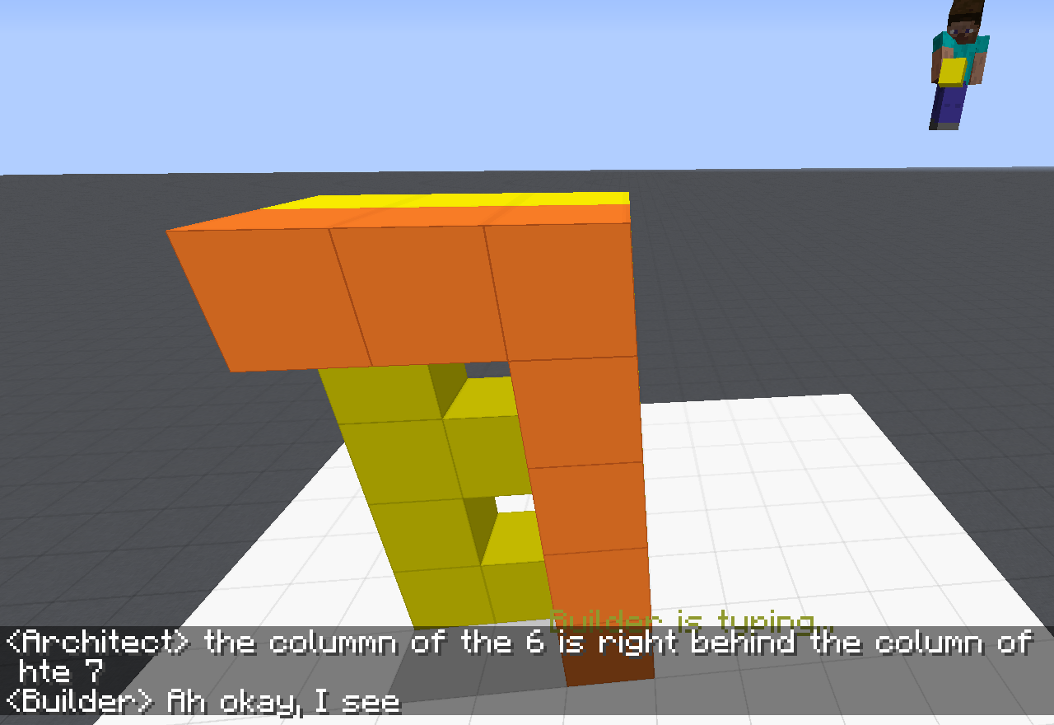
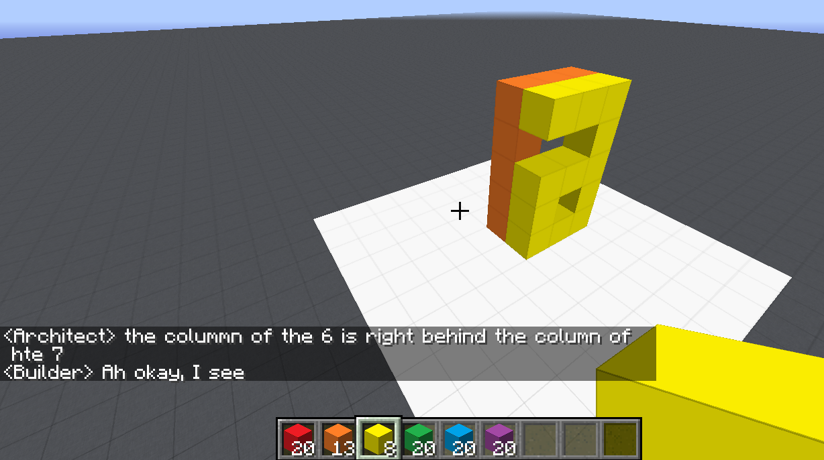
Communication (CwC Project, 2017-2020)
ARCHITECT
CHAT INTERFACE
Architect: | in about the middle build a column five tall
(Builder puts down five orange blocks)
Architect: | then two more to the left of the top to make a 7
(Builder puts down two orange blocks)
Architect: | now a yellow 6
Architect: | the long edge of the 6 aligns with the stem of the 7 and faces right
Builder: | Where does the 6 start?
Architect: | behind the 7 from your perspective
Builder: | Is it directly adjacent?
Architect: | yes directly behind it. touches it
(Builder puts down twelve yellow blocks, in the shape of a 6)
Architect: | too much overlap unfortunately
Architect: | the colummn of the 6 is right behind the column of hte 7
Target Structure
Build Region
BUILDER
[Minecraft example from Julia Hockenmaier]
Notes:
Fast forward 50 years -- we are still trying to solve the same problem --- this time open domain… We can do that, but we are running into similar problems of brittleness that are due, among other things, to our inability to deal well with situations we have never seen before. And this is really the goal of learning!

Slide 4
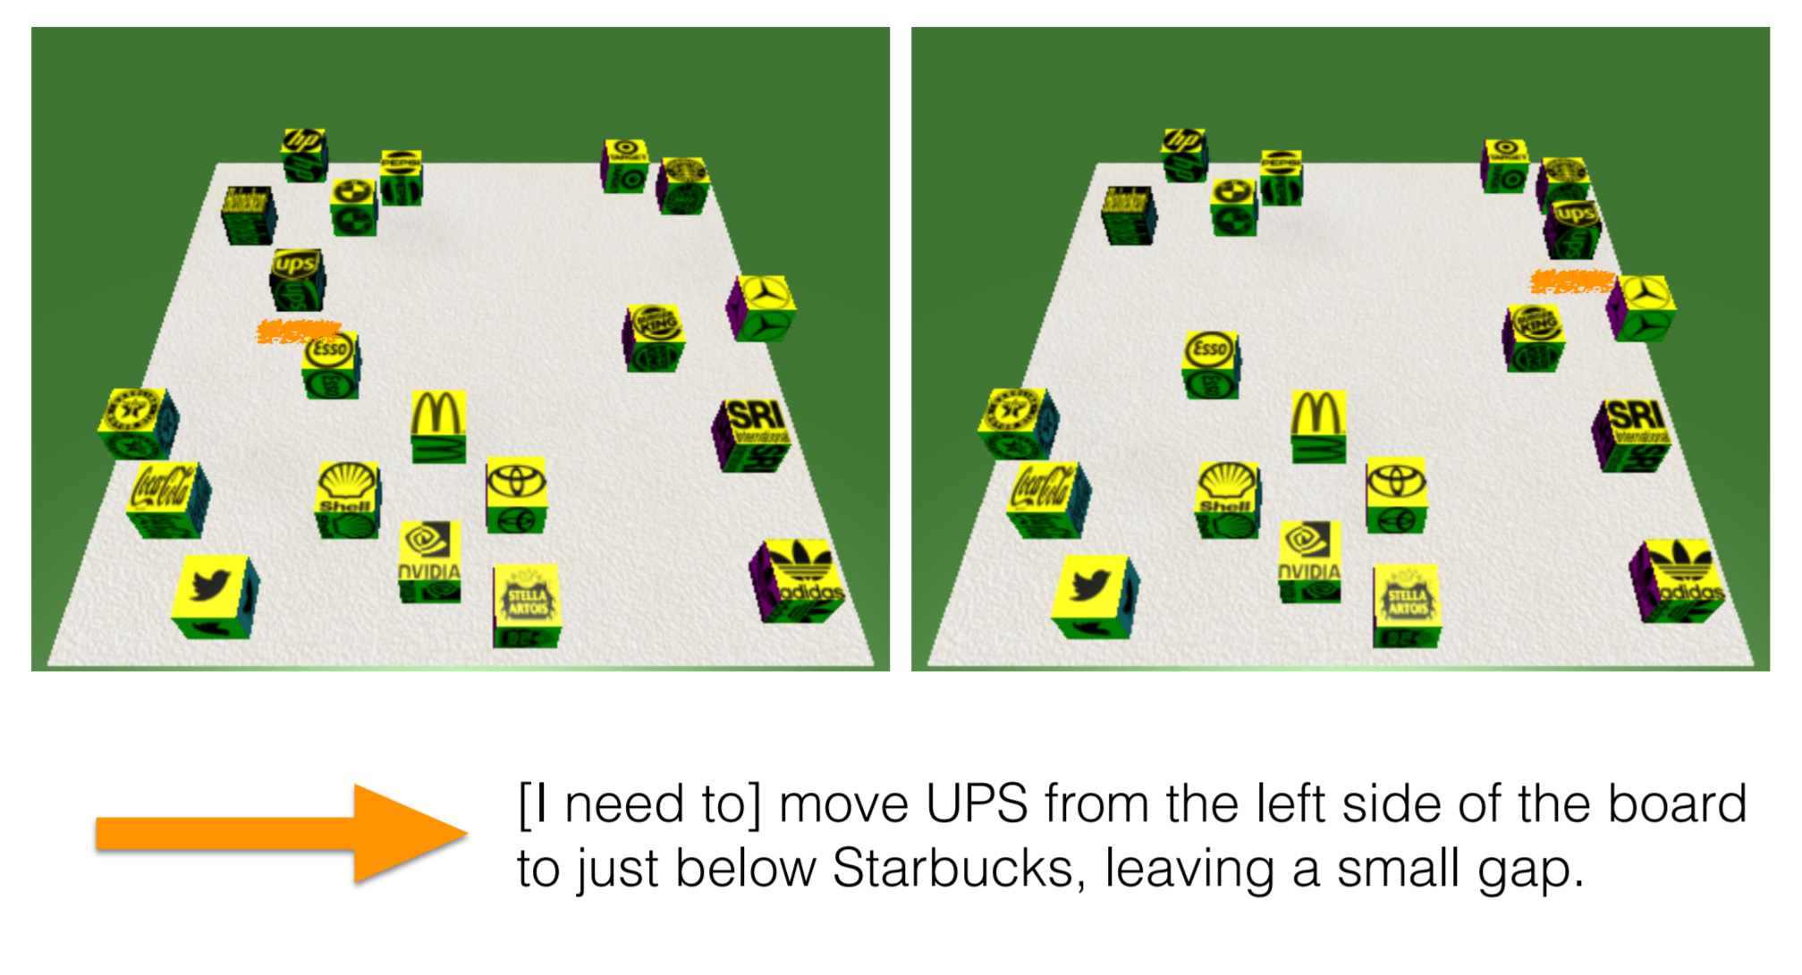
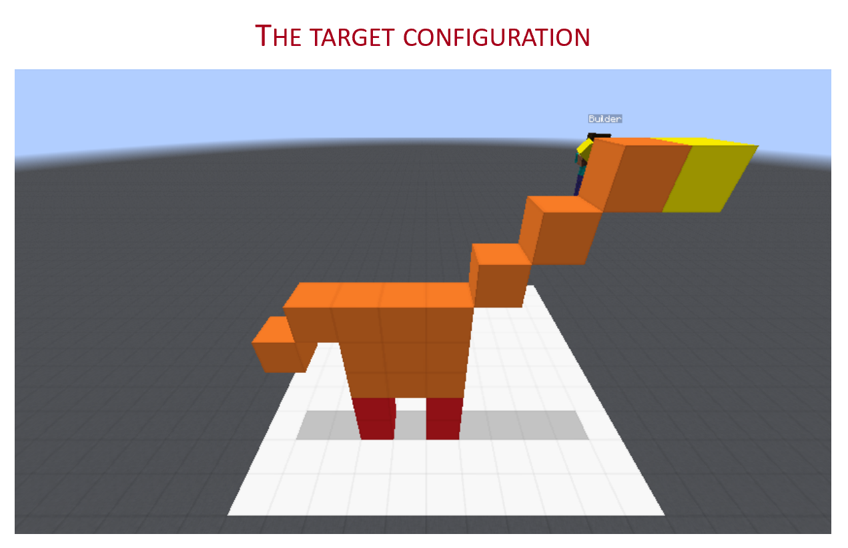
Communication (CwC Project, 2017-2020)
Consider the following explanation:
  [Example from Yonatan Bisk]
  Imagine that this is a chess board
  Place the UPS in H2, and McDonald in G6.
Can you follow these instructions?
  What’s needed for us to be able to induce programs that can do it?
Of course, there are many NLP tasks we are better at today, mostly extraction tasks (including some instruction following tasks)
But, can we do it in a way that allows us to generalize to new situations?
  Can we move away from doing well on datasets to doing well on tasks?
Without being trained on thousands of chess-understanding examples
Notes:
Why can’t we do it?
Here is one example – a much simpler scenario that we studied on the way to the more realistic Minecraft one.
… Without training specifically on chess programs, since if we do, I can then give you a tennis court analogy….
At the heart of this is the question of “how do we supervise our models?”

Slide 5
Information Extraction
Which team is Shiancoe on?
What’s his role?
Who scored the longest touchdown pass of the game?
In the first quarter, the Bears Cutler fired a 7-yard TD pass to tight end Greg Olsen. … In the third quarter, the … … Adrian Peterson's 1-yard touchdown run. The Bears increased their lead over the Vikings with Cutler's 2-yard TD pass to tight end Desmond Clark. The gap was reduced when Favre fired a 6-yard TD pass to tight end Visanthe Shiancoe. The Vikings … with Adrian Peterson's second 1-yard TD run. The Bears then responded with Cutler firing a 20-yard TD pass to wide receiver Earl Bennett. The Bears then won on Jay Cutler's game-winning 39-yard TD pass to wide receiver Devin Aromashodu.
Extracting information from text:
  Identify, contextualize, and link
    Events, Entities, Quantities (and their scope), Relations, Semantic Types, Time, ….
  Understand information needs
    E.g., questions about the text
  Reason about the text
    Responding to information needs often requires combining and manipulating the identified information
How can we supervise to support this level of understanding?
  Too many (ill-defined) latent decisions
    Annotating text for all is not scalable
    Need to find other ways
  Annotating for specific datasets does not generalize
    We need to find ways to solve tasks rather than datasets
What is her seizure frequency?
She reports worsened seizure frequency, seizures now occurring up to 10/week, in clusters about 2-3 day/week. Previously reported seizures occurring about 2-3 times per month, often around the time of menses,…
How much did his challengers raise?
Mayor Rahm Emanuel has raised more than $10 million toward his bid for a third term – more than five times the total raised by his 10 challengers combined, campaign finance records show.
The COVID-19 pandemic in the United States is part of the …. As of October 2020, there were more than 9,000,000 cases and 230,000 COVID-19-related deaths in the U.S., representing 20% of the world's known deaths, the most deaths of any country.
Notes:
I’d like to focus my presentation today on information extraction

Slide 6
How to Supervise?
Problems
  Named Entity Recognition
  Events
  Question Answering
Solutions
  Or at least some progress in this direction
    Being label-aware
      The origins of Zero-Shot
    Partial annotation
    Knowledge
    Transfer
    Latent Variables

Slide 7
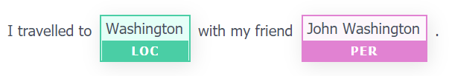
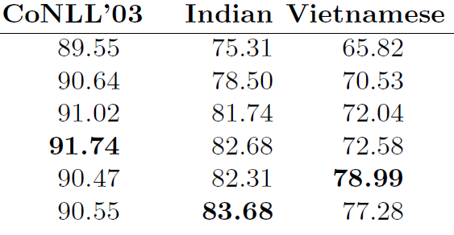

Named Entity Recognition
Is NER a solved problem?
  Multiple CoNLL SOTA systems
  Names in the test never appeared in training [Agarwal et al. 2020]
  Multiple CoNLL SOTA systems
  Tested on other datasets (same label sets) [Yu, 2019]
Notes:
Even problems that we think we solved we realize that we actually solved only the data set, not the

Slide 8
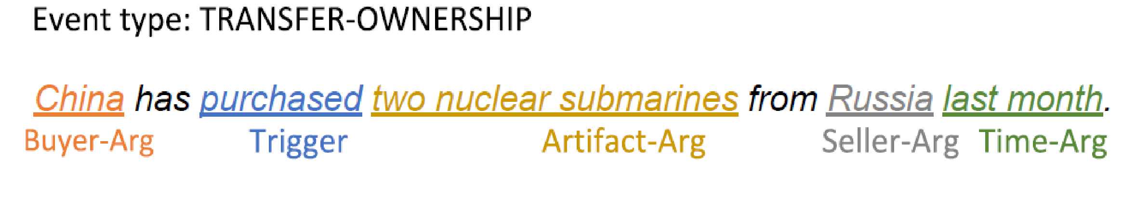
Event Extraction
Input: “China purchased two nuclear submarines from Russia last month.”
Annotation at this level is costly and requires expertise
  And, it needs to be re-done whenever we update the event anthology.
But, we have good extractive QA systems?
  Isn’t Event Extraction a simple application of Extractive QA

Slide 9
Event Extraction as a QA Problem
Input: “China purchased two nuclear submarines from Russia last month.”
Event type:
TRANSFER-OWNERSHIP
Argument slots:
Buyer-Arg: The buying agent
Seller-Arg: The selling agent
Beneficiary-Arg: The agent that benefits from the transaction
Artifact-Arg: The item or organization that was bought or sold
Price-Arg: The sale price of the ARTIFACT-ARG
Time-Arg: When the sale takes place
Place-Arg: Where the sale takes place
Event Definition
Given
  a definition of the target event
  a text snippet
(1) Identify the event type
(2) Generate questions, the answers to which are the event’s arguments.
Need to support I-don’t-know, since some of the questions will have know answer
A SOTA extractive QA system on SQuAS & ACE
Trigger: purchased
Arguments:
  Q1: What was purchased?
    A1: Two nuclear submarines. ⇒Artifact-Arg
  Q2: Who purchased two nuclear submarines?
    A2: China. ⇒Buyer-Arg
  Q3: Who did China purchase two nuclear submarines from?
    A3: Russia. ⇒Seller-Arg
  Q4: Where was the purchase?
    A4: IDK
Test on:→ | SQuAD 2.0 | ACE
Has Answer | 83.53 | 62.39
I-Don’t-Know | 78.40 | 20.8—28.46

Slide 10
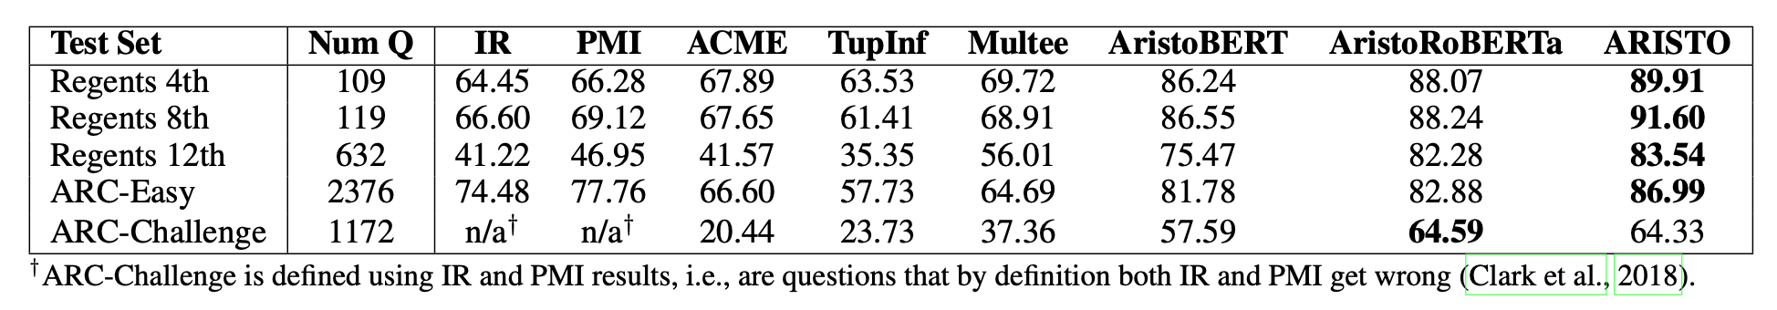
Multiple Choice Question Answering
Clark et al 2019: On the success of AI2’s ARISTO Project:
  From ‘F’ to ‘A’ on the N.Y. Regents Science Exams: An Overview of the Aristo Project
Very impressive results.
  What does the model solve?
Notes:
These examples show that we solved a dataset, not the ttask
But, do we even solve a dataset in a satisfactory way?

Slide 11
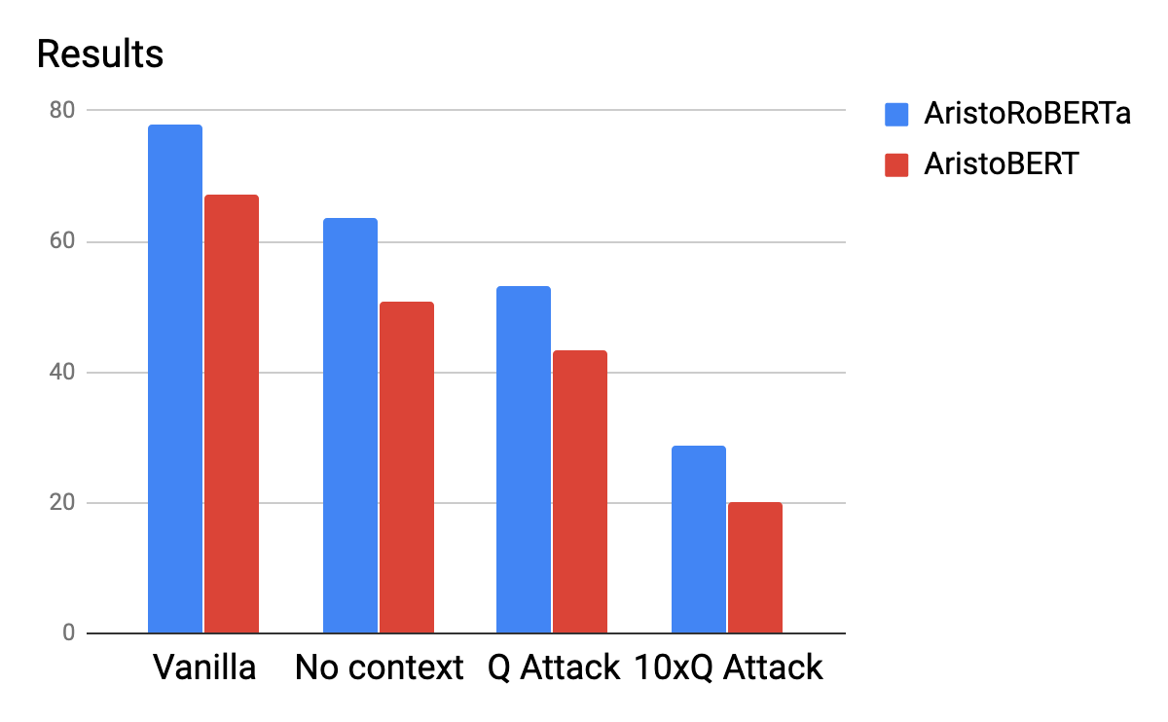
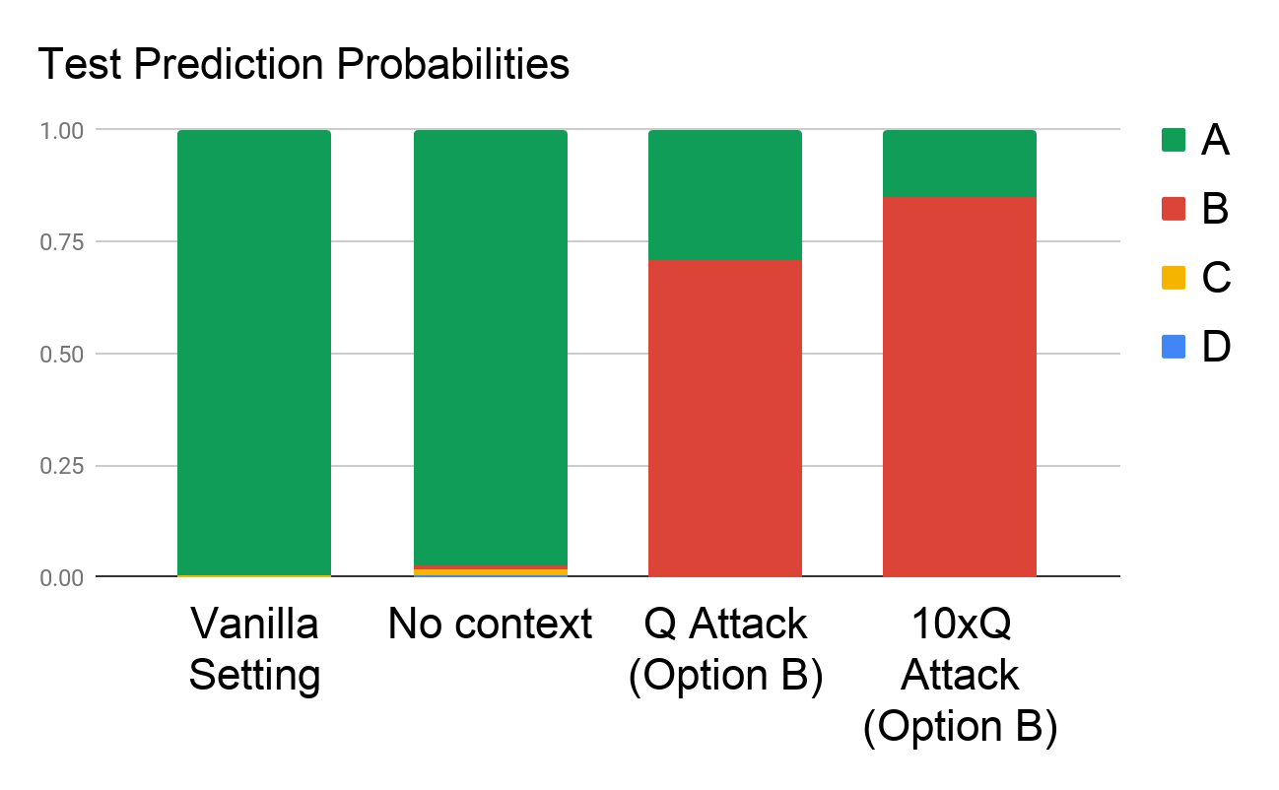
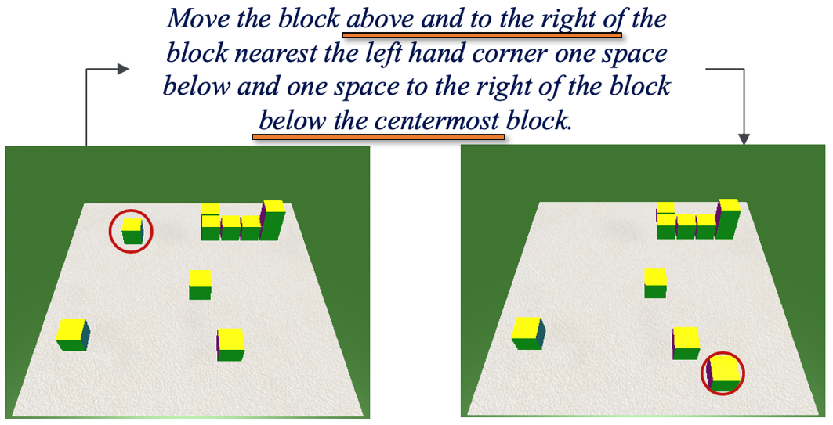
A Scientific QA Example [Shah et al. EMNLP Findings 2020]
Question: The rate at which a wave passes through a medium is known as its
Answer Options:
  speed
  amplitude
  acceleration
  wavelength
Supporting Contexts:
  The speed of a wave is the rate at which vibrations propagate through the medium…
  The greater the amplitude of vibrations of the particles of the medium, the greater…
  … hydrophones measure the acceleration of the medium as a seismic wave passes…
  The speed of an electromagnetic wave in a medium depends on its wavelength. As…
Question Question Question Question Question Question Question Question……
Question
Trivializing the competition results in worse results
Is that a reasonable expectation?
[See the paper for a more formal notion of “expectations” from a high performing QA model, along with alternative training methods]
Dan et al. NAACL’21
Notes:
Killing the competition should improve the results – but it reduces it.

Slide 12
How to Supervise?
Problems
  Named Entity Recognition
  Events
  Question Answering
Solutions
  Or at least some progress in this direction
    Being label/task aware
    Partial annotation
    Knowledge
    Transfer
    ….
Many more Problems
  We don’t generalize well outside the training sets
  We sometimes behave “correctly” for the wrong reasons

Slide 13
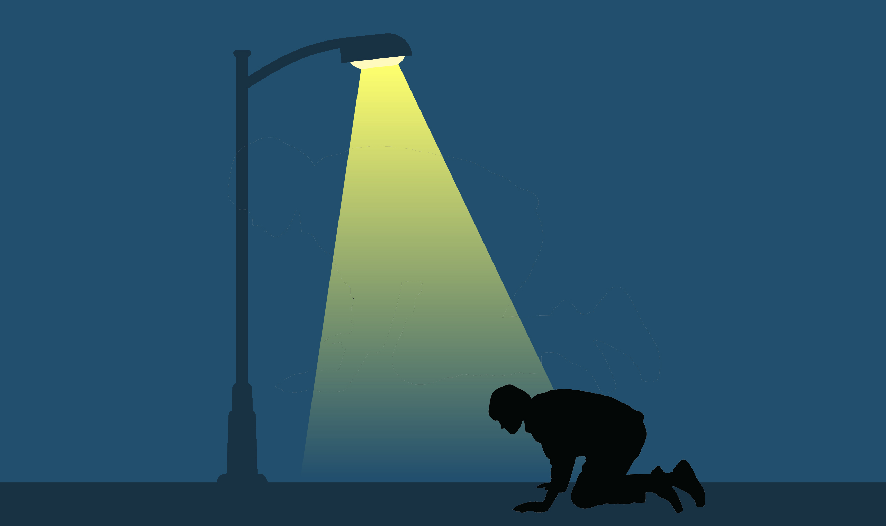
Inducing Semantics
Inducing semantic representations and making decisions that depend on it require learning and, in turn, supervision.
Standard machine learning methodology:
  Given a task
  Collect data for the task and annotate it
  Learn a model [doesn’t matter how]
We will never have enough annotated data to train all the models, for all the tasks we need.
  We don’t even know what are “all the tasks”
  We end up learning a data set
  Learning is more than “training” on many examples
Current methodology is not scalable and, often, makes no sense
  Annotating for complex tasks is difficult, costly, and sometimes impossible.
It’s ok to do supervised learning.
But what about tasks that cannot be supervised directly?
In most interesting cases, learning should be (and is) driven by incidental supervision signals [Roth AAAI’17]
Incidental supervision: How to understand, acquire and use signals that were not put there to help a specific target task.
The Streetlight Effect
Notes:
Key challenge, to facilitate reasoning, is to induce semantics
Move to the importance of supervision
Without thinking about the fact that there is more to learning than training from examples.
Looking for the coin under the lampost

Slide 14


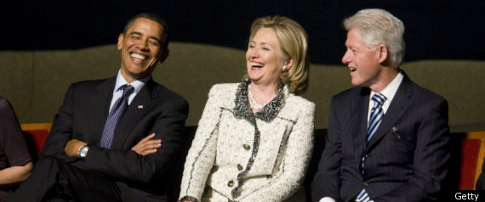

Examples: Incidental Supervision
O’Hare must be in Chicago
Feb 5 2017 Dozens of passengers heading to Chicago had to undergo additional screenings… It took Hesam Aamyab two tries to make it back to the United States from Iran. He is an Iranian citizen with a US visa who is doing post-doctoral research at UIC. …"Right now, I am in the USA and I'm very happy," Aamyab said. But now, he can't go back to Iran or anywhere else without risk. Other travelers shared the same worry. Asem Aleisawi was at O'Hare on Sunday to meet his wife who was coming in from Jordan.
  Learning/Supervision requires some level of reasoning to infer these weak signals
Coming off a road win over the Cowboys, the Redskins traveled to Lincoln Financial Field for a Week 5 NFC East duel with the Philadelphia Eagles. In the first quarter, the Redskins trailed early as RB Brian Westbrook scored on a 9-yard TD run and the Eagles DeSean Jackson returned a punt 68 yards for a touchdown.
Gender Classifier: Use all People’s Wikipedia pages
    Count gender pronouns
  Constraints are Supervision, and often more robust, and worth a lot of examples
  Difficult to label objects
  But easy to learn same/different: Superset Supervision
    Two objects in the same image are different
  Partial Supervision: Low Recall, High Precision
But she is my friend…
Gaza
Palestine
Which team is Westbrook on?
ebisi’ra giliyyaana phinnddale aaja pyaalestaaina adhiinastha gaajaa theke aaja raate ekhabara jaaniyyechhena .

Slide 15
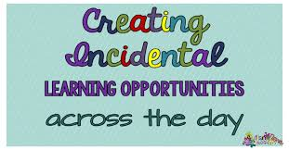
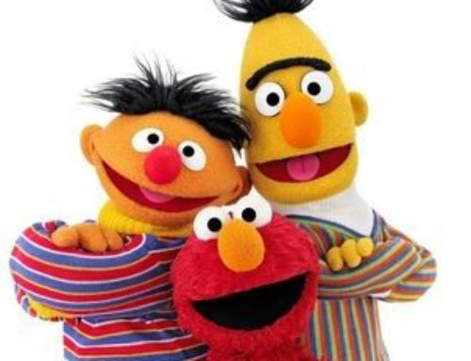
Examples: Incidental Supervision
O’Hare must be in Chicago
Feb 5 2017 Dozens of passengers heading to Chicago had to undergo additional screenings… It took Hesam Aamyab two tries to make it back to the United States from Iran. He is an Iranian citizen with a US visa who is doing post-doctoral research at UIC. …"Right now, I am in the USA and I'm very happy," Aamyab said. But now, he can't go back to Iran or anywhere else without risk. Other travelers shared the same worry. Asem Aleisawi was at O'Hare on Sunday to meet his wife who was coming in from Jordan.
  Learning/Supervision requires some level of reasoning to infer these weak signals
Coming off a road win over the Cowboys, the Redskins traveled to Lincoln Financial Field for a Week 5 NFC East duel with the Philadelphia Eagles. In the first quarter, the Redskins trailed early as RB Brian Westbrook scored on a 9-yard TD run and the Eagles DeSean Jackson returned a punt 68 yards for a touchdown.
Gender Classifier: Use all People’s Wikipedia pages
    Count gender pronouns
  Constraints are Supervision, and often more robust, and worth a lot of examples
  Difficult to label objects
  But easy to learn same/different: Superset Supervision
    Two objects in the same image are different
  Partial Supervision: Low Recall, High Precision
But she is my friend…
Label-Aware Methods
Gaza
Palestine
Which team is Westbrook on?
ebisi’ra giliyyaana phinnddale aaja pyaalestaaina adhiinastha gaajaa theke aaja raate ekhabara jaaniyyechhena .

Slide 16

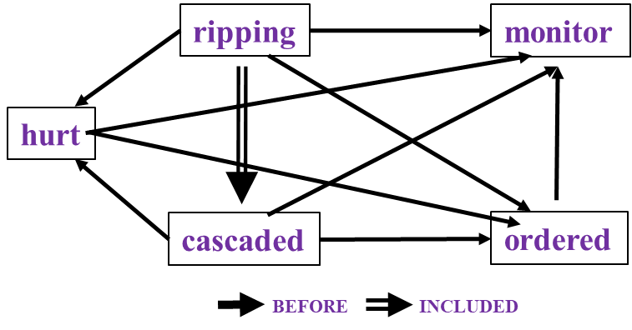

Incidental Supervision: Outline
Beyond direct annotation for a specific task, there are many additional signals that one can use in order to facilitate learning.
(1) Label Aware
  Quite often the label/task has a “meaning” that we can acquire, and use.
    Text Classification
    Semantic Typing
(2) Structure
  Many problems are structured – multiple predictions that constrain each other.
    Temporal Relations
(3) Transfer models across tasks
  Problems can be solved with models trained for other, general purpose, tasks
    Text Classification
    Events
(4) Supervise at a behavioral level
  Supervising latent variables using end-task supervision

Slide 17
Text Classification
  First zero-shot work in NLP [Chang et al. AAAI’08]
A lot of the work in NLP can be viewed as text classification
  Categorization into topics
  Identify intention of text
  Identify abusing text
  Be admitted again soon/no
  Classify fact/opinion
  ……
While you understand the labels, models are not given information about the labels
We simply view these tasks as multi-class classification
The only thing that has changed since the 70-ies is slightly better learning algorithms, and slightly better word representations
The research community uses data embeddings broadly!
And, heavily rely on task specific supervision
But there is almost no use of task/label understanding.
Promote Label-Aware Models as a form of Incidental Supervision

Slide 18
Text Categorization
Is it possible to map a document to an entry in a taxonomy of semantic categories, without training with labeled data?
Second seed Rafael Nadal continues his quest for an unprecedented 12th title at this event against Grigor Dimitrov of Bulgaria. The Spaniard leads their FedEx ATP Head2Head 11-1 and has won their past four matches, in addition to all four of their previous battles on clay. Their most recent meeting took place in the 2018 Monte-Carlo semi-finals, which saw Nadal drop just five games in his victory.
It’s about Sport
It’s about Tennis
Traditional text categorization requires training a classifier over a set of labeled documents (1,2,….k)
Someone needs to label the data (costly)
All your model knows is to classify into these given labels
Total costs for on-the-job health care benefits are expected to rise an average of 5% in 2018, surpassing $14,000 a year per employee, according to a National Business Group on Health survey of large employers. Specialty drugs continue to be the top driver of increasing costs. Companies will pick up nearly 70% of the tab, but employees must still bear about 30%, or roughly $4,400, on average.
It’s about Money
It’s about Health Care
You can classify these documents without task specific annotation, since you have an “understanding” of the labels

Slide 19
Categorization without Labeled Data [AAAI’08, AAAI’14, IJCAI’16]
This is not an unsupervised learning scenario. Unsupervised learning assumes a coherent collection of data points, where similar data points are assigned similar labels. It does not work on a single document. 0-shot learning.
Given:
  A single document (or: a collection of documents)
  A taxonomy of categories into which we want to classify the documents
Dataless/Zero-Shot procedure:
  Let f(l_{i}) be the semantic representation of the labels (label descriptions)
  Let f(d) be the semantic representation of a document
  Select the most appropriate category:
  l_{i}* = argmin_{i} dist (f(l_{i}) - f(d))
  Bootstrap (self training; pseudo labels)
    Label the most confident documents; use this to train a model.
Key Question:
  How to generate good Semantic Representations?
Originally:
  Task Independent Representations: best results with Wikipedia-based (ESA) [Gabrilovich & Markovitch AAAI’06]
  Sparse representation: a TF/IDF weighted list of URL a concept appears in
Hard to beat

Slide 20
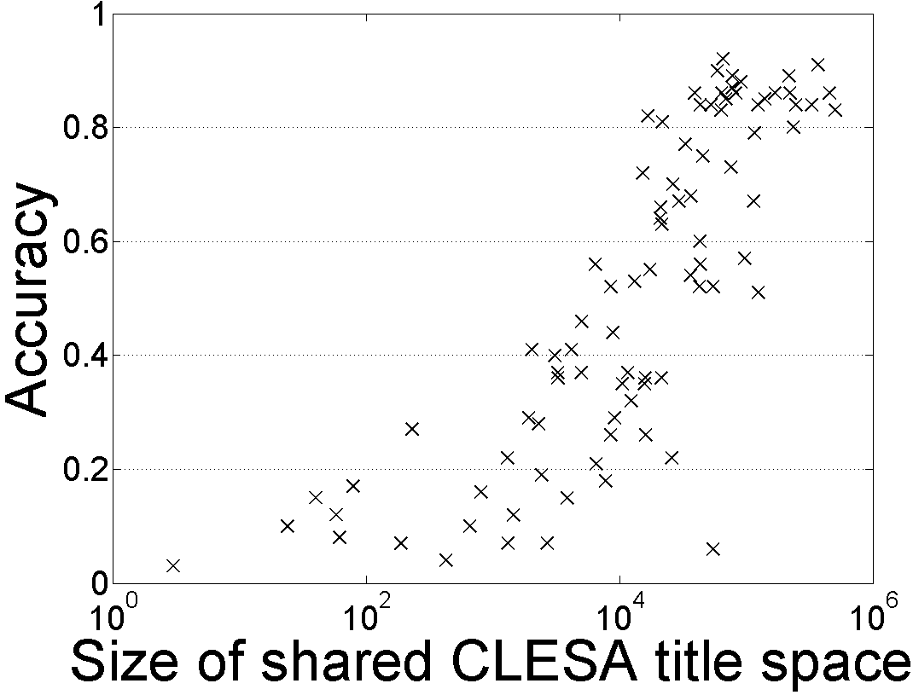
Single Document Classification (88 Languages)
[Song et. al. IJCAI’16; AIJ’19]
Can be done to all 293 languages represented in Wikipedia
Performance depends on the Wikipedia size (Cross-language links)
Dataless classification for English
Accuracy
Hausa
Hindi
Size of shared English-Language L title space

Slide 21
Incidental Supervision: Outline
Beyond direct annotation for a specific task, there are many additional signals that one can use in order to facilitate learning.
(1) Label Aware
  Quite often the label/task have a “meaning” that we can acquire, and use.
    Text Classification
    Semantic Typing
(2) Structure
  Many problems are structured – multiple predictions that constrain each other.
    Temporal Relations
(3) Transfer models across tasks
  Problems can be solved with models trained for other, general purpose, tasks
    Text Classification
    Events
(4) Supervise at a behavioral level
  Supervising latent variables using end-task supervision
A former Democrat, Bloomberg, switched his party registration in 2001.
Politician, Company, Athlete,….

Slide 22
Understanding a Taxonomy [Zhou et al’18]
A former Democrat, Bloomberg, switched his party registration in 2001.
label aware models
Key question: how do we “understand” the taxonomy?
“Type” as a conceptual container binding entities together.
  Defined extensionally as a set of members of the type
  (Not examples annotated exhaustively in context; prototypes)
politician
Richard Nixon
Bill Clinton
Elizabeth Warren
Boris Johnson
company
Computational Approach: Determine the type of an input mention by finding entities in the type-defining-set that share a similar context
Of course, each entity will be in multiple such buckets
Lehman Brothers
Reuters
CNN
Google
Notes:
Types are conceptual containers that bind entities together to form a coherent group.
I know what a politician is since I know many politicians

Slide 23
Type-Compatible Grounding
“Type” as conceptual container binding entities together.
A former Democrat, Bloomberg, switched his party registration in 2001.
politician
Richard Nixon
Bill Clinton
ELMo [Peters et al. 18]
Context-consistent
Elizabeth Warren
Boris Johnson
Different contexts where “Elizabeth Warren” is mentioned
Warren is a member of the Democratic Party, after switching party affiliation from the Republican Party in 1996.
company
Lehman Brothers
Reuters
CNN
Google
WikiLinks [Singh et al. 12]
Notes:
Types are conceptual containers that bind entities together to form a coherent group.
I know what a politician is since I know many politicians

Slide 24
Type-Compatible Grounding
“Type” as conceptual container binding entities together.
Since its founding, Bloomberg has made several acquisitions.
politician
Richard Nixon
Bill Clinton
Context-consistent
Elizabeth Warren
Boris Johnson
Different contexts where “Berkshire Hathaway” is mentioned
Berkshire Hathaway Berkshire Hathaway Inc has acquired a 25 billion rupees ($356 million) stake in the parent of digital payments company Paytm.
company
Lehman Brothers
Reuters
Berkshire Hathaway
Enron
Context consistency allows us to determine good candidates for type compatibility.
Notes:
Types are conceptual containers that bind entities together to form a coherent group.
I know what a politician is since I know many politicians

Slide 25
Zero-Shot Open Typing: Big Picture
A former Democrat, Bloomberg switched his party registration in 2001.
A mention &
its context
High-level Algorithm:
Map the mention to context-consistent Wikipedia concepts (noting that each belong to multiple types)
  Simple Entity Linking
Rank candidate titles by context-consistency and infer the types according to the type taxonomy.
Mapping type-compatible Wikipedia entities
Richard Nixon
Bill de Blasio
Elizabeth Warren
person
mayor
person
politician
politician
politician
president
person
scholar
Zero-shot Open Entity (ZOE) Typing:
Semantic typing where the label taxonomy is part of the input.
Evaluated for multiple taxonomies, including Wikipedia types.
Competitive with pre-domain supervision, for multiple domain.
Inference: aggregate and rank the consistency scores.
person
politician
official

Slide 26
Empirical Results: Fine-Typing [Zhou et al. EMNLP’18]
Outperforms supervised system in cross-domain.
Comparable results with supervised systems.
Summary: A label-aware approach leads to the ability to transfer across domains & taxonomies.
System | Trained on | Evaluated on
 |  | FIGER | BBN | Ontonotes
AFET [Ren et al. 16] | FIGER | 66 | ? | ?
NFETC [Xu&Barbosa 18] | FIGER | 79 | ? | ?
AFET [Ren et al. 16] | BBN | ? | 75 | ?
AAA [Abishek et al. 17] | BBN | ? | 79 | ?
AFET [Ren et al. 16] | Ontonotes | ? | ? | 65
NFETC [Xu&Barbosa 18] | Ontonotes | ? | ? | 70
ZOE (this work) | - | 71 | 75 | 61
politician
Richard Nixon
Elizabeth Warren

Slide 27
Incidental Supervision: Outline
Beyond direct annotation for a specific task, there are many additional signals that one can use in order to facilitate learning.
(1) Label Aware
  Quite often the label/task have a “meaning” that we can acquire, and use.
    Text Classification
    Semantic Typing
(2) Structure
  Many problems are structured – multiple predictions that constrain each other.
    Temporal Relations
(3) Transfer models across tasks
  Problems can be solved with models trained for other, general purpose, tasks
    Text Classification
    Events
(4) Supervise at a behavioral level
  Supervising latent variables using end-task supervision

Slide 28
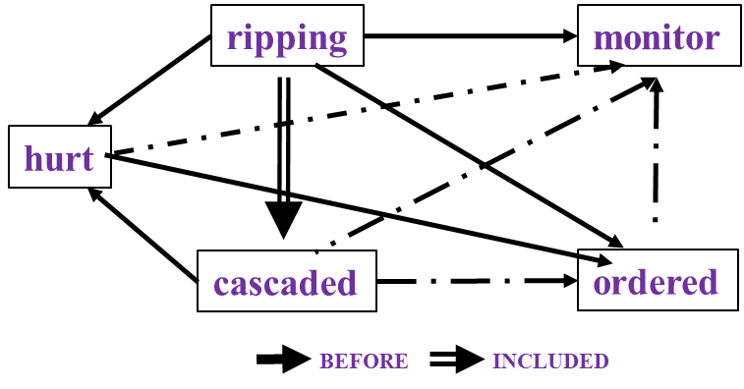

Time and Events [Ning et al. *SEM’2018; ACL’18, EMNLP’18, EMNLP’19; Wang et al. EMNLP’20]
In Los Angeles that lesson was brought home today when tons of earth cascaded down a hillside, ripping two houses from their foundations. No one was hurt, but firefighters ordered the evacuation of nearby homes and said they'll monitor the shifting ground until March 23rd.
Very difficult task— hinders exhaustive annotation (O(N²) edges)
But, it’s rather easy to get partial annotation – some relations.
And, we have strong expectations from the output
  Transitivity
  Some events tend to precede others, or follow others
How to exploit these [declarative & statistical] “expectations”?
How does it impact supervision?
cascaded
ordered
Time
ripping
Must be before

Slide 29
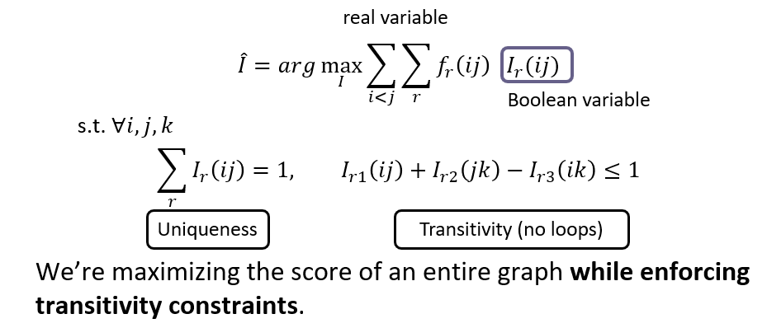
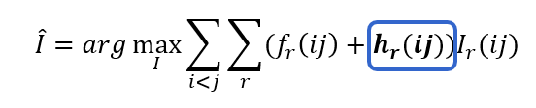
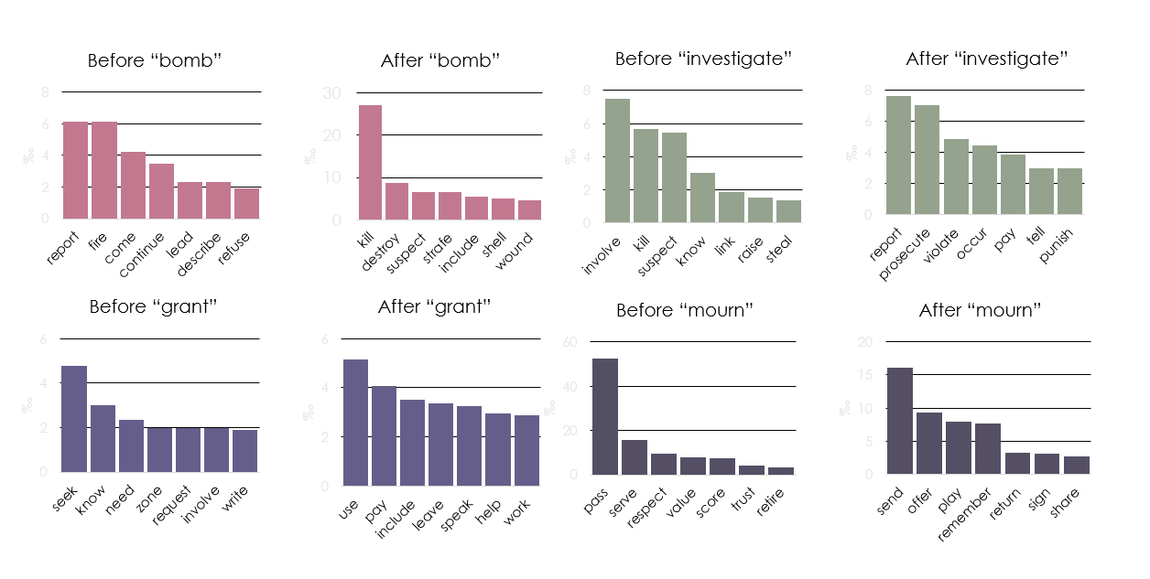
(1) How to Exploit Structure?
Constrained Conditional Models:
  [Chang et al. 2012]
  The structured decision problem can be modeled as a constrained optimization problem over learned models
  Knowledge constraints can be incorporated post-learning
    but can also be incorporated during learning, to reduce the amount of supervision needed.
  [Ning et al. *SEM’2018; ACL’18, EMNLP’18, EMNLP’19; Wang et al. EMNLP’20]
Formulation goes back to ILP: (Roth & Yih 2004), CCMs: (Chang et al. 2007, 2012) Also related to PR: (Ganchev et al. 2010)

Slide 30
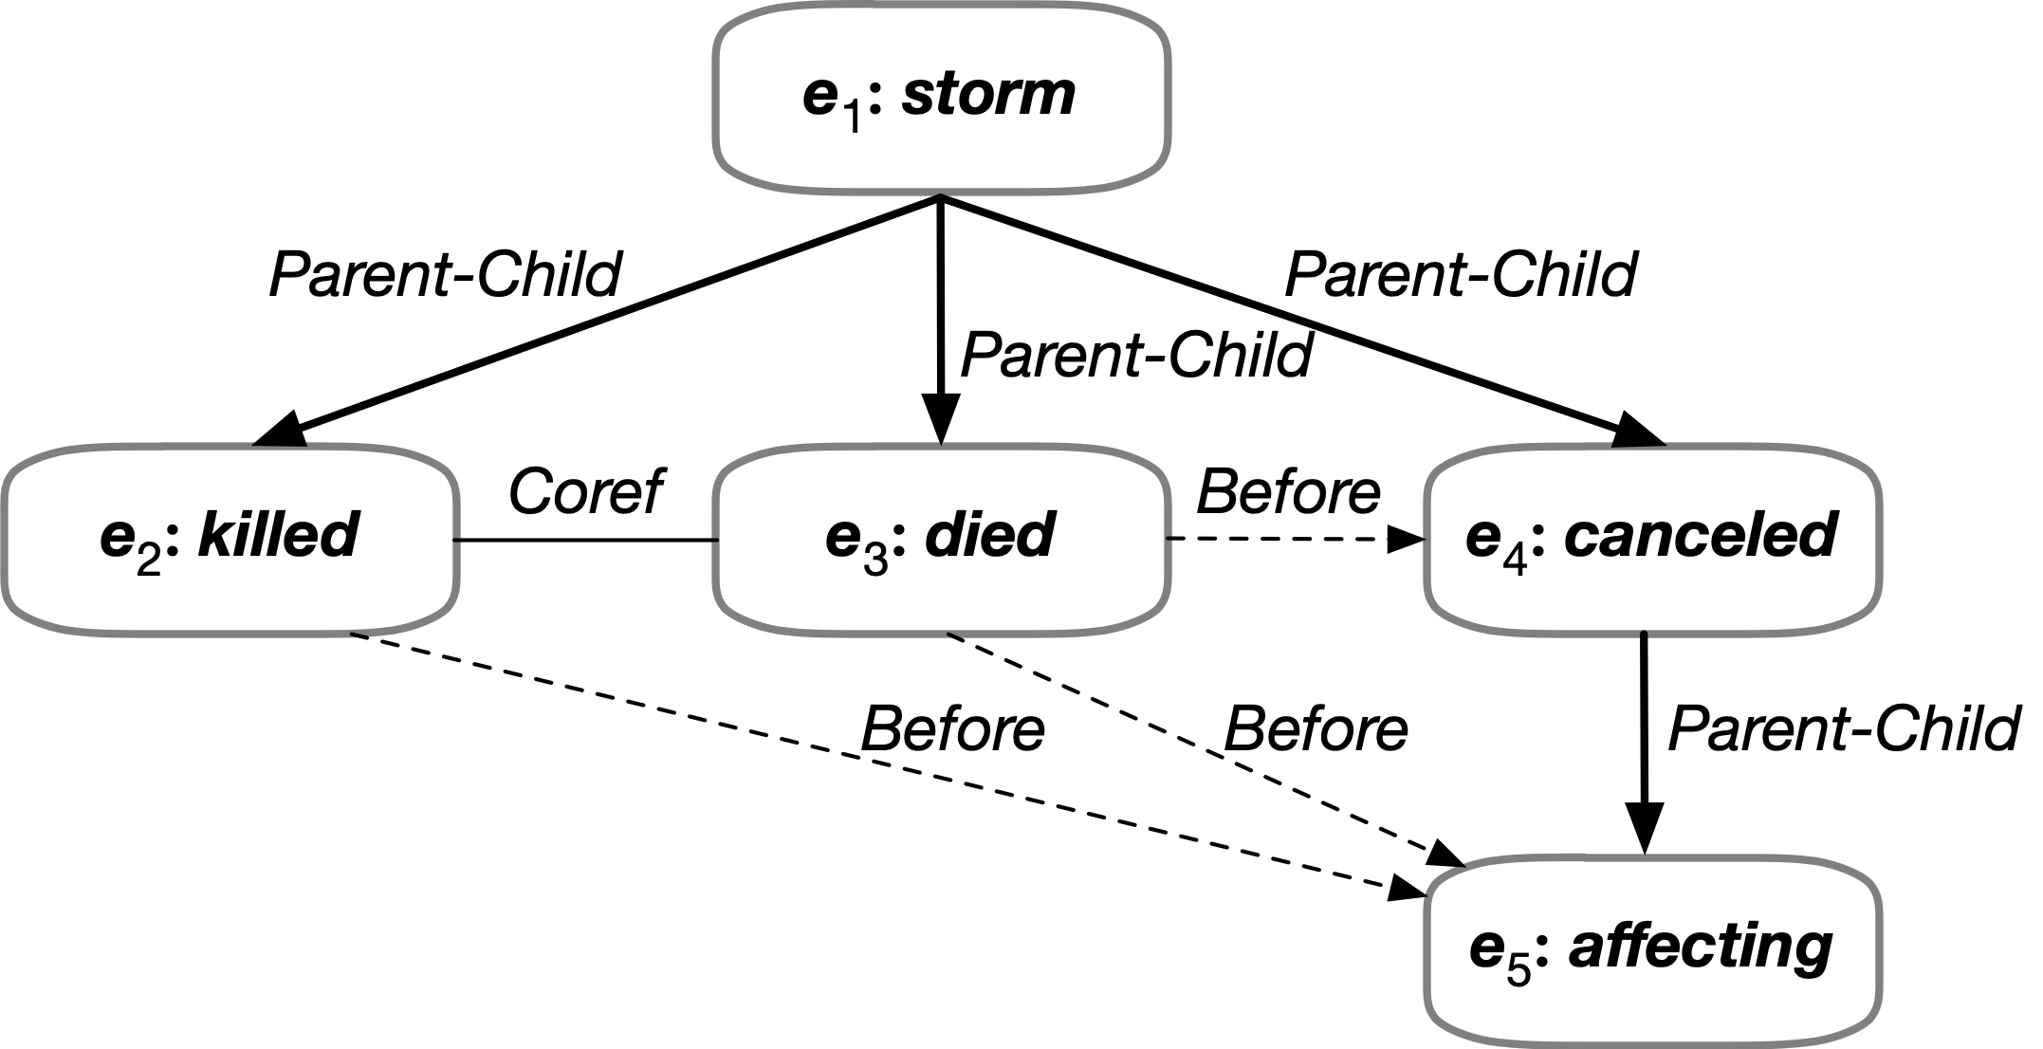

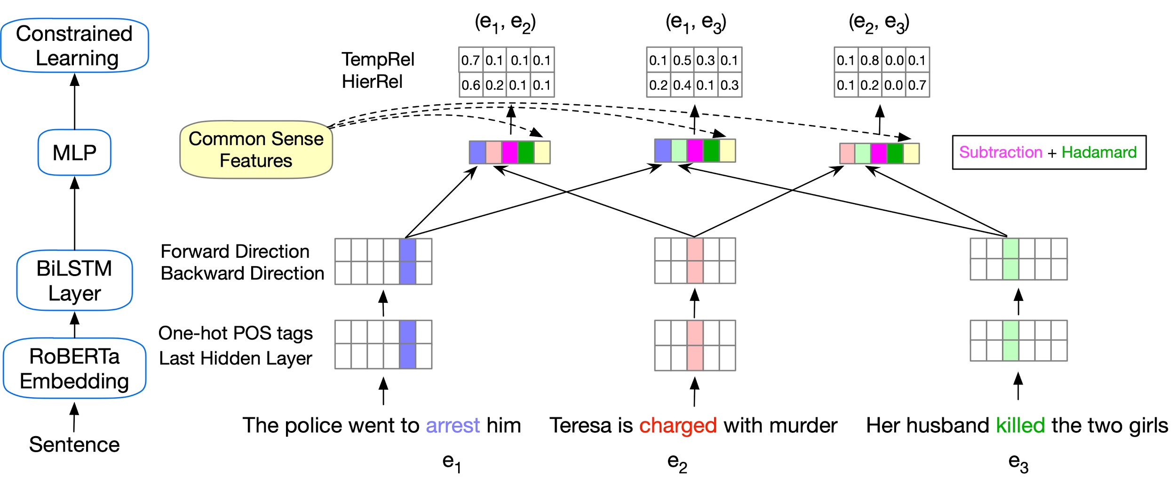
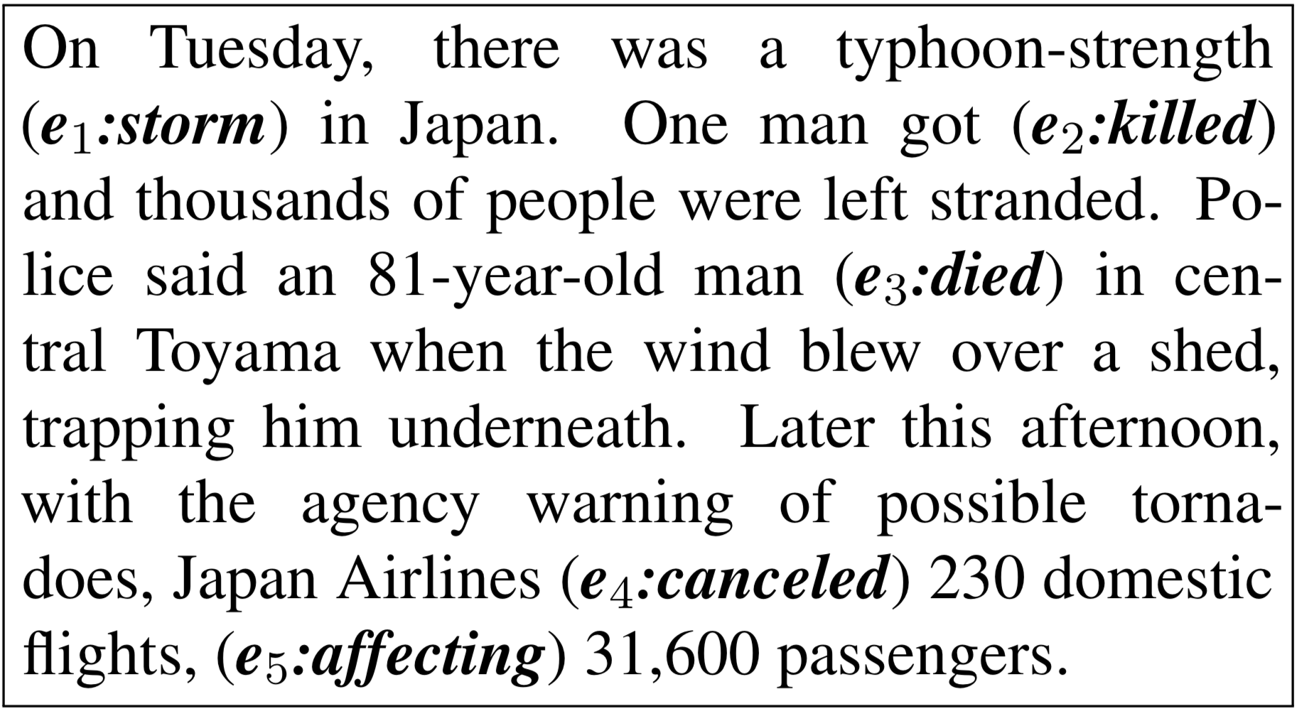
Exploiting Structure: Event Complexes [Wang et al. EMNLP’20]
Enforcing logical constraints: Temporal, Symmetry, and Conjunctive by converting declarative constraints into differentiable learning objectives [Li & Srikumar ACL’19]
Temporal Relations
Subevent Relations
Event Coreference

Slide 31
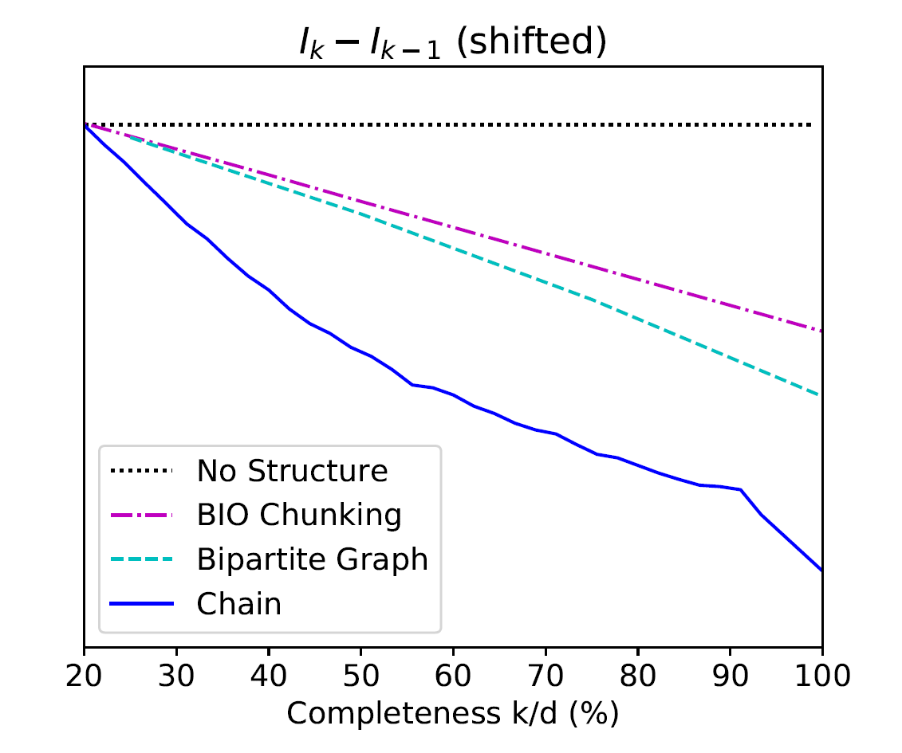
(2) Why Does Structure Help? [Ning et al. NAACL’19]
$$Δ_{k}=I_{k}−I_{k−1} \text{: }\text{The} \text{benefit} \text{of} \text{a} \text{new} \text{label}$$
Chain:
Temporal Relation Extraction
Information-theoretic considerations support quantifying the benefit of additional labels
The tighter the structure is, the smaller the benefit of an additional label is.
Consequently, better generalization even with a partial set of supervision signals.
+: p<5%
++: p<1%
++
++
++
++
++
++
++
++
+
more concave
Bipartite Graph:
Semantic Role Classification
Seq Tagging
Shallow Parsing
++
++
++
++
++
++
Notes:
When we think about it from the supervision perspective, we can ask: what is the benefit of getting a new label. And the observation, that we make using some information theoretic tools that I will not detail here is what you expect – the tighter the structure is, the smaller the benefit of a new labels is.
Consider for example this graph, and let’s think about two extreme cases. I want to label the edges, and I have the constraint that all the edges have the same label. Or, the edges’ labels are completely independent.
And indeed, we can also show experimentally, on a range of NLP problems, that this holds – the tighter the structure is, the smaller the number of examples you need…
Given that we are using constraints – structure, as an indirect supervision signal we can also think about – what kind of signals are needed to actually support learnability.

Slide 32
Incidental Supervision: Outline
Beyond direct annotation for a specific task, there are many additional signals that one can use in order to facilitate learning.
(1) Label Aware
  Quite often the label/task have a “meaning” that we can acquire, and use.
    Text Classification
    Semantic Typing
(2) Structure
  Many problems are structured – multiple predictions that constrain each other.
    Temporal Relations
(3) Transfer models across tasks
  Problems can be solved with models trained for other, general purpose, tasks
    Text Classification
    Events
(4) Supervise at a behavioral level
  Supervising latent variables using end-task supervision

Slide 33
Event Extraction
Input: “China purchased two nuclear submarines from Russia last month.”
Annotation at this level is costly and requires expertise
  And, it needs to be re-done whenever we update the event anthology.
But, we have good extractive QA systems
  Isn’t Event Extraction a simple application of Extractive QA?
Event Extraction can also be addressed via a label-aware method [Zhang et al. 20]
Event types and argument types are classified via similarity to prototypes.
Knowledge of schema
  (“Attacker” can be an argument of “Conflict:Attack”, not of “Life:Marry”)
Used as constraints, via an ILP formulation

Slide 34
Event Extraction as a QA Problem
Input: “China purchased two nuclear submarines from Russia last month.”
Event type:
TRANSFER-OWNERSHIP
Argument slots:
Buyer-Arg: The buying agent
Seller-Arg: The selling agent
Beneficiary-Arg: The agent that benefits from the transaction
Artifact-Arg: The item or organization that was bought or sold
Price-Arg: The sale price of the ARTIFACT-ARG
Time-Arg: When the sale takes place
Place-Arg: Where the sale takes place
Event Definition
Given
  a definition of the target event
  a text snippet
(1) Identify the event type
(2) Generate questions, the answers to which are the event’s arguments.
Need to support I-don’t-know, since some of the questions will have know answer
A SOTA extractive QA system on SQuAS & ACE
Trigger: purchased
Arguments:
  Q1: What was purchased?
    A1: Two nuclear submarines. ⇒Artifact-Arg
  Q2: Who purchased two nuclear submarines?
    A2: China. ⇒Buyer-Arg
  Q3: Who did China purchase two nuclear submarines from?
    A3: Russia. ⇒Seller-Arg
  Q4: Where was the purchase?
    A4: IDK
Test on:→ | SQuAD 2.0 | ACE
Has Answer | 83.53 | 62.39
I-Don’t-Know | 78.40 | 20.8—28.46

Slide 35
Transfer from Textual Entailment [Yin et al. 19, Ding et al. 21]
Label-Aware classification
  Our models need to “understand” the labels.
  While the community spends a lot of time representing input data, so far, we have not spent time representing the task.
Text classification as a textual entailment task
  Generic capability; no task/label-specific training
  Allows transfer from already existing textual entailment datasets
  Deals with multiple Text Classification tasks uniformly.
Textual Entailment: [Dagan, Roth, Sammons, Zanzoto’13]
Text Hypothesis
⊆
Eyeing the huge market potential, currently led by Google, Yahoo took over search company Overture Services Inc last year
⊆
Yahoo acquired
Overture

Slide 36

Text Classification via Transfer from Textual Entailment
At this point, the best results on zero-shot text classification are achieved via transfer from TE [Yin et al. EMNLP’19]
Can be applied to other tasks, such as relation classification, etc.
This document is about Tennis
Text Classification is inherently a Textual Entailment problem.
Given a document or a text snippet:
  Classifying it is equivalent to determining the truth value of a hypothesis
A program that “knows” how to determine textual entailment can thus classify with respect to any label (hypothesis).
It expresses joy
It constitutes harassment
Assuming, of course, that it “understands” the meaning of the hypothesis.
A model that “knows” the trick of determining textual entailment – independent of the task at hand
A model that “understands” the label – part of the input.

Slide 37
Incidental Supervision: Outline
Beyond direct annotation for a specific task, there are many additional signals that one can use in order to facilitate learning.
(1) Label Aware
  Quite often the label/task have a “meaning” that we can acquire, and use.
    Text Classification
    Semantic Typing
(2) Structure
  Many problems are structured – multiple predictions that constrain each other.
    Temporal Relations
(3) Transfer models across tasks
  Problems can be solved with models trained for other, general purpose, tasks
    Text Classification
    Events
(4) Supervise at a behavioral level
  Supervising latent variables using end-task supervision

Slide 38
End-Task Supervision [Gupta et al. ‘18, ‘19, ‘20, ‘21]
In the first quarter, the Bears Cutler fired a 7-yard TD pass to tight end Greg Olsen. … In the third quarter, the … back Adrian Peterson's 1-yard touchdown run. The Bears increased their lead over the Vikings with Cutler's 2-yard TD pass to tight end Desmond Clark. The Vikings … with Favre firing a 6-yard TD pass to tight end Visanthe Shiancoe. The Vikings … with Adrian Peterson's second 1-yard TD run. The Bears then responded with Cutler firing a 20-yard TD pass to wide receiver Earl Bennett. The Bears then won on Jay Cutler's game-winning 39-yard TD pass to wide receiver Devin Aromashodu.
Who scored the longest touchdown pass of the game?
Text Comprehension challenges:
  Understand the text
    Identify and contextualize events, entities, quantities (and their scope), relations, etc.
  Understand questions about the text
    Often, requires decomposing the question in a way that depends on the text
  Reason about the text
    Combine and manipulate the identified information to accomplish information needs (e.g., answering questions)
How can we supervise to support this level of understanding?
  Too many (ill-defined) latent decisions
    Annotating text for all is not scalable
  End-task supervision is the only realistic approach
  Introduced in [Clarke et al. CoNLL’10] in the context of semantic parsing
  But it is too loose – how can we learn all the latent decisions from end-to-end supervision?
She reports worsened seizure frequency, seizures now occurring up to 10/week, in clusters about 2-3 day/week. Previously reported seizures occurring about 2-3 times per month, often around the time of menses,…
What is her seizure frequency?
Mayor Rahm Emanuel has raised more than $10 million toward his bid for a third term – more than five times the total raised by his 10 challengers combined, campaign finance records show.
How much did his challengers raise?
The COVID-19 pandemic in the United States is part of the worldwide pandemic of coronavirus disease 2019 (COVID-19). As of October 2020, there were more than 9,000,000 cases and 230,000 COVID-19-related deaths in the U.S., representing 20% of the world's known COVID-19 deaths, and the most deaths of any country.
Notes:
We are interested in developing a question answering system that given as input a question and a relevant paragraph of context, produces the correct answer
For example, given the question “Who scored the longest touchdown pass of the game?” and a summary of an American Football game, the model should be able to produce the correct answer

Slide 39
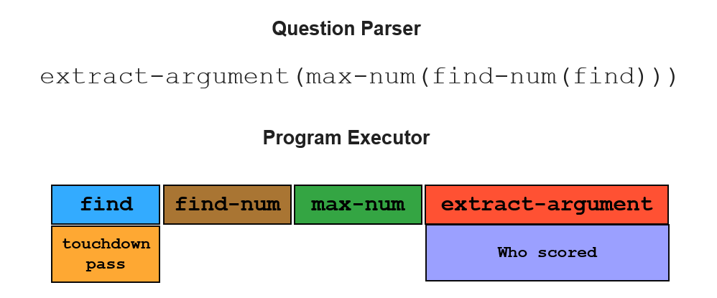
Supervising for Reasoning about Text
Who scored the longest touchdown pass of the game?
Answering complex questions about events requires reasoning, done over learned compositional, structured models, that depend on latent decisions
We need to induce a program, with some executable modules at the leaves
  “This phrase” indicates a field goal/touchdown
  “This player” scored it; “this is the length”, etc.
Reason symbolically over it.
  Possibly, over probabilistic representations of the latent variables.
One key to supervision: indirect signals
Who scored the shortest touchdown pass of the game?
In the first quarter, the Bears Cutler fired a 7-yard TD pass to tight end Greg Olsen. … In the third quarter, the … back Adrian Peterson's 1-yard touchdown run. The Bears increased their lead over the Vikings with Cutler's 2-yard TD pass to tight end Desmond Clark. The Vikings … with Favre firing a 6-yard TD pass to tight end Visanthe Shiancoe. The Vikings … with Adrian Peterson's second 1-yard TD run. The Bears then responded with Cutler firing a 20-yard TD pass to wide receiver Earl Bennett. The Bears then won on Jay Cutler's game-winning 39-yard TD pass to wide receiver Devin Aromashodu.
How many touchdowns were scored?
How long was the longest touchdown?
Jay Cutler
Notes:
We are interested in developing a question answering system that given as input a question and a relevant paragraph of context, produces the correct answer
For example, given the question “Who scored the longest touchdown pass of the game?” and a summary of an American Football game, the model should be able to produce the correct answer

Slide 40
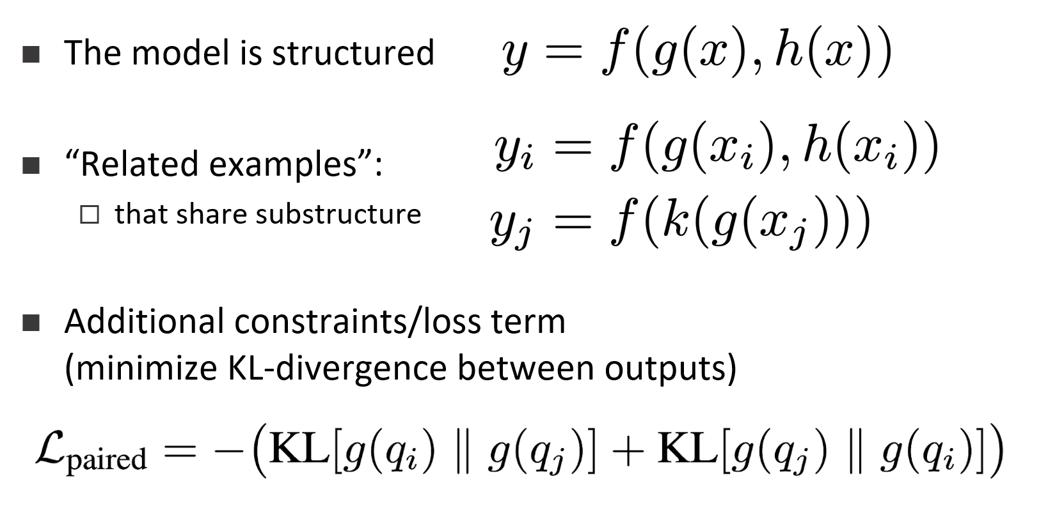
Supervising for Reasoning about Text
Who scored the longest touchdown pass of the game?
Answering complex questions about events requires learning compositional, structured models, that depend on latent decisions
End-task supervision only provides a weak indirect signal to latent decisions
  When do we learn “touchdown”?
  In fact, also: when do we learn “max”?
We introduce a way to generate and leverage indirect supervision signals via paired examples
  Stronger cues for learning latent decisions.
Who scored the shortest touchdown pass of the game?
In the first quarter, the Bears Cutler fired a 7-yard TD pass to tight end Greg Olsen. … In the third quarter, the … back Adrian Peterson's 1-yard touchdown run. The Bears increased their lead over the Vikings with Cutler's 2-yard TD pass to tight end Desmond Clark. The Vikings … with Favre firing a 6-yard TD pass to tight end Visanthe Shiancoe. The Vikings … with Adrian Peterson's second 1-yard TD run. The Bears then responded with Cutler firing a 20-yard TD pass to wide receiver Earl Bennett. The Bears then won on Jay Cutler's game-winning 39-yard TD pass to wide receiver Devin Aromashodu.
How many touchdowns were scored?
How long was the longest touchdown?
Jay Cutler
Latent Decision Model
Notes:
We are interested in developing a question answering system that given as input a question and a relevant paragraph of context, produces the correct answer
For example, given the question “Who scored the longest touchdown pass of the game?” and a summary of an American Football game, the model should be able to produce the correct answer

Slide 41
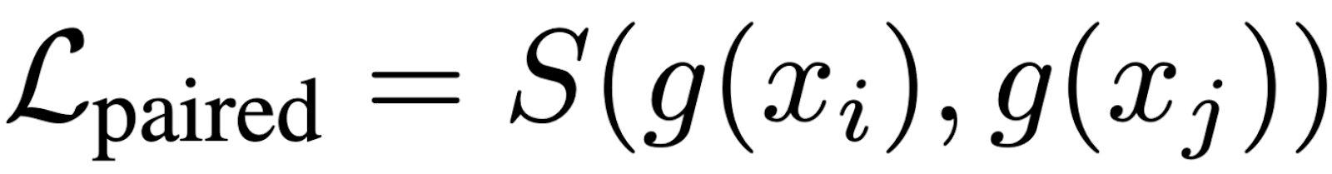
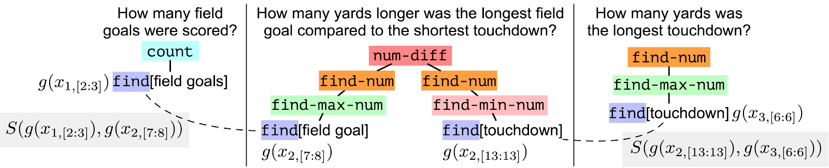
Paired Objective
Enforce consistency between outputs of shared-substructures
encourage similarity between outputs
This approach to supervision can be shown to provide better compositional generalization

Slide 42
Is This Art?
So far, we provided a few examples where signals that are co-related with the task at hand, can be used to replace “standard” supervision.
Is this an art? Can we develop a theory that supports it?
  In the case of structure (constraints) we showed:
    The tighter the structure, the less labels are needed.
More generally?
There is a beginning of a theory [Ning et al. 2019, Wang et al.2020]
  And systematic algorithms that exploit the current understanding

Slide 43
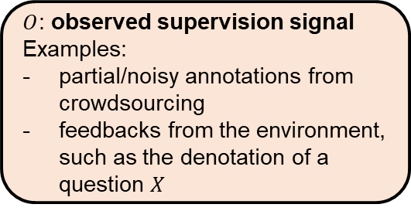





Learnability with Indirect Supervision Signals
(Wang, Ning, Roth, NeurIPS 2020)
Framework
We studied the problem of learning with general forms of indirect supervision signals ($O$),
  Any signals that contain (partial) information about the true label.
  Examples: noisy/partial labels, constraints, or indirect feedback from the environment.
We proposed a general learning scheme, which uses the predicted label to induce predictions about $O.$ The prediction is evaluated by the observed signals (fig. 1).
Question: Under what conditions on the indirect supervision can we guarantee learnability of the original classification problem?
update parameters
$\hat{Y}$: predicted label
(the gold label is not observed)
$P(\hat{O})$:
induced prediction of the supervision signal
$O$: observed supervision signal
Examples:
partial/noisy annotations from crowdsourcing
feedbacks from the environment, such as the denotation of a question $X$
$X$: input instance
$L$: loss
task
induce
Figure 1: Learning Scheme
Notes:
The fundamental goal here is the ability to replace standard supervised learning with the use of indirect, weak, and cheap supervision signals.
To understand this we study a general learning scheme where the supervision comes from any signal that contains partial information abut the true label.

Slide 44
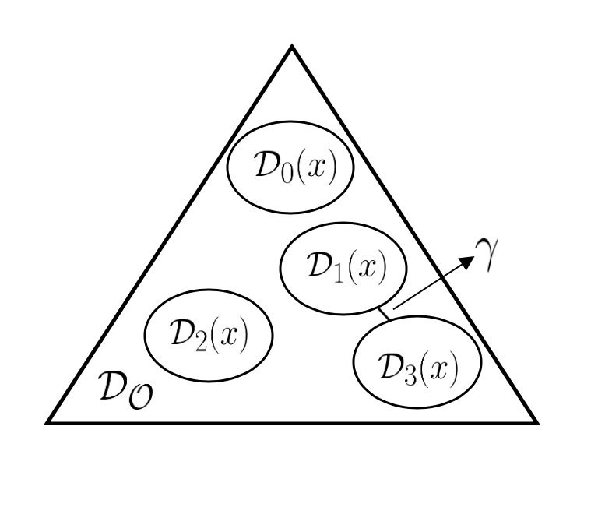




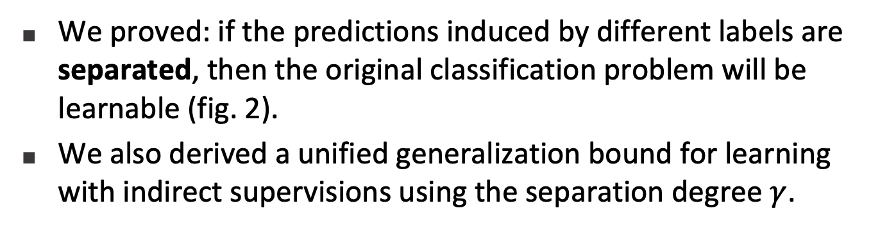
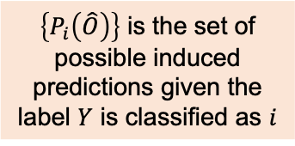
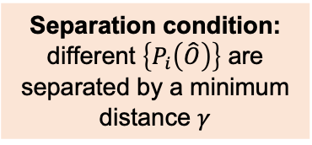
Learnability with Indirect Supervision Signals
(Wang, Ning, Roth,
To appear in NeurIPS 2020)
$\left\{P_{i}\left(\hat{O}\right)\right\}$ is the set of possible induced predictions given the label $Y$ is classified as $i$
Theory
We proved: if the predictions induced by different labels are separated, then the original classification problem will be learnable (fig. 2).
We also derived a unified generalization bound for learning with indirect supervisions using the separation degree $γ$.
$$\{P_{1}\left(\hat{O}\right)\}$$
$$\{P_{2}\left(\hat{O}\right)\}$$
$$\{P_{3}\left(\hat{O}\right)\}$$
$$\{P_{4}\left(\hat{O}\right)\}$$
Applications
Our result can be applied to recover the previous results about learnability with noisy and partial labels.
It will also help us to find and combine supervision signals that is easier to collect and ensures learnability.
Separation condition: different $\left\{P_{i}\left(\hat{O}\right)\right\}$ are separated by a minimum distance $γ$
Figure 2: Separation
(4-class Classification Example)

Slide 45
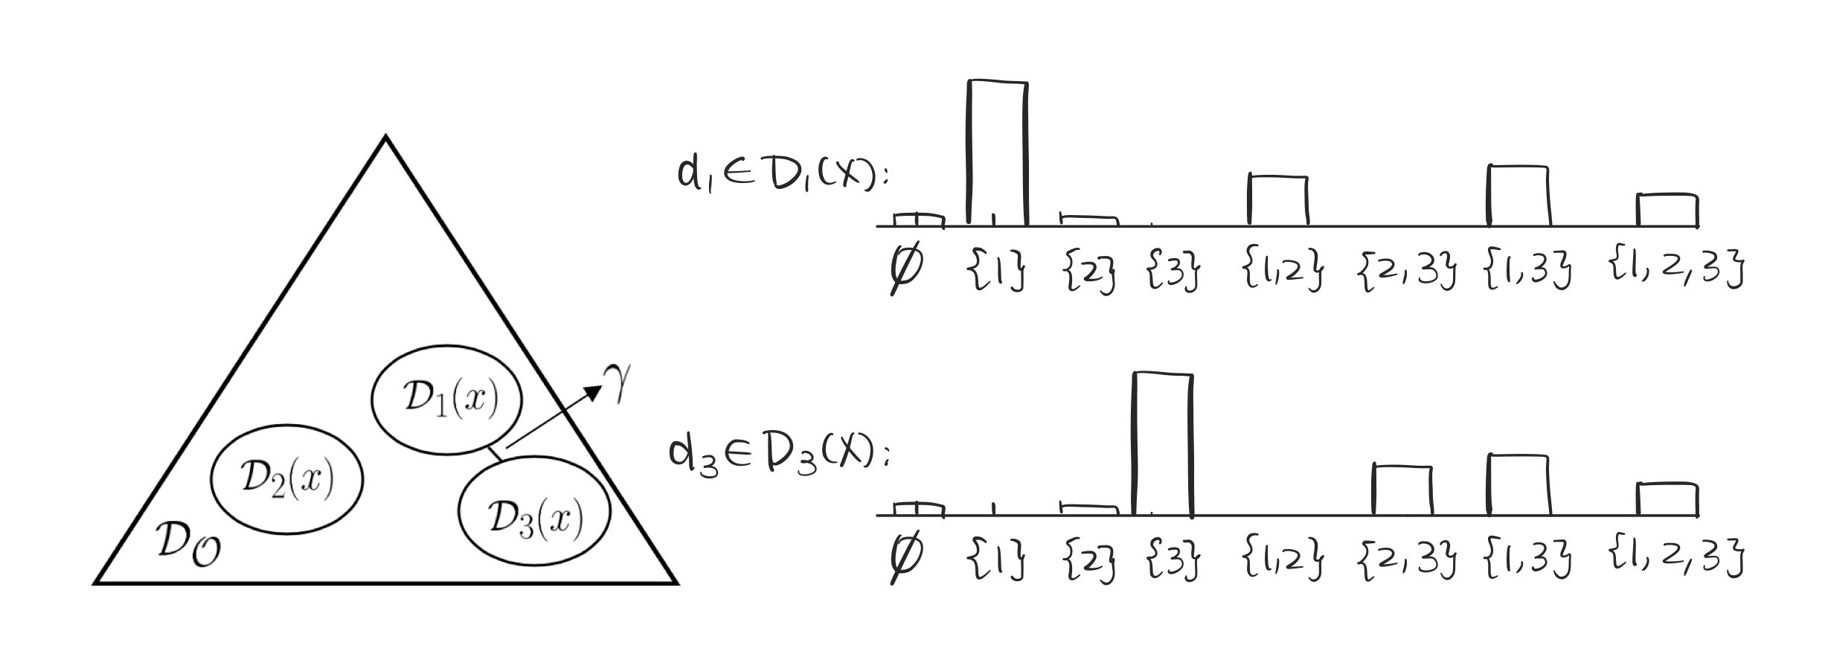
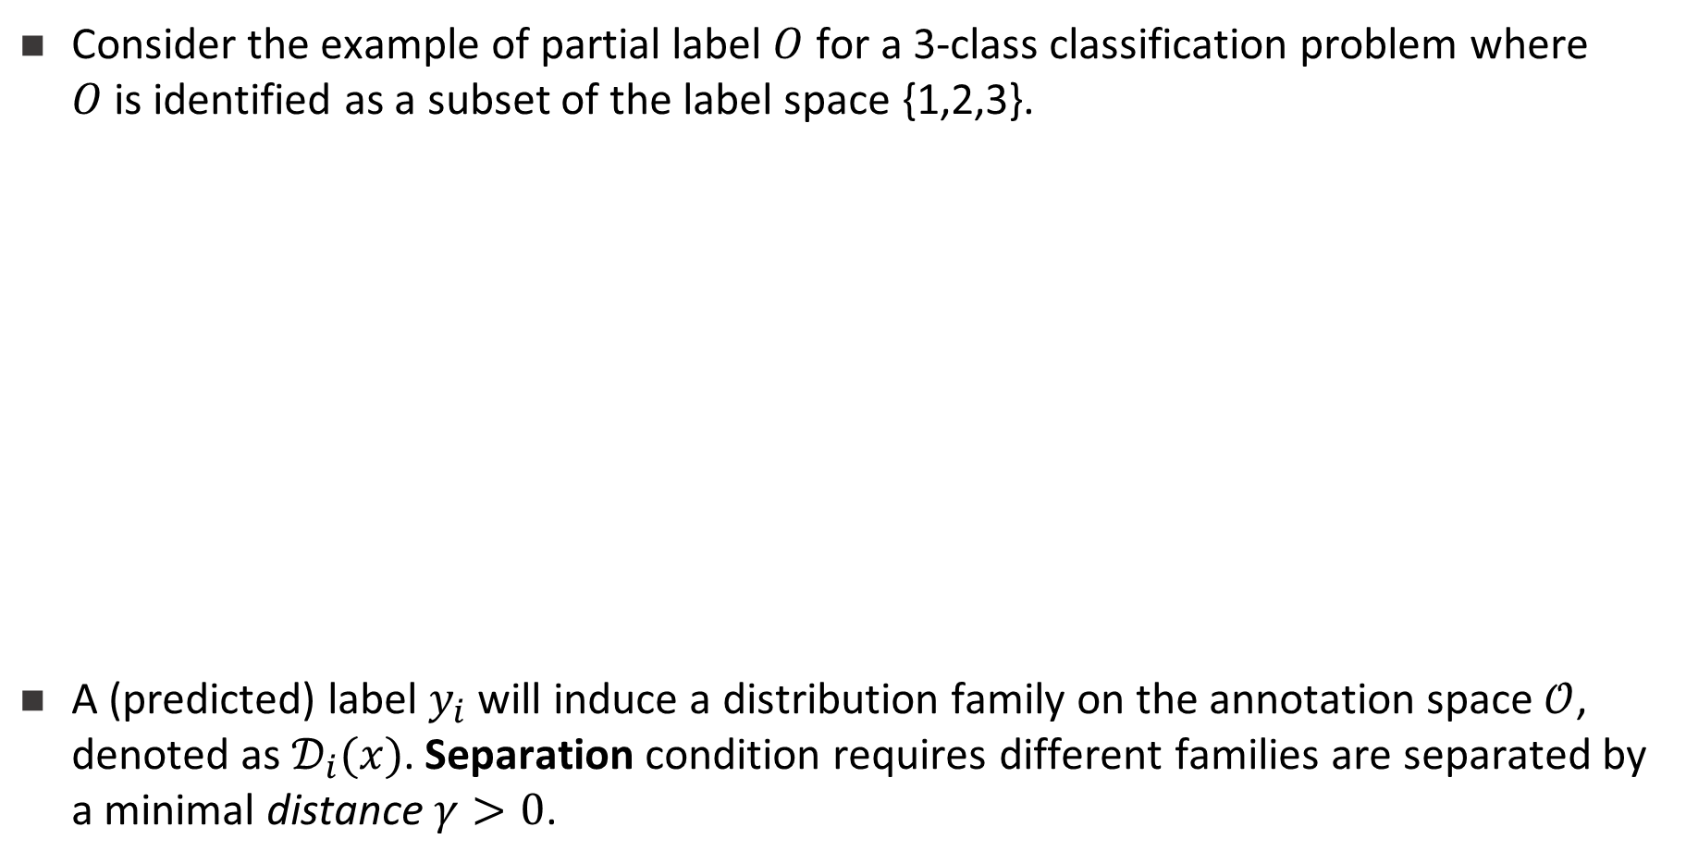
Separation: Illustration
Consider the example of partial label $O$ for a 3-class classification problem where $O$is identified as a subset of the label space {1,2,3}.
A (predicted) label $y_{i}$will induce a distribution family on the annotation space$𝒪$, denoted as $𝒟_{i}(x)$. Separation condition requires different families are separated by a minimal distance $γ>0$.

Slide 46
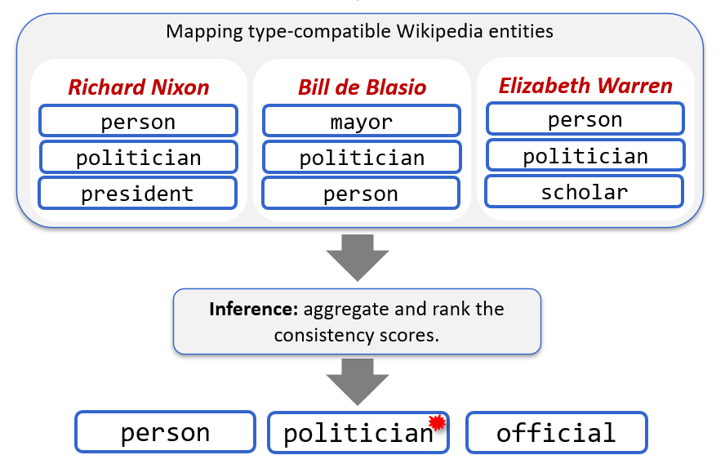
Conclusion
Thank You!
The standard, annotation heavy, machine learning we use today is not sufficient.
  It’s unrealistic, cannot scale, and very limited.
This is especially crucial as we move to more difficult tasks, with sparser output space.
Some recent samples from a research program that attempts to address some of these challenges to better extract information and understand natural language
Incidental supervision: How to understand, acquire and use signals that were not put there to help a specific target task.
  Multiple tasks; a range of methods.

