Slide 1
It’s Time to Reason
Dan Roth
University of Pennsylvania & Amazon AWS AI
IBM Neuro-Symbolic AI Workshop
January 2022
Notes:
I used this title not only since I think that it’s time to reason – think more seriously about reasoning as a way to advance AI in general, and NLP, which will be my focus, in particular. Also because many of my examples – and this talk will mostly be a set of examples -- will be about time, and temporal reasoning. But I hope that you will see that the principles apply more broadly, and beyond NLP. I will start by expressing a key concern I have about the state of AI today. While the media thinks that we have solved *almost* everything, I know that when we think about the real problems we would like to address, we are far from it, and I am concerned that, in some respects, we are climbing a tree trying to reach the moon.

Slide 2
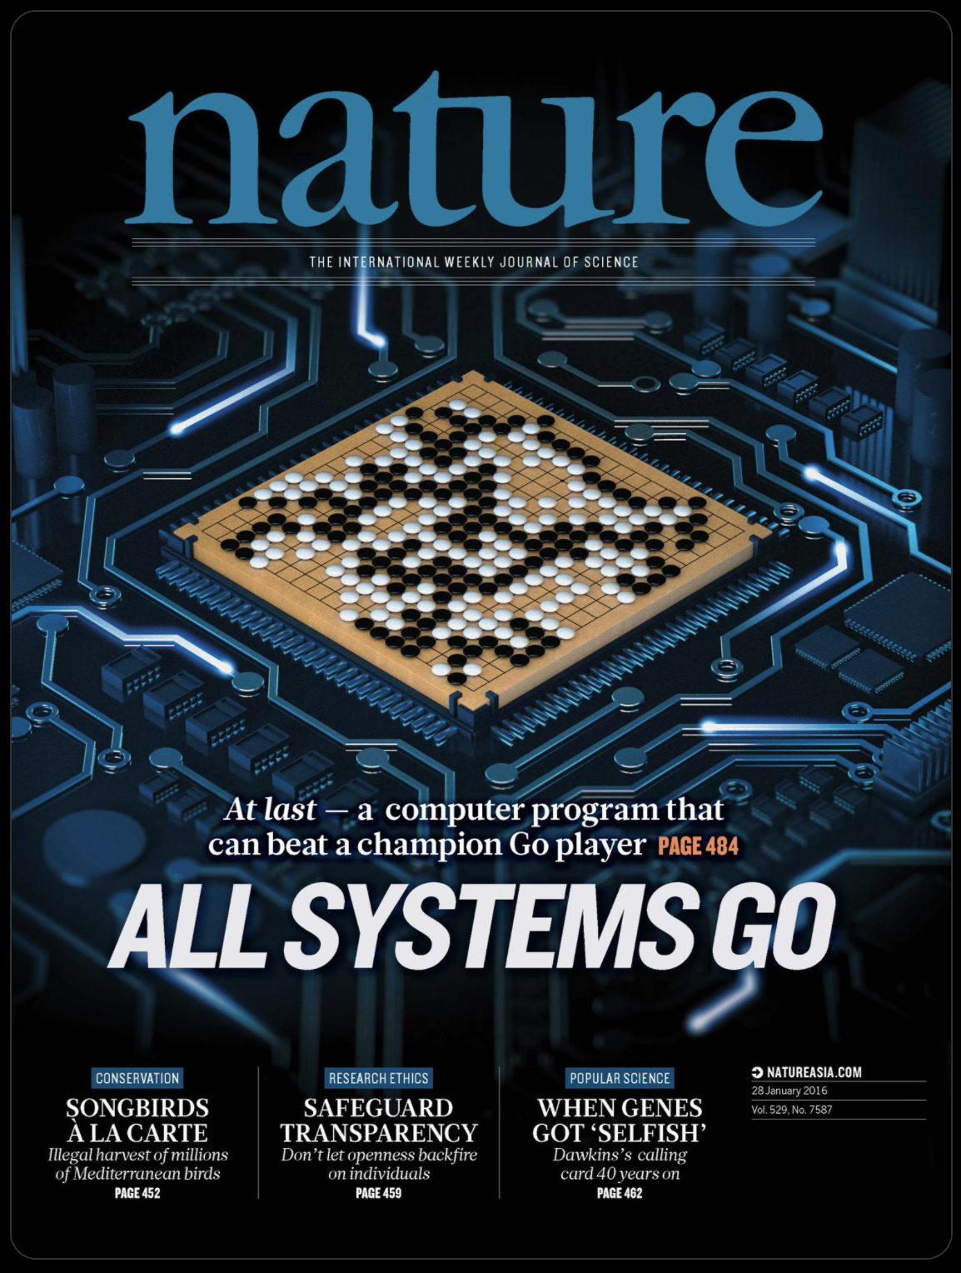

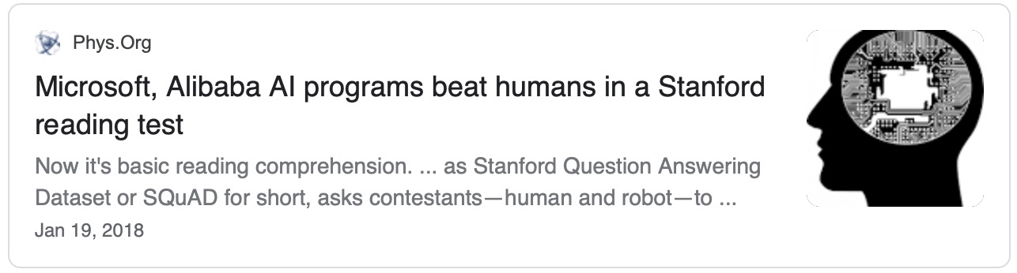



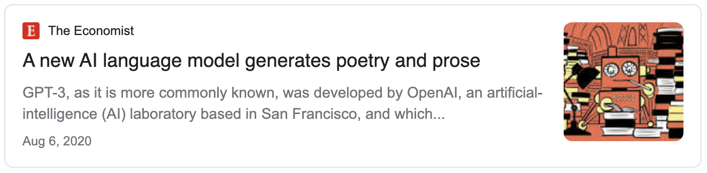
AI is in the News: The Success of Deep Learning
Notes:
I will start by expressing a key concern I have about the state of AI today. While the media thinks that we have solved *almost* everything, I know that when we think about the real problems we would like to address, we are far from it, and I am concerned that, in some respects, we are climbing a tree trying to reach the moon.

Slide 3

Is what we are doing sustainable?

Slide 4
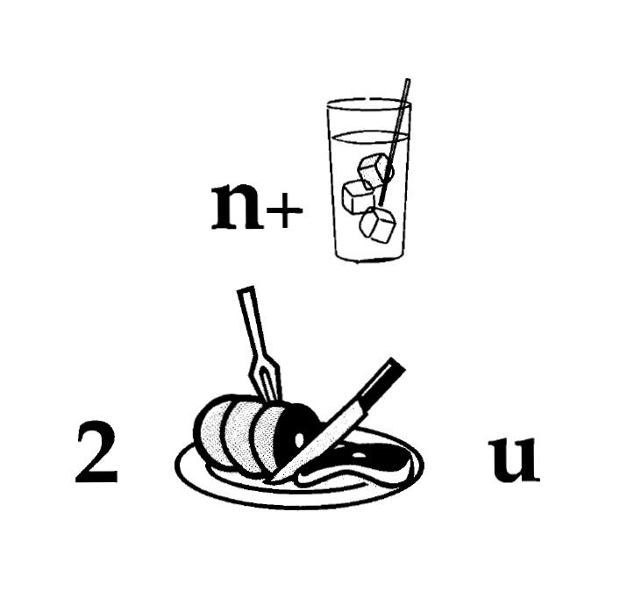
Nice to Meet You
Identify units
Consider multiple
representations & interpretations
  Pictures, text, layout, spelling, phonetics
Put it all together:
  Determine “best” global interpretation
Satisfy expectations
  Slide; puzzle
Computational Problem:
Assigning values to multiple variables, accounting for interdependencies among them
Notes:
As my first example, I’d like you to read this.
People take seconds to read this. But – this is a reasoning process. And, in many respects, I think of natural language understanding this way –
Each component has multiple interpretation on it own, but given the context, and the fact that I put it all on one slide, and you know that it has an interpretation, you quickly find a coherent solution.

Slide 5
Natural Language Understanding
Natural language understanding decisions are global decisions that require
  Making (local) predictions driven by different models trained in different ways, at different times/conditions/scenarios (and sometimes, name them)
  The ability to put these predictions together coherently
  Knowledge, that guides the decisions, so they satisfy our expectations
Of course, our programs need a lot more in order to understand and communicate in natural language
  but it exemplifies some important aspects – “discrete reasoning”;
  – “understanding ~~ best interpretation”
And this example brings up another important question:
  How do we train for these kinds of tasks?
Notes:
5
You can think about this as abductive reasoning
Knowledge guides our decisions – and also how we decomposed the problem to components.
Talk about multiple ways of training – decoupling – relate to abstraction
Examples: semantic parsing (do verb + Prep + commas together; lack of jointly annotated data)
Wikification – Relations (but also add geographical coherence; topical coherence; all interrelated signal that are acquired at different times, different contexts, etc.

Slide 6
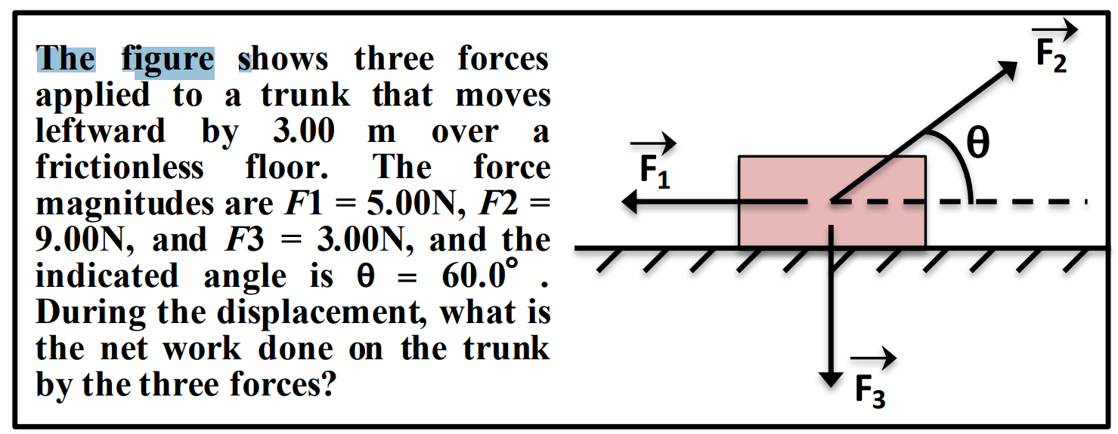
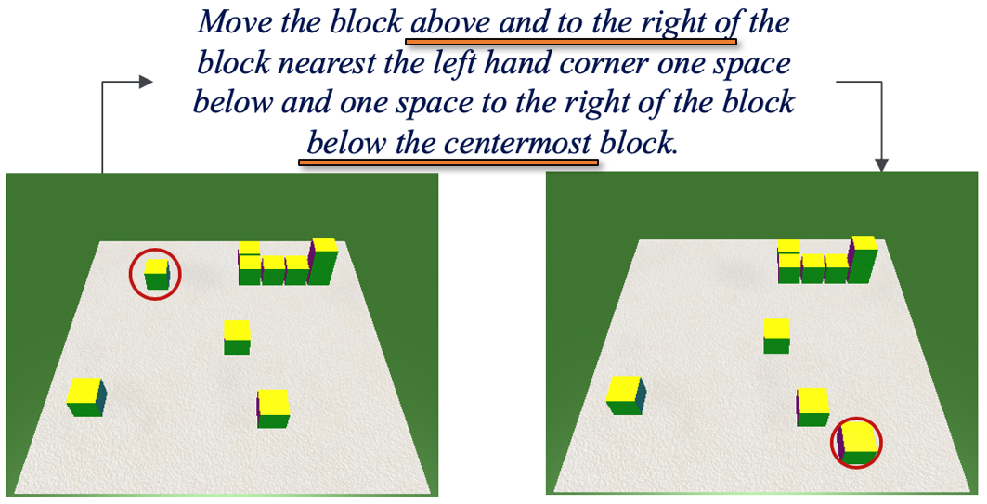
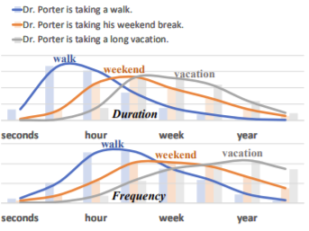
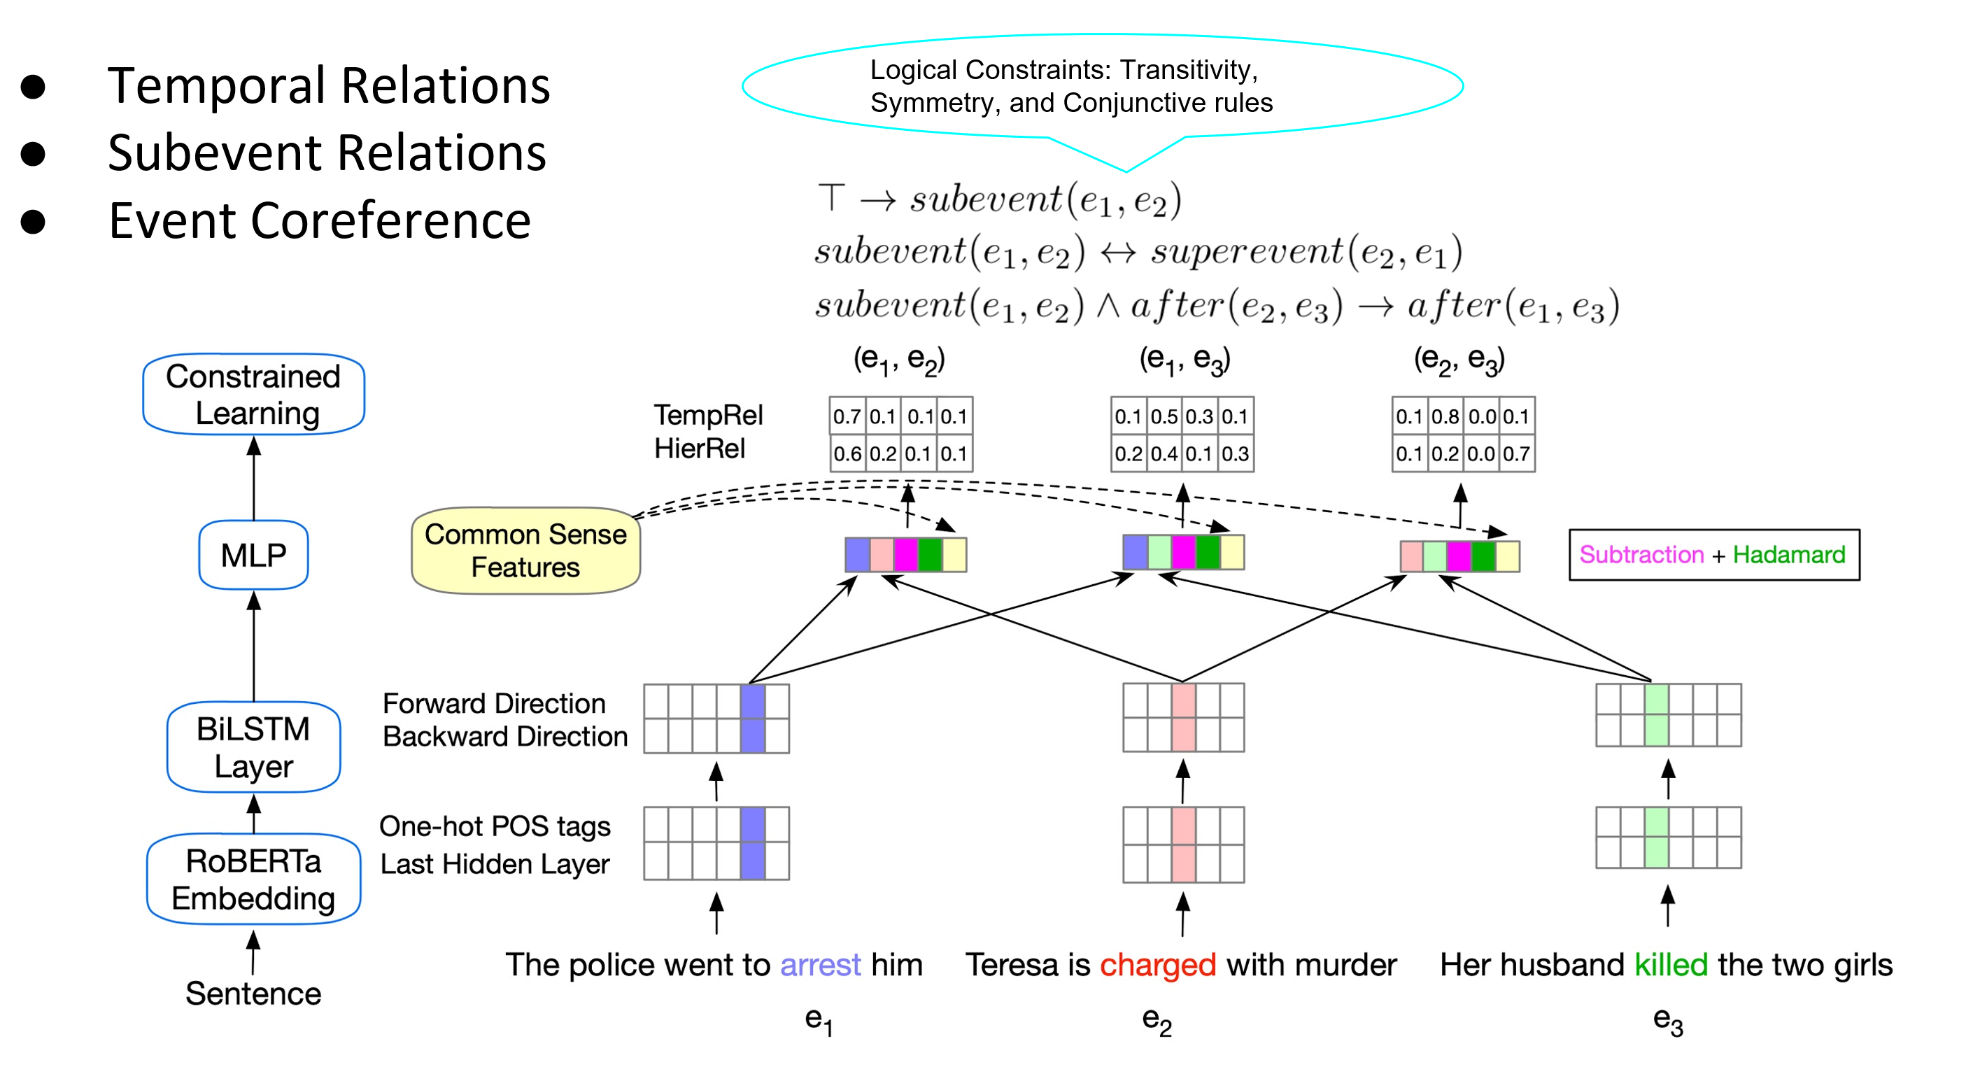
Learning to Reason over Natural Language
Making decisions that depend on natural language understanding requires reasoning abilities
  We need to decompose and compose
  Symbolic reasoning over learned models
    Reasoning with Declarative knowledge (Constraints)
  Learning with declarative knowledge
Examples:
  Compositionality
  Knowledge
  Putting things together
  Supervision
Quantitative Reasoning about Text and Diagrams
Understanding Compositional Instructions
Commonsense Reasoning
Training with Logical Constraints
Notes:
I would like to discuss the processes we need to study in order to address these challenges – qualitative reasoning over text and diagrams, understanding instructions, common sense reasoning,….
I would like to argue that these processes require that we REASON – we need to decompose and compose, make use and define symbols, that could be outcomes of learned models, but that we need to manipulate with declarative knowledge.
And I’ll illustrate the challenges by giving you examples, about the need to think about compositionality, how to incorporate and reason with knowledge that is external to our models, to put things together, and the role of supervision in all these.

Slide 7
Principle of Compositionality
The meaning of a complex expression is determined by the meaning of its constituents and the rules used to combine them
“U-Turn is allowed”
“U-Turn is not allowed”
“Swimming is allowed”
“Swimming is not allowed”
*Principle is often credited to Gottlob Frege
Notes:
Hopefully you can already see that I think about reasoning as a broader task that the standard definition – it’s not just the computation of deduction or not even abduction, but, more generally, the processes involved in solving problems that are not doable in a one-shot setting.
The need to do reasoning arises from the realization that a lot of what we face when we communicate in natural language is new. And thus, compositionality is an essential component of NLU. We need to decompose and compose. We cannot expect that all our decisions will be supported by a single function approximation model, nor that we can learn models this way.
I will focus on examples that illustrate challenges.
Thinking seriously about compositionality has essentially disappeared from modern ML – everything is one-shot function approximation, and I’d like to argue that it is essential that we think about it from the Reasoning and the Training perspective

Slide 8


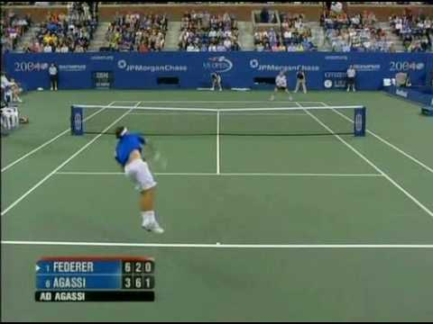
Reasoning in Natural Language
Will we make it to the movie?
  Time now + [time to get to the movie] < start of movie
Will we make it to dinner before the movie?
  Time now + [time to get to dinner] + [duration of dinner] < start of the movie
Will we make it to the movie after the game?
  Start time of the game + [duration of the game] < start of the movie
Will we make it to a movie after the game?
  Start time of the game + [duration of the game] < start of any movie
Reasoning: Is the end time of the game/dinner before the start time of the/any movie?
Identifying compositionality is essential to facilitate training of models
Notes:
So how about when we get to natural language tasks?
Unlike the “standard” extractive QA, where we train models directly to extract a span of text, here we cannot do it. There is a planning/reasoning process here, and it is done on top of multiple components, each of which is learned. And how to learn the “putting together” operator?

Slide 9
Let’s Talk about Dinner
∃ r ∈ [Restaurants] | [Cuisine](r, Mexican)∧ [InCity](PH)
Constraints:
∀ r ∈ [Restaurants] → [Contains](r, m) ∧ [Menus](m)
∀ m ∈ [Menus] → [Contains](d,m) ∧ [Dishes](d)
∃ o ∈ [Dishes] → [Tastes](o, ￢spicy)
∃ r ∈ Restaurants | Cuisine(r, Mexican)∧ InCity(PH)
Constraints:
∀ r ∈ Restaurants → Contains(r, m) ∧ Menus(m)
∀ m ∈ Menus → Contains(d,m) ∧ Dishes(d)
∃ o ∈ Dishes → Tastes(o, ￢spicy)
→ Let’s talk about dinner.
  A: Where do you want to go?
→ I really enjoy Mexican food, but not when it is spicy.
  A: How about a Mexican restaurant with plenty of non-spicy options?
→ Yep, is there one in Philadelphia?
  A: Here are a couple of good options
  …….
Don’t worry, you can still use neural embeddings for predicates and functions that are learned concepts
But this abstraction shows that we need to put some learned components together, along with incorporating declarative constraints…
[Example due to Tania Berdax-Weiss]

Slide 10
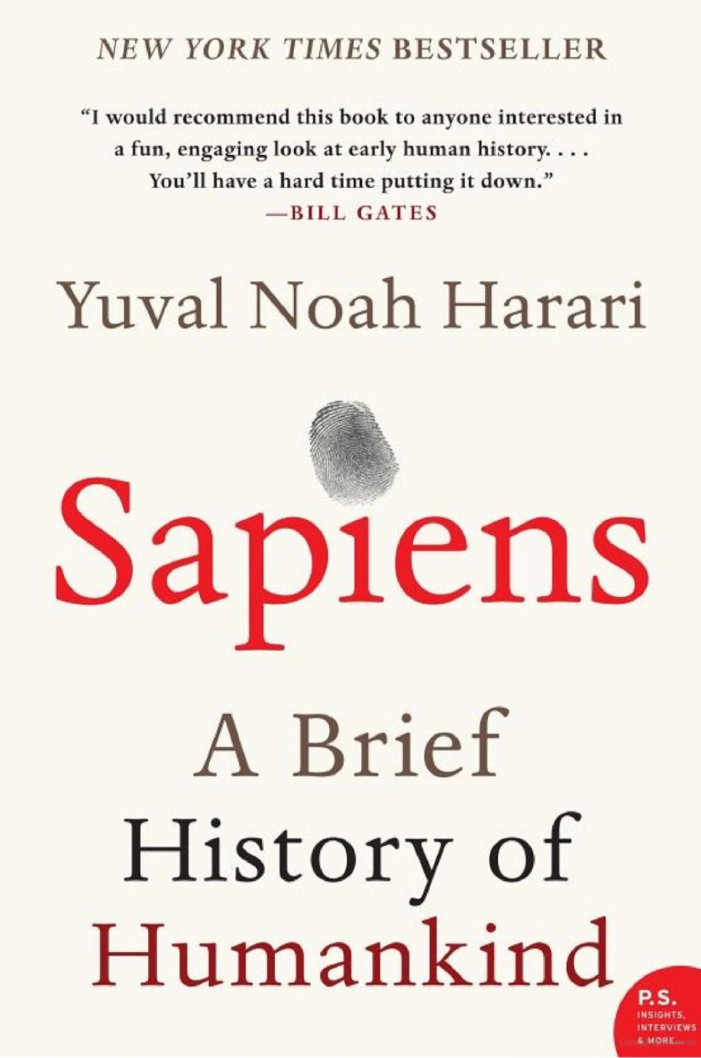
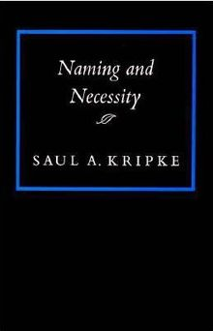

Symbolic Reasoning?
Some people think that symbols are an evil invention of old AI people.
It’s not.
Language is a symbolic system
Even though we communicate via speech, gestures, writing, which are continuous, symbols are the invariants of this communication.
  Harari: Language – the ability to assign symbols to “things” and “reason” about them is key to human cognitive revolution
  Kripke: “Naming” things is key to communication and to cognition
  The Enigma of Reason: “Reasoning is about giving reasons”
Rodgers finished 23-of-36 for 296 yards and two touchdowns. His numbers could've been even better had his receivers not dropped a couple of his passes. One dropped ball was a potential score to Allen Lazard. Despite the drop, Lazard made up for it by leading the Packers in receiving. With Davante Adams tied up with Jalen Ramsey, Lazard was able to snatch four balls for 96 yards and a touchdown. Adams still had a great game despite Ramsey's coverage, hauling in nine of his 10 targets for 66 yards and a touchdown. The score frustrated Ramsey because another defensive back was supposed to pick up Adams, who was in motion.
Mayor Rahm Emanuel now has raised more than $10 million toward his bid for a third term – more than five times the total raised by his 10 challengers combined, campaign finance records show.
Notes:
Table is a collection of things in world.

Slide 11
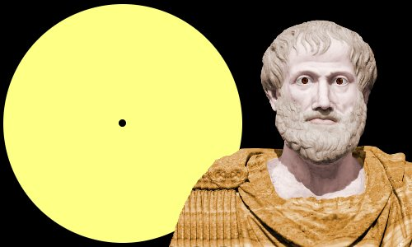

Key Challenges to NLU Researchers
Aristotle founded syllogism, a method by which known information can be used to prove a point.
What are the variables to reason about? Who asks the questions?
  In all of NLP, we have well defined tasks; we collect data & train models
Even in “will we make it to dinner….” the components were given
  And we need to figure out how to estimate them and put it together
  ~~ When did Aristotle die?
  ~~ When was the laptop invented?
  What happened first?
How to do it?
  E.g., how to determine “strategies” on the fly?
How to train for it?
  How can we supervise for these “sparse” events?
So, did Aristotle have a laptop?
[Example due to Les Valiant]

Slide 12


Reasoning
Aristotle: All beliefs come from Syllogism or induction
  Syllogism: reasoning
    We may need to extend Aristotle’s notion of reasoning
There is a lot more to cognitive behavior than induction.
  The notion of generalization is not a mystery any more
    We have mathematical theories for it
    Measure performance relative to the same distribution; computational feasibility & error control;
Reasoning, too, is a major component of cognition.
  It’s essential in order to support larger leaps
  A unified formulation of learning & reasoning will need to
    Account for acquiring and incorporating knowledge
    Figure out ways to put “components” together
    Deal with inconsistencies (by moving to “small worlds”?)
Not a new set of questions [Khardon & Roth, Learning to Reason, JACM’96]
Showed, in a formal way, the advantages of joint learning & reasoning
But, we also need to decouple learning from reasoning, de-compose, and compose
And incorporate knowledge

Slide 13
Knowledge is Key

Slide 14

Knowledge is Key
In Yokne’am, at what month of the year is the longest day?
In New York State, at what month of the year is the longest day?
In Boston, at what month of the year is the longest day?
In Malborne, at what month of the year is the longest day?
We don’t have a generalization theory here, since the examples are not “similar”
  But they are
The relevant knowledge is out there.
  We know many things about NY, Boston, etc.; how do we quickly figure out the relevant piece of knowledge?
  We cannot learn directly from these example –
You probably don’t know the answer

Slide 15
Knowledge is Key
Not only to answer questions
  But also, to know how to decompose
  And consequently, what and how to learn
So, did Aristotle have a laptop?
Did Bill Nye vote for FDR?
Did Warren Buffett vote for FDR?
It’s about Time
Not Only about Time
Did Itzhak Rabin vote for FDR?
Not about Time
In [Geva et al. TACL’21] we develop StrategyQA, a dataset that addresses the question of dynamic, implicit decomposition

Slide 16

Understanding Indirect Answers [with Annie Louis & Filip Radlinski; EMNLP’20]
How to interpret an utterance in a given situational context?
  A: “Have you eaten”
  B: “I am really hungry”
  B: “I had a really small lunch”
“Probably no”
B didn’t answer, but implied that he/she would like to eat
“Probably yes”
B didn’t answer, but implied that he/she would like to eat
Humans have no difficulty resolving such cases and carrying on the conversation
[Elazar et al. EMNLP’21]: training for commonsense knowledge directly does not generalize
[Done in the context of Winograd Schemas]
The exact answer does not matter if the intention is to invite to dinner
Do you want to have dinner?
I have a deadline tomorrow
I have friends coming over
Notes:
That is, generalization is difficult: if you ask: do you want to have dinner and the answer is “I have a deadline tomorrow” or “I have friends coming over”, you are saying ‘no’, but do we need to train for each situation separately?

Slide 17
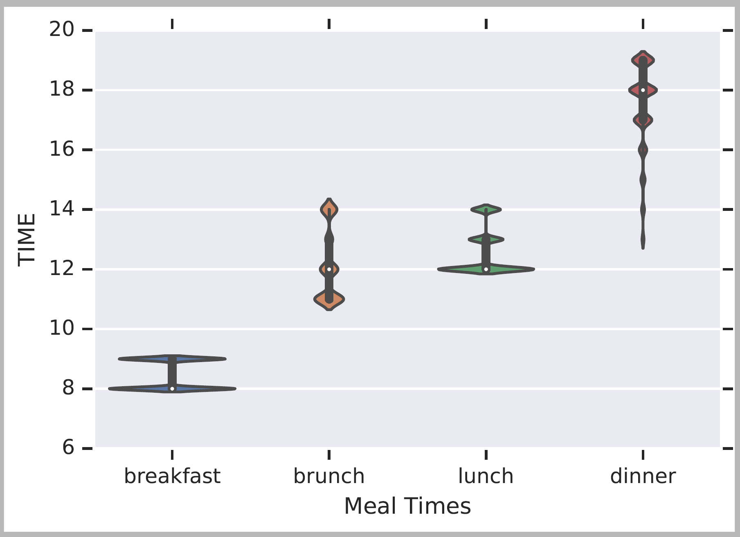

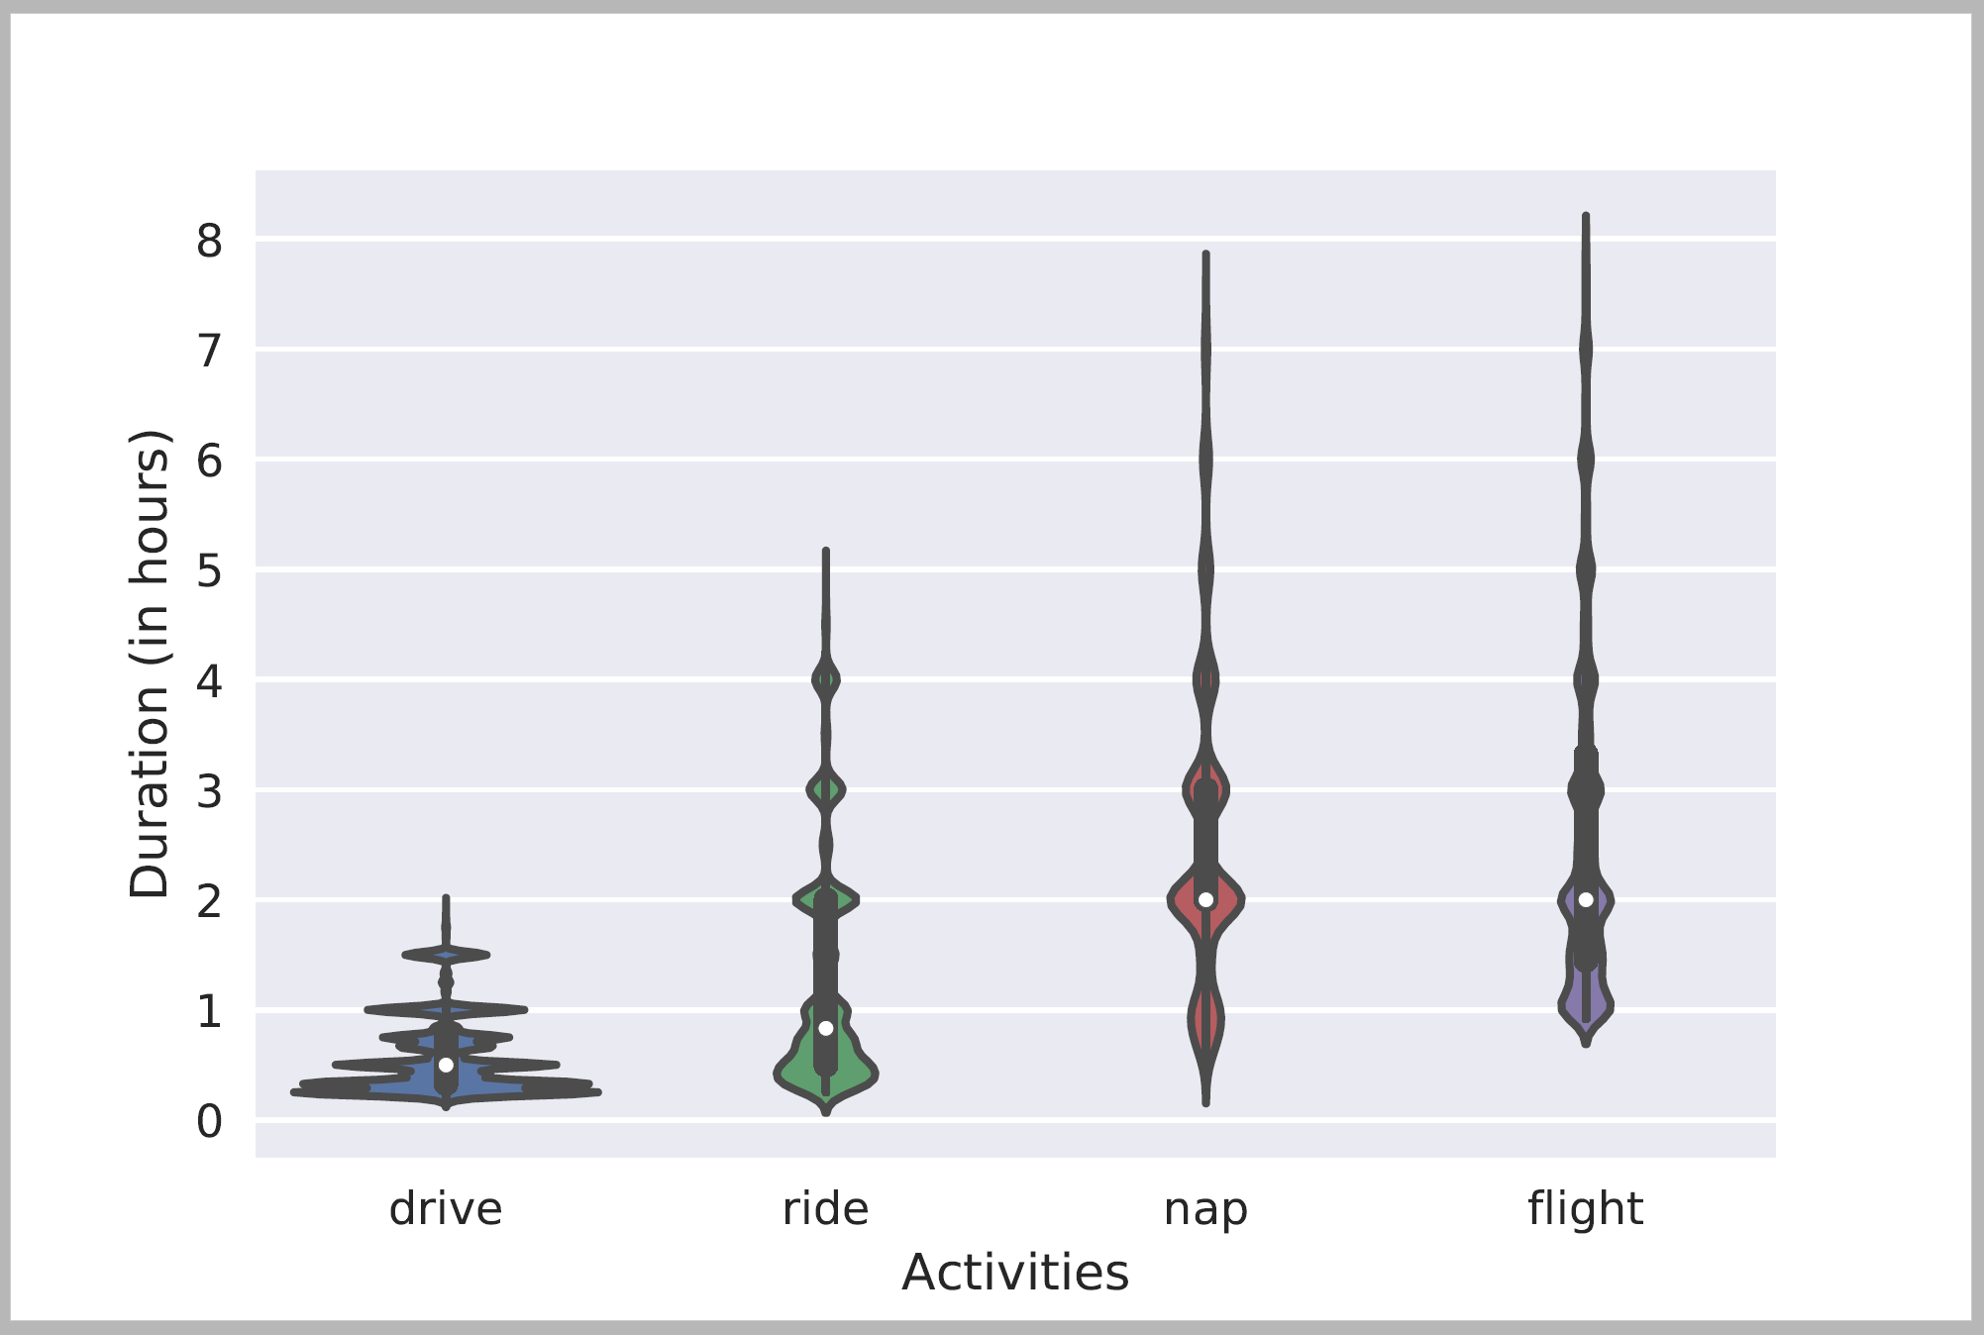
Knowledge About Time
Acquisition + Representation of Quantities, Duration, typical time, frequency.
How to use it – how to put things together?
Will we make it to dinner before the movie?
Typical Time
Typical Temporal Relations
[Zhou et al. ACL’20]
[Ning et al. NAACL’18]
Duration
[Elazar et al. ACL’19], [Zhang EMNLP-F’20]
Notes:
With the “will we make it to dinner example in mind,
I gave a few examples where knowledge is key and in particular, where knowledge about time is important.
Over the last few years we have done a lot of work on trying to acquire commonesense knowledge about time – how long things take, what is the typical time of things, what is a typical order of things? All these are important in a stand-alone way – I need to know

Slide 18
Putting Things Together

Slide 19
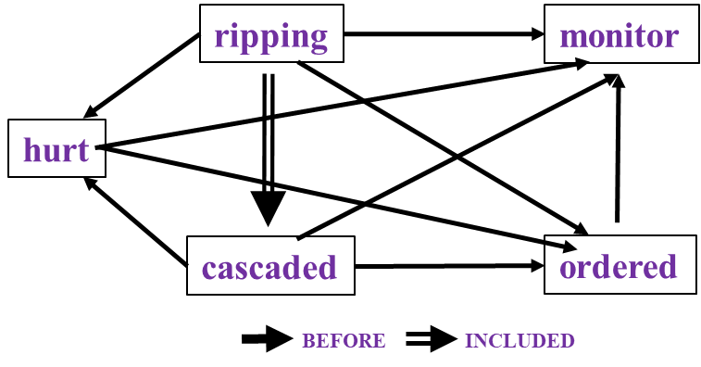
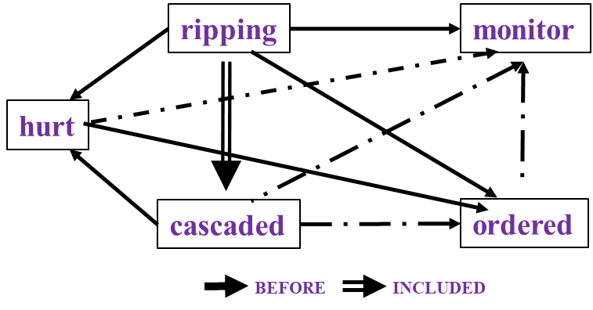

Reasoning about Time and Events
[Ning et al. *SEM’2018; ACL’18, EMNLP’18, EMNLP’19; Wang et al. EMNLP’20]
In Los Angeles that lesson was brought home today when tons of earth cascaded down a hillside, ripping two houses from their foundations. No one was hurt, but firefighters ordered the evacuation of nearby homes and said they'll monitor the shifting ground until March 23rd.
Very difficult task— hinders exhaustive annotation (O(N²) edges)
But, it’s rather easy to get partial annotation (and partial predictions)
And, we have strong expectations from the output
  Transitivity
  Some events tend to precede others, or follow others
Reasoning: How to exploit these [declarative & statistical] “expectations”?
How/why does it impact generalization & supervision?
cascaded
ordered
Time
ripping
Must be before

Slide 20
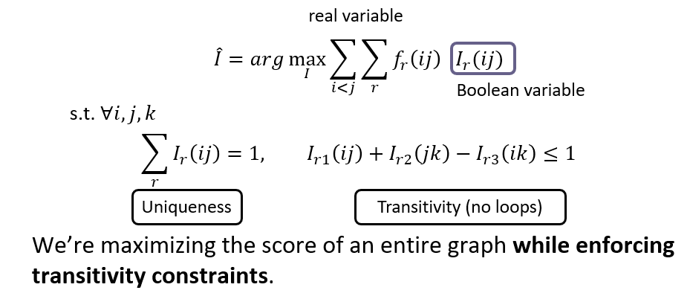
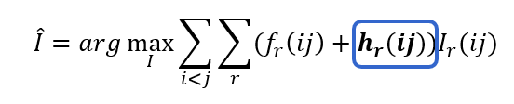
Integer Linear Programming Inference for NLP
Variables are outputs of learned models
Statistical “soft” constrains regularize the objective
Hard constrains
Maximizing the score of the entire graph while enforcing declarative (e.g., transitivity) and statistical constraints.
[Roth & Yih 2004, many others]
Involves reasoning with external knowledge on top of neural models that constitute components (here: temporal relations)
  Declarative knowledge: Transitivity
  Statistical knowledge: Commonsense knowledge
Notes:
One way (but not the only way) to think about putting things together – ordering things, planning things, etc. is to think about it as a constrained optimization problem.
In this case you have an objective function, a learned one, that you want to maximize, but you want to do it subject to knowledge constraints

Slide 21
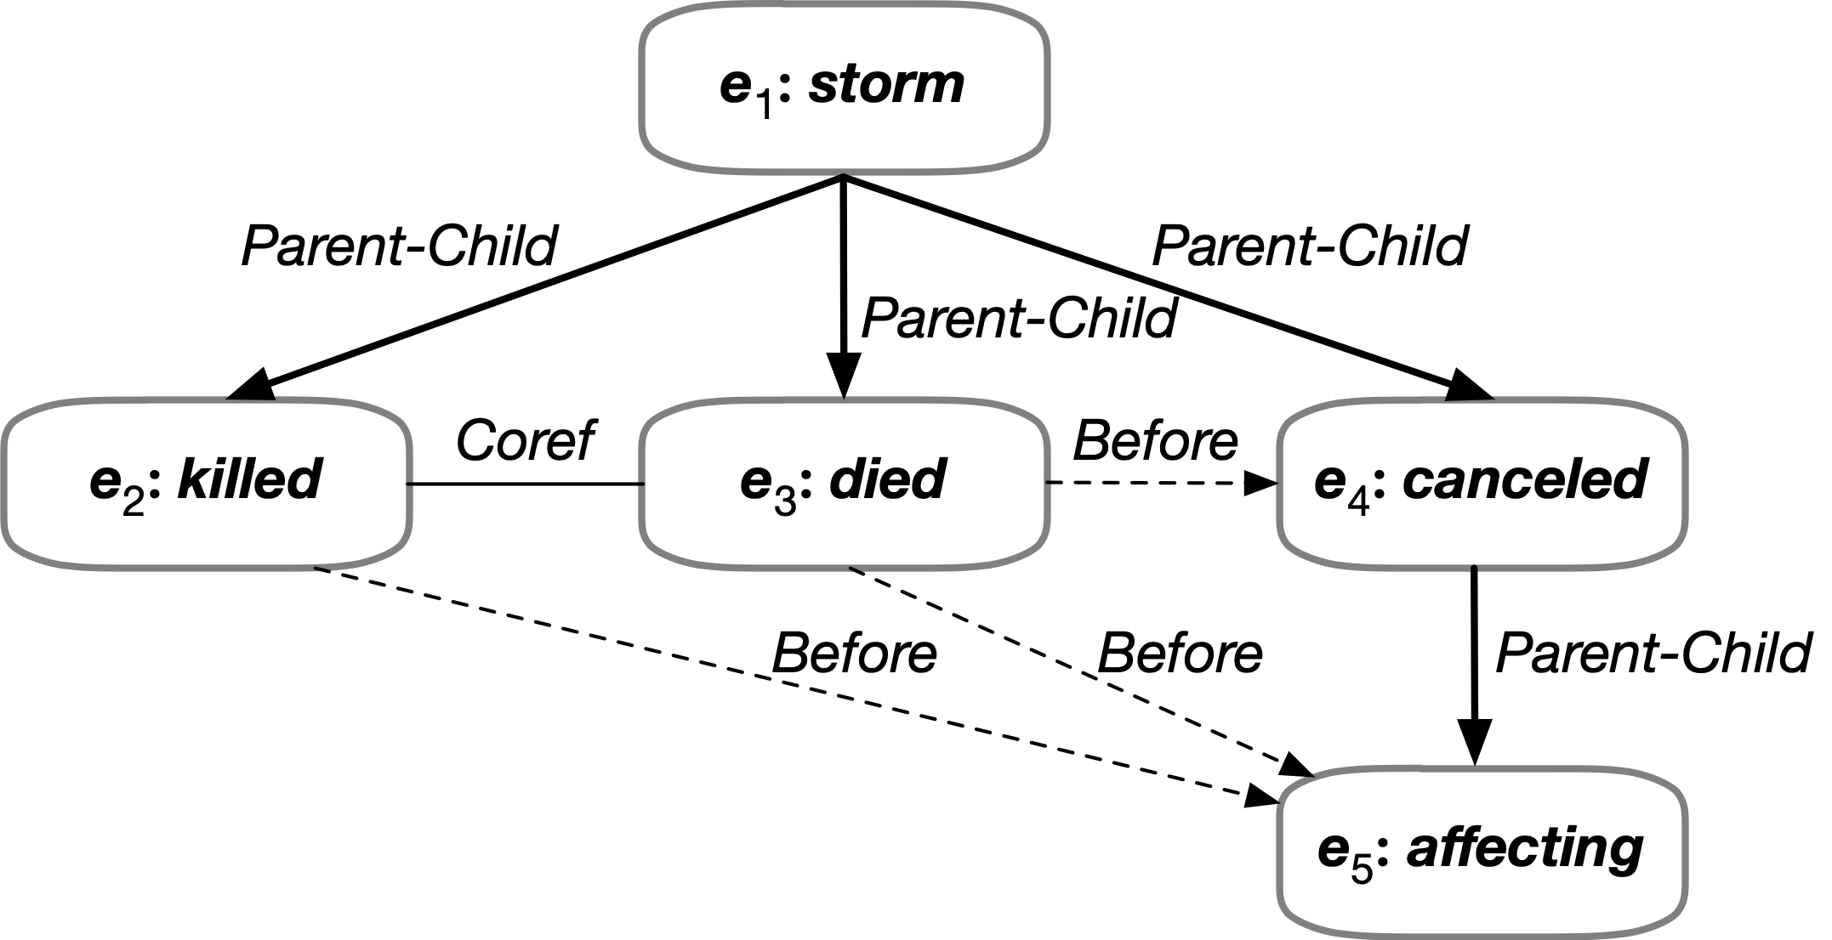

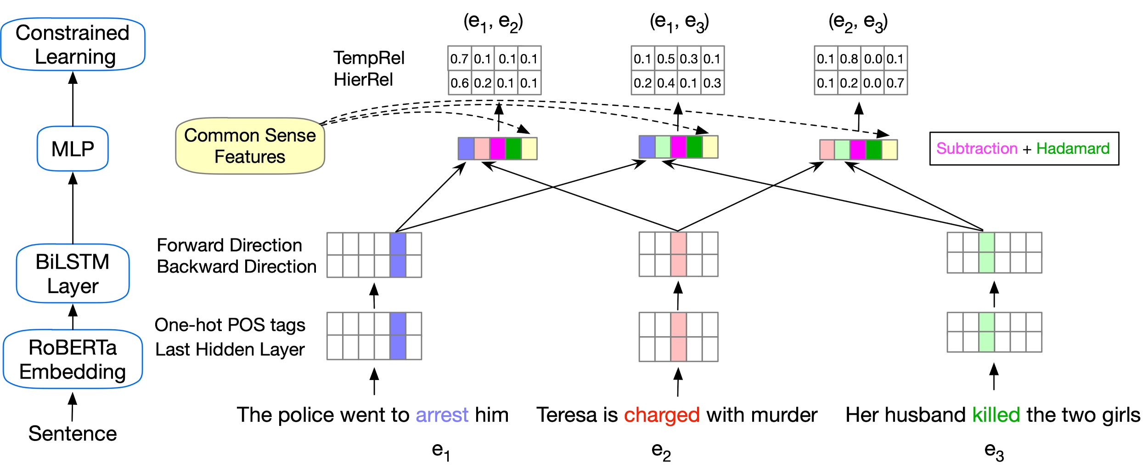
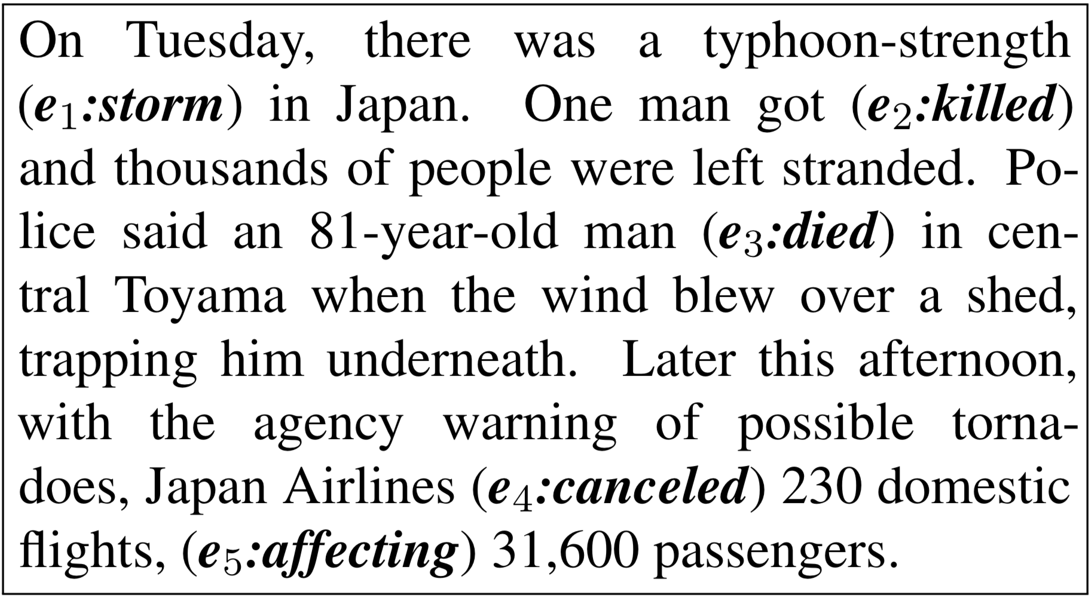
Reasoning about Event Relations [Wang et al. EMNLP’20]
Enforcing logical constraints: Temporal, Symmetry, and Conjunctive by converting declarative constraints into differentiable learning objectives
There are other ways to reason over learned components; quite often these are done via constrained optimization with learned models as variables.
[Zhou et. al NAACL’21]
Temporal Relations
Subevent Relations
Event Coreference
Notes:
This addresses the algorithmic aspect – how can we exploit structure; but is problem specific.
Perhaps even more importantly is the role structure plays in facilitating our learning and reasoning.

Slide 22
Supervision is Key

Slide 23
De-compositions for Reasoning about Text [Gupta et al. ‘18’, ’19, ’20, ’21]
In the first quarter, the Bears Cutler fired a 7-yard TD pass to tight end Greg Olsen. … In the third quarter, the … back Adrian Peterson's 1-yard touchdown run. The Bears increased their lead over the Vikings with Cutler's 2-yard TD pass to tight end Desmond Clark. The gap was reduced when Favre fired a 6-yard TD pass to tight end Visanthe Shiancoe. The Vikings … with Adrian Peterson's second 1-yard TD run. The Bears then responded with Cutler firing a 20-yard TD pass to wide receiver Earl Bennett. The Bears then won on Jay Cutler's game-winning 39-yard TD pass to wide receiver Devin Aromashodu.
Who scored the longest touchdown pass of the game?
Text Comprehension challenges:
  Understand the text
    Identify and contextualize events, entities, quantities (and their scope), relations, etc.
  Understand questions about the text
    Often, requires decomposing the question in a way that depends on the text
  Reason about the text
    Combine and manipulate the identified information to accomplish information needs (e.g., answering questions)
How can we supervise to support this level of understanding?
  Too many (ill-defined) latent decisions
    Annotating text for all is not scalable
  End-task supervision is the only realistic approach
  [Clarke et. al.’10]: Response Driven Semantic Parsing
    But then we insisted on constraining latent layer
  This level of supervision is too loose – how can we learn all the latent decisions from end-task supervision?
She reports worsened seizure frequency, seizures now occurring up to 10/week, in clusters about 2-3 day/week. Previously reported seizures occurring about 2-3 times per month, often around the time of menses,…
What is her seizure frequency?
Mayor Rahm Emanuel has raised more than $10 million toward his bid for a third term – more than five times the total raised by his 10 challengers combined, campaign finance records show.
How much did his challengers raise?
The COVID-19 pandemic in the United States is part of the worldwide pandemic of coronavirus disease 2019 (COVID-19). As of October 2020, there were more than 9,000,000 cases and 230,000 COVID-19-related deaths in the U.S., representing 20% of the world's known COVID-19 deaths, and the most deaths of any country.
Notes:
Finally, I would like to address the question of supervision.
Text comprehension systems introduce a lot of challenges --
We are interested in developing a question answering system that given as input a question and a relevant paragraph of context, produces the correct answer
For example, given the question “Who scored the longest touchdown pass of the game?” and a summary of an American Football game, the model should be able to produce the correct answer

Slide 24
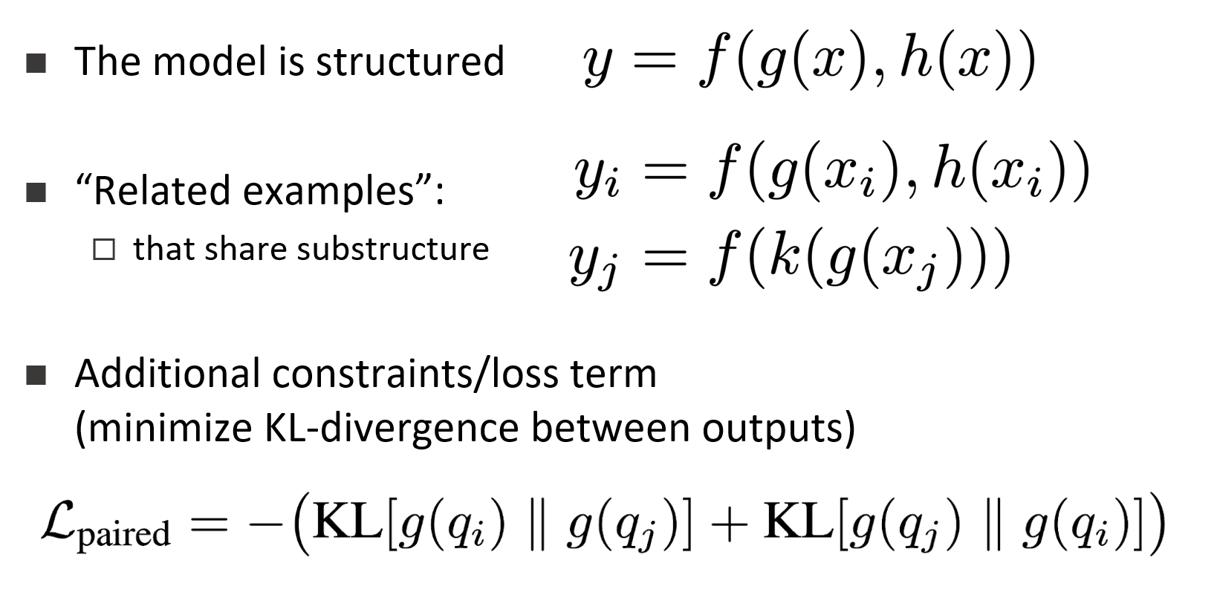
Supervising for Reasoning about Text [Gupta et al. EMNLP’21]
Answering complex questions about events requires learning compositional, structured models, that depend on latent decisions
End-task supervision only provides a weak indirect signal to latent decisions
  When do we learn “touchdown”?
  In fact, also: when do we learn “max”?
Directly teaching the intermediate layers does not scale
Indirect supervision: Dream up other examples that make use of the same “components” provides a way to learn what the variables are.
Who scored the longest touchdown pass of the game?
Who scored the shortest touchdown pass of the game?
In the first quarter, the Bears Cutler fired a 7-yard TD pass to tight end Greg Olsen. … In the third quarter, the … back Adrian Peterson's 1-yard touchdown run. The Bears increased their lead over the Vikings with Cutler's 2-yard TD pass to tight end Desmond Clark. The Vikings … with Favre firing a 6-yard TD pass to tight end Visanthe Shiancoe. The Vikings … with Adrian Peterson's second 1-yard TD run. The Bears then responded with Cutler firing a 20-yard TD pass to wide receiver Earl Bennett. The Bears then won on Jay Cutler's game-winning 39-yard TD pass to wide receiver Devin Aromashodu.
How many touchdowns were scored?
How long was the longest touchdown?
Notes:
The answer it is that we train ourselves – but that requires reasoning abilities.
We can ask ourselves questions that are similar enough to those for which we know the answer to, and use it to train ourselves for intermediate stages.

Slide 25
Making decisions that rely on local predictions driven by different models trained in different ways, at different times/conditions/scenarios

Slide 26
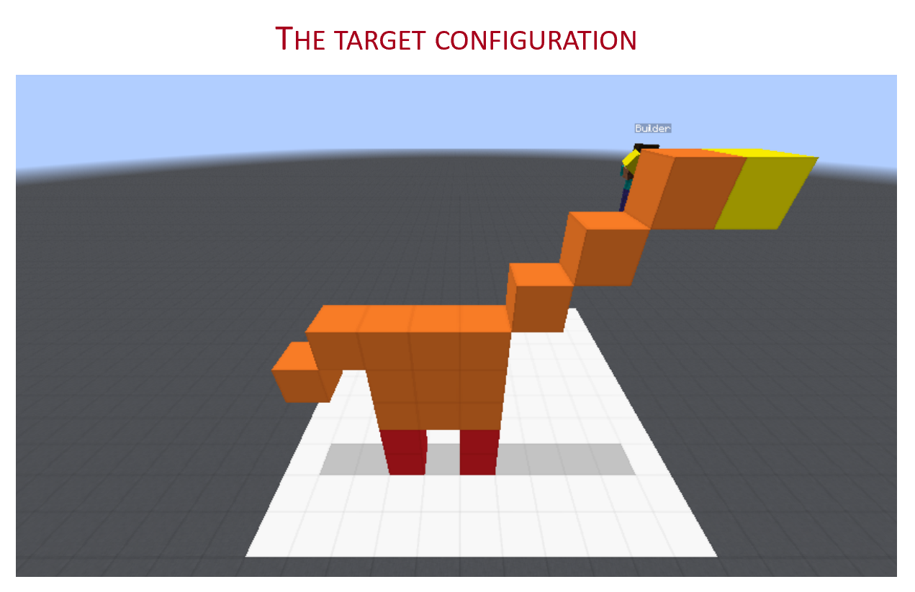
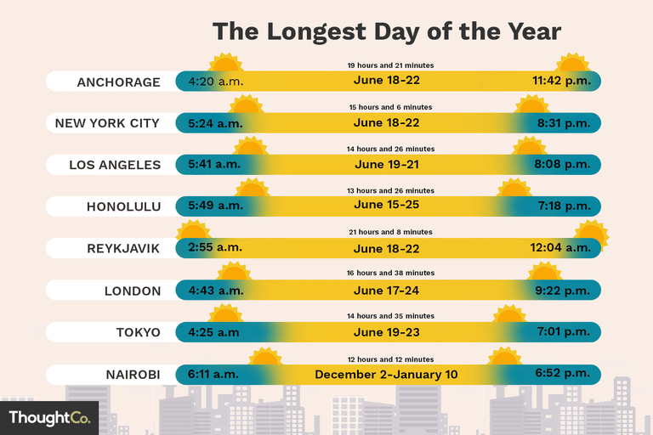

Conclusion
Thank You!
We must think more about reasoning
Our theories for learning are good for many things
  But aren’t sufficient to deal with the sparse, interesting world
  A theory of Reasoning is needed in order to handle it
Keys include:
  Knowledge
  Compositionality: how to decompose and how to put things together
  How to supervise with incidental supervision signals (those that are unrelated to the task at hand)
These are not the only issues to address in our journey to advance natural language understanding and natural communication skills; but these are core issues that underlie many important topics.

Slide 27
End

