Slide 1








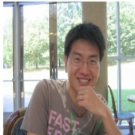











Incidental Supervision for
Natural Language Understanding
Illinois
Dan Roth
Computer and Information Science
University of Pennsylvania
Fudan Data Science Conference
Shanghai, China
December 2018
Notes:
Title

Slide 2
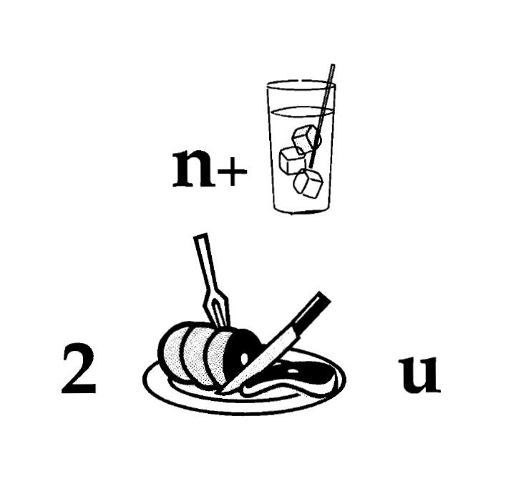
Nice to Meet You
Identify units
Consider multiple
representations and
interpretations
  Pictures, text, layout, spelling, phonetics
Put it all together:
  Determine “best” global interpretation
Satisfy expectations
  Slide; puzzle

Slide 3
Natural Language Understanding
Expectation is a knowledge intensive component
Natural language understanding decisions are global decisions that require
  Making (local) predictions driven by different models trained in different ways, at different times/conditions/scenarios
  The ability to put these predictions together coherently
  Knowledge, that guides the decisions so they satisfy our expectations
Natural Language Interpretation is an Inference Process that is best thought of as a knowledge-constrained optimization problem, done on top of multiple statistically learned models.
Notes:
3
Give examples for what’s not abductive reasoning
Focus on abductive reasoning
Show the formulation – talk about the boxes
Talk about multiple ways of training – decoupling – relate to abstraction
Examples: semantic parsing (do verb + Prep + commas together; lack of jointly annotated data)
Wikification – Relations (but also add geographical coherence; topical coherence; all interrelated signal that are acquired at different times, different contexts, etc.

Slide 4
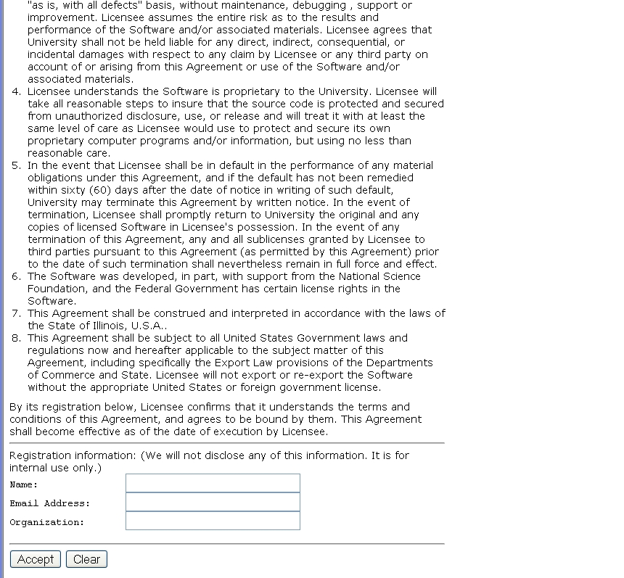
A view On Extracting Meaning from Unstructured Text
A Contract
[Data→ Meaning] Transformation
Large Scale & Scientifically Challenging
(and distinguish from other candidates)
Does it say that they will:
Give my email address away?
Log my activity
……
ACCEPT?
ACCEPT
Notes:
This is a collection of different problems of ambiguity resolution - from text correction –
Sorry, it was too tempting to use this one…
Word sense disambiguation, part of speech tagging to a decision that involves a decision across sentence
All these are essentially the same classification problem – and with progress in learning theory and NLP
We have pretty reliable solutions to these today.
Here are a few more problems of this kind.

Slide 5
Why is it Difficult?
Meaning
Variability
Ambiguity
Language

Slide 6


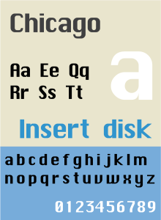



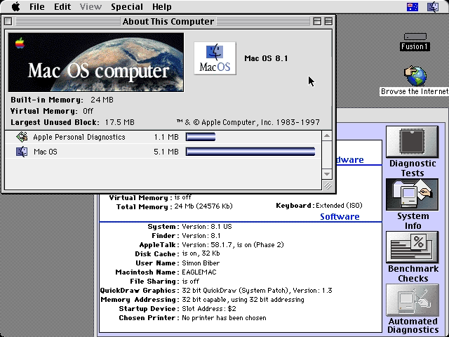
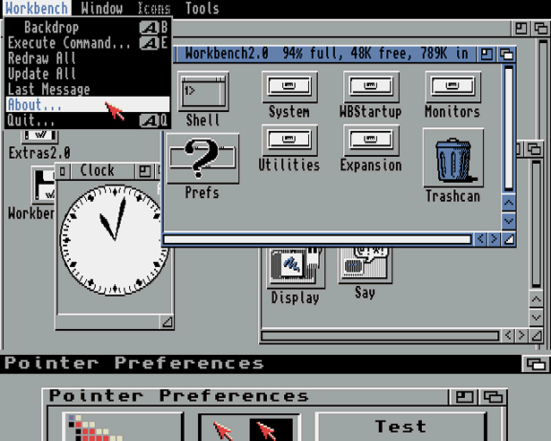
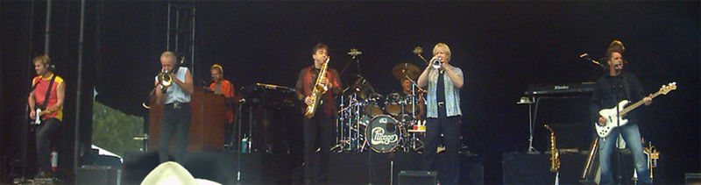
Ambiguity
It’s a version of Chicago – the standard classic Macintosh menu font, with that distinctive thick diagonal in the ”N”.
Chicago was used by default for Mac menus through MacOS 7.6, and OS 8 was released mid-1997..
Chicago VIII was one of the early 70s-era Chicago albums to catch my
ear, along with Chicago II.

Slide 7

Variability in Natural Language Expressions
Determine if Jim Carpenter works for the government
Jim Carpenter works for the U.S. Government.
The American government employed Jim Carpenter.
Jim Carpenter was fired by the US Government.
Jim Carpenter worked in a number of important positions. …. As a press liaison for the IRS, he made contacts in the white house.
Russian interior minister Yevgeny Topolov met yesterday with his US counterpart, Jim Carpenter.
Former US Secretary of Defense Jim Carpenter spoke today…
Standard techniques cannot deal with the variability of expressing meaning
nor with the
ambiguity of interpretation
  Needs:
  Understanding Relations, Entities and Semantic Classes
  Acquiring knowledge from external resources; representing knowledge
  Identifying, disambiguating & tracking entities, events, etc.
  Time, quantities, processes…
Notes:
7

Slide 8

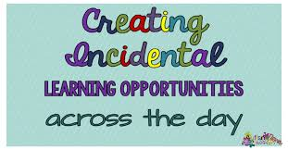
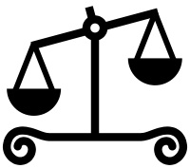
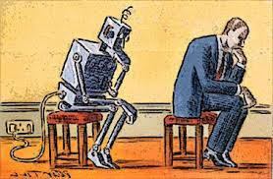
What’s Important?
Learning and Reasoning in the Presence of Knowledge.
  Combining the “soft” with the logical/declarative
Scaling Up
Computational & #(phenomena)
Knowledge is essential for effective Machine Learning
Training Models
  With Incidental Supervision
Notes:
In a more abstract way : My research span all these aspects & more; but I’ll focus on providing a framework, present some examples, and some recent, exciting results towards the end.
8

Slide 9
Inducing Semantics
Inducing semantic representations and making decisions that depend on it require learning and, in turn, supervision.
Standard machine learning methodology:
  Given a task
  Collect data for the task and annotate it
  Learn a model [doesn’t matter how]
We will never have enough annotated data to train all the models, for all the tasks we need, this way.
  We don’t even know what are “all the tasks”
  Most of what we learn we don’t learn by “training” on many examples
This methodology is not scalable and, often, makes no sense
  Annotating for complex tasks is difficult, costly, and sometimes impossible.
    When an intermediate representation is ill-defined, but the outcome is
    E.g., think about events
In most interesting cases, learning should be (and is) driven by incidental supervision [Roth AAAI’17]
Notes:
Key challenge, to facilitate reasoning, is to induce semantics

Slide 10
Incidental Supervision
Data provides hints
  These are often sufficient to infer supervision signals for a range of tasks.
  Data exists independent of the task(s) at hand.
Utilizing these hints
  Can be substantially less costly than producing explicit annotation
  More realistic – provides signals for tasks we haven’t defined
  Weak signals can be amplified to produce higher quality signals
  The strength of the incidental signals is a function of our expectations.
Notes:
Key challenge, to facilitate reasoning, is to induce semantics

Slide 11
Incidental Supervision & Reasoning
O’Hare must be in Chicago
O’Hare must be in Chicago
Feb 5 2017 Dozens of passengers heading to Chicago had to undergo additional screenings… It took Hesam Aamyab two tries to make it back to the United States from Iran. He is an Iranian citizen with a US visa who is doing post-doctoral research at UIC. …"Right now, I am in the USA and I'm very happy," Aamyab said. But now, he can't go back to Iran or anywhere else without risk. Other travelers shared the same worry. Asem Aleisawi was at O'Hare on Sunday to meet his wife who was coming in from Jordan.
  Learning/Supervision requires some level of reasoning to infer these weak signals

Slide 12
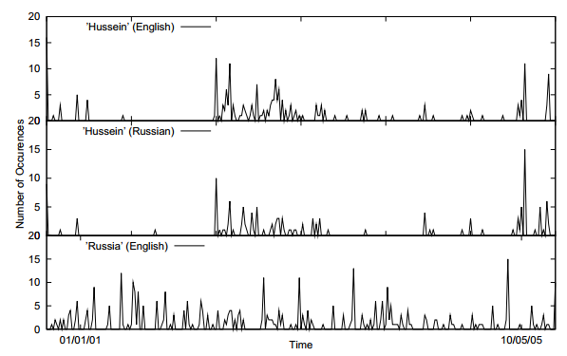
Incidental Supervision Signals
Supervision could be incidental, in the sense that it makes use of signals that are out there, and might be co-related to the target task.
Searching for supervision signals could be challenging.
Temporal histograms
Assume a comparable, weakly temporally aligned news feeds.
Hussein (English)
Transliteration: How to write “Hussein” in Russian?
Hussein (Russian)
Weak synchronicity provides a cue about the relatedness of (some) NEs across the languages, and can be exploited to associate them
[Klementiev & Roth, 06,08]
Germany (English)
Notes:
If I want to solve this transliteration task, I need examples; but I don’t need anyone to label many for me.
But I did not learn it this way – I learned from a few examples, that were not annotated, but for various reasons, I was pretty sure were pretty good….
I could make the observation, that if one looks at comparable news articles from about the same time, the key entities they cover are the same, and they occur with about the same temporal frequency.
Start with labeling
Then transliteration
Then psychology
Then semantic parsing
(Emphasize that this requires reasoning)
End with the example of reasoning in learning (Chicago)

Slide 13
Incidental Supervision Signals
Need an inference mechanism that supports combining signals/models
By itself, this temporal signal may not be sufficient to support learning robust models.
Along with weak phonetic signals, context, topics, etc. it can be used to get robust models.
Temporal histograms
Assume a comparable, weakly temporally aligned news feeds.
Hussein (English)
Hussein (Russian)
Weak synchronicity provides a cue about the relatedness of (some) NEs across the languages, and can be exploited to associate them
[Klementiev & Roth, 06,08]
Russia (English)

Slide 14
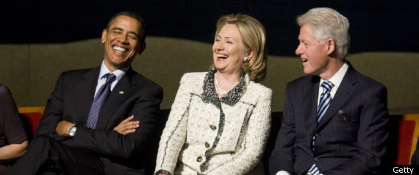
Simpler Ideas
A gender classifier
  Or maybe just a list of names classified by gender
    Name → Male/Female
  Option one: annotate
  Option two: Use all People’s Wikipedia page
    Count gender pronouns in the first paragraph; decide gender by majority
Images
  Difficult to label objects
  Easy to learn same/different
    Two objects in the same image are different
    Two consecutive video frames are likely to contain the same object.
Recent work showing the importance of pre-training [Elmo, Bert] begins to pursue the same direction.
Notes:
Give the gender example;
Give a vision example?
Key challenge, to facilitate reasoning, is to induce semantics

Slide 15
Incidental Supervision
Data provides hints
  These are often sufficient to infer supervision signals for a range of tasks.
  Data exists independent of the task(s) at hand.
(1) Representations
  Often, making prediction is all about representing knowledge
(2) Signals and Structures
  Exploiting weak signals and putting them together via structural expectations
(3) Behavioral Level Feedback
  It’s End-to-End, but with behavioral level feedback
I will present a few new and old research results from the incidental supervision angle.
Initial thoughts towards a theory for Incidental Supervision
Notes:
Give the gender example;
Give a vision example?
Key challenge, to facilitate reasoning, is to induce semantics

Slide 16
Text Classification
A lot of the work in NLP can still be viewed as text classification
  Categorization into topics
  Identify intention of text
  Identify abusing text
  Classify fact/opinion
  ……
While you understand the labels, models are not given information about the labels
We simply view this work as multi-class classification
The only thing that has changed since the 70-ies is slightly better learning algorithms, and slightly better word representations
Broad use of embeddings!
But almost no use of task/label understanding.
We just rely on supervision.
Promote Label-Aware Models

Slide 17
Text Categorization
Is it possible to map a document to an entry in a taxonomy of semantic categories, without training with labeled data?
The route for a return to No. 1 in the Emirates ATP Rankings is paved for Rafael Nadal and Roger Federer at next week’s Western & Southern Open. Andy Murray will relinquish top spot to one of the two in Cincinnati and if it is the Swiss who goes on to win the Coupe Rogers this week in Montreal, he would clinch World No. 1 with an equal or better finish than the Spaniard next week.
It’s about Sport
It’s about Tennis
Traditional text categorization requires training a classifier over a set of labeled documents (1,2,….k)
Someone needs to label the data (costly)
All your model knows is to classify into these given labels
Total costs for on-the-job health care benefits are expected to rise an average of 5% in 2018, surpassing $14,000 a year per employee, according to a National Business Group on Health survey of large employers. Specialty drugs continue to be the top driver of increasing costs. Companies will pick up nearly 70% of the tab, but employees must still bear about 30%, or roughly $4,400, on average.
It’s about Money
It’s about Health Care
You can do it, since you have an “understanding” of the labels

Slide 18
Categorization without Labeled Data [AAAI’08, AAAI’14, IJCAI’16]
This is not an unsupervised learning scenario. Unsupervised learning assumes a coherent collection of data points, where similar data points are assigned similar labels. It does not work on a single document. Related (but not identical) to 0/1-shot learning.
Given:
  A single document (or: a collection of documents)
  A taxonomy of categories into which we want to classify the documents
Dataless/Zero-Shot procedure:
  Let f(l_{i}) be the semantic representation of the labels (label descriptions)
  Let f(d) be the semantic representation of a document
  Select the most appropriate category:
  l_{i}* = argmin_{i} dist (f(l_{i}) - f(d))
  Bootstrap
    Label the most confident documents; use this to train a model.
Key Question:
  How to generate good Semantic Representations?
Originally:
  Task Independent Representations: best results with Wikipedia-based (ESA)
  Recently: augmented with task specific representations
Hard to beat

Slide 19
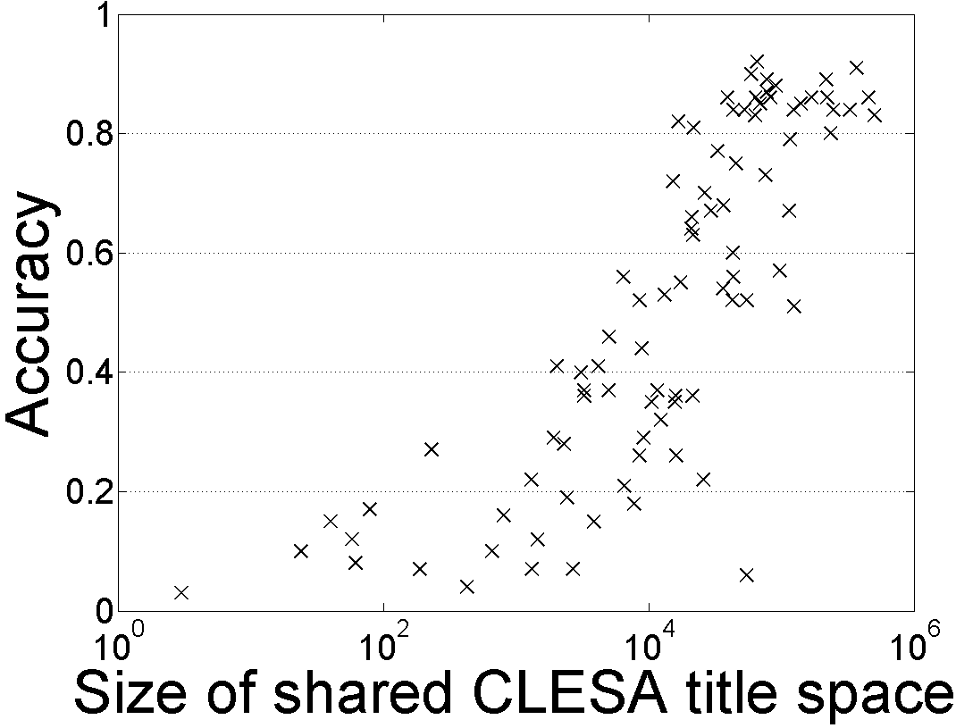
Single Document Classification (88 Language) [Song et. al. IJCAI’16]
Can be done to all 293 languages represented in Wikipedia
Performance depends on the Wikipedia size (Cross-language links)
Dataless classification for English
Accuracy
Hausa
Hindi
Size of shared English-Language L title space

Slide 20
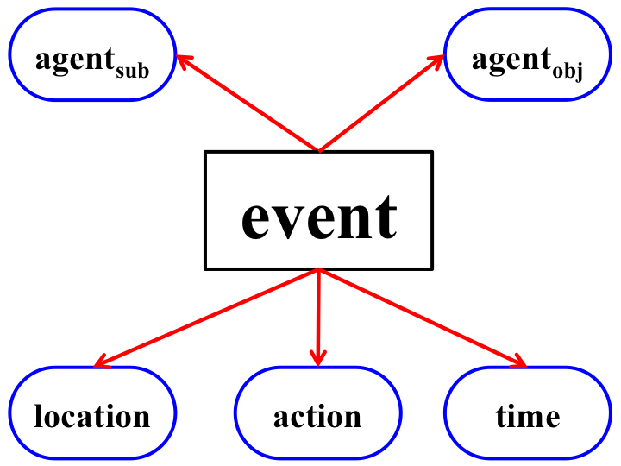
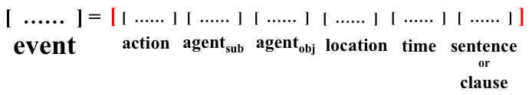
Representations for an Event Pipeline [Peng et al. EMNLP’16]
Multiclass classification into a small taxonomy.
Lack of data
Over 300 police officers were fanning out to track down the assailants who attacked Moscow tourists in the Russian city of Nizhny Novgorod, RIA Novosti news agency reported Sunday.
Event representations are structured
  We use Semantic Role Labeling (SRL) to guide this aspect.
  Type classification: zero-shot: via type definitions or proto-types
Events are represent by concatenating event components
  Explicit Semantic Analysis, Brown Clusters, Embeddings, etc.
Type: Conflict.Attack

Slide 21
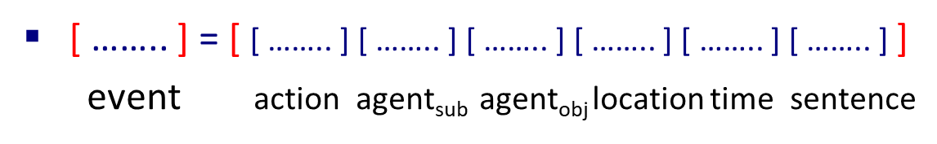
Zero-shot Event Co-reference [Peng et al. EMNLP’16]
Best 1st co-reference algorithm
  Consider each mention from left to right
  cos(v(e_{i}), v(e_{j})) as the similarity between events
  Choose the antecedent with highest similarity or start a new cluster
Domain Transfer Results
Performance across domains is significantly better than supervised methods
  Metric: CoNLL scores
Dataset: TAC-KBP-15
Within domain
Across domain
0-shot Supervised

Slide 22
Representation: Learning from Task Independent Resources
This learning protocol relies on the ability to induce good semantic representations.
Semantic representations could be learned using existing signals, independently of the task at hand.
  (Multilingual) Text Categorization
  Event Detection and Co-reference
    Requires more involved representations
  Wikification/EDL
  Relation identification
    Using definitions of concepts and relations between them [*SEM’18]
  Open Domain Zero-Shot Entity Typing (coarse and fine)
    Represent context – identify “known” entities with type-compatible contexts
    Using ELMo + ESA
In all cases – key benefits are shown in adaptation
Broad use of embeddings!
But almost no use of task/label understanding.
We just rely on supervision.
Promote Label-Aware Models
[AAAI’08, AAAI’14, IJCAI’16]

Slide 23
Open Entity Typing
The importance of semantic typing goes much beyond the application of NER. It’s a very useful abstraction for many semantic tasks.
Given (1) sentence, (2) mention, (3) target taxonomy
Label the mention with a set of types from the taxonomy.
  UW: /organization, /organization/education_institution
  Department of Chemistry: /organization, /education, /education/department
  AAAS: /organization
  Bruce Robinson: /Person/Scientist
A handful of professors in the UW Department of Chemistry are being recognized by the American Association for the Advancement of Science (AAAS) for their efforts and contributions to the scientific community .
Bruce Robinson is a theorist and spectroscopist, who
has been contributing to the field for the past 40 years.
Bruce Robinson

Slide 24
Data Sets: Entity (Fine) Typing
FIGER (Ling & Weld, 2012)
  37 Coarse Types, 75 Fine Types
  Test Set: 563 manually annotated mentions
BBN (Weischedel & Brunstein, 2005)
  16 Coarse Types, 41 Fine Types
  Test Set: 13k manually annotated mentions
  Major difference: No fine types for “/person”
Medical…
  Many data sets
Multiple datasets for coarse typing (NER)

Slide 25
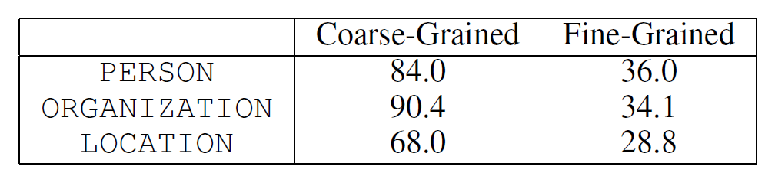
Related Work: Entity Fine Typing
Most training is based on distant supervision (using freebase). But this way “Obama” will always be trained as a politician even when the context discusses him as a parent
 | Use training? | Zero-shot? | Use annotated data with the target Taxonomy? | Results on FIGER? | Results on BBN?
Xu & Barbosa 2018 | Yes | No | Yes | Yes | No
Abhishek et al. 2017 | Yes | No | Yes | Yes | Yes
Shimaoka et al. 2016 | Yes | No | Yes | Yes | Yes
Ren et al. 2016 | Yes | No | Yes (distant) | Yes | Yes
Yuan & Downey 2018 | Yes | Label Word Embedding | Partial | Yes | No
Ma et al. 2016 | Yes | Label Prototype Embedding | Partial | Yes | Yes
Ours | No | Wikipedia Instantiation | No | Yes | Yes
Fine Typing is very different from Coarse Typing
Percentage of instances in which the type can
be inferred purely from context, (mention hidden), according to human annotators.
We need to know more!
And know whether we know…
Notes:
Xu & Barbosa 2018, “Neural Fine-Grained Entity Type Classification with Hierarchy-Aware Loss”
Focus on filter out the training noise
Abhishek et al. 2017, “Fine-Grained Entity Type Classification by Jointly Learning Representations and Label Embeddings”
Jointly learns mention and type representations
Shimaoka et al. 2016, “An attentive Neural Architecture for Fine-grained Entity Type Classification”
Attention based model
Yogatama et al. 2015, “Embedding Methods for Fine Grained Entity Type Classification”
Yuan & Downey 2018, “OTyper: A Neural Architecture for Open Named Entity Typing”
Supervised system
Works on open label set, if some similar labels are seen in the training set
Ma et al. 2016, “Label Embedding for Zero-shot Fine-grained Named Entity Typing”
Huang et al. 2016, “Building a Fine-Grained Entity Typing System Overnight for a New X (X = Language, Domain, Genre)

Slide 26
Zero-Shot Open Typing [Zhou et al. EMNLP’18]
Coarse/Fine typing of noun phrases
Zero-shot: No task specific training
Open: Classifies into a given taxonomy—transfer
Input: sentence, mention, target taxonomy
  Nodes defined in terms of Freebase taxonomy
Output: a set of types in the target taxonomy the mention belongs to
Resources:
  WikiLinks (ESA Representations)
  Pre-trained ELMo model
  Wikipedia surface-title probabilities: Pr(Title/Surface)

Slide 27
Key Notion: Label-Awareness via Type Compatibility
I know what a politician is since I know many politicians
Types are conceptual containers that bind entities together to form a coherent group.
Two entities are type-compatible, if they share at least one type with respect to a type taxonomy.
Approach: Given a mention in a sentence, we discover (several) type-compatible entities in Wikipedia and then infer the mention’s types using all the type-compatible entities together.
Again, Wikipedia provides rich information that allows one to infer types easily (even for entities outside Wikipedia)
Label-Aware: We define type as a collection of entities having this type; representatives for a type are chosen adaptively, given text.

Slide 28
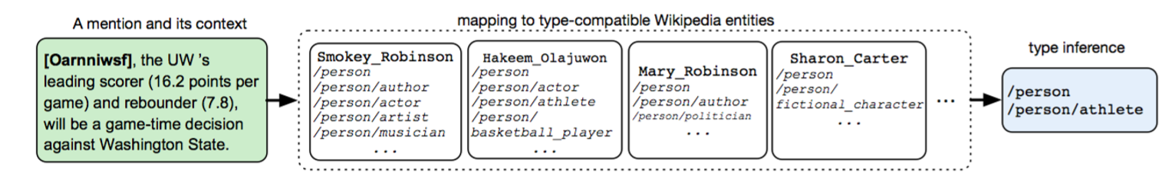
Zero-Shot Open Typing: Intuition
If the entity happens to be well known
  The Wikipedia priors are likely to identify it, and determine its type
Whether it is known or not,
  Context consistency will allow us to determine good candidates for type compatibility
High Level Algorithm:
Consider P(Concept |Surface) to generate a (strong) candidate
Use ESA to map mentions to candidate Wikipedia concepts (titles)
Rank candidate titles by similarity of context.
  Makes use of ELMo for mention aware representation of text.

Slide 29
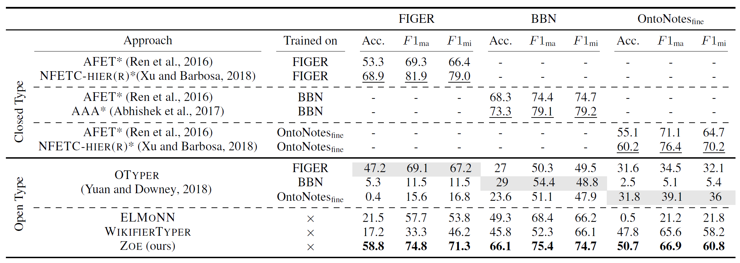
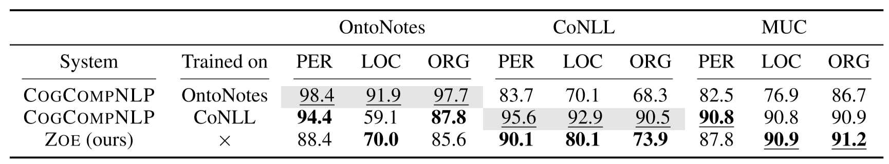
Fine typing
In all cases, the key thing to notice that this label-aware zero-shot approach leads to the ability to transfer across domains/taxonomies
29
Coarse typing

Slide 30
Incidental Supervision
Data provides hints
  These are often sufficient to infer supervision signals for a range of tasks.
  Data exists independent of the task(s) at hand.
(1) Representations
  Often, making prediction is all about representing knowledge
(2) Signals and Structures
  Exploiting weak signals and putting them together via structural expectations
(3) Behavioral Level Feedback
  It’s End-to-End, but with behavioral level feedback
Notes:
Give the gender example;
Give a vision example?
Key challenge, to facilitate reasoning, is to induce semantics

Slide 31
Signals and Structures
I have presented many cases where there are signals that are co-related with the task at hand, and argued that we can use it to replace supervision.
Is this an art? Can we develop a theory that supports it?
In many problems it’s easy to get some good signals
  High Precision annotation
But difficult to get exhaustive annotation
  Low recall
I will show that this is often good enough, and why
  In the context of partial annotation of structures.

Slide 32
NER in Low Resource Languages: Partial Annotation
Easy to get some lists and even help from non-native speakers.
ebisi’ra giliyyaana phinnddale aaja pyaalestaaina adhiinastha
gaajaa theke aaja raate ekhabara jaaniyyechhena .
  ABC’s Gillian Findale has reported from Gaza under Palestine today.
Non native speakers can provide low-recall, high-precision annotation
But, we have strong expectations from the output!
  Immediate neighbors of an entity are non-entities.
  Punctuations, numbers are non-entities
  Names have low frequency
  Ratio of entities to non-entities is quite stable across languages
    b = |E|/(|N| + |E|) ~~ 10% +/- 5% [Augenstein et al, 2017]
Expectations from the output → constraints on the unknown annotations
Notes:
Romanized Bengalli

Slide 33
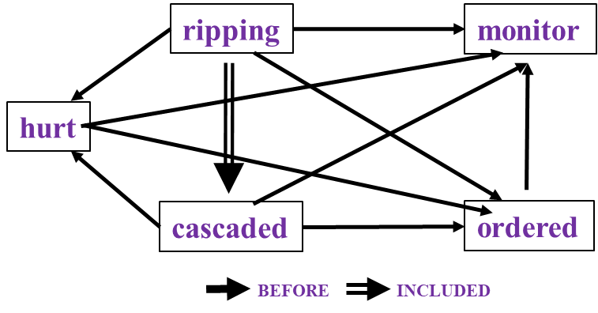
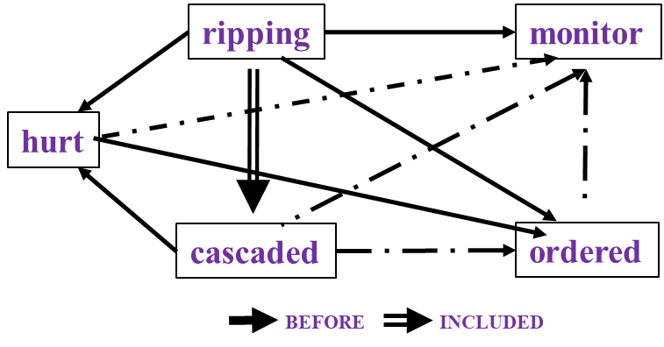
Temporal Relation Extraction [Qiang et al. *SEM’2018; EMNLP’18 Demo]
Two key questions: (i) Impact on level of supervision needed.
(ii) Algorithmic Approach: how to gain from it?
In Los Angeles that lesson was brought home today when tons of earth cascaded down a hillside, ripping two houses from their foundations. No one was hurt, but firefighters ordered the evacuation of nearby homes and said they'll monitor the shifting ground until March 23rd.
Very difficult task— hinders exhaustive annotation (O(N²) edges)
But, it’s rather easy to get partial annotation – some relations.
And, we have strong expectations from the output
  Transitivity
  Some events tend to precede others, or follow others [NAACL’18]

Slide 34
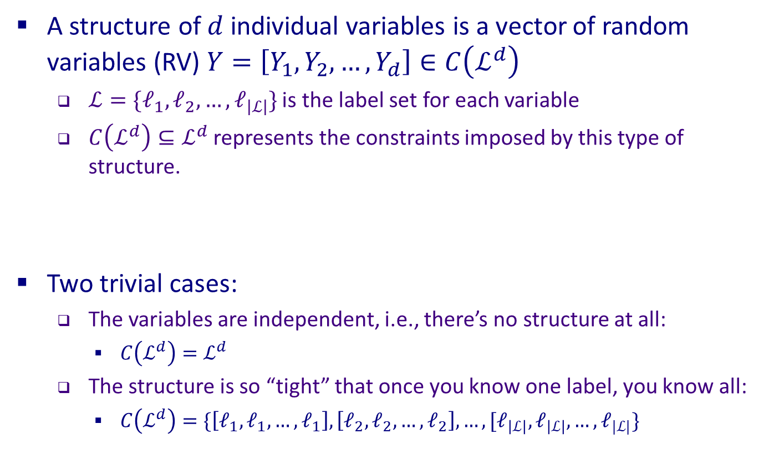
Structure
Constrained output; not all options are possible.
A structure of $d$ individual variables is a vector of random variables (RV) $Y=\left[Y_{1},Y_{2},…,Y_{d}\right]∈C\left(ℒ^{d}\right)$
  $ℒ=\{ℓ_{1},ℓ_{2},…,ℓ_{\left|ℒ\right|}\}$ is the label set for each variable
  $C\left(ℒ^{d}\right)⊆ℒ^{d}$ represents the constraints imposed by this type of structure.
Two trivial cases:
  The variables are independent, i.e., there’s no structure at all:
    $C\left(ℒ^{d}\right)=ℒ^{d}$
  The structure is so “tight” that once you know one label, you know all:
    $C\left(ℒ^{d}\right)=\{\left[ℓ_{1},ℓ_{1},…,ℓ_{1}\right],\left[ℓ_{2},ℓ_{2},…,ℓ_{2}\right],…,[ℓ_{\left|ℒ\right|},ℓ_{\left|ℒ\right|},…,ℓ_{|ℒ|}\}$

Slide 35
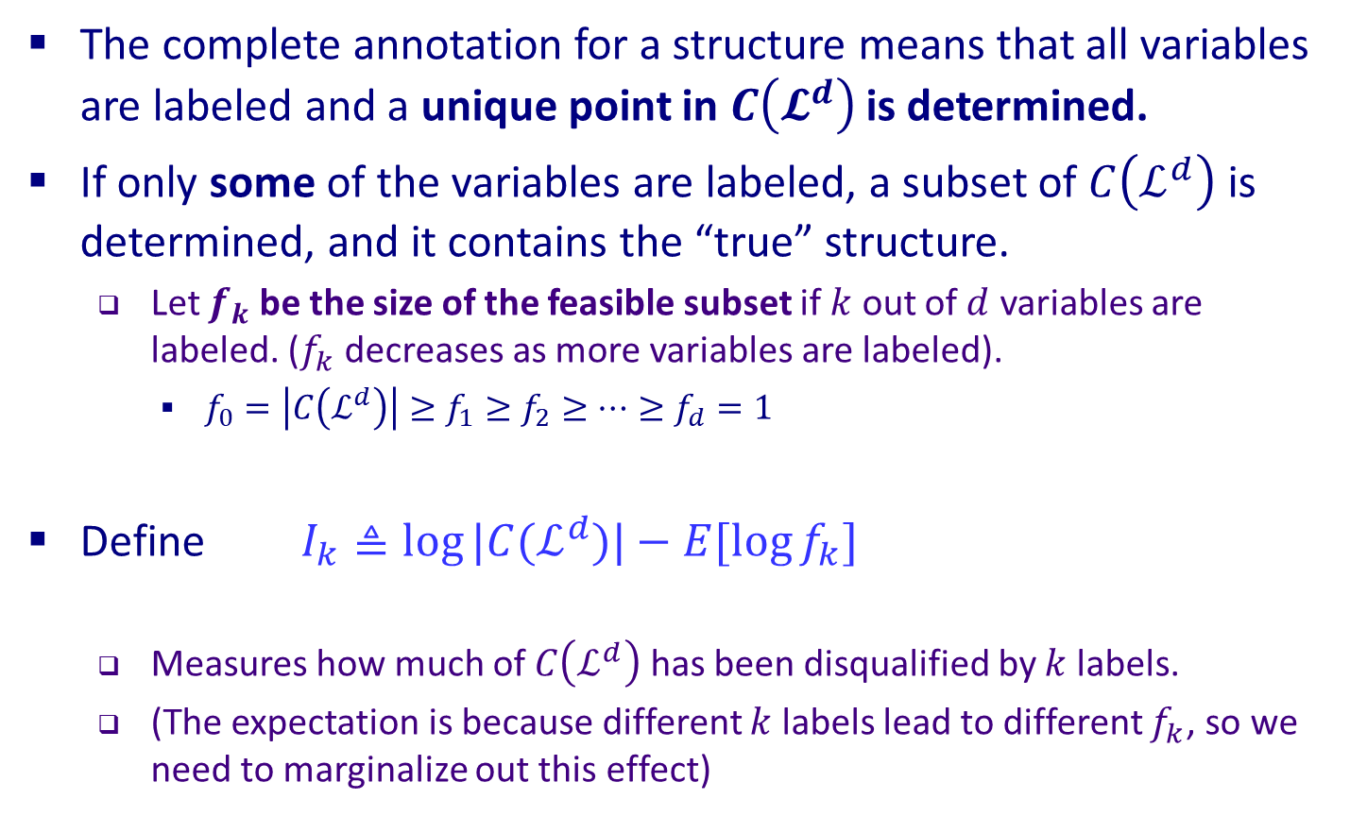
Partial Annotations of A Structure
The complete annotation for a structure means that all variables are labeled and a unique point in $C\left(𝓛^{d}\right)$ is determined.
If only some of the variables are labeled, a subset of $C\left(ℒ^{d}\right)$ is determined, and it contains the “true” structure.
  Let $f_{k}$ be the size of the feasible subset if $k$ out of $d$ variables are labeled. ($f_{k}$decreases as more variables are labeled).
    $f_{0}=\left|C\left(ℒ^{d}\right)\right|≥f_{1}≥f_{2}≥⋯≥f_{d}=1$
Define $I_{k}≜\log{|C(ℒ^{d})|}−E[\log{f_{k}}]$
  Measures how much of $C\left(ℒ^{d}\right)$ has been disqualified by $k$ labels.
  (The expectation is because different $k$ labels lead to different $f_{k}$, so we need to marginalize out this effect)

Slide 36
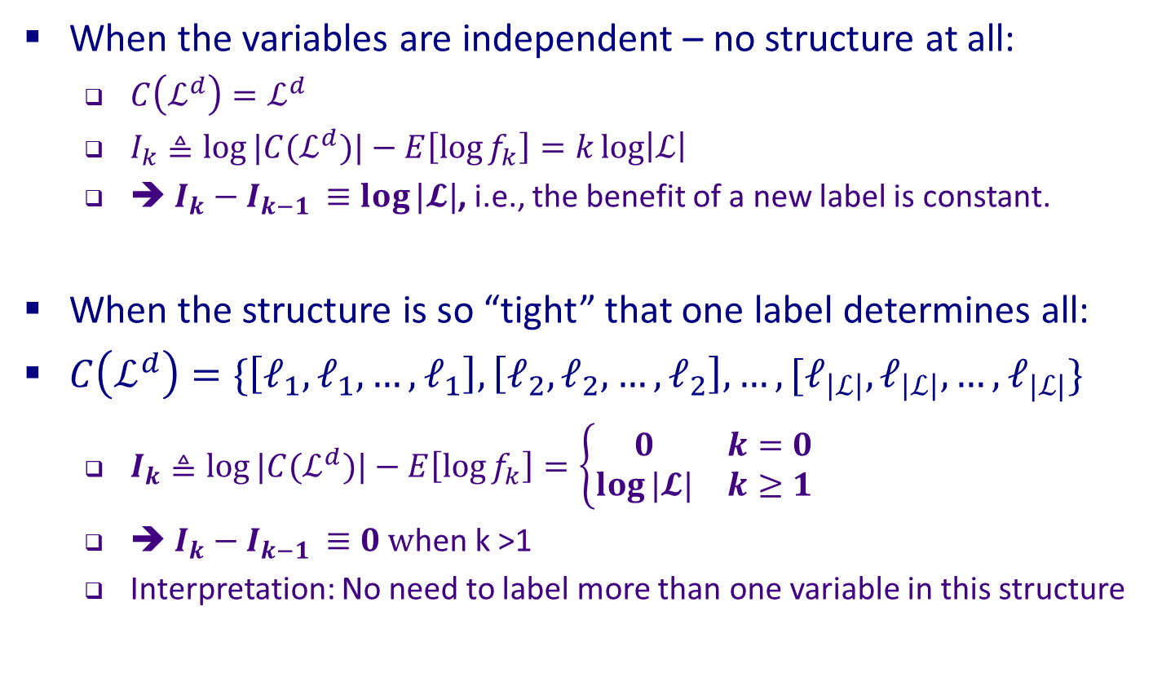
(Trivial) Examples
When the variables are independent – no structure at all:
  $C\left(ℒ^{d}\right)=ℒ^{d}$
  $I_{k}≜\log{|C(ℒ^{d})|}−E\left[\log{f_{k}}\right]=k\log\left|ℒ\right|$
  ➔ $I_{k}−I_{k−1 }≡\log{|𝓛|}$, i.e., the benefit of a new label is constant.
When the structure is so “tight” that one label determines all:
$C\left(ℒ^{d}\right)=\{\left[ℓ_{1},ℓ_{1},…,ℓ_{1}\right],\left[ℓ_{2},ℓ_{2},…,ℓ_{2}\right],…,[ℓ_{\left|ℒ\right|},ℓ_{\left|ℒ\right|},…,ℓ_{|ℒ|}\}$
  $I_{k}≜\log{|C(ℒ^{d})|}−E\left[\log{f_{k}}\right]=\left\{\begin{matrix}0 & k=0 \\ \log{|𝓛|} & k≥1\end{matrix}\right.$
  ➔ $I_{k}−I_{k−1 }≡0 w$hen k >1
  Interpretation: No need to label more than one variable in this structure

Slide 37
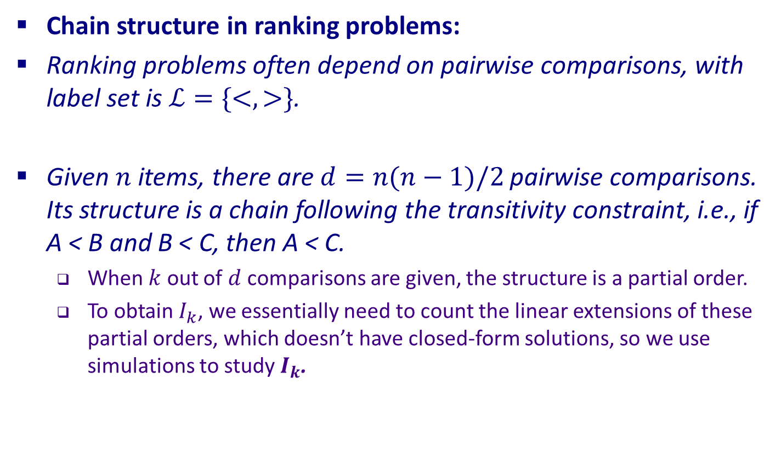
(Practical) Example 1
x₁ , x₂ , x₃ , x₄ ,… x₁₇ , x₁₀₁ ; x₁ < x₂₁ x₃ < x₄₃ x₁₇ < x₁₀₁
Chain structure in ranking problems:
Ranking problems often depend on pairwise comparisons, with label set is $ℒ=\{<,>\}$.
Given $n$ items, there are $d=n(n−1)/2$ pairwise comparisons. Its structure is a chain following the transitivity constraint, i.e., if A < B and B < C, then A < C.
  When $k$ out of $d$ comparisons are given, the structure is a partial order.
  To obtain $I_{k}$, we essentially need to count the linear extensions of these partial orders, which doesn’t have closed-form solutions, so we use simulations to study $I_{k}$.

Slide 38
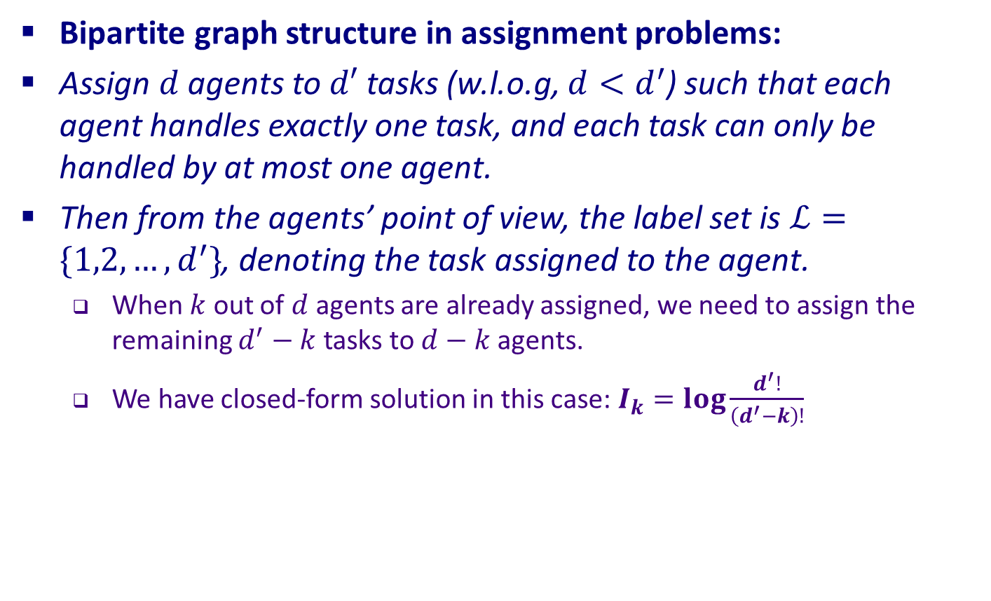
(Practical) Example 2
Agents
Labels
Bipartite graph structure in assignment problems:
Assign $d$ agents to $d′$ tasks (w.l.o.g, $d<d^{′}$) such that each agent handles exactly one task, and each task can only be handled by at most one agent.
Then from the agents’ point of view, the label set is $ℒ=\{1,2,…,d^{′}\}$, denoting the task assigned to the agent.
  When $k$ out of $d$ agents are already assigned, we need to assign the remaining $d^{′}−k$ tasks to $d−k$ agents.
  We have closed-form solution in this case: $I_{k}=\log{\frac{d^{′}!}{\left(d^{′}−k\right)!}}$

Slide 39
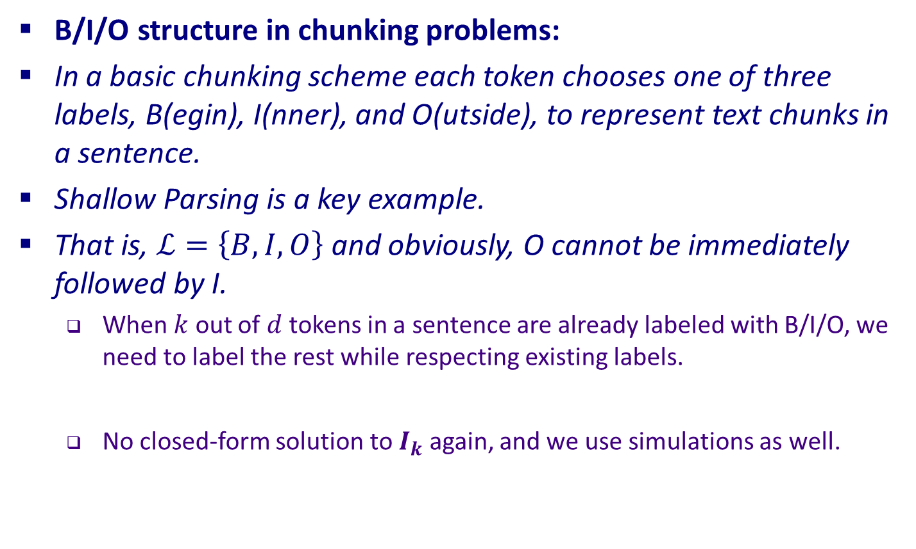
(Practical) Example 3
B/I/O structure in chunking problems:
In a basic chunking scheme each token chooses one of three labels, B(egin), I(nner), and O(utside), to represent text chunks in a sentence.
Shallow Parsing is a key example.
That is, $ℒ=\left\{B,I,O\right\}$ and obviously, O cannot be immediately followed by I.
  When $k$ out of $d$ tokens in a sentence are already labeled with B/I/O, we need to label the rest while respecting existing labels.
  No closed-form solution to $I_{k}$ again, and we use simulations as well.

Slide 40
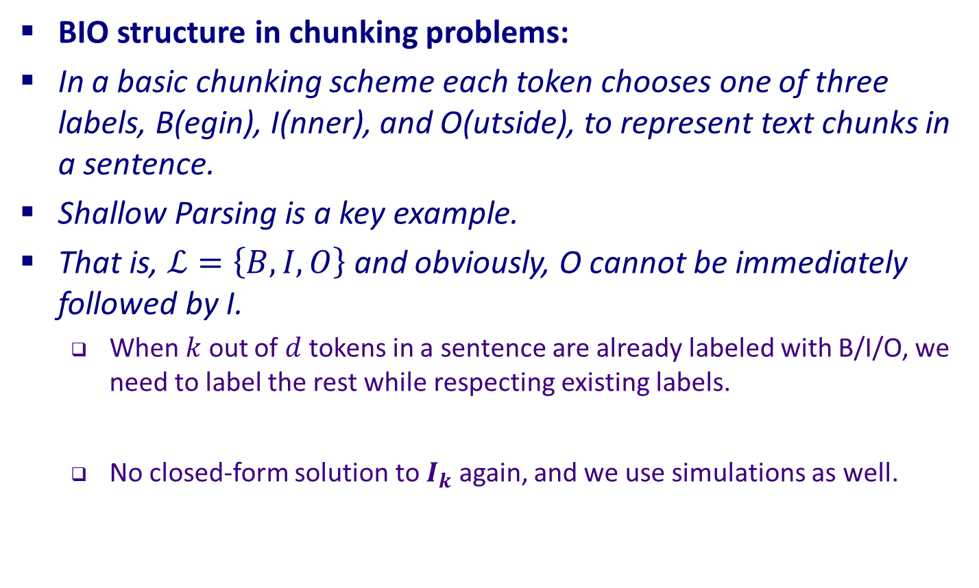
(Practical) Example 3
[I] [like] [all very short sentences] .
B B B I I I O
BIO structure in chunking problems:
In a basic chunking scheme each token chooses one of three labels, B(egin), I(nner), and O(utside), to represent text chunks in a sentence.
Shallow Parsing is a key example.
That is, $ℒ=\left\{B,I,O\right\}$ and obviously, O cannot be immediately followed by I.
  When $k$ out of $d$ tokens in a sentence are already labeled with B/I/O, we need to label the rest while respecting existing labels.
  No closed-form solution to $I_{k}$ again, and we use simulations as well.

Slide 41
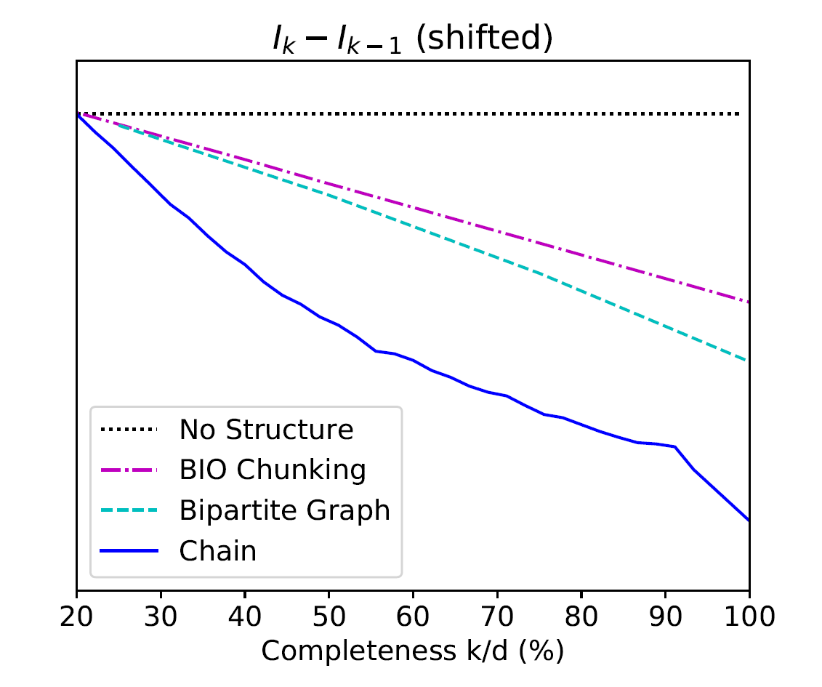
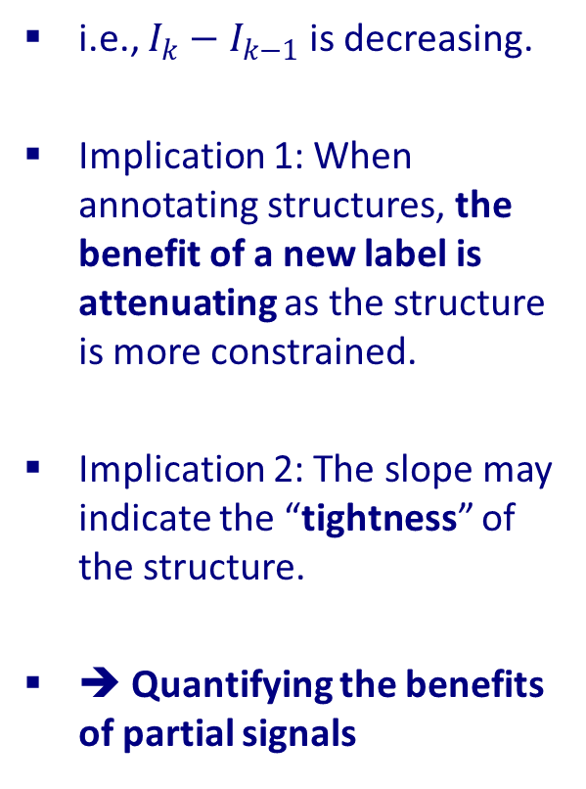

$I_{k}$ is Concave!
i.e., $I_{k}−I_{k−1}$ is decreasing.
Implication 1: When annotating structures, the benefit of a new label is attenuating as the structure is more constrained.
Implication 2: The slope may indicate the “tightness” of the structure.
➔ Quantifying the benefits of partial signals

Slide 42
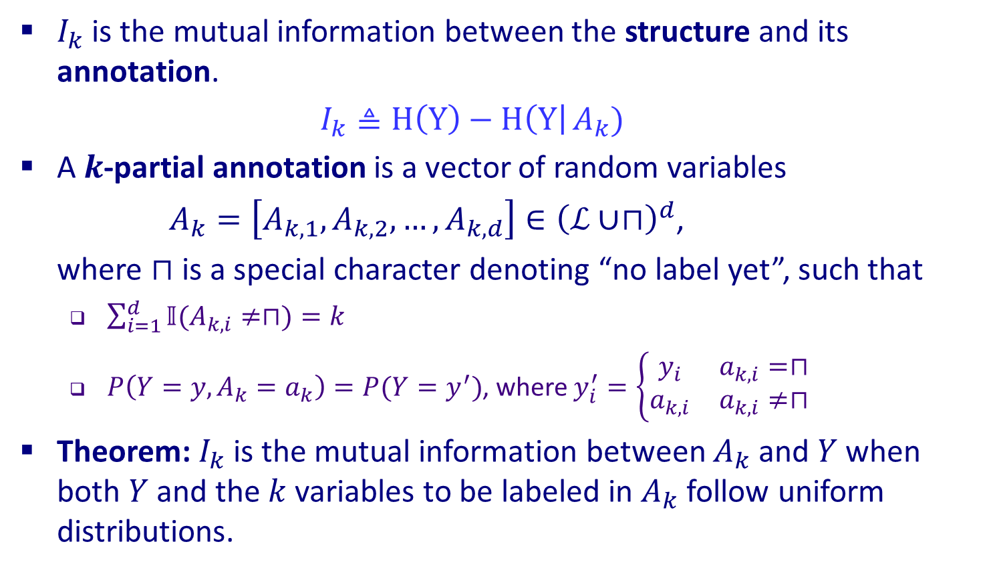
General Setting: What Is $I_{k}$ Really?
$I_{k}$ is the mutual information between the structure and its annotation.
$I_{k}≜H\left(Y\right)−H\left(Y\right|{A_{k}})$
A $k$-partial annotation is a vector of random variables
$A_{k}=\left[A_{k,1},A_{k,2},…,A_{k,d}\right]∈{\left(ℒ∪⊓\right)}^{d}$,
where $⊓$ is a special character denoting “no label yet”, such that
  $\sum_{i=1}^{d}{𝕀(A_{k,i}≠⊓)}=k$
  $P\left(Y=y,A_{k}=a_{k}\right)=P(Y=y^{′})$, where $y_{i}^{′}=\left\{\begin{matrix}y_{i} & a_{k,i}=⊓ \\ a_{k,i} & a_{k,i}≠⊓\end{matrix}\right.$
Theorem: $I_{k}$ is the mutual information between $A_{k}$ and $Y$ when both $Y$ and the $k$ variables to be labeled in $A_{k}$ follow uniform distributions.

Slide 43
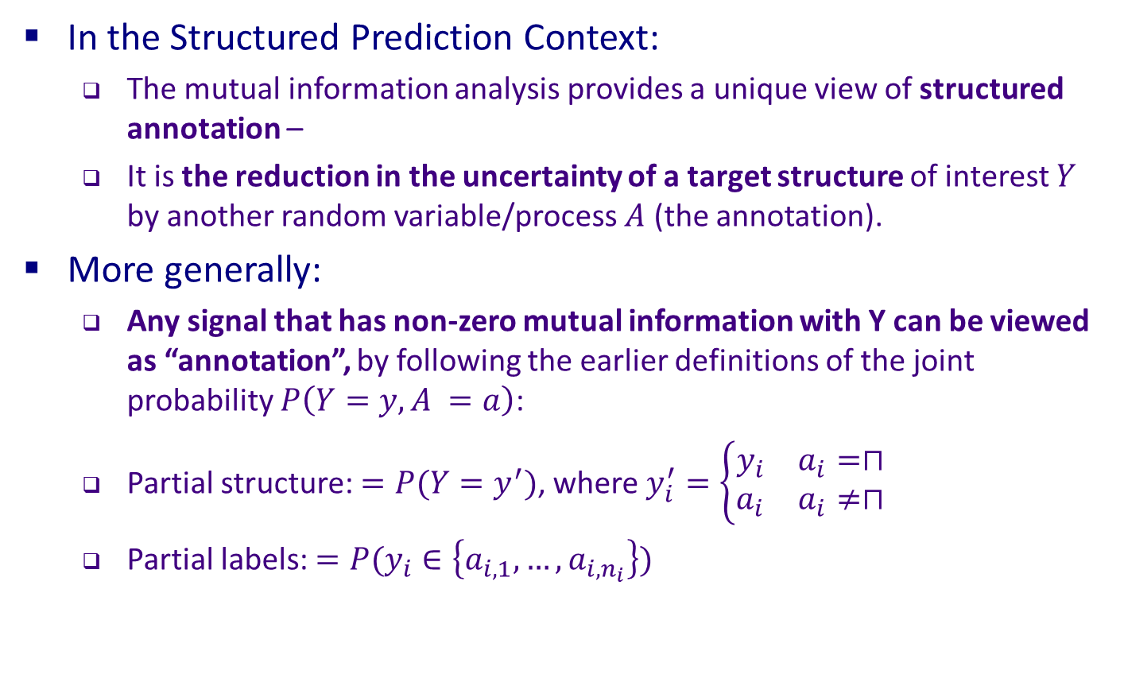
Incidental Supervision: Preliminary Formulation
Provides a way to understand and quantify the value of the incidental signals discussed earlier.
In the Structured Prediction Context:
  The mutual information analysis provides a unique view of structured annotation –
  It is the reduction in the uncertainty of a target structure of interest $Y$ by another random variable/process $A$ (the annotation).
More generally:
  Any signal that has non-zero mutual information with Y can be viewed as “annotation”, by following the earlier definitions of the joint probability $P\left(Y=y,A =a\right)$:
  Partial structure: $=P(Y=y^{′})$, where $y_{i}^{′}=\left\{\begin{matrix}y_{i} & a_{i}=⊓ \\ a_{i} & a_{i}≠⊓\end{matrix}\right.$
  Partial labels: $=P(y_{i}∈\left\{a_{i,1},…,a_{i,n_{i}}\right\})$

Slide 44
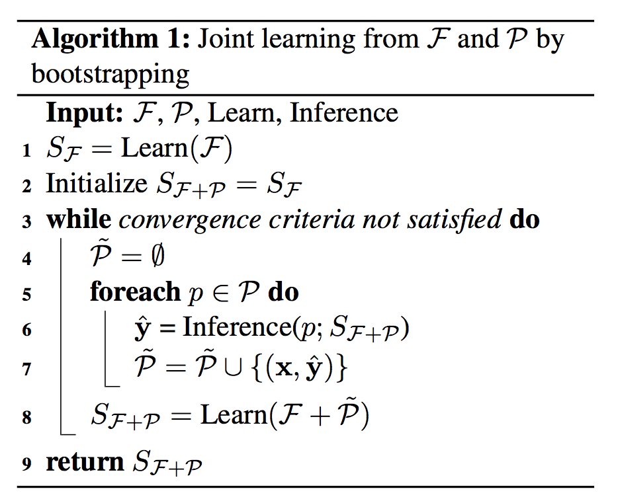
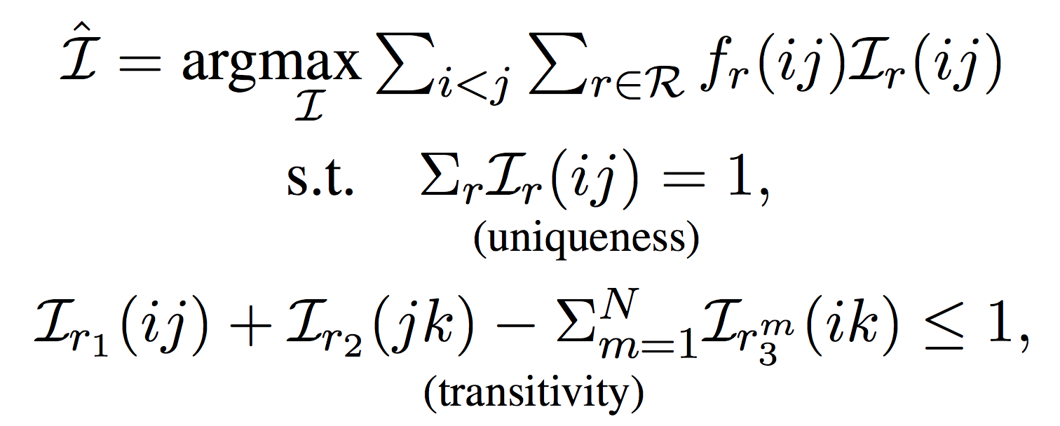
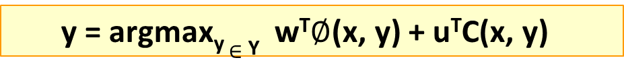
Algorithmic Implication I: Constraint-Driven Learning
  y = argmax_{y} $∈$ _{Y} w^{T}$∅$(x, y) + u^{T}C(x, y)
Knowledge, Structure, Constraints component
Constrained EM algorithms
  CoDL [Chang et al. 2007, 2012]; Posterior Regularization [Ganchev et al. 2010]
Knowledge >> Annotation
Bootstrapping with Constraints
Temporal: Transitivity Constraints
Modeled via an ILP formulation
 | F1
Bootstrapping | 45.6
+ Constraints (CoDL) | 49.0

Slide 45
Algorithmic Implication II
Assume that you have a fixed budget for annotation.
You can annotate m complete structures (n labels each), or
m*k structures, partially, with n/k labels each
Which one is better?
Clearly, this will depend on
  The tightness of the structure, for which we developed some theory,
  Our algorithmic approach

Slide 46










Experiment
Training Phase
$$𝒯_{0}$$
(a) Complete
(b) ESPA
same budget
same budget
$$𝒰_{0}$$
$$𝒰_{0}$$
$$𝒯_{1}$$
$$𝒰$$
$$𝒫$$
$$𝒫$$
CoDL: $𝒯_{0}$, $𝒯_{1}$ and $𝒰$
SSPAN: $𝒯_{0}$ and $𝒫$
$$𝒯_{test}$$
Testing Phase

Slide 47
Improvement Consistent With Tightness Analysis By $I_{k}$
Temporal Relation Extraction
+: p<5%
++: p<1%
++
++
++
++
++
++
++
++
+
Semantic Role Classification
Shallow Parsing
++
++
++
++
++
++

Slide 48
Signals and Structures
In many problems it’s easy to get some good signals
  Weak supervision; incidental supervision
But difficult to get exhaustive annotation
Examples
  Transliteration [Upadhyay et al. EMNLP’18]
  Named Entities (Low Resource Languages) [In submission]
  Temporal Relations [In submission]
These signals can be thought of as partial annotation in a well defined way
  Their usefulness is a function of the “tightness” of the expectations we have from the output
  Many questions on how to prioritize the signals to use, their order, etc.

Slide 49
Incidental Supervision
Data provides hints
  These are often sufficient to infer supervision signals for a range of tasks.
  Data exists independent of the task(s) at hand.
(1) Representations
  Often, making prediction is all about representing knowledge
(2) Signals and Structures
  Exploiting weak signals and putting them together via structural expectations
(3) Behavioral Level Feedback
  It’s End-to-End, but with behavioral level feedback
Notes:
Give the gender example;
Give a vision example?
Key challenge, to facilitate reasoning, is to induce semantics

Slide 50
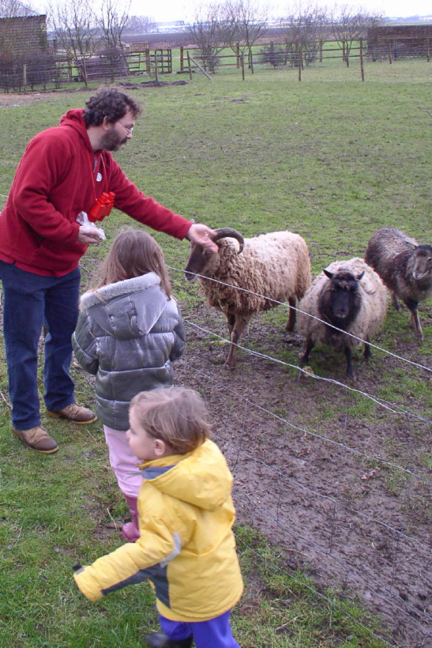
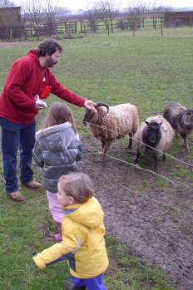


The language-world mapping problem [BabySRL: Connor, Fisher & Roth, 2012,2018]
Behavioral feedback is needed!
Take inspiration from language acquisition?
  Clearly, a lot of incidental supervision
  Harder problems (understanding verbs) bootstrap from easier
“the world”
Scene 1
Smur! Rivvo della frowler.
“the language”
Chase?
Flee?
Topid rivvo den marplox.
Nouns identified
Blert dor marplox, arno.
Scene 3
[Topid rivvo den marplox.]
Cross-situational observations
Scene n
Marplox dorinda blicket.
Representation + Expectations
Notes:
When thinking about incidental supervision, I think that we can draw inspiration from language acquisition – kids need to solve the language-wolrd mapping problem, and all they have to work with are incidental supervision signals
So let’s look at the problem facing the child. In learning a language, a child must figure out how to map words and syntactic devices onto the meanings they are meant to convey in the native language.
Viewed in this way, this is a highly unconstrained mapping problem. In principle, anything in the language could be relevant to anything in the world.

Slide 51
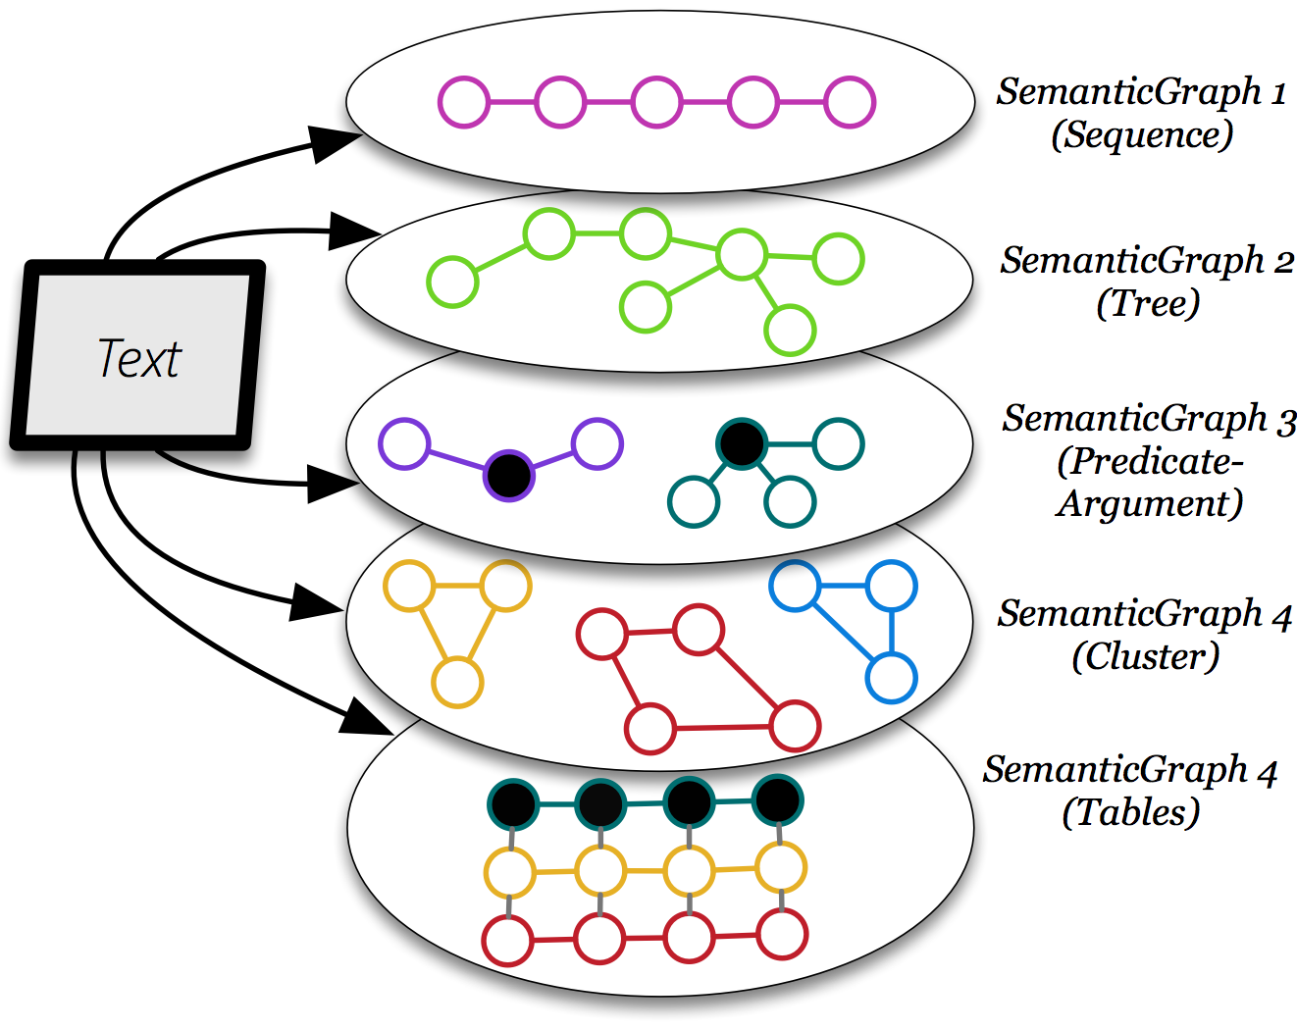
Behavioral Feedback
It’s end-to-end; but the end is not the annotated goal task.
  We care about a collection of models and representations that, via reasoning, can support many behaviors. And learning is driven by these.
Reasoning & Learning
Behaviors
Behaviors
Behaviors
Behaviors
Behaviors
Reasoning & Learning
(Many) Representations and Models we care about.
Reflect an understanding of the language
Khashabi et al. ‘18
Decoupling learning the representations from the specific task at hand.
Notes:
With this in mind, we form abstraction of a text, as a collection of graphs. Chain graphs, Trees, Predicate-Argument graphs, cluster graphs and even tables.
I’d like to emphasize that such representations has nothing to do with the QA task. It is purely genertic, and it reflects our understanding of the language.

Slide 52

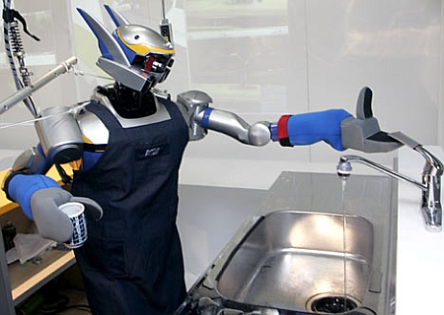

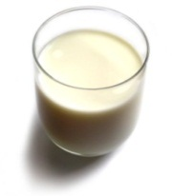
Understanding Language Requires (some) Feedback
Can we rely on this interaction to provide supervision (and eventually, recover meaning) ?
Can I get a coffee with lots of sugar and no milk
Great!
The Goal
Arggg
Meaning Representation:
MAKE(COFFEE,SUGAR=YES,MILK=NO)
How to recover meaning from text?
Standard “example based” ML: annotate text with meaning representation
  The teacher needs deep understanding of the agent ; not scalable.
Response Driven Learning (a recent name: learning from denotation): Exploit indirect signals in the interaction between the learner and the teacher/environment
[A lot of work in this direction, following Clarke et al. 2010: Driving Semantic Parsing from the World's Response – a lot more to do]
Notes:
NLU: about recovering meaning from text – a lot of work aims directly at that or at some subtasks that might look like this:….

Slide 53
Response Based Learning
We want to learn a model that transforms a natural language sentence to some meaning representation.
Instead of training with (Sentence, Meaning Representation) pairs
Think about/invent behavioral derivative(s) of the models outputs
  Supervise the derivatives (easy!) and
  Propagate it to learn the complex, structured, transformation model
English Sentence
Model
Meaning Representation

Slide 54
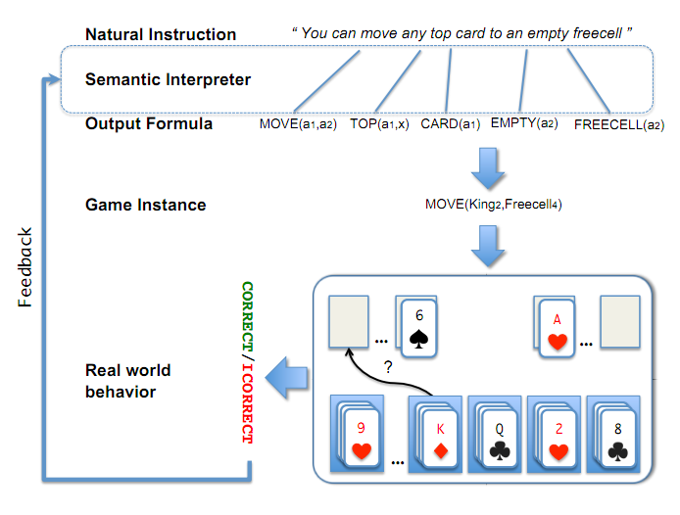
A Response based Learning Scenario
We want to learn a model to transform a natural language sentence to some meaning representation.
English Sentence
Model
Meaning Representation
A top card can be moved to the tableau if it has a different color than the color of the top tableau card, and the cards have successive values.
Move (a1,a2) top(a1,x1) card(a1) tableau(a2) top(x2,a2) color(a1,x3) color(x2,x4) not-equal(x3,x4) value(a1,x5) value(x2,x6) successor(x5,x6)
Play Freecell (solitaire)
Simple derivatives of the models outputs: game API
  Supervise the derivative and Propagate it to learn the transformation model

Slide 55
Response Based Learning
We want to learn a model that transforms a natural language sentence to some meaning representation.
Instead of training with (Sentence, Meaning Representation) pairs
Think about/invent simple derivatives of the models outputs,
  Supervise the derivative (easy!) and
  Propagate it to learn the complex, structured, transformation model
LEARNING:
Train a structured predictor (semantic parse) with this binary supervision
  Many challenges: e.g., how to make a better use of a negative response?
Learning with a constrained latent representation, use inference to expectations to exploit knowledge (e.g., on the structure of the meaning representation).
[Clarke, Goldwasser, Chang, Roth CoNLL’10; Goldwasser, Roth IJCAI’11, MLJ’14]
English Sentence
Model
Meaning Representation
As for other problems, people are excited today about NN models, but this does not get around the need to supervise models in a realistic way.

Slide 56
Incidental Supervision and Reasoning
Co-ref
  The bee landed on the flower because it had/wanted pollen.
    Lexical knowledge
  John Doe robbed Jim Roy. He was arrested by the police.
    The Subj of “rob” is more likely than the Obj of “rob” to be the Obj of “arrest”
[But see Peng et al. ACL’16, CoNLL’17, NAACL’15 for progress on this]
John had 6 books; he wanted to give them to two of his friends. How many will each one get?
share them with
How do we supervise for these problems?

Slide 57
Conclusion
Thank You!
Some recent samples from a research program that attempts to address some of the key scientific and engineering challenges between us and understanding natural language
Incidental Supervision: Utilizing hints in the data to infer/amplify supervision signals for a range of tasks.
  Representations → Label-Aware Learning
  Signals and Structures
  Behavioral feedback
Initial steps towards formulating a theory of incidental signals, quantifying their value, and using them.
Importance and effectiveness of using knowledge in learning

