Slide 1
Evaluating Evaluation
Dan Roth
University of Pennsylvania & Amazon AWS AI
Eval4NLP @ EMNLP
November 2021

Slide 2
Evaluating Evaluation
Some thoughts on Evaluation in (some) NLP tasks
  Evaluation is Essential
  Can we believe what our evaluation methods tell us?
    Not talking here about robustness, adaptation, transfer, etc.
    Even within domain
  Can we do better?

Slide 3

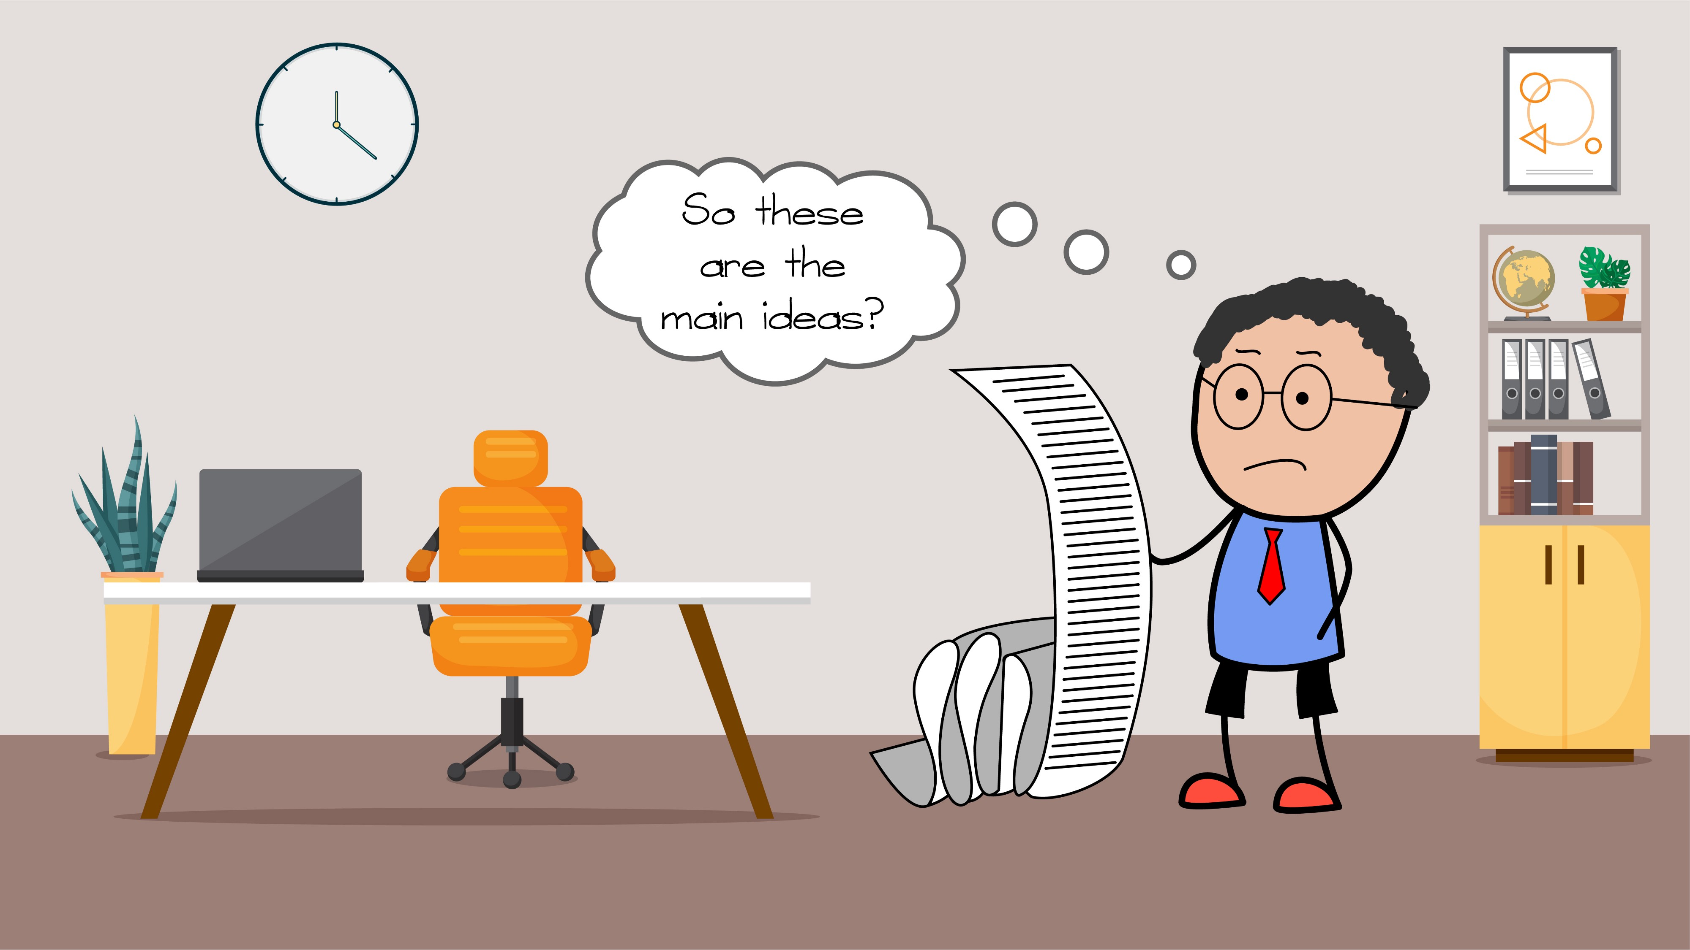
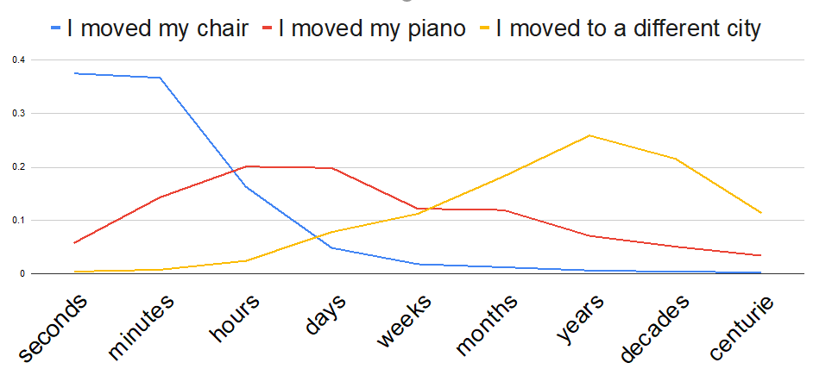
Outline
Text Correction
  I gave him a books
Summarization
  How to evaluate: a given document has multiple possible summaries
  How good is it: the statistical question
Evaluation in Commonsense Acquisition/Reasoning

Slide 4
Grammatical Error Correction (GEC)
How Good (really) are Grammatical Error Correction Systems?
Alla Rozovskaya and Dan Roth
EACL’21
When multiple golds are possible it is not clear how to evaluate the “standard” evaluation

Slide 5
Standard Reference-Based Evaluation for GEC
Source | The settings are very reallistic and the actors had a great performance .
Hypothesis 1 | The settings are very realistic and the actors had great performance.
Reference Gold (RG) | The settings are very realistic and the actors gave a great performance.
The set of possible golds for a given source sentence is extremely large
Most GEC datasets contain 1 (or 2) golds for a source sentence
  This (“unique”) gold is generated relative to the source sentence
    And is independent of the system output
System edits: (1) reallistic -> realistic;
(2) had a great -> had great
Gold edits: (1) reallistic -> realistic;
(2) had -> gave
Correct edit: (1) reallistic -> realistic
Precision: 1/2=0.5
Recall: 1/2=0.5
Impact:
  Evaluation: Reference-based evaluation underestimates system performance
  Also impacts training (which is done relative to the single reference gold)

Slide 6
Problem with Reference-Based Evaluation
The set of possible golds (space of valid corrections) for a given source sentence is extremely large
Most GEC datasets contain 1 (or 2) golds for a source sentence
  This (random) gold is generated relative to the source sentence
  The reference gold is also generated relative to the source sentence
    And is independent of the system output
Impact:
  Evaluation: Reference-based evaluation underestimates system performance
  Also impacts training (which is done relative to the single reference gold)

Slide 7
Proposal: Evaluate Relative to Closest Gold
Source | The settings are very reallistic and the actors had a great performance .
Hypothesis 1 | The settings are very realistic and the actors had great performance
Reference Gold (RG) | The settings are very realistic and the actors gave a great performance.
Closest Gold (CG) to Hypothesis 1 | The settings are very realistic and the actors had great performances.
Reference Gold:
System edits: (1) reallistic -> realistic;
(2) had a great -> had great
Gold edits: (1) reallistic -> realistic;
(2) had -> gave
Correct edits: (1) reallistic -> realistic
Precision: 1/2=0.5
Recall: 1/2=0.5
Closest Gold:
System edits: (1) reallistic -> realistic;
(2) had a great -> had great
Gold edits: (1) reallistic -> realistic;
(2) had a great -> had great
(3) performance -> performances
Correct edits: (1) reallistic -> realistic
(2) had a great -> had great
Precision: 2/2=1.0
Recall: 2/3=0.66

Slide 8
Proposal: Evaluation with Closest Golds
Closest Golds (CGs) are generated relative to system hypotheses
  Annotators generate a correct text that is the closest to the system output.
  CGs are generated for the top hypothesis and hypotheses of lower ranks (2, 5, and 10)
We use closest golds to evaluate system output of 4 GEC datasets
  2 English and 2 Russian
We claim that evaluation relative to CGs gives true system performance
Results:
  The system performance, when evaluated relative to reference gold, is severely underestimated.
  Lower rank hypotheses are often as good as top hypotheses (relative to their CGs)
    And are more “interesting”

Slide 9
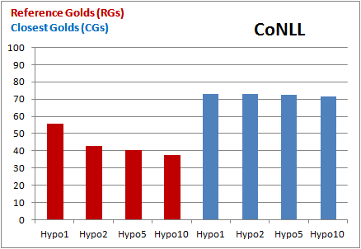
Key Findings
Evaluation against CGs is significantly better than evaluation against RGs
  This is true system performance
Evaluation against RGs shows a large gap between top hypothesis and lower-ranked hypotheses.
  Evaluation against CGs reveals very little degradation between top hypothesis and the rest
  The reason is that lower-ranked hypotheses propose more diverse changes (e.g. lexical changes), that have lower chances of matching RGs
Evaluating in multiple gold situations may not reveal the true power of a system.
More analysis & Insights in the paper.
Rozovskaya & Roth EACL’21
Need more “Semantic Evaluation” rather than just distance from a fixed gold.

Slide 10
Summarization
Understanding the Extent to which Content Quality Metrics Measure the Information Quality of Summaries
Dan Deutsch, Dan Roth
CoNLL-2021
Towards Question-Answering as an Automatic Metric for Evaluating the Content Quality of a Summary
Dan Deutsch, Tanya Bedrax-Weiss, Dan Roth
TACL-2021
A Statistical Analysis of Summarization Evaluation Metrics Using Resampling Methods
Daniel Deutsch, Rotem Dror, Dan Roth
TACL-2021
How to evaluate?
Are we sure? (Statistical View)

Slide 11
Evaluating summaries
Document(s)
Summary
The Airbus A380 is a wide-body aircraft manufactured by Airbus. It is the world's largest passenger airliner. Airbus studies started in 1988 and the project was announced in 1990 to challenge the dominance of the Boeing 747 in the long haul market. The then-designated A3XX project was presented in 1994; Airbus launched the €9.5 billion ($10.7 billion) A380 programme on 19 December 2000. The first prototype was unveiled in Toulouse on 18 January 2005, with its first flight on 27 April 2005. Difficulties in electrical wiring caused a two-year delay and the development cost ballooned to €18 billion. It obtained its type certificate from the European Aviation Safety Agency (EASA) and the US Federal Aviation Administration (FAA) on 12 December 2006. It was first delivered to Singapore Airlines on 15 October 2007 and entered service on 25 October. Production peaked at 30 per year in 2012 and 2014. However, Airbus concedes that its $25 billion investment for the aircraft cannot be recouped. On 14 February 2019, after Emirates reduced its last orders……
Linguistic Quality
3.4
0
5
The super jumbo Airbus A380, the world's largest commercial airliner, took off Wednesday into cloudy skies over southwestern France for its second test flight. The European aircraft maker, based in the French city of Toulouse, said the second flight -- which came exactly a week after the A380's highly…
Faithfulness
3.9
Chen et al. NAACL’21
0
5
Coherence
9.8
0
10
Content Quality
4.7
0
5
There are different metrics to measure all of these, but we will focus on content quality

Slide 12
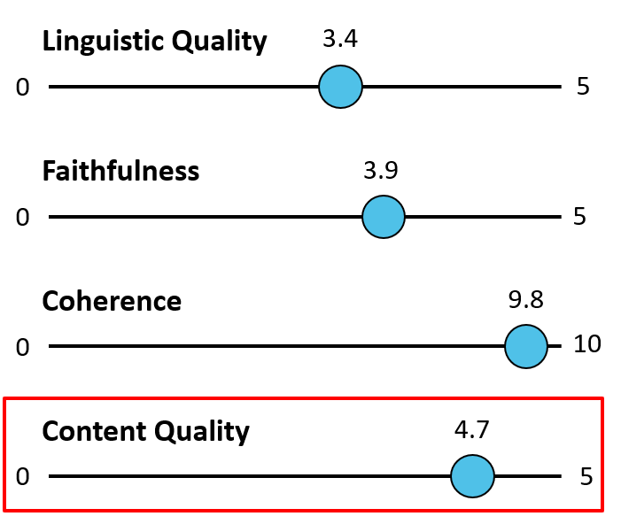
Evaluating summaries
Document(s)
Summary
The Airbus A380 is a wide-body aircraft manufactured by Airbus. It is the world's largest passenger airliner. Airbus studies started in 1988 and the project was announced in 1990 to challenge the dominance of the Boeing 747 in the long haul market. The then-designated A3XX project was presented in 1994; Airbus launched the €9.5 billion ($10.7 billion) A380 programme on 19 December 2000. The first prototype was unveiled in Toulouse on 18 January 2005, with its first flight on 27 April 2005. Difficulties in electrical wiring caused a two-year delay and the development cost ballooned to €18 billion. It obtained its type certificate from the European Aviation Safety Agency (EASA) and the US Federal Aviation Administration (FAA) on 12 December 2006. It was first delivered to Singapore Airlines on 15 October 2007 and entered service on 25 October. Production peaked at 30 per year in 2012 and 2014. However, Airbus concedes that its $25 billion investment for the aircraft cannot be recouped. On 14 February 2019, after Emirates reduced its last orders……
The superjumbo Airbus A380, the world's largest commercial airliner, took off Wednesday into cloudy skies over southwestern France for its second test flight. The European aircraft maker, based in the French city of Toulouse, said the second flight -- which came exactly a week after the A380's highly…
Reference Summary
The European Airbus A380 flew its maiden test flight from France 10 years after design development started. The A380 super-jumbo passenger jet surpasses the Boeing 747 and breaks their monopoly. Airlines worldwide have placed orders but airports may need modification to accommodate the weight and width of the A380. U.S. airlines have not placed an order. Airbus has fallen behind in production and …
The European Airbus A380 flew its maiden test flight from France 10 years after design development started. The A380 super-jumbo passenger jet surpasses the Boeing 747 and breaks their monopoly. Airlines worldwide have placed orders but airports may need modification to accommodate the weight and width of the A380. U.S. airlines have not placed an order. Airbus has fallen behind in production and …
The European Airbus A380 flew its maiden test flight from France 10 years after design development started. The A380 super-jumbo passenger jet surpasses the Boeing 747 and breaks their monopoly. Airlines worldwide have placed orders but airports may need modification to accommodate the weight and width of the A380. U.S. airlines have not placed an order. Airbus has fallen behind in production and …
The European Airbus A380 flew its maiden test flight from France 10 years after design development started. The A380 super-jumbo passenger jet surpasses the Boeing 747 and breaks their monopoly. Airlines worldwide have placed orders but airports may need modification to accommodate the weight and width of the A380. U.S. airlines have not placed an order. Airbus has fallen behind in production and …
The European Airbus A380 flew its maiden test flight from France 10 years after design development started. The A380 super-jumbo passenger jet surpasses the Boeing 747 and breaks their monopoly. Airlines worldwide have placed orders but airports may need modification to accommodate the weight and width of the A380. U.S. airlines have not placed an order. Airbus has fallen behind in production and …
The European Airbus A380 flew its maiden test flight from France 10 years after design development started. The A380 super-jumbo passenger jet surpasses the Boeing 747 and breaks their monopoly. Airlines worldwide have placed orders but airports may need modification to accommodate the weight and width of the A380. U.S. airlines have not placed an order. Airbus has fallen behind in production and …
Since there are multiple golds comparing a generated summary to a single reference limits our ability to evaluate the quality of a generated summary.

Slide 13
Content Quality
Content quality: Does the summary say the “right” things?
What is “right?”
Information Need: Describe developments in the production and launch of the Airbus A380
The European Airbus A380 flew its maiden test flight from France 10 years after design development started. The A380 super-jumbo passenger jet surpasses the Boeing 747 and breaks their monopoly. Airlines worldwide have placed orders but airports may need modification to accommodate the weight and width of the A380. U.S. airlines have not placed an order. Airbus has fallen behind in production and a backlog of orders has developed. Airbus must sell at least 250 planes to break even financially. The A380 is overweight and modifications to meet the weight requirements impacted the budget. Additional test flights are planned.
The European Aeronautic Defence and Space Co., which owns 80 percent of Airbus, says the A380 program will break even at about 250 sales. The A380 'superjumbo', which will be presented to the world in a lavish ceremony in southern France on Tuesday, will be profitable from 2008, its maker Airbus told the French financial newspaper La Tribune. Federal Express has ordered 10 of the planes. The A380 will take over from the Boeing 747 as the biggest jet in the skies. French President Jacques Chirac immediately hailed the "total success of the first test flight of the Airbus A380."
Launch
Production
Notes:
Really, evaluation should be done relative to an information need; we don’t do it this way. Instead,

Slide 14
Reference-Based Metrics
Data-driven definition of “good” quality content
Assumption: if a candidate summary is similar to a reference summary, it’s good
  Reduced problem to comparing two summaries
The superjumbo Airbus A380, the world's largest commercial airliner, took off Wednesday into cloudy skies over southwestern France for its second test flight. The European aircraft maker, based in the French city of Toulouse, said the second flight -- which came exactly a week after the A380's highly…
Candidate Summary
Reference-Based Evaluation Metric
Content Quality
4.7
0
5
The European Airbus A380 flew its maiden test flight from France 10 years after design development started. The A380 super-jumbo passenger jet surpasses the Boeing 747 and breaks their monopoly. Airlines worldwide have placed orders but airports may need modification to …
Reference (Human) Summary

Slide 15
Datasets
TAC 2008 and 2009
  48/44 multi-document summarization instances
  Provided an information need that the summary should be about
  4 human-written references for each instance
  ~50 summarization systems’ outputs for all inputs judged for responsiveness to the information need
  We evaluate the metrics on these 50 systems’ outputs across 48/44 instances
CNN/DailyMail
  Single-document summarization dataset crawled from CNN and DailyMail websites
  300k instances, but no quality judgments

Slide 16
Current Methodology: Alignment-Based
Both ROUGE/BERTScore can be cast as computing weighted alignments
  Many-to-many, some tokens may be unaligned
  Weight of the alignment = sum of the weight of the edges
Gavin and Reese were jumping on the trampoline when Gavin fell off.
0.7
0.9
1.0
1.0
0.8
1.0
0.9
Reese watched Gavin when he fell off the trampoline.
Weight of alignment = 6.3

Slide 17
ROUGE as an Alignment
ROUGE calculates a score between two summaries based on their token overlap
ROUGE score can be interpreted via (maybe many) alignments
Gavin and Reese were jumping on the trampoline when Gavin fell off.
All weights = 1.0
Reese watched Gavin when he fell off the trampoline.
Gavin and Reese were jumping on the trampoline when Gavin fell off.
Reese watched Gavin when he fell off the trampoline.
P = 7 / 12
ROUGE-1 score is the weight of the alignment, then normalized to get precision or recall
R = 7 / 9
We are only concerned about the weight of the alignment

Slide 18
BERTScore as an Alignment
BERTScore induces a unique alignment based on BERT embedding similarities
Gavin and Reese were jumping on the trampoline when Gavin fell off.
Weights = Cosine similarities
Reese watched Gavin when he fell off the trampoline.
Reference Summary
Gavin
and
Reese
were
…
Reese
0.5
0.1
0.9
0.1
BERTScore is the weight of the alignment, then normalized to get precision or recall
Max per column
watched
0.2
0.1
0.5
0.5
Candidate Summary
Gavin
0.8
0.3
0.1
0.2
We are only concerned about the weight of the alignment
when
0.4
0.2
0.7
0.1
…

Slide 19
What do ROUGE & BERTScore Measure?
One way to understand it is by comparing to the Pyramid Method
  The Pyramid Method is the gold-standard for manually comparing the content of two summaries (Nenkova and Passonneau, 2004)
  Artifact of annotation: pairs of phrases that contain the same information

Slide 20
The Pyramid Method
Reference Summaries
Exhaustively annotate SCUs (summary content units) in the reference summaries
The European Airbus A380 flew its maiden test flight from France 10 years after design development started. The A380 super-jumbo passenger jet surpasses the Boeing 747 and breaks their monopoly. Airlines worldwide have placed orders but airports may need modification to accommodate the weight and width of the A380. U.S. airlines have not placed an order. Airbus has fallen behind in production and a backlog of orders has developed. Airbus must sell at least 250 planes to break even financially. The A380 is overweight and modifications to meet the weight requirements impacted the budget. Additional test flights are planned.
Identify occurrences of those SCUs in the candidate
Candidate Summary
The European Aeronautic Defence and Space Co., which owns 80 percent of Airbus, says the A380 program will break even at about 250 sales. The A380 'superjumbo', which will be presented to the world in a lavish ceremony in southern France on Tuesday, will be profitable from 2008, its maker Airbus told the French financial newspaper La Tribune. Federal Express has ordered 10 of the planes. The A380 will take over from the Boeing 747 as the biggest jet in the skies. French President Jacques Chirac immediately hailed the "total success of the first test flight of the Airbus A380."
The largest passenger airliner ever built, the Airbus 380(A380), took off on its maiden four-hour flight on April 27, 2005 in France. The European company, Airbus, is the newest competitor with the Boeing Company. The A380 is designed to carry 555 passengers, but can be expanded to 800 seats. Airbus stresses the plane's fuel efficiency. Its first test flight was successful. Orders for 149 aircraft from airlines and freight companies have been received. No US airline has ordered the jet yet. First commercial deliveries to Singapore Airlines are scheduled for 2006.
All identical information between a reference and a candidate is annotated
Exhaustive annotation => Anything not annotated does not have the same information

Slide 21
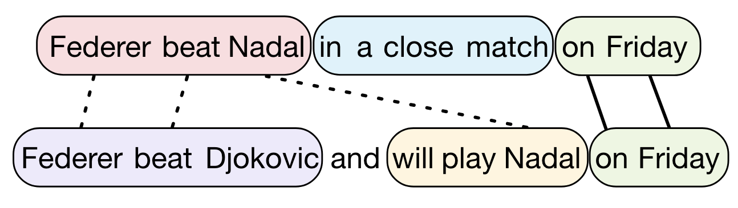
Comparison Alignment to SCUs
Colors = SCUs
“Federer played Nadal on Friday”
“Federer beat Nadal”
“The match was close”
Alignment
1.0
1.0
1.0
1.0
1.0
“Federer beat Djokovic”
“Federer will play Nadal”
Count what portion of the weight of the alignment is between phrases that have the same information
Most of the score is coming from phrases that don’t have the same information
2 / 5

Slide 22
Comparison to SCUs
Calculate percent of metric scores explained by SCU matches on TAC 2008
On average, 25% of ROUGE and 15% of BERTScore values on TAC ‘08 come from phrases with the same information
75% and 85% come from phrases that mean different things
[Deutsch & Roth’21] also analyzes the different categories of token matches.
Conclusion => ROUGE/BERTScore largely do not measure information overlap

Slide 23
So, how should we evaluate?
Towards
Question-Answering
as
an Automatic Metric for Evaluating the
Content Quality of a Summary

Slide 24
QA-Based Evaluation Metrics [Deutsch et al. TACL’21]
ROUGE and BERTScore represented summaries as bags-of-words or BERT embeddings
Two summaries compared via lexical overlap or cosine similarities
Instead, could we represent a summary using QA pairs and compare content via answering questions against a summary?
  Propose and analyze a QA-based evaluation metric called QAEval
  Demonstrate state-of-the-art results on some evaluations
  Identify performance bottlenecks = areas for future work
  Estimate upper-bound performance if bottlenecks are addressed

Slide 25
QAEval
These represent the information of the reference summary. We can throw away the reference summary text now.
Why do we need a reference at all?
We don’t – if we can determine salience well
Steps
Reference Summary
Candidate Summary
Answer Selection: select answers that will generate questions
Question Generation: generate wh-questions that target each answer using a learned model
Question Answering: answer questions against the candidate summary using a learned model
Answer verification: determine if the answers are correct or not
Final score: calculate portion of questions answered correctly
Yesterday, Nadal lost to Federer
Roger Federer beat Nadal yesterday
QA Pairs
Who lost to Federer yesterday? Nadal
Who did Nadal lose to yesterday? Federer
Predictions
Who lost to Federer yesterday? Nadal
Who did Nadal lose to yesterday? Roger Federer
EM = Exact match
F1 is ROUGE-1 F1
Answer Verification
Ground-truth: Nadal Prediction: Nadal
EM = 1, F1 = 1.0
Ground-truth: Federer Prediction: Roger Federer
EM = 0, F1 = 0.66
Final Scoring
Discuss and evaluate each step, followed by the overall metric
QAEval-EM = (1 + 0) / 2 = 0.5
QAEval-F1 = (1.0 + 0.66) / 2 = 0.83

Slide 26
(1) Answer Selection
A good answer selection method will end up generating questions that cover a large portion of the reference summary’s information
  Who is not a normal boy? Harry Potter
  Harry potter is not a normal what? Boy
  Harry potter is not a normal what? Boy
  Who was he raised by? His cruel aunt and uncle
  Who was he tormented by? His bully of a cousin, Dudley
By comparing QA pairs’ information to Pyramid Method SCUs
  Determined that NP Chunk are the best units to use as answers
Harry Potter is not a normal boy. Raised by his cruel Aunt and Uncle, and tormented by his bully of a cousin, Dudley, he has resigned to a life of neglect. On his eleventh birthday, however, a half-giant called Hagrid comes crashing-–quite literally-–into his life, and announces that Harry is a wizard. Together they journey to London to get school supplies for Harry’s first year at Hogwarts School of Witchcraft and Wizardry. On 1st September Harry takes a train from King’s Cross station, Platform 9 ¾, to Hogwarts school, where he meets Ron Weasley and Hermione Granger. The three are sorted into the same House, Gryffindor, and although Harry and Ron find Hermione bossy and annoying at first, the three soon become best friends.
Single QA pair alone does not represent a ton of the information in the summary
More questions will cover more semantic information

Slide 27
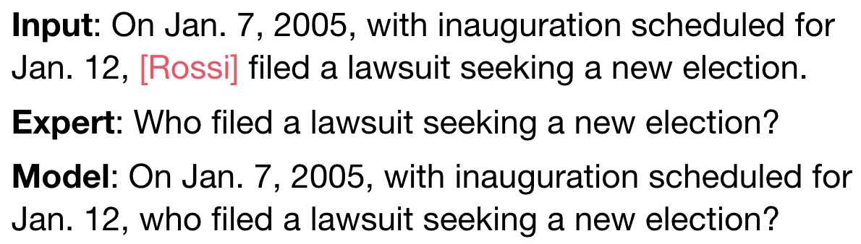
(2) Question Generation
Trained a question generation model
Empirically, questions are good, but a bit verbose
Nevertheless, the downstream performance is better when using a model versus an expert to write questions.
  Possibly since the questions are more verbose so they contain more keywords
  Summary-level is equal
  We conclude that the question generation model gives good performance
Input
Output
<m> Federer </m> beat Nadal yesterday
Who beat Nadal yesterday?

Slide 28
(3) Question Answering
QA model is trained on SQuAD 2.0
How well does it work on the summaries and questions?
  We manually answered ~3k QA pairs and verified if the answers were correct or not
    Questions generated from 20 references over 10 input document sets
    Answered against 4 systems outputs
  Key area of concern:
    Unanswerable questions (or not) [work in submission on that]
      The fraction of unanswerable questions here is larger than in the training.
    Even when the answer is there, the model does a poor job at picking the answer
Candidate Summary
Question
Harry Potter is not a normal boy. Raised by his cruel Aunt and Uncle, and tormented by his bully of a cousin, Dudley, he has resigned to a life of neglect. On his eleventh birthday, however, a half-giant called Hagrid comes crashing-–quite literally-–into his life and announces that Harry is a wizard. Together they journey to London to get school supplies for Harry’s first year at Hogwarts School of Witchcraft and Wizardry.
On 1st September Harry takes a train from King’s Cross station, Platform 9 3/4, to Hogwarts school, where he meets Ron Weasley and Hermione…
Where does Harry go to school?
Output
Probability question is not answerable: 0.2
Predicted answer: Hogwarts
Probability of predicted answer: 0.75

Slide 29
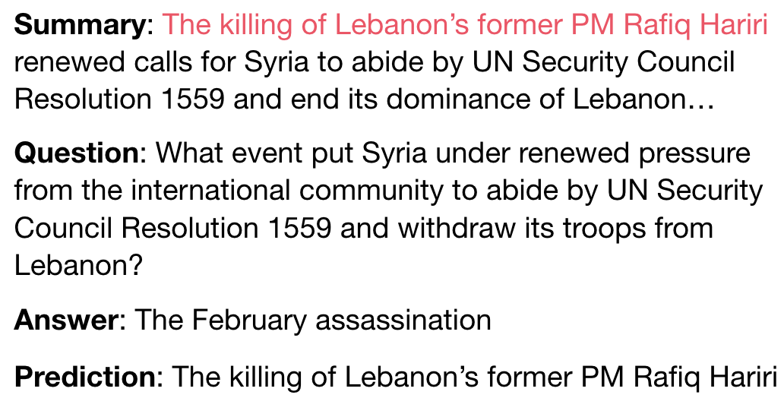
(4) Answer Verification
In typical QA data, the QA model is executed against the same text where the ground-truth was drawn from
  Exact match always exists, F1 helps with some span correction
Our ground-truth answers are selected from a different text than where the predictions come from
  No guarantee an exact match will exist or be close, but the answer might be there
Same event referred to in different ways, but EM and F1 near 0
This problem could introduce a lot of noise into the evaluation metric

Slide 30
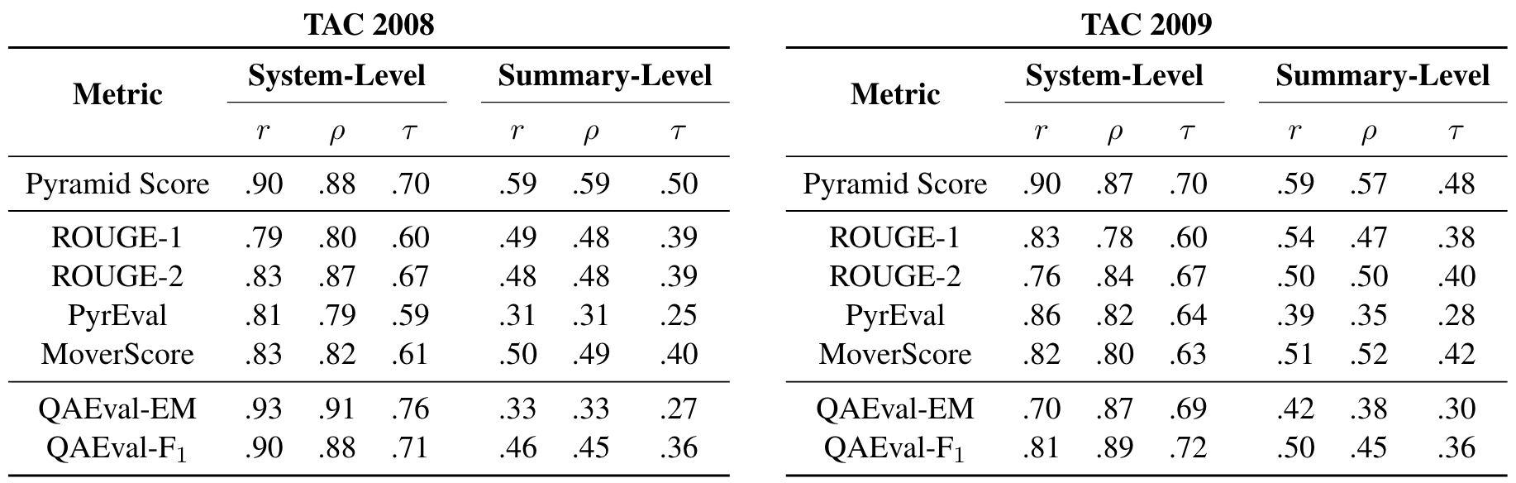
(5) Overall Evaluation
Correlations of fully automatic metric
The results are even better on CNN/Dailymail
QAEval gets best system-level correlation, > all other metrics
  Consistently better than the Pyramid Method
  Quite surprising because of the noisy QA and answer verification
But, summary-level results are lower or competitive
  Averaging over a small # of answers isn’t enough to deal with the noise introduced by the QA components.
The QA model effectively does the job of the human who marks common SCUs between summaries
QA pairs represent more information than SCUs
  Humans can’t annotate the data as exhaustively => QA can have better coverage

Slide 31
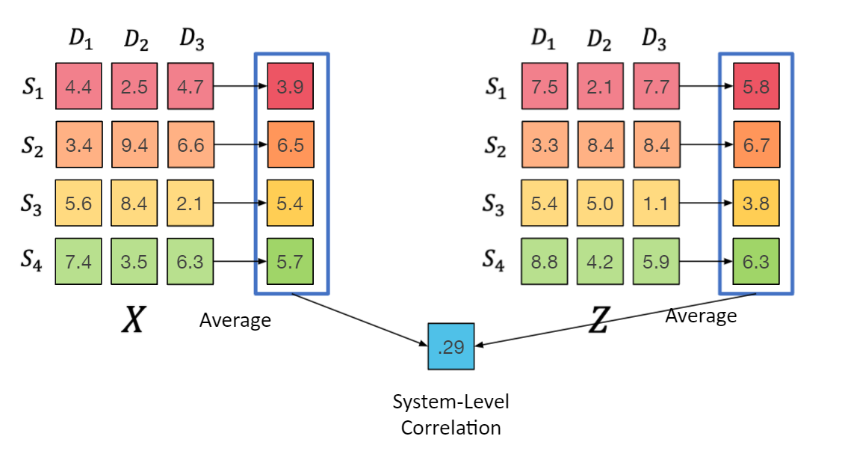
The Statistical Angle [Deutsch et al. TACL’21]
Automatic metrics are evaluated by considering their correlation to human judgments of summary quality.
  We should care about system-level correlation (not summary level) calculated with Kendall's tau.
    Since we compare systems (not individual summaries).
Ranking Comparison:
  How frequently do ROUGE and Humans agree that: system1 is better than system2?
Do this for multiple metrics, and see which correlates better with humans
  For N systems, Kendall’s tau enumerates the (N choose 2) possible pairs of systems then calculates the proportion of pairs for which ROUGE and humans agree on the ranking.

Slide 32
Statistically Rigorous Evaluation of Metrics
When scoring the quality of a System – its correlation with human performance – we need to attend to the confidence of these scores.
But, new evaluation metrics rarely come with confidence intervals or any other statistical test that shows the significance of the correlation improvements.
We propose bootstrapping/permutation tests to do exactly that.
When done the right way, the confidence intervals are shown to be very wide.
  We have a very poor idea how well automatic metrics agree with human judgments of summary quality

Slide 33
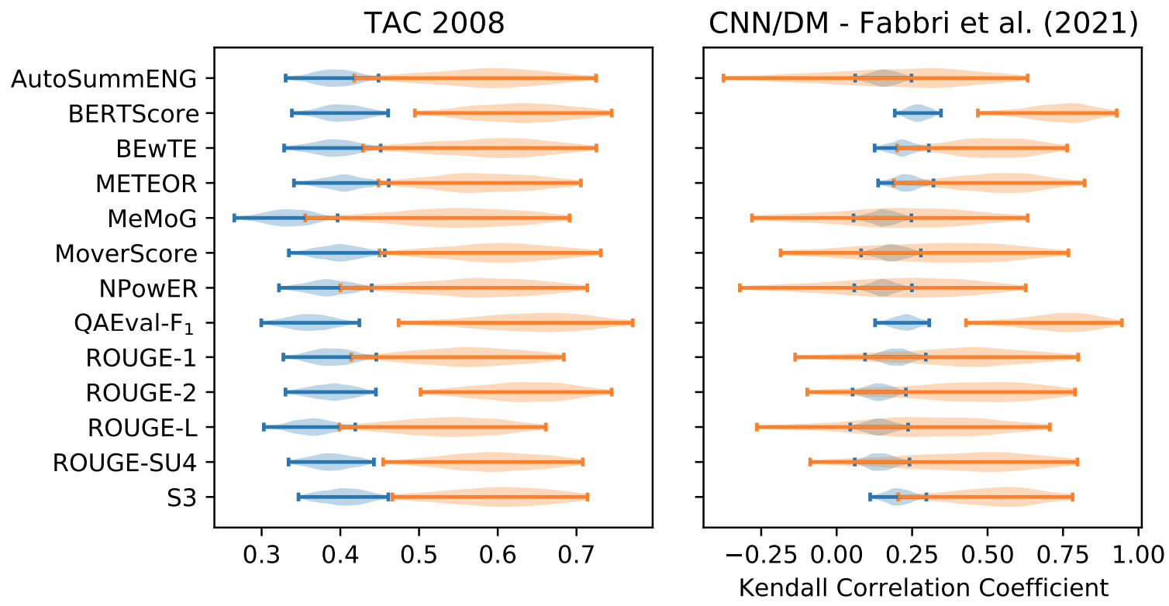
Confidence Intervals
Summary-Level
System-Level
Confidence intervals are wide
  High-level of uncertainty about their true values
Wide CIs have serious implications
  ROUGE-2 incorrectly ranks systems 9-54% of the time with respect to human rankings

Slide 34
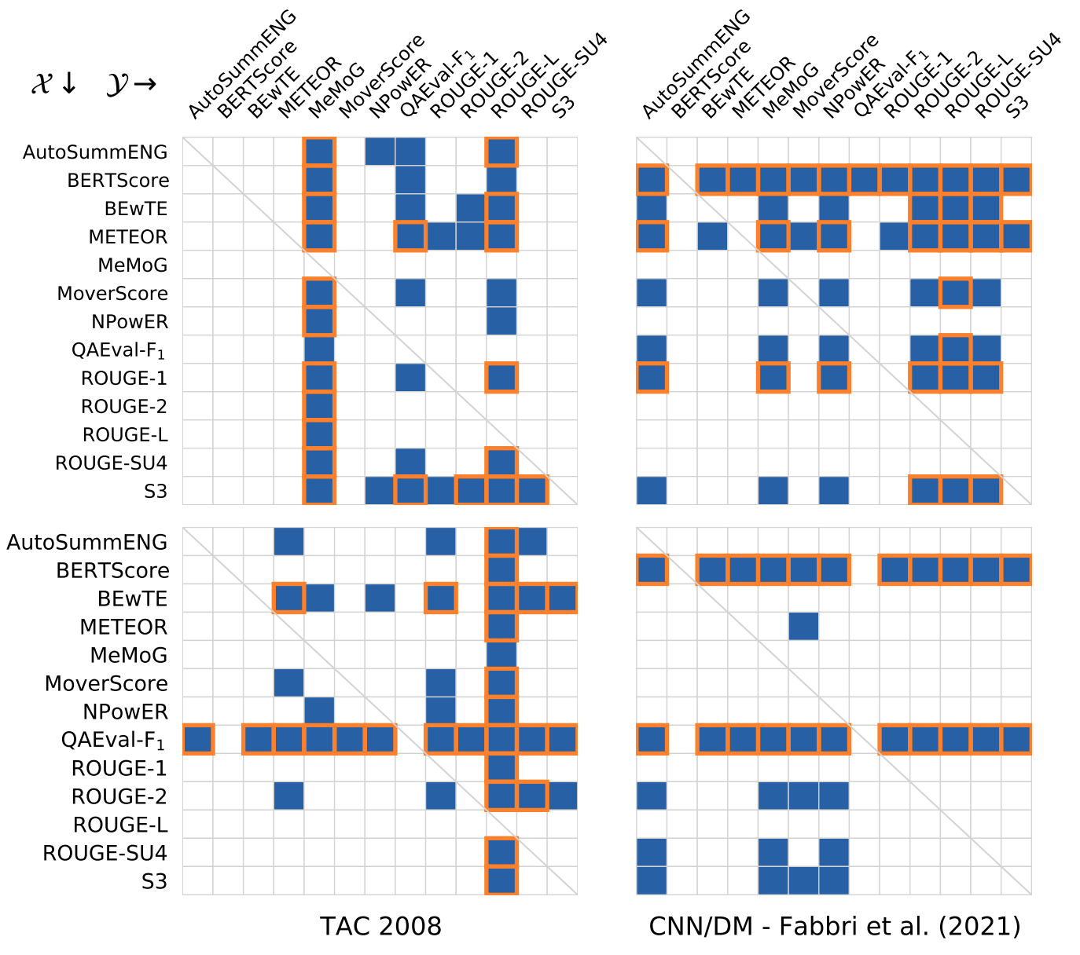
Hypothesis test results
Orange in rows = row metric is good
Orange in columns = column metric is bad
BERTScore (Zhang et al., 2020) does well on SummEval
QAEval (Deutsch et al., 2021) does well at the system-level
Many metrics don’t do better than ROUGE
Summary-
Level
System-
Level
p-value < 0.05
Remains significant after Bonferroni correction

Slide 35





























































Metrics: Summary- and System-Level Correlations
A metric is evaluated by calculating the correlation of its scores to the human responsiveness scores
  Summary-Level correlation: Measures how well the metric scores individual summaries for the same input
  System-Level correlation: Measures how well the metric scores summarization systems (averaged over many inputs)
Average x and y scores per system
(= system performance)
Summary-Level
System-Level
3 Input document sets
3 Input document sets
$$x_{1}^{1}$$
$$y_{1}^{1}$$
$$x_{1}^{2}$$
$$y_{1}^{2}$$
$$x_{1}^{3}$$
$$y_{1}^{3}$$
$$x_{1}^{1}$$
$$y_{1}^{1}$$
$$x_{1}^{2}$$
$$y_{1}^{2}$$
$$x_{1}^{3}$$
$$y_{1}^{3}$$
$${\overline{x}}_{1}$$
$${\overline{y}}_{1}$$
$$x_{2}^{1}$$
$$y_{2}^{1}$$
$$x_{2}^{2}$$
$$y_{2}^{2}$$
$$x_{2}^{3}$$
$$y_{2}^{3}$$
$$x_{2}^{1}$$
$$y_{2}^{1}$$
$$x_{2}^{2}$$
$$y_{2}^{2}$$
$$x_{2}^{3}$$
$$y_{2}^{3}$$
$${\overline{x}}_{2}$$
$${\overline{y}}_{2}$$
4 Summarization Models
4 Summarization Models
$$x_{3}^{1}$$
$$y_{3}^{1}$$
$$x_{3}^{2}$$
$$y_{3}^{2}$$
$$x_{3}^{3}$$
$$y_{3}^{3}$$
$$x_{3}^{1}$$
$$y_{3}^{1}$$
$$x_{3}^{2}$$
$$y_{3}^{2}$$
$$x_{3}^{3}$$
$$y_{3}^{3}$$
$${\overline{x}}_{3}$$
$${\overline{y}}_{3}$$
$$x_{4}^{1}$$
$$y_{4}^{1}$$
$$x_{4}^{2}$$
$$y_{4}^{2}$$
$$x_{4}^{3}$$
$$y_{4}^{3}$$
$$x_{4}^{1}$$
$$y_{4}^{1}$$
$$x_{4}^{2}$$
$$y_{4}^{2}$$
$$x_{4}^{3}$$
$$y_{4}^{3}$$
$${\overline{x}}_{4}$$
$${\overline{y}}_{4}$$
$$ρ^{1}$$
$$ρ^{2}$$
$$ρ^{3}$$
$$ρ$$
Calculate correlation of averages
Average each correlation per-input
$$ρ$$

Slide 36
Evaluation of Commonsense Acquisition/Reasoning Systems
Back to Square One: Artifact Detection, Training and Commonsense Disentanglement in the Winograd Schema
Yanai Elazar, Hongming Zhang, Yoav Goldberg, Dan Roth,
EMNLP-2021
“Going on a vacation" takes longer than "Going for a walk": A Study of Temporal Commonsense Understanding
Ben Zhou, Daniel Khashabi, Qiang Ning, Dan Roth,
EMNLP-2019

Slide 37
Have we Solved Common Sense?
Some of the evaluations we do today to commonsense task show performance that is on-par with human performance.
Are we done?
We are not;
These are artifacts of how we evaluate
  Winograd Schemas
  Temporal Commonsense
  Multiple choice QA
  Introduced in 2011 as an alternative to the Turing Test by Hector J. Levesque
The purpose is to test for common sense
“... Moreover, the test is arranged in such a way that having full access to a large corpus of English text might not help much …”

Slide 38
The Winograd Schema
Every question involves:
Two entities are mentioned in each sentence, and they can be two males, two females, two inanimate objects, or two groups of people or objects;
Joan made sure to thank Susan for all the help she had given.
Notes:
Move the example on top

Slide 39
The Winograd Schema
Every question involves:
Two entities are mentioned in each sentence, and they can be two males, two females, two inanimate objects, or two groups of people or objects;
Joan made sure to thank Susan for all the help she had given.

Slide 40
The Winograd Schema
Every question involves:
Two entities are mentioned in each sentence, and they can be two males, two females, two inanimate objects, or two groups of people or objects;
A pronoun is used in the example to refer to one of the entities
Joan made sure to thank Susan for all the help she had given.

Slide 41
The Winograd Schema
Every question involves:
Two entities are mentioned in each sentence, and they can be two males, two females, two inanimate objects, or two groups of people or objects;
A pronoun is used in the example to refer to one of the entities
Joan made sure to thank Susan for all the help she had given.

Slide 42
The Winograd Schema
Every question involves:
Two entities are mentioned in each sentence, and they can be two males, two females, two inanimate objects, or two groups of people or objects;
A pronoun is used in the example to refer to one of the entities
The task is to determine which of the two entities is referred to by the pronoun (coreference)
Joan made sure to thank Susan for all the help she had given.

Slide 43
The Winograd Schema
Every question involves:
Two entities are mentioned in each sentence, and they can be two males, two females, two inanimate objects, or two groups of people or objects;
A pronoun is used in the example to refer to one of the entities
The task is to determine which of the two entities is referred to by the pronoun (coreference)
Joan made sure to thank Susan for all the help she had given.

Slide 44
The Winograd Schema
Every question involves:
Two entities are mentioned in each sentence, and they can be two males, two females, two inanimate objects, or two groups of people or objects;
A pronoun is used in the example to refer to one of the entities
The task is to determine which of the two entities is referred to by the pronoun (coreference)
Each sentence contains a special word which, when replaced, the answer changes.
Joan made sure to thank Susan for all the help she had given.

Slide 45
The Winograd Schema
Every question involves:
Two entities are mentioned in each sentence
  two males, two females, two inanimate objects, or two groups of people or objects;
A pronoun is used in the example to refer to one of the entities
The task: coreference: which of the two entities is referred to by the pronoun
Each sentence contains a special word which, when replaced, the answer changes.
Joan made sure to thank Susan for all the help she had given.
Joan made sure to thank Susan for all the help she had received.
The trophy doesn’t fit in the brown suitcase because it was too large.
The trophy doesn’t fit in the brown suitcase because it was too small.

Slide 46
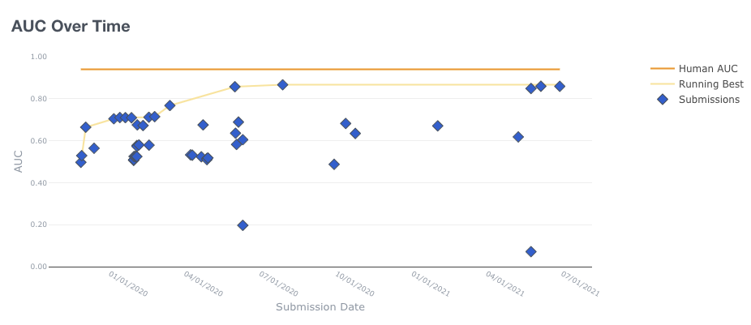
The Winograd Schema
Three reasons the results are inflated:
[Elazar et al. EMNLP’21]
1. Artifacts in the data (bias)
2. Evaluation
3. Limited Generalization
Initial dataset of 273 examples --Levesque et al., 2012
  Written by experts
2 years ago: Winogrande with 44K examples --Sakaguchi et al., 2019
  Written by crowd workers
Today:
Notes:
Check if we can separate between the first 100 and the rest

Slide 47



Standard Evaluation
We get a set of inputs, and report accuracy
  this is fine, when the data is sampled i.i.d
But this is not the case in the winograd schema!
Recall the pairs:
  The trophy doesn't fit into the brown suitcase because it is too large.
  The trophy doesn't fit into the brown suitcase because it is too small.
If a model got only one item of a pair right,
did it really understand the question?
x₁
x₂
x₃
x₄
...
x_{n}

Slide 48
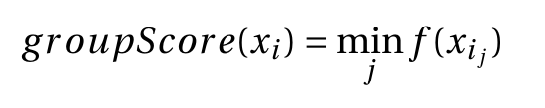
Paired Evaluation
Instead, let’s assign a point to a pair
  only if a model gets both right
This way, the risk of giving away points is reduced...
  and this evaluation becomes more robust and meaningful
The results on Winogrande go down 71.49 → 58. 45
The paired setting can be generalized to larger groups:
p₁
p₂
p*
x₁
x’₁
x₂
x’₂
x₃
x’₃
⇾
...
...
...
x_{m}
X’_{m}

Slide 49
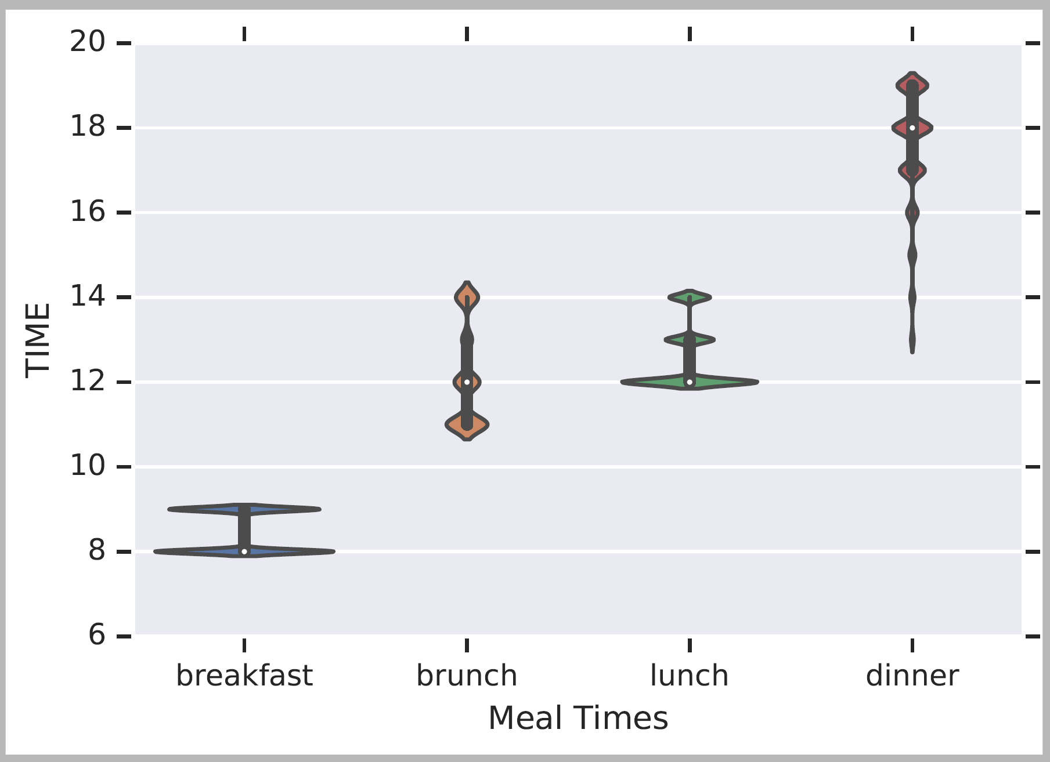
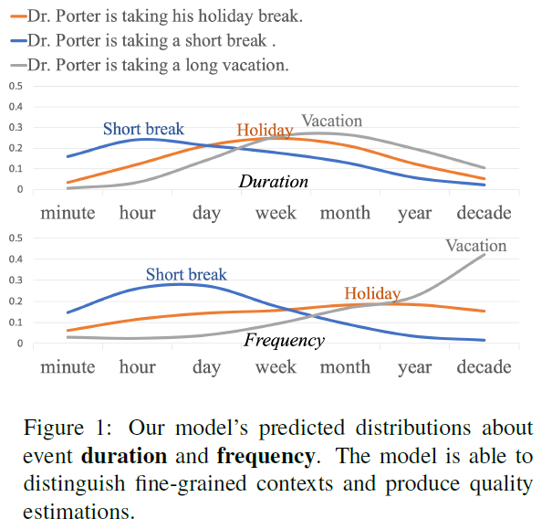
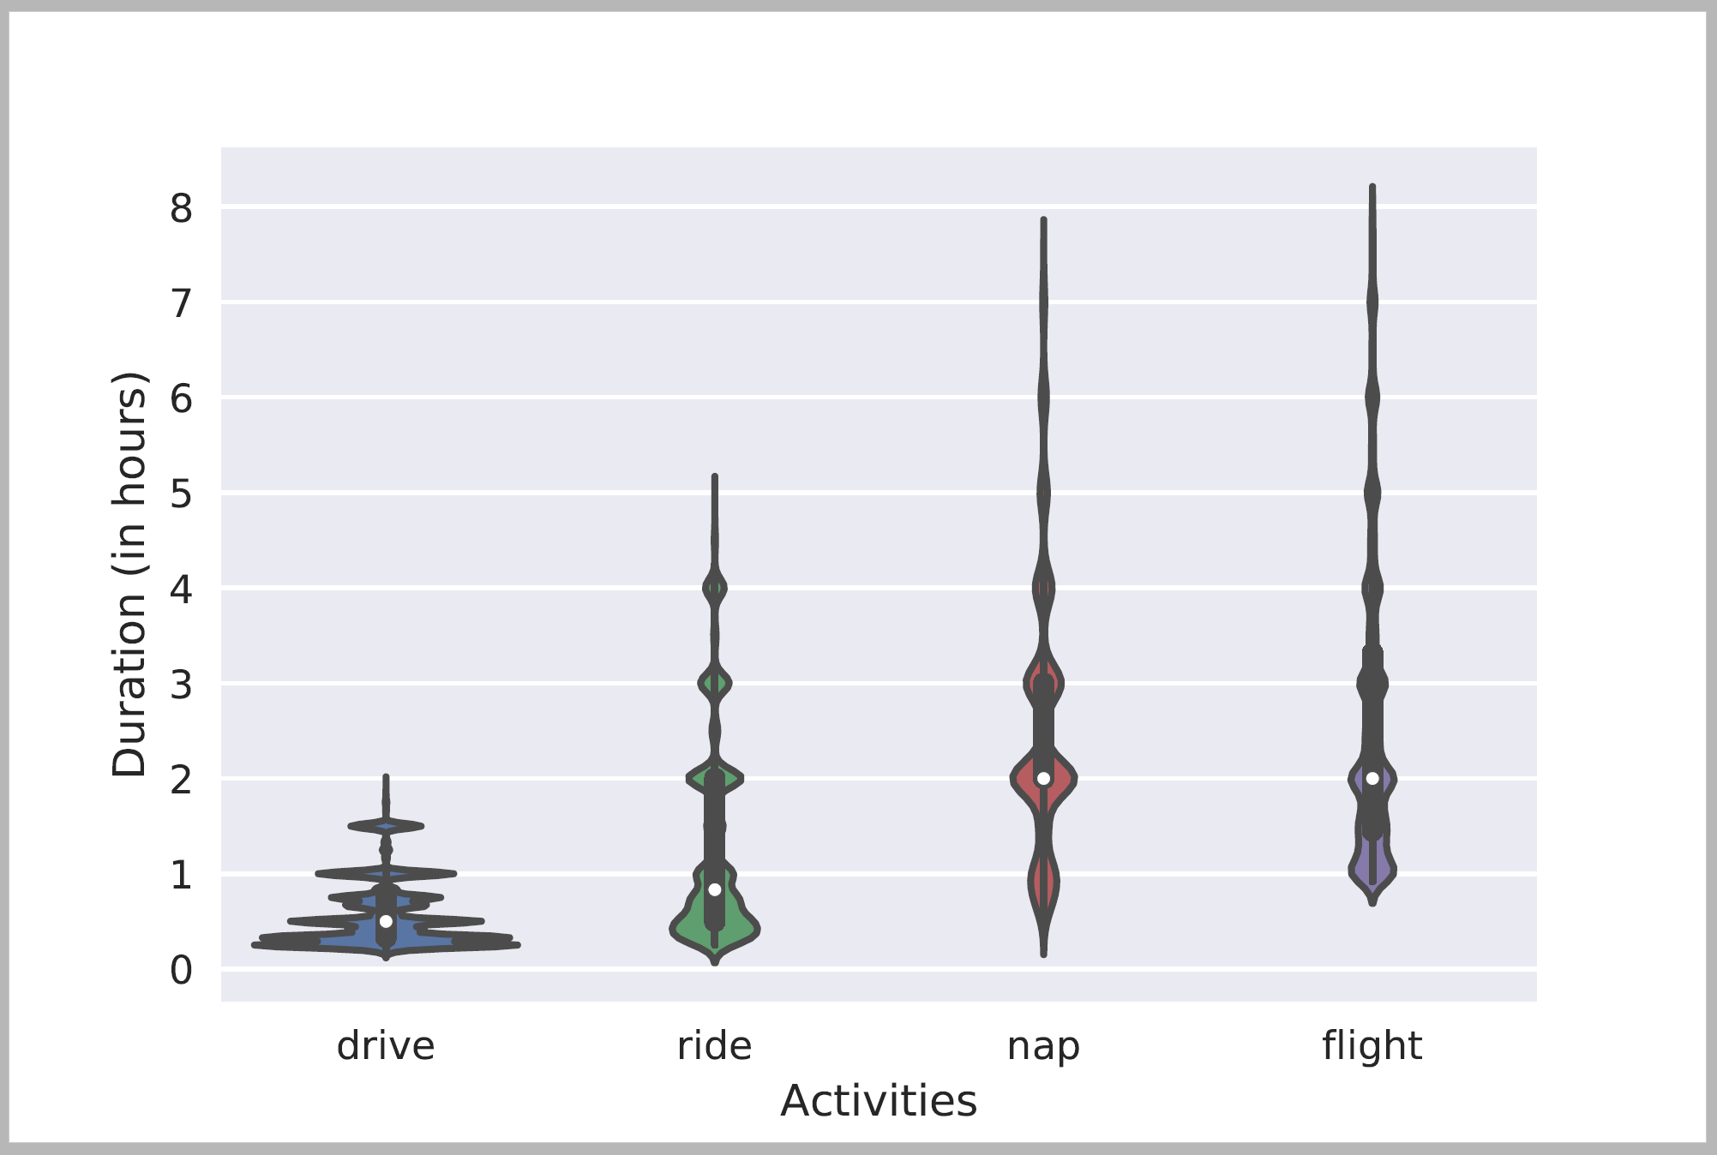
Temporal Common Sense
Two efforts:
  A dataset MC-TACO [Zhou et al. EMNLP’19]
  Acquisition + Representation [Zhou et al. ACL’20]: Duration, typical time, frequency.
Typical Time
Typical Temporal Relations
Ning et al. NAACL’18
[Zhou et al. ACL’20]
Duration
[Elazar et al. ACL’19]

Slide 50
Defining the Temporal Commonsense Challenge
MC-TACO [Zhou et al. EMNLP 2019]
  Multiple Choice TemporAl COmmon-sense
  1,893 questions; 13,225 question-answer pairs
  Querying at least one of the five dimensions:
    Duration
    Frequency
    Typical Occurring Time
    Stationarity
    Ordering
  Exact Match: the percentage of questions of which all candidates are predicted correctly (here: 0.0)
  F1: Gives partial credit (credits “accidental” correct perditions (here: 66.7%)
Gold
Prediction
He went to Duke University.
How long did it take him to graduate?
4 years
✔
10 days
✔
3.5 years
✗
16 hours
✔
Notes:
The type of systems we have today, LM based, get a lot of things right accidentally, so to really know how well we are doing we need to evaluate it carefully. In this case, we can only allow exact match as an answer.

Slide 51
Results: We are Far (from where we want to be)
It’s important to be careful when evaluating LM-based results.
We have multiple plausible answers for each question. You only understand the phenomenon if you tag all the options correctly.
13% difference
40% difference
ESIM: Enhanced LSTM for Natural Language Inference (Chen et al., 2016)
GloVe: Global Vectors for Word Representation (Pennington et al., 2014)
ELMo: Deep contextualized word representations (Peters et al., 2018)
BERT: BERT: Pre-training of Deep Bidirectional Transformers for Language Understanding (Devlin et al., 2019)
RoBERTa: A Robustly Optimized BERT Pretraining Approach (Liu et al., 2019)

Slide 52
Conclusion
Thanks!
Evaluation is important, tricky, and we are not so good at it.
  Getting results from our evaluation metrics does not mean that we know how good we are
True even for seemingly simple tasks such as Grammatical Error Correction
Summarization:
  We proposed QAEval, a QA-based metric for evaluating the content quality of summaries
    QA as an evaluation methodology is fundamentally different and better than text overlap methods
  Demonstrated state-of-the-art system-level performance
  Identified QA and answer verification as bottlenecks
Common Sense Reasoning
  Evaluations that are too relaxed credit accidentally correct predictions
    Provide misleading evaluation of where we are

Slide 53
END

Slide 54
Related Work
FEQA (Durmus et al., 2020) and
QAGS (Wang et al., 2020)
  Focus on faithfulness: is the information consistent with the input
  Compare summaries to the input documents; we compare summaries to references.
APES (Eyal et al. 2019), is the most relevant.
  Create fill-in-the-blank questions by removing named entities from the reference summary and use a reading comprehension model to predict which entity was removed using the candidate summary.
  We argue that QA as an evaluation methodology is fundamentally different and better than text overlap methods,
  Our proposed metric QAEval is more widely applicable than APES because QAEval asks and answers questions about noun phrases; APES is restricted to named entities.
  Our evaluation of QAEval is more comprehensive:

Slide 55
QA Metric Comparison
 | This Work | Eyal et al., 2019 | Wang et al., 2020 | Durmus et al., 2020
Question Source | Reference Summary | Reference Summary | Candidate Summary | Candidate Summary
Answer Type | NP Chunks | NER | 10 NER + NP | NER + NP
Question Type | Wh | Fill-in-the-blank | Wh | Wh
QA Model | SQuAD | CNN/DailyMail | SQuAD | SQuAD
Prediction Source | Candidate Summary | Candidate Summary | Input Document | Input Document
Answer Verification | EM/F1 | EM | F1 | F1

