Slide 1
Information Extraction In Low Resource Languages
Incidental Supervision and Multilingual Representations
CogComp@Penn is looking for
excellent post-docs
Dan Roth
Department of Computer & Information Science
University of Pennsylvania
With many thanks to
Stephen Mayhew, Wenpeng Yin, Xiaodong Yu
Nitish Gupta, Yangqiu Song, Shyam Upadhyay
Xingyu Fu, Jamaal Hay, Karthikeyan K, Jane Lee, Francesca Marini, Weijia Shi, Tatiana Tsygankova, Zihan Wang, Zian Zhao Google—for computational resources
November 2019
EMNLP 2019
Deep Learning for Low Resource Languages

Slide 2

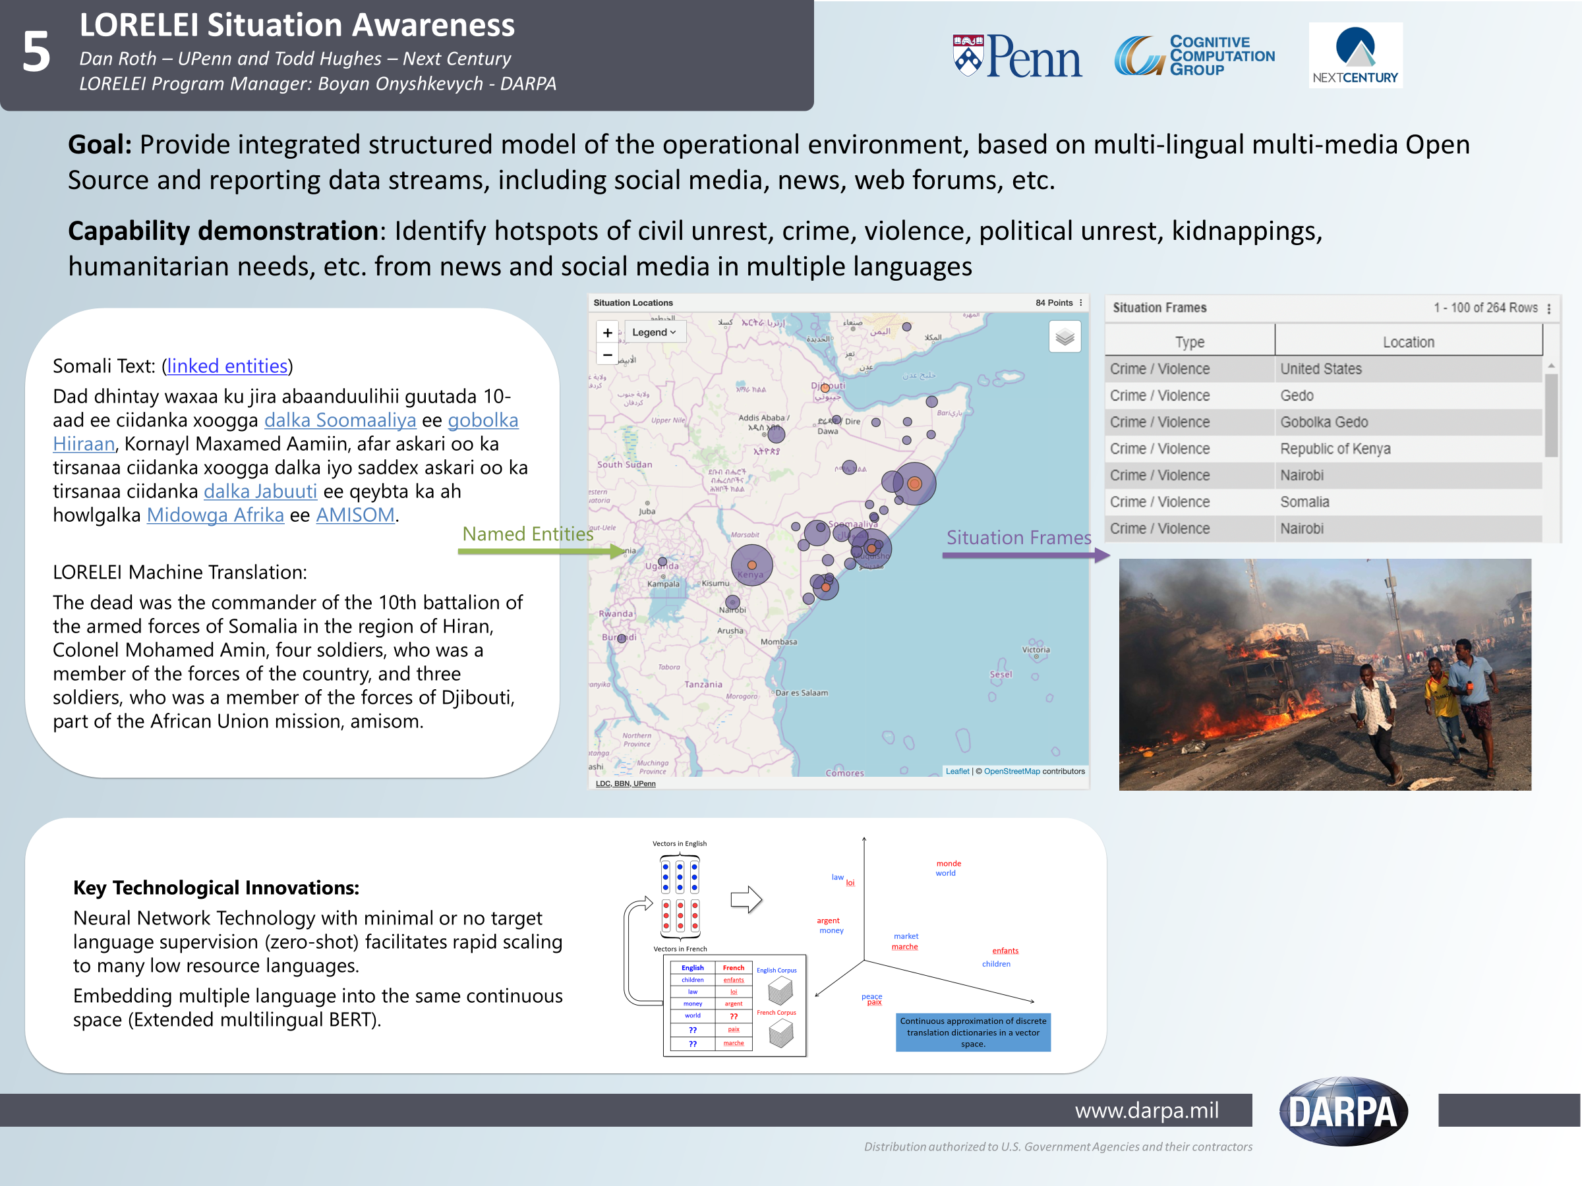
LORELEI:
Target Language Source English
DARPA-LORELEI has made a difference!
  We can do things we clearly couldn’t do 5 years ago
  Hugh impact on the community
Somali streaming data
Situation Awareness
(described in English)
What is it about?
  Topics; Events
“Understand” a situation described in Target Language
  Identify Entities & Concepts (NER)
  Ground in English Resources (EDL)

Slide 3
Incidental Supervision for Information Extraction in Low Resource Languages
We know how to develop models when it’s possible to give a lot of good annotated data
The goal is not really to solve NER for low resource languages; not even for 100 LRLs
  NER is “relatively easy” to annotate, and this can be done in a cheaper way by hiring enough annotators
The goal is to advance tasks for which it’s not realistic to annotate exhaustively
  Situation Frames is a much better representative: Involves event identification and textual entailment.
Consequently, the goal of LORELEI is to develop methods and insights and use these to develop capabilities for tasks for which there will never be enough directly annotated data
Success:
EDL, SF: no training on target language data
  Only incidental signals: Pre-training, data in other languages, Wikipedia, language specific knowledge
NER: + Bootstrapping with non-speaker, weak supervision.

Slide 4
Final LORELEI Evaluation Results
Setting:
  Two surprise languages
    2019: Odia, Ilocano
  You are given a week to develop solutions for several tasks.
.
  No annotated data; some target language data; a (limited quality) dictionary.
  Minimal (4 hours) remote exposure to native speakers (Nis)
 | Named Entities | Entity Linking | Situation Frames
IL11 (Odia) | 79.4 | 56.6 | 37.8, 16.8, 20.3 (Type, Type+Loc, nDCG)
IL12 (Ilocano) | 79.5 | 54.7 (2nd) | 34.1, 9.73, 25.65
Results in blue are the top scores among all participants
Use of many incidental signals:
Human knowledge:
  non-speaker annotation (+IL) needed to bootstrap models; declarative knowledge
Use of data that is out there, unrelated to the task: other languages & other tasks
  Using “cheap” translation; existing textual entailment data; Wikipedia; Google query logs
(Unsupervised) Pre-training of representations (extended M-BERT)
Notes:
Finfine is the name of Adis Abeba, Capital of Ethiopia

Slide 5
Talk Outline
A perspective
  What happened and where we are
Weak signals from humans
  The role on non-speakers in low-resource languages
Towards understanding M-BERT
  Looking at what makes a difference and what doesn’t

Slide 6
What Happened?

Slide 7

Cross-lingual Representations [Upadhyay et al. (ACL’16)]
Vectors in English
Research Question
What levels of supervision are needed to support multi-lingual transfer for various tasks?
monde
law
world
loi
argent
money
market
Vectors in French
marche
enfants
children
English | French
children | enfants
law | loi
money | argent
world | ??
?? | paix
?? | marche
English Corpus
peace
paix
French Corpus
Continuous approximation of discrete translation dictionaries in a vector space.

Slide 8
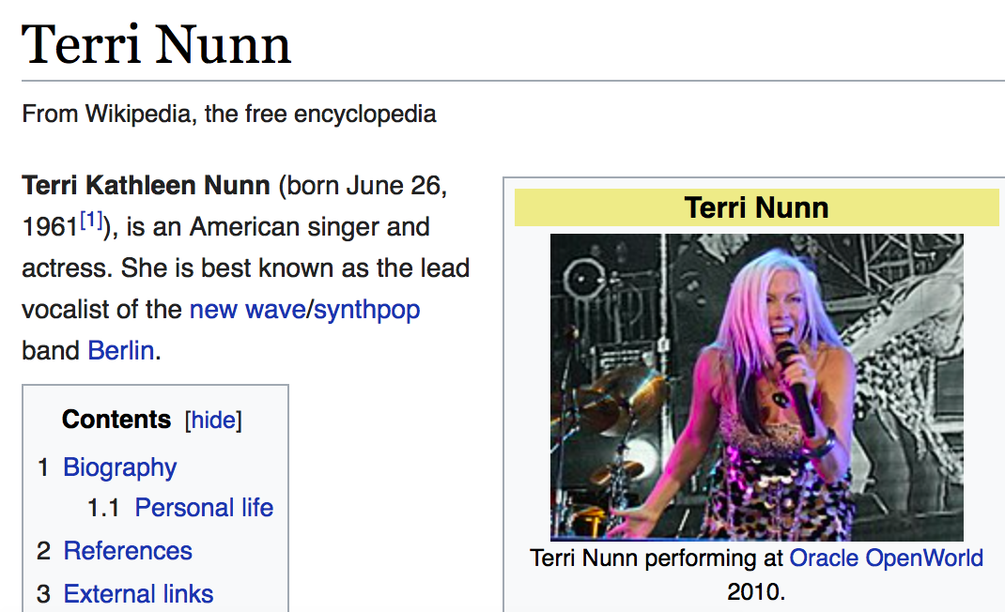
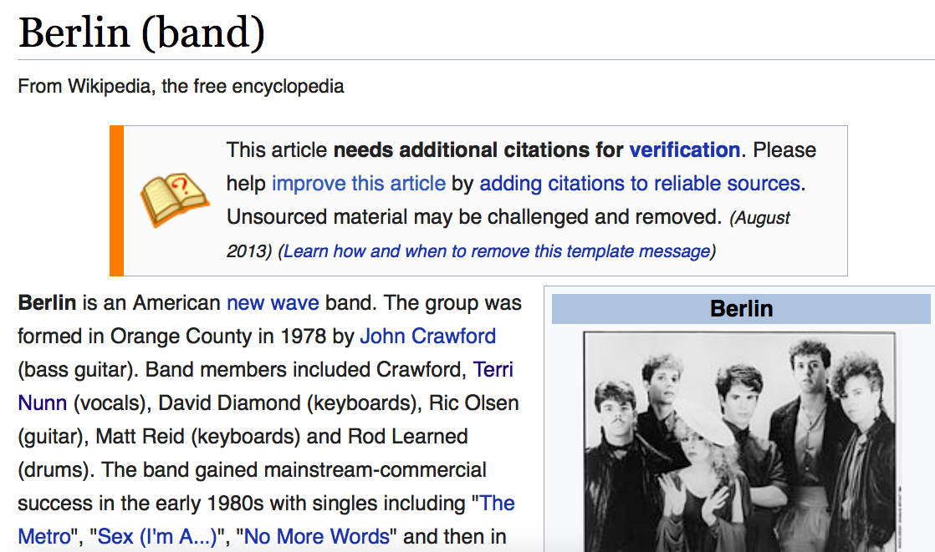
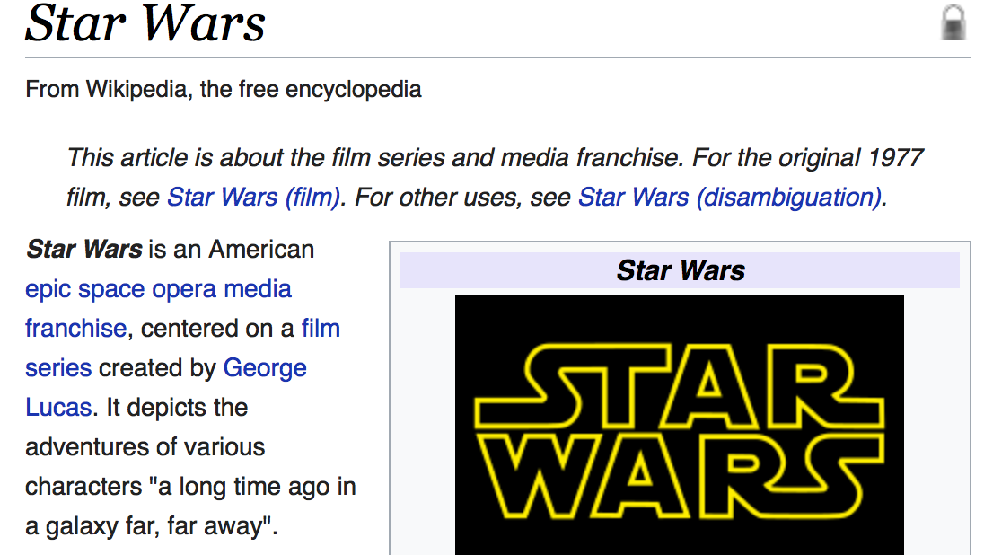
1st Cross-lingual Entity Linking (XEL) [Tsai & Roth NAACL’ 16]
Given a non-English document, extract named entities and disambiguate into the English Wikipedia (KB)
… its lead singer Nunn left Berlin to audition for Star Wars …
... sein Leadsänger Nunn verließ Berlin, um für Star Wars vorzuspielen ...
... 其主唱 纳恩 离开 柏林 去参加 星球大战 的试镜 ...
... 其主唱 纳恩 离开 柏林 去参加 星球大战 的试镜 ...
Notes:
Given a doc in a foreign language, for instance chinese, we want to identify certain spans of text and ground them to english wikipedia.
We should be able to do this regardless of the langage. Be it Germna or English. All theese sentences are translations of each other.
Note that this requires contextual understanding to identify that Berlin refers to the band and not the city.

Slide 9
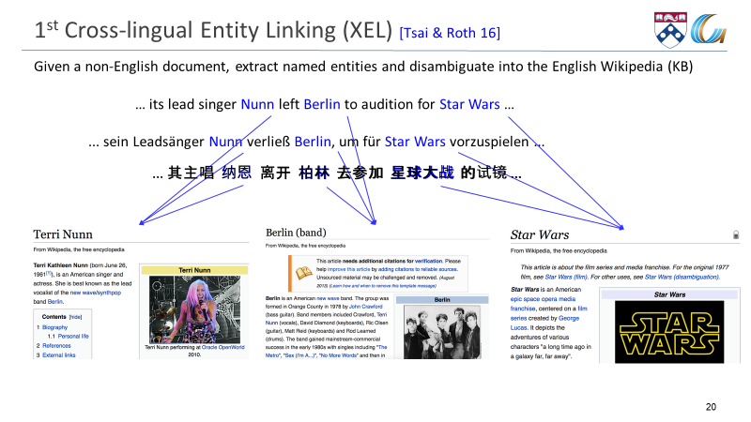
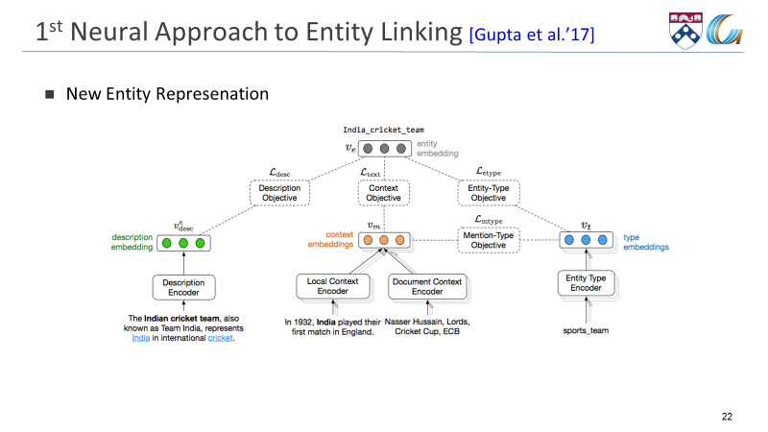
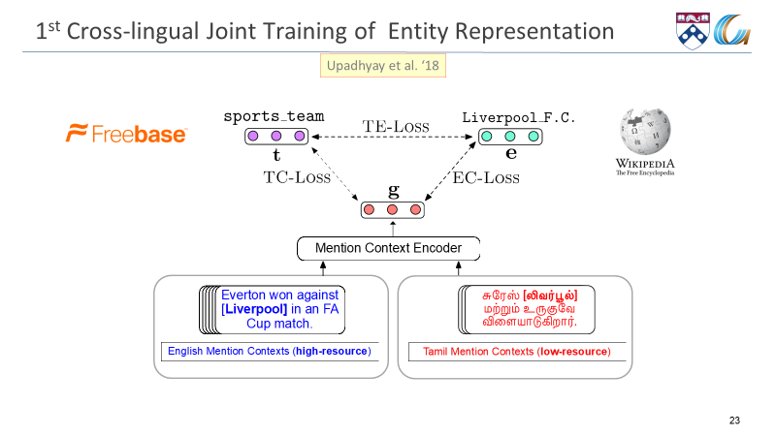
Joint Multilingual Supervision for Cross-lingual EDL
[Upadhyay et al. (EMNLP’18)]
Trains a single entity linking model for multiple languages by combining supervision from multiple languages thus facilitating EDL on low resource languages.

Slide 10


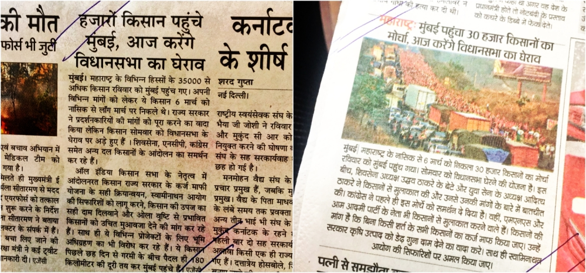
Cross-lingual Textual Classification [Song et al. IJCAI’16]
Text Classification with No Annotated data
A Wikipedia Based Representation: Cross-lingual Explicit Semantic Analysis (CL-ESA)
  Exploits existing cross-lingual links between two languages
  Represent low-resource language documents and English Labels in the corresponding CL-ESA Space
  Map representation via cross-lingual links.
  Quality depends on the (size of the) intersection of the title spaces
English Label Space
Hindi Documents
Cross lingual links
Politics
Sports
Shared Cross-lingual ESA Space
Floods
Earthquake
Notes:
To be more formal. A five step algorithm.

Slide 11
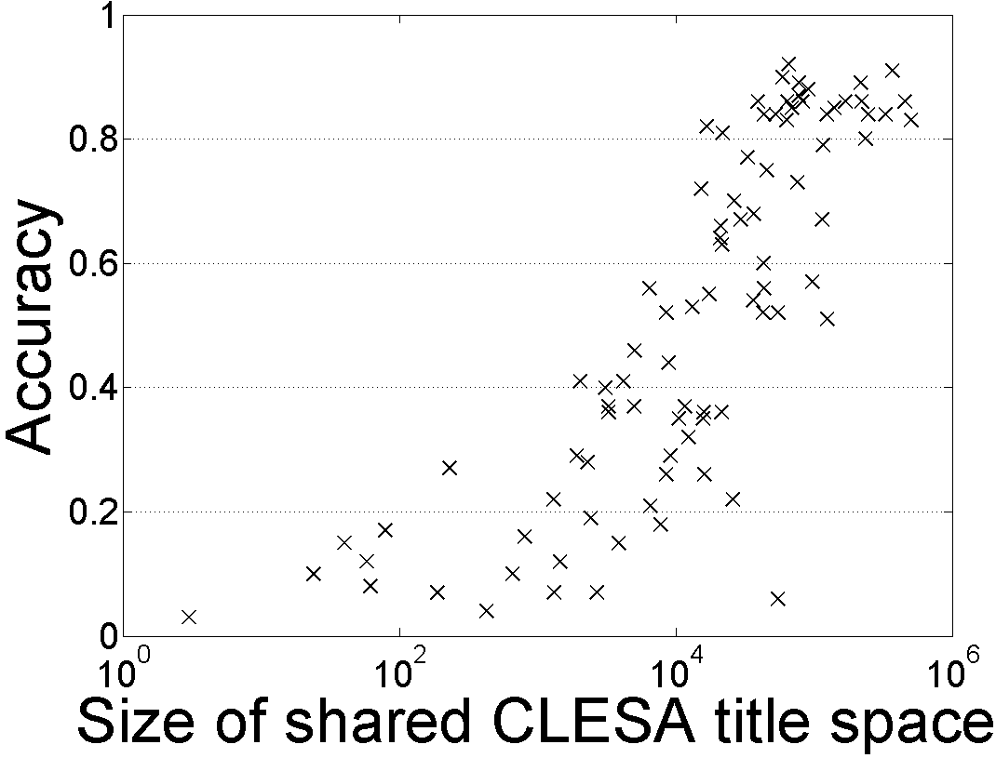
Single Document Classification (88 Language shown)
Extended to all 292 languages represented in Wikipedia
Results in English are equivalent to having 1000-2000 labels per category.
In cross-lingual classification, equivalent to having > 200 labels per category.
Dataless classification for English
Challenge I
Language Transfer
Challenge II
Beating supervised approaches
Better composition of ESA representations.
Accuracy
Hausa
Hindi
Size of shared English-Language L title space

Slide 12
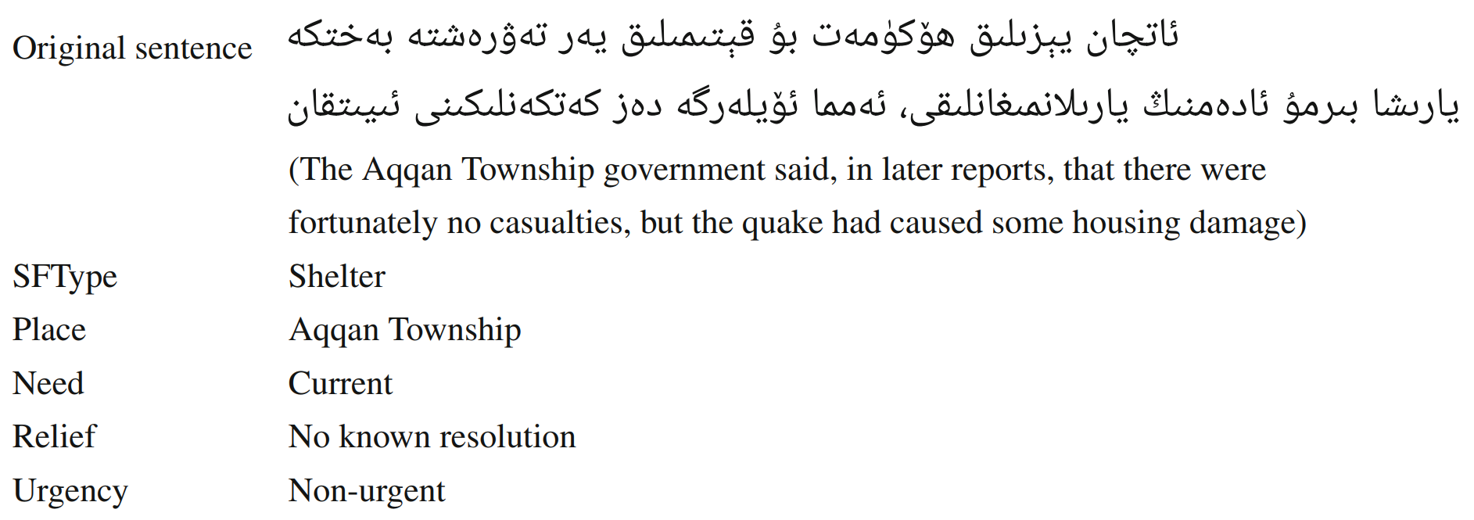
Situation Frames
No causalities, but…some housing damage ➔ there is a need for shelter
  Textual Entailment
  Templated hypotheses; lexical diversity; cross-lingual
  Here: a single document as premise. (Current work also begins to look at multi-evidence..)
Textual Inference
Text Classification
Example taken from the ARIEL-CMU LoReHLT-16 paper
Named Entities

Slide 13

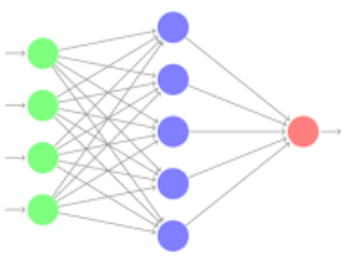
What Happened?
It’s been established that multilingual embeddings are essential to Low Resource work.
  NER, EDL, SF all rely on these representations.
BERT
  A powerful contextual language model
  M-BERT: a multilingual version – multilingual embeddings
  A single multilingual embedding for many languages.
  No direct supervision – only needs sufficient data in each languages.
Neural Everywhere
  Earlier approaches were replaced by neural models that necessitate the use of embeddings
Bi-LSTM-CRF
  Some simpler, robust, methods disappear
Averaged Perceptron
Many questions remains
  Some are addressed next in the context of NER

Slide 14
Massively Multilingual Analysis of NER
Language | 3 letter code
Akan (Twi) | aka
Amharic | amh
Arabic | ara
Bengali | ben
Farsi | fas
Hindi | hin
Hungarian | hun
Indonesian | ind
Chinese | cmn
Russian | rus
Somali | som
Spanish | spa
Swahili | swa
Tagalog | tgl
Tamil | tam
Thai | tha
Turkish | tur
Uzbek | uzb
Vietnamese | vie
Wolof | wol
Yoruba | yor
Zulu | zul
Low-resource NER:
  different methods, parameters, languages
Evaluation in 22 languages (LORELEI)
  10 different scripts
  10 language families (Niger-Congo most popular)
Methods:
  Monolingual
  Transfer with cross-lingual embeddings
  Transfer with Cheap Translation [Mayhew et al. EMNLP ‘17]
  Transfer with M-BERT
Notes:
State of the art is gerrymandered.
Patchwork understanding.

Slide 15
(i) Monolingual experiments
Train on target language text
Useful as an upper bound
CogComp & BiLSTM-CRF (2 embs)
Takeaways:
Don’t discount non-neural systems
Average about 70 F1
Averaged Perceptron based [Ratinov & Roth 09]
Notes:
Three methods are in the legend.

Slide 16
(ii) Cross-Lingual Results
English Annotation as input
Cheap Translation [Mayhew et al. EMNLP ‘17]
CP++ [Xie et al. EMNLP’18]
Takeaways:
M-BERT is best
CP and CP++ are close
Notes:
Languages in Wikipedia
Vs not languages not in Wikipedia
Mark the axes.

Slide 17
Overall: Still Ways to Go
Average of best cross-lingual (47 F1) is still less than monolingual (74 F1)
Takeaways:
Cross-lingual transfer by itself isn’t sufficient

Slide 18
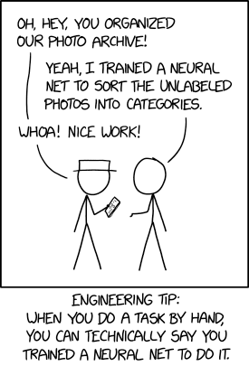
Talk Outline
A perspective
  What happened and where we are
Weak signals from humans
  The role on non-speakers in low-resource languages
Towards understanding M-BERT
  Looking at what makes a difference and what doesn’t

Slide 19
NER with Partial Annotation
Romanized Bengali
Weak signals:
  High precision, low recall signal
  Tomorrow: [Mayhew et al.’CoNLL 19] describes an algorithmic approach that allows training high quality NER from such partial annotation given by non-native speaker.
ebisi’ra giliyyaana phinnddale aaja pyaalestaaina adhiinastha gaajaa theke aaja raate ekhabara jaaniyyechhena .
ABC’s Gillian Findale has reported from Gaza in Palestine today.
Notes:
If you or I annotated this sentence, chances are we would have high-precision / low-recall annotations.
Success of non-speaker annotations is one of the biggest lessons of LORELEI EDL.

Slide 20
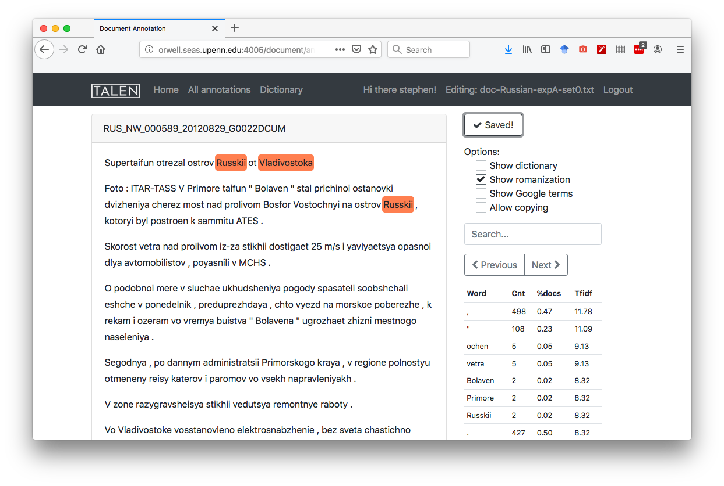
What Can We Get from Non-Speakers?
Experimental questions:
Can non-speaker (NS) annotators produce meaningful annotations?
How to compare NS annotations against a native informant (NI)
How best to combine NS/NI annotations?
Human annotation experiment:
Annotating Russian data using TALEN [Mayhew & Roth, ACL-Demo’18]
  Many bells and whistles
All annotations are done on romanized gold annotated data
  Gold annotations removed
Completed over 4 sessions (45 min each)
NI, 3 committed NS annotators, 4+ non-committed NS annotators
Notes:
Why Russian?
Access to an NI.
We also did this experiment in Tamil, but there were some procedural issues, which make our annotations look good.

Slide 21
Non-Speaker (NS) Annotation: How Good Is It?
Fixed wall clock time: 3 hours
Not Good, but comparable in performance with an NI model
 | NI | Combined NS
Annotation time | 3 hrs | ~15 person hrs
Dataset size (tokens) | 19k | 36k
Annotation quality (F1) | 76.5 | 47.8
Model performance (F1) | 55.6 | 49.6
Notes:
Ceiling is 70 (gold monolingual)

Slide 22
How Best to Use the NI?
Don’t get too excited:
NS (and NI) annotation are not sufficient, but are essential to bootstrap a model.
Our best models make use of it, but improve by 30+%, with cross-lingual training.
Giving the NI pre-annotated documents (by the NS) dramatically increases efficiency (2x)
Fixed budget of 1 hour
(Small study, on Russian; others in progress)
 | NI from scratch | Combined NS -> NI
Annotation time | 1 hr | (~4.5 hrs) -> 1 hr
Dataset size (tokens) | 4k | 9k
Annotation quality (F1) | 75.7 | 71.0
Model performance (F1) | 30.6 | 44.3

Slide 23
Talk Outline
A perspective
  What happened and where we are
Weak signals from humans
  The role on non-speakers in low-resource languages
Towards understanding M-BERT
  Looking at what makes a difference and what doesn’t

Slide 24
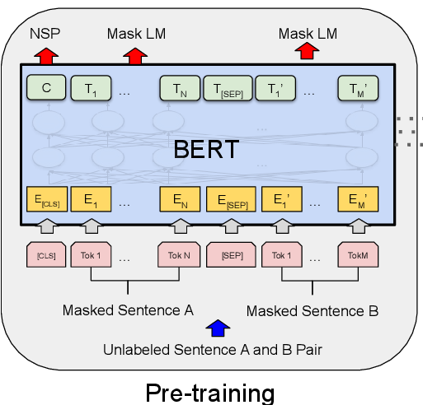
Multilingual BERT
BERT
  A transformer-based pre-training language model.
  Training objectives: Masked Language Modelling (MLM) and Next Sentence Prediction (NSP)
  Input: A pair of sentences S1 and S2, such that half of the time S2 comes after S1 in the original text and the other half of time S2 is a randomly sampled sentence.
  Data: English Wikipedia and Books corpus
Multilingual BERT (M-BERT) ?
  Same training procedure as BERT except the data.
  Data – Wikipedia text from top 104 languages
  No specific cross-lingual objectives or any cross-lingual data.

Slide 25
Surprisingly Cross Lingual
Cross-lingual: Train on one language and test on another language
M-BERT is trained without any cross-lingual objectives but it is cross-lingual
System | English | Chinese | Spanish | German | Arabic | Urdu
XNLI Baseline - Translate | 73.7 | 67.0 | 68.8 | 66.5 | 65.8 | 56.6
BERT - Translate Train | 81.4 | 74.2 | 77.3 | 75.2 | 70.5 | 61.7
M-BERT - Transfer | 81.4 | 63.8 | 74.3 | 70.5 | 62.1 | 58.3
We can see that M-BERT transfers from English to other languages very well
[XNLI paper: Conneau et al.’18]

Slide 26
Why is M-BERT Cross-lingual?
What components of M-BERT are important for its cross-lingual ability?
We consider three dimensions:
  Linguistics: What is the contribution of word-piece overlap and language similarity?
  Architecture: How do depth, multi-head attention, and total number of parameters affect the cross-lingual ability of M-BERT?
  Input and Learning Objective: Is Next Sentence Prediction or language identification really important? Is word or character vocabulary better than word-piece vocabulary ?

Slide 27
Experimental Setting
Languages:
  English is always the source language
  3 typologically different target languages: Spanish, Hindi, and Russian
Bilingual BERT (B-BERT) – BERT trained on two languages.
  B-BERT trained on language A and B is denoted as A-B
  en-hi -- B-BERT trained on English (en) and Hindi (hi), similarly for Spanish (es) and Russian (ru)
Tasks:
  Two conceptually different tasks: Textual Entailment and named entity recognition (NER)
    TE: the XNLI dataset
    Cross-lingual NER: LORELEI dataset

Slide 28
Linguistics (1): Word-piece Overlap
BERT’s representation is based on word-pieces
Hypothesis: M-BERT works due to overlapping word-pieces
  M-BERT generalizes across languages because of shared word-pieces across languages that are mapped to a shared feature space.
Indeed, texts in different languages share some common word-piece vocabulary
  Numbers, named entities, even actual words (when the script is shared).
  We refer to this as word-piece overlap.

Slide 29
Removing word-piece overlap
To study the effect of word-pieces we should compare the models with and without it, but how to get a model without word-piece overlap?
  Fake English (enfake)
Fake-English
  Shifting the Unicode of each character in English Wikipedia text by a large constant so that there is strictly no character overlap with any other Wikipedia text
  English and Fake-English don’t share any vocabulary/characters, but they have exactly the same structure.
  We measure the contribution of word-piece overlap as the drop in performance when we use Fake-English instead of English.

Slide 30
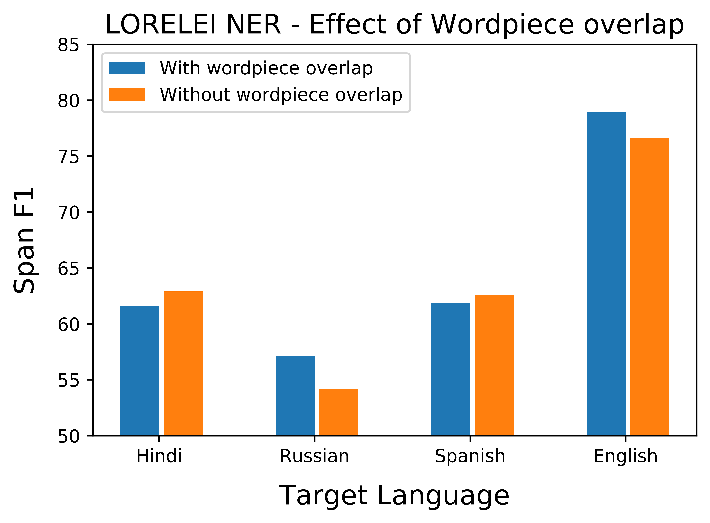
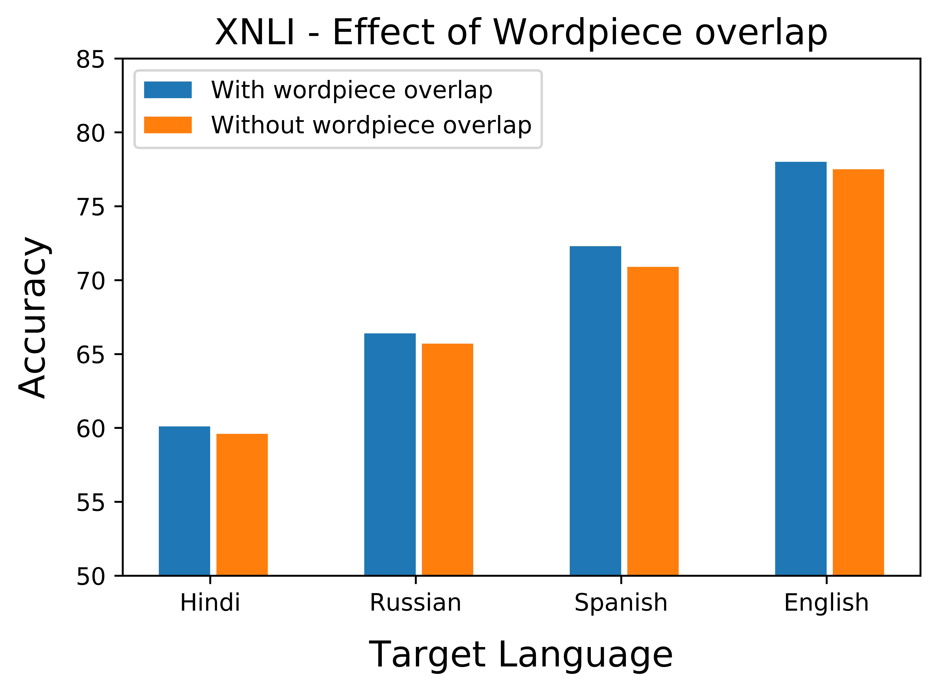
Impact of word-piece overlap
Setting:
  Train a pair of B-BERTs
    English-L vs. FakeEnglish-L
  Tune on English (FakeEnglish, resp.) data
  Test on the target Language
  (Right most: Eng-FakeEnglish B-BERT; tune on FakeEnglish; test on both)
B-BERT is cross-lingual even when there is absolutely no word-piece overlap

Slide 31
Linguistics (2): Structural Similarity
Structure of a language
  In today’s context, we define “structure” to include every aspect of the language that is invariant to its script.
  E.g., morphology, word-ordering, word frequency, word-pair frequency, etc.
Note that English and Fake-English do not share any vocabulary or characters
  but they have exactly the same structure
Intuitively, English and Spanish are more “structurally similar” than (English, Hindi) and (English, Russian).

Slide 32

The Impact of Structural Similarity
The same setting:
  Train a pair of B-BERTs
    English-L vs. FakeEnglish-L
  Tune on the English (or FakeENglish) data
  Test on the target Language
Fake-English transfers to English almost perfectly.
  And transfers to other languages as English does.
Quality of transfer:
  (English, Hindi) < (English, Russian) < (English, Spanish) < (English, FakeEnglish)
In all pairs: no word-piece overlap
  The transferability is due to the structural similarity between language L and (Fake)-English.
Leaves more questions on the specific aspects of structural similarity that matters.

Slide 33
The Impact of Structural Similarity
B-BERT | Train | Test | XNLI
 |  |  | Accuracy
en-es | en | es | 72.3
enfake-es | enfake |  | 70.9
en-hi | en | hi | 60.1
enfake-hi | enfake |  | 59.6
en-ru | en | ru | 66.4
enfake-ru | enfake |  | 65.7
en-enfake | enfake | enfake | 78.0
en-enfake | enfake | en | 77.5
The same setting:
  Train a pair of B-BERTs
  Tune on the English (or FakeENglish) data
  Test on the target Language
Fake-English transfers to English almost perfectly.
  And transfers to other languages as English does.
Quality of transfer:
  (English, Hindi) < (English, Russian) < (English, Spanish) < (English, FakeEnglish)
In all pairs: no word-piece overlap
  The transfer ability is due to the structural similarity between Spanish and (Fake)-English.
Leaves more questions on the specific aspects of structural similarity that matters.

Slide 34
Architecture
Here we study:
  The depth of the Transformer structure
  Number of attention heads
  Total number of parameters

Slide 35
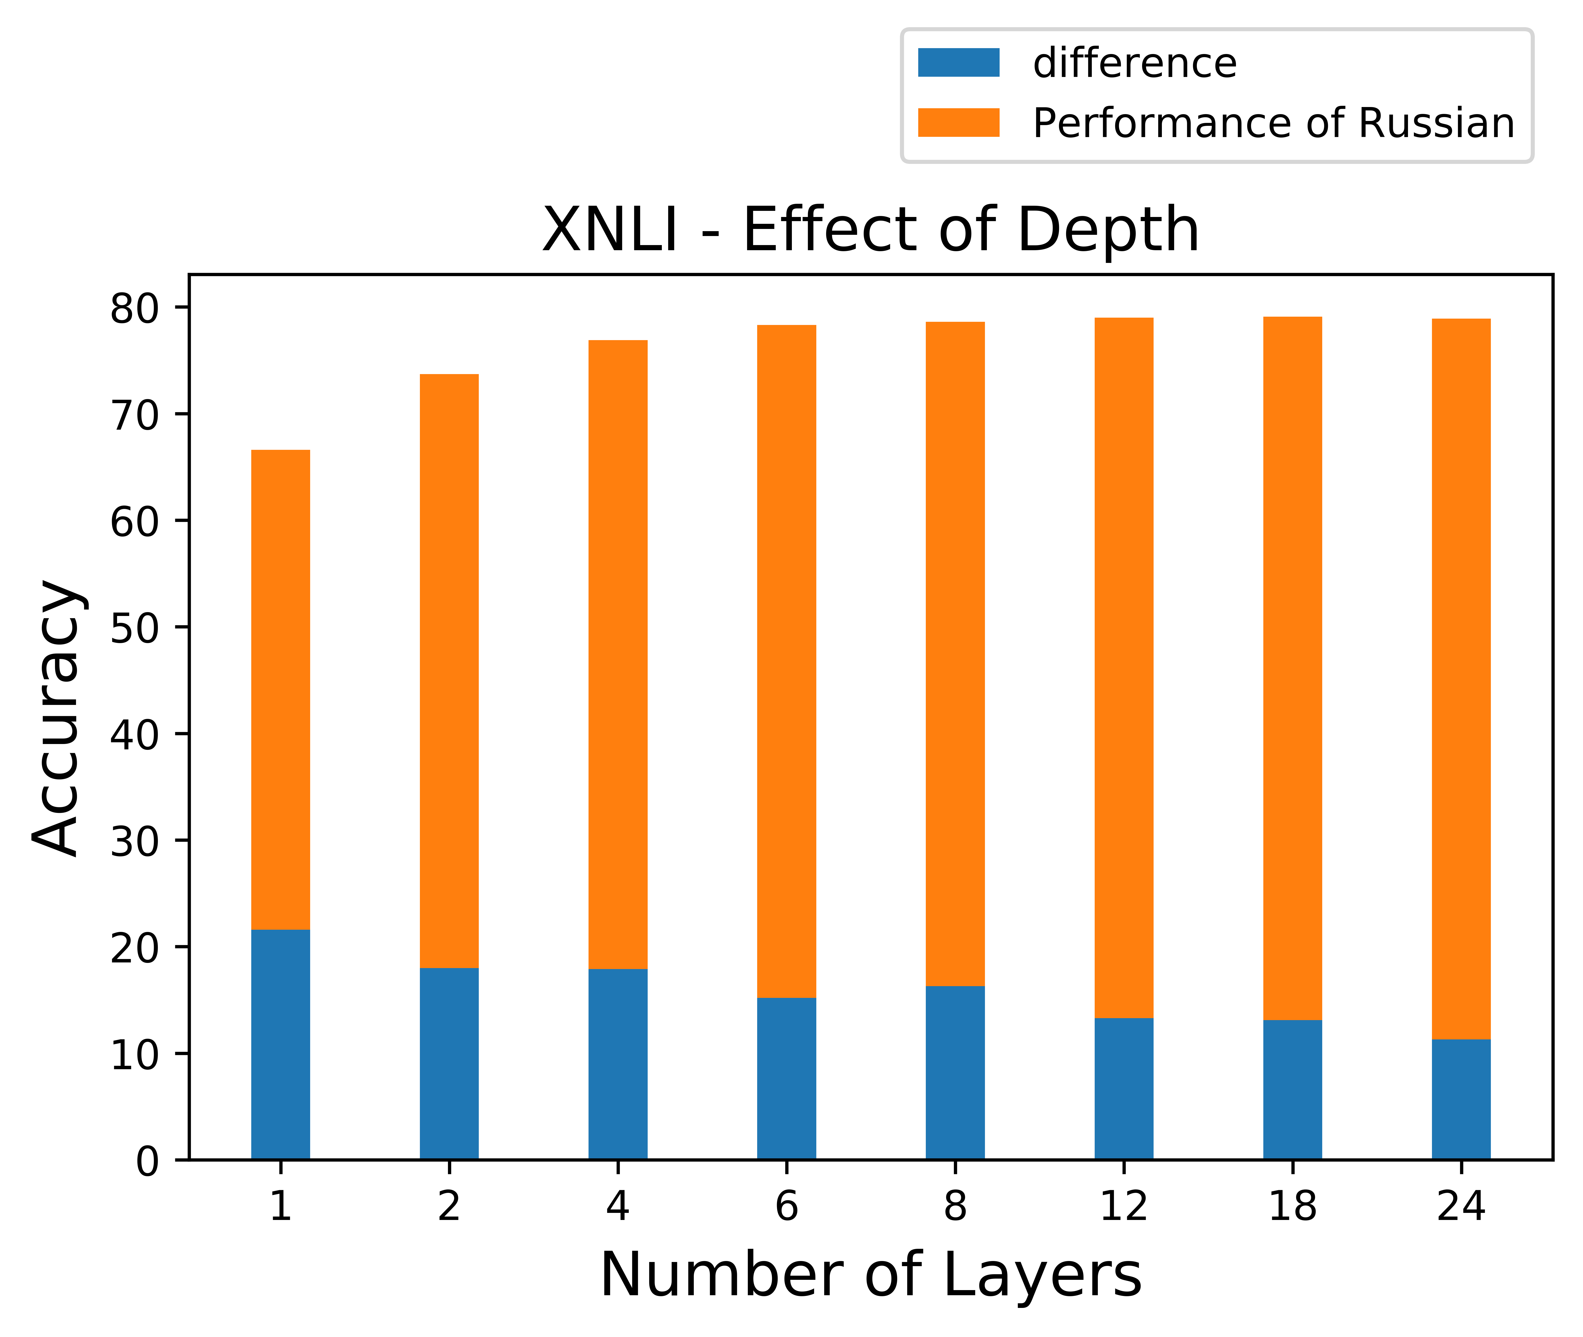
Architecture (1): Depth is critical
We vary depth
  Fix #(attention heads)
  Fix #(parameters)
    the size of the hidden and intermediate units is changed so that the total number of parameters remains almost the same
Measure cross-lingual transfer as the difference between the performance on Fake-English and vs. performance on Russian.
  Similar results in other languages.
Deeper models (1) perform better and (2) transfer better.

Slide 36
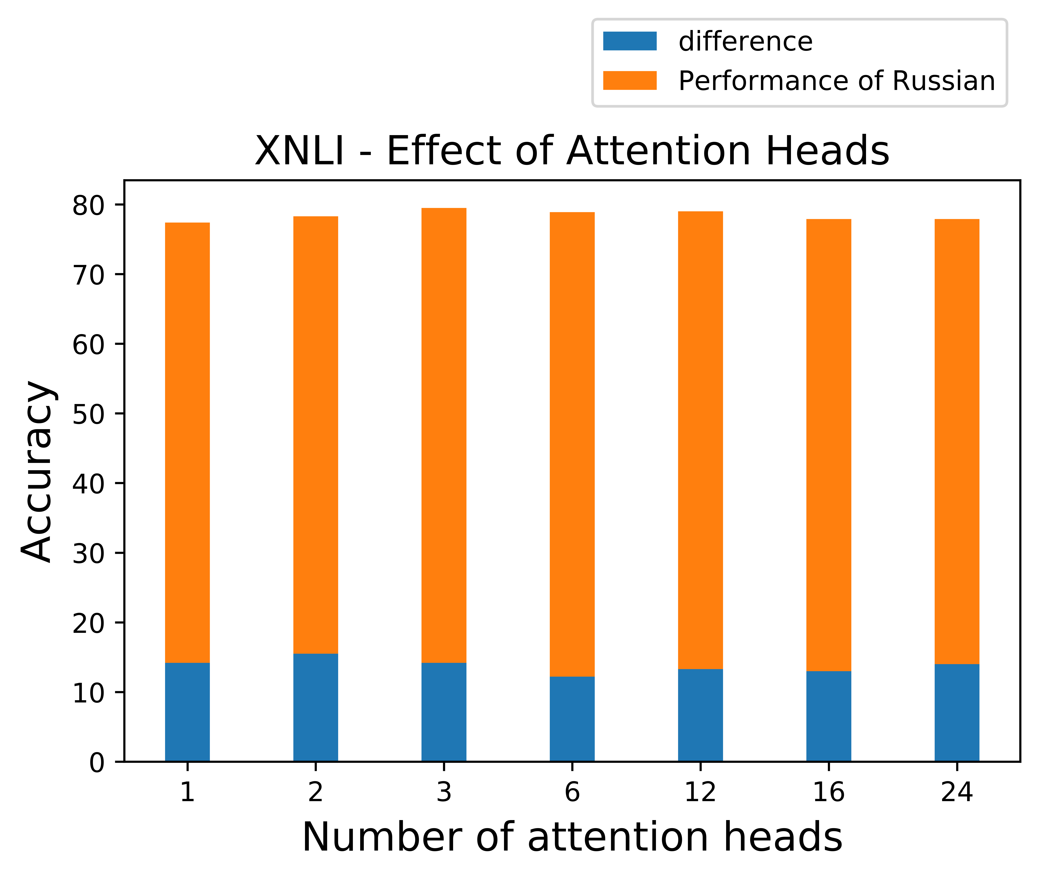
Architecture (2) #(Attention Heads)
We vary #(attention heads)
  Fix Depth
  Fix #(parameters)
Measure cross-lingual transfer as the difference between the performance on Fake-English and vs. performance on Russian.
  Similar results in other languages.
B-BERT ability to transfer exists even with a single attention head

Slide 37
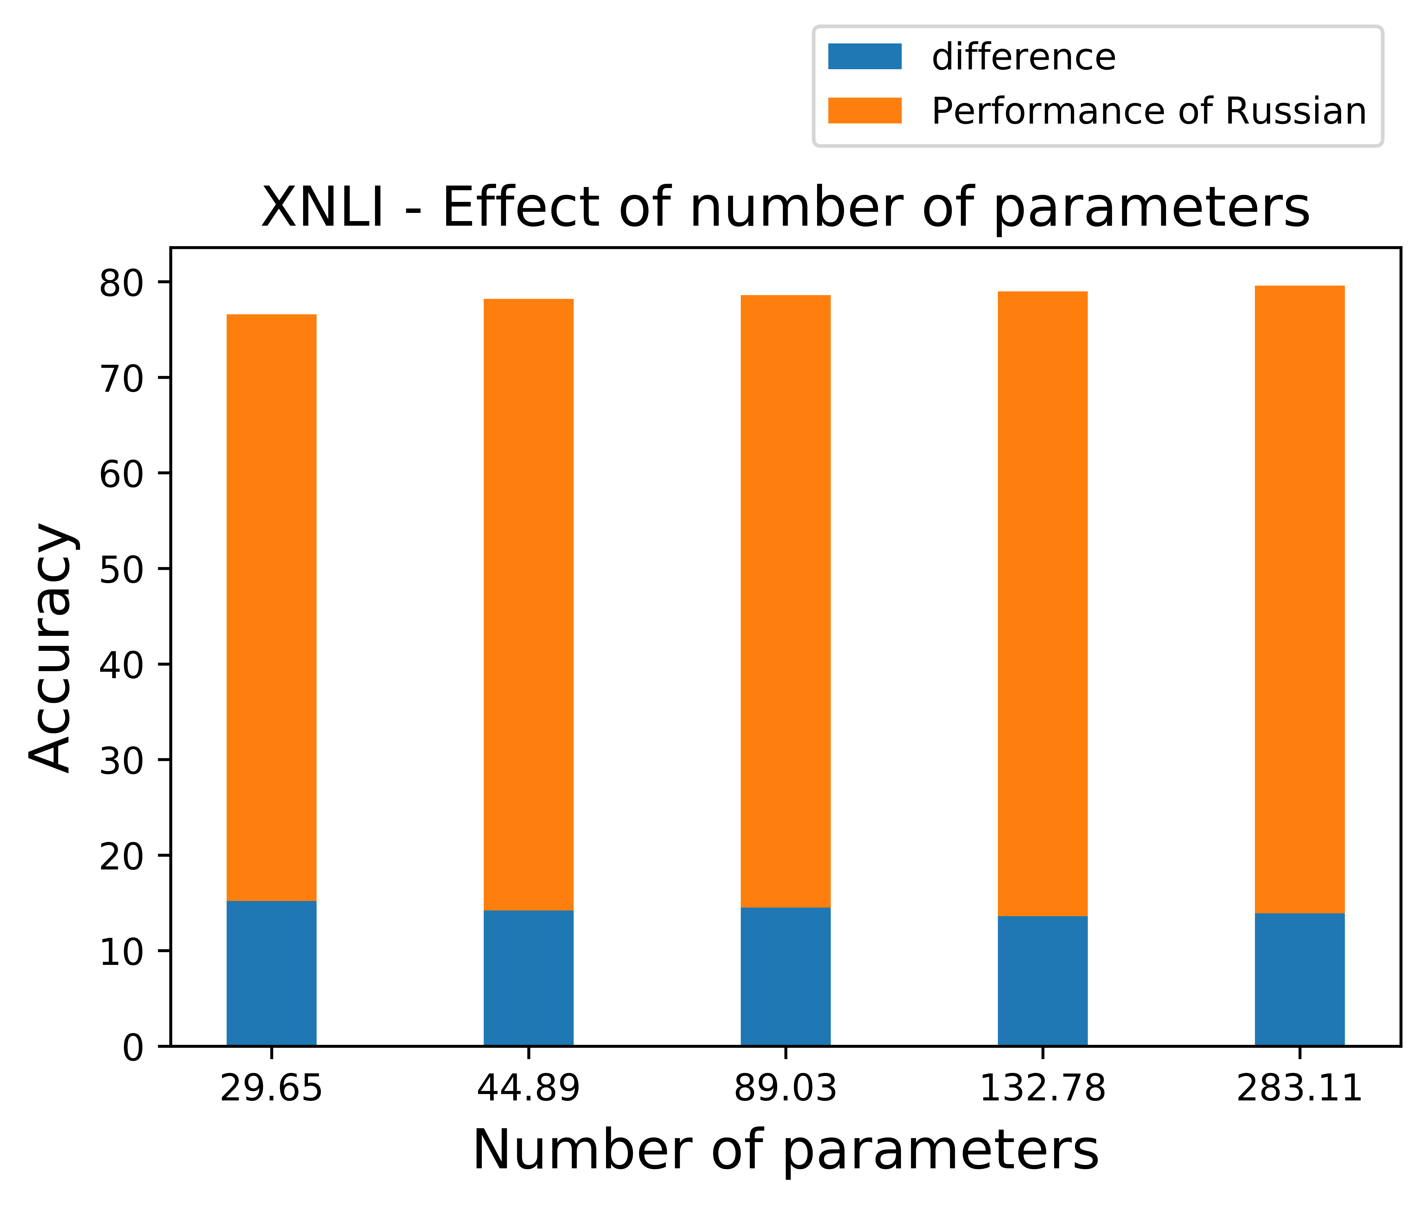
Architecture (3) #(Parameters)
We vary #(parameters)
  by changing size of hidden and intermediate units
  Fix #(attention heads)
  Fix Depth
Measure cross-lingual transfer as the difference between the performance on Fake-English and vs. performance on Russian.
  Similar results in other languages.
The #(parameters) isn’t as significant as depth
  But, below some threshold, #(parameters) seems significant (not shown)

Slide 38
Architecture (3) #(Parameters)
We vary #(parameters)
  by changing size of hidden and intermediate units
  Fix #(attention heads)
  Fix Depth
The #(parameters) isn’t as significant as depth
  But, below some threshold, #(parameters) seems significant
Parameters (M) | Depth | Multi-head Attn | XNLI
 |  |  | Fake-English | Russian | Gap
7.87 | 3 | 3 | 0.685 | 0.432 | 0.253
12.19 | 3 | 3 | 0.701 | 0.441 | 0.260
16.78 | 3 | 3 | 0.708 | 0.504 | 0.204
8.40 | 6 | 6 | 0.702 | 0.497 | 0.205
13.37 | 6 | 6 | 0.724 | 0.562 | 0.162
18.87 | 6 | 6 | 0.733 | 0.544 | 0.189
29.65 | 12 | 12 | 0.766 | 0.614 | 0.152
44.89 | 12 | 12 | 0.782 | 0.640 | 0.142
89.03 | 12 | 12 | 0.786 | 0.641 | 0.145
283.11 | 12 | 12 | 0.796 | 0.654 | 0.142
132.78 | 12 | 12 | 0.790 | 0.657 | 0.133

Slide 39
Input and Learning Objective
Does Next Sentence Prediction affect cross-lingual ability ?
  Yes, it hurts performance. Even more than in the monolingual case.
Can we include Language Identity in the input to B-BERT ?
  Adding language identify markers to the input does not make a difference.
What is the impact of token representation (Character vs Word-piece vs Word)?
  word-piece tokenized input is better than both
  It seems to carry more information than characters, and address unseen words better than words.

Slide 40
Conclusion
Thank You!
Huge progress in Low Resource NLP
  Mostly in “easy” tasks
  Some in Event-related and TE tasks
  But higher-level tasks still a challenge
Discussed some of the work in this context
  Importance of Contextual Embeddings!
    And some understanding of it
  Weak signals are strong!
    Cheap Translation
    Bootstrapping from non-speakers
We still have ways to go.
Somali streaming data
Situation Awareness
(described in English)
CogComp@Penn is looking for
excellent post-docs

