Slide 1
Learning and Inference for
Natural Language Understanding
Dan Roth
Department of Computer Science
University of Illinois at Urbana-Champaign
With thanks to:
Collaborators: Ming-Wei Chang, Dan Goldwasser, Gourab Kundu,
Lev Ratinov, Vivek Srikumar; Scott Yih, Many others
Funding: NSF; DHS; NIH; DARPA; IARPA, ARL, ONR
DASH Optimization (Xpress-MP); Gurobi.
April 2014
European ACL, Gothenburg, Sweden

Slide 2
Comprehension
(ENGLAND, June, 1989) - Christopher Robin is alive and well. He lives in England. He is the same person that you read about in the book, Winnie the Pooh. As a boy, Chris lived in a pretty home called Cotchfield Farm. When Chris was three years old, his father wrote a poem about him. The poem was printed in a magazine for others to read. Mr. Robin then wrote a book. He made up a fairy tale land where Chris lived. His friends were animals. There was a bear called Winnie the Pooh. There was also an owl and a young pig, called a piglet. All the animals were stuffed toys that Chris owned. Mr. Robin made them come to life with his words. The places in the story were all near Cotchfield Farm. Winnie the Pooh was written in 1925. Children still love to read about Christopher Robin and his animal friends. Most people don't know he is a real person who is grown now. He has written two books of his own. They tell what it is like to be famous.
1. Christopher Robin was born in England. 2. Winnie the Pooh is a title of a book.
3. Christopher Robin’s dad was a magician. 4. Christopher Robin must be at least 65 now.
This is an Inference Problem
Notes:
2
This is the problem I would like to solve. You are given a short story, a document, a paragraph, which you would like to understand. And a few questions, that you would like to answer to indicate your understanding of the story. Here I have rephrased the questions as statements, so we can think about it from the TE perspective; So, given some statement, I would like to know if they are true in this story or not….
This is a very difficult task…
This is a story that is given to 2nd-3rd graders as part of a language comprehension task.
What do we need to know in order to have a chance to do that? … Many things….
And, there are probably many other stand-alone tasks of this sort that we need to be able to address, if we want to have a chance to COMPREHEND this story, and answer questions with respect to it.
But comprehending this story, being able to determined the truth of these statements is probably a lot more than that – we need to be able to put these things,
(and what is “these” isnt’ so clear) together.
Any interesting question involves resolving some subset of these problems – a different subset every time, along with integrating with external information, that is not mentioned in this story.

Slide 3



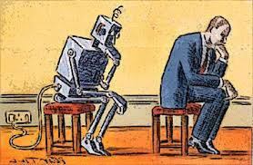
What is Needed?
Notes:
Clearly, we need to know a lot of things – things that are not part of the text we currently read, things that we brought from home.
But, as important, we need to know how to use knowledge – some notion of reasoning with knowledge.
We need to learn – most of the things we know and use are going to be models that are trained somehow; I call it here “training on the go” since I’d like to emphasize one training paradigm that I believe, we need to put more emphasis on. And finally, we need to scale things up; I will talk about one aspect of it – given that we need to do a lot of thinking, I think that we need better ways to re-use things we have done in the past
3

Slide 4
Comprehension
(ENGLAND, June, 1989) - Christopher Robin is alive and well. He lives in England. He is the same person that you read about in the book, Winnie the Pooh. As a boy, Chris lived in a pretty home called Cotchfield Farm. When Chris was three years old, his father wrote a poem about him. The poem was printed in a magazine for others to read. Mr. Robin then wrote a book. He made up a fairy tale land where Chris lived. His friends were animals. There was a bear called Winnie the Pooh. There was also an owl and a young pig, called a piglet. All the animals were stuffed toys that Chris owned. Mr. Robin made them come to life with his words. The places in the story were all near Cotchfield Farm. Winnie the Pooh was written in 1925. Children still love to read about Christopher Robin and his animal friends. Most people don't know he is a real person who is grown now. He has written two books of his own. They tell what it is like to be famous.
1. Christopher Robin was born in England. 2. Winnie the Pooh is a title of a book.
3. Christopher Robin’s dad was a magician. 4. Christopher Robin must be at least 65 now.
This is an Inference Problem
Notes:
4
A nice case showing that we need a combination of understanding what’s in this specific text, as well as bringing some knowledge from the outside…

Slide 5
Learning and Inference
Global decisions in which several local decisions play a role but there are mutual dependencies on their outcome.
  In current NLP we often think about simpler structured problems: Parsing, Information Extraction, SRL, etc.
  As we move up the problem hierarchy (Textual Entailment, QA,….) not all component models can be learned simultaneously
  We need to think about:
    (learned) models for different sub-problems
    reasoning with knowledge relating sub-problems
    knowledge may appear only at evaluation time
Goal: Incorporate models’ information, along with knowledge (constraints) in making coherent decisions
  Decisions that respect the local models as well as domain & context specific knowledge/constraints.
Many forms of Inference; a lot boil down to determining best assignment
Notes:
5
With this example in mind, it is clear that we need to think about how to make global decision, in which….

Slide 6
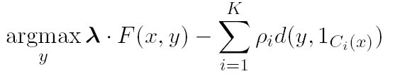
Constrained Conditional Models
Penalty for violating
the constraint.
(Soft) constraints component
Weight Vector for “local” models
Features, classifiers; log-linear models (HMM, CRF) or a combination
How far y is from
a “legal” assignment
How to solve?
This is an Integer Linear Program
Solving using ILP packages gives an exact solution.
Cutting Planes, Dual Decomposition & other search techniques are possible
How to train?
Training is learning the objective function
Decouple? Decompose?
How to exploit the structure to minimize supervision?

Slide 7
Three Ideas Underlying Constrained Conditional Models
Modeling
Idea 1:
Separate modeling and problem formulation from algorithms
  Similar to the philosophy of probabilistic modeling
Idea 2:
Keep models simple, make expressive decisions (via constraints)
  Unlike probabilistic modeling, where models become more expressive
Idea 3:
Expressive structured decisions can be supported by simply
learned models
  Global Inference can be used to amplify simple models (and even allow training with minimal supervision).
Inference
Learning

Slide 8
Examples: CCM Formulations
CCMs can be viewed as a general interface to easily combine declarative domain knowledge with data driven statistical models
  Formulate NLP Problems as ILP problems (inference may be done otherwise)
    1. Sequence tagging (HMM/CRF + Global constraints)
    2. Sentence Compression (Language Model + Global Constraints)
    3. SRL (Independent classifiers + Global Constraints)
Constrained Conditional Models Allow:
Learning a simple model (or multiple; or pipelines)
Make decisions with a more complex model
Accomplished by directly incorporating constraints to bias/re-rank global decisions composed of simpler models’ decisions
More sophisticated algorithmic approaches exist to bias the output [CoDL: Cheng et. al 07,12; PR: Ganchev et. al. 10; DecL, UEM: Samdani et. al 12]
Sequential Prediction
HMM/CRF based:
Argmax ∑ ¸_{ij} x_{ij}
Sentence Compression/Summarization:
Language Model based:
Argmax ∑ ¸_{ijk} x_{ijk}
Linguistics Constraints
Cannot have both A states and B states in an output sequence.
Linguistics Constraints
If a modifier chosen, include its head
If verb is chosen, include its arguments

Slide 9
Outline
Knowledge and Inference
  Combining the soft and logical/declarative nature of Natural Language
    Constrained Conditional Models: A formulation for global inference with knowledge modeled as expressive structural constraints
    Some examples
  Dealing with conflicting information (trustworthiness)
Cycles of Knowledge
  Grounding for/using Knowledge
Learning with Indirect Supervision
  Response Based Learning: learning from the world’s feedback
Scaling Up: Amortized Inference
  Can the k-th inference problem be cheaper than the 1st?
Notes:
Here is the outline of the rest of the talk: I will talk about Knowledge and how to incorporate it into our inferences – the focus is on thinking about ways to combine the soft and the logical/ declarative nature on NL, and I will suggest to do it using the CCM model.
The same models will be used through out the talk --
I will than talk about knowledge acquisition, and again, I will emphasize the importance of how to use knowledge we already have in acquiring additional knowledge – what I call here “cycles” of knowledge.
I will talk a bit about learning – there is a lot to say about learning since we mostly deal with Learned Models, but I will briefly talk about one specific learning protocol that I think is crucially important – Learning with Indirect Supervision; under the assumption that we will never have enough annotation for the involved decisions we need to make – a key question is how to make use of weaker, indirect signals, and propagate them to facilitate learning in more involved situations.
I will finish with some exciting results that pertain to inference but address the following very natural question – once we have already made a lot of inferences, can we do it in such a way that future inferences are cheaper? I will formulate it and show that the answer can be YES for a very broad class of problems.

Slide 10
Semantic Role Labeling
Archetypical Information Extraction Problem: E.g., Concept Identification and Typing, Event Identification, etc.
I left my pearls to my daughter in my will .
[I]_{A0} left [my pearls]_{A1} [to my daughter]_{A2} [in my will]_{AM-LOC} .
A0 Leaver
A1 Things left
A2 Benefactor
AM-LOC Location
I left my pearls to my daughter in my will .
Notes:
In the context of SRL, the goal is to predict for each possible phrase in a given sentence if it is an argument or not and what type it is.

Slide 11
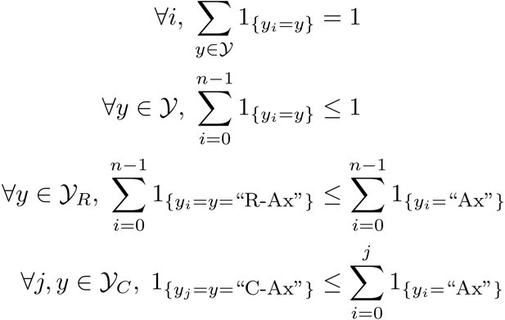
Algorithmic Approach
Learning Based Java: allows a developer to encode constraints in First Order Logic; these are compiled into linear inequalities automatically.
No duplicate argument classes
I left my nice pearls to her
candidate arguments
Unique labels
Identify argument candidates
  Pruning [Xue&Palmer, EMNLP’04]
  Argument Identifier
    Binary classification
Classify argument candidates
  Argument Classifier
    Multi-class classification
Inference
  Use the estimated probability distribution given by the argument classifier
  Use structural and linguistic constraints
  Infer the optimal global output
  Variable y^{a,t} indicates whether candidate argument a is assigned a label t.
  c^{a,t} is the corresponding model score
I left my nice pearls to her
I left my nice pearls to her
[ [ [ [ [
] ] ] ] ]
argmax ∑_{a,t} y^{a,t} c^{a,t} = ∑_{a,t} 1_{a=t} c_{a=t}
Subject to:
One label per argument: ∑_{t} y^{a,t} = 1
No overlapping or embedding
Relations between verbs and arguments,….
One inference problem for each verb predicate.
I left my nice pearls to her
Use the pipeline architecture’s simplicity while maintaining uncertainty: keep probability distributions over decisions & use global inference at decision time.
Notes:
We follow a now seemingly standard approach to SRL.
Given a sentence, first we find a set of potential argument candidates by identifying
which words are at the border of an argument.
Then, once we have a set of potential arguments, we use a phrase-level classifier to tell us how likely an argument is to be of each type.
Finally, we use all of the information we have so far to find the assignment of types to argument that gives us the “optimal” global assignment.
Similar approaches (with similar results) use inference procedures tied to their represntation.
Instead, we use a general inference procedure by setting up the problem as a linear programming problem.
This is really where our technique allows us to apply powerful information that similar approaches can not.

Slide 12
Verb SRL is not Sufficient
John, a fast-rising politician, slept on the train to Chicago.
Verb Predicate: sleep
  Sleeper: John, a fast-rising politician
  Location: on the train to Chicago
Who was John?
  Relation: Apposition (comma)
  John, a fast-rising politician
What was John’s destination?
  Relation: Destination (preposition)
  train to Chicago
Notes:
As we move up towards Language Understanding – just Verb Driven SRL is not sufficient

Slide 13
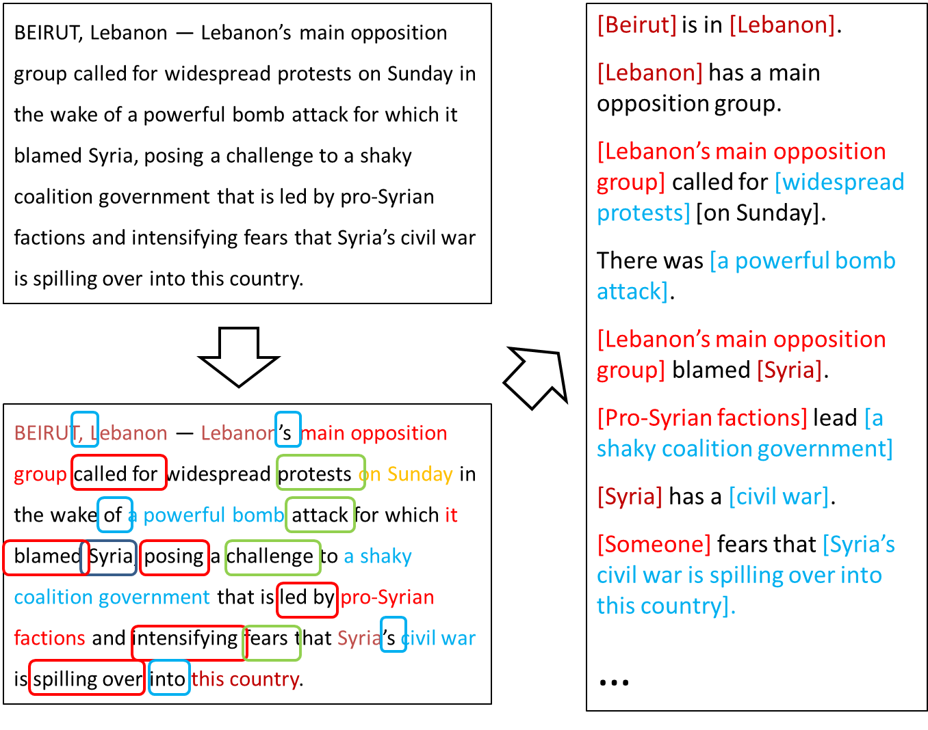
Extended Semantic Role Labeling
Improved sentence level analysis; dealing with more phenomena
Sentence level analysis may be influenced by other sentences

Slide 14
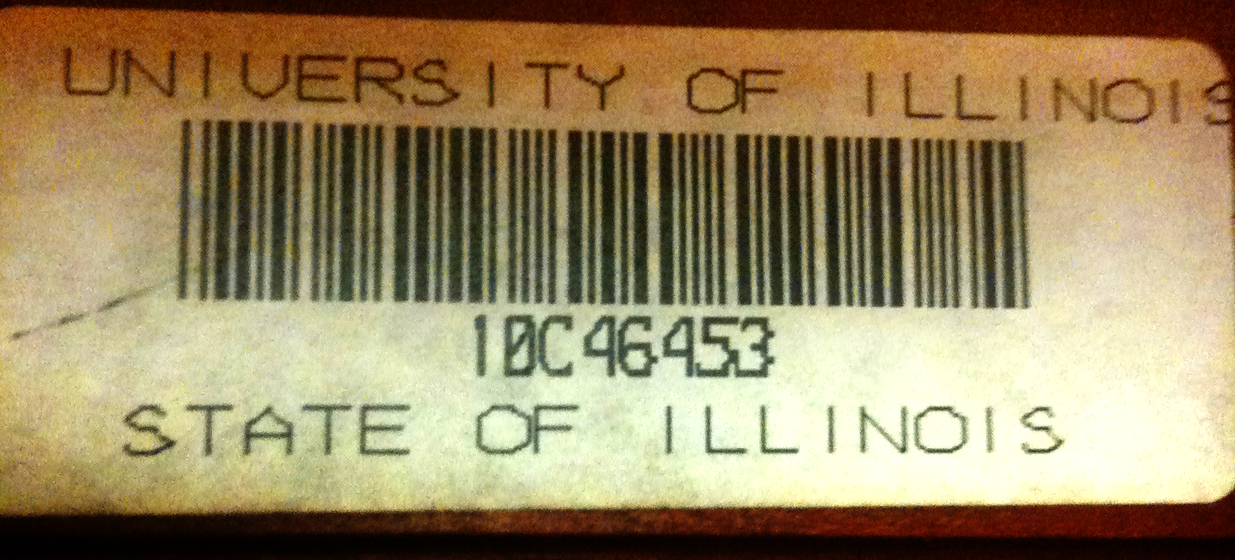
Examples of preposition relations
Queen of England
City of Chicago
Notes:
The university that serves Illinois vs. A state named Illinois

Slide 15
Predicates expressed by prepositions
Ambiguity & Variability
live at Conway House
at:1
Index of definition on Oxford English Dictionary
Location
stopped at 9 PM
at:2
drive at 50 mph
at:5
Temporal
look at the watch
at:9
Numeric
cooler in the evening
in:3
the camp on the island
on:7
ObjectOfVerb
arrive on the 9th
on:17

Slide 16
Preposition relations [Transactions of ACL, ‘13]
An inventory of 32 relations expressed by preposition
  Prepositions are assigned labels that act as predicate in a predicate-argument representation
  Semantically related senses of prepositions merged
  Substantial inter-annotator agreement
A new resource: Word sense disambiguation data, re-labeled
  SemEval 2007 shared task [Litkowski 2007]
    ~16K training and 8K test instances
    34 prepositions
  Small portion of the Penn Treebank [Dalhmeier, et al 2009]
    only 7 prepositions, 22 labels
Notes:
Since we define relations to be groups of preposition sense labels, each sense can be uniquely mapped to a relation label.

Slide 17
Computational Questions
How do we predict the preposition relations? [EMNLP, ’11]
    No (or, very small size) jointly labeled corpus (Verbs & Preps)
      Cannot train a global model
    Capturing the interplay with verb SRL?
What about the arguments? [Trans. Of ACL, ‘13]
    Annotation only gives us the predicate
    How do we train an argument labeler?
    Exploiting types as latent variables

Slide 18
Coherence of predictions
Predicate arguments from different triggers should be consistent
The bus was heading for Nairobi in Kenya.
Joint constraints linking the two tasks.
Destination ⇔ A1
Location
Destination
Predicate: head.02
A0 (mover): The bus
A1 (destination): for Nairobi in Kenya

Slide 19
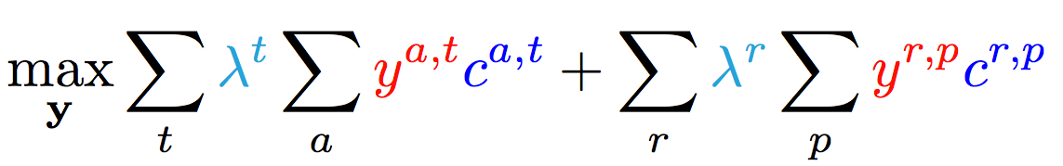
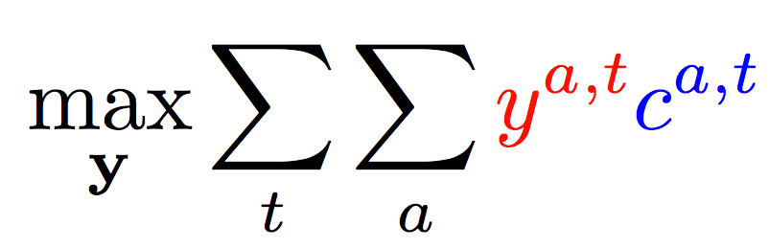
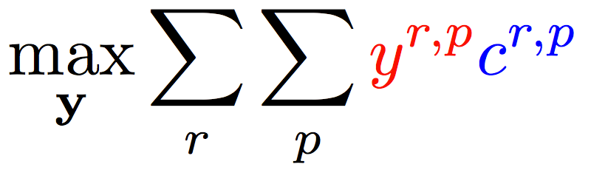
Joint inference (CCMs)
  Variable y^{a,t} indicates whether candidate argument a is assigned a label t.
  c^{a,t} is the corresponding model score
Verb arguments
Preposition relations
+ ….
Argument candidates
Re-scaling parameters (one per label)
Preposition relation
label
Constraints:
Preposition
Each argument label
Verb SRL constraints
Only one label per preposition
+ Joint constraints between tasks; easy with ILP formulation
Joint Inference – no (or minimal) joint learning

Slide 20
Preposition relations and arguments
How do we predict the preposition relations? [EMNLP, ’11]
    Capturing the interplay with verb SRL?
    Very small jointly labeled corpus, cannot train a global model!
What about the arguments? [Trans. Of ACL, ‘13]
    Annotation only gives us the predicate
    How do we train an argument labeler?
    Exploiting types as latent variables
Enforcing consistency between verb argument labels and preposition relations can help improve both

Slide 21
Predicate-argument structure of prepositions
Supervision
Prediction y
Poor care led to her death from flu.
Latent Structure
r(y)
Relation
Cause
Governor
death
flu
Object
h(y)
Governor type
“Experience”
“disease”
Object type
Hidden structured and prediction are related via a notion of Types – abstractions captured via wordnet classes and distributional clustering.

Slide 22
Latent inference
Inference takes into account constrains among parts of the structure (r and h), formulated as an ILP
Learning with Latent inference: Given an example annotated with r(y*) , predict with:
argmax_{y} w^{T} Á(x,[r(y),h(y)])
s.t r(y*) = r(y)
While satisfying constraints between r(y) and h(y)
That is: “complete the hidden structure” in the best possible way, to support correct prediction of the supervised variable
      During training, the loss is defined over the entire structure, where we scale the loss of elements in h(y).
Generalization of Latent Structure SVM [Yu & Joachims ’09] &
Learning with Indirect Supervision [Chang et. al. ’10]

Slide 23
Performance on relation labeling
Model size: 2.21 non-zero weights
Learned to predict both predicates and arguments
Model size: 5.41 non-zero weights
Using types helps. Joint inference with word sense helps too
More components constrain inference results and improve performance

Slide 24
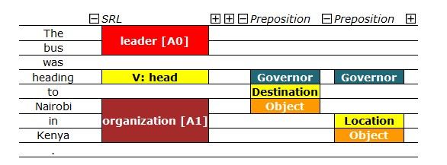
Extended SRL [Demo]
Destination [A1]
Joint inference over phenomena specific models to enforce consistency
Models trained with latent structure: senses, types, arguments
More to do with other relations, discourse phenomena,…

Slide 25
Constrained Conditional Models—ILP Formulations
Have been shown useful in the context of many NLP problems
[Roth&Yih, 04,07: Entities and Relations; Punyakanok et. al: SRL …]
  Summarization; Co-reference; Information & Relation Extraction; Event Identifications and causality ; Transliteration; Textual Entailment; Knowledge Acquisition; Sentiments; Temporal Reasoning, Parsing,…
Some theoretical work on training paradigms [Punyakanok et. al., 05 more; Constraints Driven Learning, PR, Constrained EM…]
Some work on Inference, mostly approximations, bringing back ideas on Lagrangian relaxation, etc.
Good summary and description of training paradigms: [Chang, Ratinov & Roth, Machine Learning Journal 2012]
Summary of work & a bibliography: http://L2R.cs.uiuc.edu/tutorials.html

Slide 26
Outline
Knowledge and Inference
  Combining the soft and logical/declarative nature of Natural Language
    Constrained Conditional Models: A formulation for global inference with knowledge modeled as expressive structural constraints
    Some examples
  Dealing with conflicting information (trustworthiness)
Cycles of Knowledge
  Grounding for/using Knowledge
Learning with Indirect Supervision
  Response Based Learning: learning from the world’s feedback
Scaling Up: Amortized Inference
  Can the k-th inference problem be cheaper than the 1st?

Slide 27






Wikification: The Reference Problem
Cycles of Knowledge: Grounding for/using Knowledge
Blumenthal (D) is a candidate for the U.S. Senate seat now held by Christopher Dodd (D), and he has held a commanding lead in the race since he entered it. But the Times report has the potential to fundamentally reshape the contest in the Nutmeg State.
Blumenthal (D) is a candidate for the U.S. Senate seat now held by Christopher Dodd (D), and he has held a commanding lead in the race since he entered it. But the Times report has the potential to fundamentally reshape the contest in the Nutmeg State.
Notes:
Let’s start with what is wikification
Read wiki titles slower

Slide 28
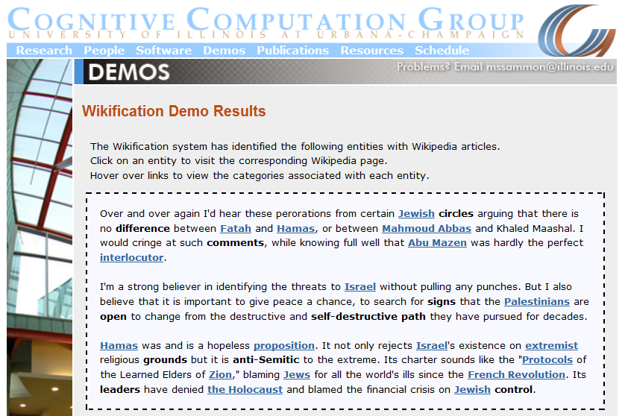
Wikifikation: Demo Screen Shot (Demo)
A global model that identifies concepts in text , disambiguates & grounds them in Wikipedia; very involved and relies on the correctness of the (partial) link structure in Wikipedia, but – requires no annotation, relying on Wikipedia
http://en.wikipedia.org/wiki/Mahmoud_Abbas
http://en.wikipedia.org/wiki/Mahmoud_Abbas

Slide 29
Challenges
Blumenthal (D) is a candidate for the U.S. Senate seat now held by Christopher Dodd (D), and he has held a commanding lead in the race since he entered it. But the Times report has the potential to fundamentally reshape the contest in the Nutmeg State.
State-of-the-art systems (Ratinov et al. 2011) can achieve the above with local and global statistical features
  Reaches bottleneck around 70%~ 85% F1 on non-wiki datasets
  Check out our demo at: http://cogcomp.cs.illinois.edu/demos
  What is missing?
Notes:
Quite impressive, bottleneck: adding more sophisticated contextual features does not help much
We do not want to level off here

Slide 30
Relational Inference
Mubarak,
the wife of deposed Egyptian President Hosni Mubarak,…

Slide 31
Relational Inference
Mubarak, the wife of deposed Egyptian President Hosni Mubarak, …
Egyptian President
Hosni Mubarak
, the of deposed , …
Mubarak
wife
What are we missing with Bag of Words (BOW) models?
  Who is Mubarak?
Textual relations provide another dimension of text understanding
Can be used to constrain interactions between concepts
  (Mubarak, wife, Hosni Mubarak)
Has impact in several steps in the Wikification process:
  From candidate selection to ranking and global decision
Notes:
Main contribution here
We will show that by identifying

Slide 32
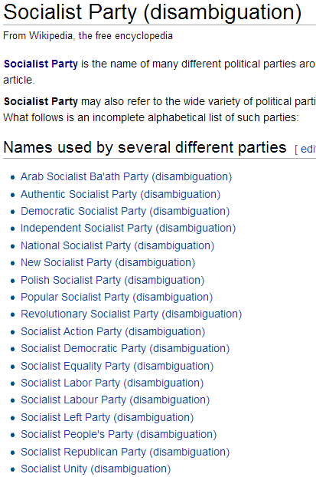

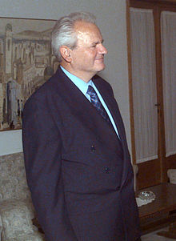
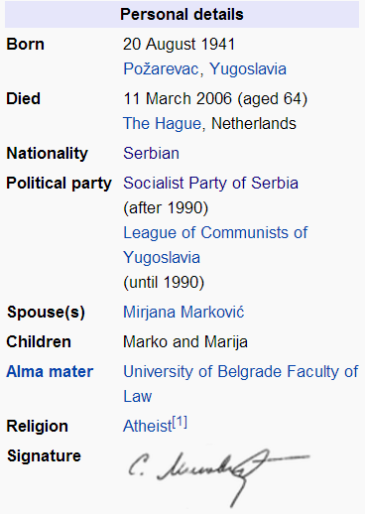
Knowledge in Relational Inference
apposition
Coreference
possessive
...ousted long time Yugoslav President Slobodan Milošević in October. The Croatian parliament... Mr. Milošević's Socialist Party
What concept does “Socialist Party” refer to?
  Wikipedia link statistics is uninformative
Notes:
Simple statistics isn’t enough – since there are hundreds of possibilities, and the correct answer will not even be close to the top.
Some of you may know it of the top of your head; some may need to search for it, and you can all figure it out?
How can we write the program that can actually “search” for it? That is, think a bit about the text and what is known outside the text?
To do it, we really need to better understand the relational structure of the text.
We do not actually care about relation types too much, as the relation will be constrained by our knowledge

Slide 33
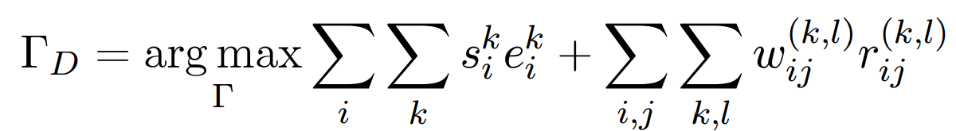
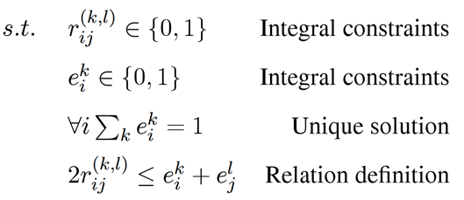
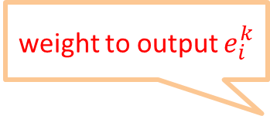
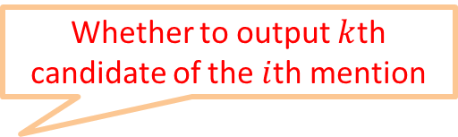
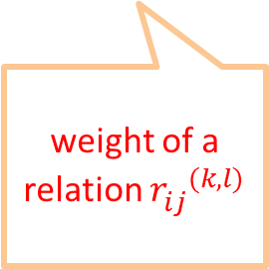
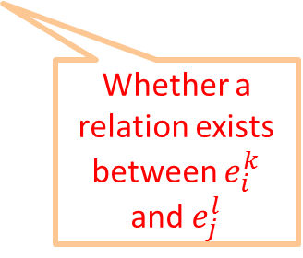
Formulation
Having some knowledge, and knowing how to use it to support decisions, facilitates the acquisition of additional knowledge.
  Goal: Promote concepts that are coherent with textual relations
Formulate as an Integer Linear Program (ILP):
If no relation exists, collapses to the non-structured decision
weight to output $e_{i}^{k}$
Whether to output $k$th candidate of the $i$th mention
weight of a relation ${r_{ij}^{}}^{(k,l)}$
Whether a relation exists between $e_{i}^{k}$ and $e_{j}^{l}$
Notes:
Formalize intuition, weights induced from data, small constraints
Objective function collapse to the original output when there is no relation, so our model is negatives-proof
True-negatives and false-negatives will not negatively impact performance of baseline

Slide 34
Wikification Performance Result [EMNLP’13]
How to use knowledge to get more knowledge?
How to represent it so that it’s useful?
Notes:
And we show that by incorporating these relational inference into the disambiguation framework, our system achieves significant improvements over the previous methods

Slide 35
Outline
Knowledge and Inference
  Combining the soft and logical/declarative nature of Natural Language
    Constrained Conditional Models: A formulation for global inference with knowledge modeled as expressive structural constraints
    Some examples
  Dealing with conflicting information (trustworthiness)
Cycles of Knowledge
  Grounding for/using Knowledge
Learning with Indirect Supervision
  Response Based Learning: learning from the world’s feedback
Scaling Up: Amortized Inference
  Can the k-th inference problem be cheaper than the 1st?

Slide 36

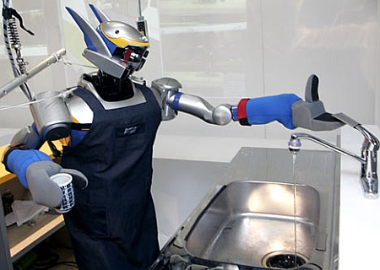

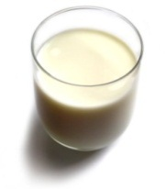
Understanding Language Requires Supervision
Can we rely on this interaction to provide supervision (and eventually, recover meaning) ?
Can I get a coffee with lots of sugar and no milk
Great!
Arggg
Semantic Parser
MAKE(COFFEE,SUGAR=YES,MILK=NO)
How to recover meaning from text?
Standard “example based” ML: annotate text with meaning representation
  Teacher needs deep understanding of the learning agent ; not scalable.
Response Driven Learning: Exploit indirect signals in the interaction between the learner and the teacher/environment
Notes:
We all know that we need some supervision in order to learn model that understand language.
So, if I want to communicate with this guy on the right and get the coffee I like, there needs to be away to transform what I say into a meaning representation that he understands.
Traditionally this requires “example based” ML – a teacher, that provides pair of (NL text, Meaning Representation) needs to understand the internal structure of the agent.
But, this is not scalable.
Can we be smarter and make use of simpler forms of supervision?
In Response based learning we try to exploit cheaper, indirect supervision signals, in the interaction, and nevertheless, learn the complex representation we need to produce.
Specifically, assume that I somehow guessed a representation that the agent understands and he makes some coffee, my response to the taste of the coffee is some form of supervision; can we learn from it?

Slide 37
Response Based Learning
We want to learn a model that transforms a natural language sentence to some meaning representation.
Instead of training with (Sentence, Meaning Representation) pairs
Think about some simple derivatives of the models outputs,
  Supervise the derivative [verifier] (easy!) and
  Propagate it to learn the complex, structured, transformation model
English Sentence
Model
Meaning Representation

Slide 38
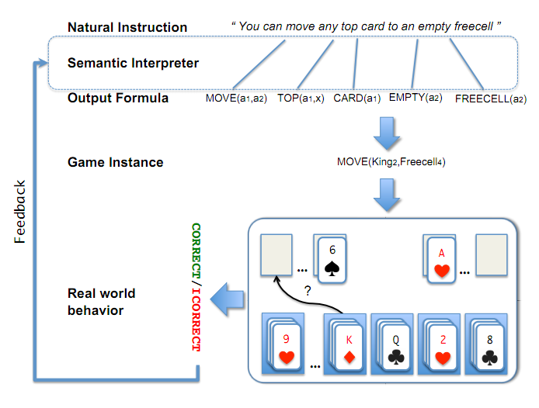
Scenario I: Freecell with Response Based Learning
We want to learn a model to transform a natural language sentence to some meaning representation.
English Sentence
Model
Meaning Representation
A top card can be moved to the tableau if it has a different color than the color of the top tableau card, and the cards have successive values.
Move (a1,a2) top(a1,x1) card(a1) tableau(a2) top(x2,a2) color(a1,x3) color(x2,x4) not-equal(x3,x4) value(a1,x5) value(x2,x6) successor(x5,x6)
Play Freecell (solitaire)
Simple derivatives of the models outputs
  Supervise the derivative and
  Propagate it to learn the transformation model

Slide 39
Scenario II: Geoquery with Response based Learning
We want to learn a model to transform a natural language sentence to some formal representation.
“Guess” a semantic parse. Is [DB response == Expected response] ?
  Expected: Pennsylvania DB Returns: Pennsylvania→ Positive Response
  Expected: Pennsylvania DB Returns: NYC, or ???? → Negative Response
English Sentence
Model
Meaning Representation
What is the largest state that borders NY?
largest( state( next_to( const(NY))))
Query a GeoQuery Database.
Simple derivatives of the models outputs

Slide 40
Response Based Learning: Using a Simple Feedback
We want to learn a model to transform a natural language sentence to some formal representation.
Instead of training with (Sentence, Meaning Representation) pairs
Think about some simple derivatives of the models outputs,
  Supervise the derivative (easy!) and
  Propagate it to learn the complex, structured, transformation model
LEARNING:
Train a structured predictor (semantic parse) with this binary supervision
  Many challenges: e.g., how to make a better use of a negative response?
Learning with a constrained latent representation, making used of CCM inference, exploiting knowledge on the structure of the meaning representation.
English Sentence
Model
Meaning Representation

Slide 41
Geoquery: Response based Competitive with Supervised
Initial Work:
Clarke, Goldwasser, Chang, Roth CoNLL’10; Goldwasser, Roth IJCAI’11, MLJ’14
Follow up work:
Semantic Parsing: Liang, M.I. Jordan, D. Klein, ACL’11; Berant et-al EMNLP’13
Here: Goldwasser & Daume (last talk on Wednesday)
Machine Translation: Riezler et. al ACL’14
Algorithm | Training Accuracy | Testing Accuracy | # Training Examples
NOLEARN | 22 | -- | -
Clarke et. al (2010) | 82.4 | 73.2 | 250 answers
Liang et-al 2011 | -- | 78.9 | 250 answers
Goldwasser et. al. (2012) | 86.8 | 81.6 | 250 answers
Supervised | -- | 86.07 | 600 structs.
NOLEARN :Initialization point
SUPERVISED : Trained with annotated data
Supervised: Y.-W. Wong and R. Mooney. Learning synchronous grammars for semantic parsing with lambda calculus. ACL’07
Notes:
Add number of examples

Slide 42
Outline
Knowledge and Inference
  Combining the soft and logical/declarative nature of Natural Language
    Constrained Conditional Models: A formulation for global inference with knowledge modeled as expressive structural constraints
    Some examples
  Dealing with conflicting information (trustworthiness)
Cycles of Knowledge
  Grounding for/using Knowledge
Learning with Indirect Supervision
  Response Based Learning: learning from the world’s feedback
Scaling Up: Amortized Inference
  Can the k-th inference problem be cheaper than the 1st?

Slide 43
Inference in NLP
In NLP, we typically don’t solve a single inference problem.
We solve one or more per sentence.
What can be done, beyond improving the inference algorithm?

Slide 44
Amortized ILP Structured Output Inference
Imagine that you already solved many structured output inference problems
  Co-reference resolution; Semantic Role Labeling; Parsing citations; Summarization; dependency parsing; image segmentation,…
  Your solution method doesn’t matter either
How can we exploit this fact to save inference cost?
We will show how to do it when your problem is formulated as a 0-1 LP, Max cx
Ax ≤ b
x 2 {0,1}
After solving n inference problems, can we make the (n+1)^{th} one faster?
All discrete MPE problems can be formulated as 0-1 LPs
We only care about inference formulation, not algorithmic solution

Slide 45
The Hope: POS Tagging on Gigaword
Number of Tokens

Slide 46
The Hope: POS Tagging on Gigaword
S1
He
is
reading
a
book
S2
They
are
watching
a
movie
POS
PRP
VBZ
VBG
DT
NN
Number of examples of a given size
Number of unique POS tag sequences
Number of structures is much smaller than the number of sentences
Number of Tokens

Slide 47
The Hope: Dependency Parsing on Gigaword
Number of examples of a given size
Number of unique Dependency Trees
Number of structures is much smaller than the number of sentences
Number of Tokens

Slide 48
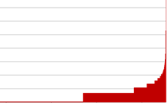
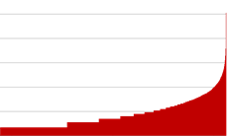
POS Tagging on Gigaword
How skewed is the distribution of the structures?
A small # of structures occur very frequently
Number of Tokens

Slide 49
Amortized ILP Inference
These statistics show that many different instances are mapped into identical inference outcomes.
  Pigeon Hole Principle
How can we exploit this fact to save inference cost over the life time of the agent? ?
We give conditions on the objective functions
(for all objectives with the same # or variables and same feasible set),
under which the solution of a new problem Q is the same as the one of P (which we already cached)

Slide 50
Amortized Inference Experiments
Setup
  Verb semantic role labeling; Entity and Relations
  Speedup & Accuracy are measured over WSJ test set (Section 23) and Test of E & R
  Baseline: solving ILPs using the Gurobi solver.
For amortization
  Cache 250,000 inference problems from Gigaword
  For each problem in test set either call the inference engine or re-use a solution from the cache
In general, no training data is needed for this method.
Once you have a model, you can generate a large cache that will be then used to save you time at evaluation time.

Slide 51
Theorem I
Cached already
A new problem
P
Q
max 2x₁+3x₂+2x₃+x₄
x₁ + x₂ ≤ 1
x₃ + x₄ ≤ 1
max 2x₁+4x₂+2x₃+0.5x₄
x₁ + x₂ ≤ 1
x₃ + x₄ ≤ 1
If
x*_{P}: <0, 1, 1, 0>
c_{P}: <2, 3, 2, 1>
c_{Q}: <2, 4, 2, 0.5>
The objective coefficients of active variables did not decrease from P to Q

Slide 52
Theorem I
Then: The optimal solution of Q is the same as P’s
Cached already
A new problem
P
Q
x*_{P}=x*_{Q}
max 2x₁+3x₂+2x₃+x₄
x₁ + x₂ ≤ 1
x₃ + x₄ ≤ 1
max 2x₁+4x₂+2x₃+0.5x₄
x₁ + x₂ ≤ 1
x₃ + x₄ ≤ 1
If
And
x*_{P}: <0, 1, 1, 0>
c_{P}: <2, 3, 2, 1>
c_{Q}: <2, 4, 2, 0.5>
The objective coefficients of active variables did not decrease from P to Q
The objective coefficients of inactive variables did not increase from P to Q

Slide 53
Speedup & Accuracy
Solve only 40% of problems
Speedup
Amortized inference gives a speedup without losing accuracy

Slide 54
Theorem II (Geometric Interpretation)
Solution x*
c_{P2}
c_{P1}
All ILPs in the cone will share the maximizer
ILPs corresponding to all these objective vectors will share the same maximizer for this feasible region
Feasible region

Slide 55
Theorem III
Theorem (margin based amortized inference): If A + B is less than the structured margin, then y* is still the optimum for Q
Decrease in objective
value of the solution
A = (C_{P} – C_{Q}) y*
Increase in objective
value of the competing
structures B = (C_{Q} – C_{P}) y
Objective values for problem P
Structured
Margin δ
Objective values for problem Q
Increasing objective value
y* the solution to problem P
Two competing structures

Slide 56
Speedup & Accuracy
Solve only one in three problems
Speedup
Amortized inference gives a speedup without losing accuracy
1.0
Amortization schemes [EMNLP’12, ACL’13]

Slide 57
So far…
Amortized inference
  Abstracts over problems objectives to allow faster inference by re-using previous computations
Techniques for amortized inference
But these are not useful if the full structure is not redundant!
Smaller Structures are more redundant

Slide 58
Decomposed amortized inference
Taking advantage of redundancy in components of structures
  Extend amortization techniques to cases where the full structured output may not be repeated
  Store partial computations of “components” for use in future inference problems
Approach
  Create smaller problems by removing constraints from ILPs
    Smaller problems -> more cache hits!
  Solve relaxed inference problems using any amortized inference algorithm
  Re-introduce these constraints via Lagrangian relaxation

Slide 59
Example: Decomposition for inference
Verb relations
Preposition relations
The Verb Problem
The Preposition Problem
Constraints:
Verb SRL constraints
Only one label per preposition
Joint constraints
    Re-introduce constraints using Lagrangian Relaxation
    [Komodakis, et al 2007], [Rush & Collins, 2011], [Chang & Collins, 2011], …

Slide 60
Decomposed inference for ER task
  Dole ’s wife, Elizabeth , is a native of Champaign , Illinois .
  Person Person Location Location
spouse
born_in
Located_at
Consistent assignment of entity types to first two entities (Dole, Elizabeth) and relation types to relations among these entities
Consistent assignment of entity types to last two entities (Champaign, Illinois) and relation types to relations among these entities
Joint constraints
    Re-introduce constraints using Lagrangian Relaxation
    [Komodakis, et al 2007], [Rush & Collins, 2011], [Chang & Collins, 2011], …

Slide 61
Speedup & Accuracy
Solve only one in six problems
Speedup
Amortized inference gives a speedup without losing accuracy
1.0
Amortization schemes [EMNLP’12, ACL’13]

Slide 62
So far…
We have given theorems that allow saving 5/6 of the calls to your favorite inference engine.
But, there is some cost in
  Checking the conditions of the theorems
  Accessing the cache
Our implementations are clearly not state-of-the-art but….

Slide 63
Reduction in wall-clock time (SRL)
Significantly more savings when inference is incorporated as part of a structured learner.
Solve only one in 2.6 problems
Notes:
This is a systems problem. We may not have the best implementation. It may be possible to match the theory. Also, the implementation itself can give rise to interesting research questions

Slide 64
Conclusion
Thank You!
Some recent samples from a research program that attempts to address some of the key scientific and engineering challenges between us and understanding natural language
Knowledge – Reasoning – Learning Paradigms – Scaling up
  Thinking about Learning, Inference and knowledge via a Constrained Optimization framework that supports “best assignment” Inference.
There is more that we need & try to do
  Reasoning: dealing with conflicting information (Trustworthiness)
  Better representations for NL
  NL in specific domains: Health
  Language Acquisition
  A Learning based Programming Language
Check out our tools, demos, LBJava, Tutorials,…

