Slide 1
Declarative Learning Based Programming
Dan Roth
Department of Computer Science
University of Illinois at Urbana-Champaign
With thanks to:
Parisa Kordjamshidi, Avi Pfeffer, Guy Van den Broeck, Sameer Singh,
Vivek Srikumar, Rodrigo de Salvo Braz, Nick Rizzolo
February 2016
DeBLP, AAAI-16

Slide 2

A Hypothetical Surveillance Program
Image i = captureImage()
for (Person p in i):
if isMasked(p) and (isRunning(p) or hasGun(p)):
soundAlarm()
Simple! …except we have to
  detect people
  determine if they are masked
  determine if they are running
  determine if they have a gun
All hard problems
All just predicates
that break problem down
Notes:
Let’s take a hypothetical surveillance program as an example. Imagine our program analyzes images coming from a camera in a bank. We must determine if each image depicts any person who is wearing a mask and either running or holding a gun. When such a person is detected, we sound the alarm.
The program is quite simple… except for what it says above. All of these are hard problems that have been studied in research settings for a long time. But essentially, when solved, they amount merely to predicates or methods; i.e., the type of thing that programmers are very familiar with designing and using. They help you break your problem down into simpler components.

Slide 3
Common Approach: Breaking it Down
Person detection:
  Detect head
  Detect arms
  Detect hands
  Detect legs
How to write detectors?
  If we could hard-code, we would
  But heuristics perform poorly
  Machine learning to the rescue
    Functions defined via data
A PhD Thesis…
Download some libraries
  Learning algorithms
  Inference algorithms
  Other researchers’ detectors
Write some feature extractors
Write some scripts to run everything
Notes:
Breaking the problem into smaller problems is how research works too. For example, a person can induce a complicated variety of images. When we find that the problem of detecting a person in an image is too complicated, we break it down into smaller components. Early attempts to the big problem then simply stitched together the solutions to the smaller problems with hard-code.
So how about the smaller problems? How does one write a hand detector? Heuristics are poor, so we turn to machine learning. Crucially, machine learning allows us to define our predicates according to patterns automatically extracted from data. We still must partially define our predicates, but the data (and the algorithm) provide the rest of the definition.

Slide 4

A (Realistic) Knowledge Management Program
Corpus c = ReadCollection()
List LikedPeople = ReadPeople()
List DisLikedBPeople = ReadPeople()
for (Email e in c):
for (Person p in body(e)):
Like = isLike(p)
if Like and (not in LikedPeople)
LikedPeople +v p
if (not Like) and (not in DisLikedPeople)
DisLikedPeople +v p
Update Likedpeople, DisLikedPeople
Simple! …except we have to
  recognize people in text
  determine if they are Liked in the text
  determine if they are new to the list
All hard problems
All just predicates
that break problem down
Notes:
In this example, we imagine that you are an application programmer in a law office, trying to keep track of people that correspond with or are mentioned in correspondence with the office. Very easy to do it you search for specific known people, but not as easy if you just look for all people mentioned.

Slide 5
Roadmap
Some thoughts on Learning Based Programming
  What other people in the community view as challenges
Two Examples
  LBJava
  Saul
More thoughts
Notes:
We’ve seen related work. The primary issue we’d like to address with our new work is the modeling of discriminative formalisms. Of course, we’ll definitely keep an eye out to make sure probabilistic techniques are also supported, but discriminative formalisms are our main focus.

Slide 6
Our Learning Based Programming Thesis
Existing programming languages are not designed to deal with real-world messy data, and to easily describe the central components of modern learning-based programs:
  Constrained optimization problems whose objective functions are derived from data
    This captures both probabilistic and discriminative models
    Emphasizes the importance of reasoning with primitives rather than just evaluating them
This can be said in different ways:
  Developing programs that have significant Machine Learning components is hard.
  We don’t have the right abstractions for “black-boxing” machine learning.

Slide 7
How to make progress?
Many of the people in this room and, in particular, workshop organizers, have thought about these issues a lot, and have developed research programs that attempts to make progress in this direction.
Rodrigo Braz:
  … machine learning uses models specified with a certain set of primitives…
  simple methods typically only *evaluate* these primitives (black boxes) rather than *reason* with them (account for the theory behind them)….
  for example, gradient descent uses just…. but more sophisticated methods, such as ILP, use more of the theory.
  Declarative Learning Based Programming uses more *expressive* languages to specify models. Once the set of primitives becomes diverse, the issue of combining these solvers as automatically as possible also becomes an interesting research problem..
  → Reasoning with expressive models; lifted inference

Slide 8
How to make progress?
Many of the people in this room and, in particular, workshop organizers, have thought about these issues a lot, and have developed research programs that attempts to make progress in this direction.
Sameer Singh
  … but restrict the models they can specify to a certain family of models.
  But this often is not enough; i.e. machine learning often doesn't "just work“…. users need to explore various paradigms to see what works, i.e. undirected models, generative models,… and so on
  …users need to modify the model…, e.g. use a slightly different formulation, training loss that reflects the task, or prior knowledge; pure black-box declarative machine learning is not universally applicable
  what is a declarative formulation that is easy to understand, yet supports many/all existing and future models? it's math!
  Therefore, need declarative math-like syntax → Wolfe

Slide 9
How to make progress?
Many of the people in this room and, in particular, workshop organizers, have thought about these issues a lot, and have developed research programs that attempts to make progress in this direction.
Avi Pfeffer:
  Much modern machine learning is probabilistic
  Need to define a probabilistic model over your domain; Learn the parameters or structure of the model from data, and
  model has to reason about the domain – predict future events, infer causes of observed events, using current observations to predict future
  Needs way to easily interact with data; easily integrate with applications
  General representation to capture common programming patterns
    Functional programming; Object-oriented programming; Constraints for undirected models
  An extensible library of inference algorithms → Figaro

Slide 10
Programming Paradigms
Even though everyone has about the same goal, there are multiple trains of thoughts.
In most cases these differences can be viewed as thoughts on how to express the learning and inference processes needed in at the right level of abstraction
  Learning: learn one or multiple models that can be used to guide decisions
  Inference: assign values to multiple, interdependent, variables of interest
People thought less about data representation, and how to move from messy, real world data to representations our programs can work with.
  .

Slide 11
Principles of Learning Based Programming
A LBP language should provide:
  High level primitives
    for feature extraction, learning, inference, and their combinations
  Relational features (a.k.a. structure)
    Features involving multiple output variables
  Infinite feature space
    Cannot assume a priori how many or which features will be present
  Customizable objective function
    Model can’t be a black box
  Model composability
    Encapsulate model in a name; re-use in larger models
  Training & Inference decomposability
    Facilitate tailored inference solutions via access to structure
    In particular, support of reusability of models, pipelines, etc.
  Algorithm independence

Slide 12


Who are our users?
Can this input be sufficient to generate a program that processes documents at this level?
From machine learning experts to application programmers
An application programmer in a law office that tries to extract information from a large number of documents.
Jim Smart resigned from his position at Fictitious Inc., and is suing its CEO, John Clever.
Jim Smart, PER
John Clever, PER
Fictitious Inc., ORG
Jim works_for Fictitious.
John works_for Ficticious
But the programmer has no idea how
to write a program that can generate
this level of annotation automatically.

Slide 13
Learning Based Java & Saul
My group has addressed the challenges,
  and the will to facilitate the development of applications by an application programmer
by developing a Learning based Programming languages that are based on Constraint Conditional Models (CCMs)
A computational formulation that supports programs that are viewed as
  An inference process that is a knowledge constrained optimization problem, done on top of multiple statistically learned models.
LBJava
Saul

Slide 14
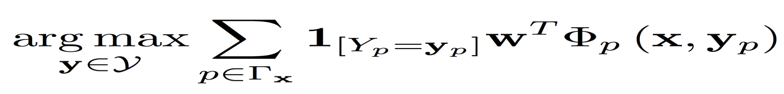
Constrained Conditional Models
Any MAP problem w.r.t. any probabilistic model, can be formulated as an Integer Linear Program (ILP) Roth+ 04, Taskar 04]
Variables are “parts” (factors); models
Penalty for violating
the constraint.
    y = argmax_{y 2 Y} w^{T}Á(x, y) + u^{T}C(x, y)
Knowledge component:
(Soft) constraints
Weight Vector for “local” models
Features, classifiers; log-linear models (HMM, CRF) or a combination
How far y is from
a “legal/expected” assignment
Learning: learning the objective function (w, u)
  Decouple? Decompose? Force u to model hard constraints?
Inference: multiple algorithmic options; knowledge representation is key.
Programming language should have defaults that facilitate learning and inference, and facilitate ease of moving between paradigms.

Slide 15

Learning Based Java [Rizzolo & Roth, ICSC’07, LREC’10]
LBP design principles:
  High level primitives
  Relational features
  Infinite feature space
  Customizable objective function
  Model composability
  Inference decomposability (not flexible enough)
  Algorithm independence (learning; not inference)

Slide 16
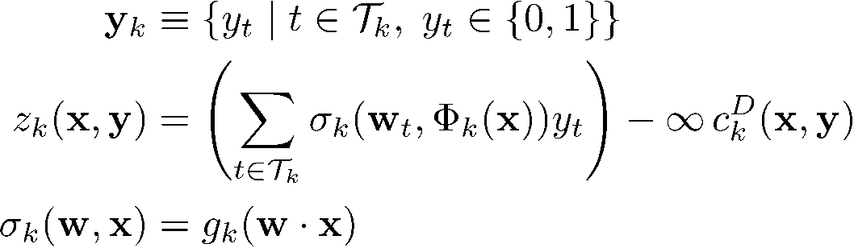
Learning Based Java [Rizzolo & Roth, ICSC’07]
Describes a particular type of CCM
  Collection of (optionally normalized) multi-class CCMs
  User-defined feature functions
  User-defined constraints (only hard constraints)
How to represent knowledge/constraints and how to perform inference?
  First order logic ➔ translate to ILP

Slide 17
Discriminative Example: Semantic Role Labeling
I left my pearls to my daughter in my will .
[I]_{A0} left [my pearls]_{A1} [to my daughter]_{A2} [in my will]_{AM-LOC} .
A0 Leaver
A1 Things left
A2 Benefactor
AM-LOC Location
I left my pearls to my daughter in my will .

Slide 18
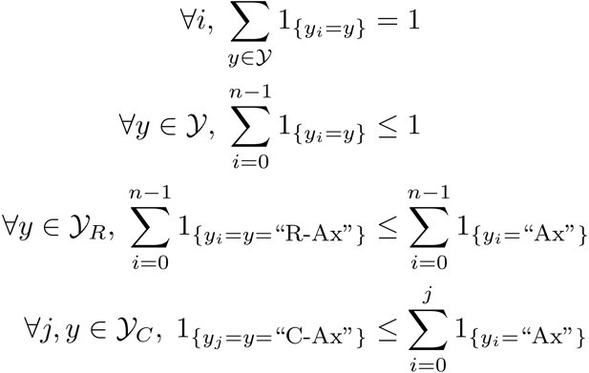
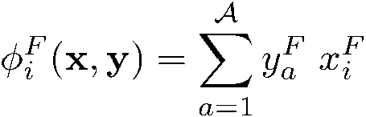
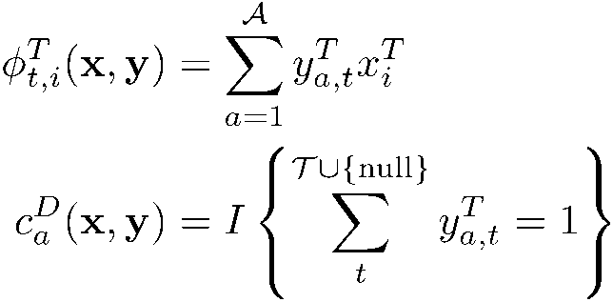
SRL: Discriminative Decomposition
Learning Based Java: allows a developer to encode constraints in First Order Logic; these are compiled into linear inequalities automatically.
No duplicate argument classes
I left my nice pearls to her
candidate arguments
Unique labels
Identify argument candidates
  Pruning Heuristics
  Argument Identifier
    Binary classification
Classify argument candidates
  Multi-class classification
  Can choose to “trust”
  output of identifier
Inference
  Use the estimated probability distribution given by the argument classifier
  Use structural and linguistic constraints
  Infer the optimal global output
  Variable y^{a,t} indicates whether candidate argument a is assigned a label t.
  c^{a,t} is the corresponding model score
I left my nice pearls to her
I left my nice pearls to her
[ [ [ [ [
] ] ] ] ]
argmax ∑_{a,t} y^{a,t} c^{a,t} = ∑_{a,t} 1_{a=t} c_{a=t}
Subject to:
One label per argument: ∑_{t} y^{a,t} = 1
No overlapping or embedding
Relations between verbs and arguments,….
One inference problem for each verb predicate.
I left my nice pearls to her
Use the pipeline architecture’s simplicity while maintaining uncertainty: keep probability distributions over decisions & use global inference at decision time.
Notes:
We follow a now seemingly standard approach to SRL.
Given a sentence, first we find a set of potential argument candidates by identifying
which words are at the border of an argument.
Then, once we have a set of potential arguments, we use a phrase-level classifier to tell us how likely an argument is to be of each type.
Finally, we use all of the information we have so far to find the assignment of types to argument that gives us the “optimal” global assignment.
Similar approaches (with similar results) use inference procedures tied to their represntation.
Instead, we use a general inference procedure by setting up the problem as a linear programming problem.
This is really where our technique allows us to apply powerful information that similar approaches can not.

Slide 19
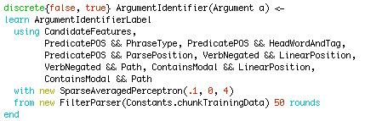
Example: Semantic Role Labeling
Classifiers take user’s objects as input; produce features
  Can be hard-coded or learned
  Learned classifiers use other classifiers to extract features
    Those can be learned too: model composability
LBJava compiler:
  Indexes features for fast training / testing
  Generates a Java class for every classifier

Slide 20
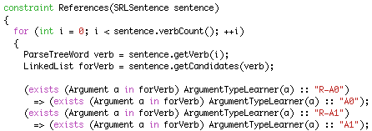
Constraints
“If there’s a reference to an A0, there must be an A0.”
Declarative, FOL-style constraints
  Learned classifiers appear as functions
  Applied directly over user’s Java objects
  Interspersed with arbitrary Java code
  New quantifiers: atleast and atmost

Slide 21
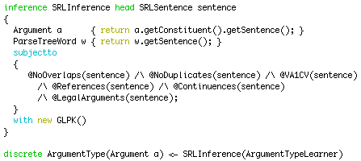
Inference Problems
“Head” object represents entire inference problem
At run-time
  Constraints translated to linear inequalities
  ILP inference solves problem
    Used broadly in NLP applications

Slide 22
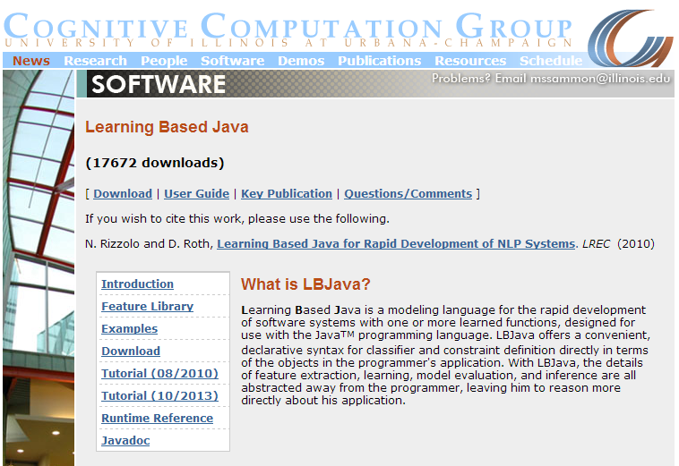
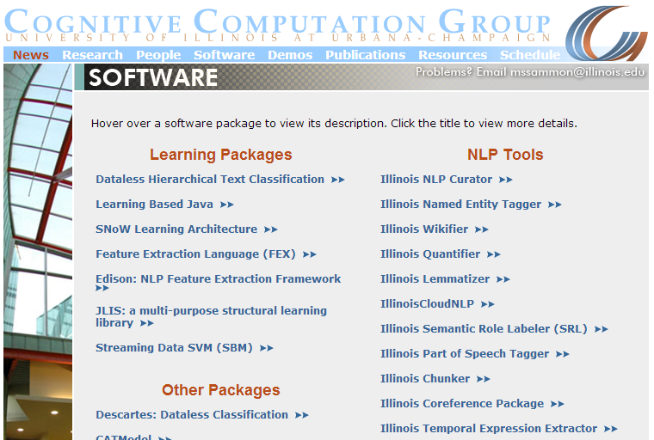
LBJava: Success Stories
Multiple state-of-the-art Natural Language Processing Tools
  Part-of-speech tagger; Named Entity Recognition
  Co-Reference Resolution; Relation and Event Extraction,…
  Recognizing authority in dialogue [Mayfield & Rose, ACL’11]
Developing a state-of-the-art NER takes ~half a day

Slide 23
Saul: 2nd Generation CCM based LBP
What’s missing?
Expressivity:
  Structures over output variables
Ease of use: from paper to program
  Declarative definition of models
    Declarative ways to define training and inference preferences
  Procedural building of an application

Slide 24
Saul
Saul is an object-functional programming language written in Scala.
  Allows a programmer to learn, name and manipulate named abstractions over relational data
  Supports seamless incorporation of trainable (probabilistic or discriminative) components into the program
  Provides a level of inference over trainable models to support composition and make decisions that respect domain and application constraints.
LBP design principles:
  High level primitives
  Relational features
  Infinite feature space
  Customizable objective function
  Model composability
  Inference decomposability
  Algorithm independence

Slide 25
From Paper* to Program
Information crucial to the development of an application is often omitted;
CCMP abstractions reveal these gaps.
The goal of Saul is to (almost) automatically generate a program from the application/model described in your paper or the design document of the application programmer
Some code is generated automatically
  But can be modified by the programmer
The program has five components:
  Data
  Y Space Definition (the variables you want to assign values to)
  Representation (features; constraints)
  Prediction (inference) Paradigm
  Training Paradigm
Decoupling decision time prediction and training facilitates reusable models, various decompositions, and pipelines

Slide 26
Recognizing Entities and Relations [Roth&Yih’04,07]
Joint inference gives good improvement
other | 0.05
per | 0.85
loc | 0.10
other | 0.05
per | 0.85
loc | 0.10
other | 0.10
per | 0.60
loc | 0.30
other | 0.10
per | 0.60
loc | 0.30
other | 0.05
per | 0.50
loc | 0.45
other | 0.05
per | 0.50
loc | 0.45
other | 0.05
per | 0.50
loc | 0.45
Key Questions:
How to learn the model(s)?
What is the source of the knowledge?
How to represent knowledge?
How to guide the global inference?
An Objective function that incorporates learned models with knowledge (output constraints)
A Constrained Conditional Model
  Bernie’s wife, Jane, is a native of Brooklyn
  E1 E2 E3
R₁₂
R₂₃
irrelevant | 0.05
spouse_of | 0.45
born_in | 0.50
irrelevant | 0.05
spouse_of | 0.45
born_in | 0.50
irrelevant | 0.05
spouse_of | 0.45
born_in | 0.50
irrelevant | 0.10
spouse_of | 0.05
born_in | 0.85
irrelevant | 0.10
spouse_of | 0.05
born_in | 0.85
Models could be learned separately/jointly; constraints may come up only at decision time.
Notes:
26
Let’s look at another example in more details.
We want to extract entities (person, location and organization) and relations between them (born in, spouse of).
Given a sentence, suppose the entity classifier and relation classifier have already given us their predictions along with the confidence values. The blue ones are the labels that have the highest confidence individually. However, this global assignment has some obvious mistakes. For example, the second argument of a born_in relation should be location instead of person. Since the classifiers are pretty confident on R23, but not on E3, so we should correct E3 to be location.
Similarly, we should change R12 from “born_in” to “spouse_of”

Slide 27
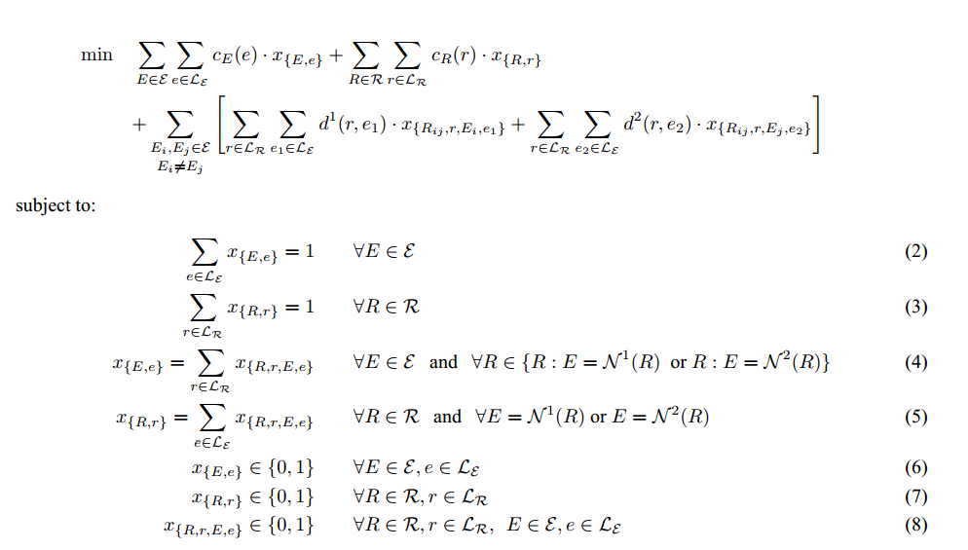
Prediction Paradigms
  Variable indicating E takes value e.
  Variable indicating R takes value r.
  Model weight
  Constraint weight
  Variable relating E and R
  Consistency Constraints

Slide 28
Saul: Declarative Specification of Problem and Solution
1. Data
  Readers into Saul graph data model; notion of “sensors”.
2. Defining the output space (Y)
  The variables we need to assign values to
  Y = { Entity(Phrase) 2 {PER, LOC, ORG} ;
  Relation(Phrase, Phrase) 2 {LivesIn, WorksFor } }
3. Representation
  Features and Constraints
  Most are generated automatically, but can be modified
4. Learning
  Defining the decomposition in Training
5. Inference
  Decision Time Prediction
The ability to define Learning and Inference paradigm independently is key in Saul

Slide 29
Learning Paradigms
There are multiple ways to train models for this problem
{E(Phrase)}; {R(Phrase, Phrase)}
  Train independent models for Entities and Relations
{E(Phrase)}; {R(Phrase, Phrase, E)}
  Pipeline E decisions as input to learning R. (Variations possible).
{E(Phrase), R(Phrase, Phrase)}
  Train E and R jointly
∑_{e} w_{e} x_{e} + ∑_{r} w_{r} x_{r}
Subject to
  X_{r=LivesIn} → x_{e1=PER}
  ….

Slide 30
Inference Paradigms
There are multiple ways to assign values to target variables
{E(Phrase)}; {R(Phrase, Phrase)}
  Mode decisions with respect to individual variables.
{E(Phrase)}; {R(Phrase, Phrase, E)}
  Pipeline E decisions as input to inferring R.
{E(Phrase), R(Phrase, Phrase)}
  Global Inference

Slide 31
Conclusions
Thank You!
Declarative Learning Based Programming
  LBP is the study of programming language abstractions for machine learning representations and techniques.
  A platform for defining and combining decision making models.
    Discriminative or probabilistic; Trained jointly or independently; Exact or approximate inference
    All of these can be left to the programmer to decide
An LBP language makes the programmer’s life easier
  Abstracts away details that distract from the main goal
  Shortens the development cycle
Presented some thoughts from people working in this area
  Along with some examples of existing langauges
More during this workshop

