Slide 1
Making Sense of
(and Trusting)
Unstructured Data
Dan Roth
Department of Computer Science
University of Illinois at Urbana-Champaign
With thanks to:
Collaborators: Jeff Pasternack, V.G.Vinod Vydiswaran
Kai-Wei Chang, Ming-Wei Chang, Xiao Chen, Gourab Kundu, Lev Ratinov, Others
Funding: NSF; DHS; NIH; DARPA; IARPA, ARL, ONR
DASH Optimization (Xpress-MP); Gurobi.
April 2016
CCICADA Retreat, Rutgers University

Slide 2
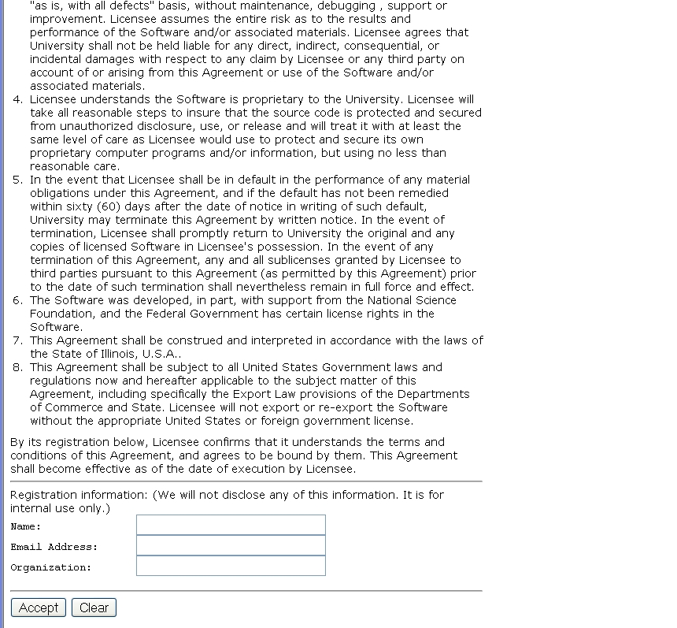
A view on Extracting Meaning from Unstructured Text
A Contract
(and distinguish from other candidates)
Does it say that they will:
Give my email address away?
Log my activity
……
ACCEPT?
Notes:
This is a collection of different problems of ambiguity resolution - from text correction –
Sorry, it was too tempting to use this one…
Word sense disambiguation, part of speech tagging to a decision that involves a decision across sentence
All these are essentially the same classification problem – and with progress in learning theory and NLP
We have pretty reliable solutions to these today.
Here are a few more problems of this kind.

Slide 3
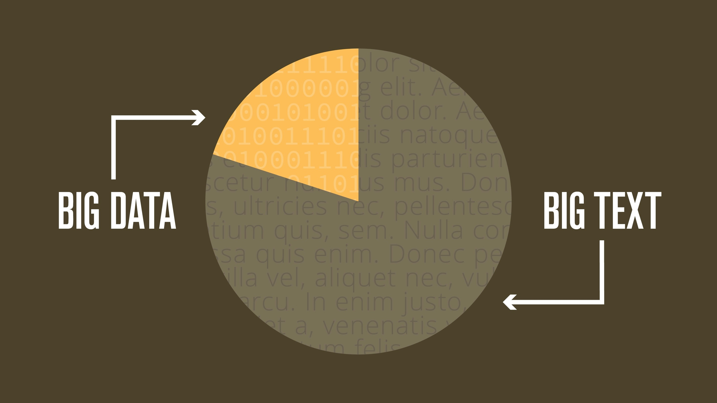
Notes:
How big is this text really? Of all of the information in corporations, 80% is unstructured text.

Slide 4

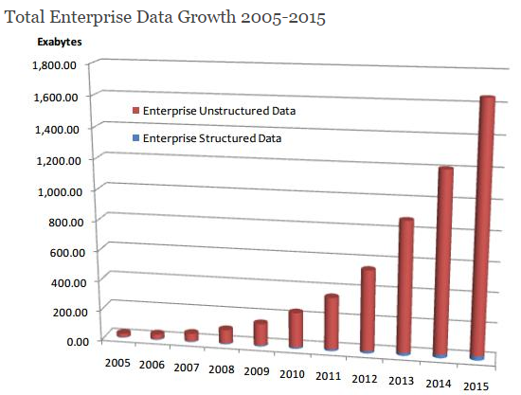
90% of the world’s text has been created in the last 2 years, and there will be a 50-fold increase by 2020.
WORLD TEXT
Large Scale
Data→ Meaning Transformation
Massive & Deep
Scientific Articles
Medical Records
Education
Business
Social Media
2012
2014
2020
http://www.dataversity.net/the-growth-of-unstructured-data-what-are-we-going-to-do-with-all-those-zettabytes/
http://breakthroughanalysis.com/2008/08/01/unstructured-data-and-the-80-percent-rule/
http://www.datasciencecentral.com/profiles/blogs/structured-vs-unstructured-data-the-rise-of-data-anarchy
Notes:
Massive and, more importantly, DEEP (and the last time I’ll use the word DEEP in this talk)
90% [click] of the world’s data has been created in the last 2 years, and there will be a [click] 50-fold increase by 2020.
The compounding effect of regulatory obligations and data is making it impossible for humans to keep up. We need machines to assist.
This is the where the NexLP Story Engine comes in.

Slide 5
Why is it Difficult?
Meaning
Variability
Ambiguity
Language

Slide 6






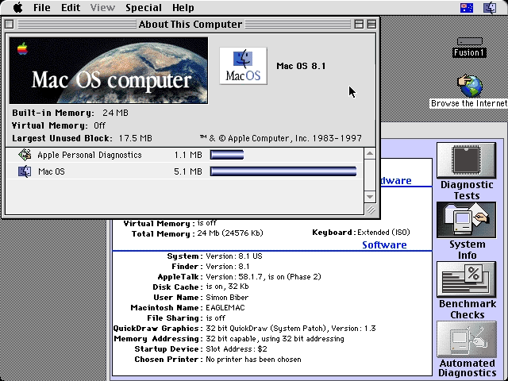
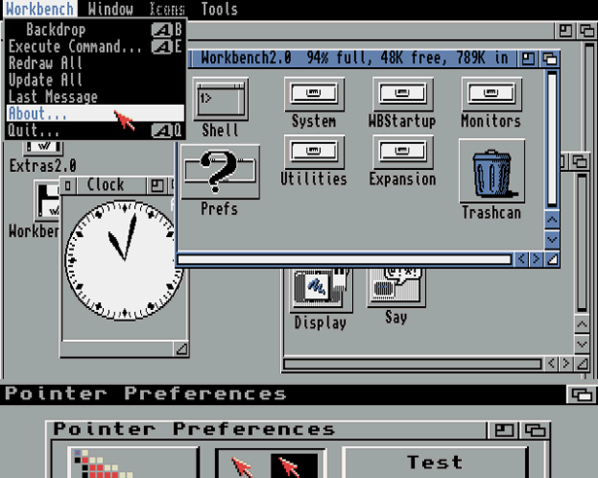
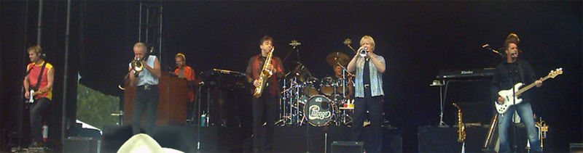
Ambiguity
It’s a version of Chicago – the standard classic Macintosh menu font, with that distinctive thick diagonal in the ”N”.
Chicago was used by default for Mac menus through MacOS 7.6, and OS 8 was released mid-1997..
Chicago VIII was one of the early 70s-era Chicago albums to catch my
ear, along with Chicago II.

Slide 7

Variability in Natural Language Expressions
Determine if Jim Carpenter works for the government
Jim Carpenter works for the U.S. Government.
The American government employed Jim Carpenter.
Jim Carpenter was fired by the US Government.
Jim Carpenter worked in a number of important positions. …. As a press liaison for the IRS, he made contacts in the white house.
Russian interior minister Yevgeny Topolov met yesterday with his US counterpart, Jim Carpenter.
Former US Secretary of Defense Jim Carpenter spoke today…
Standard techniques cannot deal with the variability of expressing meaning
nor with the
ambiguity of interpretation
  Needs:
  Understanding Relations, Entities and Semantic Classes
  Acquiring knowledge from external resources; representing knowledge
  Identifying, disambiguating & tracking entities, events, etc.
  Time, quantities, processes…
Notes:
7

Slide 8
What can this give us?
Moving towards natural language understanding…
A law office wants to get the list of all people that were mentioned in email correspondence with the office.
  For each name, determine whether is was mentioned adversarially or not.
A training facility in a large lab or a corporation wants to provide new employees easy access to all relevant key concepts, entities (people, techniques, applications) along with relevant projects and background information when they read material about their new job.
An investigator reviews large amounts of data and wants to map entities and concepts she observes to entries in existing institutional knowledge.
(e.g., think about the underpants bomber; Mohamad Attah;…)
Notes:
Almost all NLP tasks: one example, many decisions
8

Slide 9
What can this give us?
Moving towards natural language understanding…
A political scientist studies Climate Change and its effect on Societal instability. He wants to identify all events related to demonstrations, protests, parades, analyze them (who, when, where, why) and generate a timeline and a causality chain.
An electronic health record (EHR) is a personal health record in digital format. Includes information relating to:
  Current and historical health, medical conditions and medical tests; referrals, treatments, medications, demographic information etc.: A write only document
  Use it in medical advice systems; medication selection and tracking (Vioxx…); disease outbreak and control; science – correlating response to drugs with other conditions
Notes:
Almost all NLP tasks: one example, many decisions
9

Slide 10
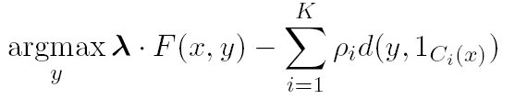
Machine Learning + Inference based NLP
Try LBJava, a very easy way to develop Learning Based Programs
It’s difficult to program predicates of interest due to
  Ambiguity (everything has multiple meanings)
  Variability (everything you want to say you can say in many ways)
Models are based on Statistical Machine Learning & Inference
Research Focus:
Modeling and learning algorithms for different phenomena
  Classification models
  Structured models
  Learning protocols that exploit Indirect Supervision
Inference as a way to introduce domain & task specific constraints
  Constrained Conditional Models: formulating inference as ILP
Well understood; easy to build black box categorizers
Learn models; Acquire knowledge/constraints; Make decisions.
Notes:
Take-home messages:
It is a reasonable assumption that local classification is easy, because: (1) we already identify the important components
In many applications, the components are identifiable and easy to learn. Person & Subject

Slide 11
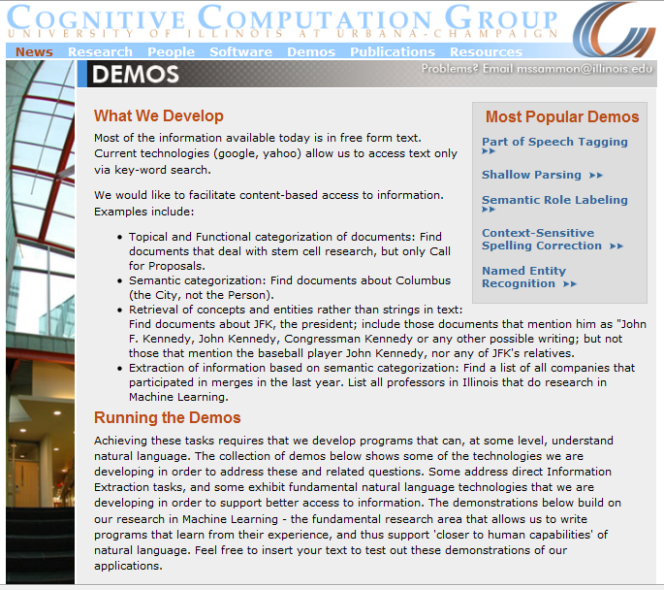
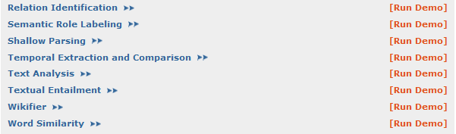
(Shallow) Semantic Parsing
Applications:
NexLP: Investigations; Compliance; E-Discovery
ICG: Tracking social media (primaries trends– who likes what?)
Caveats: Adaptation to multiple text genres
Entities
Temporal; Quantities
Significant Progress in NLP and Information Extraction
Wikifier
Co-Reference
Events

Slide 12
Events: Identification, Analysis, Co-Reference; Timeline
An “Arrest” Event
Causality
A “Kill” Event
Temporal
Distributional Association Score
The police arrested AAA because he killed BBB two days after Christmas
Discourse Relation Prediction

Slide 13
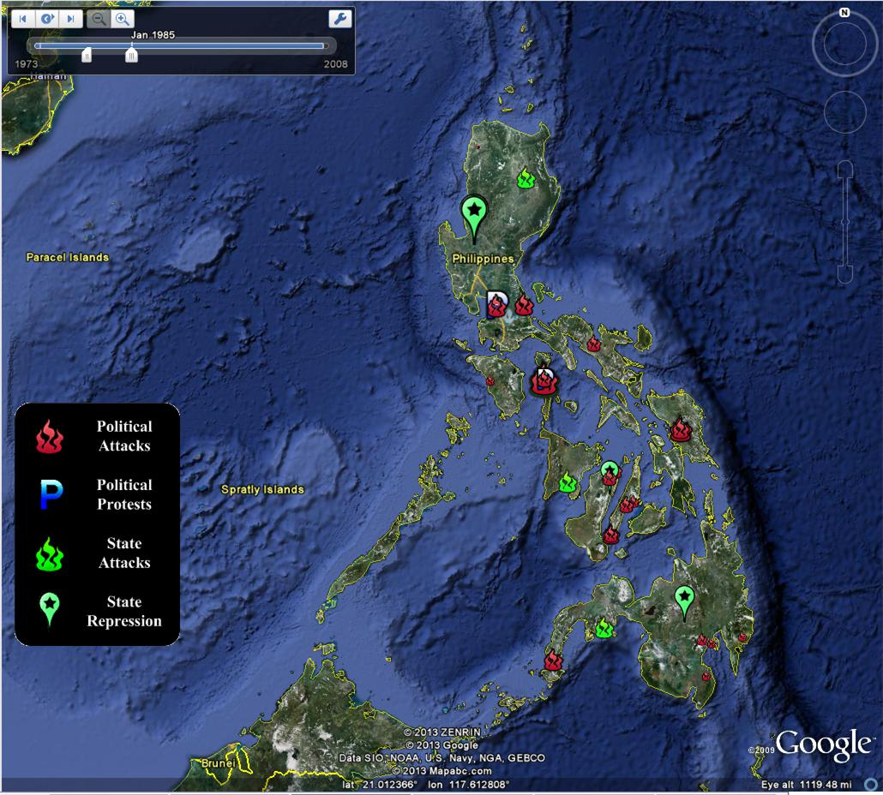
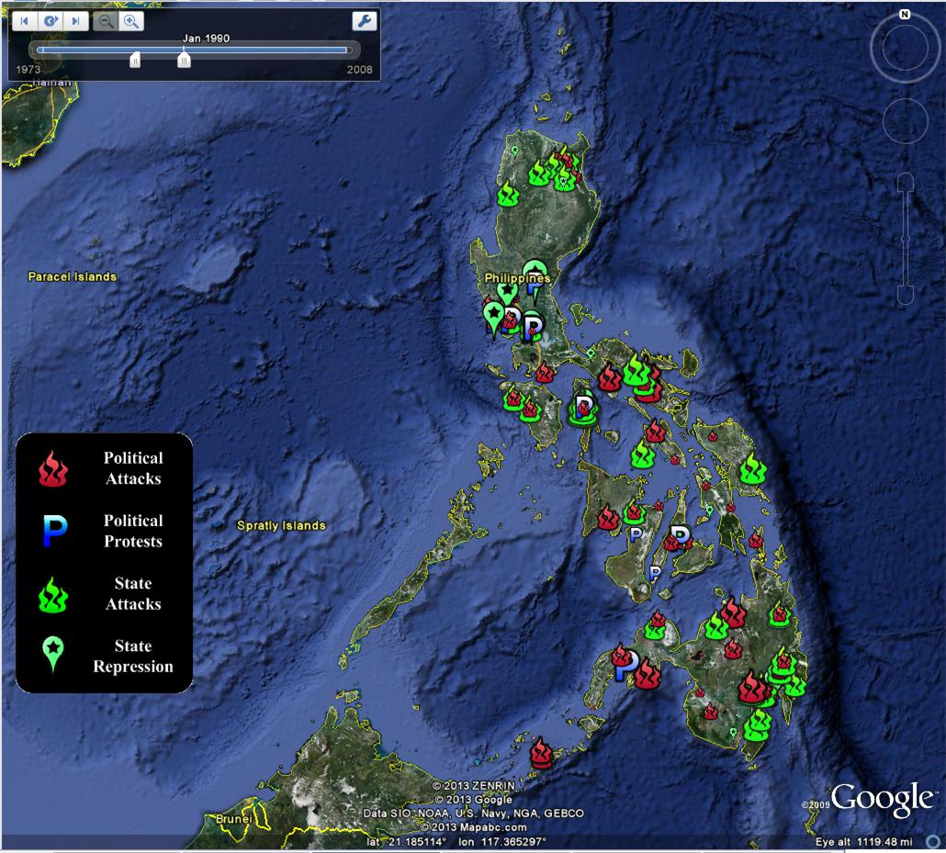
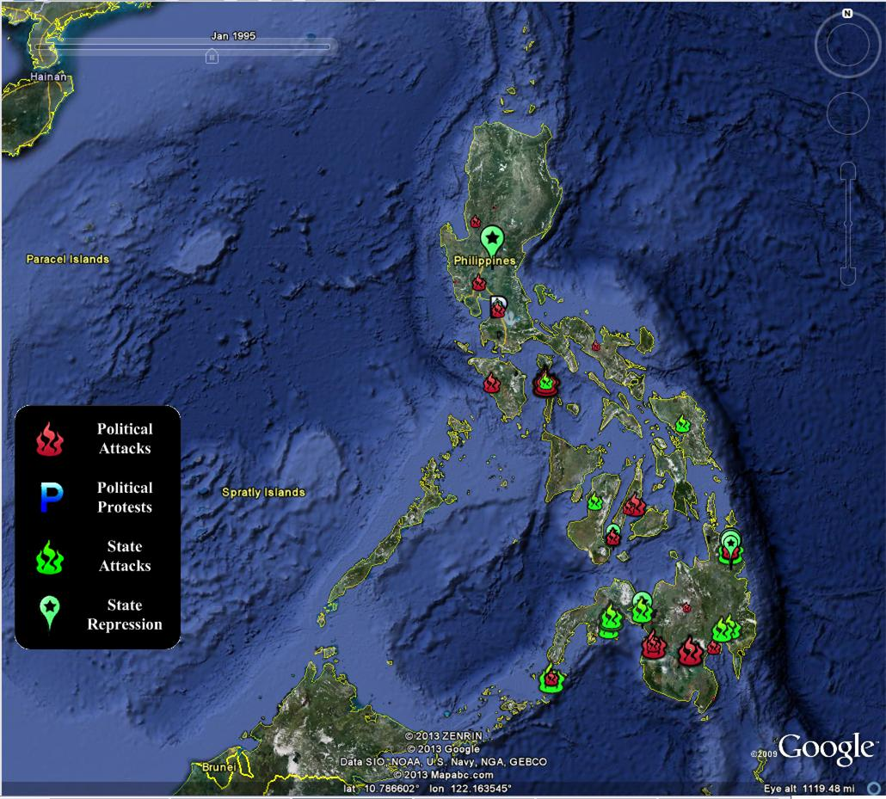
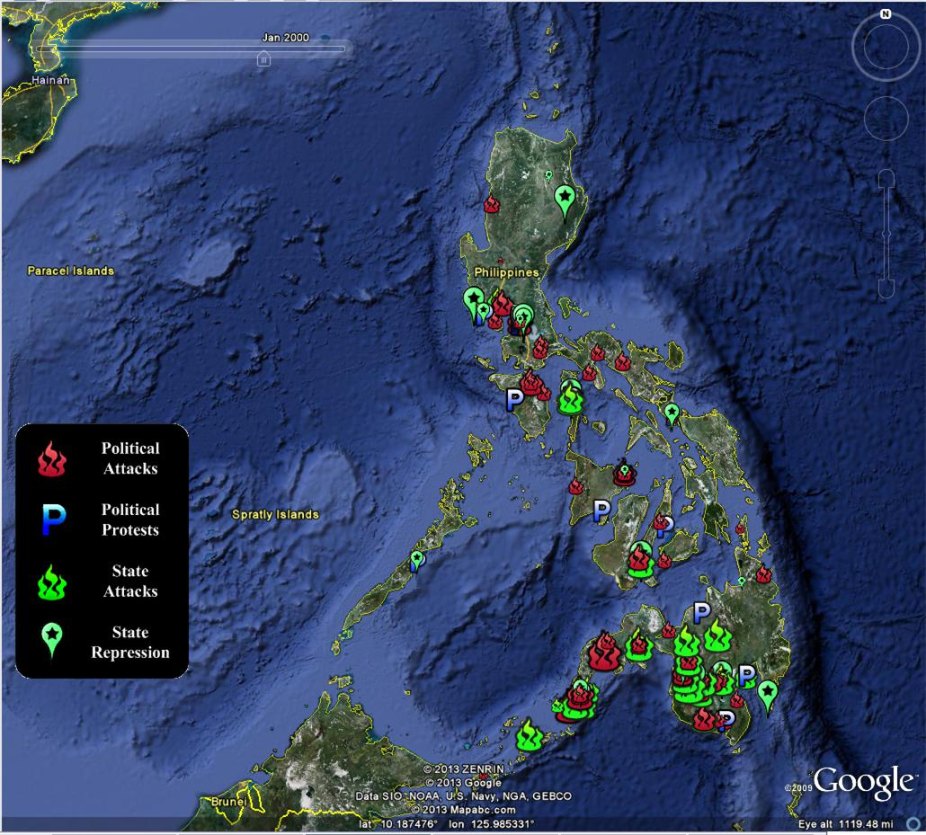
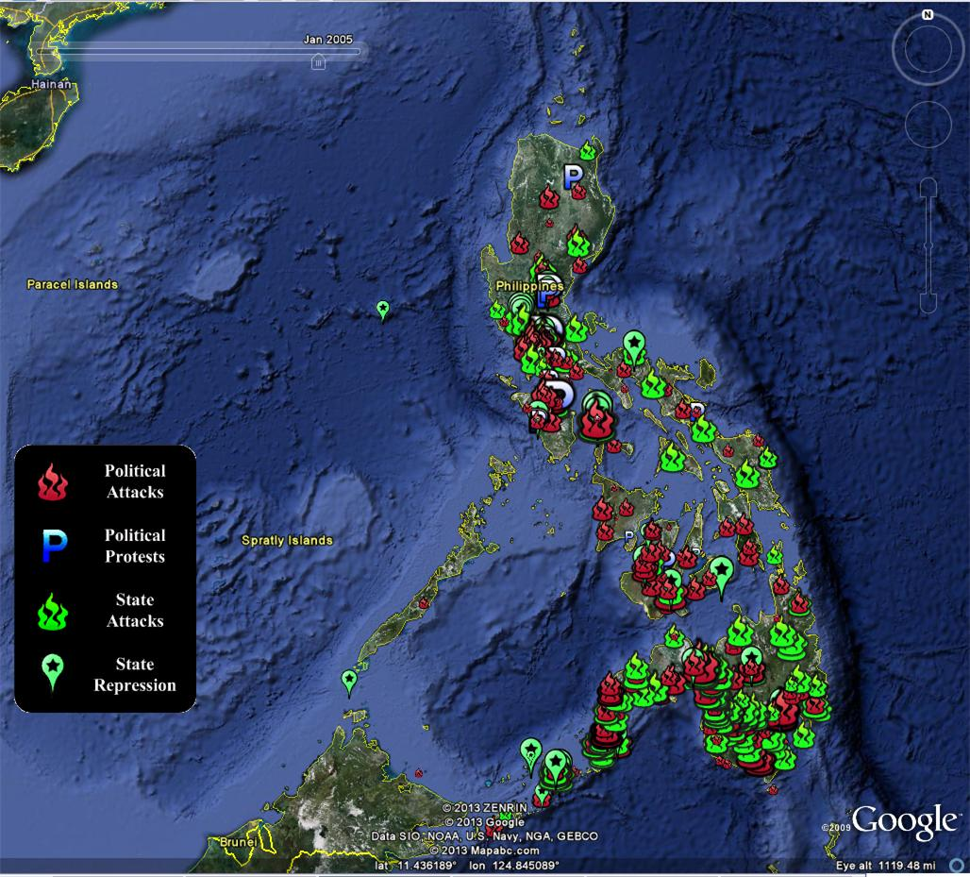
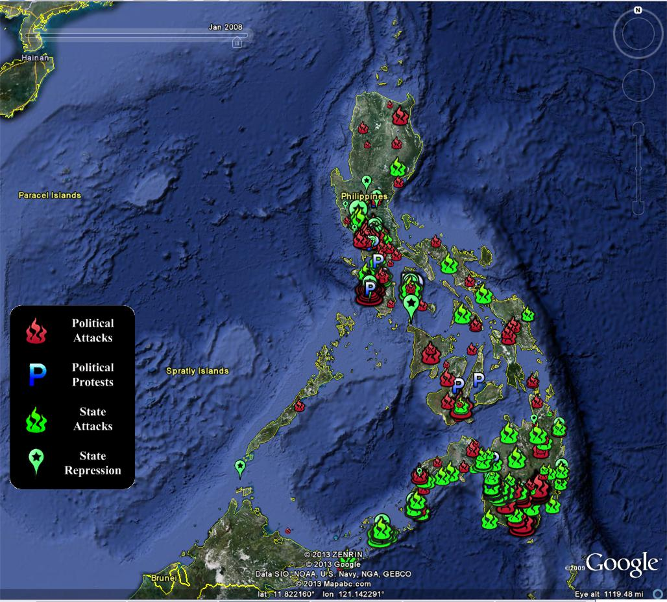
Social, Political and Economic Event Database (SPEED)
Cline Center for Democracy: Quantitative Political Science meets Information extraction
Tracking Societal Stability in the Philippines: Civil strife, Human and property rights, The rule of law, Political regime transitions

Slide 14
Natural Language Understanding
Much research into [data → meaning] attempts to tell us what a document says with some level of certainty
  Why is it difficult to do?
  What our Learning and Inference methods can do today
  A lot more should and can be done
  ……
But what should we believe, and who should we trust?

Slide 15
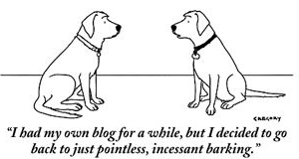
Knowing what to Believe
The advent of the Information Age and the Web
  Overwhelming quantity of information
  But uncertain quality.
    Collaborative media
      Blogs
      Wikis
      Tweets
      Message boards
    Established media are losing market share
      Reduced fact-checking
Notes:
15

Slide 16
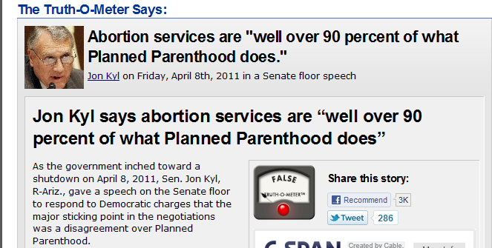
Distributed Trust
Sources may provide conflicting
information or mutually
reinforcing information.
  Mistakenly or for a reason
  Not feasible for human to
  read it all
  A computational trust system can be our proxy
  Ideally, assign the trust judgments the user would
  The user may be another system
    A question answering system; A navigation system; A news aggregator
    A warning system
False– only 3 %

Slide 17
Emergency Situations
A distributed data stream needs to be monitored
All data streams have Natural Language Content
  Internet activity
    chat rooms, forums, search activity, twitter and cell phones
  Traffic reports; 911 calls and other emergency reports
  Network activity, power grid reports, networks reports, security systems, banking
  Media coverage
Often, stories appear on tweeter before they break the news
But, a lot of conflicting information, possibly misleading and deceiving
Notes:
17

Slide 18
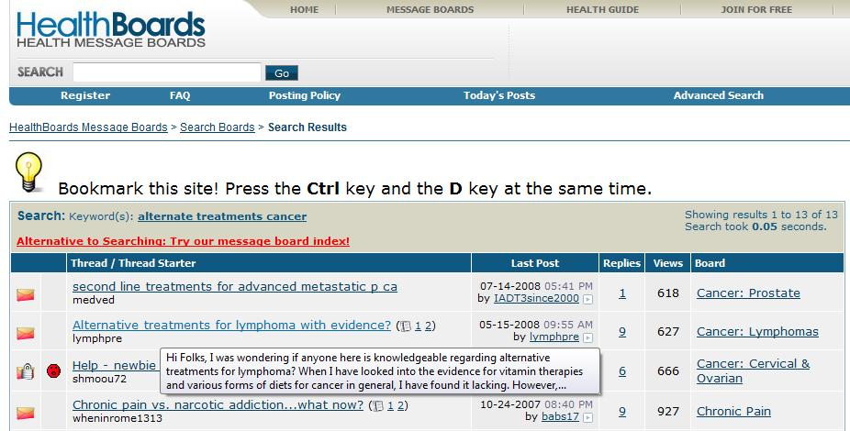
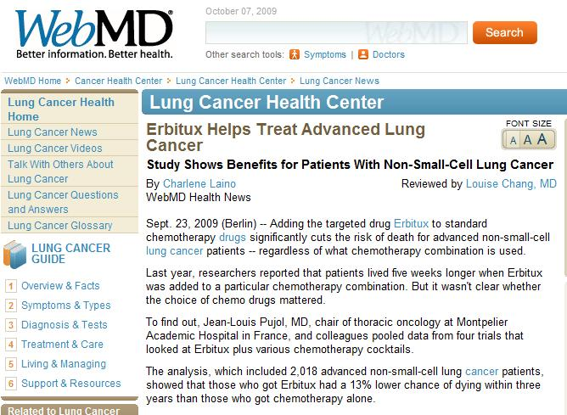
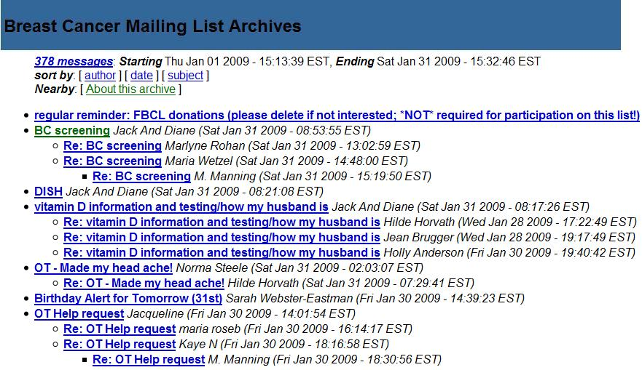
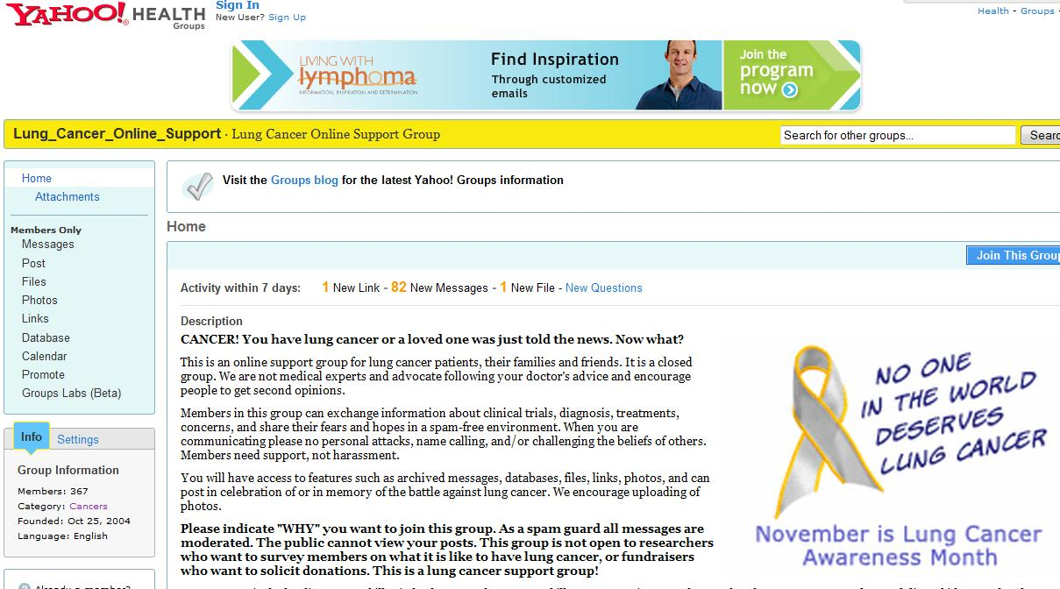
Medical Domain: Many support groups & medical forums
Hundreds of thousands of people get their medical information from the internet
Best treatment for…..
Side effects of….
But, some users have an agenda,… pharmaceutical companies…
18
Notes:
Users share their experiences in message boards, forums, and blogs.
18

Slide 19
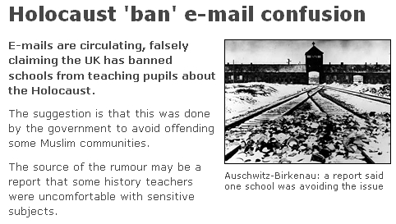
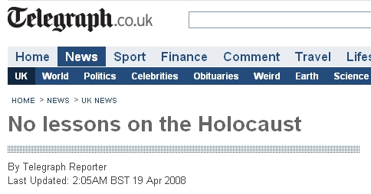
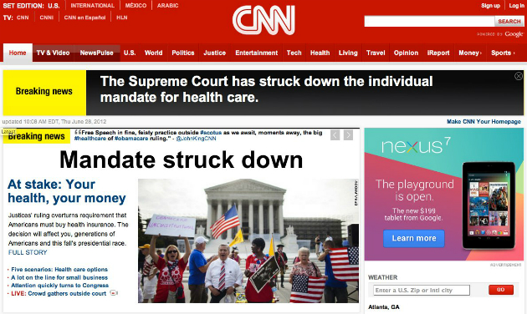
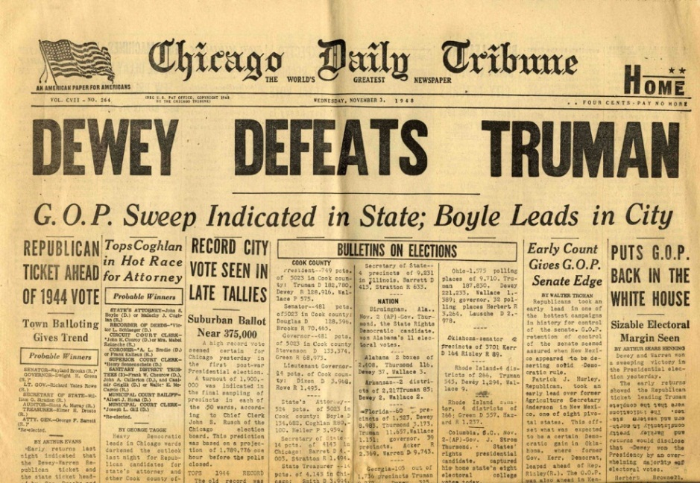
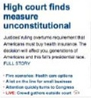
Not so Easy
Integration of data from multiple heterogeneous sources is essential.
Different sources may provide either conflicting information or mutually reinforcing information.
Interpreting a distributed stream of conflicting pieces of information is not easy even for experts.

Slide 20
Trustworthiness
Evidence
E(c)
Claims
T(s)
Sources
Sources
Claims
e₁
s₁
B(c)
Given:
  Multiple content sources
  Some target relations (“facts”)
    E.g. [disease, treatments],
    [treatments, side-effects]
  Prior beliefs & background knowledge
    “A sensor network”
Our goal is to:
  Score credibility of sources and trustworthiness of claims based on
    Support across multiple (trusted) sources
    Source characteristics:
      reputation, interest-group (commercial / govt. backed / public interest),
      verifiability of information (cited info)
    Prior Beliefs and Background knowledge
    Understanding content
s₁
e₂
c₁
c₁
s₂
e₃
s₂
c₂
s₃
e₄
c₂
s₃
e₅
c₃
s₄
c₃
s₄
e₆
c₄
s₅
e₇
c₄
s₅
e₈
e₉
e₁₀
Beyond the scientific and engineering challenges, this will have significant societal impact.

Slide 21


Research Questions [Pasternack&Roth COLING’10,[11; Vydiswaran, Zhai, Roth, KDD’11]
1. Trust Metrics
  (a) Trustworthy messages have some typical characteristics.
  (b) Accuracy is misleading. A lot of (trivial) truths do not make a message trustworthy.
2. Algorithmic Framework: Constrained Trustworthiness Models
  Just voting isn’t good enough
  Need to incorporate prior beliefs & background knowledge
3. Incorporating Evidence for Claims
  Not sufficient to deal with claims and sources
  Need to find (diverse) evidence – natural language difficulties
4. Building a Claim-Verification system
  Automate Claim Verification—find supporting & opposing evidence
  Natural Language; user biases; information credibility

Slide 22
1. Comprehensive Trust Metrics [Pasternak & Roth’10]
A single, accuracy-derived metric is inadequate
We proposed three measures of trustworthiness:
  Truthfulness: Importance-weighted accuracy
  Completeness: How thorough a collection of claims is
  Bias: Results from supporting a favored position with:
    Untruthful statements
    Targeted incompleteness (“lies of omission”)
Calculated relative to the user’s beliefs and information requirements
These apply to collections of claims and Information sources
Found that our metrics align well with user perception overall and are preferred over accuracy-based metrics
Notes:
22

Slide 23
2. Constrained Trustworthiness Models [Pasternak & Roth’10,11,12]
Veracity of claims
Trustworthiness of sources
T(s)
Sources
B(C)
Hub-Authority style
s₁
Claims
c₁
B^{(n+1)}(c)=∑_{s} w(s,c) T^{n}(s)
s₂
c₂
T^{(n+1)}(s)=∑_{c} w(s,c) B^{n+1}(c)
s₃
Encode additional information into a generalized fact-finding graph
Rewrite the algorithm to use this information
(Un)certainty of the information extractor; Similarity between claims; Attributes , group memberships & source dependence;
Often readily available in real-world domains
c₃
1
s₄
c₄
s₅
Incorporate Prior knowledge
Common-sense: Cities generally grow over time; A person has 2 biological parents
Specific knowledge: The population of Los Angeles is greater than that of Phoenix
2
Solved via Iterative constrained optimization (constrained EM), via generalized constrained models
Represented declaratively (FOL like) and converted automatically into linear inequalities
Notes:
Callout for tau and sigma

Slide 24
Fact-Finders
s₁
c₁
Model the trustworthiness of sources and the believability of claims
Claims belong to mutual exclusion sets
Input: who says what
Output: what we should believe, who we should trust
Baseline: simple voting—just believe the claim asserted by the most sources
s₂
c₂
s₃
c₃
s₄
c₄
s₅
Notes:
Instead of looking at just the sources, or doing voting, we can model both the sources and claims.

Slide 25
Basic Idea
Sources S
Claims C
Mutual exclusion sets
A fact-finder is an iterative, transitive voting algorithm:
Calculates belief in each claim from the credibility of its sources
Calculates the credibility of each source from the believability of the claims it makes
Repeats
s₁
c₁
m₁
s₂
c₂
c₃
s₃
c₄
m₂
s₄
c₅
Bipartite graph
Each source s 2 S asserts a set of claims µ C
Each claim c 2 C belongs to a mutual exclusion set m
Example ME set: “Possible ratings of the Detroit Marriot”
Notes:
25
In the domain of hotel ratings, a source would be a reviewer, say, Jim, while a mutual exclusion set would be the set of a ratings for a particular hotel, say, the Detroit Marriot, and each possible rating for that hotel would be a claim within that mutual exclusion set.

Slide 26
Fact-Finder Prediction
The fact-finder runs for a specified number of iterations or until convergence
  Some fact-finders are proven to converge; most are not
  All seem to converge relatively quickly in practice (e.g. a few dozen iterations)
Predictions are made by looking at each mutual exclusion set and choosing the claim with the highest belief score

Slide 27
Advantages of Fact-Finders
Usually work much better than simple voting
  Sources are not all equally trustworthy!
Numerous high-performing algorithms in literature
Highly tractable: all extant algorithms take time linear in the number of sources and claims per iteration
Easy to implement and to (procedurally) understand
A fact-finding algorithm can be specified by just two functions:
  T^{i}(s): How trustworthy is this source given our previous belief the claims it makes claims?
  B^{i}(c): How trustworthy is this claim given our current trust of the sources asserting it?

Slide 28
Disadvantages of Fact-Finders
Limited expressivity
  Only consider sources and the claims they make
Much more information is available, but unused
  Declarative prior knowledge
  Attributes of the source, uncertainty of assertions, and other data
No “story” and vague semantics
  A trust score of 20 is better than 19, but how much better?
  Which algorithm to apply to a given problem?
    Some intuitions are possible, but nothing concrete
Opaque; decisions are hard to explain
Notes:
Later in this tutorial we’ll see that all of these issues can be address by alternative models, although this will frequently come at the price of complexity

Slide 29
Example: The Sums Fact-Finder
We start with a concrete example using a very simple fact-finder, Sums
  Sums is similar to the Hubs and Authorities algorithm, but applied to a source-claim bipartite graph
Notes:
In Sums, the trustworthiness of a source is simply the (normalized) sum of our previous belief in the claims it makes; similarly, the believability of a claim is the sum of trustworthiness of the sources asserting it. Initially, our belief is uniform across all the claims.

Slide 30
Numerical Fact-Finding Example
Problem:
  We want to obtain the birthdays of Bill Clinton, George W. Bush, and Barack Obama
  We have run information extraction on documents by seven authors, but they disagree

Slide 31
Numerical Fact-Finding Example
John
Sarah
Kevin
Jill
Sam
Lilly
Dave
Clinton
8/20/47
Clinton
8/31/46
Clinton
8/19/46
Bush
4/31/47
Bush
7/6/46
Obama
8/4/61
Obama
2/14/61

Slide 32
Approach #1: Voting
1.5 out of 3 correct
John
Sarah
Kevin
Jill
Sam
Lilly
Dave
Clinton
8/20/47
Clinton
8/31/46
Clinton
8/19/46
Bush
4/31/47
Bush
7/6/46
Obama
8/4/61
Obama
2/14/61
WRONG
RIGHT
TIE

Slide 33
Sums at Iteration 0
Let’s try a simple fact-finder, Sums
John
Sarah
Kevin
Jill
Sam
Lilly
Dave
Clinton
8/20/47
Clinton
8/31/46
Clinton
8/19/46
Bush
4/31/47
Bush
7/6/46
Obama
8/4/61
Obama
2/14/61
1
1
1
1
1
1
1
Initially, we believe in each claim equally

Slide 34
Sums at Iteration 1A
The trustworthiness of a source is the sum of belief in its claims
1
2
1
2
2
1
1
John
Sarah
Kevin
Jill
Sam
Lilly
Dave
Clinton
8/20/47
Clinton
8/31/46
Clinton
8/19/46
Bush
4/31/47
Bush
7/6/46
Obama
8/4/61
Obama
2/14/61
1
1
1
1
1
1
1

Slide 35
Sums at Iteration 1B
1
2
1
2
2
1
1
John
Sarah
Kevin
Jill
Sam
Lilly
Dave
Clinton
8/20/47
Clinton
8/31/46
Clinton
8/19/46
Bush
4/31/47
Bush
7/6/46
Obama
8/4/61
Obama
2/14/61
3
1
2
2
5
2
1
And belief in a claim is the sum of the trustworthiness of its sources

Slide 36
Sums at Iteration 2A
Now update the sources again…
3
5
1
7
7
5
1
John
Sarah
Kevin
Jill
Sam
Lilly
Dave
Clinton
8/20/47
Clinton
8/31/46
Clinton
8/19/46
Bush
4/31/47
Bush
7/6/46
Obama
8/4/61
Obama
2/14/61
3
1
2
2
5
2
1

Slide 37
Sums at Iteration 2B
3
5
1
7
7
5
1
John
Sarah
Kevin
Jill
Sam
Lilly
Dave
Clinton
8/20/47
Clinton
8/31/46
Clinton
8/19/46
Bush
4/31/47
Bush
7/6/46
Obama
8/4/61
Obama
2/14/61
8
1
7
5
19
7
1
And update the claims…

Slide 38
Sums at Iteration 3A
Update the sources…
8
13
1
26
26
19
1
John
Sarah
Kevin
Jill
Sam
Lilly
Dave
Clinton
8/20/47
Clinton
8/31/46
Clinton
8/19/46
Bush
4/31/47
Bush
7/6/46
Obama
8/4/61
Obama
2/14/61
8
1
7
5
19
7
1

Slide 39
Sums at Iteration 3B
8
13
1
26
26
19
1
John
Sarah
Kevin
Jill
Sam
Lilly
Dave
Clinton
8/20/47
Clinton
8/31/46
Clinton
8/19/46
Bush
4/31/47
Bush
7/6/46
Obama
8/4/61
Obama
2/14/61
21
1
26
13
71
26
1
And one more update of the claims

Slide 40
Results after Iteration 3
Now (and in subsequent iterations) we get 3 out of 3 correct
8
13
1
26
26
19
1
John
Sarah
Kevin
Jill
Sam
Lilly
Dave
Clinton
8/20/47
Clinton
8/31/46
Clinton
8/19/46
Bush
4/31/47
Bush
7/6/46
Obama
8/4/61
Obama
2/14/61
21
1
26
13
71
26
1
RIGHT
RIGHT
RIGHT

Slide 41
Sums Pros and Cons
Sums is easy to express, but is also quite biased
All else being equal, favors sources that make many claims
  Asserting more claims always results in greater credibility
  Nothing dampens this effect
  Similarly, it favors claims asserted by many sources
Fortunately, in some real-world domains dishonest sources do tend to create fewer claims; e.g. Wikipedia vandals
41
Notes:
41
Sums suffers more than most from the “easy claim-making” issue because it has no dampening; the increased trust/credibility from extra assertions is linear!

Slide 42
Fact-finding algorithms
Fact-finding algorithms have biases (not always obvious) that may not match the problem domain
Fortunately, there are many methods to choose from:
  TruthFinder
  3-Estimates
  Average-Log
  Investment
  PooledInvestment
  …
The algorithms are essentially driven by intuition about what makes something a credible claim, and what makes someone a trustworthy source
Diversity of algorithms mean that one can pick the best where there is some labeled data
But some algorithms tend to work better than others overall

Slide 43
2. Constrained Trustworthiness Models [Pasternak & Roth’10,11,12]
Veracity of claims
Trustworthiness of sources
T(s)
Sources
B(C)
Hub-Authority style
s₁
Claims
c₁
B^{(n+1)}(c)=∑_{s} w(s,c) T^{n}(s)
s₂
c₂
T^{(n+1)}(s)=∑_{c} w(s,c) B^{n+1}(c)
s₃
Encode additional information into a generalized fact-finding graph
Rewrite the algorithm to use this information
(Un)certainty of the information extractor; Similarity between claims; Attributes , group memberships & source dependence;
Often readily available in real-world domains
c₃
1
s₄
c₄
s₅
Incorporate Prior knowledge
Common-sense: Cities generally grow over time; A person has 2 biological parents
Specific knowledge: The population of Los Angeles is greater than that of Phoenix
2
Solved via Iterative constrained optimization (constrained EM), via generalized constrained models
Represented declaratively (FOL like) and converted automatically into linear inequalities
SKIP EXAMPLE
Notes:
Callout for tau and sigma

Slide 44
3. Incorporating Evidence for Claims [Vydiswaran, Zhai &Roth’10,11,12]
Evidence
Sources
E(c)
Claims
T(s)
e₁
s₁
B(c)
s₂
e₄
e₂
c₁
T(s_{i})
E(c_{i})
s₂
e₃
c₃
s₃
T(s_{i})
e₅
e₄
c₂
E(c_{i})
s₃
B(c)
e₅
s₄
e₆
c₃
T(s_{i})
E(c_{i})
s₄
e₆
e₇
c₄
The truth value of a claim depends on its source as well as on evidence.
  Evidence documents influence each other and have different relevance to claims.
Global analysis of this data, taking into account the relations between stories, their relevance, and their sources, allows us to determine trustworthiness values over sources and claims.
s₅
e₈
1
e₉
e₁₀
The NLP of Evidence Search
Does this text snippet provide evidence to this claim? Textual Entailment
What kind of evidence?
For, Against: Opinion Sentiments
2
Notes:
Callout for tau and sigma

Slide 45
4. Building ClaimVerifier
Algorithmic Questions
Users
Language Understanding Questions
Retrieve text snippets as evidence that supports or opposes a claim
Textual Entailment driven search and Opinion/Sentiment analysis
Source
Claim
Presenting evidence for or against claims
HCI Questions [Vydiswasaran et. al’12]
What do subjects prefer – information from credible sources or information that closely aligns with their bias?
What is the impact of user bias?
Does the judgment change if credibility/ bias information is visible to the user?
Evidence
Data

Slide 46
Other Perspectives
The algorithmic framework of trustworthiness can be motivated form other perspectives:
Crowd Sourcing: Multiple Amazon turkers are contributing annotation/answers for some task.
  Goal: Identify who the trustworthy turkers are and integrate the information provided so it is more reliable.
Information Integration
  Data Base Integration
  Aggregation of multiple algorithmic components, taking into account the identify of the source
  Meta-search: aggregate information of multiple rankers
There have been studies in all these directions and, sometimes, the technical contents overlaps
Notes:
If you read some text online, can you believe it? We pose these questions and as a first step, try to approach it based on other users’ shared experience on something similar.
46

Slide 47
Summary: Making Sense of Unstructured Data
Thank you!
Check out our tools, demos, LBJava→Saul, Tutorials,…
Making sense of unstructured data
  Natural Language Understanding is essential to supporting better access, analysis, and synthesis of data.
  Machine Learning and Inference are at the heart of any attempt for scientific and engineering progress in these direction.
  Have given a few examples of current capabilities .
  Very active research area – the problem is far from being solved.
  But we have made significant progress, and can already offer interesting insights and practical solutions that reliably address a range a problems.
Trusting unstructured data
  Comes up in the context of social (and “standard” media), but also in the context of using other sensory information.
  Very broad applications, with huge societal impact.
  AAAI’14 Tutorial on Trustworthiness; forthcoming Survey

