Slide 1
Constrained Conditional Models:
Towards Better Semantic Analysis of Text
Dan Roth
Department of Computer Science
University of Illinois at Urbana-Champaign
With thanks to:
Collaborators: Ming-Wei Chang, Gourab Kundu, Lev Ratinov, Rajhans Samdani,
Vivek Srikumar, Many others
Funding: NSF; DHS; NIH; DARPA.
DASH Optimization (Xpress-MP)
June 2013
BENELEARN, Nijmegen

Slide 2
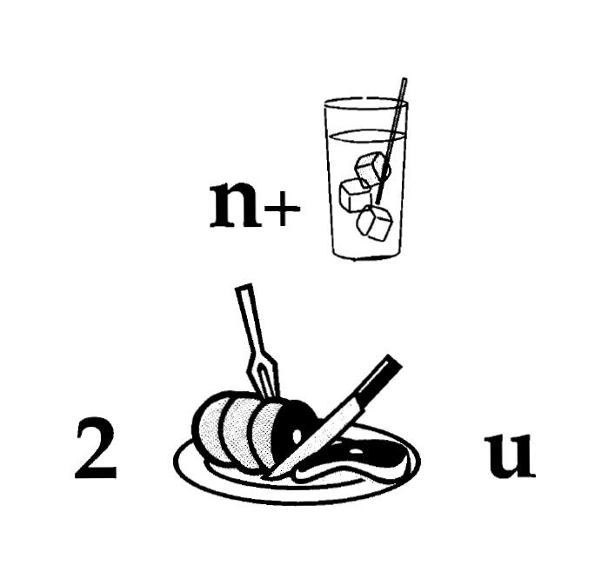
Nice to Meet You

Slide 3
Learning and Inference in NLP
Natural Language Decisions are Structured
  Global decisions in which several local decisions play a role but there are mutual dependencies on their outcome.
It is essential to make coherent decisions in a way that takes the interdependencies into account. Joint, Global Inference.
TODAY:
  How to support real, high level, natural language decisions
  How to learn models that are used, eventually, to make global decisions
  A framework that allows one to exploit interdependencies among decision variables both in inference (decision making) and in learning.
  Inference: A formulation for incorporating expressive declarative knowledge in decision making.
  Learning: Ability to learn simple models; amplify its power by exploiting interdependencies.

Slide 4
Comprehension
(ENGLAND, June, 1989) - Christopher Robin is alive and well. He lives in England. He is the same person that you read about in the book, Winnie the Pooh. As a boy, Chris lived in a pretty home called Cotchfield Farm. When Chris was three years old, his father wrote a poem about him. The poem was printed in a magazine for others to read. Mr. Robin then wrote a book. He made up a fairy tale land where Chris lived. His friends were animals. There was a bear called Winnie the Pooh. There was also an owl and a young pig, called a piglet. All the animals were stuffed toys that Chris owned. Mr. Robin made them come to life with his words. The places in the story were all near Cotchfield Farm. Winnie the Pooh was written in 1925. Children still love to read about Christopher Robin and his animal friends. Most people don't know he is a real person who is grown now. He has written two books of his own. They tell what it is like to be famous.
1. Christopher Robin was born in England. 2. Winnie the Pooh is a title of a book.
3. Christopher Robin’s dad was a magician. 4. Christopher Robin must be at least 65 now.
This is an Inference Problem
Notes:
4
I would like to talk about it in the context of language understanding problems. This is the problem I would like to solve. You are given a short story, a document, a paragraph, which you would like to understand. My working definition for Comprehension here would be “ A process that….”
So, given some statement, I would like to know if they are true in this story or not….
This is a very difficult task…
What do we need to know in order to have a chance to do that? … Many things….
And, there are probably many other stand-alone tasks of this sort that we need to be able to address, if we want to have a chance to COMPREHEND this story, and answer questions with respect to it.
But comprehending this story, being able to determined the truth of these statements is probably a lot more than that – we need to be able to put these things,
(and what is “these” isnt’ so clear) together.
So, how do we address comprehension? Here is a somewhat cartoon-she view of what has happened in this area over the last 30 years or so?
talk about – I wish I could talk about.
Here is a challenge: write a program that responds correctly to these five questions. Many of us would love to be able to do it.
This is a very natural problem; a short paragraph on Christopher Robin that we all
Know and love, and a few questions about it; my six years old can answer these
Almost instantaneously, yes, we cannot write a program that answers more than, say, 2 out of five questions.
What is involved in being able to answer these? Clearly, there are many “small” local decisions that we need to make.
We need to recognize that there are two Chris’s here. A father an a son. We need to resolve co-reference. We need sometimes
To attach prepositions properly;
The key issue, is that it is not sufficient to solve these local problems – we need to figure out how to put them
Together in some coherent way.
And in this talk, I will focus on this. We describe some recent works that we have done in this direction - …..
What do we know – in the last few years there has been a lot of work – and a considerable success on what I call here ---
Here is a more concrete and easy example -----
There is an agreement today that learning/ statistics /information theory (you name it) is of prime importance to making
Progress in these tasks. The key reason, is that rather than working on these high level difficult tasks, we have moved
To work on well defined disambiguation problems that people felt are at the core of many problems.
And, as an outcome of work in NLP and Learning Theory, there is today a pretty good understanding for how to solve
All these problems – which are essentially the same problem.

Slide 5
Learning and Inference
Global decisions in which several local decisions play a role but there are mutual dependencies on their outcome.
  In current NLP we often think about simpler structured problems: Parsing, Information Extraction, SRL, etc.
  As we move up the problem hierarchy (Textual Entailment, QA,….) not all component models can be learned simultaneously
  We need to think about (learned) models for different sub-problems
  Knowledge relating sub-problems (constraints) becomes more essential and may appear only at evaluation time
Goal: Incorporate models’ information, along with prior knowledge (constraints) in making coherent decisions
  Decisions that respect the local models as well as domain & context specific knowledge/constraints.
Notes:
5

Slide 6
Outline
Constrained Conditional Models
  A formulation for global inference with knowledge modeled as expressive structural constraints
  Some examples
Constraints Driven Learning
  Training Paradigms for Constrained Conditional Models
  Constraints Driven Learning (CoDL)
  Unified (Constrained) Expectation Maximization
Amortized Integer Linear Programming Inference
  Exploiting Previous Inference Results
  Can the k-th inference problem be cheaper than the 1st?

Slide 7
Three Ideas Underlying Constrained Conditional Models
Modeling
Idea 1:
Separate modeling and problem formulation from algorithms
  Similar to the philosophy of probabilistic modeling
Idea 2:
Keep models simple, make expressive decisions (via constraints)
  Unlike probabilistic modeling, where models become more expressive
Idea 3:
Expressive structured decisions can be supported by simply
learned models
  Global Inference can be used to amplify simple models (and even allow training with minimal supervision).
Inference
Learning

Slide 8
Inference with General Constraint Structure [Roth&Yih’04,07]
Recognizing Entities and Relations
Improvement over no inference: 2-5%
other | 0.05
per | 0.85
loc | 0.10
other | 0.05
per | 0.85
loc | 0.10
other | 0.10
per | 0.60
loc | 0.30
other | 0.10
per | 0.60
loc | 0.30
other | 0.05
per | 0.50
loc | 0.45
other | 0.05
per | 0.50
loc | 0.45
other | 0.05
per | 0.50
loc | 0.45
Y = argmax ∑_{y} score(y=v) [[y=v]] =
= argmax score(E₁ = PER)¢ [[E₁ = PER]] + score(E₁ = LOC)¢ [[E₁ = LOC]] +…
score(R₁ = S-of)¢ [[R₁ = S-of]] +…..
Subject to Constraints
Note: Non Sequential Model
An Objective function that incorporates learned models with knowledge (constraints)
A constrained Conditional Model
  Dole ’s wife, Elizabeth , is a native of N.C.
  E1 E2 E3
Key Questions:
How to guide the global inference?
How to learn? Why not Jointly?
R₁₂
R₂₃
irrelevant | 0.05
spouse_of | 0.45
born_in | 0.50
irrelevant | 0.05
spouse_of | 0.45
born_in | 0.50
irrelevant | 0.05
spouse_of | 0.45
born_in | 0.50
irrelevant | 0.10
spouse_of | 0.05
born_in | 0.85
irrelevant | 0.10
spouse_of | 0.05
born_in | 0.85
Models could be learned separately; constraints may come up only at decision time.
Notes:
8
Let’s look at another example in more details.
We want to extract entities (person, location and organization) and relations between them (born in, spouse of).
Given a sentence, suppose the entity classifier and relation classifier have already given us their predictions along with the confidence values. The blue ones are the labels that have the highest confidence individually. However, this global assignment has some obvious mistakes. For example, the second argument of a born_in relation should be location instead of person. Since the classifiers are pretty confident on R23, but not on E3, so we should correct E3 to be location.
Similarly, we should change R12 from “born_in” to “spouse_of”

Slide 9
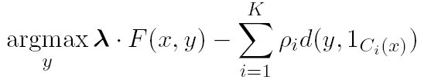
Constrained Conditional Models
Penalty for violating
the constraint.
(Soft) constraints component
Weight Vector for “local” models
Features, classifiers; log-linear models (HMM, CRF) or a combination
How far y is from
a “legal” assignment
How to solve?
This is an Integer Linear Program
Solving using ILP packages gives an exact solution.
Cutting Planes, Dual Decomposition & other search techniques are possible
How to train?
Training is learning the objective function
Decouple? Decompose?
How to exploit the structure to minimize supervision?

Slide 10
Structured Prediction: Inference
Placing in context: a crash course in structured prediction
Inference: given input x (a document, a sentence),
predict the best structure y = {y₁,y₂,…,y_{n}} 2 Y (entities & relations)
  Assign values to the y₁,y₂,…,y_{n}, accounting for dependencies among y_{i}s
Inference is expressed as a maximization of a scoring function
y’ = argmax_{y 2 Y} w^{T} Á (x,y)
Inference requires, in principle, touching all y 2 Y at decision time, when we are given x 2 X and attempt to determine the best y 2 Y for it, given w
  For some structures, inference is computationally easy.
  Eg: Using the Viterbi algorithm
  In general, NP-hard (can be formulated as an ILP)
Joint features on inputs and outputs
Set of allowed structures
Feature Weights
(estimated during learning)

Slide 11
Structured Prediction: Learning
Learning: given a set of structured examples {(x,y)}
find a scoring function w that minimizes empirical loss.
Learning is thus driven by the attempt to find a weight vector w such that for each given annotated example (x_{i}, y_{i}):

Slide 12
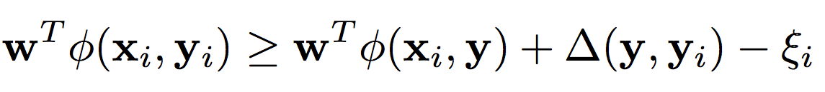
Structured Prediction: Learning
Learning: given a set of structured examples {(x,y)}
find a scoring function w that minimizes empirical loss.
Learning is thus driven by the attempt to find a weight vector w such that for each given annotated example (x_{i}, y_{i}):
We call these conditions the learning constraints.
In most learning algorithms used today, the update of the weight vector w is done in an on-line fashion
  Think about it as Perceptron; this procedure applies to Structured Perceptron, CRFs, Linear Structured SVM
W.l.o.g. (almost) we can thus write the generic structured learning algorithm as follows:
Score of annotated structure
Score of any other structure
Penalty for predicting other structure
8 y

Slide 13
Structured Prediction: Learning Algorithm
In the structured case, the prediction (inference) step is often intractable and needs to be done many times
For each example (x_{i}, y_{i})
Do: (with the current weight vector w)
  Predict: perform Inference with the current weight vector
    y_{i}’ = argmax_{y 2 Y} w^{T} Á ( x_{i} ,y)
  Check the learning constraints
    Is the score of the current prediction better than of (x_{i}, y_{i})?
  If Yes – a mistaken prediction
    Update w
  Otherwise: no need to update w on this example
EndFor

Slide 14
Structured Prediction: Learning Algorithm
Solution I: decompose the scoring function to EASY and HARD parts
For each example (x_{i}, y_{i})
Do:
  Predict: perform Inference with the current weight vector
    y_{i}’ = argmax_{y 2 Y} w_{EASY}^{T} Á_{EASY} ( x_{i} ,y) + w_{HARD}^{T} Á_{HARD} ( x_{i} ,y)
  Check the learning constraint
    Is the score of the current prediction better than of (x_{i}, y_{i})?
  If Yes – a mistaken prediction
    Update w
  Otherwise: no need to update w on this example
EndDo
EASY: could be feature functions that correspond to an HMM, a linear CRF, or even Á_{EASY} (x,y) = Á(x), omiting dependence on y, corresponding to classifiers.
May not be enough if the HARD part is still part of each inference step.

Slide 15
Structured Prediction: Learning Algorithm
Solution II: Disregard some of the dependencies: assume a simple model.
For each example (x_{i}, y_{i})
Do:
  Predict: perform Inference with the current weight vector
    y_{i}’ = argmax_{y 2 Y} w_{EASY}^{T} Á_{EASY} ( x_{i} ,y) + w_{HARD}^{T} Á_{HARD} ( x_{i} ,y)
  Check the learning constraint
    Is the score of the current prediction better than of (x_{i}, y_{i})?
  If Yes – a mistaken prediction
    Update w
  Otherwise: no need to update w on this example
EndDo

Slide 16
Structured Prediction: Learning Algorithm
Solution III: Disregard some of the dependencies during learning; take into account at decision time
For each example (x_{i}, y_{i})
Do:
  Predict: perform Inference with the current weight vector
    y_{i}’ = argmax_{y 2 Y} w_{EASY}^{T} Á_{EASY} ( x_{i} ,y) + w_{HARD}^{T} Á_{HARD} ( x_{i} ,y)
  Check the learning constraint
    Is the score of the current prediction better than of (x_{i}, y_{i})?
  If Yes – a mistaken prediction
    Update w
  Otherwise: no need to update w on this example
EndDo
    y_{i}’ = argmax_{y 2 Y} w_{EASY}^{T} Á_{EASY} ( x_{i} ,y) + w_{HARD}^{T} Á_{HARD} ( x_{i} ,y)
This is the most commonly used solution in NLP today

Slide 17
Examples: CCM Formulations
(Soft) constraints component is more general since constraints can be declarative, non-grounded statements.
CCMs can be viewed as a general interface to easily combine declarative domain knowledge with data driven statistical models
  Formulate NLP Problems as ILP problems (inference may be done otherwise)
    1. Sequence tagging (HMM/CRF + Global constraints)
    2. Sentence Compression (Language Model + Global Constraints)
    3. SRL (Independent classifiers + Global Constraints)
Sequential Prediction
HMM/CRF based:
Argmax ∑ ¸_{ij} x_{ij}
Sentence Compression/Summarization:
Language Model based:
Argmax ∑ ¸_{ijk} x_{ijk}
Linguistics Constraints
Cannot have both A states and B states in an output sequence.
Linguistics Constraints
If a modifier chosen, include its head
If verb is chosen, include its arguments

Slide 18
Semantic Role Labeling
Archetypical Information Extraction Problem: E.g., Concept Identification and Typing, Event Identification, etc.
I left my pearls to my daughter in my will .
[I]_{A0} left [my pearls]_{A1} [to my daughter]_{A2} [in my will]_{AM-LOC} .
A0 Leaver
A1 Things left
A2 Benefactor
AM-LOC Location
I left my pearls to my daughter in my will .
Notes:
In the context of SRL, the goal is to predict for each possible phrase in a given sentence if it is an argument or not and what type it is.

Slide 19
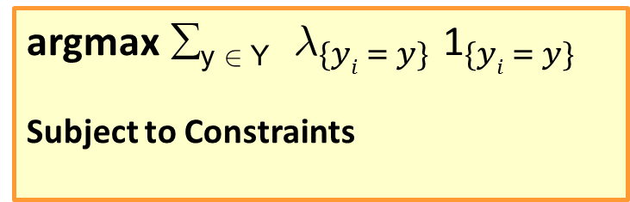
Algorithmic Approach
I left my nice pearls to her
candidate arguments
Identify argument candidates
  Pruning [Xue&Palmer, EMNLP’04]
  Argument Identifier
    Binary classification
Classify argument candidates
  Argument Classifier
    Multi-class classification
Inference
  Use the estimated probability distribution given by the argument classifier
  Use structural and linguistic constraints
  Infer the optimal global output
  Boolean variable that indicates whether candidate argument y_{i} is assigned a label y.
  ¸: the corresponding model score
I left my nice pearls to her
I left my nice pearls to her
[ [ [ [ [
] ] ] ] ]
argmax ∑_{y 2 Y} ${\text{¸}}_{\{yi = y\} }{\text{1}}_{\{yi = y\} }$
Subject to Constraints
I left my nice pearls to her
Use the pipeline architecture’s simplicity while maintaining uncertainty: keep probability distributions over decisions & use global inference at decision time.
Notes:
We follow a now seemingly standard approach to SRL.
Given a sentence, first we find a set of potential argument candidates by identifying
which words are at the border of an argument.
Then, once we have a set of potential arguments, we use a phrase-level classifier to tell us how likely an argument is to be of each type.
Finally, we use all of the information we have so far to find the assignment of types to argument that gives us the “optimal” global assignment.
Similar approaches (with similar results) use inference procedures tied to their represntation.
Instead, we use a general inference procedure by setting up the problem as a linear programming problem.
This is really where our technique allows us to apply powerful information that similar approaches can not.

Slide 20
Semantic Role Labeling (SRL)
0.5
0.15
0.15
0.1
0.1
0.05
0.1
0.2
0.6
0.05
0.15
0.6
0.05
0.05
0.05
0.05
0.05
0.7
0.05
0.15
0.3
0.2
0.2
0.1
0.2
I left my pearls to my daughter in my will .
Notes:
20
Here is how we use it to solve our problem. Assume each line and color here represent all possible arguments and argument types with the grey color means null or not actually an argument. Associated with each line is the score obtained from the argument classifier.

Slide 21
Semantic Role Labeling (SRL)
0.5
0.15
0.15
0.1
0.1
0.05
0.1
0.2
0.6
0.05
0.15
0.6
0.05
0.05
0.05
0.05
0.05
0.7
0.05
0.15
0.3
0.2
0.2
0.1
0.2
I left my pearls to my daughter in my will .
Notes:
21
If we were to let the argument classifier to make the final prediction, we would have this output which violates the non-overlapping constarints.

Slide 22
Semantic Role Labeling (SRL)
0.5
0.15
0.15
0.1
0.1
0.05
0.1
0.2
0.6
0.05
0.15
0.6
0.05
0.05
0.05
0.05
0.05
0.7
0.05
0.15
0.3
0.2
0.2
0.1
0.2
One inference problem for each verb predicate.
I left my pearls to my daughter in my will .
Notes:
22
Instead, when we use the ILP inference, it will eliminate bottom argument which is now the assignment that maximizes the linear summation of the scores that also satisfy the non-overlapping constraints.

Slide 23



Constraints
Any Boolean rule can be encoded as a set of linear inequalities.
No duplicate argument classes
Reference-Ax
Continuation-Ax
Many other possible constraints:
    Unique labels
    No overlapping or embedding
    Relations between number of arguments; order constraints
    If verb is of type A, no argument of type B
If there is an Reference-Ax phrase, there is an Ax
If there is an Continuation-x phrase, there is an Ax before it
Universally quantified rules
Learning Based Java: allows a developer to encode constraints in First Order Logic; these are compiled into linear inequalities automatically.
Notes:
23
Animation to show the following 3 constraints step by step
Binary constraints
Summation = 1 assures that it’s assigned only one label
Non-overlapping constraints
Remember to put a small bar picture

Slide 24
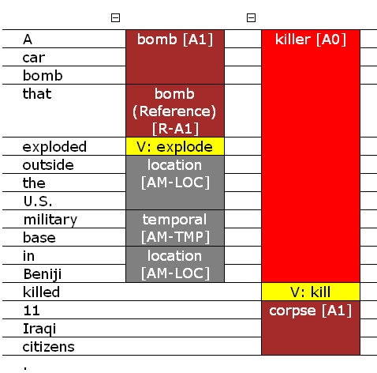
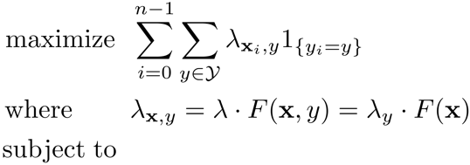
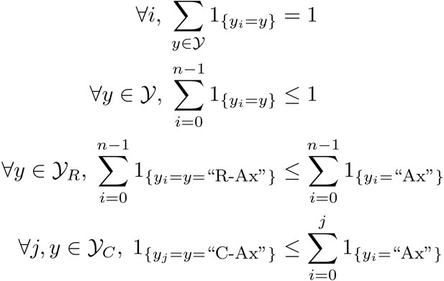
SRL: Posing the Problem
Demo: http://cogcomp.cs.illinois.edu/

Slide 25
Extended Semantic Role labeling
[EMNLP’12, TACL’13]
Verb Predicates, Noun predicates, prepositions, each dictates some relations, which have to cohere.
Predicate arguments from different triggers should be consistent
The bus was heading for Nairobi in Kenya.
Joint constraints linking the two tasks.
Destination ⇔ A1
Location
Destination
Predicate: head.02
A0 (mover): The bus
A1 (destination): for Nairobi in Kenya

Slide 26
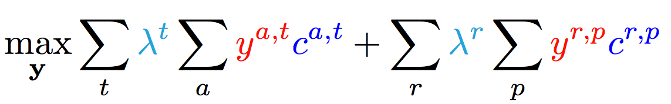
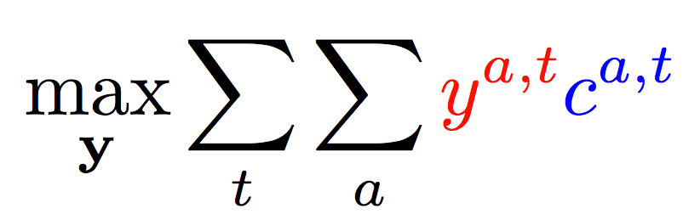
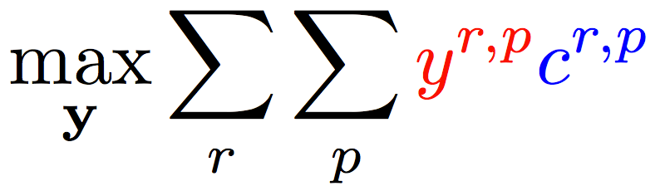
Joint inference
  Variable y^{a,t} indicates whether candidate argument a is assigned a label t.
  c^{a,t} is the corresponding score
Verb arguments
Preposition relations
Argument candidates
Re-scaling parameters (one per label)
Preposition relation
label
Constraints:
Preposition
Each argument label
Verb SRL constraints
Only one label per preposition
Joint constraints

Slide 27
Desiderata for joint prediction
Intuition: The correct interpretation of a sentence is the one that gives a consistent analysis across all the linguistic phenomena expressed in it
Should account for dependencies between linguistic phenomena
Should be able to use existing state of the art models minimal use of expensive jointly labeled data
Joint constraints between tasks, easy with ILP forumation
Use small amount of joint data to re-scale scores to be in the same numeric range
Joint Inference – no (or minimal) joint learning

Slide 28
Context: Constrained Conditional Models
Conditional Markov Random Field
Constraints Network
y₁
y₂
y₃
y₁
y₂
y₃
y₄
y₅
y₆
y₇
y₈
y₄
y₅
y₆
y₇
y₈
y* = argmax_{y} ∑ w_{i} Á(x; y)
Linear objective functions
Often Á(x,y) will be local functions, or Á(x,y) = Á(x)
− ∑_{i} ½_{i} d_{C}(x,y)
Expressive constraints over output variables
Soft, weighted constraints
Specified declaratively as FOL formulae
Clearly, there is a joint probability distribution that represents this mixed model.
We would like to:
  Learn a simple model or several simple models
  Make decisions with respect to a complex model
Key difference from MLNs which provide a concise definition of a model, but the whole joint one.

Slide 29
Constrained Conditional Models—Before a Summary
Constrained Conditional Models – ILP formulations – have been shown useful in the context of many NLP problems
[Roth&Yih, 04,07: Entities and Relations; Punyakanok et. al: SRL …]
  Summarization; Co-reference; Information & Relation Extraction; Event Identifications; Transliteration; Textual Entailment; Knowledge Acquisition; Sentiments; Temporal Reasoning, Dependency Parsing,…
Some theoretical work on training paradigms [Punyakanok et. al., 05 more; Constraints Driven Learning, PR, Constrained EM…]
Some work on Inference, mostly approximations, bringing back ideas on Lagrangian relaxation, etc.
Good summary and description of training paradigms: [Chang, Ratinov & Roth, Machine Learning Journal 2012]
Summary of work & a bibliography: http://L2R.cs.uiuc.edu/tutorials.html

Slide 30
Outline
Constrained Conditional Models
  A formulation for global inference with knowledge modeled as expressive structural constraints
  Some examples
Constraints Driven Learning
  Training Paradigms for Constrained Conditional Models
  Constraints Driven Learning (CoDL)
  Unified (Constrained) Expectation Maximization
Amortized Integer Linear Programming Inference
  Exploiting Previous Inference Results
  Can the k-th inference problem be cheaper than the 1st?

Slide 31
Constrained Conditional Models (aka ILP Inference)
Penalty for violating
the constraint.
(Soft) constraints component
Weight Vector for “local” models
Features, classifiers; log-linear models (HMM, CRF) or a combination
How far y is from
a “legal” assignment
How to solve?
This is an Integer Linear Program
Solving using ILP packages gives an exact solution.
Cutting Planes, Dual Decomposition & other search techniques are possible
How to train?
Training is learning the objective function
Decouple? Decompose?
How to exploit the structure to minimize supervision?

Slide 32
Training Constrained Conditional Models
Decompose Model
Decompose Model from constraints
Training:
  Independently of the constraints (L+I)
  Jointly, in the presence of the constraints (IBT)
  Decomposed to simpler models
There has been a lot of work, theoretical and experimental, on these issues, starting with [Punyakanok et. al IJCAI’05]
Not surprisingly, decomposition is good.
  See a summary in [Chang et. al. Machine Learning Journal 2012]
There has been a lot of work on exploiting CCMs in learning structures with indirect supervision [Chang et. al, NAACL’10, ICML’10]
Some recent work: [Samdani et. al ICML’12]

Slide 33
Information extraction without Prior Knowledge
Lars Ole Andersen . Program analysis and specialization for the C Programming language. PhD thesis. DIKU , University of Copenhagen, May 1994 .
Prediction result of a trained HMM
Lars Ole Andersen . Program analysis and
specialization for the
C
Programming language
. PhD thesis .
DIKU , University of Copenhagen , May
1994 .
[AUTHOR]
[TITLE]
[EDITOR]
[BOOKTITLE]
[TECH-REPORT]
[INSTITUTION]
[DATE]
Violates lots of natural constraints!
Notes:
33
33

Slide 34
Strategies for Improving the Results
Increasing the model complexity
Increase difficulty of Learning
Can we keep the learned model simple and still make expressive decisions?
(Pure) Machine Learning Approaches
  Higher Order HMM/CRF?
  Increasing the window size?
  Adding a lot of new features
    Requires a lot of labeled examples
  What if we only have a few labeled examples?
Other options?
  Constrain the output to make sense
  Push the (simple) model in a direction that makes sense
Notes:
34

Slide 35
Examples of Constraints
Each field must be a consecutive list of words and can appear at most once in a citation.
State transitions must occur on punctuation marks.
The citation can only start with AUTHOR or EDITOR.
The words pp., pages correspond to PAGE.
Four digits starting with 20xx and 19xx are DATE.
Quotations can appear only in TITLE
…….
Easy to express pieces of “knowledge”
Non Propositional; May use Quantifiers

Slide 36
Information Extraction with Constraints
Adding constraints, we get correct results!
  Without changing the model
[AUTHOR] Lars Ole Andersen .
[TITLE] Program analysis and specialization for the
C Programming language .
[TECH-REPORT] PhD thesis .
[INSTITUTION] DIKU , University of Copenhagen ,
[DATE] May, 1994 .
Constrained Conditional Models Allow:
Learning a simple model
Make decisions with a more complex model
Accomplished by directly incorporating constraints to bias/re-rank decisions made by the simpler model
Notes:
36

Slide 37
Guiding (Semi-Supervised) Learning with Constraints
In traditional Semi-Supervised learning the model can drift away from the correct one.
Constraints can be used to generate better training data
  At training to improve labeling of un-labeled data (and thus improve the model)
  At decision time, to bias the objective function towards favoring constraint satisfaction.
Seed examples
Model
Constraints
Better Predictions
Better model-based labeled data
Un-labeled Data
Decision Time
Constraints

Slide 38
Archetypical Semi/un-supervised learning: A constrained EM
Constraints Driven Learning (CoDL)
[Chang, Ratinov, Roth, ACL’07;ICML’08,MLJ’12]
See also: Ganchev et. al. 10 (PR)
(w,½)=learn(L)‏
For N iterations do
T=φ
For each x in unlabeled dataset
h Ã argmax_{y} w^{T} Á(x,y) - ∑ ½ d_{C}(x,y)
T=T ∪ {(x, h)}
(w,½) = γ (w,½) + (1- γ) learn(T)
Supervised learning algorithm parameterized by
(w,½). Learning can be justified as an optimization
procedure for an objective function
Inference with constraints:
augment the training set
Learn from new training data
Weigh supervised &
unsupervised models.
Excellent Experimental Results showing the advantages of using constraints, especially with small amounts of labeled data [Chang et. al, Others]
Notes:
38
38

Slide 39

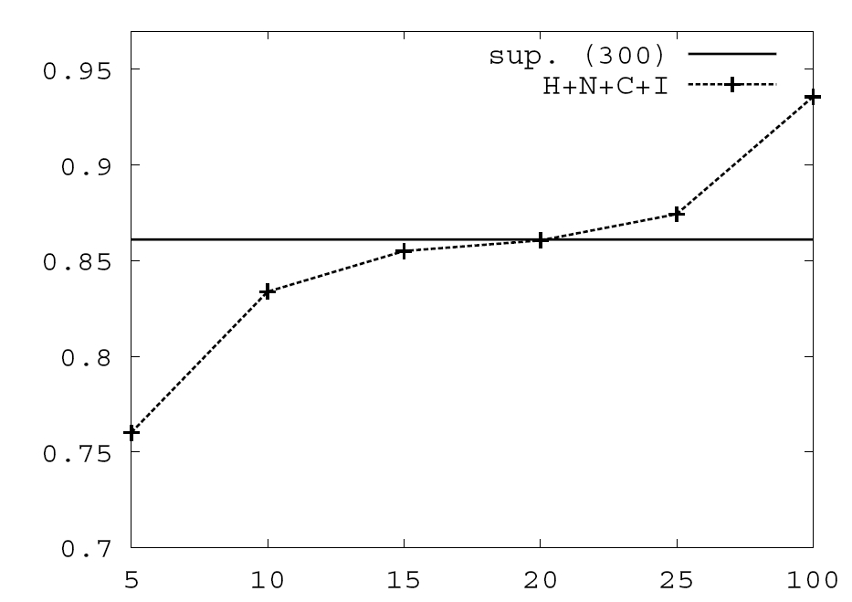
Value of Constraints in Semi-Supervised Learning
Objective function:
Learning w/o Constraints: 300 examples.
Constraints are used to Bootstrap a semi-supervised learner
Poor model + constraints used to annotate unlabeled data, which in turn is used to keep training the model.
Learning w 10 Constraints
# of available labeled examples

Slide 40
CoDL as Constrained Hard EM
Hard EM is a popular variant of EM
While EM estimates a distribution over all y variables in the E-step,
… Hard EM predicts the best output in the E-step
y*= argmax_{y} P(y|x,w)
Alternatively, hard EM predicts a peaked distribution
q(y) = ±_{y=y*}
Constrained-Driven Learning (CODL) – can be viewed as a constrained version of hard EM:
y*= argmax_{y:Uy· b} P_{w}(y|x)
Constraining the feasible set

Slide 41
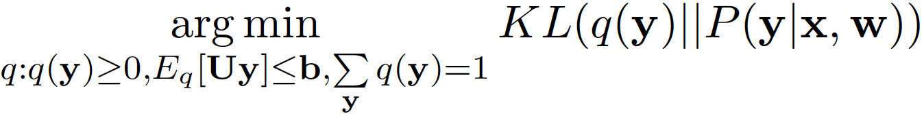
Constrained EM: Two Versions
While Constrained-Driven Learning [CODL; Chang et al, 07,12] is a constrained version of hard EM:
y*= argmax_{y:Uy· b} P_{w}(y|x)
… It is possible to derive a constrained version of EM:
To do that, constraints are relaxed into expectation constraints on the posterior probability q:
E_{q}[Uy] · b
The E-step now becomes:
q’ =
This is the Posterior Regularization model [PR; Ganchev et al, 10]
Constraining the feasible set

Slide 42
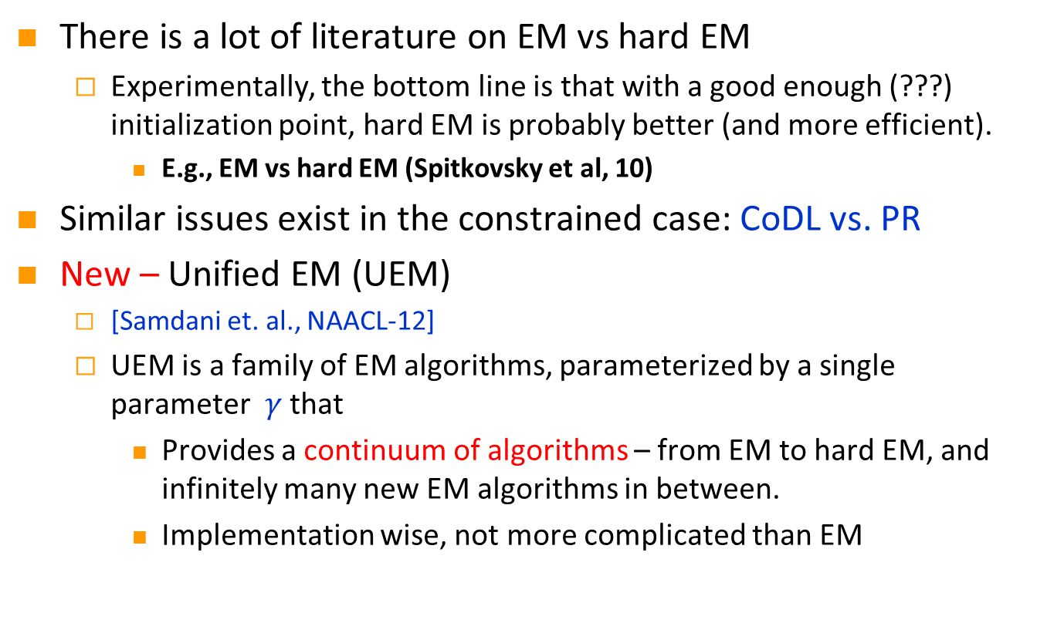
Which (Constrained) EM to use?
There is a lot of literature on EM vs hard EM
  Experimentally, the bottom line is that with a good enough (???) initialization point, hard EM is probably better (and more efficient).
    E.g., EM vs hard EM (Spitkovsky et al, 10)
Similar issues exist in the constrained case: CoDL vs. PR
New – Unified EM (UEM)
  [Samdani et. al., NAACL-12]
  UEM is a family of EM algorithms, parameterized by a single parameter $γ$that
    Provides a continuum of algorithms – from EM to hard EM, and infinitely many new EM algorithms in between.
    Implementation wise, not more complicated than EM

Slide 43
Unified EM (UEM)
EM (PR) minimizes the KL-Divergence KL(q , P (y|x;w)) KL(q , p) = ∑_{y} q(y) log q(y) – q(y) log p(y)
UEM changes the E-step of standard EM and minimizes a modified KL divergence KL(q , P (y|x;w); °) where
KL(q , p; °) = ∑_{y} ° q(y) log q(y) – q(y) log p(y)
Provably: Different ° values ! different EM algorithms
Neal & Hinton 99
Changes the entropy of the posterior
Notes:
In order to see the details of UEM, let’s have a look at how em WORKS.

Slide 44
Effect of Changing °
KL(q , p; °) = ∑_{y} ° q(y) log q(y) – q(y) log p(y)
q with ° = 1
q with ° = 1
Original Distribution p
q with ° = 0
q with ° = -1
Notes:
Explain why 0 is linear programming

Slide 45
Unifying Existing EM Algorithms
KL(q , p; °) = ∑_{y} ° q(y) log q(y) – q(y) log p(y)
Changing ° values results in different existing EM algorithms
Infinitely many new EM algorithms
No
Constraints
Deterministic Annealing (Smith and Eisner, 04; Hofmann, 99)
Hard EM
EM
-1
0
1
1
With Constraints
°
CODL
(New)LP approx to CODL
PR
Notes:
Put a tick

Slide 46
Unsupervised POS tagging: Different EM instantiations
Measure percentage accuracy relative to EM
Initialization with 40-80 examples
Initialization with 20 examples
Performance relative to EM
Initialization with 10 examples
Initialization with 5 examples
Uniform Initialization
EM
Gamma
Hard EM

Slide 47
Summary: Constraints as Supervision
Introducing domain knowledge-based constraints can help guiding semi-supervised learning
  E.g. “the sentence must have at least one verb”, “a field y appears once in a citation”
Constrained Driven Learning (CoDL) : Constrained hard EM
PR: Constrained soft EM
UEM : Beyond “hard” and “soft”
Related literature:
  Constraint-driven Learning (Chang et al, 07; MLJ-12),
  Posterior Regularization (Ganchev et al, 10),
  Generalized Expectation Criterion (Mann & McCallum, 08),
  Learning from Measurements (Liang et al, 09)
  Unified EM (Samdani et al 2012: NAACL-12)

Slide 48
Outline
Constrained Conditional Models
  A formulation for global inference with knowledge modeled as expressive structural constraints
  Some examples
Constraints Driven Learning
  Training Paradigms for Constrained Conditional Models
  Constraints Driven Learning (CoDL)
  Unified (Constrained) Expectation Maximization
Amortized Integer Linear Programming Inference
  Exploiting Previous Inference Results
  Can the k-th inference problem be cheaper than the 1st?

Slide 49
Constrained Conditional Models (aka ILP Inference)
Penalty for violating
the constraint.
(Soft) constraints component
Weight Vector for “local” models
Features, classifiers; log-linear models (HMM, CRF) or a combination
How far y is from
a “legal” assignment
How to solve?
This is an Integer Linear Program
Solving using ILP packages gives an exact solution.
Cutting Planes, Dual Decomposition & other search techniques are possible
How to train?
Training is learning the objective function
Decouple? Decompose?
How to exploit the structure to minimize supervision?

Slide 50

Inference in NLP
In NLP, we typically don’t solve a single inference problem.
We solve one or more per sentence.
Beyond improving the inference algorithm, what can be done?
S1
He
is
reading
a
book
S2
I
am
watching
a
movie
POS
PRP
VBZ
VBG
DT
NN
S1 & S2 look very different but their output structures are the same
The inference outcomes
are the same
After inferring the POS structure for S1,
Can we speed up inference for S2 ?
Can we make the k-th inference problem cheaper than the first?

Slide 51
Amortized ILP Inference [Kundu, Srikumar & Roth, EMNLP-12,ACL-13]
We formulate the problem of amortized inference: reducing inference time over the lifetime of an NLP tool
We develop conditions under which the solution of a new problem can be exactly inferred from earlier solutions without invoking the solver.
Results:
  ➔ A family of exact inference schemes
  ➔ A family of approximate solution schemes
  Algorithms are invariant to the underlying solver; we simply reduce the number of calls to the solver
Significant improvements both in terms of solver calls and wall clock time in a state-of-the-art Semantic Role Labeling

Slide 52
The Hope: POS Tagging on Gigaword
Number of Tokens

Slide 53
The Hope: POS Tagging on Gigaword
Number of examples of a given size
Number of unique POS tag sequences
Number of structures is much smaller than the number of sentences
Number of Tokens

Slide 54
The Hope: Dependency Parsing on Gigaword
Number of examples of a given size
Number of unique Dependency Trees
Number of structures is much smaller than the number of sentences
Number of Tokens

Slide 55
The Hope: Semantic Role Labeling on Gigaword
Number of examples of a given size
Number of unique SRL structures
Number of structures is much smaller than the number of sentences
Number of Arguments per Predicate

Slide 56
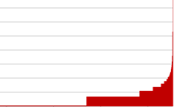
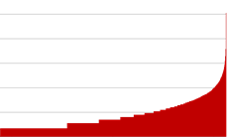
POS Tagging on Gigaword
How skewed is the distribution of the structures?
A small # of structures occur very frequently
Number of Tokens

Slide 57
Amortized ILP Inference
These statistics show that many different instances are mapped into identical inference outcomes.
How can we exploit this fact to save inference cost?
We do this in the context of 0-1 LP, which is the most commonly used formulation in NLP.
Max cx
Ax ≤ b
x 2 {0,1}

Slide 58
Example I
We define an equivalence class as the set of ILPs that have:
  the same number of inference variables
  the same feasible set
  (same constraints modulo renaming)
P
Q
max 2x₁+3x₂+2x₃+x₄
x₁ + x₂ ≤ 1
x₃ + x₄ ≤ 1
max 2x₁+4x₂+2x₃+0.5x₄
x₁ + x₂ ≤ 1
x₃ + x₄ ≤ 1
Same equivalence
class
We give conditions on the objective functions, under which the solution of P (which we already cached) is the same as that of the new problem Q
x*_{P}: <0, 1, 1, 0>
c_{P}: <2, 3, 2, 1>
c_{Q}: <2, 4, 2, 0.5>
Optimal Solution
Objective coefficients of problems P, Q

Slide 59
Example I
P
Q
max 2x₁+3x₂+2x₃+x₄
x₁ + x₂ ≤ 1
x₃ + x₄ ≤ 1
max 2x₁+4x₂+2x₃+0.5x₄
x₁ + x₂ ≤ 1
x₃ + x₄ ≤ 1
x*_{P}: <0, 1, 1, 0>
c_{P}: <2, 3, 2, 1>
c_{Q}: <2, 4, 2, 0.5>
Objective coefficients of active variables did not decrease from P to Q

Slide 60
Example I
Conclusion: The optimal solution of Q is the same as P’s
P
Q
x*_{P}=x*_{Q}
max 2x₁+3x₂+2x₃+x₄
x₁ + x₂ ≤ 1
x₃ + x₄ ≤ 1
max 2x₁+4x₂+2x₃+0.5x₄
x₁ + x₂ ≤ 1
x₃ + x₄ ≤ 1
x*_{P}: <0, 1, 1, 0>
c_{P}: <2, 3, 2, 1>
c_{Q}: <2, 4, 2, 0.5>
Objective coefficients of inactive variables did not increase from P to Q

Slide 61
Exact Theorem I
x*_{P,i} = 0
c_{Q,i} ≤ c_{P,i}
x*_{P,i} = 1
c_{Q,i} ≥ c_{P,i}
Denote: δc = c_{Q} - c_{P}
Theorem:
Let x*_{P} be the optimal solution of an ILP P We are and assume that an ILP Q
  Is in the same equivalence class as P
  And, For each i ϵ {1, …, n_{p} } (2x*_{P,i} – 1)δc_{i} ≥ 0, where δc = c_{Q} - c_{P}
Then, without solving Q, we can guarantee that the optimal solution of Q is x*_{Q}= x*_{P}

Slide 62
Example II
Conclusion: The optimal solution of Q is the same as the P’s
x*_{P1}= x*_{P2} = x*_{Q}
P1
x*_{P1=p2}: <0, 1, 1, 0>
c_{P1}: <2, 3, 2, 1>
c_{P2}: <2, 4, 2, 0.5>
max 2x₁+3x₂+2x₃+x₄
x₁ + x₂ ≤ 1
x₃ + x₄ ≤ 1
P2
c_{Q}: <10, 18, 10, 3.5>
c_{Q} = 2c_{P1} + 3c_{P2}
max 2x₁+4x₂+2x₃+0.5x₄
x₁ + x₂ ≤ 1
x₃ + x₄ ≤ 1
Q
max 10x₁+18x₂+10x₃+3.5x₄
x₁ + x₂ ≤ 1
x₃ + x₄ ≤ 1

Slide 63
Exact Theorem II
Theorem:
Assume we have seen m ILP problems {P₁, P₂, …, P_{m}} s.t.
  All are in the same equivalence class
  All have the same optimal solution
Let ILP Q be a new problem s.t.
  Q is in the same equivalence class as P₁, P₂, …, P_{m}
  There exists an z ≥ 0 such that c_{Q} = ∑ z_{i} c_{Pi}
Then, without solving Q, we can guarantee that the optimal solution of Q is x*_{Q}= x*_{Pi}
Notes:
Conic combination: linear with positive weights

Slide 64
Exact Theorem II (Geometric Interpretation)
Solution x*
c_{P2}
c_{P1}
All ILPs in the cone will share the maximizer
ILPs corresponding to all these objective vectors will share the same maximizer for this feasible region
Feasible region

Slide 65
Exact Theorem III (Combining I and II)
Theorem:
Assume we have seen m ILP problems {P₁, P₂, …, P_{m}} s.t.
  All are in the same equivalence class
  All have the same optimal solution
Let ILP Q be a new problem s.t.
  Q is in the same equivalence class as P₁, P₂, …, P_{m}
  There exists an z ≥ 0 such that δc = c_{Q} - ∑ z_{i} c_{Pi} and (2x*_{P,i} – 1) δc_{i} ≥ 0
Then, without solving Q, we can guarantee that the optimal solution of Q is x*_{Q}= x*_{Pi}

Slide 66
Approximation Methods
Will the conditions of the exact theorems hold in practice?
The statistics we showed
almost guarantees
they will. There are very
few structures relative to
the number of instances.
To guarantee that the conditions on the objective coefficients be satisfied we can relax them, and move to approximation methods.
Approximate methods have potential for more speedup than exact theorems. It turns out that indeed:
  Speedup is higher without a drop in accuracy.

Slide 67
Simple Approximation Method (I, II)
Most Frequent Solution:
  Find the set C of previously solves ILPs in Q‘s equivalence class
  Let S be the most frequent solution in C
  If the frequency of S is above a threshold (support) in C, return S, otherwise call the ILP solver
Top K Approximation:
  Find the set C of previously solves ILPs in Q‘s equivalence class
  Let K be the set of most frequent solutions in C
  Evaluate each of the K solutions on the objective function of Q and select the one with the highest objective value

Slide 68
Theory based Approximation Methods (III, IV)
Approximation of Theorem I:
  Find the set C of previously solves ILPs in Q‘s equivalence class
  If there is an ILP P in C that satisfies Theorem I within an error margin of ϵ, (for each i ϵ {1, …, n_{p} } (2x*_{P,i} – 1)δc_{i} + ϵ ≥ 0, where δc = c_{Q} - c_{P} ), return x*_{P}
Approximation of Theorem III:
  Find the set C of previously solves ILPs in Q‘s equivalence class
  If there is an ILP P in C that satisfies Theorem III within an error margin of ϵ, (There exists an z ≥ 0 such that:
    δc = c_{Q} - ∑ z_{i} c_{Pi} and
    (2x*_{P,i} – 1) δc_{i} + ϵ ≥ 0,
  return x*_{P}

Slide 69
Semantic Role Labeling Task
Who did what to whom, when, where, why,…
I left my pearls to my daughter in my will .
[I]_{A0} left [my pearls]_{A1} [to my daughter]_{A2} [in my will]_{AM-LOC} .
A0 Leaver
A1 Things left
A2 Benefactor
AM-LOC Location
Notes:
Here is the problem of learning the representation –
Notice that these constraints are represented in terms of the arguments – so I need to generate the vocabulary, which I will do using learning, to be able to talk about it and say that I don’t like A2, unless I have an AI.
The other problem is semantic role labeling problem. This is the problem that we will focus on in this talk.
In this problem, given a sentence, we want to identify for each verb, all the participants or arguments of that verb.
We can view the process also as trying to identifying different arguments represented by different lines and colors here. What makes the problem hard is that not only there are quadratic number of possible arguments but if we look at all possible assignments for the whole structure there will be exponential number of them. And making prediction for each of these arguments independently is not possible because some of the assignments are illegal due to the constraint that the output arguments may not overlap.
The rest of the talk will focus on how we tackle this problem, and also discuss some of the related issues by using this problem in experiment. We have a demo of the system that we have developed which is currently the state-of-the-art system. The URL is http://l2r.cs.uiuc.edu/~cogcomp/srl-demo.php. At any point in this talk if you get tired, you can start playing with this demo. There are also demos of the other systems developed in our group.

Slide 70
Experiments: Semantic Role Labeling
SRL: Based on the state-of-the-art Illinois SRL
  [V. Punyakanok and D. Roth and W. Yih, The Importance of Syntactic Parsing and Inference in Semantic Role Labeling, Computational Linguistics – 2008]
  In SRL, we solve an ILP problem for each verb predicate in each sentence
Amortization Experiments:
  Speedup & Accuracy are measured over WSJ test set (Section 23)
  Baseline is solving ILP using Gurobi 4.6
For amortization:
  We collect 250,000 SRL inference problems from Gigaword and store in a database
  For each ILP in test set, we invoke one of the theorems (exact / approx.)
  If found, we return it, otherwise we call the baseline ILP solver

Slide 71
Speedup & Accuracy
Solve only one in three problems
ACL’13: one in six problems
Speedup
F1
1.0
Exact
Approximate

Slide 72
Summary: Amortized ILP Inference
Inference can be amortized over the lifetime of an NLP tool
Yields significant speed up, due to reducing the number of calls to the inference engine, independently of the solver.
Current/Future work:
  Decomposed Amortized Inference
    Possibly combined with Lagrangian Relaxation
  Approximation augmented with warm start
  Relations to lifted inference

Slide 73
Conclusion
Thank You!
Presented Constrained Conditional Models:
  An ILP based computational framework that augments statistically learned linear models with declarative constraints as a way to incorporate knowledge and support decisions in an expressive output spaces
  Maintains modularity and tractability of training
A powerful & modular learning and inference paradigm for high level tasks.
  Multiple interdependent components are learned and, via inference, support coherent decisions, modulo declarative constraints.
Learning issues:
  Constraints driven learning, constrained EM
  Many other issues have been and should be studied
Inference:
  Presented a first step in amortized inference: How to use previous inference outcomes to reduce inference cost
Check out our tools, demos, tutorials
Notes:
73

