Slide 1
It’s Time to Reason
Dan Roth
Computer and Information Science
University of Pennsylvania
Baidu Research
October 2020

Slide 2

Cognitive Computation Group: What We Do
Natural Language Understanding
Learning to Reason
Learning
with Incidental Supervision
Events: Time, Quantities, Space
Semantic Typing
Information Extraction
Linking
Entailment
ESL
Multi-Lingual NLP
Interaction
Common Sense
Navigating
Information Pollution
Representation
Continuous, Symbolic,
Multilingual
Grounding
Psycho-linguistics

Slide 3
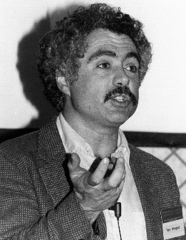
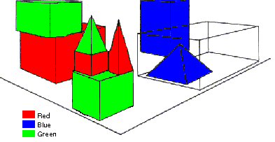
SHRDLU (Terry Winograd, 1968)
Person: Pick up a big red block.
Computer: OK.
Person: Grasp the pyramid.
Computer: I DON'T UNDERSTAND WHICH PYRAMID YOU MEAN.
Person: Find a taller block than the one you are holding and put it into the box.
Computer: BY "IT", I ASSUME YOU MEAN…..
Computer: OK.
Person: What does the box contain?
Computer: THE BLUE PYRAMID AND THE BLUE BLOCK.
Person: What is the pyramid supported by?
Computer: **What do you mean by “supported”?
……….
Person: How many blocks are not in the box?
Computer: FOUR OF THEM.
Understanding, executing and interacting requires language understanding & reasoning
to recognize and understand the domain, the goals and to advance the task
Notes:
SHRDLU, Computer program that has conversation with user, via Natural Language interface
-> About “block world”, virtual box filled with different blocks, different shapes, sizes and colors: e.g. Red block, white box, blue pyramid
The robot can pick the objects, move them, count them ..
Combination of a few principles made the simulation of robot behavior very realistic
SHRDLU's world was so simple that the entire set of objects and locations could be described by including as few as perhaps 50 words:
nouns like "block" and "cone", verbs like "place on" and "move to", and adjectives like "big" and "blue".
The possible combinations of these basic language building blocks were quite simple, and the program was fairly adept at figuring out what the user meant.
SHRDLU also included a basic memory to supply context. One could ask SHRDLU to "put the green cone on the red block" and then "take the cone off"; "the cone" would be taken to mean the green cone one had just talked about. SHRDLU could search back further through the interactions to find the proper context in most cases when additional adjectives were supplied. One could also ask questions about the history, for instance one could ask "did you pick up anything before the cone?“
Deduction rules: Could deduce that blocks could be stacked by looking for examples, but would realize that triangles couldn't be stacked
Learn new names: For instance one could say "a steeple is a small triangle on top of a tall rectangle"; SHRDLU could then answer questions about steeples in the blocks world, and build new ones.
SHRDLU, Computer program that has conversation with user, via Natural Language interface
-> About “block world”, virtual box filled with different blocks, different shapes, sizes and colors: e.g. Red block, white box, blue pyramid
The robot can pick the objects, move them, count them ..
Combination of a few principles made the simulation of robot behavior very realistic
SHRDLU's world was so simple that the entire set of objects and locations could be described by including as few as perhaps 50 words:
nouns like "block" and "cone", verbs like "place on" and "move to", and adjectives like "big" and "blue".
The possible combinations of these basic language building blocks were quite simple, and the program was fairly adept at figuring out what the user meant.
SHRDLU also included a basic memory to supply context. One could ask SHRDLU to "put the green cone on the red block" and then "take the cone off"; "the cone" would be taken to mean the green cone one had just talked about. SHRDLU could search back further through the interactions to find the proper context in most cases when additional adjectives were supplied. One could also ask questions about the history, for instance one could ask "did you pick up anything before the cone?“
Deduction rules: Could deduce that blocks could be stacked by looking for examples, but would realize that triangles couldn't be stacked
Learn new names: For instance one could say "a steeple is a small triangle on top of a tall rectangle"; SHRDLU could then answer questions about steeples in the blocks world, and build new ones.

Slide 4
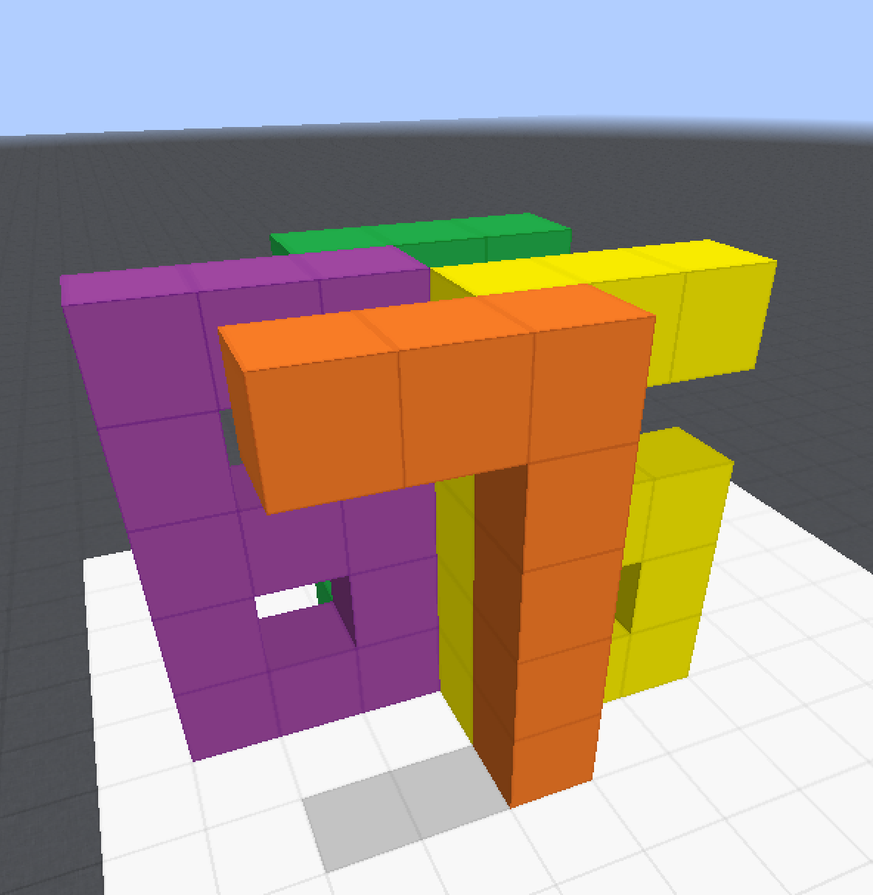
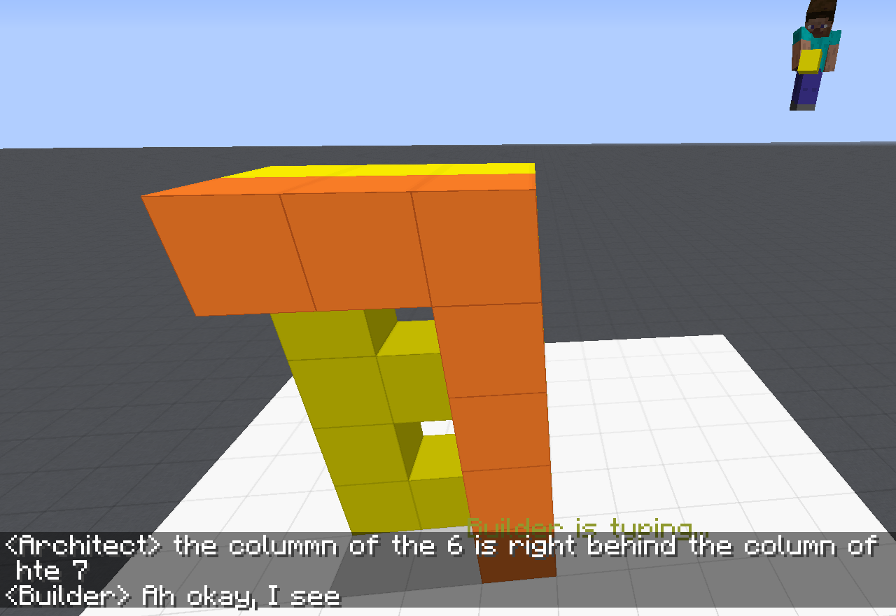
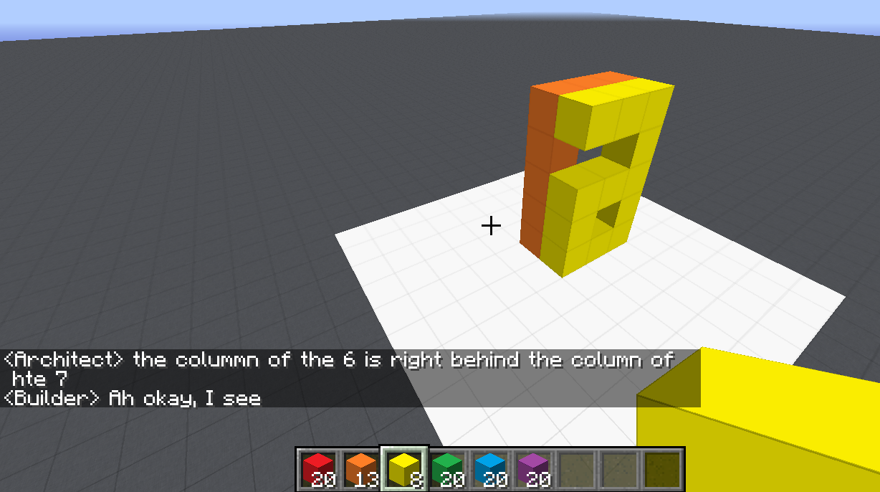
Communication (CwC Project, 2017-2020)
ARCHITECT
CHAT INTERFACE
Architect: | in about the middle build a column five tall
(Builder puts down five orange blocks)
Architect: | then two more to the left of the top to make a 7
(Builder puts down two orange blocks)
Architect: | now a yellow 6
Architect: | the long edge of the 6 aligns with the stem of the 7 and faces right
Builder: | Where does the 6 start?
Architect: | behind the 7 from your perspective
Builder: | Is it directly adjacent?
Architect: | yes directly behind it. touches it
(Builder puts down twelve yellow blocks, in the shape of a 6)
Architect: | too much overlap unfortunately
Architect: | the colummn of the 6 is right behind the column of hte 7
Target Structure
Build Region
BUILDER
[Minecraft example from Julia Hockenmaier]

Slide 5
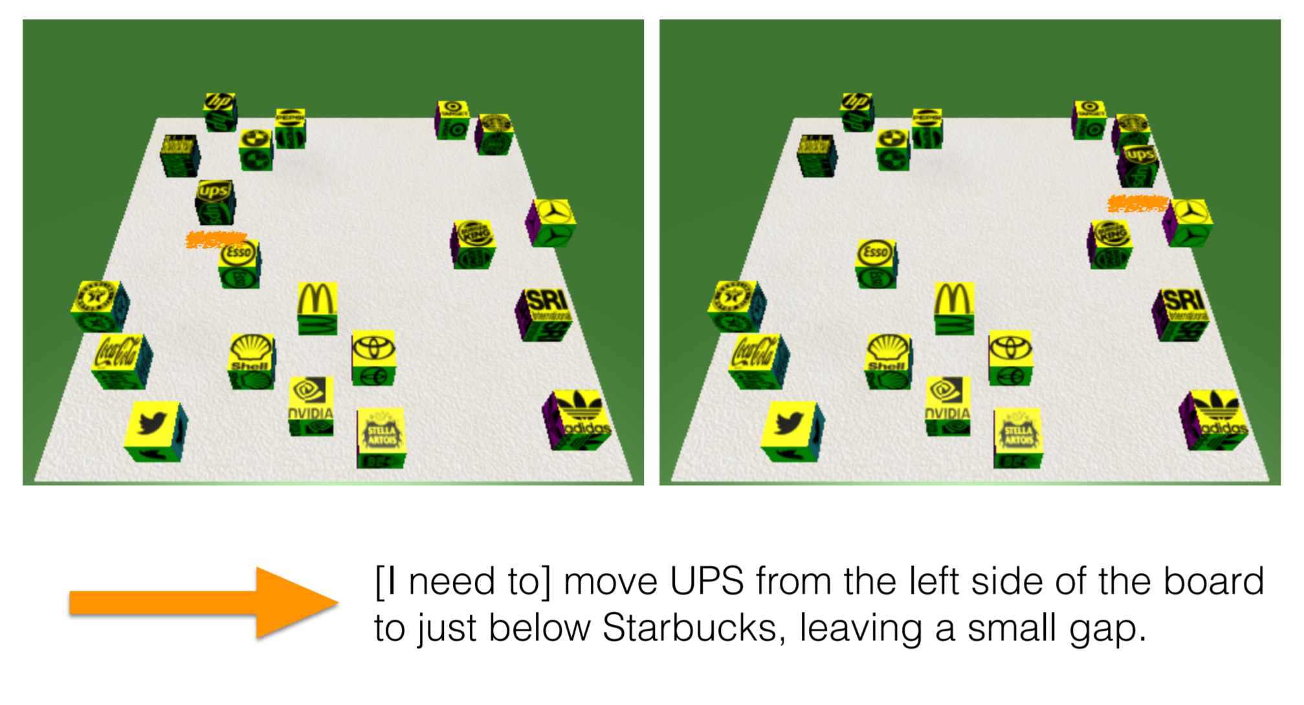
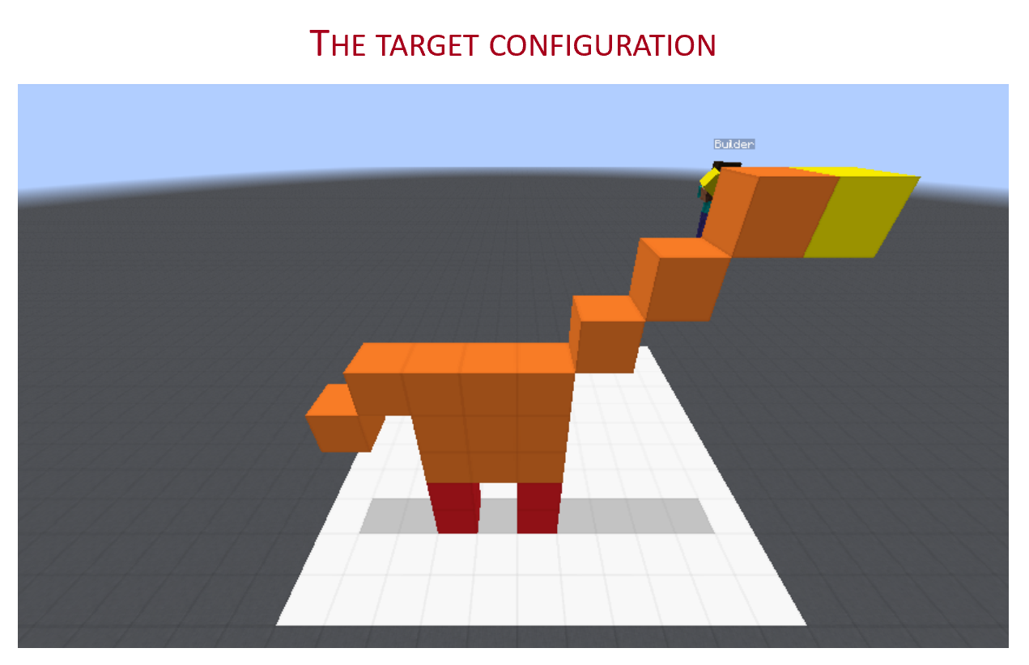
Communication (CwC Project, 2017-2020)
Consider the following explanation:
  [Example from Yonatan Bisk]
  Imagine that this is a chess board
  Place the UPS in H2, and McDonald in G6.
Can you follow these instructions?
  What’s needed for us to be able to write programs that can do it?
Of course, there are many NLP tasks we are better at today, mostly at the sentence level, and mostly extraction tasks.
Today:
Some (optimistic) thoughts and challenges from the perspective of Learning to Reason, in the context of reasoning about time.
  How can we think about learning in the context of doing reasoning?

Slide 6
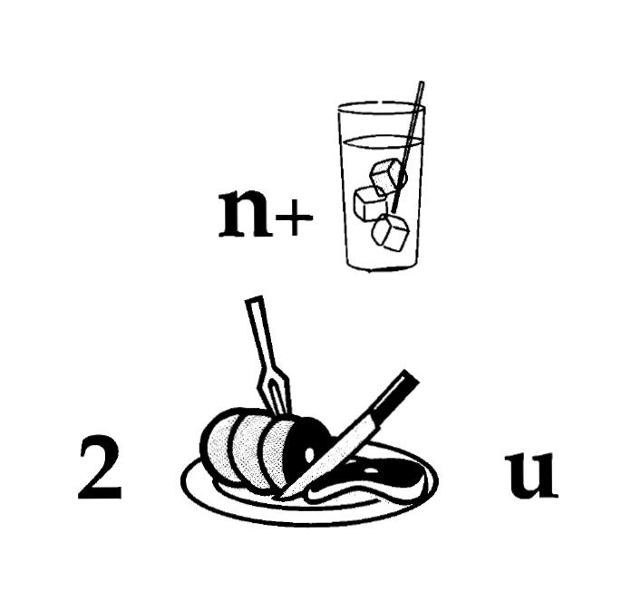
Nice to Meet You
Identify units
Consider multiple
representations & interpretations
  Pictures, text, layout, spelling, phonetics
Put it all together:
  Determine “best” global interpretation
Satisfy expectations
  Slide; puzzle
Computational Problem:
Assigning values to multiple variables, accounting for interdependencies among them

Slide 7
Natural Language Understanding
Natural language understanding decisions are global decisions that require
  Making (local) predictions driven by different models trained in different ways, at different times/conditions/scenarios
  The ability to put these predictions together coherently
  Knowledge, that guides the decisions, so they satisfy our expectations
Of course, our programs need a lot more in order to understand and communicate in natural language
  but it exemplifies some important aspects – “discrete reasoning”;
  – “understanding ~~ best interpretation”
Expectation is a knowledge intensive component
Notes:
7
Give examples for what’s not abductive reasoning
Focus on abductive reasoning
Show the formulation – talk about the boxes
Talk about multiple ways of training – decoupling – relate to abstraction
Examples: semantic parsing (do verb + Prep + commas together; lack of jointly annotated data)
Wikification – Relations (but also add geographical coherence; topical coherence; all interrelated signal that are acquired at different times, different contexts, etc.

Slide 8
Let’s Talk about Dinner
∃ r ∈ Restaurants | Cuisine(r, Mexican)∧ InCity(PH)
Constraints:
∀ r ∈ Restaurants → Contains(r, m) ∧ Menus(m)
∀ m ∈ Menus → Contains(d,m) ∧ Dishes(d)
∃ o ∈ Dishes → Tastes(o, ￢spicy)
→ Let’s talk about dinner.
  A: Where do you want to go?
→ I really enjoy Mexican food, but not when it is spicy.
  A: How about a Mexican restaurant with plenty of non-spicy options?
→ Yep, is there one in Philadelphia?
  A: Here are a couple of good options
  …….
Don’t worry, you can still use neural embeddings for the predicates and functions…
But this abstraction shows that we need to incorporate declarative constraints…
[Example due to Tania Berdax-Weiss]

Slide 9
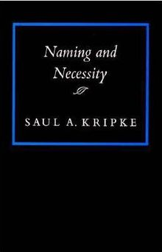

Symbolic Reasoning?
Some people think that symbols are an evil invention of old AI people.
It’s not.
Language is a symbolic system
  Table is a collection of things in world.
Even though we communicate via speech, gestures, writing, which are continuous, symbols are the invariants of this communication.
  Harari: Language – the ability to assign symbols to “things” and “reason” about them is key to human cognitive revolution
  Kripke: “Naming” things is key to communication and to cognition
  The Enigma of Reason: “Reasoning is about giving reasons”

Slide 10
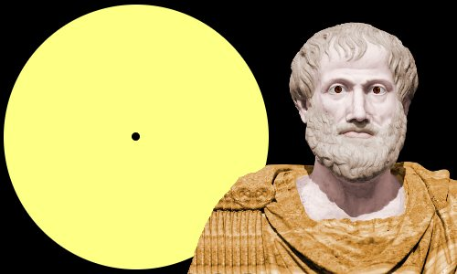
Aristotle’s Logic https://www.famousscientists.org/aristotle/
Aristotle founded the study of formal logic, systematizing logical arguments – he is famous for the syllogism, a method by which known information can be used to prove a point.
Here is a famous example, from Aristotle himself, of a simple syllogism:
  All men are mortal.
  Socrates is a man.
  Therefore, Socrates is mortal.
So, did Aristotle have a laptop?
[Geva et al. In Submission]
[Example due to Les Valiant]
Notes:
Google will say yes!

Slide 11
Key Challenges to NLU Researchers
Today’s NLP addresses well-defined tasks for which we have, or can generate, a lot of training data, but:
Who asks the questions?
  ~~ When did Aristotle die?
  ~~ When was the laptop invented?
  What happened first?
The question isn’t if we need reasoning, but rather:
  How to do it?
    E.g., how to determine “strategies” on the fly?
  How to train for it?
    How can we supervise for these “sparse” events? [A different talk: On Incidental Supervision]
    Should we learn “everything” together? When/how should we decouple/decompose tasks?
Not a new set of questions [Khardon & Roth, Learning to Reason, JACM’1996]
  Showed, in a formal way, the advantages of joint learning & reasoning

Slide 12
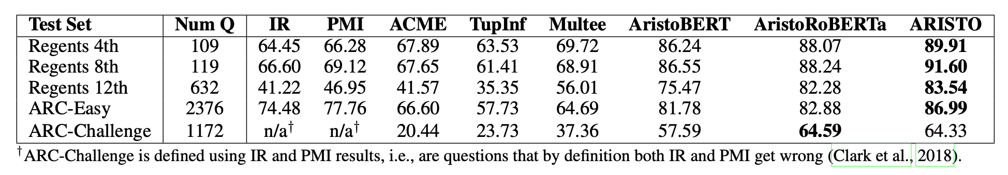
Are We Doing Any Reasoning in NLP Today?
Very little, if at all.
Not only because “we are asking the questions”
Clark et al 2019: On the success of AI2’s ARISTO Project:
  From ‘F’ to ‘A’ on the N.Y. Regents Science Exams: An Overview of the Aristo Project
Very impressive results. But does it do reasoning?

Slide 13
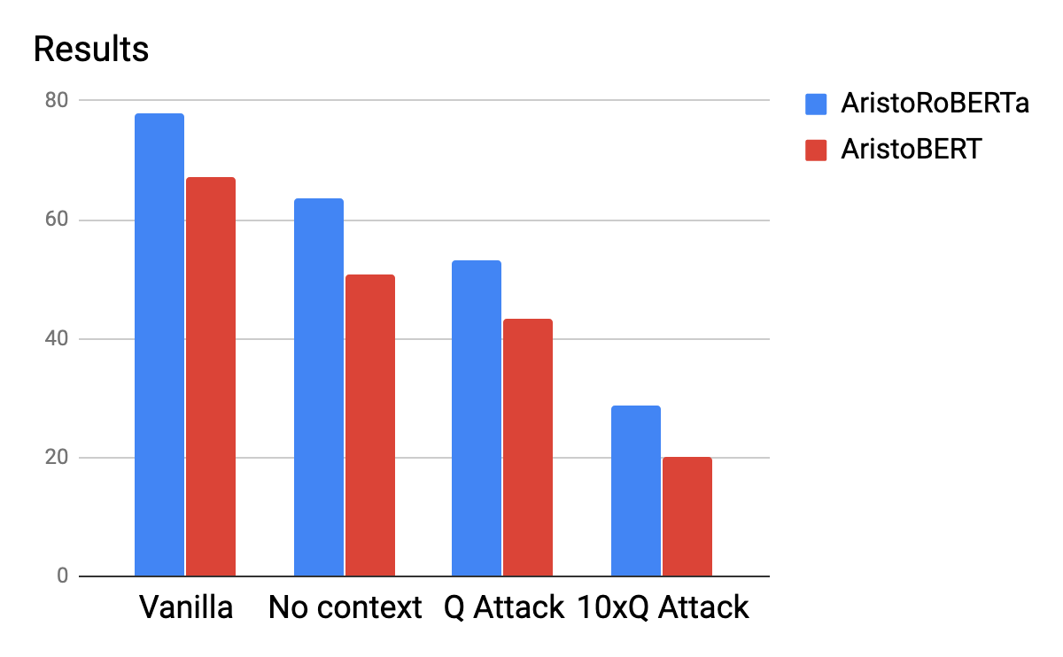
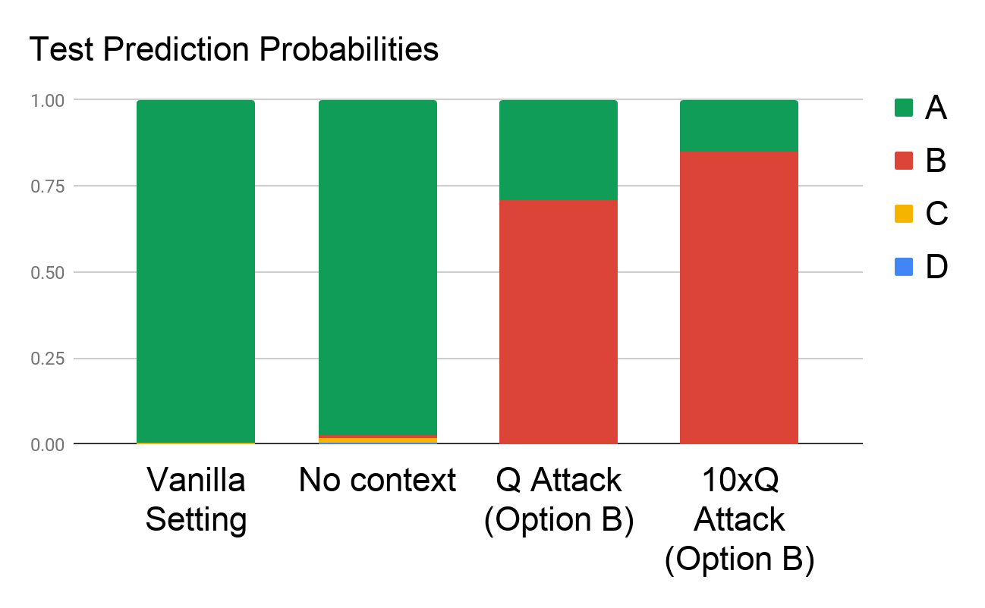
A Scientific QA Example [Shah et al. EMNLP Findings 2020]
Question: The rate at which a wave passes through a medium is known as its
Answer Options:
  speed
  amplitude
  acceleration
  wavelength
Supporting Contexts:
  The speed of a wave is the rate at which vibrations propagate through the medium…
  The greater the amplitude of vibrations of the particles of the medium, the greater…
  … hydrophones measure the acceleration of the medium as a seismic wave passes…
  The speed of an electromagnetic wave in a medium depends on its wavelength. As…
Question Question Question Question Question Question Question Question……
Question
The paper goes on with more experiments, and suggests alternative ways of training so that the models better satisfy our expectation
Are we doing Reasoning?
Notes:
Killing the competition should improve the results – but it reduces it.

Slide 14
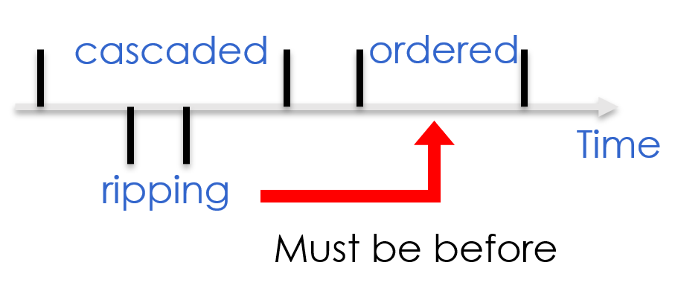
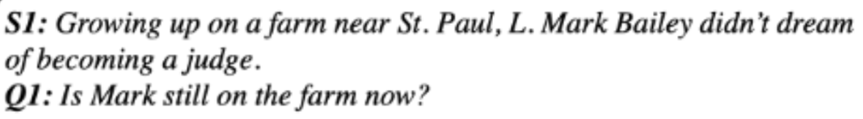
It’s Time to Reason:
Outline
Addressing “sparse” challenges that one cannot train for directly
  Decomposition and Composition (and some more)
Assigning values to multiple interrelated variables
  Given observations and knowledge
  Most likely assignment: Abduction
Computing functions over multiple interrelated inferred variables
  Last; longest, most frequent, etc.
Decisions over a dynamic set of interrelated variables
  The Aristotle example
    Need a strategy to decide what the variables are & a function computed over it
  Temporal Commonsense
(1)
(3)
Who scored the last field goal for the Eagles?
[given a recap of the game]
(2)
Will we make it to dinner before the movie?

Slide 15
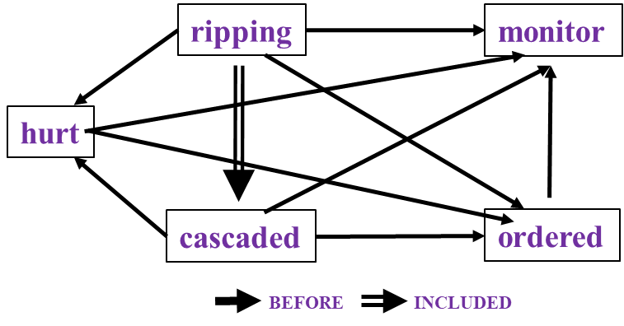
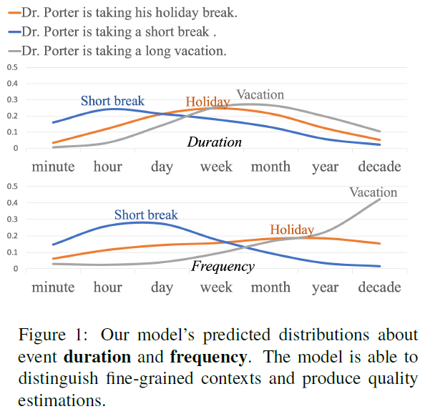
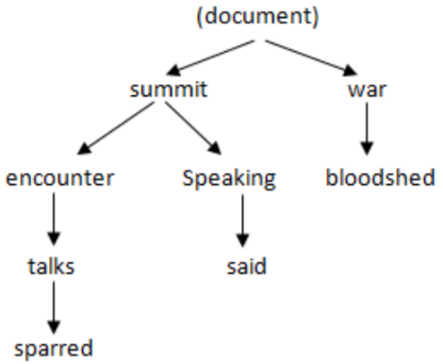
Reasoning about Time and Events
                Temporal relations between events
  Hierarchical relations between events
  Temporal Commonsense
Study them independently and develop approaches to study them as interrelated tasks: Situations
In Los Angeles that lesson was brought home today when tons of earth cascaded down a hillside, ripping two houses from their foundations. No one was hurt, but firefighters ordered the evacuation of nearby homes and said they'll monitor the shifting ground until March 23rd.
U.S. President Barack Obama sparred with Russia’s Vladimir Putin over how to end the war in Syria on Monday during an icy encounter at a G8 summit. Speaking after talks with Obama, Putin said Moscow and Washington agreed the bloodshed must stop…
Reflects an important move in NLU from sentence level to event/situation level.
Addresses issues in combining learning and reasoning, and supervision.
Notes:
In many respects, natural language is here to communicate about events; now that we can processes sentences at a reasonable level, we can start thinking about event.

Slide 16
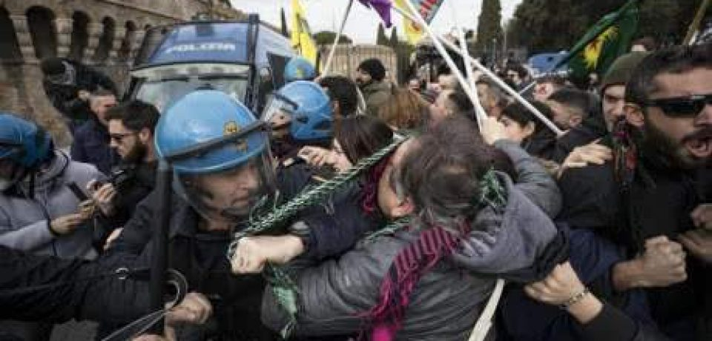
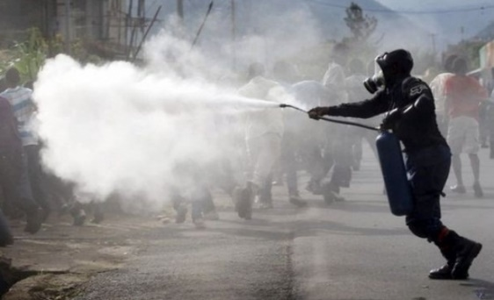
Understanding Time is Important
People were angry
Police used tear gas
Time
People were angry at something (which ended in violent conflicts with the police)…The police finally used tear gas (to restore order).
Notes:
Understanding time is important; to realize it think about two events – of the type we have seen a lot recently in the US
Given two events, the order in which they occur on the timeline could give rise to two completely different interpretation of the what has happened

Slide 17
Understanding Time is Important
Police used tear gas
People were angry
Time
Police used tear gas…People were angry at the police.
Notes:
If we simply reverse the order of these events, we get a new story, which says that police used tear gas and then people were angry at the police. We can see that time is crucial if we want to understand what’s going on in a situation.

Slide 18
Understanding Time is Important
Police used tear gas
People were angry
Time
In natural language, we rarely see explicit timestamps, so we have to figure out the temporal order from cues in the text.
Notes:
But in natural language, we never have timestamps like here telling us which one is earlier and which one is later. That leads to “temporal relations”

Slide 19
Understanding Time
Natural Language rarely communicates explicit temporal information
Vagueness with respect to time is inherent in natural language
  But some of it can be handled using inference and (commonsense) knowledge
Police used tear gas starting at 7pm on Saturday and stopped at 7:30;….
People were angry at the police between 7:01 and 9pm.
Police used tear gas
People were angry
Notes:
The space is defined by these two statements:
How time is communicates in NL
2. The mmaping to KR

Slide 20
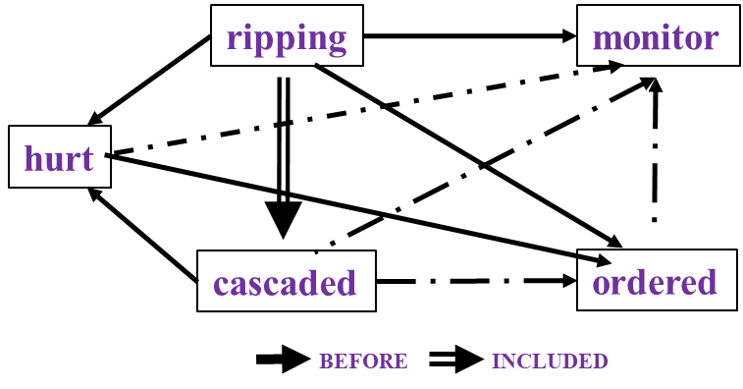

Time and Events [Ning et al. *SEM’2018; ACL’18, EMNLP’18, EMNLP’19; Wang et al. EMNLP’20]
In Los Angeles that lesson was brought home today when tons of earth cascaded down a hillside, ripping two houses from their foundations. No one was hurt, but firefighters ordered the evacuation of nearby homes and said they'll monitor the shifting ground until March 23rd.
Very difficult task— hinders exhaustive annotation (O(N²) edges)
But, it’s rather easy to get partial annotation – some relations.
And, we have strong expectations from the output
  Transitivity
  Some events tend to precede others, or follow others
How to exploit these [declarative & statistical] “expectations”?
How does it impact supervision?
cascaded
ordered
Time
ripping
Must be before

Slide 21
Constrained Conditional Models [Abductive Reasoning; Chang et al.’12]
Supporting structured, knowledge intensive, NLP decisions
Variables are models
Penalty for violating
the constraints.
Formulation goes back to (Roth & Yih 2004). Also related to PR (Ganchev et al. 2010)
y = argmax_{y} ∑ 1_{∅(x, y)} w_{x,y} subject to Constraints C(x,y)
    y = argmax_{y} $∈$ _{Y} w^{T}$∅$(x, y) + u^{T}C(x, y)
Knowledge component:
(Soft) constraints
A linear function over models – can be used to model any logical function
Features, Models, NN
(non-linearity comes here)
How far are the decisions (y) is from a “legal/expected” assignment
Is it needed/useful in the NN era? Yes [Deutsch et al. CoNLL’19] ; → a neural implementation of CCMs
  But, it’s not sufficient to support all types or reasoning we care about.
It has been used extensively and successfully used in many NLU tasks from IE to discourse to summarization.
  A good starting point for thinking about further progress in natural language understanding.
Can be incorporated in a neural architecture [Li & Srikumar 19]
What are the variables? How to represent knowledge?
Is it expressive enough?
  All Boolean functions can be represented as sets of linear constrains.
  Any MAP problem w.r.t. any probabilistic model, can be formulated as an ILP [Roth&Yih 04, Taskar 04]
Training: Learning the objective function (w, u)? Learning all the intermediate functions ∅(x, y)?
  Joint? Decoupled? Learned/provided constraints? Hard/soft?
  There is some understanding for when to do what [IJCAI’05]
Reasoning: A way to push a function over learned models to satisfy output expectations
  (can also think about expectations from a latent representation)

Slide 22
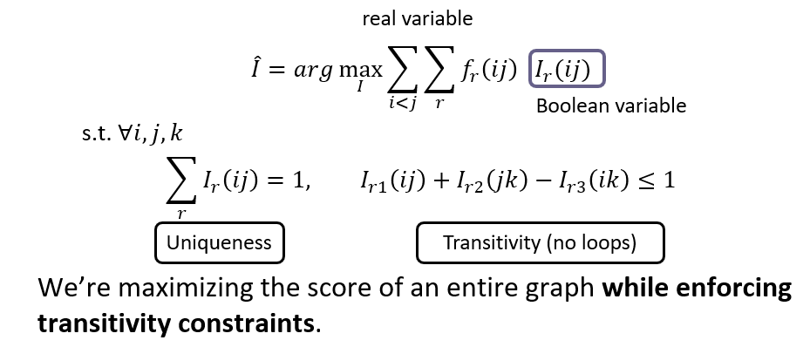
A Revolution in Temporal Reasoning
Generalized common sense
BERT
Neural + ILP
+3%
Axes dataset
+4%
Involves reasoning with external knowledge via a neural implementation of CCMs
Declarative knowledge
  Transitivity
Statistical knowledge
  commonsense knowledge
Common sense
+3%
Structured learning
+11%*
Previous SOTA
+4%
+2%
2015
2017
2019
Thesis work of Qiang Ning (2019)
Notes:
This is a final summary for our progress on this task. CAEVO is the previous SOTA, structured learning 2%, common sense 4%, new dataset 11%, LSTM with standard word embeddings 3%, LSTM with BERT embeddings 4% (BERT is the most recent word embedding), and Siamese another 3%.

Slide 23
Multi-Axis View of Events [Ning et al. ACL’18]
The improvements involves another conceptually important step:
  We suggest that not all events are comparable
  Events reside on multiple axes.
Police tried to eliminate the pro-independence army and restore order. At least 51 people were killed in clashes between police and citizens in the troubled region.
Events could be actual, hypothetical, intentions,..
  Not all events are comparable.
Result: inter-annotator agreements are much higher.
Higher quality training data, with significant improvement in temporal relation identification
Intention axis
restore order
✓
to eliminate army
✓
police tried
51 people killed
Main axis
✓
Notes:
In this particular example, we used intention axis. We also define other axes, such as opinion and hypothesis.

Slide 24
TemProb: Temporal Relation Probabilistic Knowledge Base
TemProb: Temporal Relation Probabilistic Knowledge Base [Ning et al. NAACL’18]
Run initial temporal relations system on New York Times 1987-2007, #Articles~1M
Identify events; identify temporal order
80M temporal relations
Noisy statistics is sufficient to give good priors.
Example pairs |  | Temporal Before (%) | Temporal After (%)
Text Before | Text After
Ask | Help | 86 | 9
Attend | Schedule | 1 | 82
Accept | Propose | 10 | 77
Die | Explode | 14 | 83
Priors on order are often different than order of occurrence in text
Notes:
In NAACL'18, we proposed TemProb, short for ... The intuition is that humans get common sense through lots of life experience. We want to mimic this, so we collected over 1 million articles from new york times. We ran our system on top of it to imitate human's reading experience. To accelerate it, we used 100 AWS instances in parallel and finished it within one day. We find that simply by counting, we could get many interesting statistics. For example, we find ask before help, attend after schedule, accept after propose, and die after explode.
(1min)

Slide 25
Event distributions Support Temporal Relations
Notes:
We also plotted the distribution of events that usually precede or follow specific events, of course, in terms of time. Although we only have the verbs here, we can still get some intuitive answers.

Slide 26
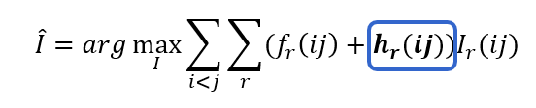
Event distributions from TemProb
Can be implemented within the same framework, and it’s neural counterpart.
Notes:
This is what I like the most. I have a long list of such examples, and of course, there can be errors in it. But the good thing is, we mined these automatically and no more human annotations were used, so it's pretty nice. Imagine that if we could incorporate the common sense knowledge in TemProb into the temporal relation extraction task, then we can further improve the performance. The only question is how to apply TemProb in our task.
(1 min 20 sec)

Slide 27
A Neural Architecture for Temporal Relations
[Ning et al. EMNLP’19]
LSTM takes word embeddings as input
Hidden vectors represent events
Siamese network is a generalized TemProb
FFNN predicts the labels of temporal relations (followed by ILP inference)
Siamese network trained on TemProb
v₁
v₂
500
500
150
dropout 0.3
45
dropout 0.3
h_{e1}
LSTM
128
output
before
after
equal
vague
word embeddings
h_{e2}
64
128
t₀ t₁ t₂ t_{n}
LSTM w/ concatenations of two hidden states
Output confidence scores
We should address additional aspects of temporal commonsense…
Notes:
And provides additional embeddings that can be used in the feedforward neural net.
When we think about temporal commonsense we think about more basic phenomena

Slide 28
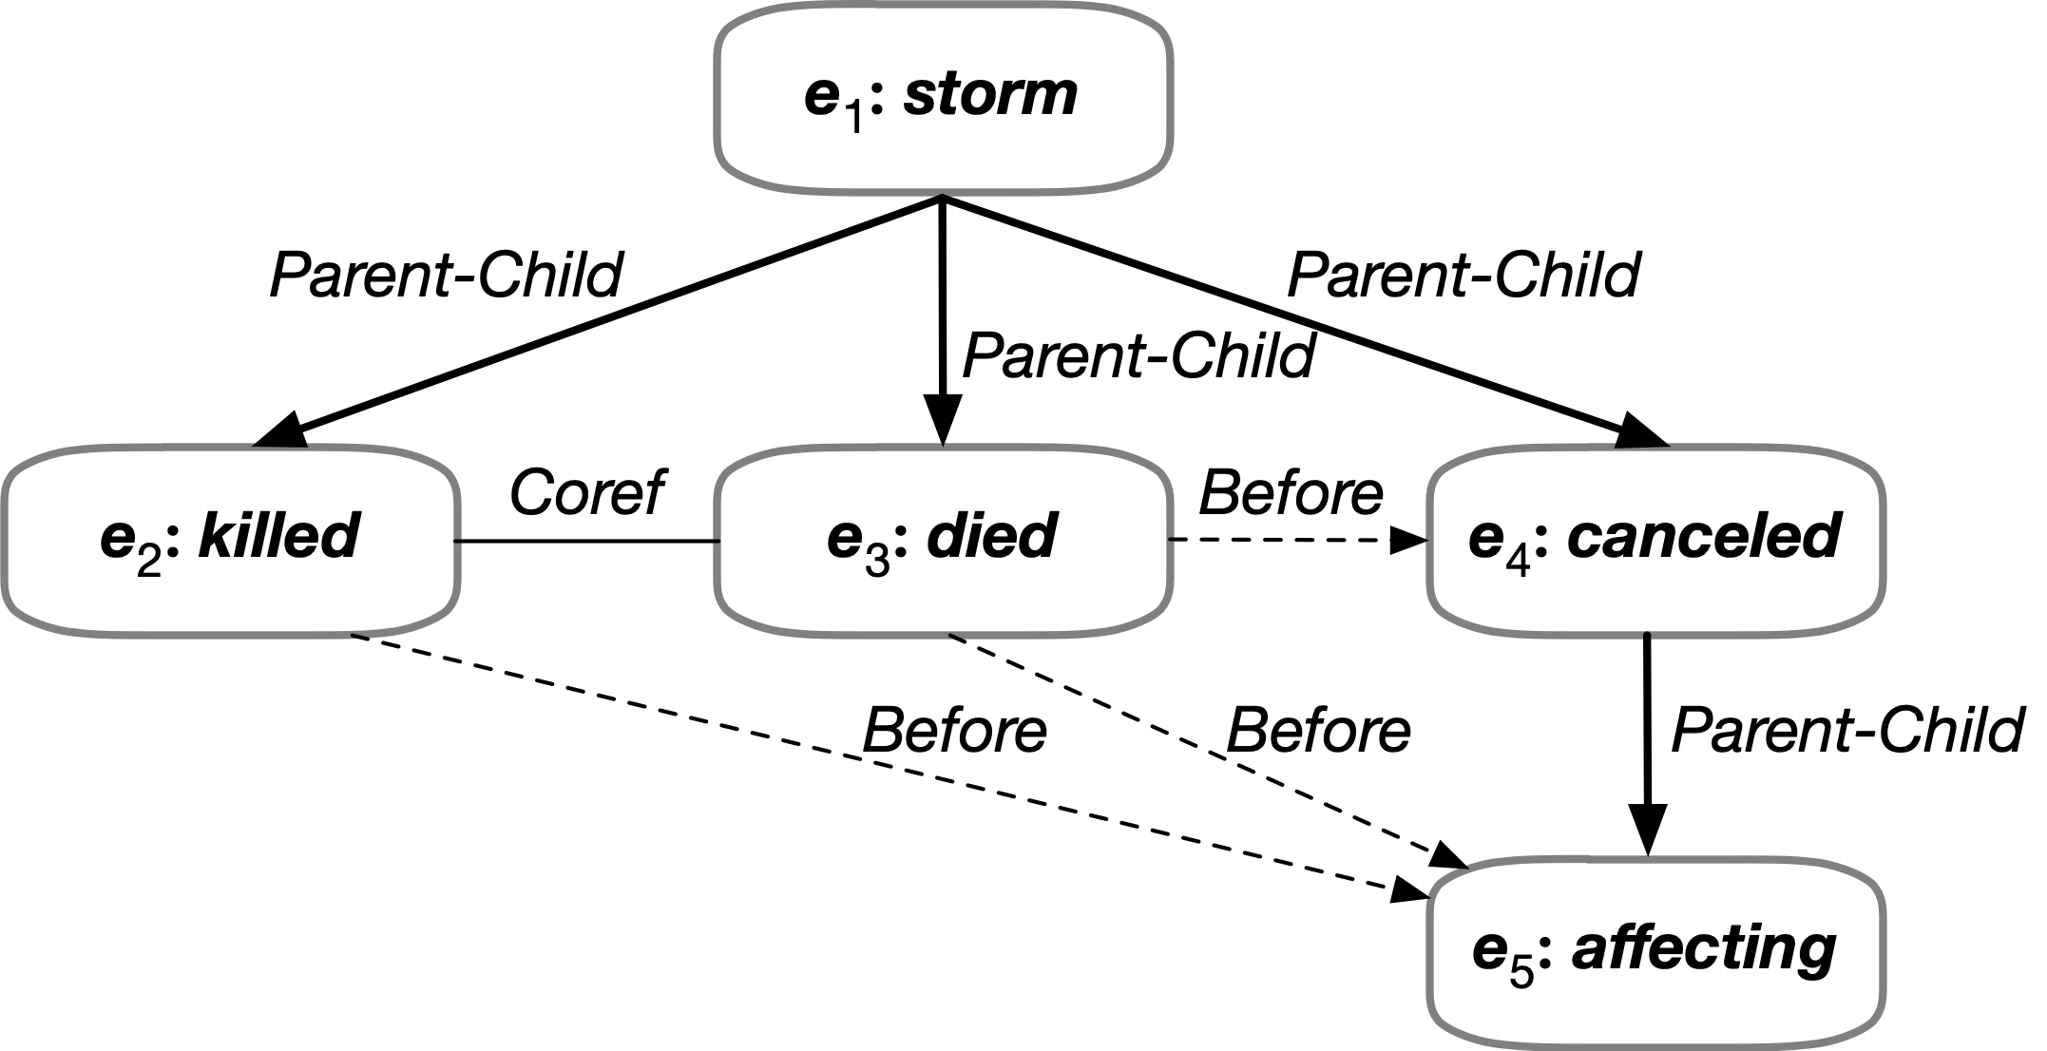

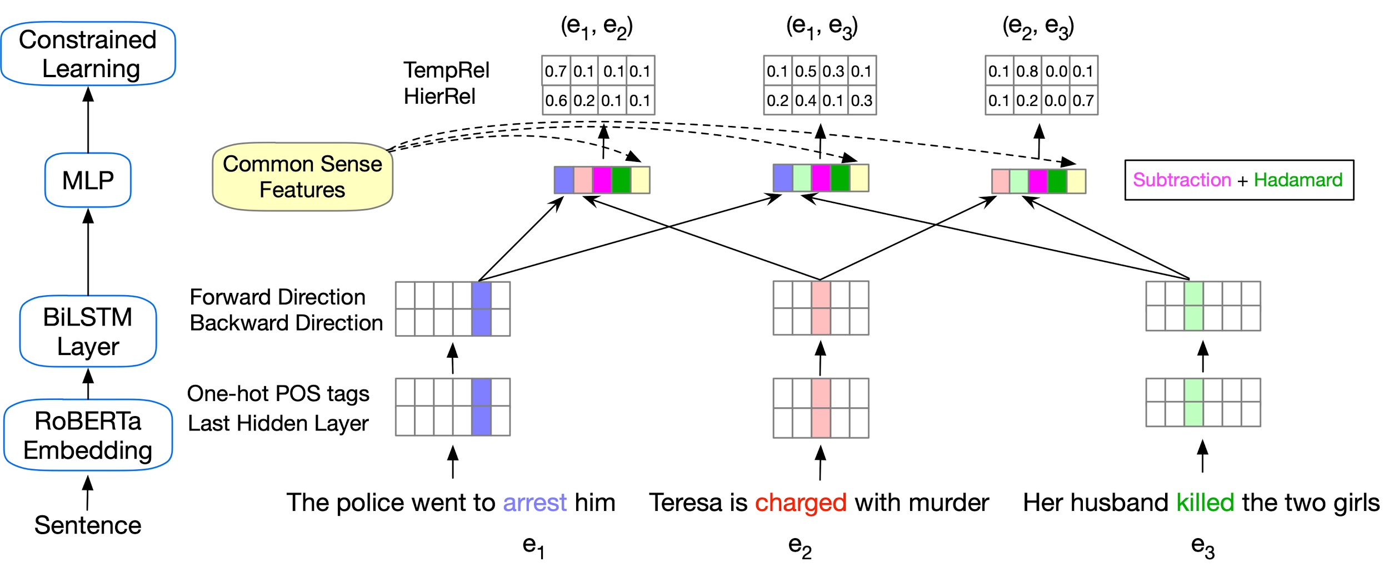
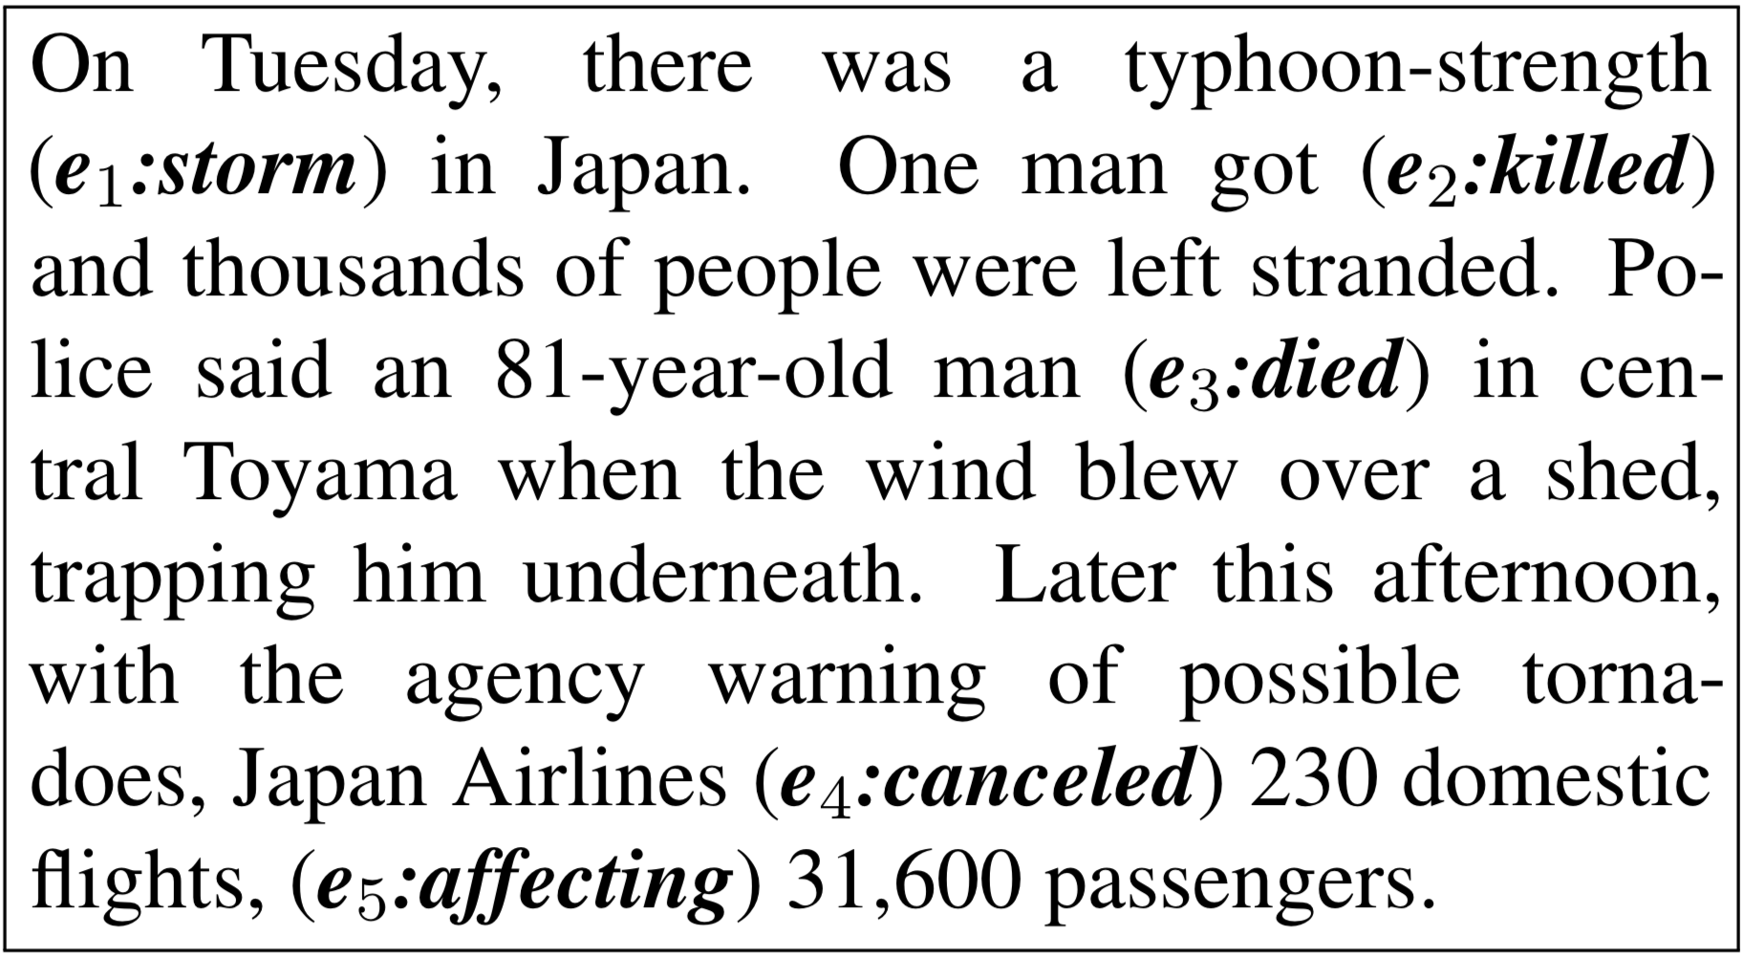
More Reasoning: Event Complexes [Wang et al. EMNLP’20]
Enforcing more logical constraints: Temporal, Symmetry, and Conjunctive by converting these constraints into differentiable learning objectives [Li & Srikumar ACL’19]
Temporal Relations
Subevent Relations
Event Coreference
A second challenge is that there is no dataset that annotates all the phenomena we care about

Slide 29
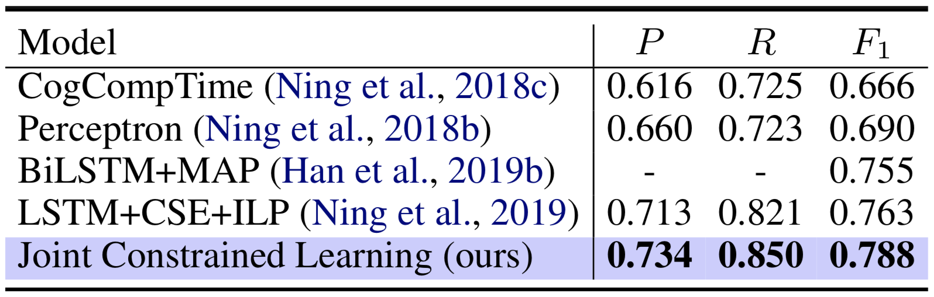
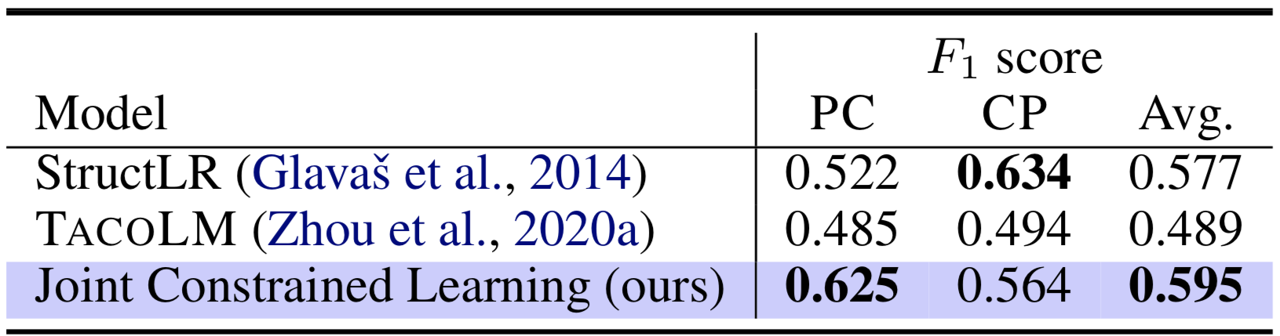
Event Complexs
Results on MATRES
Results on MATRES
Results on HiEve
Observation
  Constraints within and across two classes of relations contribute a lot to the improvements on both tasks
  Adding constraints while training is sufficient to enforce logical consistency of outputs, surpassing adding constraints at inference time by 2.6-12.3%
Notes:
Here we show the model’s performance on two benchmark datasets, namely MATRES for temporal relations and HiEve for subevent relations. The effectiveness of the joint constrained learning framework can be seen from the results that outperform previous methods. We have two main observations, the first one is the constraints within and across two classes of relations are very important to the model, not only in the sense that it serve as a bridge connecting different tasks in joint learning, but in the sense that it assists the model to make logically consistent predictions; the second observation is that the constrained learning framework can replace the commonly used ILP to enforce the consistency of prediction.

Slide 30
It’s Time to Reason:
Outline
Addressing “sparse” challenges that one cannot train for directly
  Decomposition and Composition (and some more)
Assigning values to multiple interrelated variables
  Given observations and knowledge
  Most likely assignment: Abduction
Computing functions over multiple interrelated inferred variables
  Last; longest, most frequent, etc.
Decisions over a dynamic set of interrelated variables
  The Aristotle example
    Need a strategy to decide what the variables are & a function computed over it
  Temporal Commonsense
(1)
(3)
Who scored the last field goal for the Eagles?
[given a recap of the game]
(2)
Will we make it to dinner before the movie?

Slide 31
Temporal Commonsense
“will” or “will not”?
Days
Minutes
Dr. Porter is taking a vacation and will not be able to see you soon.
Dr. Porter is taking a walk and will be able to see you soon.
Notes:
When we think about temporal commonsense we think about even more basic things –

Slide 32
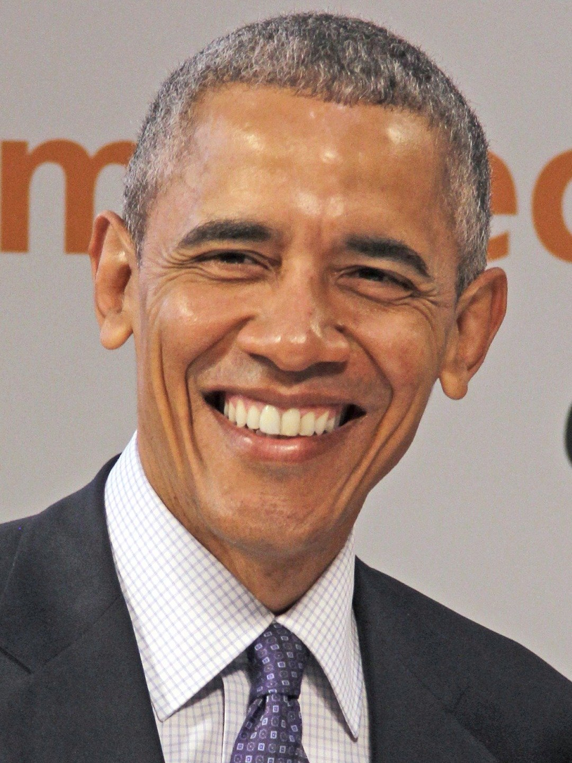
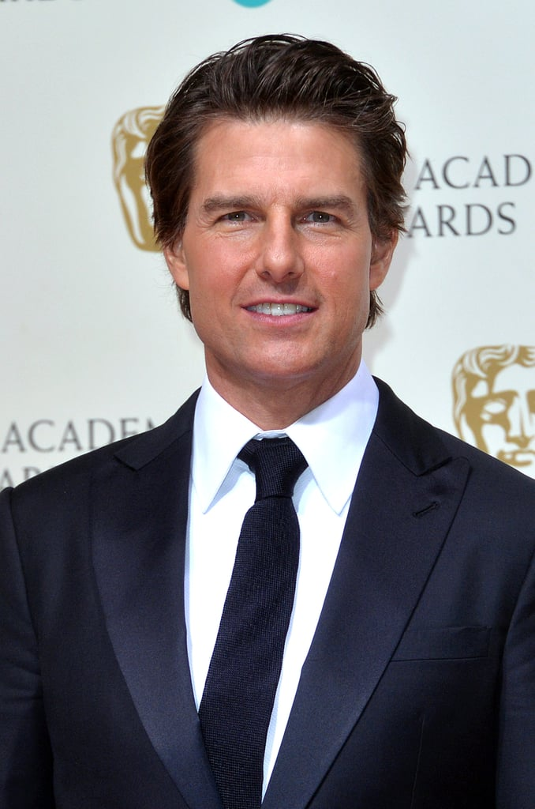
Defining the Temporal Commonsense Challenge
Events are associated with time
  Beyond order – Typical Time, Duration, Frequency
Most attributes and relations change over time
  Employment, schooling, location, nationality, headquarters, president, event participation , etc.
Knowledge Bases (knowledge Graphs) need to be qualified temporally
Goal: Represent a range of temporal aspects of conditions that change over time, and reason about it.
Temporal information is often implicit in text
Senator Obama & President Obama
Tom Cruise has three spouses

Slide 33
The Temporal Commonsense Challenge
My friend Bill went to Duke University in North Carolina. With a degree in CS, he joined Google MTV as a software engineer. As a huge basketball fan, he has attended all 3 NBA finals since then. He also plans to visit Duke regularly as an alumnus to attend their home games.

Slide 34
The Temporal Commonsense Challenge
My friend Bill went to Duke University in North Carolina. With a degree in CS, he joined Google MTV as a software engineer. As a huge basketball fan, he has attended all 3 NBA finals since then. He also plans to visit Duke regularly as an alumnus to attend their home games.
College: about 4 years, starts at the age of 18
Duration
Typical Time
Bill in North Carolina: about 4 years
Duration
Stationarity
Duke in North Carolina: always
Stationarity

Slide 35
The Temporal Commonsense Challenge
My friend Bill went to Duke University in North Carolina. With a degree in CS, he joined Google MTV as a software engineer. As a huge basketball fan, he has attended all 3 NBA finals since then. He also plans to visit Duke regularly as an alumnus to attend their home games.
College: about 4 years, starts at the age of 18
Duration
Typical Time
Bill in North Carolina: about 4 years
Duration
Stationarity
Duke in North Carolina: always (expected)
Stationarity
Join Google: after college graduation
Ordering

Slide 36
The Temporal Commonsense Challenge
My friend Bill went to Duke University in North Carolina. With a degree in CS, he joined Google MTV as a software engineer. As a huge basketball fan, he has attended all 3 NBA finals since then. He also plans to visit Duke regularly as an alumnus to attend their home games.
College: about 4 years, start at the age of 18
Duration
Typical Time
Bill in North Carolina: about 4 years
Duration
Stationarity
Duke in North Carolina: always (expected)
Stationarity
Join Google: after college graduation
Ordering
NBA Finals: every year
Frequency

Slide 37
The Temporal Commonsense Challenge
My friend Bill went to Duke University in North Carolina. With a degree in CS, he joined Google MTV as a software engineer. As a huge basketball fan, he has attended all 3 NBA finals since then. He also plans to visit Duke regularly as an alumnus to attend their home games.
College: about 4 years, start at the age of 18
Duration
Typical Time
Bill in North Carolina: about 4 years
Duration
Stationarity
Duke in North Carolina: always (expected)
Stationarity
Join Google: after college graduation
Ordering
NBA Finals: every year
Frequency
Visit Alma Mater: a few times a year, 1-2 days each time
Frequency
Duration
Attend basketball games: a few hours
Duration

Slide 38
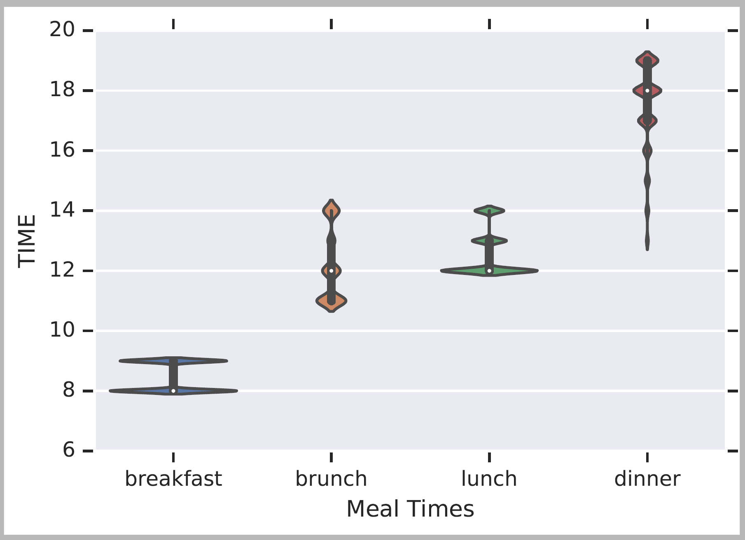
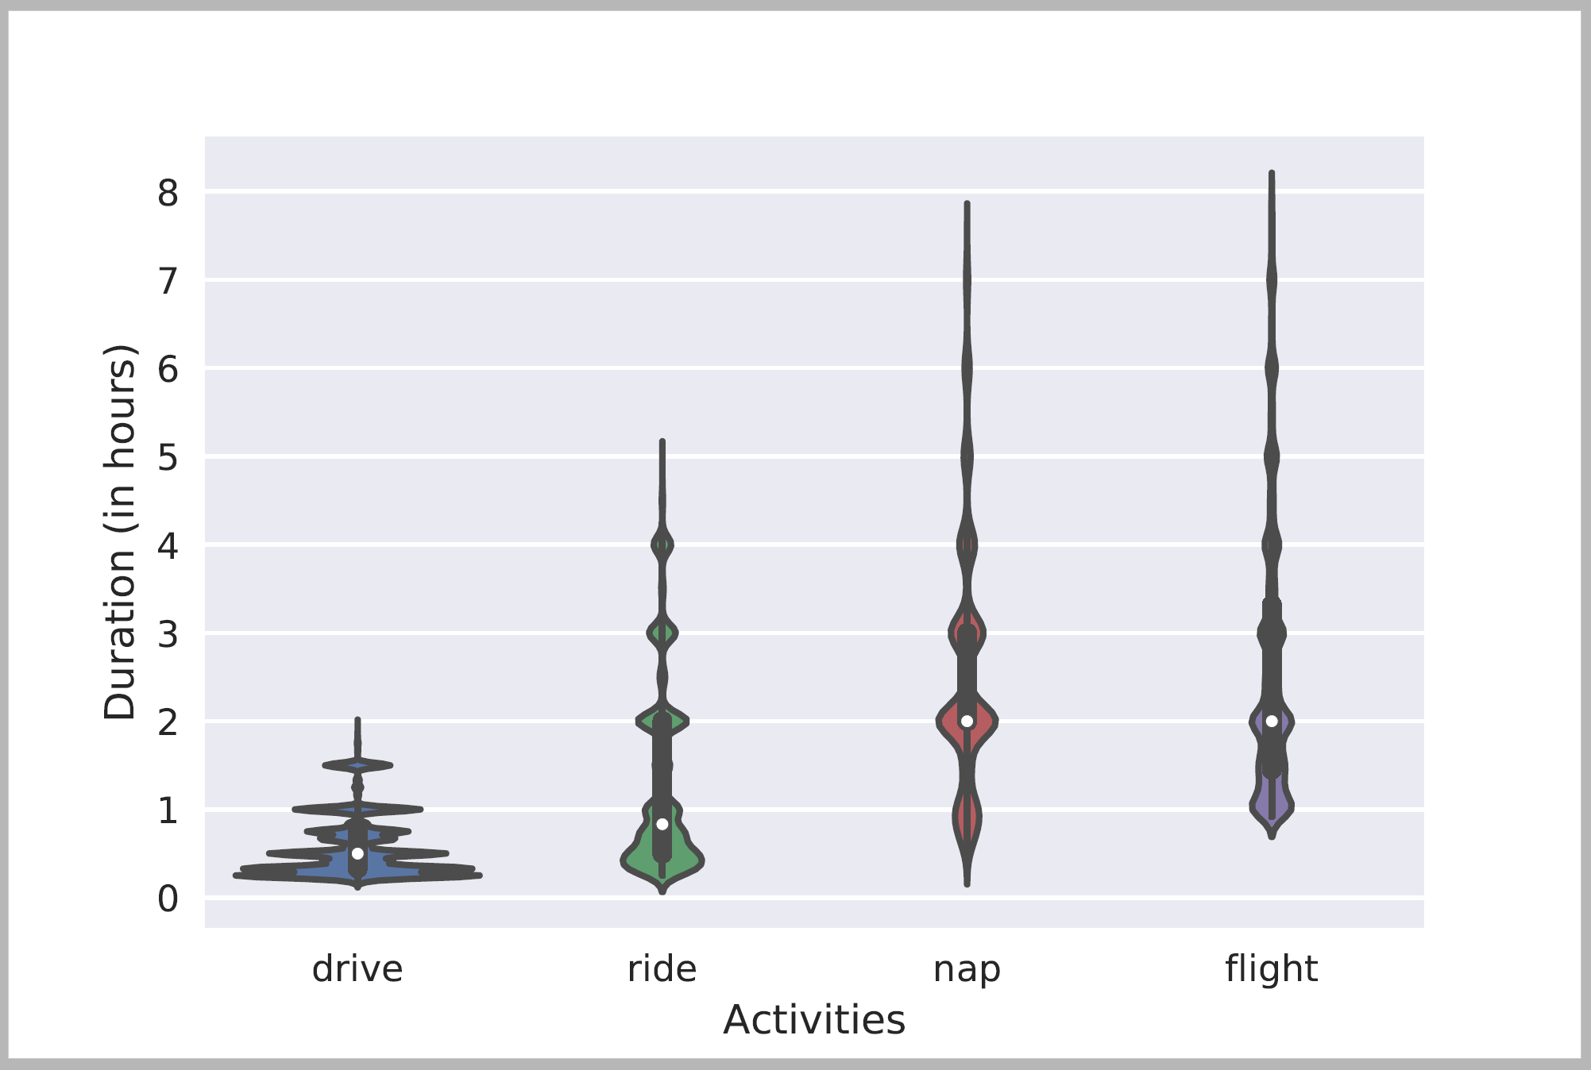
Temporal Common Sense
Two efforts:
  A dataset MC-TACO [Zhou et al. EMNLP’19]
  Acquisition + Representation [Zhou et al. ACL’20]: Duration, typical time, frequency.
Typical Time
Typical Temporal Relations
Ning et al. NAACL’18
[Zhou et al. ACL’20]
Duration
[Elazar et al. ACL’19]

Slide 39
Defining the Temporal Commonsense Challenge
MC-TACO [Zhou et al. EMNLP 2019]
  Multiple Choice TemporAl COmmon-sense
  1,893 questions; 13,225 question-answer pairs
  Querying at least one of the five dimensions:
    Duration
    Frequency
    Typical Occurring Time
    Stationarity
    Ordering
  Exact Match: the percentage of questions of which all candidates are predicted correctly (here: 0.0)
  F1: Gives partial credit (credits “accidental” correct perditions (here: 66.7%)
Gold
Prediction
He went to Duke University.
How long did it take him to graduate?
4 years
✔
10 days
✔
3.5 years
✗
16 hours
✔

Slide 40
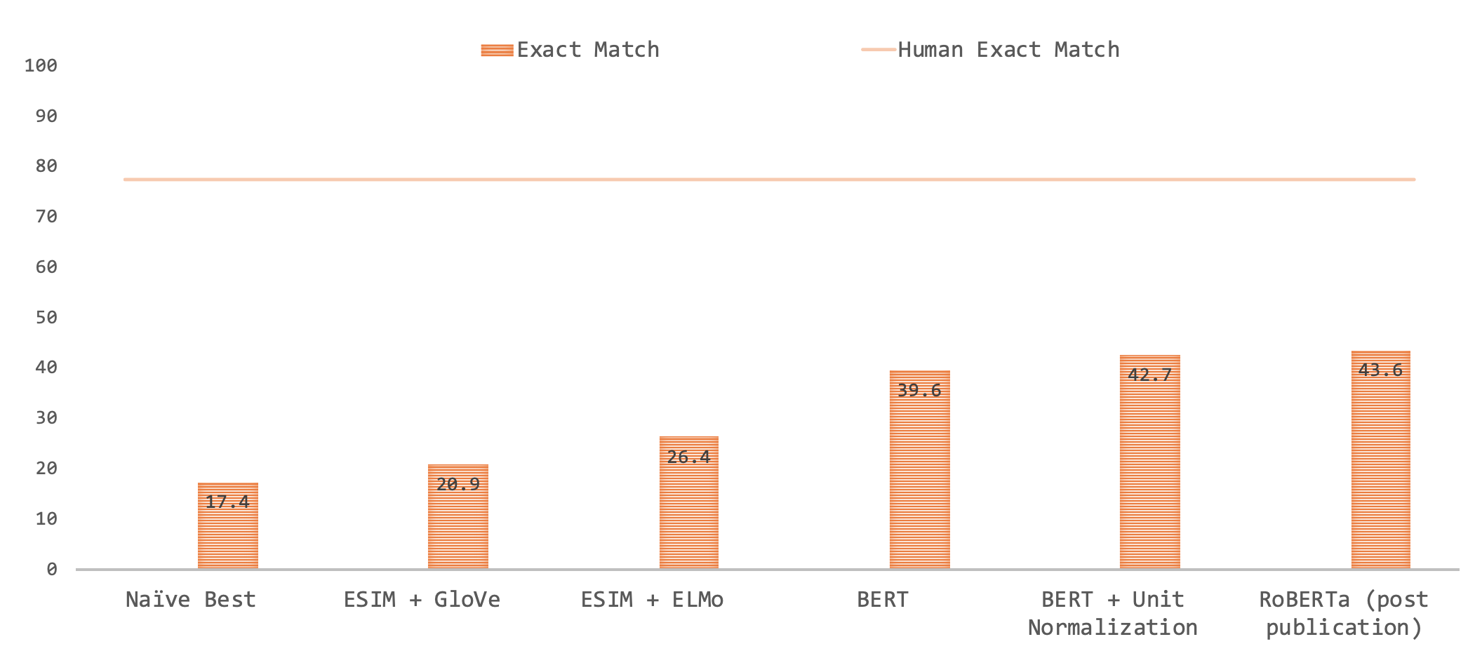
Defining the Temporal Commonsense Challenge
MC-TACO (Zhou et al. EMNLP 2019)
  RoBERTa is 30% behind human performance on Exact Match

Slide 41
Results: We are Far (from where we want to be)
It’s important to be careful when evaluating LM-based results.
We have multiple plausible answers for each question. You only understand the phenomenon if you tag all the options correctly.
13% difference
40% difference
ESIM: Enhanced LSTM for Natural Language Inference (Chen et al., 2016)
GloVe: Global Vectors for Word Representation (Pennington et al., 2014)
ELMo: Deep contextualized word representations (Peters et al., 2018)
BERT: BERT: Pre-training of Deep Bidirectional Transformers for Language Understanding (Devlin et al., 2019)
RoBERTa: A Robustly Optimized BERT Pretraining Approach (Liu et al., 2019)

Slide 42
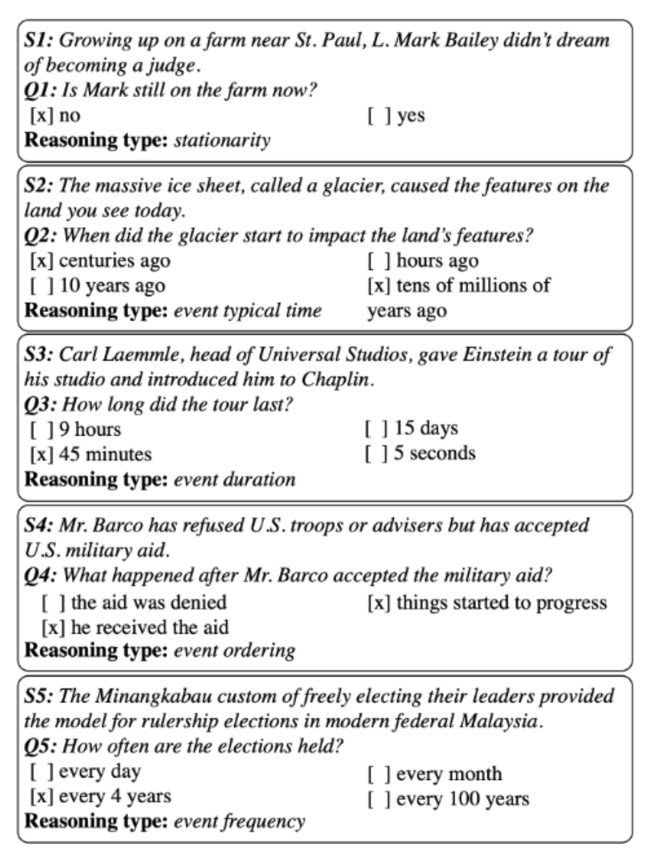


MC-TACO🌮: A Temporal Commonsense Dataset [Zhou et al. EMNLP’19]
The results of a RoBERTa-based models are very low. Not surprising given the need to have commonsense to address these challenges.
Perhaps more importantly, it illustrates the need to decompose, and know how to incorporate knowledge.
Stationarity:
  Paul Simon is in NYC. Let’s go see him.
  The Empire State Building is in NYC.
Stationarity
Typical Time
Duration
Will we make it to dinner before the movie?
Temporal Ordering
Event Frequency
Notes:
The time now, the movie time, but also – how long is our typical dinner?

Slide 43
TemporAl COmmonsense LM
TacoLM – A general LM that is aware of time and temporal common sense
  Minimal Supervision
Used to develop contextual estimation for Duration, Typical Time, and Frequency
  Time is represented as a distribution over time units
confidence
Notes:
In this work, we propose TacoLM, a general language model that is aware of time and temporal common sense, and at the same time built without any annotations. We show that our model is better at solving time-related tasks. For example, in this actual prediction of duration from our model,

Slide 44
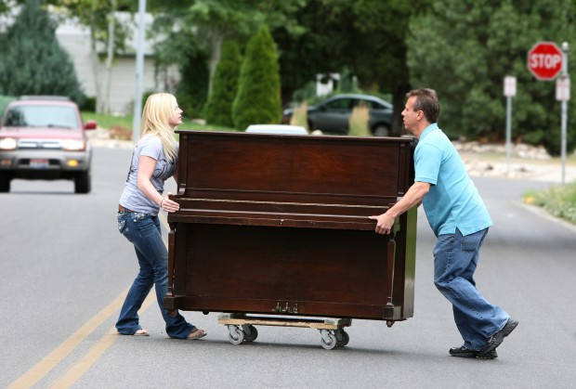

Modeling Temporal Common Sense
Context
  How long does “move” take?
    Highly contextual: Move a chair? Move a piano?
    Needs more than direct event arguments
Joint Modeling
  Do people often write how long they brushed their teeth in text?
    But they’ll say: I brushed my teeth in the morning; I brushed it in the shower
  (Partly) addresses reporting bias

Slide 45
Technical Highlights
Unsupervised collection of auxiliary signals
  Using patterns from free text
  Extract complete events – predicate and arguments
Joint model across interrelated dimensions
  Assume no signal on the duration of “brushing teeth”, we can still get upper bounds from “brush teeth in the morning” or “brush teeth every day” or “brush teeth during shower”
  Natural constraints: duration <= 1/frequency

Slide 46
TacoLM – the Big Picture
Goal: build a general time-aware LM with minimal supervision
  Using high-precision patterns to acquire temporal information
    Unsupervised automatic extraction
  Overcomes reporting biases with a large amount of natural text
  Multiple temporal dimensions
    Duration ~ 1 / Frequency
    Further generalization to combat reporting biases
Step 1: Information Extraction
Step 2: Joint Masked Language Model
“I brush my teeth every morning”
Duration of “brushing teeth” < morning
Output: TacoLM- a time-aware general BERT
Notes:
♦With the goal of building a general time-aware LM with minimal supervision, ♦we start with a focused, unsupervised information extraction step, ♦in which we use a set of high-precision patterns to acquire temporal information. ♦This helps the model to overcome reporting biases as we can automatically extract over a large amount of natural text.
♦We use the temporal information acquired in step 1 in the second step called joint language model pretraining. ♦That is, we pre-train our language model jointly over multiple temporal dimensions, ♦so that it is able to utilize the natural relations such as duration being inversely related to frequency. ♦This is beneficial. For example, we may not see direct mentions of the duration of brushing teeth, however, we know that it is shorter than a morning as the frequency is likely to be every morning. ♦This provides further generalization to combat reporting biases.
♦Finally, we obtain our final model TacoLM, a BERT transformer that is more aware of time.

Slide 47
Information Extraction
Use high-precision patterns based on SRL
  Duration
  Frequency
  Typical Time
  Duration Upper bound
  Hierarchy
Labels
  Units (seconds, … centuries)
  Temporal keywords (Monday, January, …)
Output
  4.3M instances of
  (event, dimension, value) tuple
I played basketball for 2 hours.
Original sentence
SRL Parse
Arg-0
Arg-1
I played basketball for 2 hours.
Verb
Arg-Tmp
Pattern Matching
for 2 hours: matches Duration pattern
Event
Value
I played basketball, Duration, Hours
Formatted Output Instance
Dimension
Notes:
Time units: for duration and frequency
Temporal keyworkd: for typicaly time

Slide 48
Sequence Formatting
Consider [Event] [Dimension] [Value] tuples in each instance
[E1, E2, … M, ET … En, SEP, M, Dim, Val]
  M is a special marker, same across all dimension/value
  Dim is a marker for each dimension, Val is a marker for the value of the dimension
An example:
I played basketball for 2 hours.
Information Extraction
I played basketball, Duration, Hours
Sequence Formatting
I [M] played basketball [SEP] [M] [DUR] [HRS]
Notes:
♦Specifically, for each event, dimension and value tuple, ♦we format it into a sequence of tokens, in which we use special markers to mark the location of the verb, in order to represent the event, and place special tokens that represent the temporal dimension and the value in the same sequence.
♦♦Consider the same example I played basketball for 2 hours. ♦♦We extracted a training instance from the information extraction step, ♦♦and we now further format it into a single sequence containing all the information.

Slide 49
Joint Model with Masked LM
I [M] played basketball [SEP] [M] [DUR] [HRS]
Baseline Model: Pre-trained BERT-base
Main objective: mask some tokens and recover them
How we mask:
  With some probability, mask temporal value while keeping others
  Otherwise, mask a certain portion of E1...En while keeping temporal value unchanged
  Max (P(Event|Dim,Val) + P(Val|Event,Dim)); Preserving original LM capability
Benefits:
  Jointly learns one transformer for all dimensions
  Labels play a role in the transformer
  One event may contain more than one (Dim + Val), so the model learns dimension relationships
I [M] played basketball [SEP] [M] [DUR] [MASK]
I [M] [MASK] [MASK] [SEP] [M] [DUR] [HRS]
Notes:
♦We build our model on top of the pre-trained BERT-base model and ♦employ a simple objective of masking some tokens in our formatted sequence and then recover them. ♦♦♦With the higher probability, we mask the temporal value while keeping the others. ♦♦Otherwise, We will instead mask some event tokens and keep the temporal value token unchanged. ♦In this case, we can maximize the conditional probability of the events and the value at the same time to preserve the original capability of a language model.
♦The benefits of formatting sequences and use the masked LM objective are that we can jointly learn one transformer towards all dimensions, including the original language model capability, ♦and labels play a role in the transformer architecture. ♦As one event may contain more than one (Dim + Val) pair, the model is able to learn inter-dimension relationships.

Slide 50
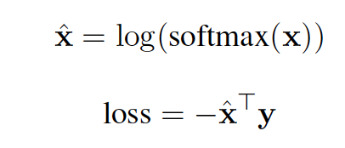
Joint Model with Masked LM
I [M] played basketball [SEP] [M] [DUR] [HRS]
1: Soft cross entropy for recovering Val
  If gold label is “hours”, the label vector y for “minutes, hours, days” will be [0.16, 0.47, 0.25]
2: Label weight adjustment
  Instances with “seconds” have higher loss than those with “years”
3: Full event masking
  Instead of 15% used by BERT, we use 60% when masking E1, … En to reduce biases
I [M] had a cup of [MASK] [SEP] [M] [TYP] [Evening]
-> MASK = coffee, because “cup of”
I [M] had [MASK] [MASK] of [MASK] [SEP] [M] [TYP] [Evening]
Notes:
♦We also use additional techniques including a soft cross entropy loss for temporal value recovery. ♦♦For example, if the gold label is hours, the neighboring values minutes and days will have a non-zero target value. ♦We use label weight adjustments to address the label imbalance in the training data.
♦We also use an additional technique called full event masking to further reduce biases, where instead of the 15% used by BERT, we use 60% when masking the event tokens.
♦This is helpful because a model may attend too much on strong priors, for example, ♦BERT will always predict “coffee” to follow “a cup of”, no matter what the temporal argument is. ♦However, if we mask the phrase “a cup of”, the prediction of the drink will be more conditioned to the temporal value, so that we may see some drink other than coffee to be the most popular choice in evenings.

Slide 51
Evaluation: (Embedding space)
A collection of events with duration of “seconds,” “weeks” or “centuries” (three extremes)
BERT (left), Ours (right) representation on the event’s trigger
  PCA + t-SNE to 2D visualization
Our model separates the events much better (➔ our model is aware of time)
BERT
TacoLM
Notes:
We start by looking at the embedding space comparison between BERT and TacoLM. The visualization is done over a set of events with durations of seconds, weeks, or centuries. ♦The left visualization is from BERT, ♦while the one on the right is from TacoLM, where events are better clustered by their durations.

Slide 52
Quantitative Evaluation:
Metric: Distance to gold label
  Dist (seconds, hours)=2, Dist (minutes, hours)=1
  Lower the better
RealNews [Zellers et al. 2019]: no document overlap
  Raw corpus + MTurk annotation
UDS-T [Vashishtha et al. 2019]: duration only
19% average improvement
Notes:
We also conduct quantitative intrinsic evaluations where the task is to directly predict events’ temporal dimensions including duration, frequency and typical time. ♦♦We use a metric called distance to gold which is lower the better. ♦For the data. we annotated some instances based on raw texts from RealNews so that there is no document overlap with our pre-training data. ♦We see that our model is able to produce ♦an average improvement of 19% over the baseline model BERT.
♦We also evaluate on UDS-T, a duration only annotation benchmark, ♦on which our proposed TacoLM is also able to improve.

Slide 53
Evaluation: Event-Event Relations
Use as a general language model with finetuning
Task: Identify event-event hierarchical relations
  HiEVE [Glavas et al. 2014]
  Child-Parent / Parent-Child / Coreference
    A bomb exploded. This is the sixth accident since the war started.
Model (finetuned):
  Sentence pair classification
Results (F1, higher is better)
war
accident
=
exploded
Notes:
♦To show that our model is indeed a general language model, we also evaluate on extrinsic tasks with finetuning on task-specific training data. ♦♦One task we selected is to identify inter-event relations ♦including child-parent, parent-child and coreference. ♦♦For example, accident and explosion are coreferencing each other in this example sentence, and they are both child events of war.
♦We use BERT’s sequence pair classification model and apply the same training process with the only difference being the internal weights of the transformer. ♦♦In this task, we see that TacoLM is able to improve around 8% on child-parent, parent-child relations.
♦There are more experiments in our paper, please read it for other comparisons.

Slide 54
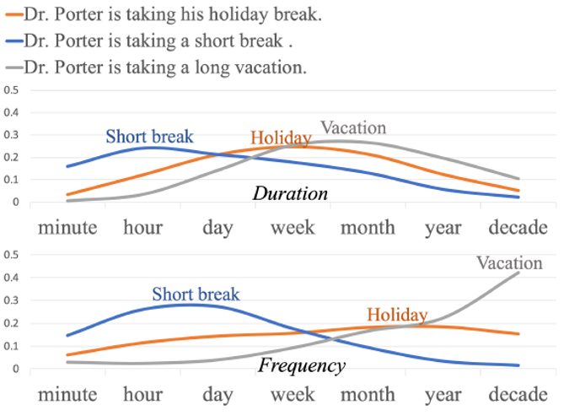


Conclusion – Temporal Commonsense
A range of natural language understanding tasks require that we “understand” time
  And many of these require that we have commonsense
    E.g., time is transitive; how long things take; typical order, etc.
Time is interesting for many reasons
  In particular, since natural language rarely provides explicit temporal information
    How long does it take to open a window?
    What “things” change with time (and what do not)?
  In most cases – temporal knowledge is distributional
Presented MC-TACO data set
  A challenge QA dataset for temporal commonsense
Discussed TACO-LM
  A time-aware Contextual Language Model
  Duration, typical time, frequency
There is a lot more to do!
Did Aristotle have a laptop?
Decompose or not decompose?
  The strategy: What do we need to know in order to answer
  What functions are to be computed over components?
How/What to learn?
Notes:
In conclusion, ♦we build a time-aware language model, and we are able to do this without annotations thanks to the ♦unsupervised information extraction step based on patterns. ♦We propose a joint learning scheme ♦that is able to utilize the inter-dimension relations. ♦The final model is able to directly predict events’ duration, frequency and typical time, ♦with an average 19% improvement over BERT. ♦It also produces bell-shaped distributions over continuous labels, ♦♦ and it differentiates fine grained contexts.
♦It also works as a general language mode, achieving 8% improvement on child-parent event relation extraction tasks. ♦Please refer to this link for our model and data, thank you!

Slide 55
It’s Time to Reason:
Outline
Addressing “sparse” challenges that one cannot train for directly
  Decomposition and Composition (and some more)
Assigning values to multiple interrelated variables
  Given observations and knowledge
  Most likely assignment: Abduction
Computing functions over multiple interrelated inferred variables
  Last; longest, most frequent, etc.
Decisions over a dynamic set of interrelated variables
  The Aristotle example
    Need a strategy to decide what the variables are & a function computed over it
  Temporal Commonsense
(1)
(3)
Who scored the last field goal for the Eagles?
[given a recap of the game]
(2)
Will we make it to dinner before the movie?

Slide 56
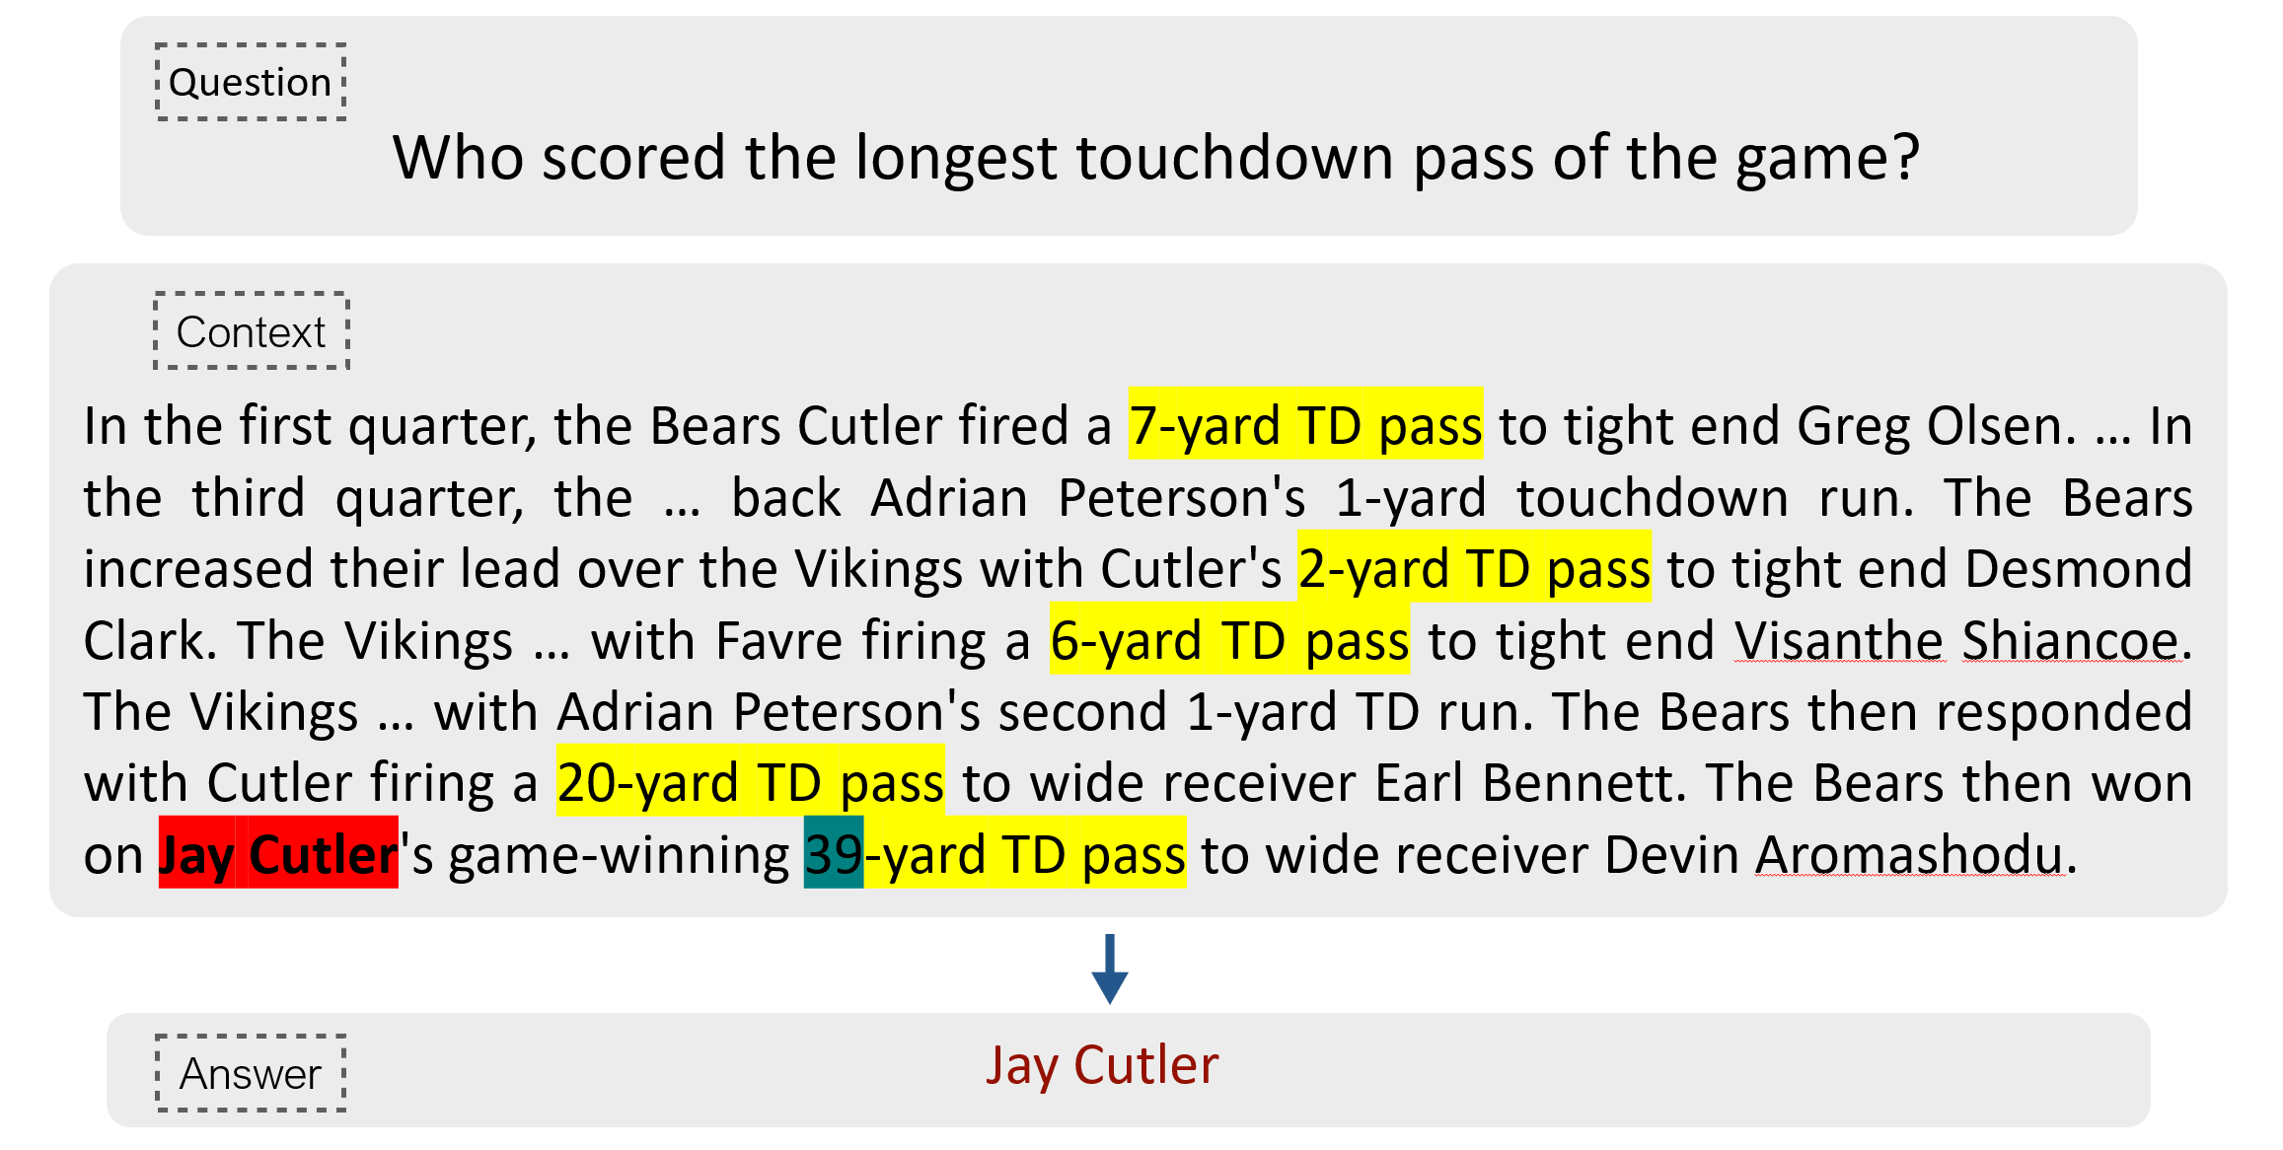
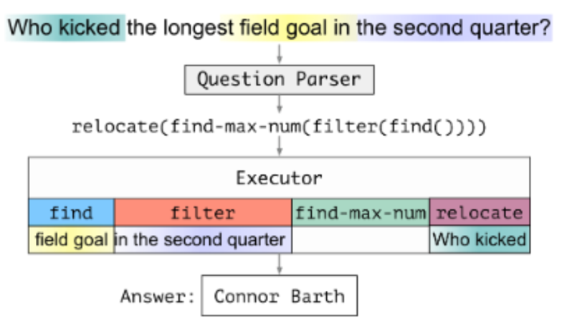
Decomposition for Reasoning about Text[Gupta et al. ICLR’20]
Answering complex questions require learning compositional, structured models, that depend on latent decisions
  Hopefully prevents model from latching onto data artifacts, supports better generalization
We need to induce a program, with some executable modules at the leaves
  “This phrase” indicates a field goal/touchdown
  “This player” scored it; “this is the team” that scored it
  “This is the length” of the field goal
Reason symbolically over it.
  Possibly, over probabilistic representations of the latent variables.
Notes:
We are interested in developing a question answering system that given as input a question and a relevant paragraph of context, produces the correct answer
For example, given the question “Who scored the longest touchdown pass of the game?” and a summary of an American Football game, the model should be able to produce the correct answer

Slide 57
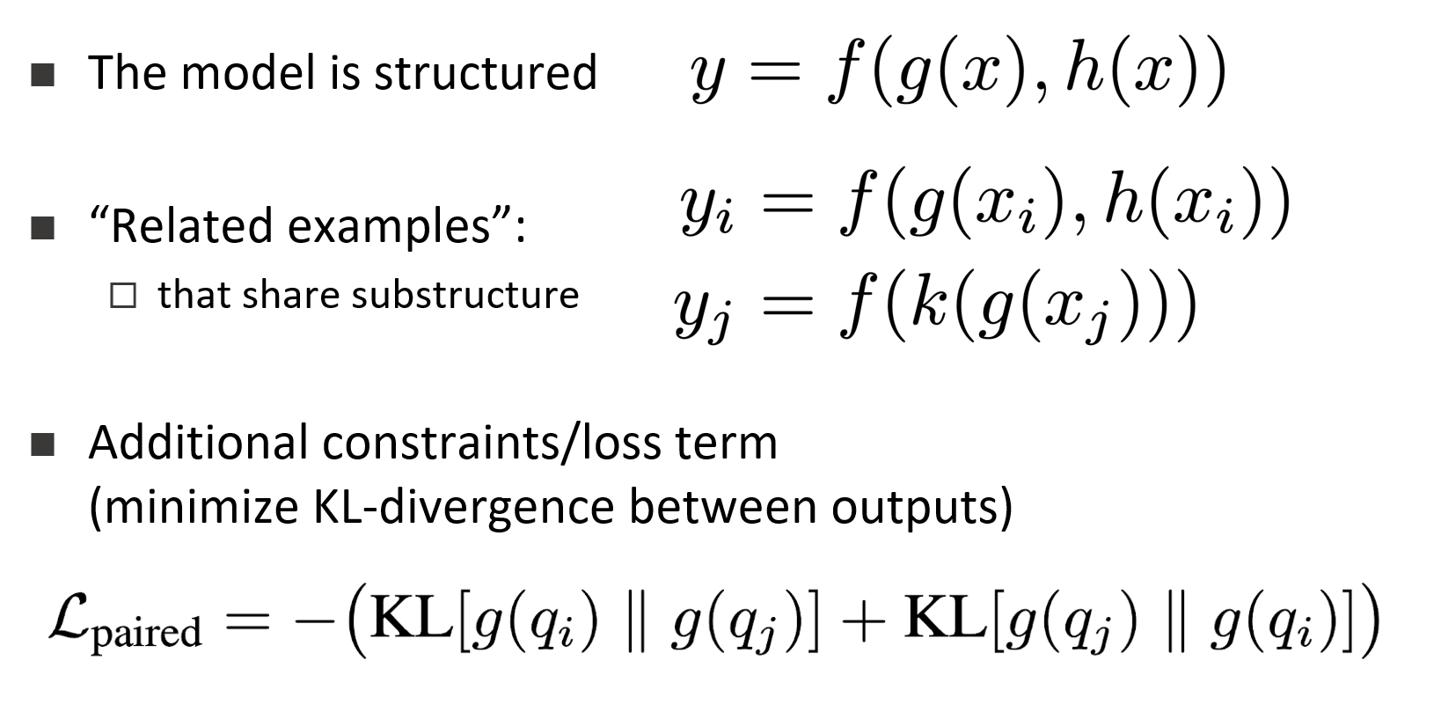
Indirect Supervision in Latent Decision Models
Gupta, Gardner, Singh, Roth,
In Submission
Answering complex questions require learning compositional, structured models, that depend on latent decisions
  Hopefully prevents model from latching onto data artifacts, supports better generalization
However, end-task supervision provides a weak indirect signal to latent decisions
  When do we learn “touchdown”?
  In fact, also: when do we learn “max”?
We introduce a way to generate and leverage indirect supervision signals via paired examples
  Stronger cues for learning latent decisions.
Latent Decision Model
Notes:
We are interested in developing a question answering system that given as input a question and a relevant paragraph of context, produces the correct answer
For example, given the question “Who scored the longest touchdown pass of the game?” and a summary of an American Football game, the model should be able to produce the correct answer

Slide 58
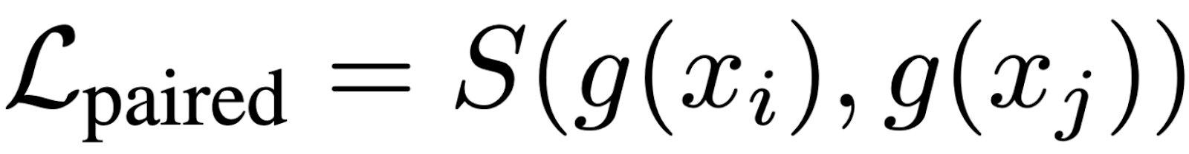
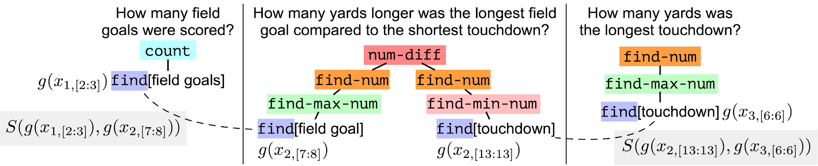
Paired Objective
Enforce consistency between outputs of shared-substructures
encourage similarity between outputs

Slide 59
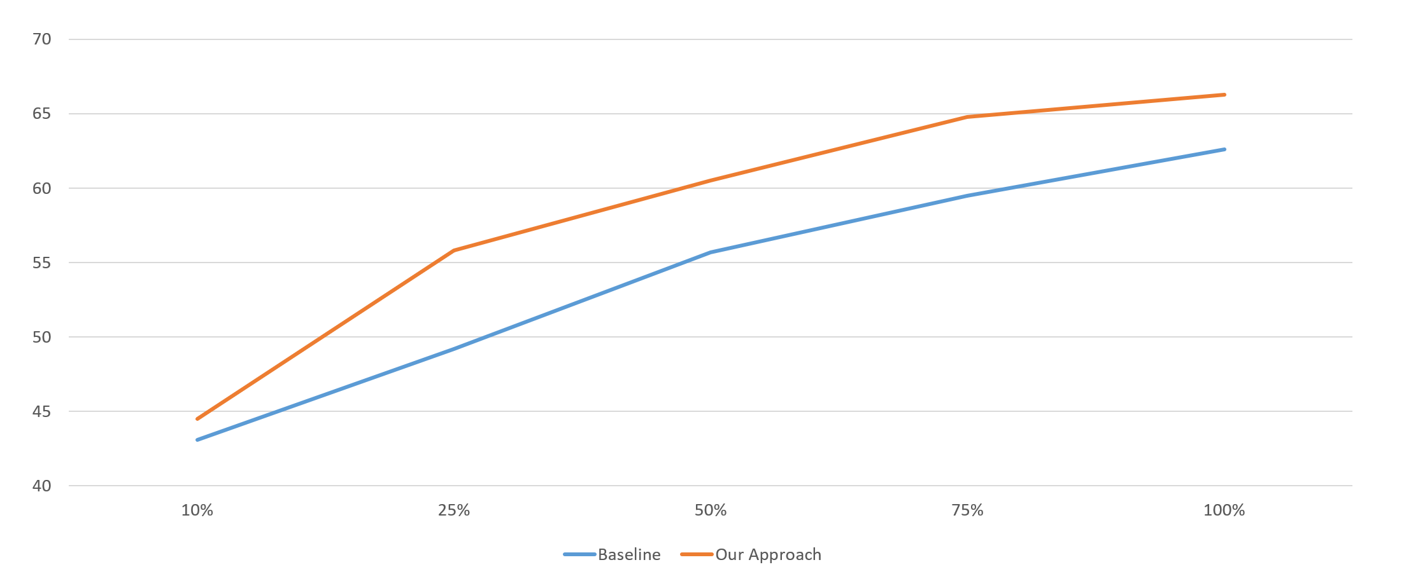
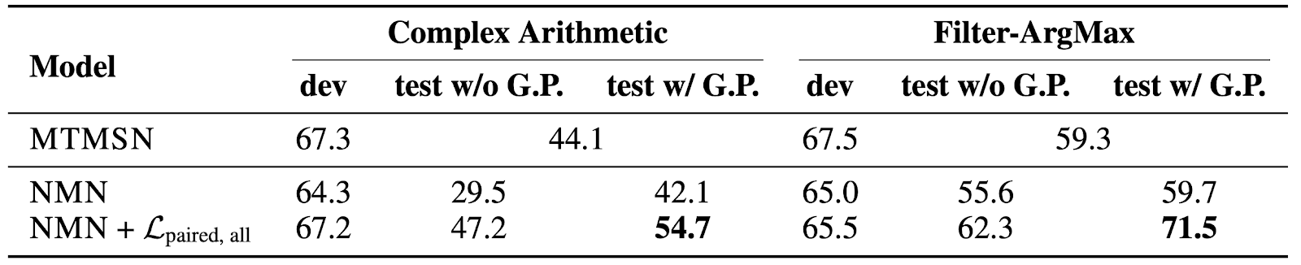
Results: compositional generalization
Test on more complex questions than trained on
E.g. How many more mg/L is the highest amount of arsenic in drinking water linked to skin cancer risk than the lowest mg/L amount?
Performance vs. Training Instances

Slide 60
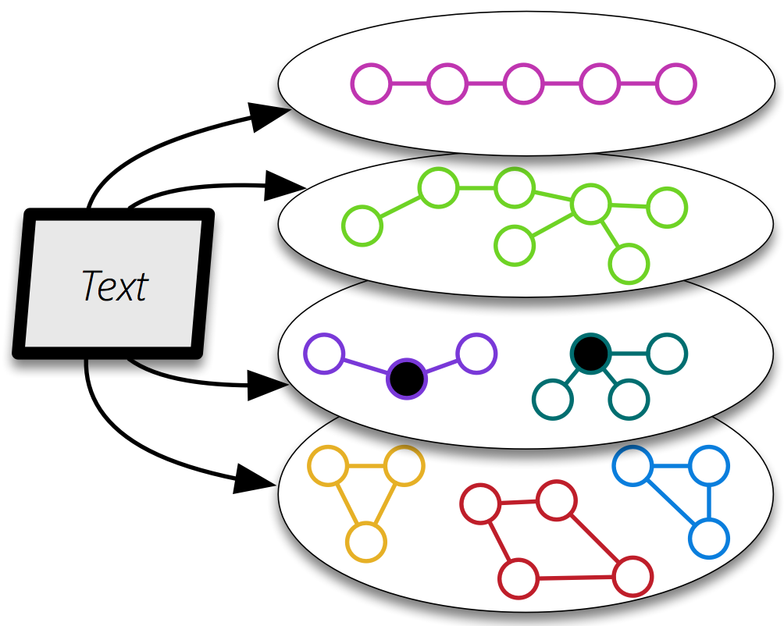
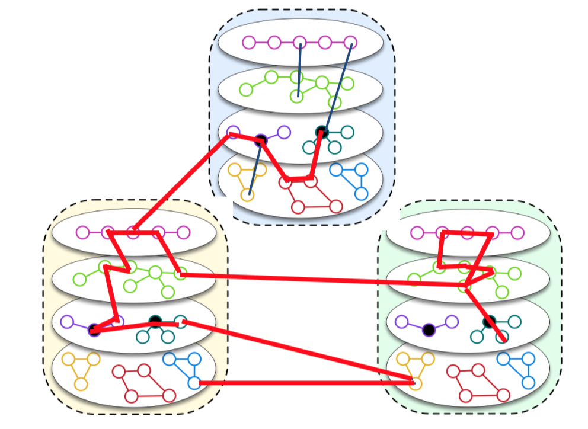
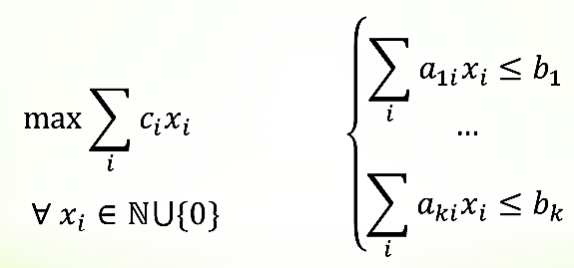
QA via Inference over Semantic Graphs [Khashabi et. al AAAI’18]
Addressing “sparse” QA challenges that one cannot train for directly
Create a unified representation of families of graphs (symbolic + continuous).
Decouple learning representation from inference
Use constrained optimization for inference over it.
Allows us to think about abductive inference – the best explanation given observations and knowledge
Not a QA specific representation
  Used also to address Algebra word problems, Physics 101 , etc.
Components can be as neural as you want
Robust, due to a stronger notion of modularity
Easier to bring in:
  Previously trained models
  Knowledge: declarative and statistical
Notes:
To show you the big picture, we form an abstraction of text, as a collection of semantic graphs.
- Each instantiation of the graphs, can contain a different phenomena over text, with nodes being mentions within your text.
- Nodes could contain embeddings/representations that will be used during the reasoning time to create alignments.
I’d like to emphasize that such representations has nothing to do with the QA task. It is purely generic, and it reflects an understanding of the language.
consequently, we expect these representations to be useful for a range of tasks;
============
also, they are to be learned from/as part of/ a range of tasks.

Slide 61
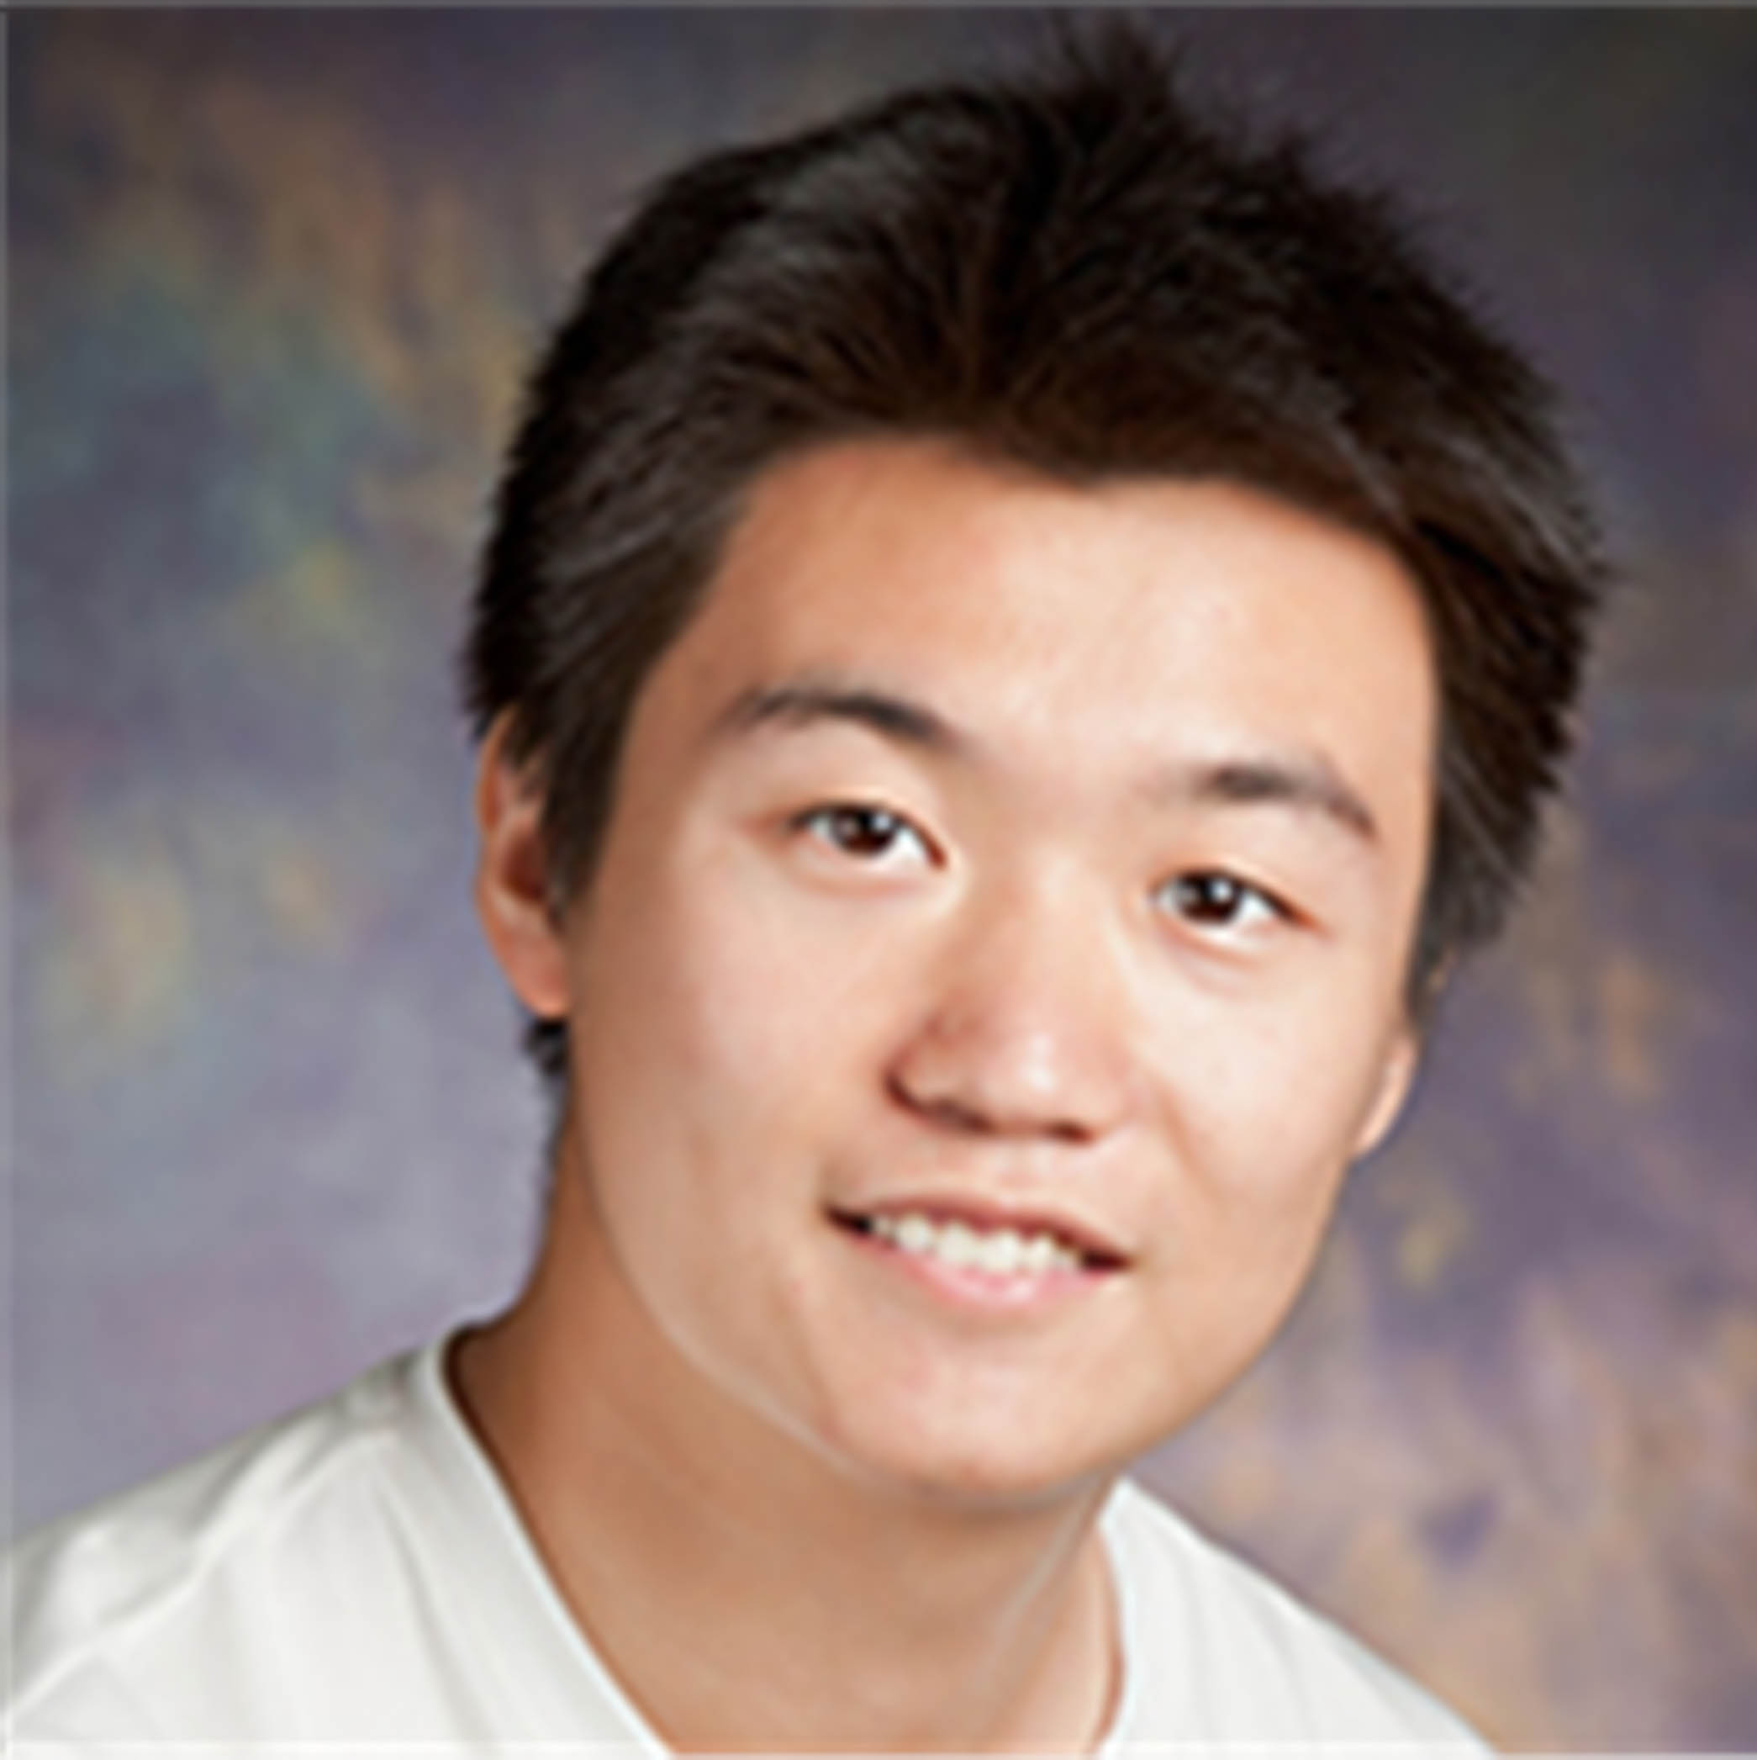


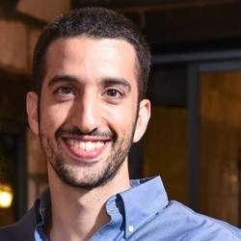




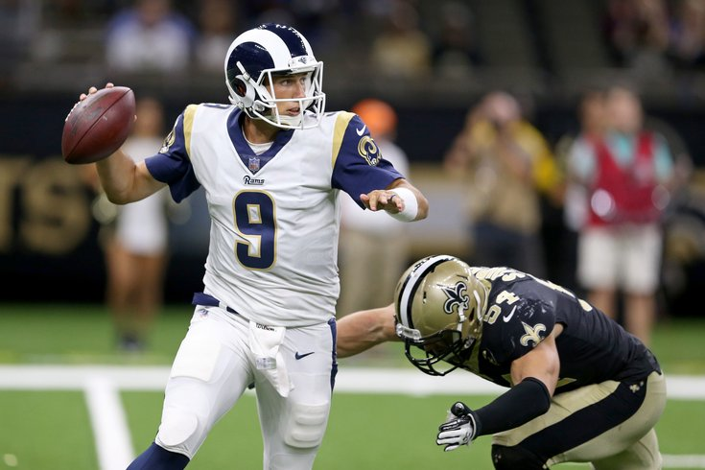


Conclusion
Thank You!
A small sample from a research program that attempts to address some of the key scientific and engineering challenges between us and understanding natural language
In the context of reasoning about events and time
  Reasoning: To decouple or not to decouple?
  (Temporal) Common Sense
  Supervision: how to think about it when we actually want to do reasoning?

Slide 62
End

