Slide 1
Inducing Semantics with Minimal (or No) Supervision
Dan Roth
Department of Computer Science
University of Illinois at Urbana-Champaign
With thanks to:
Collaborators: Ming-Wei Chang, Chritos Christodoulopoulos, Dan Goldwasser,
Haoruo Peng, Lev Ratinov, Chen-Tse Tsai, Yangqiu Song, Vivek Srikumar
Funding: NSF; DHS; NIH; DARPA; IARPA, ARL, ONR
DASH Optimization (Xpress-MP); Gurobi.
June 2016
Workshop on Broad-Coverage Semantic Analysis
University of Amsterdam

Slide 2
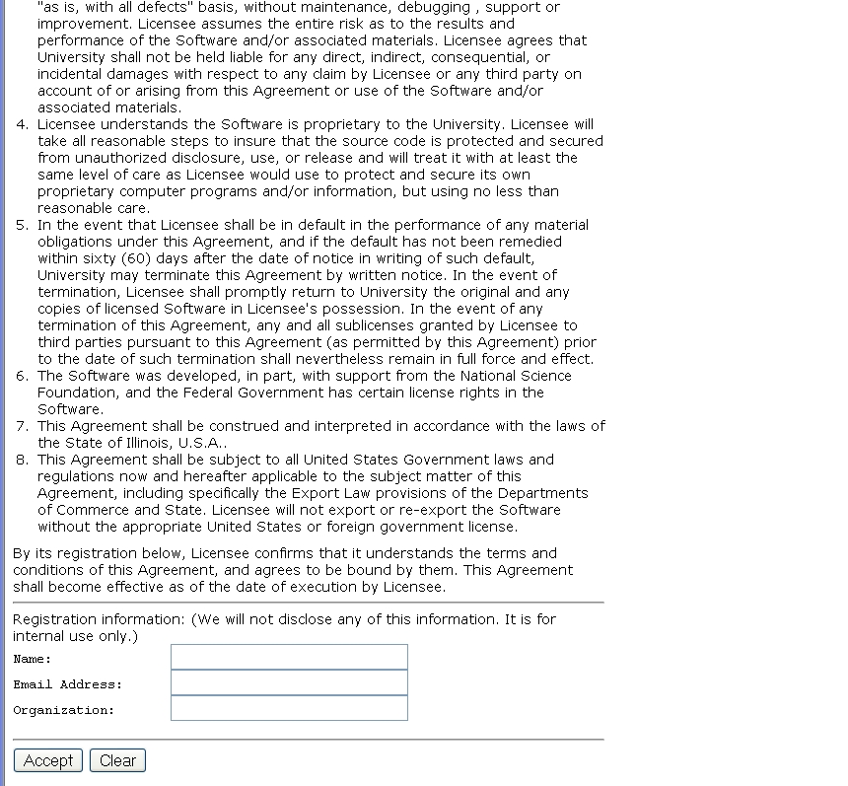
A view on Extracting Meaning from Unstructured Text
A Contract
(and distinguish from other candidates)
Does it say that they will:
Give my email address away?
Log my activity
……
ACCEPT?

Slide 3
Why is it Difficult?
Meaning
Variability
Ambiguity
Language

Slide 4






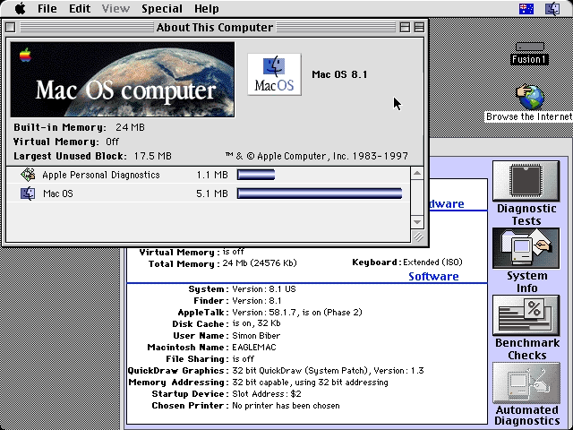
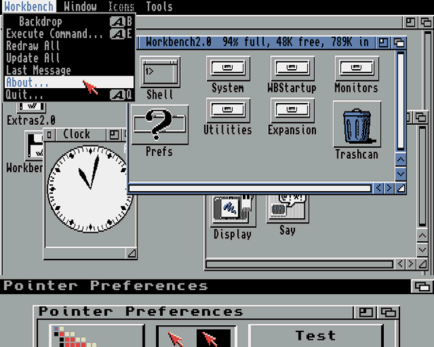
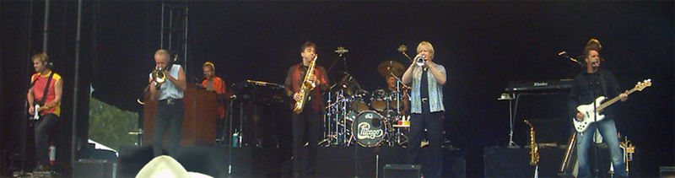
Ambiguity
It’s a version of Chicago – the standard classic Macintosh menu font, with that distinctive thick diagonal in the ”N”.
Chicago was used by default for Mac menus through MacOS 7.6, and OS 8 was released mid-1997..
Chicago VIII was one of the early 70s-era Chicago albums to catch my
ear, along with Chicago II.

Slide 5

Variability in Natural Language Expressions
Determine if Jim Carpenter works for the government
Jim Carpenter works for the U.S. Government.
The American government employed Jim Carpenter.
Jim Carpenter was fired by the US Government.
Jim Carpenter worked in a number of important positions. …. As a press liaison for the IRS, he made contacts in the white house.
Russian interior minister Yevgeny Topolov met yesterday with his US counterpart, Jim Carpenter.
Former US Secretary of Defense Jim Carpenter spoke today…
Standard techniques cannot deal with the variability of expressing meaning
nor with the
ambiguity of interpretation
  Needs:
  Understanding Relations, Entities and Semantic Classes
  Acquiring knowledge from external resources; representing knowledge
  Identifying, disambiguating & tracking entities, events, etc.
  Time, quantities, processes…
Notes:
5

Slide 6
Inducing Semantics
Inducing semantic representations and making decisions that depend on it require learning and, in turn, supervision.
Standard machine learning methodology:
  Given a task
  Collect data and annotate it
  Learn a model
We will never have enough annotated data to train all the models we need this way.
This methodology is not scalable and, often, makes no sense
  Annotating for complex tasks is difficult, costly, and sometimes impossible.
    When an intermediate representation is ill-defined, but the outcome is

Slide 7
Learning with Indirect Supervision
In most interesting cases, learning should be (and is) driven by incidental supervision
  Re-thinking the current annotation-heavy approaches to NLP.
  Dimension I: Types of task: “Lexical” and “Structural”
  Dimension II: Types of indirect supervision:
    Exploiting incidental cues in the data, unrelated to the task, as sources of supervision
    Learning complex models by putting together simpler models + some (declarative) knowledge
    Supervising indirectly, via the supervision of the model outcomes
Not a lot of experimental results; not a lot of formulas.

Slide 8
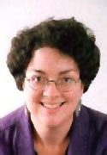
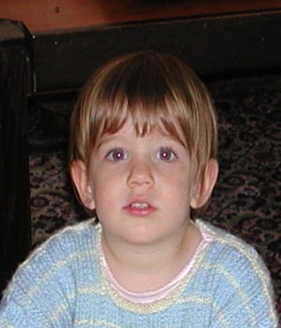
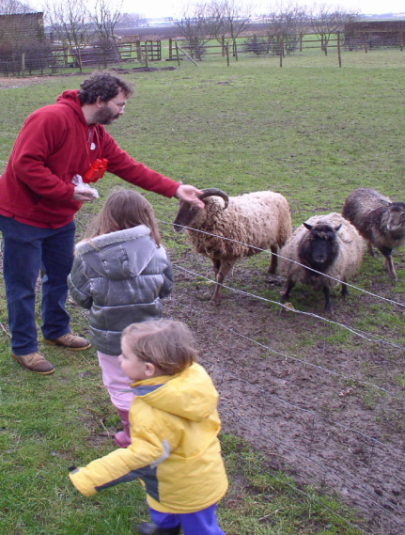
The language-world mapping problem
How do we acquire language?
Psycholinguistics: How to learn the meaning of verbs (and other predicates) from natural, behavior level, feedback? (no “intermediate representation” level feedback).
    Need to acquire “lexical” information, conditioned on “expectation signals”
    Need to learn intermediate representations by propagating signals from behavior level feedback
“the world”
“the language”
[Topid rivvo den marplox.]
Notes:
So let’s look at the problem facing the child. In learning a language, a child must figure out how to map words and syntactic devices onto the meanings they are meant to convey in the native language.
Viewed in this way, this is a highly unconstrained mapping problem. In principle, anything in the language could be relevant to anything in the world.

Slide 9
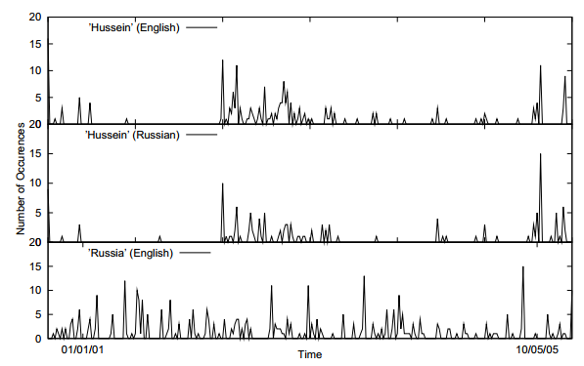
Incidental Supervision Signals [Klementiev & Roth’06]
Supervision need not be only in the form of labeled data
It could be incidental, in the sense that it provides some signals that might be co-related to the target task.
Temporal histograms
Assume a comparable, weakly temporally aligned news feeds.
Hussein (English
Hussein (Russian)
Weak synchronicity provides a cue about the relatedness of (some) NEs across the languages, and can be exploited to associate them
[Klementiev & Roth, 06,08]
Russia (English)

Slide 10
Incidental Supervision Signals [Klementiev & Roth’06]
By itself, such temporal signal is not sufficient to support training robust models.
Along with weak phonetic signals, context, topics, etc. it can be used to train robust models.
Temporal histograms
Assume a comparable, weakly temporally aligned news feeds.
Hussein (English
Hussein (Russian)
Weak synchronicity provides a cue about the relatedness of (some) NEs across the languages, and can be exploited to associate them
[Klementiev & Roth, 06,08]
Russia (English)

Slide 11

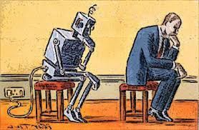

Outline
Incidental Supervision
  Exploiting existing information as supervision
    Dataless Classification
    Wikification (KBs, Multilingual)
    Events
Learning only simple models
  Put it together via knowledge
Response Driven Learning
  Learning from the world’s feedback
Conclusion

Slide 12

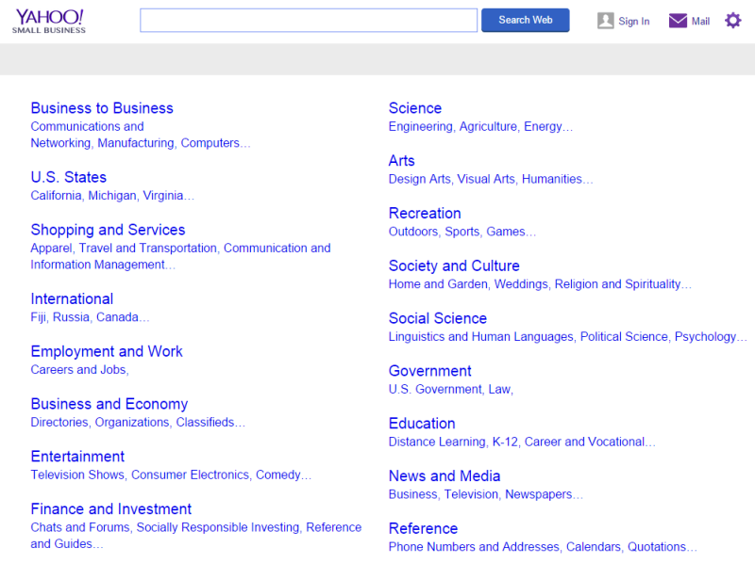
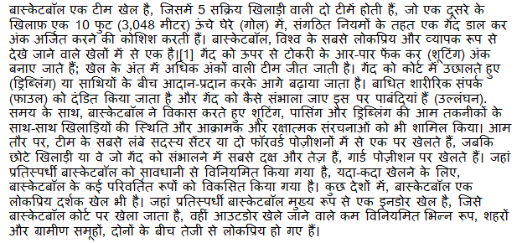
Topical Categorization
How to map a document in language L to an English ontology of semantic categories, without training with task-specific labeled data.
Potentially, given a single document (not a coherent collection)
Economy
-Taxation
Natural Disaster
-Flood

Slide 13
Text Categorization
On Feb. 8, Dong Nguyen announced that he would be removing his hit game Flappy Bird from both the iOS and Android app stores, saying that the success of the game is something he never wanted. Some fans of the game took it personally, replying that they would either kill Nguyen or kill themselves if he followed through with his decision.
Frank Lantz, the director of the New York University Game Center, said that Nguyen's meltdown resembles how some actors or musicians behave. "People like that can go a little bonkers after being exposed to this kind of interest and attention," he told ABC News. "Especially when there's a healthy dose of Internet trolls."
Nguyen did not respond to ABC News' request for comment.
7 February 2014 is going to be a great day in the history of Russia with the upcoming XXII Winter Olympics 2014 in Sochi. As the climate in Russia is subtropical, hence you would love to watch ice capped mountains from the beautiful beaches of Sochi. 2014 Winter Olympics would be an ultimate event for you to share your joys, emotions and the winning moments of your favourite sports champions. If you are really an obsessive fan of Winter Olympics games then you should definitely book your ticket to confirm your presence in winter Olympics 2014 which are going to be held in the provincial town, Sochi. Sochi Organizing committee (SOOC) would be responsible for the organization of this great international multi sport event from 7 to 23 February 2014.
Traditional text categorization requires training a classifier over a set of labeled documents (1,2,….k)
Someone needs to label the data (costly)
All your model knows is to classify into these given labels
It is possible to map a document to an ontology of semantic categories, without training with labeled data?

Slide 14

Text Categorization
On Feb. 8, Dong Nguyen announced that he would be removing his hit game Flappy Bird from both the iOS and Android app stores, saying that the success of the game is something he never wanted. Some fans of the game took it personally, replying that they would either kill Nguyen or kill themselves if he followed through with his decision.
Frank Lantz, the director of the New York University Game Center, said that Nguyen's meltdown resembles how some actors or musicians behave. "People like that can go a little bonkers after being exposed to this kind of interest and attention," he told ABC News. "Especially when there's a healthy dose of Internet trolls."
Nguyen did not respond to ABC News' request for comment.
Sports
Mobile Games
7 February 2014 is going to be a great day in the history of Russia with the upcoming XXII Winter Olympics 2014 in Sochi. As the climate in Russia is subtropical, hence you would love to watch ice capped mountains from the beautiful beaches of Sochi. 2014 Winter Olympics would be an ultimate event for you to share your joys, emotions and the winning moments of your favourite sports champions. If you are really an obsessive fan of Winter Olympics games then you should definitely book your ticket to confirm your presence in winter Olympics 2014 which are going to be held in the provincial town, Sochi. Sochi Organizing committee (SOOC) would be responsible for the organization of this great international multi sport event from 7 to 23 February 2014.
Flappy Bird
Russia
iOS
Olympics
Winter
Android
apps
champions
Sochi
stores
game
mountains
beaches
musicians
sports
Goal: categorize (short) snippets of text into a given (possibly large) ontology, without supervision.

Slide 15
Categorization without Labeled Data [AAAI’08, AAAI’14;IJCAI’16]
This is not an unsupervised learning scenario. Unsupervised learning assumes a coherent collection of data points, and that similar labels are assigned to similar data points. It cannot work on a single document.
Given:
  A single document (or: a collection of documents)
  A taxonomy of categories into which we want to classify the documents
Dataless procedure:
  Let Á(l_{i}) be the semantic representation of the labels
  Let Á(d) be the semantic representation of a document:
  Select the most appropriate category:
  l_{i}* = argmin_{i} ||Á(l_{i}) - Á(d)||
  Bootstrap
    Label the most confident documents; use this to train a model.
Key Questions:
  How to generate a good Semantic Representations?
  How to do it in many languages, with minimal resources?

Slide 16
General Framework
Mobile Game or Sports?
Label
names
Map labels/documents to the same space
Compute document and label similarities
Document(s)
World knowledge
(Cross-lingual)
Choose labels
M. Chang, L. Ratinov, D. Roth, V. Srikumar: Importance of Semantic Representation: Dataless Classification. AAAI‘08.
Y. Song, D. Roth: On dataless hierarchical text classification. AAAI’14.
Y. Song, D. Roth: Unsupervised Sparse Vector Densification for Short Text Similarity. HLT-NAACL’15.
Y. Song, S. Upadhyay, H. Peng, D. Roth: Cross-lingual Dataless Classification for Many Languages. IJCAI’16.

Slide 17
Text Representation
The ideal representation is task specific.
These ideas can be shows also in the context of more involved tasks such as Events and Relation Extraction
[Dense] Distributed Representations (Embeddings)
  New powerful implementations of good old ideas
    Learn a representation for a word as a function of words in its context
Brown Clusters
  An HMM based approach
  Found a lot of applications in other NLP tasks
[Sparse] Explicit Semantic Analysis (ESA)
  A Wikipedia driven approach – best for topical classification
    Represent a word as a (weighted) list of all Wikipedia titles it occurs in
Cross-Lingual ESA:
  Exploits the shared semantic space between two languages.
  This allows us to represent the label space of the English Wikipedia and the text space in language L in the same space.
No task specific supervision. Wikipedia is there.
Additionally, make use of cross-lingual titles space links

Slide 18
Wikipedia Pages Across Languages
Topical classification of documents in language L relies on:
  The ability to generate a Wikipedia-based representation of words in L: the availability of L-Wikipedia
  The existence of a title space mapping between L and English
292 languages have Wikipedia.
We filter the title space to only include long, well linked pages that are linked to the English Wikipedia, yielding 179 languages.
Current work augments these ideas via bridge languages
 | English | Deutsch | Spanish | Hindi
 | English | Deutsch | Español | हिन्दी
# Wikipedia Pages | >15.8M | 3,653,951 | 3,165,178 | 179,131
# Pruned pages: (Len>=100, link>=5) | 3,090,649 | 1,482,675 | 914,927 | 33,298
# Pages linked to English Wikipedia |  | 459,421 | 342,285 | 16,463

Slide 19
Experimenting with Cross-lingual Topic Classification
For 88 languages that have translation, we generate a new data set.
  20 newsgroups.
  Take 100 documents that the English Dataless classifies correctly
  Translate to 88 languages
  This gives us a multi-lingual collection for which we know the labels
  Evaluate the Cross Lingual Dataless
We use two existing multilingual text categorization collections:
  RCV2: 13 languages; 15 labels; 1200 documents/label.
  TED: 13 languages; 4 labels (top level); 10²—10⁴ documents/label.

Slide 20
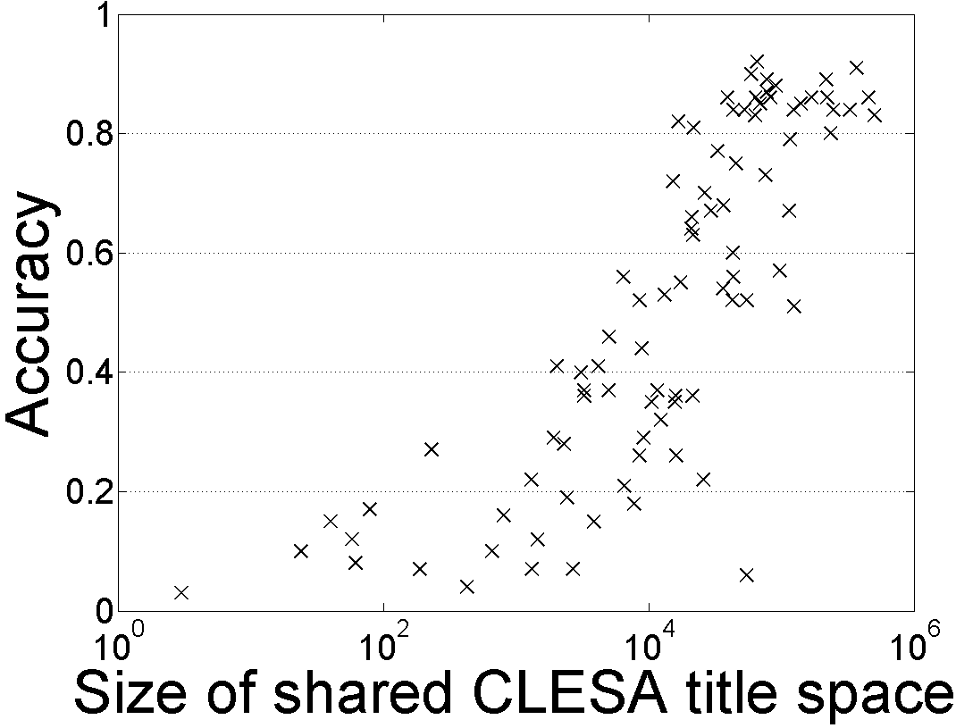
88 Languages: 20-Newsgroups Topic Classification
Dataless classification for English
Accuracy
Hausa
Hindi
Size of shared English-Language L title space

Slide 21
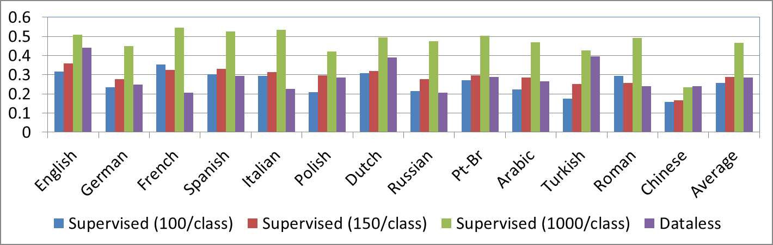
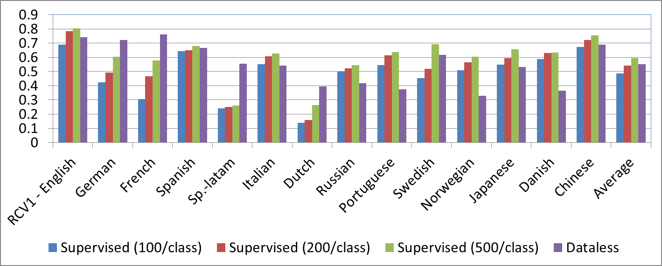
TED DATA
RCV DATA
Better than 200 supervised docs/label
Not as good as 500 docs/label

Slide 22
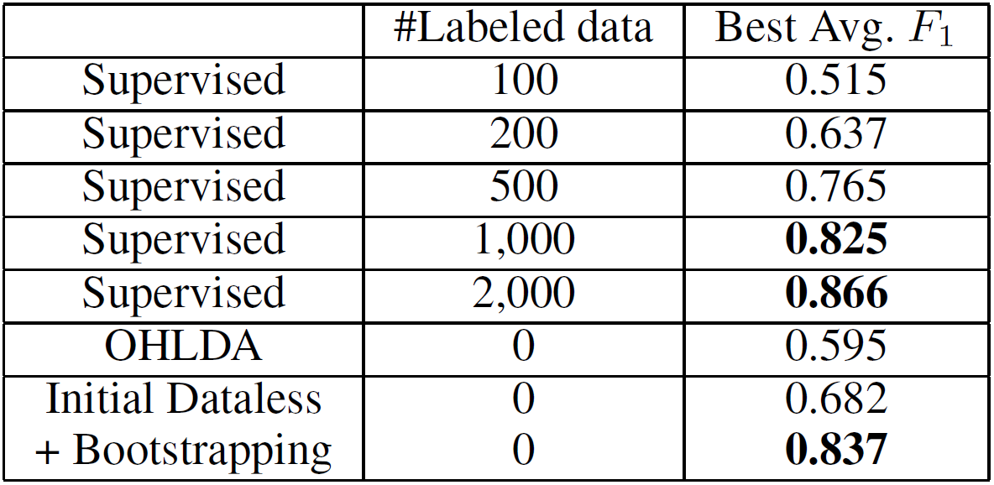
Dataless Cross-lingual Topical Classification
Can classify documents in all Wikipedia Languages into any given English Taxonomy
  No additional resources needed
Current performance is better than supervising with 200 documents/label.
  Goal: be better than 500/label
For comparison, in English:
No task specific annotated data!!

Slide 23
Outline
Incidental Supervision
  Exploiting existing information as supervision
    Dataless Classification
    Wikification (KBs, Multilingual)
    Events
Learning only simple models
  Put it together via knowledge
Response Driven Learning
  Learning from the world’s feedback
Conclusion

Slide 24






Wikification: The Reference Problem
Blumenthal (D) is a candidate for the U.S. Senate seat now held by Christopher Dodd (D), and he has held a commanding lead in the race since he entered it. But the Times report has the potential to fundamentally reshape the contest in the Nutmeg State.
Blumenthal (D) is a candidate for the U.S. Senate seat now held by Christopher Dodd (D), and he has held a commanding lead in the race since he entered it. But the Times report has the potential to fundamentally reshape the contest in the Nutmeg State.
Notes:
Let’s start with what is wikification
Read wiki titles slower

Slide 25
Wikification Challenges
Blumenthal (D) is a candidate for the U.S. Senate seat now held by Christopher Dodd (D), and he has held a commanding lead in the race since he entered it. But the Times report has the potential to fundamentally reshape the contest in the Nutmeg State.
    Training a global model that [Ratinov et. al., ‘09; Chen & Roth’13]
  Identifies concepts in text
  Identifies candidate Wikipedia titles for these
  Ranks the corresponding titles
    Accounting for local context and global page/title space considerations
Relies on the correctness of the (partial) link structure in Wikipedia, but – requires no task specific human annotation.
“Standard” Wikification already makes use of incidental supervision to train the key model – ranking the candidate titles for a given mention.
Notes:
Quite impressive, bottleneck: adding more sophisticated contextual features does not help much
We do not want to level off here

Slide 26
(I) Grounding into Resources w/o a Hyperlink Structure
Training Wikification and Entity Linking builds on the hyperlink structure in Wikipedia
  And the large amount of text describing each entry
In many cases, Knowledge Bases are available, and grounding into them could be useful, but
  No hyperlinks
  Small amount of text for each entry
The BioMedical domain is a key example

Slide 27
Biomedical Wikification
Text
Mentions
BRCA2 and homologous recombination.
Multiple reference KBs & Medical taxonomies
Concept ID
Concept ID
PR:000004804, EG:675
GO:0006310
Protein Ontology
Entrez Gene
id: PR:000004804
name: breast cancer type 2
susceptibility protein
def: A protein that is a translation
product of the human BRCA2
gene or a 1:1 ortholog thereof
synonyms: BRCA2, FACD,…
is_a: PR:000000001
id: EG:675
symbol: BRCA2
description:
protein-coding BRCA2
breast cancer 2, early
onset
synonyms: BRCC2,
BROVCA2, …
Notes:
I’ll describe the task by an example. Given a piece of text, it can be a sentence, a paragraph, or a document. Here it is a title of a journal paper.
There are actually two sub tasks. The first one is mention detection. We want to extract substrings which are concepts. In this example, mentions are the two underlined words.
This task is already very challenging and I’m currently working on it.
In this work, we take the mentions as given and focus on the second step, grounding the mentions to multiple KBs.
Here, BRCA2 is grounded to two concepts in two different ontologies. We can see that the concepts in KBs can overlap and we want to find all concepts the mention refers to.
And here are examples of an entry in the ontology. A concept usually contains an id, name, a short definition, some synonyms, and few relations with other concepts.
This succinct information is quite different from what wikipedia has, which makes this task harder.

Slide 28
KB Wikification Challenges
Ambiguity
  A term in text can be used to express many different concepts
  E.g., BRCA2 is used by 177 concepts
Variability
  A concept may be expressed in text using many surface forms
  E.g., EG:675 has synonyms BRCC2, FACD, FAD, FANCD, …
No Supervision
  Wikipedia has nice hyperlink structure which does not exist here
  It is difficult to obtain human annotations
  Minimal descriptive text in the KBs/Ontologies
Exploiting indirect supervision we develop: [Tsai & Roth ‘16]
  An algorithmic approach that trains a ranking model by building on [a small percentage of] concepts that are mentioned in multiple KBs.
  Outperforming existing unsupervised methods.
Notes:
This task is very challenging, the main challenges are coming from the general WSD problem, the ambiguity and variability.
Ambiguity means a term can be ….
Variability means. …
Another challenge of not using wikipedia is the supervision.
A good wikification system usually trains a ranking model to score concepts using supervised learning. And wikipedia’s hyperlink structure kind of provides free supervision
Which the ontologies we use don’t have. Also, it is reletively difficult to
One of the key contributions in this work is we

Slide 29
Key Idea: Indirect Supervision
Mentions in Text
Candidate Generation
Candidate Ranking
KB₁
KB₂
…
KB_{l}
Indirect Supervision
We explore the redundancy and relationship between KBs to construct training examples for ranking
1. Discovering positive examples
  Cross reference
    Make one as “mention” which is annotated by another
  Has participant relationship
2. Use “incidental” context from the KB and neighbors
  Adaptation issue, since at evaluation, the context is from the given text
Evaluation is done on the Colorado Richly Annotated Full-Text corpus [Bada et al., 2012]: 67 full text of biomedical journal articles, 7 ontologies
GO:0005649
SO:0000340
xref
xref
Wikipdeia:Chromosome
GO:0005649
SO:0000340
fructose metabolic process
GO:0006000
has_participant
fructose
GO:0006000

Slide 30
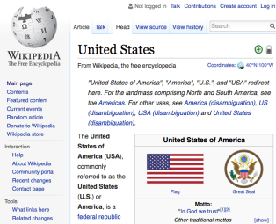
Cross-Lingual Wikification (II)
Given mentions in a non-English document, find the corresponding titles in the English Wikipedia
cuarto y actual presidente de los Estados Unidos de América
Amerika Birleşik Devletleri'nin devlet başkanıdır.
ஐக்கிய அமெரிக்காவின் தற்போதைய குடியரசுத் தலைவர்
นประธานาธิบดีคนที่ 44 คนปัจจุบันของสหรัฐอเมริกา
也是第44任美國總統
dake yankin Hawai a ƙasar Amurika
Key Challenge
  Matching words in a foreign language to
  English Wikipedia titles

Slide 31
Cross lingual Wikification [Tsai et. al. NAACL’16]
Incidental Supervision: Existing links between Wikipedia titles across languages
  Used to develop a technique that applies to all Wikipedia languages
  The only requirement is a Wikipedia dump.
Specifically, the incidental supervision is used to develop a cross lingual similarity metric between text in L and text (titles) in English.
  Via a joint embedding of words and titles in different languages into the same continuous vector space
Notes:
We perform very well on the Spanish Mention Discovery step, describe in the next slide

Slide 32
Multilingual Word and Title Embeddings (I)
Learn joint mono-lingual word and title embeddings [Wang et. al. 14]
  "It is led by and mainly composed of Sunni Arabs from Iraq..."
  "It is led by and mainly composed of en.wikipedia.org/wiki/Sunni_Islam Arabs from en.wikipedia.org/wiki/Iraq..."
  Skip-gram with negative sampling [Mikolov et al., 2013]
Done for English and target Language L.
Since titles appear as a token in the transformed text, we will obtain an embedding for each word and title from the model.

Slide 33
Multilingual Word and Title Embeddings (II)
Aligning embeddings of two languages using the CCA-based model [Hotelling, 1936; Faruqui and Dyer, 2014]
  Rather than using a dictionary which maps the words between two languages, we use the title mappings in Wikipedia.
P_{en}, P_{tr} = CCA( , )
M_{en} = E_{en} P_{en} , M_{tr} = E_{tr} P_{tr}
  E: Monolingual embeddings ; M: Multilingual embeddings
These representations are used for both algorithmic steps:
  Title Candidate Generation
  Title Candidate Ranking
United_States
Texas
Turkey
Istanbul
…
Amerika_Birleşik_Devletleri
Teksas
Türkiye
İstanbul
…

Slide 34
Wikipedia Dataset
For many mentions in Wikipedia, the baseline of simply choosing the title that maximizes Pr(title|mention) is very good
Language | Method | Hard | Easy | Total
Spanish | EsWikifier | 40.11 | 99.28 | 79.56
 | MonoEmb | 38.46 | 96.12 | 76.90
 | WordAlign | 48.75 | 95.78 | 80.10
 | WikiME | 54.46 | 94.83 | 81.37
Chinese | MonoEmb | 43.73 | 97.85 | 79.81
 | WikiME | 57.61 | 98.03 | 84.55
Turkish | MonoEmb | 40.47 | 98.15 | 78.93
 | WikiME | 60.18 | 97.55 | 85.10
Tamil | MonoEmb | 34.51 | 98.65 | 77.30
 | WikiME | 54.13 | 99.13 | 84.15
Tagalog | MonoEmb | 35.47 | 99.44 | 78.12
 | WikiME | 56.70 | 98.46 | 84.54
Top TAC’15 Entity Linking System; used to produce a state-of-the-art multilingual NER.

Slide 35
Comments
Wikipedia signals were used in multiple ways to generate various representations
  Relations between title and text in the
  Cross lingual links between related titles
In other work, e.g., dataless classification of events and relations we founds the these signals along are not sufficient.
Inducing better representations requires that we account for structural issues.

Slide 36
Outline
Incidental Supervision
  Exploiting existing information as supervision
    Dataless Classification
    Wikification (KBs, Multilingual)
    Events
Learning only simple models
  Put it together via knowledge
Response Driven Learning
  Learning from the world’s feedback
Conclusion

Slide 37
Semantic Role Labeling (SRL)
Archetypical Information Extraction Problem: E.g., Concept Identification and Typing, Event Identification, etc.
I left my pearls to my daughter in my will .
[I]_{A0} left [my pearls]_{A1} [to my daughter]_{A2} [in my will]_{AM-LOC} .
A0 Leaver
A1 Things left
A2 Benefactor
AM-LOC Location
I left my pearls to my daughter in my will .
Notes:
In the context of SRL, the goal is to predict for each possible phrase in a given sentence if it is an argument or not and what type it is.

Slide 38
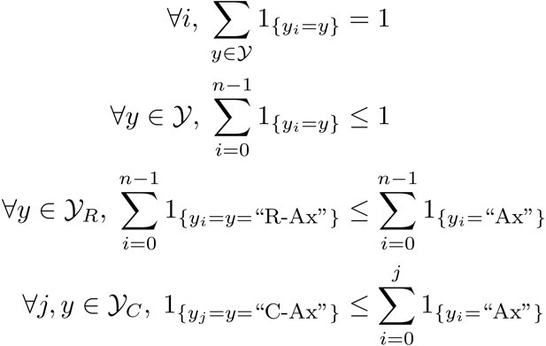
Algorithmic Approach [Here: Fully Supervised]
Learning Based Java: allows a developer to encode constraints in First Order Logic; these are compiled into linear inequalities automatically.
No duplicate argument classes
I left my nice pearls to her
candidate arguments
Identify argument candidates
  Pruning [Xue&Palmer, EMNLP’04]
  Argument Identifier
    Binary classification
Classify argument candidates
  Argument Classifier
    Multi-class classification
Inference
  Use the estimated probability distributions given
  by the argument classifier
  Use structural and linguistic constraints
  Infer the optimal global output
Unique labels
  Variable y^{a,t} indicates whether candidate argument a is assigned a label t.
  c^{a,t} is the corresponding model score
I left my nice pearls to her
I left my nice pearls to her
[ [ [ [ [
] ] ] ] ]
argmax ∑_{a,t} y^{a,t} c^{a,t} = ∑_{a,t} 1_{a=t} c_{a=t}
Subject to:
One label per argument: ∑_{t} y^{a,t} = 1
No overlapping or embedding
Relations between verbs and arguments,….
One inference problem for each verb predicate.
I left my nice pearls to her
Use the pipeline architecture’s simplicity while maintaining uncertainty: keep probability distributions over decisions & use global inference at decision time.
Notes:
We follow a now seemingly standard approach to SRL.
Given a sentence, first we find a set of potential argument candidates by identifying
which words are at the border of an argument.
Then, once we have a set of potential arguments, we use a phrase-level classifier to tell us how likely an argument is to be of each type.
Finally, we use all of the information we have so far to find the assignment of types to argument that gives us the “optimal” global assignment.
Similar approaches (with similar results) use inference procedures tied to their represntation.
Instead, we use a general inference procedure by setting up the problem as a linear programming problem.
This is really where our technique allows us to apply powerful information that similar approaches can not.

Slide 39
Verb SRL is not Sufficient
skip
John, a fast-rising politician, slept on the train to Chicago.
Verb Predicate: sleep
  Sleeper: John, a fast-rising politician
  Location: on the train to Chicago
Who was John?
  Relation: Apposition (comma)
  John, a fast-rising politician
What was John’s destination?
  Relation: Destination (preposition)
  train to Chicago

Slide 40
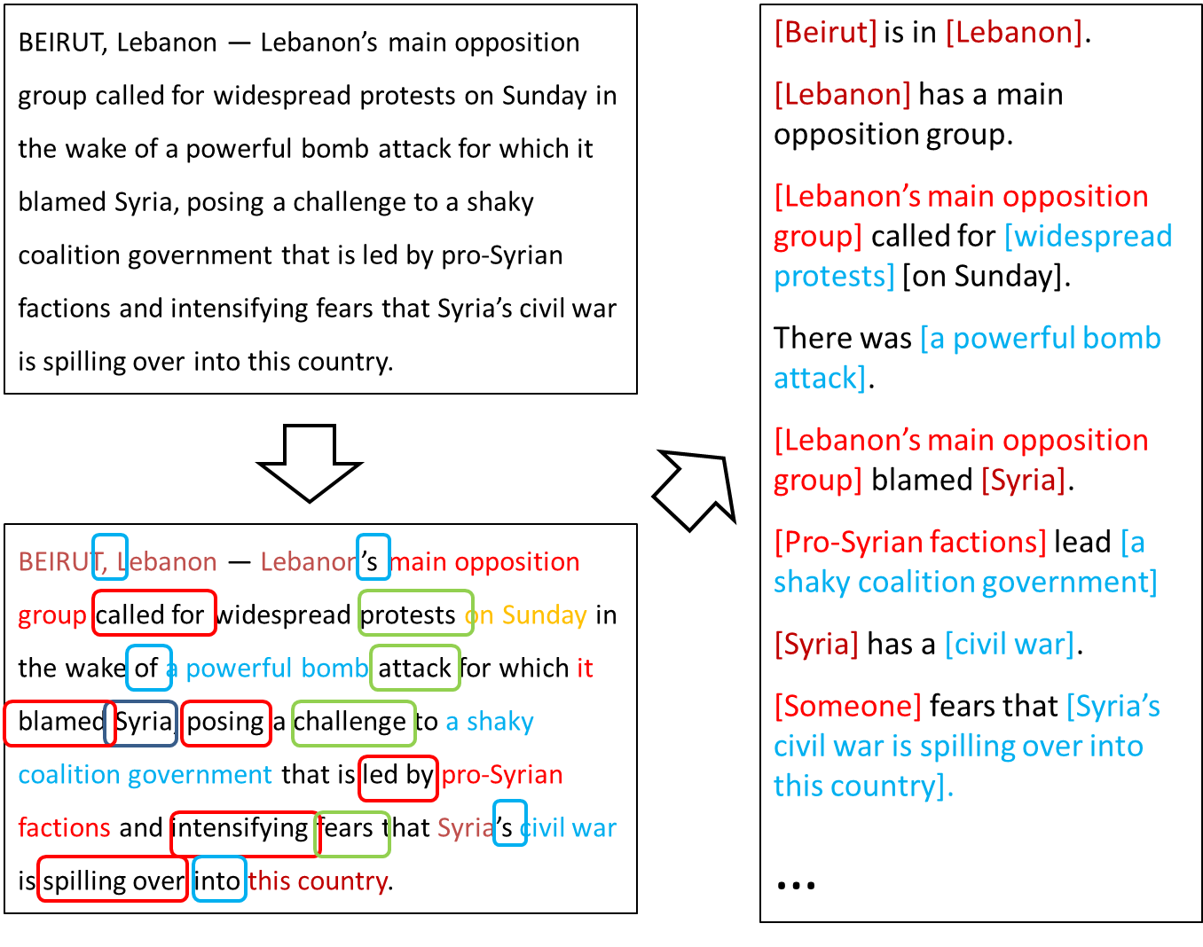
Extended Semantic Role Labeling
Many predicates; many roles; how to induce interdependent phenomena?
How to do it without the need to have jointly annotated data?

Slide 41
Extended SRL Motivation
The goal is a comprehensive semantic representations (SRL++)
  Covering a large number of predicate types
Abstract Meaning Representation (AMR) [Banarescu et al. 2013]
  Builds on joint annotation
  Expensive to produce large amounts of hand-annotated AMRs
  Limitations in terms of phenomena covered (hard to add more)
Extended SRL:
  Builds on lots of independently annotated data for semantic tasks
  Ontonotes, PDTB, Semeval/CoNLL/*SEM shared tasks
    For each one, it is easy to build an independent module
  Propose a learning approach that does not require joint annotation
Verbs
Nouns
Commas
Prepositions
Compounds
Possessives
Adjective-Noun
Light verbs
Phrasal verbs
NER
Wikification
Events
Implicit relations
  Missing Arguments
  Missing Predicates
Conjunctions
Quantifiers
Negations
Quantities (comparators)

Slide 42
Extended SRL
Modular semantic representation
Inference with independent models

Slide 43
Extended SRL
Modular semantic representation
Inference with independent models
Tokens
Five
prisoners
are
held
captive
in
Guantanamo

Slide 44
Extended SRL
Modular semantic representation
Inference with independent models
Tokens
Five
prisoners
are
held
captive
in
Guantanamo
Quantities
[#5] [unit: prisoner]

Slide 45
Extended SRL
Modular semantic representation
Inference with independent models
Tokens
Five
prisoners
are
held
captive
in
Guantanamo
Quantities
[#5] [unit: prisoner]
NER
Card.
Location

Slide 46
Extended SRL
Modular semantic representation
Inference with independent models
Tokens
Five
prisoners
are
held
captive
in
Guantanamo
Quantities
[#5] [unit: prisoner]
NER
Card.
Location
VerbSRL
Arg1
hold
Arg2
NomSRL
Arg1
captive
ArgM-LOC
PrepSRL
Gov
Loc
Obj

Slide 47
Extended SRL
Modular semantic representation
Inference with independent models
Tokens
Five
prisoners
are
held
captive
in
Guantanamo
Quantities
[#5] [unit: prisoner]
NER
Card.
Location
VerbSRL
Arg1
hold
Arg2
NomSRL
Arg1
captive
ArgM-LOC
PrepSRL
Gov
Loc
Obj
LVC
Light Verb
FrameNet
Being_in_
captivity
Wiki
Guantanamo_Bay_
detention_camp

Slide 48
Extended SRL
Modular semantic representation
Inference with independent models
Tokens
Five
prisoners
are
held
captive
in
Guantanamo
Quantities
[#5] [unit: prisoner]
NER
Card.
Location
How can we coherently join predictions
across these phenomena?
VerbSRL
Arg1
hold
Arg2
NomSRL
Arg1
captive
ArgM-LOC
PrepSRL
Gov
Loc
Obj
LVC
Light Verb
FrameNet
Being_in_
captivity
Wiki
Guantanamo_Bay_
detention_camp

Slide 49
Extended SRL
Modular semantic representation
Inference with independent models
Tokens
Five
prisoners
are
held
captive
in
Guantanamo
NomSRL(arg)::ArgM-LOC →
¬PrepSRL(prep)::Instrument
Quantities
[#5] [unit: prisoner]
NER
Card.
Location
VerbSRL
Arg1
hold
Arg2
NomSRL
Arg1
captive
ArgM-LOC
NER(phrase)::Cardinal →
Quant(phrase)::Number
PrepSRL
Gov
Loc
Obj
LVC
Light Verb
FrameNet
Being_in_
captivity
Wiki
Guantanamo_Bay_
detention_camp

Slide 50
Coherency in Semantic Role Labeling
Predicate-arguments generated should be consistent across phenomena
The touchdown scored by Bradford cemented the victory of the Eagles.
Verb | Nominalization | Preposition
Predicate: score A0: Bradford (scorer) A1: The touchdown (points scored) | Predicate: win A0: the Eagles (winner) | Sense: 11(6) “the object of the preposition is the object of the underlying verb of the nominalization”
Linguistic Constraints:
A0: the Eagles ⇔ Sense(of): 11(6)
A0: Bradford ⇔ Sense(by): 1(1)
Notes:
50

Slide 51
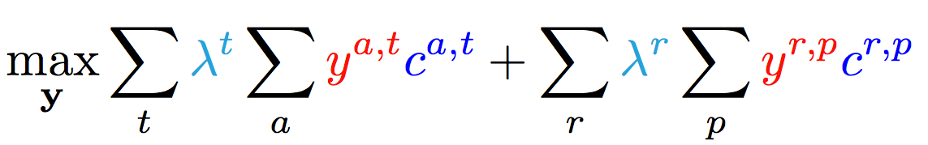
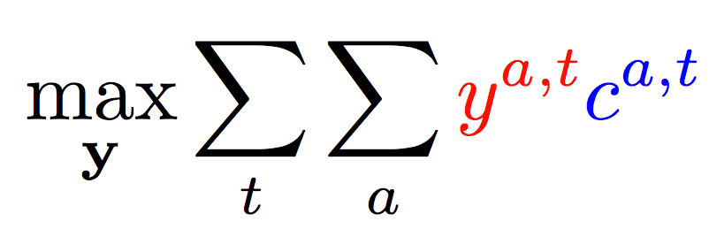
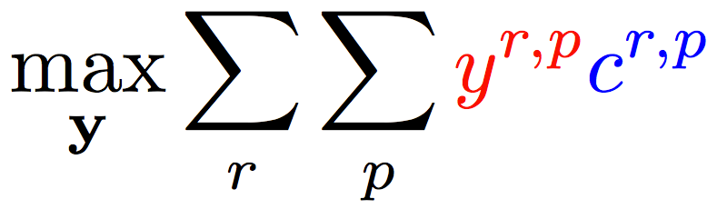
Enforce Coherence via Joint inference (CCMs)
  Variable y^{a,t} indicates whether candidate argument a is assigned a label t.
  c^{a,t} is the corresponding model score
Verb arguments
Preposition relations
+ ….
Argument candidates
Re-scaling parameters (one per label)
Preposition relation
label
Constraints:
Preposition
Each argument label
Verb SRL constraints
Preposition SRL Constraints
+ Joint constraints between tasks
How to learn the coefficients of different components?

Slide 52
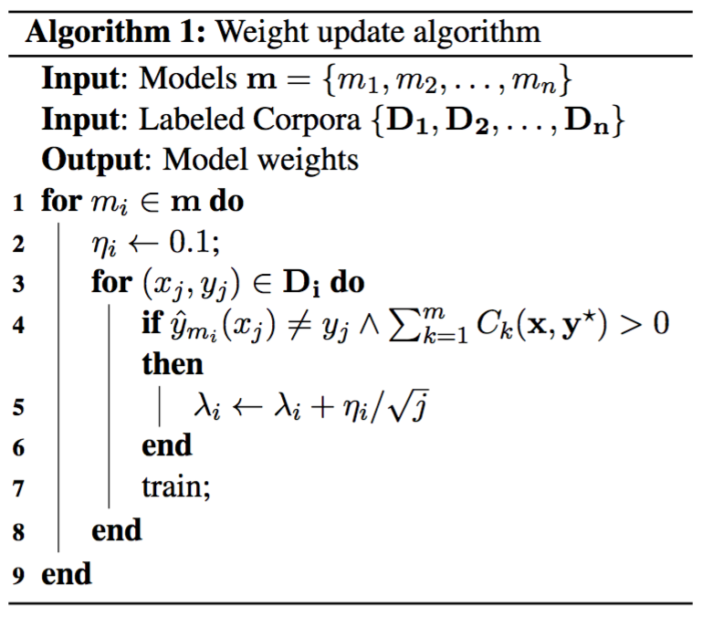
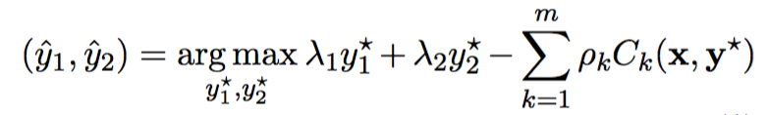
Constraint-driven inference
Consider independent data sets. Update weight λ_{i} given the performance of the joint model on D_{i}
Inference: Constrained Conditional Models [Chang et al., 2012]
  First-order-like constraints across tasks
  ILP inference
Learning Scaling Coefficients: Multi-view model combination [Burkett et al., 2010]
joint prediction
independent predictions
model weights
violation penalty (here: ∞)
constraints

Slide 53
Examples: Constraints
[LVC(phrase)::true → ¬PVC(phrase)::true] ∧
[PVC(phrase)::true → phrase contains {IN|PRT|RB}]
  LVC accuracy: 81.2 → 82.2
  Same PVC accuracy (89.9)
  Candidate selection prevented constraint violation
Quantities(phrase)::Date → Temporal(phrase)::Date
  Quantities overall F1: 78.7 → 78.9 (Date acc: 79.2 → 85.5)
  Temp overall F1: 75.7 → 75.9
  Double implication doesn’t work

Slide 54
Extended SRL: Summary & future work
Combination of multiple phenomena
  No need for joint annotations
Joint inference via first-order constraints
  Offer linguistic insights
Highly Modular, with a Flexible interface
  Only requirement is list of k-best predictions
Future work
  Mine for constraints

Slide 55
Outline
Incidental Supervision
  Exploiting existing information as supervision
    Dataless Classification
    Wikification (KBs, Multilingual)
    Events
Learning only simple models
  Put it together via knowledge
Response Driven Learning
  Learning from the world’s feedback
Conclusion

Slide 56

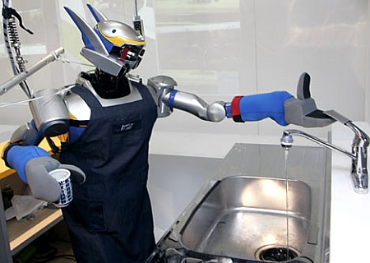

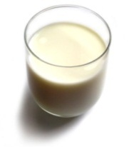
Understanding Language Requires (some) Supervision
Can we rely on this interaction to provide supervision (and eventually, recover meaning) ?
Can I get a coffee with lots of sugar and no milk
Great!
Arggg
Semantic Parser
MAKE(COFFEE,SUGAR=YES,MILK=NO)
How to recover meaning from text?
Standard “example based” ML: annotate text with meaning representation
  Teacher needs deep understanding of the learning agent ; not scalable.
Response Driven Learning: Exploit indirect signals in the interaction between the learner and the teacher/environment
Notes:
NLU: about recovering meaning from text – a lot of work aims directly at that or at some subtasks that might look like this:….

Slide 57
Response Based Learning
We want to learn a model that transforms a natural language sentence to some meaning representation.
Instead of training with (Sentence, Meaning Representation) pairs
Think about some simple derivatives of the models outputs,
  Supervise the derivative [verifier] (easy!) and
  Propagate it to learn the complex, structured, transformation model
English Sentence
Model
Meaning Representation

Slide 58
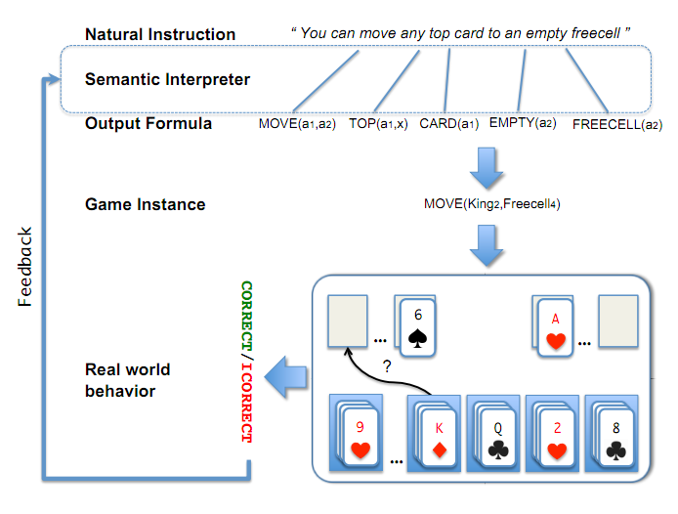
Scenario I: Freecell with Response Based Learning
We want to learn a model to transform a natural language sentence to some meaning representation.
English Sentence
Model
Meaning Representation
A top card can be moved to the tableau if it has a different color than the color of the top tableau card, and the cards have successive values.
Move (a1,a2) top(a1,x1) card(a1) tableau(a2) top(x2,a2) color(a1,x3) color(x2,x4) not-equal(x3,x4) value(a1,x5) value(x2,x6) successor(x5,x6)
Play Freecell (solitaire)
Derivatives of the models outputs: execute moves on a game API
  Supervise the derivative and Propagate it to learn the transformation model

Slide 59
Scenario II: Geoquery with Response based Learning
We want to learn a model to transform a natural language sentence to some formal representation.
“Guess” a semantic parse. Is [DB response == Expected response] ?
  Expected: Pennsylvania DB Returns: Pennsylvania→ Positive Response
  Expected: Pennsylvania DB Returns: NYC, or ???? → Negative Response
English Sentence
Model
Meaning Representation
What is the largest state that borders NY?
largest( state( next_to( const(NY))))
Simple derivatives of the models outputs
Query a GeoQuery Database.

Slide 60
Response Based Learning
We want to learn a model that transforms a natural language sentence to some meaning representation.
Instead of training with (Sentence, Meaning Representation) pairs
Think about some simple derivatives of the models outputs,
  Supervise the derivative [verifier] (easy!) and
  Propagate it to learn the complex, structured, transformation model
LEARNING:
Train a structured predictor (semantic parse) with this binary supervision
  Many challenges: e.g., how to make a better use of a negative response?
Learning with a constrained latent representation, making use of a CCM, exploiting knowledge on the structure of the meaning representation.
[Clarke, Goldwasser, Chang, Roth CoNLL’10; Goldwasser, Roth IJCAI’11, MLJ’14]
English Sentence
Model
Meaning Representation

Slide 61
Geoquery: Response based Competitive with Supervised
Clarke, Goldwasser, Chang, Roth CoNLL’10; Goldwasser, Roth IJCAI’11, MLJ’14
Current work addresses challenges due to the complexity of the natural language, types of interaction, and generalization across domains.
Algorithm | Training Accuracy | Testing Accuracy | # Training Examples
NOLEARN | 22 | -- | -
Response-based (2010) | 82.4 | 73.2 | 250 answers
Liang et-al 2011 | -- | 78.9 | 250 answers
Response-based (2012,14) | 86.8 | 81.6 | 250 answers
Supervised | -- | 86.07 | 600 structs.
NOLEARN :Initialization point
SUPERVISED : Trained with annotated data
Response based Learning is gathering momentum:
Liang, M.I. Jordan, D. Klein, Learning Dependency-Based Compositional Semantics, ACL’11.
Berant et-al ’ Semantic Parsing on Freebase from Question-Answer Pairs, EMNLP’13, ‘15
Supervised: Y.-W. Wong and R. Mooney. Learning synchronous grammars for semantic parsing with lambda calculus. ACL’07
Notes:
Still a lot of problems. Still, if you think that we can do supervision, let’s think about these problems…

Slide 62
Before Conclusion
Knowledge representation called “predicate schemas”
The bee landed on the flower because it had/wanted pollen.
  Lexical knowledge
John Doe robbed Jim Roy. He was arrested by the police.
  Subj of “rob” is more likely than the Obj of “rob” to be the Obj of “arrest”
  Need: Learning & Inference approach that acquire the knowledge and use it appropriately.
  (See our work in NAACL’15, ACL’16 for interesting progress on this)
John had 6 books; he wanted to give it to two of his friends. How many will each one get?
  (See our EMNLP’15 & TACL’15 work for progress on Math word problems)
share it with
How do we supervise for these problems?

Slide 63
Summary
Thank you!
We need to re-think how we train models in NLP
Proposed some evidence that a range of indirect supervision frameworks are possible and can often rival standard techniques.
The process of re-thinking learning methodologies is important also as we try to move up the semantics hierarchy, and attempt to define “events” and other highly involved structures.
It will also force us to re-think evaluation – should it always be at the specific task level, or should we, more systematically, move to extrinsic evaluations?
Notes:
63

