Slide 1
Adaptation without
Retraining
Dan Roth
Department of Computer Science
University of Illinois at Urbana-Champaign
With thanks to:
Collaborators: Ming-Wei Chang, Michael Connor, Gourab Kundu, Alla Rozovskaya
Funding: NSF, MIAS-DHS, NIH, DARPA, ARL, DoE
December 2011
NIPS Adaptation Workshop

Slide 2
Natural Language Processing
Adaptation is essential in NLP.
Vocabulary differs across domains
  Word occurrence may differ, word usage may differ; word meaning may be different.
  “can” is never used as a noun in a large collection of WSJ articles
Structure of sentences may differ
  Use of quotes could be different across writing styles
Task definition may differ

Slide 3

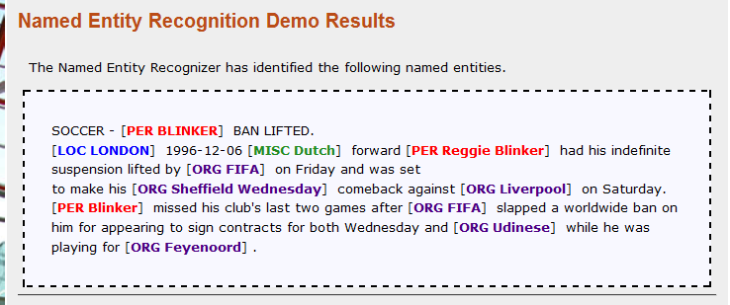
Example 1: Named Entity Recognition
Screen shot from a CCG demo http://L2R.cs.uiuc.edu/~cogcomp
Entities are inherently ambiguous (e.g. JFK can be both location and a person depending on the context)
  Using lists isn’t sufficient
After training we can be very good.
But: moving to blogs could be a problem…

Slide 4
Example 2: Semantic Role Labeling
Who did what to whom, when, where, why,…
I left my pearls to my daughter in my will .
[I]_{A0} left [my pearls]_{A1} [to my daughter]_{A2} [in my will]_{AM-LOC} .
A0 Leaver
A1 Things left
A2 Benefactor
AM-LOC Location
I left my pearls to my daughter in my will .
Propbank Based
Core arguments: A0-A5 and AA
  different semantics for each verb
  specified in the PropBank Frame files
13 types of adjuncts labeled as AM-arg
  where arg specifies the adjunct type
Overlapping arguments
If A2 is present, A1 must also be present.
Notes:
Here is the problem of learning the representation –
Notice that these constraints are represented in terms of the arguments – so I need to generate the vocabulary, which I will do using learning, to be able to talk about it and say that I don’t like A2, unless I have an AI.
The other problem is semantic role labeling problem. This is the problem that we will focus on in this talk.
In this problem, given a sentence, we want to identify for each verb, all the participants or arguments of that verb.
We can view the process also as trying to identifying different arguments represented by different lines and colors here. What makes the problem hard is that not only there are quadratic number of possible arguments but if we look at all possible assignments for the whole structure there will be exponential number of them. And making prediction for each of these arguments independently is not possible because some of the assignments are illegal due to the constraint that the output arguments may not overlap.
The rest of the talk will focus on how we tackle this problem, and also discuss some of the related issues by using this problem in experiment. We have a demo of the system that we have developed which is currently the state-of-the-art system. The URL is http://l2r.cs.uiuc.edu/~cogcomp/srl-demo.php. At any point in this talk if you get tired, you can start playing with this demo. There are also demos of the other systems developed in our group.

Slide 5
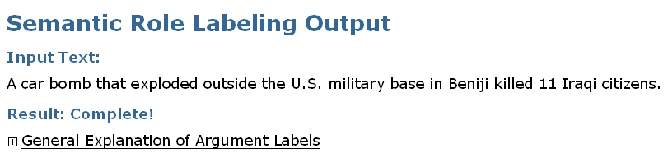
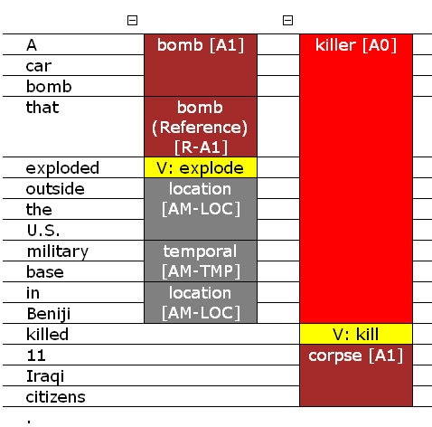
Extracting Relations via Semantic Analysis
Screen shot from a CCG demo
http://cogcomp.cs.illinois.edu/page/demos
  Semantic parsing reveals several relations in the sentence along with their arguments.
Top system available

Slide 6
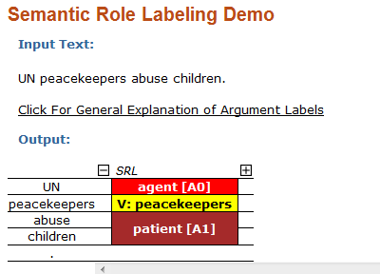
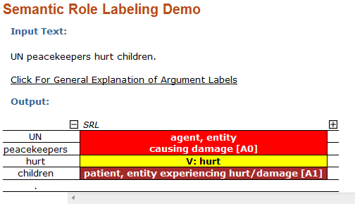
Domain Adaptation
Adaptation
Reason: “abuse” was never observed as a verb
UN Peacekeepers abuse children
UN Peacekeepers hurt children
Correct!
Wrong!
“Peacekeepers” is not the Verb

Slide 7
Adaptation without Model Retraining
Not clear what the domain is
We want to achieve “on the fly” adaptation
No retraining
Goal:
Use a model that was trained on (a lot of) training data
Given a test instance– perturb it to be more like the training data
Transform annotation back to the instance of interest

Slide 8
Todays talk
Lessons from “Standard” domain adaptation
  [Chang, Connor, Roth, EMNLP’10]
  Interaction between F(Y|X) and F(X) adaptation
  Adaptation of F(X) may change everything
Changing the text rather than the model
  [Kundu, Roth, CoNLL’11]
  Label Preserving Transformation of Instances of Interest
  Adaptation without Retraining
Adaptation for Text Correction
  [Rozovskaya, Roth, ACL’11]
  Goal: Improving English as a Second Language (ESL)
  Source language of the authors matters – how to adapt to it

Slide 9
Domain Adaptation Problems
WSJ NER ➔ Bio NER
Examples: Reviews
Similar P(Y|X)
English Movies ➔ Chinese Movies
English Books ➔ Music
English Movies ➔ Music
c
Same Task
Similar P(X)

Slide 10
P(Y|X) vs. P(X)
P(Y|X)
  Assumes a small amount of labeled data for the target domain.
  Relates source and target weight vectors, rather than training two weight vectors independently (for source and target domains).
  Often achieved by using a specially designed regularization term.
  [ChelbaAc04,Daume07,FinkelMa09]
P(X)
  Typically, do not use labeled examples in the target domain.
  Attempts to resolve differences in feature space statistics of two domains.
  Find (or append) a better shared representation that brings the source domain and the target domain closer.
  [BlitzerMcPe06,HuangYa09]

Slide 11
Domain Adaptation Problems: Analysis
Domain Adaptation Works (Daume’s Frustratingly Easy)
WSJ NER ➔ Bio NER
Need to train on target
Examples: Reviews
Similar P(Y|X)
English Movies ➔ Chinese Movies
English Books ➔ Music
English Movies ➔ Music
Just pool all data together
c
Most work assumes we are here
Same Task
Similar P(X)

Slide 12
Domain Adaptation Methods: Analysis
Zoomed in to the F(Y|X) similar region
English Books ➔ Music
What happens when
we add P(X) Adaptation
(Brown Clusters) ?
English Movies ➔ Music
So, do we need F(Y|X) ?
Similar P(Y|X)
Domain Adaptation Works
Just pool all data together
Similar P(X)
Similar P(X)

Slide 13
The Necessity of Combining Adaptation Methods
Theorem: Mistake Bound Analysis: FE improves if Cos(w₁ ,w₂) >1/2
On a number of real tasks (NER, PropSense)
  Before adding clusters (P(X) adaptation): FE is best
  With clusters: training on source + target together is best (leads to state of the art results)
Source + Target
Frustratingly Easy
Train on Target only
Adaptation without Clusters
Adaptation with Clusters
Error on Target
Error on Target
P(Y|X) Similarity Cos(w₁ ,w₂)
P(Y|X) Similarity Cos(w₁ ,w₂)

Slide 14
Todays talk
Lesson : Important to consider both adaptation methods
Can we get away w/o knowing a lot about the target?
On the fly adaptation
Lessons from “Standard” domain adaptation
  [Chang, Connor, Roth, EMNLP’10]
  Interaction between F(Y|X) and F(X) adaptation
  Adaptation of F(X) may change everything
Changing the text rather than the model
  [Kundu, Roth, CoNLL’11]
  Label Preserving Transformation of Instances of Interest
  Adaptation without Retraining
Adaptation for Text Correction
  [Rozovskaya, Roth, ACL’11]
  Goal: Improving English as a Second Language (ESL)
  Source language of writer matters – how to adapt to it

Slide 15
On the fly Adaptation
Reason: “abuse” was never observed as a verb
UN Peacekeepers abuse children
UN Peacekeepers hurt children
Correct!
Wrong!
“Peacekeepers” is not the Verb

Slide 16
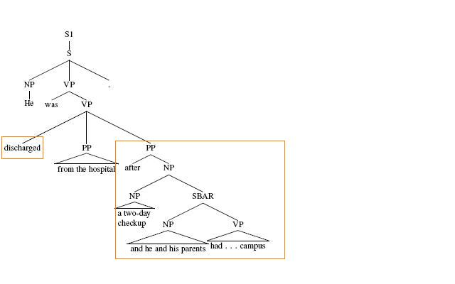
2nd Motivating Example
Original Sentence
He was discharged from the hospital after a two-day checkup
and he and his parents had what Mr. Mckinley described as a “celebration lunch” in the campus.
AM-TMP
Wrong
Predicate

Slide 17
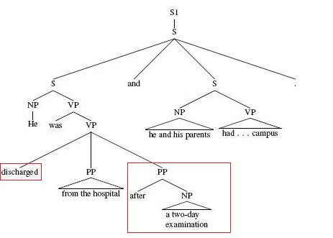
2nd Motivating Example
Modified Sentence
He was discharged from the hospital after a two-day examination
and he and his parents had what Mr. Mckinley described as a “celebration lunch” in the campus.
Highlights another difficulty in re-training NLP systems for adaptation: Systems are typically large pipeline systems; retraining should apply to all components.
Correct!
Predicate
AM-TMP

Slide 18
“On the fly” Adaptation
Can text perturbation be done in an automatic way to yield better NLP analysis?
Can it be done using training data information only?
  Given a target instance “perturb” it based on training data information
  Idea: statistics on training should allow us to determine “what needs to be perturbed” and how
Experimental study:
  Semantic Role Labeling.
  Model trained on WSJ and evaluated on Fiction data
Notes:
we focus on improving the performance of the tool in a different domain to help the domain adaptation problem.

Slide 19
ADaptation Using Transformations (ADUT)
Adapt text to be similar to data the existing model "likes”
Transformed Sentences
Model Outputs
t₁
o₁
Transformation Module
Trained Models
(with Preprocessing)
Combination Module
Sentence s
t₂
o₂
Output o
…
…
t_{k}
o_{k}
Existing model
Notes:
bias the perturbations to bias

Slide 20
Transformation Functions
We develop a family of Label Preserving Transformations
  A transformation that maps an instance to a set of instances
  An output instance has the property that is it more likely to appear in the training corpus than the existing instance
  Is (likely to be) label preserving
E.g.
  Replacing a word with synonyms that are common in training data
  Replacing a structure with a structure that is more likely to appear in training

Slide 21
Transformation Functions
Resource Based Transformations
  Use resources and prior knowledge
Learned Transformations
  Learned from training data

Slide 22
Resource Based Transformation
Replacement of Infrequent Predicates
  Observed Verbs that have not happen a lot in training
  (There is some noise)
Replacement of Unknown Words
  WordNet and word clusters are used
Sentence Simplification transformations
  Dealing with quotations
  Dealing with prepositions (splitting)
  Simplifying NPs (conjunctions)
Transformed Sentences
Input Sentence
We just sat quietly.
“We just sat quietly” , he said .
He said, “We just sat quietly”.
He said, “This is good”.

Slide 23
Learned Transformation Rules
Identify a context and role candidate in target sentence
Transform the candidate argument to a simpler context in which the SRL is expected to be more robust
Map back the role assignment
23
23

Slide 24
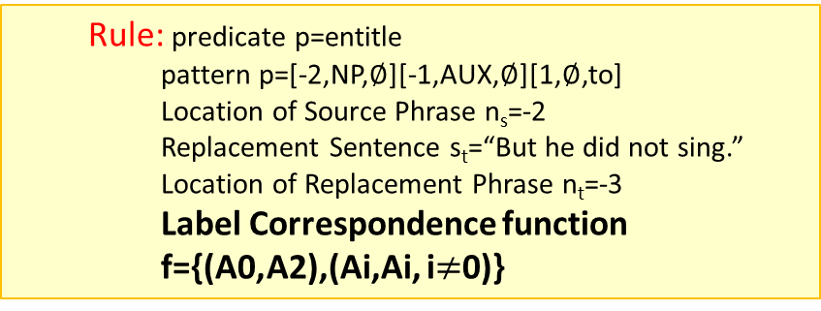
Learned Transformation Rules
Identify a context and role candidate in target sentence
Transform the candidate argument to a simpler context in which the SRL is more robust
Map back the role assignment
Rule learning is done via beam search, triggered for infrequent words and roles.
Input Sentence
Transformed Sentence
Replacement Sentence
Mr. Mckinley
was entitled to a discount .
But
he
did not sing .
-2
-1
0
1
2
-4
-3
-2
-1
0
1
A2
Gold Annotation
A0
Apply SRL System
  Rule: predicate p=entitle
  pattern p=[-2,NP,$∅$][-1,AUX,$∅$][1,$∅$,to]
  Location of Source Phrase n_{s}=-2
  Replacement Sentence s_{t}=“But he did not sing.”
  Location of Replacement Phrase n_{t}=-3
  Label Correspondence function f={(A0,A2),(Ai,Ai, i$≠$0)}
A2 = f(A0)
24
24

Slide 25
Final Decision via Integer Linear Programming
argmax_{y} w^{T} I_{y(a)=r} subject to constraints C
We have to make several interdependent decisions – assign roles to all arguments of a given predicate
For each predicate, we have multiple role candidates and a distribution over their possible labels , given by the model
For same argument in different proposed sentences, compute the average score
We apply standard SRL (hard) constraints:
  No overlapping phrases
  Verb centered sub-categorization constraints
  Frame files constraints
ILP here is very efficient

Slide 26
Results for Single Parse System (F1)

Slide 27
Results for Multi Parse System (1)

Slide 28
Effect of each Transformation

Slide 29
Prior Knowledge Driven Domain Adaptation
More can be said about the use of Prior Knowledge in Adaptation without Re-training [Kundu, Chang & Roth, ICML’11 workshop]
Assume you know something about the target domain
Incorporate Target domain knowledge as constraints.
Impose constraints c and c’ at inference time.
Linear model trained on Source (could be a collection of classifiers)
“Standard” constraints for decision task (e.g., SRL)
Additional Constraints encoding information about the Target domain

Slide 30
Today’s talk
Lessons from “Standard” domain adaptation
  [Chang, Connor, Roth, EMNLP’10]
  Interaction between F(Y|X) and F(X) adaptation
  Adaptation of F(X) may change everything
Changing the text rather than the model
  [Kundu, Roth, CoNLL’11]
  Label Preserving Transformation of Instances of Interest
  Adaptation without Retraining
Adaptation for Text Correction
  [Rozovskaya, Roth, ACL’11]
  Goal: Improving English as a Second Language (ESL)
  Source language of authors matters – how to adapt to it
Adaptation is possible without retraining and unlabeled data
13% error reduction
More work is needed

Slide 31
English as a Second Language (ESL) learners
Two common mistake types
  Prepositions
    He is an engineer with a passion to*/for what he does.
  Articles
    Laziness is the engine of the*/? progress.
A multi-class classification task
1. Specify a candidate set:
articles: {a,the, ?}
prepositions: {to,for,on,…}
2. Define features based on context
3. Select a machine learning algorithm (usually a linear model)
4. Train the model: what data?
5. One vs. All Decision
Yes, we can do better than language models
10⁶ better
Page 31

Slide 32
Key issue for today
Adapting the model to the first language of the writer
  ESL error correction is in fact the same problem as Context Sensitive Spelling [Carlson et al. ’01, Golding and Roth ’99]
But there is a twist to ESL error correction that we want to exploit
  Non-native speakers make mistakes in a systematic manner
  Mistakes often depend on the first language (L₁) of the writer
  How can we adapt the model to the first language of the writer?

Slide 33
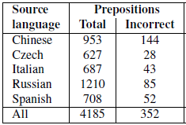
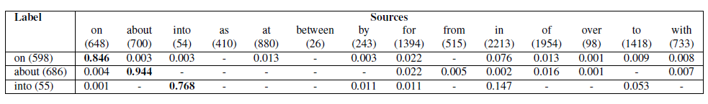
Errors
Preposition Error Statistics by Source Language
Confusion matrix for preposition Errors (Chinese)
Each row shows the author’s preposition choices for that label and Pr(source|label)

Slide 34
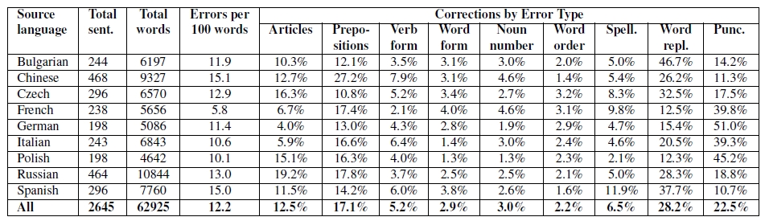
Errors
Error Statistics by Source Language and error type

Slide 35
Two training paradigms
The source preposition is not used in this model!
On correct native English data
He is an engineer with a passion ___ what he does.
On data with prepositions errors
He is an engineer with a passion to what he does.
w₁B=passion, w₁A=what, w₂Bw₁B=a-passion, …
source=to
w₁B=passion, w₁A=what, w₂Bw₁B=a-passion, …, source=to
label=for
Page 35
Notes:
35

Slide 36
Two training paradigms for ESL error correction
Paradigm 1: Train on correct native data
  Plenty of cheap data available
  No knowledge about typical errors
Paradigm 2: Using knowledge about typical errors in training
  Train on annotated ESL data
  Knowledge about typical errors used in training
    Requires annotated data for training – very little data
Adaptation problem: Adapt (1) to gain from (2)

Slide 37
Adaptation Schemes for ESL error correction
We use error statistics on the few annotated ESL sentences
  For each observed preposition – a distribution over possible corrections
Two adaptation schemes:
Generative (Naïve Bayes)
  Train a single model for each proposition: native data; (no source feature)
  Given an observed preposition in a test sentence – update the model priors based on the source preposition and the error statistics.
Discriminative (Average Perceptron)
  Must train a different model for each preposition and each confusion set
  Confusion set matters in training
  Instead: Noisify the training data according to the error statistics.
    Now we can train with source feature included.
Both schemes result in dramatic improvements over training on native data
Discriminative method requires more work (little negative data) but does better

Slide 38
Conclusions
Thank You!
There is more to adaptation than F(X) and F(Y|X)
  Lessons from “Standard” domain adaptation [Chang, Connor, Roth, EMNLP’10]
It’s possible to adapt without retraining
  Changing the text rather than the model [Kundu, Roth, CoNLL’11]
  This is a preliminary work; a lot more is possible
Adaptation is needed in many other problems
  Adaptation for ESL Text Correction [Rozovskaya, Roth, ACL’11]
  A range of very challenging problems in ESL

Slide 39
Thank You!

