Slide 1


Starting from Scratch in
Semantic Role Labeling
(with some lessons to NLP)
Dan Roth
Department of Computer Science
University of Illinois at Urbana-Champaign
With Michael Connor, Christos Christodoulopoulos, Cynthia Fisher
August 2016
ACL Workshop on Cognitive Aspects of Computational Language Learning
Berlin

Slide 2
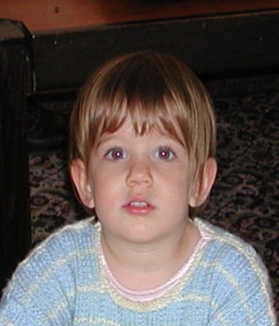
How do we acquire language?
Topid rivvo den marplox.
Notes:
Hearing this sentence, with unknown words in a language with unknown grammar, where do you start?

Slide 3
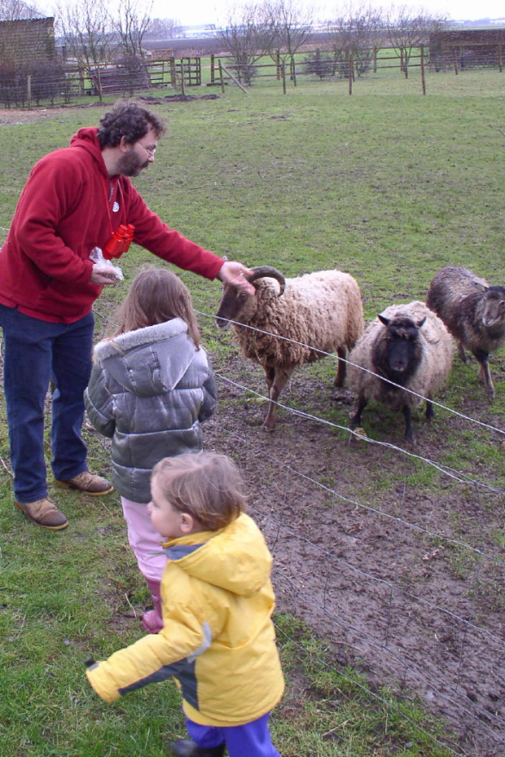
The language-world mapping problem
“the world”
“the language”
[Topid rivvo den marplox.]
Notes:
So let’s look at the problem facing the child. In learning a language, a child must figure out how to map words and syntactic devices onto the meanings they are meant to convey in the native language.
Viewed in this way, this is a highly unconstrained mapping problem. In principle, anything in the language could be relevant to anything in the world.

Slide 4
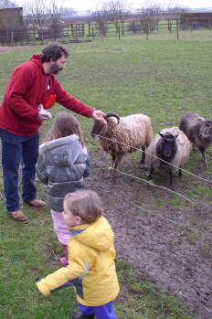
Observe how words are distributed across situations
Scene 1
Smur! Rivvo della frowler.
Topid rivvo den marplox.
Blert dor marplox, arno.
Scene 3
Scene n
Marplox dorinda blicket.
Notes:
Ultimately, the story goes, you can figure out AHA, this word co-occurs with these animals, it means ‘sheep’. And this word co-occurs with this action, it means ‘GIVE’. or maybe ‘give food’ (feed)

Slide 5

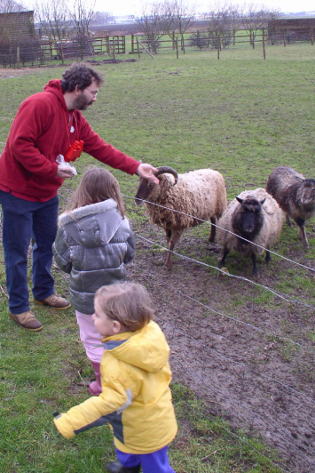

Structure-Mapping: A starting point for syntactic bootstrapping
Children can learn the meanings of some nouns via cross-situational observation alone [Fisher 1996, Gillette, Gleitman, Gleitman, & Lederer, 1999; Snedeker & Gleitman, 2005]
But how do they learn the meaning of verbs?
“The girl krads the boy”
“The boy krads”
krad = RUN ??
krad = CHASE ??
[Johanna rivvo den sheep.]
Nouns identified
Notes:
To explore this possibility, my colleagues and I have been thinking about how very simple aspects of sentence structures might be intrinsically meaningful to children -- even before they’ve learned much about the syntax of the native language.
Verbs do not simply label events; instead they denote abstract construals of them. Pairs of verbs like feed and eat, give and receive, chase and flee, describe not different world events, but different perspectives on the same events. Top-down 'feedback' thus provides highly ambiguous evidence for verb and sentence meaning
On this account, children begin with an unlearned bias toward one-to-one mapping between nouns in sentences and participant-roles in events. Given this bias, children find the number of nouns in a sentence inherently meaningful.
One possibility is that the set of nouns in the sentence might provide an initial cue to the structure of the semantic predicate conveyed by the verb.
The set of nouns is useful because it provides a probabilistic estimate of the verb’s number of semantic arguments.

Slide 6
Structure-Mapping: A starting point for syntactic bootstrapping
Children can learn the meanings of some nouns via cross-situational observation alone [Fisher 1996, Gillette, Gleitman, Gleitman, & Lederer, 1999; Snedeker & Gleitman, 2005]
But how do they learn the meaning of verbs?
  Sentences comprehension is grounded by the acquisition of an initial set of concrete nouns
  These nouns yield a skeletal sentence structure — candidate arguments; cue to its semantic predicate—argument structure.
  Represent sentences in an abstract form that permits generalization to new verbs
Goal: describe a computational account of this theory.
[Johanna rivvo den sheep.]
Nouns identified
Notes:
To explore this possibility, my colleagues and I have been thinking about how very simple aspects of sentence structures might be intrinsically meaningful to children -- even before they’ve learned much about the syntax of the native language.
One possibility is that the set of nouns in the sentence might provide an initial cue to the structure of the semantic predicate conveyed by the verb.
The set of nouns is useful because it provides a probabilistic estimate of the verb’s number of semantic arguments.

Slide 7
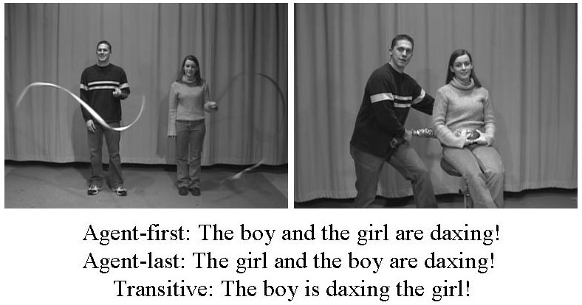
Strong Predictions [Gertner & Fisher, 2006]
  Test 21 month olds on assigning arguments with novel verbs
  How order of nouns influences interpretation
Who is doing what to whom?
How to identify verbs?
* The boy and the girl are daxing!
* The boy is daxing the girl!
Error disappears by 25 months
preferential looking paradigm

Slide 8
Outline
BabySRL
  Realistic Computational model for Syntactic Bootstrapping via Structure Mapping:
    Assumptions
    Computational Model
    Experiments
    [M. Connor and C. Fisher and D. Roth, Starting from Scratch in Semantic Role Labeling: Early Indirect Supervision Cognitive Aspects of Computational Language Acquisition (2012)]
Implications to NLP
  Incidental Supervision
  Some examples

Slide 9
BabySRL
Realistic Computational model for Syntactic Bootstrapping via Structure Mapping:
  Verbs meanings are learned via their syntactic argument-taking roles
  Semantic feedback to improve syntactic & meaning representation
Develop Semantic Role Labeling System (BabySRL) to experiment with theories of early language acquisition
  SRL as minimal level language understanding
  Determine who does what to whom.
Inputs and knowledge sources
  Only those we can defend children have access to

Slide 10
BabySRL: Key Components
Syntactic Bootstrapping (BabySRL features)
Words
Syntax
Semantics
Representation:
  Theoretically motivated representation of the input
  Shallow, abstract, sentence representation consisting of
    # of nouns in the sentence
    Noun Patterns (1st of two nouns)
    Relative position of nouns and predicates
Learning:
  Guided by knowledge kids have
    Classify words by “part-of-speech”
    Identify arguments and predicates
    Determine the role arguments take
Some Assumptions

Slide 11
BabySRL vs. SRL
SRL
BabySRL
Feedback
Feedback
Words
Parse
Argument Identifications
Role Identification
Semantic Feedback
Words
HMM
Latent syntax and argument identification
Role Identification
Weak
Semantic Feedback

Slide 12
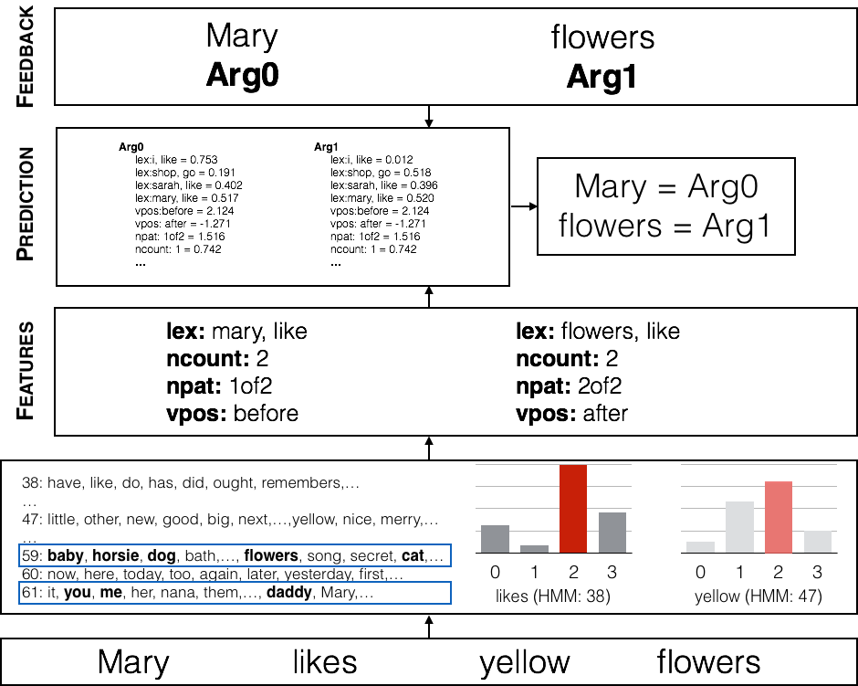
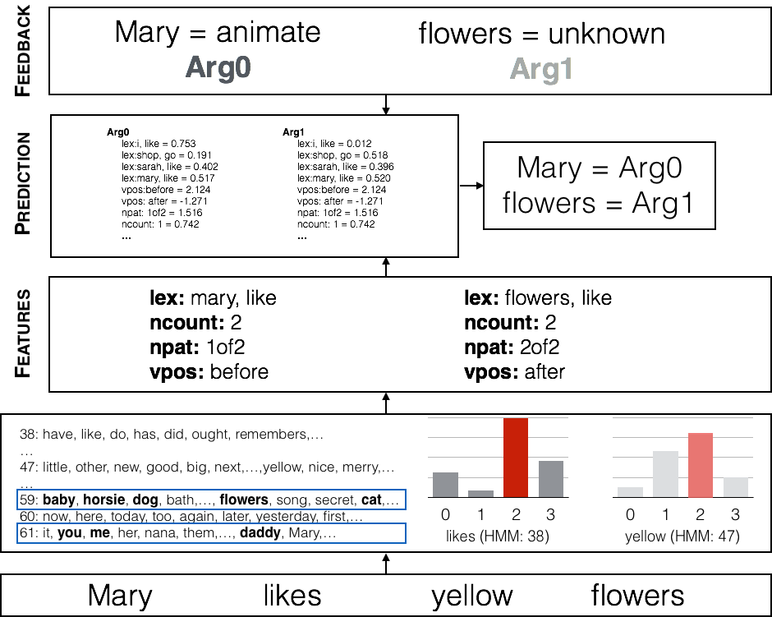
BabySRL

Slide 13
BabySRL: Early Results [Connor et. al 08—13]
Fine grained experiments with how language is represented
Test different levels of representation fixing the rest to gold
Primary focus on noun pattern (NPattern) feature
  Hypothesis: number and order of nouns are important
    Once we know some nouns, can use them to represent structure
  NPattern gives count and placement:
    First of two, second of three, etc.
Alternative: Verb Position
  Target argument is before or after verb
  Depends on identifying verbs
Key Finding:
  NPattern reproduces errors in children
    Promotes A0-A1 interpretation in transitive, but also intransitive sentences
  Verb position does not make this error
    Incorporating it recovers correct interpretation

Slide 14
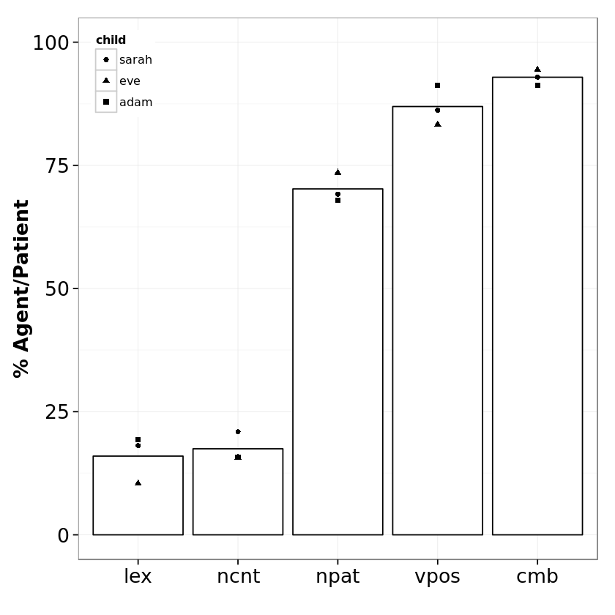
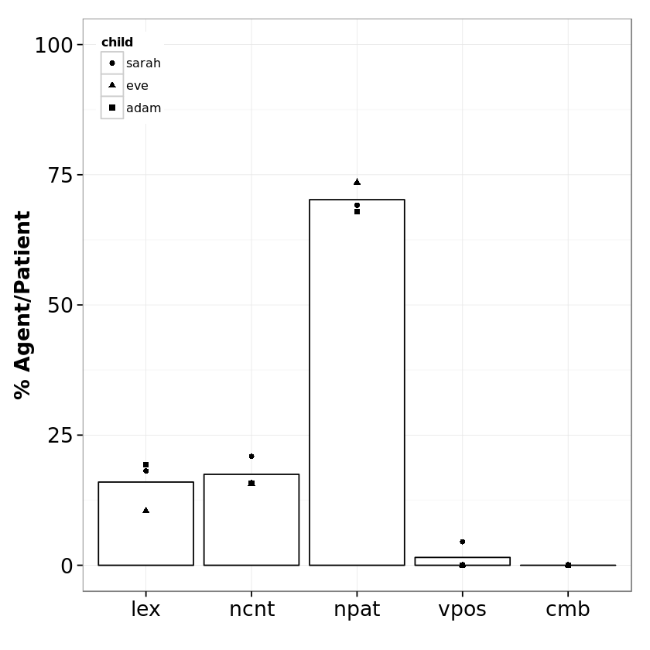
Results on novel-verb sentences
A krads B
A and B krad
Predicted error in 21mo
[Gertner & Fisher, 2006]

Slide 15
Summary: Representation (with supervision)
Given veridical feedback (“mind reading”), do low-level syntactic features capture anything useful about semantic roles/verb preferences?
Yes, but verb knowledge is crucial

Slide 16
BabySRL: Key Components
Representation:
  Theoretically motivated representation of the input
  Shallow, abstract, sentence representation consisting of
    # of nouns in the sentence
    Noun Patterns (1st of two nouns)
    Relative position of nouns and predicates
Learning:
  Guided only by knowledge kids have
    Classify words by “part-of-speech”
    Identify arguments and predicates
    Determine the role arguments take

Slide 17
Unsupervised “Parsing”
We want to generate a representation that permits generalization over word forms
  Incorporate Distributional Similarity
  Context Sensitive
Hidden Markov Model (HMM)
  Simple model, 80 states
  Essentially provides Part of Speech information
    Without names for states; we need to figure this out
Train on child directed speech
  CHILDES repository
  Around 2.2 million words, across multiple children

Slide 18
Unsupervised Parsing (II)
Standard way to train unsupervised HMM
  Simple EM produces uniform size clusters
  Solution: Include priors for sparsity
    Dirichlet prior (Variational Bayes, VB)
Replace this by psycholinguistically plausible knowledge
Knowledge of function words
  Function and content words have different statistics
  Evidence that even newborns can make this distinction
    We don't use prosody, but it may provide this.
Technically: allocate a number of states to function words
  Leave the rest to the rest of the words
  Done before parameter estimation, can be combined with EM or VB learning: EM+Func, VB+Func

Slide 19
Unsupervised Parsing Evaluation
Test as unsupervised POS on subset of hand corrected CHILDES data.
    Incorporating function word pre-clustering allows both EM & VB to achieve the same performance with an order of magnitude fewer sentences
EM: HMM trained with EM
VB: HMM trained with Variational Bayes & Dirichlet Prior
EM+Funct
VB+Funct: Different training methods with function word pre-clustering
Variance of Information
Better
Training Sentences

Slide 20
Argument Identification
Now we have a “parser” that gives us states (clusters) each word belongs to
Next: identify states that correspond to arguments & predicates
Noun Relevant assumptions: A list of frequent seed nouns
  A lot of evidence that children know and recognize nouns early on
  MacArthur-Bates CDI production norms [Dale & Fenson, 1996]
  < 75 nouns + pronouns
Noun Identification Algorithm: Those states that contain > k seed nouns (k=4)
  Assume that nouns = arguments

Slide 21
Argument Identification
Knowledge: Frequent Nouns:
You, it, I, what, he, me, ya, she, we, her, him, who, Ursula,
Daddy, Fraser, baby, something, head, chair, lunch,…
She | 46 | {it he she who Fraser Sarah Daddy Eve...}
always | 48 | {just go never better always only even ...}
has | 26 | {have like did has...}
salad | 74 | {it you what them him me her something...}
. | 2 | {. ? !}
She | 46
always | 48
has | 26
salad | 74
. | 2
She
always
has
salad
.
List of words that occurred with state 46 in CHILDES

Slide 22
Predicate Identification
Nouns are concrete, can be identified
  Predicates are more difficult
  Not learned easily via cross-situational observation
Structure-mapping account: sentence comprehension is grounded in the learning of an initial set of nouns
Key question: How can one identify verbs without any seeds?

Slide 23
Verb Identification: Assumptions
Statistical information accumulated in an unsupervised way over large amounts of data can provide “state” information; states weakly correspond to part-of-speech tags.
Sentences have Verbs.
Verbs are different from Nouns and from Function words.
Once a verb always a verb
  This assumption can be utilized at the token level or at the state level
  When used at the state level it supports additional abstraction:
    Infrequent verbs can also be identified
    A token can be both a verb and a noun

Slide 24
Verb Identification Algorithms
True Random: each token in the sentence can be a verb
N/F-Random: Only non-nouns and non-function-words can be verbs
+ Aggregate with “once a verb always a verb” assumption
  Token level
  State level
  (Note that aggregation diminished differences between algorithms)
Consistency: Verbs are identified by taking a consistent number of arguments
  Not as important as we originally thought

Slide 25
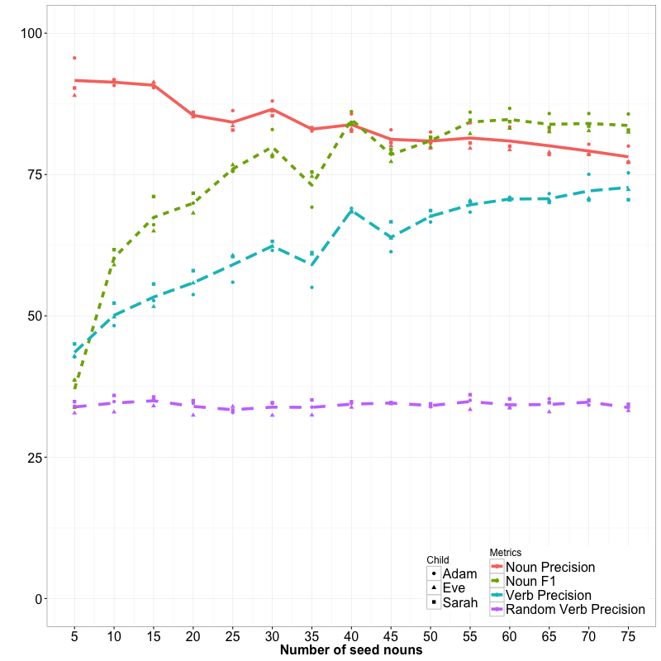
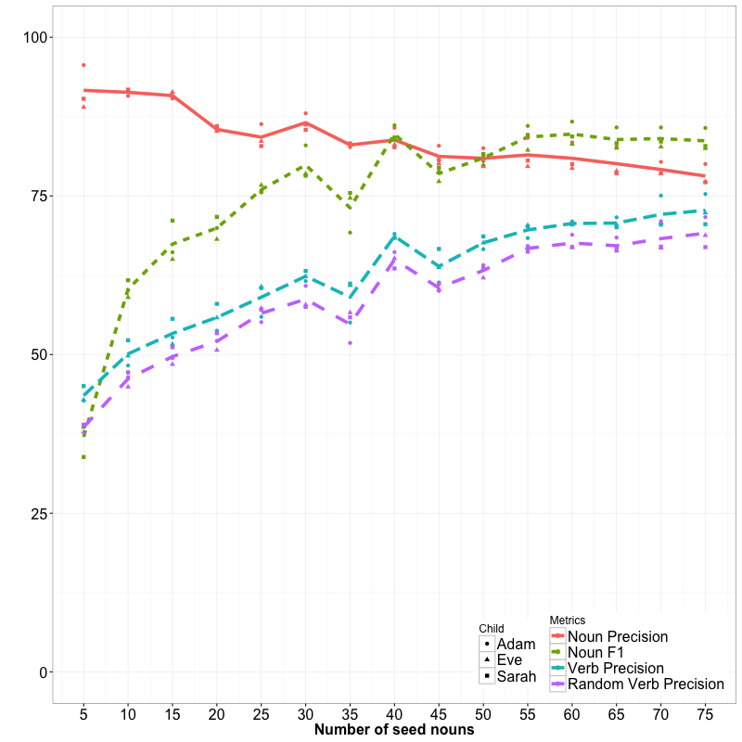
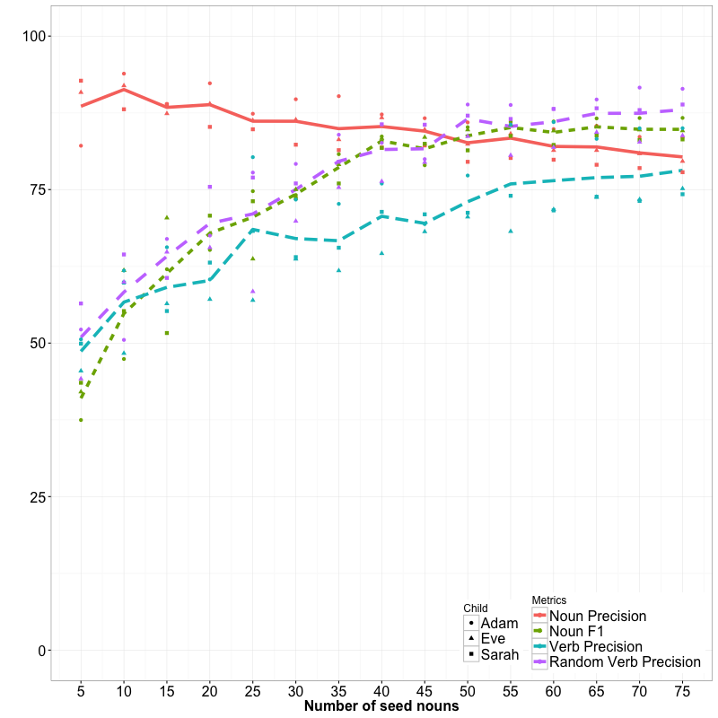
Identifying Arguments and Predicates
Simple, unsupervised cues provide accurate identification!
Syntactic Bootstrapping (BabySRL features)
Noun-F1
Words
Syntax
Semantics
Noun Precision
Seed nouns and verb aggregation
Verb--Consistent
True Random
N/F—Random
NF—Random + Aggr
Number of seed nouns (5 – 75)

Slide 26
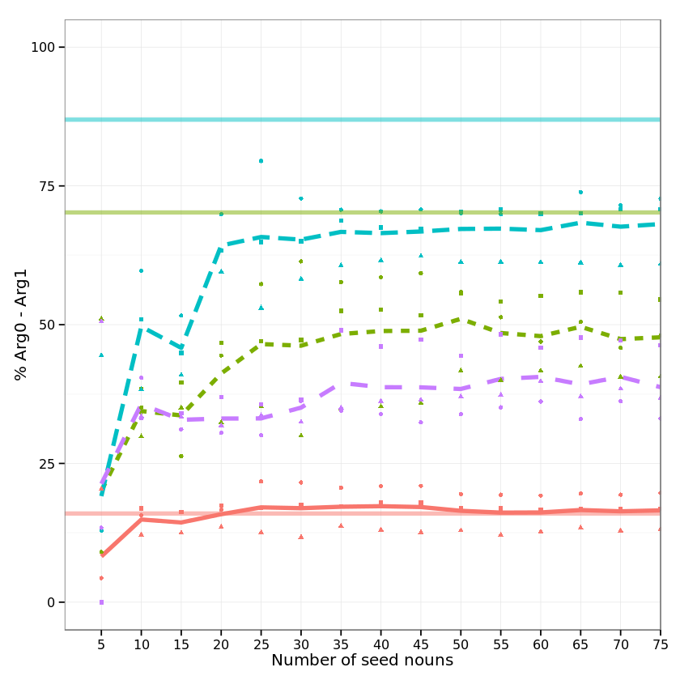
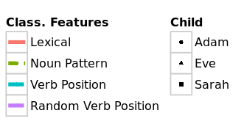
SRL Results on Novel-Verb sentences (transitive)
Verb and Argument identification accuracy directly translate to SRL performance
gold
Verb-Position feature
pred
gold
Noun Pattern feature
pred

Slide 27
BabySRL: Weak Supervision
Check the types of weak supervision and latent learning algorithms @
M. Connor and C. Fisher and D. Roth, Starting from Scratch in Semantic Role Labeling: Early Indirect Supervision Cognitive Aspects of Computational Language Acquisition (2012)

Slide 28
Baby SRL Summary
Modelling early language acquisition
  Testbed for psycholinguistic theories
  Replication of experimental results with children
Structure-mapping for syntactic bootstrapping
  Minimal assumptions
  Identifying verbs from noun structure
  Predicting semantic roles using low-level syntactic features
  Novel insights
Syntactic Bootstrapping (BabySRL features)
Words
Syntax
Semantics
Seed nouns and verb aggregation

Slide 29
Outline
BabySRL
  Realistic Computational model for Syntactic Bootstrapping via Structure Mapping:
    Assumptions
    Computational Model
    Experiments
    [M. Connor and C. Fisher and D. Roth, Starting from Scratch in Semantic Role Labeling: Early Indirect Supervision Cognitive Aspects of Computational Language Acquisition (2012)]
Implications to NLP
  Incidental Supervision
  Some examples

Slide 30
Inducing Semantics
Inducing semantic representations and making decisions that depend on it require learning and, in turn, supervision.
Standard machine learning methodology:
  Given a task
  Collect data and annotate it
  Learn a model
We will never have enough annotated data to train all the models we need this way.
This methodology is not scalable and, often, makes no sense
  Annotating for complex tasks is difficult, costly, and sometimes impossible.
    When an intermediate representation is ill-defined, but the outcome is

Slide 31
Learning with Indirect Supervision
In most interesting cases, learning should be (and is) driven by incidental supervision
  Re-thinking the current annotation-heavy approaches to NLP.
  Dimension I: Types of task: “Lexical” and “Structural”
  Dimension II: Types of indirect supervision:
    Exploiting incidental cues in the data, unrelated to the task, as sources of supervision
    Learning complex models by putting together simpler models + some (declarative) knowledge
    Supervising indirectly, via the supervision of the model outcomes

Slide 32

(Inspiration from) The language-world mapping problem
How do we acquire language?
Learning: Exploits incidental cues, makes use of natural, behavior level, feedback (no “intermediate representation” level feedback).
    Learning depends on “expectation signals”
    Learning intermediate representations is done by propagating signals from behavior level feedback
“the world”
“the language”
[Topid rivvo den marplox.]
Notes:
So let’s look at the problem facing the child. In learning a language, a child must figure out how to map words and syntactic devices onto the meanings they are meant to convey in the native language.
Viewed in this way, this is a highly unconstrained mapping problem. In principle, anything in the language could be relevant to anything in the world.

Slide 33
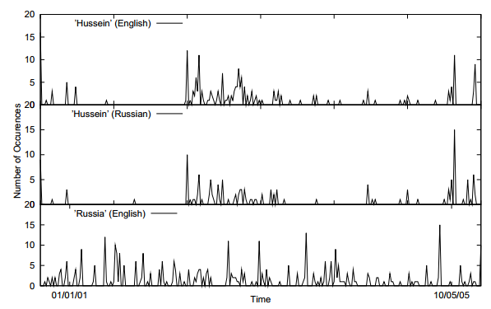
Incidental Supervision Signals [Klementiev & Roth’06]
Supervision need not be only in the form of labeled data
It could be incidental, in the sense that it provides some signals that might be co-related to the target task.
Temporal histograms
Assume a comparable, weakly temporally aligned news feeds.
Hussein (English
Hussein (Russian)
Weak synchronicity provides a cue about the relatedness of (some) NEs across the languages, and can be exploited to associate them
[Klementiev & Roth, 06,08]
Russia (English)

Slide 34
Incidental Supervision Signals [Klementiev & Roth’06]
By itself, such temporal signal is not sufficient to support training robust models.
Along with weak phonetic signals, context, topics, etc. it can be used to train robust models.
Temporal histograms
Assume a comparable, weakly temporally aligned news feeds.
Hussein (English
Hussein (Russian)
Weak synchronicity provides a cue about the relatedness of (some) NEs across the languages, and can be exploited to associate them
[Klementiev & Roth, 06,08]
Russia (English)

Slide 35


Examples
Incidental Supervision
  Exploiting existing information as supervision
    Dataless Classification
    Wikification (KBs, Multilingual)
    Events
Response Driven Learning
  Learning from the world’s feedback

Slide 36
Can we Classify Text? (Towards dataless classification)
``We have a strong interest in supporting Yugoslavia's newly voted leaders as they work to build a truly democratic society,'' Clinton said
  Is this event about :
Type 1 or Type 2 ?
  Labels carry a lot of information!
  But current approaches are misguided and are not using it
    Models are trained with “numbers” as labels and only make use of the task annotated data
We could go a long way without annotated data
  … if our models “knew” (some of) the meaning of the text
Election or Demonstration?

Slide 37
Text Categorization
On Feb. 8, Dong Nguyen announced that he would be removing his hit game Flappy Bird from both the iOS and Android app stores, saying that the success of the game is something he never wanted. Some fans of the game took it personally, replying that they would either kill Nguyen or kill themselves if he followed through with his decision.
Frank Lantz, the director of the New York University Game Center, said that Nguyen's meltdown resembles how some actors or musicians behave. "People like that can go a little bonkers after being exposed to this kind of interest and attention," he told ABC News. "Especially when there's a healthy dose of Internet trolls."
Nguyen did not respond to ABC News' request for comment.
7 February 2014 is going to be a great day in the history of Russia with the upcoming XXII Winter Olympics 2014 in Sochi. As the climate in Russia is subtropical, hence you would love to watch ice capped mountains from the beautiful beaches of Sochi. 2014 Winter Olympics would be an ultimate event for you to share your joys, emotions and the winning moments of your favourite sports champions. If you are really an obsessive fan of Winter Olympics games then you should definitely book your ticket to confirm your presence in winter Olympics 2014 which are going to be held in the provincial town, Sochi. Sochi Organizing committee (SOOC) would be responsible for the organization of this great international multi sport event from 7 to 23 February 2014.
Traditional text categorization requires training a classifier over a set of labeled documents (1,2,….k)
Someone needs to label the data (costly)
All your model knows is to classify into these given labels
It is possible to map a document to an ontology of semantic categories, without training with labeled data?

Slide 38

Text Categorization
On Feb. 8, Dong Nguyen announced that he would be removing his hit game Flappy Bird from both the iOS and Android app stores, saying that the success of the game is something he never wanted. Some fans of the game took it personally, replying that they would either kill Nguyen or kill themselves if he followed through with his decision.
Frank Lantz, the director of the New York University Game Center, said that Nguyen's meltdown resembles how some actors or musicians behave. "People like that can go a little bonkers after being exposed to this kind of interest and attention," he told ABC News. "Especially when there's a healthy dose of Internet trolls."
Nguyen did not respond to ABC News' request for comment.
Sports
Mobile Games
7 February 2014 is going to be a great day in the history of Russia with the upcoming XXII Winter Olympics 2014 in Sochi. As the climate in Russia is subtropical, hence you would love to watch ice capped mountains from the beautiful beaches of Sochi. 2014 Winter Olympics would be an ultimate event for you to share your joys, emotions and the winning moments of your favourite sports champions. If you are really an obsessive fan of Winter Olympics games then you should definitely book your ticket to confirm your presence in winter Olympics 2014 which are going to be held in the provincial town, Sochi. Sochi Organizing committee (SOOC) would be responsible for the organization of this great international multi sport event from 7 to 23 February 2014.
Flappy Bird
Russia
iOS
Olympics
Winter
Android
apps
champions
Sochi
stores
game
mountains
beaches
musicians
sports
Goal: categorize (short) snippets of text into a given (possibly large) ontology, without supervision.

Slide 39
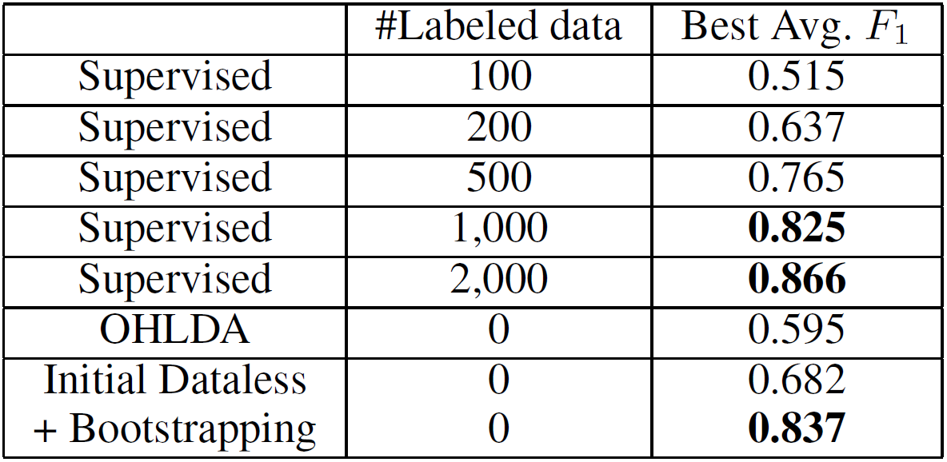
Dataless Classification Results [AAAI’08, AAAI’14;IJCAI’16]
Hierarchical Multiclass classification
  Dataless followed by bootstrapping
Moreover, dataless is more flexible in choosing the appropriate category in the taxonomy
No task specific annotated data!!
OHLDA refers to an LDA based unsupervised method proposed in (Ha-Thuc and Renders 2011).

Slide 40
Categorization without Labeled Data [AAAI’08, AAAI’14;IJCAI’16]
This is not an unsupervised learning scenario. Unsupervised learning assumes a coherent collection of data points, and that similar labels are assigned to similar data points. It cannot work on a single document.
Not 0-shot learning; similar to 1-shot learning.
Given:
  A single document (or: a collection of documents)
  A taxonomy of categories into which we want to classify the documents
Dataless procedure:
  Let Á(l_{i}) be the semantic representation of the labels
  Let Á(d) be the semantic representation of a document:
  Select the most appropriate category:
  l_{i}* = argmin_{i} ||Á(l_{i}) - Á(d)||
  (If a collection of documents is available) Bootstrap
    Label the most confident documents; use this to train a model.
Key Questions:
  How to generate a good Semantic Representations?
  Many languages? Short snippets of text? Events? Relations?

Slide 41
Text Representation
The ideal representation is task specific.
These ideas can be shown also in the context of more involved tasks such as Events and Relation Extraction
[Dense] Distributed Representations (Embeddings)
  New powerful implementations of good old ideas
    Represent a word as a function of words in its context
Brown Clusters
  An HMM based approach
  Found a lot of applications in other NLP tasks
[Sparse] Explicit Semantic Analysis (ESA Gabrilovich & Markovitch’2007)
  A Wikipedia driven approach – best for topical classification
    Represent a word as a function of the Wikipedia titles it occurs in
Cross-Lingual ESA [Song et. al. IJCAI’16]:
  Exploits the shared semantic space between two languages.
  This allows us to represent the label space of the English Wikipedia and the text space in language L in the same space.
No task specific supervision. Wikipedia is there.
Additionally, make use of cross-lingual titles space links

Slide 42
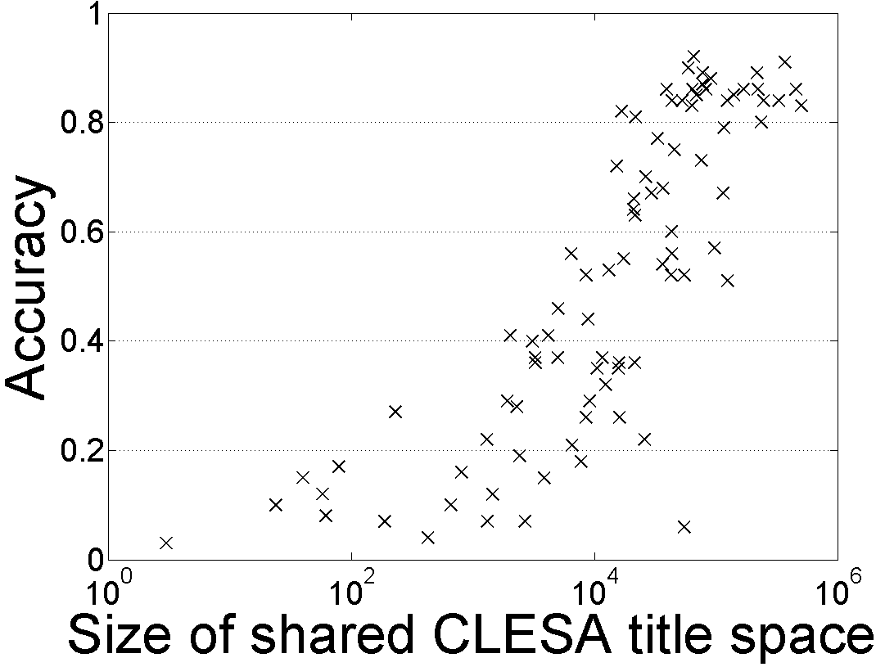
88 Languages: 20-Newsgroups Topic Classification
Dataless classification for English
Accuracy
Hausa
Hindi
Size of shared English-Language L title space

Slide 43
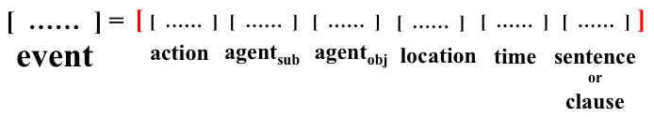
General Scheme (Indirect Supervision Type I):
Communication
Mapping (similarity)
Events are represented uniformly, facilitating determining event co-reference and, potentially, other relations between events: Causality, Timelines
Events: The representation needs to respect the structure
Peng & Roth EMNLP’16
Representation of the Y space (labels)
Representations can be induced in a task-independent way (“we know the language”)
Representation of the X space (input)

Slide 44
Outline
Skip
Incidental Supervision
  Exploiting existing information as supervision
    Dataless Classification [AAAI’08, 14; IJCAI’15]
    Wikification (KBs, Multilingual) [NAACL’16, TACL’16]
    Events [EMNLP’16]
Response Driven Learning
  Learning from the world’s feedback
Conclusion

Slide 45






Wikification: The Reference Problem
Blumenthal (D) is a candidate for the U.S. Senate seat now held by Christopher Dodd (D), and he has held a commanding lead in the race since he entered it. But the Times report has the potential to fundamentally reshape the contest in the Nutmeg State.
Blumenthal (D) is a candidate for the U.S. Senate seat now held by Christopher Dodd (D), and he has held a commanding lead in the race since he entered it. But the Times report has the potential to fundamentally reshape the contest in the Nutmeg State.
Notes:
Let’s start with what is wikification
Read wiki titles slower

Slide 46
Wikification Challenges
Blumenthal (D) is a candidate for the U.S. Senate seat now held by Christopher Dodd (D), and he has held a commanding lead in the race since he entered it. But the Times report has the potential to fundamentally reshape the contest in the Nutmeg State.
    Training a global model that [Ratinov et. al., ‘09; Chen & Roth’13]
  Identifies concepts in text
  Identifies candidate Wikipedia titles for these
  Ranks the corresponding titles
    Accounting for local context and global page/title space considerations
Relies on the correctness of the (partial) link structure in Wikipedia, but – requires no task specific human annotation.
“Standard” Wikification already makes use of incidental supervision to train the key model – ranking the candidate titles for a given mention.
Notes:
Quite impressive, bottleneck: adding more sophisticated contextual features does not help much
We do not want to level off here

Slide 47
Biomedical Wikification
Text
Mentions
BRCA2 and homologous recombination.
Multiple reference KBs & Medical taxonomies
Concept ID
Concept ID
PR:000004804, EG:675
GO:0006310
Protein Ontology
Entrez Gene
id: PR:000004804
name: breast cancer type 2
susceptibility protein
def: A protein that is a translation
product of the human BRCA2
gene or a 1:1 ortholog thereof
synonyms: BRCA2, FACD,…
is_a: PR:000000001
id: EG:675
symbol: BRCA2
description:
protein-coding BRCA2
breast cancer 2, early
onset
synonyms: BRCC2,
BROVCA2, …
Notes:
I’ll describe the task by an example. Given a piece of text, it can be a sentence, a paragraph, or a document. Here it is a title of a journal paper.
There are actually two sub tasks. The first one is mention detection. We want to extract substrings which are concepts. In this example, mentions are the two underlined words.
This task is already very challenging and I’m currently working on it.
In this work, we take the mentions as given and focus on the second step, grounding the mentions to multiple KBs.
Here, BRCA2 is grounded to two concepts in two different ontologies. We can see that the concepts in KBs can overlap and we want to find all concepts the mention refers to.
And here are examples of an entry in the ontology. A concept usually contains an id, name, a short definition, some synonyms, and few relations with other concepts.
This succinct information is quite different from what wikipedia has, which makes this task harder.

Slide 48
KB Wikification Challenges
Ambiguity
  A term in text can be used to express many different concepts
  E.g., BRCA2 is used by 177 concepts
Variability
  A concept may be expressed in text using many surface forms
  E.g., EG:675 has synonyms BRCC2, FACD, FAD, FANCD, …
No Supervision
  Wikipedia has nice hyperlink structure which does not exist here
  It is difficult to obtain human annotations
  Minimal descriptive text in the KBs/Ontologies
Exploiting indirect supervision: [Tsai & Roth ‘16]
  Building on [a small percentage of] concepts that are mentioned in multiple KBs.
  Outperforming existing unsupervised methods.
Notes:
This task is very challenging, the main challenges are coming from the general WSD problem, the ambiguity and variability.
Ambiguity means a term can be ….
Variability means. …
Another challenge of not using wikipedia is the supervision.
A good wikification system usually trains a ranking model to score concepts using supervised learning. And wikipedia’s hyperlink structure kind of provides free supervision
Which the ontologies we use don’t have. Also, it is reletively difficult to
One of the key contributions in this work is we

Slide 49
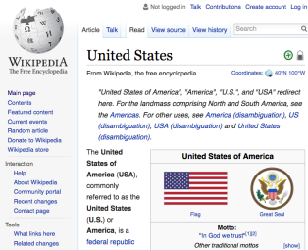
Cross-Lingual Wikification (II)
Given mentions in a non-English document, find the corresponding titles in the English Wikipedia
cuarto y actual presidente de los Estados Unidos de América
Amerika Birleşik Devletleri'nin devlet başkanıdır.
ஐக்கிய அமெரிக்காவின் தற்போதைய குடியரசுத் தலைவர்
นประธานาธิบดีคนที่ 44 คนปัจจุบันของสหรัฐอเมริกา
也是第44任美國總統
dake yankin Hawai a ƙasar Amurika
Key Challenge
  Matching words in a foreign language to
  English Wikipedia titles

Slide 50
Cross lingual Wikification [Tsai et. al. NAACL’16]
Incidental Supervision: Existing links between Wikipedia titles across languages
  Used to develop a technique that applies to all Wikipedia languages
  The only requirement is a Wikipedia dump.
Specifically, the incidental supervision is used to develop a cross lingual similarity metric between text in L and text (titles) in English.
  Via a joint embedding of words and titles in different languages into the same continuous vector space
Notes:
We perform very well on the Spanish Mention Discovery step, describe in the next slide

Slide 51
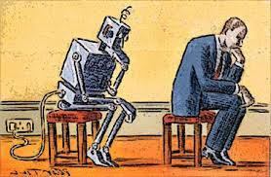
Outline
Incidental Supervision
  Exploiting existing information as supervision
    Dataless Classification
    Wikification (KBs, Multilingual)
    Events
Response Driven Learning
  Learning from the world’s feedback
Conclusion

Slide 52

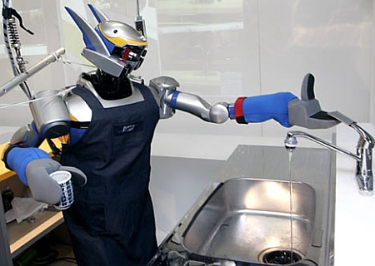

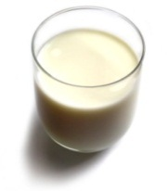
Understanding Language Requires (some) Supervision
Can we rely on this interaction to provide supervision (and eventually, recover meaning) ?
Can I get a coffee with lots of sugar and no milk
Great!
Arggg
Semantic Parser
MAKE(COFFEE,SUGAR=YES,MILK=NO)
How to recover meaning from text?
Standard “example based” ML: annotate text with meaning representation
  Teacher needs deep understanding of the learning agent ; not scalable.
Response Driven Learning: Exploit indirect signals in the interaction between the learner and the teacher/environment
[Clarke, Goldwasser, Chang, Roth CoNLL’10; Goldwasser, Roth IJCAI’11, MLJ’14]
Notes:
NLU: about recovering meaning from text – a lot of work aims directly at that or at some subtasks that might look like this:….

Slide 53
Before Conclusion
The bee landed on the flower because it had/wanted pollen.
  Lexical knowledge
John Doe robbed Jim Roy. He was arrested by the police.
  Subj of “rob” is more likely than the Obj of “rob” to be the Obj of “arrest”
  Need: Learning & Inference approach that acquire the knowledge and use it appropriately.
  (See our work in NAACL’15, ACL’16 for interesting progress on this)
John had 6 books; he wanted to give it to two of his friends. How many will each one get?
  (See our EMNLP’15, 16 & TACL’15 work for progress on Math word problems)
share it with
How do we supervise for these problems?

Slide 54
Summary
Thank you!
BabySRL
  Realistic Computational model for Syntactic Bootstrapping via Structure Mapping
Argued that NLP should take inspiration and think more about incidental supervision in support of semantics.
Notes:
54

Slide 55
Response Based Learning
We want to learn a model that transforms a natural language sentence to some meaning representation.
Instead of training with (Sentence, Meaning Representation) pairs
Think about some simple derivatives of the models outputs,
  Supervise the derivative [verifier] (easy!) and
  Propagate it to learn the complex, structured, transformation model
English Sentence
Model
Meaning Representation

Slide 56
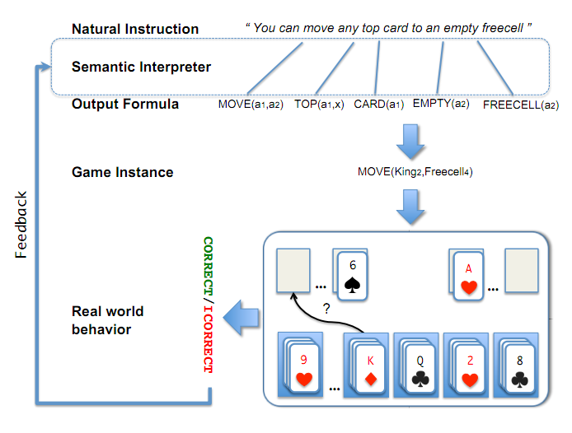
Scenario I: Freecell with Response Based Learning
We want to learn a model to transform a natural language sentence to some meaning representation.
English Sentence
Model
Meaning Representation
A top card can be moved to the tableau if it has a different color than the color of the top tableau card, and the cards have successive values.
Move (a1,a2) top(a1,x1) card(a1) tableau(a2) top(x2,a2) color(a1,x3) color(x2,x4) not-equal(x3,x4) value(a1,x5) value(x2,x6) successor(x5,x6)
Play Freecell (solitaire)
Derivatives of the models outputs: execute moves on a game API
  Supervise the derivative and Propagate it to learn the transformation model

Slide 57
Scenario II: Geoquery with Response based Learning
We want to learn a model to transform a natural language sentence to some formal representation.
“Guess” a semantic parse. Is [DB response == Expected response] ?
  Expected: Pennsylvania DB Returns: Pennsylvania→ Positive Response
  Expected: Pennsylvania DB Returns: NYC, or ???? → Negative Response
English Sentence
Model
Meaning Representation
What is the largest state that borders NY?
largest( state( next_to( const(NY))))
Simple derivatives of the models outputs
Query a GeoQuery Database.

Slide 58
Response Based Learning
We want to learn a model that transforms a natural language sentence to some meaning representation.
Instead of training with (Sentence, Meaning Representation) pairs
Think about some simple derivatives of the models outputs,
  Supervise the derivative [verifier] (easy!) and
  Propagate it to learn the complex, structured, transformation model
LEARNING:
Train a structured predictor (semantic parse) with this binary supervision
  Many challenges: e.g., how to make a better use of a negative response?
Learning with a constrained latent representation, making use of a CCM, exploiting knowledge on the structure of the meaning representation.
[Clarke, Goldwasser, Chang, Roth CoNLL’10; Goldwasser, Roth IJCAI’11, MLJ’14]
English Sentence
Model
Meaning Representation

Slide 59
Geoquery: Response based Competitive with Supervised
Clarke, Goldwasser, Chang, Roth CoNLL’10; Goldwasser, Roth IJCAI’11, MLJ’14
Current work addresses challenges due to the complexity of the natural language, types of interaction, and generalization across domains.
Algorithm | Training Accuracy | Testing Accuracy | # Training Examples
NOLEARN | 22 | -- | -
Response-based (2010) | 82.4 | 73.2 | 250 answers
Liang et-al 2011 | -- | 78.9 | 250 answers
Response-based (2012,14) | 86.8 | 81.6 | 250 answers
Supervised | -- | 86.07 | 600 structs.
NOLEARN :Initialization point
SUPERVISED : Trained with annotated data
Response based Learning is gathering momentum:
Liang, M.I. Jordan, D. Klein, Learning Dependency-Based Compositional Semantics, ACL’11.
Berant et-al ’ Semantic Parsing on Freebase from Question-Answer Pairs, EMNLP’13, ‘15
Supervised: Y.-W. Wong and R. Mooney. Learning synchronous grammars for semantic parsing with lambda calculus. ACL’07
Notes:
Still a lot of problems. Still, if you think that we can do supervision, let’s think about these problems…

Slide 60
Before Conclusion
Knowledge representation called “predicate schemas”
The bee landed on the flower because it had/wanted pollen.
  Lexical knowledge
John Doe robbed Jim Roy. He was arrested by the police.
  Subj of “rob” is more likely than the Obj of “rob” to be the Obj of “arrest”
  Need: Learning & Inference approach that acquire the knowledge and use it appropriately.
  (See our work in NAACL’15, ACL’16 for interesting progress on this)
John had 6 books; he wanted to give it to two of his friends. How many will each one get?
  (See our EMNLP’15, 16 & TACL’15 work for progress on Math word problems)
share it with
How do we supervise for these problems?

Slide 61
Summary
Thank you!
BabySRL
  Realistic Computational model for Syntactic Bootstrapping via Structure Mapping:
Argued that NLP should take inspiration and think more about incidental supervision in support of semantics.
Notes:
61

