Slide 1
Information Extraction In Low Resource Languages
Dan Roth
Department of Computer & Information Science
University of Pennsylvania
Penn in India
January 2021

Slide 2

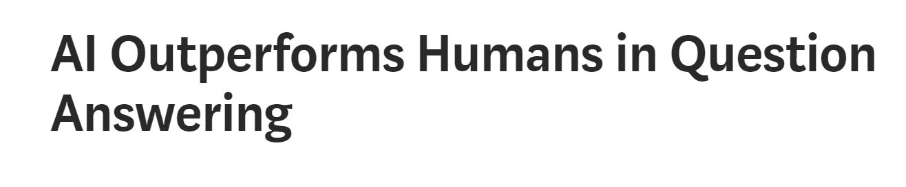
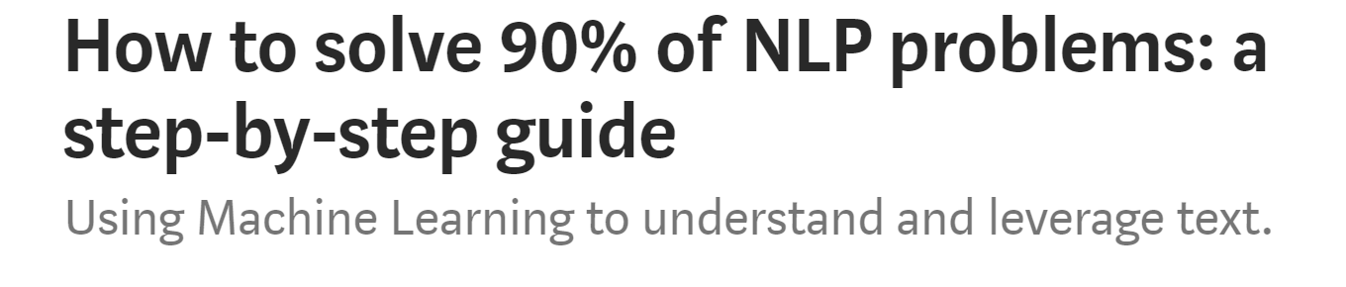
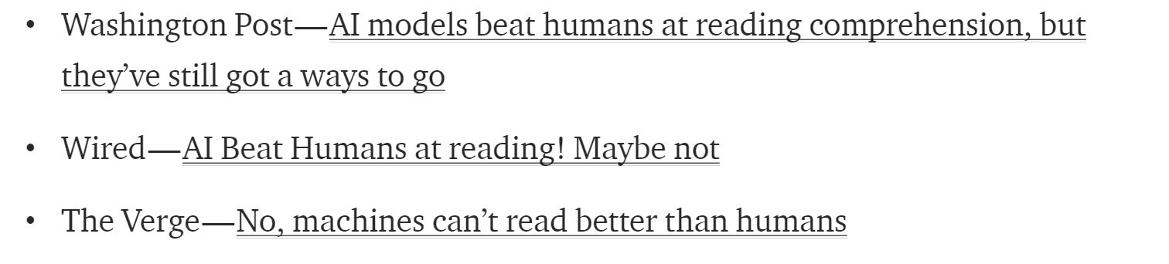
AI/NLP is in the News
Artificial Intelligence is riding a wave
  Not for the first time
Machine Learning (esp. Deep Learning) has brought a lot of excitement to Natural Language Processing (NLP)
Visible NLP achievements are not new
  IBM Watson
  (limited) Translation
  Siri et al.
  Speech Recognition
This progress is limited to those tasks for which we have a lot of annotated data, so that we can supervise machine learning programs

Slide 3
Named Entity Recognition (NER)
Finding and classifying named entities in text
Foundational task in NLP
  Challenge: find a news story with no named entities
Requires a large amount of task-specific supervision
State of the art:
  English ➡ OK [80-90%, depending on genre]
  All other languages ➡ Less OK
And what about low resource languages?

Slide 4
Low Resource Languages
Written languages
(3.5K)
All languages
(7K)
Can we translate the annotation to other languages?
Requires parallel data for training
Languages with
NER Annotation
(30?)
(Diagram roughly to scale. Numbers from ethnologue.com)

Slide 5
Low Resource Languages
Written languages
(3.5K)
All languages
(7K)
Languages with
parallel text
(100?)
Wikipedia
languages
(300)
Can we use the multilingual links in Wikipedia?
Languages with
NER Annotation
(30?)
(Diagram roughly to scale. Numbers from ethnologue.com)

Slide 6
Low Resource Languages
Written languages
(3.5K)
All languages
(7K)
Languages with
Query Logs
(?)
Languages with
Lexicons
(2K?)
Languages with
parallel text
(100?)
Wikipedia
languages
(300)
What else can we do?
Languages with
NER Annotation
(30?)
(Diagram roughly to scale. Numbers from ethnologue.com)

Slide 7
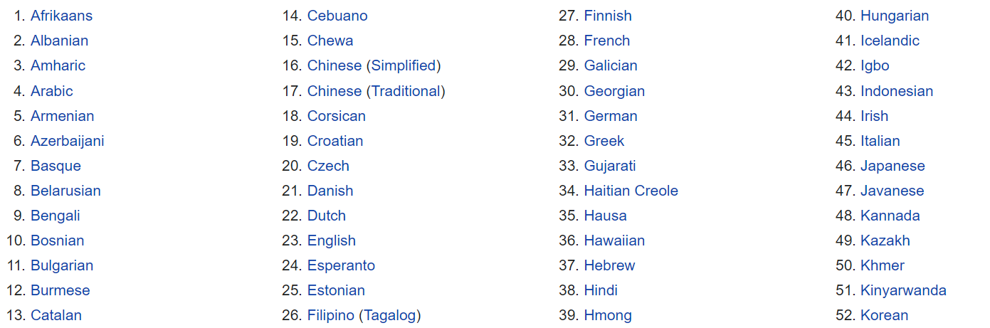
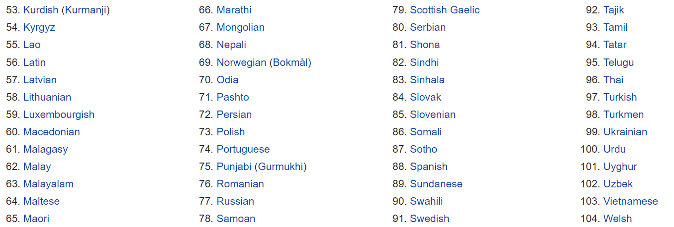
Indian Languages
Languages Translated by Google
Among the top 80 languages in the world, spoken by more than 10m people, 18 are Indian languages
http://www2.harpercollege.edu/mhealy/g101ilec/intro/clt/cltclt/top100.html
There are 109 languages in Google Translate
10 of them are Indian Languages
(all, with >25m speakers)

Slide 8
Is There Another Solution?
How can we address language understanding in low resource languages
  Still, an open problem
Instead, we can provide access to low resource languages
Allow non-native speaker (partially) “understand” what is written in documents in other languages
  Do it without translation (which is resource-heavy)

Slide 9

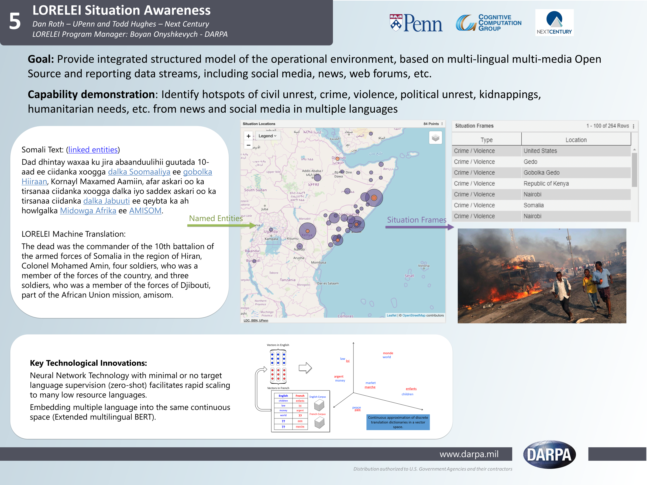
Target Language Source English
A major progress in the ability to “understand” documents in low resource languages over the last five years.
  Driven by a DARPA project: LORELEI
Somali streaming data
Situation Awareness
(described in English)
What is it about?
  Identify topics & events
“Understand” a situation described in Target Language
  Identify Entities & Concepts (NER)
  Ground in English Resources (XEL)

Slide 10
Final LORELEI Evaluation Results
Setting:
  Two surprise languages
    2019: Odia, Ilocano
  You are given a week to develop solutions for several tasks.
.
  No annotated data; some target language data; a (limited quality) dictionary.
  Minimal (4 hours) remote exposure to native speakers
 | Named Entities | Entity Linking | Situation Frames
IL11 (Odia) | 79.4 | 56.6 | 37.8, 16.8, 20.3 (Type, Type+Loc, nDCG)
IL12 (Ilocano) | 79.5 | 54.7 (2nd) | 34.1, 9.73, 25.65
Results in blue are the top scores among all participants
Use of many incidental signals:
Human knowledge:
  non-speaker annotation (+IL) needed to bootstrap models; declarative knowledge
Use of data that is out there, unrelated to the task: other languages & other tasks
  Using “cheap” translation; existing textual entailment data; Wikipedia; Google query logs
(Unsupervised) Pre-training of representations (extended M-BERT)
Notes:
Finfine is the name of Adis Abeba, Capital of Ethiopia

Slide 11
Tasks
Romanized Bengali
ebisi’ra giliyyaana phinnddale aaja pyaalestaaina adhiinastha gaajaa theke aaja raate ekhabara jaaniyyechhena .
ABC’s Gillian Findale has reported from Gaza in Palestine today.

Slide 12
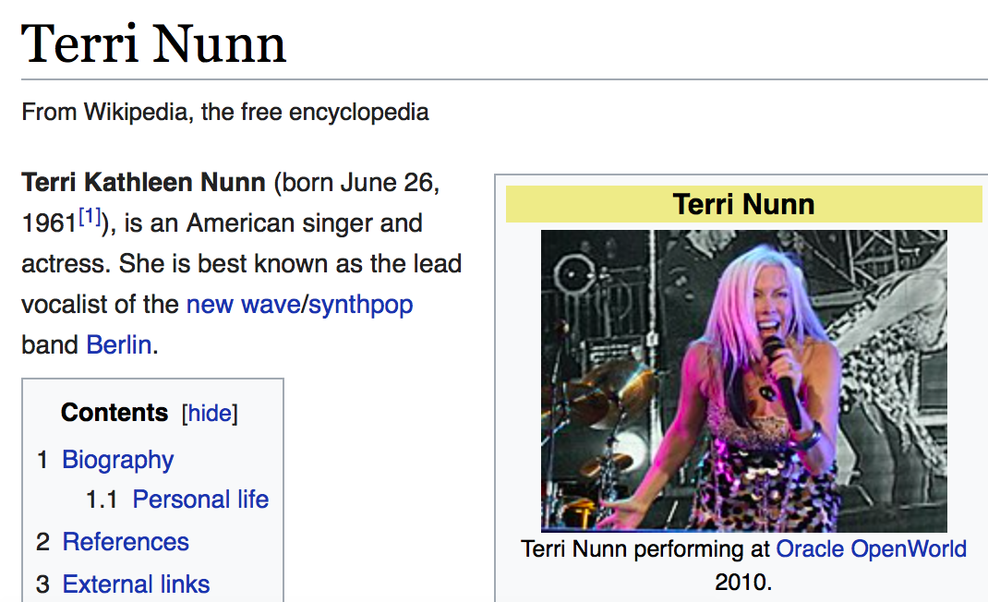
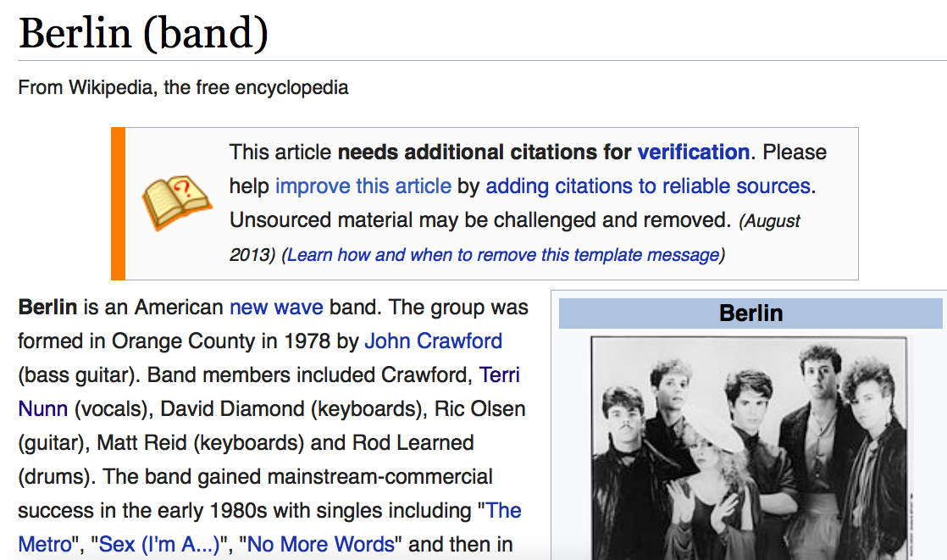
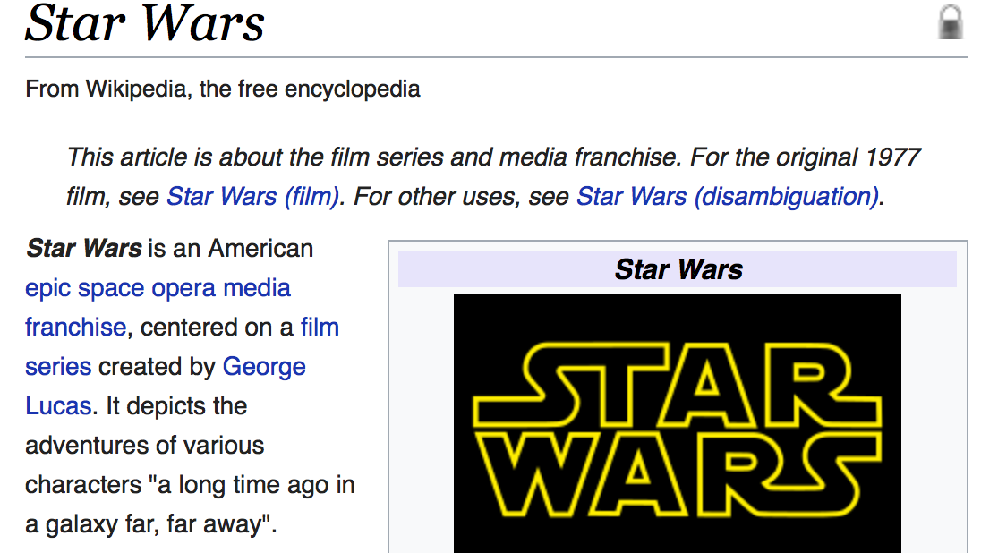
1st Cross-lingual Entity Linking (XEL) [Tsai & Roth 16]
Given a non-English document, extract named entities and disambiguate into the English Wikipedia (KB)
… its lead singer Nunn left Berlin to audition for Star Wars …
... sein Leadsänger Nunn verließ Berlin, um für Star Wars vorzuspielen ...
... 其主唱 纳恩 离开 柏林 去参加 星球大战 的试镜 ...
... 其主唱 纳恩 离开 柏林 去参加 星球大战 的试镜 ...
Notes:
Given a doc in a foreign language, for instance chinese, we want to identify certain spans of text and ground them to english wikipedia.
We should be able to do this regardless of the langage. Be it Germna or English. All theese sentences are translations of each other.
Note that this requires contextual understanding to identify that Berlin refers to the band and not the city.

Slide 13


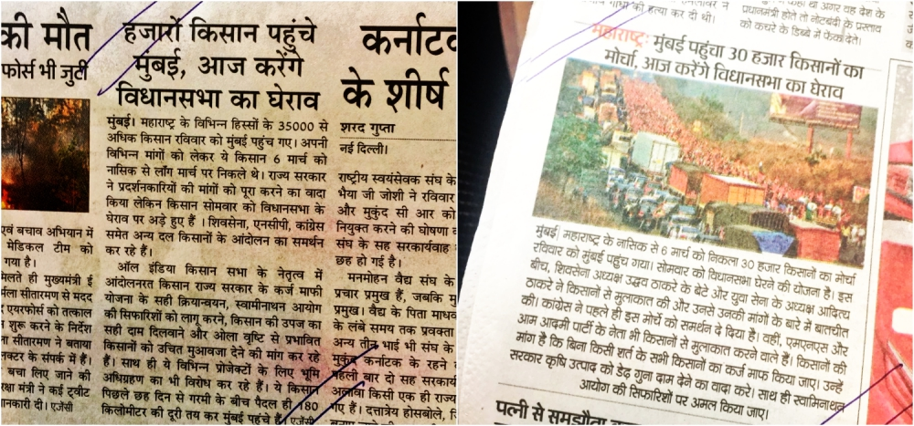
Cross-lingual Textual Classification [Song et al. IJCAI’16]
Text Classification with No Annotated data
A Wikipedia Based Representation: Cross-lingual Explicit Semantic Analysis (CL-ESA)
  Exploits existing cross-lingual links between two languages
  Represent low-resource language documents and English Labels in the corresponding CL-ESA Space
  Map representation via cross-lingual links.
  Quality depends on the (size of the) intersection of the title spaces
English Label Space
Hindi Documents
Cross lingual links
Politics
Sports
Shared Cross-lingual ESA Space
Floods
Earthquake
Notes:
To be more formal. A five step algorithm.

Slide 14
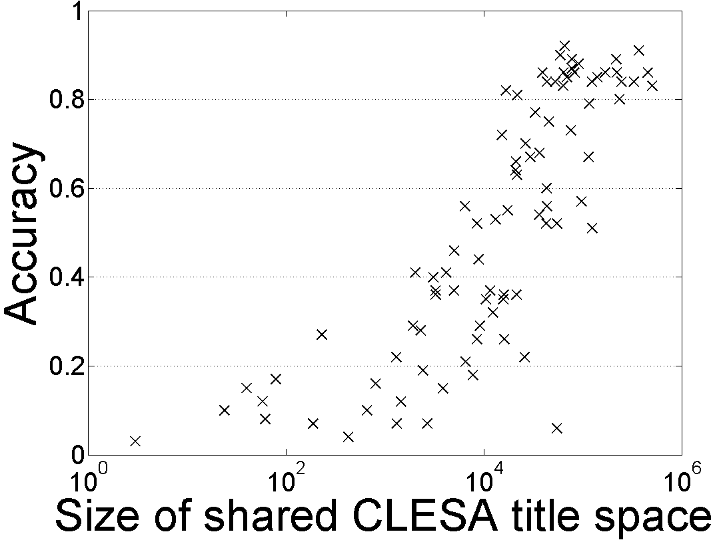
Single Document Classification (88 Language shown)
Extended to all 292 languages represented in Wikipedia
Results in English are equivalent to having 1000-2000 labels per category.
In cross-lingual classification, equivalent to having > 200 labels per category.
Accuracy
Hausa
Hindi
Size of shared English-Language L title space

Slide 15
Solutions
Key Technology: Multilingual Embeddings

Slide 16

Cross-lingual Representations [Upadhyay et al. (ACL’16)]
Vectors in English
Research Question
What levels of supervision are needed to support multi-lingual transfer for various tasks?
monde
law
world
loi
argent
money
market
Vectors in French
marche
enfants
children
English | French
children | enfants
law | loi
money | argent
world | ??
?? | paix
?? | marche
English Corpus
peace
paix
French Corpus
Continuous approximation of discrete translation dictionaries in a vector space.

Slide 17

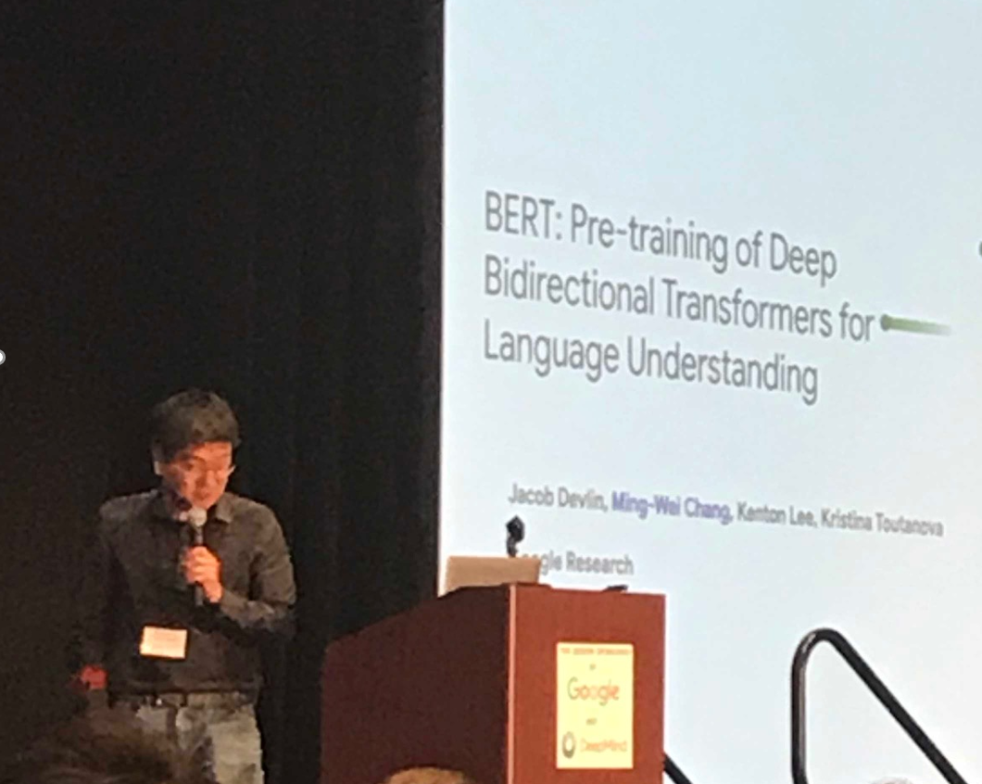
What Happened?
It has been established that multilingual embeddings are essential
  NER, EDL, SF all rely on these representations.
However, it’s also clear that in order to develop tools that span many languages we may need many models, and some (minimal) level of supervision.
BERT: powerful contextual language model
  mBERT: a multilingual version – multilingual embeddings
  A single multilingual embedding for many languages.
  No direct supervision – only needs sufficient data in each language.
Needs to be extended to make use in low-resource languages
Many questions remain
  Why and when does it work?
Ming-Wei Chang
NAACL’19 Best Paper Award
Contextual embeddings are behind all the advances in NLP in the last couple of years. But, on their own, they are not sufficient to address low-resource languages

Slide 18
Massively Multilingual Analysis of NER
Language | 3 letter code
Akan (Twi) | aka
Amharic | amh
Arabic | ara
Bengali | ben
Farsi | fas
Hindi | hin
Hungarian | hun
Indonesian | ind
Chinese | cmn
Russian | rus
Somali | som
Spanish | spa
Swahili | swa
Tagalog | tgl
Tamil | tam
Thai | tha
Turkish | tur
Uzbek | uzb
Vietnamese | vie
Wolof | wol
Yoruba | yor
Zulu | zul
Low-resource NER:
  different methods, parameters, languages
Evaluation in 22 languages (LORELEI)
  10 different scripts
  10 language families (Niger-Congo most popular)
Notes:
State of the art is gerrymandered.
Patchwork understanding.

Slide 19
Overall: Still Ways to Go
Average of best cross-lingual (47 F1) is still less than monolingual (74 F1)
Amazing: this can be done almost “for free”
Cross-lingual transfer by itself isn’t sufficient
The gap can be narrowed with additional methods

Slide 20
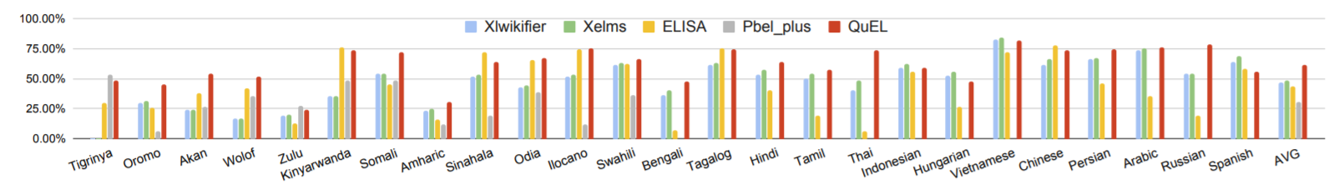
Cross-lingual Entity Linking (XEL)
XEL is a harder task, but it is possible today to support many low-resource languages

Slide 21
Conclusion
Thank You!
Huge progress in Low Resource NLP
  Mostly in “easy” tasks
  But higher-level tasks still a challenge
Discussed some of the work in this context
  Importance of Contextual Embeddings!
    And some understanding of it
    Karthikeyan K and Zihan Wang and Stephen Mayhew and Dan Roth, Cross-Lingual Ability of Multilingual BERT: An Empirical Study ICLR (2020)
  Weak signals are strong!
    Cheap Translation
    Bootstrapping from non-speakers
We still have ways to go.
Somali streaming data
Situation Awareness
(described in English)

Slide 22
End

