Slide 1
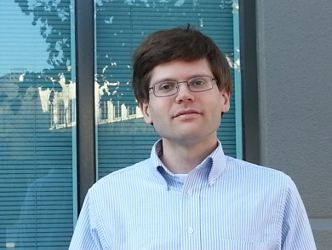
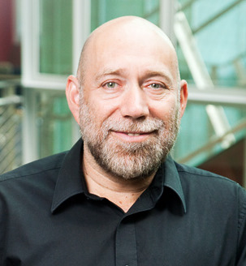

Information Trustworthiness
AAAI 2013 Tutorial
http://l2r.cs.uiuc.edu/Information_Trustworthiness_Tutorial.pptx
Jeff Pasternack
Dan Roth
V.G.Vinod Vydiswaran
University of Illinois at Urbana-Champaign
July 15th, 2013
TexPoint fonts used in EMF.
Read the TexPoint manual before you delete this box.: AAAAAAAAAAAA

Slide 2
Knowing what to Believe
A lot of research efforts over the last few years target the question of how to make sense of data.
For the most part, the focus is on unstructured data, and the goal is to understand what a document says with some level of certainty: [data → meaning]
    Only recently we have started to consider the importance of what should we believe, and who should we trust?
Notes:
2

Slide 3
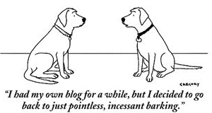
Knowing what to Believe
The advent of the Information Age and the Web
  Overwhelming quantity of information
  But uncertain quality.
    Collaborative media
      Blogs
      Wikis
      Tweets
      Message boards
    Established media are losing market share
      Reduced fact-checking
Notes:
3

Slide 4
Example: Emergency Situations
A distributed data stream needs to be monitored
All Data streams have Natural Language Content
  Internet activity
    chat rooms, forums, search activity, twitter and cell phones
  Traffic reports; 911 calls and other emergency reports
  Network activity, power grid reports, networks reports, security systems, banking
  Media coverage
Often, stories appear on tweeter before they break the news
But, a lot of conflicting information, possibly misleading and deceiving.
How can one generate an understanding of what is really happening?
Notes:
4

Slide 5



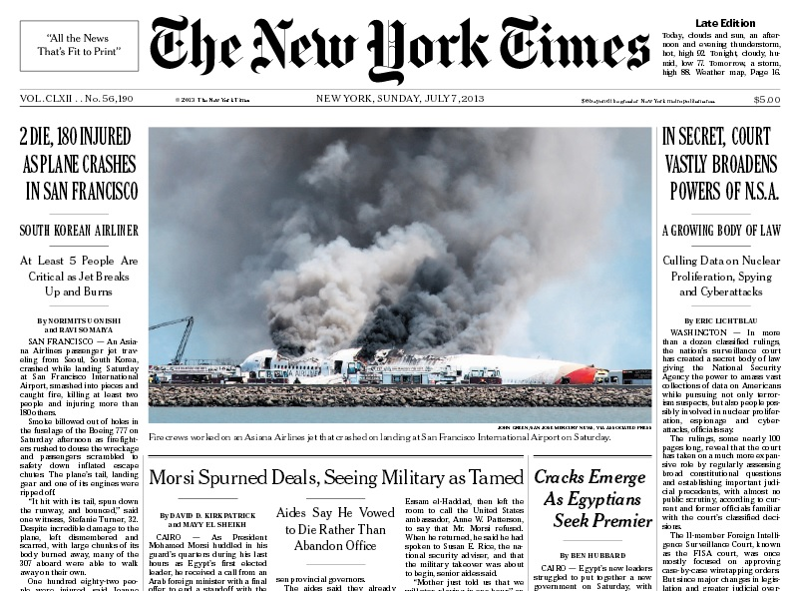
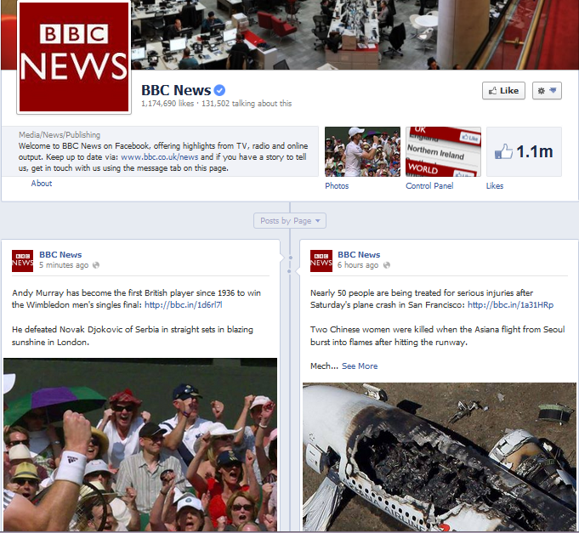

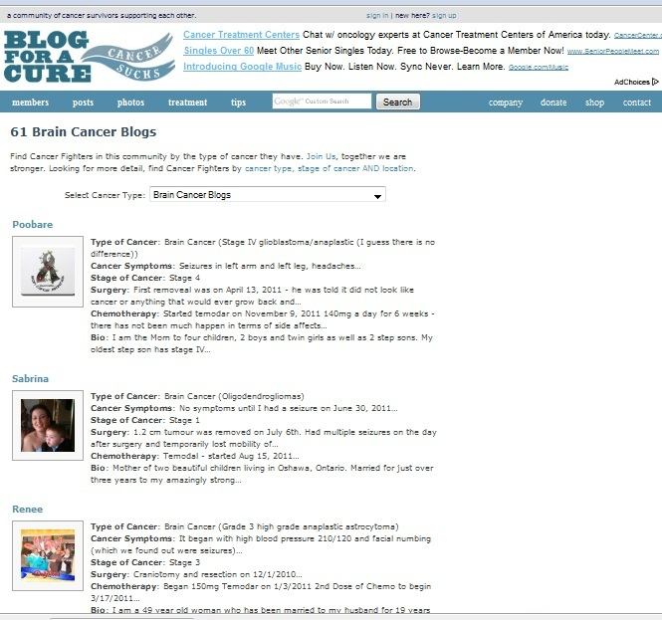
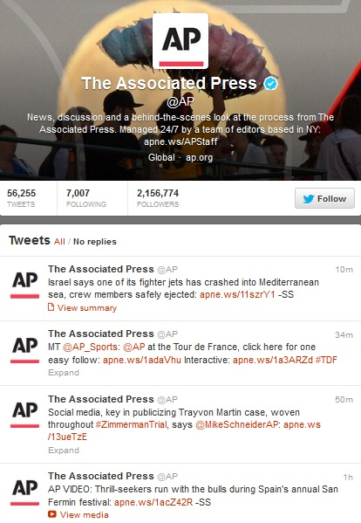


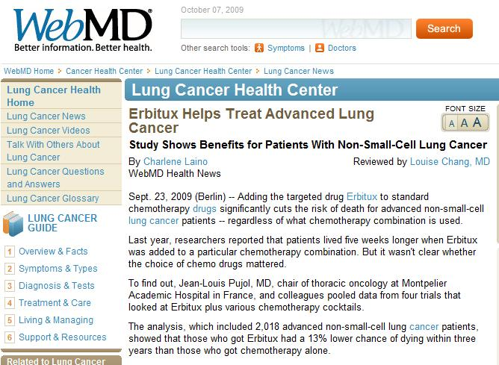

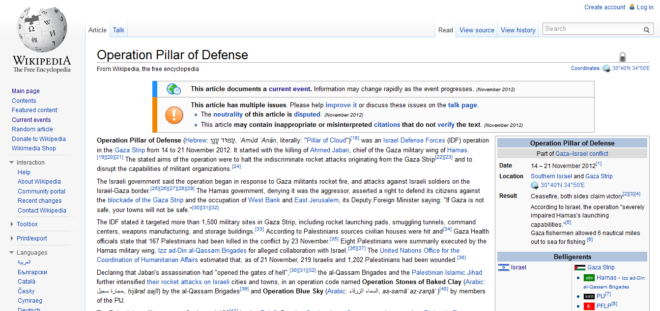


Many sources of information available
Are all these sources equally trustworthy?

Slide 6
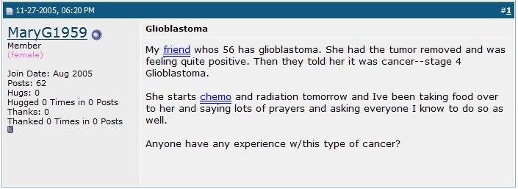
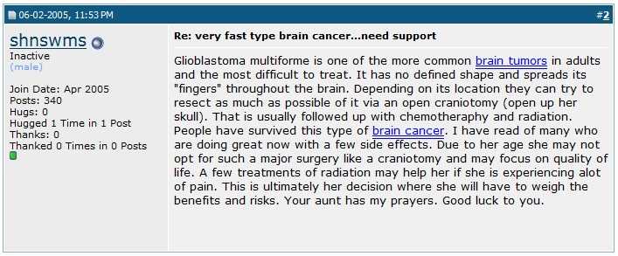
Information can still be trustworthy
Sources may not be “reputed”, but information can still be trusted.

Slide 7
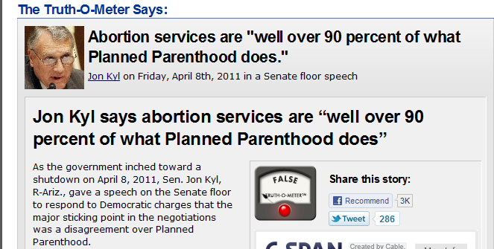
Distributed Trust
Integration of data from multiple heterogeneous sources is essential.
Different sources may provide
conflicting information or mutually
reinforcing information.
  Mistakenly or for a reason
  But there is a need to estimate
  source reliability and (in)dependence.
  Not feasible for human to read it all
  A computational trust system
  can be our proxy
  Ideally, assign the same trust judgments a user would
  The user may be another system
    A question answering system; A navigation system; A news aggregator
    A warning system
False– only 3 %

Slide 8
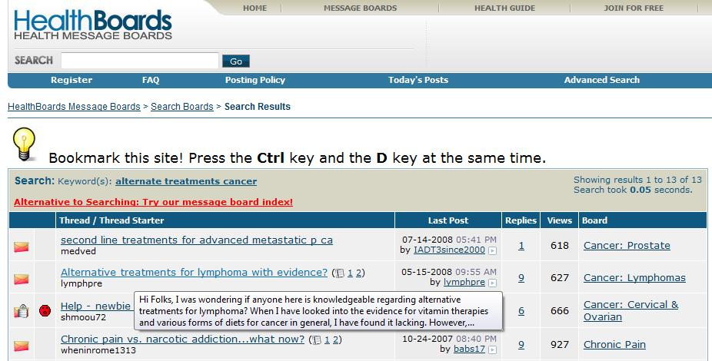
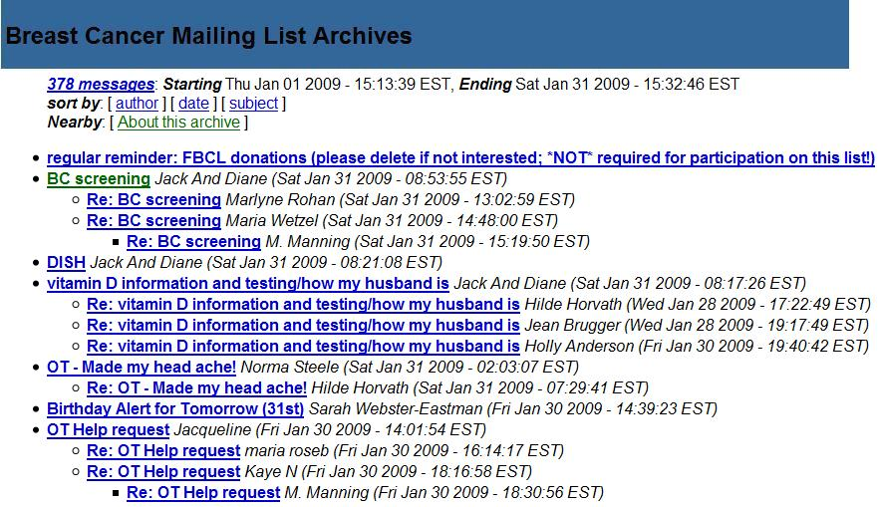
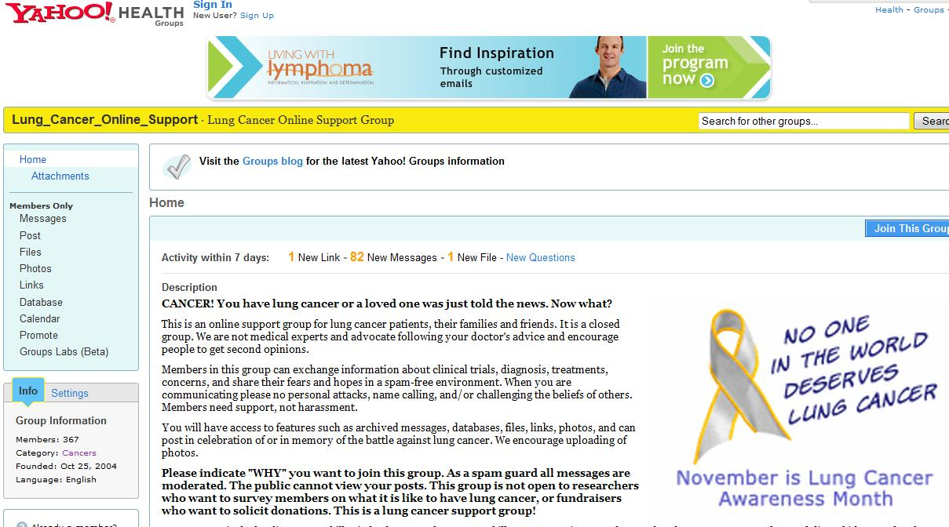
Medical Domain: Many support groups and medical forums
Hundreds of Thousands of people get their medical information from the internet
Best treatment for…..
Side effects of….
But, some users have an agenda,… pharmaceutical companies…
8
Notes:
Users share their experiences in message boards, forums, and blogs.
8

Slide 9
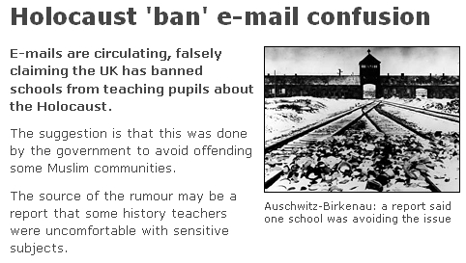
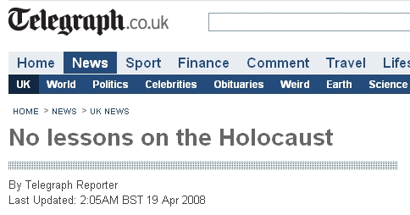
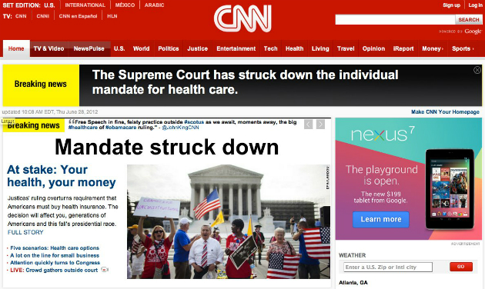
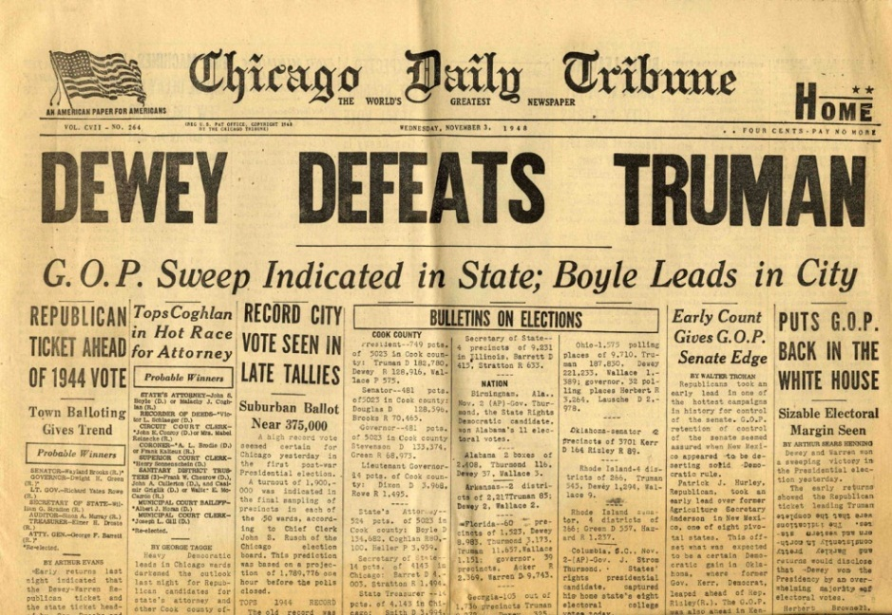
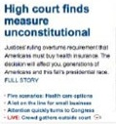
Not so Easy
Integration of data from multiple heterogeneous sources is essential.
Different sources may provide either conflicting information or mutually reinforcing information.
Interpreting a distributed stream of conflicting pieces of information is not easy even for experts.

Slide 10

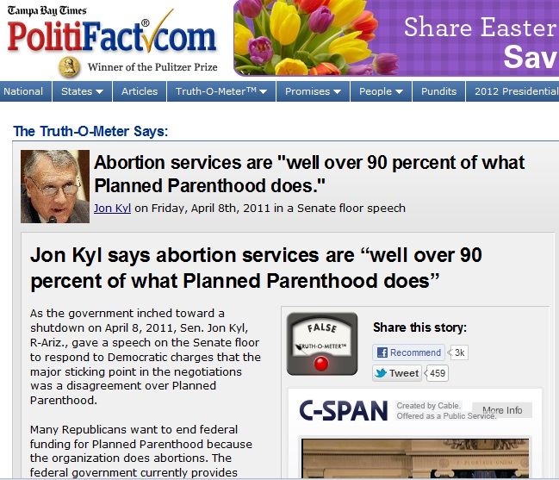
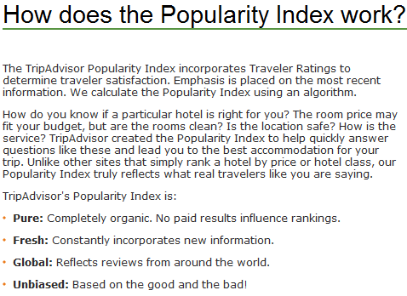

Online (manual) fact verification sites
Trip Adviser’s Popularity Index

Slide 11
Trustworthiness
Given:
  Multiple content sources: websites, blogs, forums, mailing lists
  Some target relations (“facts”)
    E.g. [disease, treatments], [treatments, side-effects]
  Prior beliefs and background knowledge
Our goal is to:
  Score trustworthiness of claims and sources based on
    Support across multiple (trusted) sources
    Source characteristics:
      reputation, interest-group (commercial / govt. backed / public interest),
      verifiability of information (cited info)
    Prior Beliefs and Background knowledge
    Understanding content

Slide 12


Research Questions
1. Trust Metrics
  (a) What is Trustworthiness? How do people “understand” it?
  (b) Accuracy is misleading. A lot of (trivial) truths do not make a message trustworthy.
2. Algorithmic Framework: Constrained Trustworthiness Models
  Just voting isn’t good enough
  Need to incorporate prior beliefs & background knowledge
3. Incorporating Evidence for Claims
  Not sufficient to deal with claims and sources
  Need to find (diverse) evidence – natural language difficulties
4. Building a Claim-Verification system
  Automate Claim Verification—find supporting & opposing evidence
  What do users perceive? How to interact with users?

Slide 13
1. Comprehensive Trust Metrics
Often, Trustworthiness is subjective
A single, accuracy-derived metric is inadequate
We will discuss three measures of trustworthiness:
  Truthfulness: Importance-weighted accuracy
  Completeness: How thorough a collection of claims is
  Bias: Results from supporting a favored position with:
    Untruthful statements
    Targeted incompleteness (“lies of omission”)
Calculated relative to the user’s beliefs and information requirements
These apply to collections of claims and Information sources
Found that our metrics align well with user perception overall and are preferred over accuracy-based metrics
Notes:
13

Slide 14

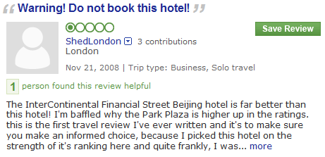
Example: Selecting a hotel
For each hotel, some reviews are positive
And some are negative
Notes:
Basically I want to know the true quality of the hotel is relative to me
14

Slide 15
2. Constrained Trustworthiness Models
T(s)
Sources
B(C)
Hubs-Authority style
Trustworthiness of sources
s₁
Claims
c₁
B^{(n+1)}(c)=∑_{s} w(s,c) T^{n}(s)
s₂
c₂
T^{(n+1)}(s)=∑_{c} w(s,c) B^{n+1}(c)
s₃
Veracity of claims
c₃
1
s₄
Encode additional information into such a fact-finding graph & augment the algorithm to use this information
(Un)certainty of the information extractor; Similarity between claims; Attributes , group memberships & source dependence;
Often readily available in real-world domains
Within a probabilistic or a discriminative model
c₄
s₅
Incorporate Prior knowledge
Common-sense: Cities generally grow over time; A person has 2 biological parents
Specific knowledge: The population of Los Angeles is greater than that of Phoenix
2
Represented declaratively (FOL like) and converted automatically into linear inequalities
Solved via Iterative constrained optimization (constrained EM), via generalized constrained models
Notes:
Callout for tau and sigma

Slide 16
3. Incorporating Evidence for Claims
Evidence
E(c)
Claims
s₂
e₄
T(s)
Sources
e₁
T(s_{i})
E(c_{i})
s₁
B(c)
e₂
c₁
s₃
e₅
c₃
s₂
e₃
T(s_{i})
E(c_{i})
c₂
B(c)
e₄
s₄
e₆
T(s_{i})
E(c_{i})
s₃
e₅
c₃
s₄
e₆
The truth value of a claim depends on its source as well as on evidence.
  Evidence documents influence each other and have different relevance to claims.
Global analysis of this data, taking into account the relations between stories, their relevance, and their sources, allows us to determine trustworthiness values over sources and claims.
e₇
1
c₄
s₅
e₈
e₉
e₁₀
2
The NLP of Evidence Search
Does this text snippet provide evidence to this claim? Textual Entailment
What kind of evidence?
For, Against: Opinion Sentiments
Notes:
Callout for tau and sigma

Slide 17
4. Building ClaimVerifier
Users
Algorithmic Questions
Language Understanding Questions
Retrieve text snippets as evidence that supports or opposes a claim
Textual Entailment driven search and Opinion/Sentiment analysis
Source
Claim
Presenting evidence for or against claims
HCI Questions [Vydiswaran et al., 2012]
What do subjects prefer – information from credible sources or information that closely aligns with their bias?
What is the impact of user bias?
Does the judgment change if credibility/ bias information is visible to the user?
Evidence
Data

Slide 18
Other Perspectives
The algorithmic framework of trustworthiness can be motivated form other perspectives:
Crowd Sourcing: Multiple Amazon turkers are contributing annotation/answers for some task.
  Goal: Identify who the trustworthy turkers are and integrate the information provided so it is more reliable.
Information Integration
  Data Base Integration
  Aggregation of multiple algorithmic components, taking into account the identify of the source
  Meta-search: aggregate information of multiple rankers
There have been studies in all these directions and, sometimes, the technical content overlaps with what is presented here.
Notes:
If you read some text online, can you believe it? We pose these questions and as a first step, try to approach it based on other users’ shared experience on something similar.
18

Slide 19
Summary of Introduction
Trustworthiness of information comes up in the context of social media, but also in the context of the “standard” media
Trustworthiness comes with huge Societal Implications
We will address some of the Key Scientific & Technological obstacles
  Algorithmic Issues
  Human-Computer Interaction Issues
  ** What is Trustworthiness?
A lot can (and should) be done.
Notes:
If you read some text online, can you believe it? We pose these questions and as a first step, try to approach it based on other users’ shared experience on something similar.
19

Slide 20
Components of Trustworthiness
Source
Source
Claim
Source
Claim
Claim
Claim
Evidence
Users

Slide 21
Outline
Source-based Trustworthiness
Basic Trustworthiness Framework
  Basic Fact-finding approaches
  Basic probabilistic approaches
Integrating Textual Evidence
Informed Trustworthiness Approaches
  Adding prior knowledge, more information, structure
Perception and Presentation of Trustworthiness
BREAK

Slide 22
Source-based Trustworthiness Models
http://l2r.cs.uiuc.edu/Information_Trustworthiness_Tutorial.pptx

Slide 23
Components of Trustworthiness
Source
Source
Claim
Source
Claim
Claim
Claim
Evidence
Users

Slide 24
What can we do with sources alone?
Assumption: Everything that is claimed depends only on who said it.
  Does not depend on the claim or the context
Model 1: Use static features of the source
  What features indicate trustworthiness?
Model 2: Source reputation
  Features based on past performance
Model 3: Analyze the source network (the “link graph”)
  Good sources link to each other

Slide 25
1. Identifying trustworthy websites
[Sondhi, Vydiswaran & Zhai, 2012]
For a website
  What features indicate trustworthiness?
  How can you automate extracting these features?
Can you learn to distinguish trustworthy websites from others?

Slide 26
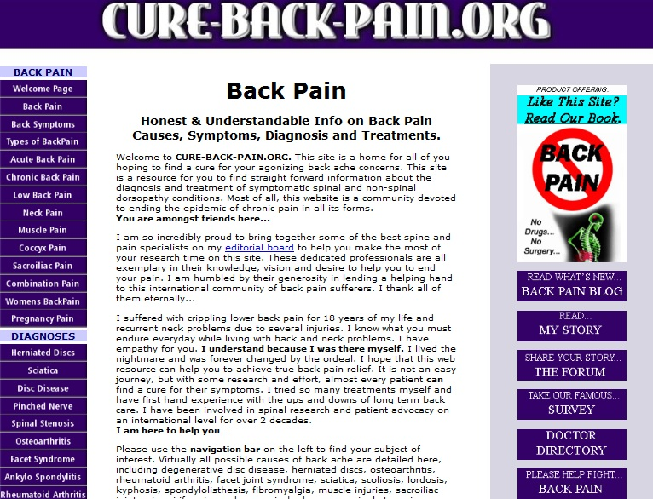
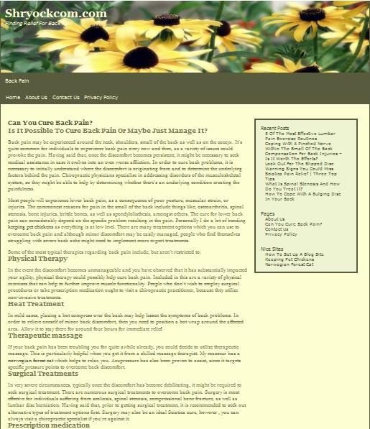

“cure back pain”: Top 10 results
health2us.com
Content
Presentation
Financial interest
Transparency
Complementarity
Authorship
Privacy
Notes:
this is related to the general theme – people (programs) will look at a lot of sources and the question is “what to look at to determine if the source is reliable”?
This also is different from looking at the content of the message, so it is important to emphasize and place in the right place in the overall picture.
QD: Ehow.com – how does commercial purpose affect trustworthiness?

Slide 27
Trustworthiness features
HON code Principles
Authoritative
Complementarity
Privacy
Attribution
Justifiability
Transparency
Financial disclosure
Advertising policy
Our model (automated)
Link-based features
  Transparency
  Privacy Policy
  Advertising links
Page-based features
  Commercial words
  Content words
  Presentation
Website-based features
  Page Rank

Slide 28
Medical trustworthiness methodology
Learning trustworthiness
For a (medical) website
  What features indicate trustworthiness?
  How can you automate extracting these features?
Can you learn to distinguish trustworthy websites from others?
HON code principles
link, page, site features
Yes

Slide 29
Medical trustworthiness methodology (2)
Incorporating trustworthiness in retrieval
How do you bias results to prefer trustworthy websites?
Evaluation Methodology
  Use Google to get top 10 results
  Manually rate the results (“Gold standard”)
  Re-rank results by combining with SVM classifier results
  Evaluate the initial ranking and the re-ranking against the Gold standard
Learned SVM and used it to re-rank results

Slide 30
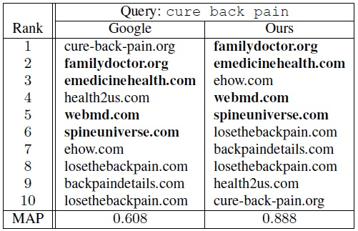
Use classifier to re-rank results
Reranked
MAP | Google | Ours
22 queries | 0.753 | 0.817
+8.5% Relative
Notes:
46% Relative

Slide 31
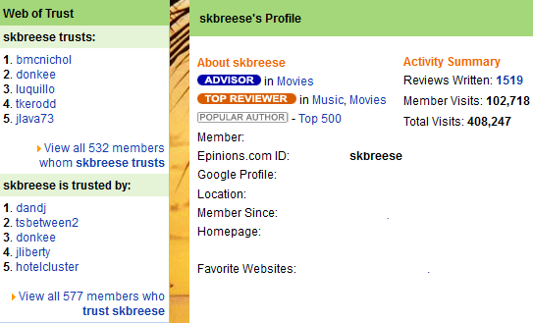

2. Source reputation models
Social network builds user reputation
  Here, reputation means extent of good past behavior
Estimate reputation of sources based on
  Number of people who agreed with (or did not refute) what they said
  Number of people who “voted” for (or liked) what they said
  Frequency of changes or comments made to what they said
Used in many review sites

Slide 32
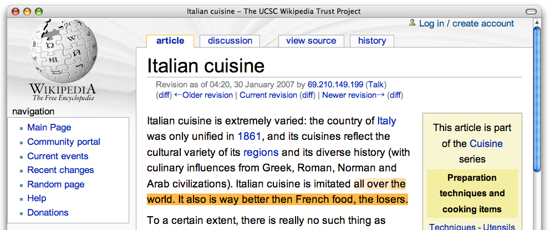
Example: WikiTrust
[Adler et al., 2008]
[Adler and de Alfaro, 2007]
Computed based on
  Edit history of the page
  Reputation of the authors making the change

Slide 33
An Alert
A lot of the algorithms presented next have the following characteristics
  Model Trustworthiness Components – sources, claims, evidence, etc. – as nodes of a graph
  Associate scores with each node
  Run iterate algorithms to update the scores
Models will be vastly different based on
  What the nodes represent (e.g., only sources, sources & claims, etc.)
  What update rules are being used (a lot more on that later)

Slide 34
3. Link-based trust computation
HITS
PageRank
Propagation of Trust and Distrust
s₁
s₂
s₃
s₄
s₅

Slide 35
Hubs and Authorities (HITS)
[Kleinberg, 1999]
Proposed to compute source “credibility” based on web links
Determines important hub pages and important authority pages
Each source p 2 S has two scores (at iteration i)
  Hub score: Depends on “outlinks”, links that point to other sources
  Authority score: Depends on “inlinks”, links from other sources
and are normalizers (L₂ norm of the score vectors)

Slide 36
Page Rank
[Brin and Page, 1998]
Another link analysis algorithm to compute the relative importance of a source in the web graph
Importance of a page p 2 S depends on probability of landing on the source node p by a random surfer
Used as a feature in determining “quality” of web sources
N: number of sources in S
L(p): number of outlinks of p
d: combination parameter; d \in (0,1)

Slide 37
PageRank example – Iteration 1
1
1
0.5
1
0.5
1
1

Slide 38
PageRank example – Iteration 2
1
1.5
0.5
1.5
0.5
0.5
0.5

Slide 39
PageRank example – Iteration 3
1.5
1
0.75
1
0.75
0.5
0.5

Slide 40
PageRank example – Iteration 4
1
1.25
0.5
1.25
0.5
0.75
0.75

Slide 41
Eventually…
1.2
1.2
0.6

Slide 42
Topic-sensitive PageRank
[Haveliwala, 2002]
One PageRank score per basic topic
  Instead of running over the entire web graph, restrict to pages known to be on the topic.
  Each node gets a vector of scores (over the set of topics)

Slide 43
Semantics of Link Analysis
Computes “reputation” in the network
Thinking about reputation as trustworthiness assumes that the links are recommendations
  May not be always true
It is a static property of the network
  Do not take the content or information need into account
  It is objective
The next model refines the PageRank approach in two ways
  Explicitly assume links are recommendations (with weights)
  Update rules are more expressive

Slide 44
Propagation of Trust and Distrust
[Guha et al., 2004]
Model propagation of trust in human networks
Two matrices: Trust (T) and Distrust (D) among users
Belief matrix (B): typically T or T-D
Atomic propagation schemes for Trust
  1. Direct propagation (B)
  2. Co-Citation (B^{T}B)
  3. Transpose Trust (B^{T})
  4. Trust Coupling (BB^{T})
P
Q
P
Q
R
R
S
P
Q
P
Q
R
S

Slide 45
Propagation of Trust and Distrust (2)
Propagation matrix: Linear combination of the atomic schemes
Propagation methods
  Trust only
  One-step Distrust
  Propagated Distrust
Finally: or weighted linear combination:

Slide 46
Summary
Source features could be used to determine if the source is “trustworthy”
Source network significantly helps in computing “trustworthiness” of sources
However, we have not talked about what is being said -- the claims themselves, and how they affect source “trustworthiness”

Slide 47
Outline
Source-based Trustworthiness
Basic Trustworthiness Framework
  Basic Fact-finding approaches
  Basic probabilistic approaches
Integrating Textual Evidence
Informed Trustworthiness Approaches
  Adding prior knowledge, more information, structure
Perception and Presentation of Trustworthiness

Slide 48
Basic Trustworthiness Frameworks:
Fact-finding algorithms and simple probabilistic models
http://l2r.cs.uiuc.edu/Information_Trustworthiness_Tutorial.pptx
TexPoint fonts used in EMF.
Read the TexPoint manual before you delete this box.: AAAAAAA

Slide 49
Components of Trustworthiness
Source
Source
Claim
Source
Claim
Claim
Claim
Evidence
Users

Slide 50
Fact-Finders
s₁
c₁
Model the trustworthiness of sources and the believability of claims
Claims belong to mutual exclusion sets
Input: who says what
Output: what we should believe, who we should trust
Baseline: simple voting—just believe the claim asserted by the most sources
s₂
c₂
s₃
c₃
s₄
c₄
s₅
Notes:
Instead of looking at just the sources, or doing voting, we can model both the sources and claims.

Slide 51
Basic Idea
Sources S
Claims C
Mutual exclusion sets
A fact-finder is an iterative, transitive voting algorithm:
Calculates belief in each claim from the credibility of its sources
Calculates the credibility of each source from the believability of the claims it makes
Repeats
s₁
c₁
m₁
s₂
c₂
c₃
s₃
c₄
m₂
s₄
c₅
Bipartite graph
Each source s 2 S asserts a set of claims µ C
Each claim c 2 C belongs to a mutual exclusion set m
Example ME set: “Possible ratings of the Detroit Marriot”
Notes:
51
In the domain of hotel ratings, a source would be a reviewer, say, Jim, while a mutual exclusion set would be the set of a ratings for a particular hotel, say, the Detroit Marriot, and each possible rating for that hotel would be a claim within that mutual exclusion set.

Slide 52
Fact-Finder Prediction
The fact-finder runs for a specified number of iterations or until convergence
  Some fact-finders are proven to converge; most are not
  All seem to converge relatively quickly in practice (e.g. a few dozen iterations)
Predictions are made by looking at each mutual exclusion set and choosing the claim with the highest belief score

Slide 53
Advantages of Fact-Finders
Usually work much better than simple voting
  Sources are not all equally trustworthy!
Numerous high-performing algorithms in literature
Highly tractable: all extant algorithms take time linear in the number of sources and claims per iteration
Easy to implement and to (procedurally) understand
A fact-finding algorithm can be specified by just two functions:
  T^{i}(s): How trustworthy is this source given our previous belief the claims it makes claims?
  B^{i}(c): How trustworthy is this claim given our current trust of the sources asserting it?

Slide 54
Disadvantages of Fact-Finders
Limited expressivity
  Only consider sources and the claims they make
Much more information is available, but unused
  Declarative prior knowledge
  Attributes of the source, uncertainty of assertions, and other data
No “story” and vague semantics
  A trust score of 20 is better than 19, but how much better?
  Which algorithm to apply to a given problem?
    Some intuitions are possible, but nothing concrete
Opaque; decisions are hard to explain
Notes:
Later in this tutorial we’ll see that all of these issues can be address by alternative models, although this will frequently come at the price of complexity

Slide 55
Example: The Sums Fact-Finder
We start with a concrete example using a very simple fact-finder, Sums
  Sums is similar to the Hubs and Authorities algorithm, but applied to a source-claim bipartite graph
Notes:
In Sums, the trustworthiness of a source is simply the (normalized) sum of our previous belief in the claims it makes; similarly, the believability of a claim is the sum of trustworthiness of the sources asserting it. Initially, our belief is uniform across all the claims.

Slide 56
Numerical Fact-Finding Example
Problem:
  We want to obtain the birthdays of Bill Clinton, George W. Bush, and Barack Obama
  We have run information extraction on documents by seven authors, but they disagree

Slide 57
Numerical Fact-Finding Example
John
Sarah
Kevin
Jill
Sam
Lilly
Dave
Clinton
8/20/47
Clinton
8/31/46
Clinton
8/19/46
Bush
4/31/47
Bush
7/6/46
Obama
8/4/61
Obama
2/14/61

Slide 58
Approach #1: Voting
1.5 out of 3 correct
John
Sarah
Kevin
Jill
Sam
Lilly
Dave
Clinton
8/20/47
Clinton
8/31/46
Clinton
8/19/46
Bush
4/31/47
Bush
7/6/46
Obama
8/4/61
Obama
2/14/61
WRONG
RIGHT
TIE

Slide 59
Sums at Iteration 0
Let’s try a simple fact-finder, Sums
John
Sarah
Kevin
Jill
Sam
Lilly
Dave
Clinton
8/20/47
Clinton
8/31/46
Clinton
8/19/46
Bush
4/31/47
Bush
7/6/46
Obama
8/4/61
Obama
2/14/61
1
1
1
1
1
1
1
Initially, we believe in each claim equally

Slide 60
Sums at Iteration 1A
The trustworthiness of a source is the sum of belief in its claims
1
2
1
2
2
1
1
John
Sarah
Kevin
Jill
Sam
Lilly
Dave
Clinton
8/20/47
Clinton
8/31/46
Clinton
8/19/46
Bush
4/31/47
Bush
7/6/46
Obama
8/4/61
Obama
2/14/61
1
1
1
1
1
1
1

Slide 61
Sums at Iteration 1B
1
2
1
2
2
1
1
John
Sarah
Kevin
Jill
Sam
Lilly
Dave
Clinton
8/20/47
Clinton
8/31/46
Clinton
8/19/46
Bush
4/31/47
Bush
7/6/46
Obama
8/4/61
Obama
2/14/61
3
1
2
2
5
2
1
And belief in a claim is the sum of the trustworthiness of its sources

Slide 62
Sums at Iteration 2A
Now update the sources again…
3
5
1
7
7
5
1
John
Sarah
Kevin
Jill
Sam
Lilly
Dave
Clinton
8/20/47
Clinton
8/31/46
Clinton
8/19/46
Bush
4/31/47
Bush
7/6/46
Obama
8/4/61
Obama
2/14/61
3
1
2
2
5
2
1

Slide 63
Sums at Iteration 2B
3
5
1
7
7
5
1
John
Sarah
Kevin
Jill
Sam
Lilly
Dave
Clinton
8/20/47
Clinton
8/31/46
Clinton
8/19/46
Bush
4/31/47
Bush
7/6/46
Obama
8/4/61
Obama
2/14/61
8
1
7
5
19
7
1
And update the claims…

Slide 64
Sums at Iteration 3A
Update the sources…
8
13
1
26
26
19
1
John
Sarah
Kevin
Jill
Sam
Lilly
Dave
Clinton
8/20/47
Clinton
8/31/46
Clinton
8/19/46
Bush
4/31/47
Bush
7/6/46
Obama
8/4/61
Obama
2/14/61
8
1
7
5
19
7
1

Slide 65
Sums at Iteration 3B
8
13
1
26
26
19
1
John
Sarah
Kevin
Jill
Sam
Lilly
Dave
Clinton
8/20/47
Clinton
8/31/46
Clinton
8/19/46
Bush
4/31/47
Bush
7/6/46
Obama
8/4/61
Obama
2/14/61
21
1
26
13
71
26
1
And one more update of the claims

Slide 66
Results after Iteration 3
Now (and in subsequent iterations) we get 3 out of 3 correct
8
13
1
26
26
19
1
John
Sarah
Kevin
Jill
Sam
Lilly
Dave
Clinton
8/20/47
Clinton
8/31/46
Clinton
8/19/46
Bush
4/31/47
Bush
7/6/46
Obama
8/4/61
Obama
2/14/61
21
1
26
13
71
26
1
RIGHT
RIGHT
RIGHT

Slide 67
Sums Pros and Cons
Sums is easy to express, but is also quite biased
All else being equal, favors sources that make many claims
  Asserting more claims always results in greater credibility
  Nothing dampens this effect
  Similarly, it favors claims asserted by many sources
Fortunately, in some real-world domains dishonest sources do tend to create fewer claims; e.g. Wikipedia vandals
67
Notes:
67
Sums suffers more than most from the “easy claim-making” issue because it has no dampening; the increased trust/credibility from extra assertions is linear!

Slide 68
Fact-finding algorithms
Fact-finding algorithms have biases (not always obvious) that may not match the problem domain
Fortunately, there are many methods to choose from:
  TruthFinder
  3-Estimates
  Average-Log
  Investment
  PooledInvestment
  …
The algorithms are essentially driven by intuition about what makes something a credible claim, and what makes someone a trustworthy source
Diversity of algorithms mean that one can pick the best where there is some labeled data
But some algorithms tend to work better than others overall

Slide 69
TruthFinder
[Yin et al., 2008]
Pseudoprobabilistic fact-finder algorithm
The trustworthiness of each source is calculated as the average of the [0, 1] beliefs in its claims
The intuition for calculating the belief of each claim relies on two assumptions:
  T(s) can be taken as P(claim c is true | s asserted c)
  Sources make independent mistakes
The belief in each claim can then be found as one minus the probability that everyone who asserted it was wrong:
TexPoint Display

Slide 70
TruthFinder
More precisely, we can give the update rules as:

Slide 71
TruthFinder Implication
This is the “simple” form of TruthFinder
In the “full” form, the (log) belief score is adjusted to account for implication between claims
  If one claim implies another, a portion of the former’s belief score is added to the score of the latter
  Similarly, if one claim implies that another can’t be true, a portion of the former’s belief score is subtracted from the score of the latter
  Scores are run through a sigmoidal function to keep them [0, 1]
This same idea can be generalized to all fact-finders (via the Generalized Fact-Finding framework presented later)

Slide 72
TruthFinder: Computation

Slide 73
TruthFinder Pros and Cons
Works well in real data sets
  Both, especially the “full” version, which usually works better
Bias from averaging the belief in asserted claims to find a source’s trustworthiness
  Sources asserting mostly “easy” claims will be advantaged
  Sources asserting few claims will likely be considered credible just by chance; no penalty for making very few assertions
    In Sums, reward for many assertions was linear

Slide 74
AverageLog
Intuition: TruthFinder does not reward sources making numerous claims, but Sums rewards them far too much
Sources that make more claims tend to be, in many domains, more trustworthy (e.g. Wikipedia editors)
AverageLog scales the credibility boost of multiple sources by the log of the number of sources

Slide 75
AverageLog Pros and Cons
AverageLog falls somewhere between Sums and TruthFinder
Whether this is advantageous will depend on the domain

Slide 76
Investment
A source “invests” its credibility into the claims it makes
That credibility “investment” grows according to a non-linear function G
The source’s credibility is then a sum of the credibility of its claims, weighted by how much of its credibility it previously “invested”
(where C_{s} is the number of claims made by source s)

Slide 77
Pooled Investment
Like investment, except that the total credibility of claims is normalized by mutual exclusion set
This effectively creates “winners” and “losers” within a mutual exclusion set, dampening the tendency for popular mutual exclusion sets to become hyper-important relative to those with fewer sources

Slide 78
Investment and PooledInvestment Pros and Cons
The ability to choose G is useful when the truth of some claims is known and can be used to determine the best G
Often works very well in practice
PooledInvestment tends to offer more consistent performance

Slide 79
3-Estimates
Relatively complicated algorithm
Interesting primarily because it attempts to capture difficulty of claims with a third set of “D” parameters
Rarely a good choice in our experience because it rarely beats voting, and sometimes substantially underperforms it
  But other authors report better results on their datasets

Slide 80
Evaluation (1)
Measure accuracy: percent of true claims identified
Book authors from bookseller websites
  14,287 claims of the authorship of various books by 894 websites
  Evaluation set of 605 true claims from the books’ covers.
Population infoboxes from Wikipedia
  44,761 claims made by 171,171 Wikipedia editors in infoboxes
  Evaluation set of 274 true claims identified from U.S. census data.

Slide 81
Evaluation (2)
Stock performance predictions from analysts
  Predicting whether stocks will outperform S&P 500.
  ~4K distinct analysts and ~80K distinct stock predictions
  Evaluation set of 560 instances where analysts disagreed.
Supreme Court predictions from law students
  FantasySCOTUS: 1138 users
  24 undecided cases
  Evaluation set of 53 decided cases
  10-fold cross-validation
We’ll see these datasets again when we discuss more complex models

Slide 82
Population of Cities
Notes:
44,761 claims made by 171,171 Wikipedia editors in infoboxes, with an evaluation set of 274 true claims identified from U.S. census data. A popular city like LA will have far more discord than a petty city like Lincoln, Illinois
Some cities are far more contentious than others; we expected models capable of capturing the varying difficulty of ME sets to do well, which they did.

Slide 83
Book Authorship
Notes:
Fact-finders and are on the left, LCA models are on the right. _g _s _m subscripts.
14,287 claims of the authorship of various books by 894 websites, with an evaluation set of 605 true claims collected by examining the books’ covers.
Notice the performance of GuessLCA—GuessLCA performs consistently well across domains and is quite tractable; it’s a good thing.
LieLCA_s: sources vary in tendency to lie (consistent mistakes) or guess by copying prevailing sources.
---
The LieLCA_s generative story fits especially well with what we know about online booksellers a priori: some sources will consistently corrupt, abbreviate or omit authors names (in other words, they consistently “lie”), while others “guess” by copying prevailing sources
since they tend not to research the information themselves (low Ds)

Slide 84
Stock Performance Prediction
Notes:
You can’t use this to make money!
Predicting whether stocks would outperform S&P 500. Rather complicated setup, but ~4K distinct analysts and ~80K distinct stock predictions; evaluation set consists of 560 correct predictions where analysts disagreed. Semi-supervised because we looked at the problem over time and (at each given point) was known to us.
Stocks are very hard to predict, and voting does worse than random. Analysts as a whole are overly optimistic, and stocks are all comparably hard to predict. Therefore it makes sense that we suffer overfitting trying capture difficulty of individual stocks or tendency towards mistake of individual analysts.

Slide 85
SCOTUS Prediction
Notes:
FantasySCOTUS: 1138 users; 53 decided cases, 24 undecided.
10-fold cross-validation, each fold tuned by nested 4-fold cross-validation.
LieLCA and MistakeLCA are too expensive to tune this way and are omitted here.

Slide 86
Average Performance Ratio vs. Voting

Slide 87
Conclusion
Fact-finders are fast and can be quite effective on real problems
The best fact-finder will depend on the problem
Because of the variability of performance, having a pool of fact-finders to draw on is highly advantageous when tuning data is available!
PooledInvestment tends to be a good first choice, followed by Investment and TruthFinder

Slide 88
Basic Probabilistic Models

Slide 89
Introduction
We’ll next look at some simple probabilistic models
These are more transparent than fact-finders and tell a generative story, but are also more complicated
For the three simple models we’ll discuss next:
  Their assumptions also specialize them to specific scenarios and types of problem
  Binary mutual exclusion sets (is something true or not?)
    No multinomials
We’ll see more general, more sophisticated Latent Credibility Analysis models later

Slide 90
1. On Truth Discovery and Local Sensing
[Wang et al., 2012]
Used when: sources only report positive claims
Scenario:
  Sources never report “claim X is false”; they only assert the “claim X is true”
  This poses a problem for most models, which will assume a claim is true if some people say a claim is true and nobody contradicts them
Model Parameters
  a_{x} = P(s ! “X” | claim “X” is true), b_{x} = P(s ! “X” | claim “X” is false)
  d = Prior probability that P(claim is true)
  To compute the posterior P(claim “X” is true | s ! “X”), use Bayes’ rule and these two assumptions:
    Estimate P(s ! “X”) as the proportion of claims asserted by s relative to the total number of claims
    Assume that P(claim “X” is true”) = d (for all claims)

Slide 91
On Truth Discovery and Local Sensing
Interesting concept—requires only positive examples
Inference done to maximize the probability of the observed source ! claim assertions given the parameters via EM
Many real world problems where only positive examples will be available, especially from human sources
  But there are other ways to model this, e.g. by assuming implicit, low-weight negative examples from each non-reporting source
  Also, in many cases negative assertions are reliably implied, e.g. the omission of an author from a list of authors for a book
Real world evaluation in paper is qualitative
  Unclear how well it really works in general

Slide 92
2. A Bayesian Approach to Discovering Truth from Conflicting Sources for Data Integration
[Zhao et al.]
Used when: want to model source’s false negative rate and false positive rate separately
  E.g. when predicting lists, like authors of a book or cast of a movie
  Some sources may have higher recall, others higher precision
Claims are still binary “is member of list/is not member of list”
Inference is (collapsed) Gibb’s sampling

Slide 93



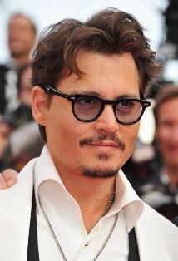

Example
As already mentioned, negative claims can be implicit; this is especially true with lists
IMDB
Positive Claim
IMDB: TP=2, FP=0, TN=1, FN=0
Precision=1, Recall=1, FPR = 0
Netflix: TP=1, FP=0, TN=1, FN=1
Precision=1, Recall=0.5, FPR = 0
BadSource: TP=1, FP=1, TN=0, FN=1
Precision=0.5, Recall=0.5, FPR=1
Negative Claim
Netflix
True Claim
BadSource
False Claim
Harry Potter
Notes:
Negative claims is critical for probabilities (0.5 threshold). If only want to top-1, it’s probably ok to only consider positive claims.

Slide 94
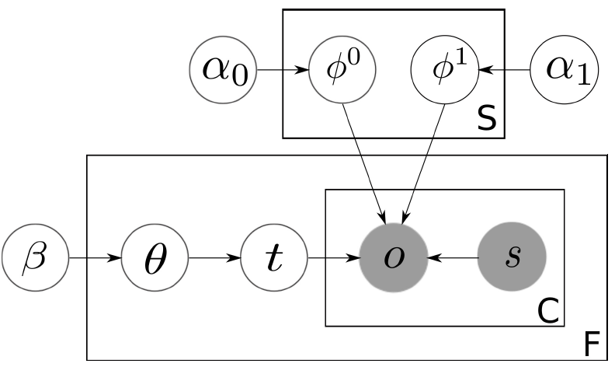






Generative Story
For each source k
  Generate false positive rate (with
  strong regularization, believing most
  sources have low FPR):
  Generate its sensitivity/recall (1-FNR)
  with uniform prior, indicating low FNR is
  more likely:
For each fact (binary ME set) f
  Generate its prior truth prob, uniform prior:
  Generate its truth label:
For each claim c of fact f, generate observation of c.
  If f is false, use false positive rate of source:
  If f is true, use sensitivity of source:
Quality of Sources
Observation of Claims
Truth of Facts
Graphical Representation

Slide 95
Pros and Cons
Assumes low false positive rate from sources
  May not be robust against those that are very bad/malicious
Reported experimental results
  99.7% F1-score on book authorship
    1263 books, 879 sources, 48153 claims, 2420 book-author, 100 labels
  92.8% F1-score on movie directors
    15073 movies, 12 sources, 108873 claims, 33526 movie-director, 100 labels
Experimental evaluation is incomparable to standard fact-finder evaluation
  Implicit negative assertions were not added
  Thresholding on the positive claims’ belief scores was used instead (!)
  Still unclear how good performance is relative to fact-finders
  Further studies are required
Notes:
Experimental results suspicious

Slide 96
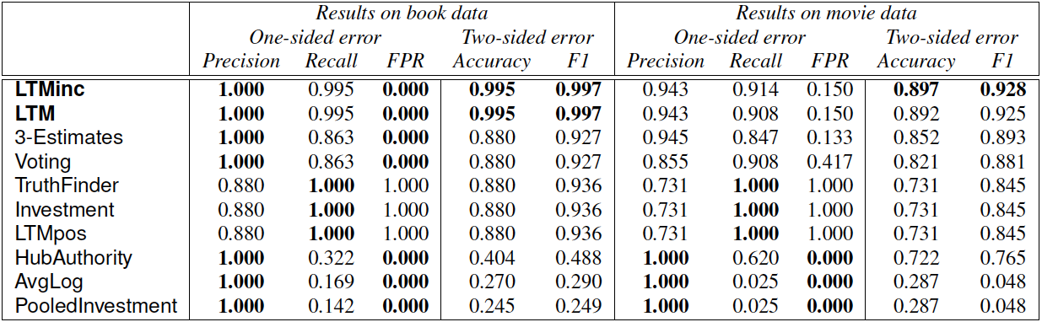
Experiments
Datasets:
  Book Authors from abebooks.com (1263 books, 879 sources, 48153 claims, 2420 book-author, 100 labeled)
  Movie Directors from Bing (15073 movies, 12 sources, 108873 claims, 33526 movie-director, 100 labeled)
Notes:
LTMpos only consider positive claims. 3-Estimate and voting too conservative. TruthFinder, etc (does not consider negative claims) too optimistic predicting everything is true.

Slide 97
3. Estimating Real-valued Truth from Conflicting Sources
[Zhao and Han, 2012]
Used when: the truth is real-valued
Idea: if the claims are 94, 90, 91, and 20, the truth is probably ~92
Put another way, sources assert numbers according to some distribution around the truth
Each mutual exclusion set is the set of real numbers

Slide 98
Real-valued data is important
Numerical data is ubiquitous and highly valuable:
  Prices, ratings, stocks, polls, census, weather, sensors, economy data, etc.
Much harder to reach a (naïve) consensus than with multinomial data
Can also be implemented with other methods:
  Implication between claims in TruthFinder and Generalized Fact-Finders [discussed later]
  Implicit assertion of distributions about the observed claim in Latent Credibility Analysis [also discussed later]
  However, such methods will limit themselves to numerical claims asserted by at least one source

Slide 99
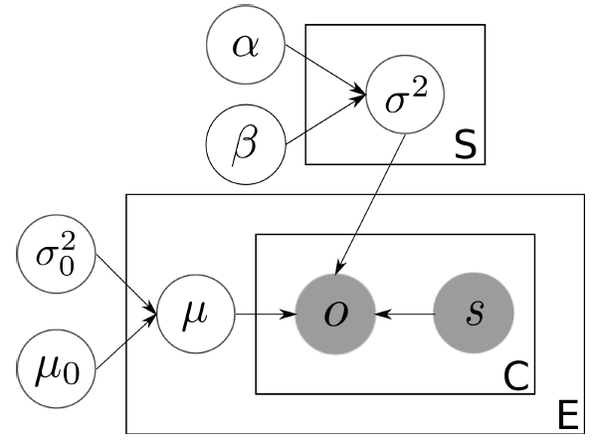
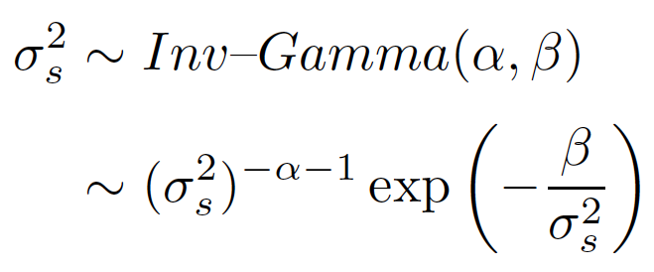
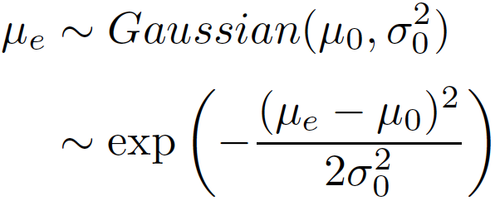
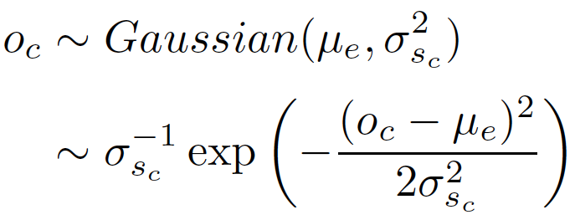
Generative Story
For each source k
  Generate source quality:
For each ME set E,
generate its true value:
Generate each observation of c:
Quality of Sources
Observation of Claims
True Values of ME sets E

Slide 100
Pros and Cons
Modeling real-valued data directly allows the selection of a value not asserted by any source
Can do inference with EM
May go astray without outlier detection and removal
  Also need to somehow scale data
Assumes sources generate their claims based on the truth
  Not good against malicious sources
  Bad/sparse claims in an ME set will skew ¹ the
Easy to understand: source’s credibility is the variance it produces

Slide 101
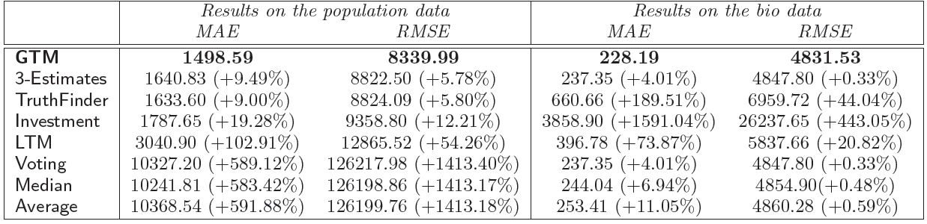
Experiments
Evaluation: Mean Absolute Error (MAE), Root Mean Square Error (RMSE).
Notes:
Uh, scale? Ideally we would want to also see the average relative error; getting the population of one huge city slightly wrong is not as bad as getting the population of 100 small towns totally wrong. Also not clear how much the outlier pruning is helping.

Slide 102
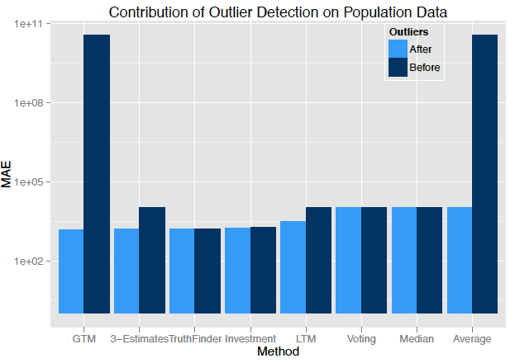
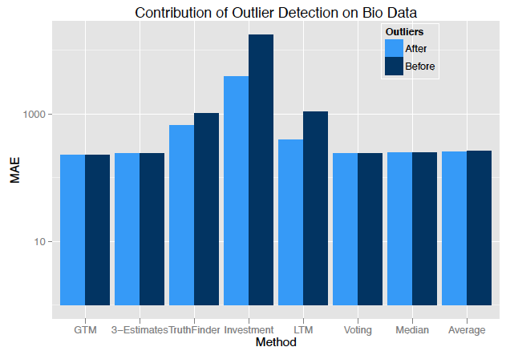
Experiments: Effectiveness
Benefits of outlier detection on population data and bio data.

Slide 103
Conclusions
Fact-finders work well on many real data sets
  But are opaque
The simple probabilistic models we’ve outlined have generative stories
  Fairly specialized domains, e.g. real-valued claims without malevolence, positive-only observations, lists of claims
We expect that they will do better in the domains they’ve been built to model
But currently experimental evidence on real data sets is lacking
Later on we’ll present both more sophisticated fact-finders and probabilistic models that address these issues

Slide 104
Outline
Source-based Trustworthiness
Basic Trustworthiness Framework
  Basic Fact-finding approaches
  Basic probabilistic approaches
Integrating Textual Evidence
Informed Trustworthiness Approaches
  Adding prior knowledge, more information, structure
Perception and Presentation of Trustworthiness
BREAK

Slide 105
Outline
Source-based Trustworthiness
Basic Trustworthiness Framework
  Basic Fact-finding approaches
  Basic probabilistic approaches
Integrating Textual Evidence
Informed Trustworthiness Approaches
  Adding prior knowledge, more information, structure
Perception and Presentation of Trustworthiness
BREAK

Slide 106
Content-Driven Trust Propagation Framework
http://l2r.cs.uiuc.edu/Information_Trustworthiness_Tutorial.pptx
[Vydiswaran et al., 2011]

Slide 107
Components of Trustworthiness
Source
Source
Claim
Source
Claim
Claim
Claim
Evidence
Users

Slide 108




Typical fact-finding is over structured data
Sources
Claims
Assume
structured claims
and
accurate IE modules
Claim 1
Claim 2
.
.
.
Claim n
Mt. Everest | 8848 m
K2 | 8611 m
Mt. Everest | 8500 m
Notes:
maybe say something about why this works;

Slide 109
Incorporating Text in Trust Models
Trust
Sources
Evidence
Claims
Claim 1
“Essiac tea treats cancer.”
Passages that give evidence for the claim
“SCOTUS rejects Obamacare.”
Web Sources
News coverage on the issue of “Immigration” is biased.
News media
(or reporters)
News stories

Slide 110
Evidence-based Trust models
Sources
Evidence
Claims
Claim 1
Claim 2
.
.
.
Claim n
1. Textual evidence
2. Supports adding IE accuracy, relevance, similarity between text
Free-text claims
Special case: structured data

Slide 111
Understanding model parameters
Scores computed
  : Claim veracity
  : Evidence trust
  : Source trust
Influence factors
  : evidence similarity
  : Relevance
  : Source-evidence influence (confidence)
Initializing
  Uniform distribution for
  Retrieval score for
Notes:
Sources copying
How is similarity of evidence a measure of trustworthiness

Slide 112
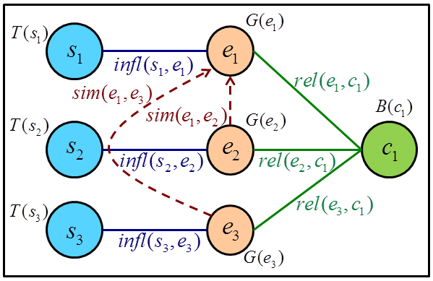
Computing Trust scores
Trust scores computed iteratively
Veracity of claims
Trustworthiness of sources
Confidence in evidence
Veracity of a claim depends on
the evidence documents for the claim and their sources.
Trustworthiness of a source is based on the claims it supports.
Confidence in an evidence document depends on source trustworthiness and confidence in other similar documents.

Slide 113

Computing Trust scores
Trust scores computed iteratively
Adding influence factors
$B^{(n+1)}\left(c_{i}\right)=$ $\frac{\sum_{e_{j}∈ E(c_{i})}{ \left[G^{\left(n\right)}\left(e_{j}\right){ × T}^{\left(n\right)}\left(s(e_{j})\right)\right] }}{\left|E(c_{i})\right|}$
$T^{(n+1)}\left(s_{i}\right)=$ $\frac{\sum_{c_{j}∈C(s_{i})}{ \left[B^{\left(n+1\right)}\left(c_{j}\right)\right] }}{\left|C(s_{i})\right|}$
$G^{(n+1)}\left(e_{i}\right)=$ $μ G^{(n)}\left(e_{i}\right)+\left(1−μ\right)$ $T^{(n+1)}\left({s(e}_{i})\right)$
${\hat{G}}^{(n+1)}\left(e_{i}\right)=$ $λ \left(\frac{\sum_{e_{j}∈ E\left(c\left(e_{i}\right)\right),e_{j}≠e_{i}}{ \left[G^{\left(n\right)}\left(e_{j}\right) × sim\left(e_{i}{ , e}_{j}\right)\right] }}{\left|E(c(e_{i}))\right|−1}\right)+\left(1−λ\right)$ $G^{(n+1)}\left(e_{i}\right)$
${\hat{B}}^{(n+1)}\left(c_{i}\right)=$ $\frac{\sum_{e_{j}∈ E(c_{i})}{ \left[G^{\left(n\right)}\left(e_{j}\right){ × T}^{\left(n\right)}\left(s(e_{j})\right) × rel(e_{j}{ , c}_{i})\right] }}{\left|E(c_{i})\right|}$
Trustworthiness of source of evidence e_{j}
Sum over all other pieces of evidence for claim c(e_{i})
Similarity of evidence e_{i} to e_{j}
Relevance of evidence e_{j} to claim c_{i}
Notes:
at some point you need to talk about the assumptions that underlie the model. Just formulae isn’t good enough.
QD: How do you initialize the model

Slide 114
Generality: Relationship to other models
  TruthFinder [Yin, Han & Yu, 2007]; Investment [Pasternack & Roth, 2010]

Slide 115


Finding relevant evidence passages
Traditional search
Lookup pieces of evidence only on relevance
User searches for a claim
Evidence search
Lookup pieces of evidence supporting and opposing the claim
One approach:
Relation Retrieval + Textual Entailment

Slide 116
Stage 1: Relation Retrieval
Relation
Query Formulation
  structured relation
  possibly typed
Query Expansion
  Relation: with synonyms, words with similar contexts
  Entities: with acronyms, common synonyms
Query weighting
  Reweighting components
Entity
Entity
type
type
cure
treat
help prevent
reduce
cured by
Entity 1
Entity 2
Disease
Treatment
Cancer
Glioblastoma
Brain cancer
Leukemia
Chemotherapy
Chemo

Slide 117
Stage 2: Textual Entailment
Text
Hypothesis
Text:
A review article of the latest studies looking at red wine and cardiovascular health shows drinking two to three glasses of red wine daily is good for the heart.
Hypothesis 1: Drinking red wine is good for the heart.
Hypothesis 2: The review article found no effect of drinking wine on cardiovascular health.
Hypothesis 3: The article was biased in its review of latest studies looking at red wine and cardiovascular health.

Slide 118
Textual Entailment in Search
[Sammons, Vydiswaran & Roth, 2009]
Text Corpus
Indexes
Preprocessing:
Identification of
  named entities
  multi-word expressions
Document parsing, cleaning
Word inflexions / stemming
Preprocessing
Indexing
Retrieval
Scalable Entailed Relation Recognizer
Expanded Lexical Retrieval
Entailment Recognition
Hypothesis
(Claim) Relation
Applications in Intelligence community, document anonymization / redaction

Slide 119
Application 1: News Trustworthiness
Sources
Evidence
Claims
Claim 1
News media
(or reporters)
Biased news coverage on a particular topic or genre?
News stories
Whom can you trust?
Which news stories can you trust?
How true is a claim?

Slide 120
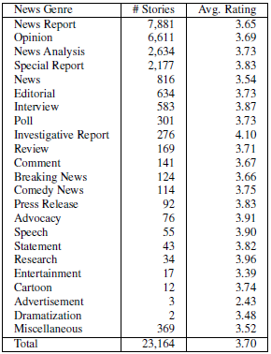
Evidence corpus in News domain
Data collected from NewsTrust (Politics category)
Articles have been scored by volunteers on journalistic standards
Scores on [1,5] scale
Some genres inherently more trustworthy than others

Slide 121
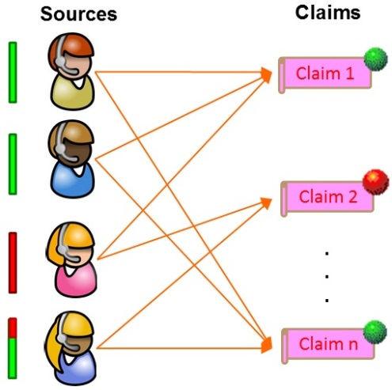
Using Trust model to boost retrieval
Documents are scored on a 1-5 star scale by NewsTrust users.
This is used as golden judgment to compute NDCG values.
# | Topic | Retrieval | 2-stg models | 3-stg model
1 | Healthcare | 0.886 | 0.895 | 0.932
2 | Obama administration | 0.852 | 0.876 | 0.927
3 | Bush administration | 0.931 | 0.921 | 0.971
4 | Democratic policy | 0.894 | 0.769 | 0.922
5 | Republican policy | 0.774 | 0.848 | 0.936
6 | Immigration | 0.820 | 0.952 | 0.983
7 | Gay rights | 0.832 | 0.864 | 0.807
8 | Corruption | 0.874 | 0.841 | 0.941
9 | Election reform | 0.864 | 0.889 | 0.908
10 | WikiLeaks | 0.886 | 0.860 | 0.825
 | Average | 0.861 | 0.869 | 0.915
+6.3% Relative
Notes:
you can present it first as a retrieval model, where ranking is done w.r.t. another metric.

Slide 122
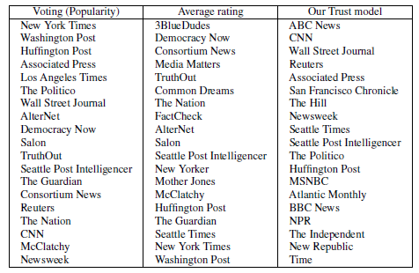
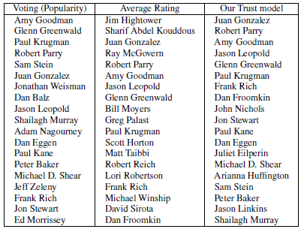
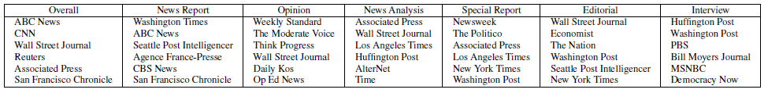
Which news sources should you trust?
News media
News reporters
Does it depend on news genres?

Slide 123



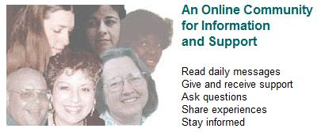


Application 2: Medical treatment claims
[Vydiswaran, Zhai &Roth, 2011b]
Treatment claims
Claim
Essiac tea is an effective treatment for cancer.
Chemotherapy is an effective treatment for cancer.
Evidence & Support DB

Slide 124
Treatment claims considered
Disease | Approved Treatments | Alternate Treatments
AIDS | Abcavir, Kivexa, Zidovudine, Tenofovir, Nevirapine | Acupuncture, Herbal medicines, Multi-vitamins, Tylenol, Selenium
Arthritis | Physical therapy, Exercise, Tylenol, Morphine, Knee brace | Acupuncture, Chondroitin, Gluosamine, Ginger rhizome, Selenium
Asthma | Salbutamol, Advair, Ventolin Bronchodilator, Xolair | Atrovent, Serevent, Foradil, Ipratropium
Cancer | Surgery, Chemotherapy, Quercetin, Selenium, Glutathione | Essiac tea, Budwig diet, Gerson therapy, Homeopathy
COPD | Salbutamol, Smoking cessation, Spiriva, Oxygen, Surgery | Ipratropium, Atrovent, Apovent
Impotence | Testesterone, Implants, Viagra, Levitra, Cialis | Ginseng root, Naltrexone, Enzyte, Diet

Slide 125
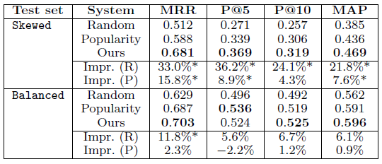
Are valid treatments ranked higher?
Datasets
  Skewed: 5 random valid + all invalid treatments
  Balanced: 5 random valid + 5 random invalid treatments
Finding: Our approach improves ranking of valid treatments, significant in Skewed dataset.
Notes:
The research question here is more basic, and goes to the ability to determine what is trustworthy, given a large collection of text. I think that you need to emphasize it; and, then argue that people can only sample it; this justifies, in some sense, the overall research program.
QD: How do baselines work?

Slide 126
Measuring site “trustworthiness”
Trustworthiness should decrease
Database score
Ratio of degradation

Slide 127
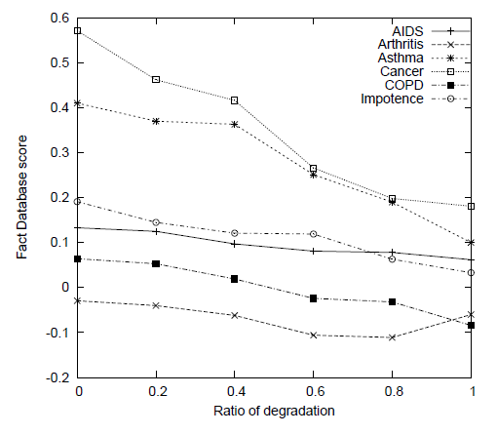
Over all six disease test sets
As noise added to the claim database, the overall score reduces.
Exception: Arthritis, because it starts off with a negative score

Slide 128
Conclusion: Content-driven Trust models
The truth value of a claim depends on its source as well as on evidence
  Evidence documents influence each other and have different relevance to claims
A computational framework that associates relevant stories (evidence) to claims and sources
Experiments with News Trustworthiness shows promising results on incorporating evidence in trustworthiness computation
It is feasible to score claims using signal from million of patient posts: “wisdom of the crowd” to validate knowledge through crowd-sourcing
Notes:
in what way does it depend on evidence?

Slide 129
Generality: Relationship to other models
  TruthFinder [Yin, Han & Yu, 2007]; Investment [Pasternack & Roth, 2010]
Constraints on claims [Pasternack & Roth, 2011]
Structure on sources, groups [Pasternack & Roth, 2011]
Source copying [Dong, Srivastava, et al., 2009]

Slide 130
Outline
Source-based Trustworthiness
Basic Trustworthiness Framework
  Basic Fact-finding approaches
  Basic probabilistic approaches
Integrating Textual Evidence
Informed Trustworthiness Approaches
  Adding prior knowledge, more information, structure
Perception and Presentation of Trustworthiness
BREAK

Slide 131
Informed Trustworthiness Models
http://l2r.cs.uiuc.edu/Information_Trustworthiness_Tutorial.pptx

Slide 132
1. Generalized Fact-Finding

Slide 133
Generalized Fact-Finding: Motivation
Sometimes standard fact-finders are not enough
Consider the question of President Obama’s birthplace:
Source
Source
John
Sarah
Kevin
Jill
Source
Claim
Claim
Obama born in
Kenya
Obama born in Hawaii
Obama born in Alaska
Claim
Claim
Claim

Slide 134
President Obama’s Birthplace
Let’s ignore the rest of the network
Now any reasonable fact-finder will decide that Obama is born in Kenya
John
Sarah
Kevin
Jill
Obama born in
Kenya
Obama born in Hawaii
Obama born in Alaska

Slide 135
How to Do Better: Basic Idea
Encode additional information into a generalized fact-finding graph
Rewrite the fact-finding algorithm to use this generalized graph
More information gives us better trust decisions

Slide 136
Leveraging Additional Information
So what additional knowledge can we use?
  The (un)certainty of the information extractor in each source-claim assertion pair
  The (un)certainty of each source in his claim
  Similarity between claims
  The attributes and group memberships of the sources

Slide 137
Encoding the Information
We can encode all of this elegantly as a combination of weighted edges and additional “layers”
Will transform problem from unweighted bipartite to weighted k-partite network
Fact-finders will then be generalized to use this network
  Generalizing is easy and mechanistic

Slide 138
Calculating the Weight
!_{u}(s,c) £ !_{p}(s,c)
!(s, c)
!_{¾}(s,c)
!_{g}(s,c)
!_{u}(s, c): Uncertainty in information extraction
!_{p}(s, c): Uncertainty of the source
!_{¾}(s, c): Similarity between claims
!_{g}(s, c): Source group membership and attributes
Notes:
138

Slide 139
1. Information Extraction Uncertainty
May come from imperfect model or ambiguity
!_{u}(s, c) = P(s ! c)
Sarah’s statement was “Obama was born in Kenya.”
  President Obama, or Obama Sr.?
  If the information extractor was 70% sure of the former:
John
Sarah
Kevin
Jill
0.7
1
1
1
Obama born in
Kenya
Obama born in Hawaii
Obama born in Alaska

Slide 140
2. Source Uncertainty
A source may qualify an assertion to express their own uncertainty about a claim
!_{p}(s, c) = P_{s}(c)
  Let’s say the information extractor is 70% certain that Sarah said “I am 60% certain President Obama was born in Kenya”. The assertion weight is now 0.6 x 0.7 = 0.42.
John
Sarah
Kevin
Jill
0.42
0.7
1
1
1
Obama born in
Kenya
Obama born in Hawaii
Obama born in Alaska

Slide 141
3. Claim Similarity
A source is less opposed to similar yet competing claims
  Hawaii and Alaska are much more similar (e.g. in location, culture, etc.) to each other than they are to Kenya.
  Jill and Kevin would thus support a claim of Hawaii or Alaska, respectively, over Kenya.
  John and Sarah would, however, be indifferent between Hawaii and Alaska.
John
Sarah
Kevin
Jill
0.42
1
1
1
Obama born in
Kenya
Obama born in Hawaii
Obama born in Alaska

Slide 142
3. Claim Similarity
Equivalently, a source is more supportive of similar claims
  Modeled by “redistributing” a portion ® of a source’s support for the original claim according to similarity
  For similarity function ¾, information extraction certainty weight !_{u} and source certainty weight !_{p}, we can calculate:
Certainty weight for claim d multiplied by its [0, 1]
similarity to claim c and the [0, 1] redistribution factor ®
Proportion ® of s ) c certainty weight
redistributed to other similar claims.
Weight given to the assertion s ) c because c is close to the claims
originally made by s (with varying IE and source certainty)
Sum of similarities of all other claims

Slide 143
3. Claim Similarity
Sarah is indifferent between Hawaii and Alaska
A small part of her assertion weight is redistributed evenly between them
Sarah
Sarah
0.42
0.336
0.042
0.042
Obama born in
Kenya
Obama born in
Kenya
Obama born in Hawaii
Obama born in Alaska

Slide 144
4. Encoding Source Attributes and Groups with Weights
If two sources share the same group or attribute, they are assumed to implicitly support their co-member’s claims
  John and Sarah are “Republicans”, other Republicans implicitly support their claim that President Obama was born in Kenya
  If Kevin and Jill are “Democrats”, other Democrats implicitly split their support between Hawaii and Alaska
  If “Democrats” are very trustworthy, this will exclude Kenya
Redistribute weight to the claims made by co-members
Simple idea, complex formula!

Slide 145
Generalizing Fact-Finding Algorithms to Weighted Graphs
Standard fact-finding algorithms do not use edge weights
Able to mechanistically rewrite any fact-finder with a few simple rules (listed in [Pasternack & Roth, 2011])
For example, Sums becomes:

Slide 146
Group Membership and Attributes of the Sources
We can also model groups and attributes as additional layers in a k-partite graph
Often more efficient and more flexible than edge weights
Republican
Democrat
John
Sarah
Kevin
Jill
Obama born in
Kenya
Obama born in Hawaii
Obama born in Alaska

Slide 147
K-Partite Fact-Finding
Source trust (T) and claim belief (B) functions generalize to “Up” and “Down” functions
  “Up” calculates the trustworthiness of an entity given its children
  “Down” calculates the belief or trustworthiness of an entity given its parents

Slide 148
Running Fact-Finders on K-Partite Graphs
=
Republican
Democrat
D₃(G)
U₃(G)
John
Sarah
Kevin
Jill
U₂(S)
D₂(S)
Obama born in
Kenya
Obama born in Hawaii
Obama born in Alaska
U₁(C)
D₁(C)
=

Slide 149
Experiments
We’ll go over two sets of experiments that use the Wikipedia population infobox data
  Groups with weighted assertions
  Groups as an additional layer
More results can be found in [Pasternack & Roth, 2011]
All experiments show that the additional information used in generalized fact-finding yields significantly more accurate trust decisions
Notes:
149

Slide 150
Groups
Three groups of Wikipedia editors
  Administrators
  Regular editors
  Blocked editors
We can represent these groups
  As edge weights that implicitly model group membership
  Or as an additional “layer” that explicitly models the groups
    Faster in practice
Notes:
150

Slide 151
Weight-Encoded Grouping: Wikipedia Populations
Notes:
151

Slide 152
Summary
Generalized fact-finding allows us to make better trust decisions by considering more information
  And easily inject that information into existing high-performing fact-finders
Uncertainty, similarity and source attribute information are frequently and readily available in real-world domains
Significantly more accurate across a range of fact-finding algorithms
Notes:
152

Slide 153
2. Constrained Fact-Finders

Slide 154
Constrained Fact-Finding
We frequently have prior knowledge in a domain:
  “Bush was born in the same year as Clinton”
  “Obama is younger than both Bush and Clinton”
  “All presidents are at least 35”
  Etc.
Main idea: if we use declarative prior knowledge to help us, we can make much better trust decisions
Challenge: how do use this knowledge with fact-finders?
We’ll now present a method that can apply to all fact-finding algorithms

Slide 155
Types of Prior Knowledge
Prior knowledge comes in two flavors
  Common-sense
    Cities generally grow over time
    A person has two biological parents
    Hotels without Western-style toilets are bad
  Specific knowledge
    John was born in 1970 or 1971
    The population of Los Angeles is greater than Phoenix
    The Hilton is better than the Motel 6
Notes:
155
Note that the mutual exclusion (e.g. a person has exactly one age) is excluded from these FOL sentences

Slide 156
Prior Knowledge and Subjectivity
Truth is subjective
  Proof: Different people believe different things
User’s prior knowledge biases what we should believe
  User A believes that man landed on the moon
  User B believes the moon landing was faked
  Different belief in the claim “there is a mirror on the moon”
Notes:
156
Should replace with city examples?

Slide 157
First-Order Logic Representation
We represent our prior knowledge in FOL:
  Population grows over time [pop(city,population, year)]
    8_{v,w,x,y,z} pop(v,w,y) Æ pop(v,x,z) Æ z > y ) x > w
  Tom is older than John
    8_{x,y} Age(Tom, x) Æ Age(John, y) ) x>y
Notes:
Mention FOL is a convenient high-level representation

Slide 158
Enforcement Mechanism
We will enforce our prior knowledge via linear programming
  We will convert first-order logic into linear programs
  Polynomial-time (Karmarkar, 1984)
The constraints are converted to linear constraints
We choose an objective function to minimize the distance between a satisfying set of beliefs and those predicted by the fact-finder
  Details: [Pasternack & Roth, 2010] and [Rizzolo & Roth, 2007]

Slide 159
The Algorithm
Calculate T^{i}(S) given B^{i-1}(C)
Calculate B^{i}(C)’ given T^{i}(S)
“Correct” B^{i}(C)’ ! B^{i}(C)
Fact-Finding Graph
Prior Knowledge
Notes:
159

Slide 160
Experiments
Wikipedia population infoboxes
American vs. British Spelling (articles)
  British National Corpus, Reuters, Washington Post
Notes:
160

Slide 161
Population Infobox Dataset (1)
Specific knowledge (“Larger”): city X is larger than city Y
  2500 randomly-selected pairings
  There are 44,761 claims by 4,107 authors in total
Notes:
161
“Truth” comes from census data

Slide 162
Population Infobox Dataset (2)
Notes:
162
“Truth” comes from census data

Slide 163
British vs. American Spelling (1)
“Color” vs. “colour”: 694 such pairs
An author claims a particular spelling by using it in an article
Goal: find the “true” British spellings
  British viewpoint
  American spellings predominate by far
  No single objective “ground truth”
Without prior knowledge the fact-finders do very poorly
  Predict American spellings instead
Notes:
163
Subject truth experiment

Slide 164
British vs. American Spelling (2)
Specific prior knowledge: true spelling of 100 random words
  Not very effective by itself
But what if we add common-sense?
  Given spelling A, if |A| ¸ 4 and A is a substring of B, A , B
    e.g. colour , colourful
  Alone, common-sense hurts performance
    Makes the system better at finding American spellings!
  Need both common-sense and specific knowledge
Notes:
164
“Truth” comes from census data

Slide 165
British vs. American Spelling (3)
Notes:
165
“Truth” comes from census data

Slide 166
Summary
Framework for incorporating prior knowledge into fact-finders
  Highly expressive declarative constraints
  Tractable (polynomial time)
Prior knowledge will almost always improve results
  And is absolutely essential when the user’s judgment varies from the norm!
Notes:
166

Slide 167
Joint Approach: Constrained Generalized Fact-Finding

Slide 168
Joint Framework
Recall that constrained Fact-Finding and Generalized Fact-Finding are orthogonal
  We can constrain a generalized fact-finder
  This allows us to simultaneously leverage the additional information of generalized fact-finding and the declarative knowledge of constrained fact-finding
  Still polynomial time
Notes:
168

Slide 169
Joint Framework Population Results
Notes:
169
These results are extremely good—in many cases the joint framework is almost summing the advantage of its two constituent frameworks!

Slide 170
3. Latent Credibility Analysis

Slide 171
Latent Credibility Analysis
Generative graphical models
Describe how sources assert claims, given their credibility (expressed as parameters)
Intuitive “stories” and semantics
Modular, easily extensible
    More general than the simpler, specialized probabilistic models we saw previously
Voting
Fact-Finding, Simple Probabilistic Models
Latent Credibility Analysis
Constrained, Generalized Fact-Finders
Increasing information utilization, performance, flexibility and complexity

Slide 172
SimpleLCA Model
We’ll start with a very basic, very natural generative story:
Each source has an “honesty” parameter H_{s}
Each source makes assertions independently of the others

Slide 173
Additional Variables and Constants
Notation | Description | Example
b_{s,c} 2 B (B µ X) | Assertions (s ! c) ∑_{c 2 m} b_{s,c} = 1 | John says “90% chance SCOTUS will reverse Bowman v. Monsanto”
w_{s,m} | Confidence of s in its assertions over m | John 100% confident in his claims
y_{m} 2 Y | True claim in m | SCOTUS affirmed Bowman v. Monsanto
µ | Parameters describing the sources and claims | H_{s}, D_{m}
Notes:
b_{s,c} and w_{s,m} can be real-valued.
Many other possible observations X: properties of the mutual exclusion sets/claims that indicate they’re “harder”, properties of sources that indicate they’re more credible, etc.
W’s are constant! Typically used as binary switch. We don’t care how they’re generated (e.g. how sources choose which ME sets to talk about).

Slide 174
SimpleLCA Plate Diagram
w_{s,m}
m 2 M
y_{m}
c 2 m
b_{s,c}
c | Claim
s | Source
m | ME Set
y_{m} | True claim in m
b_{s,c} | P(c) according to s
w_{s,m} | Confidence of s
H_{s} | Honesty of s
H_{s}
s 2 S
Notes:
If you’re comfortable with plate diagrams, here you go

Slide 175
SimpleLCA Joint
c | Claim
s | Source
m | ME Set
y_{m} | True claim in m
b_{s,c} | P(c) according to s
w_{s,m} | Confidence of s
H_{s} | Honesty of s
Notes:
We can write the joint probability as such, and this drives the algorithm

Slide 176
Computation

Slide 177
Conditional Distribution over Claims
The exact distribution over the unknown true claims given the assertions and known true claims is:
But this is impossible to compute in practice!

Slide 178
MAP Approximation
Use EM to find the MAP parameter values:
Then assume those parameters are correct:
Y_{U} | Unknown true claims
Y_{L} | Known true claims
X | Observations
µ | Parameters
Notes:
We want a conditional distribution over the claims where we don’t already know the truth given our observations, the parameters, and the claims for which the truth is known (in a semi-supervised setting). However, calculating this exactly would be too hard: instead we use a MAP approximation.

Slide 179
Example: SimpleLCA EM Updates
E-step is easy: just calculate the distribution over Y given the current honesty parameters
The maximizing parameters in EM’s “M-step” can be (very) quickly found in closed form:
Notes:
Closed form EM updates == linear time per iteration == really fast (as fast as fact-finders)
It isn’t always this easy! Resort to gradient descent in other cases, sometimes per parameter (GuessLCA), sometimes jointly (others).
The new value of H_s is essentially the expected proportion of true claims made by the source given our current parameters

Slide 180
Modularity and Extensibility
Want the joint distribution P(X, Y | µ)
X = { B [ X_{f} }
Unadorned LCA model: P_{LCA}(B, Y | µ)
Model for additional features: P_{f} (X_{f} | µ)
Models are independent given µ, so just concatenate:
P(X, Y | µ) = P_{LCA}(B, Y | µ) P_{f} (X_{f} | µ)
Y | True claims
B | Assertions
X_{f} | Other Features
µ | Parameters
Notes:
Example: probability of observing PhD degrees is higher for sources with higher honesty
It’s incredibly easy to add arbitrary features to an LCA model

Slide 181
Four Models

Slide 182
Four increasingly complex models:
SimpleLCA
GuessLCA
MistakeLCA
LieLCA
Notes:
These are not iterative supersets! They tell different stories; the sets of possible worlds described by the models are disjoint

Slide 183
SimpleLCA
Very fast, very easy to implement
But the semantics are sometimes troublesome:
  The probability of asserting the true claim is fixed regardless of how many claims are in the ME set
  But the difficulty clearly varies with |m|
    You can guess the true claim 50% of the time if |m| = 2
    Only 10% of the time if |m| = 10

Slide 184
GuessLCA
We can solve this by modeling guessing
  With probability H_{s}, the source knows and asserts the true claim
  With probability 1 – H_{s}, it guesses a c 2 m according to P_{g}(c | s)
Notes:
The full joint distribution, etc. is in the paper; from here going forward I’m going to stick with just telling the generative story for brevity and clarify

Slide 185
Guessing
The guessing distribution is constant and determined in advance
  Uniform guessing
  Guess based on number of other, existing assertions at the time of the source’s assertion
    Captures “difficulty”: just saying what everyone else was saying is easy
  Create based on a priori expert knowledge

Slide 186
GuessLCA Pros/Cons
Pros: tractable and effective
  Can optimize each H_{s} parameter independently in the M-step via gradient ascent
  Accurate across broad spectrum of tasks
Cons: fixed “difficulty” is limiting
  Can infer difficulty from estimates of latent variables
  A source is never expected to do worse than guessing
Notes:
If we know two users with high honesty values are contradicting each other we can infer that the mutual exclusion set is “difficult”, which we may not have been able to know a priori. Also, a source that does no worse than guessing presupposes that users do not intentionally assert the wrong claim.

Slide 187
MistakeLCA
We can instead model difficulty explicitly
Add a “difficulty” parameter D
  Global, D_{g}
  Per mutual exclusion set, D_{m}
If a source is honest and knows the answer with probability H_{s} ¢ D, it asserts the correct claim
Otherwise, chooses a claim according to a mistake distribution:

Slide 188
MistakeLCA
Pro: models difficulty directly
Con: does not distinguish between intentional lies and honest mistakes

Slide 189
LieLCA
Distinguish intentional lies from mistakes
  Lies follow the distribution:
  Mistakes follow a guess distribution
 | Knows Answer (probability = D) | Doesn’t Know (probability = 1 - D)
Honest (probability = H_{s}) | Asserts true claim | Guesses
Dishonest (probability = 1 - H_{s}) | Lies | Guesses

Slide 190
LieLCA
“Lie” doesn’t necessarily mean malice
  Difference in subjective truth

Slide 191
Experiments

Slide 192
Experiments
Book authors from bookseller websites
Population infoboxes from Wikipedia
Stock performance predictions from analysts
Supreme Court predictions from law students

Slide 193
Book Authorship
Fact-Finders
Notes:
Fact-finders and are on the left, LCA models are on the right. _g _s _m subscripts.
14,287 claims of the authorship of various books by 894 websites, with an evaluation set of 605 true claims collected by examining the books’ covers.
Notice the performance of GuessLCA—GuessLCA performs consistently well across domains and is quite tractable; it’s a good thing.
LieLCA_s: sources vary in tendency to lie (consistent mistakes) or guess by copying prevailing sources.
---
The LieLCA_s generative story fits especially well with what we know about online booksellers a priori: some sources will consistently corrupt, abbreviate or omit authors names (in other words, they consistently “lie”), while others “guess” by copying prevailing sources
since they tend not to research the information themselves (low Ds)

Slide 194
Population of Cities
Fact-Finders
LCA Models
Notes:
44,761 claims made by 171,171 Wikipedia editors in infoboxes, with an evaluation set of 274 true claims identified from U.S. census data. A popular city like LA will have far more discord than a petty city like Lincoln, Illinois
Some cities are far more contentious than others; we expected models capable of capturing the varying difficulty of ME sets to do well, which they did.

Slide 195
Stock Performance Prediction
Fact-Finders
LCA Models
Notes:
You can’t use this to make money!
Predicting whether stocks would outperform S&P 500. Rather complicated setup, but ~4K distinct analysts and ~80K distinct stock predictions; evaluation set consists of 560 correct predictions where analysts disagreed. Semi-supervised because we looked at the problem over time and (at each given point) was known to us.
Stocks are very hard to predict, and voting does worse than random. Analysts as a whole are overly optimistic, and stocks are all comparably hard to predict. Therefore it makes sense that we suffer overfitting trying capture difficulty of individual stocks or tendency towards mistake of individual analysts.

Slide 196
SCOTUS Prediction
Fact-Finders
LCA Models
Notes:
FantasySCOTUS: 1138 users; 53 decided cases, 24 undecided.
10-fold cross-validation, each fold tuned by nested 4-fold cross-validation.
LieLCA and MistakeLCA are too expensive to tune this way and are omitted here.

Slide 197
Summary
LCA models outperform state-of-the-art
  Domain knowledge informs choice of LCA model
  GuessLCA has high accuracy across range of domains, with low computational cost
    Recommended!
Easily extended with new features of both the sources and claims
Generative story makes decisions “explainable” to users

Slide 198
Conclusion
Generalized, constrained fact-finders, and Latent Credibility Analysis, allow increasingly more informed trust decisions
But at the cost of complexity!
Voting
Fact-Finding and Simple Probabilistic Models
Generalized and Constrained Fact-Finding
Latent Credibility Analysis
Increasing information utilization, performance, flexibility and complexity
Notes:
198
L(µ) - KL(Q || p_{µ}(Y|X)) objective function

Slide 199
Outline
Source-based Trustworthiness
Basic Trustworthiness Framework
  Basic Fact-finding approaches
  Basic probabilistic approaches
Integrating Textual Evidence
Informed Trustworthiness Approaches
  Adding prior knowledge, more information, structure
Perception and Presentation of Trustworthiness
BREAK

Slide 200
Perception and presentation of trustworthiness
http://l2r.cs.uiuc.edu/Information_Trustworthiness_Tutorial.pptx

Slide 201
Components of Trustworthiness
Source
Source
Claim
Source
Claim
Claim
Claim
Evidence
Users

Slide 202
Comprehensive Trust Metrics
Current approach: calculate trustworthiness as a simple function of the accuracy of claims
  If 80% of the things John says are factually correct, John is 80% trustworthy
But this kind of trustworthiness assessment can be misleading and uninformative
  We need a more comprehensive trustworthiness score
202
Notes:
202

Slide 203
Accuracy is Misleading
Sarah writes the following document:
  “John is running against me. Last year, John spent $100,000 of taxpayer money on travel. John recently voted to confiscate, without judicial process, the private wealth of citizens.”
Assume all of these statements are factually true.
Is Sarah 100% trustworthy? Certainly not.
  John is running against Sarah is well-known
    Stating the obvious does not make you more trustworthy
  John’s position might require a great deal of travel
    Sarah conveniently neglects to mention this (incompleteness and bias)
  “Wealth confiscation” is an intimidating way of saying “taxation” (bias)
203
Notes:
203

Slide 204
Additional Trust Metrics
A single, accuracy-derived metric is inadequate
[Pasternack & Roth, 2010] propose three measures of trustworthiness:
  Truthfulness
  Completeness
  Bias
Calculated relative to the user’s beliefs and information requirements
These apply to collections of claims, C
  Information sources
  Documents
  Publishers
  Etc.
204
Notes:
204

Slide 205
Benefits
By better representing the trustworthiness of an information resource, we can:
  Moderate our reading to account for the source’s inaccuracy, incompleteness, or bias
    Question claims for inaccurate source
    Augment an incomplete source with further research
    Read carefully and objectively from a biased source
  Select good information sources, e.g. observing that bias and completeness may not be important for our purposes
  Correspondingly, calculate a single trust score that reflects our information needs when required (e.g. when ranking)
  Explain each component of trustworthiness separately, e.g. for completeness, by listing important claims the source omits
205
Notes:
205

Slide 206
Truthfulness Metric
Importance-weighted accuracy
“Dewey Defeats Truman” is more significant than an error reporting the price of corn futures
  Unless the user happens to be a futures trader
I(c, P(c)) is the importance of a claim c to the user, given its probability (belief)
  “The sky is falling” is very important, but only if true
Accuracy weighted by importance
Total importance of claims
206
Notes:
206

Slide 207
Completeness Metric
How thorough a collection of claims is
  A reporter who lists military casualties but ignores civilian losses cannot be trusted as a source of information for the war
  Incomplete information is often symptomatic of bias
    But not always
Where:
  A is the set of all claims
  t is the topic the collection of claims, C, purports to cover
  R(c, t) is the [0,1] relevance of a claim c to the topic t.
c₂
c₁
c₃
A
207
Notes:
207

Slide 208
Bias Metric
Measuring bias is difficult
Results from supporting a favored position with:
  Untruthful statements
  Targeted incompleteness (“lies of omission”)
A single claim may also have bias
  “Freedom fighter” versus “terrorist”
The degree of bias perceived depends on how much the user agrees/disagrees
  Conservatives think MSNBC is biased
  Liberals think Fox News is biased
208
Notes:
208

Slide 209
Calculating the Bias Metric
Distance between:
  The distribution of the user’s support for the positions
    E.g. Support(pro-gun) = 0.7; Support(anti-gun) = 0.3
  The distribution of support implied by the collection of claims
Difference between what (belief and importance-weighted)
collection of claims support and what user supports
Normalized by the sum of (belief and importance-weighted)
total support over all positions for each claim
Z is the set of possible positions for the topic
  E.g. pro-gun-control, anti-gun-control
Support(z) is the user’s support for position z
Support(c, z) is the degree to which claim c supports position z
209
Notes:
209

Slide 210
Pilot Study
Baseline metric: average accuracy of a source’s claims
Goal: compare our metrics against the baseline and direct human judgment
Nine participants (all computer scientists) read an article and answered trust-related questions about it
  Source: The People’s Daily
    Accurate but extreme pro-CCP bias
  Topic: China’s family planning policy
  Positions: Good for China / Bad for China
Asked overall trustworthiness questions, and solicited their opinion of each of the claims
  Subjective accuracy and importance
210
Notes:
210

Slide 211
Study: Truthfulness
Users gave very similar scores for subjective “reliability”, “accuracy” and “trustworthiness”, 74% +/- 2%
True mean accuracy of the claims was > 84%
  Some were unverifiable, none were contradictable
Calculated truthfulness 77% close to user’s judgments
211
Notes:
211

Slide 212
Study: Completeness
Article was 60% informative according to users
  This in spite of omitting information like forced abortions, international condemnation, exceptions for rural folk, etc.
This aligns well with our notion of completeness
  People (like our respondents) less interested in the topic only care about the most basic elements
    Details are unimportant to them
    The mean importance of the claims was rated at only 41.6%
212
Notes:
212

Slide 213
Study: Bias
Calculated relative bias: 58%
Calculated absolute bias: 82%
User-reported bias: 87%
When bias is extreme, users seem unable to ignore it, even if they are moderately biased in the same direction
Calculating absolute bias (calculated relative to a hypothetical unbiased user) is much closer to reported user perceptions
213
Notes:
213

Slide 214
What Do Users Prefer?
After these calculations, we asked our participants which set of metrics best captured the trustworthiness of the article
  “The truthfulness of the article is 7.7 (out of 10), the completeness of the article was 6 (out of 10), and the bias of the article was 8.2 (out of 10)”
    Preferred by 61%
  “The trustworthiness of the article is 7.4 (out of 10)”
    Preferred by 28%
214
Notes:
214

Slide 215
Comprehensive Trust Metrics Summary
The trustworthiness of a source cannot be captured in a single, one-size fits all number derived from accuracy
We have introduced the triple metrics of trustworthiness, completeness and bias
  Which align well with user perception overall
  And are preferred over accuracy-based metrics
215
Notes:
215

Slide 216
BiasTrust: Understanding how users perceive information
[Vydiswaran et al., 2012a, 2012b]

Slide 217
Milk is good for humans… or is it?
Yes
No
Milk contains nine essential nutrients…
Dairy products add significant amounts of cholesterol and saturated fat to the diet...
The protein in milk is high quality, which means it contains all of the essential amino acids or 'building blocks' of protein.
Milk proteins, milk sugar, and saturated fat in dairy products pose health risks for children and encourage the development of obesity, diabetes, and heart disease...
It is long established that milk supports growth and bone development
rbST [man-made bovine growth hormone] has no biological effects in humans. There is no way that bST [naturally-occurring bovine growth hormone] or rbST in milk induces early puberty.
Given these evidence docs, users can make a decision
Drinking of cow milk has been linked to iron-deficiency anemia in infants and children
One outbreak of development of enlarged breasts in boys and premature development of breast buds in girls in Bahrain was traced to ingestion of milk from a cow given continuous estrogen treatment by its owner to ensure uninterrupted milk production.
Notes:
pretty early (given Rajhans question on maybe issue just needs more research and it is not clear which side is correct) you should be able to present it as a goal of us in CS—current search engines may be misleading and not supporting us in making decision, since they work only by ranking in the wrong way (from this perspective); use this to say in a clear way what issue you will address.

Slide 218
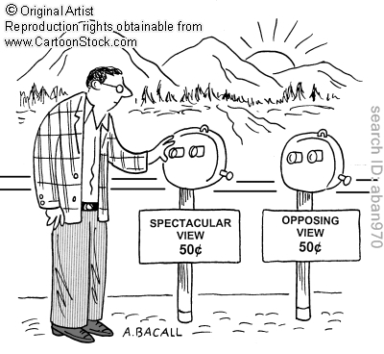
Every coin has two sides
People tend to be biased, and may be exposed to only one side of the story
Confirmation bias
Effects of filter bubble
For intelligent choices, it is wiser to also know about the other side
What is considered trustworthy may depend on the person’s viewpoint
Presenting contrasting viewpoints may help

Slide 219
Presenting information to biased users
What do people trust when learning about a topic – information from credible sources or information that aligns with their bias?
Does display of contrasting viewpoints help?
Are (relevance) judgments on documents affected by user bias?
Do the judgments change if credibility/ bias information is visible to the user?
Proposed approach to answer these questions:
BiasTrust: User study to test our hypotheses
Notes:
What are you really asking here: How to convince people? What do people trust? What do people judge as trustworthy? You need to be a bit clearer here (and maybe, again, push the key point to the beginning).

Slide 220
BiasTrust: User study task setup
Participants asked to learn more about a “controversial” topic
Participants are shown quotes (documents) from “experts” on the topic
  Expertise varies, is subjective
  Perceived expertise varies much more
Participants are asked to judge if quotes are biased, informative, interesting
Pre- and post-surveys measure extent of learning

Slide 221
Many “controversial” topics
Is milk good for you?
  Is organic milk healthier? Raw? Flavored?
  Does milk cause early puberty?
Are alternative energy sources viable?
  Different sources of alternative energy
Israeli – Palestinian Conflict
  Statehood? History? Settlements?
  International involvement, solution theories
Creationism vs. Evolution?
Global warming
Health
Science
Politics
Education

Slide 222
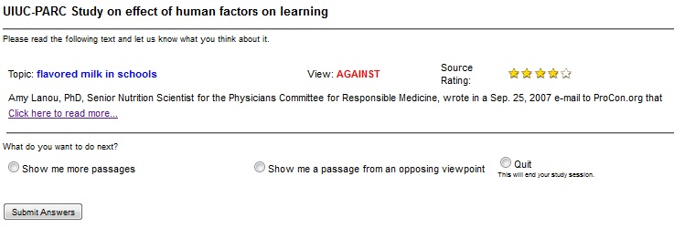


Factors studied in the user study
Does contrastive display help / hinder in learning
Do multiple documents per page have any effect?
Does sorting results by topic help?
Single viewpoint scheme
Contrastive viewpoint scheme
vs.
Quit
Show me more passages
Show me a passage from an opposing viewpoint
Multiple documents / screen
Single document / screen
vs.
Show me more passages
Quit

Slide 223
Factors studied in the user study (2)
Effect of display of source expertise on
  readership
  which documents subjects consider biased
  which documents subjects agree with
Experiment 1: Hide source expertise
Experiment 2: Vary source expertise
  Uniform distribution: Expertise ranges from 1 to 5 stars
  Bimodal distribution: Expertise either 1 star or 3 stars

Slide 224
Interface variants
UI identifier | # docs | Contrast view | Topic sorted | Rating
1a: SIN-SIN-BIM-UNSRT | 1 | No | No | Bimodal
1b: SIN-SIN-UNI-UNSRT | 1 | No | No | Uniform
2a: SIN-CTR-BIM-UNSRT | 2 | Yes | No | Bimodal
2b: SIN-CTR-UNI-UNSRT | 2 | Yes | No | Uniform
3: MUL-CTR-BIM-UNSRT | 10 | Yes | No | Bimodal
4a: MUL-CTR-BIM-SRT | 10 | Yes | Yes | Bimodal
4b: MUL-CTR-UNI-SRT | 10 | Yes | Yes | Uniform
5: MUL-CTR-NONE-SRT | 10 | Yes | Yes | None
Possibly to study them in groups
  SINgle vs. MULtiple documents/screen
  BIModal vs. UNIform rating scheme

Slide 225



User interaction workflow
Expertise
Source
Evidence
Pre-survey
Agreement
Novelty
Bias
Show similar
Show contrast
Quit
Post-survey
Study phase

Slide 226
User study details
Issues being studied
  Milk: Drinking milk is a healthy choice for humans.
  Energy: Alternate sources of energy are a viable alternative to fossil fuels.
40 study sessions from 24 participants
Average age of subjects: 28.6 ± 4.9 years
Time to complete one study session: 45 min (7 + 27 + 11)
Particulars | Overall | Milk | Energy
Number of documents read | 18.6 | 20.1 | 17.1
Number of documents skipped | 12.6 | 13.0 | 12.1
Time spent (in min) | 26.5 | 26.5 | 26.6
Notes:
Include some numerical parameters of the first study—how many claims, how many evidence pieces for each claim, how many sources, etc….
The question of independence is good; it is possible to improve the trustworthiness model to take this into account. You can probably point to works that know how to incorporate (in)dependence structure (like the generalized FF of Jeff) and argue that you can take your study and replace the algorithmic framework with something that takes it into account.

Slide 227
Contrastive display encourages reading
First page
Second page
Contrastive
Readership (in %)
Primary docs
Contrast docs
Single
| 1 | 2 | 3 | 4 | 5 | 6 | 7 | 8 | 9 | 10 |
Document position
Area Under Curve | Single display | Contrastive display | Readership
Top 10 pairs | 45.00 % | 64.44 %
Only contrast docs | 22.00 % | 64.44 %
(Relative)
+ 19.44 %
+ 43 %
+ 42.44 %
+ 193 %

Slide 228
Readership higher for expert documents
Readership (in %)
Expertise rating (in “stars”)
Expertise rating
Documents rated uniformly at random
Documents rated 1 or 3
When no rating given for documents, readership was 49.8%

Slide 229
Interface had positive impact on learning
Knowledge-related questions
  Relevance/importance of a sub-topic in overall decision
    Importance of calcium from milk in diet
    Effect of milk on cancer/diabetes
  Measure of success
    Higher mean knowledge rating
Bias-related questions
  Preference/opinion about a sub-topic
    Flavored milk is healthy or unhealthy
    Milk causes early onset of puberty
  Measure of success
    Lower spread of overall bias neutrality
    Shift from extremes
Issue | # |  |  | Change
Milk | 9 | 7 | 2 | + 12.3 % *
Energy | 13 | 8 | 5 | + 3.3 %
Issue | # |  |  | Change
Milk | 11 | 2 | 9 | - 31.0 % *
Energy | 7 | 2 | 5 | - 27.9 % *
* Significant at p = 0.05

Slide 230
Additional findings
Showing multiple documents per page increases readership.
Both highly-rated and poorly-rated documents perceived to be strongly biased.
Subjects learned more about topics they did not know.
Subjects changed strongly-held biases.

Slide 231
Summary: Helping users verify claims
User study helped us measure the impact of presenting contrastive viewpoints on readership and learning about controversial topics.
Display of expertise rating not only affects readership, but also impacts whether documents are perceived to be biased.

Slide 232
Conclusion
http://l2r.cs.uiuc.edu/Information_Trustworthiness_Tutorial.pptx

Slide 233
Knowing what to Believe
A lot of research efforts over the last few years target the question of how to make sense of data.
For the most part, the focus is on unstructured data, and the goal is to understand what a document says with some level of certainty: [data → meaning]
    Only recently we have started to consider the importance of what should we believe, and who should we trust?
Notes:
233

Slide 234
Topics Addressed
Source-based Trustworthiness
Basic Trustworthiness Framework
  Basic Fact-finding approaches
  Basic probabilistic approaches
Integrating Textual Evidence
Informed Trustworthiness Approaches
  Adding prior knowledge, more information, structure
Perception and Presentation of Trustworthiness

Slide 235
Research Questions
We are at only at the beginning
Beyond interesting research issues,
significant societal implications
1. Trust Metrics
  (a) What is Trustworthiness? How do people “understand” it?
  (b) Accuracy is misleading. A lot of (trivial) truths do not make a message trustworthy.
2. Algorithmic Framework: Constrained Trustworthiness Models
  Just voting isn’t good enough
  Need to incorporate prior beliefs & background knowledge
3. Incorporating Evidence for Claims
  Not sufficient to deal with claims and sources
  Need to find (diverse) evidence – natural language difficulties
4. Building a Claim-Verification system
  Automate Claim Verification—find supporting & opposing evidence
  What do users perceive? How to interact with users?
Thank you!

