Slide 1
CIS 110: Introduction to Computer Programming
Lecture 15
Our Scanner eats files
(§ 6.1-6.2)

Slide 2
Outline
Programming assertion recap
The Scanner object and files
Token-based file processing

Slide 3
Exam announcements
Attempting to reschedule midterm #2 to 11/21 (Monday of Thanksgiving break)
Let me know asap if you will be out of town.
Final time has been confirmed for 12/19, 6-8 PM
Let me know asap if you need to reschedule.

Slide 4
Programming assertions revisited

Slide 5
An extended example: mystery
public static int mystery(int n) {
int x = 0;
// Point A
if (n < 0) { return -1; }
while (n != 0) {
// Point B
int d = n % 10;
if (d % 2 == 1) {
x += d;
}
// Point C
n /= 10;
}
// Point D
return x;
}
For each point, are the following always/sometimes/never true?
1) n < 0
2) x >= 0
3) d < 10
4) x < n
(See AssertionProblem.java.)

Slide 6
The Scanner object and files

Slide 7
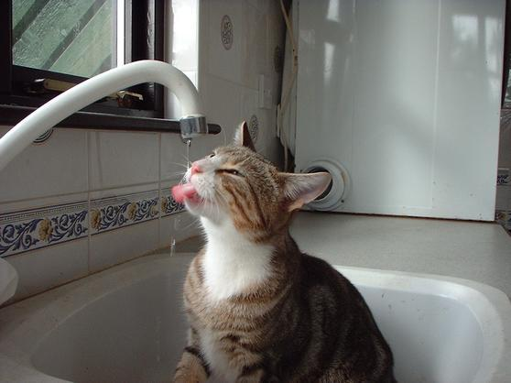
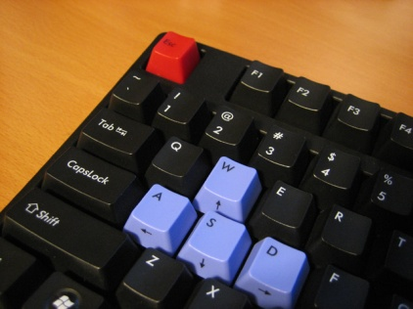
Scanners revisited
A Scanner is a faucet over some pipe of data.
Scanner
System.in

Slide 8
Empty pipes
If the pipe is empty, the scanner first gets a line of input from the user, e.g., one call to next().
Scanner
System.in
Hello world! 42\n

Slide 9
Consuming input from the pipe
The call to next() then consumes the first token of input.
Scanner
System.in
world! 42\n
Hello
(Token = chunk of text separated by whitespace)

Slide 10
Consuming tokens
When we consume a token, there's no way to "go back", only forward!
Scanner
System.in
42\n
world!
Hello

Slide 11
Consuming tokens as different types
We can consume a token and translate it to a particular type, e.g., nextInt().
Scanner
System.in
\n
42
world!
Hello

Slide 12
Consuming the rest of a line
We can consume the rest of a line with nextLine().
Scanner
System.in
\n
\n
42
world!
Hello

Slide 13
Plugging in different data sources
A Scanner can accept many kinds of data sources such as Files instead!
Scanner
File
Scanner file =
new Scanner(new File("data.txt"));

Slide 14
The File object
A File object represents a file or directory on disk.
Exists in the java.io package.
File file = new File("data.txt");
System.out.println("canRead? " + file.canRead());
System.out.println("exists? " + file.exists());
// Renames the file to the given file's name.
file.renameTo(new File("foo.txt"));
// Deletes the file from disk if it exists.
file.delete();
File

Slide 15
An exceptional problem
public static void main(String[] args) {
Scanner file = new Scanner(new File("data.txt"));
}
The following code fails to compile. Why?
"unreported exception java.io.FileNotFoundException; must be caught or declared to be thrown"
Example of a checked exception in Java.

Slide 16
Checked and unchecked exceptions
Java distinguishes between two sorts of exceptions.
Unchecked exceptions represent program bugs
Checked exceptions represent badness outside of the program's control.
Unchecked exceptions
IndexOutOfBoundsException
IllegalArgumentException
StackOverflowError
Checked exceptions
FileNotFoundException

Slide 17
Dealing with checked exceptions
Two solutions:
Annotate the enclosing method with a throws clause.
Use a try-catch block.
public static void main(String[] args)
throws FileNotFoundException {
Scanner file =
new Scanner(new File("data.txt"));
}
Which do we use!?
try {
Scanner file = new Scanner(
new File("data.txt"));
} catch (FileNotFoundException ex) {
ex.printStackTrace();
}

Slide 18
Checked exceptions: a holy war
Big debate if checked exceptions are "worth it".
General advice: use try-catch when you can do something meaningful with the exception.
Give a good error message, re-throw, etc.
For this class: we'll use throws clauses.
public static void main(String[] args)
throws FileNotFoundException {
Scanner file =
new Scanner(new File("data.txt"));
}

Slide 19
Token-based processing

Slide 20
Abstraction at its finest
The methods of the Scanner we've learned so far apply when we use a File instead!
Scanner
File
Scanner file =
new Scanner(new File("data.txt"));

Slide 21
File processing example: FileSum
import java.util.*;
// Necessary since FileNotFoundException is also in java.io.
import java.io.*;
public class FileSum {
public static void main(String[] args)
throws FileNotFoundException {
Scanner file = new Scanner(new File("data.txt"));
double sum = 0.0;
while(file.hasNextDouble()) {
double d = file.nextDouble();
System.out.println("Adding up " + d + "...");
sum += d;
}
System.out.println("Total = " + sum);
}
}

Slide 22
A file is just a long-ass string
data.txt
We can think of a file as a sequence of characters by replacing newlines with '\n'
3.4 7.1 4.3
5.9 1.1 2.5
3.6 -1.2
3.4 7.1 4.3\n 5.9 1.1 2.5\n\n\n3.6 -1.2\n
while(file.hasNextDouble()) {
double d = file.nextDouble();
}

Slide 23
Input cursor
3.4 7.1 4.3\n 5.9 1.1 2.5\n\n\n3.6 -1.2\n
Input cursor
The input cursor is our current position in the file, initially at the beginning.
data.txt
while(file.hasNextDouble()) {
double d = file.nextDouble();
}

Slide 24
Input cursor and input consumption
3.4 7.1 4.3\n 5.9 1.1 2.5\n\n\n3.6 -1.2\n
On each call to nextDouble, we consume the next double and advance the input just past the token.
Input cursor
data.txt
while(file.hasNextDouble()) {
double d = file.nextDouble();
}

Slide 25
Jumping that whitespace
3.4 7.1 4.3\n 5.9 1.1 2.5\n\n\n3.6 -1.2\n
Input cursor
Calls to nextX() skip whitespace to the next token.
data.txt
while(file.hasNextDouble()) {
double d = file.nextDouble();
}

Slide 26
Newlines are whitespace
3.4 7.1 4.3\n 5.9 1.1 2.5\n\n\n3.6 -1.2\n
Input cursor
3.4 7.1 4.3\n 5.9 1.1 2.5\n\n\n3.6 -1.2\n
Input cursor
data.txt
while(file.hasNextDouble()) {
double d = file.nextDouble();
}

Slide 27
hasNextX looks ahead
3.4 7.1 4.3\n 5.9 1.1 2.5\n\n\n3.6 -1.2\n
hasNextDouble() now returns false!
Input cursor
data.txt
while(file.hasNextDouble()) {
double d = file.nextDouble();
}

Slide 28
Mixing up types
We can mix different nextX functions as necessary.
Jerry 21 13.7 true
file.next();
file.nextInt();
file.nextDouble();
But we get NoSuchElementException if we're wrong!
file.nextBooelean();

