Slide 1
CIS 110: Intro to Computer Programming
Lecture 10
Interaction and Conditionals
(§ 3.3, 4.1-4.2)

Slide 2
Outline
The Scanner Object
Introducing Conditional Statements
Cumulative Algorithms

Slide 3
The Scanner Object

Slide 4
What Do Our Programs Look Like?

Slide 5
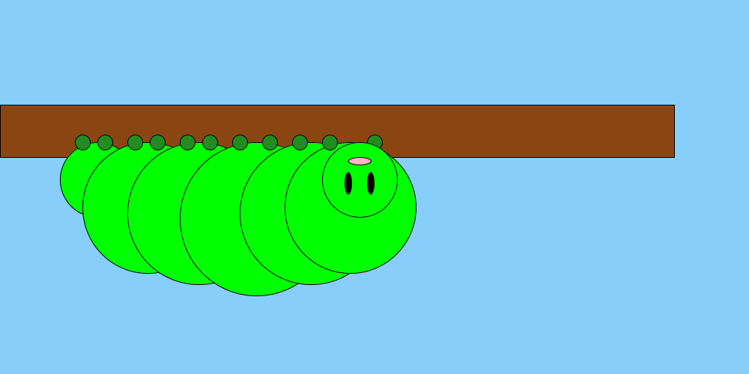
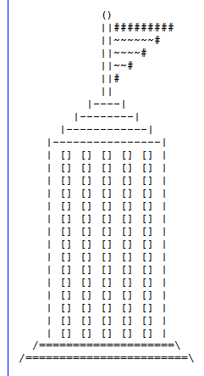

Slide 6
This program replicates a drawing of the sinking Titanic and two survivors in the water.
****
*****
******
*******
********
*********
**********
***********
*********** \o_ \o/ ~^~^~^~^~^~^~^~^~^~^~^~^~^~^ ~^~^~^~^~^~^~^~^~^~^~^~^~^~^ ~^~^~^~^~^~^~^~^~^~^~^~^~^~^ ~^~^~^~^~^~^~^~^~^~^~^~^~^~^

Slide 7
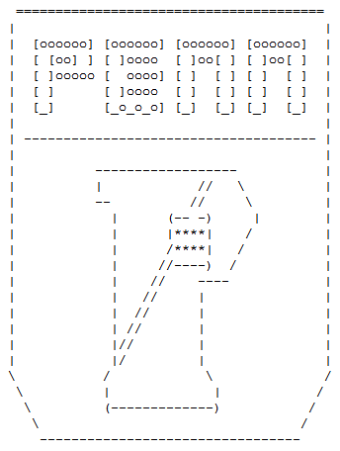
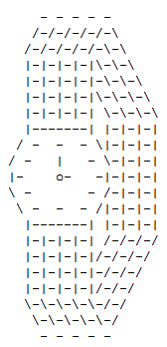
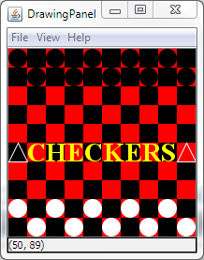

Slide 8
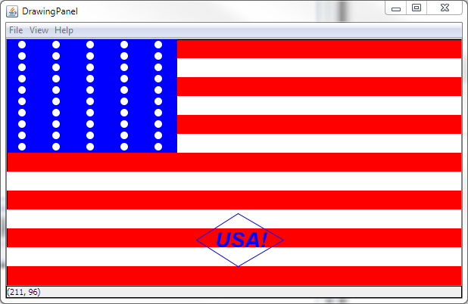
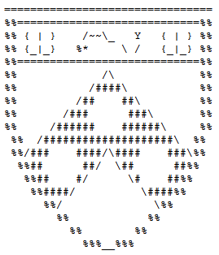

Slide 9
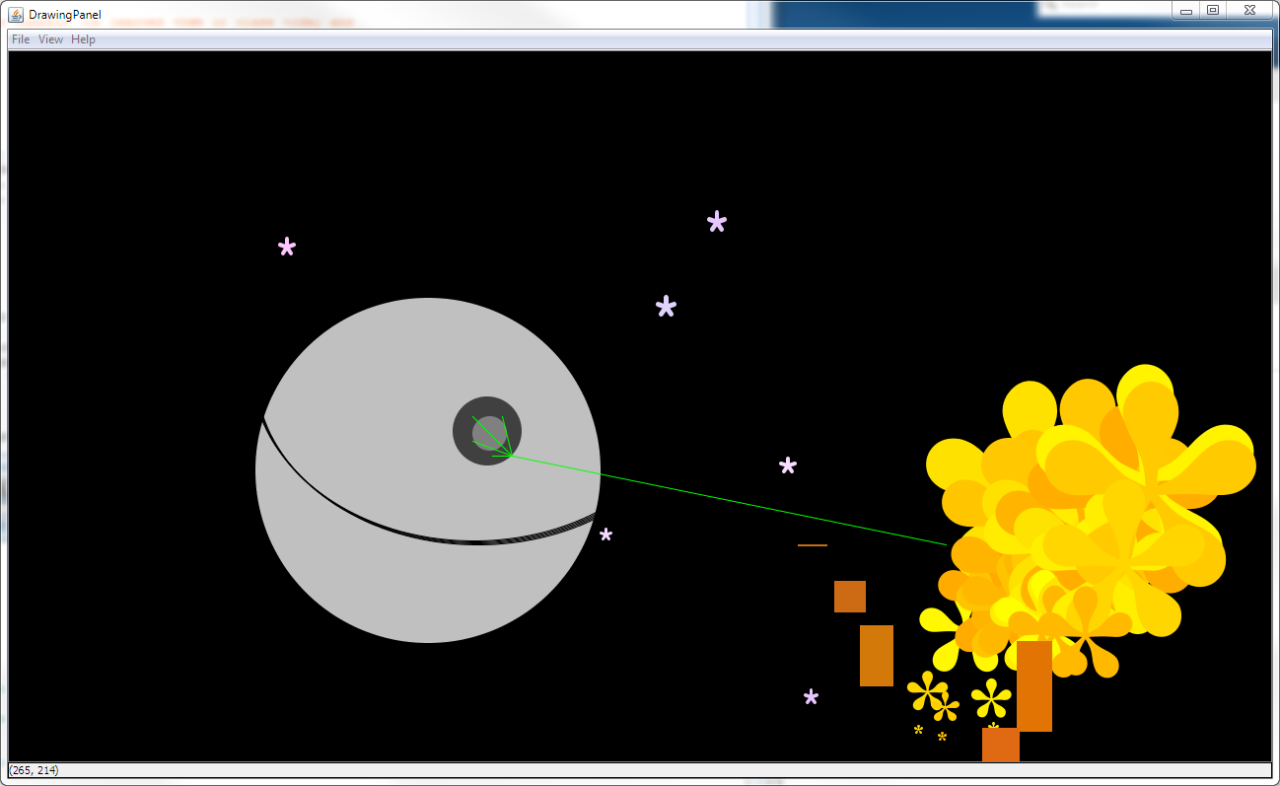

Slide 10
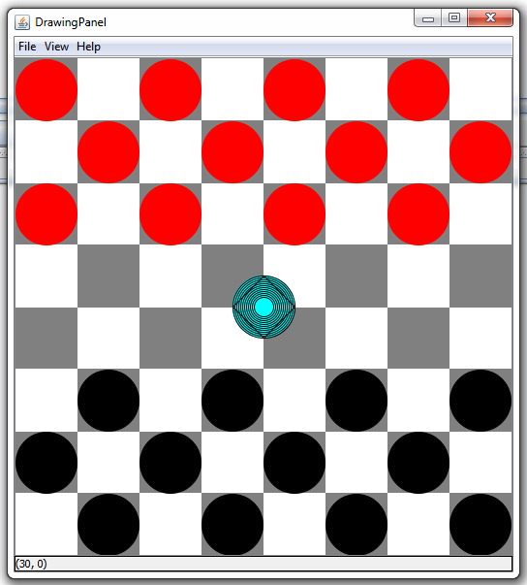
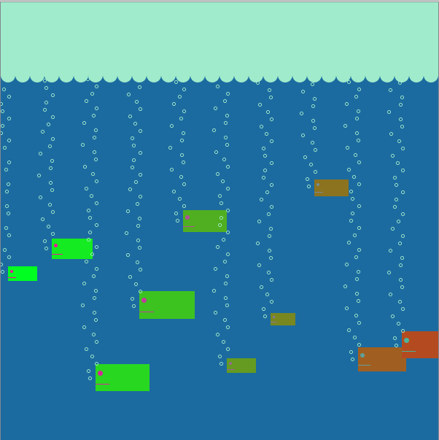

Slide 11
/ \ / \
\./ \./ -------------
\/ (o) (o) \/ \/ <> \/ ^ ^ ^ ************ ^ ^ * /\ /\ * ^ ^ * /\ /\ /\ * ^ ^ * /\ /\ /\ * ^ ^ * * ^ ^ * * ^ ^ * * ^ -------------

Slide 13
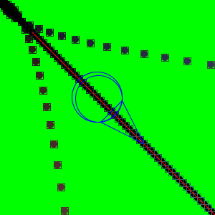

Slide 14
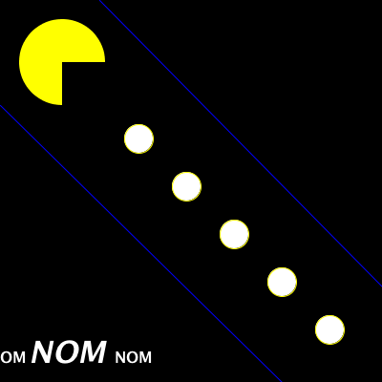

Slide 15
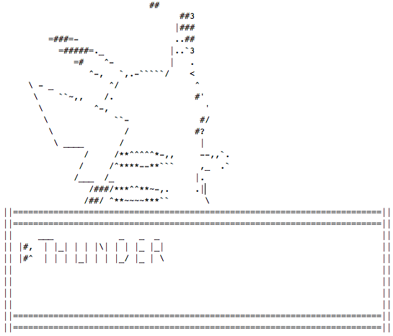

Slide 16
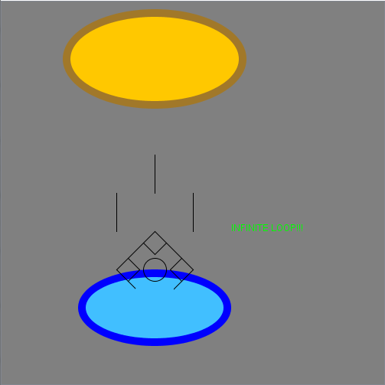
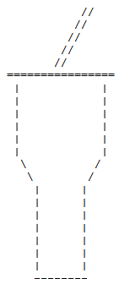

Slide 17
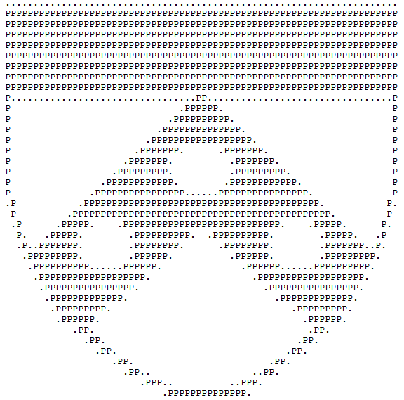
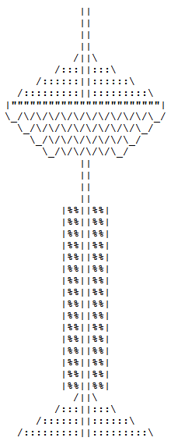

Slide 18
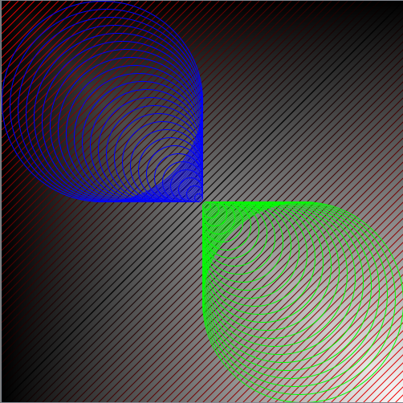

Slide 20
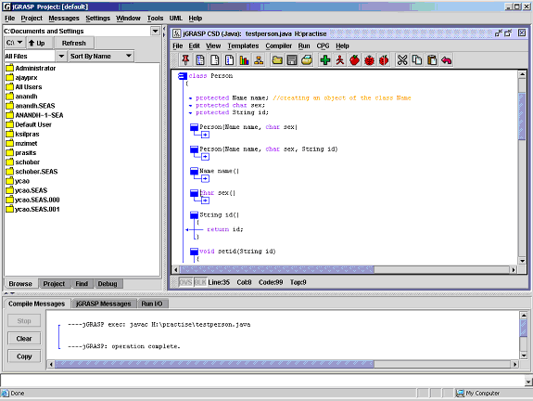
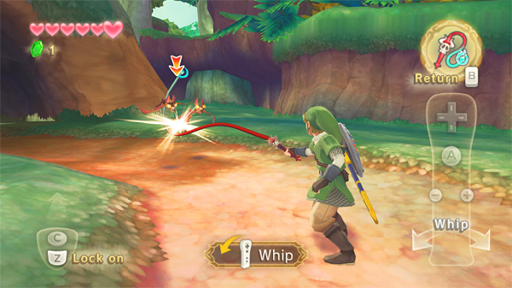
Real World Programs Out There
Real programs are INTERACTIVE!

Slide 21
Introducing the Scanner Class
Object that lets you read input from the user.
Scanner is in the "java.util" package.
Creates a new Scanner that reads from some source.
import java.util.*;
Scanner in = new Scanner(System.in);
System.out.println(
"Echo: " + in.nextLine());
"The keyboard"
Grabs the next line of input from the Scanner.

Slide 22
Reading Input From The User
// Reads in a double
double d = in.nextDouble();
// Reads in an integer
int n = in.nextInt();
// Reads in an entire line
String line = in.nextLine();
// Reads a token
String token = in.next();

Slide 23
Tokens
Tokens are "chunks" of an input separated by a delimiter (here, whitespace).
This is a string with
"some tokens" in it!
Tokens: this, is, a, string, with, "some, tokens", in, it!
Includes punctuation (e.g., quotes and bangs).

Slide 24
Aside: Packages and import
Classes are bundled into sets called packages.
The import declaration says that you wish to use classes found in a particular package.
// Make available all classes in java.util
import java.util.*;
// Make available just the Scanner class
import java.util.Scanner;

Slide 25
Conditional Statements

Slide 26
Problem: Making Decisions Based on User Input
Scanner in = new Scanner(System.in);
double savings = in.nextDouble();
// If amount is greater than 100,
// print a congratulations msg!

Slide 27
Introducing Conditional Statements
"Execute this block only if savings is greater than 100."
Scanner in = new Scanner(System.in);
double savings = in.nextDouble();
if (savings > 100) {
System.out.println("Congratulations!");
}

Slide 28
Syntax of Conditional Statements
The test or guard
if (<test>) {
<statement>
<statement>
…
<statement>
}
The statements to execute, the body or block

Slide 29
Semantics of Conditionals
TRUE
Is the guard true?
Execute the Block
Execute statements after conditional
FALSE

Slide 30
Else Branches
double savings = in.nextDouble();
if (savings > 100) {
System.out.println("Congratuations!");
} else {
System.out.println("You need more money!");
}
"Execute this block if we don't go into the first block" (i.e., when savings is less than or equal to 0).

Slide 31
Else-if Branches
double savings = in.nextDouble();
if (savings > 100) {
System.out.println("Congratuations!");
} else if (savings > 50) {
System.out.println("That's decent.");
} else {
System.out.println("Need more!");
}
"Else" = if the previous guard fails, try this one!

Slide 32
Relational Operators
> /* greater than */
< /* less than */
>= /* greater than or equals */
<= /* less than or equals */
== /* equals */
!= /* not-equals*/
// Syntax: <expr> <op> <expr>, e.g., 1 != 2
Only works on primitive data.
We'll discuss what to do for objects, e.g., Strings, later.

Slide 33
Operator Precedence
| ++, --, +, - // Unary operators
| *, /, % // Multiplication operators
| +, - // Addition operators
| <, >, <=, >= // Relational operators
| ==, != // Equality operators
| =, +=, -=, *=, /=, %= // Assignment operators
V
Lower
Precedence

Slide 34
Mutually exclusive branches
if (savings < 100) {
}
if (savings >= 50) {
}
if (savings == 75) {
}
if (savings < 100) {
} else if (savings >= 50) {
} else if (savings == 75) {
}
double savings = 75;
else if gives you true mutually exclusive branches.

Slide 35
Object Equality
Scanner in = new Scanner(System.in);
String s = in.nextLine();
// Will never be true. == only works for primitive types.
if (s == "yes") {
System.out.println("s1 is yes!");
}
// Need to use the equals method to check equality for objects.
if (s.equals("yes")) {
System.out.println("s1 is really yes!");
}

Slide 36
Multiple Conditions
Scanner in = new Scanner(System.in);
String name = in.nextLine();
double amount = in.nextDouble();
// Logical AND: true if both conditions are true
if (name.equals("McScrooge") && amount > 1000) {
System.out.println("Y U SO RICH!?");
}
// Logical OR: true if one of the conditions is true
if (name.equals("Peter") || amount < 10) {
System.out.println("Y U SO POOR!?");
}

Slide 37
Cumulative Algorithms

Slide 38
Problem: Interactive Sum
Can you write a program that computes the sum of numbers from 1 to the user's input?
Scanner in = new Scanner(System.in);
System.out.print("n? ");
int n = in.nextInt();
System.out.println();
int sum = 0;
for (int i = 0; i < n; i++) {
sum += i;
}
System.out.println(
"Sum of 1 to " + n + " is " + sum + ".");

Slide 39
Interactive Sum Trace (1)
01 Scanner in = new Scanner(System.in);
02 System.out.print("n? ");
03 int n = in.nextInt();
04 System.out.println();
05
06 int sum = 0;
07 for (int i = 0; i < n; i++) {
08 sum += i;
09 }
System.out.println("Sum of 1 to " +
n + " is " + sum + ".");

Slide 40
Interactive Sum Trace (2)
01 Scanner in = new Scanner(System.in);
02 System.out.print("n? ");
03 int n = in.nextInt();
04 System.out.println();
05
06 int sum = 0;
07 for (int i = 0; i < n; i++) {
08 sum += i;
09 }
System.out.println("Sum of 1 to " +
n + " is " + sum + ".");
in
…

Slide 41
Interactive Sum Trace (3)
01 Scanner in = new Scanner(System.in);
02 System.out.print("n? ");
03 int n = in.nextInt();
04 System.out.println();
05
06 int sum = 0;
07 for (int i = 0; i < n; i++) {
08 sum += i;
09 }
System.out.println("Sum of 1 to " +
n + " is " + sum + ".");
in
…

Slide 42
Interactive Sum Trace (4)
01 Scanner in = new Scanner(System.in);
02 System.out.print("n? ");
03 int n = in.nextInt();
04 System.out.println();
05
06 int sum = 0;
07 for (int i = 0; i < n; i++) {
08 sum += i;
09 }
System.out.println("Sum of 1 to " +
n + " is " + sum + ".");
in
…
n
5

Slide 43
Interactive Sum Trace (5)
01 Scanner in = new Scanner(System.in);
02 System.out.print("n? ");
03 int n = in.nextInt();
04 System.out.println();
05
06 int sum = 0;
07 for (int i = 0; i < n; i++) {
08 sum += i;
09 }
System.out.println("Sum of 1 to " +
n + " is " + sum + ".");
in
…
n
5

Slide 44
Interactive Sum Trace (6)
01 Scanner in = new Scanner(System.in);
02 System.out.print("n? ");
03 int n = in.nextInt();
04 System.out.println();
05
06 int sum = 0;
07 for (int i = 0; i < n; i++) {
08 sum += i;
09 }
System.out.println("Sum of 1 to " +
n + " is " + sum + ".");
in
…
n
5
sum
0

Slide 45
Interactive Sum Trace (7)
01 Scanner in = new Scanner(System.in);
02 System.out.print("n? ");
03 int n = in.nextInt();
04 System.out.println();
05
06 int sum = 0;
07 for (int i = 0; i < n; i++) {
08 sum += i;
09 }
System.out.println("Sum of 1 to " +
n + " is " + sum + ".");
i
0
in
…
n
5
sum
0

Slide 46
Interactive Sum Trace (8)
01 Scanner in = new Scanner(System.in);
02 System.out.print("n? ");
03 int n = in.nextInt();
04 System.out.println();
05
06 int sum = 0;
07 for (int i = 0; i < n; i++) {
08 sum += i;
09 }
System.out.println("Sum of 1 to " +
n + " is " + sum + ".");
i
0
in
…
n
5
sum
0

Slide 47
Interactive Sum Trace (9)
01 Scanner in = new Scanner(System.in);
02 System.out.print("n? ");
03 int n = in.nextInt();
04 System.out.println();
05
06 int sum = 0;
07 for (int i = 0; i < n; i++) {
08 sum += i;
09 }
System.out.println("Sum of 1 to " +
n + " is " + sum + ".");
i
1
in
…
n
5
sum
0

Slide 48
Interactive Sum Trace (10)
01 Scanner in = new Scanner(System.in);
02 System.out.print("n? ");
03 int n = in.nextInt();
04 System.out.println();
05
06 int sum = 0;
07 for (int i = 0; i < n; i++) {
08 sum += i;
09 }
System.out.println("Sum of 1 to " +
n + " is " + sum + ".");
i
1
in
…
n
5
sum
0

Slide 49
Interactive Sum Trace (11)
01 Scanner in = new Scanner(System.in);
02 System.out.print("n? ");
03 int n = in.nextInt();
04 System.out.println();
05
06 int sum = 0;
07 for (int i = 0; i < n; i++) {
08 sum += i;
09 }
System.out.println("Sum of 1 to " +
n + " is " + sum + ".");
i
1
in
…
n
5
sum
1

Slide 50
Interactive Sum Trace (12)
01 Scanner in = new Scanner(System.in);
02 System.out.print("n? ");
03 int n = in.nextInt();
04 System.out.println();
05
06 int sum = 0;
07 for (int i = 0; i < n; i++) {
08 sum += i;
09 }
System.out.println("Sum of 1 to " +
n + " is " + sum + ".");
i
2
in
…
n
5
sum
1

Slide 51
Interactive Sum Trace (13)
01 Scanner in = new Scanner(System.in);
02 System.out.print("n? ");
03 int n = in.nextInt();
04 System.out.println();
05
06 int sum = 0;
07 for (int i = 0; i < n; i++) {
08 sum += i;
09 }
System.out.println("Sum of 1 to " +
n + " is " + sum + ".");
i
2
in
…
n
5
sum
3

Slide 52
Interactive Sum Trace (13)
01 Scanner in = new Scanner(System.in);
02 System.out.print("n? ");
03 int n = in.nextInt();
04 System.out.println();
05
06 int sum = 0;
07 for (int i = 0; i < n; i++) {
08 sum += i;
09 }
System.out.println("Sum of 1 to " +
n + " is " + sum + ".");
i
3
in
…
n
5
sum
3

Slide 53
Interactive Sum Trace (14)
01 Scanner in = new Scanner(System.in);
02 System.out.print("n? ");
03 int n = in.nextInt();
04 System.out.println();
05
06 int sum = 0;
07 for (int i = 0; i < n; i++) {
08 sum += i;
09 }
System.out.println("Sum of 1 to " +
n + " is " + sum + ".");
i
3
in
…
n
5
sum
6

Slide 54
Interactive Sum Trace (15)
01 Scanner in = new Scanner(System.in);
02 System.out.print("n? ");
03 int n = in.nextInt();
04 System.out.println();
05
06 int sum = 0;
07 for (int i = 0; i < n; i++) {
08 sum += i;
09 }
System.out.println("Sum of 1 to " +
n + " is " + sum + ".");
i
4
in
…
n
5
sum
6

Slide 55
Interactive Sum Trace (16)
01 Scanner in = new Scanner(System.in);
02 System.out.print("n? ");
03 int n = in.nextInt();
04 System.out.println();
05
06 int sum = 0;
07 for (int i = 0; i < n; i++) {
08 sum += i;
09 }
System.out.println("Sum of 1 to " +
n + " is " + sum + ".");
i
4
in
…
n
5
sum
10

Slide 56
Interactive Sum Trace (17)
01 Scanner in = new Scanner(System.in);
02 System.out.print("n? ");
03 int n = in.nextInt();
04 System.out.println();
05
06 int sum = 0;
07 for (int i = 0; i < n; i++) {
08 sum += i;
09 }
System.out.println("Sum of 1 to " +
n + " is " + sum + ".");
i
5
in
…
n
5
sum
10

Slide 57
Interactive Sum Trace (18)
01 Scanner in = new Scanner(System.in);
02 System.out.print("n? ");
03 int n = in.nextInt();
04 System.out.println();
05
06 int sum = 0;
07 for (int i = 0; i < n; i++) {
08 sum += i;
09 }
System.out.println("Sum of 1 to " +
n + " is " + sum + ".");
in
…
n
5
sum
10

